Slide 1
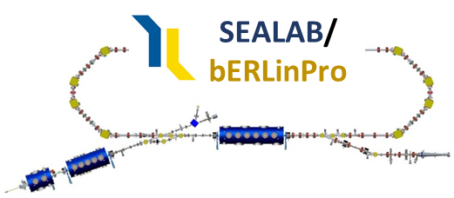
Status of the ERL at HZB
How can bERLinPro contribute to the Accelerator Roadmap?
07/12/23, A. Neumann for the Sealab/bERLinPro Team
Community Report on Accelerators Roadmap
INFN Frascati, Roma, Italia
INFN Frascati
National Laboratories

Slide 2
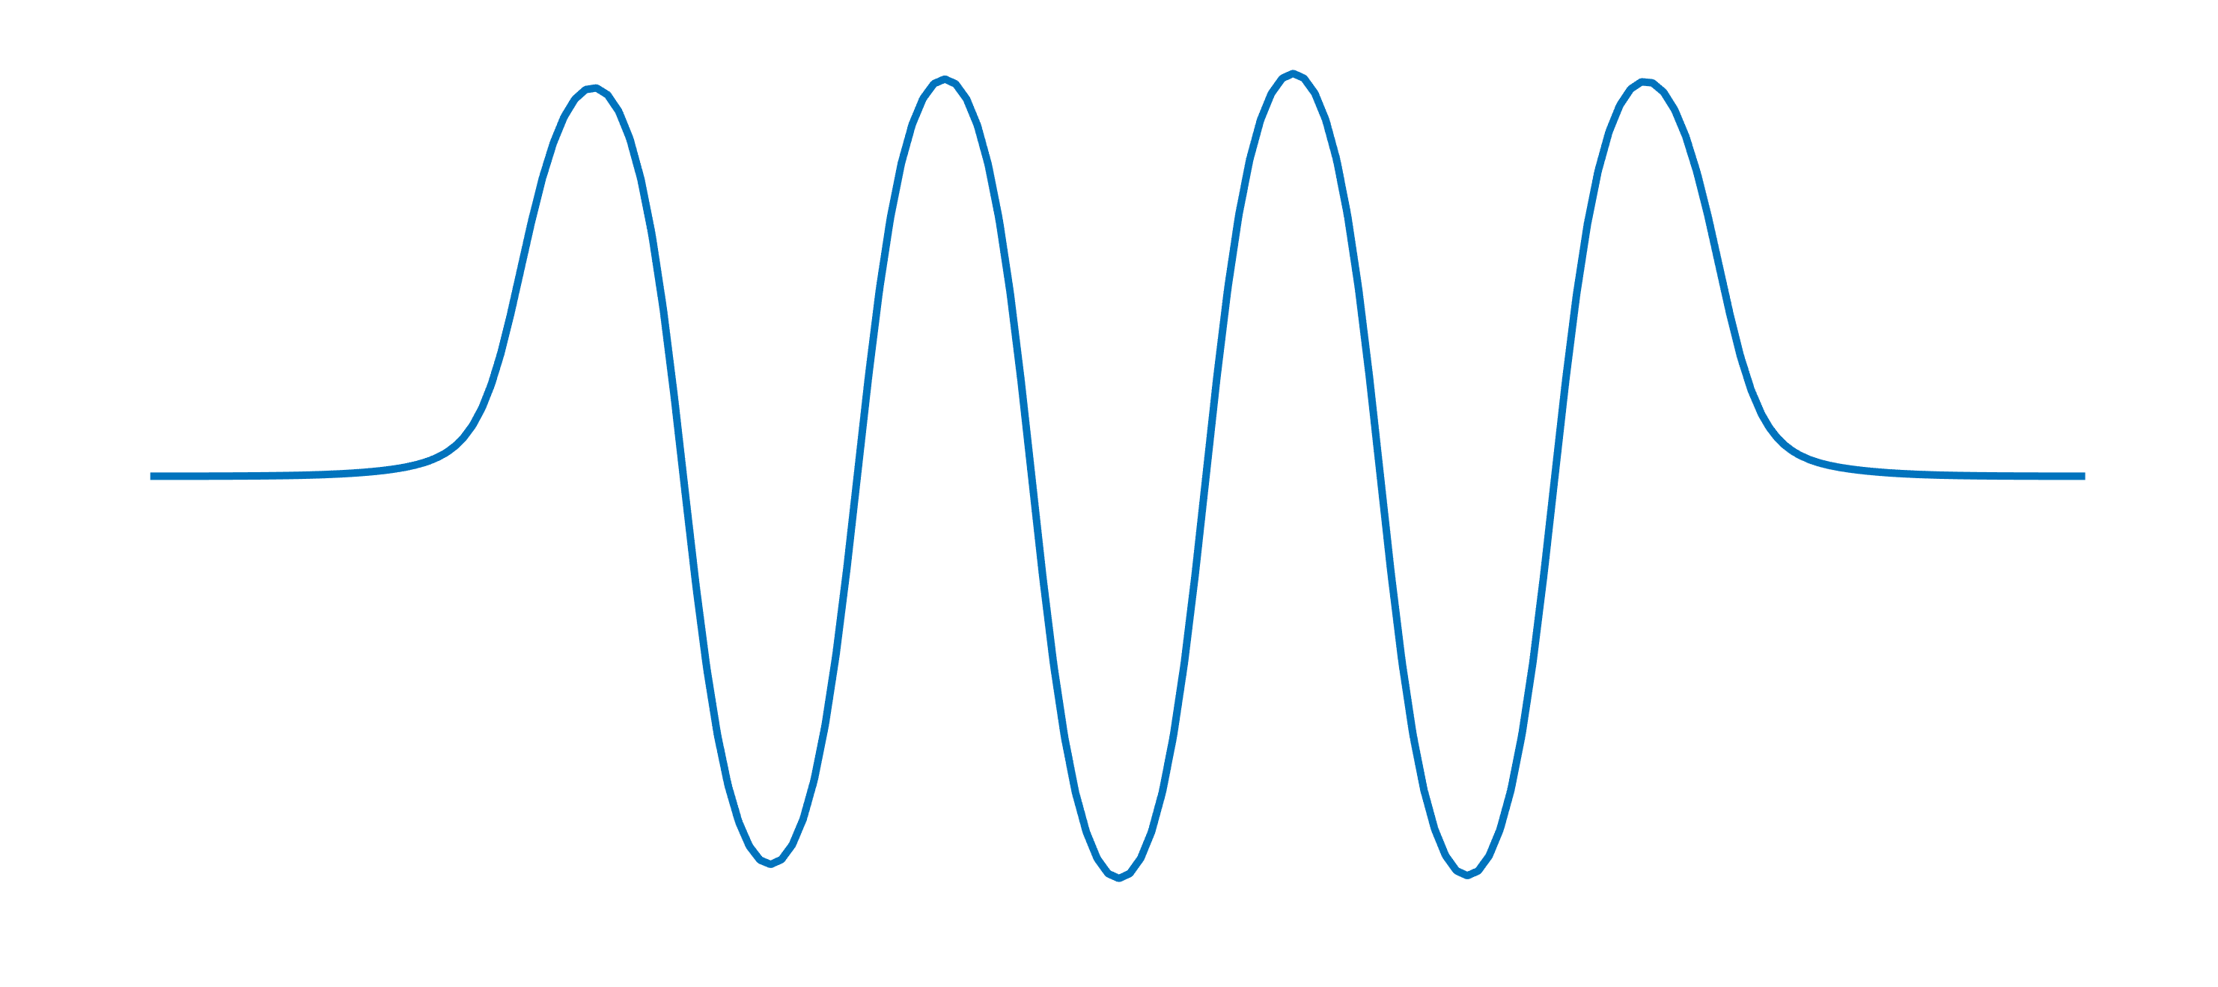
THE ERL Principle: The Promise
The promise
Maury Tigner, A possible apparatus for electron clashing-beam experiments, Nuovo Cim.,
37:1228–1231, 1965, http://doi.org/10.1007/BF02773204.
Recirculated beam: f_{rep}= 1.3 GHz
On-crest acceleration
50 MeV
Recirculated beam deceleration
with π phase shift to RF
Merger for low energy
injection and high energy
recirculated beam
Recirculator
Injector
TM₀₁₀-π mode at 1.3 GHz
6.5 MeV
High average current with Linac like
beam emittance/phase space:
No net beam power transfer in Linac!
6.5 MeV
Beam dumped at
Injection energy
High average brilliance
Linac quality beam

Slide 3
All perfect, can we start right away?
The promise?
No net power transfer between cavity and beam: tens to 100 mA beam current possible → Higher order mode issues*
Note: SRF based machine record 10 mA (JLab)
Only RF power required to sustain field in SRF cavity (+over-coupling for stability reasons, detuning control)
Main power invest in the injector, which is also transferred to the beam dump → High power RF couplers, 100 kW class
Beam losses in the recirculator need to be controlled to a low level
→ Beam halo formation, precise synchronization, beam loss diagnostics
*We roughly know from thermodynamics, nothing is for free in physics: The limits
or, why do we need demonstrator facilities like PERLE and bERLinPro?

Slide 4
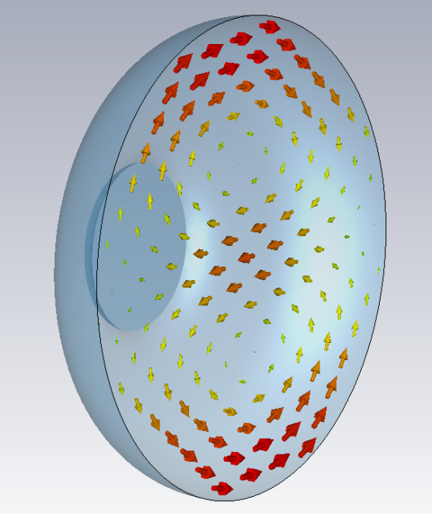
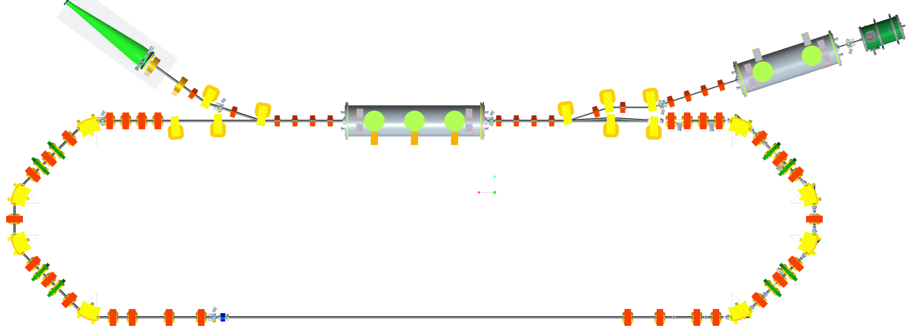
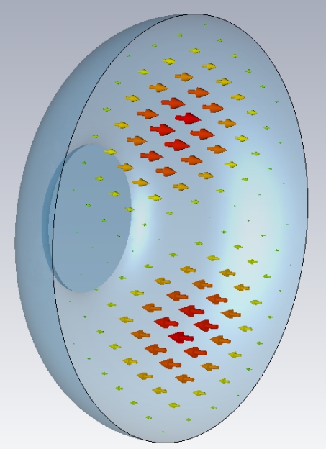
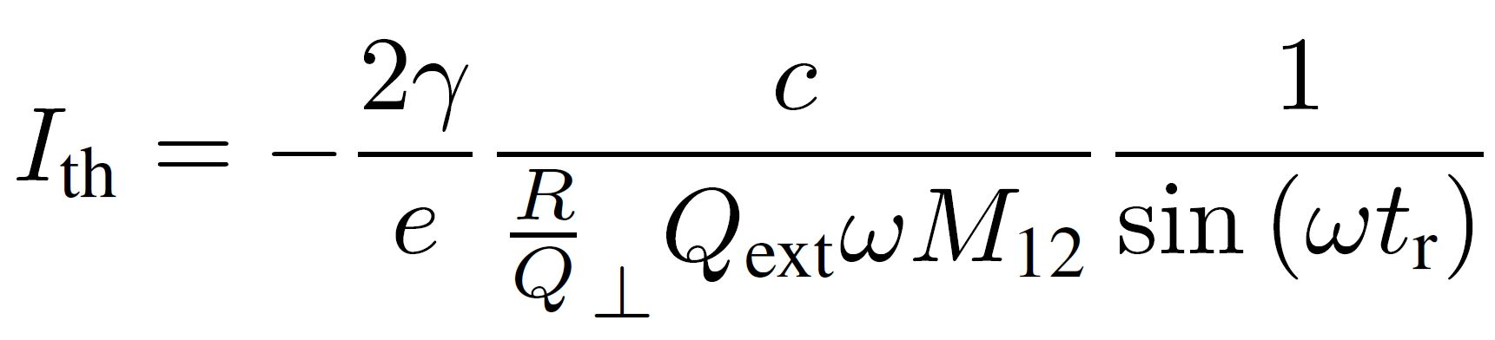
The limit: Beam Break-Up in ERLs
The limit
1st
Beam-breakup instability theory for energy recovery linacs
Georg H. Hoffstaetter and Ivan V. Bazarov, PRST-AB, Vol. 7, 054401 (2004)
TM₁₁₀ magnetic field
Multi-pass transverse beam breakup (BBU):
An injected beam receives an initial kick
by a given dipole higher-oder mode (HOM)
or excites in first pass a dipole mode by its
initial injection caused offset
Kick→offset by optics, beam couples to
HOM dipole electric field
Following beam is deflected by the dipole
mode and receives more offset → stronger
excitation of HOM if phase advance by
optics allows positive feedback
Single mode BBU can be mitigated by
proper setting of optics phase advance
(while preserving recovery) or by
RF feedback techniques within cavity
or transverse optics manipulations
Multi-mode problem usually tackled by
proper HOM damping techniques
This is an intensity effect!
2nd
TM₁₁₀ electric field
Single cavity, single HOM case!
Recirculation time
Sum and product of transport
matrix, HOM polarization
Cavity figure of merits:
R/Q, w determined by shape
HOM damping

Slide 5

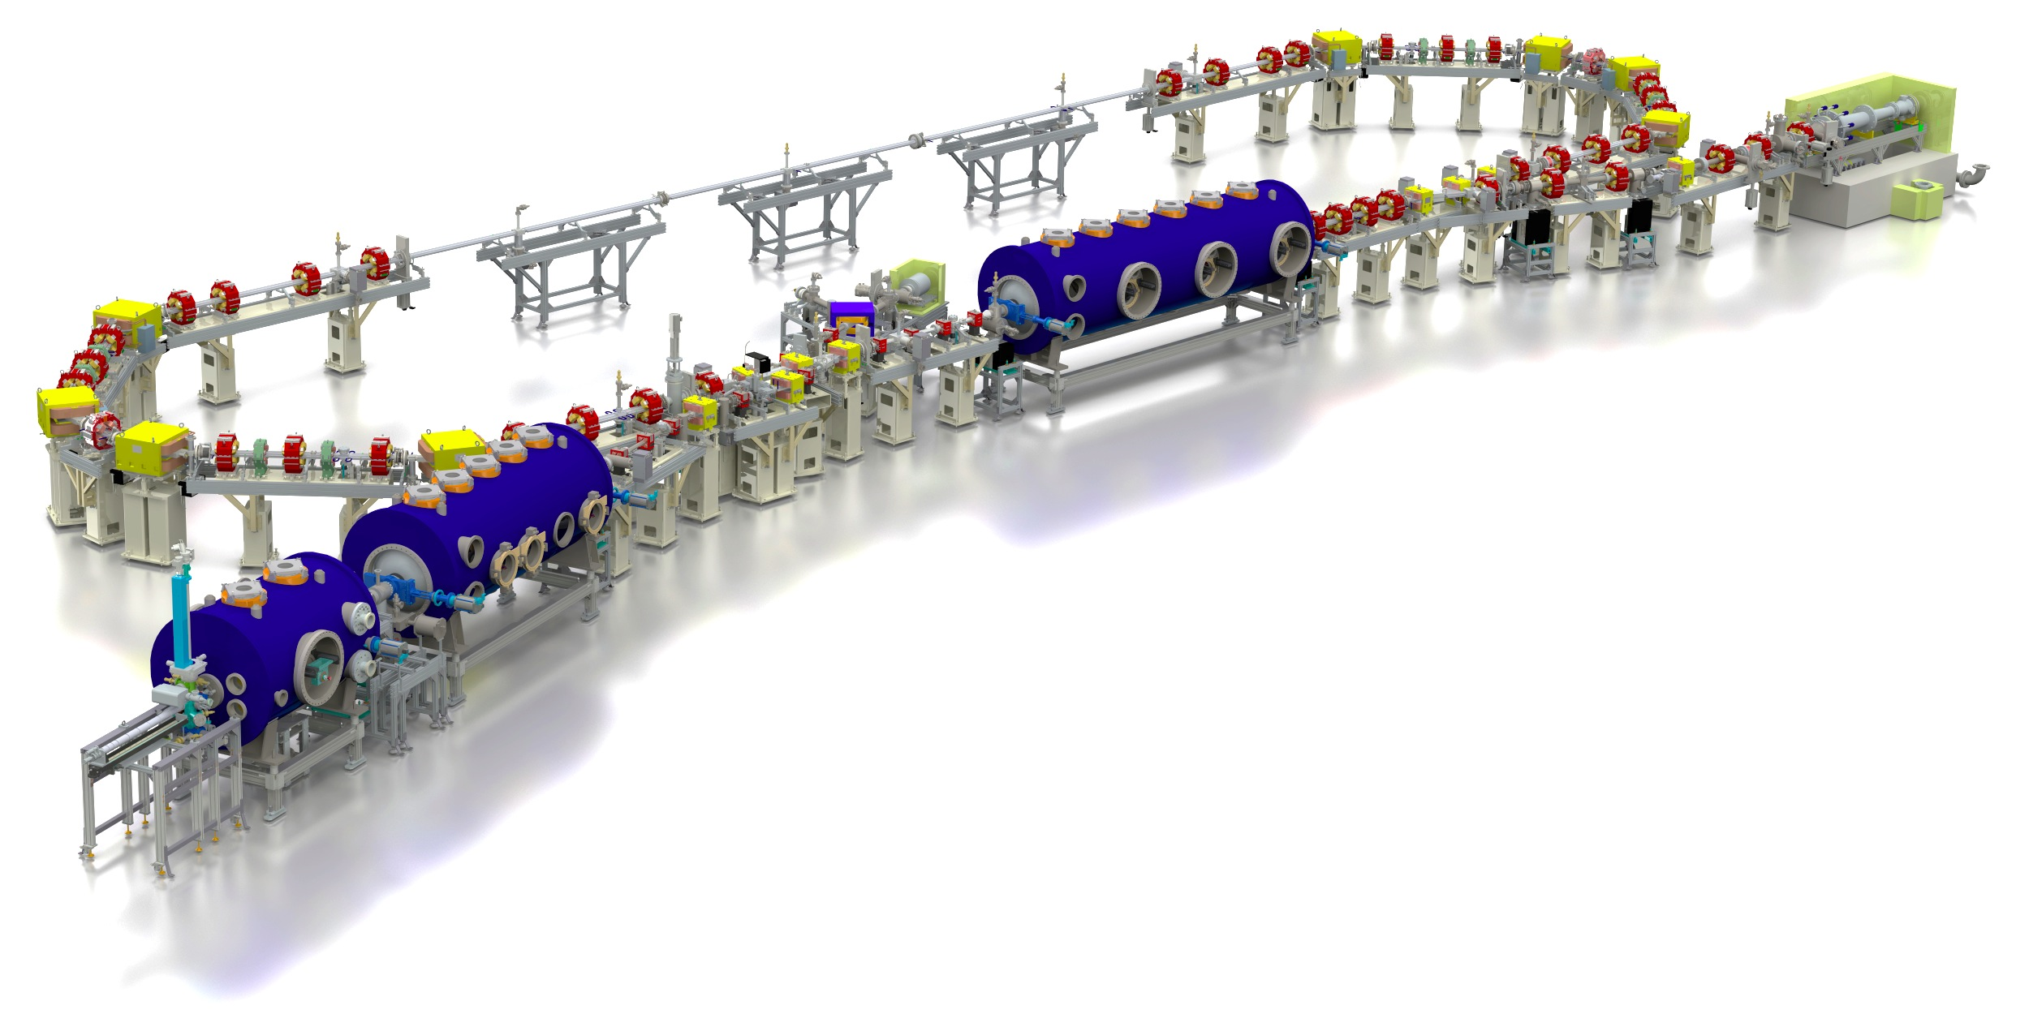
How did bERLinPro tackle this?
introduction
bERLinPro: A demonstration facility for ERL science and technology
New developments:
Beam dynamics and manipulation
(merger, recirculator, study beam break-up)
SRF systems: Photo-injector, high power
booster, HOM damped Linac
Electron source: High repetition
laser system
high QE cathode development
Control of beam losses and
radiation protection
High power beam dump
High power CW RF
  Few 100 kW class
  klystrons → Power couplers!
  Some 10 kW solid
  state amplifier
Diagnostics, synchronization
machine protection, beam
loss monitoring, LLRF and detuning control
A stable, efficient Cryoplant
Recirculator
test and
diagnostic line
beam dump
6.5 MeV, 100 mA
= 650 kW
linac module
3 x 7 cell SRF cavities
44 MeV
merger
dogleg
Parameter | bERLinPro
Beam energy recirculator (MeV) | 50
Beam current ERL mode (mA) | 100
Frequency RF and Laser (GHz) | 1.3
Normalized emittance (mm mrad) | 1 (< 0.6 in simulations)
Bunch length (ps) | < 2 (ERL mode), 100 fs @ 10 mA
Beam losses | << 10⁻⁵ @ 100 mA
modified Cornell booster
3 x 2 cell SRF cavities
4.5 MeV
srf-gun
1.4 cell SRF cavities
1.5-2.3 MeV, single SC solenoid,
A fully funded 42 M€ project (including completely new building!)

Slide 6
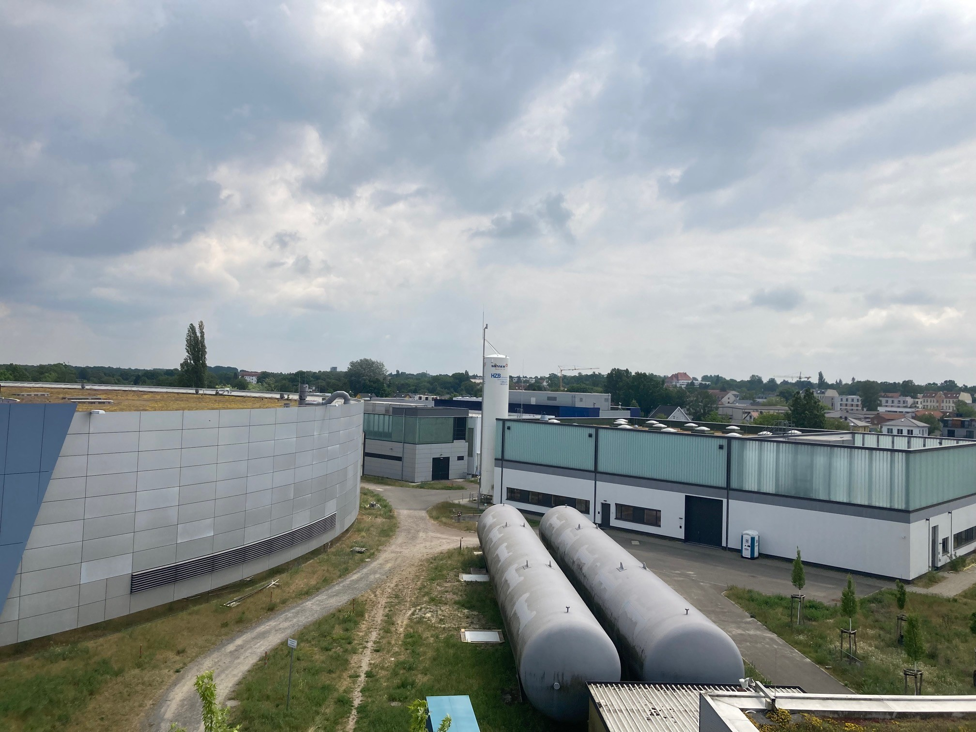
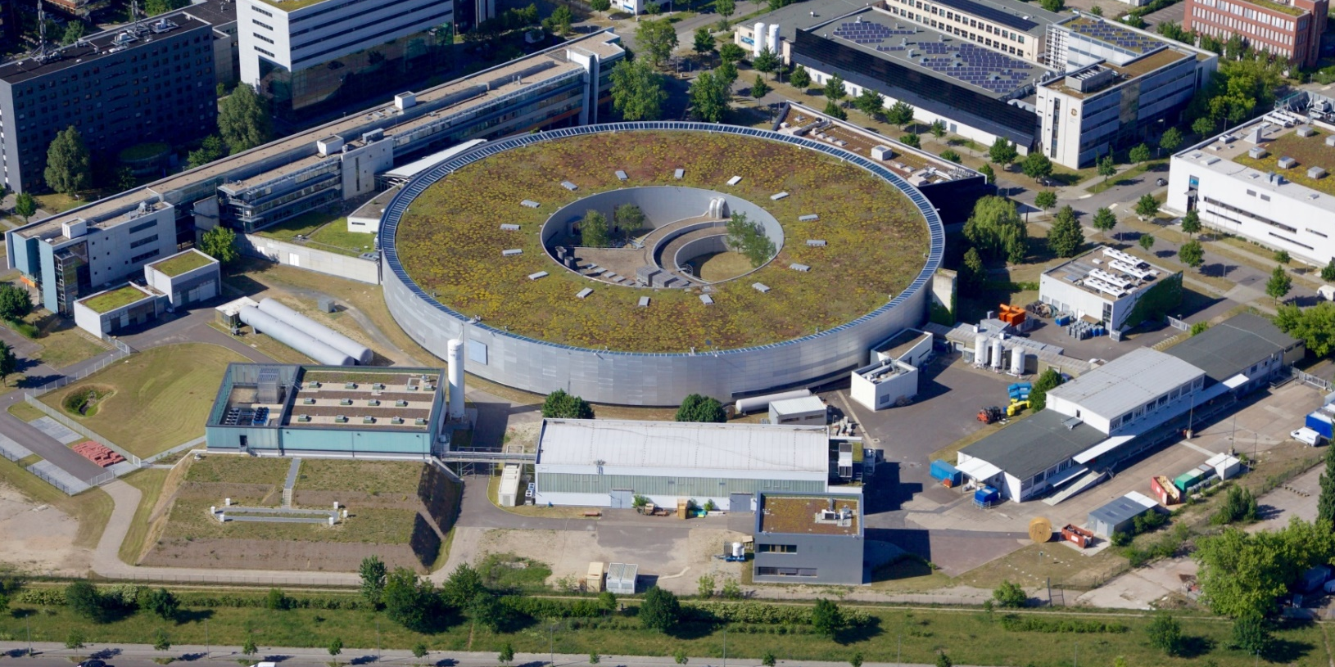
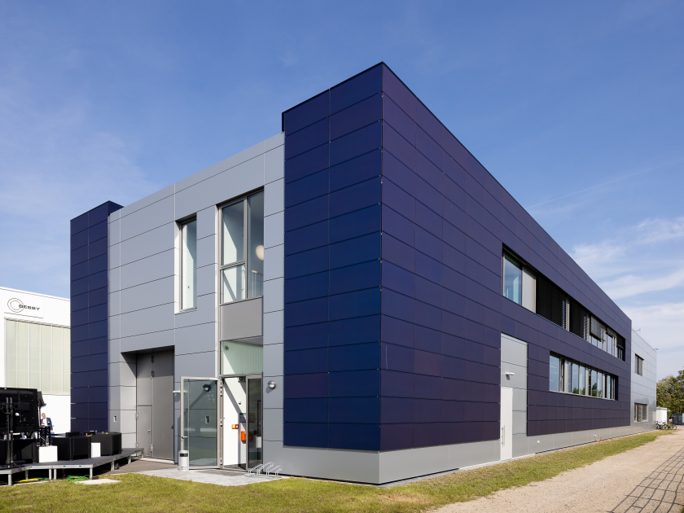
Where is bERLinPro?
bERLinPro in Berlin Adlershof
introduction
Fala-FEL Place
BESSY II
BESSY II
N
SEALAB
SLH
bERLinPro
TH2, TH1: Cleanrooms, SRF Teststands

Slide 7
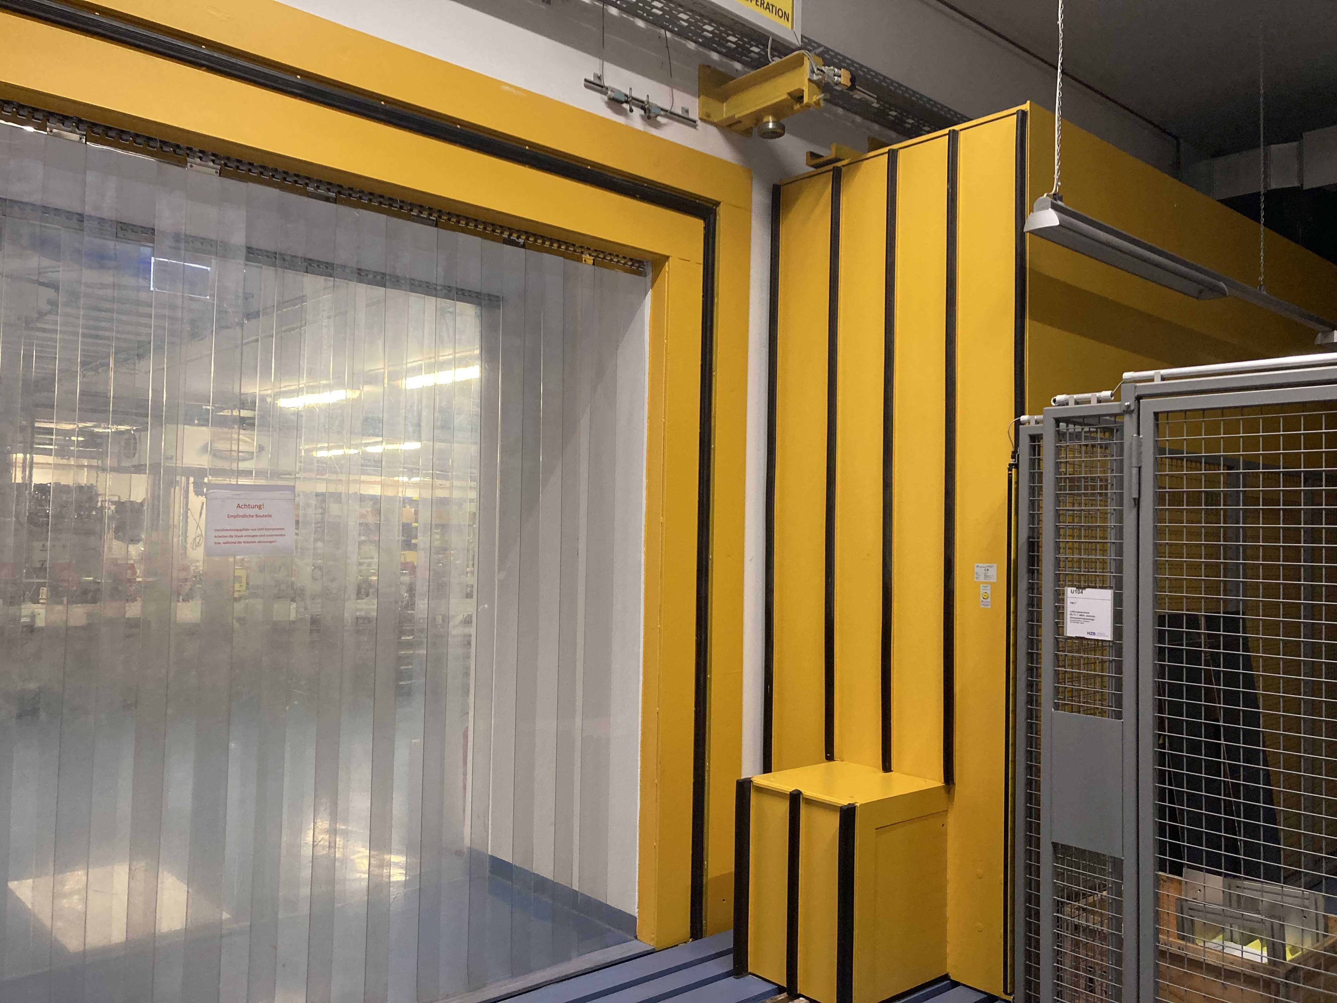
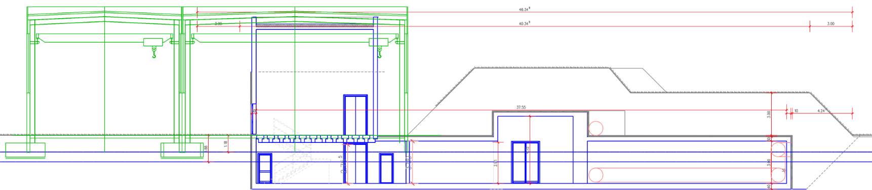

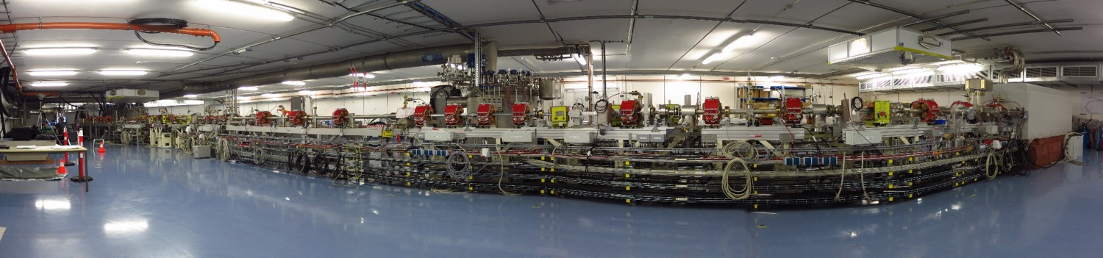

bERLinPro: A quick orientation
introduction
60t
Technical Hall
Radiation protection cover
Klystron gallery
Accelerator Hall
Basement
bERLinPro is located in a
subterraneous radiation protection
shelter prepared for maximum
beam loss (30 kW in theory)
All technical infrastructure, besides
the klystron and some cryogenic
installations are above ground in a
technical hall
HoBiCaT, sVTS
bERLinPro
LVTs,mVTS

Slide 8
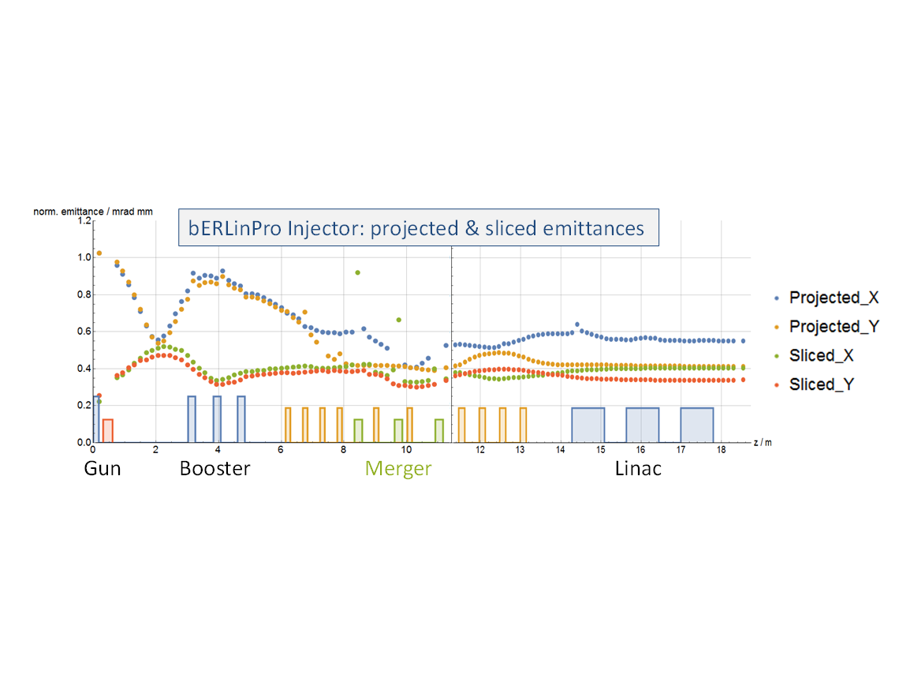
Beam optics studies
Achievements
Injector and recirculator
optics design, magnet
layout, collimators
Start to end simulations (Astra+
Elegant), full 3D studies (OPAL),
genetic optimization algorithms
(MOGA), first look into ML
Wanted vs. unwanted
beam studies, dark
current, halo formation,
Beam break-up studies
and countermeasures, wake
analysis and component opt.
Orientation of injector cavities
optimized to:
  Reduce coupler kick effects
  Limit back travelling dark current
  towards cathode
  Short pulse and low emittance modes
Parameters at LINAC exit
Energy / MeV | 50.1
Bunch length / ps | 4.65
Emittance x,y / µm | 0.58/0.41
Energy spread / keV | 254
Dark current losses along
injector
M. Abo-Bakr, M. McAteer, J. Völker
B. Kuske, M. Matveenko, E. Panofski, S. Wesch,
J. Knedel et al.

Slide 9
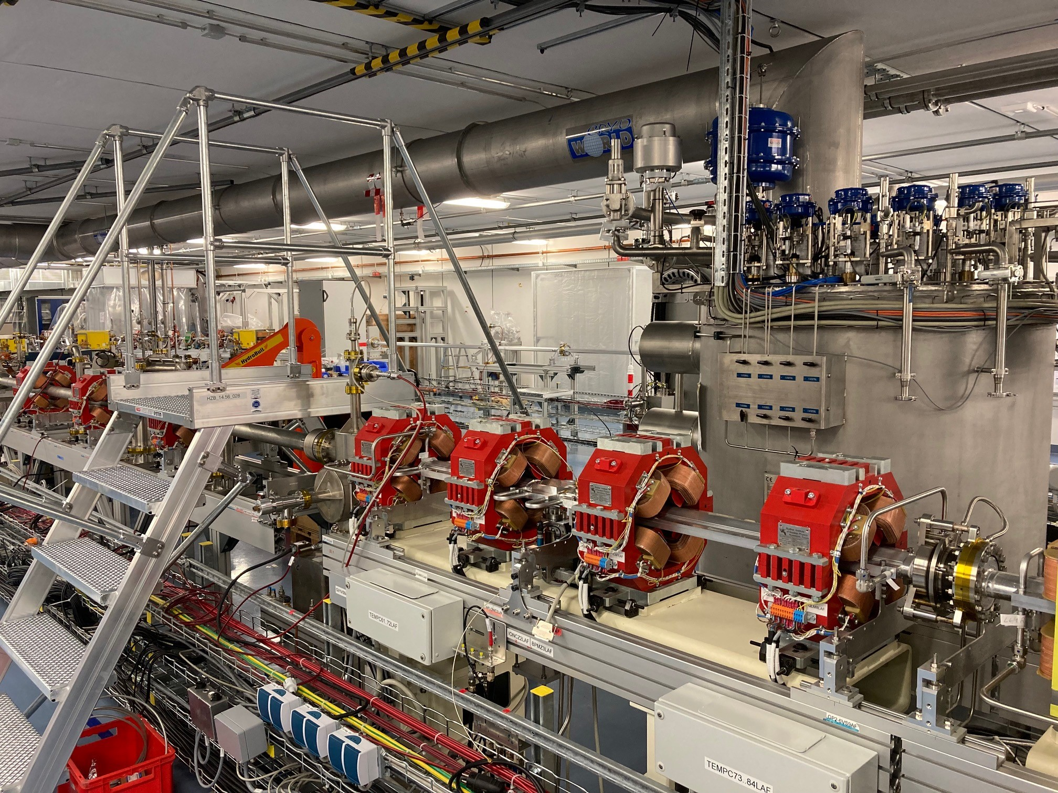
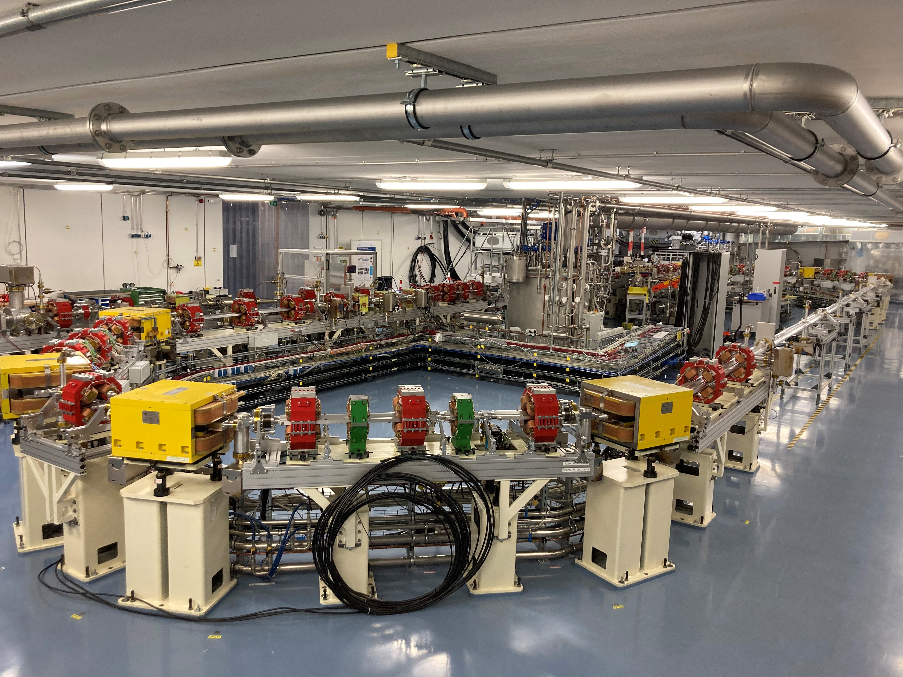
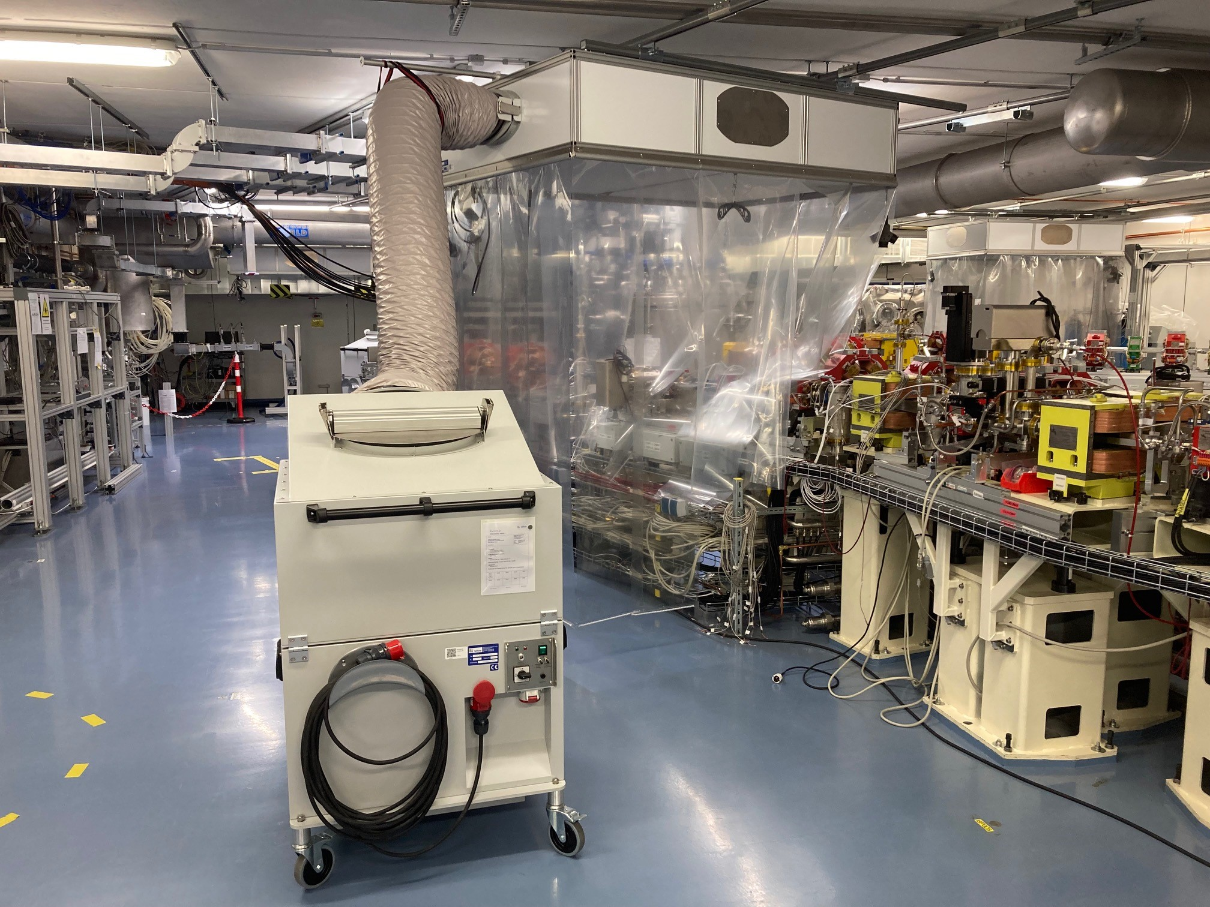
Beam vacuum system, magnets, cold boxes
Achievements
Linac section with
coldbox for cryogenics
supplies
Rail system at ceiling
to allow ISO5 flow-
boxes everywhere at
the machine to avoid
particulates
Vacuum system complete, realigned with coordinate system
adjusted to building (moved over the years)
Cabling of diagnostics well advanced

Slide 10
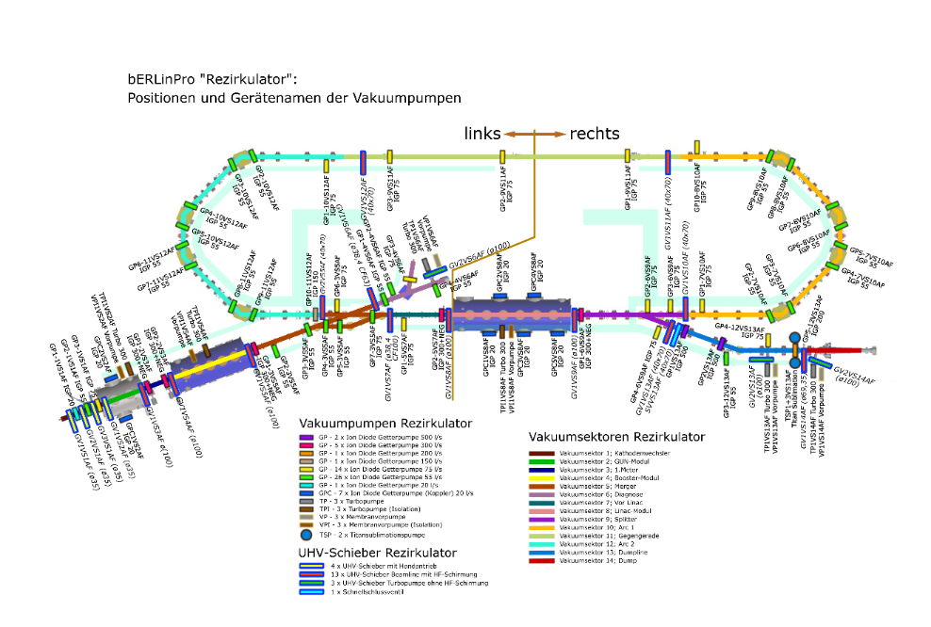
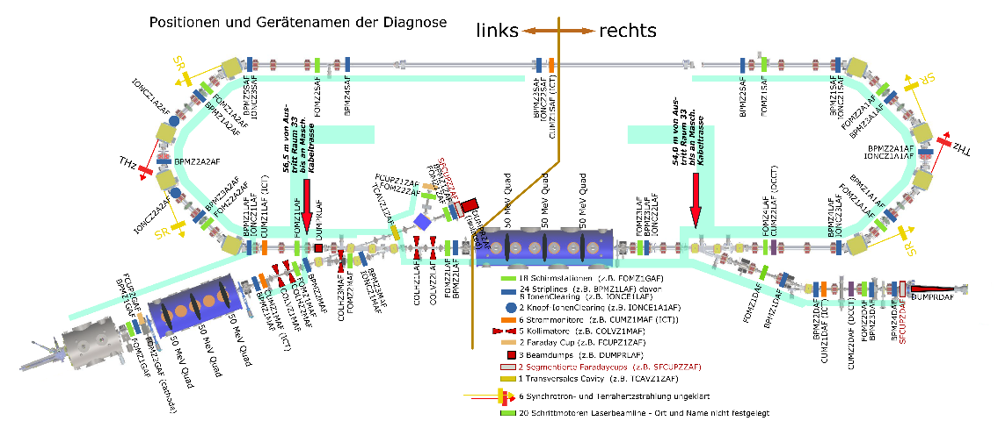
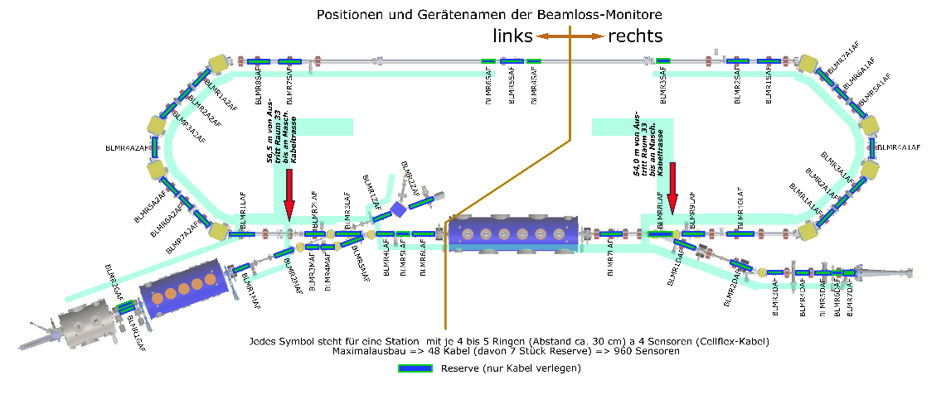
A glance at diagnostics and vacuum system
Achievements
Vacuum sectors
Beam
diagnostics
Beamloss
diagnostics
18x screen stations
24x Striplines, of which 8 with Ion clearing
2x button ion clearing
6x current monitors (ICT)
5x collimators
2x Faraday cups
3x Beam dumps
2 segmented Faraday cups
1 transverse defl. Cavity
Option: 6x THz/Sync. Rad.
+ Control system EPICS, visualization and data archiving
Jupyter Notebooks for
Python based data analysis and
measurement programs

Slide 11
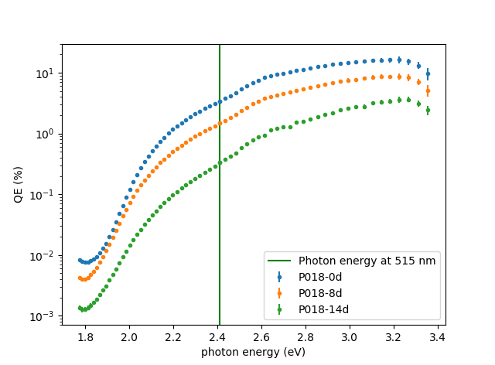
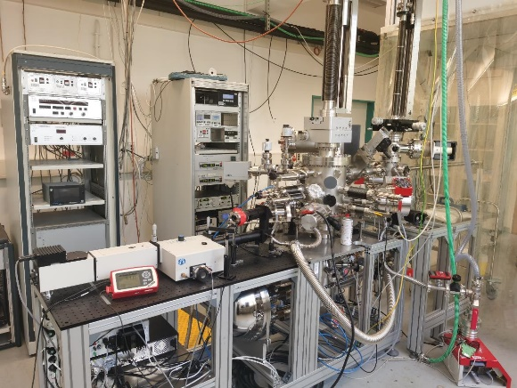
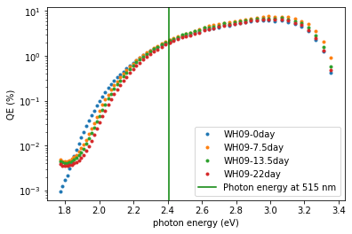



Optimizing the recipe for Na-K-Sb growth by QE and XPS measurements
Cathodes
Investigations into Na-K-Sb as more temperature robust alternative to Cs-K-Sb (baseline cathode)
Photocathode Preparation & Analysis System
Sepctral Response Na-K-Sb (WH09)
Spectral response Cs-K-Sb (P18)
Remember:
Best so far 16.8% at
515 nm (specs 1%)
Time after deposition | Na-K-Sb (WH09) QE @ 515 nm | Cs-K-Sb (P18) QE @ 515 nm
0 days | 2.0% | 3.4 %
8 days | 2.4% | 1.5 %
14 days | 2.2% | 0.3 %
22 days | 2.0% | -
High QE photocathodes for SEALAB photoinjector:
Explore multi-alkali Cs- and Na-K-Sb systems, from theoretical modeling (DFG fund), growth and characterization, towards operation in a SRF gun.
Complete infrastructure: growth and characterization system, UHV transport vessels, access to materials science lab EMIL at HZB, collaboration with theory.
Lower QE, robust
High QE, sensitive
J. Kühn, S. Mistry, C. Wang, J. Dube, C. Cocchi, R. Schier, H. Sassnick, et al.

Slide 12
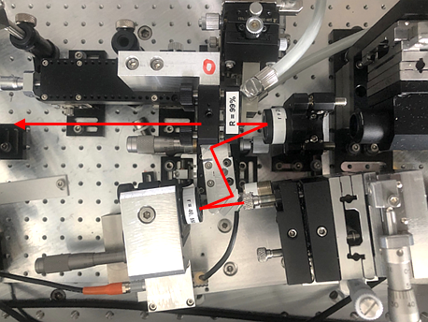
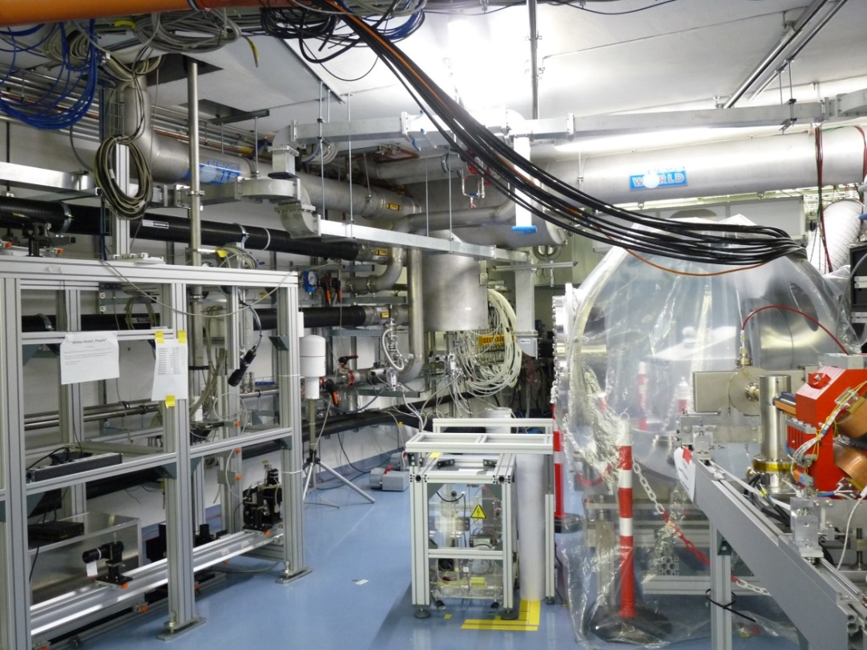

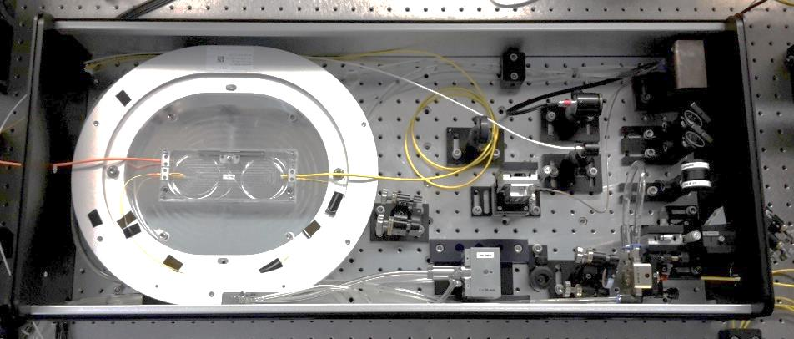
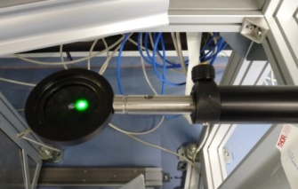
Drive laser ready for operation, laser beamline on-going (90% complete)
Two oscillators (50 MHz and 1.3 GHz), many pulse schemes, high average power (up to ~40 Watt) at 515 nm output
mode-locked (NIR)
1.3 GHz oscillator
Bunch spacing and current options:
50 MHz Laser:
  1-100 Hz macro-pulse:
  → I_{avg} = 77 pA – 7.7 µA
  CW 3.8 mA
1.3 GHz Laser:
  1 Hz – 1 kHz macro-pulse:
  → Iavg = 77 pA – 20 µA
  CW 100 mA
All this with 77 pC bunch charge,
laser power set up for QE of 1 %
last section of 20 m long vacuum pipeline for laser beam transport
photoinjector module
laser window
Water cooled fiber
power amplifier:
laser spot in accelerator hall
G. Klemz, I. Will, et al

Slide 13
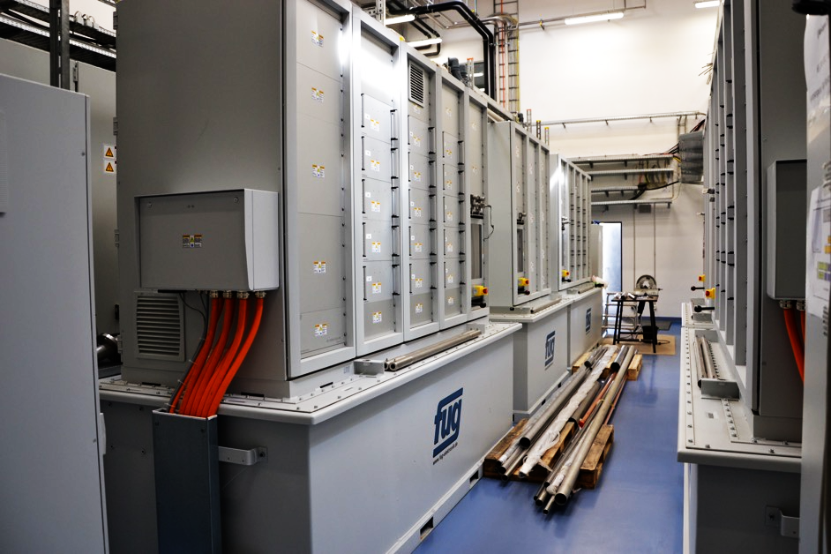
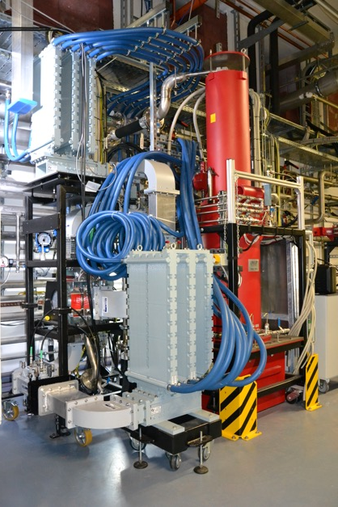
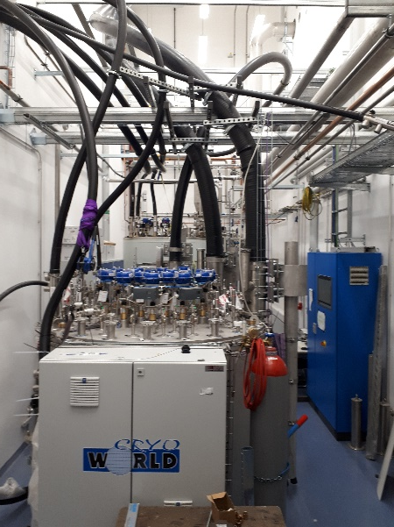
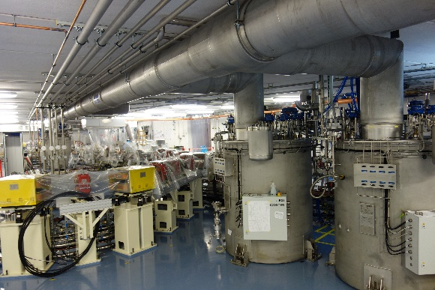
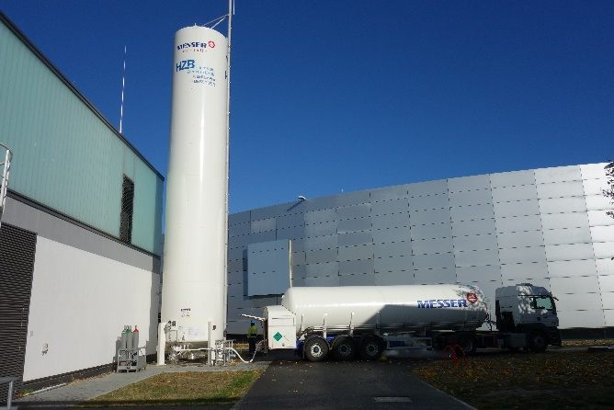
RF and cryogenics installation status
Achievements
1.3 GHz CW 270 kW Klystron
Second test in dummy
load
Pics
courtesy
W. Anders
600 kW FuG power supply
3 Klystrons in house, 1 tested in
SLH and at bERLinPro up to 270kW,
currently in use for coupler
conditioning
2 Klystrons will power Booster,
1 an high-power gun at some point
15 kW solid state amplifiers for Linac
Tcav and 1st Booster (zero-crossing)
Made by CPI
N₂ to cool L700
Booster+Gun coldbox

Slide 14
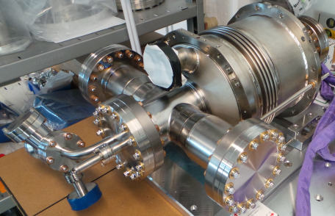

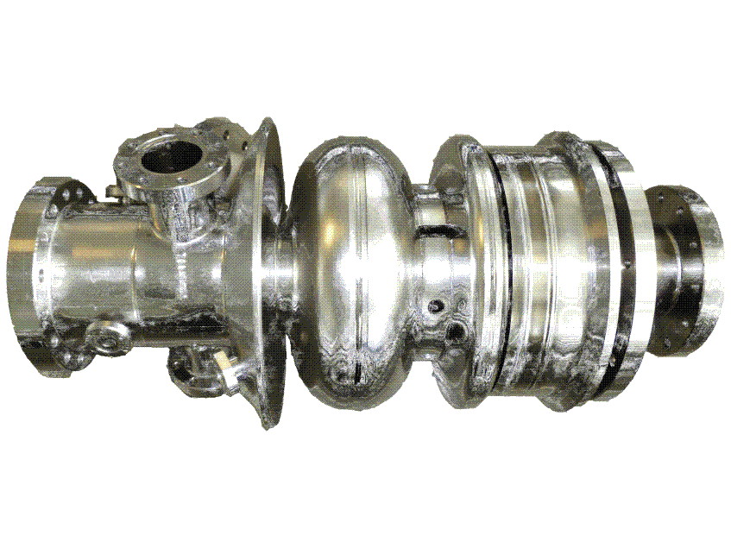
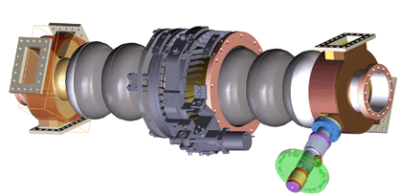
Challenges for the SRF+vacuum systems
SRF systems
+4.5 MeV (100mA)
Compact machine: All vacuum parts need to be treated
within ISO 4-5 environment
Complete machine analyzed and optimized by wake/impedance
studies
SRF booster cavity (Cornell)
High beam power
High beam current
Intermediate field levels
10 MV/m
Low coupler kicks
Zero-crossing operation
+45 MeV (2x 100 mA, recovered)
Main linac cavity
2.3 MeV, 100 mA
SRF Gun:
Low emittance high brightness beam
Insertion of a thermally isolated high QE
Cs-K-Sn cathode (particulate free)
Control of field emission to avoid dark current based
losses and halo formation
High current, high beam power operation (HOM, FPCs)
High emission RF field → beam dynamics optimized
shape
Avoid coupler kick-based emittance dilution
Synchronization Laser ←→ RF, precise RF control
Low beam power
High beam current
Strong higher order mode damping
Higher field levels: 19 MV/m
Multi-pass beam
Precise field control and tuning
Movable local cleanrooms
ISO 5, rail system
on the ceiling for proper
placement

Slide 15


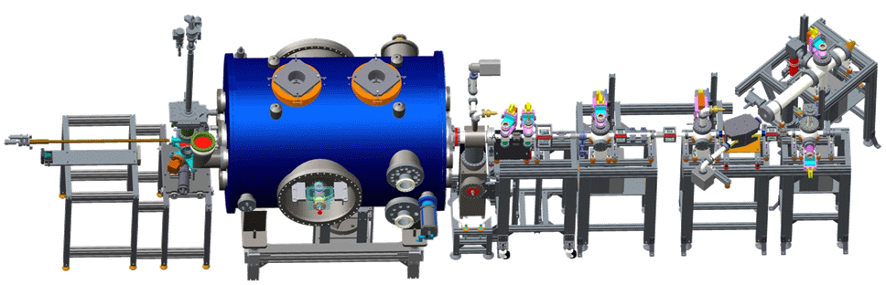
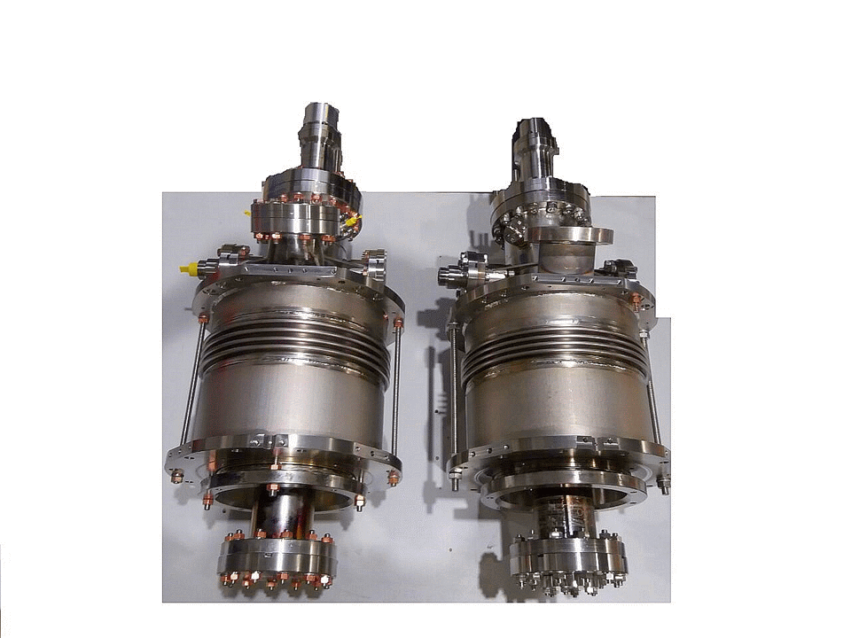
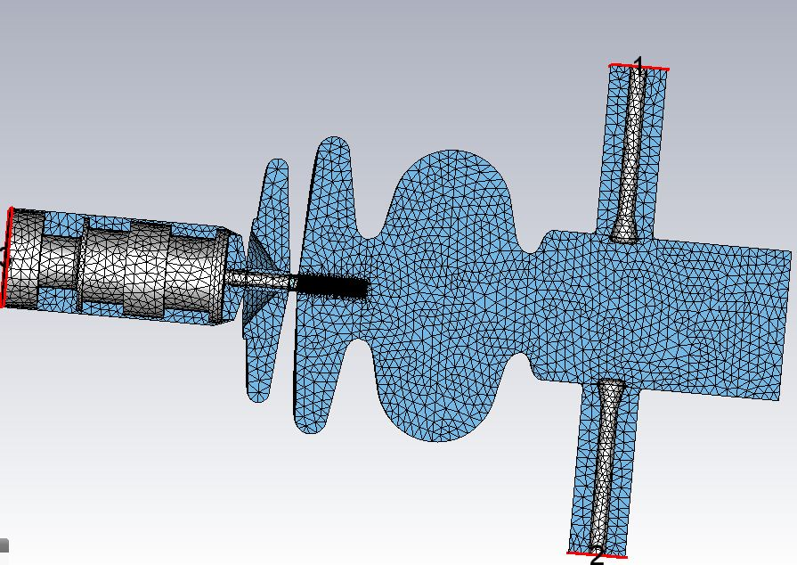
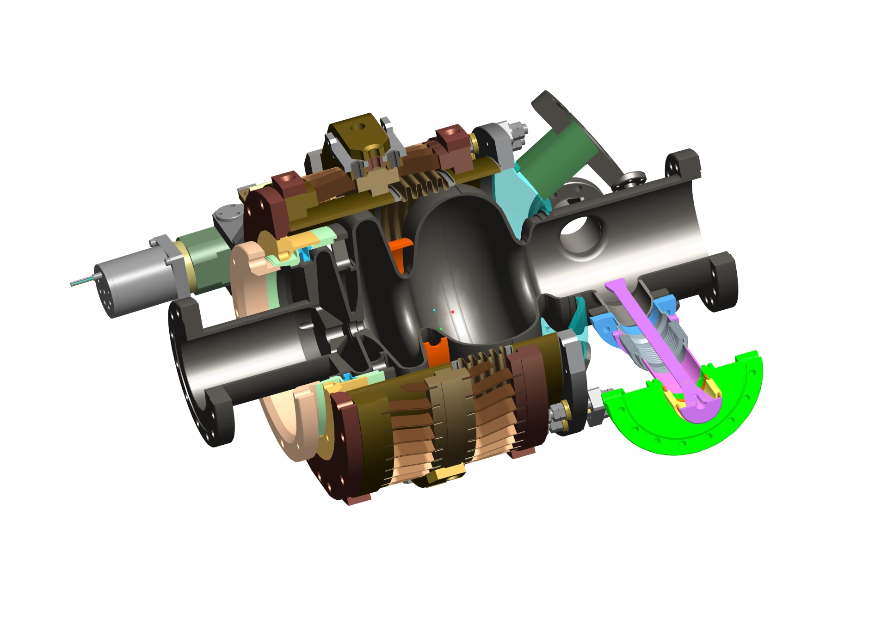
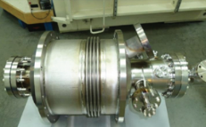
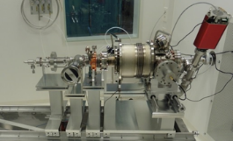
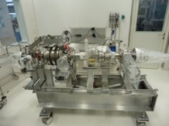
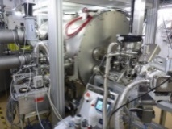
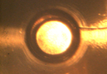
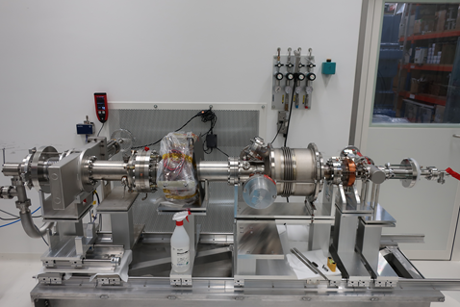
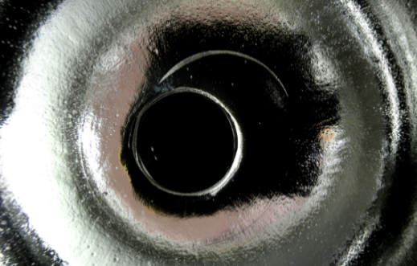
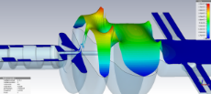

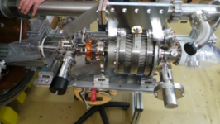
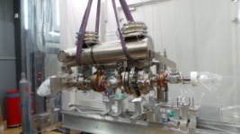
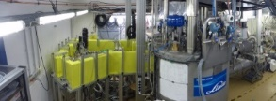
Evolution of the SRF Gun at HZB
SRF gun history
SRF photo-injector: From cradle to grave and resurrection
Fully in-house developed SRF photoinjector with strong partners
HZB
HZB
HZB
PC
VTA
VTA/HTA
HTA
Gunlab
1.1
1.0
Reassembly
1st Beam
Cathode transfer
Design
Manufacture
Test/Assembly
String test
String/Cold mass
Module assembly
Commissioning
Damage and Recovery
2011-2012
2013
2014-2016
2016
2017/2018
2018-2021
2022
Time

Slide 16


The SRF Injector 1.0
Status
Twin power coupler:
Modified TTF-III type
20 kW power
Transverse steerer magnets
Exchangeable
Photocathode
Beam dynamics
+SRF optimized
1.4 λ/2 cell cavity
SiC HOM absorber
SC solenoid for
beam emittance
Booster cavity + couplers
Straight diagnostic
line
Cathode
transfer
system
SRF gun
SRF booster
Merger section
Recirculator
1st diagnostic
Laser window

Slide 17

Short to Midterm plans
What next?
There is light at the end of the tunnel……

Slide 18


When will we have first beam?
Will we have first beam?
First beam?
TCav
30 kW dump
Injector line
Booster
Gun
MESA
“Banana line”
650 kW dump
Focus on commissioning injector with SRF gun and transverse deflecting cavity + diagnostic line
Next stage installation of the Booster module, possible beam transfer into the high power dump
Recirculation, when Linac funding is secured or an interim arrangement can be found
Cathode transfer
system
SRF gun module fully assembled, ready for cooldown
and RF test, cathode transfer system on standby
First beam planned for Christmas this year, but
unclear because of attack on HZB’s computing system
Use the time to finalize all assemblies

Slide 19
First studies with bERLinPro (injector)
Topics to study
Even with the medium-power gun (20kW) cavity we can study:
Up to 6-10 mA with the full injection energy
→ Explore the full parameter space of the SRF injector
100 mA can be potentially studied in macro-pulse regime (large power overhead by klystrons)
Bunch charges up to 0.5 nC are in reach with a high QE cathode
Proof of cathode exchange concept
Studies of beam loss scenarios by dark current or
beam halo formation by bunch tails
Propagation of beam and unwanted beam from injector to dump
Beam loss and machine protection concepts
Diagnostic concepts from low-current start-up to
mid-power operation (sub µA to some mA)
Beam arrival time and jitter studies
Advanced control concepts, digital twins of the
machine, ML+AI assisted control methods
This comes all with the given budget
and project status.
A Linac and a high power gun version
still need new resources to be
realized, though designs exist
“in the drawer”

Slide 20





Ultra-fast scattering experiments with the SRF photoinjector
Many ARD aspects: SRF, beam dynamics, instrumentation, controls, …
SRF Gun
Aperture
SRF Booster
Sample Area A
Sample Area B
Detector Area
Dogleg option
Demonstrator phase within funds!
0
1
2
3
4
5
6
7
8
9
10
11
12
13
14
16
Capabilities of the photoinjector:
1 to 3.5 MeV beam energy with variable bunch charge (1 fC to 100 pC), pulse length (10 fs to 6 ps) and spot size (10 to 100s μm), high stability at MHz repetition rate.
Very flexible longitudinal accelerator/lens system: one gun cavity and three booster cavities, done optimization for bunching scheme, see B. Alberdi et al. [1].
TOF jitter at position A in units of initial jitter
vs number of cavities in the photoinjector
Ultrafast science drivers:
Diffraction camera for molecular movies with MHz repetition rate (UED).
Imaging of macromolecular structures in liquid phase (UEI).
Complementary to SR and FEL light sources. Enabling multi-modal capabilities for Bessy II/III.
[1] B. Alberdi, et al, Sci. Rep. 12, 13365 (2022)
T. Kamps, B. Alberdi Esuain, J. Völker, T. Spohr, E. Ergenlik, A. Neumann, J.-G. Hwang, S. Barg, et al.

Slide 21






Realize a Linac for SEALab/bERLinPro
Linac for sealab
A bERLinPro Linac was developed
Funding
Limit
New baseline:
Cut down to a simplified more cost saving, less complicated design
Simplified module concept, Cornell like, no room temperature parts
Contributes to
European ERL
roadmap
HORIZON-INFRA-2023-TECH-01-01 iSAS funded!
Cryo allows to potentially operate one cavity at 4 K as new material demonstrator
Full three-cavity string HOM
analysed, coupler kick studies, manufacturing
study etc….
For a BBU threshold of 2x 100 mA
+ margin this design is an overkill
threshold current in the Ampère regime!
Cornell shape cells
No waveguides, TTF coupler + Fast reactive
tuner port
Beamtube HOM absorber like Booster/Gun

Slide 22
















Acknowledgements
Fin
Many thanks to:
J. Teichert, A. Arnold, P. Murcek, R. Rimmer, A. Burrill, F. Marhauser, S. Belomestnykh, E. Zaplatin, E. Kako, N. Shipman
R. Eichhorn, J. Sekutowicz, P. Kneisel, G. Ciovati, A. Matheisen, B. van-der-Horst, M. Schmökel, W.A. Clemens, C. Dreyfuss, D. Forehand, T. Harris, R.B. Overton, L. Turlington, M. Schalwat, S. Lederer, V. Volkov, I. Will, MAC members
+many more
HZB bERLinPro Team & friends
former colleagues
Team Sealab
Thanks for your attention!
Funding: Bundesministerium für Bildung & Forschung
Bundesland Berlin, Helmholtz Gemeinschaft

