Slide 1

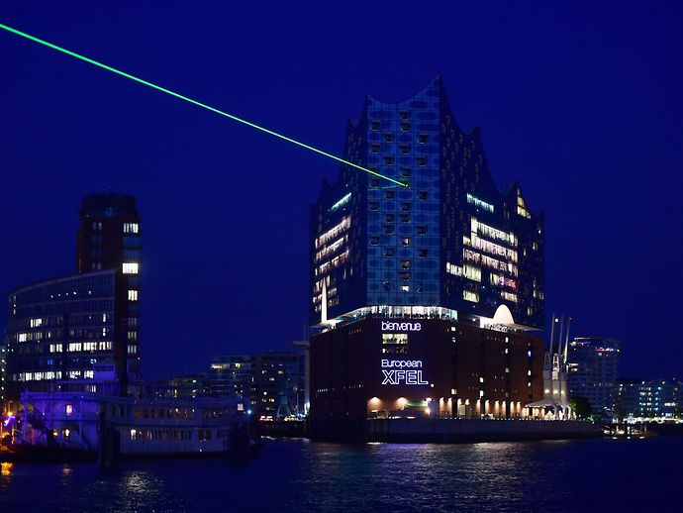
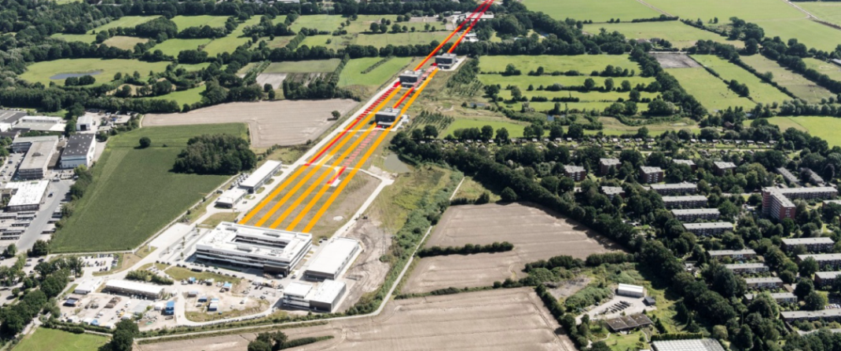
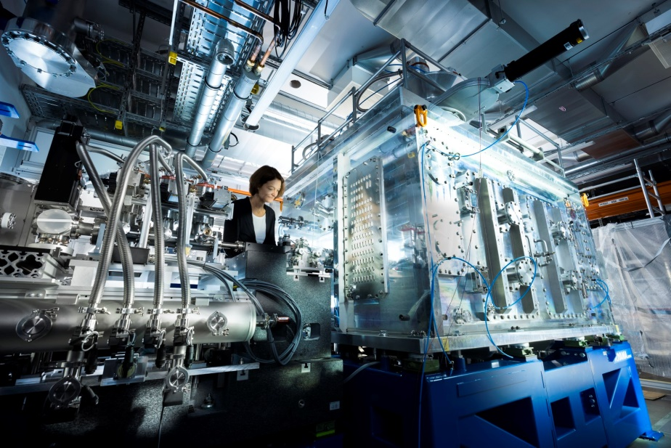
Introduction to European XFEL
Prof. Thomas Feurer
Incoming European XFEL Managing Director (Start January 2024)
Elba, September 22, 2023

Slide 2
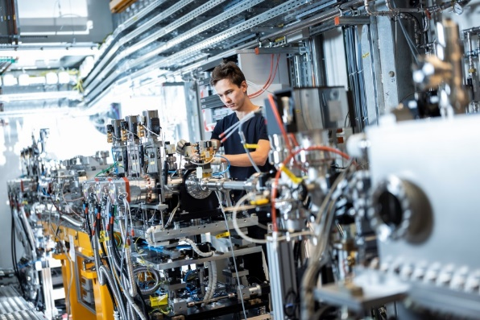

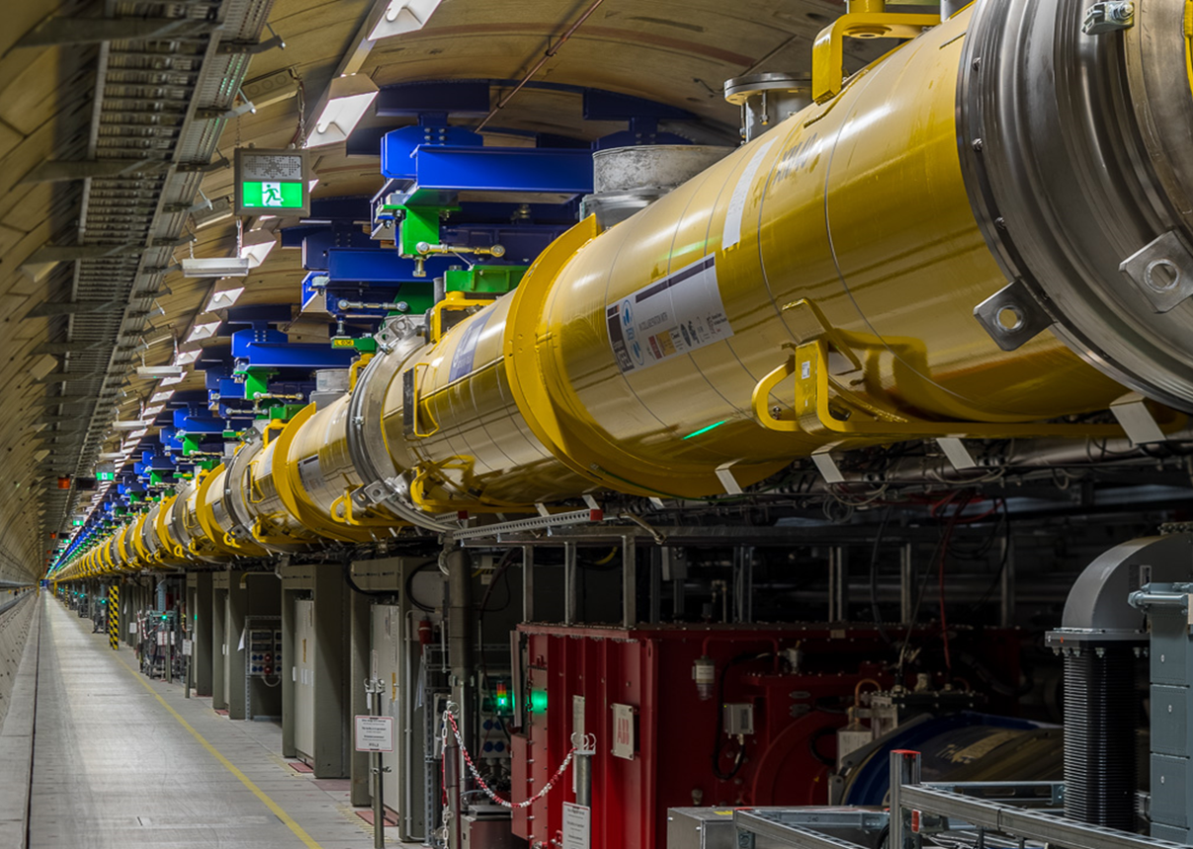

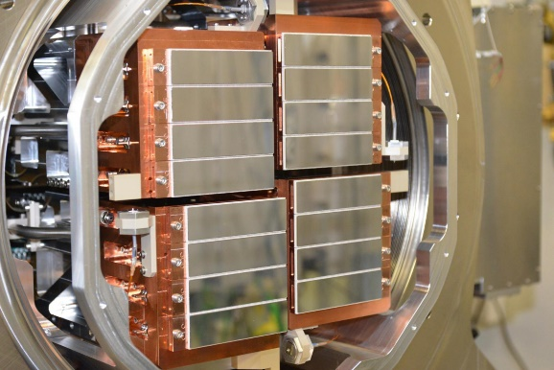
European XFEL Mission and Vision
European XFEL offers ultrashort X-ray pulses of outstanding spatial coherence and spectral brilliance. In collaboration with international user communities, especially from our shareholder countries, we perform world-class experiments for a broad range of scientific applications. By creating research opportunities, developing novel scientific methods, and pioneering beyond state-of-the-art technologies, we strengthen the competitiveness of European science. As a culturally diverse workforce with a collaborative spirit we place user support, research and knowledge transfer at the core of our mission.

Slide 3

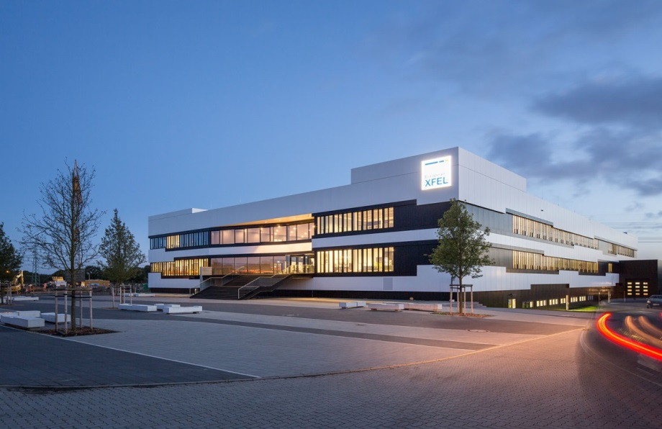
European XFEL – a user facility of superlatives
Facts and Figures
  Non-profit company with 12 partner countries
  Start of construction in 2009
  Start of operation in September 2017
    6-year anniversary this year
  Construction costs: 1.54 billion Euro
  Annual budget: about 140 million Euro
  More than 500 employees (plus 250 at DESY)
The largest and strongest X-ray laser in the world!

Slide 4
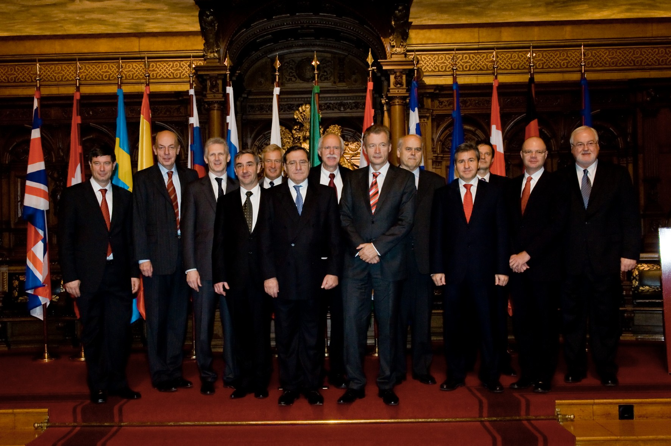
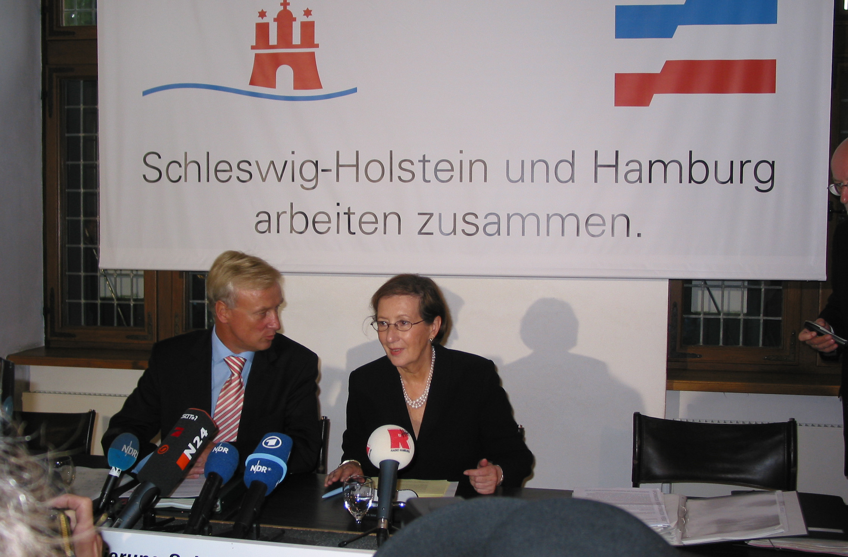
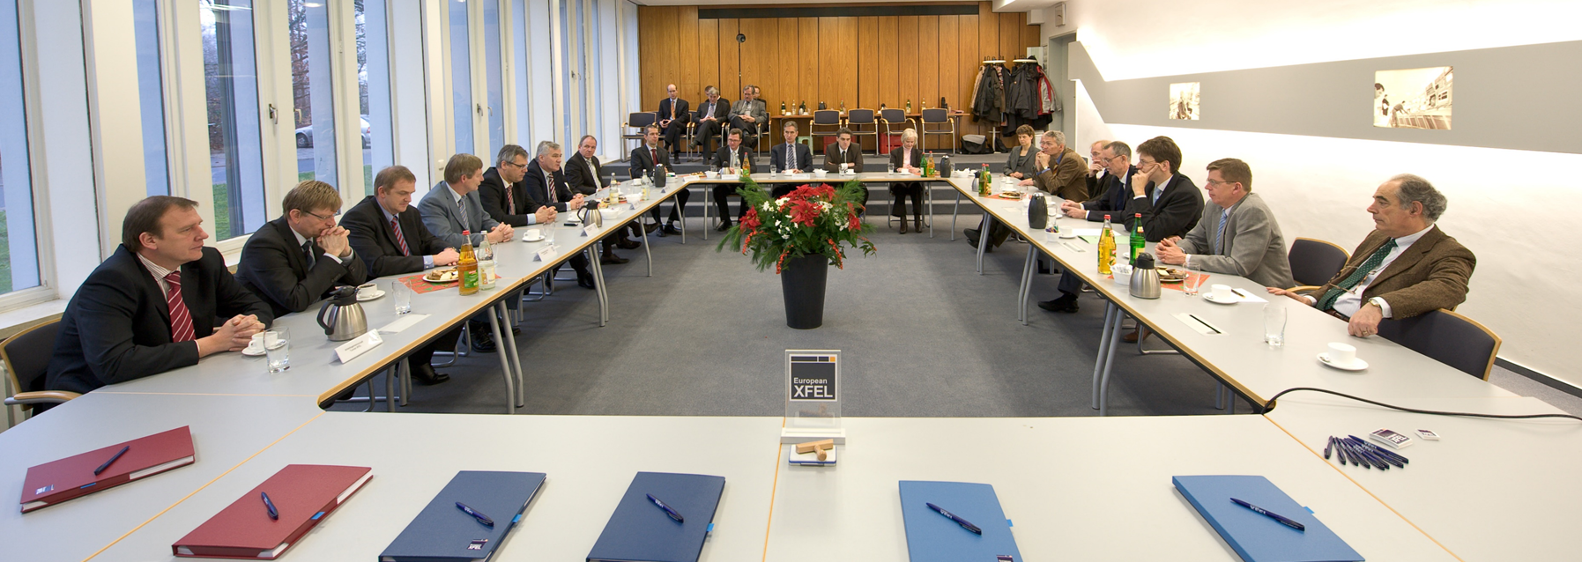
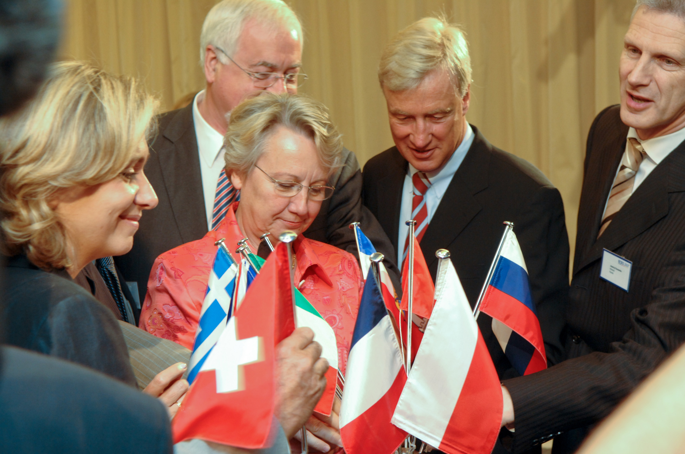
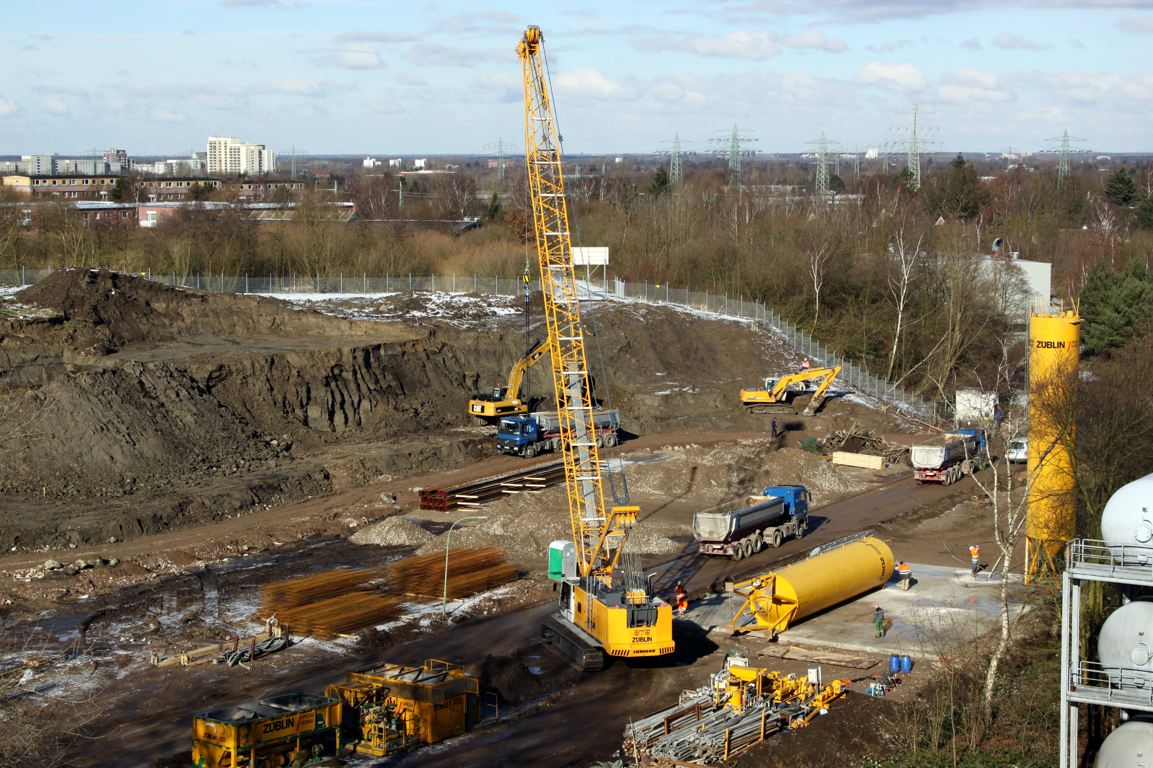
Founding European XFEL
European XFEL
project officially launched
Civil
construction
begins
2007
2009
2004
2008
2009
Treaty for
founding and
construction
1st construction
contracts
awarded
Signing of the
international
European XFEL
convention

Slide 5
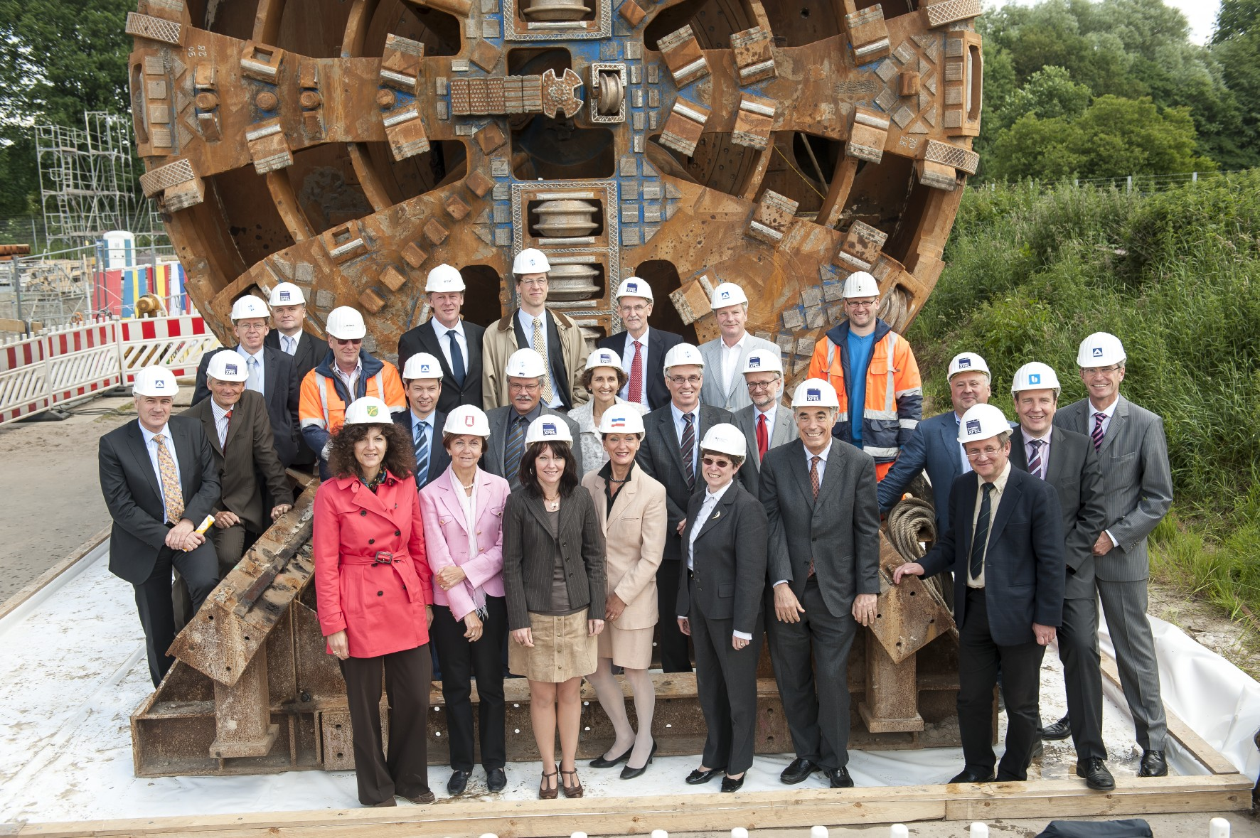
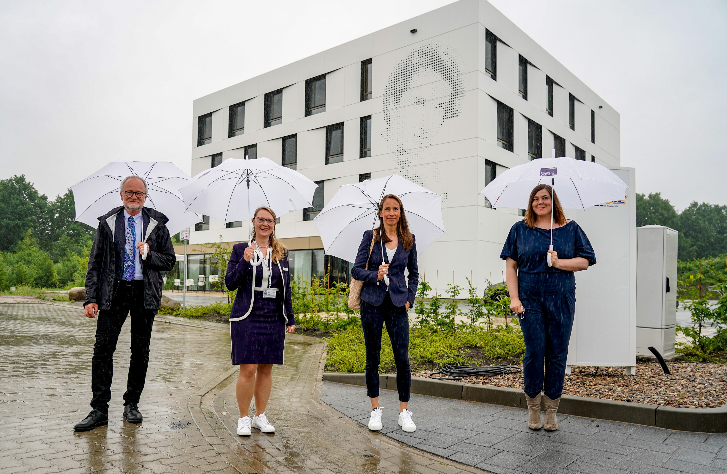
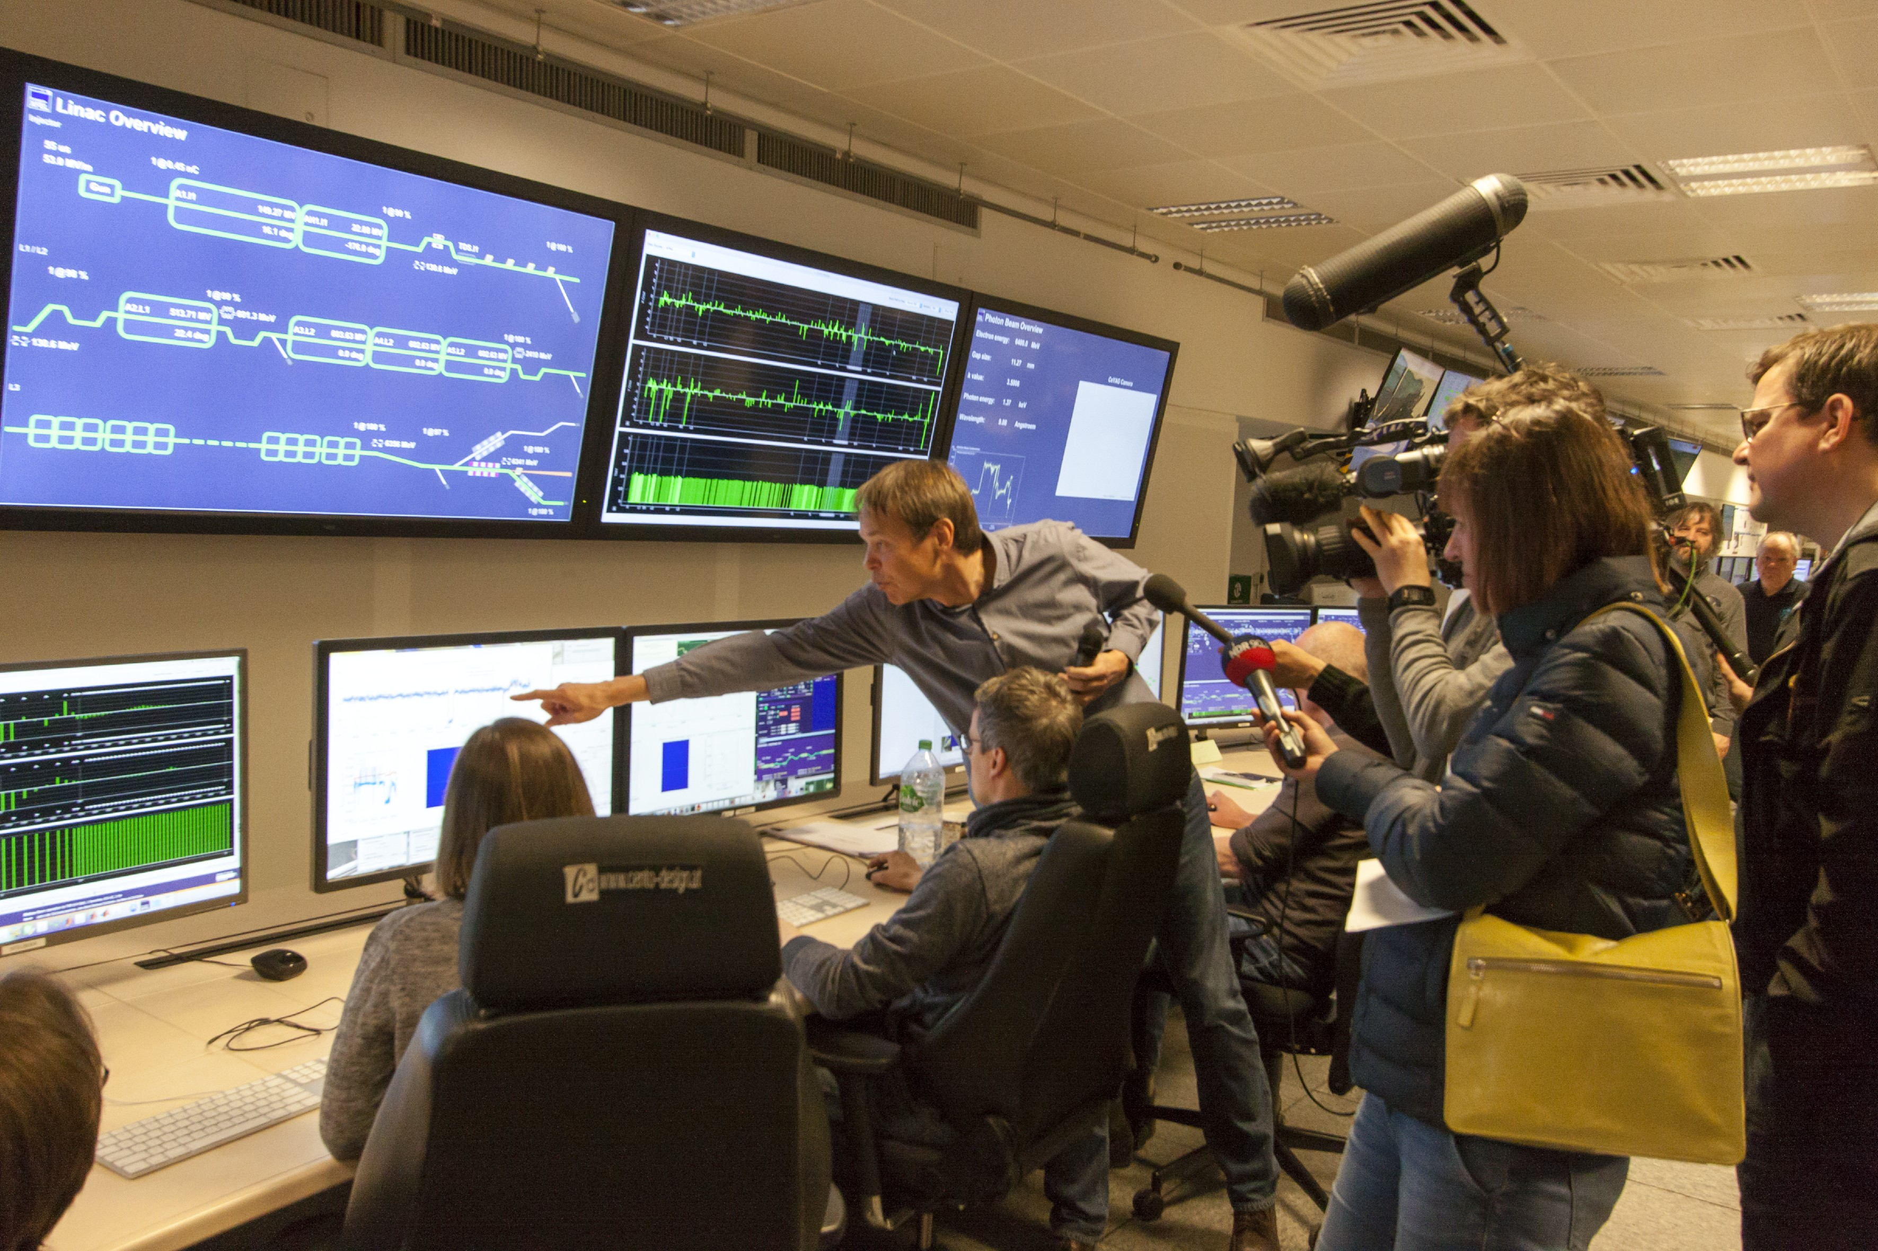
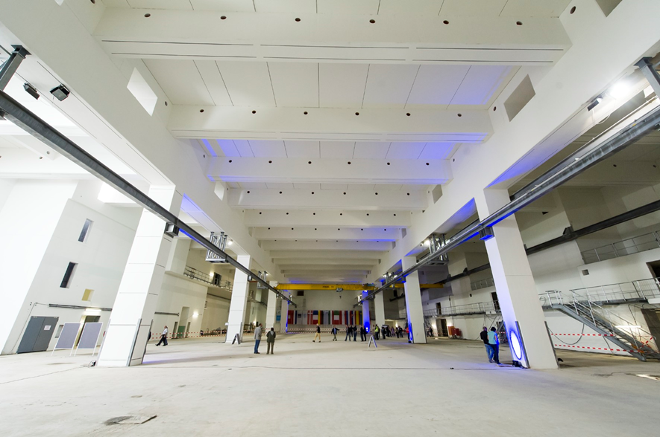
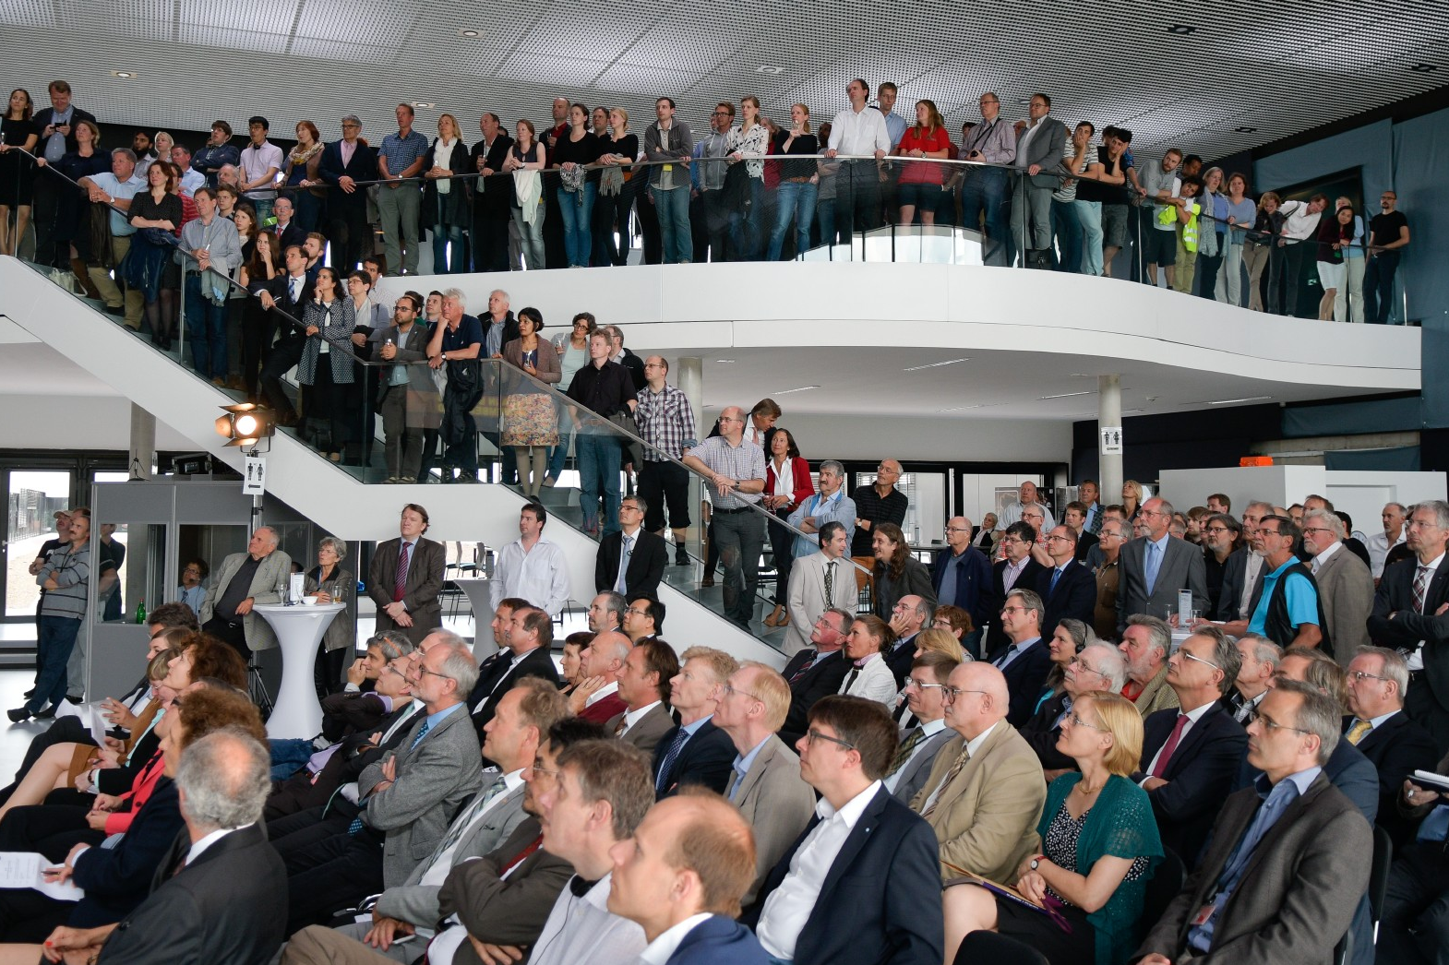
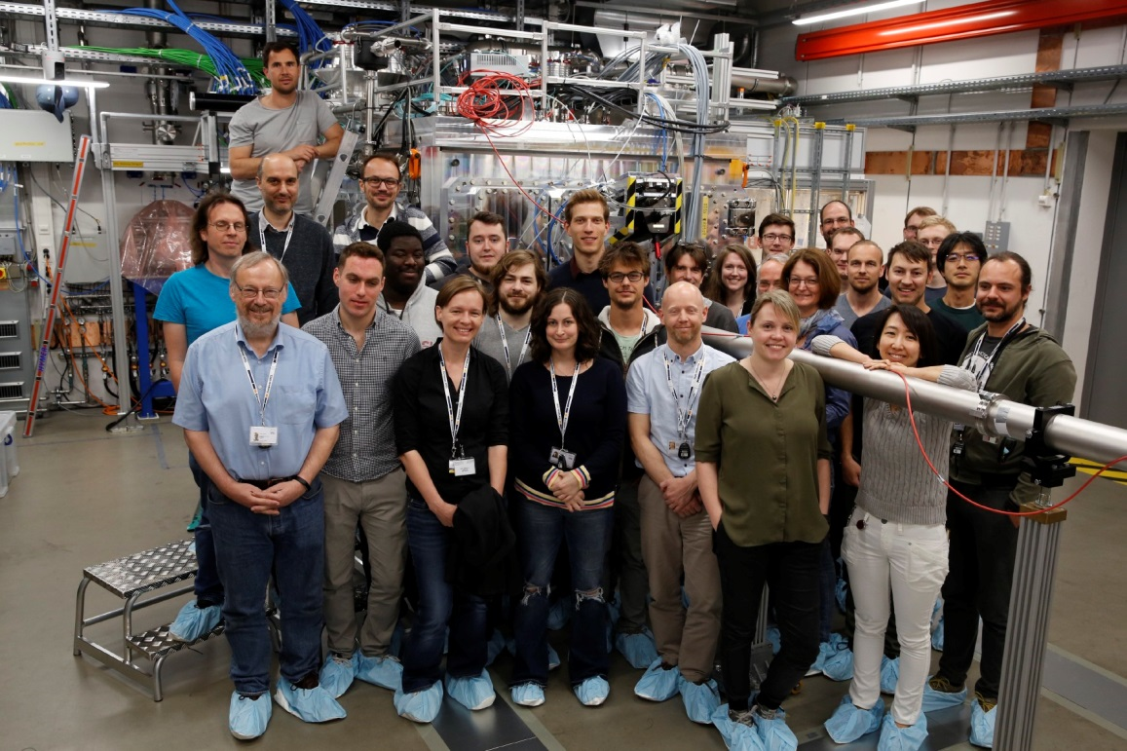
Building European XFEL
All scientific
instruments in
operation
Inauguration
of headquarter
2015
2019
2012
2017
2021
Completion
of tunnels
and
underground
construction
Facility
inauguration
and start of
operation
Opening of
guest
house

Slide 6
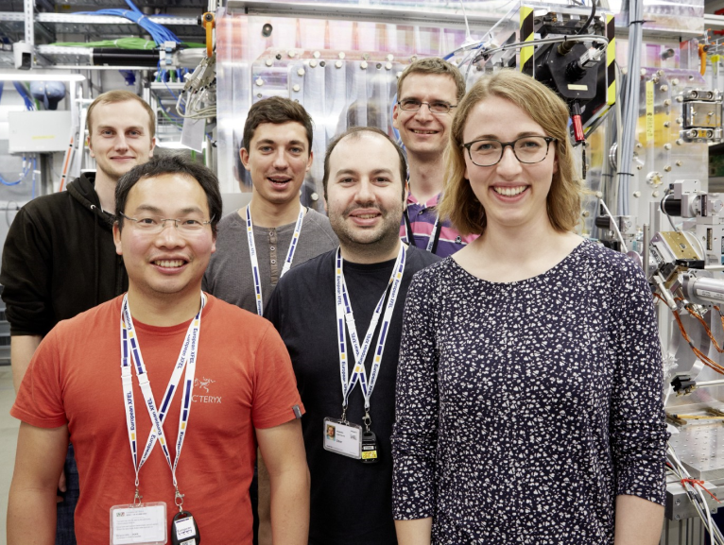
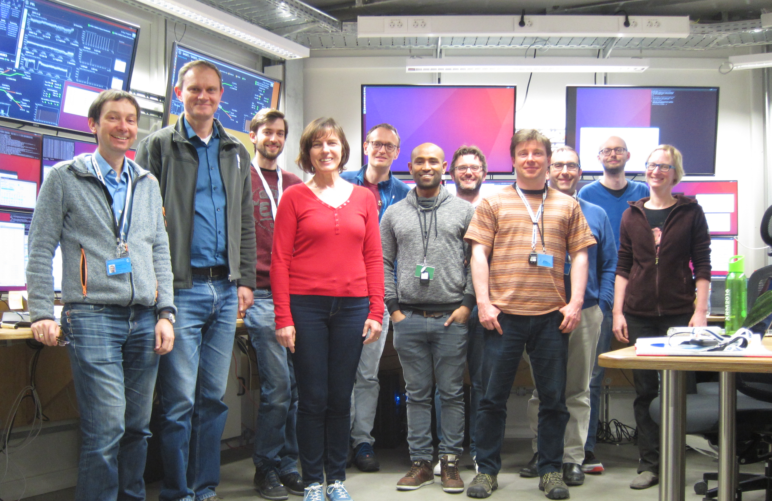
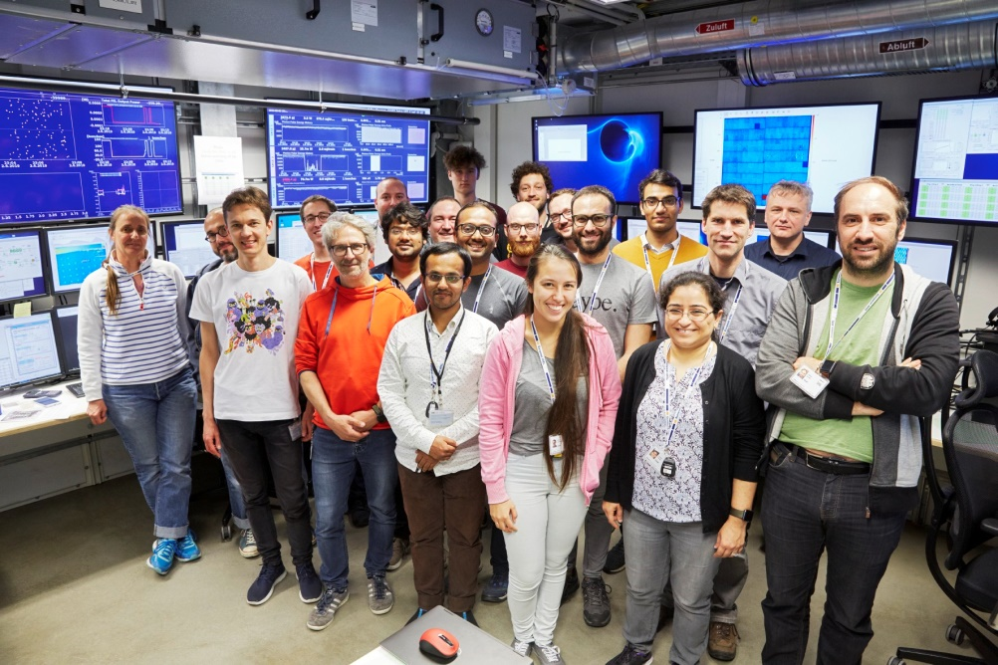
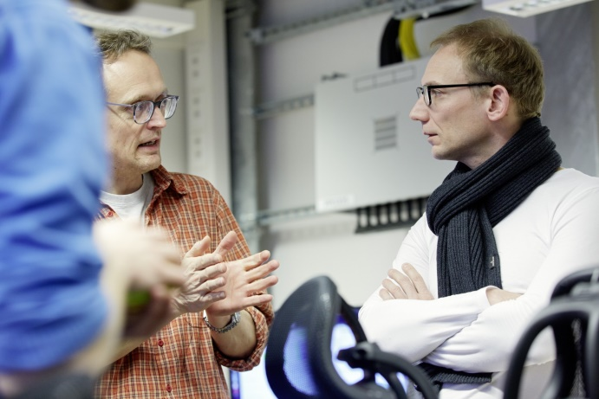
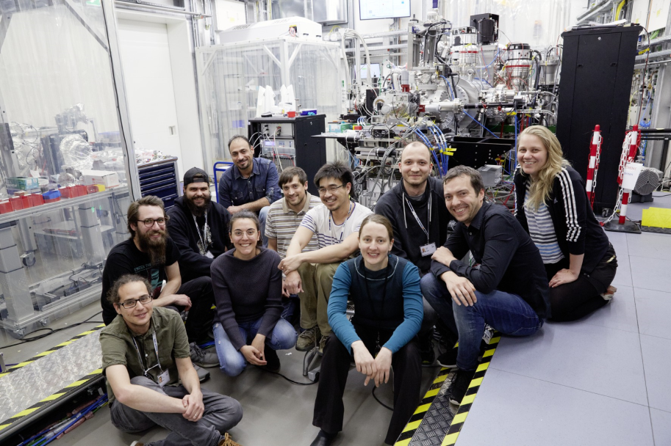
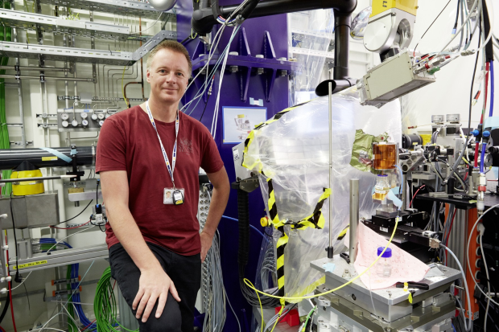
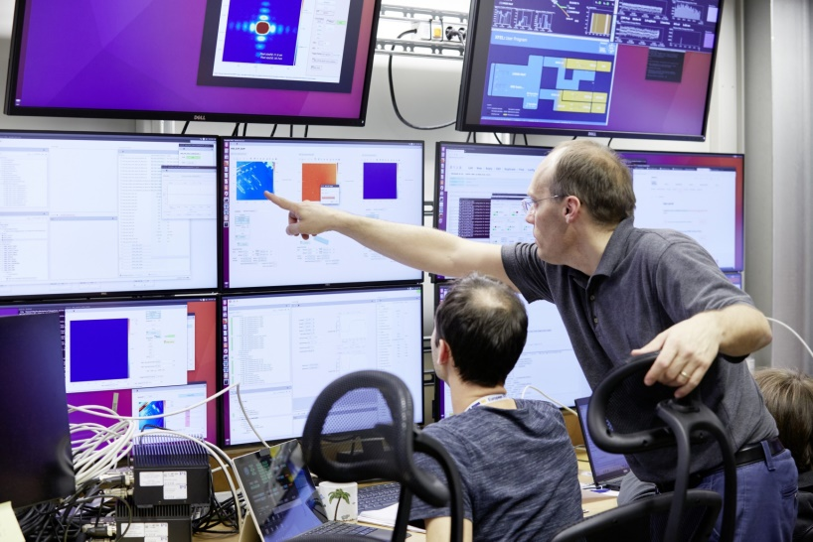
A user facility
European XFEL is a research facility open for users from around the world
  One experiment takes about 3-5 days
  Today ~ 100 experiments/year
  Topics defined by the user
To gain access:
  Research groups write proposals
  Panels of experts review the proposals
  Selection based on excellence
  European XFEL scientists and engineers support the users

Slide 7
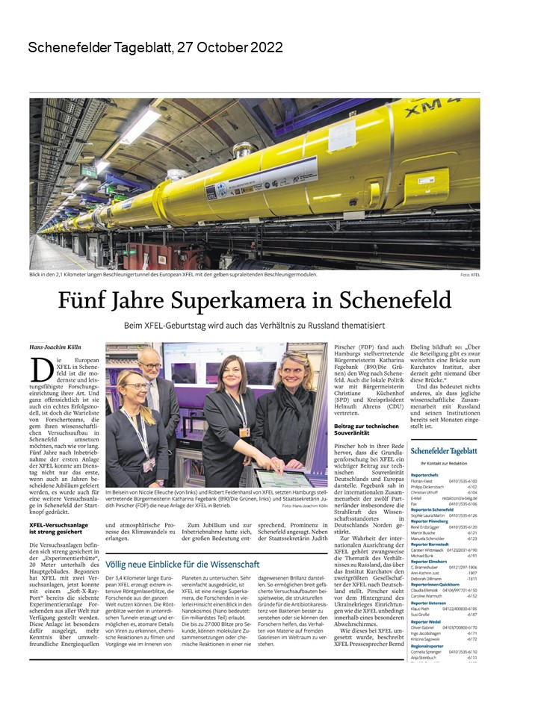
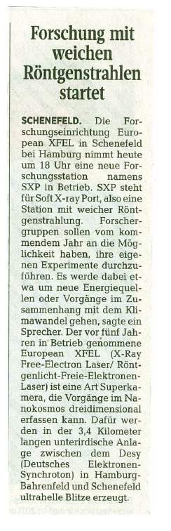
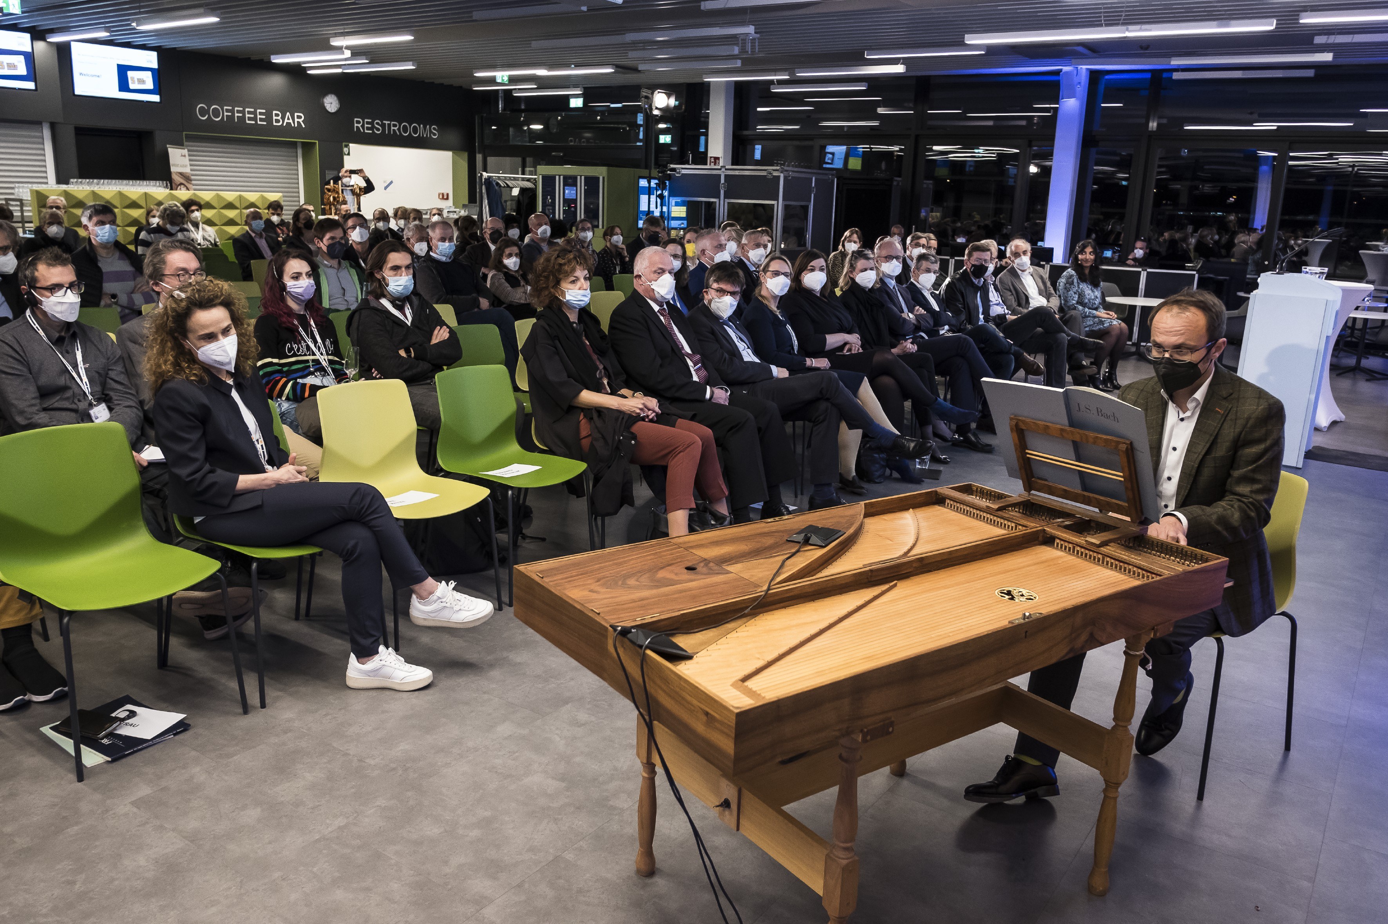
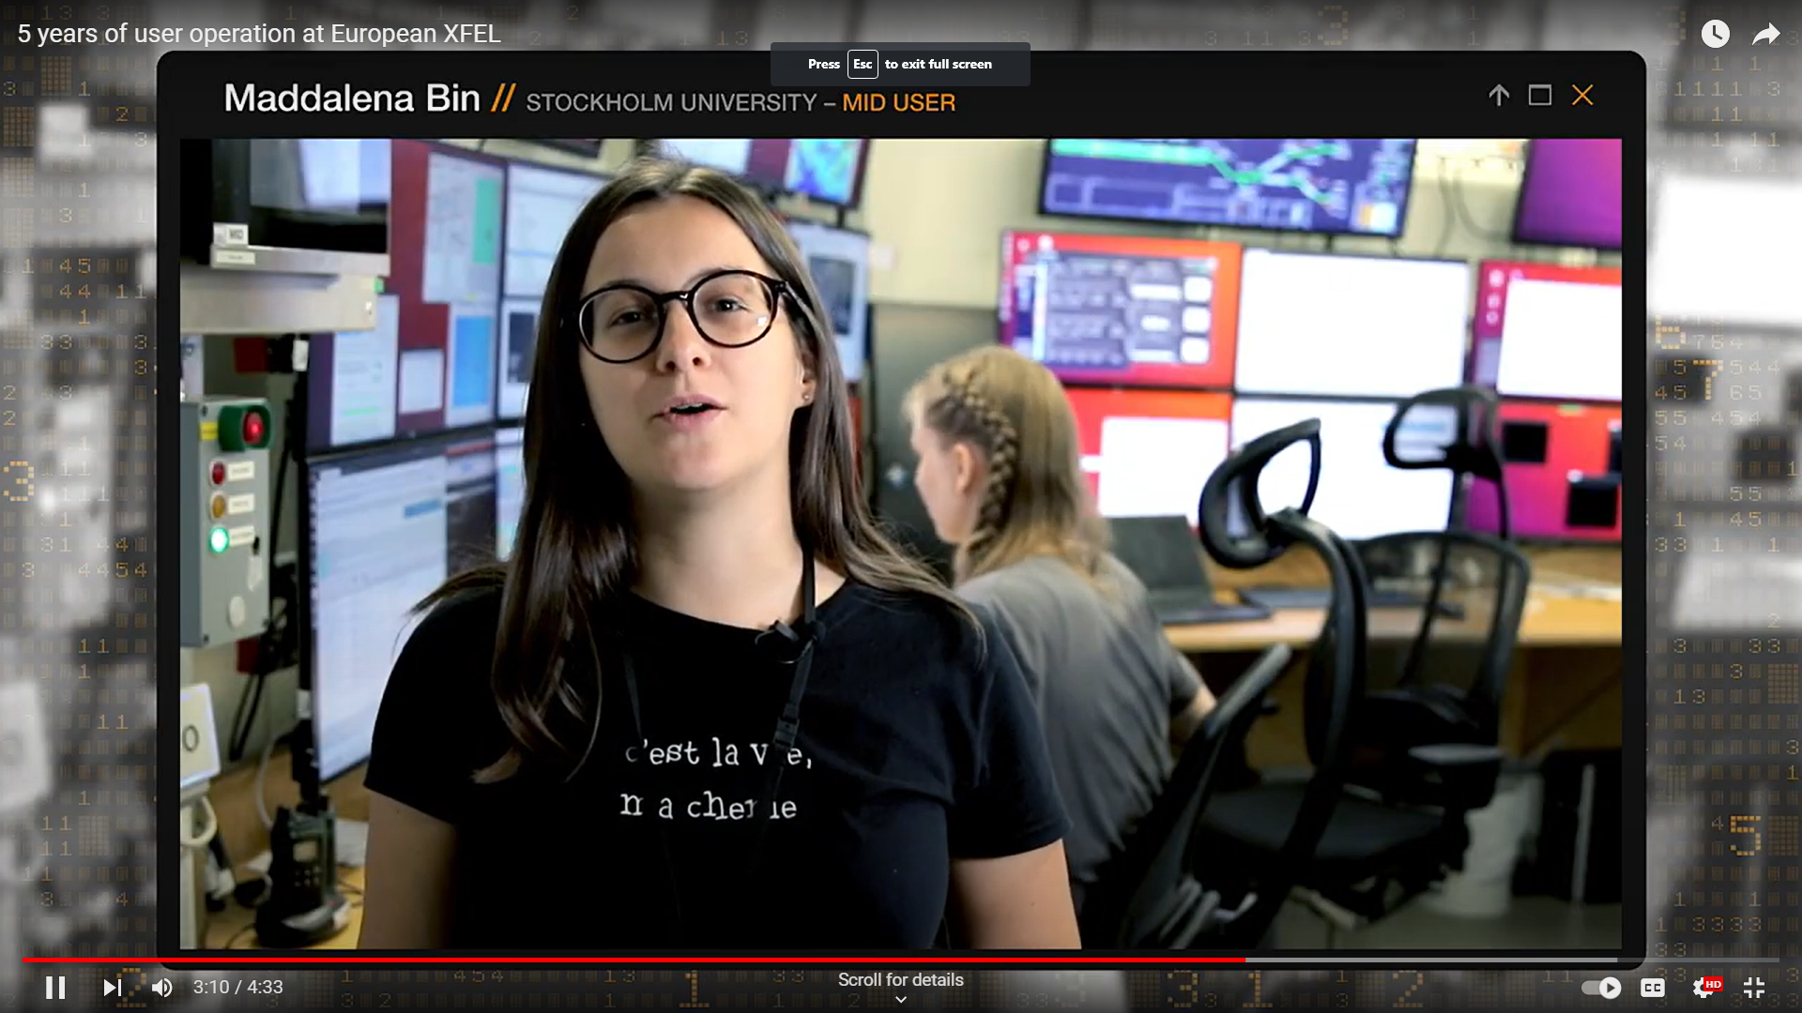
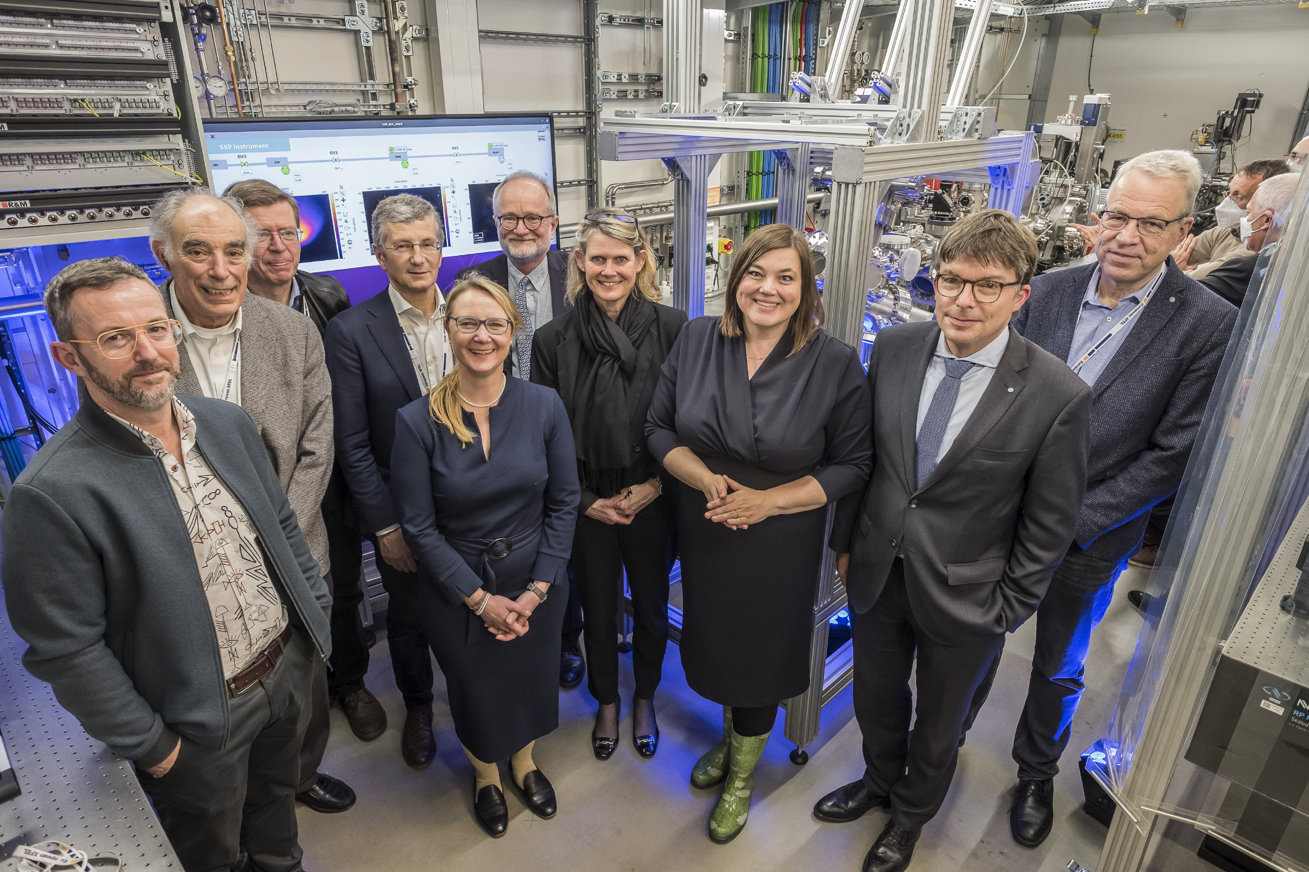
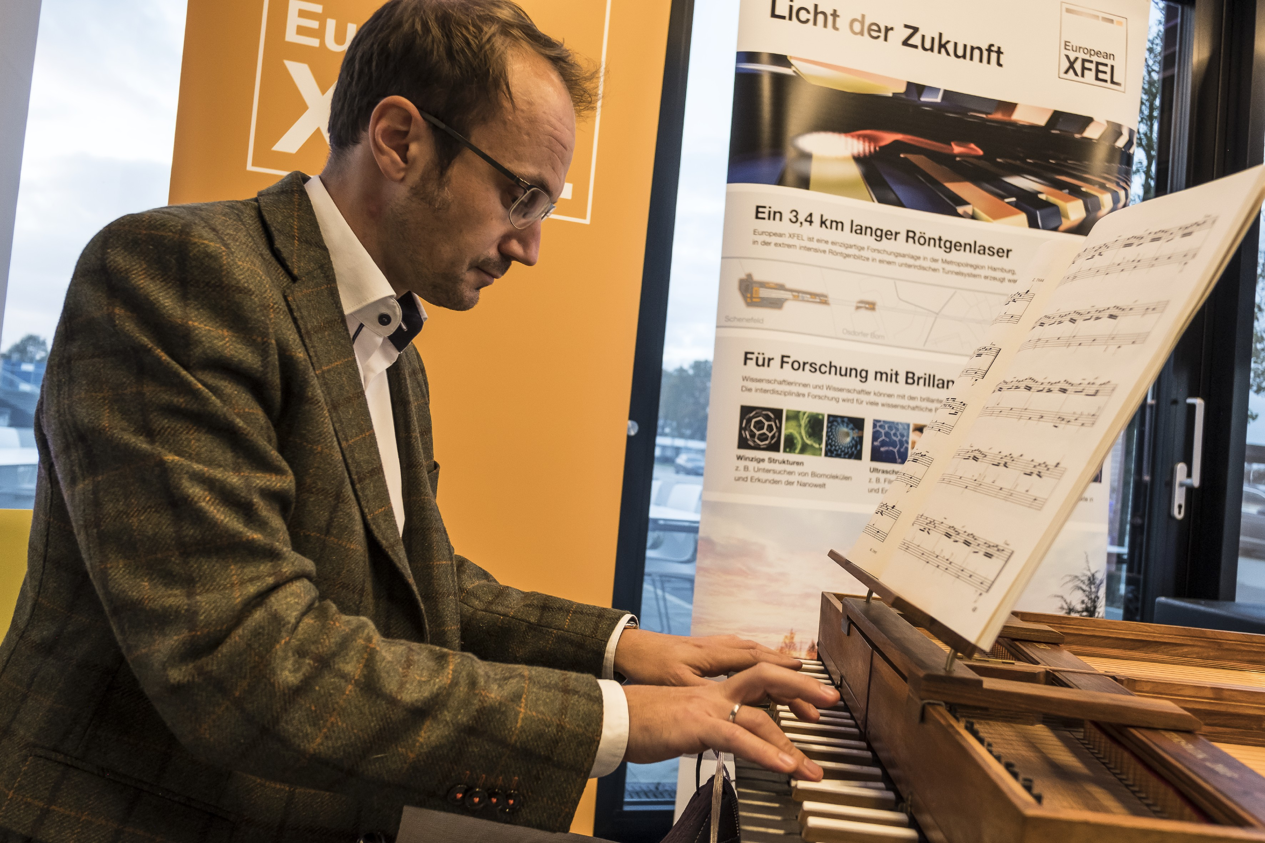
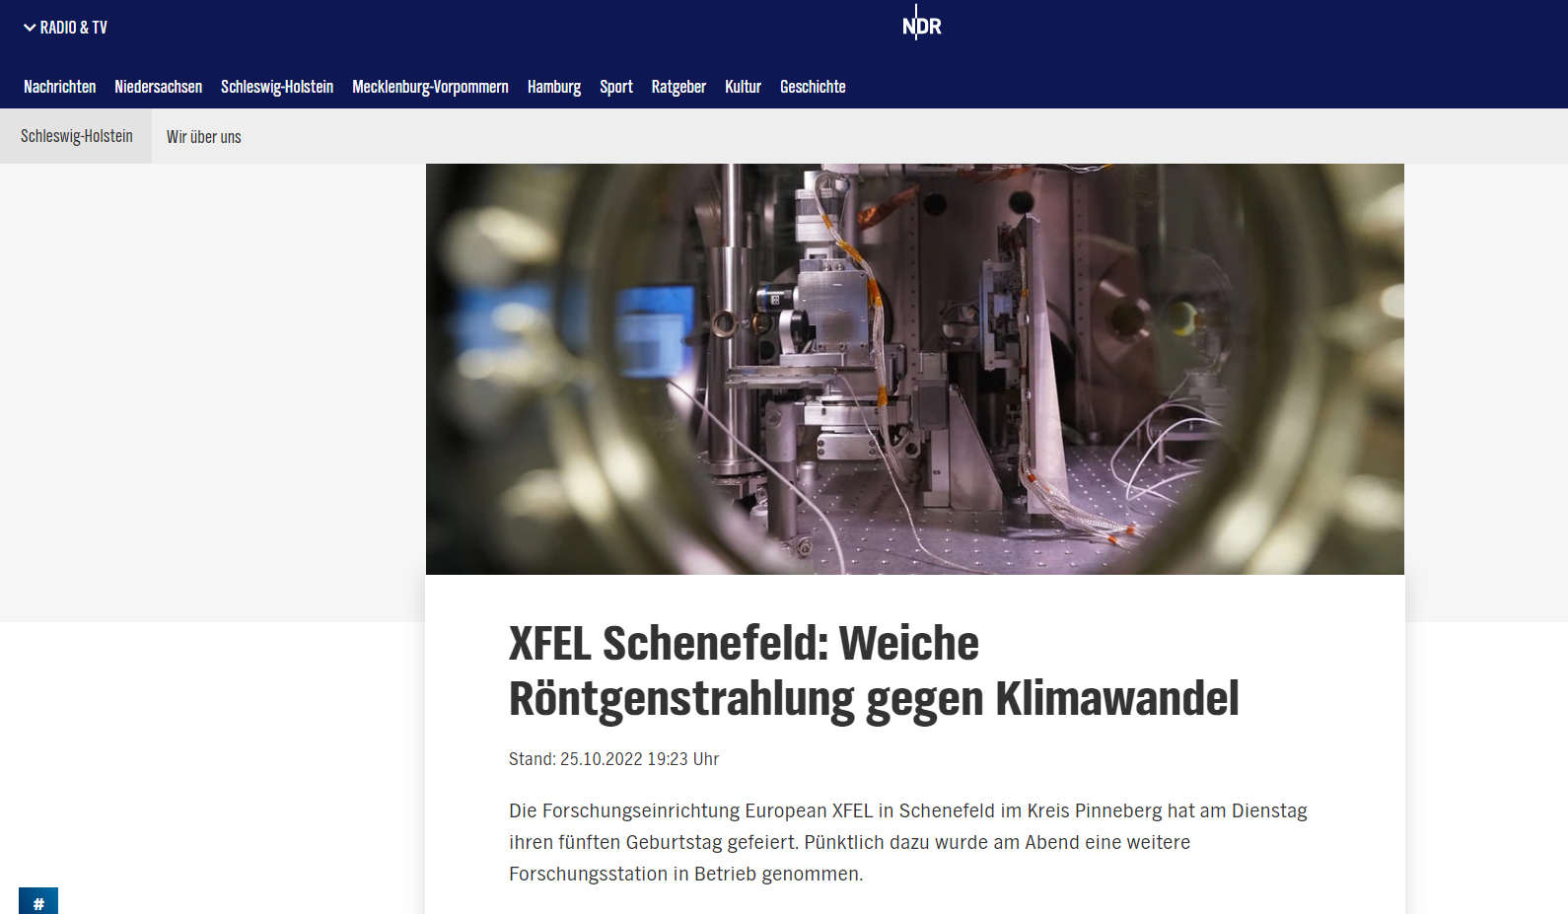
Six years of user operation

Slide 8
Our User Community
1191 individual users in 2022
  637 of them on site
European XFEL is open for researchers from our Shareholder countries and world-wide
    In collaboration with our Shareholder country communities
  Basic research
  Applied research
  Innovation promotion
  Technology development
Notes:
Grundlagenforschung
Angewandte Forschung
Innovationsförderung
Technologie-Entwicklung

Slide 9
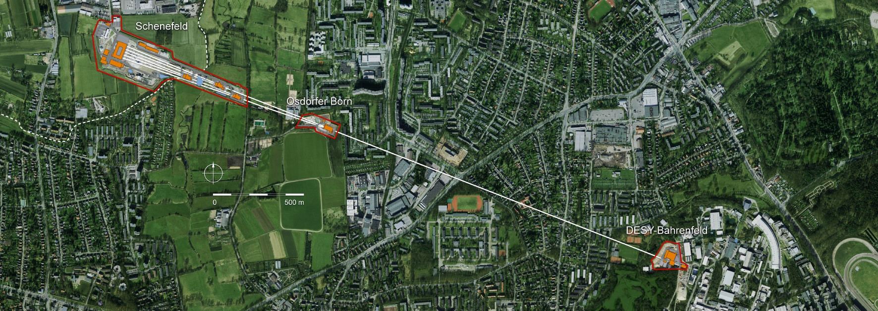
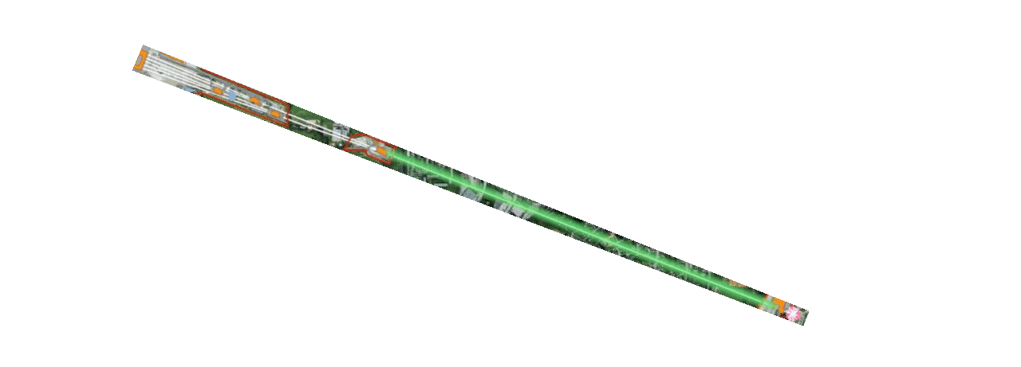
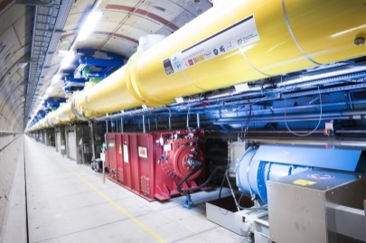
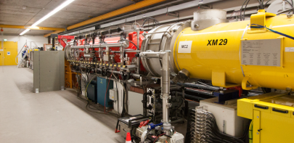
The European XFEL in a nutshell
Total length: 3.4 km
Superconducting linear accelerator
Electron injector

Slide 10
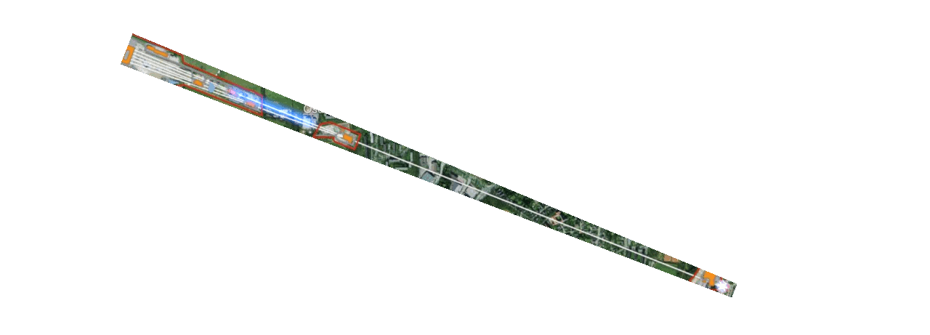
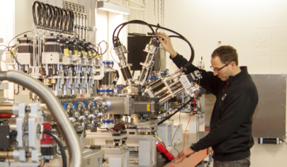
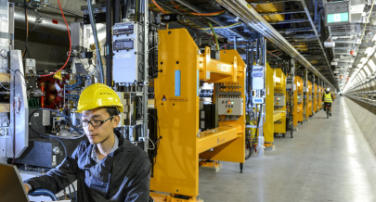
The European XFEL in a nutshell
Total length: 3.4 km
Superconducting linear accelerator
6 Experiment stations for research in Schenefeld
Undulator systems
Electron injector

Slide 11
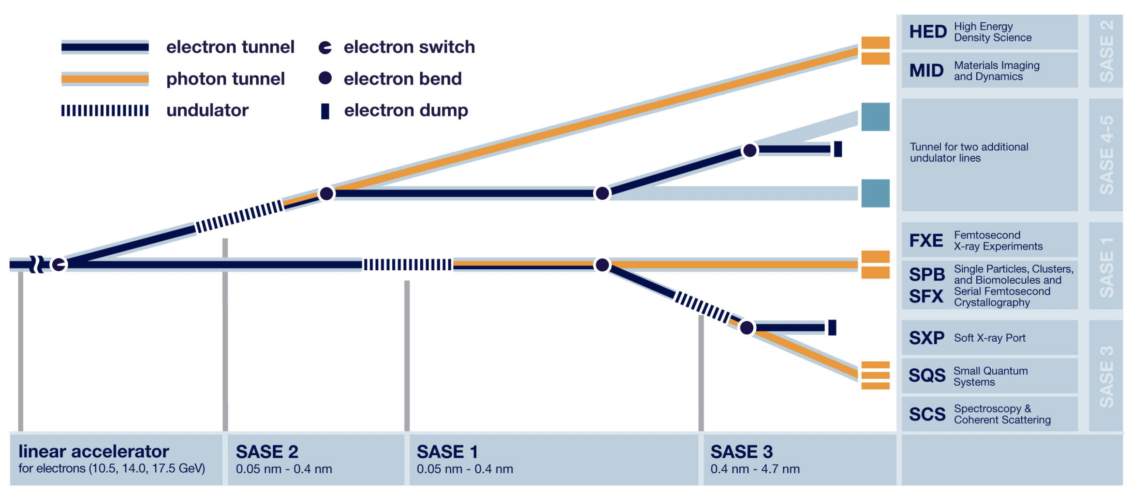
On-going and recently completed developments
Construction of third hutch on SASE2 will start in 2023
Self-seeding and two color SASE 2
Self-seeding SASE 1 2025
Two-color SASE 3
APPLE-X Helical undulator SASE 3 (2024)
h-RIXS 2022
Third port SXP SASE3 in operation

Slide 12
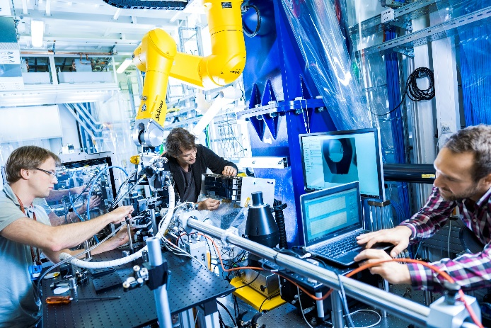
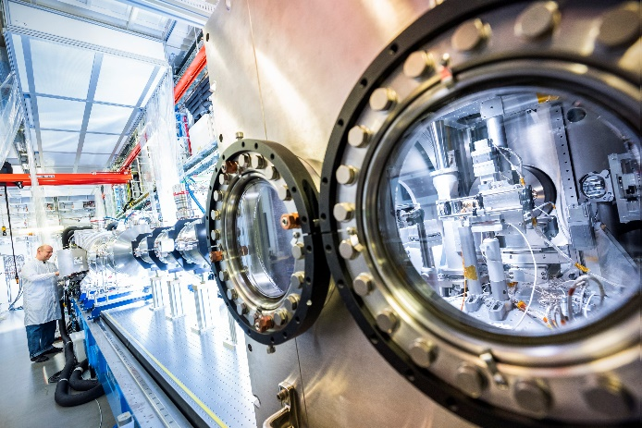
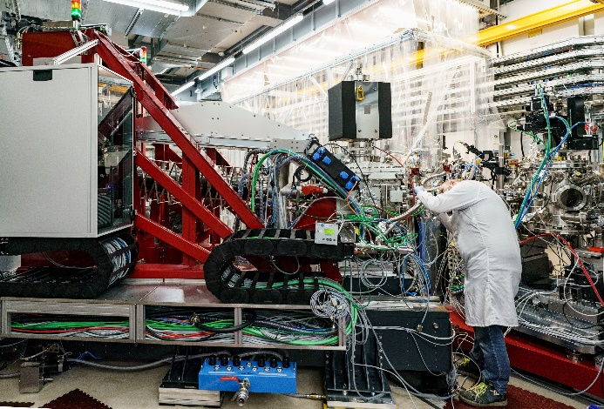
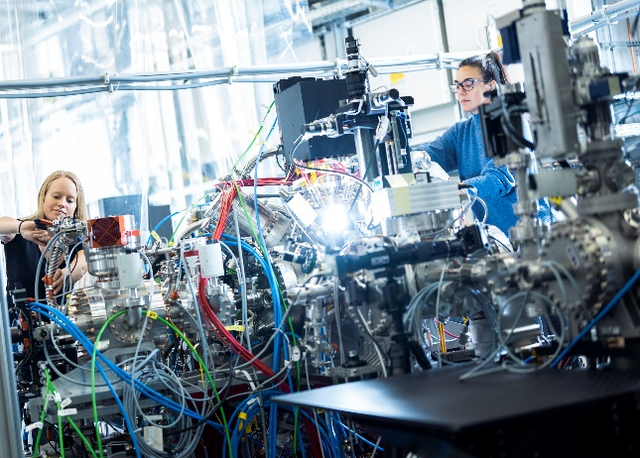
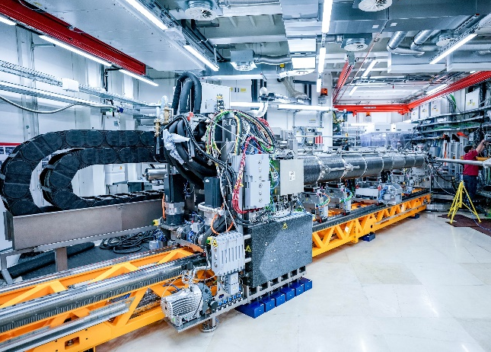
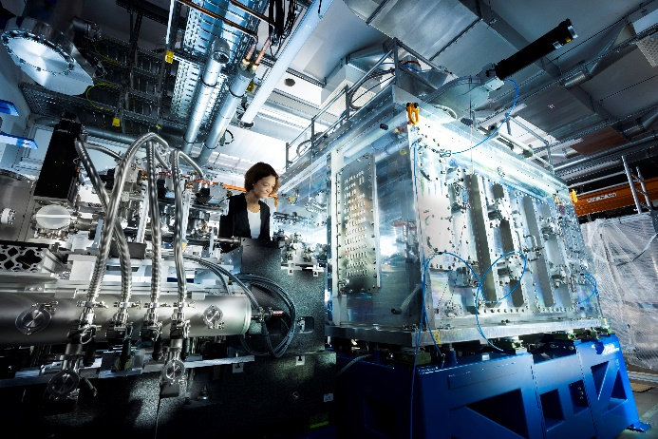
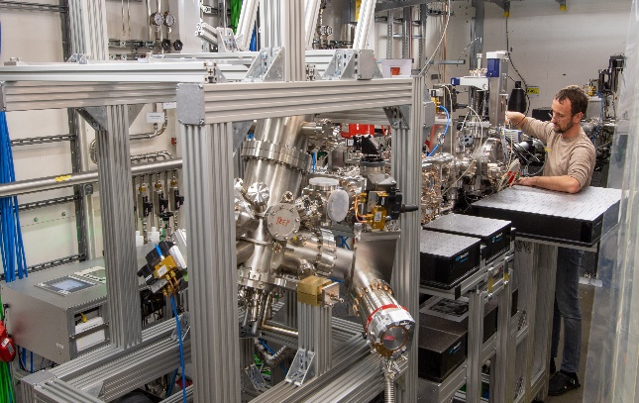
Seven instruments are in user operation
MID and HED only 4 years of which about 2 years were under pandemic conditions
FXE (start Sep 2017)
SPB/SFX (start Sep 2017)
SCS (start Nov 2018)
SQS (start Nov 2018)
MID (start Apr 2019)
HED (start May 2019)
SXP (start summer 2023)

Slide 13
European XFEL Facility Roadmap
Strategy 2030 – Two-level strategy
“Harvesting Science and developing opportunities”
It is essential to prioritize and focus
“Upgrade Path”
2024–2029
2030⁺
MID-TERM DEVELOPMENTS
FACILITY UPGRADE
2022–2030
HARVESTING
2017–2021
STARTUP

Slide 14
Future plans
Experiments at XFELS will become more standardised and automatized and more accessible for new and smaller user groups.
Lasing at 70-100 keV
  European XFEL has started a superconductor undulator program
  A hard photon detector program will be started
Attosecond pulses and capabilities to perform attosecond experiments
  An accelerator program for shorter pulses has started
Fully coherent laser sources
  R&D‘s projects have been started at European XFEL and LCLS

Slide 15
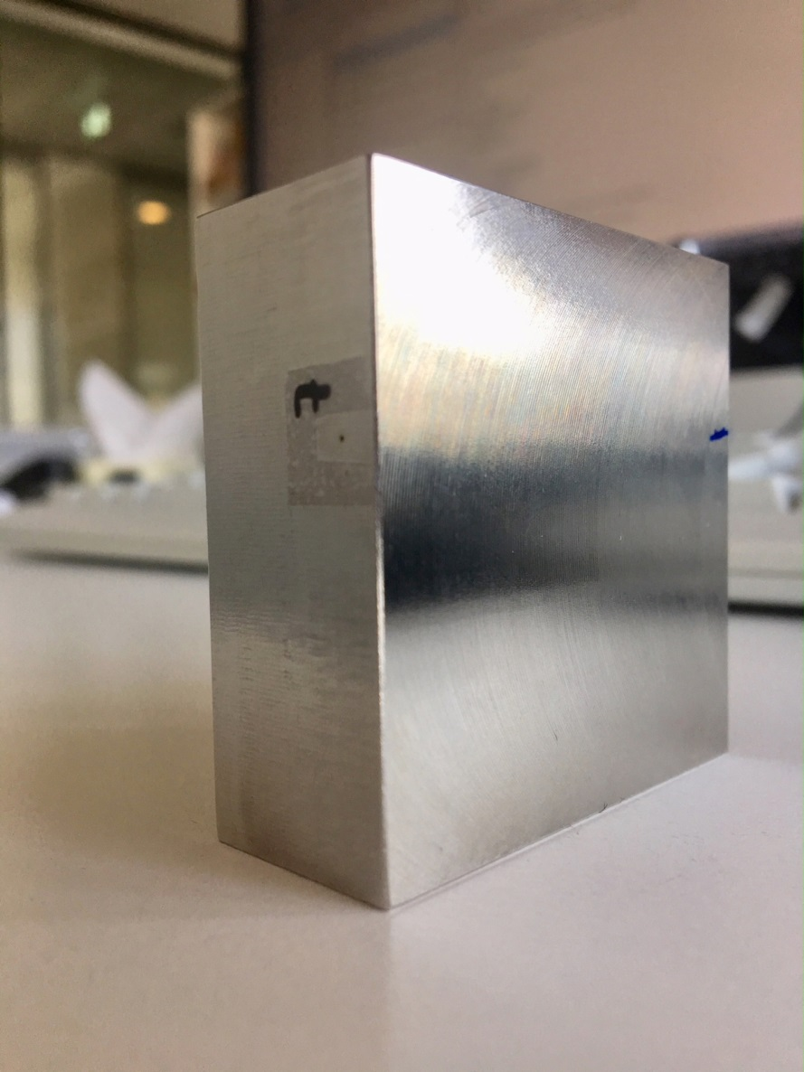
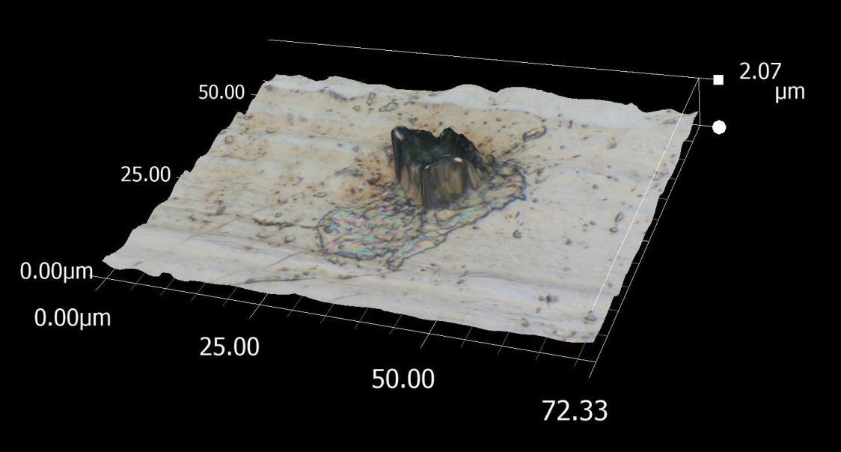
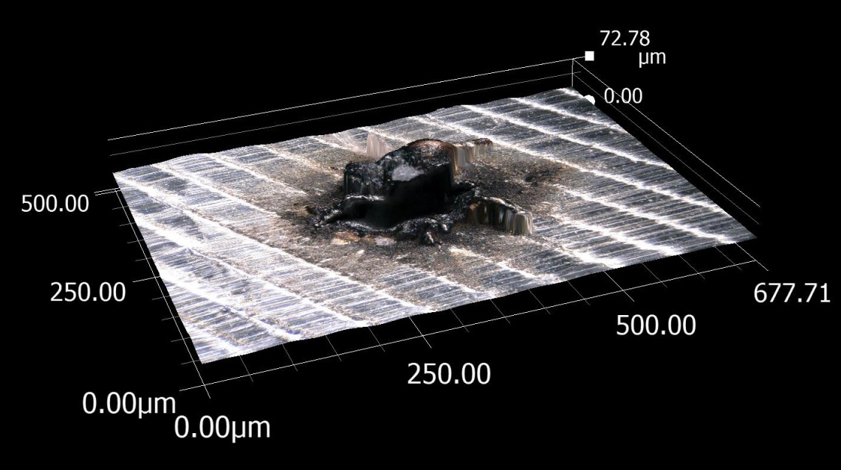
We have an exceptionally strong beam:
Drilling with XFEL beam through 50 mm of steel in 26 seconds
Courtesy Harald Sinn
exit hole: 13 µm
XFEL beam
entrance hole: 150 µm

Slide 16





European XFEL, in collaboration with the users, contributes to the solutions of the future
Health
Climate & Energy
  Structure & dynamics of biomolecules
  to understand fundamental processes important for human health
Structure & dynamics of new materials for
more sustainable energy solutions and
improved energy efficiency, storage & transport
Digitalization
Environment & Sustainability
  Driving data science by managing and
  analyzing (AI/ML) voluminous experimental data in near-to real time
Study novel materials from sustainable sources, sustainable agriculture and geophysical processes of our planet

Slide 17


HEALTH
High pulse energy @ high photon energies essential for high resolution
Available only at EuXFEL
First human GPCR structure determined at EuXFEL at very high resolution
Understand fundamental processes important for human health
G protein-coupled receptors initiate signaling pathways, for instance, in inflammation and neurotransmission
In humans, vision, smell, and taste depend on GPCRs
Many fundamental questions still open
SPB/SFX Instrument
Notes:
.

Slide 18



HEALTH (MID)
Dynamics of antibody proteins
M. Reiser et al.: Nature Communications
13, 5528 (2022) (SE)
Notes:
Highly concentrated solutions of immunoglobulin (Ig) with polyethylene glycol (PEG) are measured in quartz capillaries.
An individual Ig molecule has a hydrodynamic radius of Rh = 5.5 nm. Megahertz X-ray photon correlation spectroscopy (MHz-XPCS) measurements are performed by using trains of X-ray pulses, which illuminate the sample. The spacing between two pulses within a train is τp and was varied between 443 and 886 ns where a train
contains Np individual X-ray pulses. The length of an individual X-ray pulse is ≤50 fs50. A new train is delivered every 100ms. The train duration is determined by the number of pulses per train and the delay time between the pulses : τtrain = (Np − 1)τp. The longest train duration during the experiment was τtrain,max = (144− 1) × 886 ns ≈ 127 μs. For a period of 100ms − τtrain, the sample is not illuminated by X-rays. By analyzing sequential X-ray scattering patterns measured with the AGIPD, information about the dynamics of the sample can be obtained in the form of intensity auto-correlation functions calculated fromfluctuating speckle patterns. A measurement consists of a series of Ntrain individual trains.
Plot on the right:
Apparent hydrodynamic radii normalized to the initial value Rh(0) as a function of rootmean square displacement (RMSD). The red solid line is a guide to the eye. The dashed red circle describes a spherewith a radius of about 10nmandmarks the space an Igmolecule can explore before the onset of aggregation.

Slide 19




  HEALTH and ENVIRONMENT
Fragmentation of the water molecule is initiated by soft X-ray pulse
Understanding the response of H₂O to ionizing radiation
Theory:
L. Inhester, R. Santra
(CFEL)
Dissociation dynamics of individual molecules imaged in unprecedented detail
Subsequent formation of ions and/or radicals
A key question for radiation damage in biological tissue, radio-oncology, corrosion in nuclear reactors, …
Crucial for high energy radiation chemistry
Jahnke et al., Physical Review X 11, 041044 (2021)
SQS Instrument

Slide 20






  CLIMATE and ENERGY
Co₃O₄
Cheap and abundant
Water-splitting, Batteries, Photovoltaics, CO-oxidation, …
new materials for greener and more sustainable energy solutions and improved energy efficiency
Requires combining ultrafast methods with electronic, spin and nuclear sensitivity
H₂ one of most important fuels in a new energy economy
Electrochemical water splitting: clean, large scale production of H₂
Today: Pt, RuO₂, IrO₂ state-of-the-art catalysis
High cost and scarce
PI Giulia F Mancini, Universitàt Pavia; Majed Chergui, EPFL
FXE Instrument

Slide 21




Non-equilibrium Plasmon and Paramagnon Dynamics in Electron-doped High-T_{c} Cuprate
PI Wei-Sheng Lee
  ENERGY (SCS)
New materials for sustainable energy solutions and improved energy efficiency
h-RIXS, SCS instrument
Static RIXS
Users – historical result: High resolution, high repetition rate,
high-quality pump–probe RIXS is now demonstrated to be possible!
G. Ghiringhelli (Italy)
Track their evolution upon photoexcitation:
Status of operation
New insight into the mechanism of High-Tc superconductivity
Photo-engineering on quantum materials
hRIXS is the only tr-RIXS instrument with sufficient resolution for this investigation
q-dependent collective dynamics with unexpectedly fast timescale.

Slide 22







Photo-induced polaron localization in BiVO₄ for photosynthesis
  GREEN ECONOMY (FXE)
New materials for sustainable O₂ and H₂ production
User Team:
Felix Deschler, Markus Heindl, Stanislav Bodnar, Lissa Eyre, Danyellen Galindo (DE)
Ian Sharp, Viktoria Kunzelmann, Guanda Zhou, Elise Sirotti (DE)
David Egger, Frederico Delgado, Franziska Hegner (DE)
Energy Environ. Sci., 2015, 8, 2851

Slide 23



DIGITALISATION
Magnetization and magneto-elastic atomic displacements across the boundary
sub-10nm spin-wave soliton self-assembles following fs laser excitation
promising candidates for future high-density magnetic data storage media
Opens the door to miniaturized information processing and possibly bioinspired computing applications
Miniaturization of magnetic recording devices
Information stored in nanosized magnetic grains (bits)
When grains too small, thermal fluctuations can easily flip direction of magnetization, information is permanently lost
16 nm FePt potential magnetic storage layer
Turenne et al., Sci. Adv. 8, eabn0523 (2022)
SCS Instrument

Slide 24




DIGITALISATION
Coherent phonon wave packets generated in SrTiO₃ following fs IR laser excitation
designing heterostructures for future nano-optoelectronics
SrTiO₃ Cubic unit cell with perovskite structure
Phonon damping constants experimentally determined
Desired length scale approaches few atomic unit cells
Heat transport in the “nanoworld” is unknown
Processes limiting heat transport very difficult to measure and to model
Shayduk et al. Appl. Phys. Lett. 120, 202203 (2022)
MID Instrument

Slide 25



ENVIRONMENT and SUSTAINABILITY
Continuous Heating
Contaminated
States
understanding of geophysical processes of our planet
Ideal
States
European XFEL
Fast Heating
Unstable
States
Time
femtoseconds
microseconds
seconds
Burst Mode of EuXFEL to probe ideal states
Melting @ European XFEL
The Iron-rich core of the Earth is the source of our protective magnetic field.
Requires liquid Iron
But melting point of Iron at core pressure and temperature is very uncertain.
Phase Diagram
of Iron at Earth’s
Core Conditions
PI Stewart McWilliams, Univ. Edinburgh
HED Instrument

Slide 26




FUNDAMENTAL RESEARCH (SPB/SFX)
Kossel lines from single shots
Crystal structure determination is serial at XFELs: the sample has to be measured in many orientations.
This excludes determination of structures in non-repeatable processes, such as at high pressures, magnetic fields, and in all those cases where the transient phases cannot be reached by pump–probe experiments.
Zoomed in showing detail of Kossel lines
Goal: To work out a method that can give the crystal structure from a single scattering pattern taken during one XFEL pulse.
The single shot measurement of Kossel lines allows this. Here, we used GaAs as the sample.
Background corrected single shot
PI Gyula Faigel, Wigner Research Centre for Physics, Hungary
Notes:
Kossel lines are formed when radiation from point x-ray sources inside a single crystal are diffracted by the crystal itself.
In principle, Kossel line patterns contain full information on the crystalline structure: phase and magnitude of the structure factors.
The phase is coded into the profile of the lines.
Scientific reports 2016
Although this was known for a long time, experimental realization has not been presented.
In this work we demonstrate experimentally that phases can be directly determined from the profile of the Kossel lines.
These measurements are interesting not only theoretically, but they would facilitate structure solution of samples within extreme conditions, such as high pressure, high and low temperatures, high magnetic fields and extremely short times. The parallel measurement of many diffraction lines on a stationary sample will allow a more efficient use of the new generation of x-ray sources the X-ray free electron lasers (XFELs)

Slide 27





Education and career development at European XFEL
European XFEL Ph. D. program
  ~50 international Ph. D. students involved
  Joint supervision with partners in Shareholder countries
  Cooperations with other graduate schools
Summer schools and lectures for international students
Awards and internships for young students
EuXFEL Young Scientist Award 2023:
Elke de Zitter, IBS Grenoble
„The Lighthouse –
European XFEL Visitor and Conference Centre“
Construction ongoing, opening expected for 2024
  350 m² of permanent exhibition, virtual reality experience
  Physics and biochemistry school labs
  Conference centre for events and meetings
EUCYS Award 2020/2021:
Yana Holovatska

Slide 28

Thank you for your attention!

Slide 29


Our values

Slide 31










Innovation und Transfer
Technical Problem as Opportunity
Technology trend analysis
Assessment of the innovation
content and its impact
Awareness
and Incentive
CULTURAL
CHANGES
INNOVATION
R&D
project
THIRD-PARTY
FUNDING
INTELLECTUAL
PROPERTY
INDUSTRIAL
COLLABORATION
PRE-
PROCUREMENT
Notes:
Erkenntnis-orientierte Forschung

Slide 32




Equal opportunities at European XFEL
European XFEL is committed to promote equal opportunites
  Charta of Diversity signed in 2022
  Gender Equality and Diversity Plan launched 2022
  Participation in DynaMENT mentoring programs for female PhD and Postdoc students
  Annual Girls and Boy´s Days

Slide 33

The European XFEL Lighthouse visitor center
350 m² permanent exhibition,
100 m² Virtual Reality area
School labs (physics and molecular biology)
Conference centre for events and meetings

Slide 34

Impact of the war in Ukraine for European XFEL
Ukrainian student Yana Holovatska
(EUCYS Award 2020/2021)
Statement of the employees and the Management published, supported by European XFEL´s Shareholders (except the Russian one)
    Guest House opened for refugees, support and donations offered by employees
All collaborations with Russian institutions suspended
No more Russian users at European XFEL
(present or remote)
Uncertainty of Russian financial contribution to operation budget (26% of the annual budget)

