Slide 1
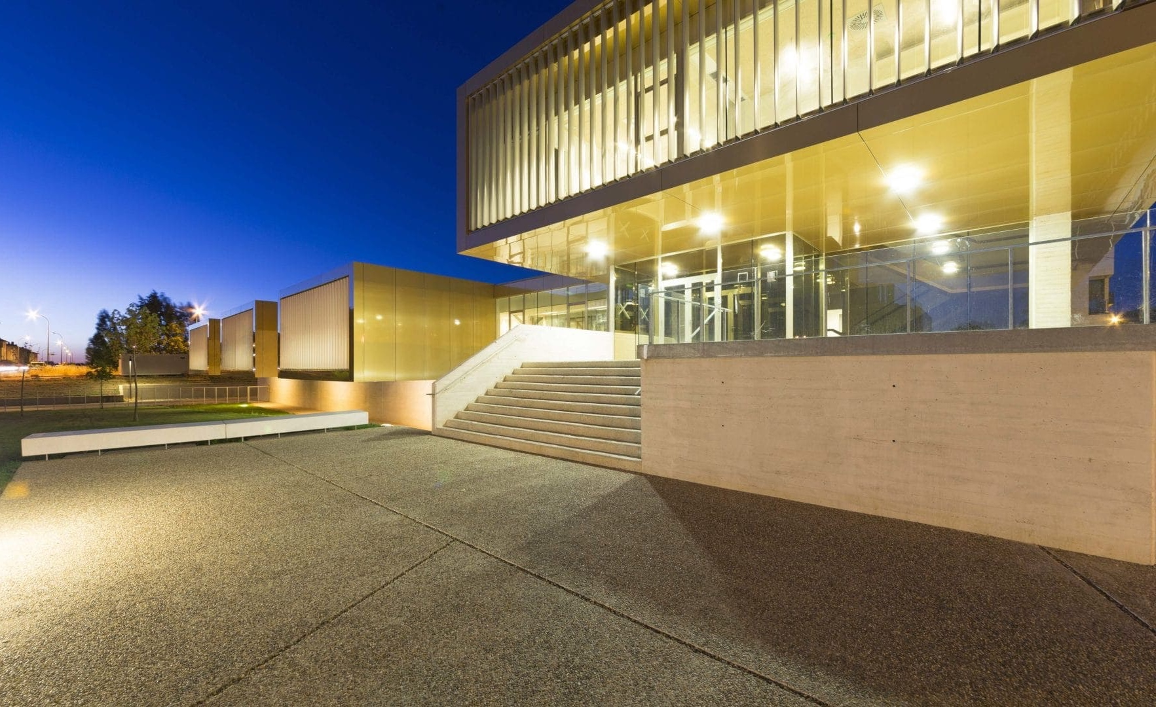
EUPRAXIA 2nd SITE: Option CLPU
G. Gatti
Scientific Division Head
Infrastructure
International Framework
User Access
Building Upgrade
Activities
Strong Points

Slide 2
Infrastructure
PW Laser “easily” Upgradable
To higher Repetition Rate

Slide 3
Present and future Laser Beamlines
AMP VEGA1
Compressor
VEGA-1
VEGA1:
0.5J,30 fs, 10 Hz
Double pulse setup
VEGA 3_1 / VEGA 3_2
Uncompressed VEGA3:
40J, 550ps, 1 Hz
2CPA+XPW frontend
Preamp
AMP VEGA3
Compressor
VEGA-3
VEGA3:
30J, 30 fs, 1 Hz
Ti:Sa Oscillator 1
Delay line VEGA2-VEGA3
AMP VEGA2
Compressor
VEGA-2
VEGA2:
5J, 30 fs, 10 Hz
fs sync.
Synchro module
CEP1:
2 mJ, 20 fs, 1 kHz
Ti:Sa Oscillator 2
CEP4
Module
AMP CEP
Compressor CEP
CEP2:
0.6 mJ, 5 fs, 1 kHz
Hollow Fiber
ns sync.
Nd2: 532 nm, 1J, 10 ns, 10 Hz
Nd:Yag Oscillator
AMP
Nd1: 1064 nm, 2J, 10 ns, 10 Hz
Notes:
Add some boundary to isolate the different beamlines

Slide 4
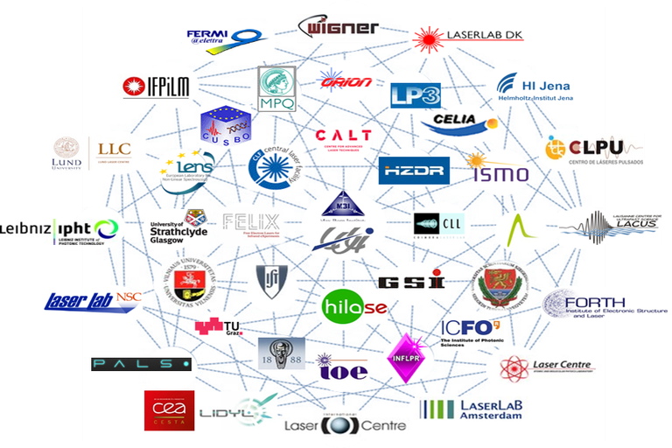

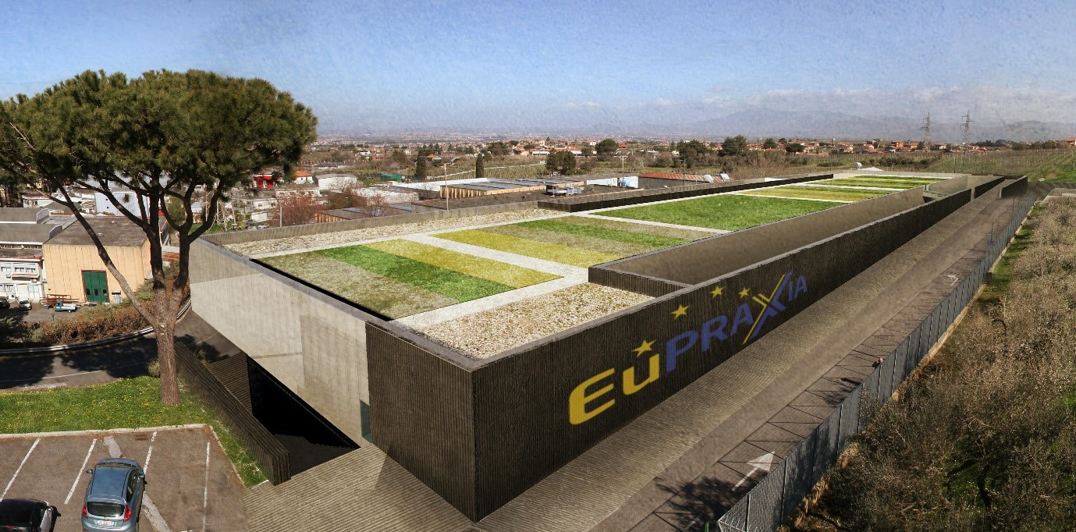
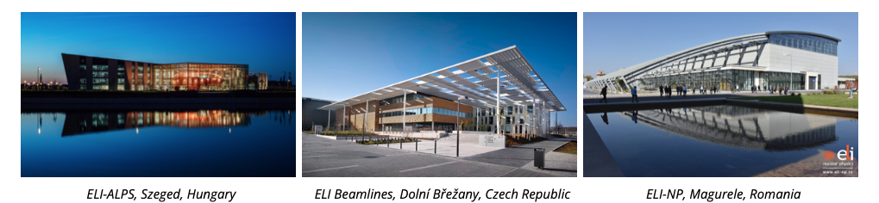
International Framework
Networks & Projects
EUPRAXIA
ELI-ERIC
LASER LAB Europe
Extreme Light Infrastructure

Slide 5
Glimpses on User Access
3 Calls for Access so far
Countries

Slide 6




Users support
ACCESS
A user facility requires dedicated resources supporting the INFRASTRUCTURE and the USERS
Mainly Laser
Ongoing Programs
Mainly Sec. Sources
Laser & Sec. Sources
Lasers4EU
RIANA
Future
INFRASERV Call Horizon Europe:
Approved!

Slide 7

in
PP
WP8 Simulations
WP9 Magnets & RF
WP12 Laser Technology &…
WP13 Diagnostics
Official Involvement (by contract) in:
WP2 Communication & Outreach
WP3 Organization & Rules
WP4 Finantial & Legal Models
WP6 Membership Strategy
WP10 Plasma Components…
WP14 Transformative Paths
Voluntary Contribution in:
It would be natural to join:
WP16 TDR Photon Site

Slide 8
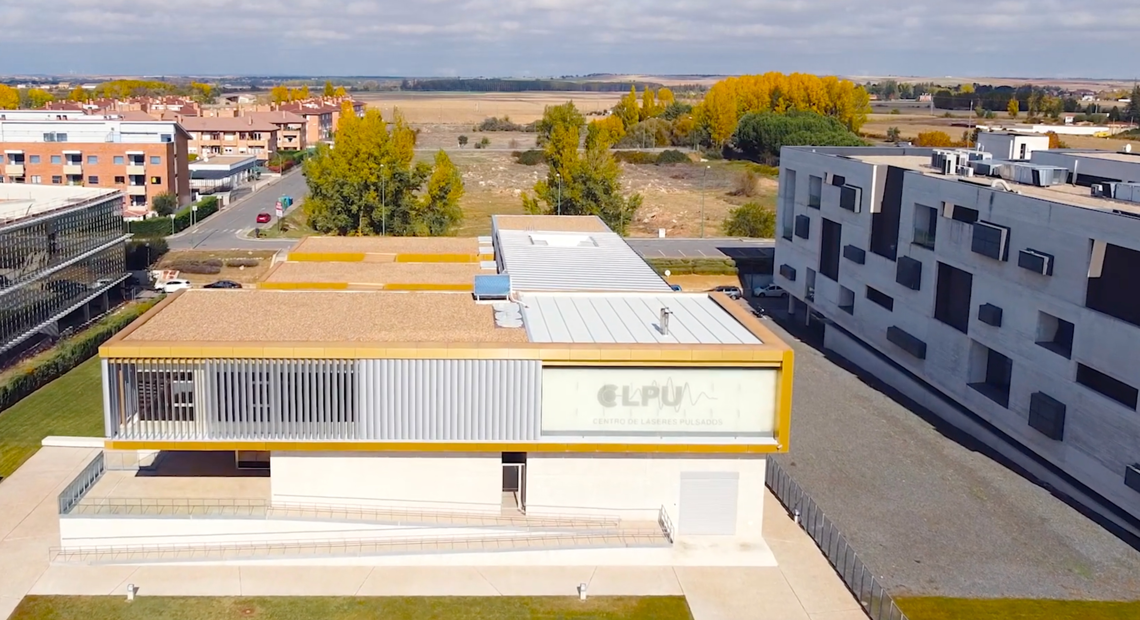
Building Upgrade
Available Area
New Building
Multiple Users & Set-ups
Get Advantage of Laser Independence
Further Area available
At least a factor 2 in number
of experiments!
Spring 24 (starting)
Notes:
Possible crop of the image

Slide 9
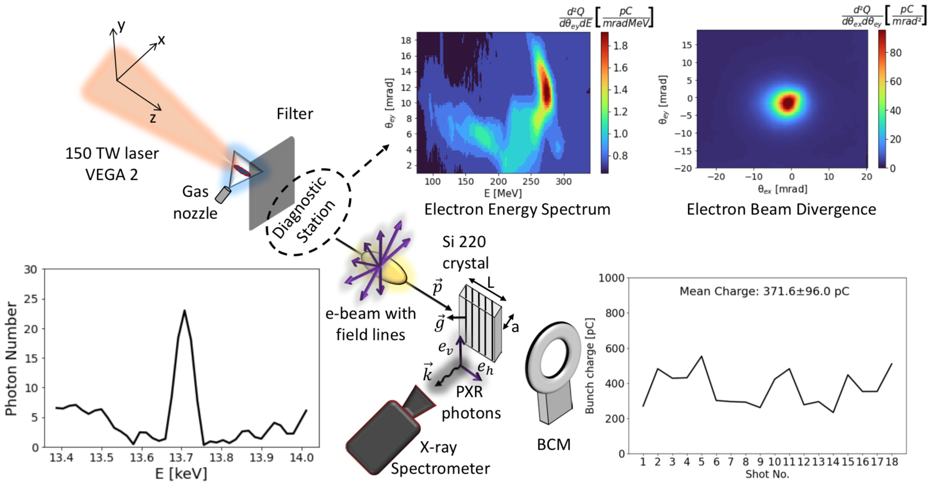
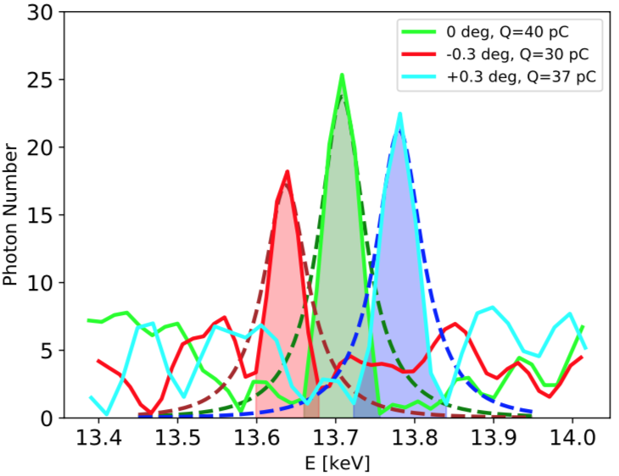
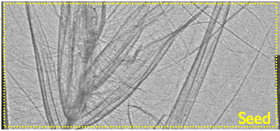
Electron sources & applications
PXR Radiation
Tunability
X-ray Phase-contrast Imaging (Betatron)
Applications
Photon sources
HEP
Radiation hardness
Flash Rad. therapy
A. Curcio et al., Physical Review Accelerators and Beams. American Physical Society. 25-6, pp.063403-063403
A. Curcio et al., Physical Review E. American Physical Society. 105-2, pp.025201-025201
Notes:
In case add more.

Slide 10



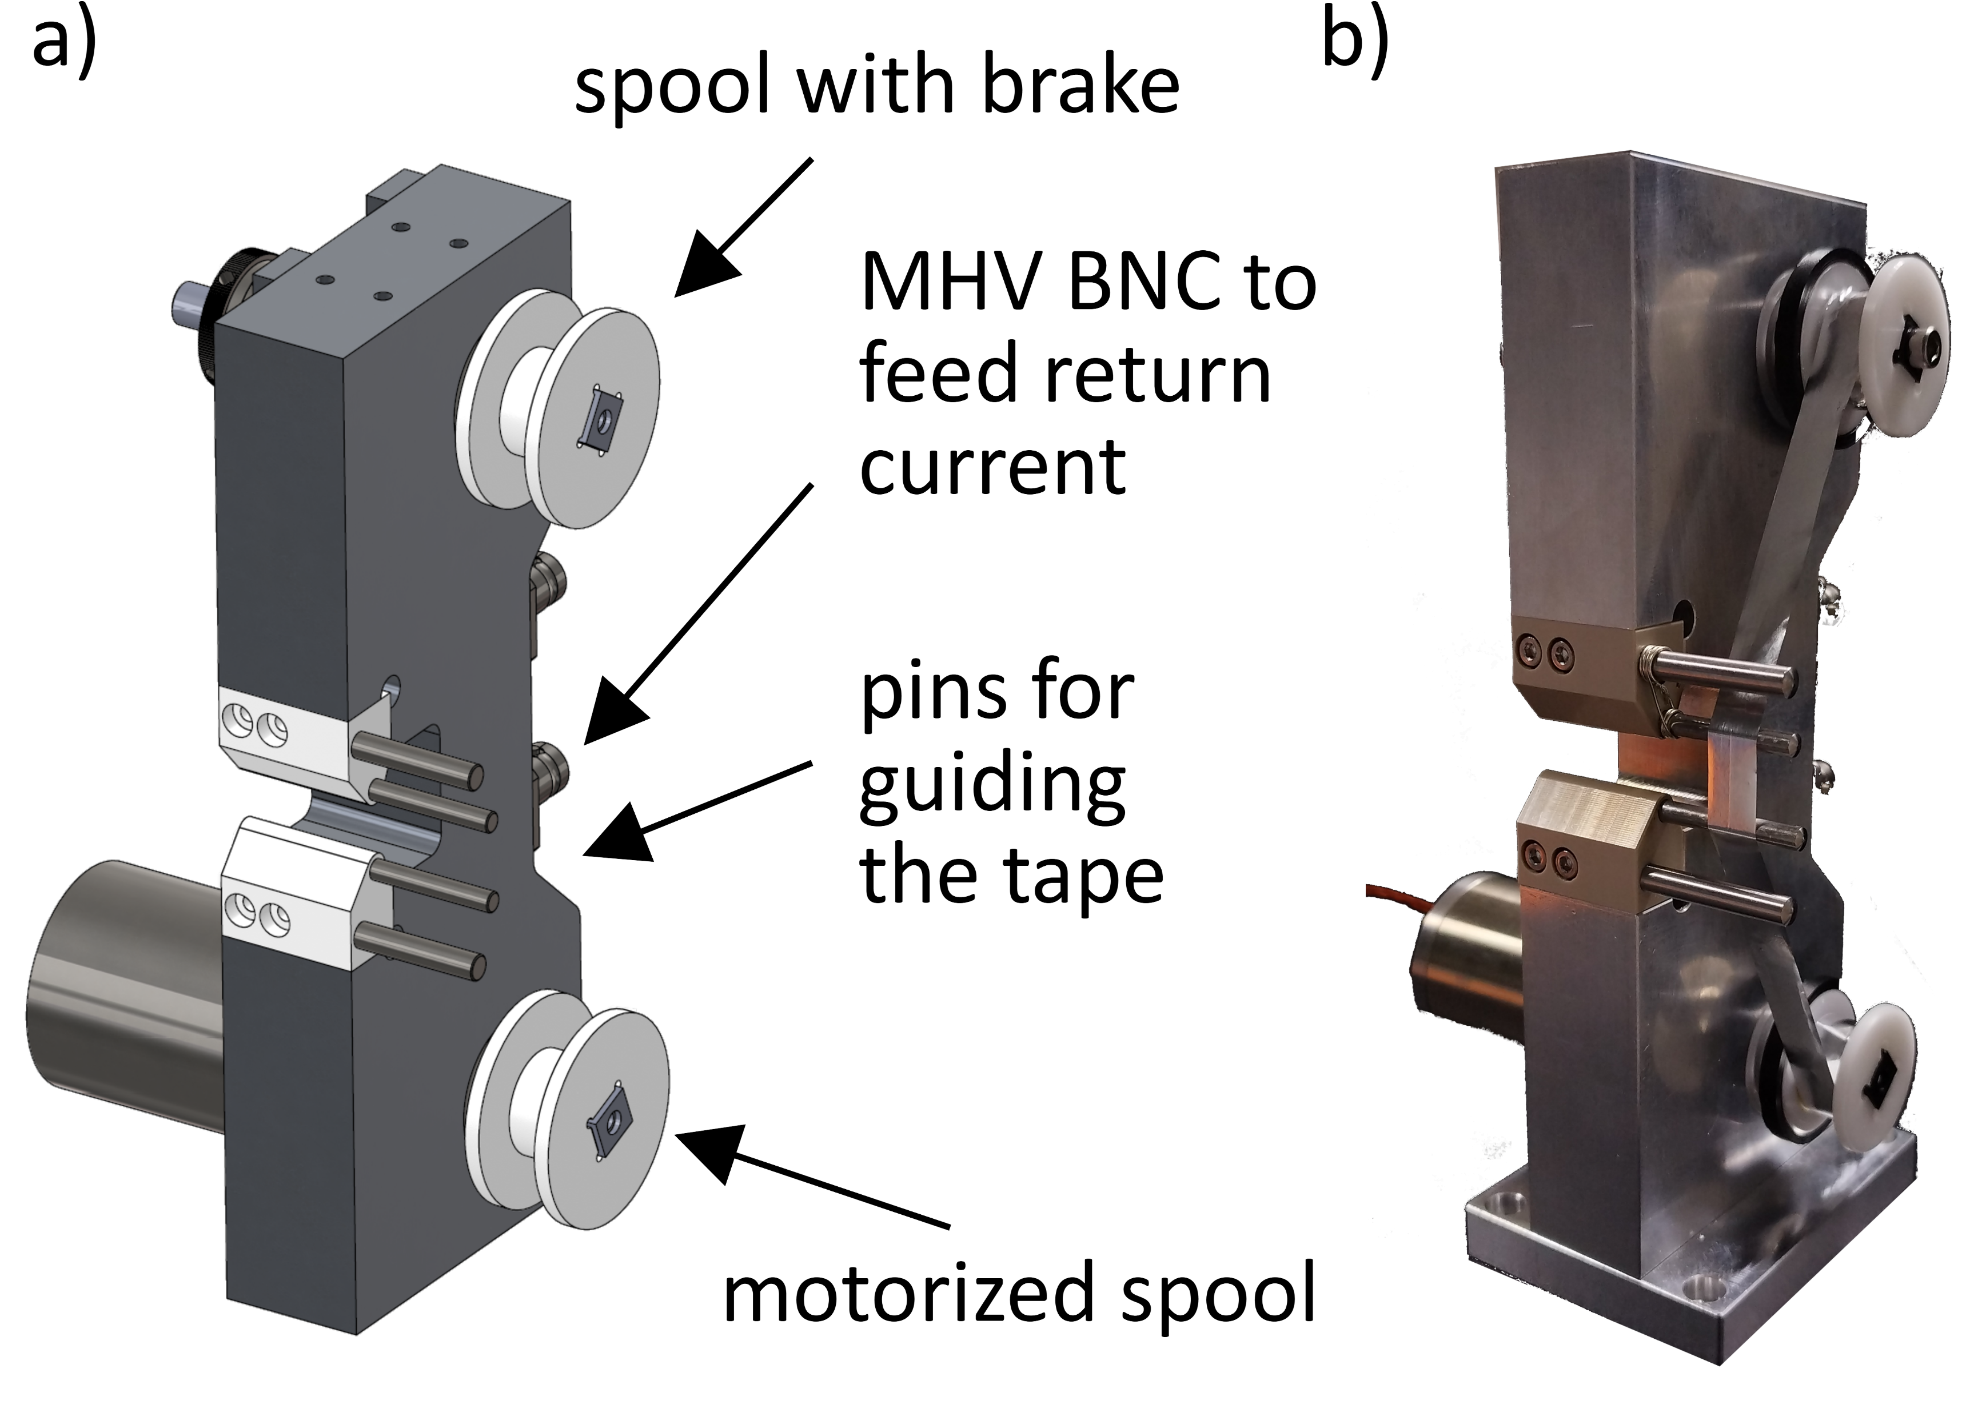
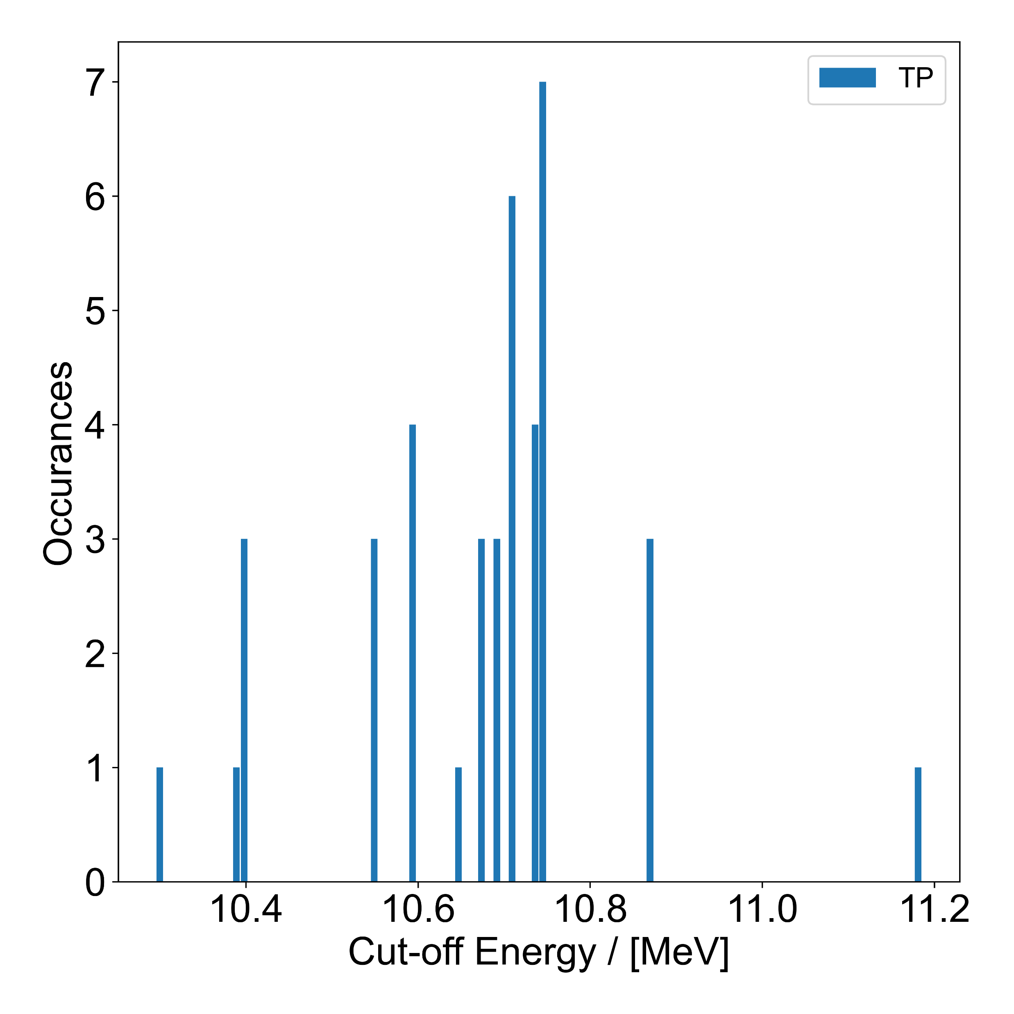
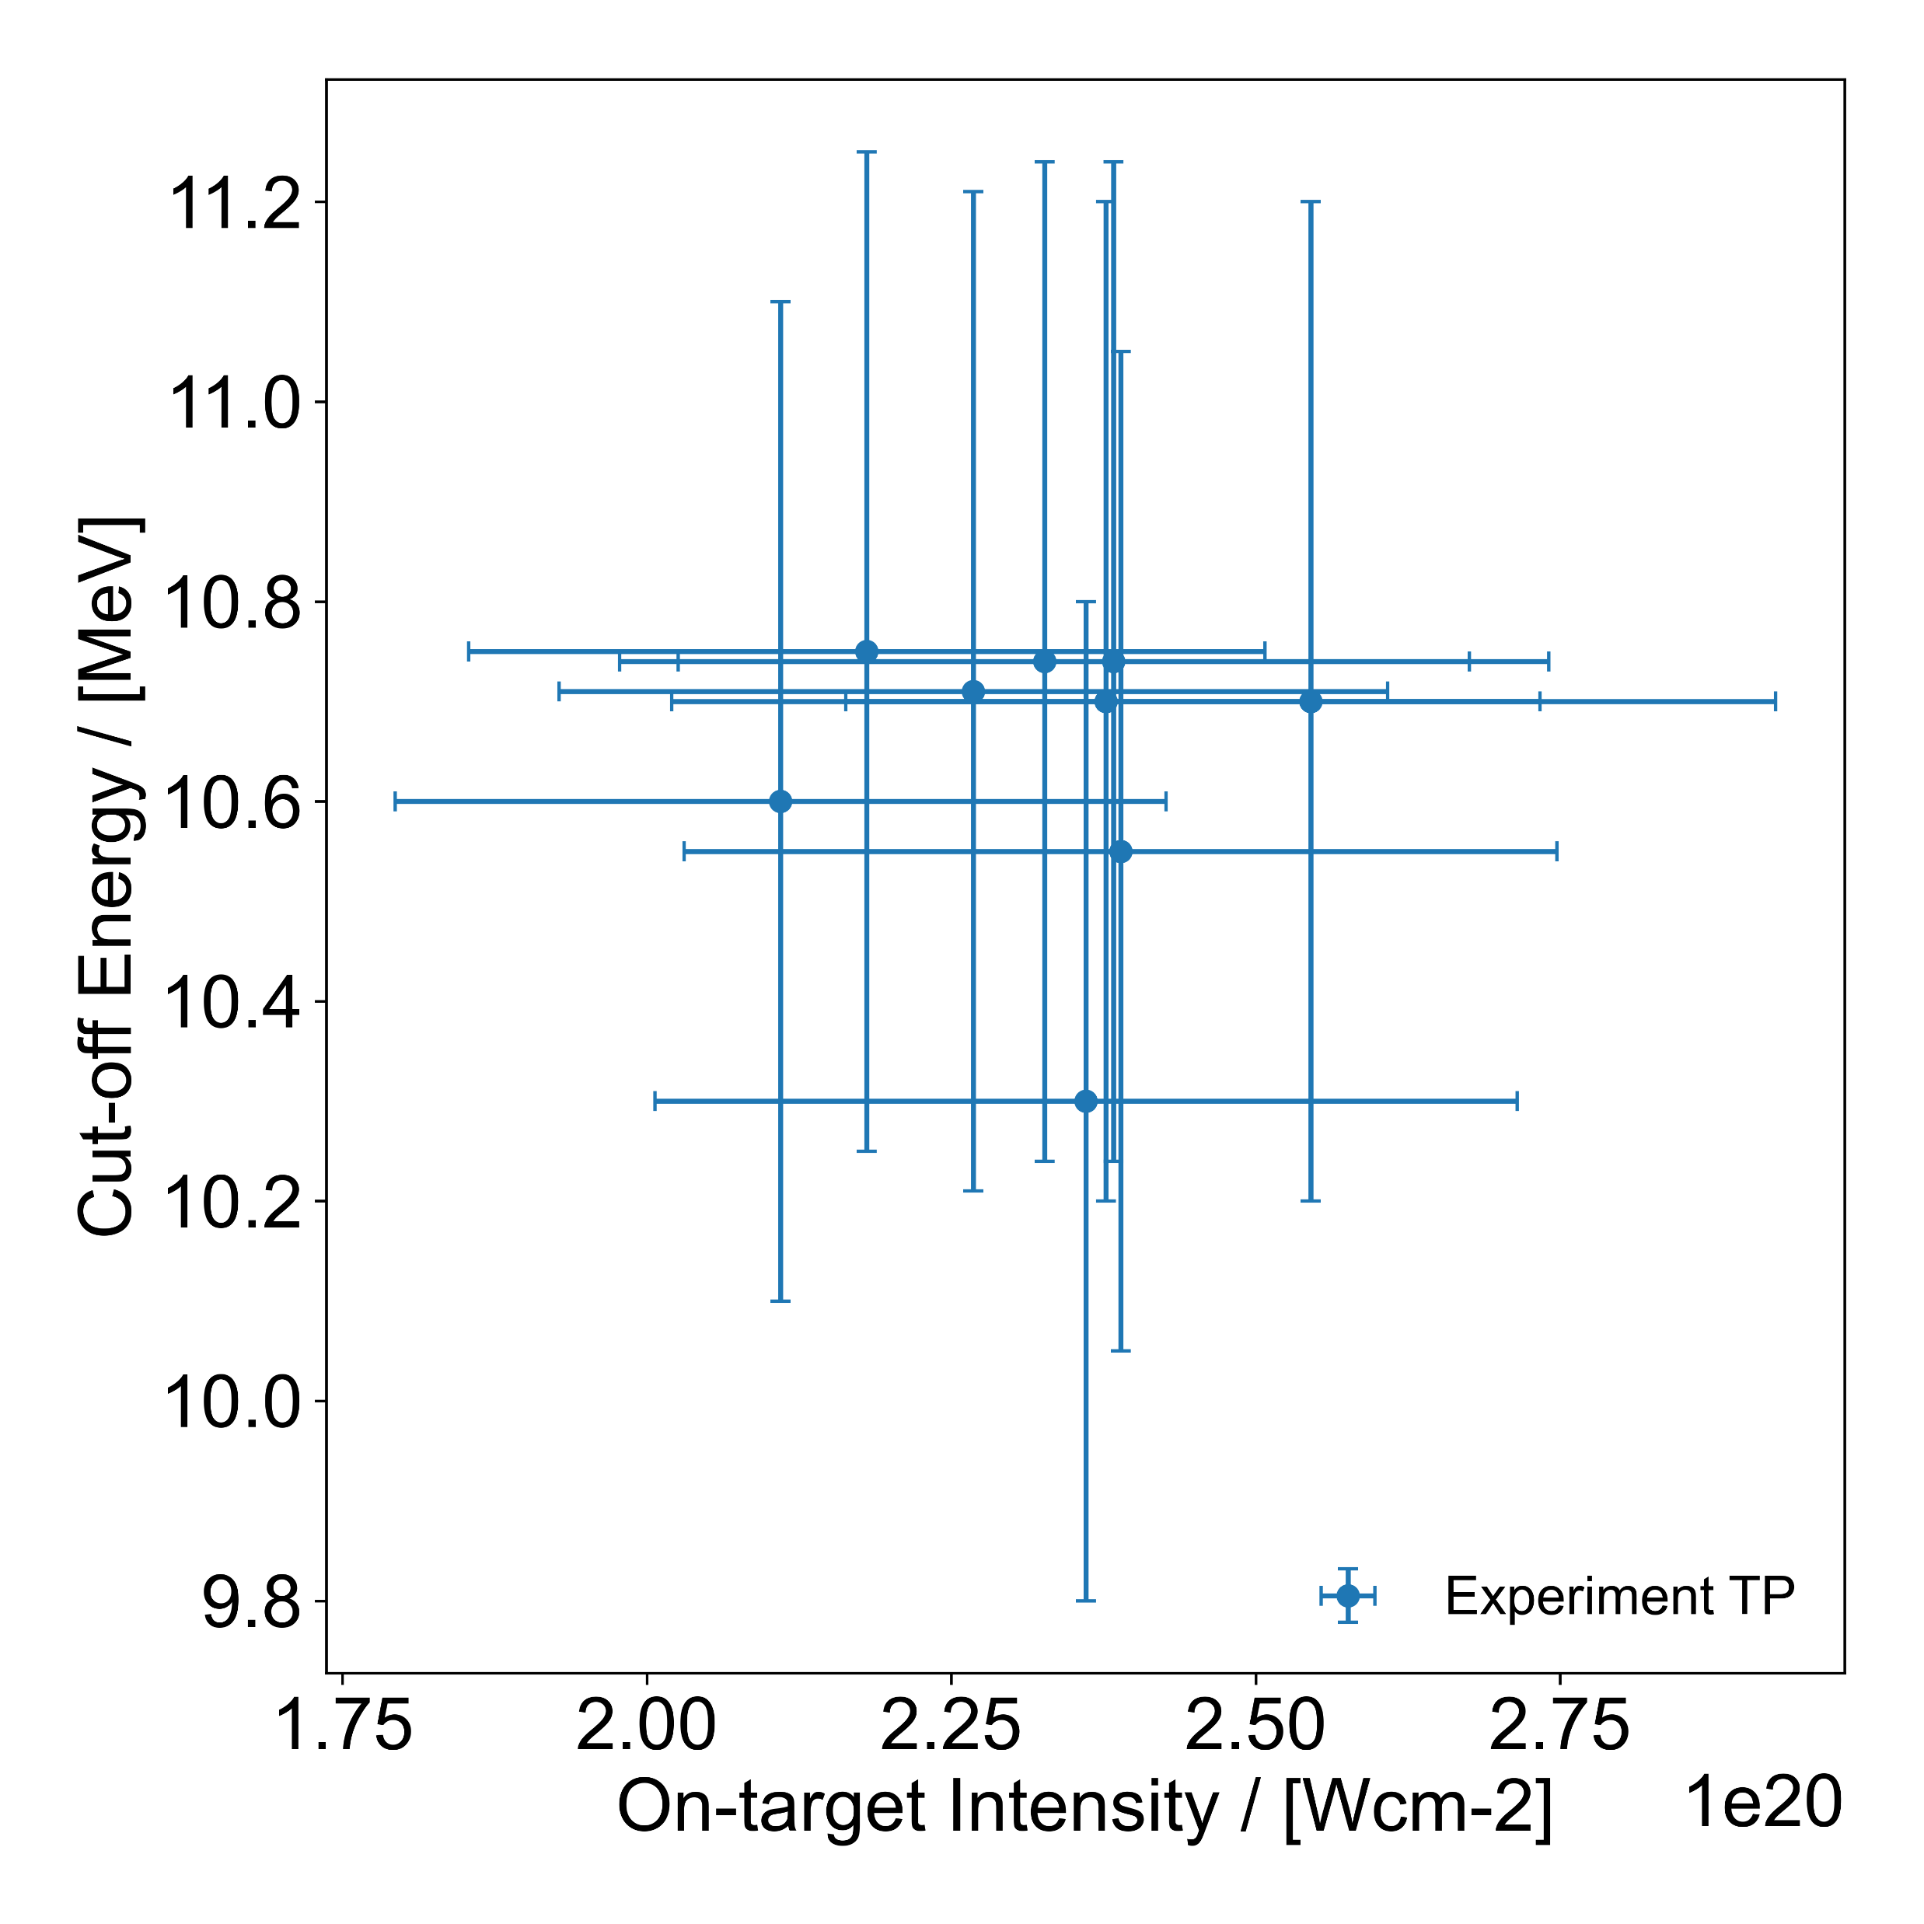
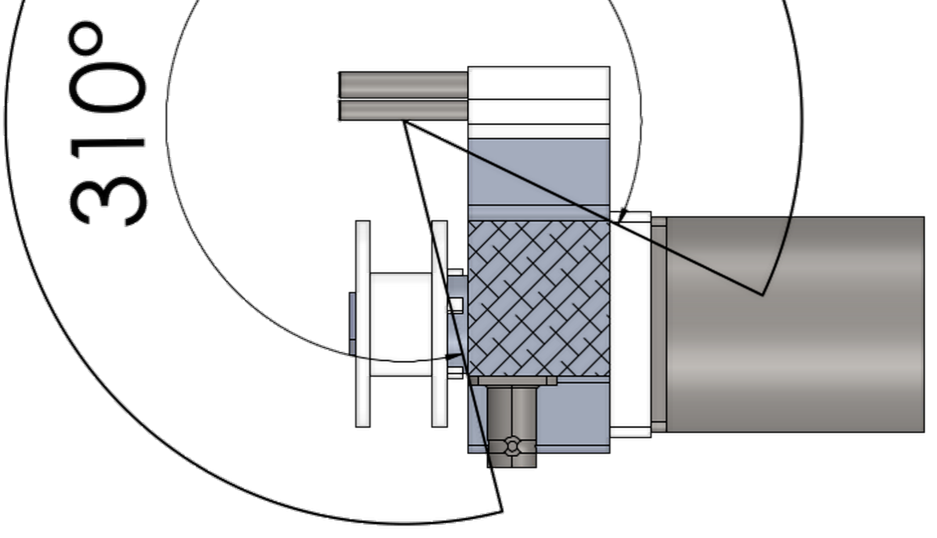
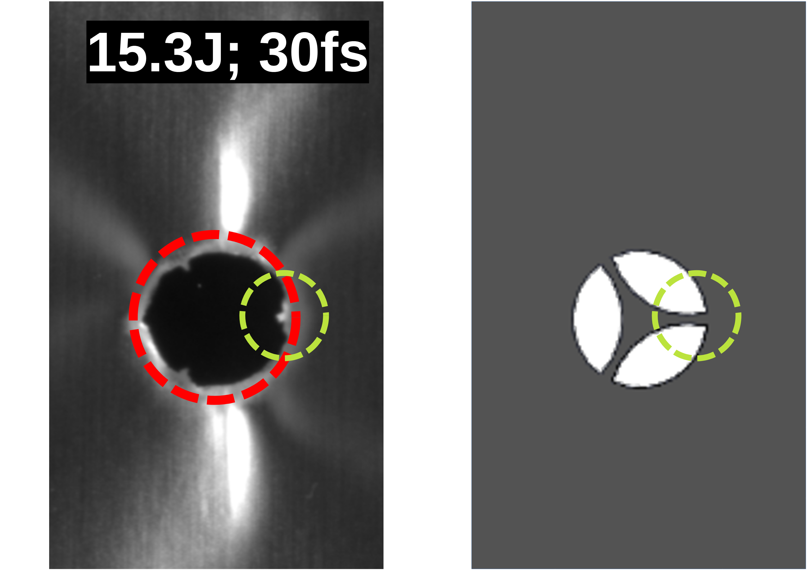
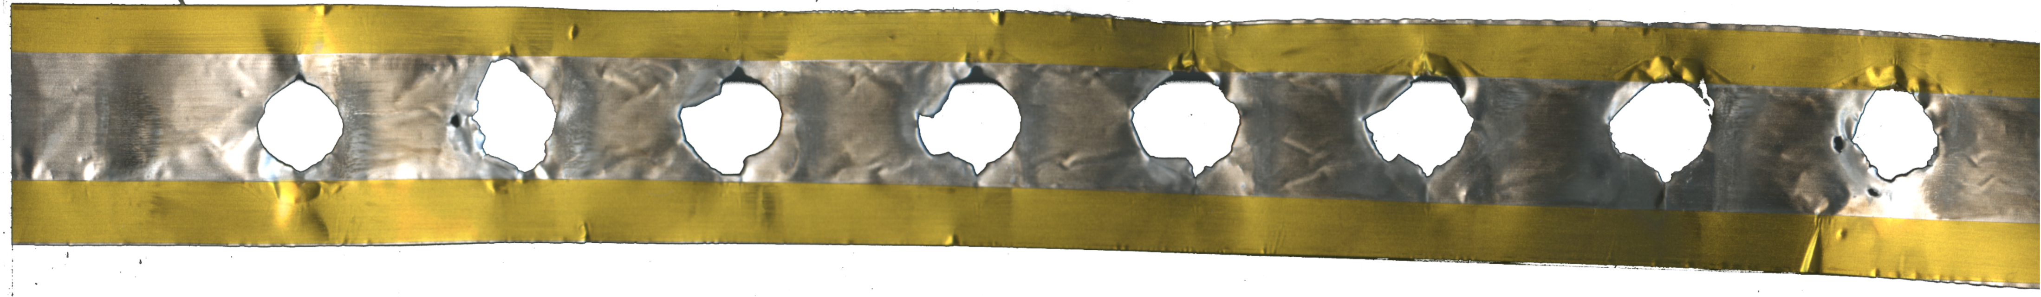
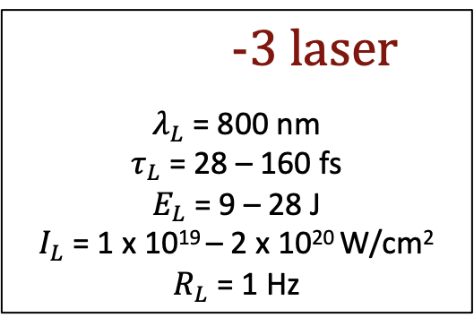
High-Rep. Operations
Successful in
Relevant For
WP10: Staging
-3 laser
$λ_{L}$ = 800 nm
$τ_{L}$ = 28 – 160 fs
$E_{L}$ = 9 – 28 J
$I_{L}$ = 1 x 10¹⁹ – 2 x 10²⁰ W/cm²
$R_{L}$= 1 Hz
Advanced shape
10 mm wide and 9 µm thick Al target
Enforced with Kapton tape on the edges

Slide 11
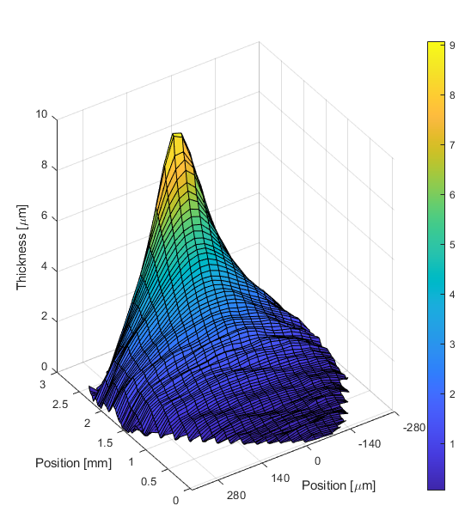
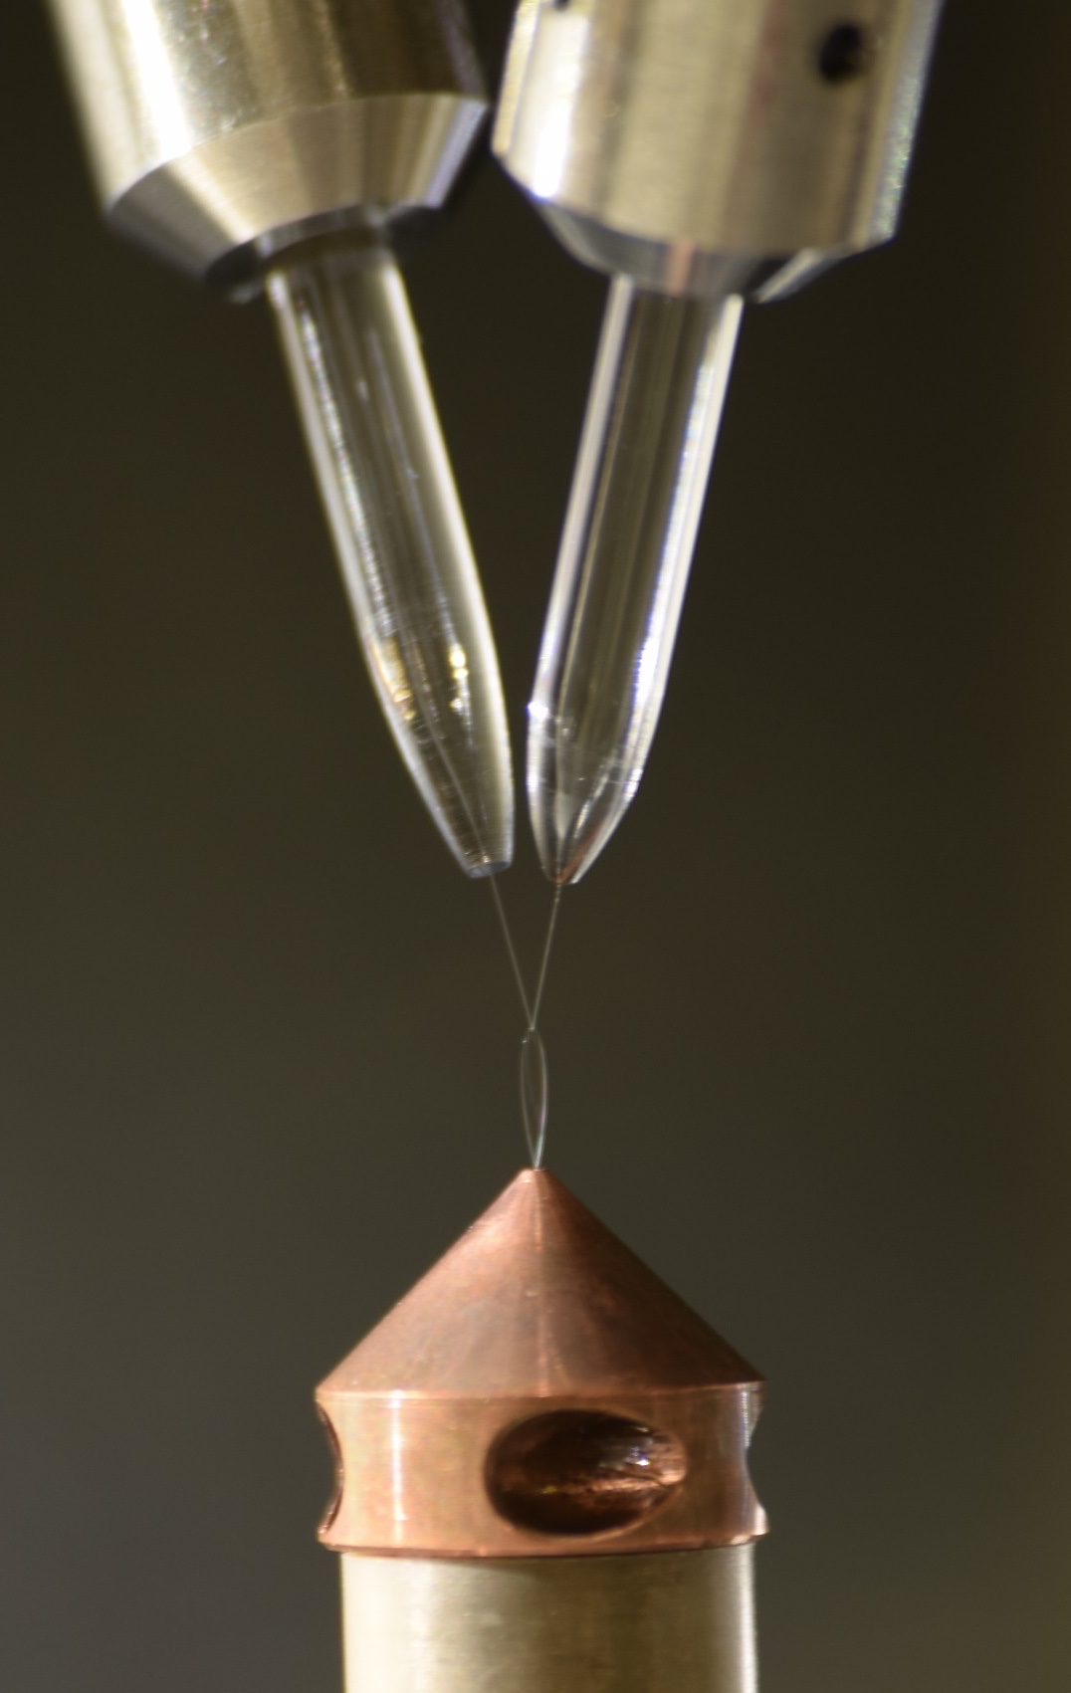
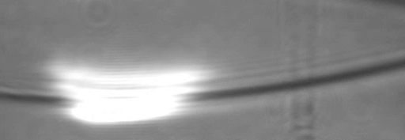
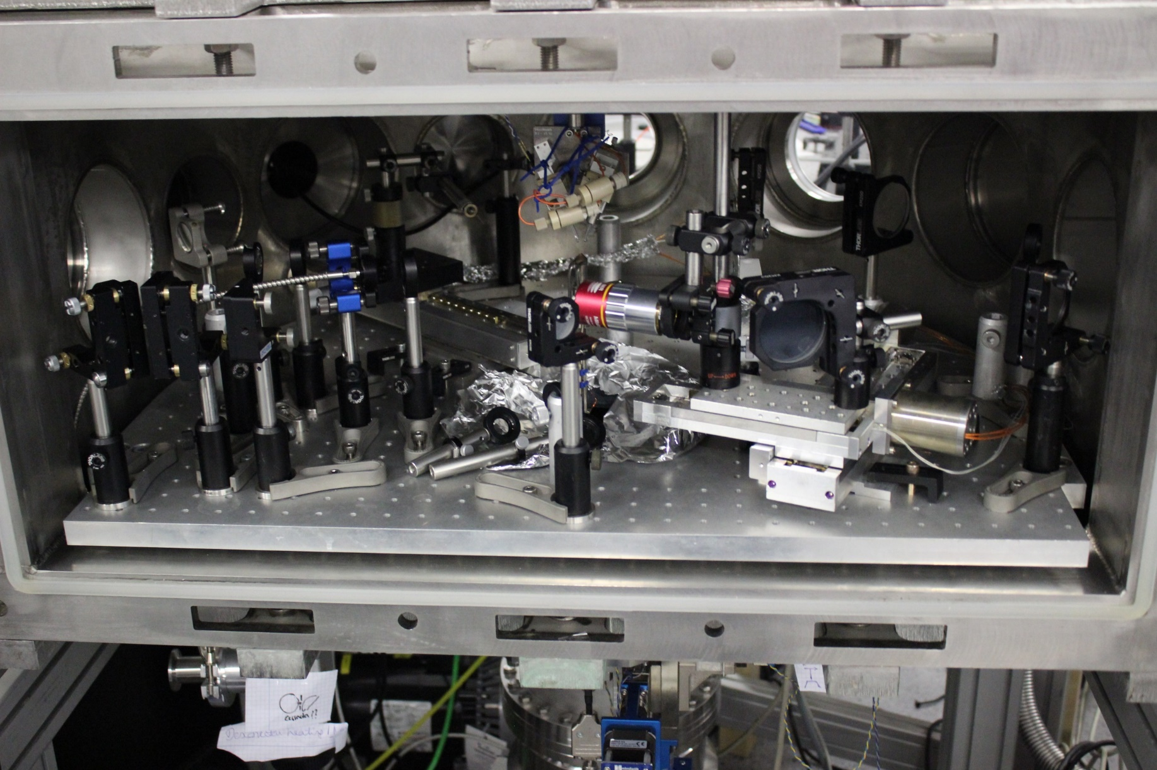
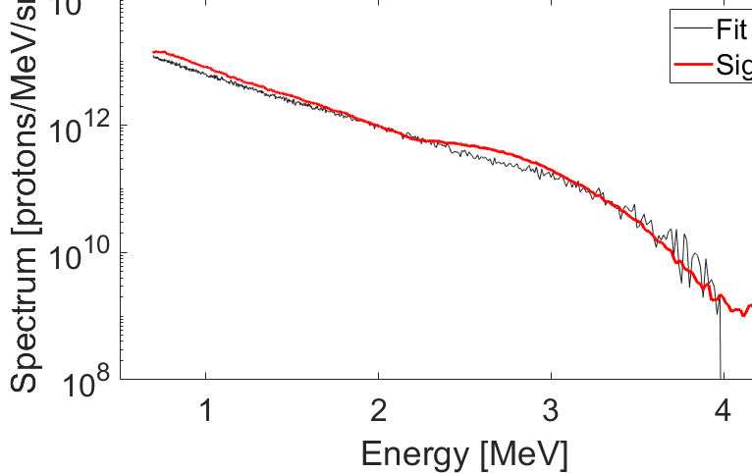
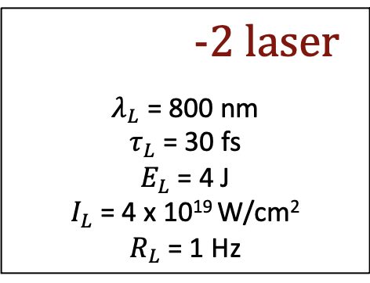
High-Rep. Operations
Relevant For
WP10: Staging
15⁰ shadow
T₁ = 0.65 MeV with
E_{max1}= 3.5 MeV
≈ 1 µm thick target.
T₂ = 0.35 MeV
E_{max2}= 2.4 MeV
≈ 5 µm thick target.
More than 1000 shots were performed in 1 Hz bursts
P. Puyuelo-Valdés et al., Plasma Phys. Control. Fusion 64, 054003 (2022)
-2 laser
$λ_{L}$ = 800 nm
$τ_{L}$ = 30 fs
$E_{L}$ = 4 J
$I_{L}$ = 4 x 10¹⁹ W/cm²
$R_{L}$= 1 Hz

Slide 12
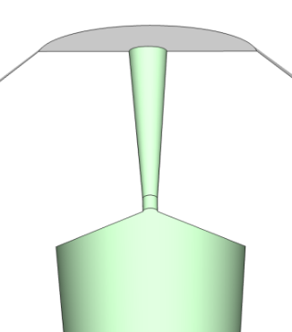

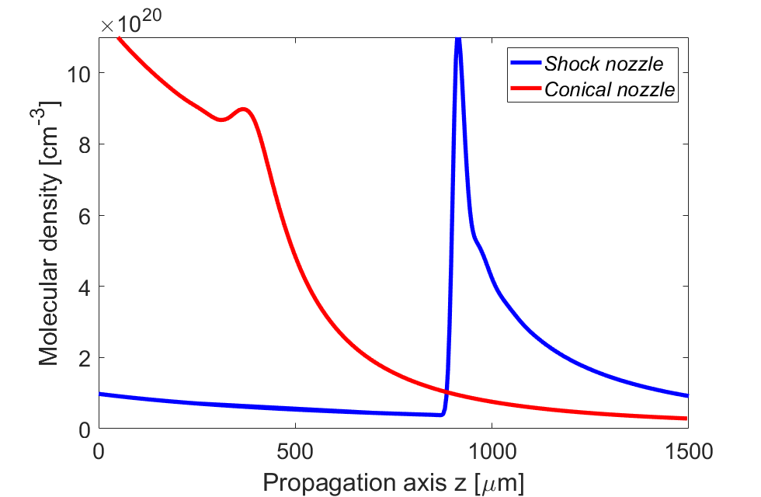
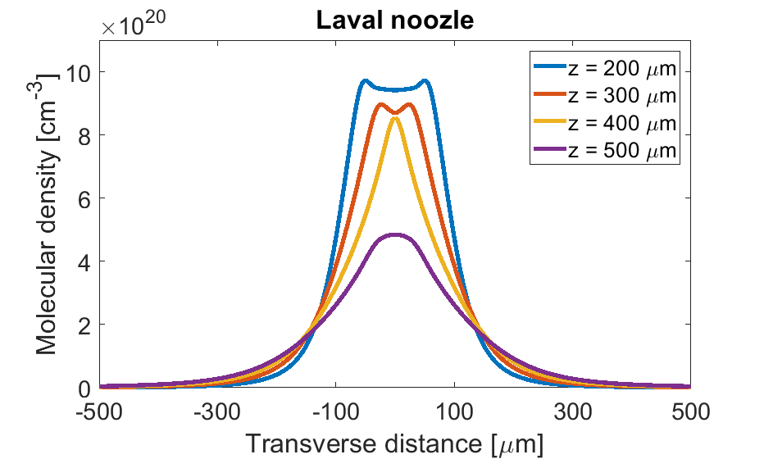
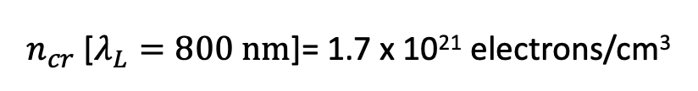
High-Repetition Operations: gas-target
1000 Bar
Conical nozzle
Shock nozzle
Efficient laser absorption
$n_{cr}$[$λ_{L}=800 nm$]= 1.7 x 10²¹ electrons/cm³
Laval nozzle
2D Computational fluid dynamics (CFD)
J.L. Henares et al., Rev. Sci. Instrum., 90, 063302 (2019)
Notes:
FTMC Helped in some nozzle

Slide 13
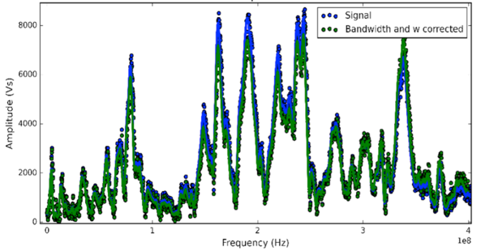
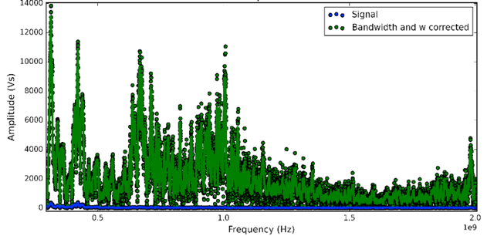
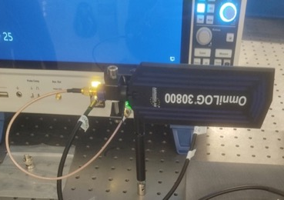
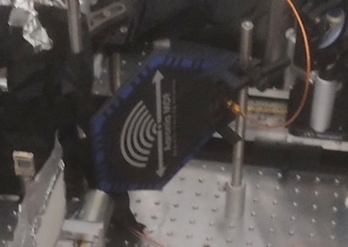
High Rep. Operations: EMP Management
The Laser/target interaction generates discharge currents and associated EM fields
dangerous for the equipment (e.g. motors, cameras, electronics etc.). Bottleneck for
The establishment of High Repetition Rate operations
Campaigns collaborating with ELI-ALPS*
Now establishing methods and standards
Assessing the role of different parameters
Focusing on solid, liquid and gas
B-Field (gas) In-chamb.
E-Field (gas) Out-chamb.
El. Field 300 MHz-8GHz
Mag. Field 9KHz-400MHz
Newly acquired equipment
2GHz (6GHz) High Sens. Scope
V. Network Analyzer
Commercial Antennas
*K. Nelissen et al., Scient. Reports-Nat. Pub. Group, 2020,10-1, Pg. 1-8

Slide 14
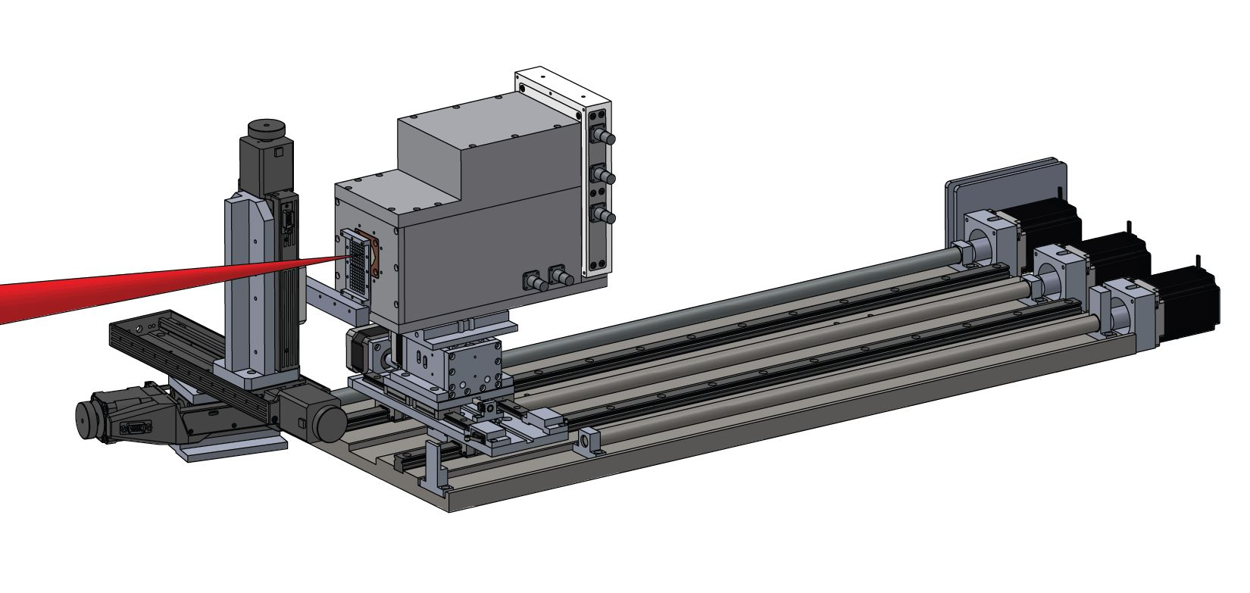
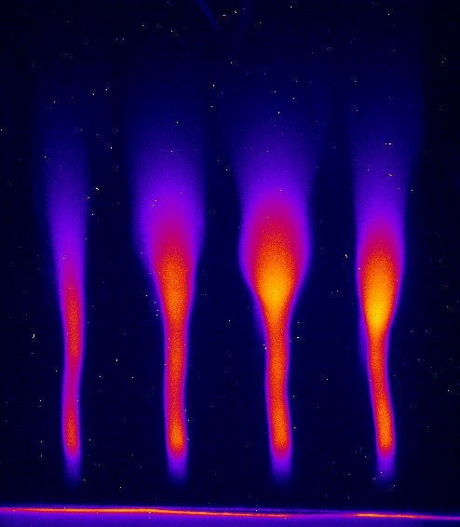
Diagnostic development
Organic scintillator
Energy
Outlook: energy resolved emittance
for LWFA electrons
Relevant
WP13

Slide 15
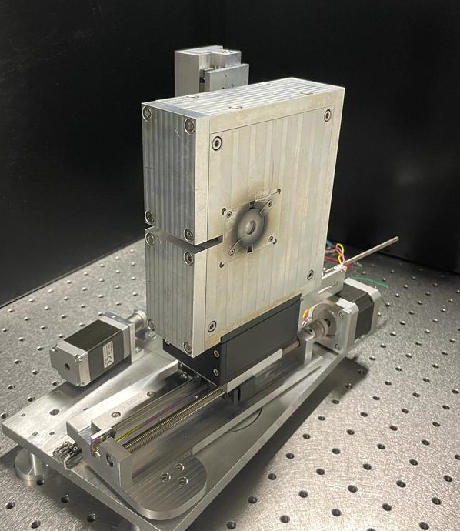
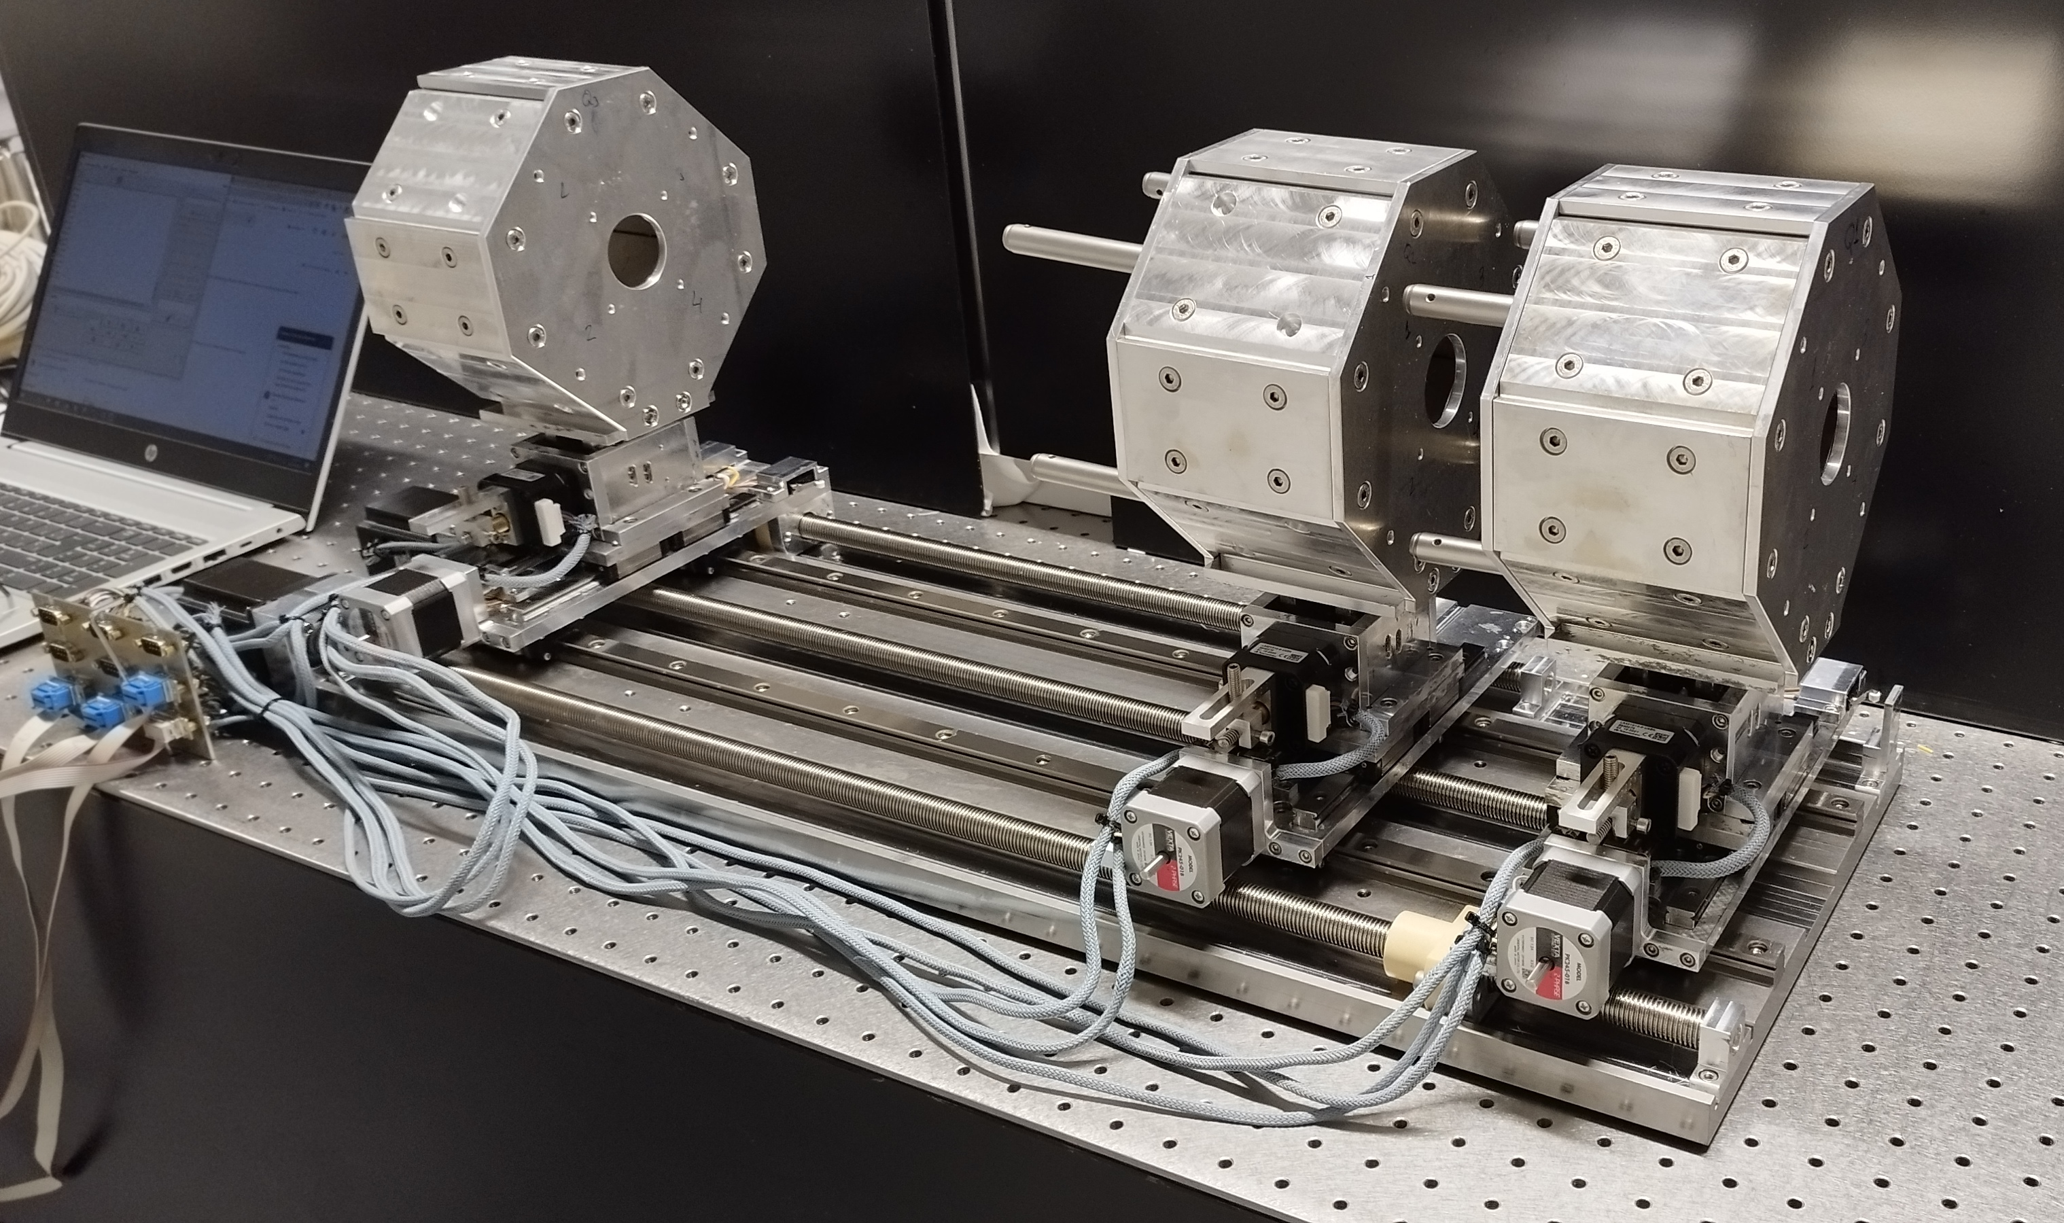
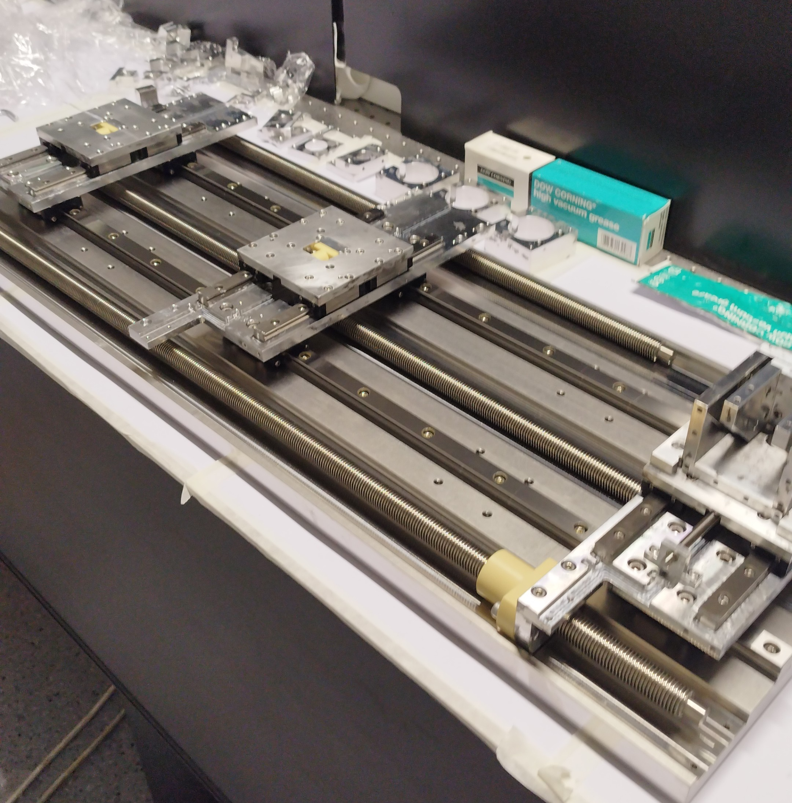
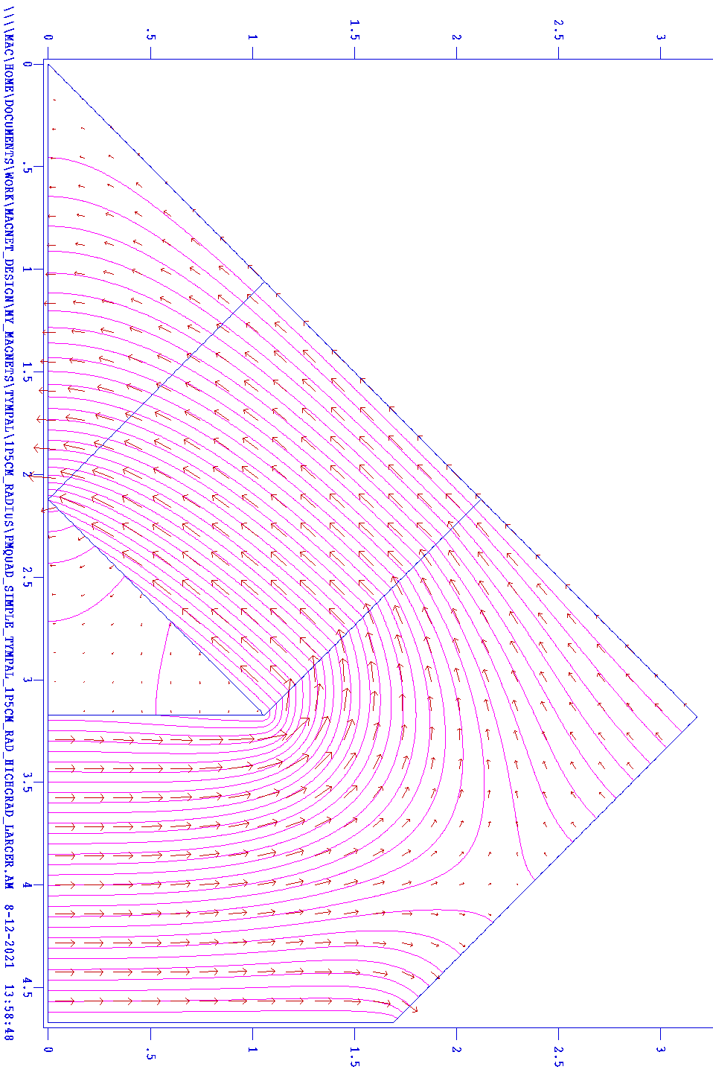


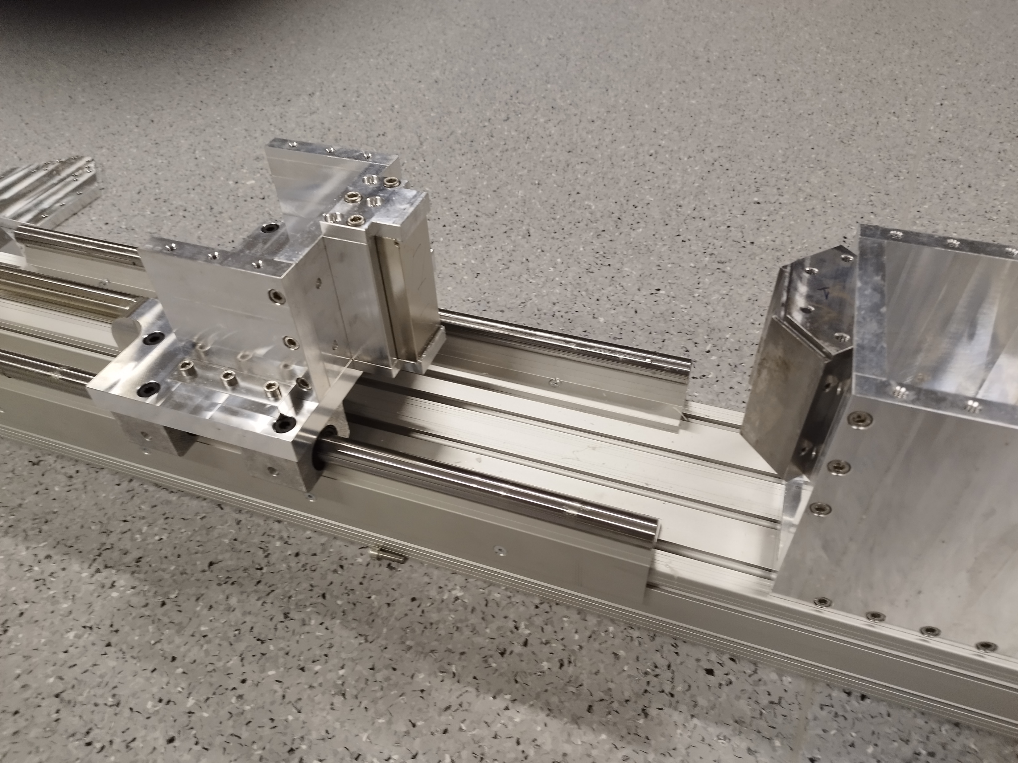
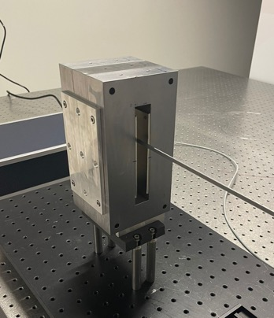
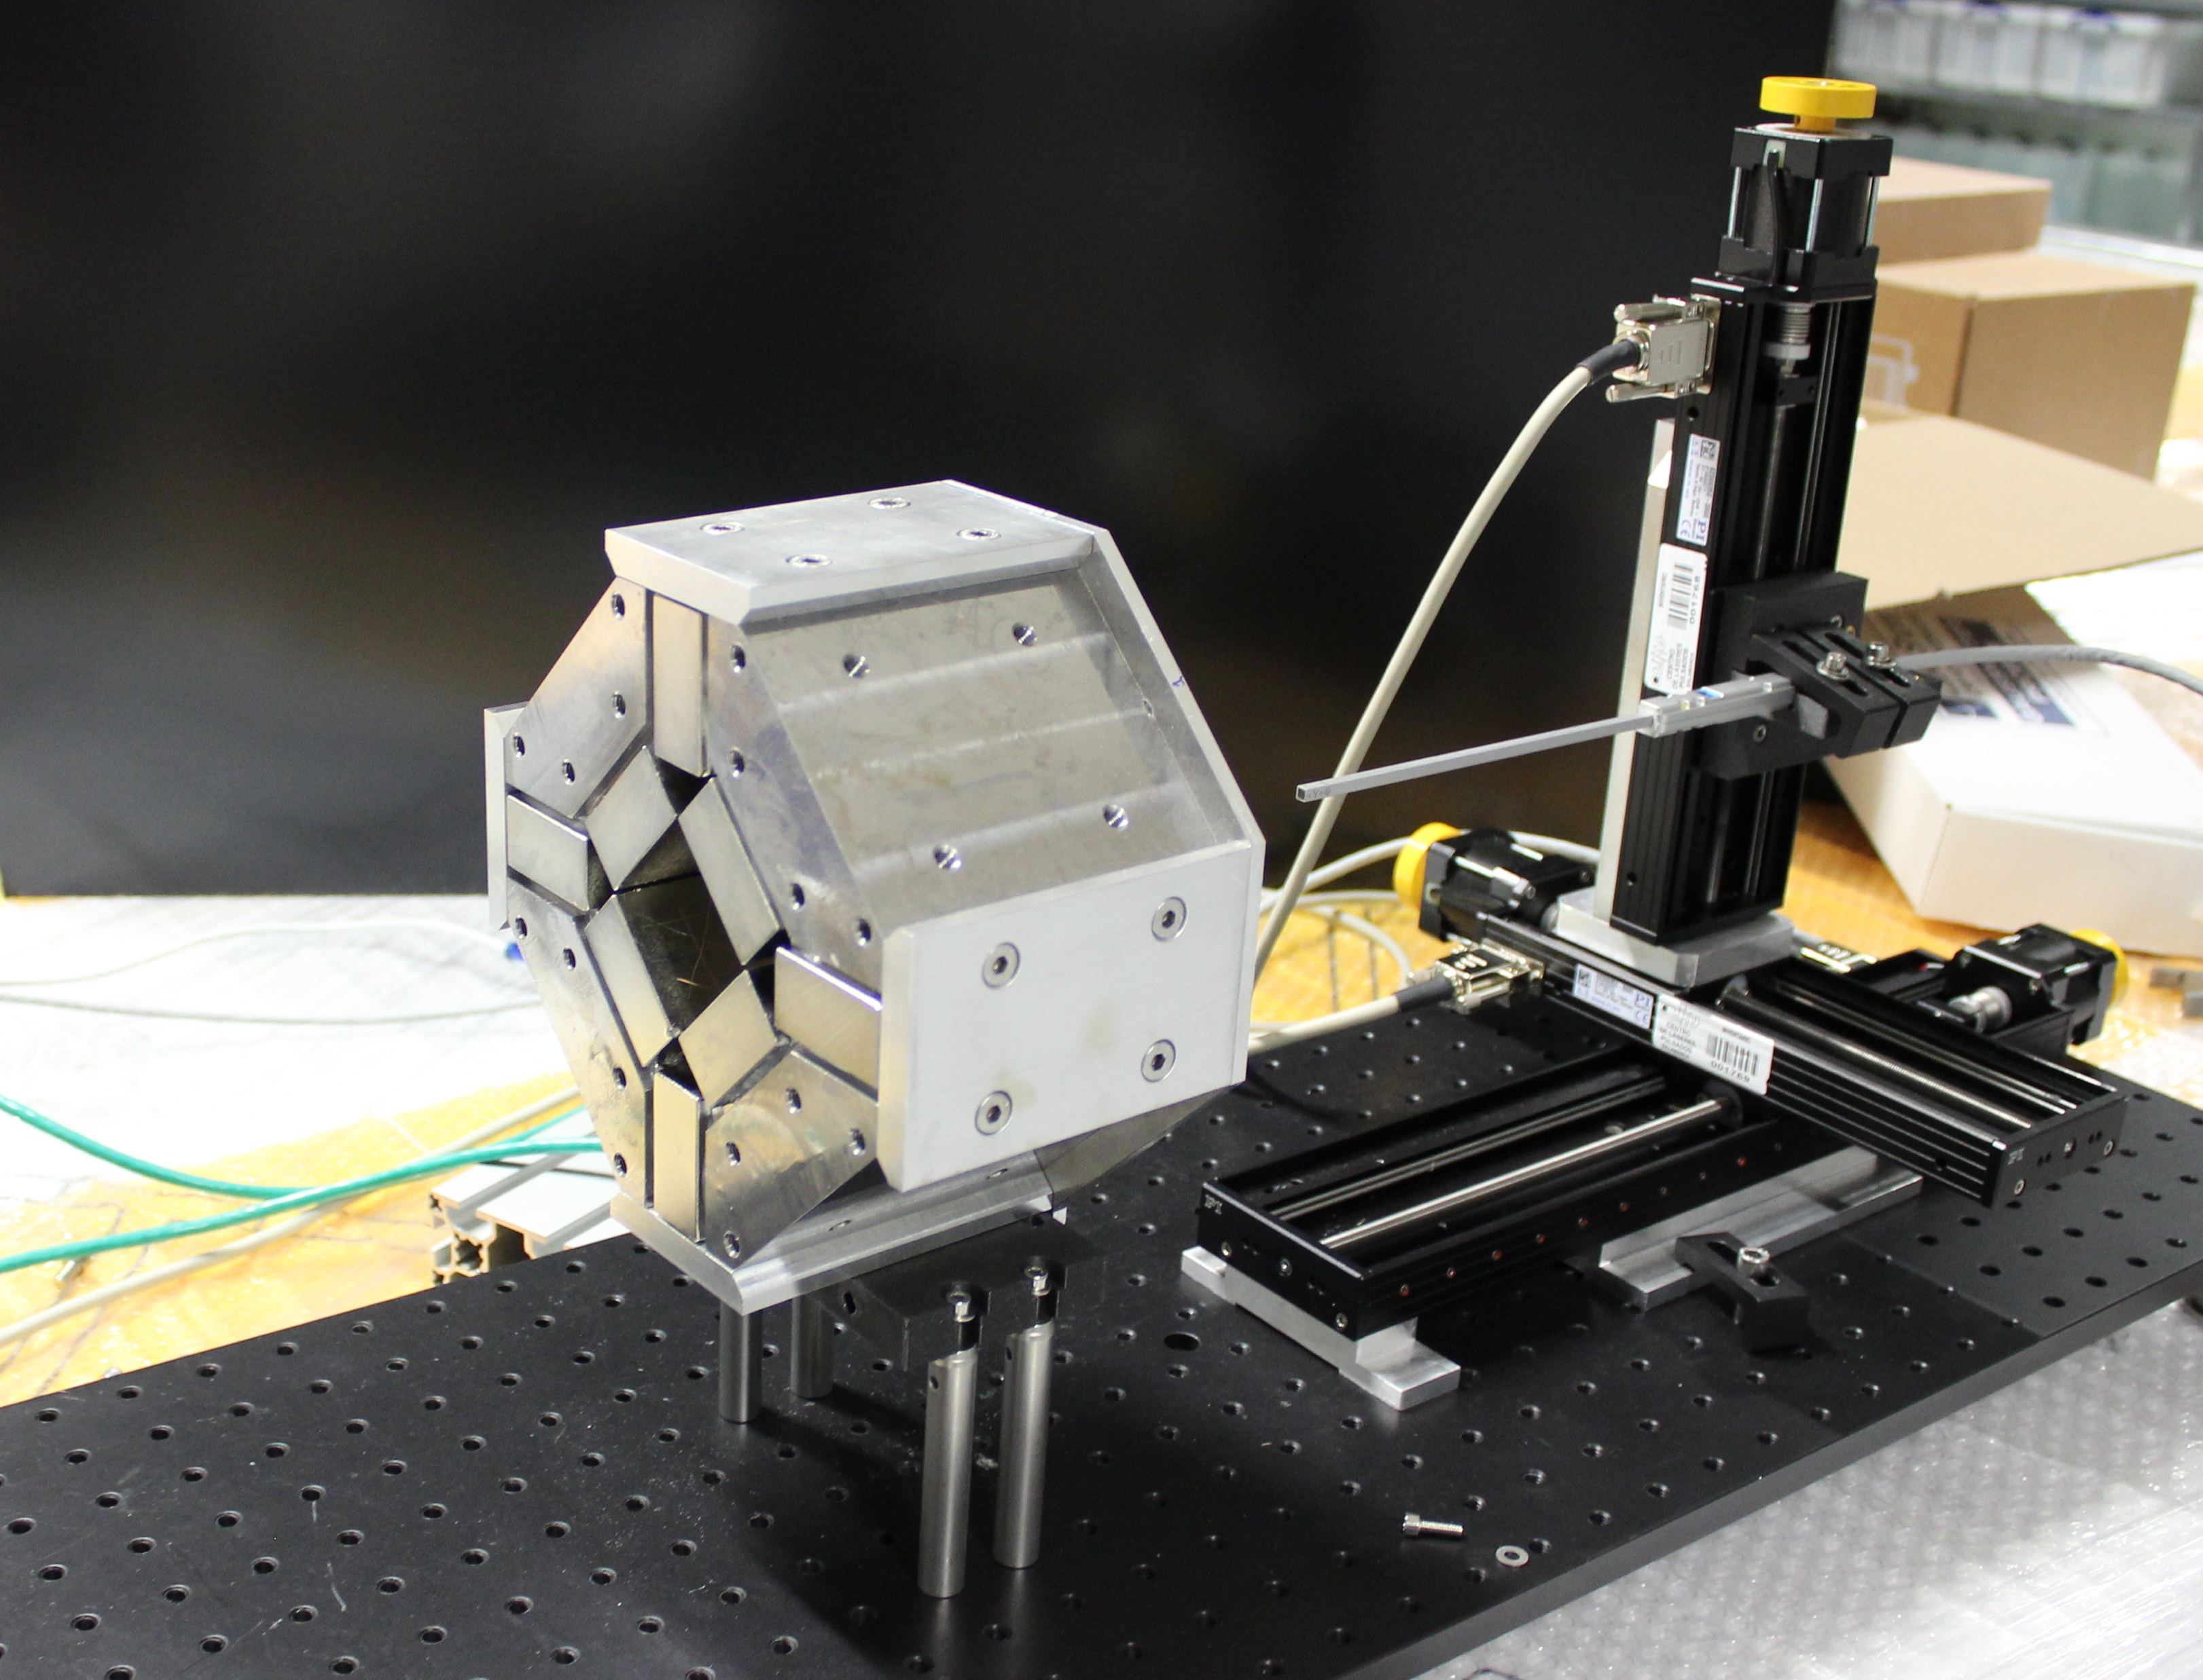
Relevant
For WP9
Magnetic Elements development
Mainly rare earth Magnets (NdFeB)
Full in-house implementation (simulations, assembly, characterization)
Energy Selector
Quadrupoles
Simulations
Assembly
Collaboration
3D Hall Probe mapping

Slide 16
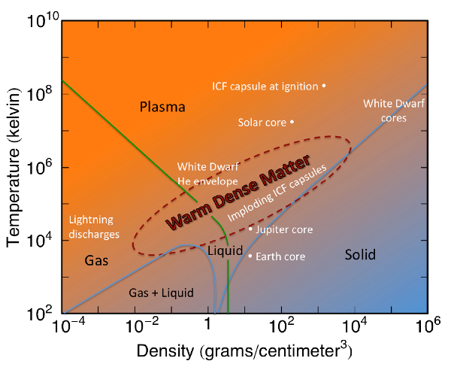
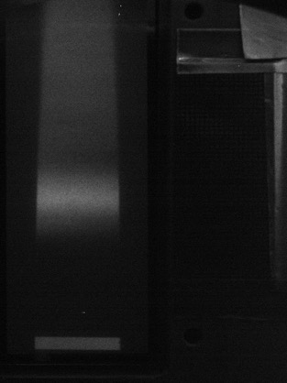
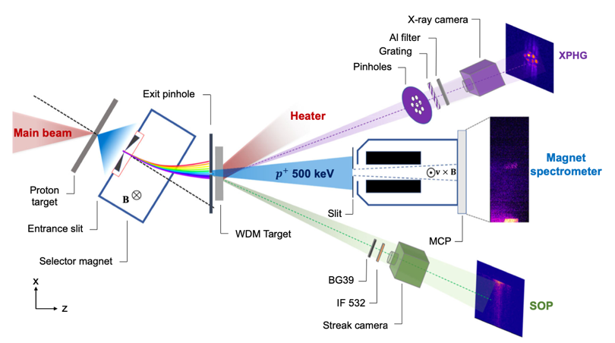
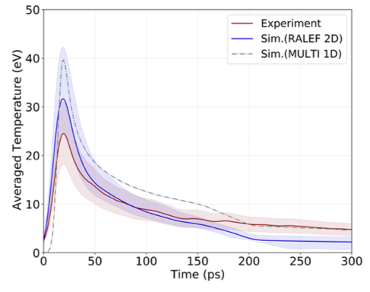
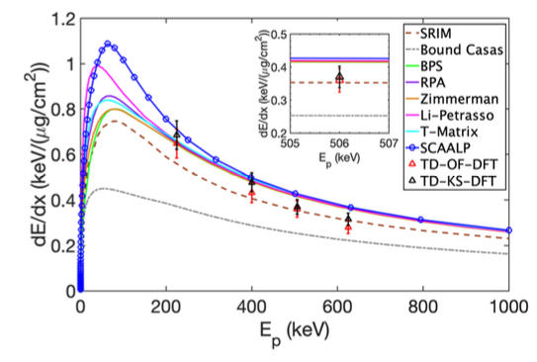
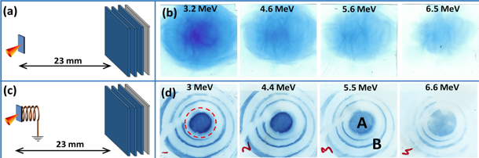
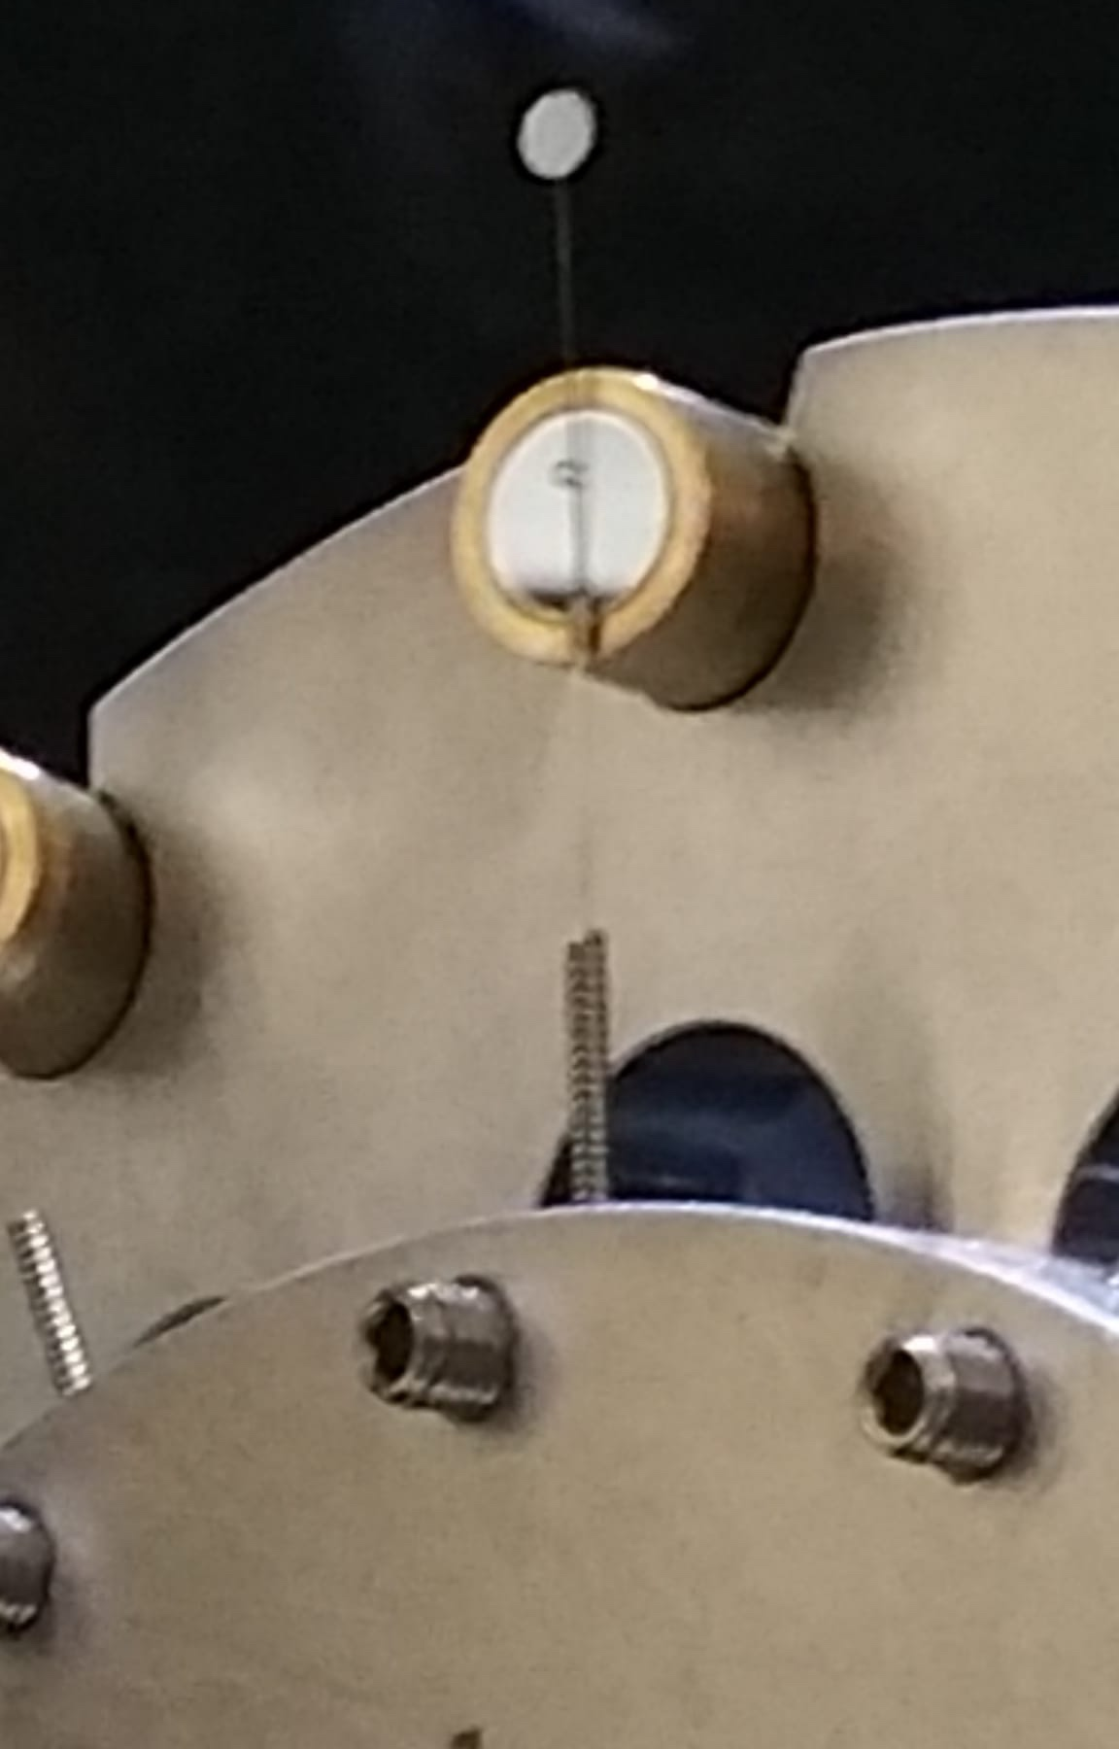
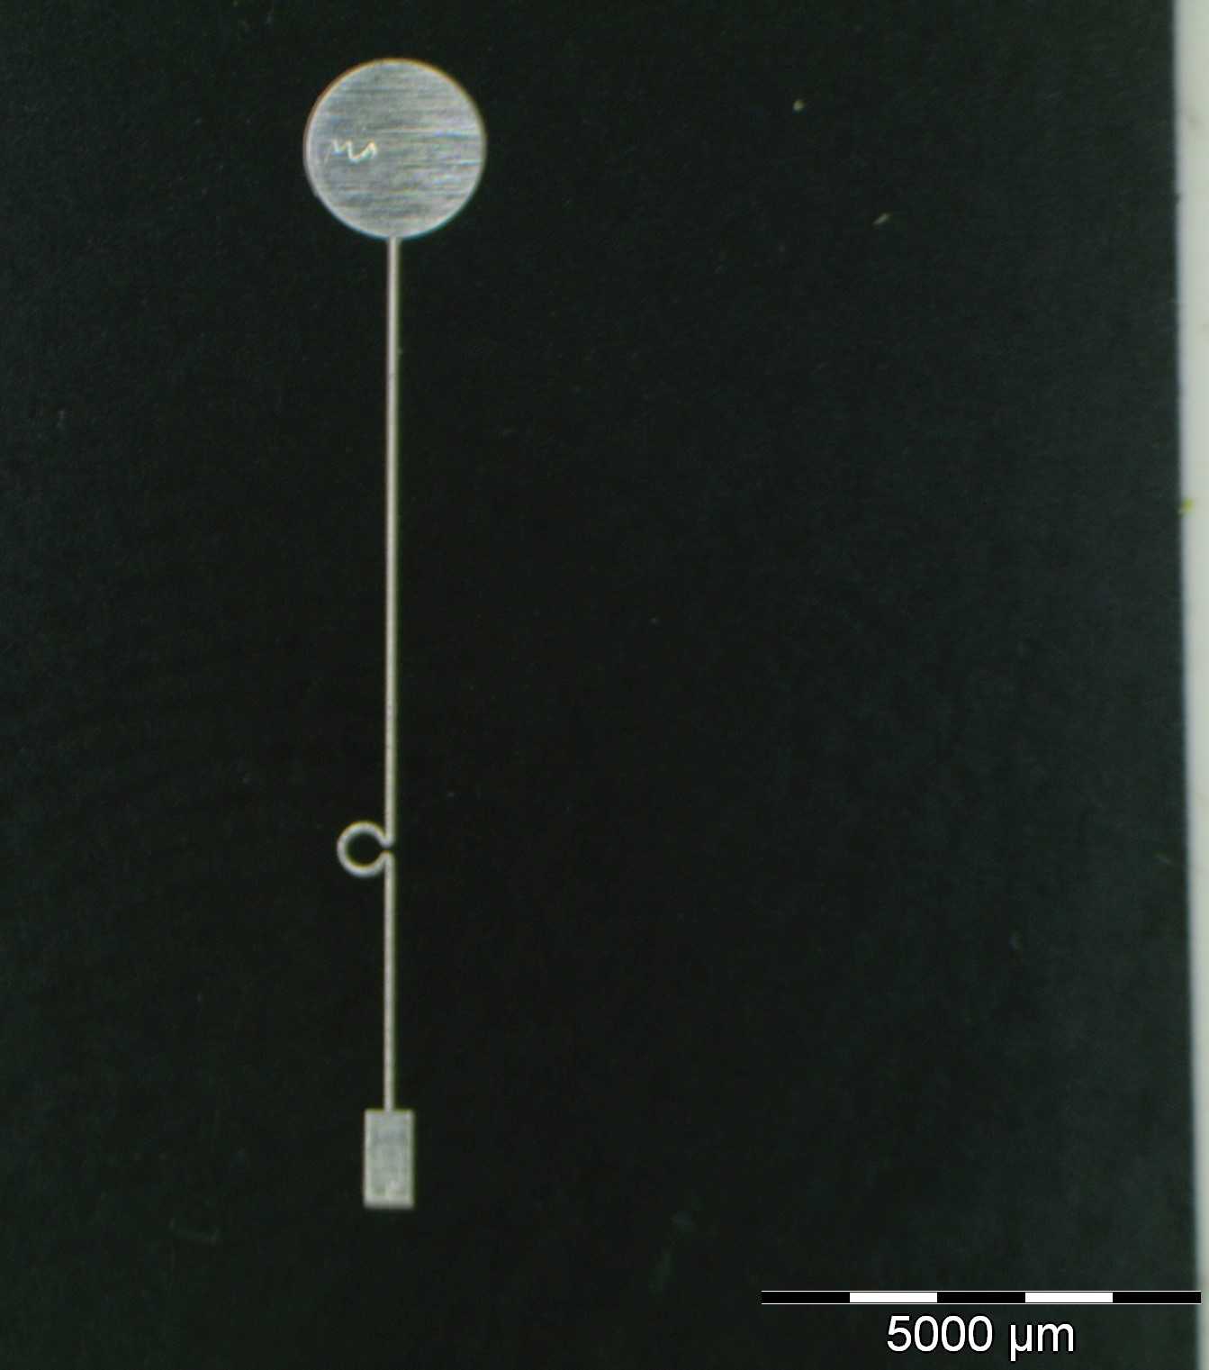

HEDP-Lab. Astrophysics
ICF Community. User beamlines in XFEL/LCLS
Proton stopping power in plasma
Spectrum
Out
plasma
Energy
1 MeV
Transient Magnetic Fields (ns)
Tens-Hundreds of Tesla
Exp. CLPU & CSU
Exp. ELI-NP
S. Malko et al., Nat. Comm. 13, 2893 (2022)
J. Apiñaniz et al., Sci. Rep. 11, 6881 (2021)
Prof. L. Volpe
Prof. J. Honrubia
Generación de Conocimiento: APPLE

Slide 17
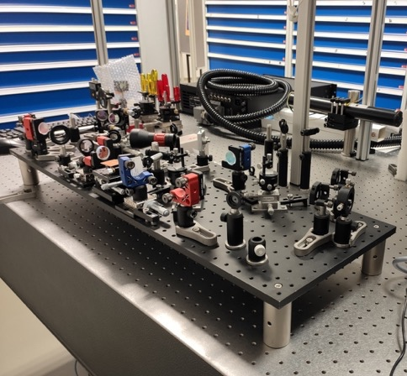
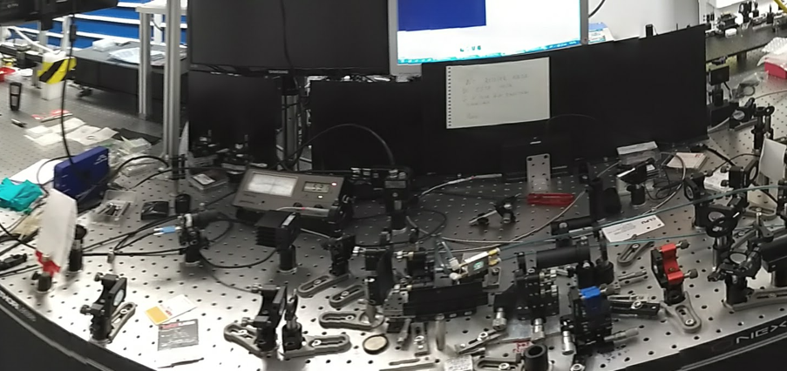
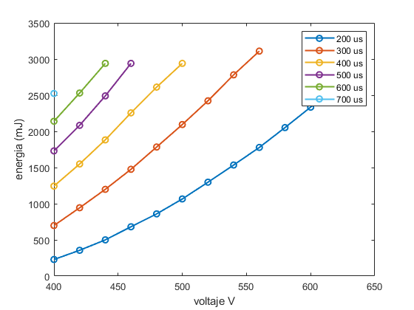
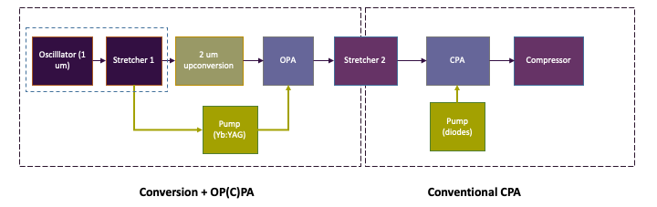

Development of 2 𝜇m lasers
Laser Development
Oscillators long term development and now High Power Lasers
Relevant
For WP12
1 𝜇m lasers
Hybrid system of OPA + conventional amplification
All-diode pumped
Scheme for 100 mJ, 100 fs, 100 Hz @ 2 um (10 W)
Generación de Conocimiento: NAPEL

Slide 18
Conclusions
The CLPU is a mature infrastructure to host EuPraxia 2nd site
Full Operating User Facility (ending the 3rd call for Users 23)
Space available (upgrade & surrounding area)
Shifting the distributed infrastructure to Western Europe
Bridge towards new countries (Latin America & more)
Financially sustainable infrastructure
Well inscribed in the European framework
Multi-disciplinary facility: smooth transition to FEL
Eupraxia would be the Flagship project of the Center
Lower Mass, Faster Response (flexibility to react to changes)

Slide 19


Post-scriptum
Next Events
December 4th 2023: Site visit
EPS Plasma Conference- July 2024
EOSAM (Europ. Optical Society)- September 2024

