Slide 1
EuPRAXIA 2nd SITE
6th European Advanced Accelerator Concepts Workshop
17–23 Sept 2023
Hotel Hermitage, La Biodola Bay, Isola d'Elba, Italy
View from CNR
Leonida A. GIZZI,
CNR-INO and INFN, Pisa, Italy

Slide 2
CONTENTS
Motivation
ID of host Institution (CNR)
2nd site supporting Laboratory (ILIL): profile and topics
Role in EuPRAXIA
Ongoing developments towards 2nd site
2nd site proposal institutional support
Future actions
Leonida A. Gizzi | EAAC 2023 | 17-22 September 2023 | Isola d’Elba, Italy

Slide 3
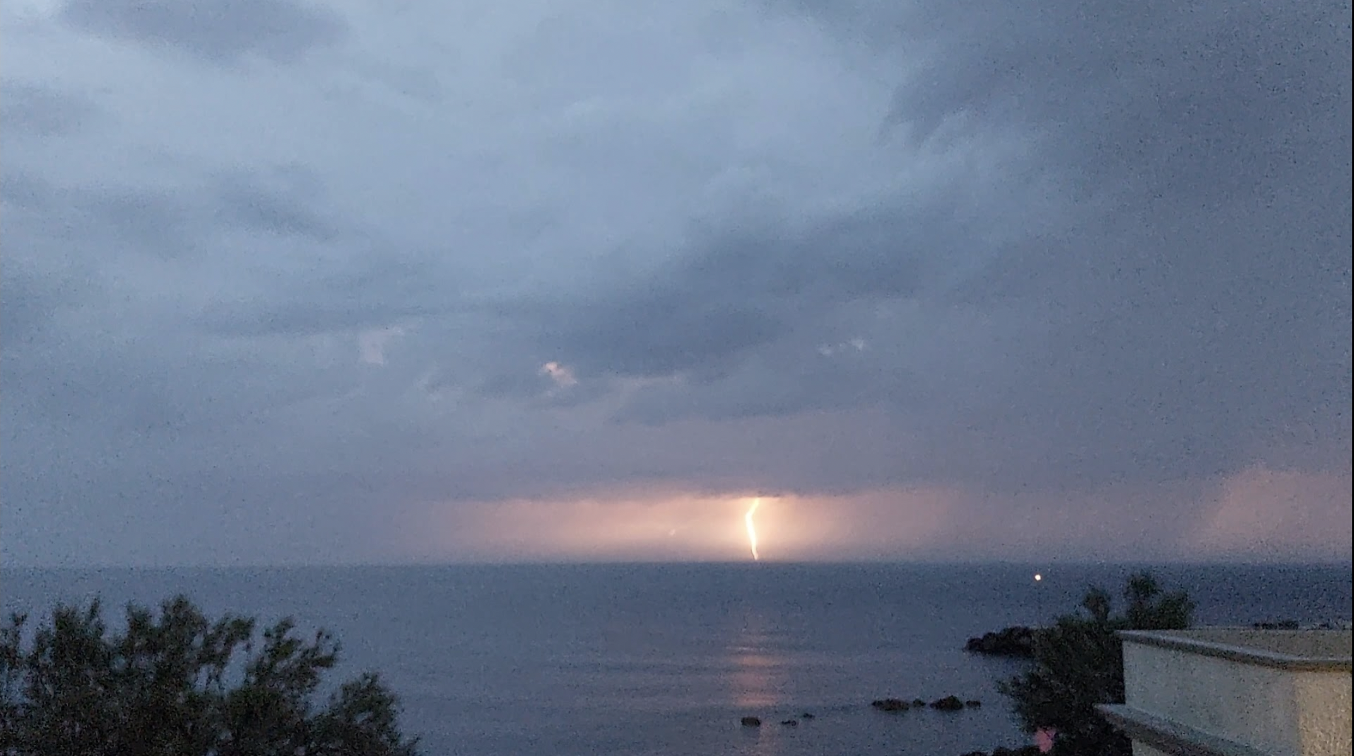
MOTIVATION
Long term engagement in high power laser and laser-plasma interactions;
Strong multidisciplinary scientific potential;
Emerging innovation and disruptive approaches;
Leverage on national support to the field;
Growing industrial impact of intense lasers.
Leonida A. Gizzi | EAAC 2023 | 17-22 September 2023 | Isola d’Elba, Italy

Slide 4
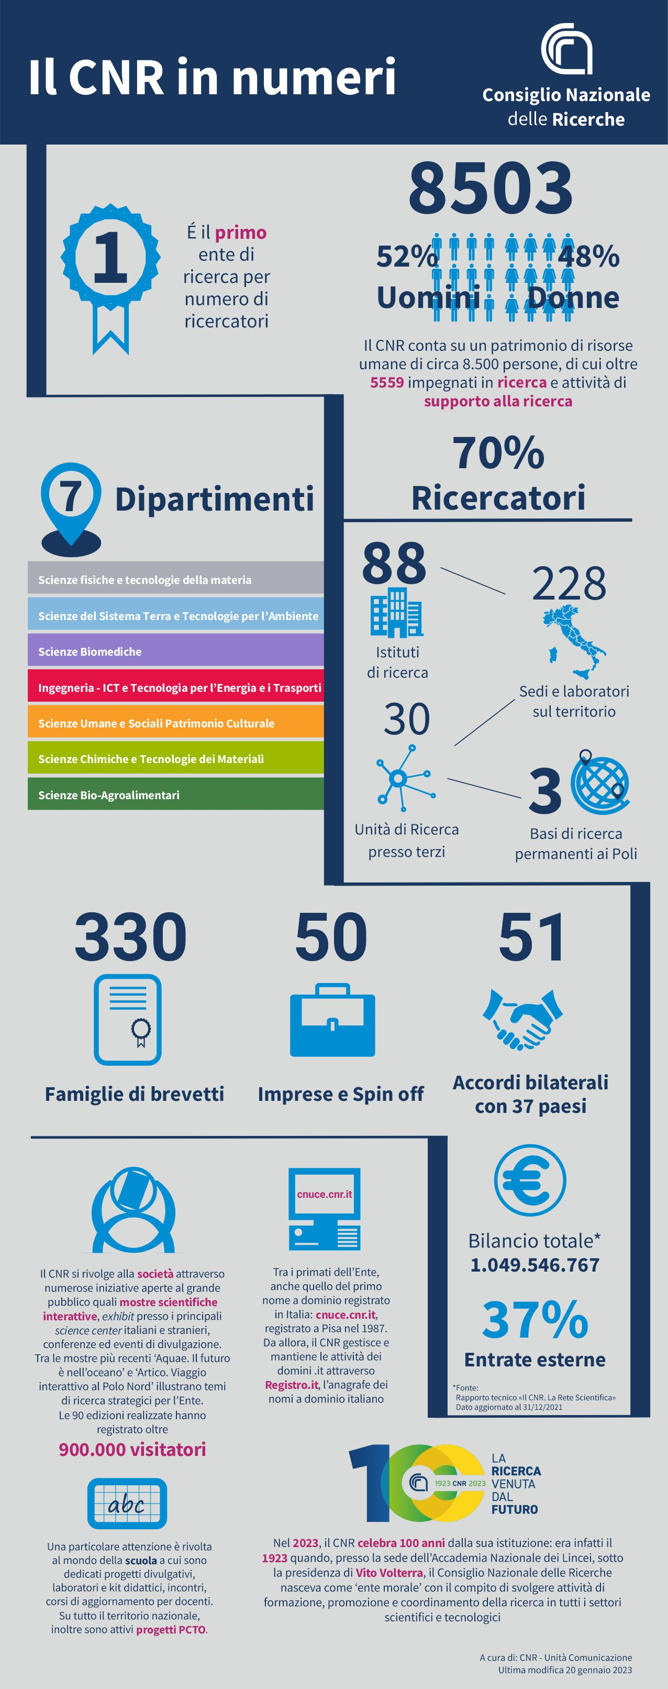
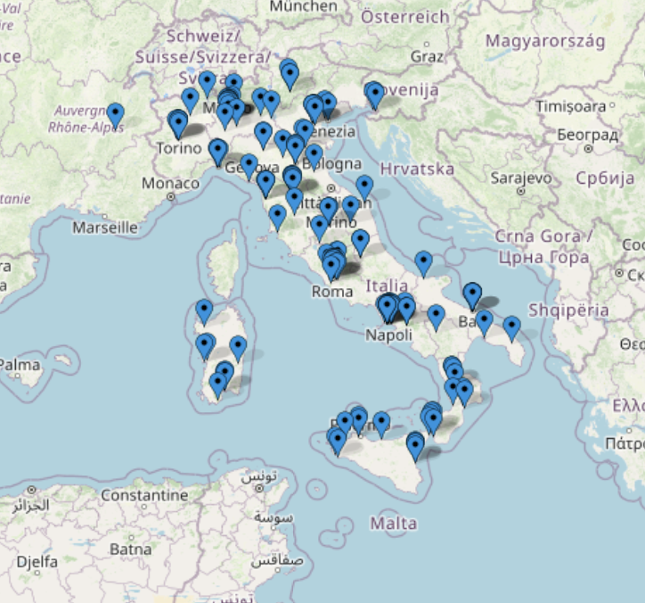
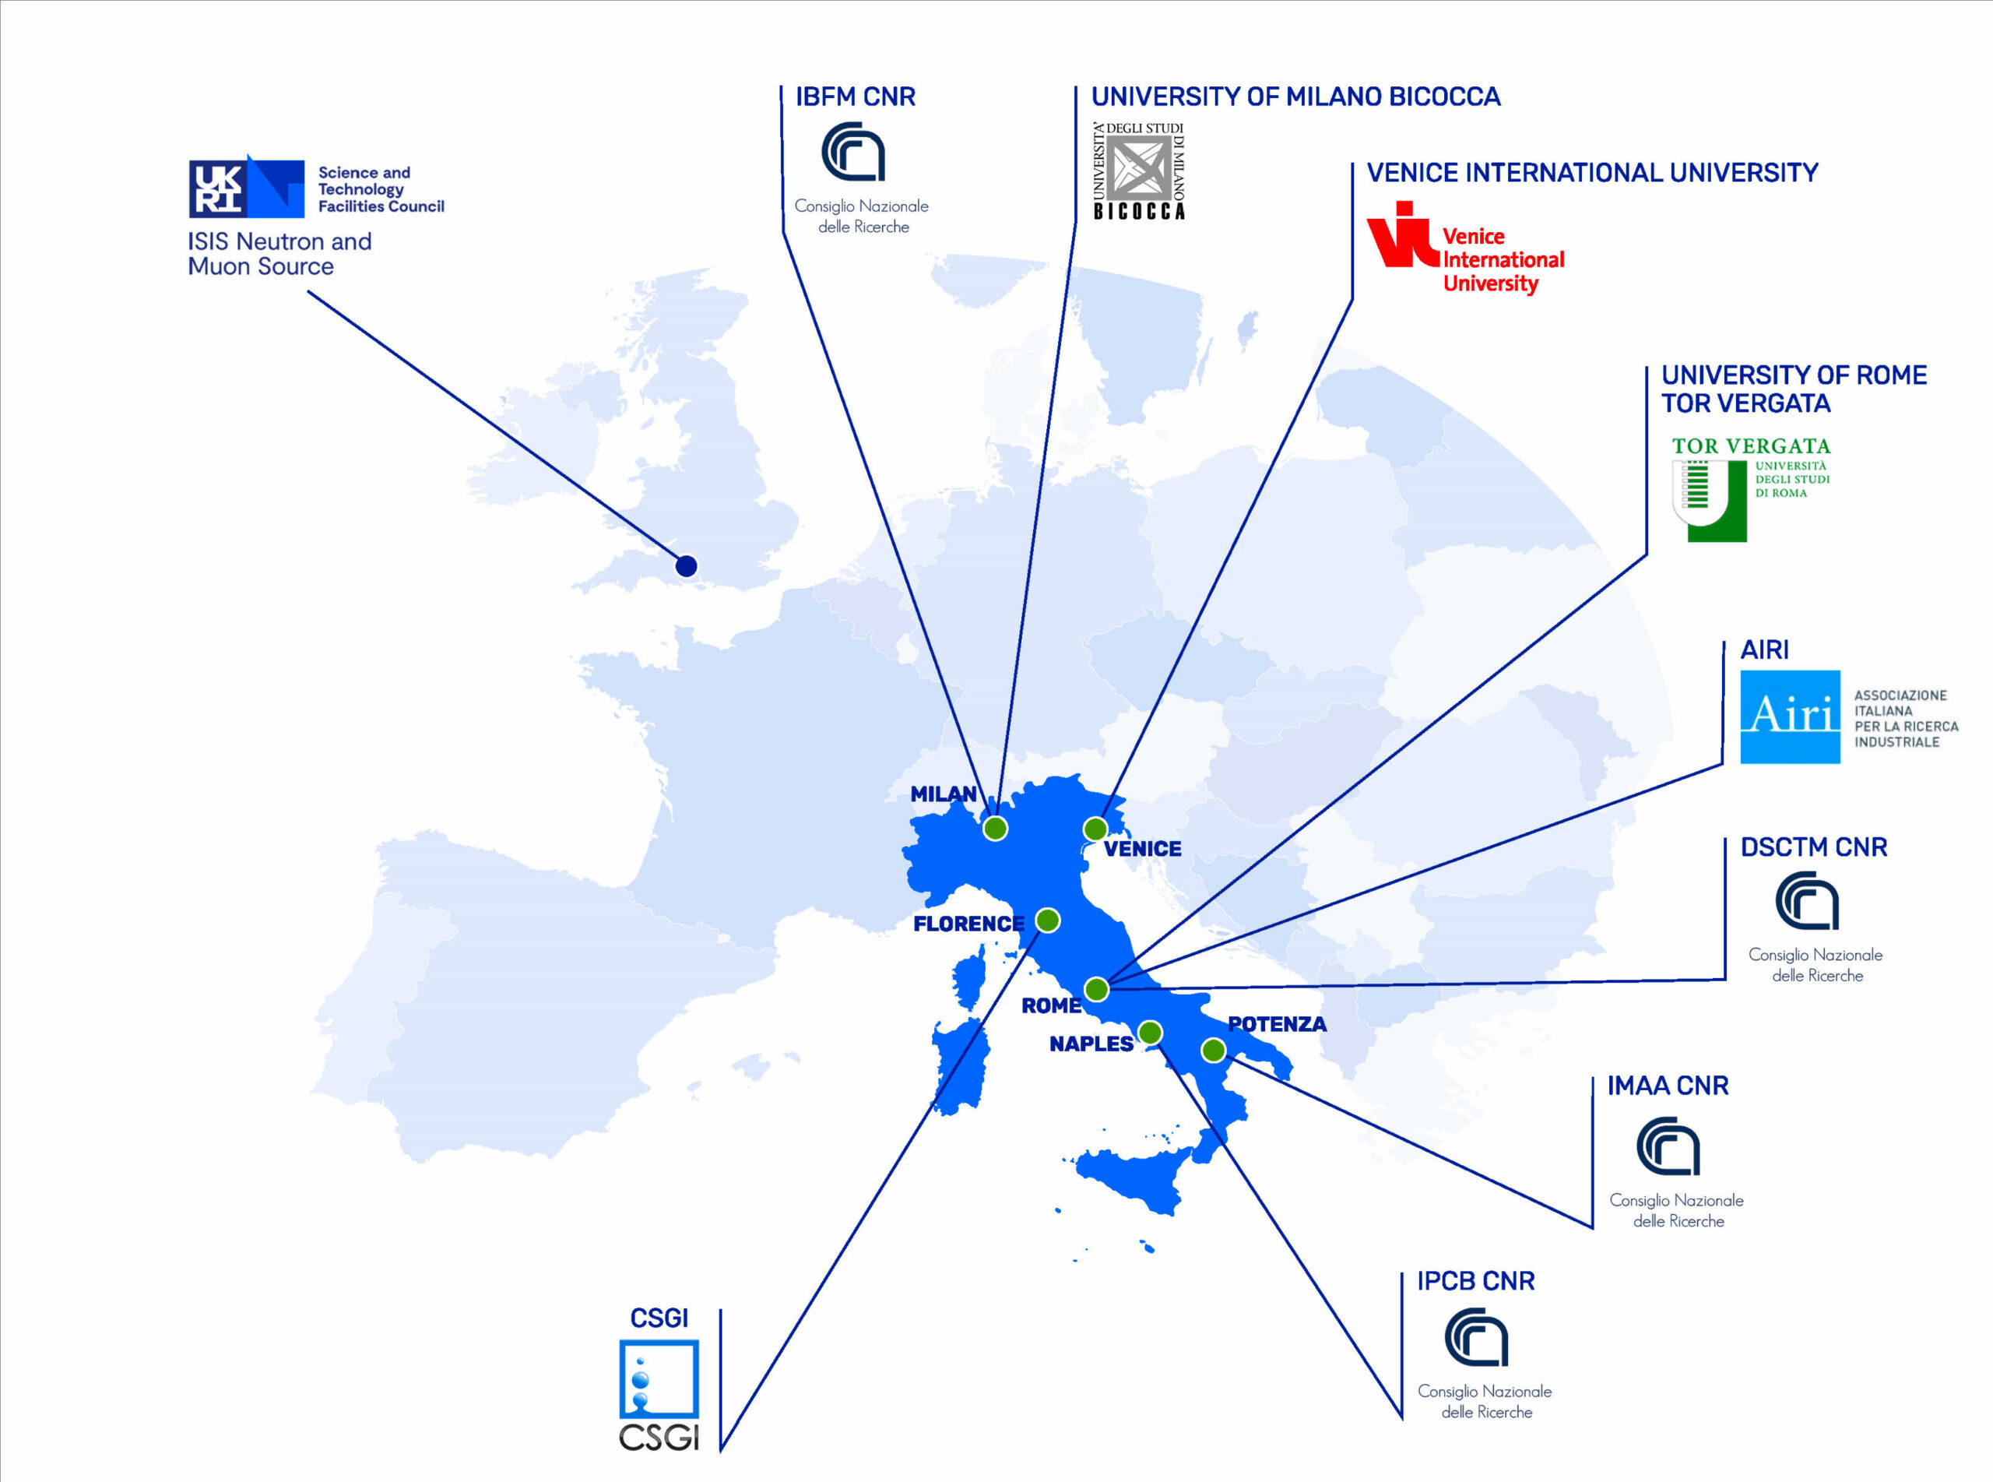
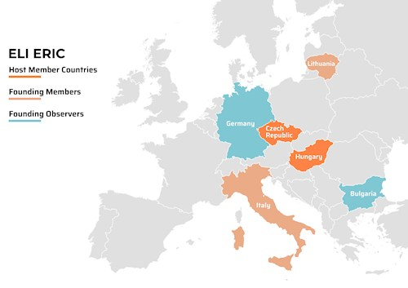
Consiglio Nazionale delle Ricerche (CNR)
Strong commitments to large scale facilities
http://www.dsftm.cnr.it/large-scale-facilities/
ELETTRA and FERMI (beamlines),
ESRF (beamlines)
ILL, ISIS, ESS, NFFA, XFEL, ELI
Leonida A. Gizzi | EAAC 2023 | 17-22 September 2023 | Isola d’Elba, Italy

Slide 5
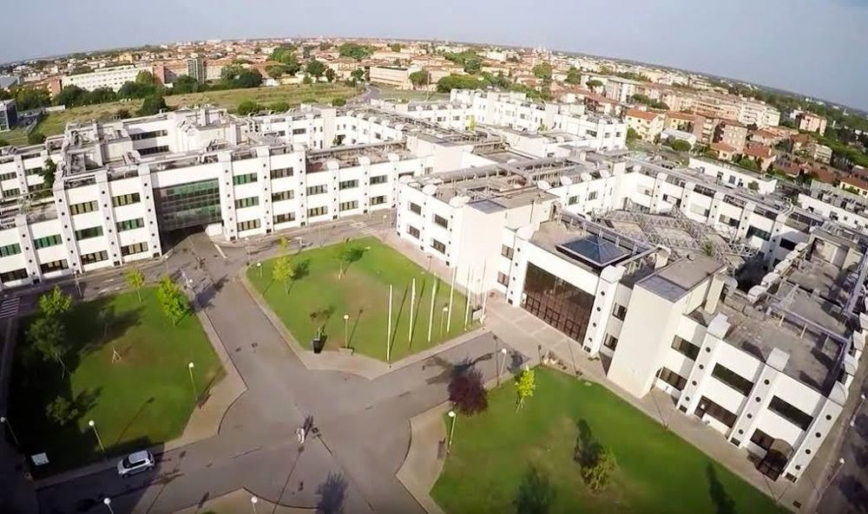
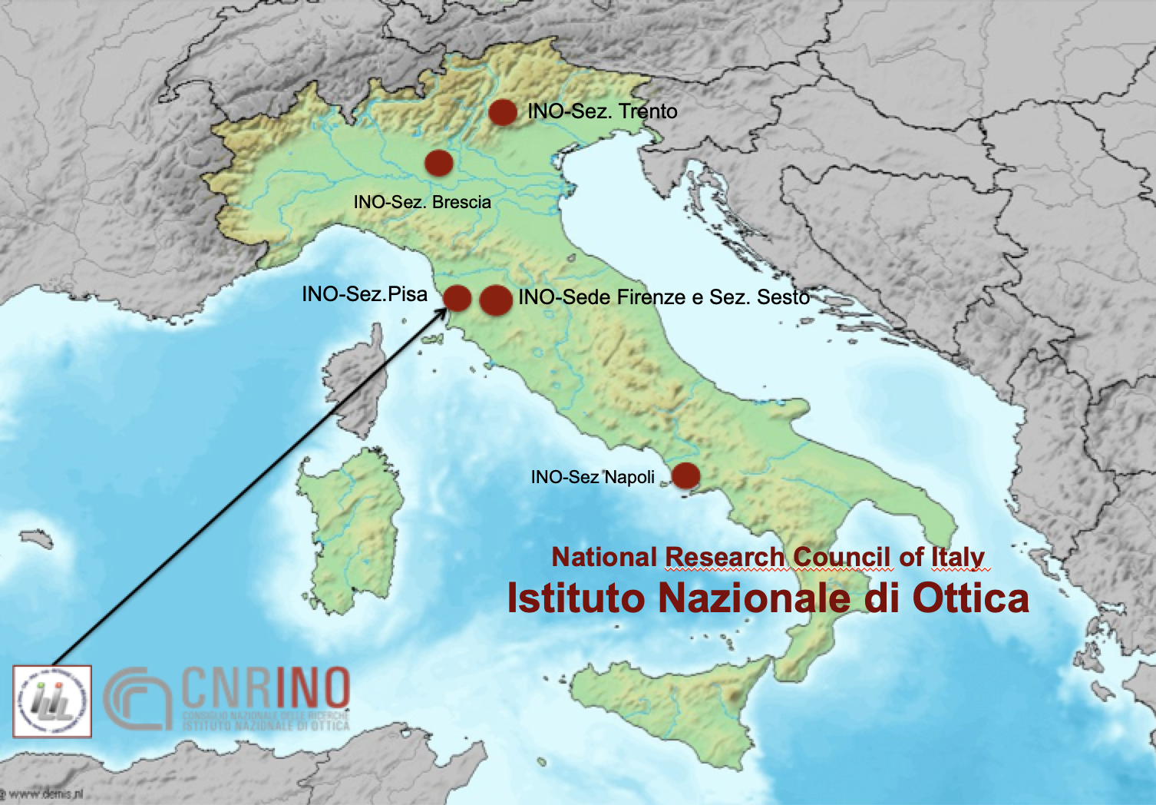
CNR, Area della Ricerca del CNR, Pisa
Leonida A. Gizzi | EAAC 2023 | 17-22 September 2023 | Isola d’Elba, Italy

Slide 6
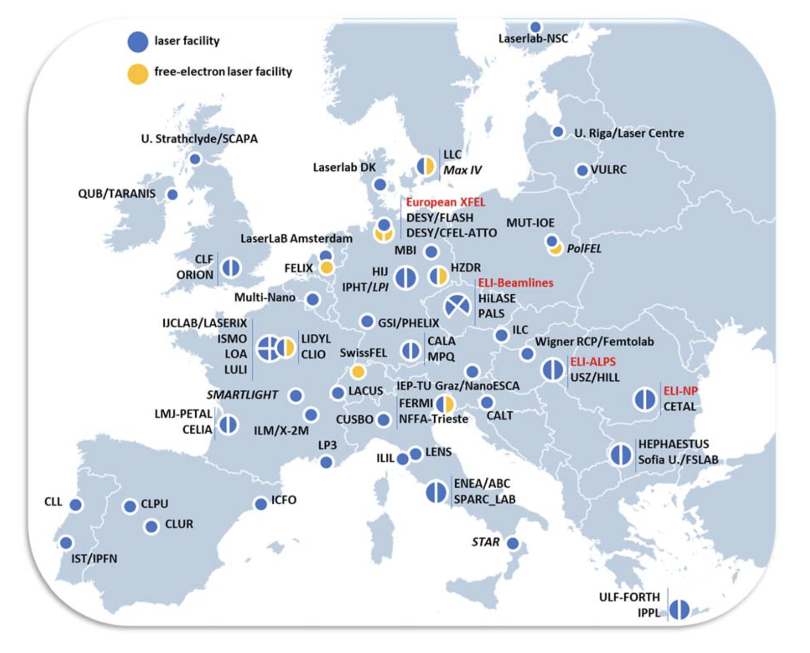
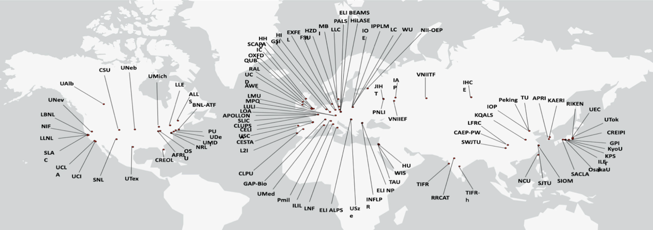
Facilities and infrastructures
Fast growing research and technology
Emerging new installations
Overview of laser and light sources infrastructures obtained by a recent LASERLAB-ELI-ERIC joint study.
ICUIL World map of lasers with peak power >100 TW, G. Mourou Nobel Lecture: Extreme light physics and application”, Rev. Mod. Phys., 91, 030501 (2019).
Leonida A. Gizzi | EAAC 2023 | 17-22 September 2023 | Isola d’Elba, Italy

Slide 7
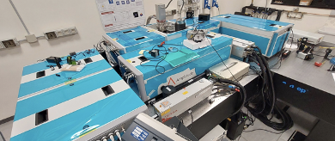
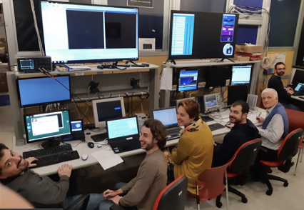
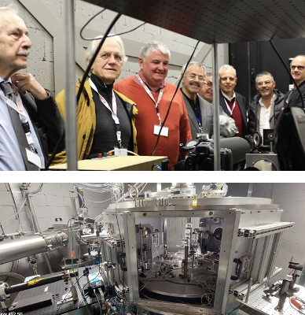
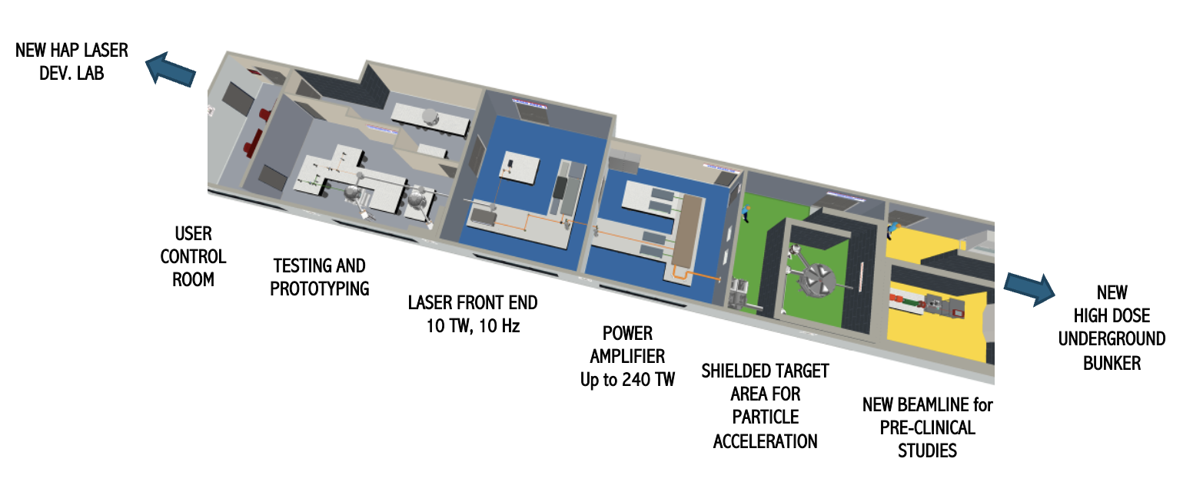
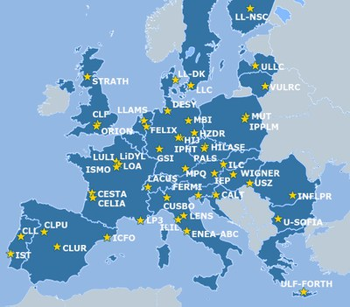
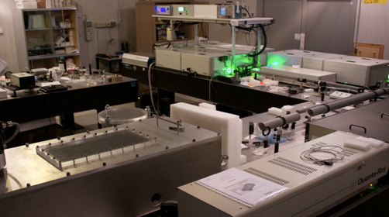
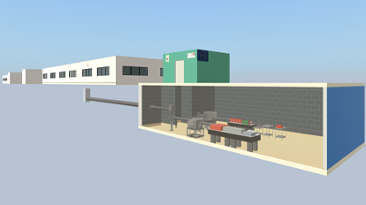
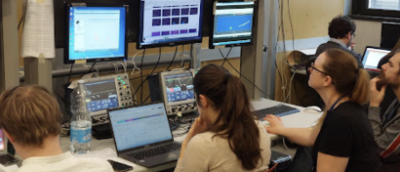
The Intense Laser Irradiation Laboratory (ILIL)
LASER CAPABILITIES:
240 TW, Ti:Sa, up to 5 Hz, 27 fs;
1kHz, >20 mJ, Ti:Sa + OPA
100 Hz, >1J, TiSA (procurement in progress)
2018
A member of Laserlab-Europe-AISBL
Leonida A. Gizzi | EAAC 2023 | 17-22 September 2023 | Isola d’Elba, Italy

Slide 8
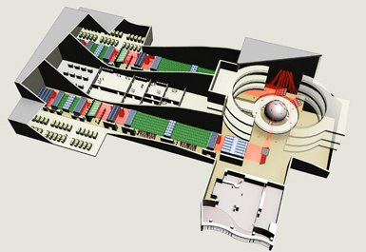
MAIN SCIENTIFIC ENGAGEMENTS @ ILIL
High intensity laser-plasma interaction physics and applications
Laser-plasma acceleration
High quality GeV electron beamline design
VHEE beamline for medical applications
Advanced laser-target interaction for proton beamline and applications
Laser-fusion studies
LPI studies for Inertial Fusion (HiPER+)
kJ, laser concept development
Material studies
HiPER+
Laser development
100 Hz beamline
kHz laser technology development for high efficiency operation
Leonida A. Gizzi | EAAC 2023 | 17-22 September 2023 | Isola d’Elba, Italy

Slide 9
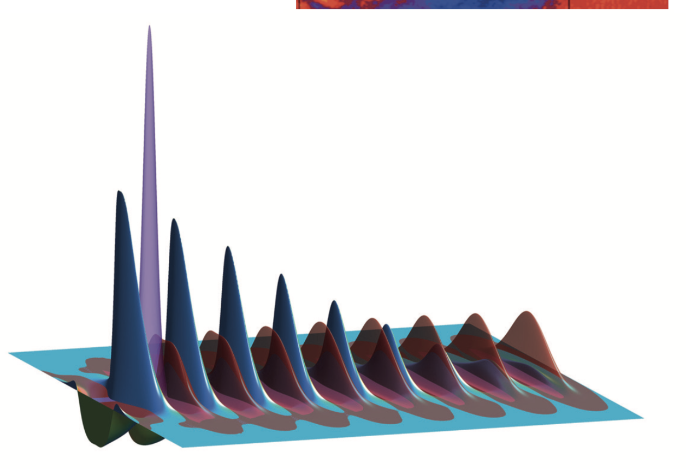
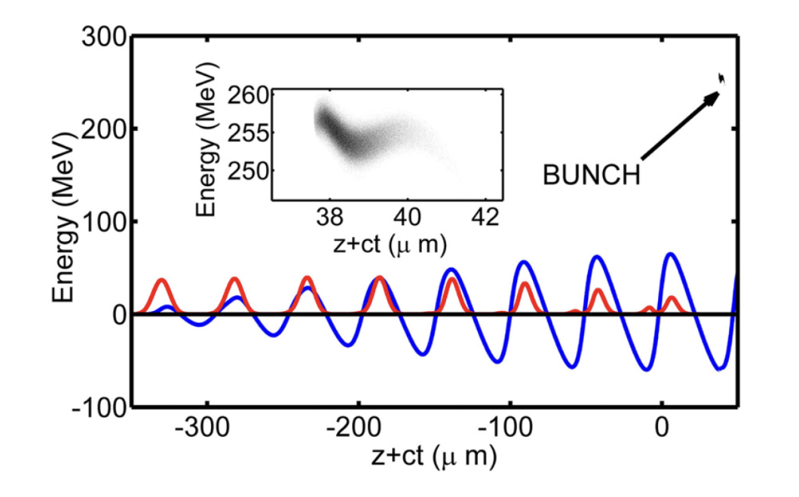
HIGH QUALITY GEV SCALE LWFA
The REsonant Multi-Pulse Ionization Injection (REMPI) scheme
Motivation: Within the EuPRAXIA project we aim at generating 4.5/5GeV bunches with FEL quality
R. Assmann et al., “EuPRAXIA Conceptual Design Report” The European Physical Journal Special Topics 229, 3675–4284 (2020); https://doi.org/10.1140/epjst/e2020-000127-8
Bunch
specifications - GOAL:
dE/E SLICE | ε_{n} SLICE | Q | I_{peak}
<0.1% | <0.1 mm mrad | >30 pC | >2kA
This is a very challenging working point for a plasma-based accelerator.
We developed a laser-driven scheme, the Resonance Multi-Pulse Ionization Injection scheme (REMPI [1])
The REMPI scheme combines the most advanced concepts conceived to date in LWFA to deliver high quality electron beam to drive an X-ray FEL.
[1] Test platform: P. Tomassini et al., “The resonant multi-pulse ionization injection,” Physics Of Plasmas 24, 103120, 2017.
Leonida A. Gizzi | EAAC 2023 | 17-22 September 2023 | Isola d’Elba, Italy

Slide 10
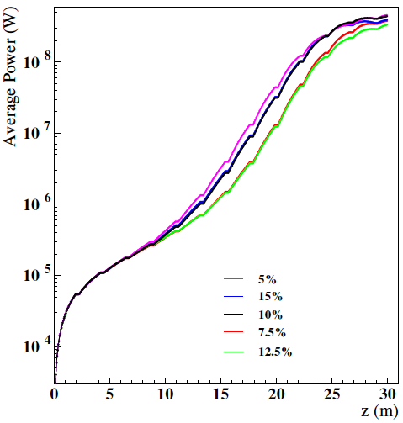
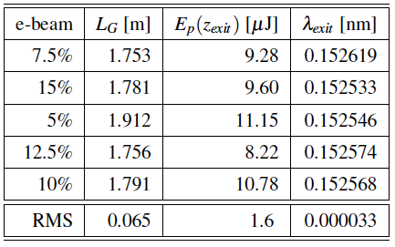
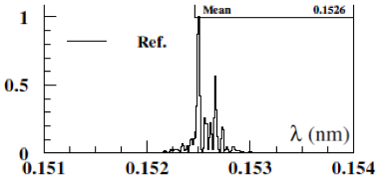
FEL MODELLING of REMPI BEAM
Laser-plasma
REMPI SCHEME
TRANSPORT
to undulator
FEL
emission
Up to 39 m planar undulator line with period λ_{u} = 14 mm, with E_{beam} ≈ 4.5 GeV, the resonant wavelength of 1.5 Å.
The Self-Amplified Stimulated Emission (SASE) vs. pulse energy, gain length and resonant wavelength
GENESIS 1.3 simulations by
Federico NGUYEN
(ENEA, Frascati)
Emission stable against plasma density variations (10%)
P. Tomassini, L. Giannessi, A. Giribono, F. Nguyen, and L. A. Gizzi, “Brilliant X-Ray Free Electron Laser Driven by Resonant Multi-Pulse Ionization Injection Accelerator”, presented at the FEL2022, Triest, Italy, Aug. 2022, paper TUP17.
Now working on the proof of principle implementation and model refining
See WG1 talk today by Paolo Tomassini (ELI-NP)
Leonida A. Gizzi | EAAC 2023 | 17-22 September 2023 | Isola d’Elba, Italy

Slide 11
TOWARDS EuPRAXIA LASER DEVELOPMENT
Three main modules: LASER1, LASER2, LASER3
LASER1: stand-alone for LPI 150 MeV
LASER2: output stage for LPI 1 GeV, second stage for LPA 5GeV
LASER3: high energy stage for LPA 5GeV
Two levels of performance : P0 and P1
LASER1
E_{out} 8.8 J (P0) / 12.5 J (P1)
To the
compressor
LASER
FRONT-END
100 HZ
J-SCALE
E_{pump}: 19.2J (P0)/ 25.7 J (P1)
LPI 1GeV
LASER1
E_{out} 8.8 J (P0) / 12.5 J (P1
LASER2
E_{out} 18.8 J (P0) / 37.5 J (P1)
To the
compressor
E_{pump}: 37.2J (P0)/ 65.2 J (P1)
LPA 5GeV
LASER1
E_{out} 8.8 J (P0) / 12.5 J (P1)
LASER2
E_{out} 18.8 J (P0) / 37.5 J (P1)
LASER3
E_{out} 62.5 J (P0) / 125 J (P1)
To the
compressor
E_{pump}: 105J (P0)/ 197 J (P1)
Leonida A. Gizzi | EAAC 2023 | 17-22 September 2023 | Isola d’Elba, Italy

Slide 12
LASER: INTERMEDIATE MILESTONE
EuPRAXIA
PW class,
100 Hz repetition rate,
multi kW average power,
diode pumped
Full thermal load transport
Eupraxia laser development is aimed at delivering more efficient, kW-PW laser driver for plasma acceleration at >100 Hz rate
EuAPS@CNR-Pisa
30 TW peak power
100 Hz repetition rate
≈100 W average power
Diode pumped
Thermal load effects
CURRENT
PW class,
Hz repetition rate,
≈10 W average power
flashlamp pumped
No thermal load transport
Leonida A. Gizzi | EAAC 2023 | 17-22 September 2023 | Isola d’Elba, Italy

Slide 13
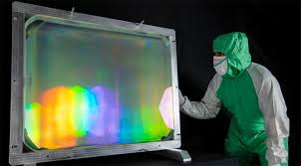
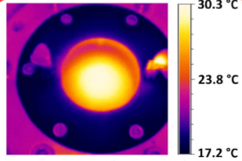
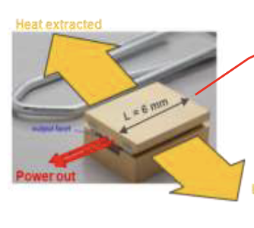
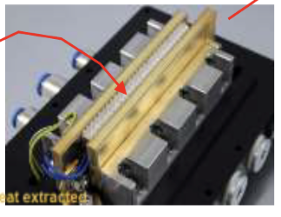
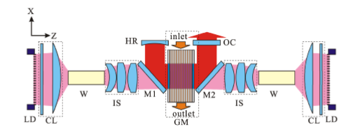
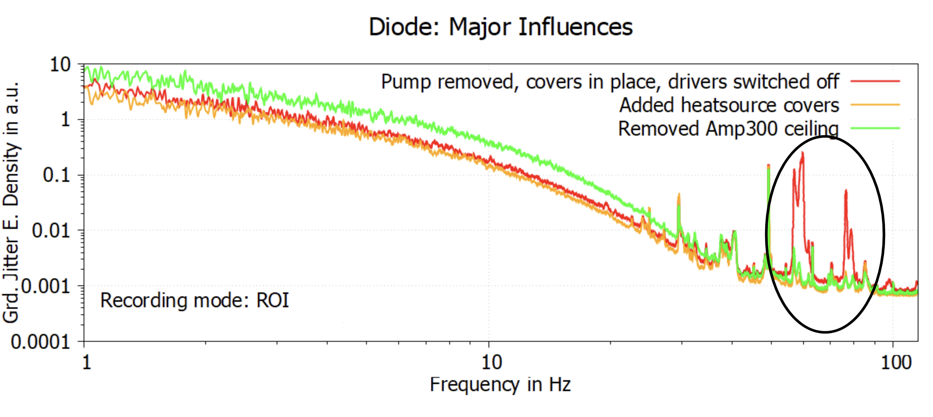
Underpinning EuPRAXIA Laser development
High repetition rate (100 Hz) will speed up R&D of pending issues for Ti:Sa laser TDR
THERMAL
MANAGEMENT OF
POWER AMPLIFIERS
AMPLIFIER GEOMETRY
TRANSMISSION
VS. REFLECTION
DPSSL PUMP
SOURCES
TECHNOLOGY
DIODE LASERS EFFICIENCY,
BRIGHTNESS AND
LIFETIME
COMPRESSOR AND TRANSPORT: THERMAL AND MECHANICAL STABILITY
Multipass transmission
Gold -> MD, MLD, MMLD
reduction of the thermal load
cooling of residual heat
control of thermal effects
DiPOLE 100 (STCF)
WATER/GAS COOLING
Multipass reflection
P-60 technology (Amplitude)
Currently no solution for full system specs (P1): development
Main challenges: large optics, mechanical stability, beam quality control, pointing stability
Prototyping needed
Prototyping needed
Needs development
Leonida A. Gizzi | EAAC 2023 | 17-22 September 2023 | Isola d’Elba, Italy

Slide 14
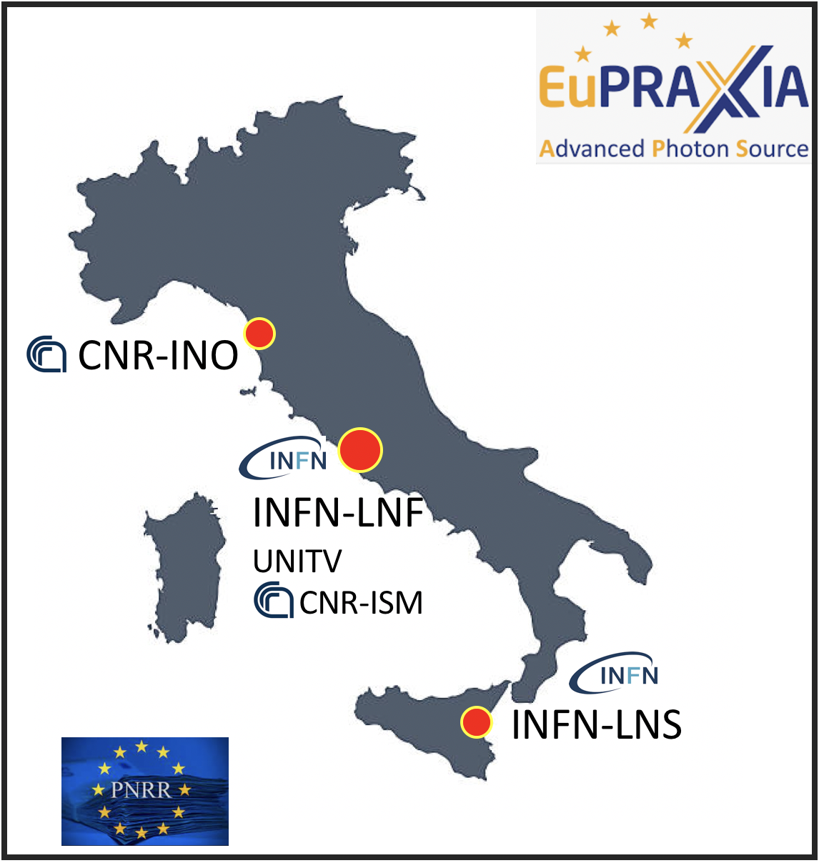
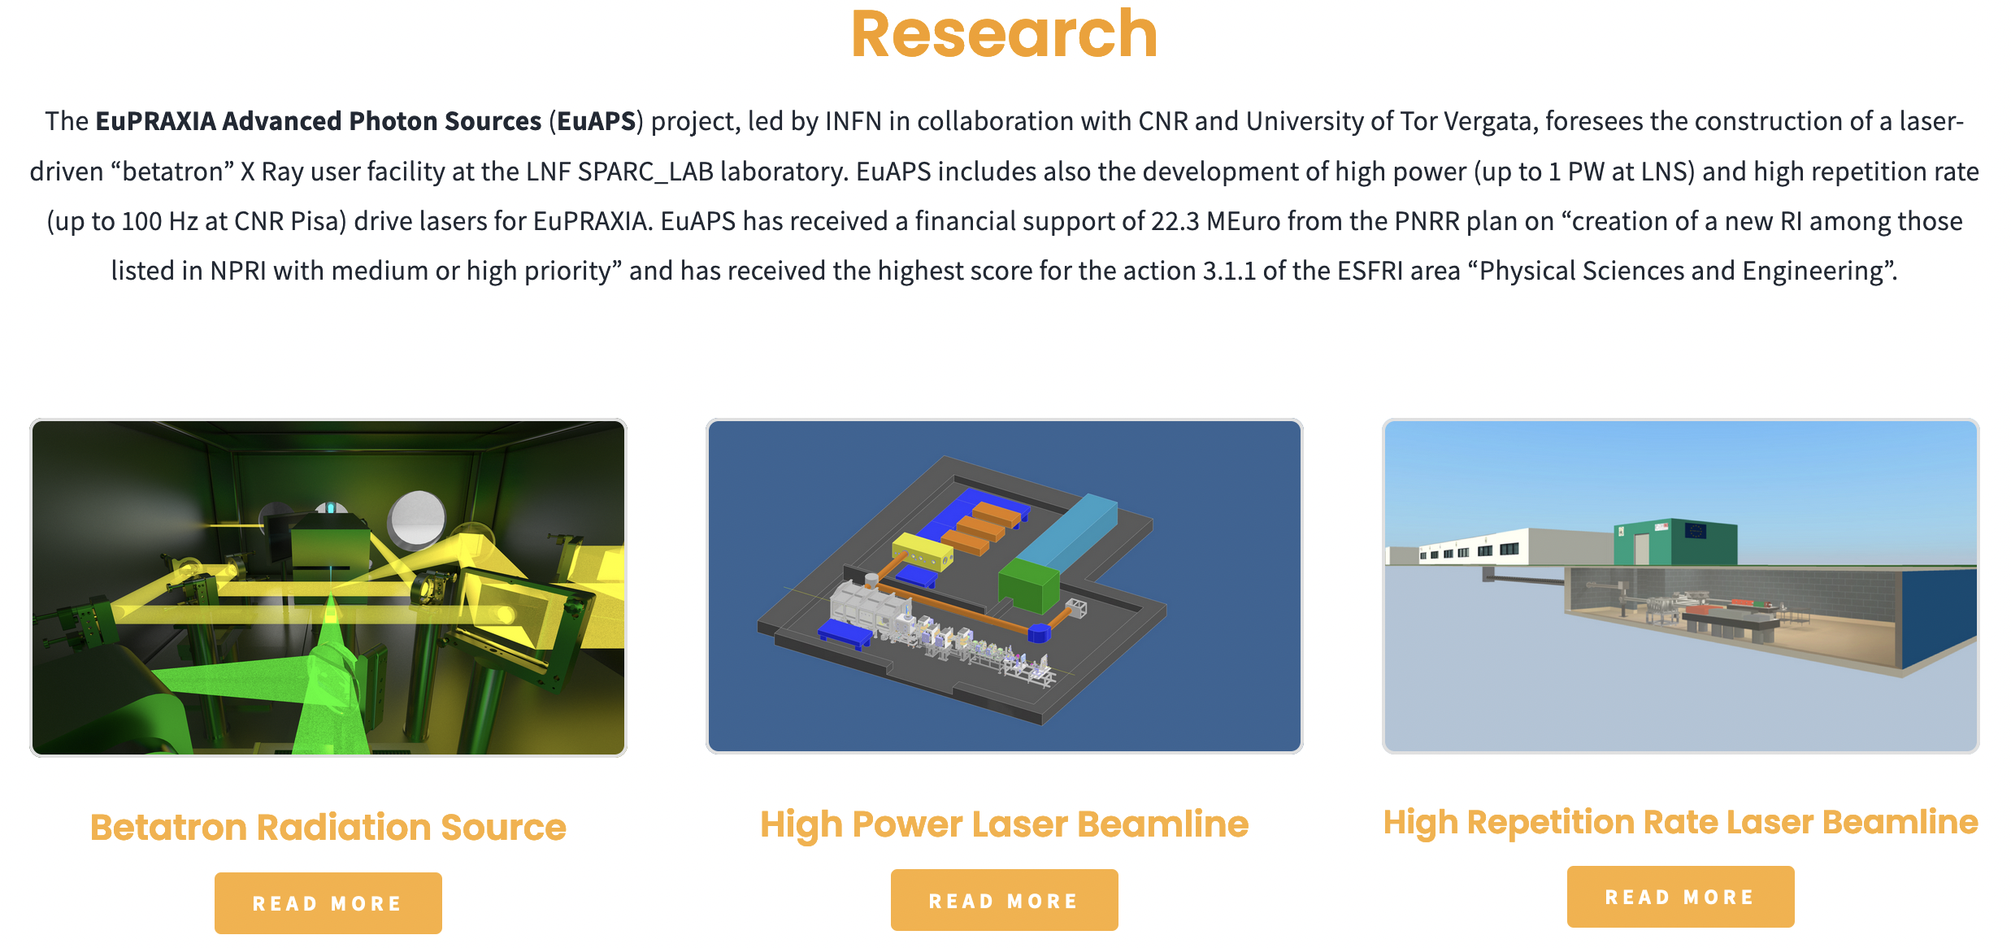
Cutting edge infrastructure: EUAPS
Strong upgrade of existing labs and implementation of user access to unique laser and laser-plasma configurations
Strengthens the integration of national effort in the field and paves the way to further initiatives
Leonida A. Gizzi | EAAC 2023 | 17-22 September 2023 | Isola d’Elba, Italy

Slide 15
Cutting edge infrastructure: IPHOQS
A new network of priority national RI with a broad view on photonics and related fields, including high field photonics
Part of :
Will provide a platform for coordinated user access to the most advanced labs and facilities
Leonida A. Gizzi | EAAC 2023 | 17-22 September 2023 | Isola d’Elba, Italy

Slide 16
ILIL LAB UPGRADES IN PROGRESS
Planned underground Bunker (100 Hz operation)
Operating 240 TW Facility
Laser Dev. Lab (kHz)
BEAMLINE for
PRE-CLINICAL
STUDIES
SHIELDED TARGET AREA for PARTICLE ACCELERATION
POWER AMPLIFIER
Up to 240 TW
USER
CONTROL ROOM
kHz 20 mJ 800nm/ 1.5 mJ OPA
LASER FRONT END
10 TW, 10 Hz
DIAGNOSTICS DEV. LAB
Offices and support
Offices and support
UPGRADE OF ILIL FACILITY FOR:
Upgrade of existing laser system (240 TW) for enhanced stability and control;
New laser systems for high repetition rate operation (100 Hz-1J, 1kHz-20 mJ);
New Infrastructure development, including underground bunker for user access to beamlines;
All upgrades funded and in progress – completion expected by mid-2026.
Leonida A. Gizzi | EAAC 2023 | 17-22 September 2023 | Isola d’Elba, Italy

Slide 17
ROADMAP for 2nd Site: Institutional Support
So far a bottom-up approach was followed, building the case on scientific and technological development;
Following the success of the PP application and the outcome of significant funding proposals, higher level support is emerging;
National (NGE-PNRR) RI are speeding up the establishment of the national cooperation;
CNR headquarters have been engaged with positive feedback;
Scientific council is being involved;
Contact established with ESFRI delegate;
Higher level (ministerial) engagement is in progress;
Engagement of the National (INFN, Universities …) partners for synergic approach;
Discussion of EuPRAXIA partners and collaborators ongoing.
Leonida A. Gizzi | EAAC 2023 | 17-22 September 2023 | Isola d’Elba, Italy

Slide 18
THE END
Thank you
Leonida A. Gizzi | EAAC 2023 | 17-22 September 2023 | Isola d’Elba, Italy

