Slide 1
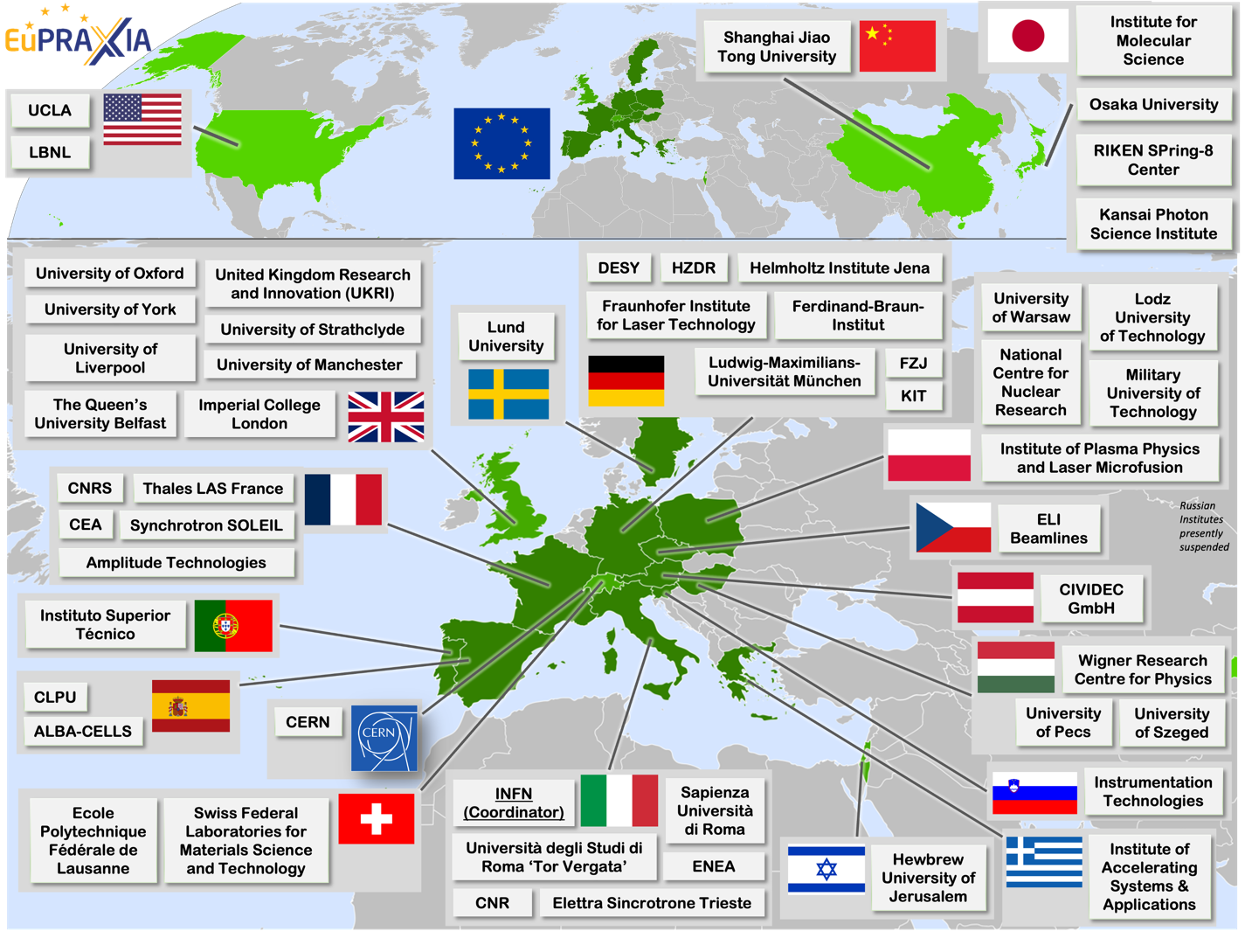
The EuPRAXIA Preparatory Phase Project
http://www.eupraxia-facility.org/
R. Assmann, GSI & INFN
EAAC 2023 Workshop
Elba, Italy, 19 Sep 2023

Slide 2
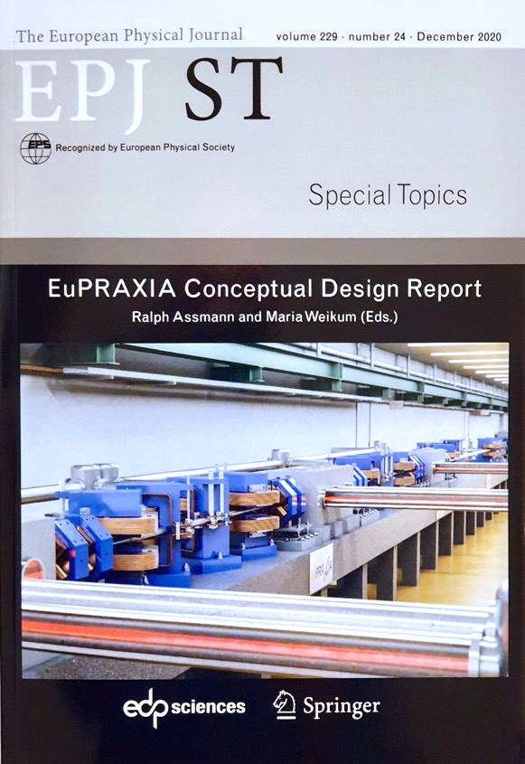
The EuPRAXIA Project
http://www.eupraxia-project.eu/
1st ever design of a plasma accelerator facility. 1st ESFRI plasma acc. project. 1st ESFRI acc. project since 2016.
Conceptual Design Report for a distributed research infrastructure funded by EU Horizon2020 program. Completed by 16+25 institutes.
Challenges addressed by EuPRAXIA since 2015:
  Can plasma accelerators produce usable electron beams?
  For what can we use those beams
Next phase consortium: > 50 institutes
Preparatory Phase project: 2022 – 2026 (ongoing)
Start of 1st operation: 2028
600+ page CDR, 240 scientists contributed

Slide 3
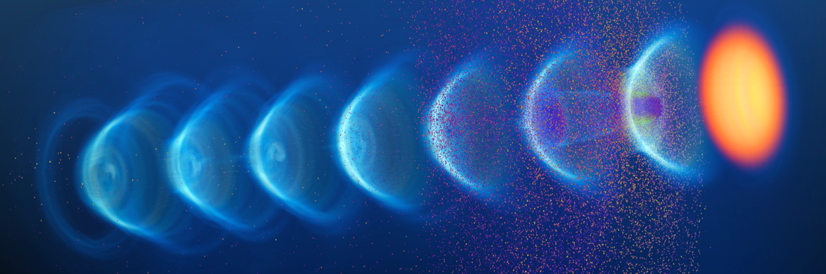
A New European High-Tech Research Facility Delivering Frontier Science
Building a facility with very high field plasma accelerators, driven by lasers or beams
1 – 100 GV/m accelerating field
Shrink down the facility size
1
Producing particle and photon pulses to support several urgent and timely science cases
Enable frontier science in new regions and parameter regimes
2

Slide 4

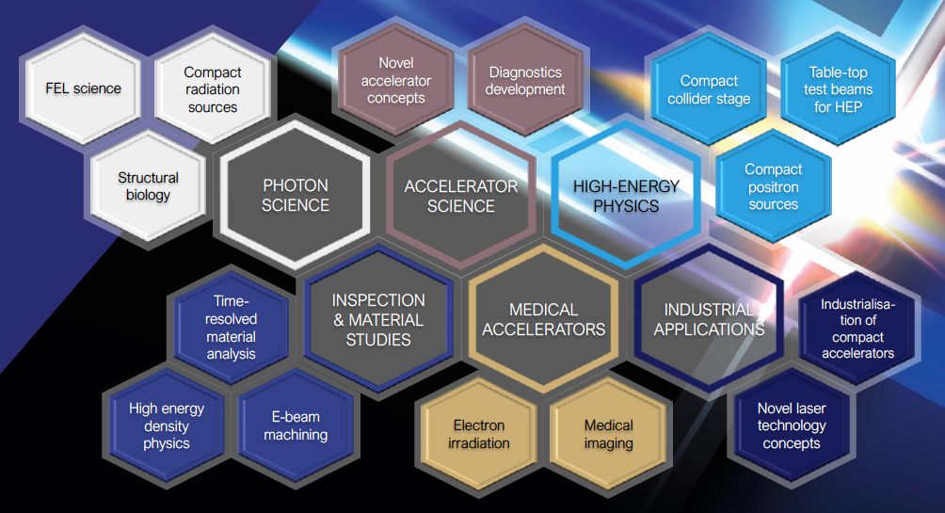

European Plasma Research Accelerator with eXcellence In Applications
Versatile – Designed for Users in Multiple Science Fields
Delivers 10-100 Hz ultra-short pulses
Electrons
(0.1-5 GeV, 30 pC)
Positrons
(0.5-10 MeV, 10⁶)
Positrons (GeV source)
Lasers
(100 J, 50 fs, 10-100 Hz)
Betatron X rays
(1-110 keV, 10¹⁰)
FEL light
(0.2-36 nm, 10⁹-10¹³)
Topics of research: proteins, viruses, bacteria, cells, metals, semiconductors, superconductors, magnetic materials, organic molecules

Slide 5

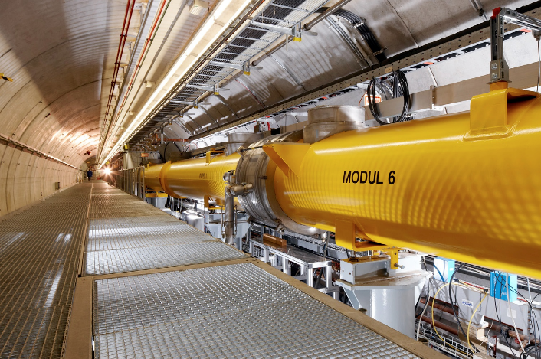
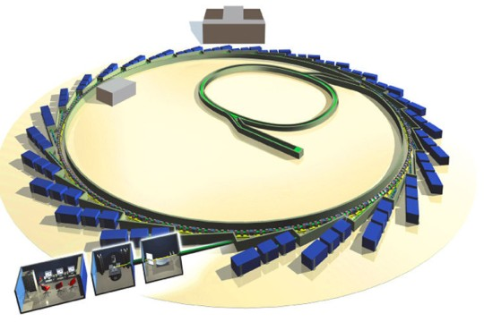







EuPRAXIA: Enabling Additional Science → FEL
Visible
light
Beautiful and highly optimized masterpieces of science.
Go here for best possible performance.
Issue: Only few FEL´s can be built due to their size and cost. Access to beam time is strongly limited.
Ultraviolet light
Soft X Rays
In addition: Compact plasma-based FEL´s
Hard X Rays
Gamma Rays
1 μm 100 nm 10 nm 1 nm 100 pm 10 pm 1 pm 100 fm 10 fm

Slide 6
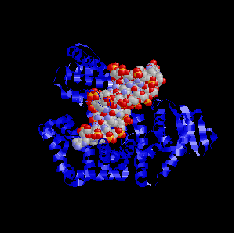
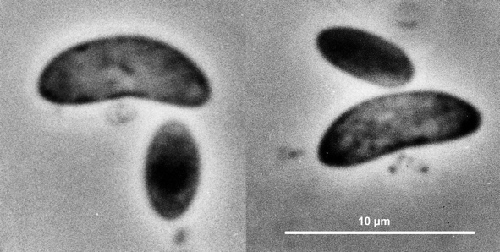

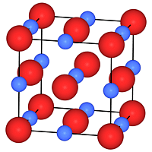
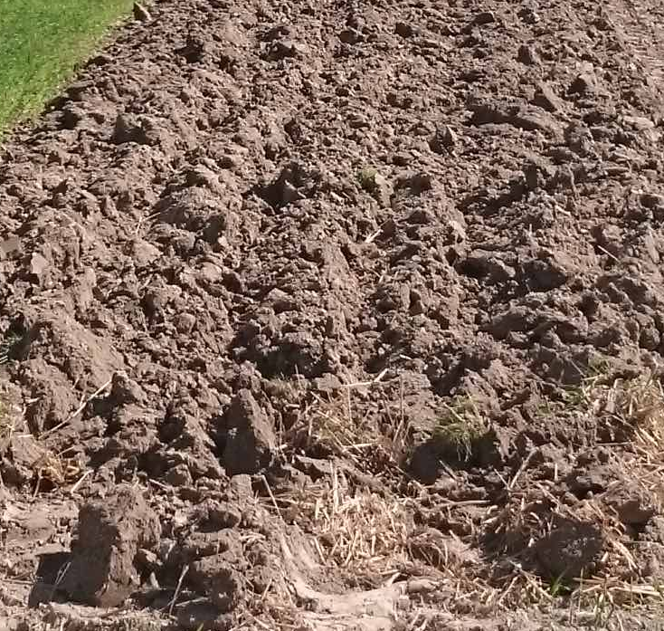
“Unlimited“ Number of Study Objects with Strong Impacts on Our Lives
Visible
light
About 320,000 unknown viruses that infect mammals
Ultraviolet light
There may be a million bacterial species in 30 grams of rich soil in Norway
Soft X Rays
Need for access and screening time – work for students at many universities
Hard X Rays
Gamma Rays
1 μm 100 nm 10 nm 1 nm 100 pm 10 pm 1 pm 100 fm 10 fm

Slide 7
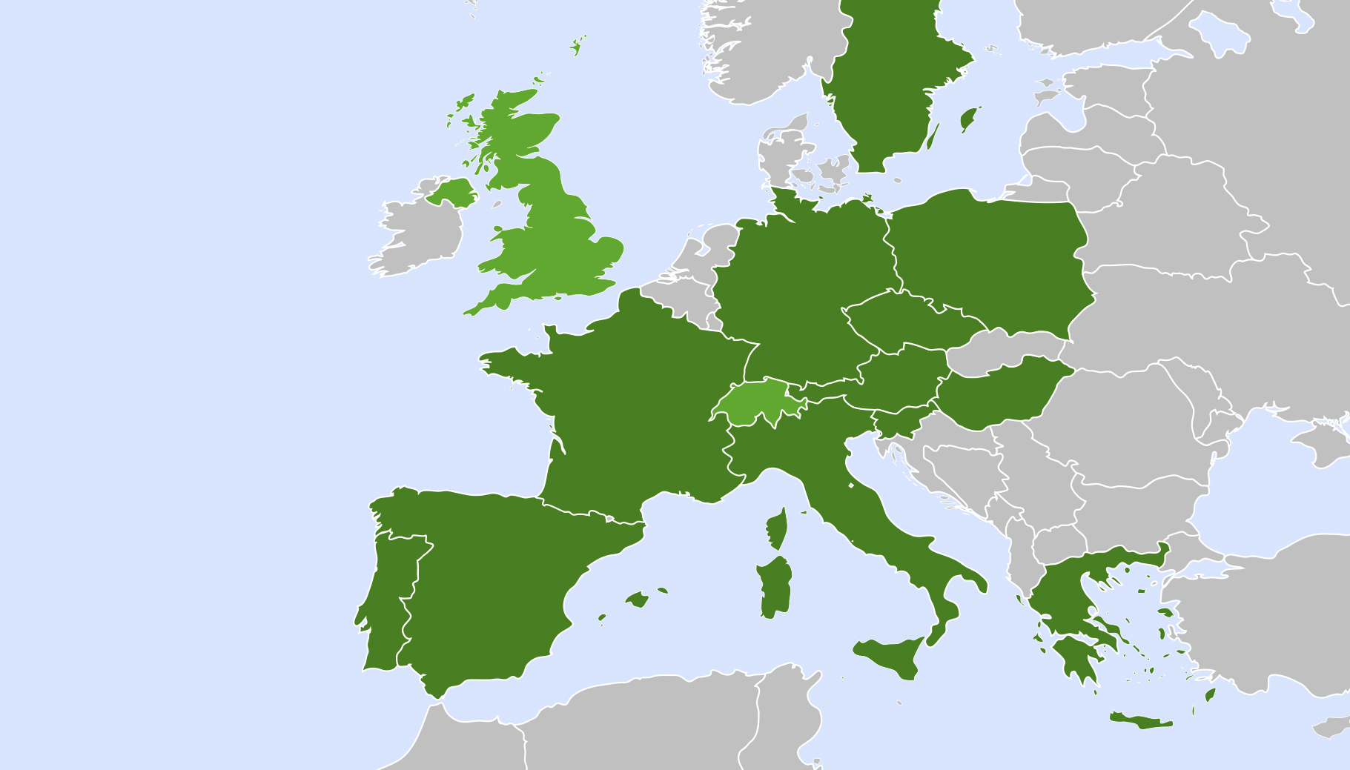


Distributed Research Infrastructure (Sep 23)
Today`s status
Excellence centers: several (6 – 10) assumed to be realized
Second site: one to be selected
Connect with WP´s to Horizon Europe and national funding lines
Beam-driven plasma user facility
EuPRAXIA Headquarter
Laser-driven plasma user facility: candidates
Excellence Center
Advanced Applications Beamlines (UK)
Plasma Acc. & High Rep. Rate Dev. (D)
2
2
3
4
Technology Incubator (CZ - ELI)
Second site will be decided in Preparatory Phase project.
Excellence centers (EC) perform technical developments, prototyping and component construction. Number of EC’s, locations, roles, responsibilities reviewed in Prep. Phase.
2
5
2
6
User Data Center (H)
Laser-Plasma Acc. & 1 GeV FEL (F)
Beam-driven plasma user facility
EuPRAXIA Headquarter
2
2
1
Theory & simulations (P)
Horizon Europe

Slide 8
Phased Implementation of Construction Sites
 | Laser-driven | Beam-driven
Phase 1 | FEL beamline to 1 GeV + user area 1 Ultracompact positron source beamline + positron user area | FEL beamline to 1 GeV + user area 1 GeV-class positrons beamline + positron user area
Phase 2 | X-ray imaging beamline + user area Table-top test beams user area FEL user area 2 FEL to 5 GeV | ICS source beamline + user area HEP detector tests user area FEL user area 2 FEL to 5 GeV
Phase 3 | High-field physics beamline / user area Other future developments | Medical imaging beamline / user area Other future developments
INFN (Italy):
Facility for beam-driven plasma accelerators
Beamline BB-A: Radiation sources
FEL user area 1
Undulator
Undulator
Plasma Accelerator
FEL user area 2
RF Injector
RF Accelerator
ICS X-ray source user area (BU3)
HEP detector test user area
laser
Plasma Accelerator
Conversion & conditioning
electrons
GeV-class positron user area
positrons
Beamline BB-B: GeV-class positrons & HEP detector test stand
Beamline LB-C: X-ray imaging – life sciences & materials
Facility for laser-driven plasma accelerators
Plasma Injector
Life-science & materials X-ray imaging user area
Beamline LB-B: Positron beam source & table-top test beam
Table-top test beam user area
Plasma Injector
Plasma Accelerator
Conversion & conditioning
Ultracompact positron source user area
Laser
FEL user area 1
Plasma Accelerator
Undulator
Undulator
RF Injector
Beamline LB-A: FEL
FEL user area 2

Slide 9
EuPRAXIA European Project: History and Today
Idea & funding proposal
2013 - 2015
Next critical decision point
Conceptual Design Study
2015 - 2019
Political selection for ESFRI
2020 - 2021
Today
Preparatory phase project
2022 - 2026
Implementation 2019 - 2032
Operation as European RI
2028 - 2065

Slide 10
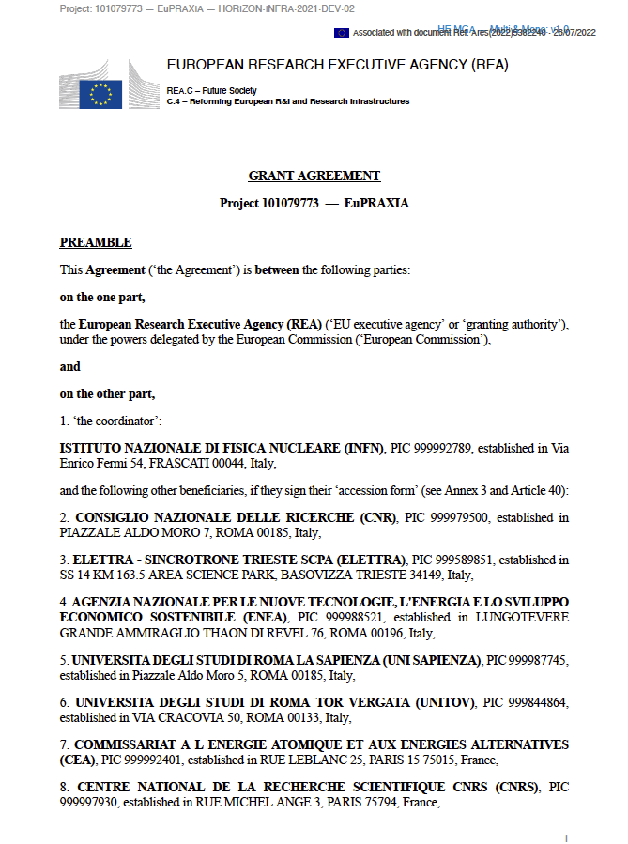

Reference Documents EuPRAXIA-PP

Slide 11
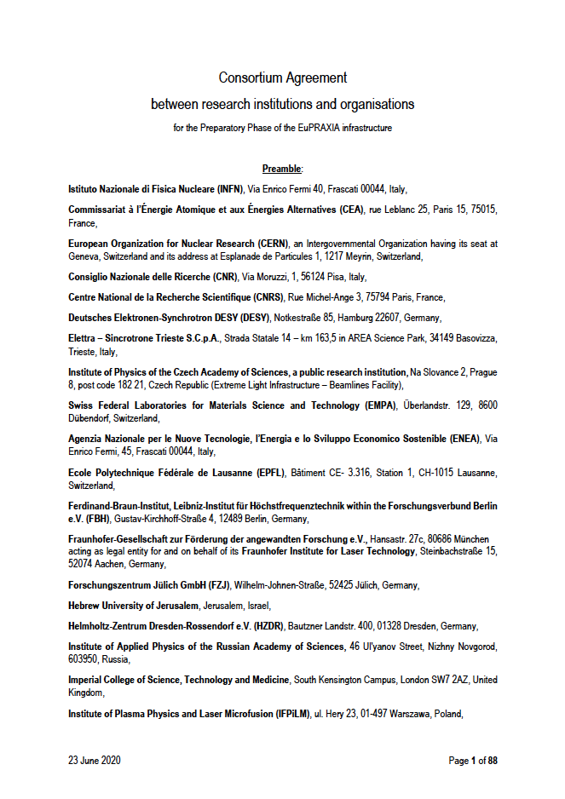
Reference Documents EuPRAXIA-ESFRI

Slide 12

The EuPRAXIA Consortia Today
54 institutes (in addition > 6 asked to join us presently)
from 18 countries plus CERN
signed on one or several presently active EuPRAXIA consortia:
  ESFRI consortium (funding in-kind)
  Preparatory Phase consortium (funding EU, UK, Switzerland, in-kind)
  Doctoral Network (funding EU, UK, in-kind)

Slide 13
EuPRAXIA European Project: History and Today
Idea & funding proposal
2013 - 2015
€ € €
EU funding
Next critical decision point
Conceptual Design Study
2015 - 2019
Science-political support: users, ESFRI, EU science ministers
Political selection for ESFRI
2020 - 2021
Today
Preparatory phase project
2022 - 2026
Funding today:
176.4 M€
Excellence, innovative
solutions
Implementation 2019 - 2032
Operation as European RI
2028 - 2065
€ € € In-kind support - national funding - regional (EU) funding

Slide 14
EuPRAXIA: Cost/Budget Status Aug 2023
Cost item | Invest (M€) | Personnel (M€) | Total cost (M€) | Obtained (M€) | Coverage (%) | Missing (§) (M€)
Site 1 (*), Frascati | 151,0 | 23,0 | 174,0 | 138,8 | 80% | 35,2
Site 2 (**), tbd | 149,0 | 29,0 | 178,0 | 0,0 | 0% | 178,0
Termination | 1,0 | 2,0 | 3,0 | 0,0 | 0% | 3,0
CDR | 0,2 | 2,8 | 3,0 | 3,0 | 100% | 0,0
Preparation, incl. excellence centers | 137,0 | 74,0 | 211,0 | 34,6 | 16% | 176,4
Total | 438,2 | 130,8 | 569,0 | 176,4 | 31% | 392,6
(*) includes estimate of 240 FTE-y of personpower from LNF-INFN
(**) cost will be reduced in case of relevant pre-invests (exisiting infrastructure, equipment)
(§) for full implementation, phased EuRAXIA approach allows user operation without full funding

Slide 15
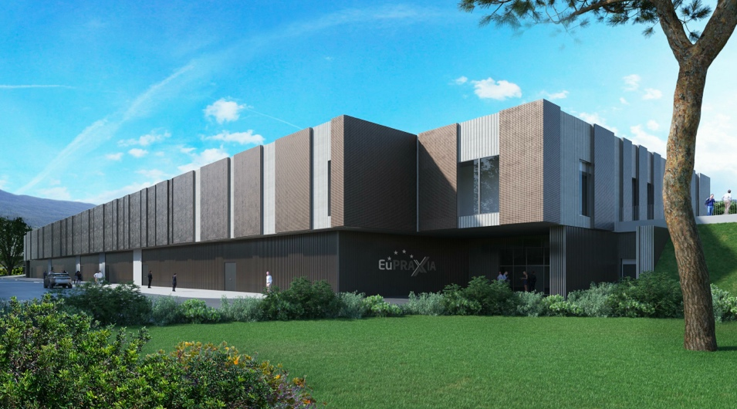
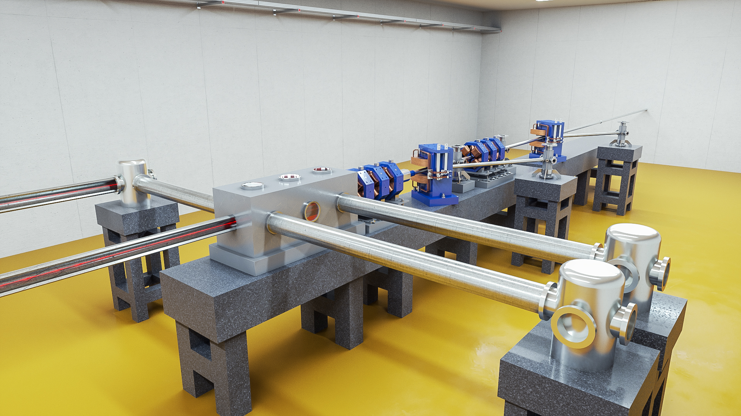
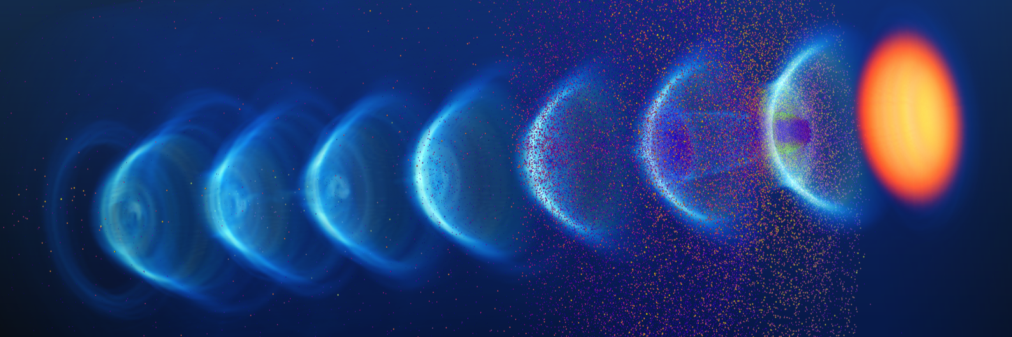
Outstanding Success in Funding so Far
It is highly unusual to have this high funding rate at this stage of the project.
We have sufficient funds to construct Phase 1 of EuPRAXIA at Site 1 = Frascati → construction process started
But of course we want to build the full things:
we can reduce the scope but we will loose some of our possible impact and we compromise leadership in the international landscape
So Preparatory Phase will work out details for the full EuPRAXIA proposal with two sites, excellence centers, laser leg, applications and clusters of institutes!

Slide 16
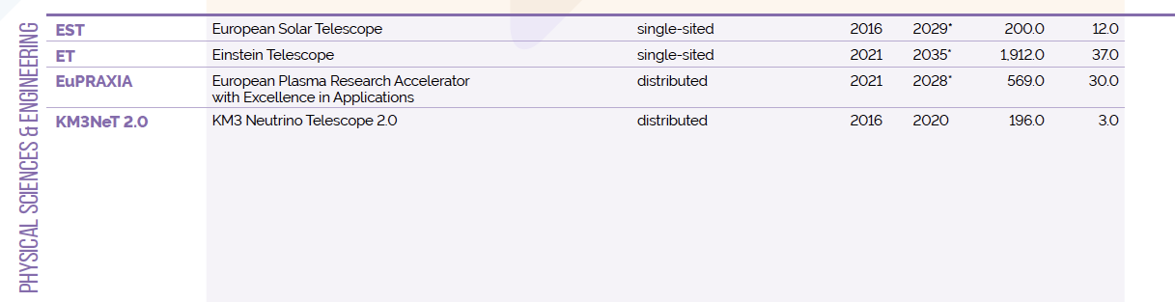

We are on ESFRI Roadmap of 2021
ESFRI = European Strategy Future Research Infrastructures
Two new entries in 2021: Einstein Telescope (ET) and EuPRAXIA
EuPRAXIA is the only accelerator facility selected in the last 6 years
EuPRAXIA is the first plasma accelerator facility ever included

Slide 17
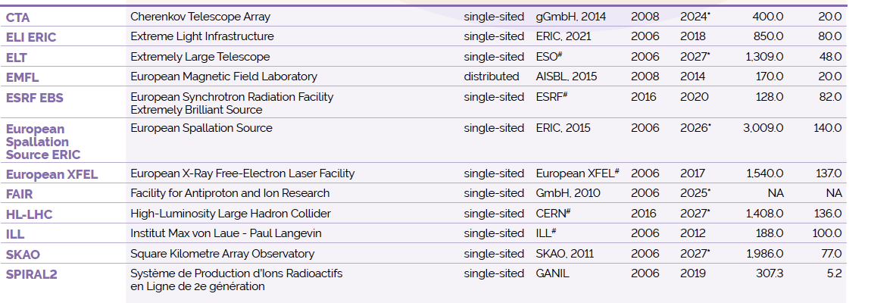
EuPRAXIA: Official Member of the Big Club
https://roadmap2021.esfri.eu

Slide 18
EuPRAXIA European Project: Next Step
Idea & funding proposal
2013 - 2015
Next critical decision point
Conceptual Design Study
2015 - 2019
Political selection for ESFRI
2020 - 2021
Today
Preparatory phase project
2022 - 2026
Implementation 2019 - 2032
Operation as European RI
2028 - 2065

Slide 19
EuPRAXIA European Project: Next Step
Idea & funding proposal
2013 - 2015
€ € €
EU funding
Next critical decision point
Conceptual Design Study
2015 - 2019
Science-political support: users, ESFRI, EU science ministers
Political selection for ESFRI
2020 - 2021
Today
Resources
Preparatory phase project
2022 - 2026
Funding: today 176.4 M€
Still required for full implementation:
200 – 390 M€
Legal model
Legal OP Structure
Implementation 2019 - 2032
Operation as European RI
2028 - 2065
Resources
Resources
€ € € In-kind support - national funding - regional (EU) funding

Slide 20
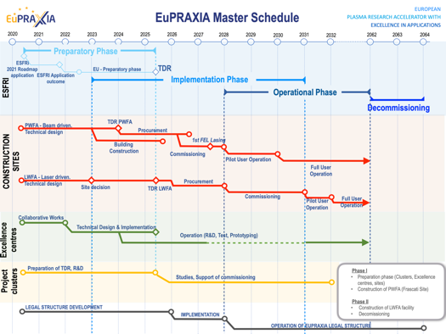
Preparatory Phase Main Goals
Managerial WP`s
  Outreach to public, users, EU decision makers and industry
  Define legal model (how is EuPRAXIA governed?), financial model, rules, user services and membership extension for full implementation
  Works with project bodies and funding agencies → Board of Financial Sponsors
Technical WP‘s (correspond to Project Clusters):
  Update of CDR concepts and parameters, towards technical design (full technical design requires more funding)
  Specify in detail Excellence Centers and their required funding: TDR related R&D, prototyping, contributions to construction
  Help in defining funding applications for various agencies
Output defined in milestones & deliverables with dates

Slide 21
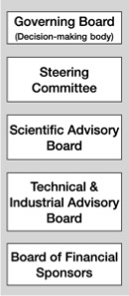
PP Steering Committee: Leaders Behind EuPRAXIA
WP1 - Coordination & Project Management
R. Assmann, INFN & DESY
M. Ferrario, INFN
WP2 - Dissemination and Public Relations
C. Welsch, U Liverpool
S. Bertellii, INFN
WP3 - Organization and Rules
A. Specka, CNRS
A. Ghigo, INFN
WP4 - Financial & Legal Model. Economic Impact
A. Falone, INFN
WP5 - User Strategy and Services
F. Stellato, U Tor Vergata
E. Principi, ELETTRA
WP6 - Membership Extension Strategy
B. Cros, CNRS
A. Mostacci, U Sapienza
WP7 - E-Needs and Data Policy
R. Fonseca, IST
S. Pioli, INFN
WP8 - Theory & Simulation
J. Vieria, IST
H. Vincenti, CEA
WP9 - RF, Magnets & Beamline
Components
S. Antipov, DESY
F. Nguyen, ENEA
WP10 - Plasma Components & Systems
K. Cassou, CNRS
J. Osterhoff, DESY
WP11 - Applications
G. Sarri, U Belfast
E. Chiadroni,U Sapienza
WP12 - Laser Technology, Liaison to Industry
L. Gizzi, CNR
P. Crump, FBH
WP13 - Diagnostics
A. Cianchi, U Tor Vergata
R. Ischebeck, EPFL
WP14 - Transformative Innovation Paths
B. Hidding, U Strathclyde
S. Karsch, LMU
WP15 - TDR EuPRAXIA @SPARC-lab
C. Vaccarezza, INFN
R. Pompili, INFN
WP16 - TDR EuPRAXIA Site 2
A. Molodozhentsev, ELI-Beamlines
R. Pattahil, STFC
WP’s on coordination & implementation as ESFRI RI (organization, legal model, financing, users)
WPs on technical implementation and sites

Slide 22
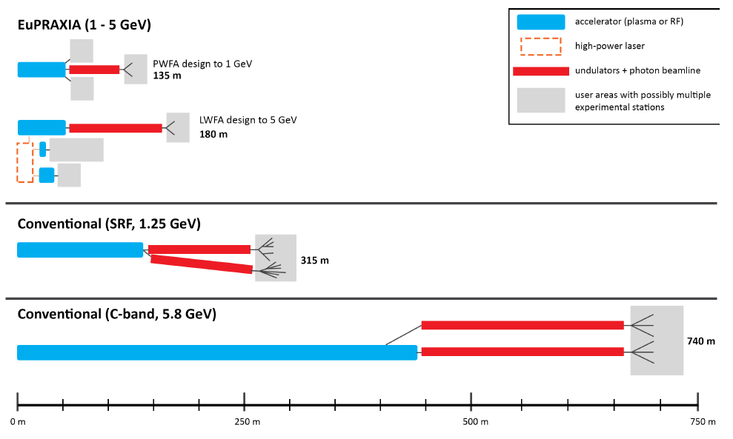
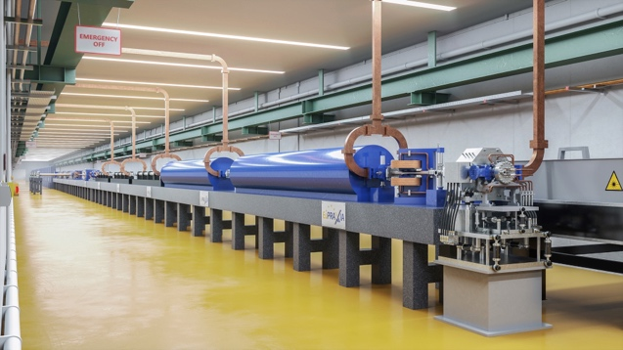
Preparatory Phase: Decide 2nd FEL Site
Distributed RI
2 FEL Construction Sites
Several Excellence Centers
EuPRAXIA at
Frascati (Site 1)
Site 1
EuPRAXIA at ELI-Beamlines or EPAC
or Pisa or Salamanca or ?
Site 2

Slide 23
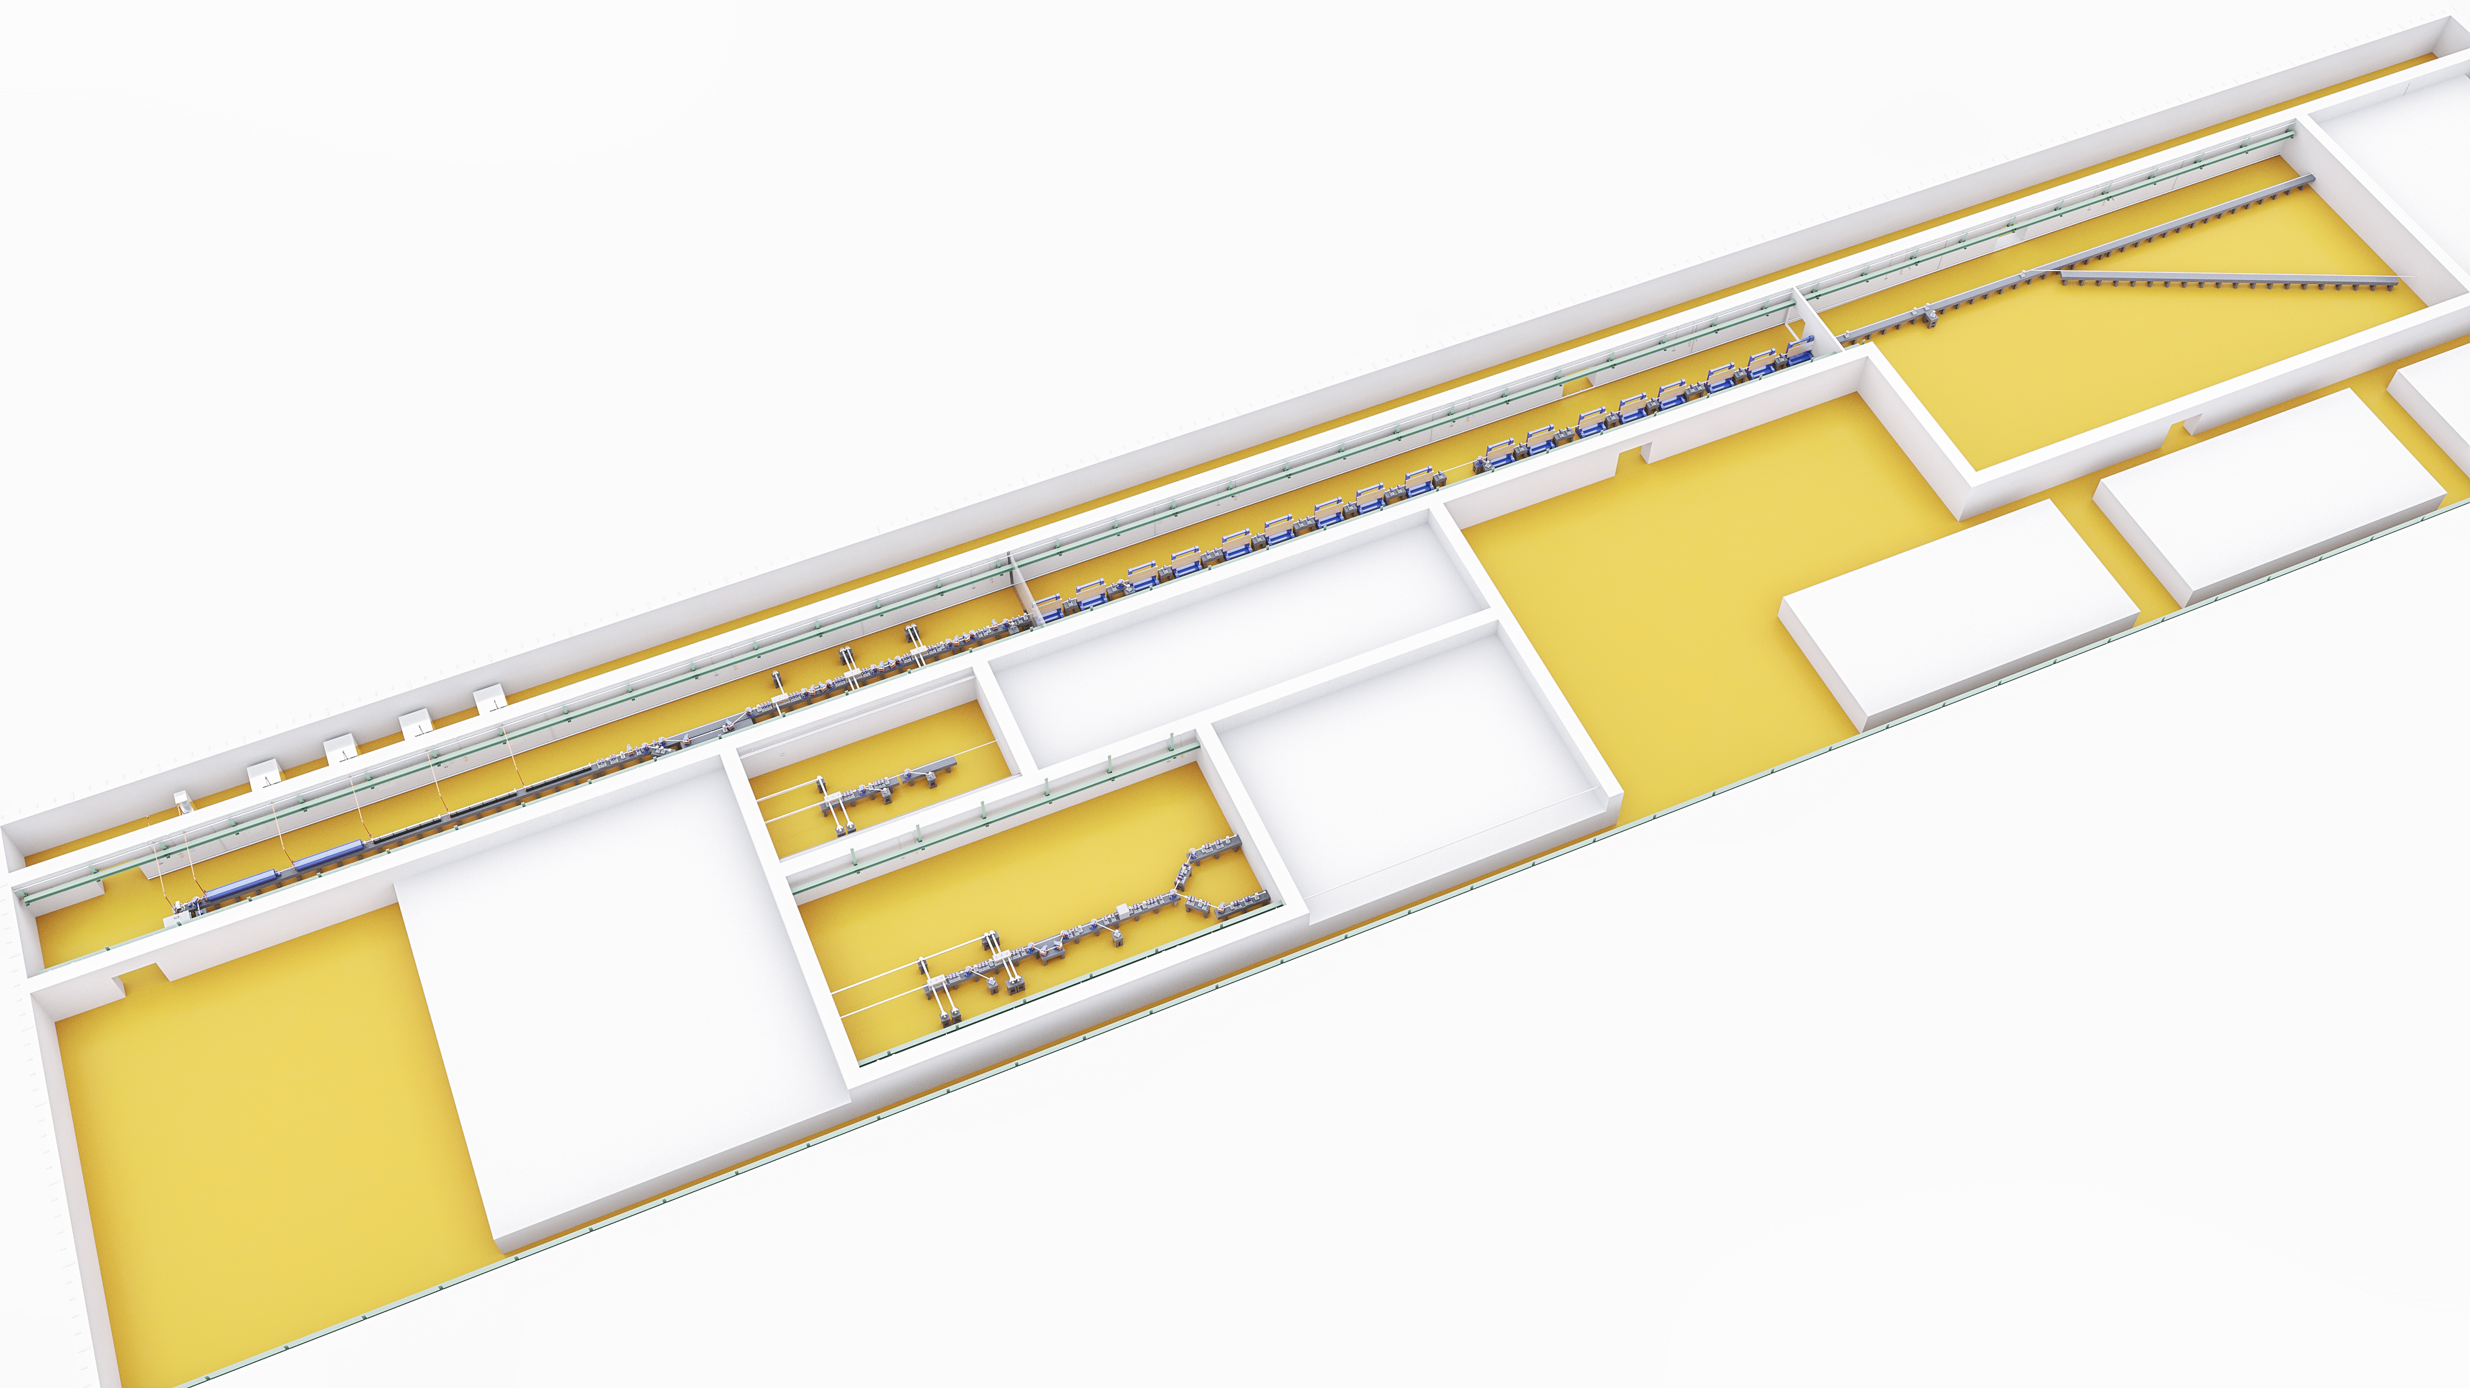
135 – 175 m
∼35 m

Slide 24
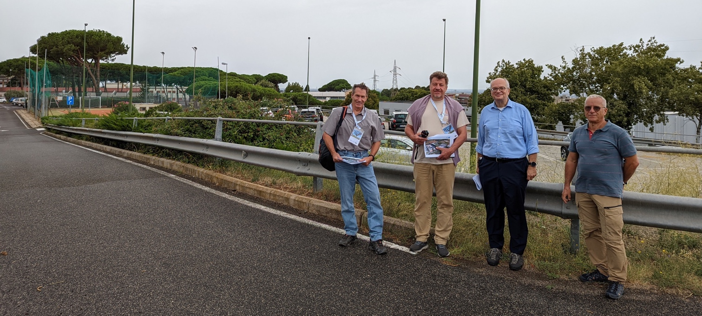
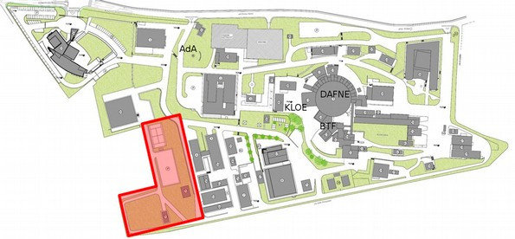
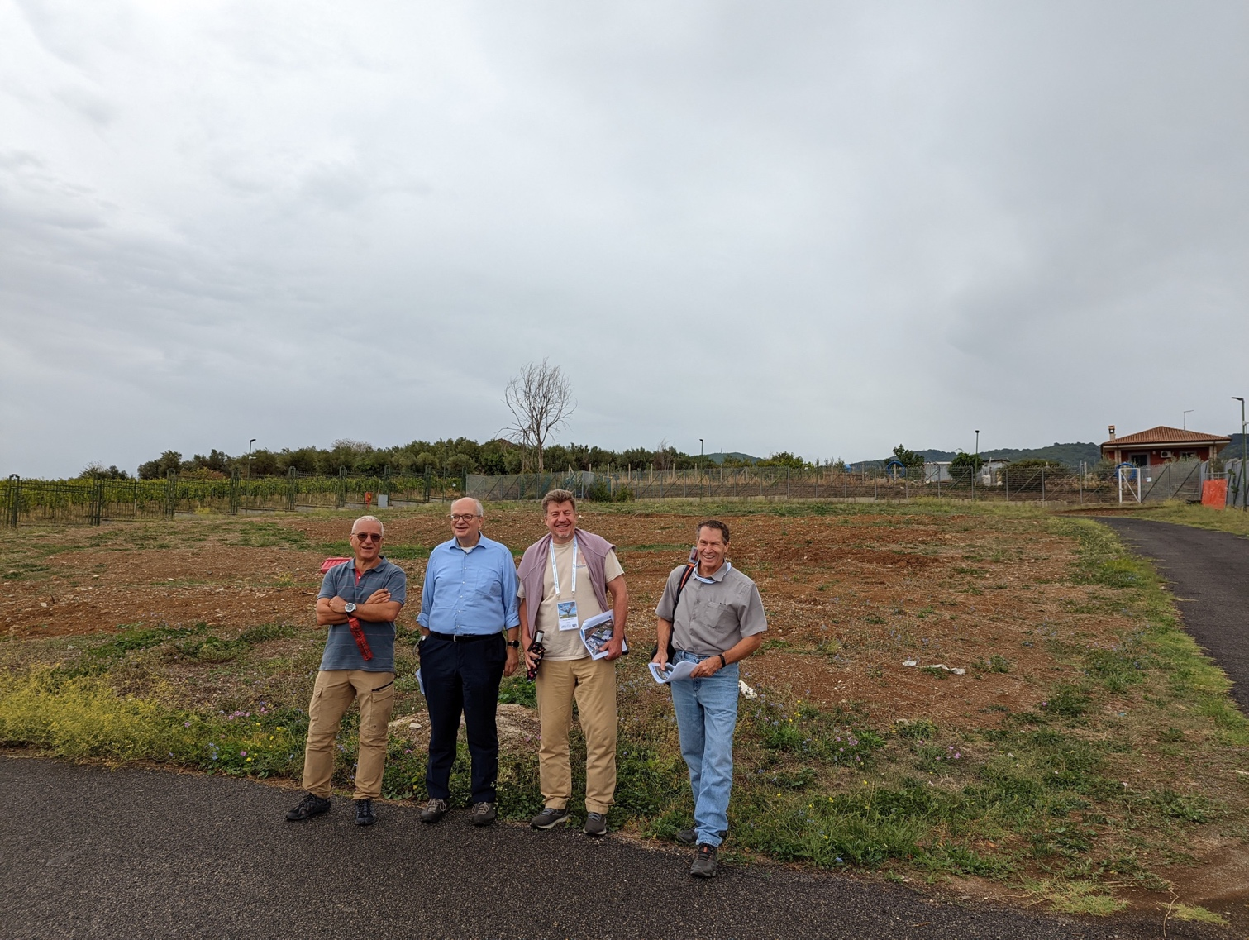
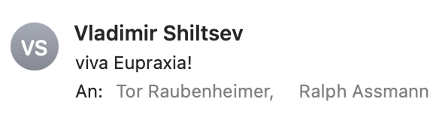

It Fits the Frascati Site
(also fits sites at a large university, hospital, company, …)
Directorate building
Canteen
INFN central administra-tion
SPARClab (seeding with plasma acc.)
Tor Raubenheimer
SLAC, Stanford University, USA
@ SPARClab
(European site 1)
Vladimir Shiltsev, Fermilab National Laboratory, USA

Slide 25
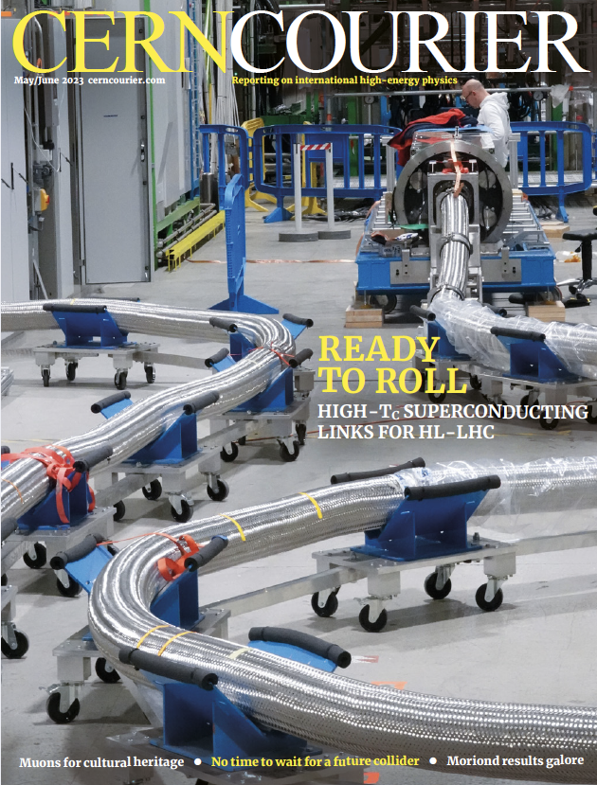
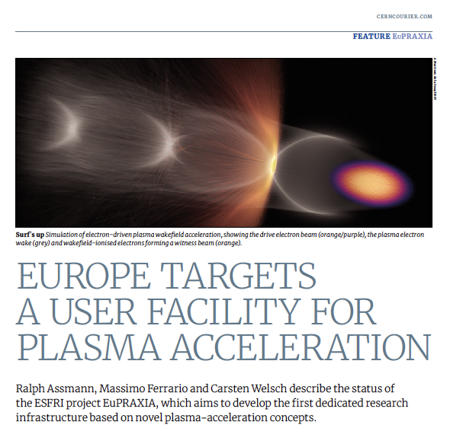
Conclusion
Plasma accelerators have advanced considerably in beam quality, achieving FEL lasing.
EuPRAXIA is a design and an ESFRI project for a distributed European Research Infrastructure, building two plasma-driven FEL´s in Europe.
EuPRAXIA FEL site in Frascati LNF-INFN is sufficiently funded for first FEL user operation in 2028.
Second EuPRAXIA FEL site will be selected in next 18 months, among 4 excellent candidate sites.
Concept today works in design and in reality. Expect (solvable) problems in stability for 24/7 user operation. Facility needed to demonstrate!
Many thanks to all my EuPRAXIA colleagues and close friends, especially Massimo Ferrario from INFN.

Slide 26
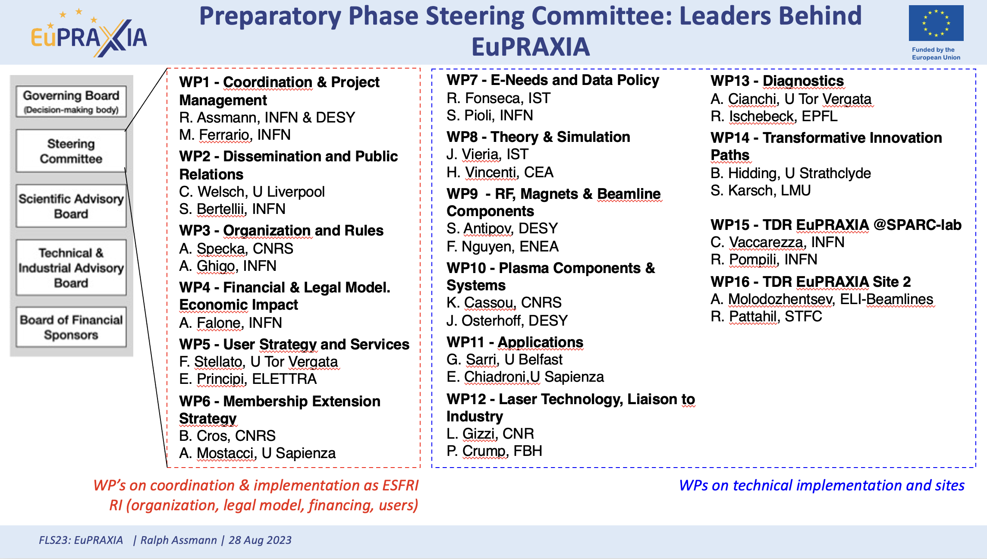
Thank You

