Slide 1
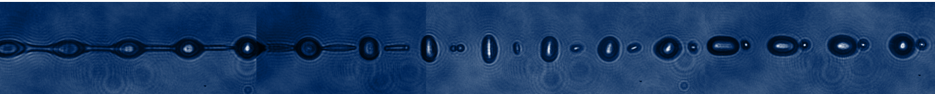
Characterization of Liquid Micro-Droplets for Laser-Driven Proton Acceleration
Mathis Nolte

Slide 2
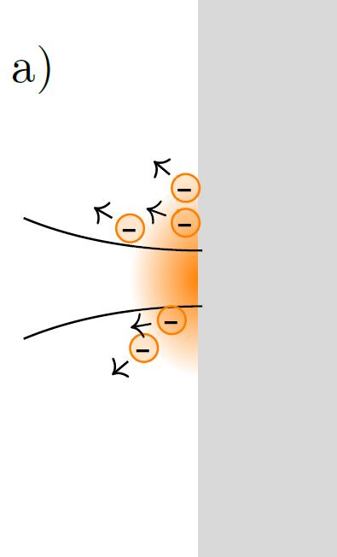
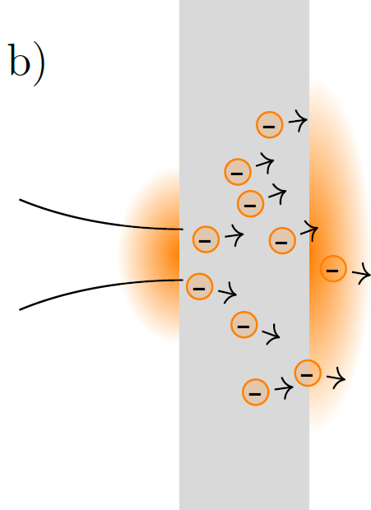
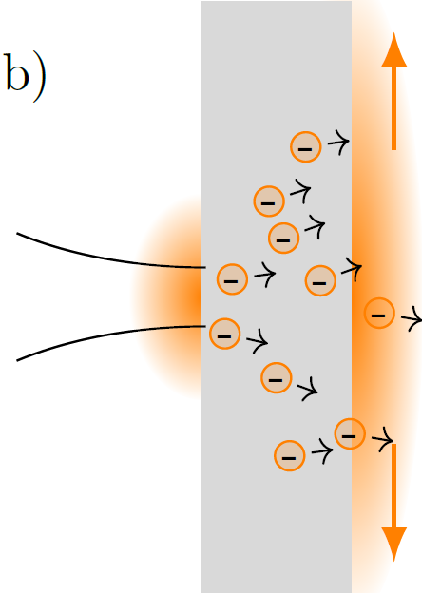
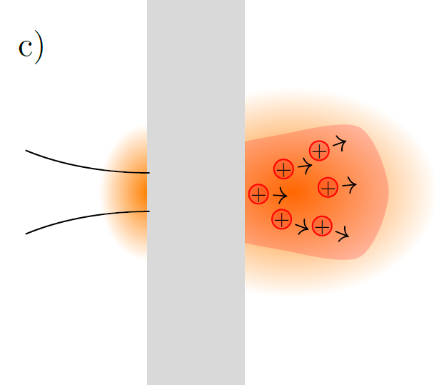
Motivation: Target Normal Sheath Acceleration (TNSA)
Working principle of the TNSA process with foil targets
Electrons can leave the interaction zone along the foil rear side
Notes:
100 TV/m

Slide 3
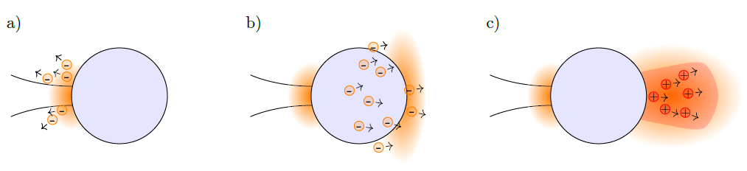
Motivation: Target Normal Sheath Acceleration (TNSA)
Working principle of the TNSA process with micro droplets targets
Limited spatial extension
Cheap
High repetition rate

Slide 4
Outline
Fundamentals of Jet Breakup
Experimental Creation of Liquid Micro-Droplets from Liquid Jets
Proton Acceleration Experiment at the POLARIS Laser System

Slide 5
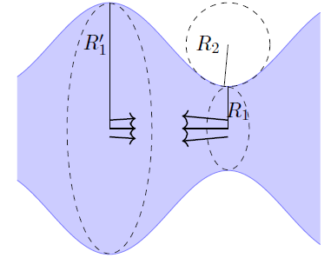
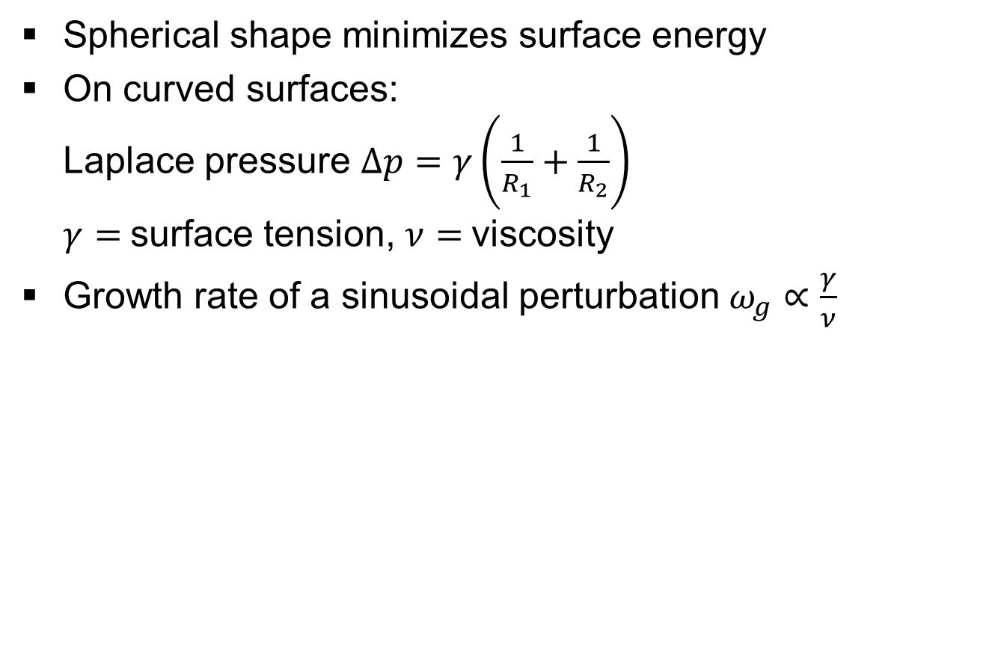
Droplet Breakup from Liquid Jets – Laplace Pressure
Spherical shape minimizes surface energy
On curved surfaces:
Laplace pressure $Δp=γ\left.\left(\frac{1}{R_{1}}+\frac{1}{R_{2}}\right.\right)$
$γ=$surface tension, $ν=$viscosity
Growth rate of a sinusoidal perturbation $ω_{g}∝\frac{γ}{ν}$

Slide 6
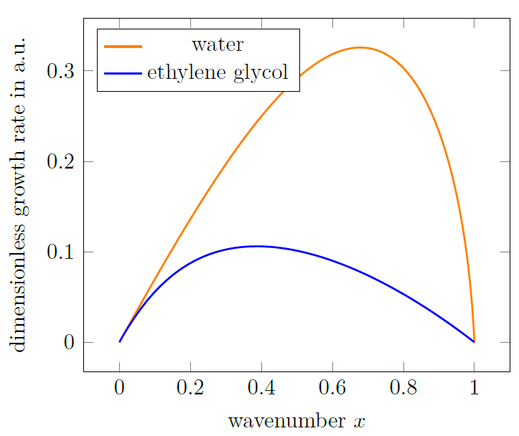
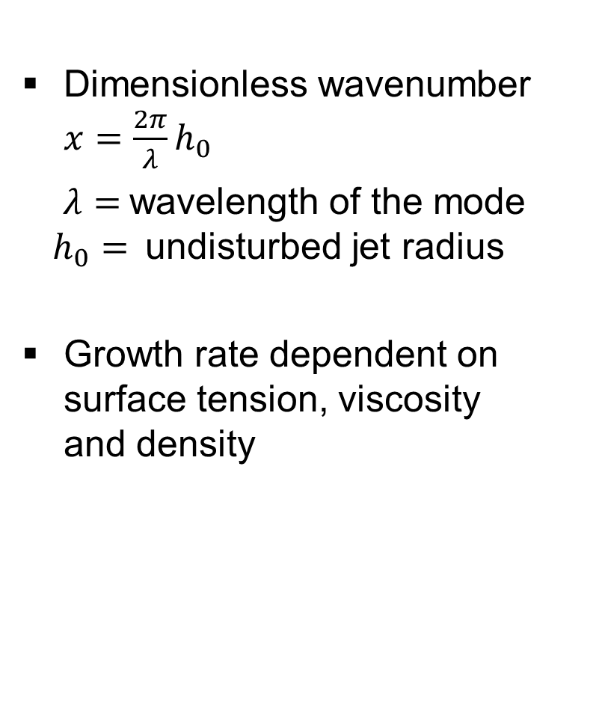
Growth of sinusoidal modes in liquid jets
Dimensionless wavenumber $x=\frac{2π}{λ}h_{0}$
$λ=$wavelength of the mode
$h_{0}=$undisturbed jet radius
Growth rate dependent on surface tension, viscosity
and density

Slide 7
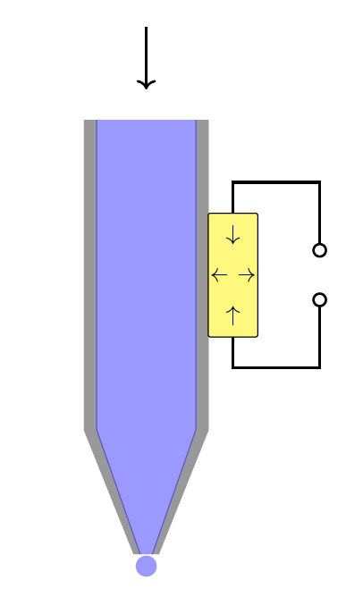
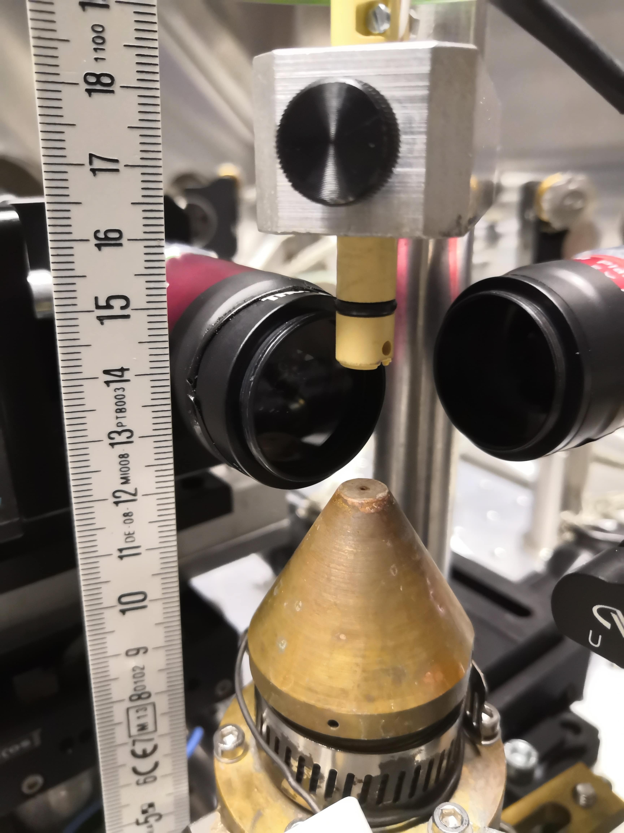
Nozzle and droplet catcher setup
< 30 bar
Nozzle
High-frequency Generator
Piezo-crystal
Droplet catcher
Imprint perturbations with a piezo crystal

Slide 8
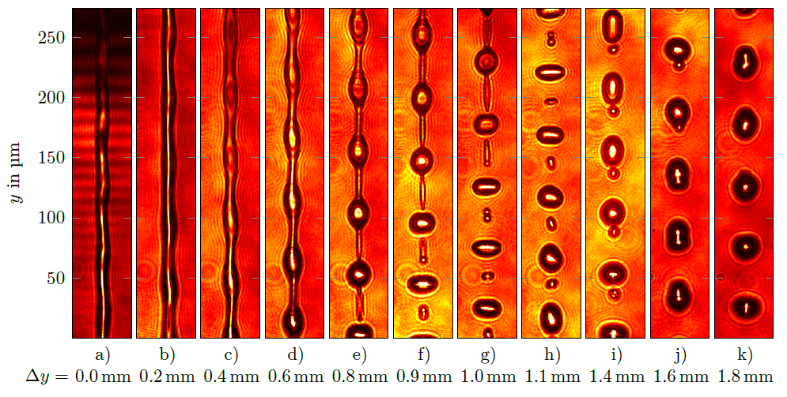
Droplet breakup
$Δy$ is the distance to the nozzle in the moving direction of the liquid jet

Slide 9
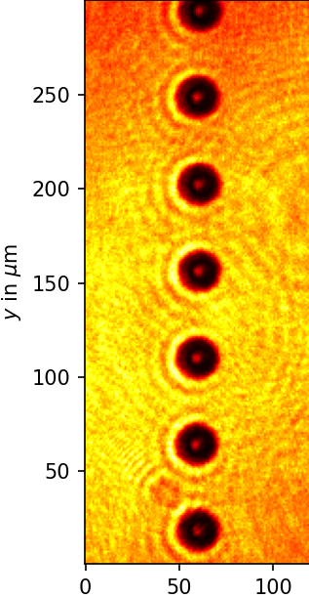
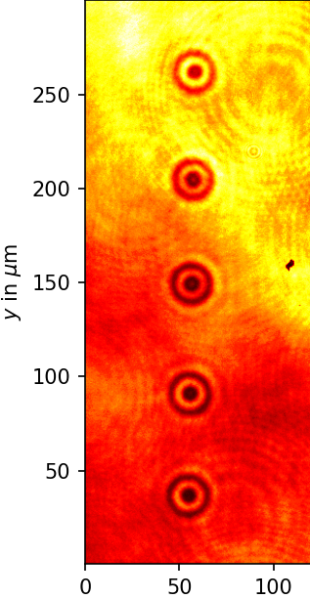
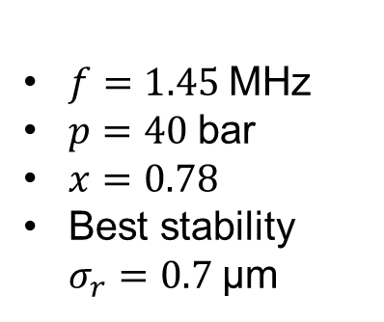
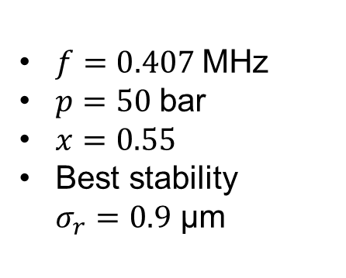
Stability Measurement
Water
Ethylene Glycol
$f=1.45$MHz
$p=40$bar
$x=0.78$
Best stability
$σ_{r}=0.7$μm
$f=0.407$MHz
$p=50$bar
$x=0.55$
Best stability
$σ_{r}=0.9$ μm

Slide 10
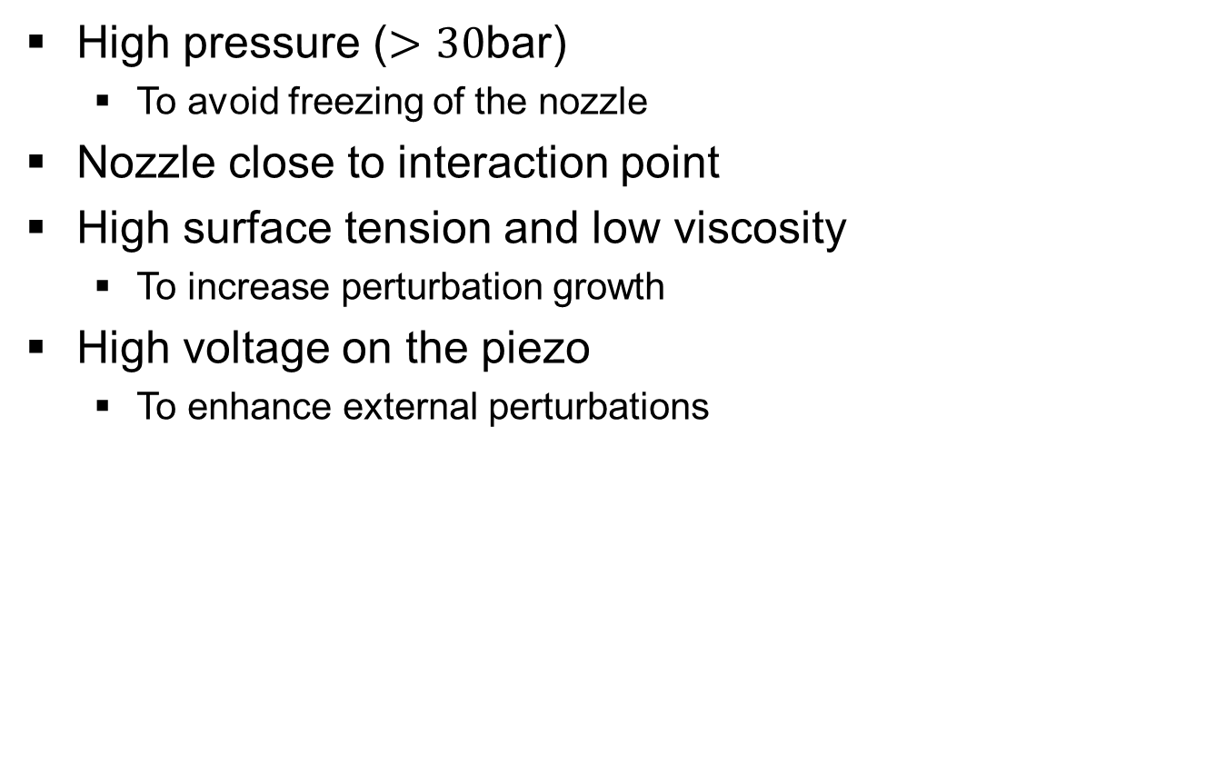
Parameters for high Stability
High pressure ($>30$bar)
  To avoid freezing of the nozzle
Nozzle close to interaction point
High surface tension and low viscosity
  To increase perturbation growth
High voltage on the piezo
  To enhance external perturbations

Slide 11
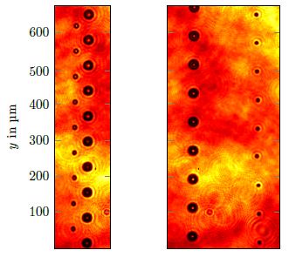
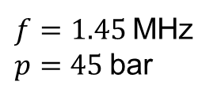
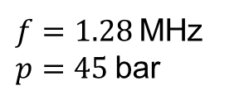
Satellite Droplets from a Water Jet
$f=1.45$MHz
$p=45$bar
$f=1.28$MHz
$p=45$bar

Slide 12
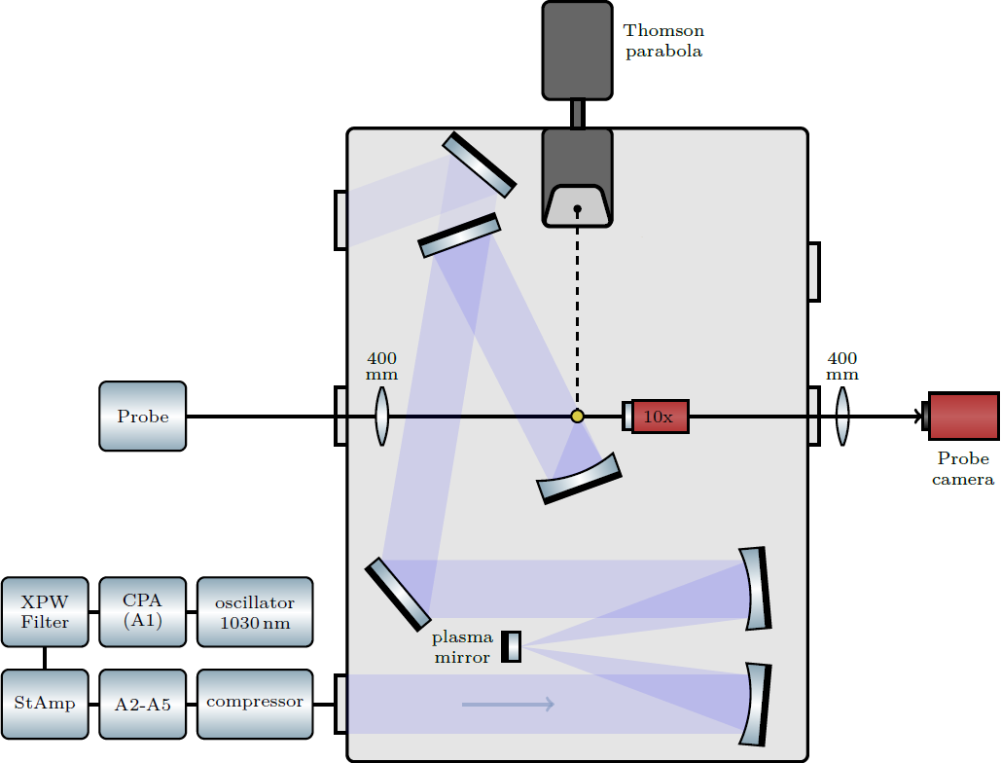
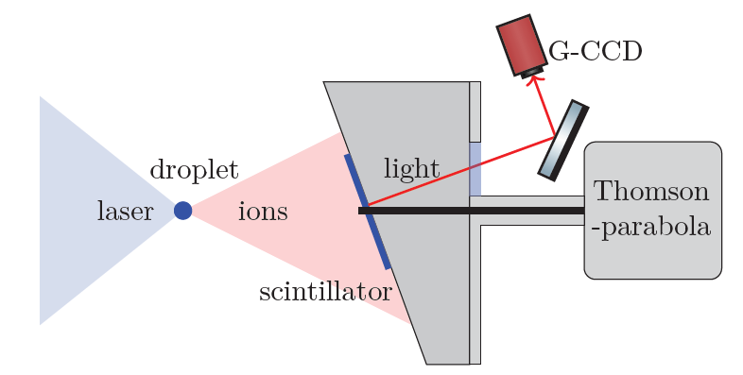
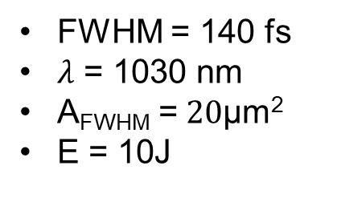
Setup - POLARIS
Scintillator
FWHM = 140 fs
$λ$ = 1030 nm
A_{FWHM} =$20\text{μ}$m²
E = 10J
Notes:
1030nm; 15cm beam diameter; <10J in exp
Focus parabola: 30cm
19 micro squared; q = 0.15;
140fs
Peak intensity 4e19 W/cm^2 (a = 5)

Slide 13
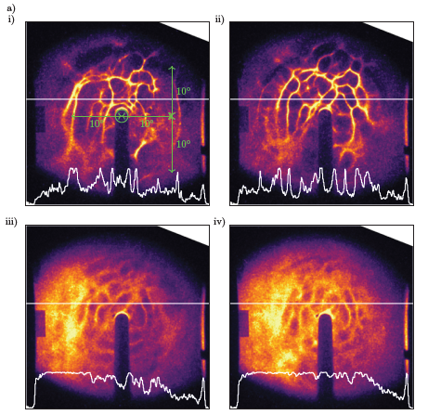
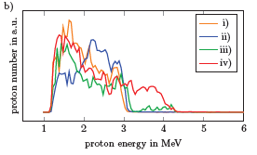
Proton Beam Profile
Proton beam profile. In i) and ii) water droplets were used. In iii) and iv) ethylene glycol droplets were used.

Slide 14
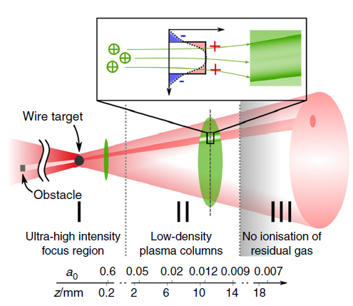

Modulations due to Ionized Background Gas
Laser light ionizes background gas behind the target and separate charges
Resulting fields deflect the ion beam
$p_{vap, water}=23$mbar, $p_{vap, ethylene glycol}=0.08$mbar
L. Obst-Huebl et al., “All-optical structuring of laser-driven proton beam profiles,”
Nature communications, vol. 9, no. 1, pp. 1–7, 2018.
Notes:
Fields remain tens of picoseconds

Slide 15
Summary
Creation of micro-droplets from liquid jets by imprinting perturbations
Stable in space and time by synchronization with the laser pulse
Tuning liquid pressure and driving frequency for stability
Proton acceleration from liquid droplets produces beam density modulations
Likely reason is charge separation in background gas

Slide 16
Thank you for your Attention!

Slide 17
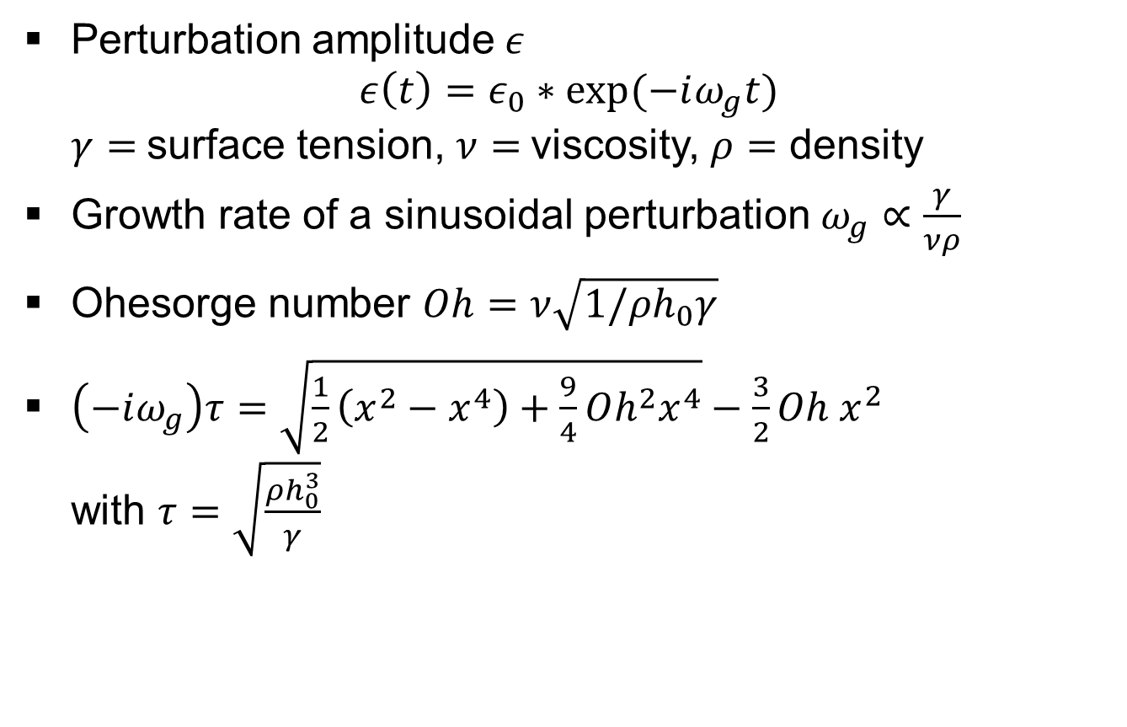
Droplet Breakup from Liquid Jets – Laplace Pressure
Perturbation amplitude$ε$
$ε\left(t\right)=ε_{0}∗exp⁡(−iω_{g}t)$
$γ=$surface tension, $ν=$viscosity, $ρ=$ density
Growth rate of a sinusoidal perturbation $ω_{g}∝\frac{γ}{νρ}$
Ohesorge number $Oh=ν\sqrt{1/ρh_{0}γ}$
$\left(−iω_{g}\right)τ=\sqrt{\frac{1}{2}\left(x^{2}−x^{4}\right)+\frac{9}{4}Oh^{2}x^{4}}−\frac{3}{2}Oh x^{2}$
with $τ=\sqrt{\frac{ρh_{0}^{3}}{γ}}$

Slide 18
Corresponding proton spectra to the gccd images

Slide 19
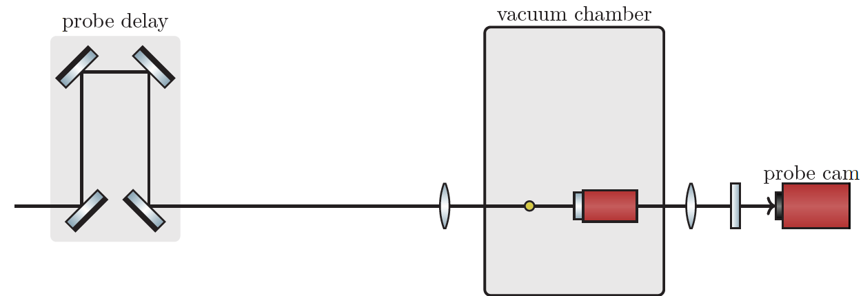

Probe Setup
Notes:
2inch focal length
probe focus: 200mm; probe image 250mm
focus image: 400mm
90:10 beam splitter;

Slide 20
Part II
Plasma Expansion from Liquid Micro Droplets

Slide 21
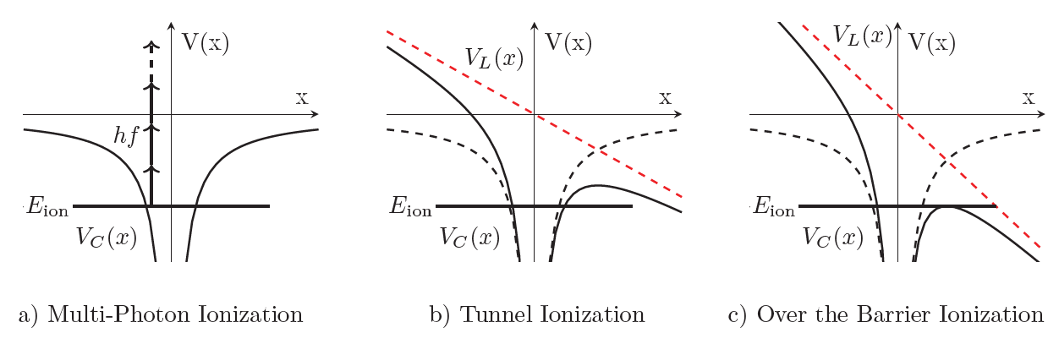

Ionization Mechanisms
Photoelectric effect: $E_{photon}=ℏω≥E_{ion}$
Oxygen: $E_{ion}=12.1$eV
$λ=1030nm$: $E_{photon}=1.2$eV
For higher intensities:

Slide 22
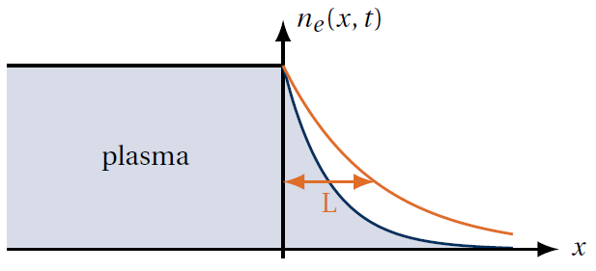

Plasma Expansion
$n_{e}\left(x,t\right)=n_{e0}$exp$\left(−\frac{x}{L}\right)$
$L=c_{s}t$
$c_{s}= {\left(\frac{{Zk}_{B}T_{e}}{m_{i}}\right)}^{\frac{1}{2}}$

Slide 23

Plasma Properties
Plasma frequency: $ω_{p}=\sqrt{\frac{n_{e}e^{2}}{ε_{0}m_{e}}}$
Critical density: $n_{crit}=\frac{ε_{0}m_{e}ω_{L}^{2}}{e^{2}}$
Refractive index: $η=\sqrt{1−\frac{ω_{p}^{2}}{ω_{L}^{2}}}$

Slide 24
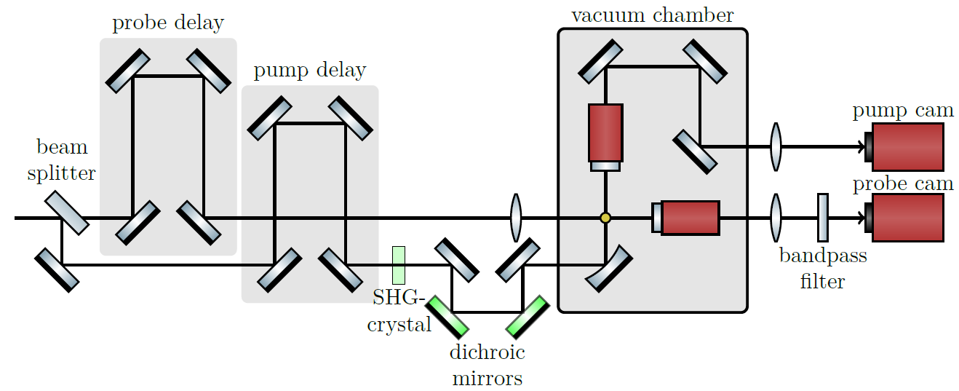

Pump-Probe Setup
Notes:
130fs
2.1 micro squared
1030nm
1.7mm strahlradius 1/e

Slide 25
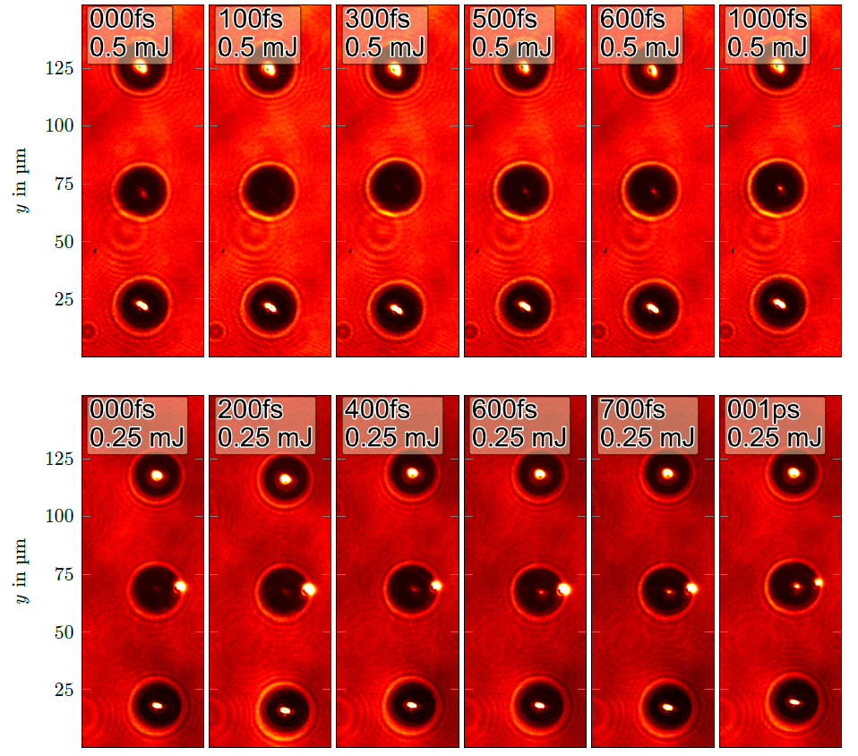
Ionization of Water Droplets

Slide 26
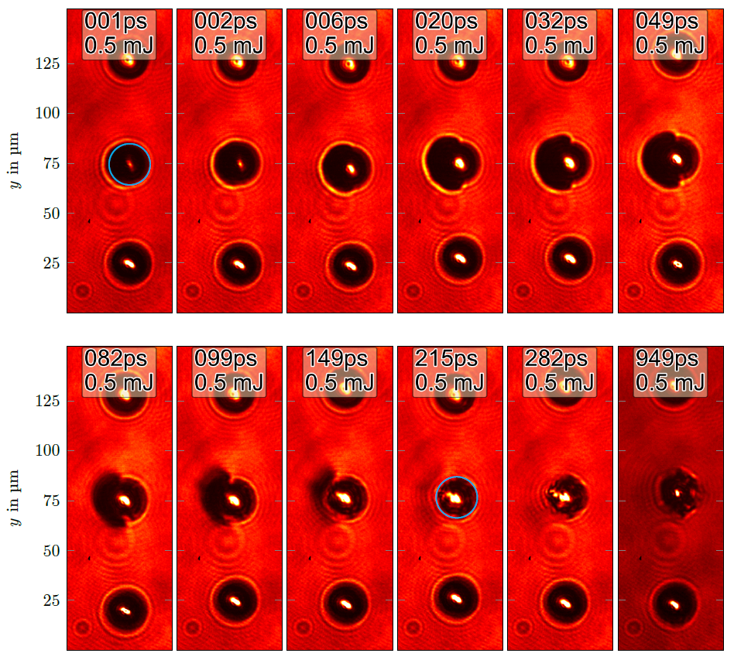
Plasma from Water Micro Droplets

Slide 27
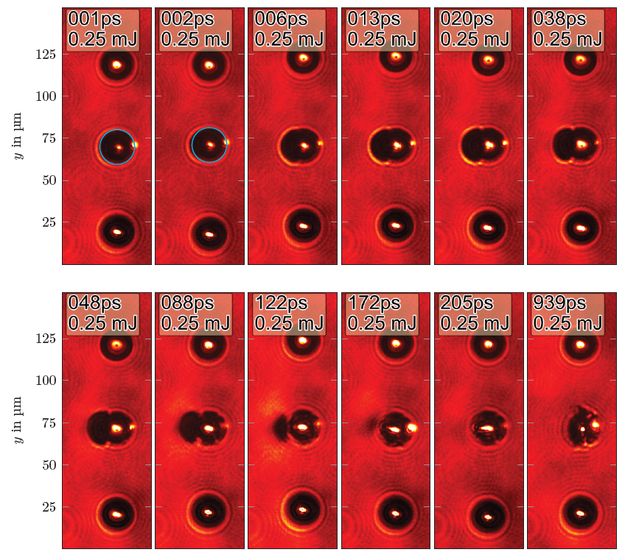
Plasma from Water Micro Droplets

Slide 28
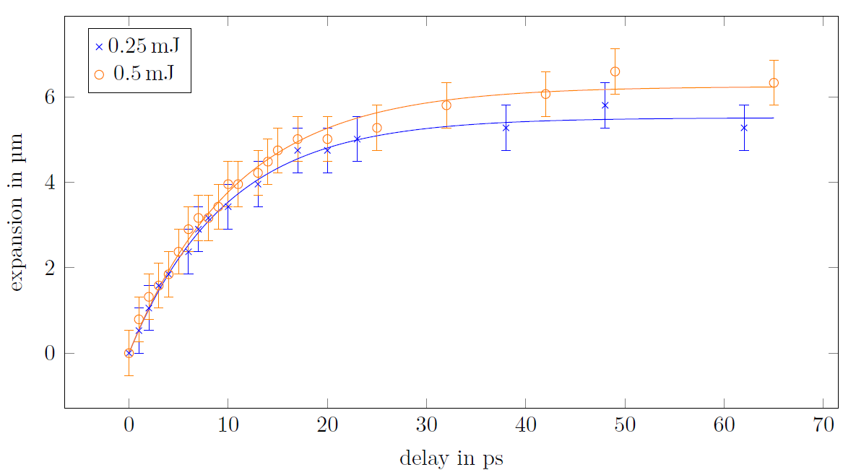
Plasma Expansion from Water Micro Droplets
Distance from the estimated undisturbed droplet edge to the edge of the shadow in beam direction depending on the delay time

Slide 29
Part III
Ray Tracing Simulations

Slide 30


Lagrangian Ray Optics
Fermat‘s principle:
Light minimizes the optical path length
Using the variational method
Equations of motion for a light ray
$$δ∫n\left(x,y,z\right)ds=0$$
$$\frac{dx_{k}}{dt}=\frac{p_{k}}{n} \\ \frac{dp_{k}}{dt}=\frac{∂n}{∂x_{k}}$$

Slide 31
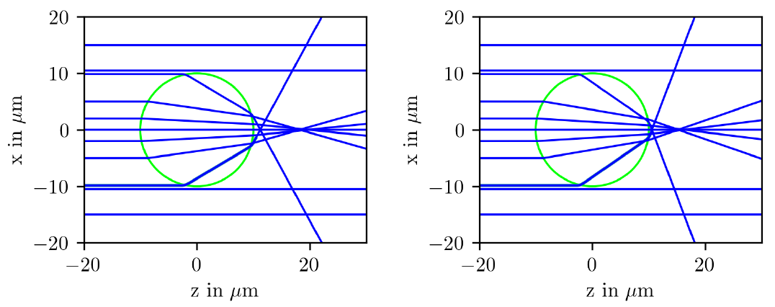
Simulated Ray Paths
Ray paths through a water droplet (marked in green)
Ray paths through an ethylene glycol droplet (marked in green)

Slide 32
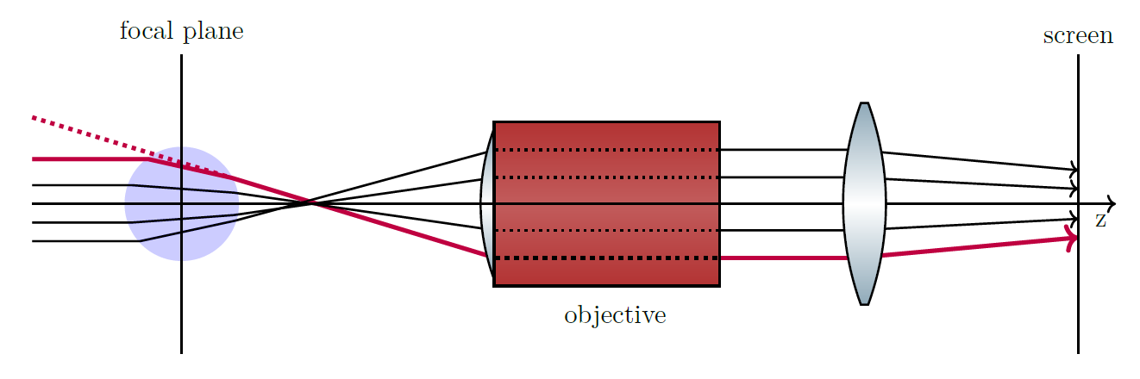
Simulations: Setup
Ray paths through a droplet, an objective and a field lens. The point, where the ray hits the screen, corresponds to the point, where the dotted line intersects with the focus plane.

Slide 33
Simulations – Fourier filter
Shadowgraphic image of a water droplet
Shadowgraphic image of a water droplet after a low-pass filter

Slide 34
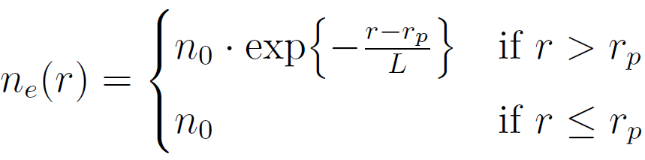
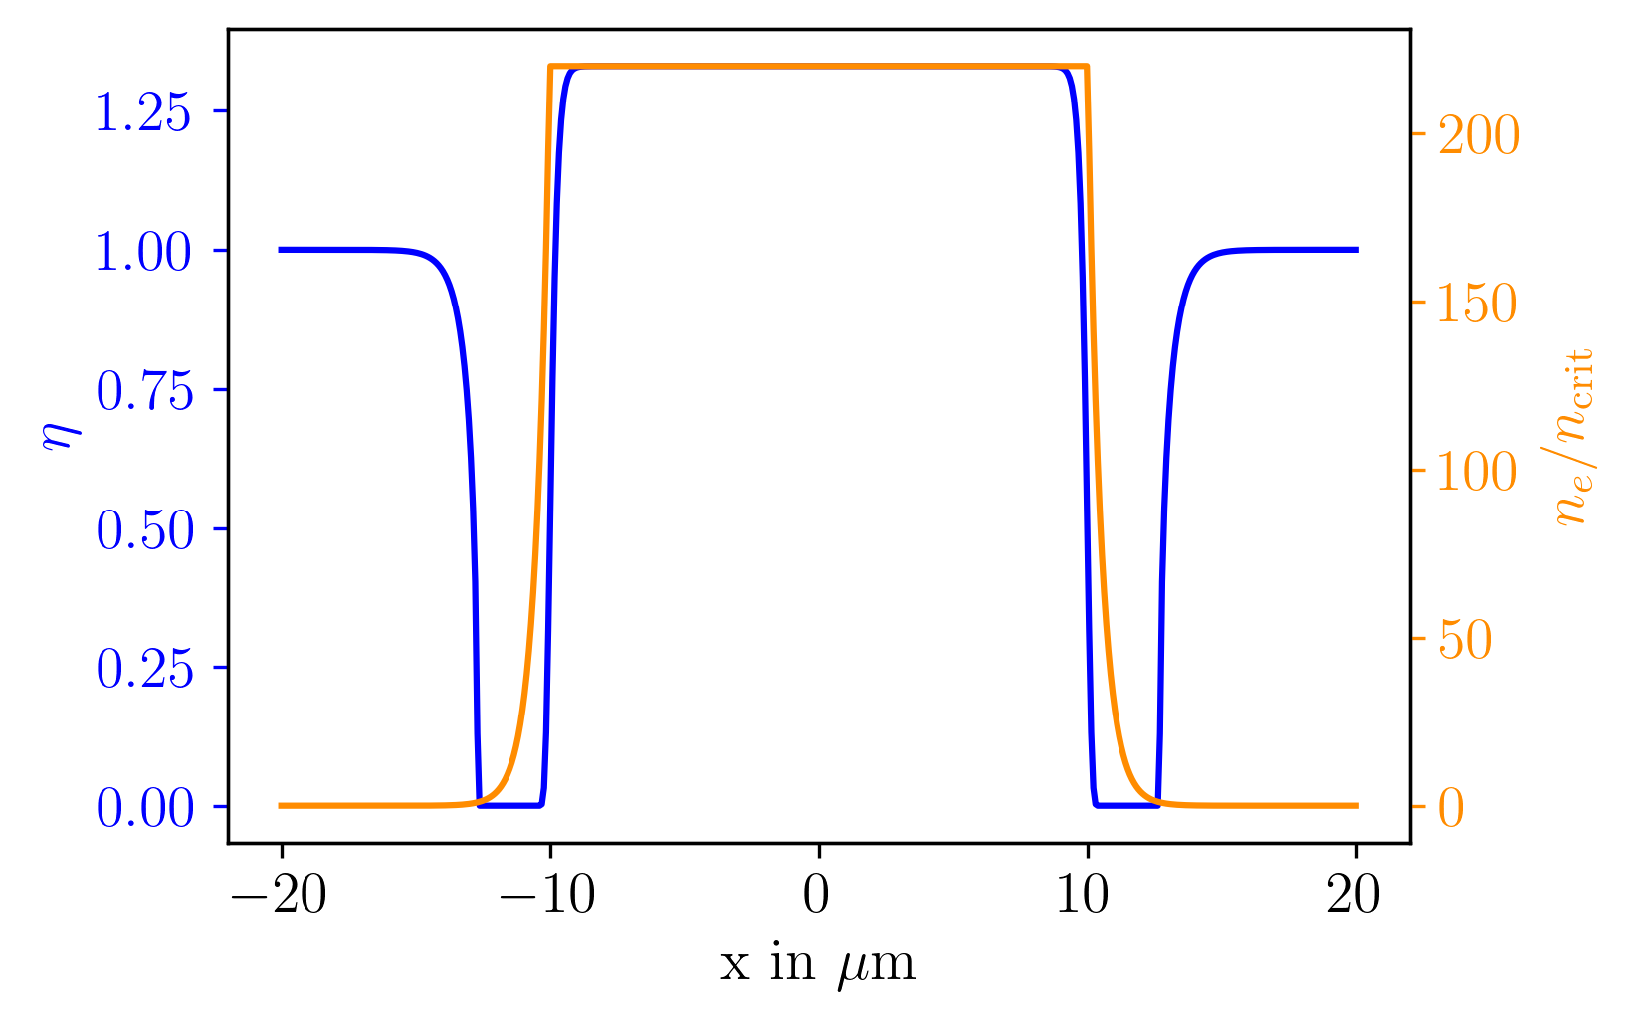
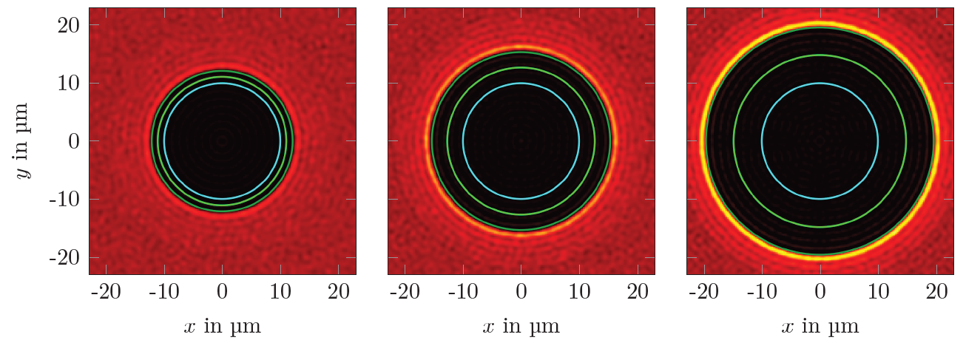
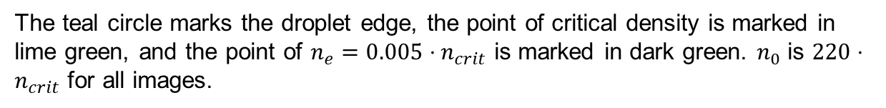
Shadowgraphic images for a decaying Electron Distribution
Electron density given by
L = 0.2 µm
L = 0.5 µm
L = 0.9 µm
The teal circle marks the droplet edge, the point of critical density is marked in lime green, and the point of $n_{e}=0.005⋅n_{crit}$ is marked in dark green. $n_{0}$ is $220⋅n_{crit}$ for all images.

Slide 35
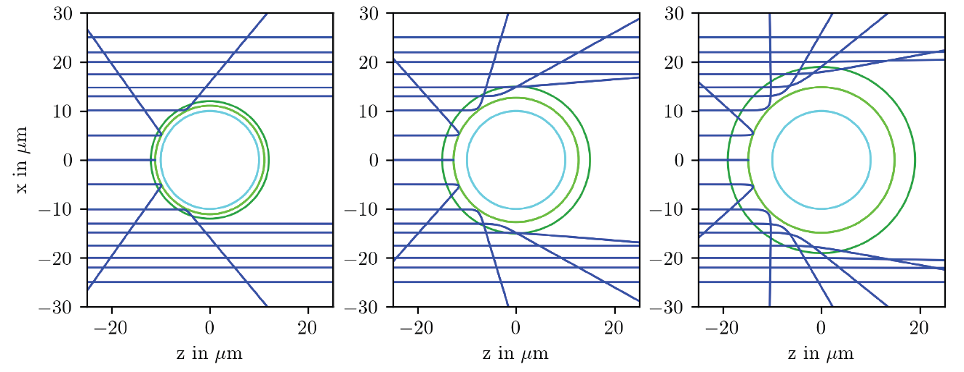
Beam paths and the resulting images

Slide 36
Part IV
Ion Acceleration at the POLARIS Laser System

Slide 37
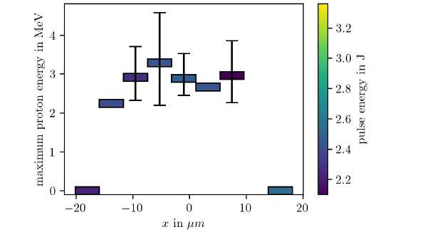
Scan of the droplet x-position at the POLARIS laser-system
Average proton maximum proton energy at different target x-positions. For positions with less than six shots no error bar is given.

Slide 38
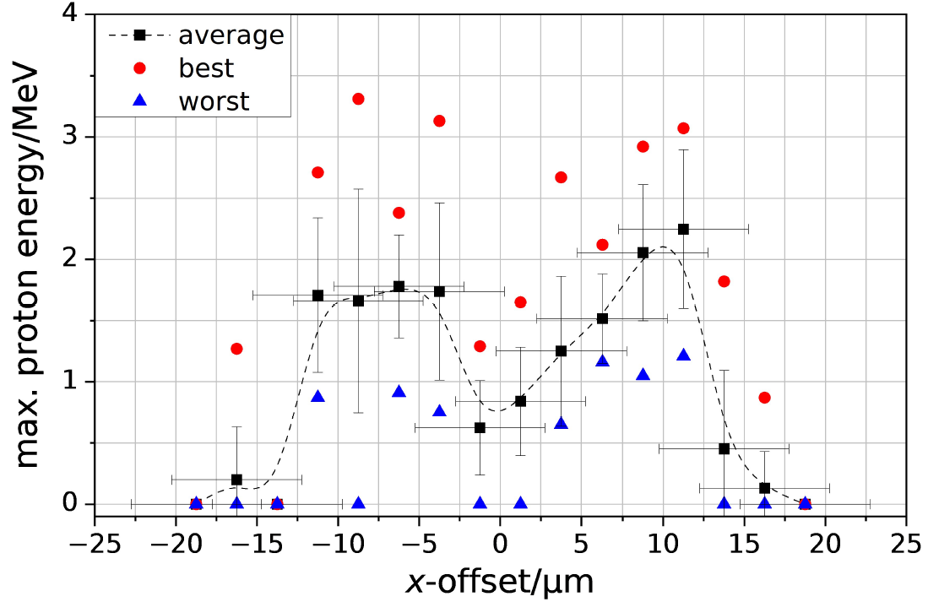

Scan of the droplet x-position at the JETI laser-system
Without an additional prepulse
With an additional prepulse
G. A. Becker, “Characterization of laser-driven proton acceleration with contrastenhanced
laser pulses,” Ph.D. dissertation, Friedrich-Schiller-Universität Jena,
2021.
Notes:
Prepulse 5ps before main pulse

Slide 39


Growth of sinusoidal modes in liquid jets
Growth rate $ω_{g}∝\frac{γ}{ν}$
Ohnesorge number
$$Oh=ν\sqrt{\frac{1}{ρh_{0}γ}}$$
Dimensionless wavenumber $x=\frac{2π}{λ}h_{0}<1$
$ν= \text{viscosity}$
$ρ=$density
$λ=$wavelength
$h_{0}=$undisturbed jet radius

Slide 40

Estimated Scale Length
Estimated scale length for the plasma from water micro droplets after different probe delays.
Notes:
Assumed n = 220 n_crit

Slide 41


Influence of the Position of the Probe Objective
$$E=0.25 mJ$$
$$L=1 μm$$

Slide 42

Shadow Size and Objective Position in Simulations

Slide 43

Plasma Expansion under Obliquie Irradiantion

Slide 44

Ionization of Ethylene Glycol Droplets

Slide 45

Plasma Expansion from Satellite Droplets

Slide 46

Fourier
Lens conducts a Fouriertransform of the field distribution in the focal plane
Schematic setup of a two lens imaging system with lenses with the focal length f

Slide 47

Different Objective Positions in Droplet Simulations

Slide 48

Maximum Proton Energy with corrsponding Spectra

Slide 49


Slide 50

Resonance Absorption

Slide 51

Electron movement in a plane electromagnetic wave

Slide 52


Ponderomotive Force
$$F_{pond}=−\frac{e^{2}}{4 m_{e}ω_{L}^{2}}∇(E^{2})$$

Slide 53




Laser Plasma Heating
B feld einzeichnen
Koordinatensystem?
Schöner machen. Sieht aus wie ein Prototyp
Resonace absorption
Vacuum heating
jxB heating
E
E
E

Slide 54

Single stage pressure regulator

Slide 55


Slide 56



Water and Ethylene Glycol
 | Water | Ethylene Glycol
Viscosity | 0.8 mPa s | 18.4 mPa s
Surface tension | $$72.8\frac{mN}{m}$$ | $$48.5\frac{mN}{m}$$
Vapour pressure | 0.08 mbar | 23 mbar

Slide 57

Over The Barrier Ionization

Slide 58

Electron Temperature
$k_{B}T=m_{e}c^{2} \left(\sqrt{1+\frac{a_{0}^{2}}{2}}−1\right)$
With $I=1e17\frac{W}{cm^{2}}$
=> $k_{B}T_{e}=2.4$keV and $c_{s}=0.48\frac{μm}{ps}$
From measured expansion velocity
0.5mJ: $c_{s}=0.12\frac{μm}{ps}$ ($k_{B}T_{e}=150 eV$)
0.25mJ: $c_{s}=0.09\frac{μm}{ps}$ ($k_{B}T_{e}=85 eV$)
P. Mulser and D. Bauer, High power laser-matter interaction. Springer, 2010
Notes:
Assuming n_e = 220 n_crit
Schattengeschw. 0.5mJ: 0.6 micro m / ps
0.25mJ: 0.5 micro m / ps
Geschätzte Temp für expansion dann 2.4 keV / 16 = 150 eV

Slide 59

Electron Ion Collision Rate
Plasma ion density from water at
$I=1e17 W/cm^{2}$: $1e23 cm^{−3}$
Electron ion collision frequency:
$ν_{ei}=1e12 Hz$
$t_{ei}=100 fs$

Slide 60

Pre-Pulse Reduction with SHG

Slide 61

Specifications of the Abbeanum Laser
Energy < 5mJ
FWHM= 130 fs
Beam radius = 1.7mm (1/e)
$λ=1030$nm
2 inch focal length parabola
$A≥2.1 μm^{2}$, q = 0.5
$I≤1⋅{10}^{17}\frac{W}{cm^{2}}$ ($a_{0}≤0.13$)
Probe Intensity $<{10}^{12}\frac{W}{cm^{2}}$

Slide 62

Specifications of the POLARIS Laser System
Peak intensity $I=4⋅{10}^{19}\frac{W}{cm^{2}}$ ($a_{0}=5$)
$FWHM=140 fs$
$λ=1030 nm$
$15 cm$beam diameter
$E≤10 J$ in the experiments
Focus parabola: $30 cm$focal length
$q=0.15$
$A=19 μm^{2}$

Slide 63


Keldish Parameter for the Abbeanum and POLARIS
Keldysh parameter:
$γ≫1$: multi photon absorption
$γ≤1$: tunnel ionization
Abbeanum: $γ=0.6$
POLARIS: $γ≪0.6$

Slide 64


Simulated Shadow Radius over n and L

Slide 65

Dispersion of mode growth in liquid jets
J. Eggers and E. Villermaux, „Physics of liquid jets“, Reports on progress in physics, vol. 71 no. 3p. 036 601, 2008

Slide 66


Debye Shielding

Slide 67








Plasma Definition

Slide 68



Time Intensity Constrast
TIC of the JETI laser
G. A. Becker, “Characterization of laser-driven proton acceleration with contrastenhanced
laser pulses,” Ph.D. dissertation, Friedrich-Schiller-Universität Jena,
2021.
I. Tamer, “Petawatt-Class Laser Optimization and
Ultrashort Probe Pulse Generation for
Relativistic Laser-Plasma Interactions” Ph.D. dissertation, Friedrich-Schiller-Universität Jena,
2020.

Slide 69
Proton Energy and Droplet Position
Vacuum-heating and beneficial electron currents at oblique incidence
jxB-heating at central irradiation
Similar acceleration process for all positions
G. A. Becker, “Characterization of laser-driven proton acceleration with contrastenhanced
laser pulses,” Ph.D. dissertation, Friedrich-Schiller-Universität Jena, 2021.

Slide 70
Pump-Probe Setup
Beam block
Notes:
130fs
2.1 micro squared
1030nm
1.7mm strahlradius 1/e

