Slide 1



New methods to produce polarized ³He ion beams
Polarized Fusion: The time has come!
6th European Advanced Accelerator Concepts Workshop | Isola d'Elba | 20 September 2023
Markus Büscher
Notes:
15 + 5 minutes

Slide 2
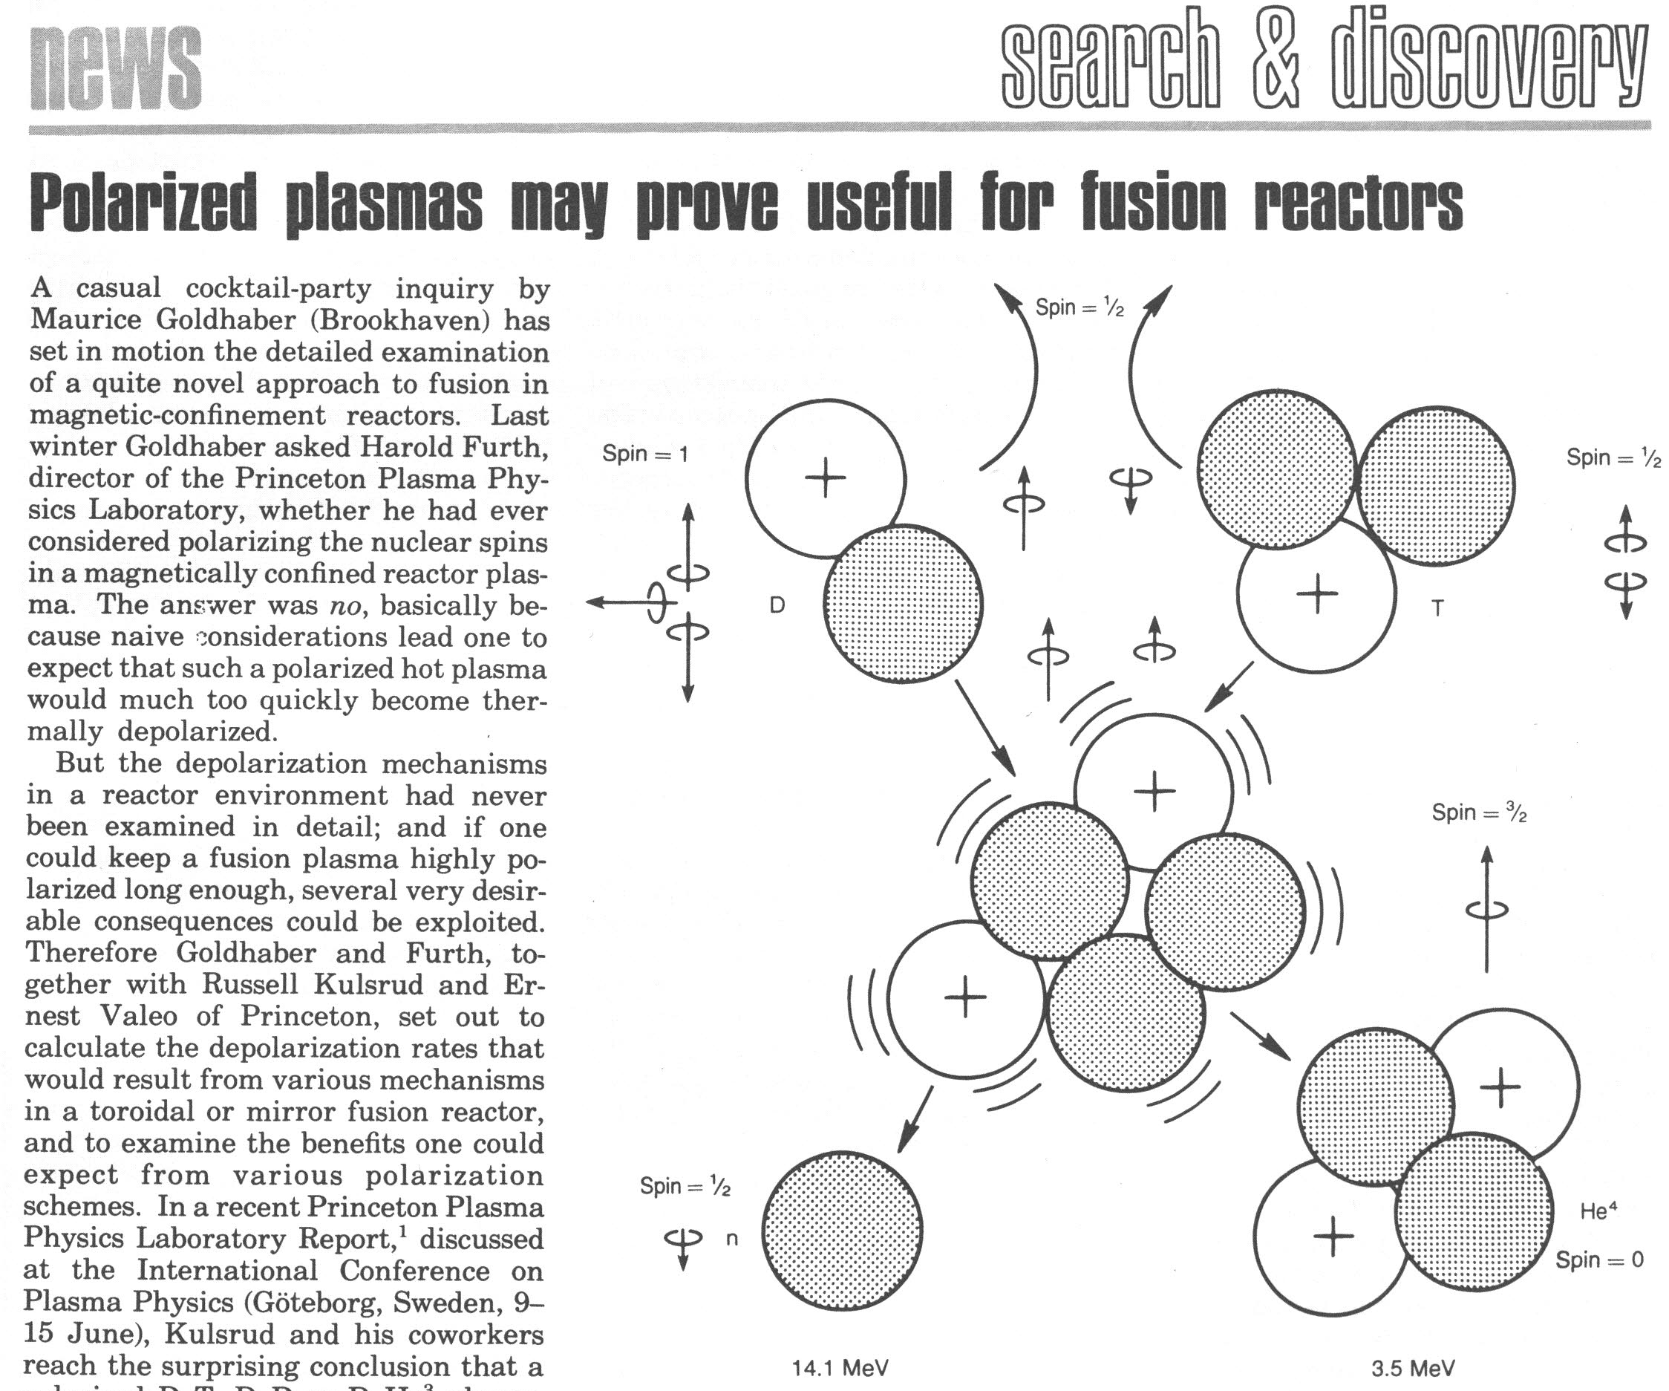
Polarized Fusion: The basic idea
Physics Today, August 1982
T or ³He
D
(A=5)*

Slide 3
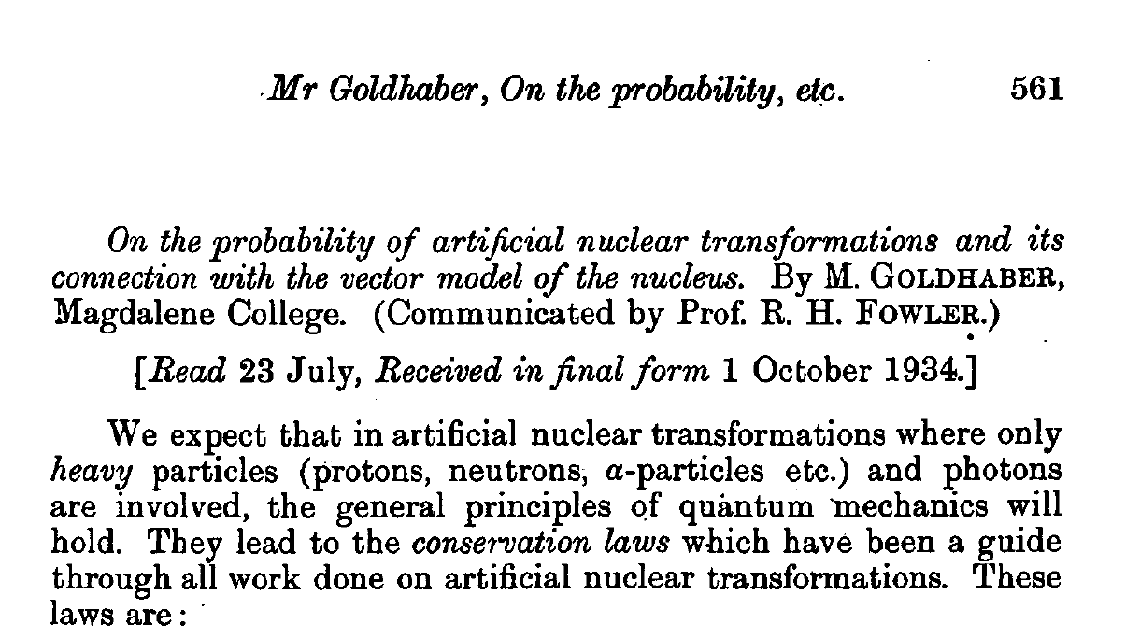
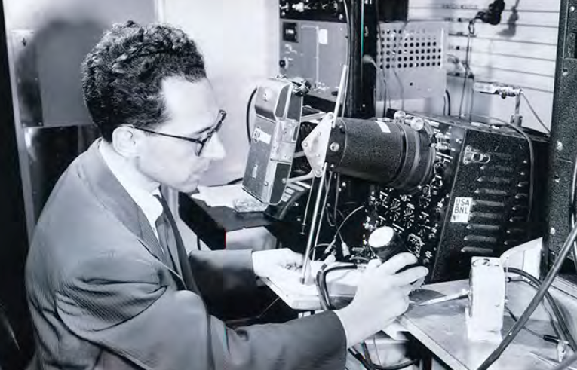
Polarized Fusion: in The beginnings of nuclear physics
First ideas date back to the 1930s
Maurice Goldhaber, 1911 – 2011
Mathematical Proceedings of the Cambridge Philosophical Society, 30, 561 (1934). doi:10.1017/S0305004100012810
Notes:
In 1934, with James Chadwick from the Cavendish Laboratory at Cambridge, he was the first to measure accurately the mass of the neutron
“I don’t have time to age.”

Slide 4
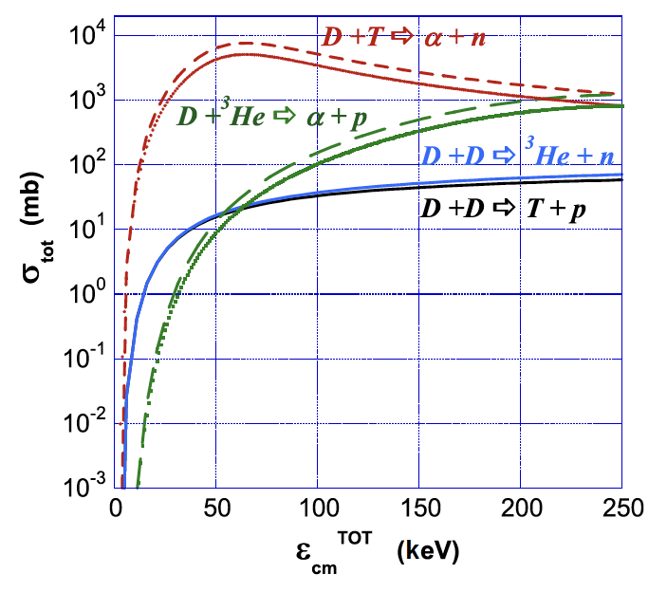
Enhanced Fusion cross sections
Typical increase of fusion cross sections by factor 1.5
Tokamaks:
Increase in fusion power by factor 1.8
(estimate for ITER)
Laser-induced:
Gain increases by ~45% while the required laser power decreases by about 20%
L. Baylor et al., Nucl. Fusion 63 076009 (2023). doi.org/10.1088/1741-4326/acc3ae
M. Temporal et al., Nucl. Fusion 52 103011 (2012). doi:10.1088/0029-5515/52/10/103011
Notes:
Hupin et al.: „operational temperature decreased by as much as 45%“

Slide 5
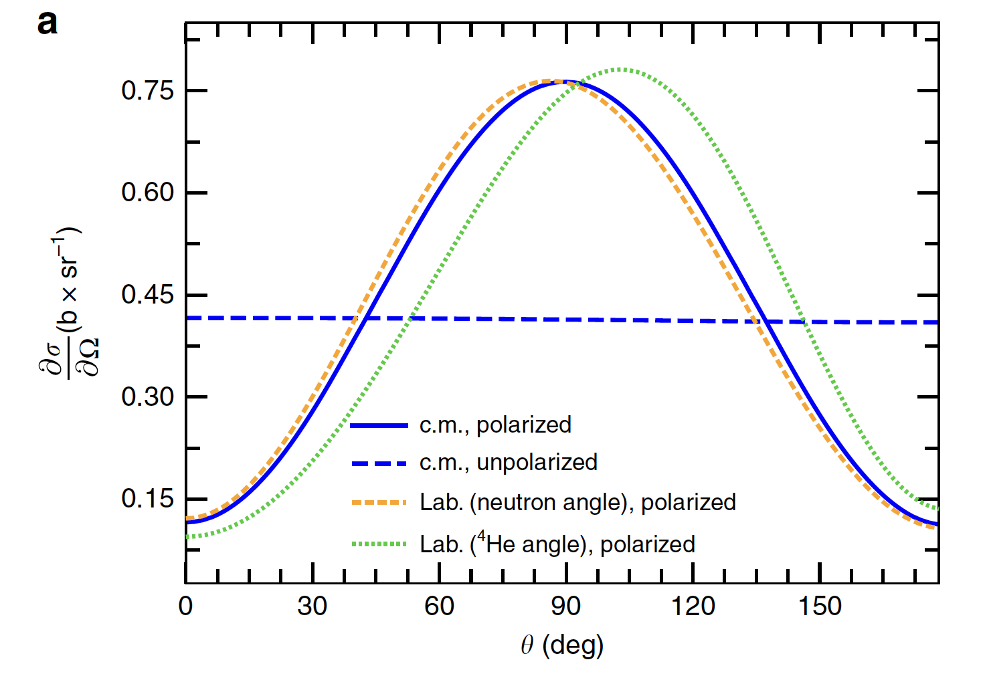
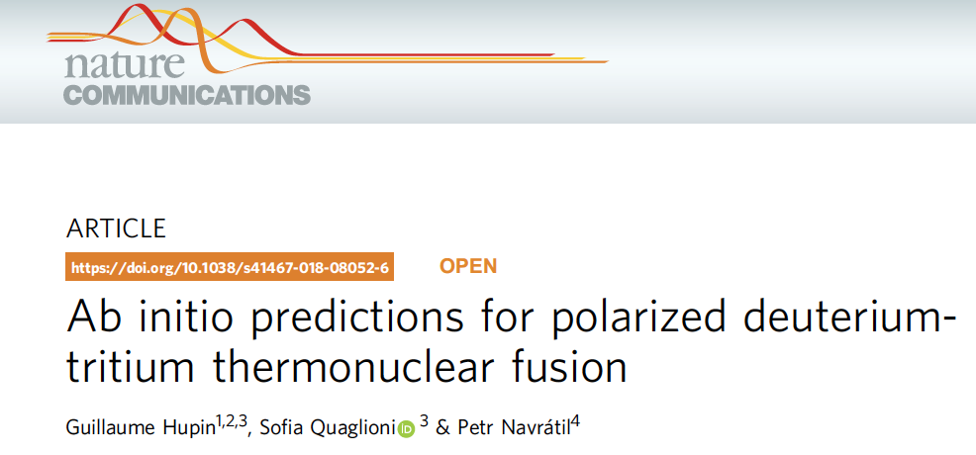
Anisotropic Angular distributions
(2019)
„The anisotropy of the angular differential cross section ... can be used to force the emitted neutrons and α to be two to five times more focused towards the reactor blanket.“
See also: The status of “polarized fusion”, H. Paetz gen. Schieck, Eur. Phys. J. A 44, 321 (2010)
Nuclear Fusion with polarized fuel, Springer Proceedings in Physics 187 (2016)
Notes:
Hierfür reicht es, wenn nur das Deuteron polarisiert ist.

Slide 6

Are there show-stoppers?
Does polarization survive (in the fusion plasma) long enough?
How to produce enough polarized fuel (e.g. neutral beams, pellets)?

Slide 7

Episode 1: Polarization in Fusion plasmas
“The typical association of nuclear spin alignments is with low temperatures, making it counter-intuitive that they could endure in a 10⁸ Kelvin plasma long enough to have practical applications.”
🤯

Slide 8


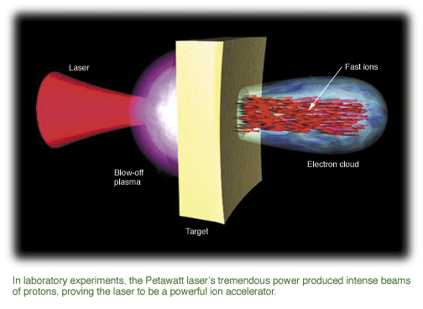
The first experimental approach (2010)
foil
target
200 TW laser beam
Accelerated protons
☞ „Are the accelerated (MeV) protons polarized?“
µm-sized relativistic plasma
Notes:
µm sized laser-plasmas = test bed for fusion plasmas

Slide 9
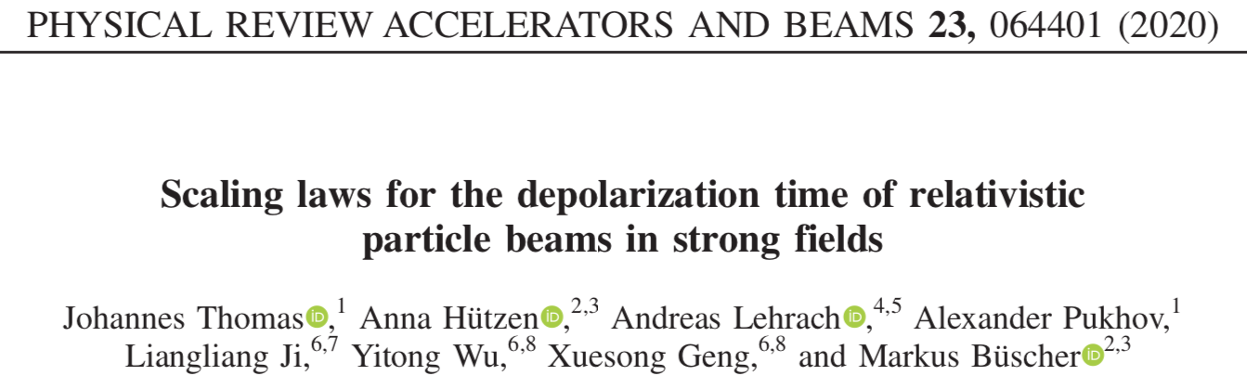
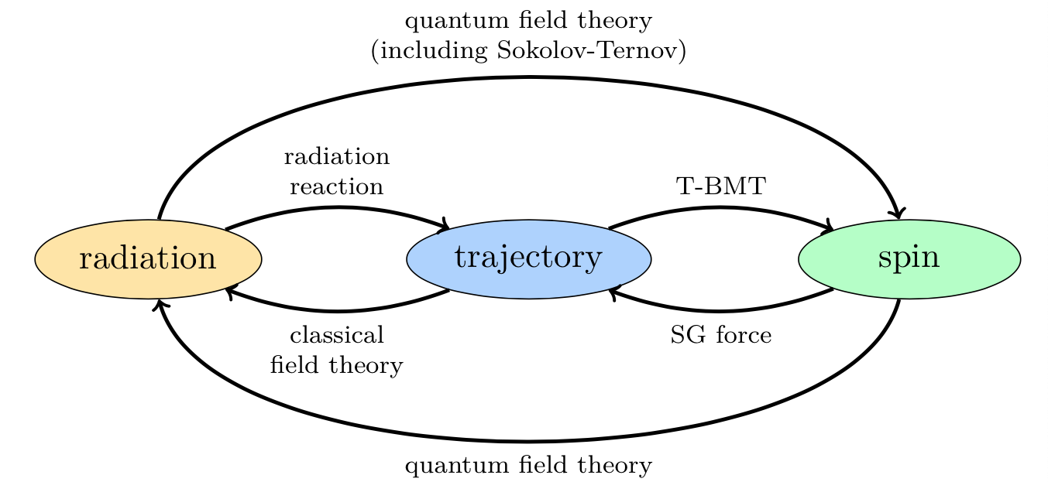
Interactions in plasmas involving Spins
A theoretical study for particle acceleration in plasmas
Relevant processes for e⁻, p, ions:
T-BMT (Thomas precession)
Sokolov-Ternov effect
Stern-Gerlach force
Radiation reaction (only for ultra-relativistic particles)
Notes:
Thomas-Bargmann-Michel-Telegdi
Since then approx. 20-30 theoretical paper on pol. Beam production

Slide 10
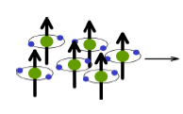


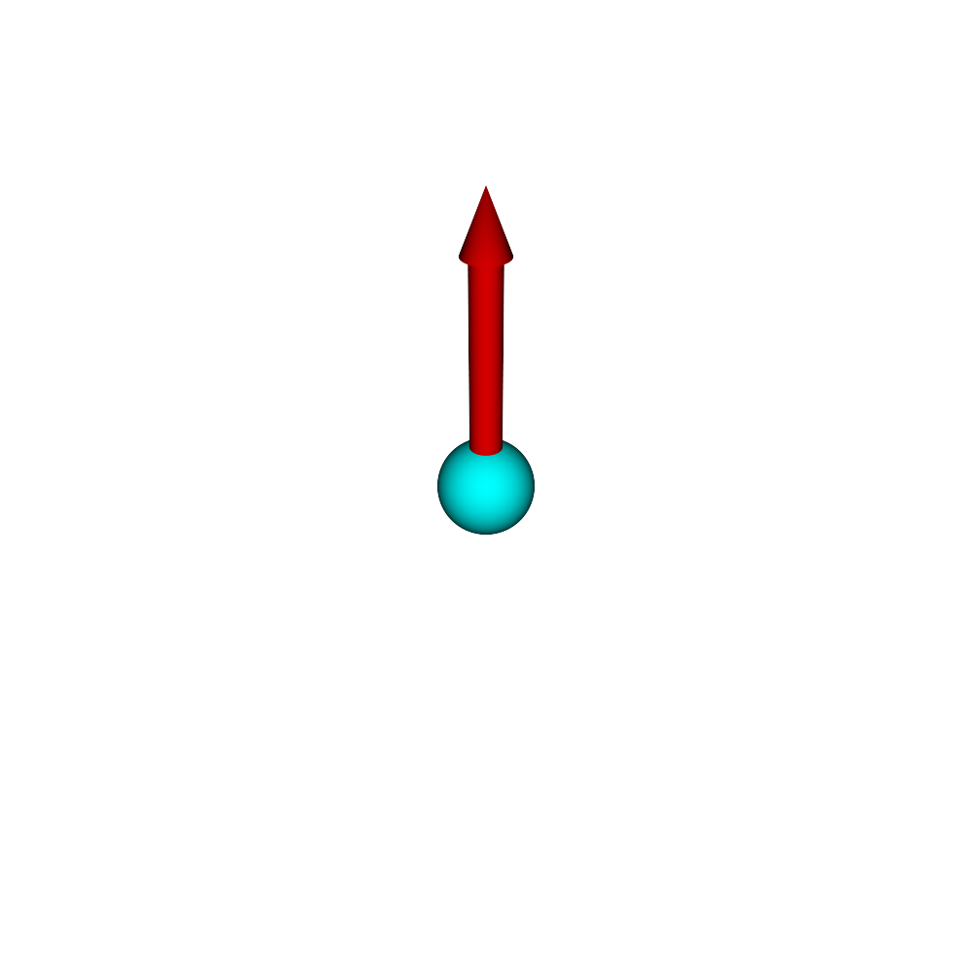
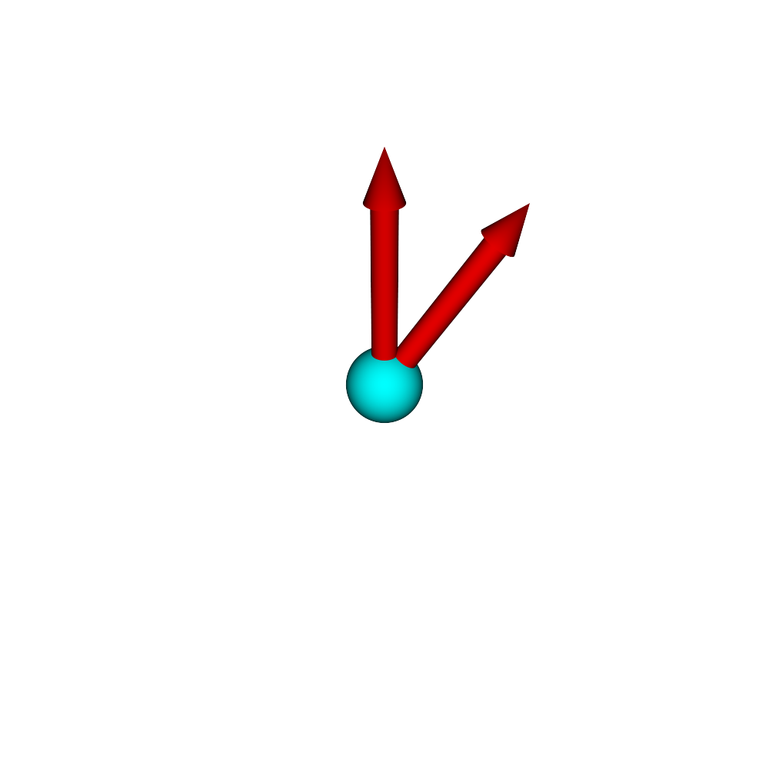
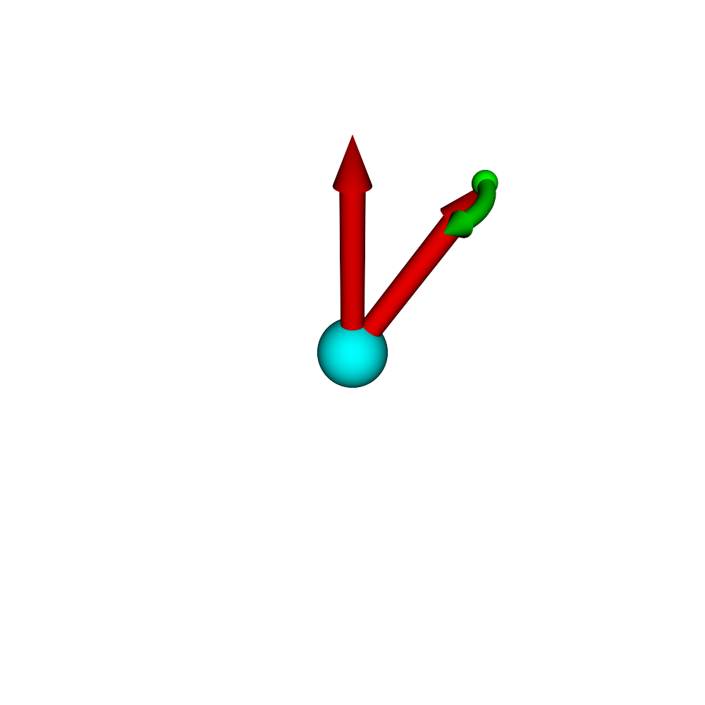
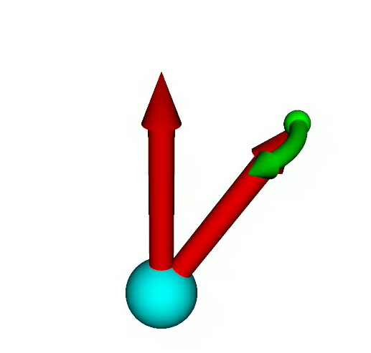
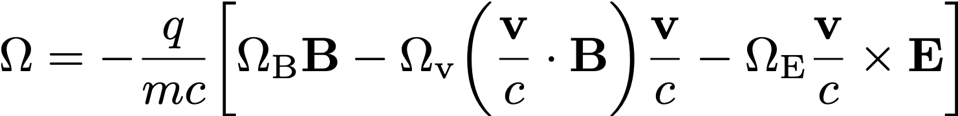

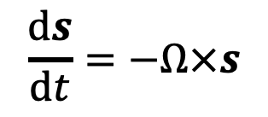


Modelling of Spins in laser-induced plasmas
Implementation of particle spins into a simulation code (in collaboration with A. Pukhov & P. Gibbon …)
Thomas-BMT equation
PIC Code (VLPL, EPOCH)
Description of spin motion in arbitrary electric and magnetic fields in the semi-classical approach
$$\frac{ds}{dt}=−Ω×s$$
$$\overset{⃑}{B}$$
$$\overset{⃑}{s}$$
$$\overset{⃑}{Ω}$$
Rotation frequency in cgs units
with
Notes:
Paul Ehrenfest: under certain conditions the classical equations of motion apply to the mean values of quantum mechanics; classical mechanics is thus to a certain extent contained in quantum mechanics (principle of correspondence).

Slide 11
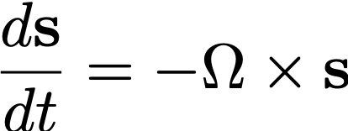
Modelling of Spins in laser-induced plasmas
Implementation of particle spins into a simulation code (in collaboration with A. Pukhov & P. Gibbon …)
Thomas-BMT equation
PIC Code (VLPL, EPOCH)
Description of spin motion in arbitrary electric and magnetic fields in the semi-classical approach
$$\overset{⃑}{B}$$
➔ Talk by Lars Reichwein on Thursday:
„Acceleration of polarized protons from laser-plasmas“
Notes:
Paul Ehrenfest: under certain conditions the classical equations of motion apply to the mean values of quantum mechanics; classical mechanics is thus to a certain extent contained in quantum mechanics (principle of correspondence).

Slide 12
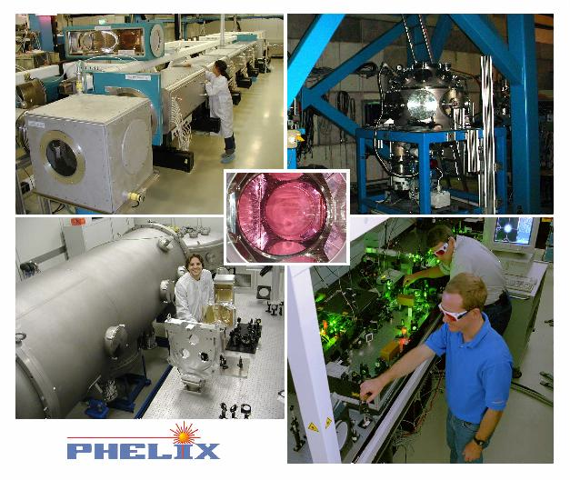
The (updated) experimental approach
Fusion reactions
☞ „Does the (fusion) rate depend on the target polarization?“
polar.
³He^{*)}
target
Petawatt laser beam
Accelerated Ions
☞ „Are the accelerated (MeV) ions polarized?“
µm- to mm-sized relativistic plasma
☞ „Angular dependence of fusion products?“
^{*)} Isospin partner of tritium (non-radioactive)
Notes:
µm sized laser-plasmas = test bed for fusion plasmas

Slide 13
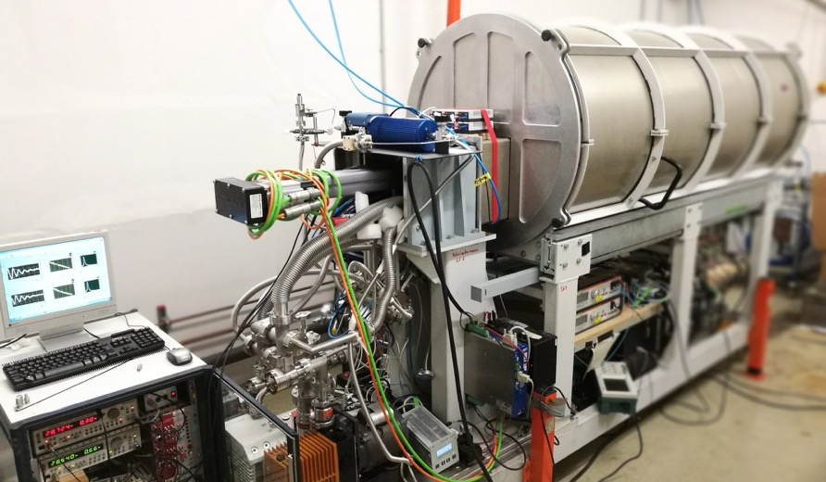
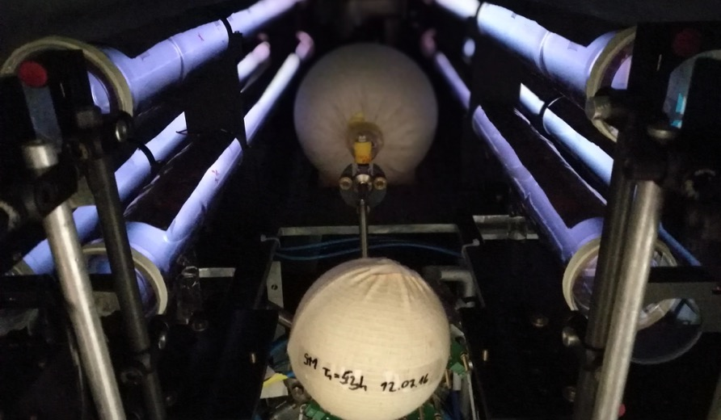
The Target material: Polarized ³He gas
Metastability-Exchange Optical Pumping (polarizer borrowed from Univ. Mainz)
Photos: Ilhan Engin
Max. ³He polarization: ~75%
Relaxation times: hundreds of hours (up to 3 bar in transport vessels)
C. Mrozik et al., Construction of a compact ³He polarizing facility, J. Phys. Conf. Ser. 2011, 294, 012007
Notes:
MEOP rapidly produces nuclear polarization in metastable ³He atoms at mbar-scale pressures by a combination of optical pumping and hyperfine mixing. The metastable nuclear spin polarization is then rapidly transferred to the ground state population via metastability exchange collisions. Typically the gas is then compressed for use in applications.

Slide 14
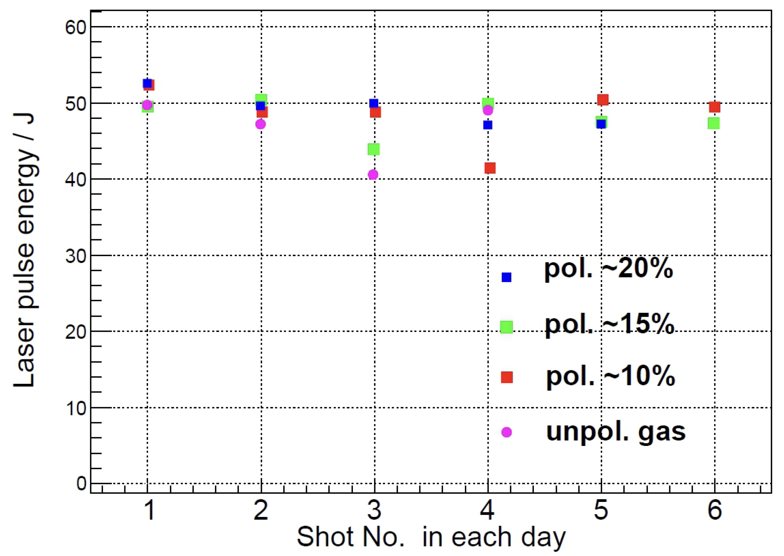
The Laser: PHELIX @ GSI Darmstadt
Petawatt High-Energy Laser for Heavy Ion EXperiments
 | Short pulse | Long pulse
Pulse duration | 0.4 – 20 ps | 0.7 – 20 ns
Pulse energy | up to 250 J | 300 – 1000 J
Max. intensity | 2 ∙ 10²¹ W/cm² | 10¹⁶ W/cm²
Pulse duration 2.2 ps
Flashlamp-pumped Nd:glass system
Shot # per day

Slide 15
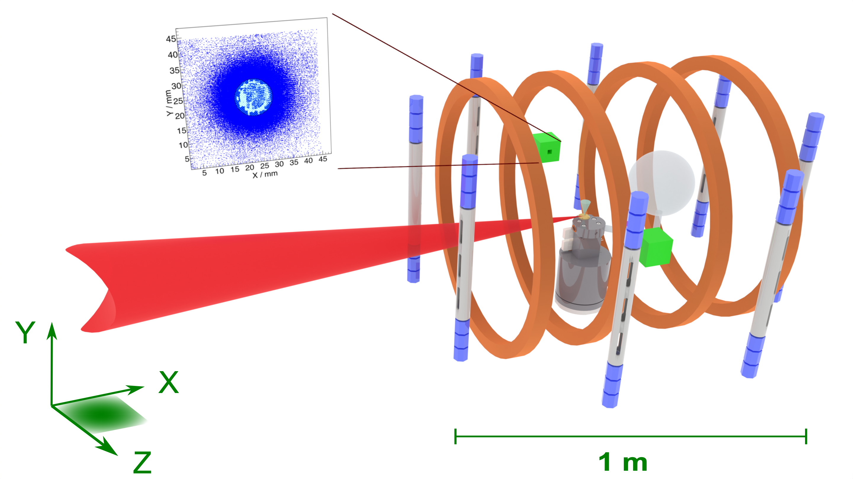

Experimental setup @Phelix (Aug. 2021)
Polarimeter
${}_{ }^{3}{\vec{He}}$ gas
Phelix laser beam
³He jet
Pressure booster

Slide 16
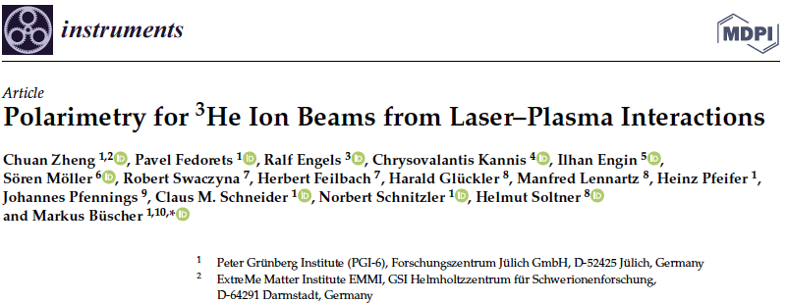
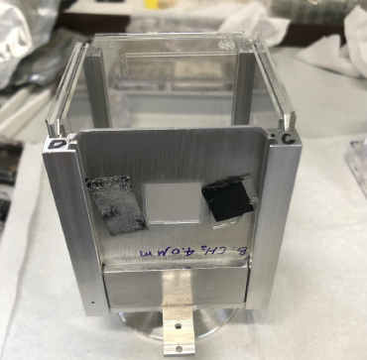
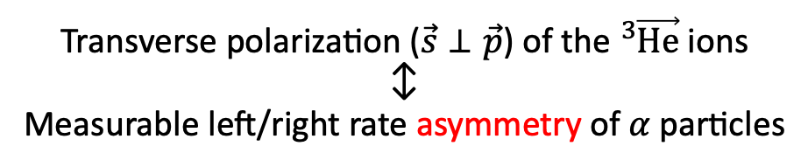
Polarimetry for ³He ions
Employ analyzing power of the $D\left({}_{ }^{3}{\vec{He}},α\right)p$ reaction
on
CD₂ foil
Helmholtz coils
off
− on
Transverse polarization ($\vec{s}⊥\vec{p}$) of the ${}_{ }^{3}{\vec{He}}$ ions
↕︎
Measurable left/right rate asymmetry of 𝛼 particles

Slide 17
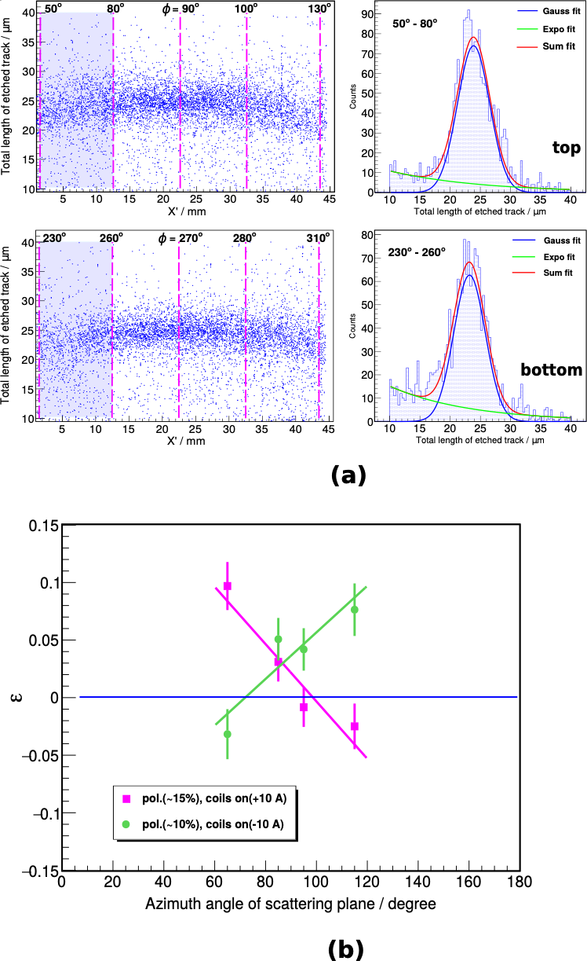
After 2 years of data analysis …
… shown for the first time!
³He-ion polarization conserved after acceleration
2x increased ³He-ion flux from pol. plasma (reason unclear)
Our concept (polarized target @ PW laser) works
Plasma acceleration of polarized beams (e^{–*)}, p, ions) feasible
Models/simulation codes incomplete (topic for the coffee breaks)
Preliminary
Asymmetry
expected signal for unpol. ions
^{*)} Talk by K.Poder

Slide 18
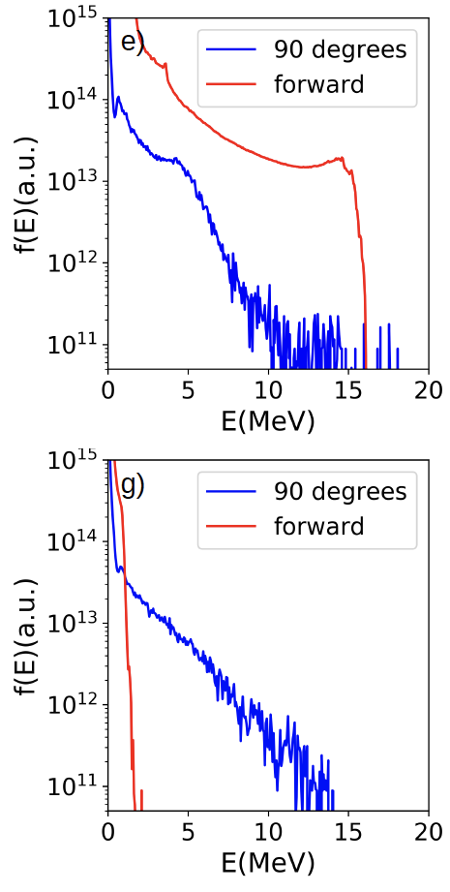
Towards polarized ³He beams
EPOCH & VLPL simulations: predicted degree of polarization ≈99%
PHELIX Experiment 2021:
Target: gas-jet width 1 mm
Max. ³He ion flux ⊥ to laser propagation (→ polarimeters)
Next PHELIX Experiment:
Target jet width 0.5 mm
Max. ³He ion flux ∥ to laser propagation
P. Gibbon, talk at 48th European Conference on Plasma Physics (2022)

Slide 19





Episode 2: How to produce polarized fuel
$$\vec{D}$$
$$\vec{T }\left(\vec{H}\right)$$
$$\vec{{}_{ }^{3}{He}}$$
$$\vec{{}_{ }^{11}B}$$

Slide 20
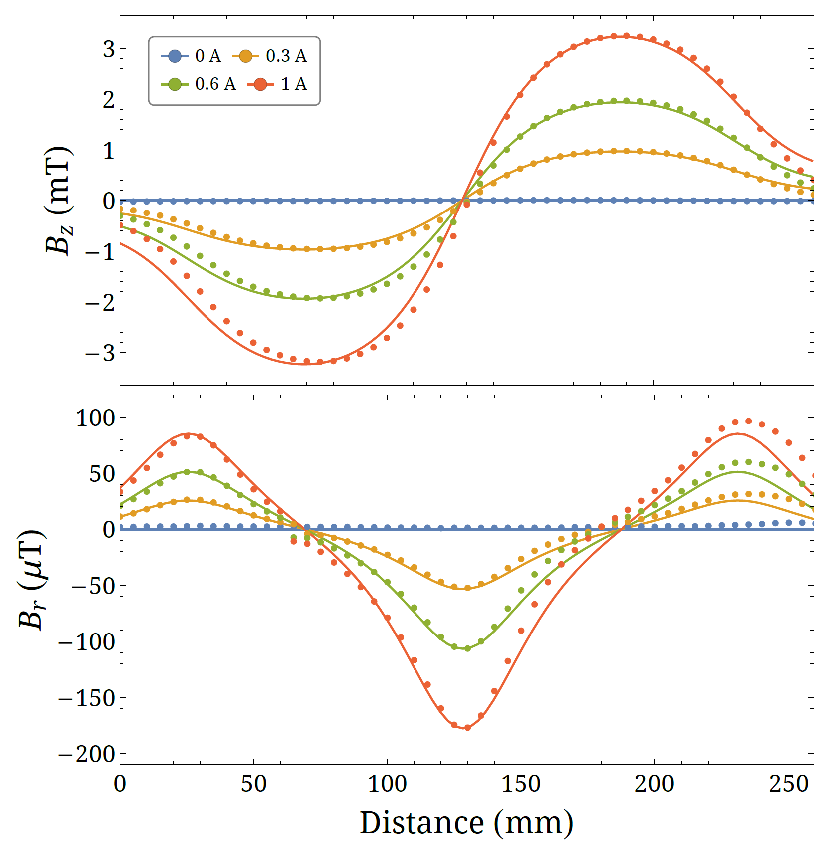
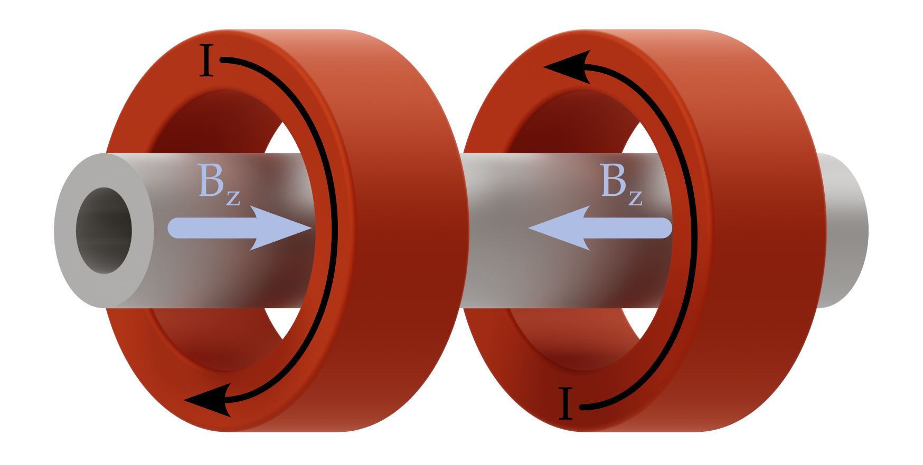
Top news: it‘s so simple!
Particle beam

Slide 21
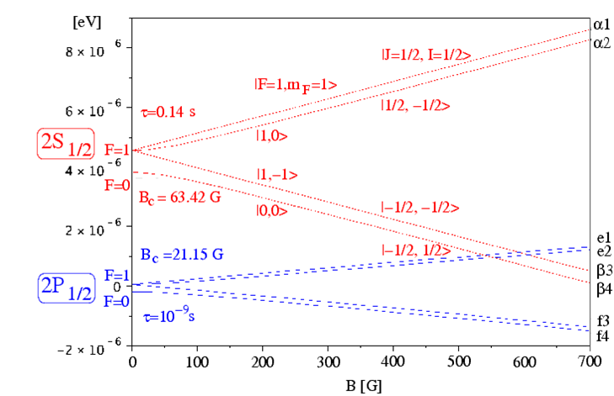
Breit-Rabi diagram of metastable hydrogen atoms
e–
😮
p
The typical energy difference (=photon energy) is very small (neV)
e–
p
Notes:
Das Magnetfeld, das das Proton durch den Elektronenspin sieht, ist 2.08 T für metastabile Atome (16.6 T für den Grundzustand).
Alpha 1 hat ein abstoßendes mag. Moment durch m_J=+1/2 und ein anziehendes durch m_I=+1/2.
Die gemischten Zustände haben zwei anziehende Anteile durch m_J=-1/2 und m_I=+1/2 und zwei abstoßende durch m_J=-1/2 und m_I=+1/2.
Ist B noch relativ klein, dann ist „a“ zwar klein, aber der anziehende Teil von m_J=-1/2 Ist immer noch größer als der abstoßende von m_I=-1/2.
Bei 2.08 T kippt das gerade: Der Einfluß von m_J=-1/2 ist dann kleiner als der von m_I=-1/2.

Slide 22
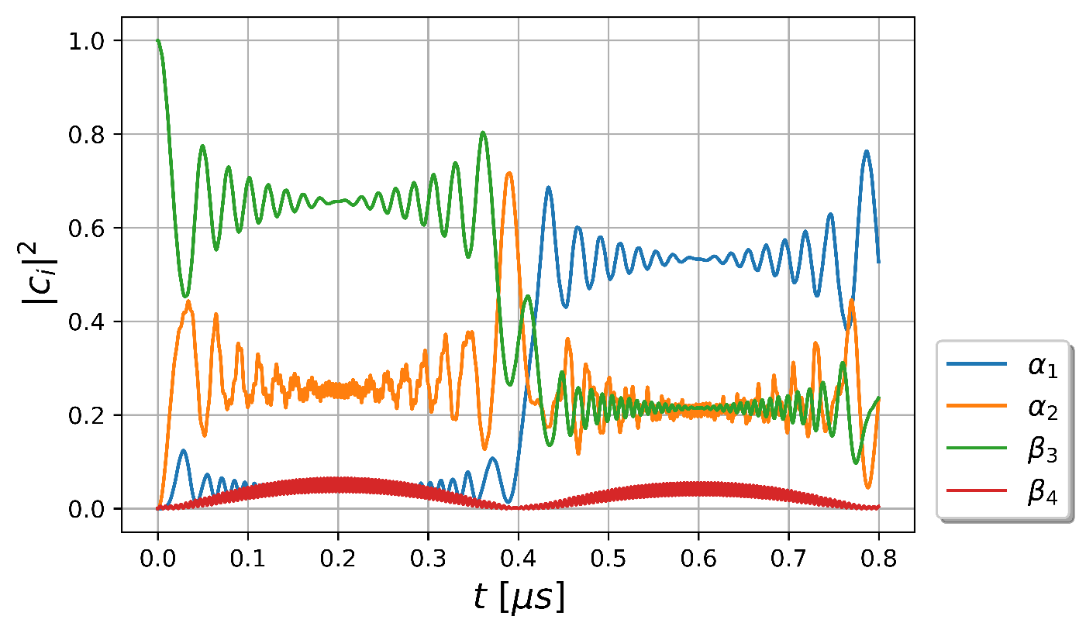
Solving the Schrödinger Equation
Metastable Hydrogen atoms traversing the Sona unit
B_{max} = 7 mT
Chr. Kannis, PhD thesis, RWTH Aachen (Dez. 2022)

Slide 23
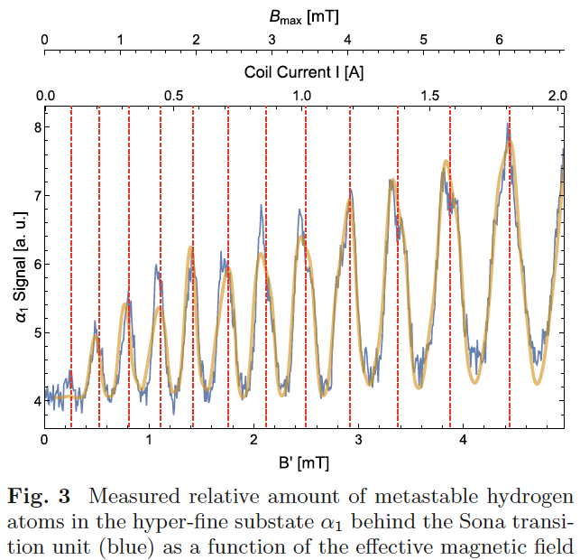
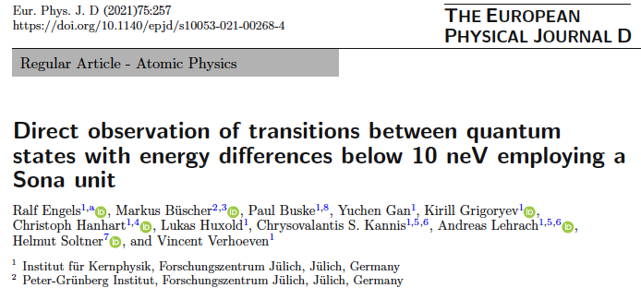
First experimental results (2021)

Slide 24
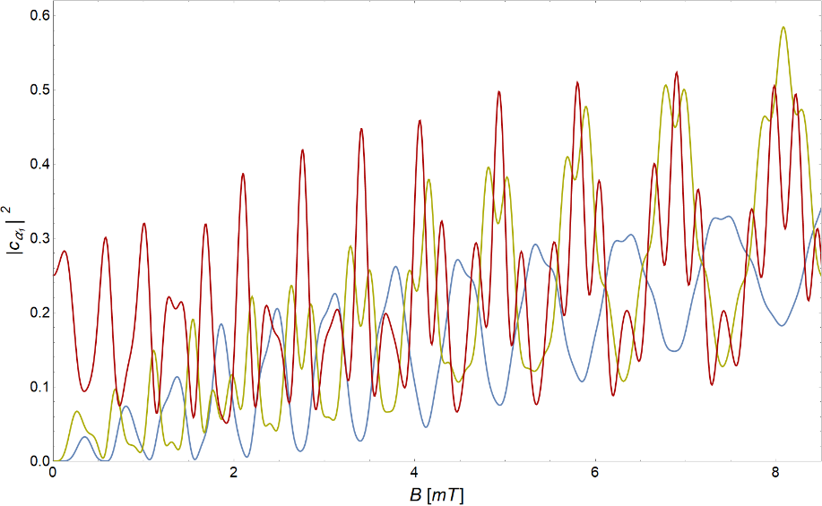
Different starting conditions
Metastable Hydrogen
N_{α1}
Start:
|c_{α1}|² = 1
| c_{αi}|² = 0.5
| c_{i}|² = 0.25
😮
This also works for ground states ➜ everything with a (known) hyperfine structure can be polarized!
Notes:
Grün und blau gemessen, blau veröffentlicht (EPJA)
Koordinatensystem hinter Sona-Einheit

Slide 25
Possible Applications
Deutsche Patentanmeldung 102022213860.0 (19.12.2022):
„Eine universelle Methode zur Polarisationserzeugung durch einen kohärenten Radiowellen-Puls“
Polarized (ground-state) ion sources: Many ion beams can be polarized
→ Oct. 2023 @COSY: ³He⁺ (polarized neutron beams!)
Polarized fuel for nuclear fusion
→ collaboration with US (Univ. California, DIII-D San Diego, JLab und Oak Ridge)
UK (Tokamak Energy)
Precision physics / Spectroscopy of anti-matter?
Hyperpolarized samples / New type of MRI?

Slide 26
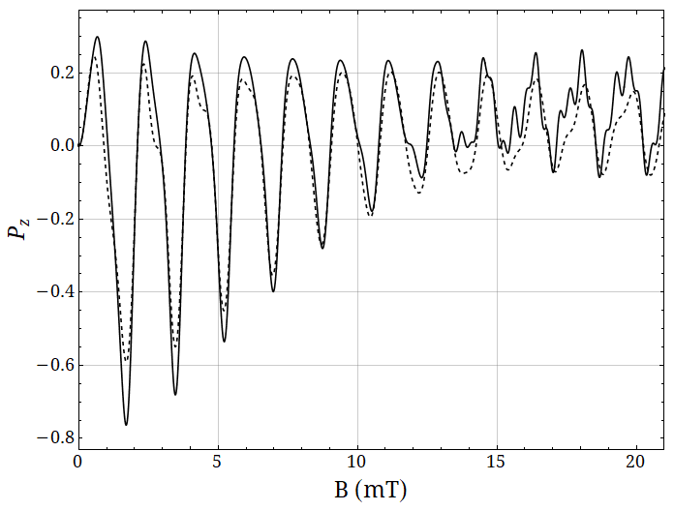
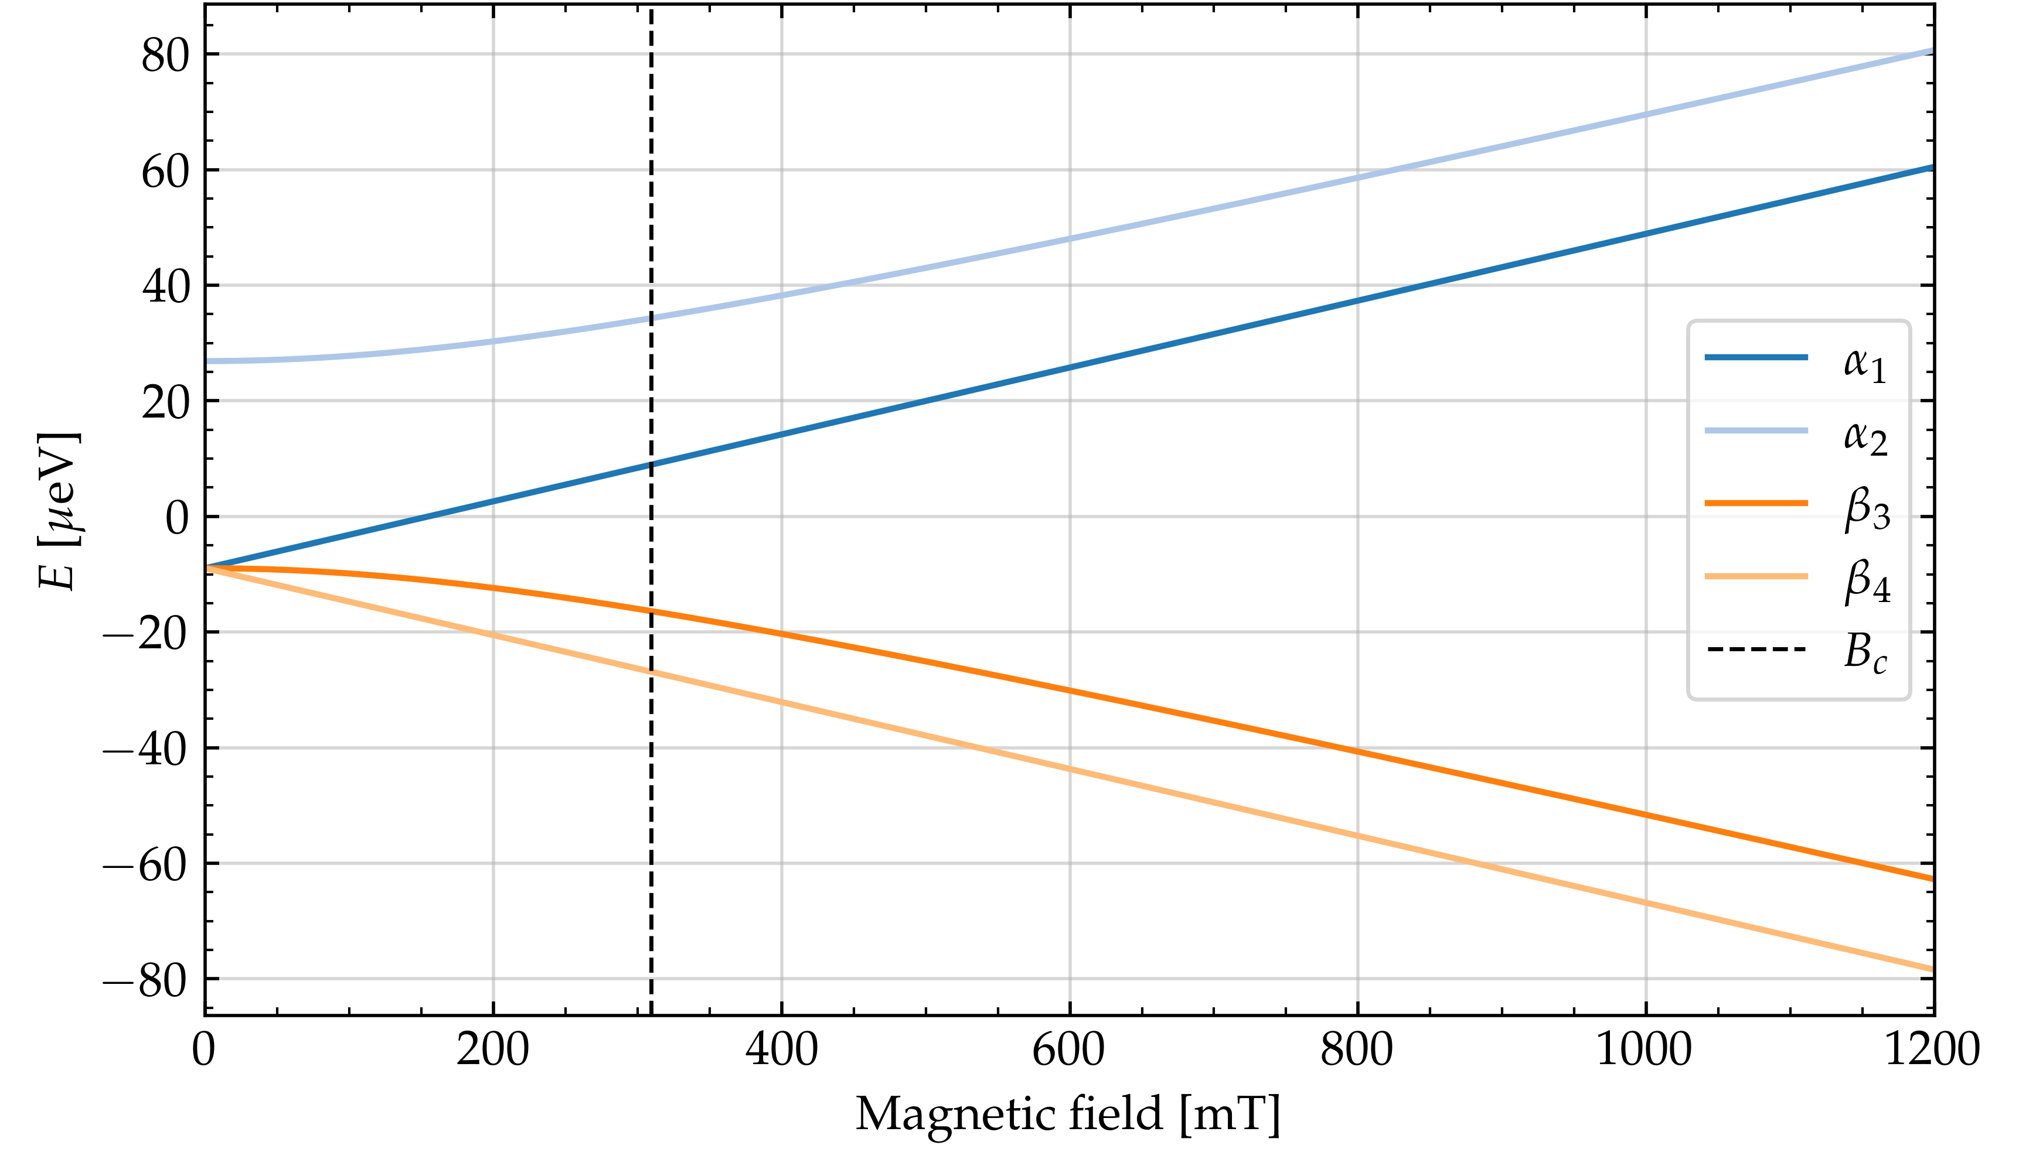
Simulations for a polarized ³He¹⁺ BEAM source
Breit-Rabi diagram of ³He⁺ (very similar to hydrogen)
E = 10 keV, 𝜆 = 10 cm, 𝜎 = 2/3 cm
A. Schneider et al., Direct measurement of the ³He⁺magnetic moments,
Nature 606, 878 (2022)

Slide 27
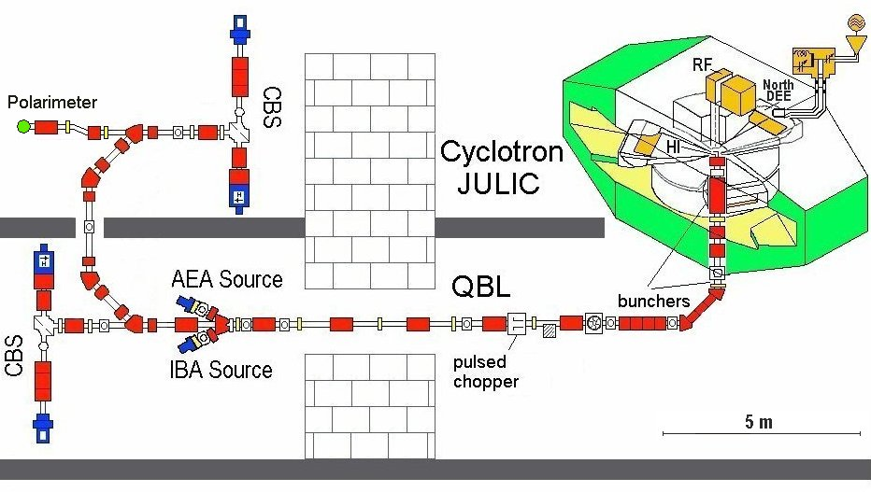
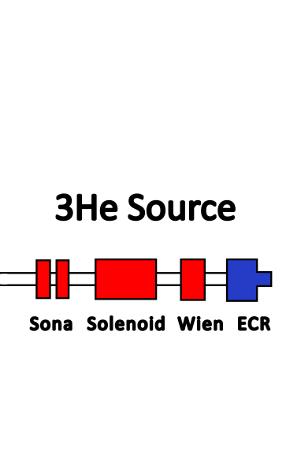
Acceleration of ³He ion beams @COSY
Beam time scheduled for Oct. 2023 / acceleration to 100 MeV

Slide 28
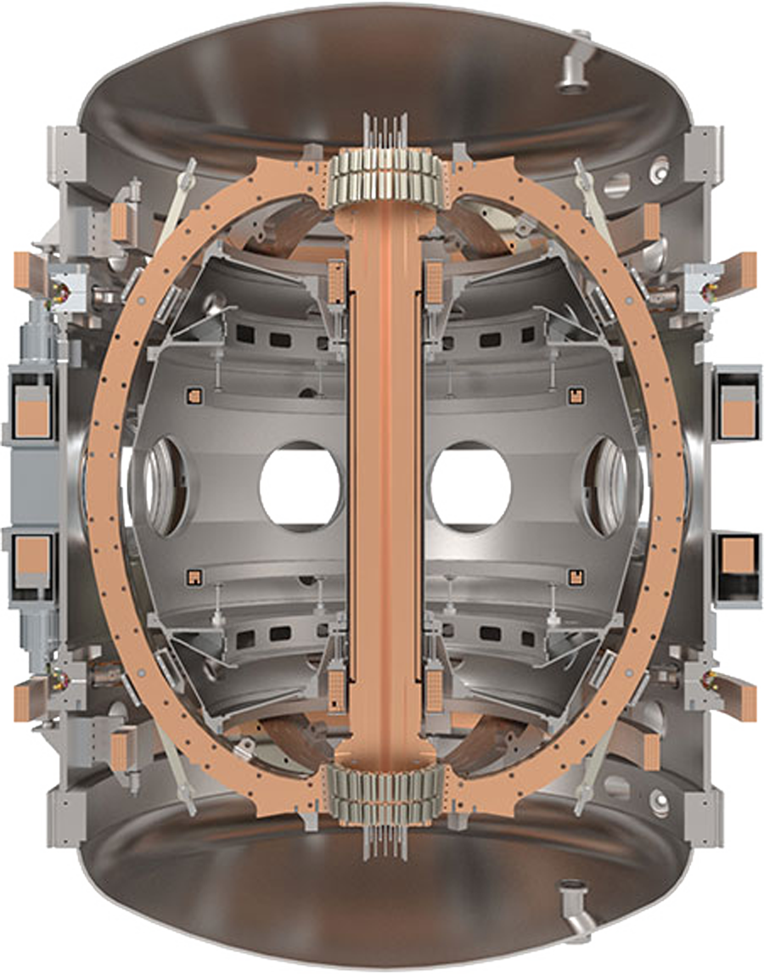

A first test at a tokamak
First test are planned for fall 2023
➔ Use deuterium diagnostic neutral beam to demonstrate that our method produces highly polarized, high-current-density, ~40 keV neutral beams

Slide 29


Back to the “show-stoppers”
Does polarization survive (in the fusion plasma) long enough?
How to produce enough polarized fuel (e.g. neutral beams, pellets)?
2023 has been a great year for polarized fusion!
Let‘s finally implement it at fusion facilities!

Slide 31
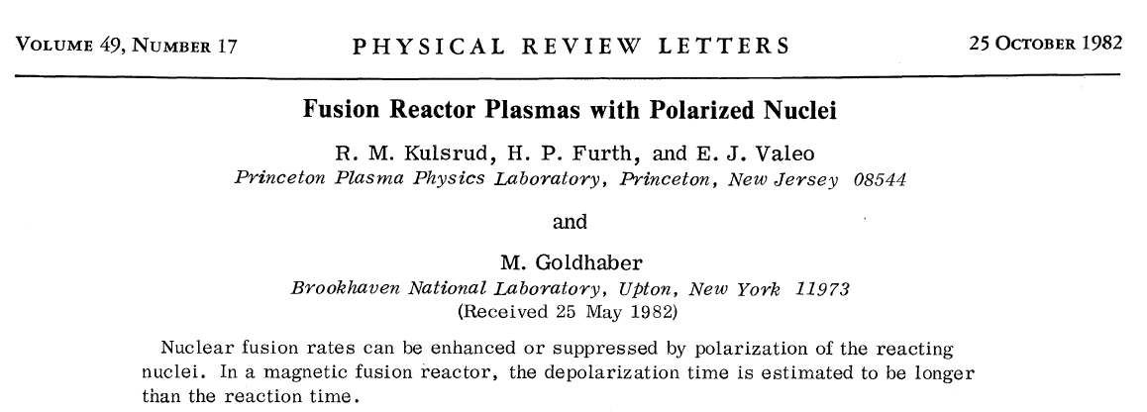
50 years later ... Back on the agenda

Slide 32
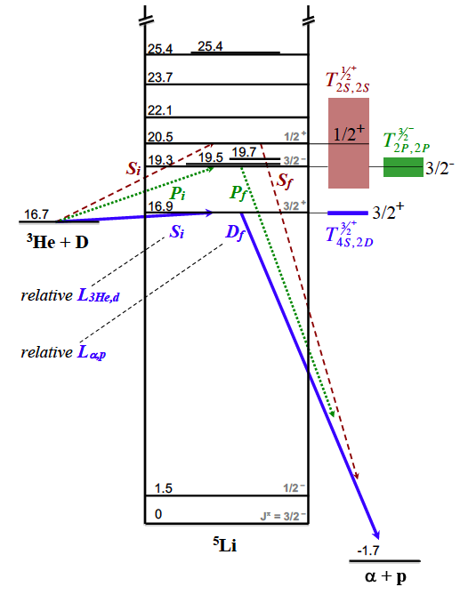
Use D-³He as a proxy for D-T
L. Baylor et al., Nucl. Fusion 63 (2023) 076009

Slide 33

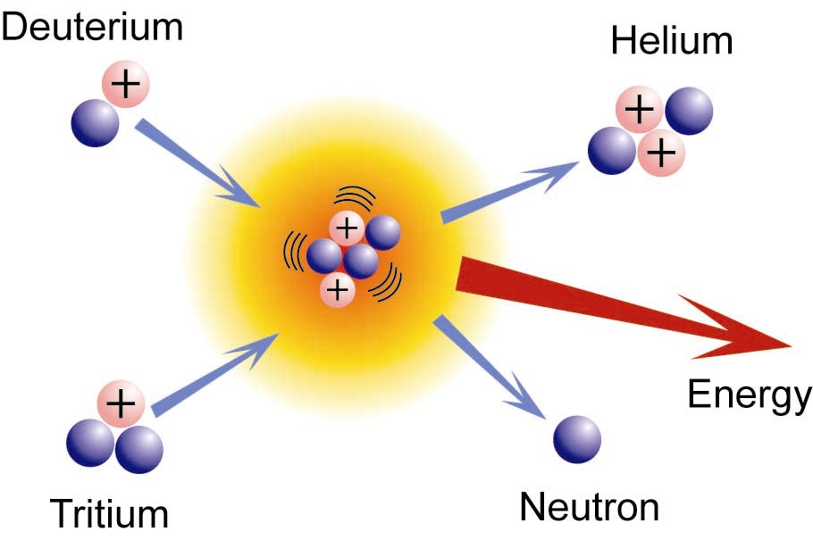
Further reading …
2016
Deuterium
Tritium
Notes:
the prospects are bright

Slide 34
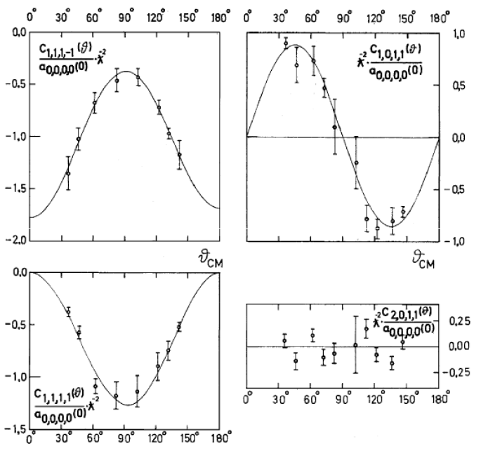
Anisotropic Angular distributions
Measurements in Basel 1971
Spin-correlation of the ${}_{ }^{3}{\vec{He}}\left(\vec{d},p\right){}_{ }^{4}{He}$ reaction at E_{d} = 430 keV
Polarized fuel
Increases the total cross section
Enhances the differential cross section for ϑ = 0°/180° (decrease for 90°)
The status of “polarized fusion”, H. Paetz gen. Schieck, Eur. Phys. J. A 44, 321 (2010)

Slide 35
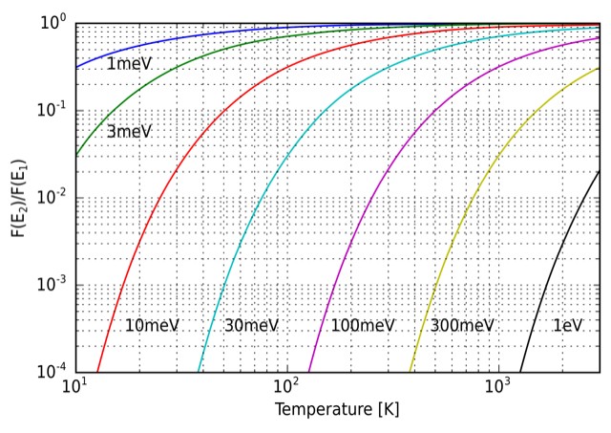

Polarization in plasmas??? What???
Boltzmann factor as a function of temperature for several energy differences ΔE (taken from Wikipedia)
Typical energy of (proton) spin states:
$E_{spin,p}=μ∙B=6∙{10}^{−8}\frac{eV}{T}∙1000 T ≈1 meV$
Typical temperature of the plasma:
10⁸ K $≈$ 10 keV
occupation probability of both spin states
(almost) equal in thermal equilibrium
no polarization (in thermal equilibrium)

Slide 36
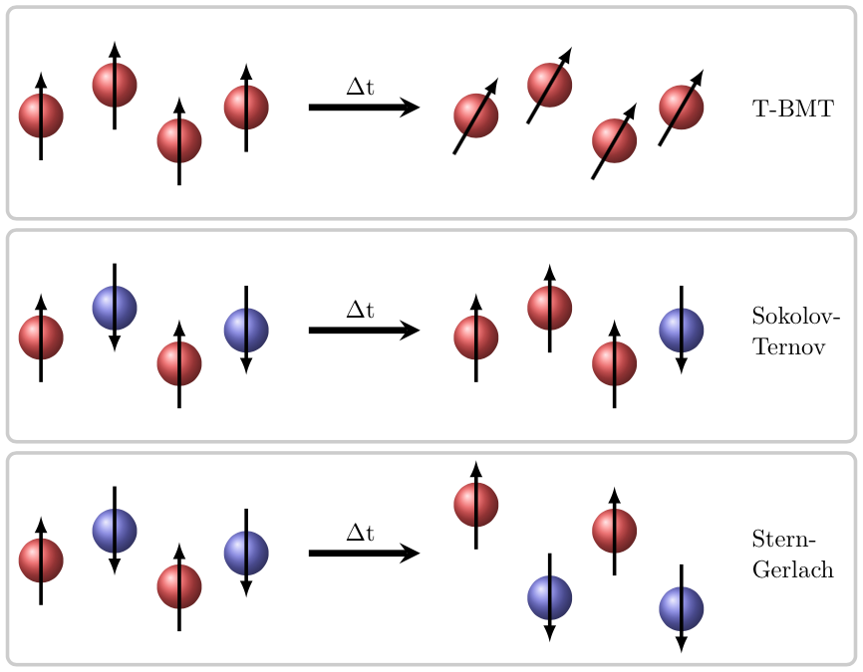
Possible (De-)Polarization effects
Conservation of polarization for times
< 1 ps in a 10³ T field
→ Dominant effect
Polarization time ~ 5 ms for a 100 GeV proton beam in a 1000 T field
Time scale too long
Separation distances are in the nm-range for e– & sub pm-range for protons
→ Spatial separation too small
Notes:
Thomas-Bargmann-Michel-Telegdi

Slide 37
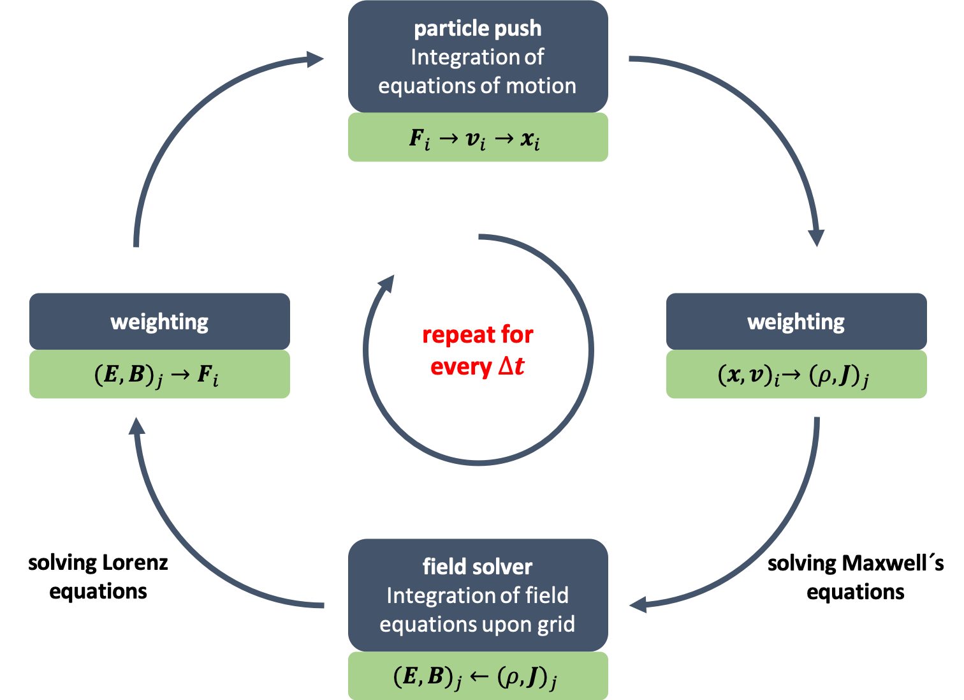
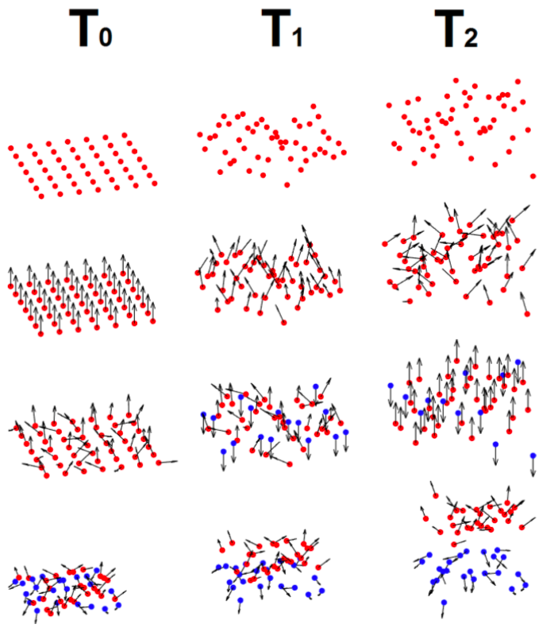

Spin dynamics in PIC simulation codes
Implementation into already existing code
Spin precession described by the Thomas-BMT equation
$∆$t
Notes:
If only T-BMT: no influence of spins on trajectories

Slide 38
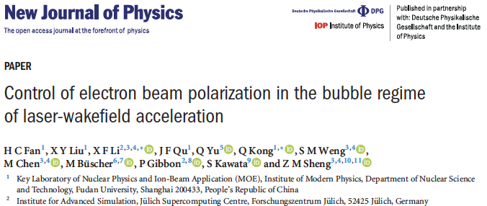
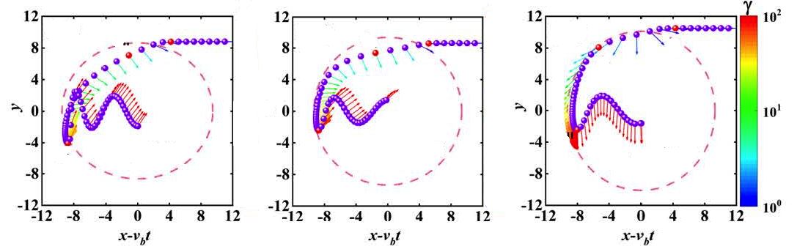
Modelling of Spins in laser-induced plasmas
An example: Laser-plasma acceleration of polarized electrons from a pre-polarized target
accelerated polarized electrons
accelerating plasma cavities („bubble“)

Slide 39

³He acceleration from unpolarized gas-jet
Pilot study (Oct. 2015)
Data
Simulation

Slide 40





Transport of polarized ³He Gas
Every morning: Transfer of 3 bar-liter ³He from FZJ to GSI (250 km)

Slide 41



polarized ³He gas: Pressure booster
Polarized ³He gas jet
Required pressure: ≈30 bar
Transport vessel: ≲3 bar

Slide 42



polarized ³He gas: Holding fields
Spins need a magnetic field to hold on
Notes:
Halbach-type magnetization pattern

Slide 43

Experimental setup @Phelix
Installation in the Phelix vacuum chamber (Aug. 2021)

Slide 44



Polarimetry for ³He ions
Test beam time at Jülich Tandetron
with unpolarized ³He beam
CR-39 stack
³He beam
CD₂ foil:
$$D\left({}_{ }^{3}{He},p\right){}_{ }^{4}{He}$$
Analysis by: C. Zheng
Notes:
Fusionsreaktion mit Deuterium with unpolarized 3He
We employ this fusion reation with transplates the degree of polarization into a measuble angluar asymmetry
The degree of polariztion is tranferred into a spatical asymmetry, the so-called analysing power
Ersatz für pol. Neutronenstrahlen, da hier die Polarisation sitzt
Of course 3He is a bit special, in generall proton acceleration would be adventageous

Slide 45


“front“ detectors (direct ³He Detection)
Unpolarized gas vs. polarized / Helmholtz coils off
Unpolarized ³He gas
Polarized ³He gas
x
z
Polarized gas: ~2 times higher count rate
Possible reason: Higher ³He-ion energy (³He¹⁺ vs. ³He²⁺)
😮

Slide 46


Measured (a-)symmetry
Unpolarized ³He gas
Unpolarized gas vs. polarized / Helmholtz coils off
$D\left({}_{ }^{3}{\vec{He}},α\right)p$
Long. polarized ³He gas
x
z
😮
Change of 𝛼-distribution: modified kinematics for polarized ³He gas
In both cases no left/right (up/down) asymmetry ➔ polarimeter works as expected
😀

Slide 47
Measured (a-)symmetry
Polarized gas / Helmholtz coils on ➔ Transversal ³He polarization expected
expected signal for unpol. ions
Asymmetry changes sign ➔ clear indication of ³He-ion polarization
😀

Slide 48



Polarized Hydrogen target
Nozzle
For HCl gas jet
Method described in:
T. P. Rakitzis,
Chem.Phys.Chem. 5, 1489 (2004)
IR/UV Laser
For photo-dissociation & polarization of H atoms,
100 mJ @ 1064 nm,
20 mJ @ 213 nm,
5 Hz, 170 ps
Lamb-Shift polarimeter
For measurement of nuclear polarization
R. Engels et al., Rev.Sci.Instrum. 74, 4607 (2003)

Slide 49


Polarized Hydrogen target @ FZJ
Circularly polarized 213 nm beam
Wien filter
Cs cell
Glavish ionizer
Linearly polarized 1064 nm beam
Spin filter

Slide 50
The Sona Transition
P.G. Sona:
“A new method proposed to increase polarization in polarized ion sources of H– and D–”
Energia Nucleare 14, 295 (1967).
➔ efficient method to exchange the occupation numbers of the ‘pure‘ hyperfine substates α₁ and β₃
(|F=+1, m_{F}=+1> and |F=1, m_{F}= –1>)
Idea:
Flip the quantization axis (B_{z}) faster than the Larmor precession (non-adiabatic transition)

Slide 51

The Sona Transition (original idea)
ω_{B}
B
Before: α₁
After: β₃
ω_{Larmor}
Sona coil 1
Sona coil 2
μ
B
Zero-Crossing Point
B
μ
$$ω_{B}≫ω_{Larmor} ⟹B_{long.}/dz≪100 {mT}/{cm} ({\text{∅}}_{\text{Beam}}\text{ = 2 }\text{cm}\text{ / }\text{λ} \text{=} \text{20 }\text{cm}\text{ / }\text{E} \text{= 1 }\text{keV}\text{)}$$

Slide 52

Solving the Schrödinger Equation
Metastable Deuterium
1 keV, 3𝜎=1.5 cm
“This also works for ground states”
😮

Slide 53


Another (even bigger) surprise!!
Oscillations also visible without initial polarization
Simulation
Data
“If magnetic field amplitude (B_{long} ) and frequency (B_{rad} ) match, everything with a (known) hyperfine structure can be polarized!”
B [a.u.]
😮

Slide 54

Source for polarized ³He ion beams

Slide 55

Polarimetry
$p\left({}_{ }^{3}{\vec{He}},{}_{ }^{3}{He}\right)p$ elastic scattering has high sensitivity
Optimum ³He⁺ beam energy: ~80 MeV
➔ Acceleration at JULIC cyclotron

Slide 56


³He Polarimeter
Target-Ladder
holds 5 different targets
Measurements: Sept. 2023
12 Detectors
Scintillator and Photomultiplier
exchangeable aperture
³He⁺ beam
8 motorized carts
automated angle-selection

Slide 57
Polarized fuel for fusion reactors
Option 1: Neutralized kA beams (use ‚standard‘ Sona units)
Option 2: Pellet injection into Tokamaks / Fuel pellets for Laser fusion
➔ Sona coils maybe not useful (velocity to small, magnetic stray fields, ...)
➔ Galileo-Transformation: Sample at rest
B_{r}
RF generator 1
t
B_{z}
😯
1 W = 1 J/s ~ 10¹⁹ eV/s ~ 10²⁸ Photons/s
RF generator 2
t

Slide 58
A versatile method to produce hyperpolarized samples
This method should work for any (liquid, solid) material with a (simple, known) hyperfine structure
    ➔ e.g. H₂O, ¹¹B₁₀H₁₄ and many more!
How to measure the nuclear polarizations? How does the BR-diagram look like?
B_{r}
RF generator 1
t
B_{z}
RF generator 2
t

Slide 59
Dealing with Polarized Particles …
.... is relevant, interesting … and fun!^{*)}
^{*)} Not only for fusion research!
Notes:
Kreisel = spinning top

