Slide 1
Highly efficient proton acceleration from solid ultra thin plastic foils
Isra Salaheldin, M. Shi, P. Hilz, A. Sävert, G. Schäfer & M. Zepf
6th EAAC Workshop
19 September 2023

Slide 2
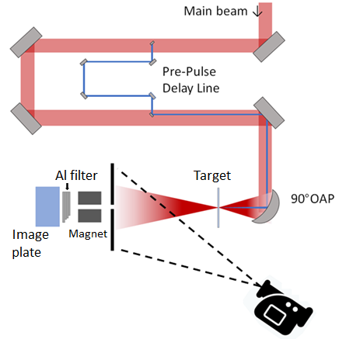
Overview
Experimental campaign at HI-Jena with thin plastic foils
High-quality proton beams (20 MeV/J) via …
… high laser contrast
… high focus quality
… thin plastic foils
Results from the experiment

Slide 3
JETi200 laser system
Wavelength: 800 nm
Medium: Ti:Sapphire
Energy on target: up to 5 J
Pulse duration: 17 fs Peak power: 300 TW
Repetition rate: 5 Hz
Probe beam: 5 fs @ 750 nm
Double CPA system + XPW

Slide 4
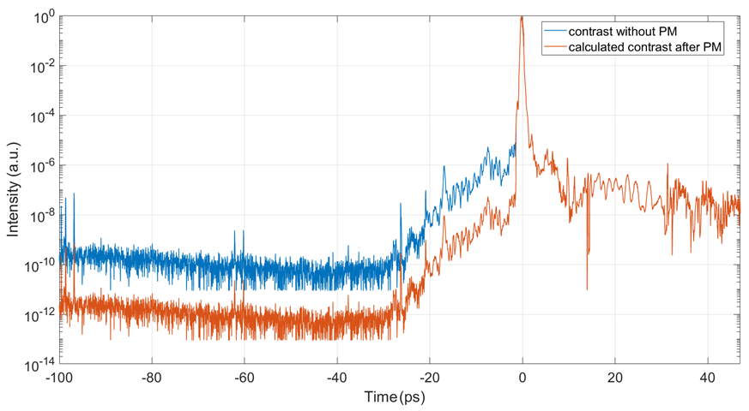
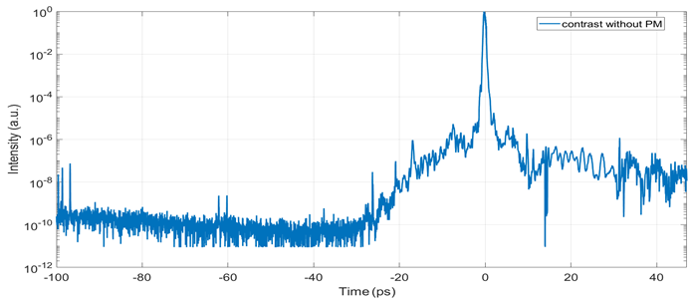
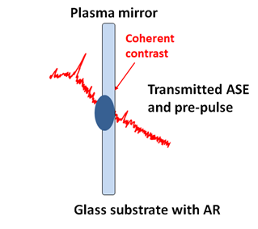
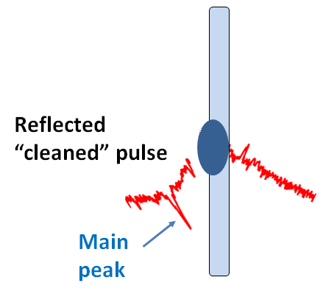
Plasma mirror for high laser contrast

Slide 5
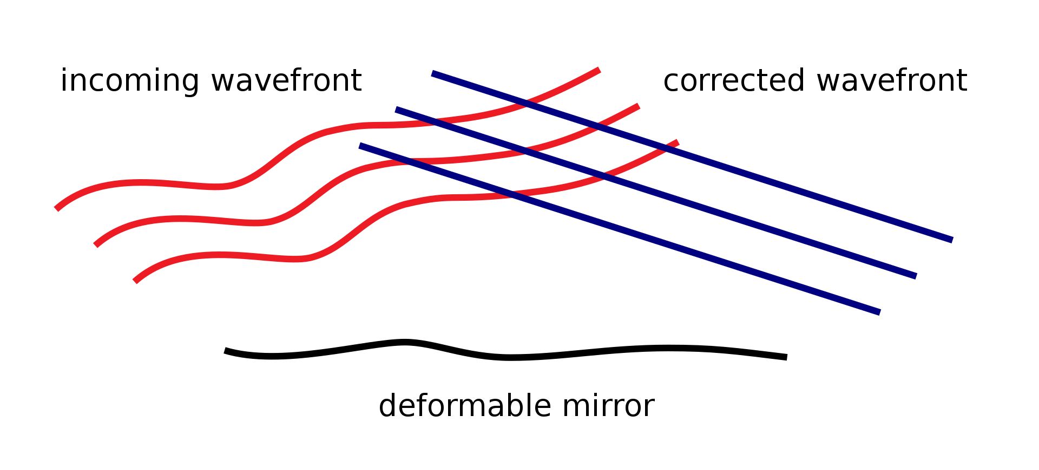
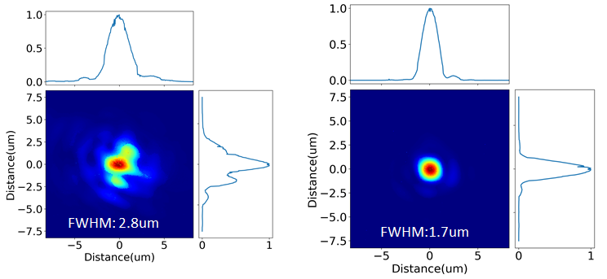
Deformable mirror for high-quality focus

Slide 6
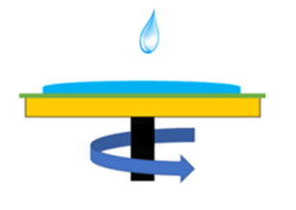
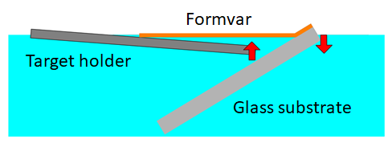
Ultra-thin foil fabrication in Jena
Spin coating
Target floating
Fabrication Method:
Spin coating
Solution:
Formvar powder
Solvent:
Dichloroethane
Formvar Structure :
Glass substrate
$$\left[C_{3}H_{6}O_{2}\right], 1.23 g/ml$$
Thickness of 10 nm – 1 µm
30 nm target on the target holder

Slide 7
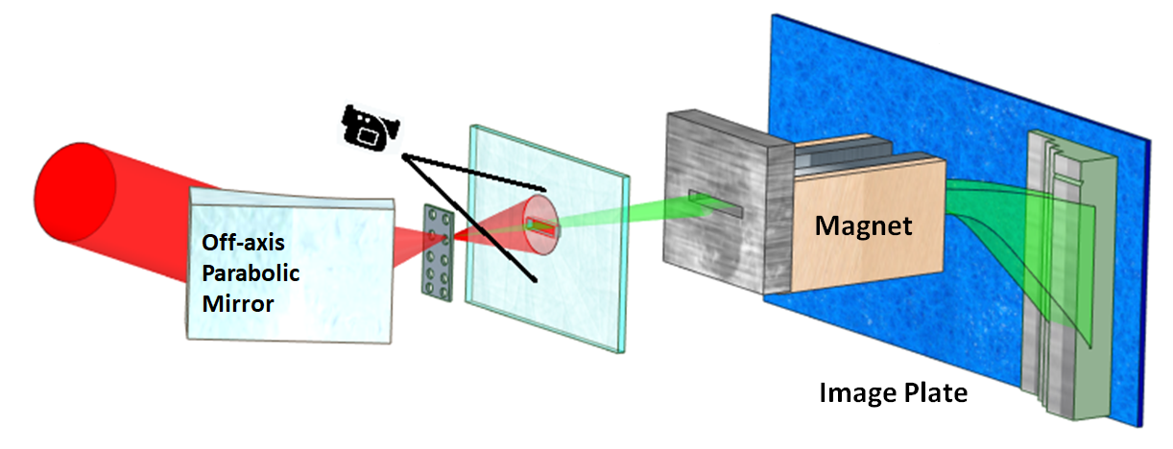
Experimental parameters
$a_{0}$ for LP = 30
$a_{0}$for CP = 21
Pulse duration = 25 fs
Energy on target = 1.23 J
Focal spot size = 1.7 µm
Target: Ultrathin (Formvar) foils
Foil thickness range = (10-200) nm

Slide 8
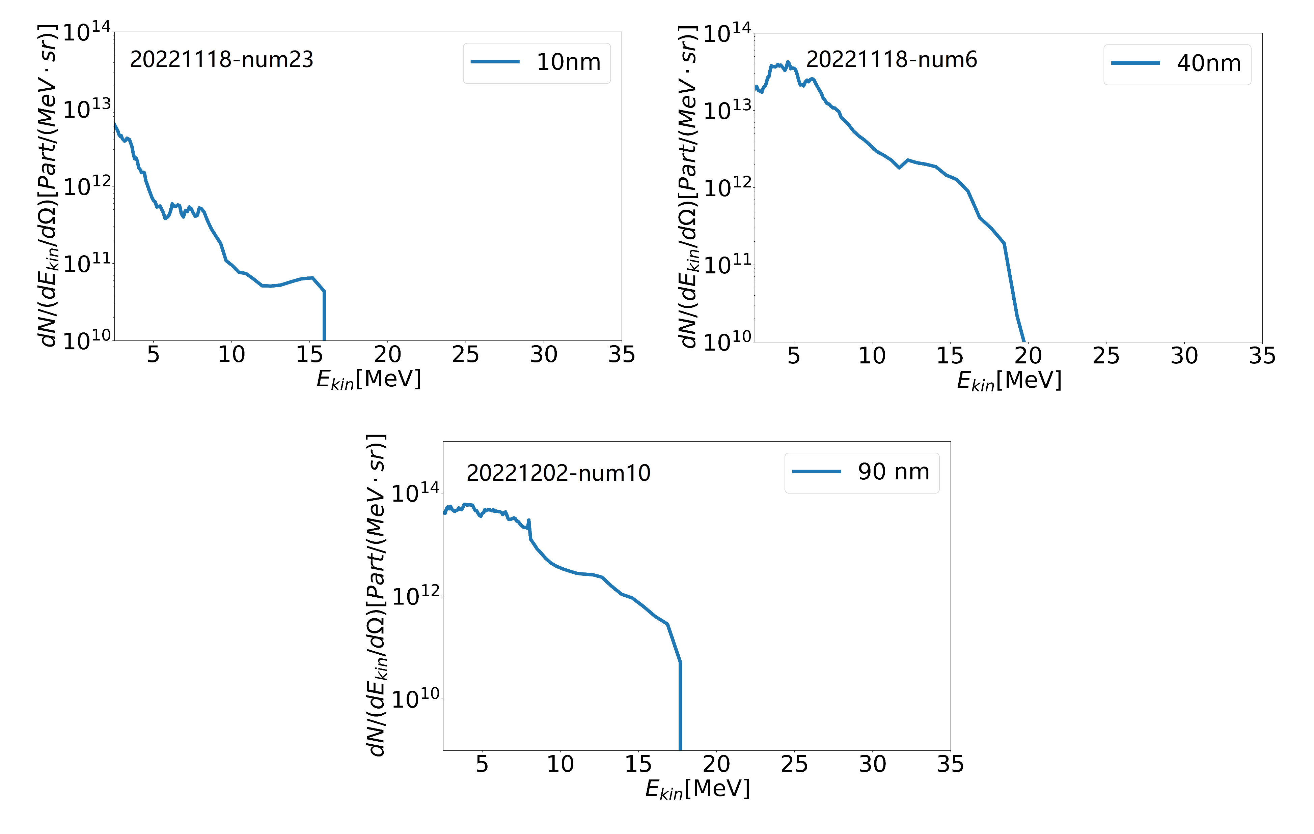
Energy spectrum with LP from solid foils

Slide 9
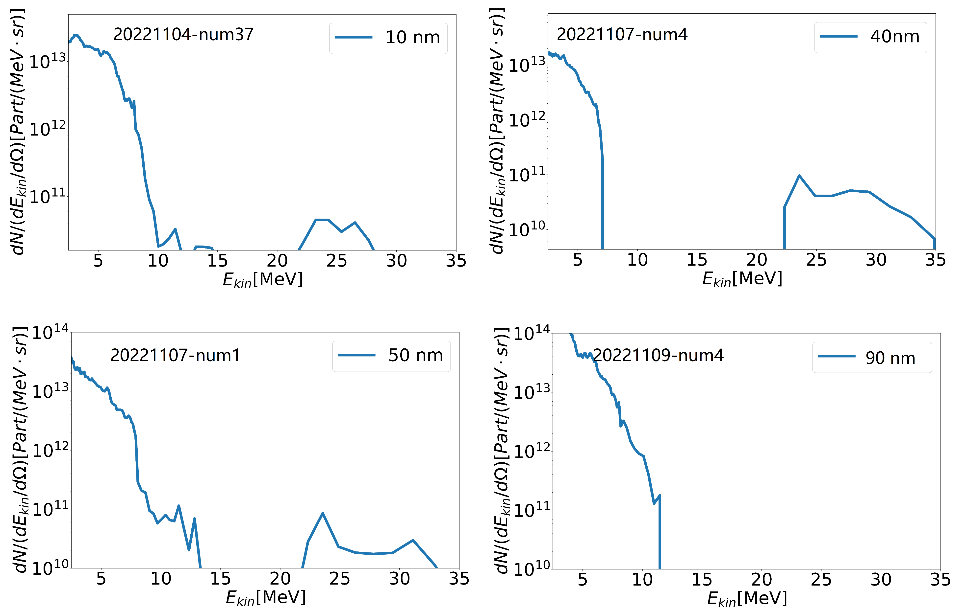
Energy spectrum with CP from solid foils

Slide 10
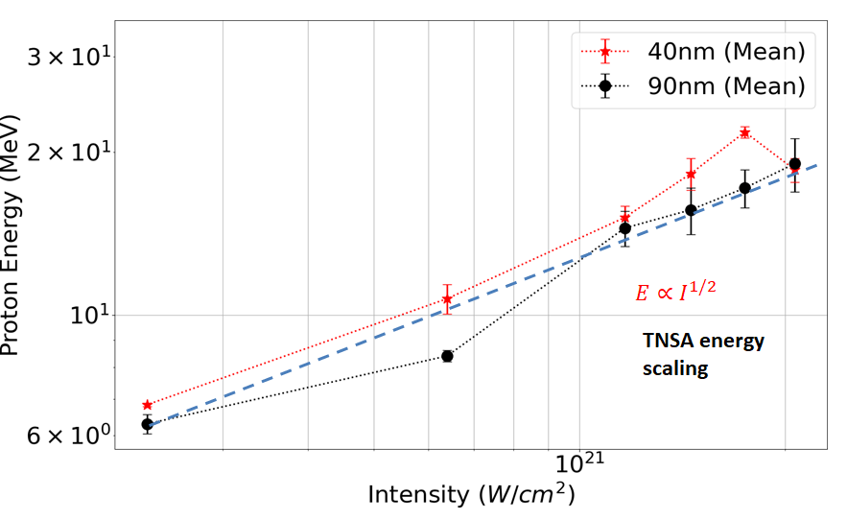
Scaling with Intensity (LP)
LP

Slide 11
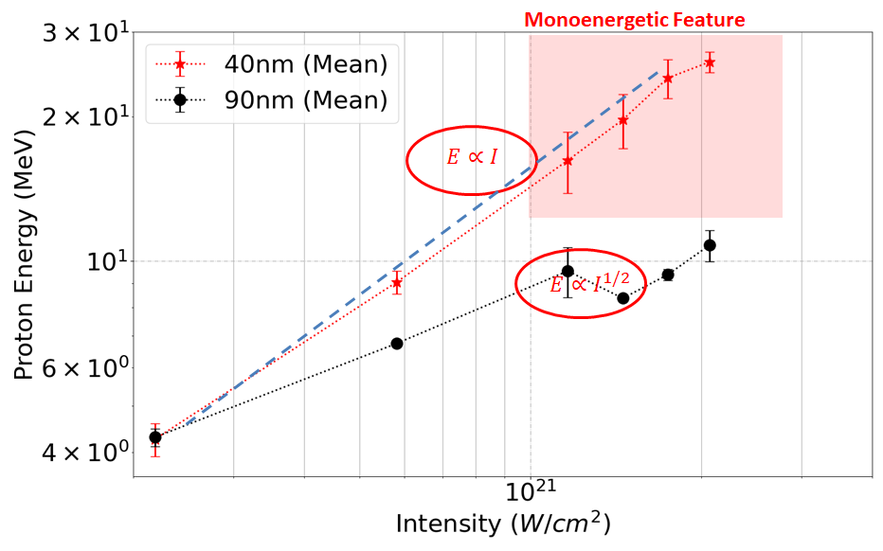
Scaling with Intensity (CP)
CP

Slide 12
Summary
LP
Experimentally obtained monoenergetic proton beams (~35 MeV)
High energy conversion rate (~20 MeV/J)
TNSA for thicker targets with LP
Hybrid (RPA-CE) thin targets with CP
Reproduceable results
CP

Slide 14
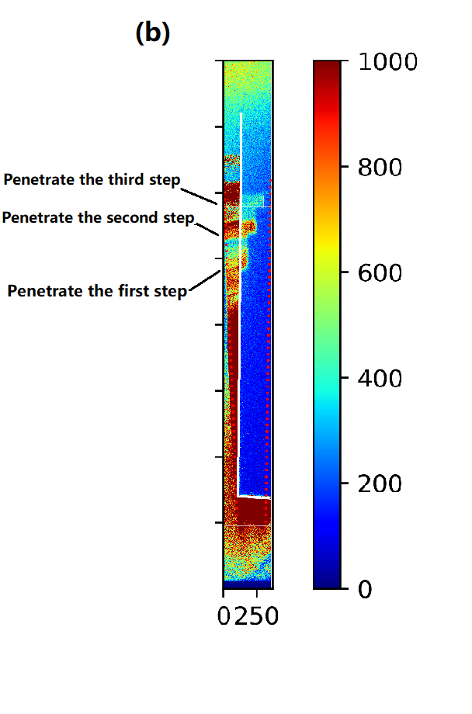
Aluminum step filter
(a) (b) (c)
front top
Aluminum step filter
raw data

Slide 15
Target thickness scan with CP laser

Slide 16
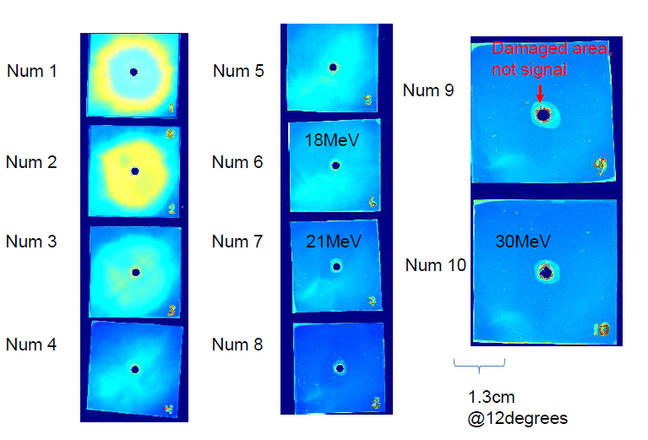
40 nm target under CP laser incidence

