Slide 1
3D structure of microbunched plasma-wakefield-accelerated electron beams inferred by coherent optical transition radiation
Helmholtz-Zentrum Dresden-Rossendorf
M. LaBerge, A. Debus, O. Zarini, A. Willmann, R. Pausch, Y. Y. Chang,
J. Couperus Cabadağ, S. Schöbel, P. Ufer, U. Schramm, A. Irman
University of Texas – Austin
A. Hannasch, B. Bowers, R. Zgadzaj, M. C. Downer
Fermilab
A. H. Lumpkin

Slide 2
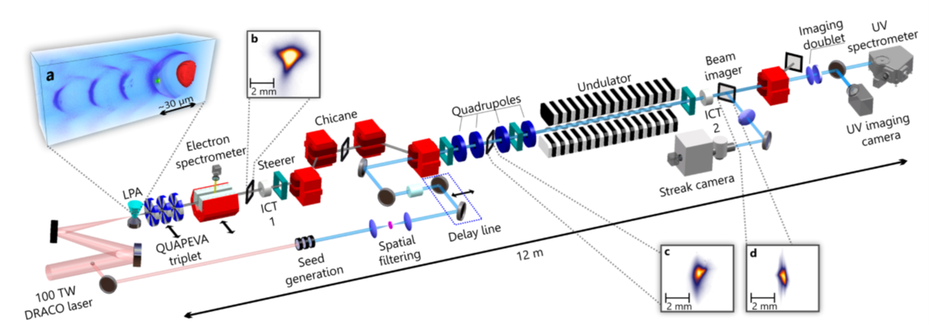
We have produced consistent FEL quality electron beams at HZDR
Comprehensive in-situ diagnostics are important to improve the LPA performance
High spectral-charge density LPA beams + COXINEL line enable free-electron lasing in a seed configuration.
Marie Labat et al., „Seeded free-electron laser driven
by a compact laser plasma accelerator“, Nat. Photon. 17, 150 (2022). https://doi.org/10.1038/s41566-022-01104-w

Slide 3
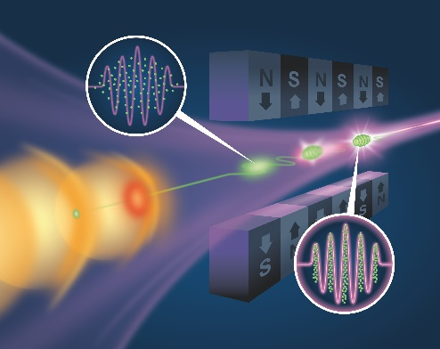
What would we like to know about our electron beams
Size (micron scale resolution)
Emittance
Structures
  Correlations
  Microbunching
Observe the beam evolution
Ideally observed in a single shot
Dependence of these parameters on the injection process
  Pre-bunched beams

Slide 4
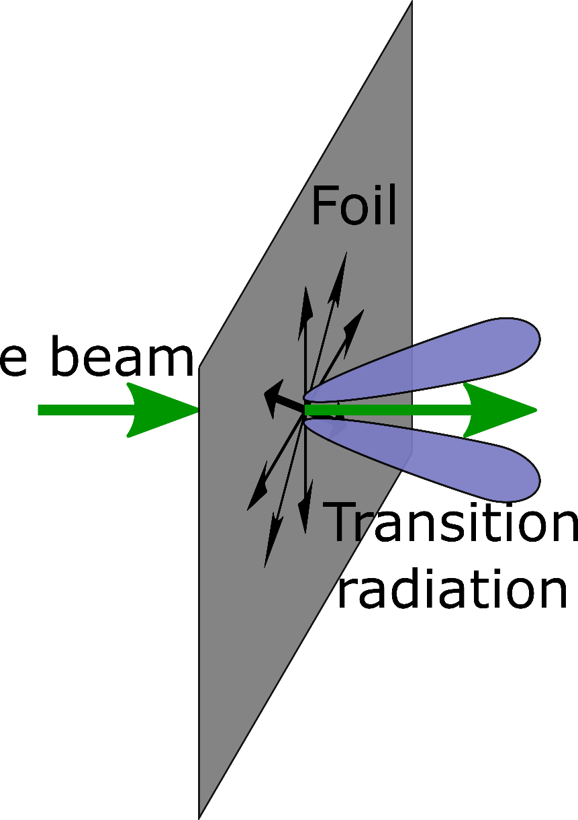
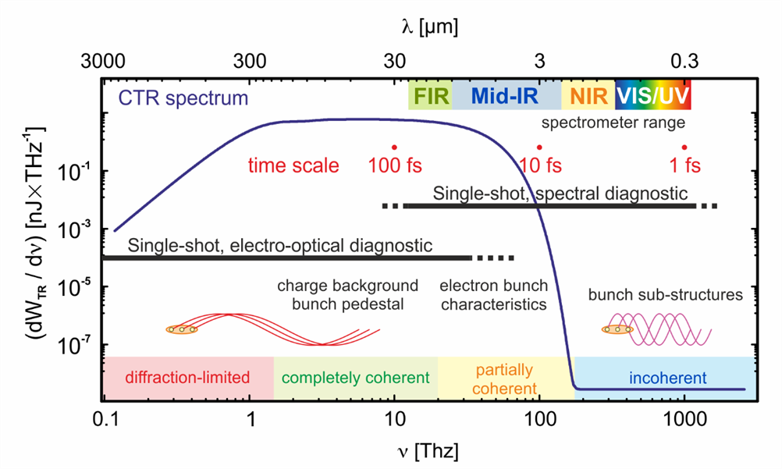
Longitudinal beam structure is encoded in the coherent transition radiation spectrum
Currents on the foil surface are driven by the electron beam
These radial currents give way to broadband transition radiation
Longitudinal structures in the electron beam are encoded in the transition radiation spectrum
Sim: 200 MeV, 20pC, 10 fs bunch length, 20 µm diameter

Slide 5
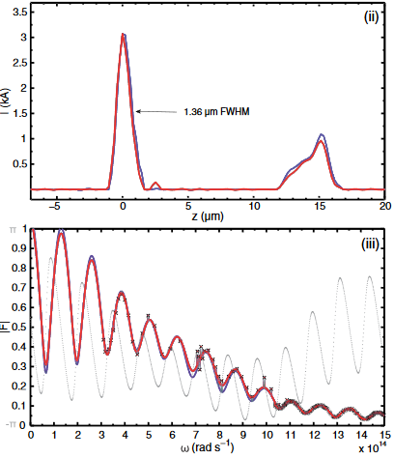
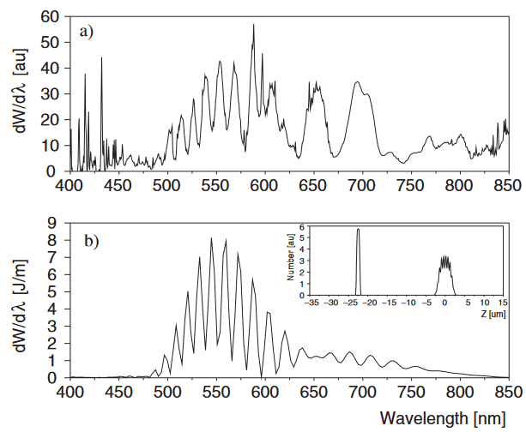
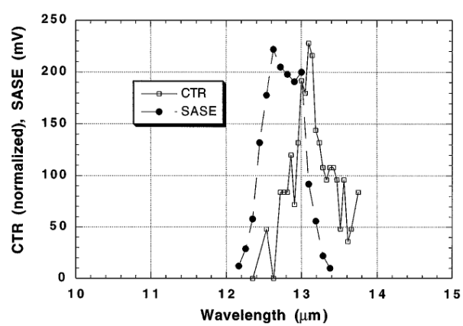
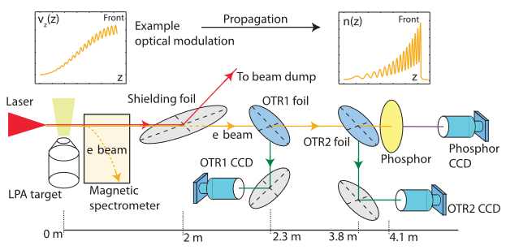
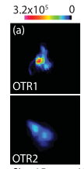
Coherent transition radiation has been a valuable tool for observing electron beam structures
CTR has been used to diagnose microbunching
Determine the displacement between two LPA beams
Characterize slice energy spread of LPA beams
Reconstruct LPA longitudinal beam profile
See also:
Lumpkin, A.H. et al.: Evidence for Microbunching “Sidebands” in a Saturated Free-Electron Laser Using Coherent Optical Transition Radiation. Phys. Rev. Lett. 88(23), 234801 (2002).
Glinec, et al.: Observation of fine structures in laser-driven electron beams using coherent transition radiation. Phys. Rev. Lett. 98(19), 98–101 (2007).
Lin, C. et al.: Long-range persistence of femtosecond modulations on laser-plasma-accelerated electron beams. Phys. Rev. Lett. 108, 094801 (2012).
Lin, C. et al.: Long-range persistence of femtosecond modulations on laser-plasma-accelerated electron beams. Phys. Rev. Lett. 108, 094801 (2012).
See also:
Lundh, O. et al. Few femtosecond, few kiloampere electron bunch produced by a laser–plasma accelerator. Nature Phys 7, 219–222 (2011).
Heigoldt, M. et al.: Temporal evolution of longitudinal bunch profile in a laser wakefield
accelerator. Phys. Rev. ST Accel. Beams 18, 121302 (2015).
Bakkali Taheri, F. et al.: Electron bunch profile reconstruction based on phase-constrained iterative algorithm. Phys. Rev. Accel. Beams 19(3), 032801 (2016).
Tremaine, A., et al.: Observation of self-amplified spontaneous-emission-induced electron-beam microbunching using coherent transition radiation. Phys. Rev. Lett. 81(26), 5816–581 (1998).
Bajlekov, S. I., et al. "Longitudinal electron bunch profile reconstruction by performing phase retrieval on coherent transition radiation spectra." Physical Review Special Topics-Accelerators and Beams 16.4 (2013): 040701.
Glinec, et al.: Observation of fine structures in laser-driven electron beams using coherent transition radiation. Phys. Rev. Lett. 98(19), 98–101 (2007).

Slide 6
Coherent transition radiation based longitudinal reconstructions at HZDR

Slide 7
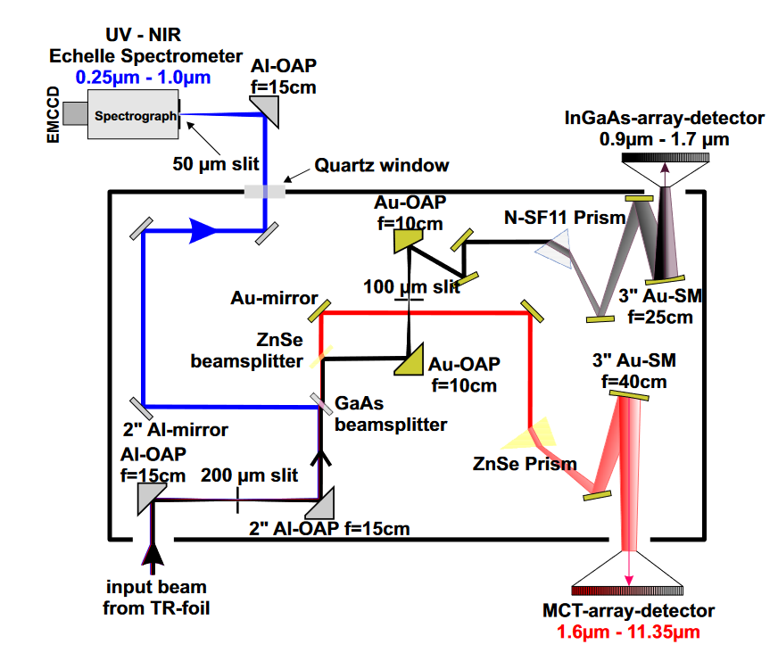
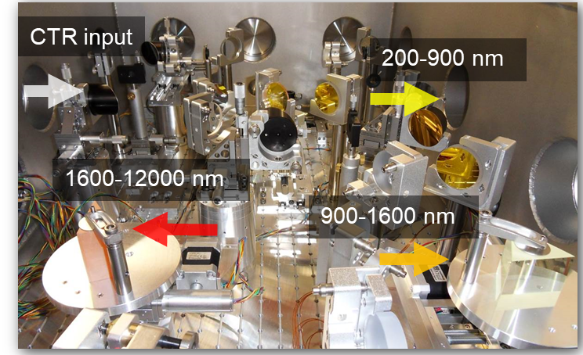
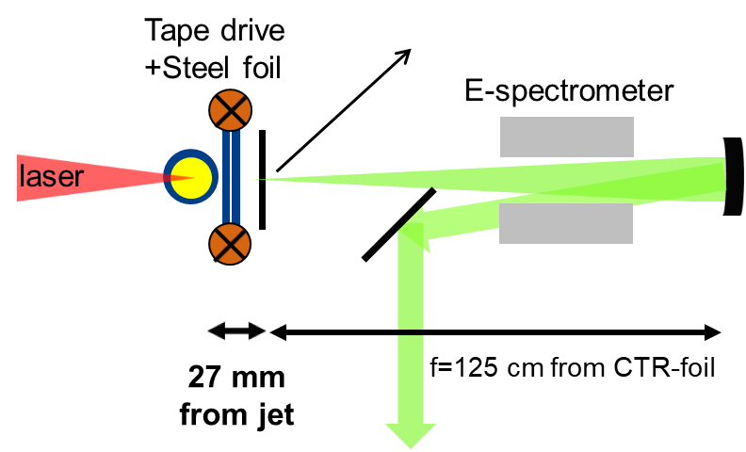
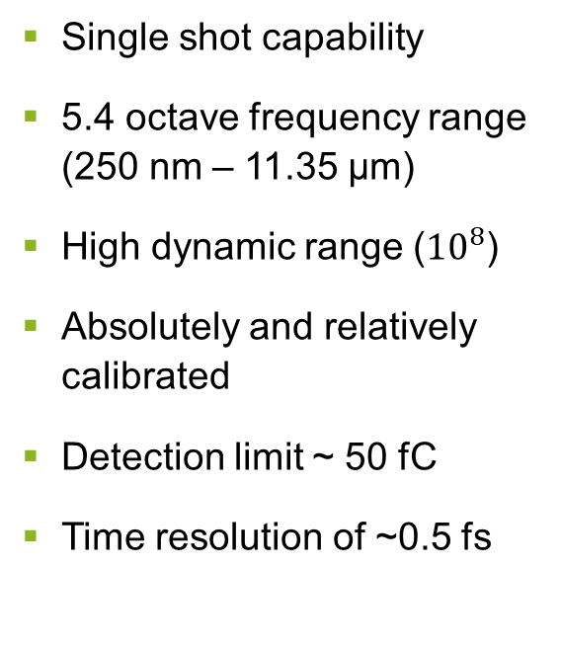
We use a multi-octave spectrometer to measure coherent transition radiation from LPA electron bunches
Single shot capability
5.4 octave frequency range (250 nm – 11.35 µm)
High dynamic range (${10}^{8}$)
Absolutely and relatively calibrated
Detection limit ~ 50 fC
Time resolution of ~0.5 fs

Slide 8
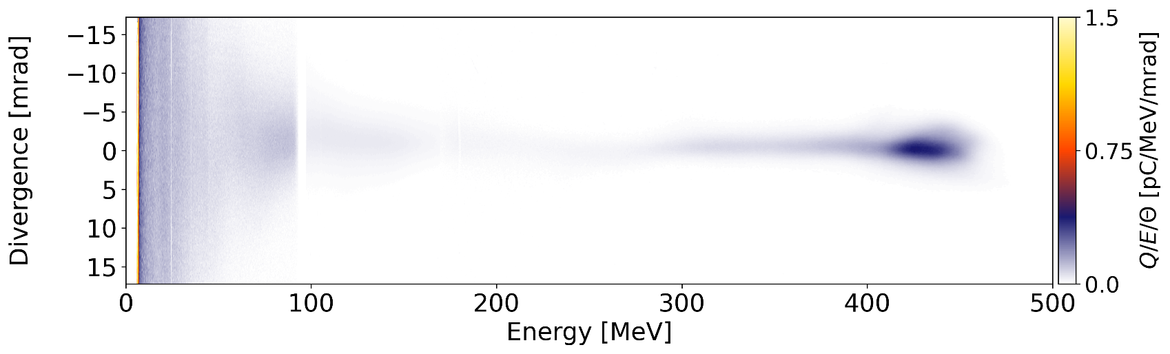
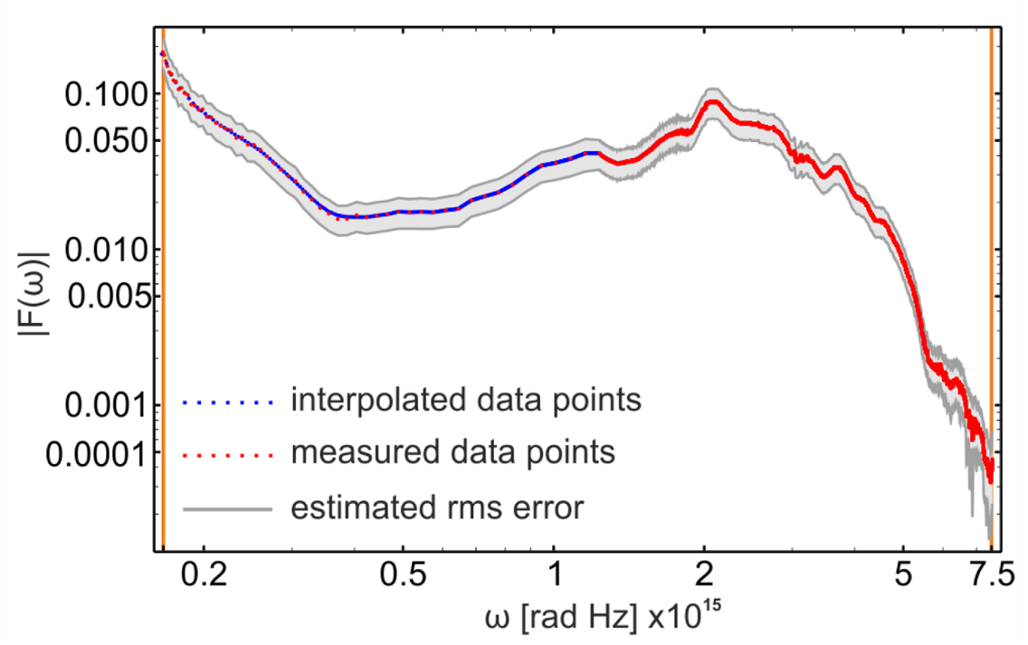
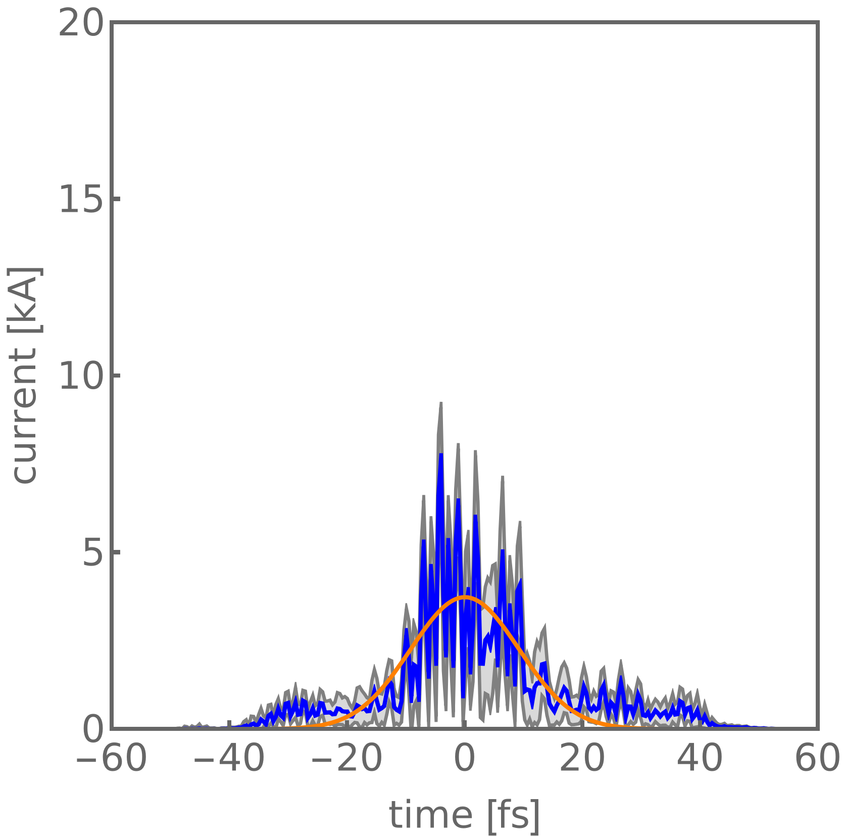
Using the radiation spectrum and an iterative phase reconstruction algorithm, we determine the longitudinal beam profile
Measured
Measured
Reconstructed
O. Zarini et al., “Multioctave high-dynamic range optical spectrometer for single-pulse, longitudinal characterization of ultrashort electron bunches,” Phys. Rev. Accel. Beams 25, 012801, 2021.
O. Zarini et al., "Advanced Methods for Temporal Reconstruction of Modulated Electron Bunches," Breckenridge, CO, USA, 2018, pp. 1-5, doi: 10.1109/AAC.2018.8659388.
Notes:
Hybrid-input-output and Gerchberg-Saxton reconstruction algorithms sequentially used

Slide 9
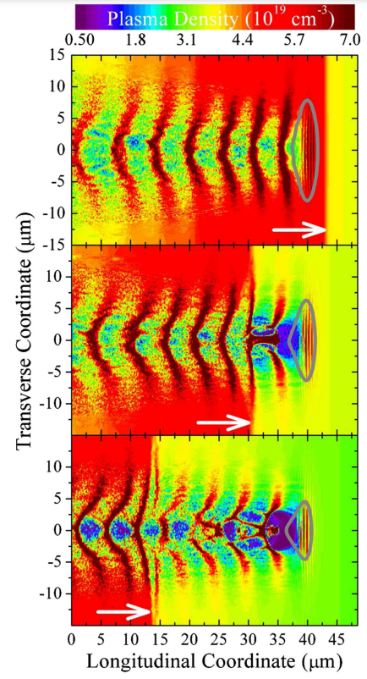
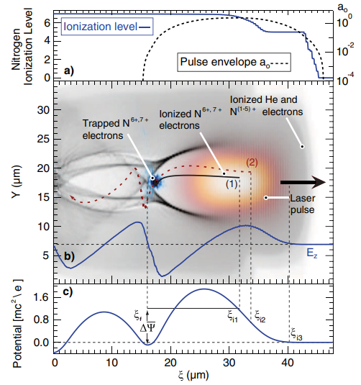
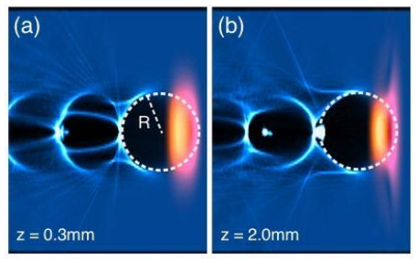
Injection mechanisms have a critical effect on the structure of the electron bunch
Down-ramp injection
Ionization injection
Self injection
Lu et al., “Generating multi-GeV electron bunches using single stage laser wakefield acceleration in a 3D nonlinear regime”, Phys. Rev. ST Accel. Beams, vol. 10, no. 6, pp. 061301, 2007.
Down-ramp: Plasma density gradient changes the shape of the bubble
Ionization injection: Inner shell electrons from nitrogen are ionized inside the bubble
K. Schmid et al., "Density-transition based electron injector for laser driven wakefield accelerators", Phys. Rev. ST Accel. Beams, Vol. 13 pp. 091301, 2010
Self injection: Laser evolution changes the shape of the bubble
Pak et al., “Injection and Trapping of Tunnel-Ionized Electrons into Laser-Produced Wakes”, Phys. Rev. Lett., vol 104, no. 2 pp. 025003, 2010.

Slide 10
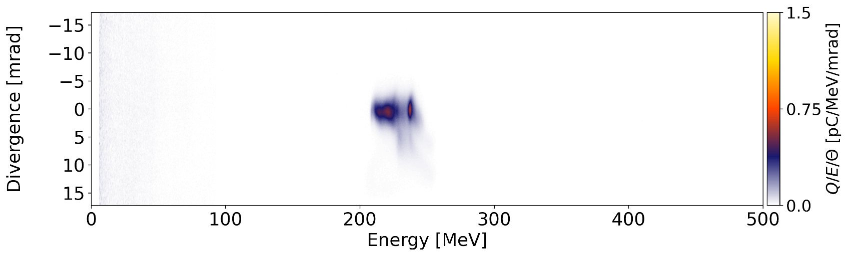
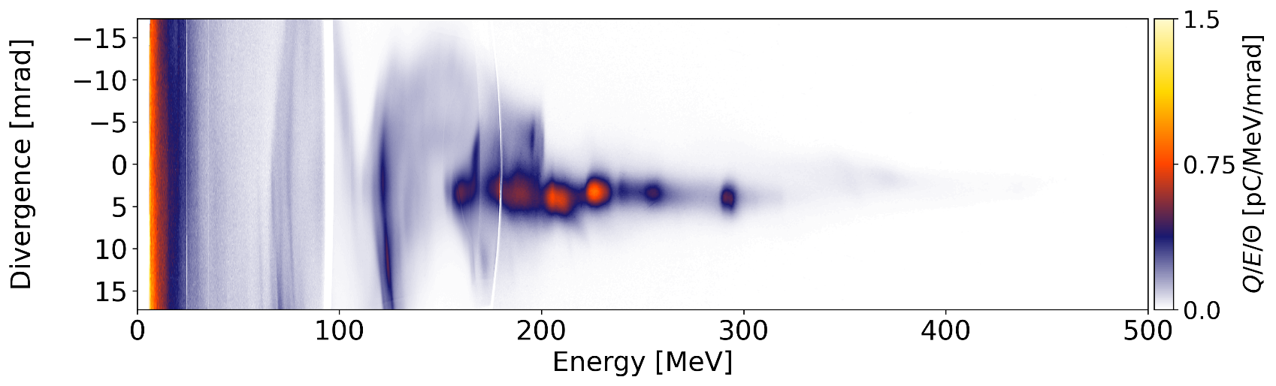
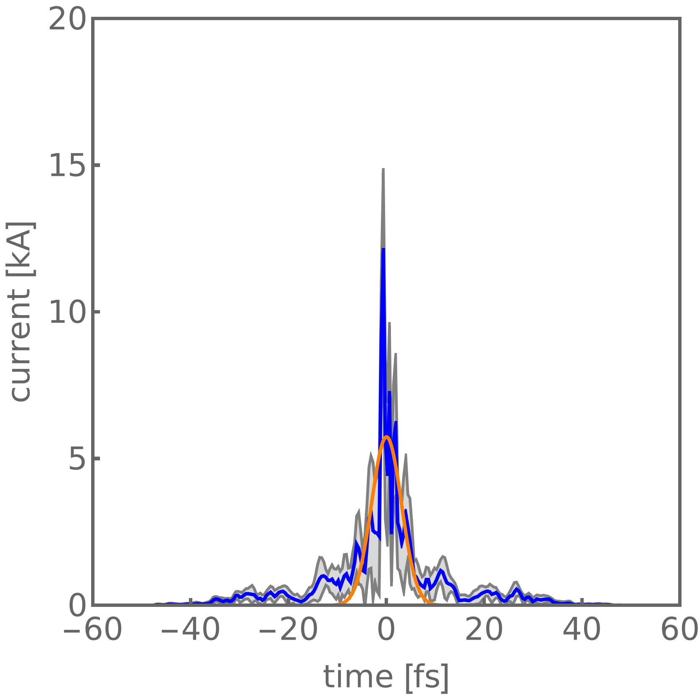
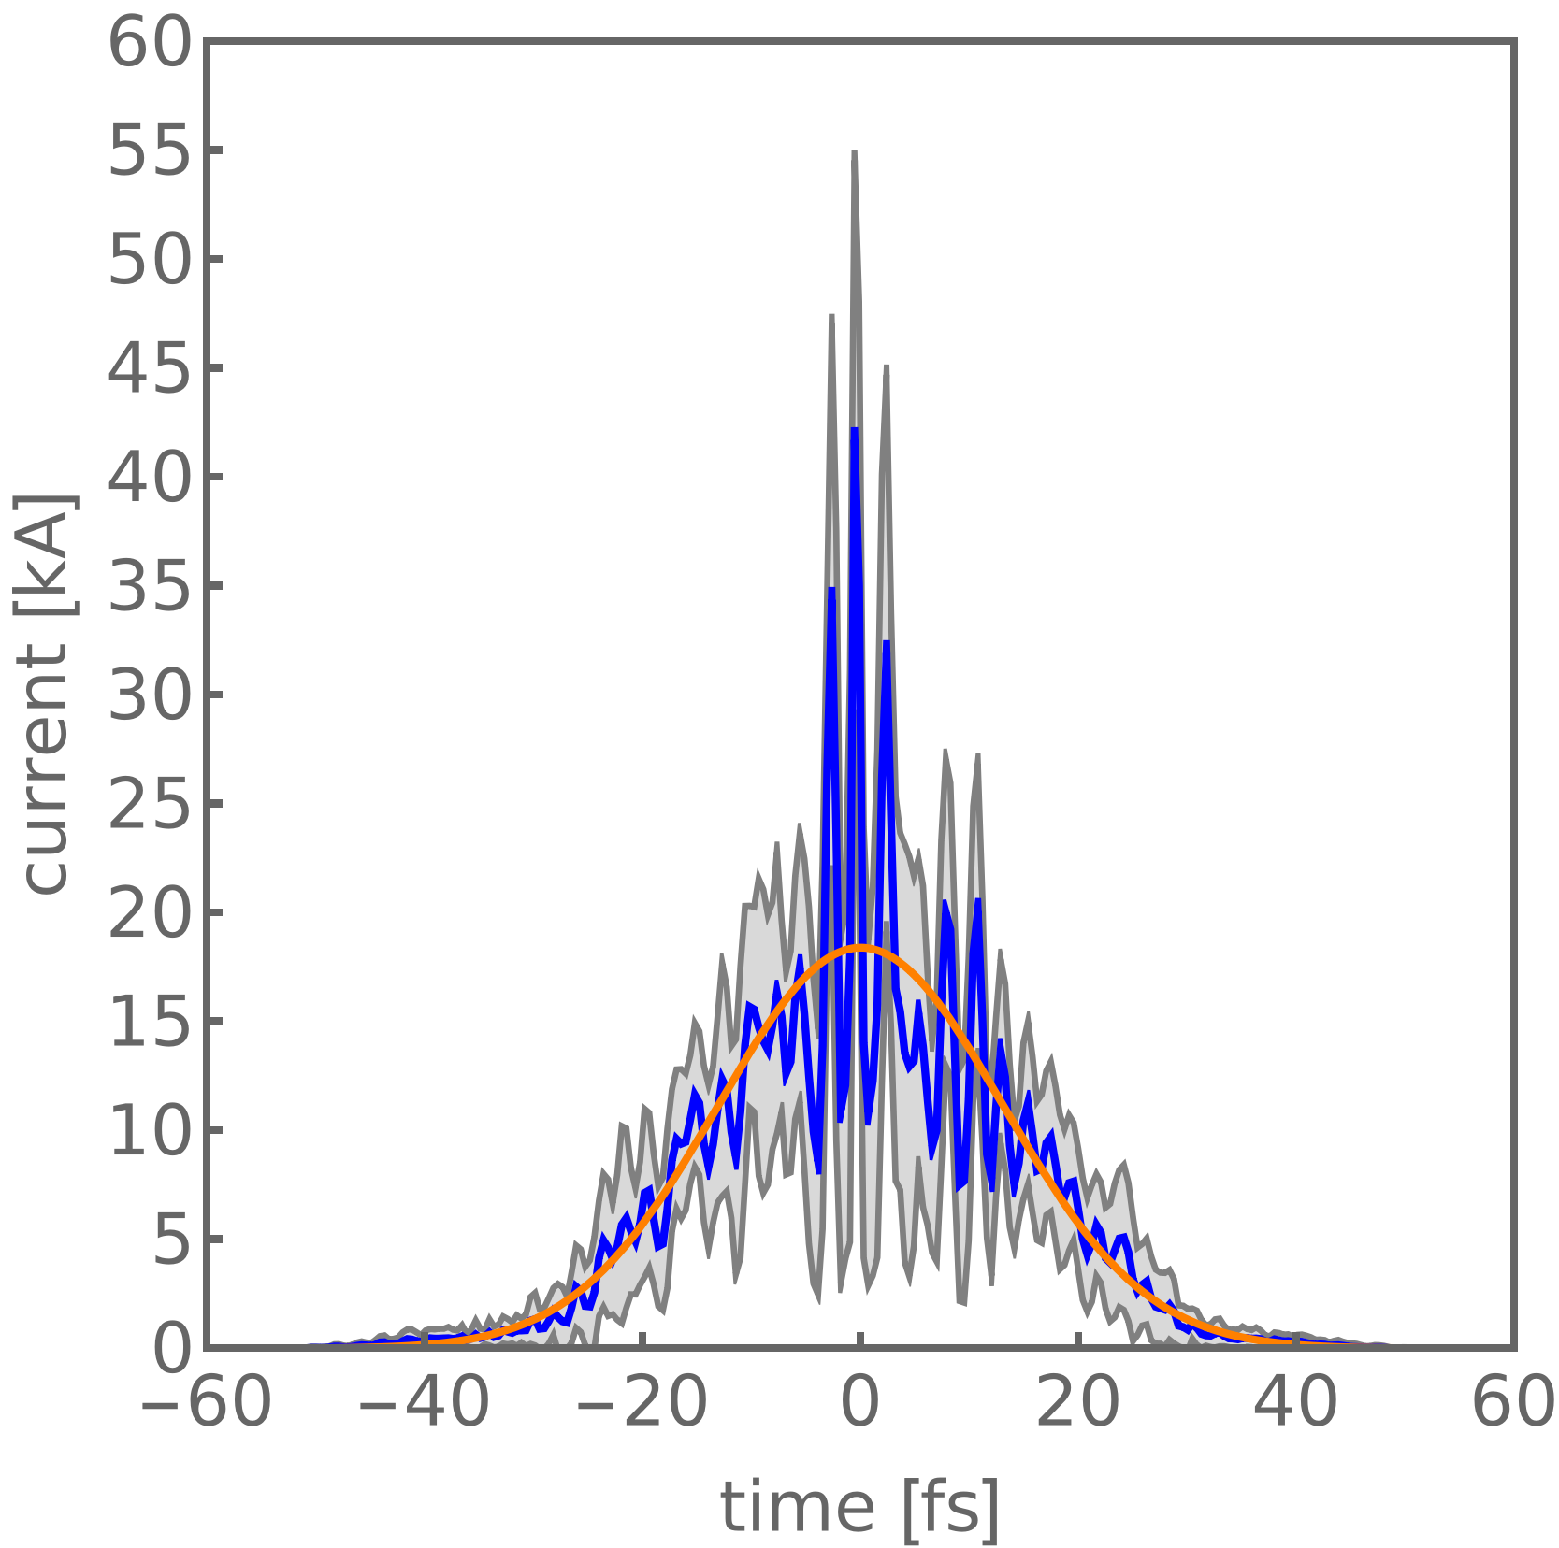
Observed longitudinal bunch structure is injection regime dependent
Measured
Down-ramp injection
Ionization injection (STII)
Self-injection
Reconstructed
Injection regime affects both bunch duration and substructure
Discussed in depth yesterday by Alexander Debus, WG 7

Slide 11
Transverse information encoded in coherent optical transition radiation

Slide 12
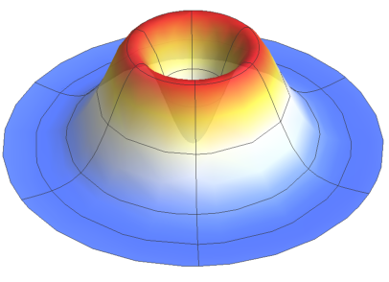
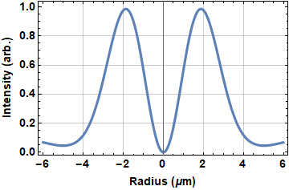
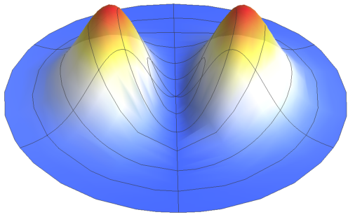
Near field optical transition radiation encodes electron bunch spatial information
Single electron point spread function (PSF)
Signal after a horizontal linear polarizer
Lens
Radiation from a single electron is annular and radially polarized
When the foil is imaged (near field), a point spread function intensity pattern occurs around the electron location

Slide 13
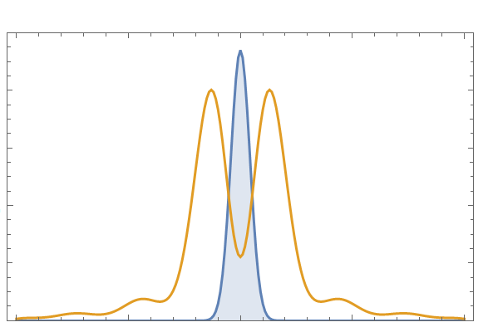
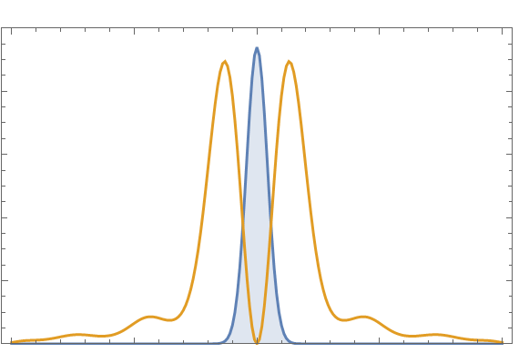
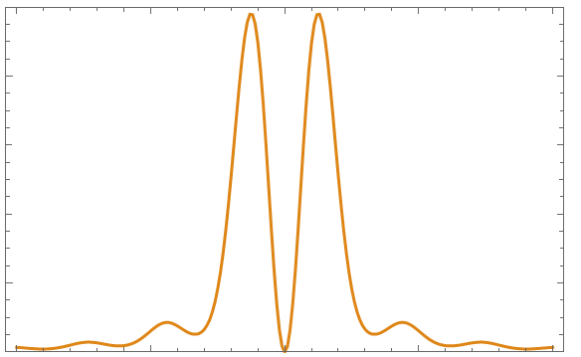
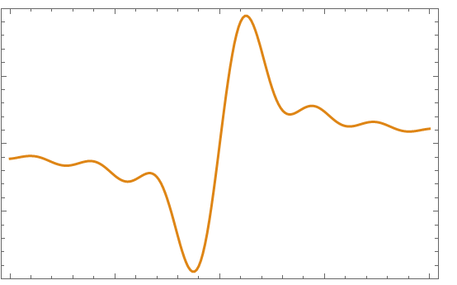
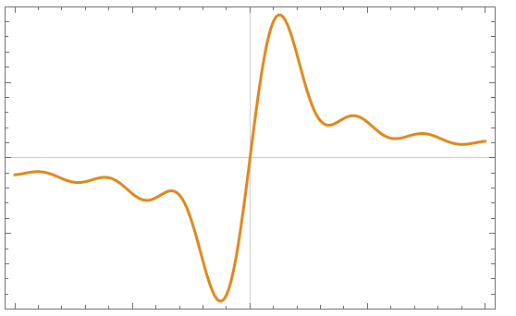
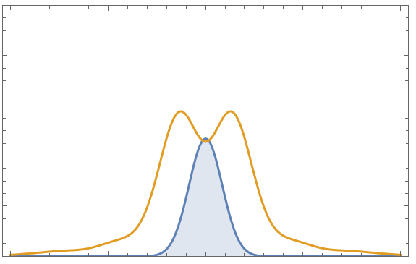
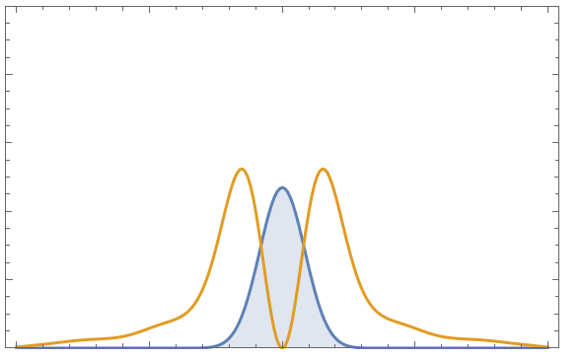
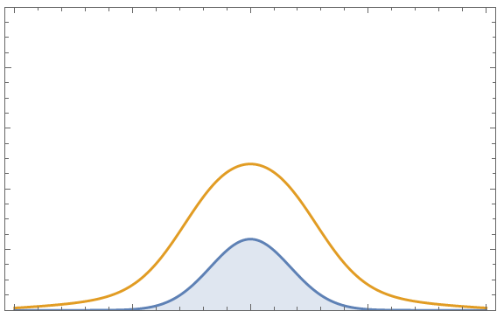
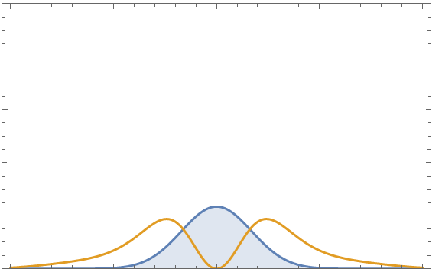

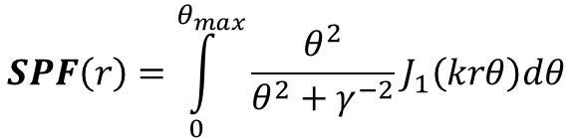
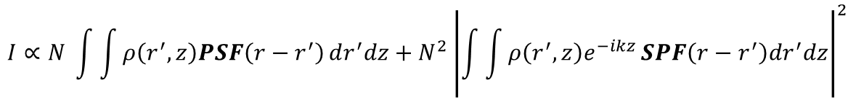
Coherent OTR is the result of sums of fields as opposed to intensities
Single particle
field (SPF)
Incoherent OTR
Coherent OTR
Point spread function (PSF)
e- bunch
1
1 µm
FWHM
OTR
Intensity (arb.)
Charge/ µm
Intensity (arb.)
Electric field (arb)
0
2 µm
FWHM
-10
-1
Intensity (arb.)
Charge/ µm
0
10
-10
0
10
Radius (µm)
Radius (µm)
$$SPF\left(r\right)=\int_{0}^{θ_{max}}{\frac{θ^{2}}{θ^{2}+γ^{−2}}J_{1}\left(krθ\right)dθ}$$
4 µm
FWHM
Intensity (arb.)
Charge/ µm
$$PSF={\left|SPF\right|}^{2}$$
-5
0
5
-5
0
5
$$I∝N \int{\int{ρ\left(r^{′},z\right)PSF\left(r−r^{′}\right)}dr^{′}dz}+N^{2}{\left|\int{\int{ρ\left(r^{′},z\right)e^{−ikz}}SPF\left(r−r^{′}\right)dr^{′}dz}\right|}^{2}$$
Radius (µm)
Radius (µm)
Incoherent
Coherent

Slide 14
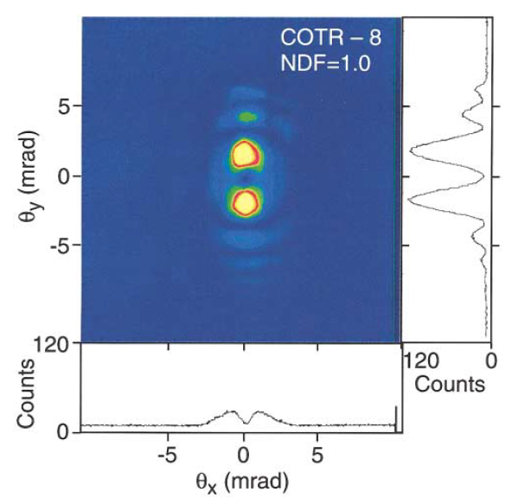
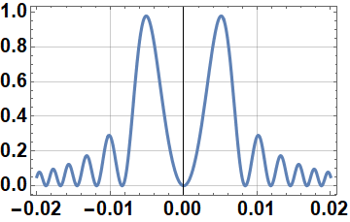
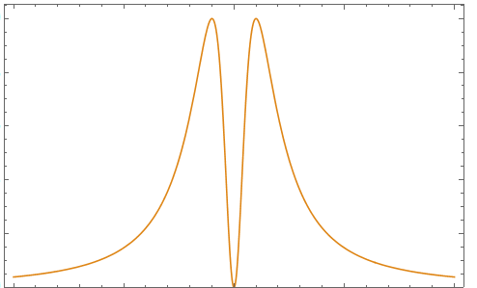
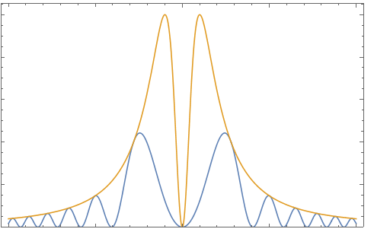
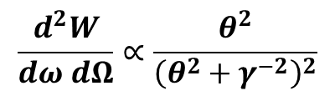
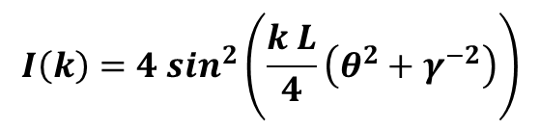
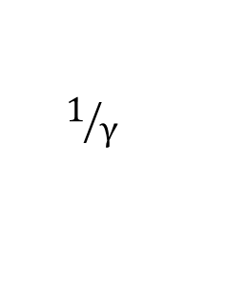
COTR interferometry fringes are due to interference between two COTR sources
OTR radiation
Two COTR sources close enough together will interfere, resulting in COTR interferometry (COTRI)
In the far field intensity pattern, this manifests as the single source pattern scaled by an interference function
e-
$$1/γ$$
Foil
Far field OTR
$$\frac{d^{2}W}{dω dΩ}∝\frac{θ^{2}}{{\left(θ^{2}+γ^{−2}\right)}^{2}}$$
OTR
COTRI
Intensity (arb.)
Interference Function
A. H. Lumpkin et al. “Evidence for Microbunching “Sidebands” in a Saturated Free-Electron Laser Using Coherent Optical Transition Radiation“, Phys. Rev. Let., vol. 88, pp. 234801, 2002.
$${I\left(k\right)=4 sin}^{2}\left(\frac{k L}{4}\left(θ^{2}+γ^{−2}\right)\right)$$
θ Radians

Slide 15
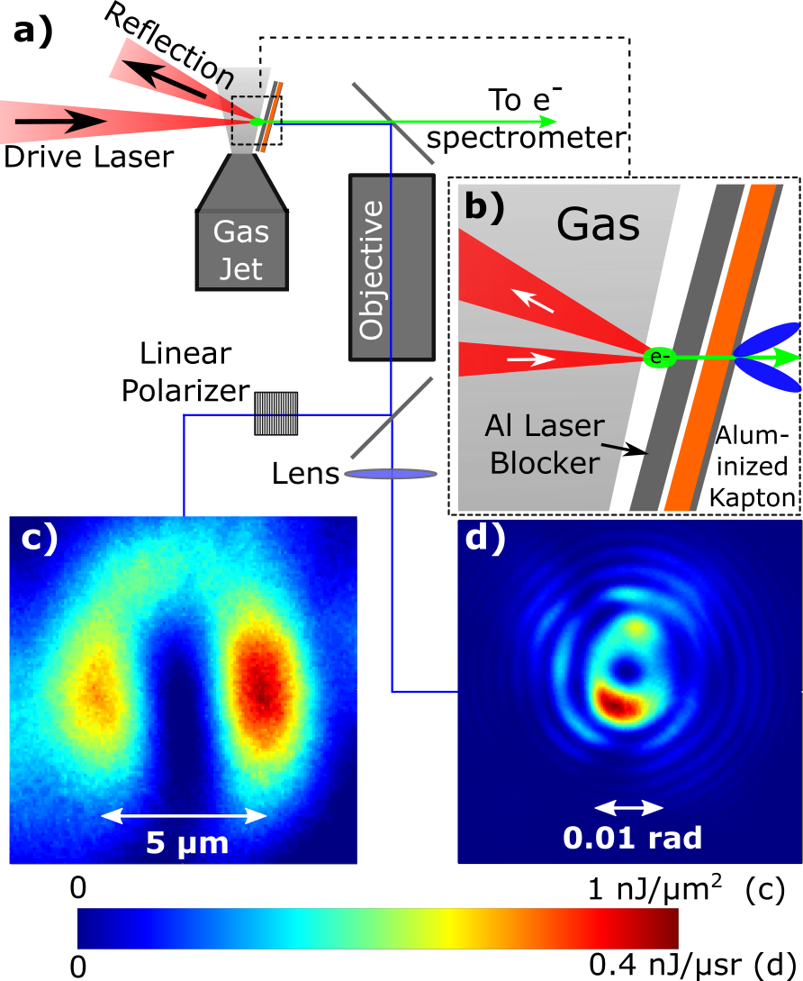
We measure the far field and near field COTR simultaneously on a single shot
A. Lumpkin, M. LaBerge et al., “Coherent Optical Signatures of Electron Microbunching in Laser-Driven Plasma Accelerators”, Phys. Rev. Lett., vol 88, pp. 234801, 2020.
Blocking foil reflects ~2.5 J Draco pulse
Aluminized Kapton foil is first COTR source
Si wafer is second COTR source
Linearly polarized near field COTR imaged with microscope objective
  Only sees COTR from first source
  600 nm image
Focus of objective imaged using second lens to create far field image on camera
  Sees interference from both COTR sources
Measured
Measured

Slide 16
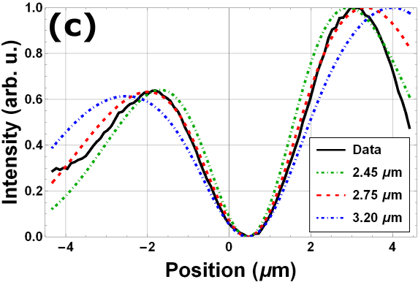
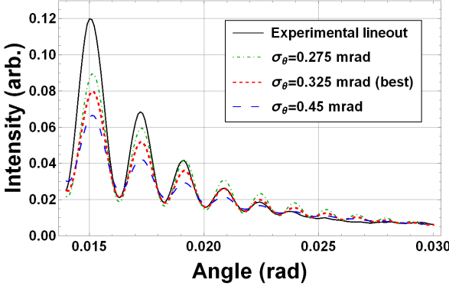

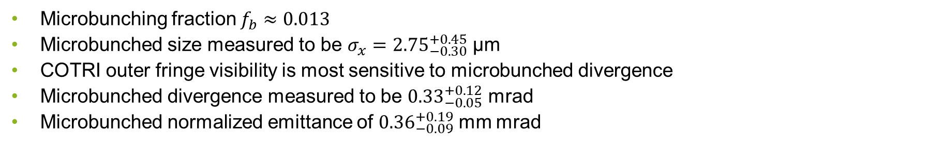
Near field and far field COTR can constrain the microbunched emittance
COTR from various
microbunched sizes
COTRI from various
microbunched divergences
Microbunching fraction $f_{b}≈0.013$
Microbunched size measured to be $σ_{x}={2.75}_{−0.30}^{+0.45}$ µm
COTRI outer fringe visibility is most sensitive to microbunched divergence
Microbunched divergence measured to be ${0.33}_{−0.05}^{+0.12}$ mrad
Microbunched normalized emittance of ${0.36}_{−0.09}^{+0.19}$ mm mrad
A. Lumpkin, M. LaBerge et al., “Coherent Optical Signatures of Electron Microbunching in Laser-Driven Plasma Accelerators”, Phys. Rev. Lett., vol 88, pp. 234801, 2020.

Slide 17
Multi-spectral imaging of coherent optical transition radiation

Slide 18
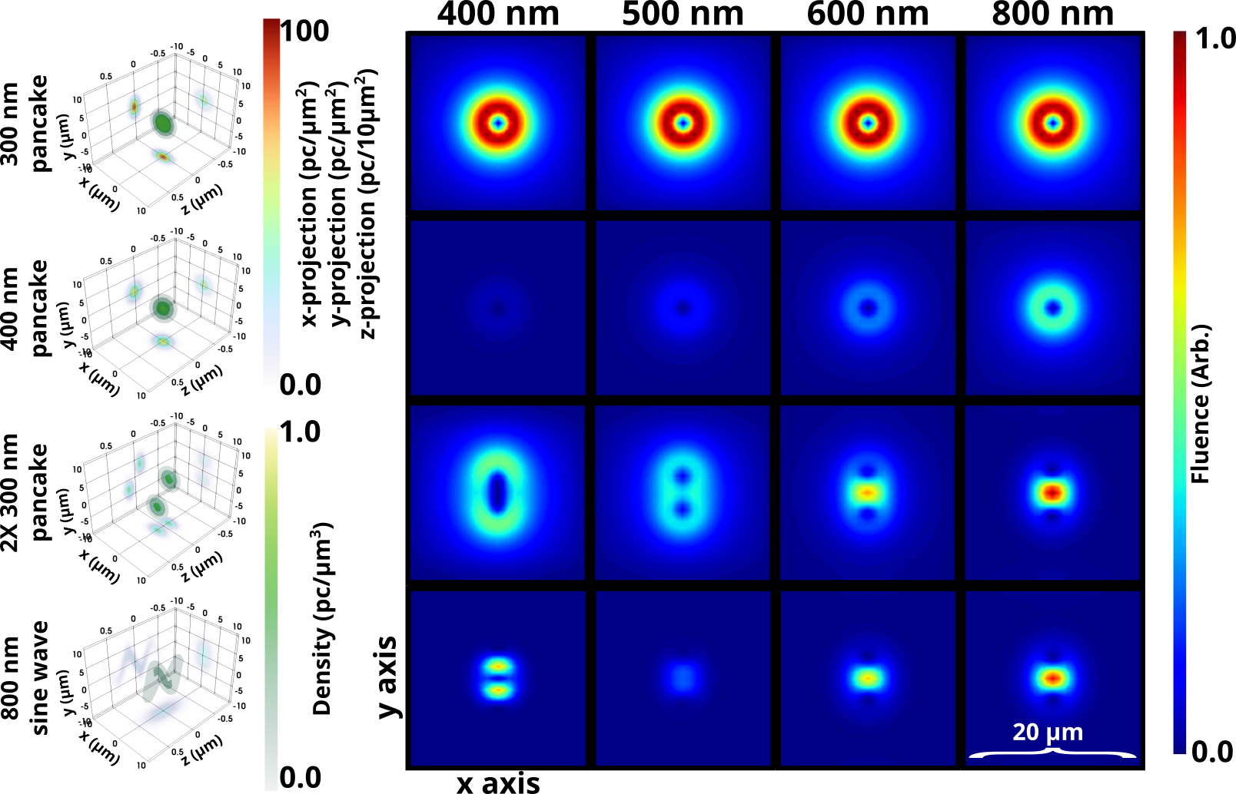
Different wavelength COTR patterns exhibit unique aspects of the beam structure
Longer bunches suppress the shorter wavelength COTR
Multiple beamlets will constructively and destructively interfere at different locations at different wavelengths
Multispectral COTR imaging is sensitive to correlations in transverse-longitudinal beam structure

Slide 19
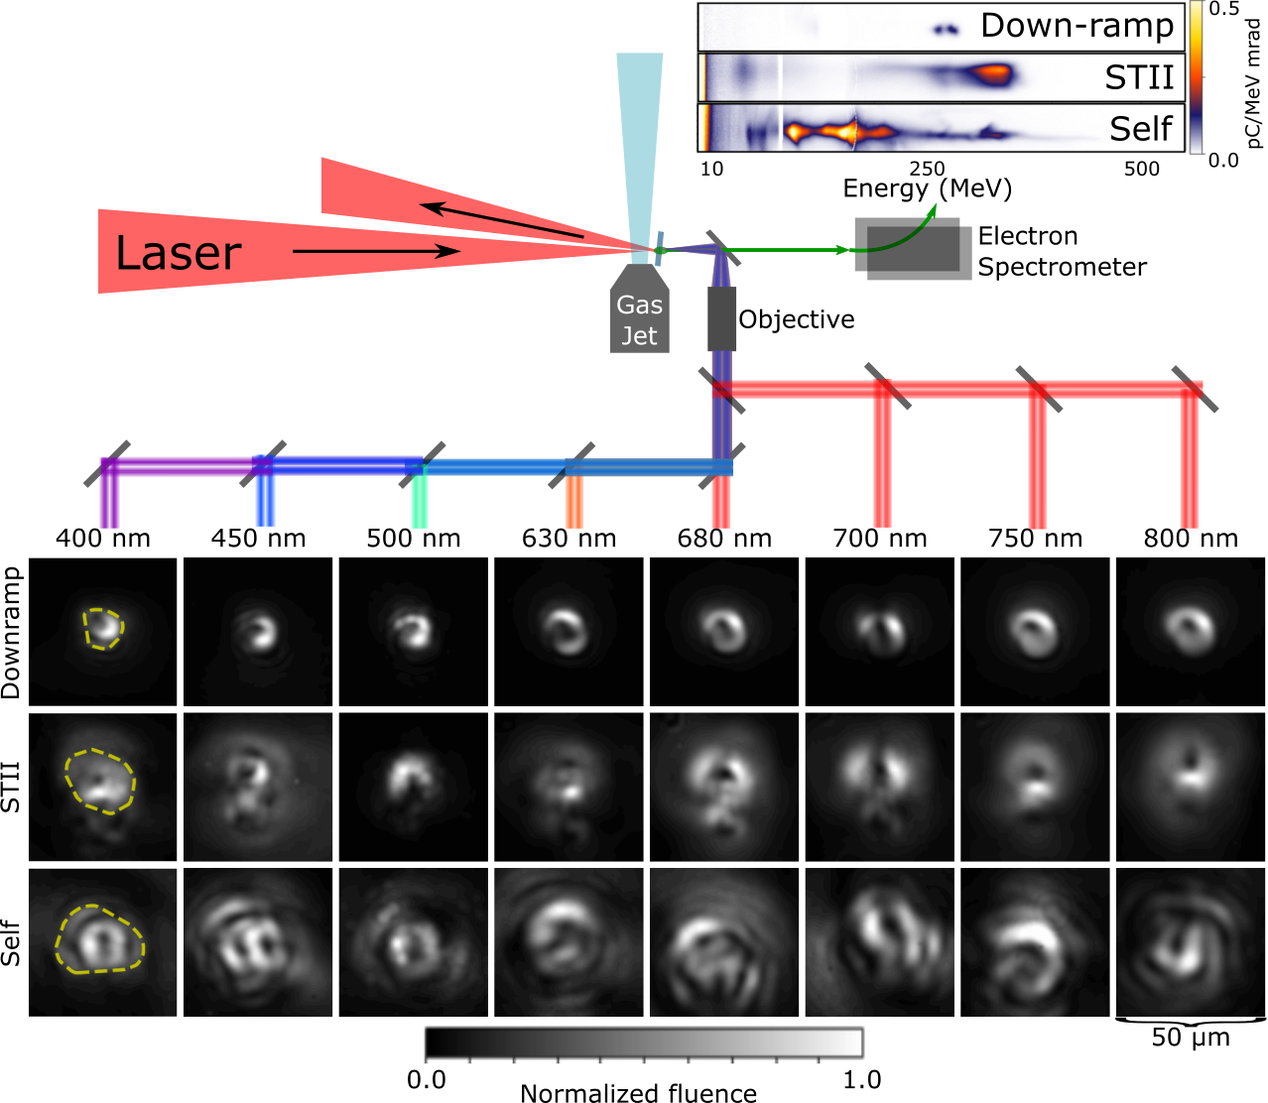
Coherent optical transition radiation patterns correlate with injection regime
Ionization
Down-ramp:
Small (~5 µm size)
Shape does not dramatically change across wavelengths
Ionization injection:
Larger (~10 µm size)
Two annular patterns visible at longer wavelengths
Self injection:
Largest (~15 µm size) and most complex

Slide 20


The effective radius ($\sqrt{Area/π}$) of COTR patterns is also very sensitive to injection regime
Radiation size across different regimes
Radiation size scales roughly linearly with coherent bunch size
For lower densities, down-ramp generates slightly smaller radiation patterns
Self injected electron bunches consistently produced the largest radiation patterns

Slide 21

Particle in cell simulations show structures that are corroborated by COTR images
Observed COTR patterns show evidence of laser-induced transverse-longitudinal modulation
Isolating the contribution of such a modulation qualitatively reproduces observed long wavelength COTR
High spatial frequency features from the ionization injection process could be responsible for the COTR patterns at shorter wavelengths

Slide 22


Using independent information about the beam’s longitudinal profile and COTR images, we reconstruct a 3D bunch
Measured
Reconstructed
The geometry of down-ramp induces injection leads to a chirp in the bunch
With a reasonable chirp estimate, we back out the beam profile
Using the COTR images and beam profile as inputs to a differential evolution reconstruction algorithm, we can make a 3D bunch reconstruction

Slide 23



We use clustering to determine the uniqueness of our reconstructions solutions
Principle component analysis of 120 reconstructions
These reconstructions are not necessary unique
Principle component analysis allows us to identify the number of clusters of reconstructions
When the average of reconstructions in a cluster reproduce the data, we have a compact family of solution
With COTR imaged at more wavelengths, we could further constrain these reconstruction solutions
Normalized $R^{2}$

Slide 24



Outlook and challenges
Diffraction radiation
Combining CTR spectra and images
Pre/post undulator CTR
CTR from a beam driven geometry
Coherent x-ray transition radiation
Non-intercepting diagnostics
Lumpkin, A.H. et al.: Evidence for Microbunching “Sidebands” in a Saturated Free-Electron Laser Using Coherent Optical Transition Radiation. Phys. Rev. Lett. 88(23), 234801 (2002).
Bajlekov, S. I., et al. "Longitudinal electron bunch profile reconstruction by performing phase retrieval on coherent transition radiation spectra." Physical Review Special Topics-Accelerators and Beams 16.4 (2013): 040701.
+
Lumpkin, Alex H., William M. Fawley, and Donald W. Rule. "A Concept for Z-dependent Microbunching Measurements with Coherent X-ray Transition Radiation in a SASE FEL." (2004).
Konoplev, I. V., et al. "Single shot, nondestructive monitor for longitudinal subpicosecond bunch profile measurements with femtosecond resolution." Physical Review Accelerators and Beams 24.2 (2021): 022801.

Slide 25
Conclusion
Characterizing high peak current, micron-scale beams requires the development and adaptation of various diagnostics
High resolution longitudinal beam information is spectrally encoded in coherent transition radiation
Combined with multi-spectral transverse information, 3D beam structure can be gleaned
Microbunched structures present in LPA accelerated electron beams are injection regime dependent

Slide 26

Thank you for your attention

