Slide 1
EAAC23
September 18th 2023
Plasma mirrors:
a promising path to
extreme intensity light sources & compact accelerators
Henri Vincenti
CEA Saclay
1 μm

Slide 2




Challenge 1: SF and NP-QED
Challenge 2: compact accelerators
Europe
Asia
USA
Danson et al, HPLSE, 2019
Can we probe QED in the strong-field and fully-non perturbative regimes ?

Slide 3
Challenge 1: SF and NP-QED
Challenge 2: compact accelerators
Europe
Asia
USA
Danson et al, HPLSE, 2019
Can we probe QED in the strong-field and fully-non perturbative regimes ?
QED : most accurate predictions of modern physics in the perturbative regime

Slide 4
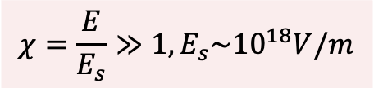
Challenge 1: SF and NP-QED
Challenge 2: compact accelerators
Europe
Asia
USA
Danson et al, HPLSE, 2019
Can we probe QED in the strong-field and fully-non perturbative regimes ?
QED : most accurate predictions of modern physics in the perturbative regime
QED : almost terra incognita when particles interact in a strong background field E
$$χ=\frac{E}{E_{s}}≫1,E_{s}\sim {10}^{18}V/m$$

Slide 5
Challenge 1: SF and NP-QED
Challenge 2: compact accelerators
Europe
Asia
USA
Danson et al, HPLSE, 2019
Can we probe QED in the strong-field and fully-non perturbative regimes ?
QED : most accurate predictions of modern physics in the perturbative regime
QED : almost terra incognita when particles interact in a strong background field E
$$χ=\frac{E}{E_{s}}≫1,E_{s}\sim {10}^{18}V/m$$
→ $χ>1$: theory developed but needs experimental validation
→ $αχ^{2/3}\sim 1$, ($i.e.,χ \sim$1600) : fully non-perturbative regime (no accepted theory)
Theory needs experimental validation in the strong-field regime (SF): $χ≫1$

Slide 6

Challenge 1: SF and NP-QED
Challenge 2: compact accelerators
Europe
Asia
USA
Danson et al, HPLSE, 2019
Can we probe QED in the strong-field and fully-non perturbative regimes ?
QED : most accurate predictions of modern physics in the perturbative regime
QED : almost terra incognita when particles interact in a strong background field E
$$χ=\frac{E}{E_{s}}≫1,E_{s}\sim {10}^{18}V/m$$
→ $χ>1$: theory developed but needs experimental validation
→ $αχ^{2/3}\sim 1$, ($i.e.,χ \sim$1600) : fully non-perturbative regime (no accepted theory)
Major limitation: hard with conventional laser technology (E$≪$E_{S})
Theory needs experimental validation in the strong-field regime (SF): $χ≫1$

Slide 7
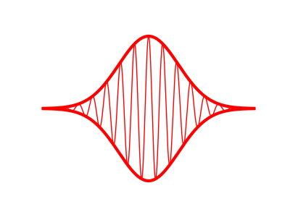
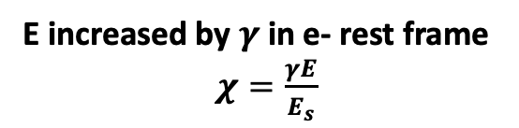

Challenge 1: SF and NP-QED
Challenge 2: compact accelerators
Collisions with e- beams
Laser pulse, E
e- beam, $γ$
E increased by $γ$in e- rest frame
$χ=\frac{γE}{E_{s}}$

Slide 8
Challenge 1: SF and NP-QED
Challenge 2: compact accelerators
Collisions with e- beams
Laser pulse, E
e- beam, $γ$
E increased by $γ$in e- rest frame
$χ=\frac{γE}{E_{s}}$
E144 (1994)
46.6GeV e- + 1TW
NP-QED
0.3
$$χ$$
Burke et al,
(1994)
1600

Slide 9

Challenge 1: SF and NP-QED
Challenge 2: compact accelerators
Collisions with e- beams
Laser pulse, E
e- beam, $γ$
E increased by $γ$in e- rest frame
$χ=\frac{γE}{E_{s}}$
Planned experiments
?
E144 (1994)
46.6GeV e- + 1TW
LUXE 16.5GeV e- + 350TW
NP-QED
E320 13 GeV e- + 20TW
0.3
$∼$1
$$χ$$
Burke et al,
(1994)
Meuren et al
(2020)
Abramowicz et al,
(2021)
1600

Slide 10
Our approach: reflection off curved relativistic mirrors
→ The Curved Relativistic Mirror (CRM) concept
CRM
Incident laser
𝜸>>1
Doppler
upshifted light
(i) Intensification by temporal compression
(ii) Intensification by spatial
focusing to a tighter spot (λ << λ_{L})
Total intensification scales as 𝜸⁶
⇒ Schwinger limit could be reached with a PW laser and 𝜸>10!
Landecker, 86, 852 Phys. Rev. (1952)
Bulanov et al, PRL 91, 095001 (2003)
But how to actually implement this in the lab?
8

Slide 11
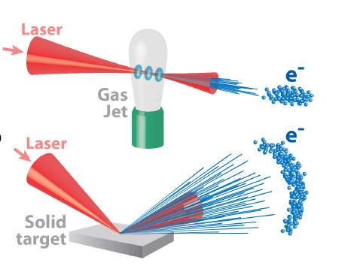
Challenge 1: SF and NP-QED
Challenge 2: compact accelerators
How to increase the charge of LPA at multi-GeV while keeping a high-beam quality ?
« Laser Wakefield Accelerator » - (LWFA)
Considerable progress in the past 15 years
100MeV e- beams (2004)
LOA-CNRS, V. Malka’s group
LBNL, W. Leemans’ group
IC/RAL/Strathclyde collaboration
8 GeV e- beams on cm-scale (2019)
LBNL, W. Leemans’ group
Plasma Accelerating field ≅ 100GV.m⁻¹
Compact
Very promising candidate to build cheaper and more compact accelerators
Good candidates as building blocks for a TeV e-/e+ colliders

Slide 12
Challenge 1: SF and NP-QED
Challenge 2: compact accelerators
How to increase the charge of LPA at multi-GeV while keeping a high-beam quality ?
« Laser Wakefield Accelerator » - (LWFA)
Considerable progress in the past 15 years
100MeV e- beams (2004)
LOA-CNRS, V. Malka’s group
LBNL, W. Leemans’ group
IC/RAL/Strathclyde collaboration
8 GeV e- beams on cm-scale (2019)
LBNL, W. Leemans’ group
Plasma Accelerating field ≅ 100GV.m⁻¹
Compact
Very promising candidate to build cheaper and more compact accelerators
Good candidates as building blocks for a TeV e-/e+ colliders
Important limitation : low charge >GeV
>nC bunch
10%-level dE/E
<10pC/bunch
100MeV
Multi-GeV
Götzfried et al, PRX (2020)
Couperus et al, Nat. Comm (2017)

Slide 13
Challenge 1: SF and NP-QED
Challenge 2: compact accelerators
How to increase the charge of LPA at multi-GeV while keeping a high-beam quality ?
« Laser Wakefield Accelerator » - (LWFA)
Considerable progress in the past 15 years
100MeV e- beams (2004)
LOA-CNRS, V. Malka’s group
LBNL, W. Leemans’ group
IC/RAL/Strathclyde collaboration
8 GeV e- beams on cm-scale (2019)
LBNL, W. Leemans’ group
Plasma Accelerating field ≅ 100GV.m⁻¹
Compact
Very promising candidate to build cheaper and more compact accelerators
Good candidates as building blocks for a TeV e-/e+ colliders
Important limitation : low charge >GeV
How to increase charge to nC >GeV while
keeping a high-beam quality?
>nC bunch
10%-level dE/E
<10pC/bunch
100MeV
Multi-GeV
Götzfried et al, PRX (2020)
Couperus et al, Nat. Comm (2017)

Slide 14


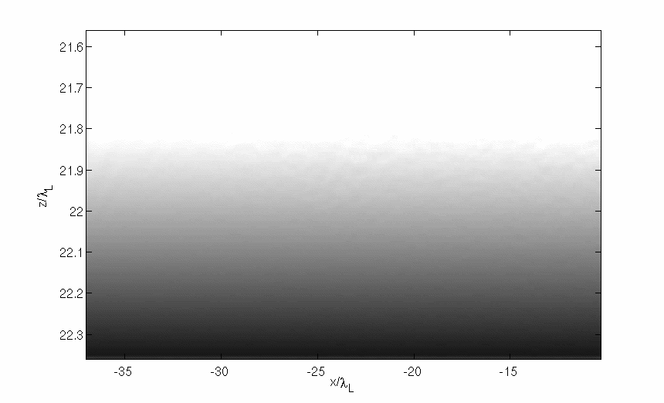
Plasma mirrors: a common and elegant solution to these challenges
Relativistic
Oscillating
Mirror (ROM)
C. Thaury et al, Nat. Phys (2007)
Dromey et al, Nat. Phys (2009)
Solid target
n_{e}
≈400 n_{c}
Vacuum
Plasma
n_{c}
x
L << λ

Slide 15
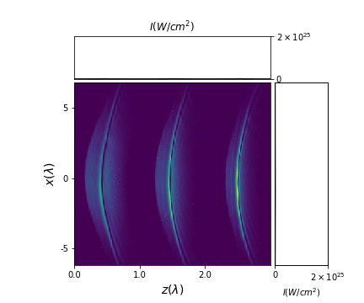
Plasma mirrors: a common and elegant solution to these challenges
C. Thaury et al, Nat. Phys (2007)
Dromey et al, Nat. Phys (2009)
Solid target
n_{e}
≈400 n_{c}
Vacuum
Plasma
n_{c}
H. Vincenti, PRL (2019)
x
L << λ

Slide 16

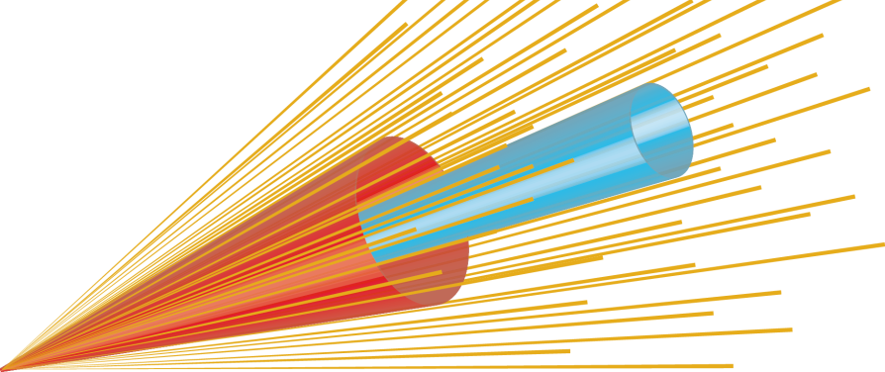
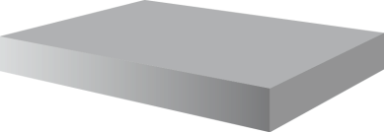
Plasma mirrors: a common and elegant solution to these challenges
Solid target
Sub-fs /nC/MeV
electron bunches
M. Thévenet et al, Nat. Phys (2016)

Slide 17
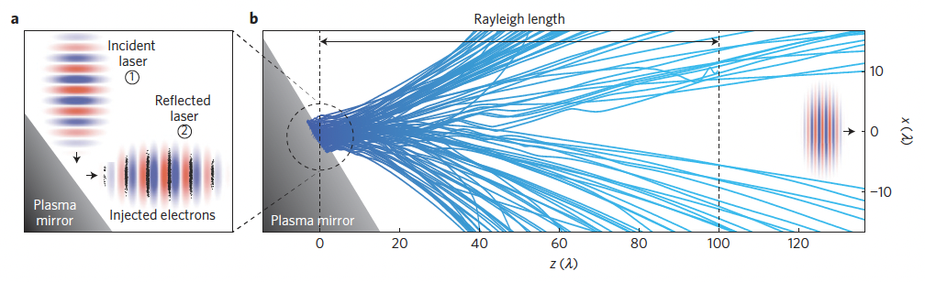
Plasma mirrors: a common and elegant solution to these challenges
Solid target
Sub-fs /nC/MeV
electron bunches
M. Thévenet et al, Nat. Phys (2016)

Slide 18
Outline
I. Plasma mirrors as high-charge, high-precision injectors for
laser-plasma accelerators
II. Reaching SF and NP QED regimes with Plasma mirrors
III. Conclusion/prospects

Slide 19
Outline
I. Plasma mirrors as high-charge, high-precision injectors for
laser-plasma accelerators
II. Reaching SF and NP QED regimes with Doppler-boosted beams
III. Conclusion/prospects

Slide 20
Advantages of LWFA vs VLA approaches
Laser Wakefield Accelerators
Laser Wakefield Accelerators
High energy (multi-GeV)
High energy (multi-GeV)
Low energy spread (a few %)
Low energy spread (a few %)
Small divergence (a few mrad)
Small divergence (a few mrad)
Low charge (<10’s pC for E>GeV)
Low charge (<10’s pC for E>GeV)
Low charge at multi-GeV

Slide 21
Advantages of LWFA vs VLA approaches
Laser Wakefield Accelerators
Vaccum Laser Acceleration –
PM injector
Laser Wakefield Accelerators
Vaccum Laser Acceleration –
PM injector
High energy (multi-GeV)
Low energy (10MeV)
High energy (multi-GeV)
Low energy (10MeV)
Low energy spread (a few %)
High energy spread (50%)
Low energy spread (a few %)
High energy spread (50%)
Small divergence (a few mrad)
High divergence (100mrad)
Small divergence (a few mrad)
High divergence (100mrad)
Low charge (<10’s pC for E>GeV)
Low charge (<10’s pC for E>GeV)
High charge (10nC)
Low charge at multi-GeV
High charge (10nC)

Slide 22
Advantages of LWFA vs VLA approaches
Laser Wakefield Accelerators
Vaccum Laser Acceleration –
PM injector
Laser Wakefield Accelerators
Vaccum Laser Acceleration –
PM injector
High energy (multi-GeV)
Low energy (10MeV)
How to combine the advantages of both approaches?
High energy (multi-GeV)
Low energy (10MeV)
Low energy spread (a few %)
High energy spread (50%)
Low energy spread (a few %)
High energy spread (50%)
Small divergence (a few mrad)
High divergence (100mrad)
Small divergence (a few mrad)
High divergence (100mrad)
Low charge (<10’s pC for E>GeV)
Low charge (<10’s pC for E>GeV)
High charge (10nC)
Low charge (<10’s pC for E>GeV)
Low charge (<10’s pC for E>GeV)
High charge (10nC)

Slide 23
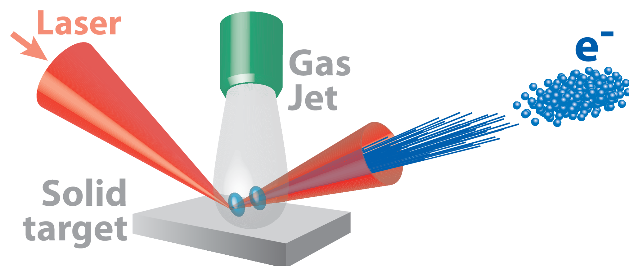
The hybrid solid-gas target concept

Slide 24

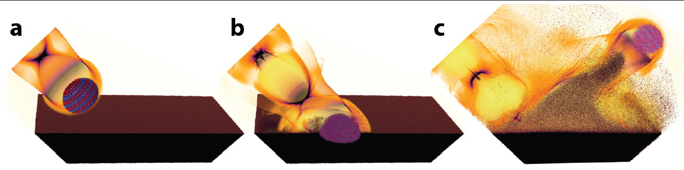
The hybrid solid-gas target concept

Slide 25
The hybrid solid-gas target concept
nC at high-energy?

Slide 26
The hybrid solid-gas target concept
Simulations are key
Understand the basic physics
Design/guide/interpret exp

Slide 27
The hybrid solid-gas target concept
Simulations are key
Understand the basic physics
Design/guide/interpret exp
The numerical difficulty
3D kinetic description needed
Huge spatio-temporal ranges
(10⁻⁸m to 10⁻³m & 10⁻¹⁶s to 10⁻¹²s)

Slide 28
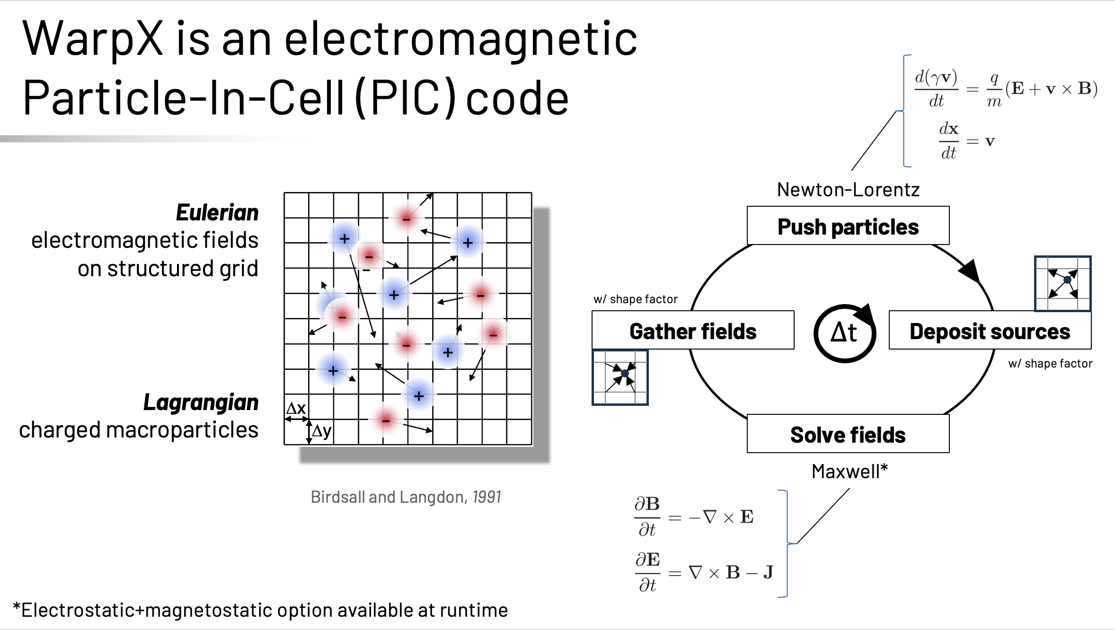
The WarpX PIC code

Slide 29
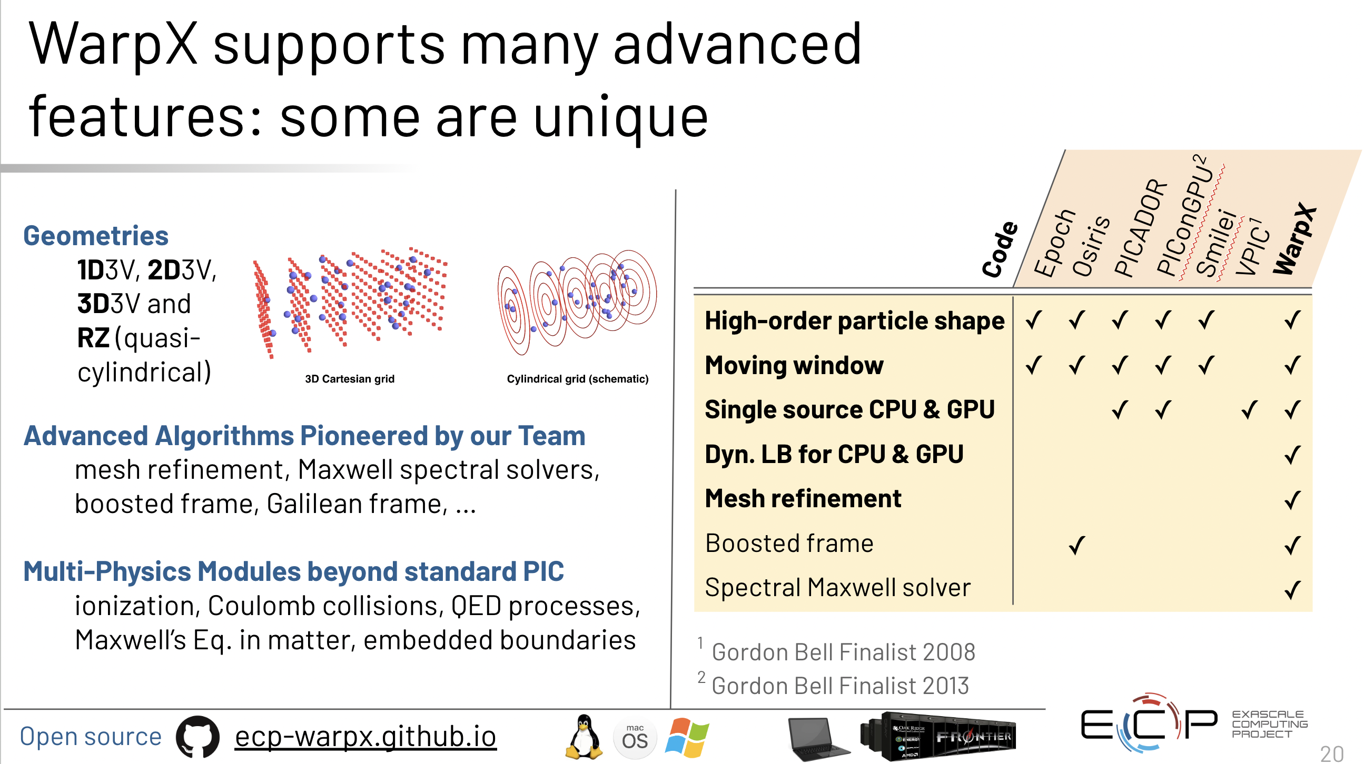
The WarpX PIC code

Slide 30
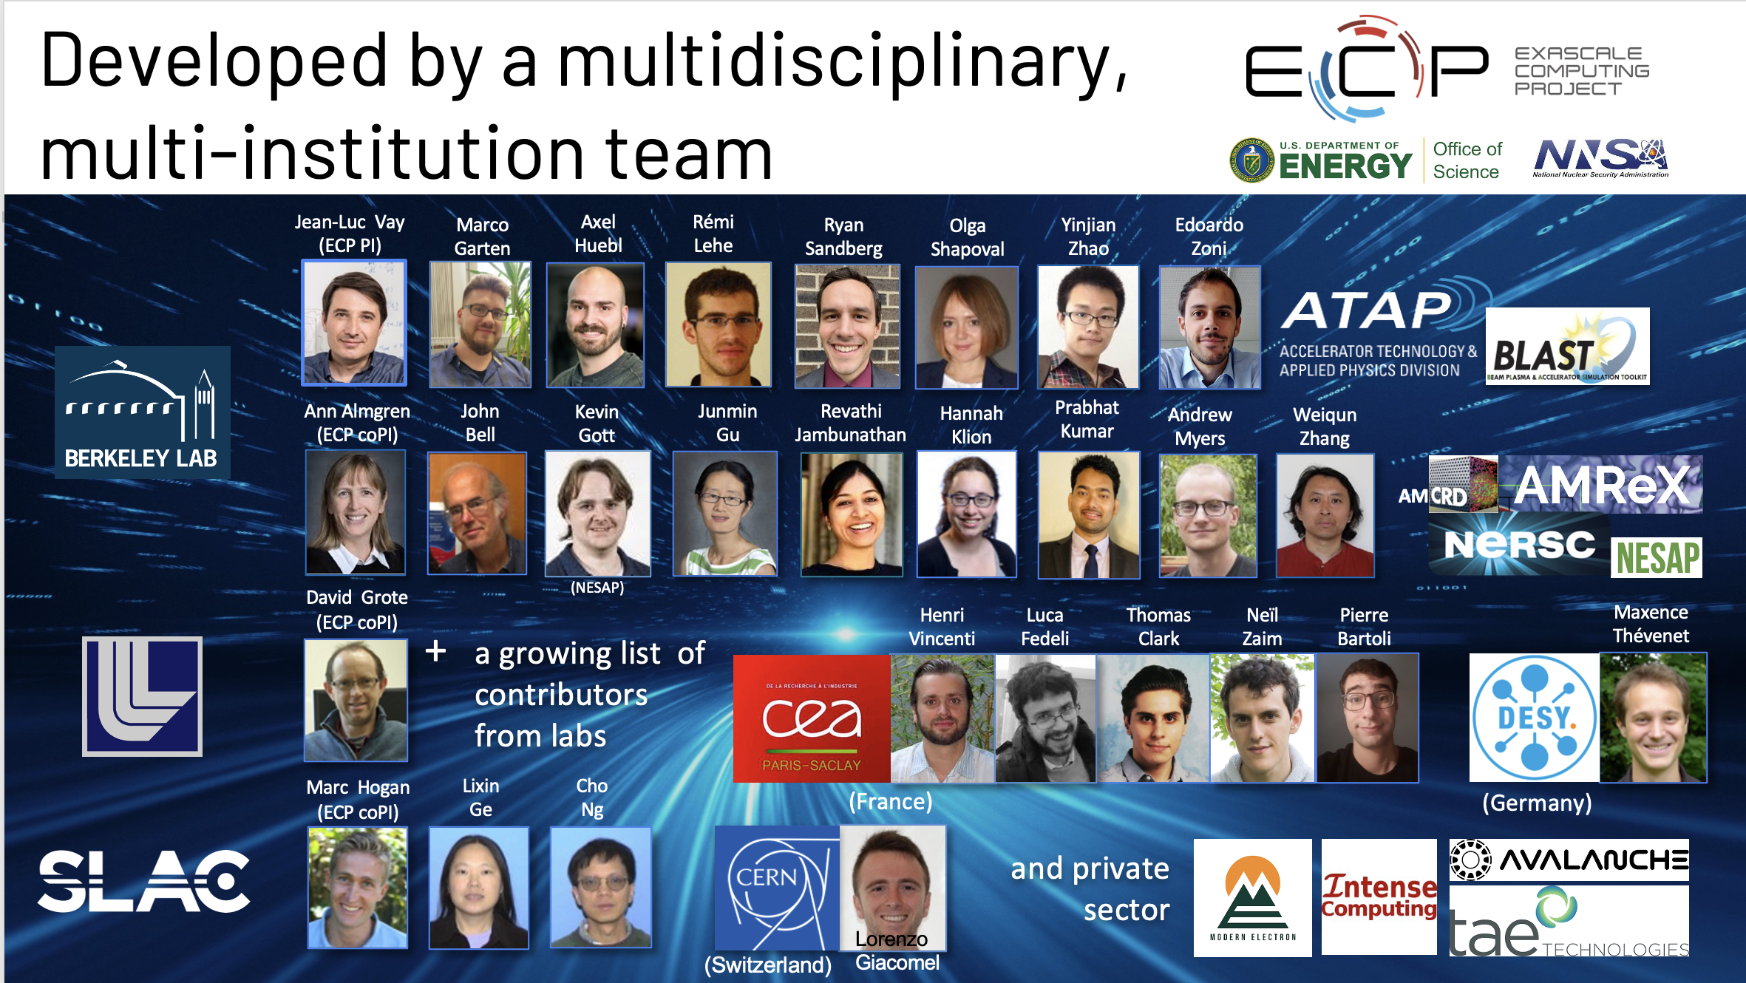
The WarpX PIC code
See J-L. Vay and A. Huebl presentations on WarpX on Wednesday (WG3)

Slide 31

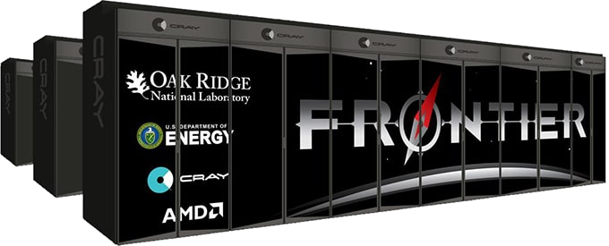
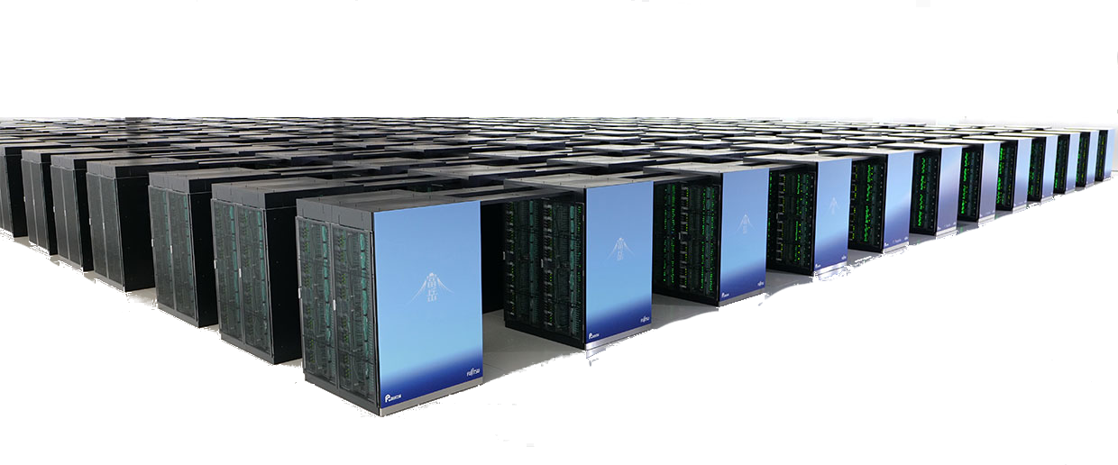
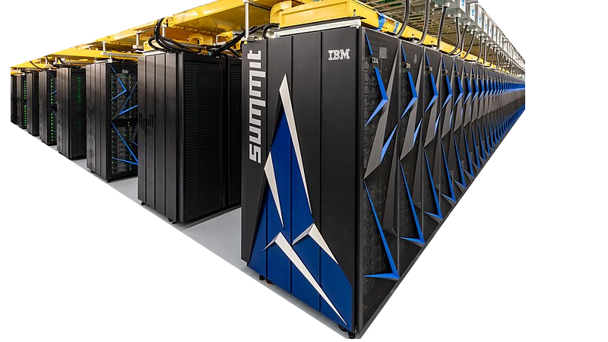
The WarpX PIC code
Validation of the concept 3D simulations
Scaling of the code at exascale
Mesh refinement enabled a x4
time-to-solution speed-up
Movie: L. Fedeli
L. Fedeli, A. Huebl et al, Proc. SC22 (2022)

Slide 32
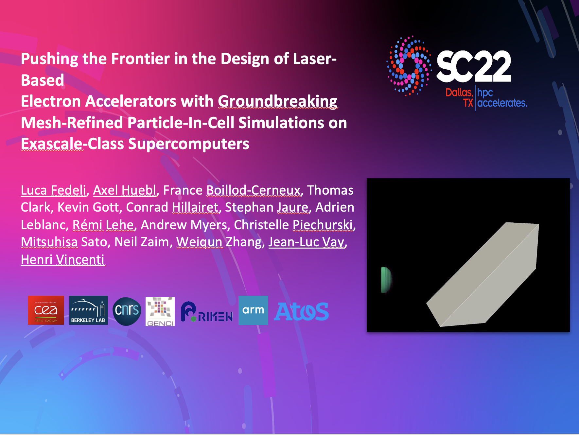

ACM Gordon Bell Prize 2022

Slide 33
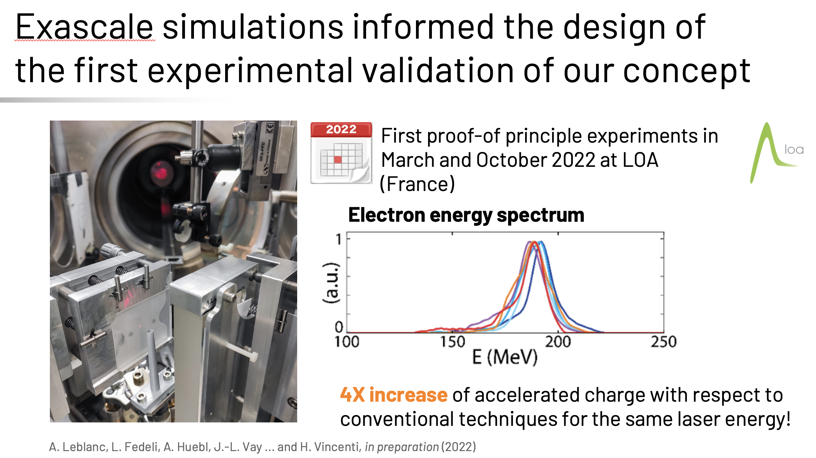
First experimental validations at LOA
A. Leblanc et al, in prep (2023)

Slide 34
First experimental validations at LOA
20 TW
80 pC
300 MeV
<10% energy spread
mrad divergence
A. Leblanc et al, in prep (2023)
Good agreement between PIC and experiments at 20TW
We expect nC charge at GeV-level with % energy spread with a PW-class laser

Slide 35
Outline
I. Plasma mirrors as high-charge, high-precision injectors for
laser-plasma accelerators
II. Reaching SF and NP QED regimes with Doppler-boosted beams
III. Conclusion/prospects

Slide 36
Relativistic plasma mirrors : a feasible implementation of a CRM
What are the maximum intensities attainable at the focus of a curved plasma mirror ?
26

Slide 37
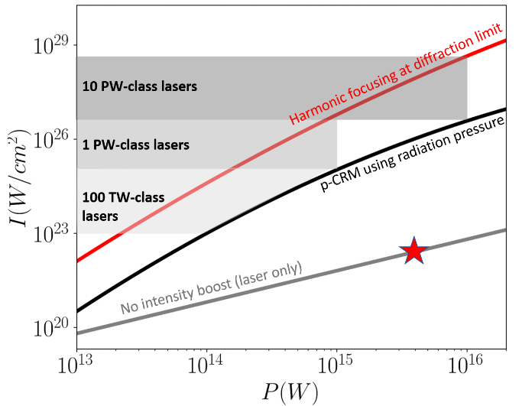
What intensity could we achieve with Doppler-boosted beams ?
F. Quéré and H.Vincenti,
HPLSE, (2021)
Present record
Corels (Korea)
Plasma mirrors can achieve 10³ to 10⁶ intensitification factors !
19

Slide 38
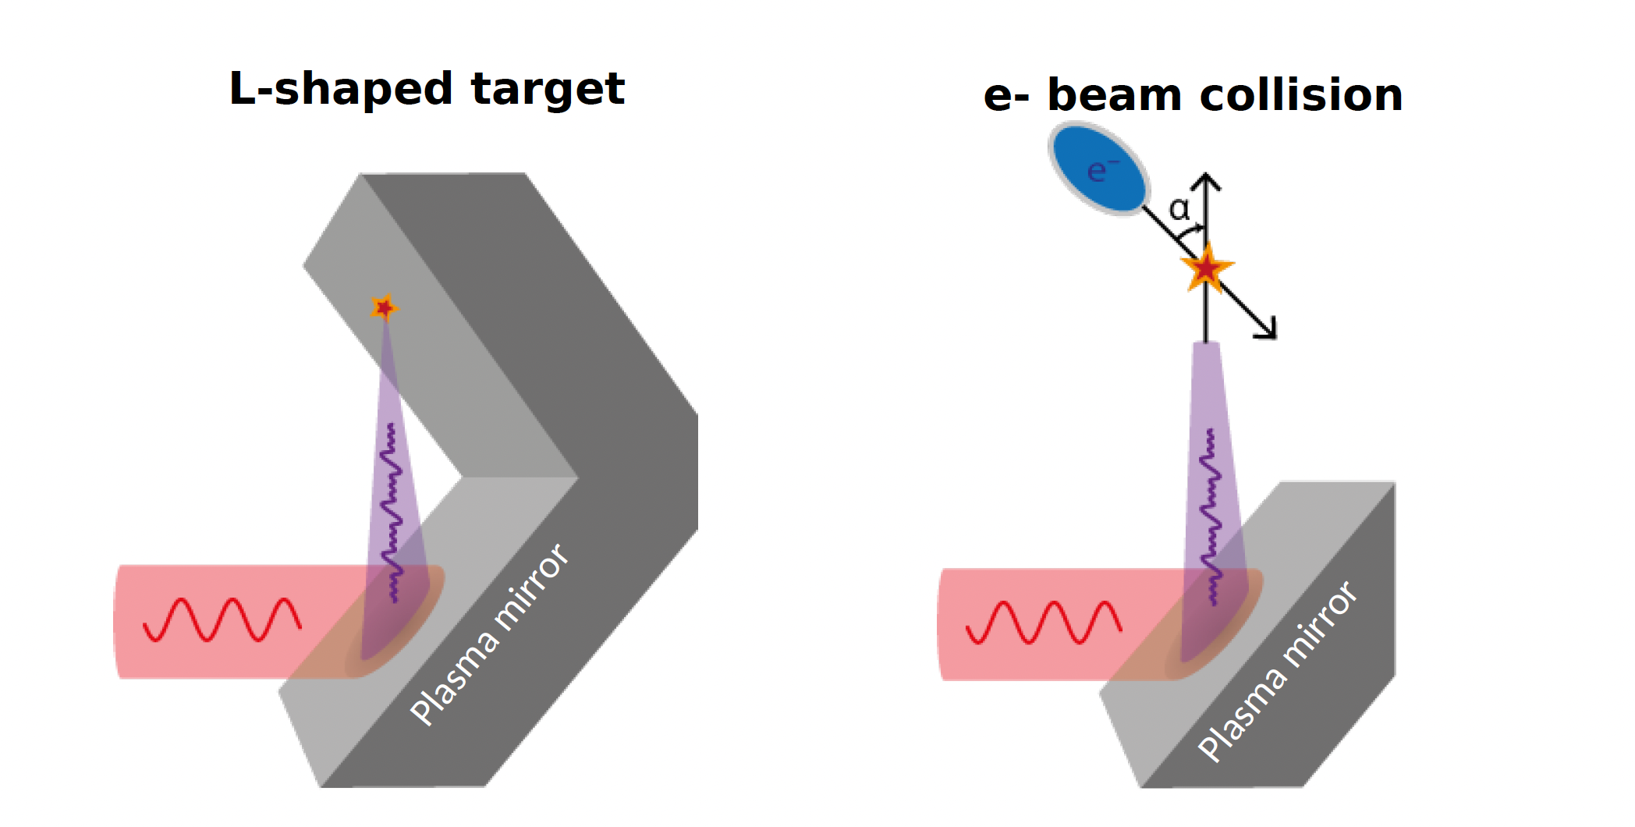
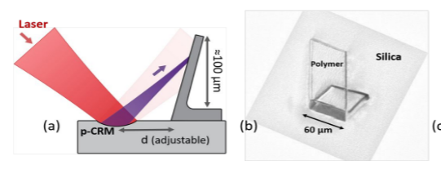
How to reach SF and NP-QED with Doppler-boosted lasers ?
Configuration 1
Focusing on a secondary
solid target
SF-QED probing
Study of SF-QED pair plasmas

Slide 39
How to reach SF and NP-QED with Doppler-boosted lasers ?
Configuration 1
Configuration 2
Focusing on a secondary
solid target
Collision with a relativistic e-
beam
SF-QED probing
Study of SF-QED pair plasmas
SF- QED validation
NP-QED probing

Slide 40
What $χ$ parameter-space can we reach with DBB?
Courtesy of B. King
Fedotov et al, Physics Report (2022)

Slide 41
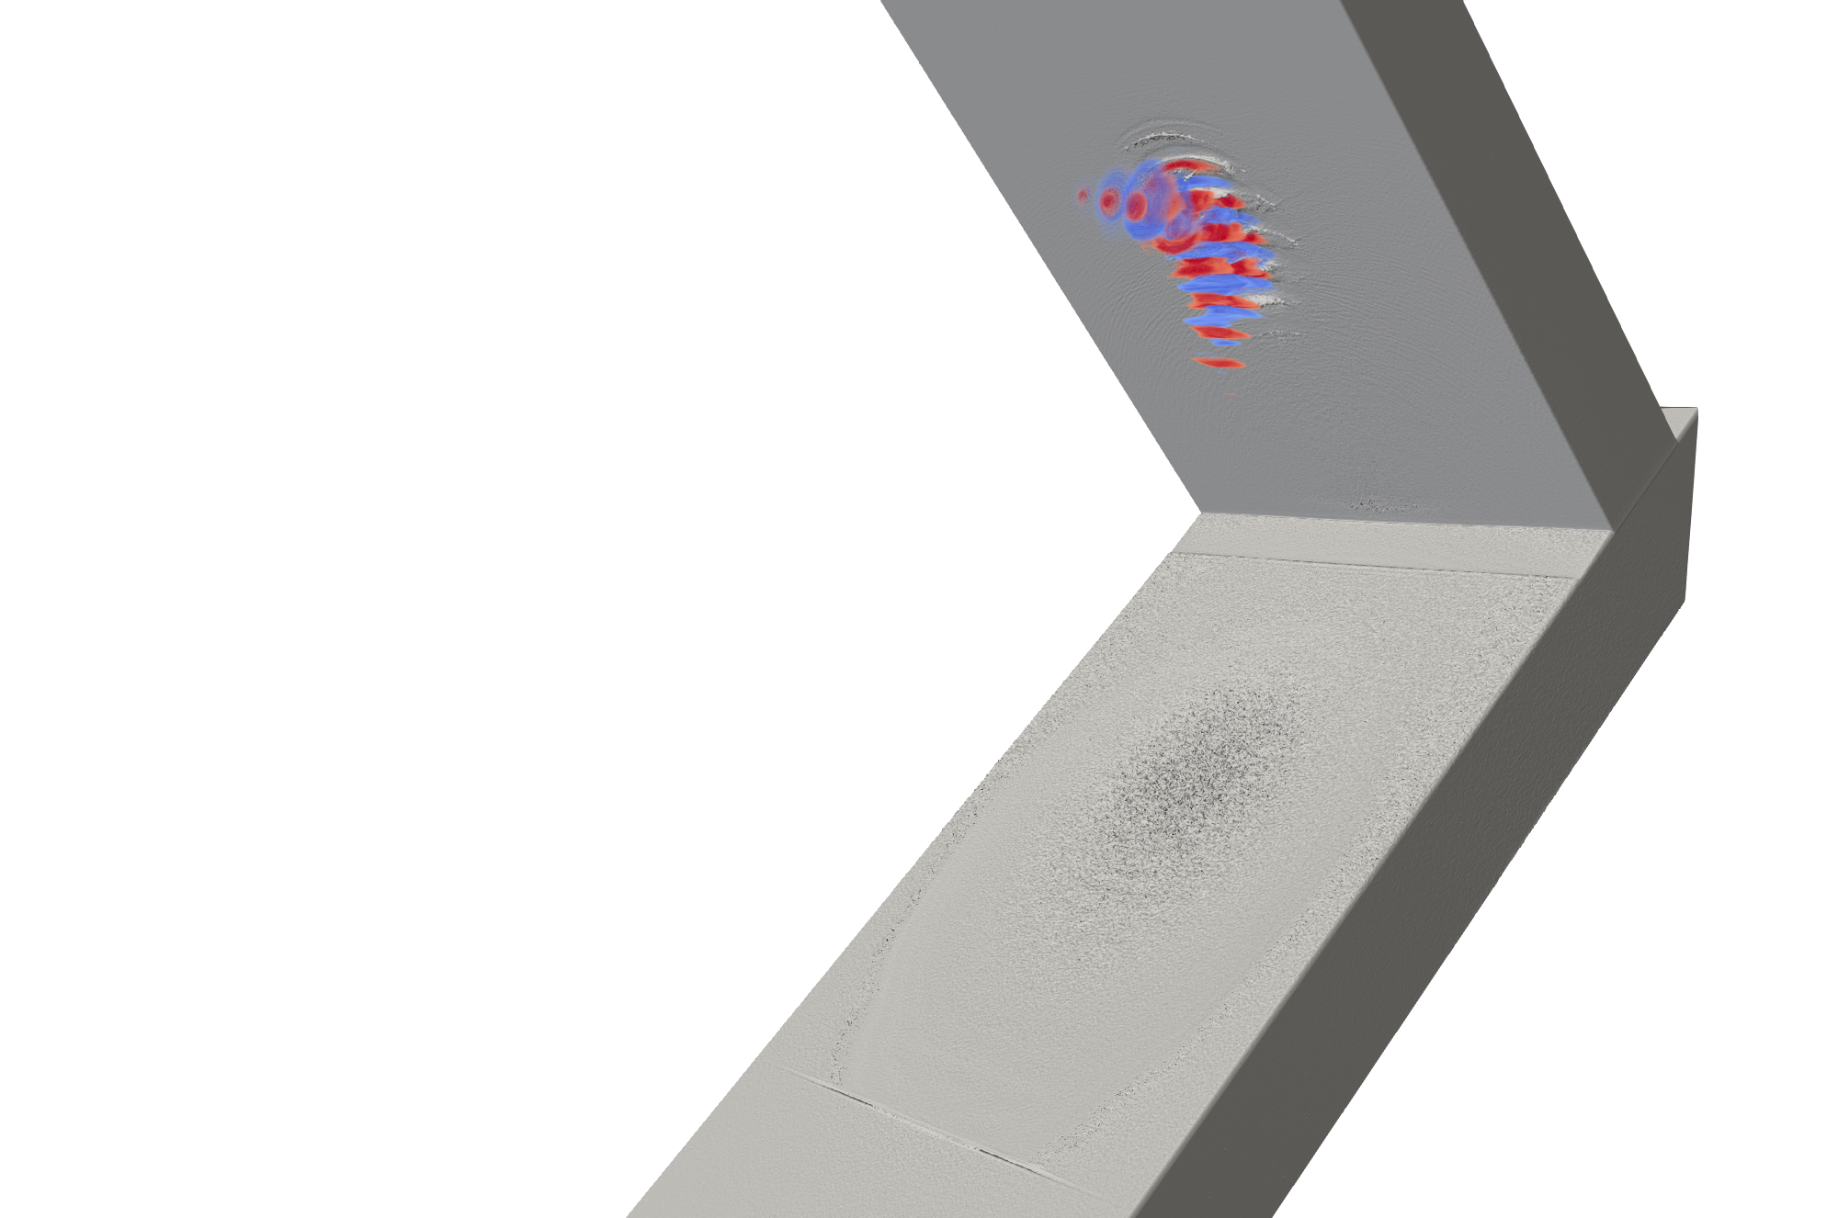
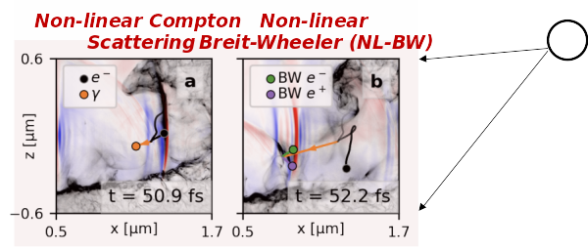
What signatures could we expect ?
xx
SF-QED signatures
Fedeli et al, PRL (2021)

Slide 42
What signatures could we expect ?
xx
Summary
Result #1 ⇒
DBB can increase SF-QED signal by orders of magnitude with existing
lasers
Fedeli et al, PRL, (2021)
Sainte-Marie et al, NJP, (2022)
Zaïm et al, ArXiv:2303.17581 (2023)

Slide 43
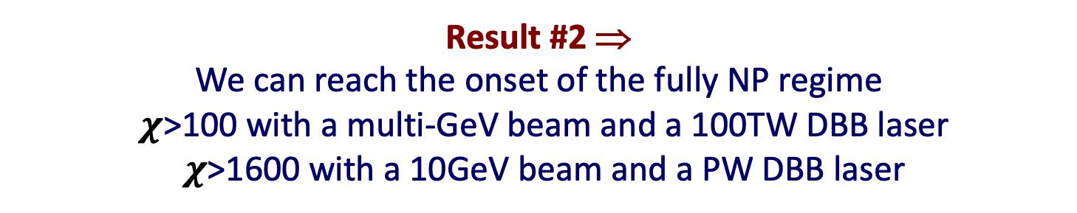
What signatures could we expect ?
xx
Summary
Result #1 ⇒
DBB can increase SF-QED signal by orders of magnitude with existing
lasers
Fedeli et al, PRL, (2021)
Sainte-Marie et al, NJP, (2022)
Zaïm et al, ArXiv:2303.17581 (2023)
Result #2 ⇒
We can reach the onset of the fully NP regime
$χ$>100 with a multi-GeV beam and a 100TW DBB laser
$χ$>1600 with a 10GeV beam and a PW DBB laser
Zaïm et al, ArXiv:2303.17581 (2023)

Slide 44
Conclusion
Message #1 ⇒
Plasma mirrors can act as high-quality high-charge injectors to level-up the charge accelerated by LWFA
Message #2 ⇒
Plasma mirrors can act as intensity boosters to reach SF/NP QED
regimes with existing laser technology

Slide 45
Looking ahead
xx
Project #1 ⇒ ANR FemtoDose (lead PI: H. Vincenti, CEA
co-PIs: A. Leblanc/ A. Flacco, LOA)
collab: LBNL
Hybrid target from 100TW to PW
Goal: demonstrate PM injection up to PW and Hz rep rate
100TW experiments at Salle Jaune (LOA) and UHI100 (CEA)
PW-class experiments at APOLLON

Slide 46


Looking ahead
Project #2 ⇒ ERC STG EXAFIELD (PI: A. Leblanc, LOA)
collab: CEA, LBNL
100TW DBB experiments at LOA
Goal: reach the onset of SF-QED with 100TW DBB
Two experimental configurations explored:
L-shaped target at 100TW
$$χ<1$$
100TW DBB/ 100MeV LPA beam collision

Slide 47


Looking ahead
Project #3 ⇒ CEA/DESY/Univ Rochester
collab: LBNL, LOA
High-precision DBB experiments at up to 1Hz
Goal: Probe the SF and fully NP regimes of QED using DBB
Two experimental configurations explored:
1Hz 200TW DBB / 6 GeV Kaldera LPA
$$1<χ<100$$
Single-shot L-shaped target up to 10PW
$$1<χ<30$$

Slide 48
THANK YOU
QUESTIONS ?

