Slide 1
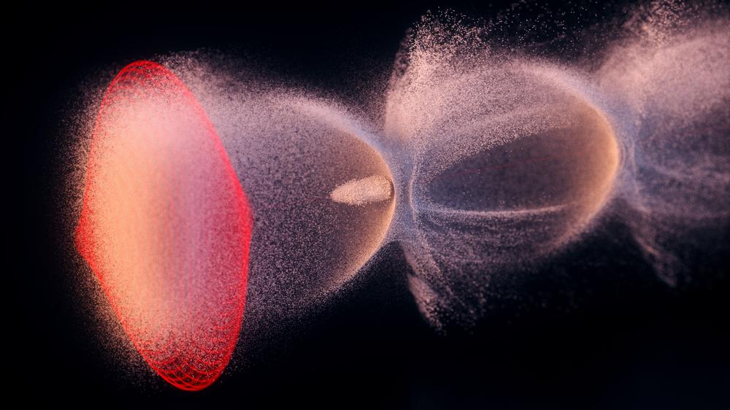














ESPP Roadmap Update – Plasma Accelerators
Status of Plasma Accelerator Efforts
Wim Leemans Accelerator Division, DESY
Rajeev Pattathil STFC UKRI, RAL
EAAC 2023, Elba
wim.leemans@desy.de
rajeev.pattathil@stfc.ac.uk

Slide 2
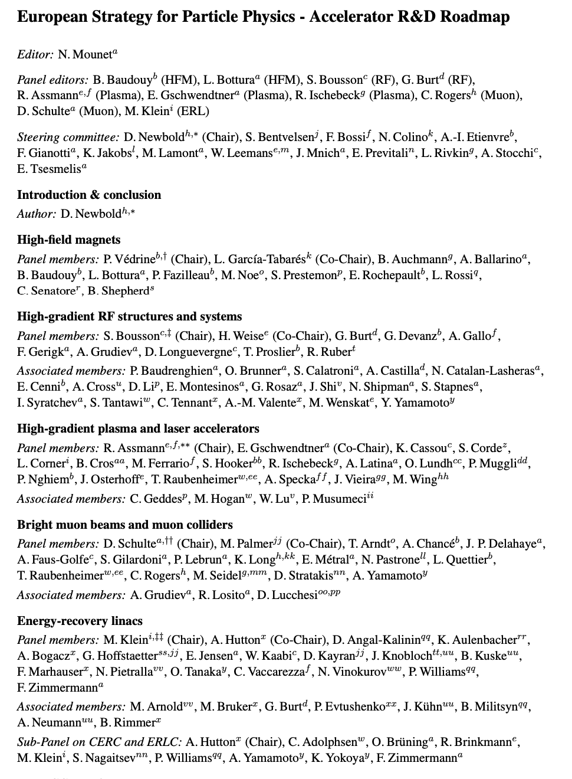


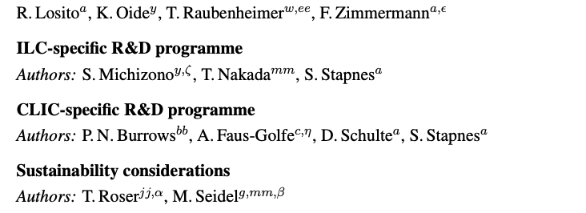
ESPP Roadmap

Slide 3
ESPP Roadmap
To develop R&D for the next generation of particle accelerators and colliders (beyond 2045)
Commissioned by Lab Directors’ Group – CERN
To provide an agreed structure for a coordinated and intensiﬁed programme
Develop in consultation with the community and expert panels
Coordinate with international activities
Specify a series of concrete deliverables, including demonstrators, over the next decade

Slide 4
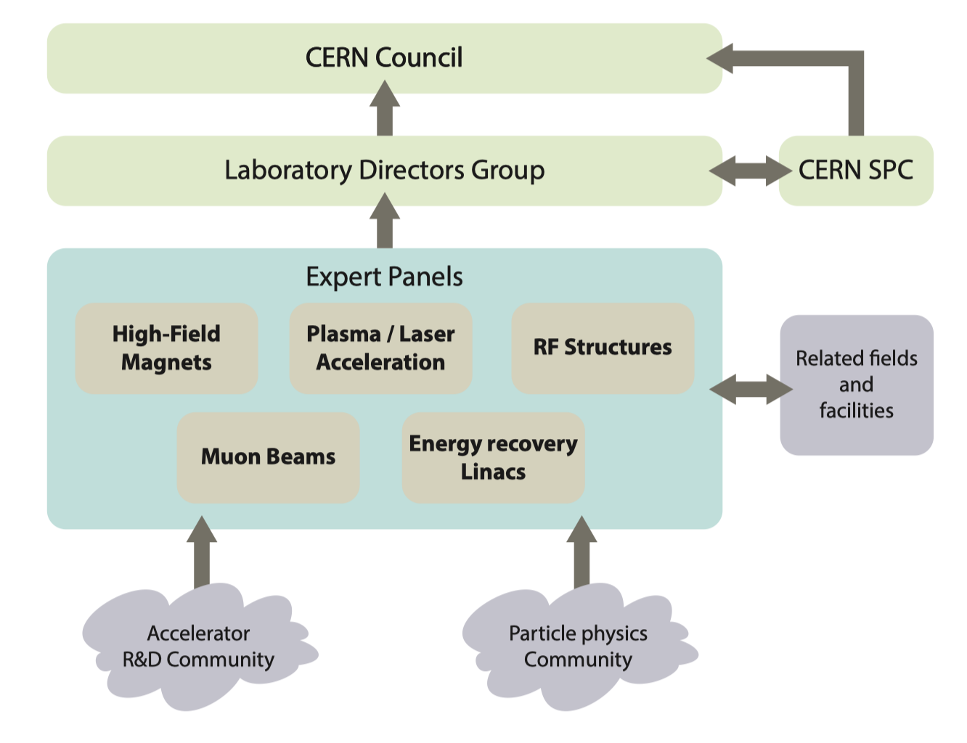
ESPP Roadmap
Identified 5 topics for R&D – 5 panels
Further development of high-ﬁeld superconducting magnet technology.
Advanced technologies for superconducting and normal-conducting radio-frequency (RF) accelerating structures.
Development and exploitation of laser / plasma acceleration techniques.
Studies and development towards future bright muon beams and muon colliders.
Advancement and exploitation of energy-recovery linear accelerator technology.

Slide 5
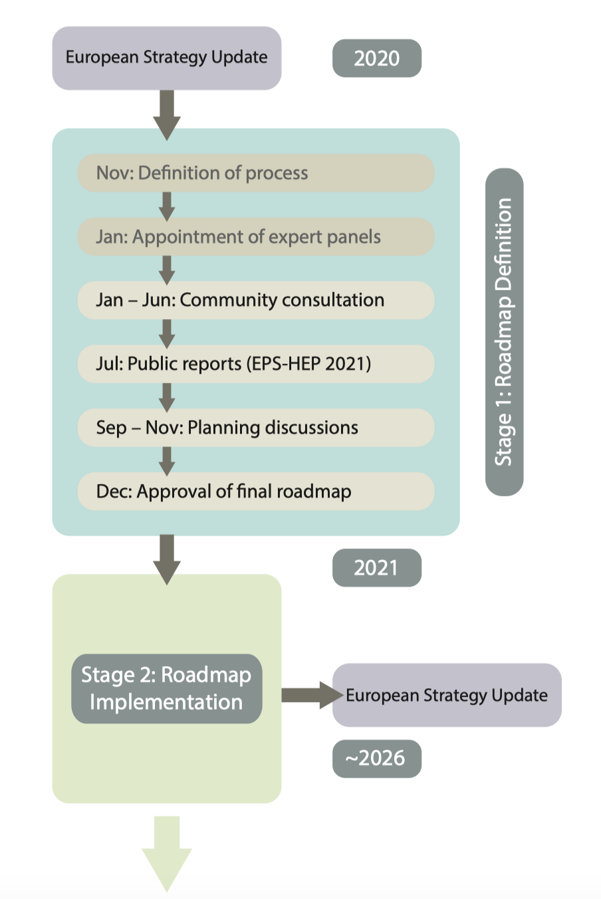
ESPP Roadmap – Process & Timescales
A significant collaborative effort through expert panels
Identifying key R&D objectives
Weighted under indicative funding scenarios:
  ‘minimal’ scenario: achieved with restricted resources (only if current activities already align)
  ‘nominal’ scenario: extra funding conditions continue
  ‘aspirational’: significant additional funding
Doesn’t identify a ring-fenced funding pot
Doesn’t provide recommendations between technologies (i.e. no prioritization)
2022

Slide 6

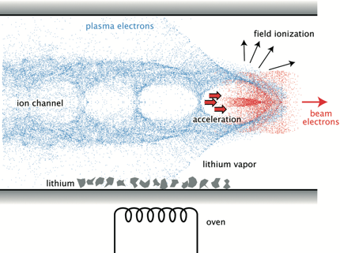
R&D Coordination Panel: Plasma Accelerators
EPPS Roadmap exercise aims at delivering a pre-CDR study by December 2025
Deliverable | Due by
Report: Electron High Energy Case Study (from 175GeV to 190GeV) | Jun-24
Report: Positron High Energy Case Study (similar to above) | Jun-25
Report: Spin-Polarised Beams in Plasma Accelerators | Dec-25
Report: Physics Case of an Advanced Collider | Jun-24
Report: Low Energy Study Cases for Electrons and Positrons (15-50GeV) | Jun-25
Report: Pre-CDR and Collider Feasibility Report | Dec-25
Experiment: High-Repetition Rate (Laser) Plasma Accelerator Module (kHz) | Dec-25
Experiment: High-Efﬁciency, Electron/Proton-Driven Plasma Accelerator Module with High Beam Quality | Dec-25

Slide 7
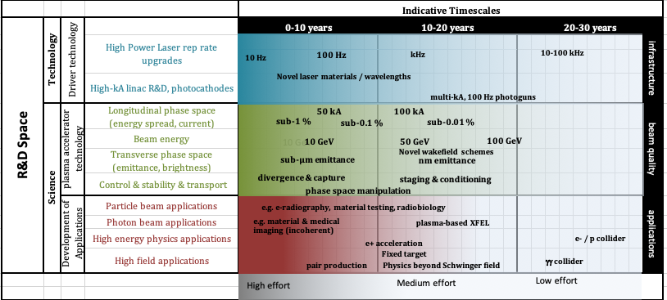
Shaping a multi-decadal program towards plasma based colliders and experiments
Current research in LPA and e-PWFA concentrated on producing high-quality beams for light sources and their applications
AWAKE has a programmatic path towards HEP relevant energies
Dedicated R&D is critical for a future plasma-based collider
Need a program (and funding)
0-10 years | 10-20 years | 20-30 years
Demonstration of: Preserved beam quality, acceleration in very long plasmas, plasma uniformity | Fixed-target experiment (AWAKE) Dark-Photon search, strong-field QED etc, (50-200GeV e⁻)
 | Demonstration of: Use of LHC beams, TeV acceleration, beam delivery | Energy-frontier collider 10 TeV c.o.m. electron-proton collider
AWAKE
LPA and e-PWFA Programs
EuPRAXIA
PWASC Roadmap 2019

Slide 8
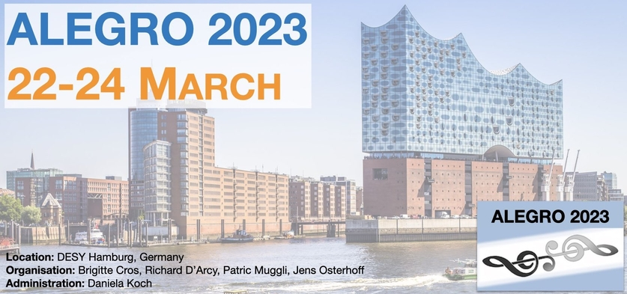
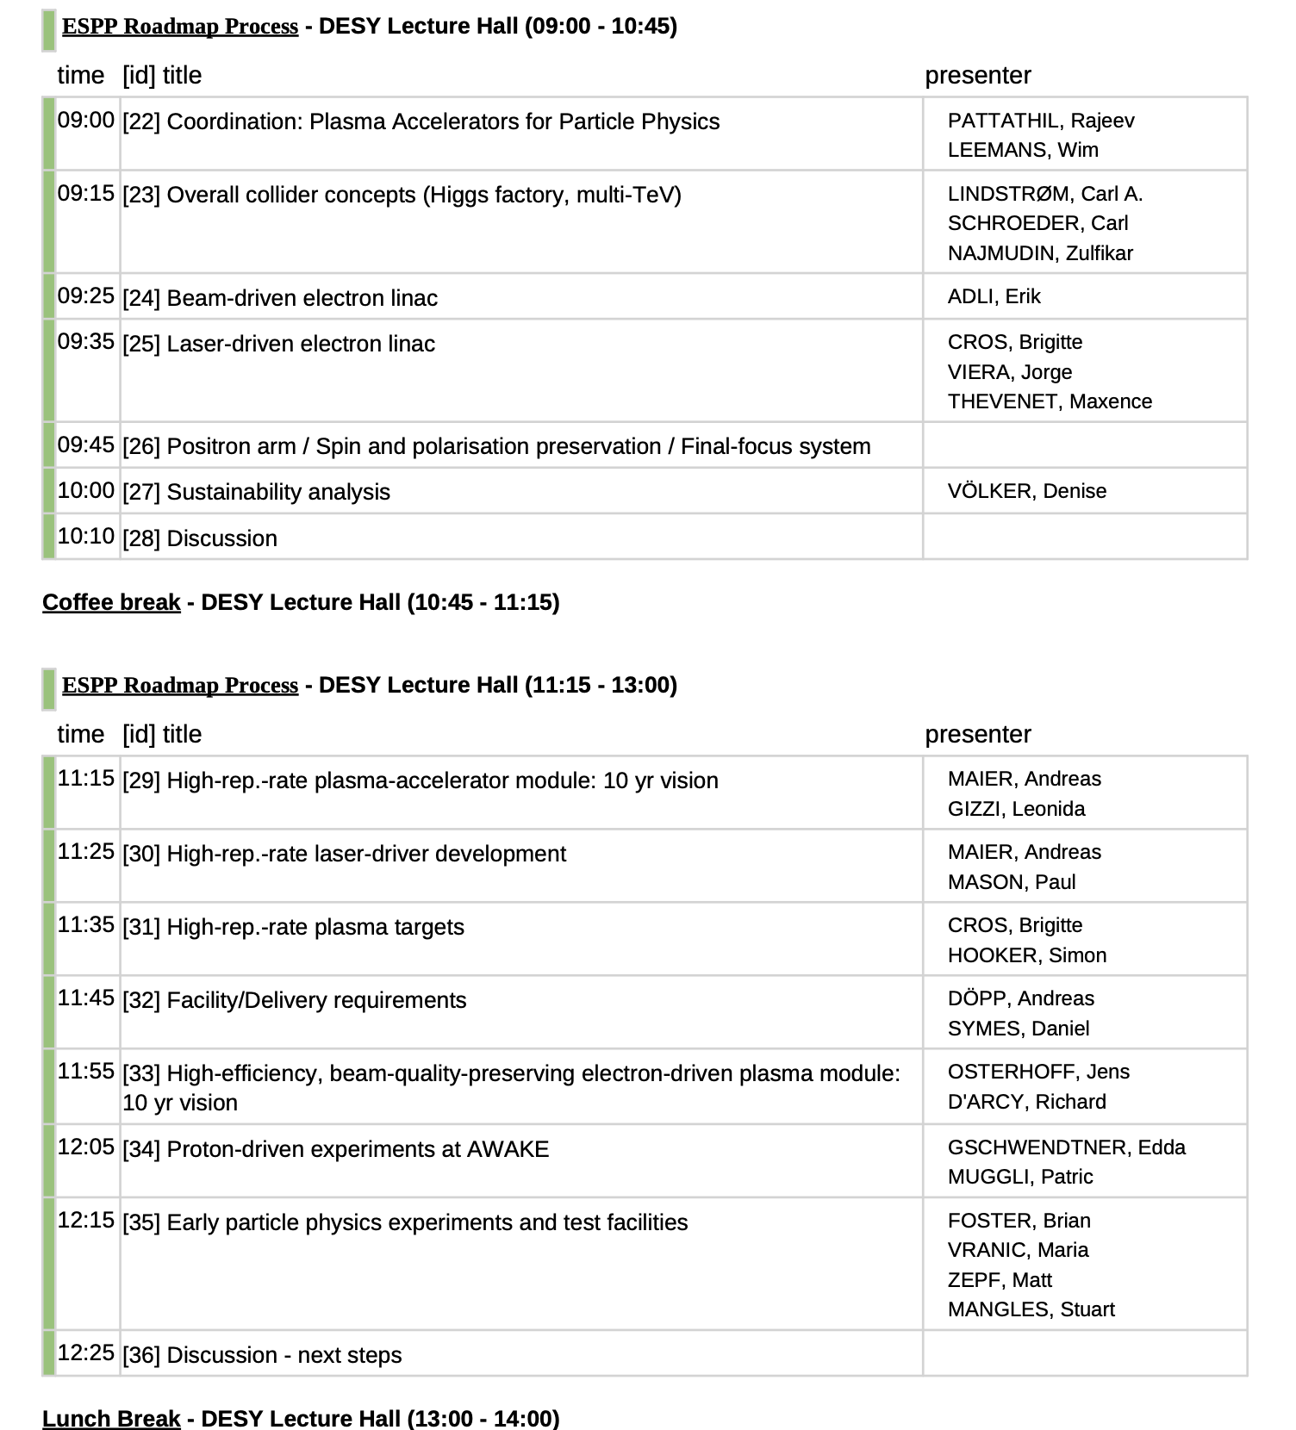
Kick-off meeting at ALEGRO – March ‘23
First Community Meeting to put together a program of work
https://indico.cern.ch/event/1193719/
Analysis of a pre-conceptual (straw-person) model of a collider and fixed target experiments
Collider building block analysis:
  Injector (electron and positron, spin-polarized,….)
  Accelerator stages
  Beam transport and final focus
  Power sources (laser and/or particle drivers)
Experimental studies on laser/electron/proton-driven plasma accelerator concepts towards solving some key R&D Challenge
Goal: Prepare for start of a CDR in second half of the decade
Two dedicated sessions for ESPP
Representation from almost all work packages
Brief presentations on proposed activities and resources

Slide 9
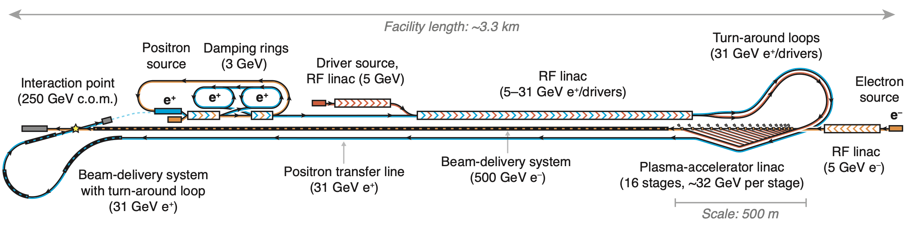
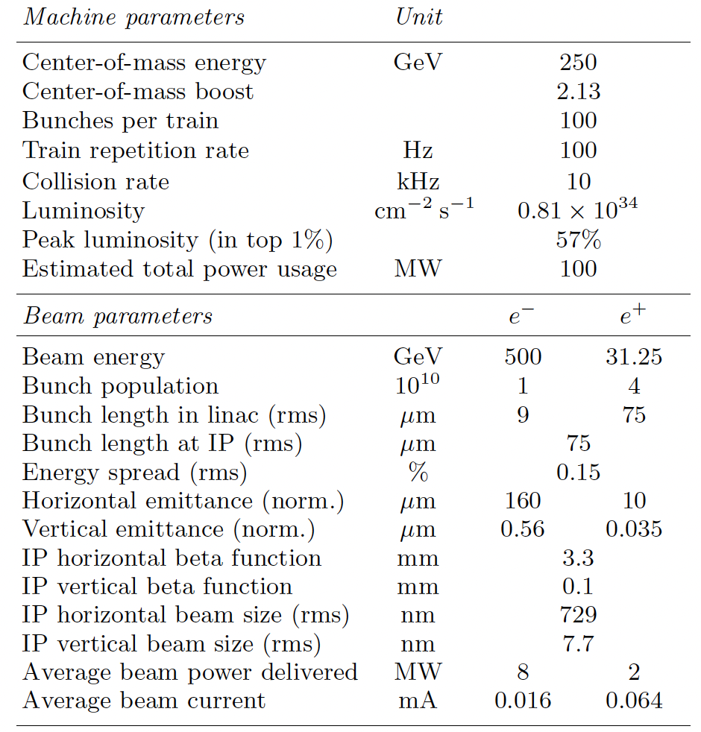
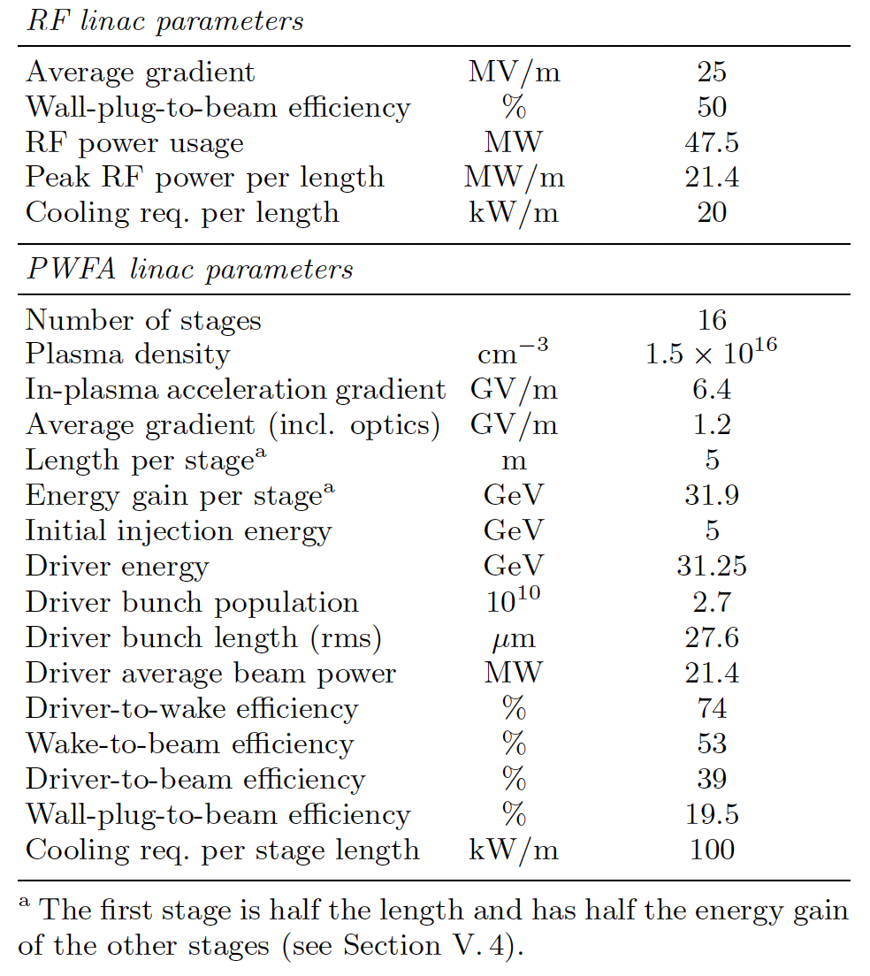
A new proposal: HALHF – a plasma accelerator scheme for a Higgs Factory
An end-to-end preliminary collider design presented by Brian Foster, Richard D’Arcy and Carl Lindstrøm
Asymmetric energy e+e- collider design with a 500GeV electron arm and a 31GeV positron arm.
Plasma-accelerator driven electron arm and a positron-arm based on conventional linac
Credible, yet novel (asymmetric) design concept with some key parameters required for colliders
Parameters, tolerance levels, technical feasibility etc. need to be scrutinized through extensive modelling and simulations (and experimental prototypes)
Previous Talk by Carl Lindstrøm
https://arxiv.org/pdf/2303.10150.pdf

Slide 10
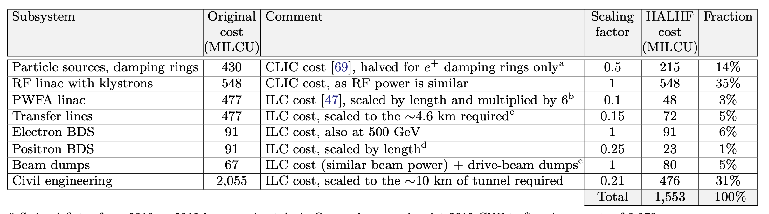
Opportunity to build a pre-CDR case around HALHF
Higgs Factory at potentially ~1/4th of the cost
Plasma accelerator arm of HALHF can be beam-driven or laser-driven
First generation to consider PWFA from a technological readiness level (TRL) perspective and LPA stages can be incorporated later, providing an even more compact architecture
Many synergies between all plasma accelerator technologies (laser-, electron-, and proton-driven), and all will contribute to the pre-CDR.
ALL plasma accelerator concepts, and associated technologies should continue to be developed to ensure that synergies can be leveraged
Potential upgrade paths for HALHF remain open.

Slide 11
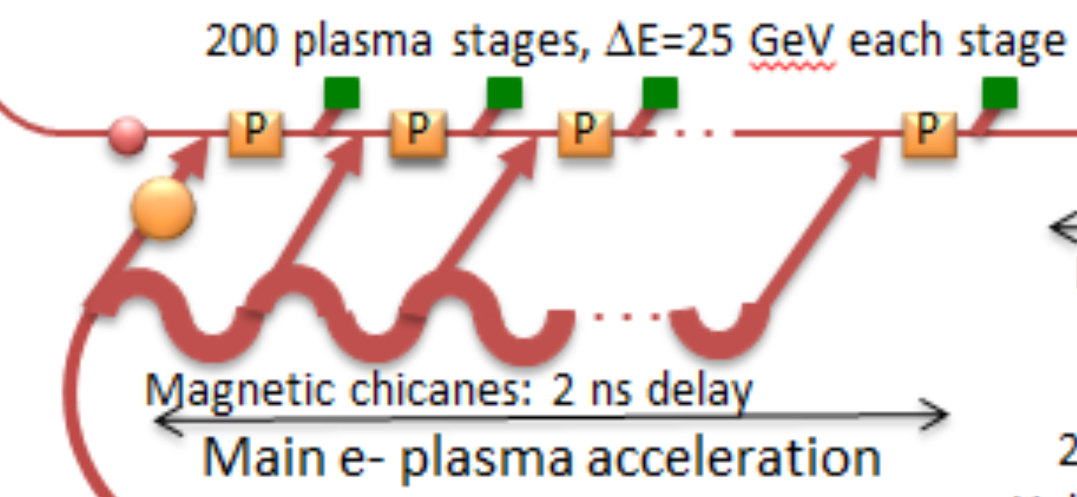
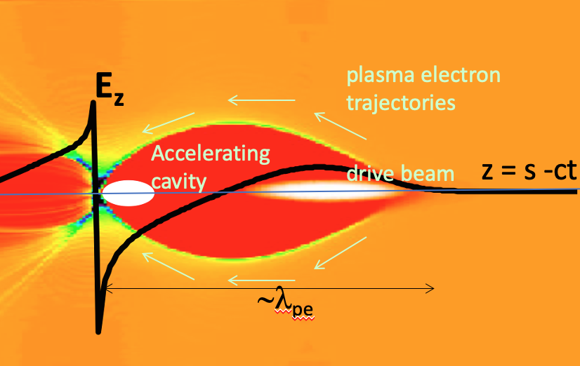
Plasma-based collider: Feasibility studies
Theory/simulation – based works
  WP 1.1: Overall collider concepts (Carl Lindstrøm, Brian Foster, Richard D’Arcy) + Zulfikar Najmudin
  Provides crucial input to the development of HALHF into pre-CDR
WP 1.2: Beam driven electron linacs (Erik Adli, Carl Lindstrøm)
  Simulations to underpin HALHF design
  Develop single stage and interstage models with all the relevant physics needed
  Tolerance checks/self-correction concepts
Single-stage physics
Drive beam generation and distribution
Talks in WG10 yesterday

Slide 12
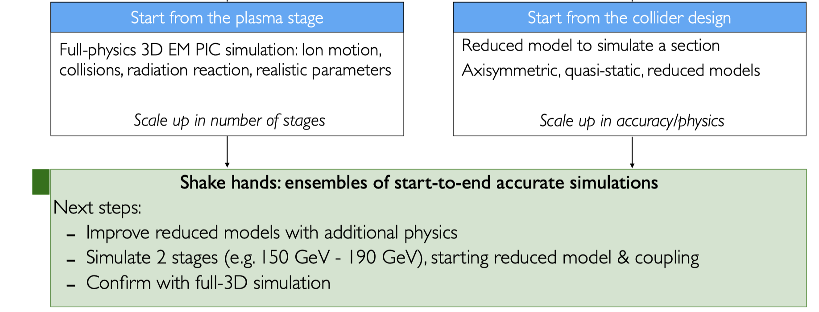
Plasma-based collider: Feasibility studies
Theory/simulation – based works
  WP 1.3: Laser driven electron linacs
  (Jorge Viera, Maxence Thévenet, Brigitte Cros, Zulfikar Najmudin)
  Looking out for fundamental show-stoppers
  Improving reduced models with additional physics
  Simulate 2 stages, starting with reduced model & coupling and conﬁrm with full-3D simulation
  Could underpin future plasma-based collider designs/upgrades to HALHF
  Experimental verification via 2.4 and in-kind contributions at LPA facilities
Common topics:
Pre- and post-driver plasma modeling
Multi-time and length scales
Radiation and mass transport
Ionization and MHD
Heat management

Slide 13
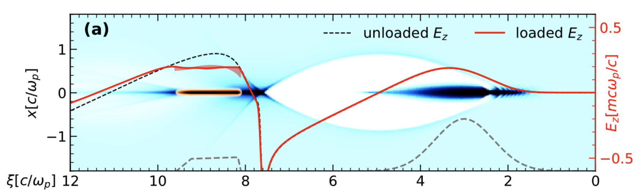
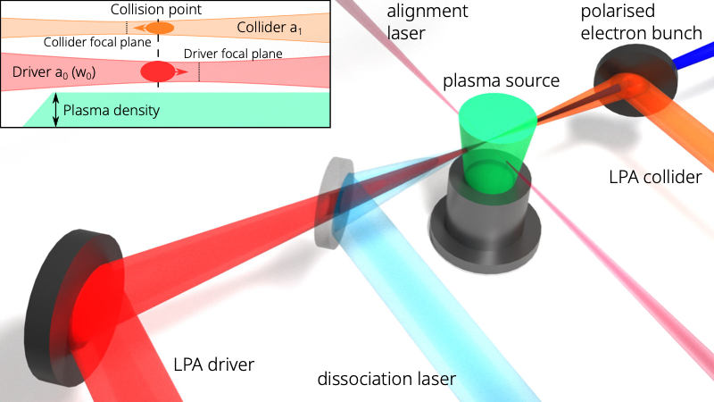
Plasma-based collider: Feasibility studies
Requires theory/simulations along with experimental verifications
  WP 1.4: Positron acceleration (Gianluca Sarri, Severin Diederichs)
    Important to continue effort. A few potential schemes have recently emerged – need to investigate tolerances etc. before experimental realisation
    Development of experimental areas where positron wakefield acceleration can be studied
    Systematic simulation studies and improvements of simulation codes:
WP 1.5: Spin and polarization preservation (Kristjan Põder)
    Important to continue effort
    A few potential schemes – need experimental realisation (eg. LEAP project)
    S. Diederichs – Wed
    Spencer Gessner – Thurs
    Sébastien Corde - Thurs

Slide 14
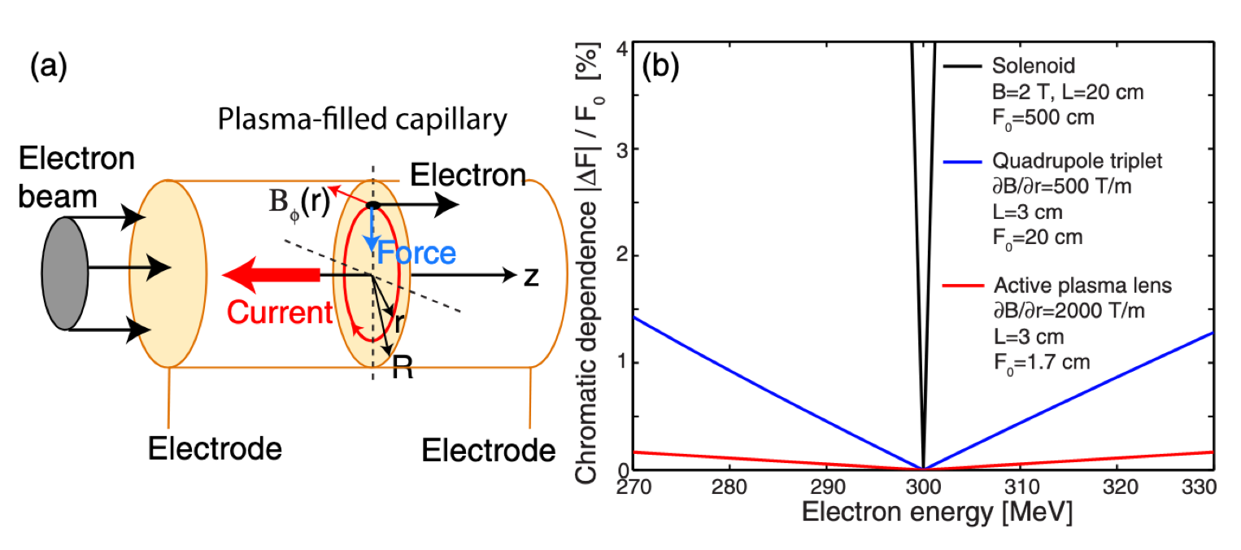
Plasma-based collider: Feasibility studies
Requires theory/simulations along with experimental verifications
  1.6: Assess final-focus system concepts;
    Explore other technologies (eg. adiabatic plasma lens.) that could underpin future upgrades to HALHF
Active plasma lenses can work independent of beam shape
Both for electrons and positrons
This might result in making HALHF upgrades more compact.
→ Need to find someone to lead this

Slide 15
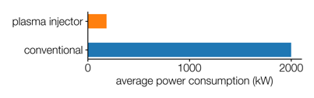
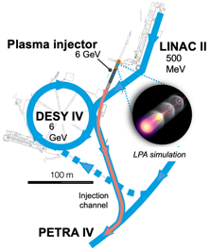
Sustainability and environmental impact study
WP 1.7 Coordinated by D. Voelker (DESY) & M. Turner (CERN)
Development of guidelines that allow comparison of the environmental impact of the proposed HALHF and ILC Higgs-factory design.
  Community input will assure incorporation of different stakeholder views, help prioritize guiding criteria and continuation of existing efforts.
  Community outreach will help gathering reliable data from similar previous projects and synergistic efforts (e.g. CLIC efforts, iFAST,...).
  External consultancy will ensure conformity with European legislation and industry standards in methods and criteria.
Application of the developed guidelines for the environmental impact comparison of the HALHF and ILC Higgs-factory proposal.
A facility-wide energy consumption assessment for electron, proton and laser drivers.
Communicate, share and spread analysis results. Establish platforms that enable networking, exchanges and cooperation between accelerator physics, other scientific areas and industry.
Identify highest impact R&D that would allow to reduce the environmental footprint of future accelerators.
225 kW (estimate)

Slide 16
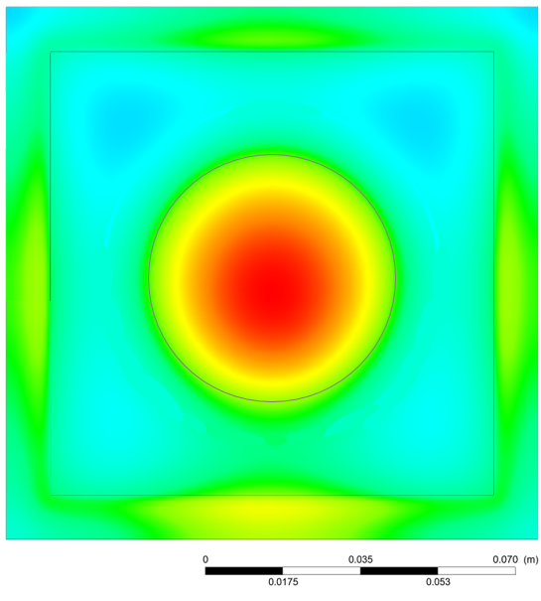
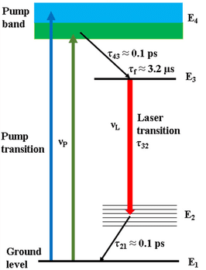
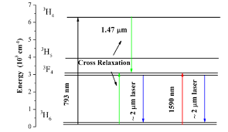
Technology developments need to continue
Can address major plasma accelerator challenges – need extra resources for aligning activities
  WP 2.1: High-repetition rate laser-driven plasma module (coordination) (Leo Gizzi, Andi Maier)
      Plan a joint workshop to develop concepts and carry out R&D (lasers, plasma targets, facility aspects)
      Focus on inter-stage technology R&D
  WP 2.2: Development of high-rep rate, high-efficiency lasers (Paul Mason, Andi Maier)
      Important for laser plasma accelerator developments and fusion drivers
      A lot of development towards industrial applications – need to channel this to our advantage
Ti:Sa
Tm:X (2µm)
316
300
Gas-cooled clad Ti:Sa slab pumped at 1.4 kW @ 10 Hz
Potential synergy with laser-fusion drivers

Slide 17
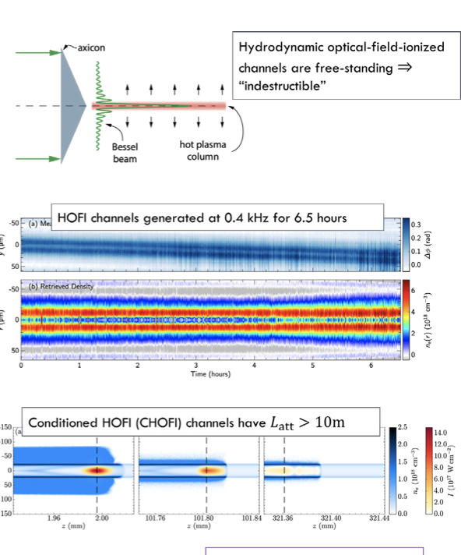
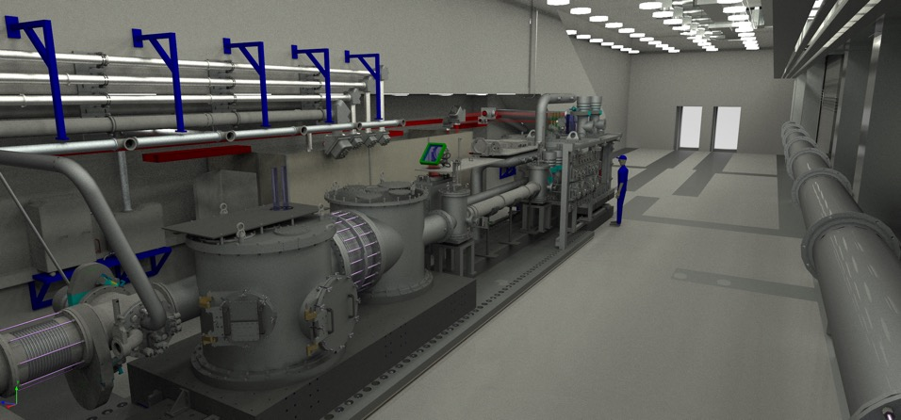
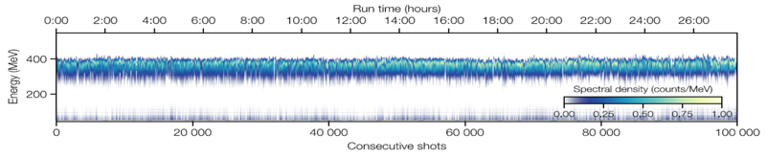
Technology developments need to continue
Can address major plasma accelerator challenges – need extra resources for aligning activities
  WP 2.3: Plasma source technology (Simon Hooker, Brigitte Cros)
  Developing gas cells and HOFI channels – including PWFA-relevant targets
  Solutions for heat load management in plasma sources and multi-time and length scale modeling aimed at pre- and post-driver interactions
  WP 2.4: Experimental LPA Facility Developments: (Dan Symes, Andreas Döpp)
      Experimental verifications and prototyping: beam manipulation and propagation, stability optimization and feedback control, plasma mirrors and driver removal, staging demonstrations
      Aspects important for 1.1 and 1.3
Aaron’s talk - Monday
Andreas’ talk - Monday
LPA-based facilities are under construction – requires resources to align with the CDR

Slide 18
Technology developments need to continue
Can address major plasma accelerator challenges – need extra resources for aligning activities
kHz, multi-GeV accelerators are already under development based on novel schemes
Simon Hooker, Monday

Slide 19

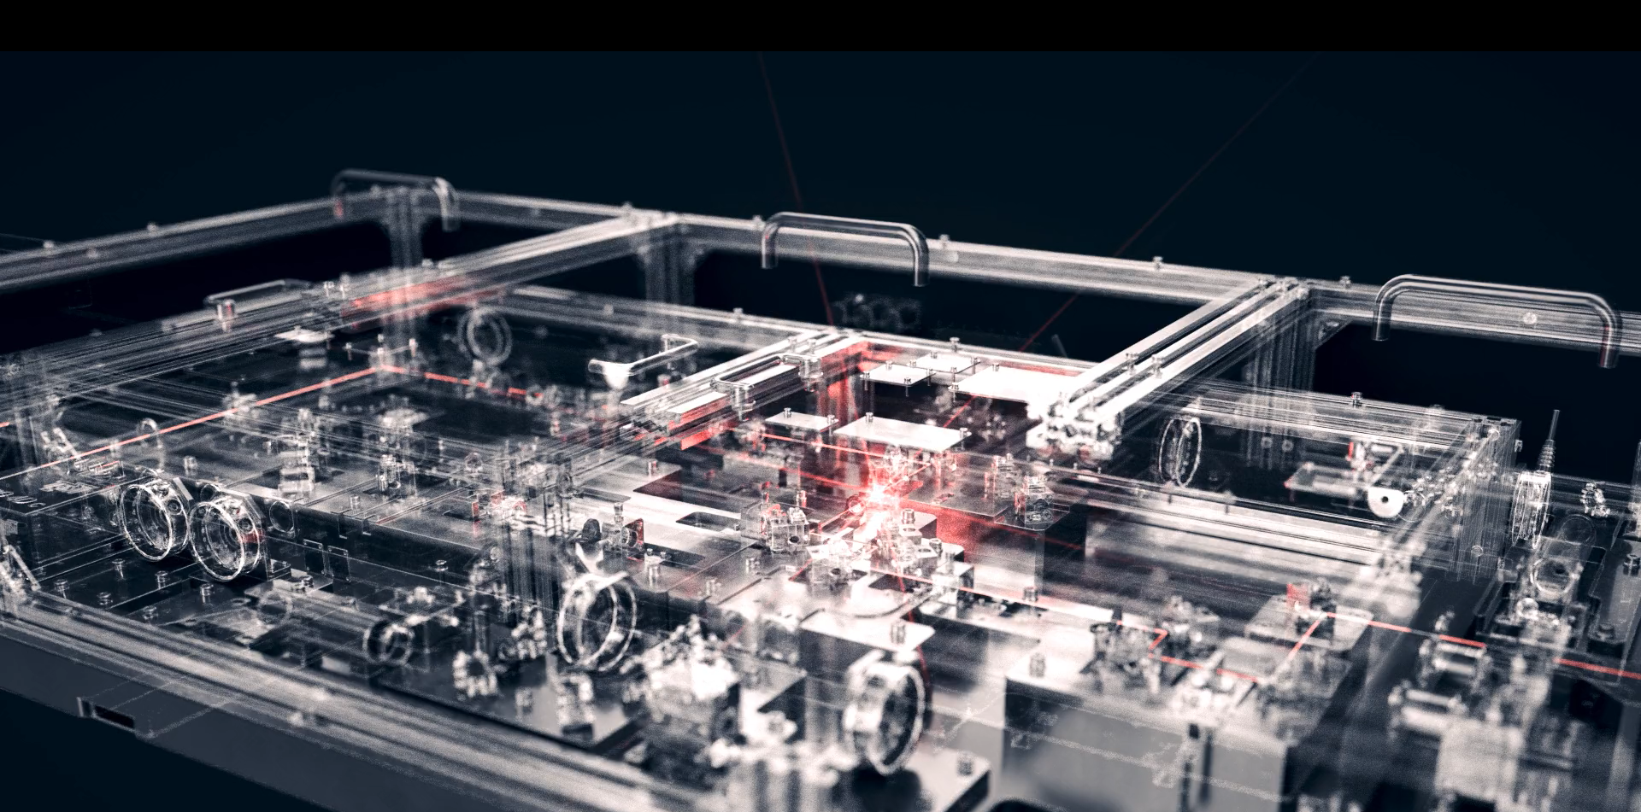
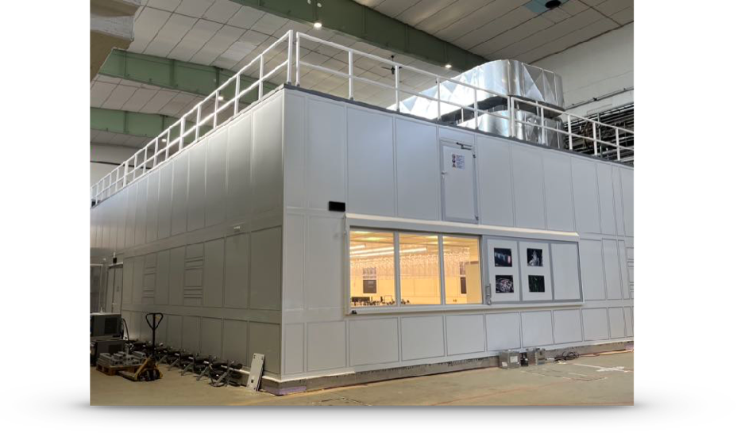
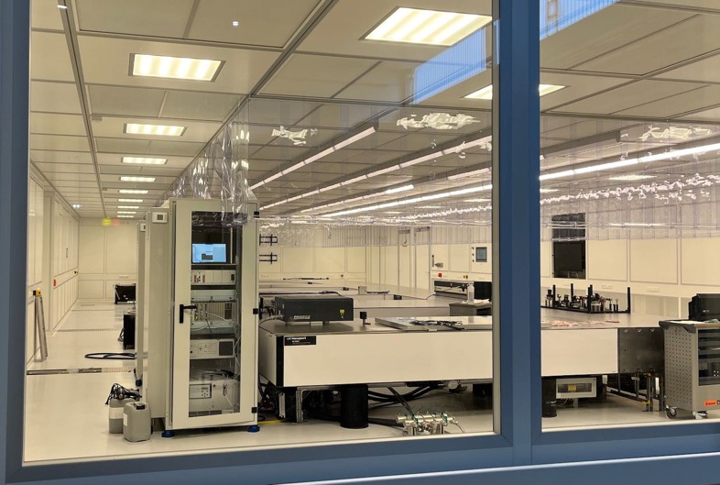

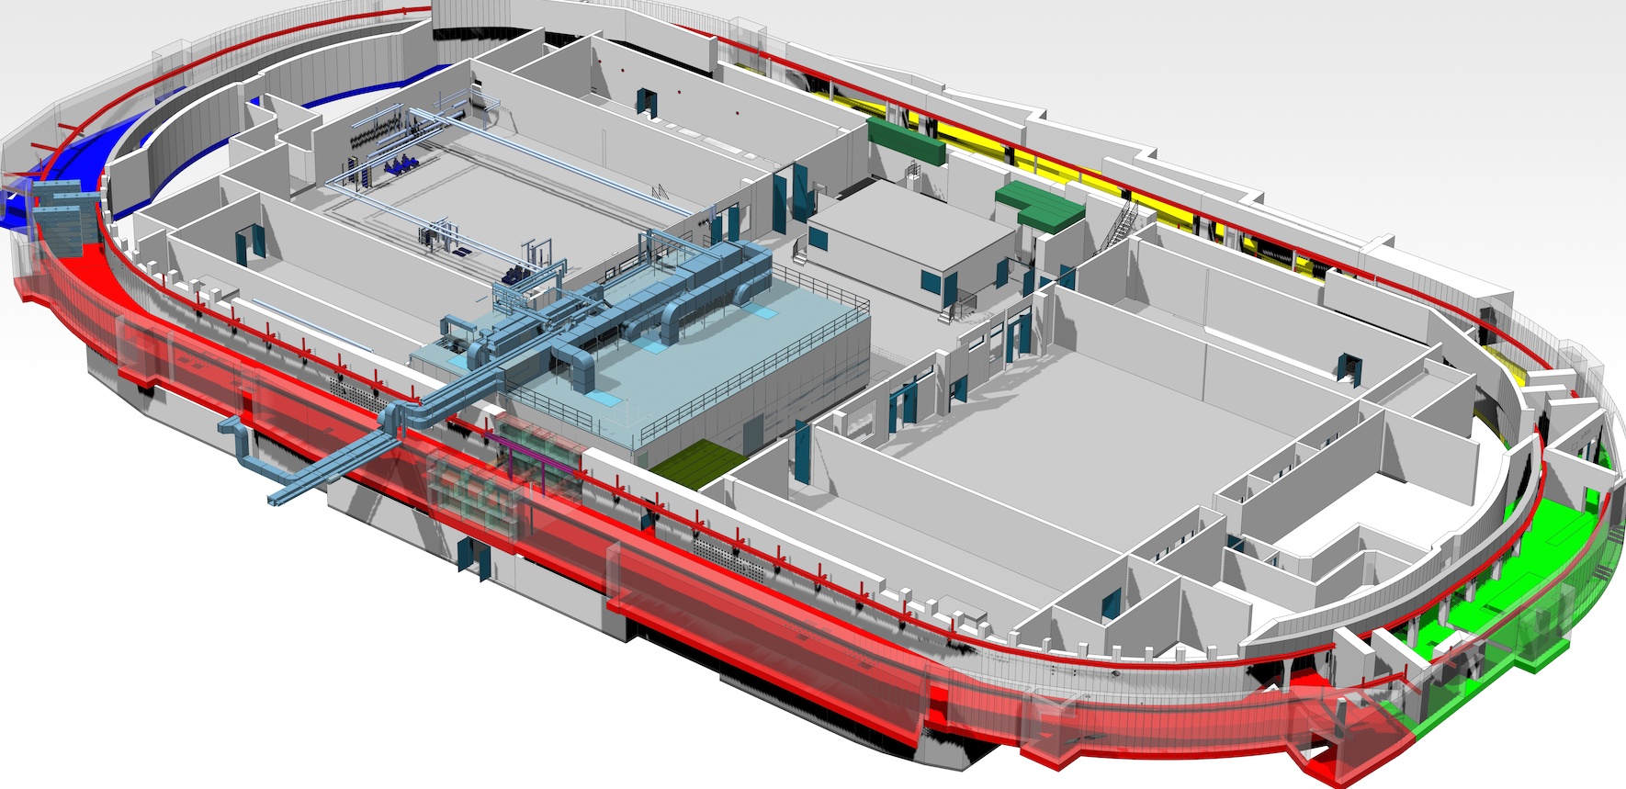
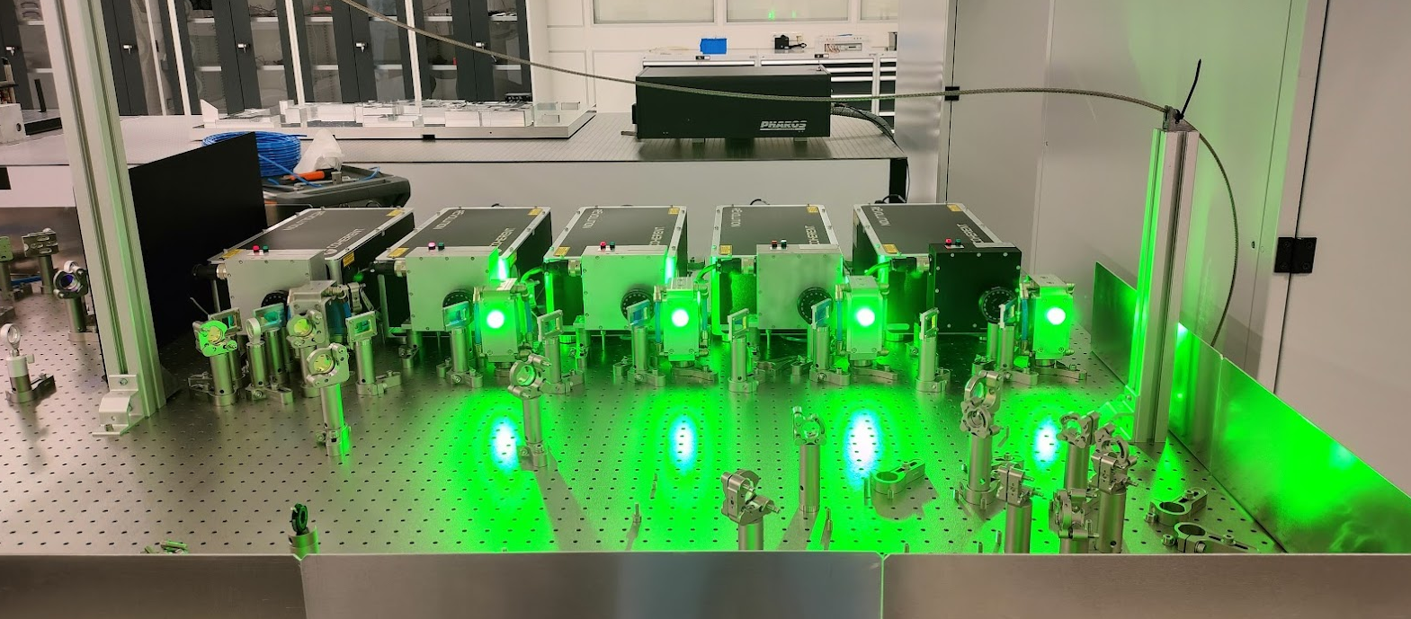
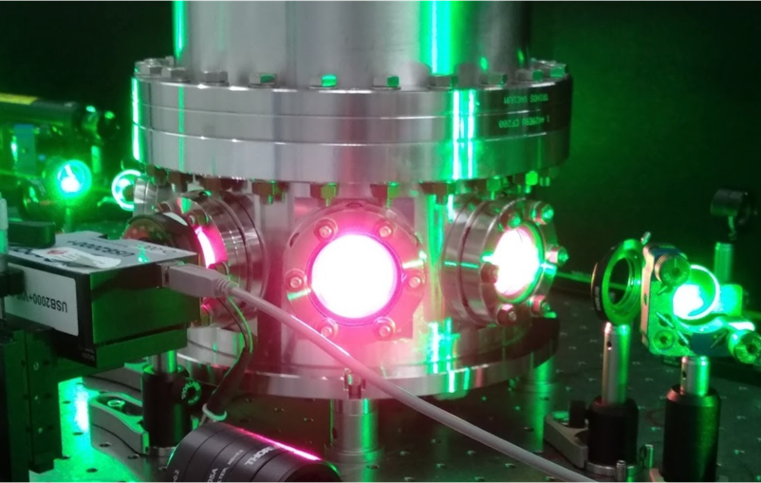
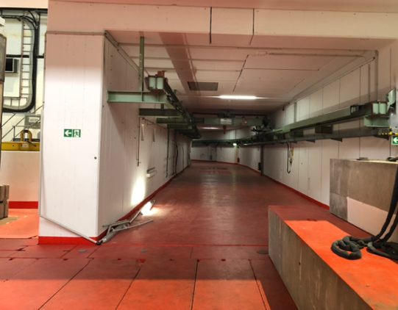
KALDERA LaserLab @DESY completed, and laser development has started
KALDERA
Science Case:
Active Stabilization
Competitive Technology
Technology Demonstrator
Specifically
New LPA Drive Laser
100 TW at 1 kHz rep rate, 3 J in 30 fs
Goal: FEL-quality electron beams @ 1 GeV
Laser Lab
400m² ISO5/6 clean room
0.1° temperature stability
Lab completed end 2022
Laser
Setting up seed laser, stretcher, and preamp in parallel
Finalizing concept for main amplifier, including compressor and pump laser
Developing feedback mechanism also as part of HI-ACTS innovation plattform
Kaldera Tunnel
Generic infrastructure for experiments
(many different experiments over time)
Supports up to 1GeV @ 1kHz
Started installation of interlock systems, new venting, IT and electricity
19

Slide 20
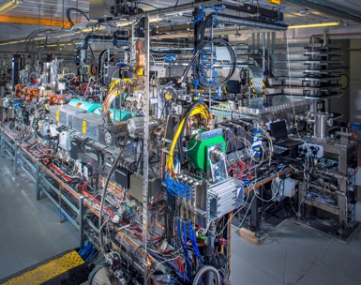
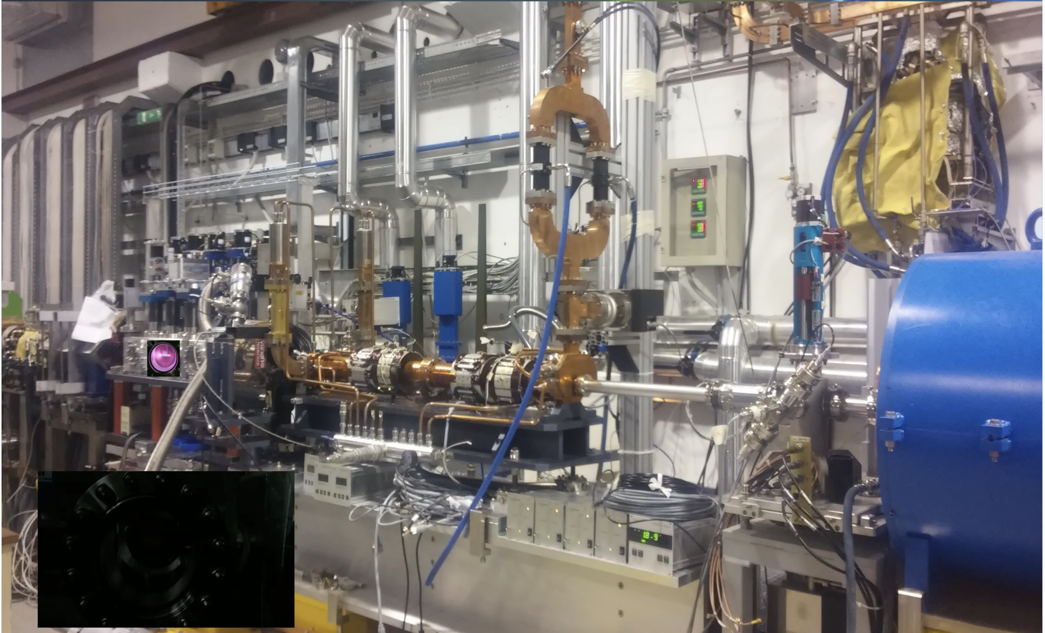
Strategies of PWFA facilities align with pre-CDR work
Plan covers major plasma accelerator challenges – need extra resources for coordination
CLARA is an ultrabright, electron beam test facility under development at STFC Daresbury Laboratory
FEBE will combine CLARA with a Plasma Wakefield Accelerator stage driven by a 100TW laser
FLASHForward at DESY explores high energy, high power PWFAs
Frascati (INFN) explores PWFA based light sources and applications (EuPRAXIA)
CLARA beamline
Contributing to
Electron beam-driven PWFA/Plasma photocathode
Plasma source development/plasma-based beam diagnostics
External injection LPA, Trojan Horse, …
INFN PWFA chamber

Slide 21
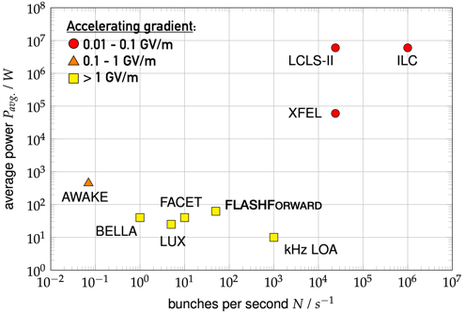


Strategies of PWFA facilities align with pre-CDR work
Plan covers major plasma accelerator challenges – need extra resources for coordination
2018
FLASHForward
Plasma dechirper
2019
    D’Arcy et al., PRL 122, 034801 (2019)
complete
ILC
LCLS-II
Energy depletion and energy doubling
planned
Wakefield sampling
10 kW FLASHForward
    Schröder et al., Nat. Commun. 11 5984 (2020)
KALDERA
2020
Energy spread preservation by beam loading control
FL
    Lindstrøm et al., PRL 126, 014801 (2021)
Emittance preservation
F. Peña) Wed
    Lindstrøm et al., submitted (2022)
2022
High gain and overall efficiency for sustainable operation
kHz-to-GHz plasma response
    D’Arcy et al., Nature 603, 58 (2022)
2024
WP 3.1 Electron-beam driven PWFA experiments (Jens Osterhoff, Richard D’Arcy)
Scaling to HALHF-relevant energies and parameters
10 kW avg. power operation
2026
2030
➞ FLASH: increase FEL energies,
access oxygen K-edge at
2.33 nm wavelength

Slide 22
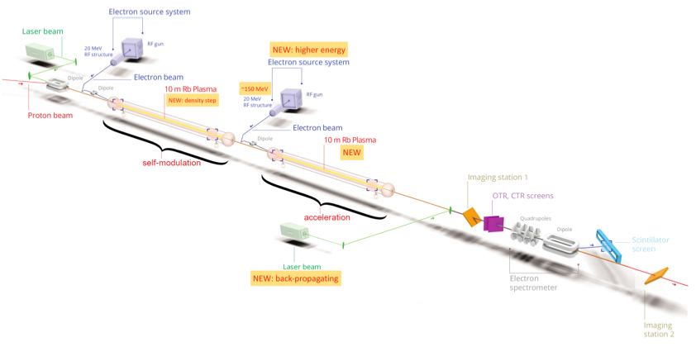
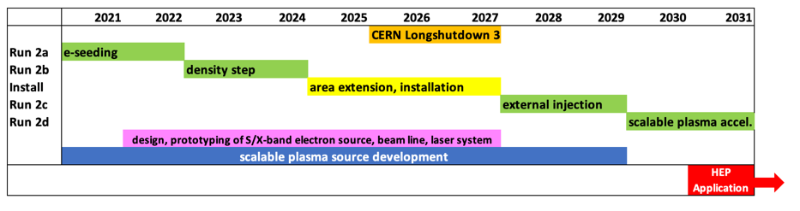


Strategies of PWFA facilities align with pre-CDR work
Plan covers major plasma accelerator challenges – need extra resources for coordination
CERN is committed to AWAKE and included in the Mid Term Plan
AWAKE Has developed a clear scientific roadmap towards first particle physics applications within the next decade!
AWAKE achieved all milestones so far. Many general issues are studied, which are relevant for concepts that are based on plasma wakefield acceleration (external electron injection, scalable plasma sources, emittance control, etc.)
Edda’s talks: Tue, Thurs
Milestones for AWAKE Run 2
✔️ Run 2a (2021-2022): demonstrate the seeding of the self-modulation of the entire proton bunch with an electron bunch
Run 2b (2023-2024): maintain large wakefield amplitudes over long plasma distances
LS3: CNGS dismantling, installation of Run 2c
Run 2c (2028-2029): demonstrate electron acceleration and emittance preservation of externally injected electrons.
Run 2d (2021- ): development of scalable plasma sources to 100s meters length with sub-% level plasma density uniformity.
➔ Propose first applications for particle physics experiments with 50-200 GeV electron bunches!
WP 3.2 Proton-beam driven PWFA – AWAKE (Edda Gschwendtner, Patric Muggli)

Slide 23
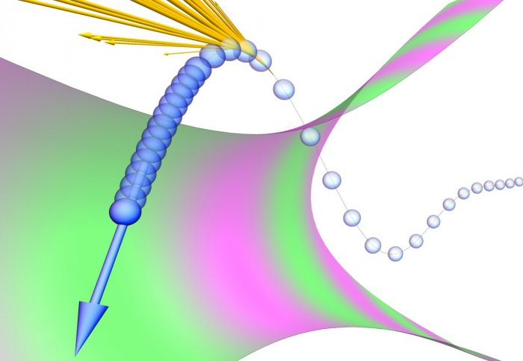
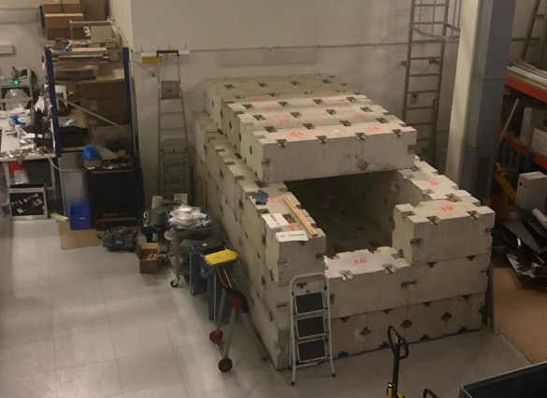
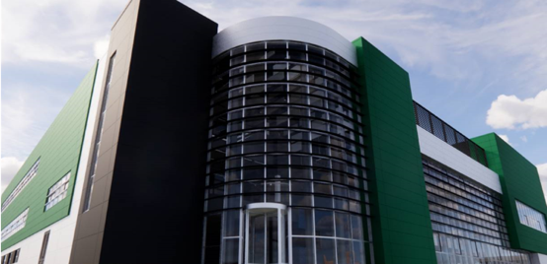
Early Particle Physics-relevant experiments are already being planned
4.1 Early particle physics with advanced accelerators
(Matt Zepf, Brian Foster, Stuart Mangles, Marija Vranic)
  Non-linear QED using plasma mirrors: EPAC, CALA, ELI, DESY,…
  Fixed target experiments – AWAKE
  Some experiments are already planned
Detection region construction at CALA
Radiation Reaction
Phys. Rev. X 8, 031004 (2018)
Phys. Rev. X 8, 011020 (2018)
EPAC

Slide 24
Work packages aim to address some of the major R&D challenges towards future colliders
Some of the key R&D challenges for future plasma-based colliders will be addressed by the laser-, electron- and proton-driven schemes
Work packages aim to address a number of them
The CDR will exploit the synergies amongst these developments
Some key developments will be beyond the scope of this roadmap
2.4
2.4

Slide 25
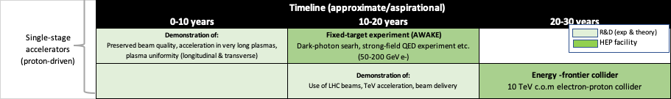
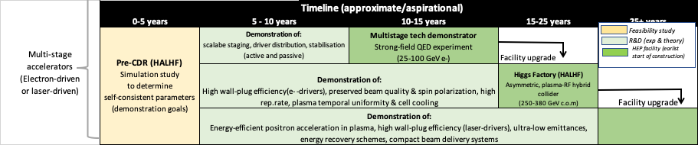
Timelines for R&D on plasma-based colliders
This is the eventual scenario but not the full picture

Slide 26

Timelines for R&D on plasma-based colliders: how does the other HALF fit in?
R&D on EuPRAXIA will de-risk HALHF and other plasma-based collider concepts considerably

Slide 27

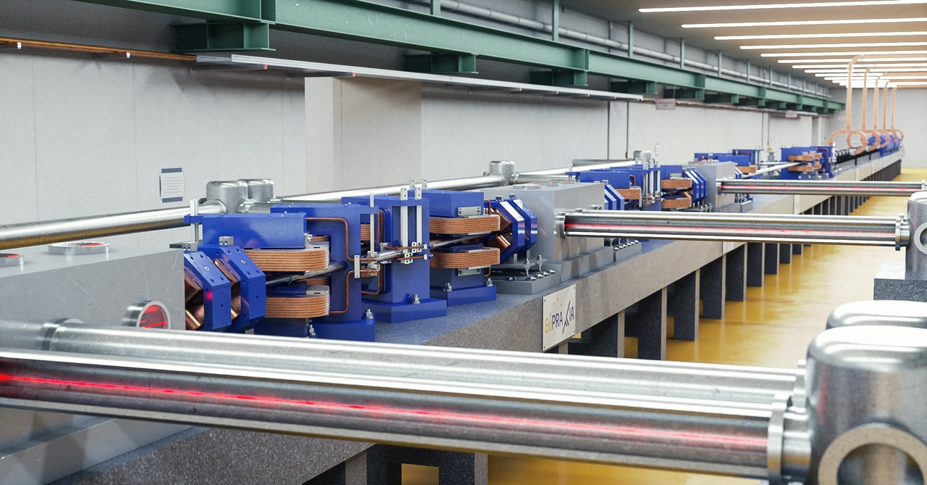
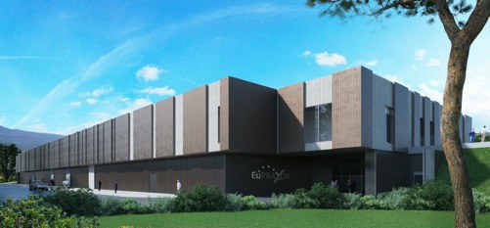
EuPRAXIA could be a major stepping-stone towards this
A flagship international research facility for propelling laser-driven plasma accelerators to transformative real-world applications
EuPRAXIA will drive plasma accelerators producing multi-GeV electron beams at 100 Hz
This is now on ESFRI roadmap – has/will attract funding
Will address some of the key issues regarding the suitability of plasma accelerators for future colliders
  Low emittance beams
  Reliable facility-mode operation – 24/7
  Staging/positron beams etc.
Energy upgrades limited only by funding

Slide 28
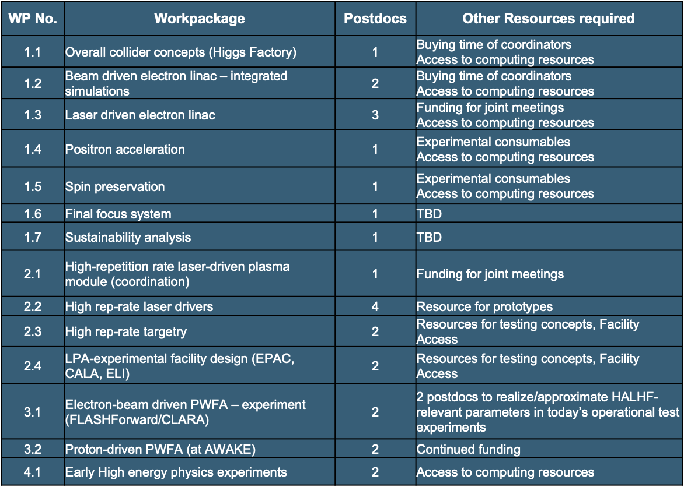


Funding required for activities
Opportunity:
  We have a compelling list of goals and activities that we aim at achieving in the next 2 years but time is ticking…
  New activities are leveraged by at times very significant in-house activities by major labs
Key challenge:
  We need to secure funding on the order of 3M€/a to do everything
  Will sufficient, suitably qualified students/post-docs be available?
Exploring funding options via STFC, Helmholtz…
Workshop on developing HALHF concept: 23rd October - DESY

