Slide 1
WP6 - Task 6.2:
LASers for PLAsma accelerators (LASPLA)
Task Leader: Leonida A. GIZZI – CNR-INO

Slide 2
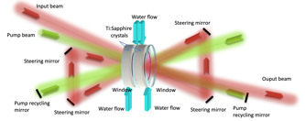
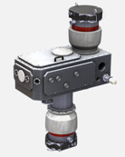
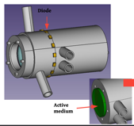
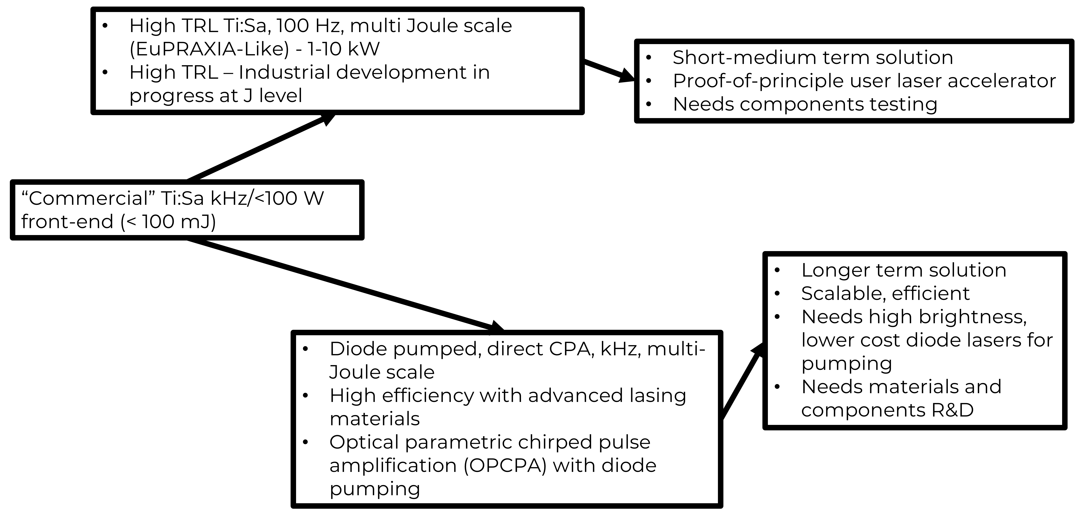
Task 6.2 (LASPLA): Objectives
Establish a roadmap to foster delivery of advanced industrial laser drivers with high-repetition rate and higher efficiency, for the first user laser-plasma based accelerators.
Establish a coordination activity with networking and training of main laser labs and industrial partners, focused on laser-driver R&D.

Slide 3
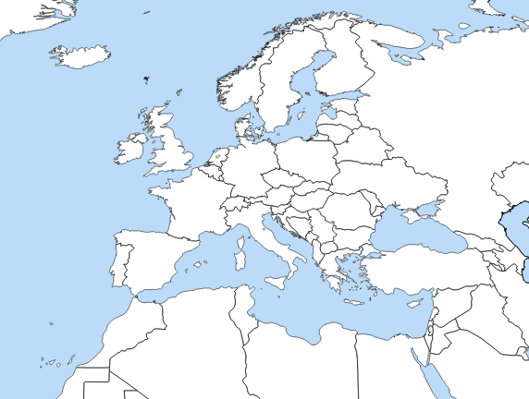
TASK 6.2 (LASPLA): warm up technical meetings
Warm up technical meetings on Laser Development for Plasma Acceleration (online)
1st Technical Meeting – 23rd June 2021
2nd Technical Meeting – 7th October 2021
Up to 50 attendees to the 2nd technical meeting
LLNL, LBNL, LLE (US)
Strong participation from laser industrial partners
Very positive feedback from participants: informative and effective

Slide 4
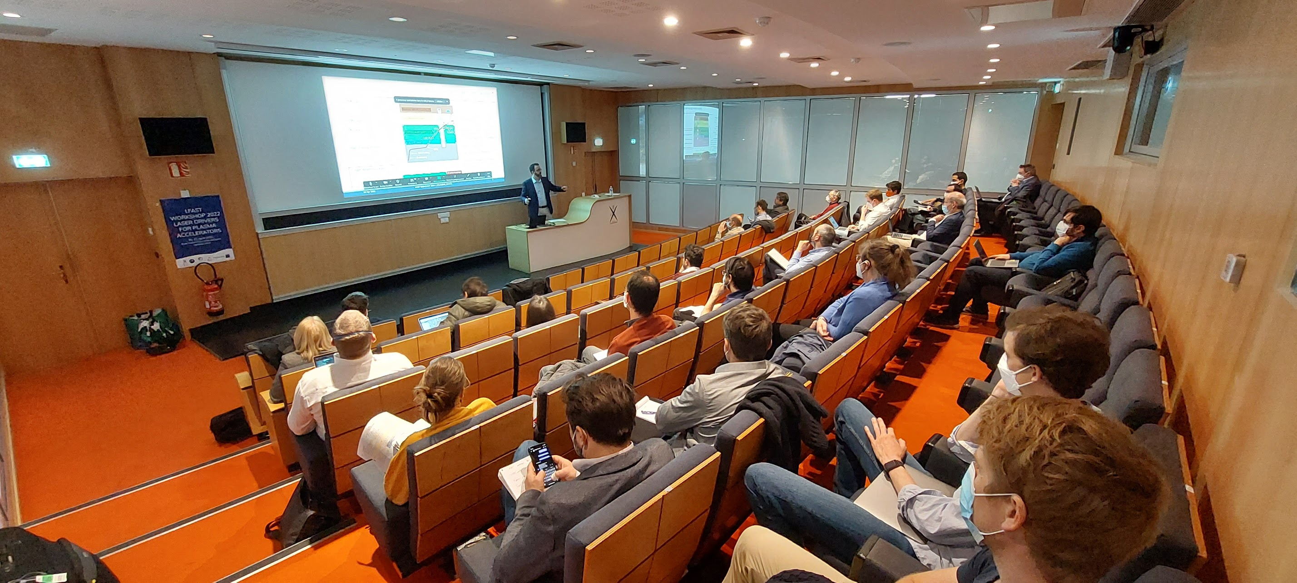
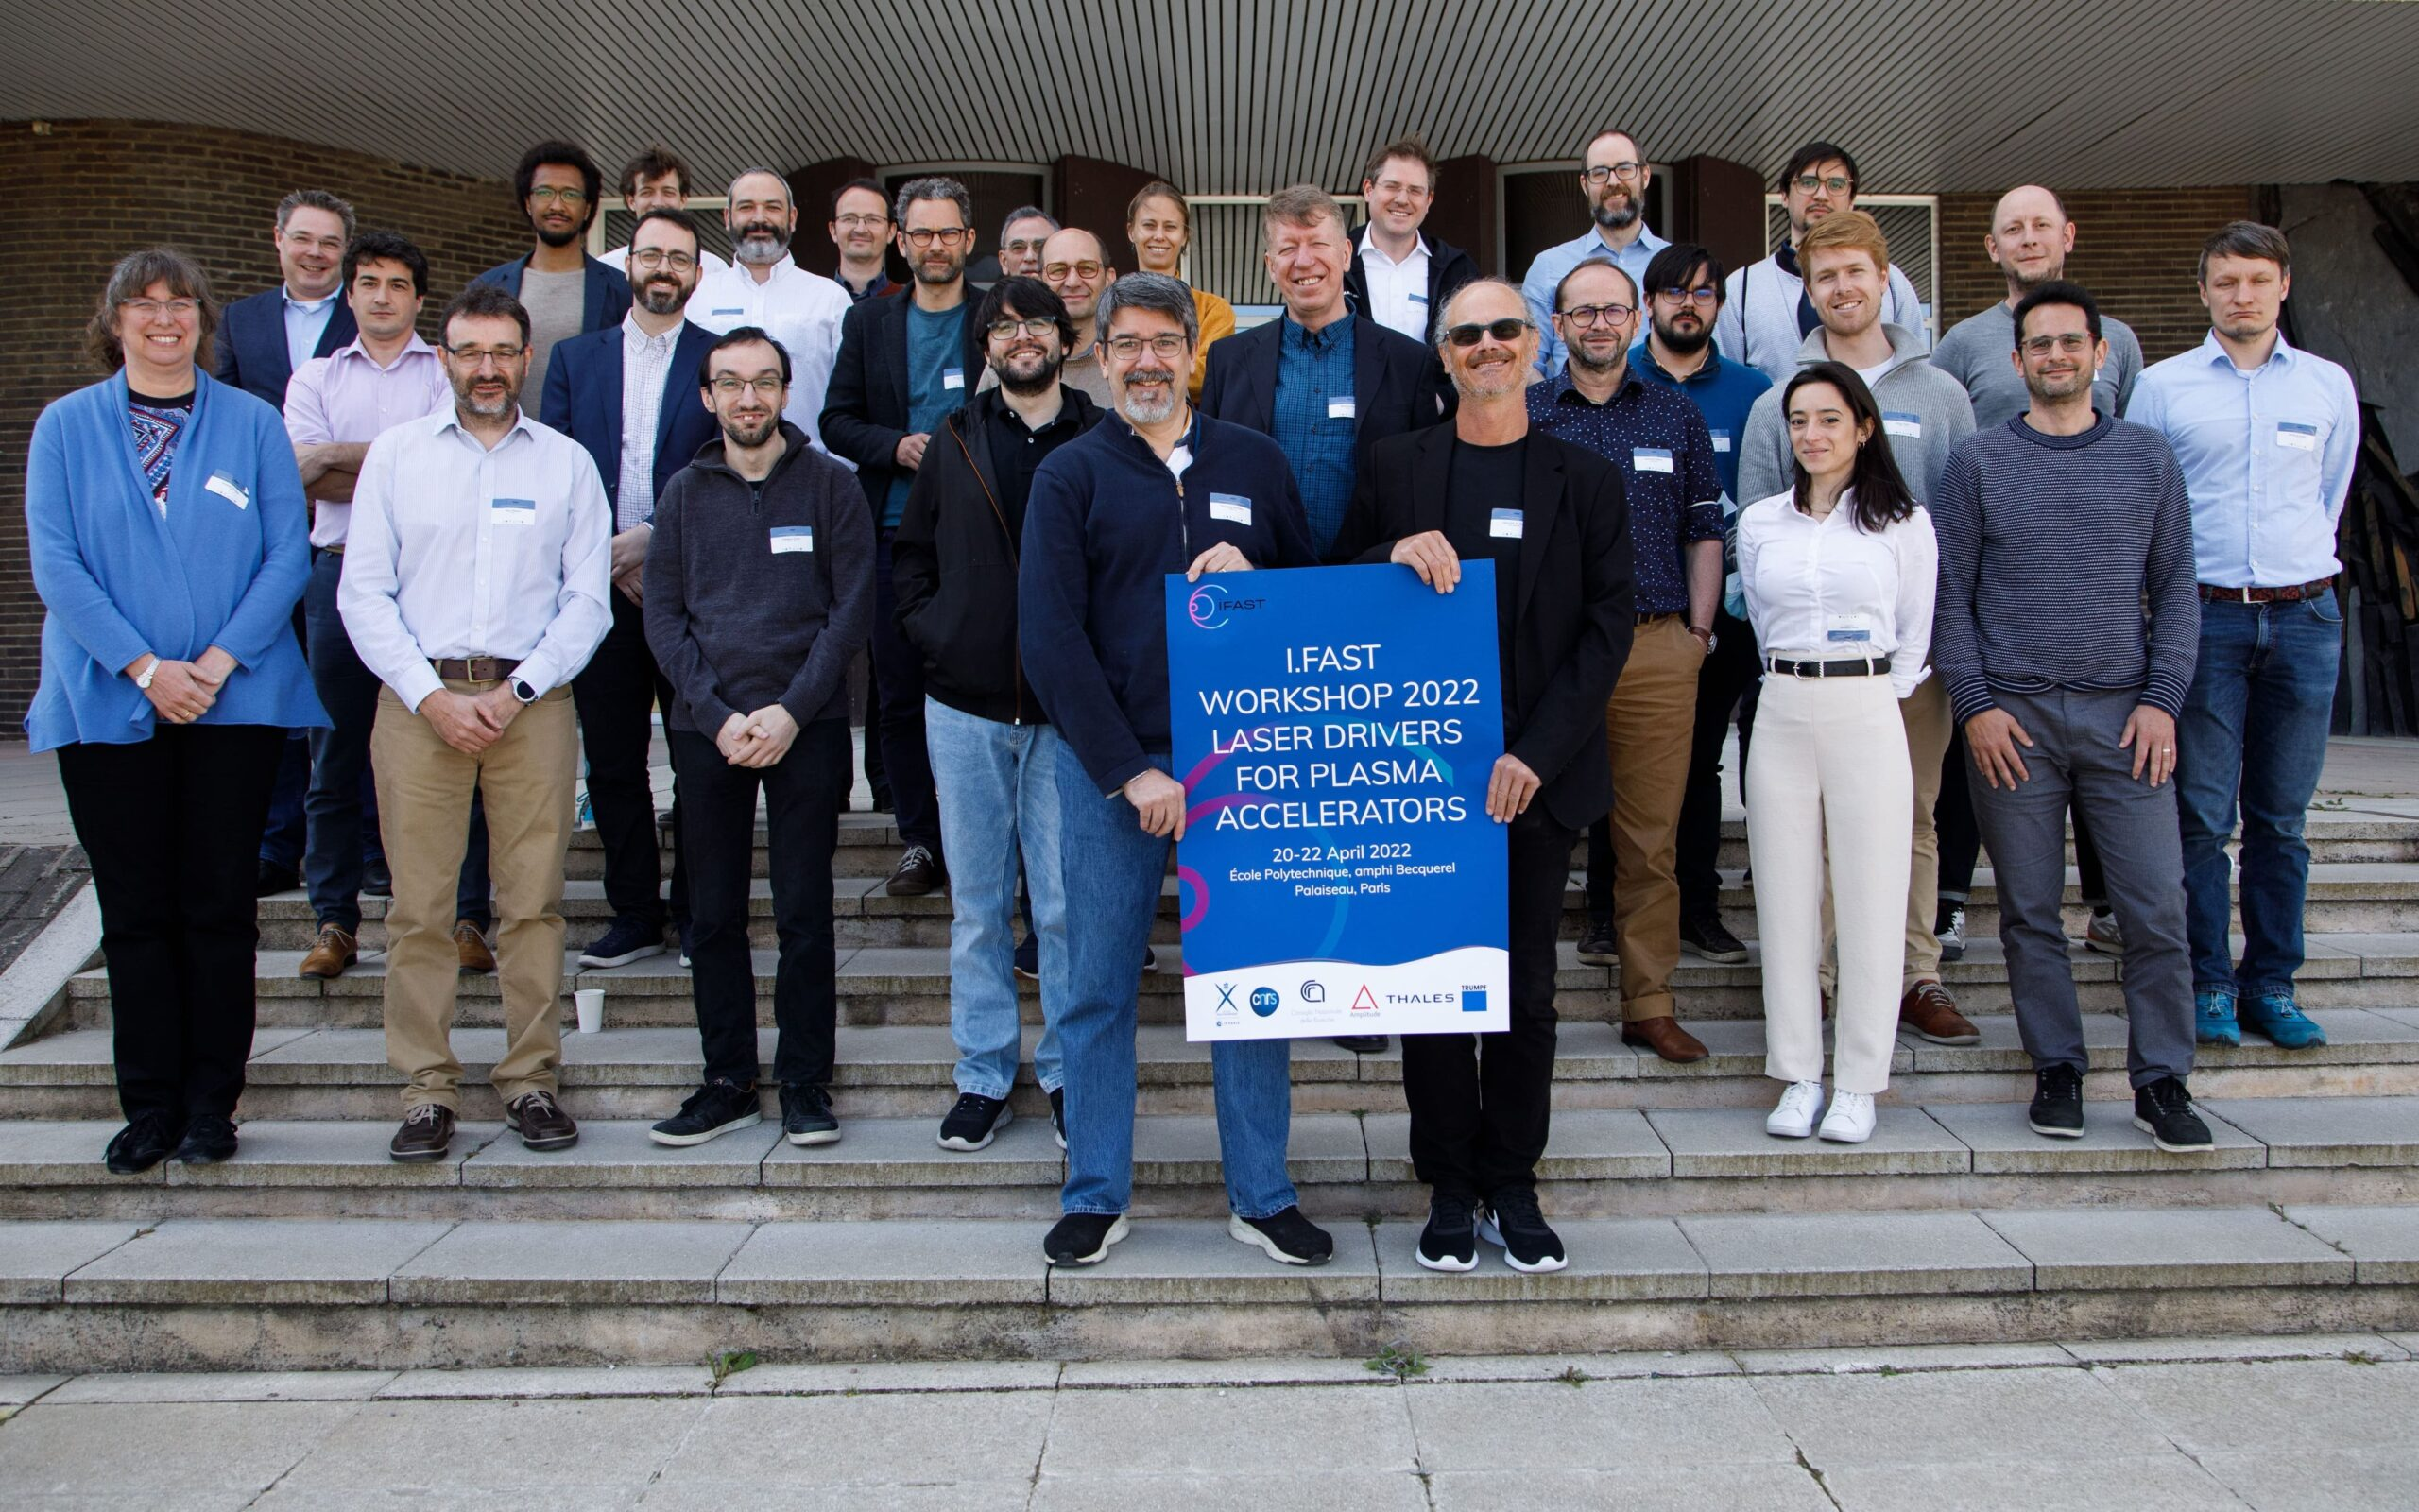
TASK 6.2 (LASPLA): Laser Workshop (in presence), April 20-22, 2022, Palaiseau (FR)
Laser workshop is towards milestone MS22 (M30)
• Establish a roadmap to foster delivery of advanced industrial laser drivers with high-repetition rate and higher efficiency;
• Highlight laser requirements for user plasma-based accelerators and other key high power, high intensity laser applications:
• Promote a coordination activity with networking and training of main laser labs and industry, focused on laser-driver R&D.
52 registred participants in presence
>100 participants online
>300 connections per day

Slide 5
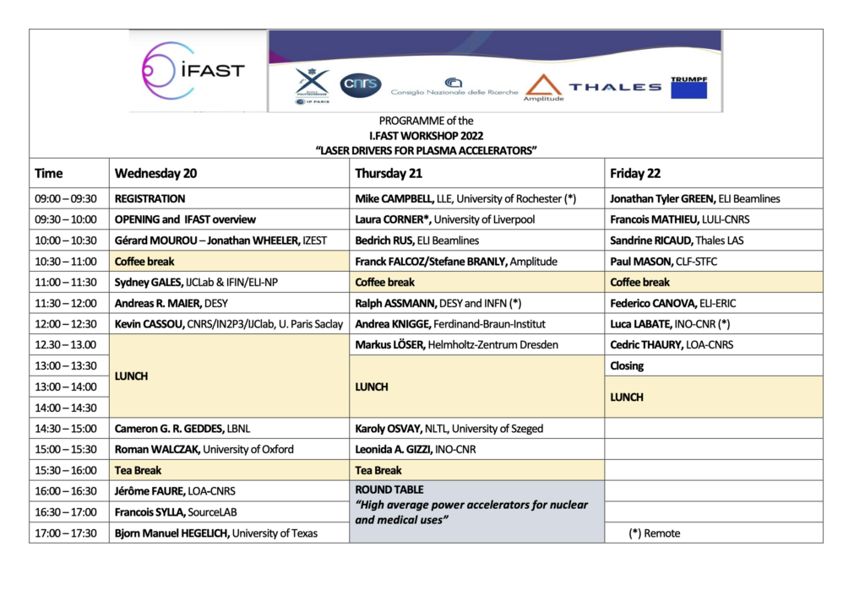
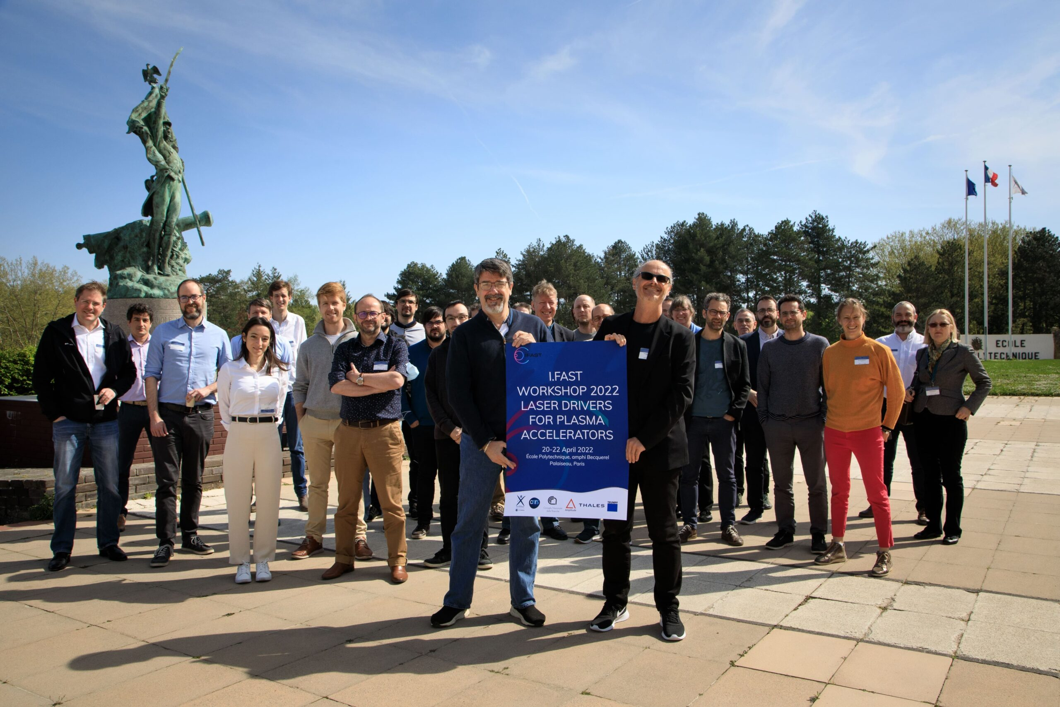
IFAST Laser Workshop (in presence), April 20-22, 2022, Palaiseau
OUTCOME
New and major laser-based facilities progressing fast and going online
Key Labs delivering repetitive operation of LPA with quality and stability
Laser developments addressing high repetition rate and high efficiency
Major cases for medical and industrial applications being established

Slide 6
EURONNAC Special Topics
18–24 Sep 2022, Hotel Hermitage, La Biodola Bay, Isola d'Elba, Italy
SUMMARY of Special Topic S-ST3:
Laser Technology and LPA Results (e-, p+, ion)
Conveners:
Leonida Antonio GIZZI (CNR-INO also at INFN, Pisa)
Stefan KARSCH (LMU, München)

Slide 7
Part 1 – Laser Challenges
Progress on industrial scientific laser development towards ≈ kW regime of Ti:Sa systems for prototype development and EuPRAXIA baseline (F. Falcoz, C. Simon-Boisson)
Robust industrial multi kW, thin disk laser technology entering rapidly the contest for LPA laser-driver, via NL compression or plasma-modulation resonant wakefield (T. Metzger, R. Walczak).
Fiber coherent combination aiming at few cycle, 100 Hz, with self-phase modulation and J-scale pulses with multi-core fibers. Highlight on efficiency (30%) (J. Limpert).
OPCPA efficient and ”cold”. Relies on robust and high beam quality pump lasers. 100 TW scale in progress (T. Green)
Pump lasers also a key issue, along with other major blocks (compressor gratings, kW amplifiers) for Ti:Sa systems for user LPA (EuPRAXIA, Kaldera, EPAC …)
Direct diode-pumping of new materials (sesquioxides) now in development phase and needs coordinated effort across labs for materials and architecture (L. Labate)
https://ifast-project.eu/

Slide 8
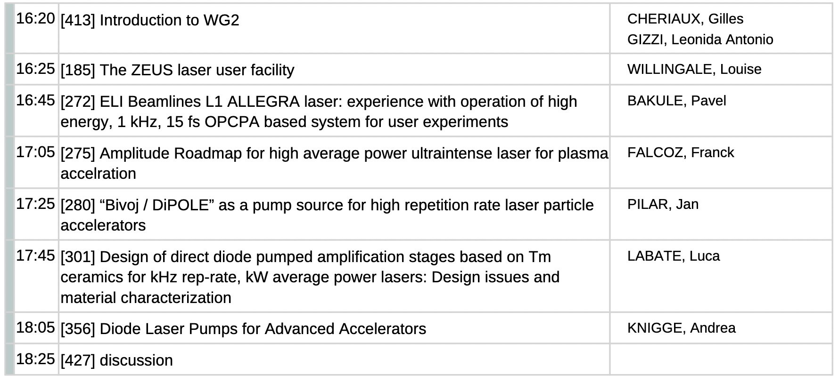
EAAC 2023 – WG2: Laser technology (WP6 - Task2)
Monday, 18 September 2023, H. 16.20 – 19.00

Slide 9
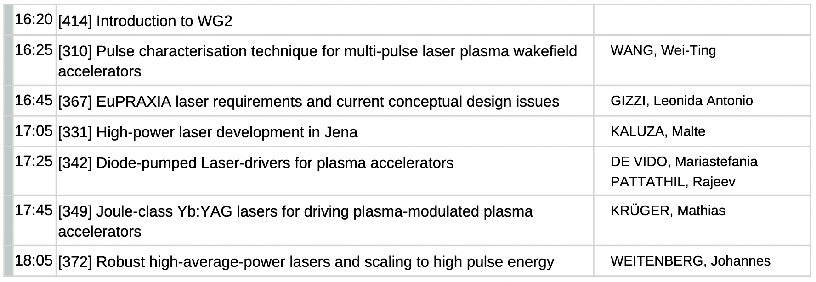
EAAC 2023 – WG2: Laser technology (WP6 - Task2)
Tuesday, 19 September 2023, H. 16.20 – 19.00
SIMON-BOISSON, Christophe

Slide 10
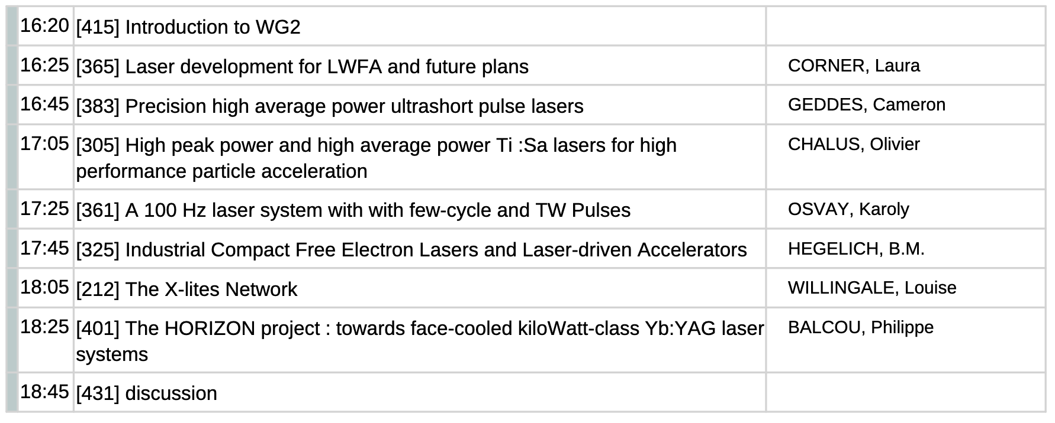
EAAC 2023 – WG2: Laser technology (WP6 - Task2)
Thursday, 21 September 2023, H. 16.20 – 19.00
GIZZI, Leonida Antonio

