Slide 1





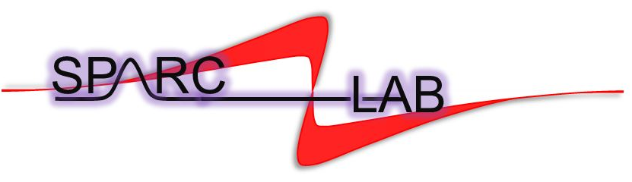
European Advanced Accelerator Concepts Workshop Elba Island, Italy
Beam Dynamics Simulation of a High Brightness
RF C-band Photoinjector for Future EuPRAXIA@SPARC_LAB Upgrade
Gilles Jacopo Silvi (Sapienza University of Rome - INFN Roma1)
gillesjacopo.silvi@uniroma1.it
On behalf of the SPARC_LAB collaboration

Slide 2
European Advanced Accelerator Concepts Workshop Elba Island, Italy
OUTLINE
EuPRAXIA@SPARC_LAB
EuPRAXIA@SPARC_LAB full S-band RF injector
Upgrade to a full C-band RF injector
Single beam and driver and witness beam dynamics
Conclusions
On behalf of the SPARC_LAB collaboration

Slide 3


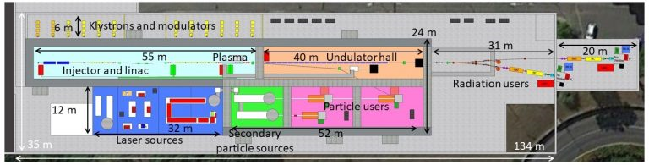
EuPRAXIA@SPARC_LAB
M. Ferrario et al., EuPRAXIA@SPARC_LAB Conceptual Design Report, LNF Technical Note 18-03.
Assmann, R.W., Weikum, M.K., Akhter, T. et al. EuPRAXIA Conceptual Design Report. Eur. Phys. J. Spec. Top. 229, 3675–4284 (2020).
EuPRAXIA@SPARC_LAB is the first European research infrastructure to demonstrate the usability of a plasma accelerator combining a high-brightness GeV–range electron beam generated in a state-of-the-art linac, and a 0.5 PW–class laser system.
EuPRAXIA@SPARC_LAB will be a user facility dedicated for instance to the production of a high-brightness plasma accelerated beam to induce Self Amplified Spontaneous Emission (SASE) in an FEL undulator.
ultra-short, high-quality electron beams
S-band RF photo-injector
X-band RF booster linac
Plasma Stage
Undulator

Slide 4
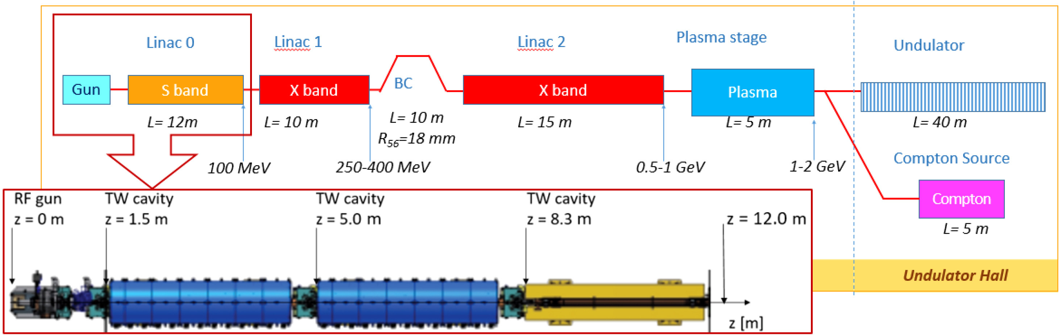
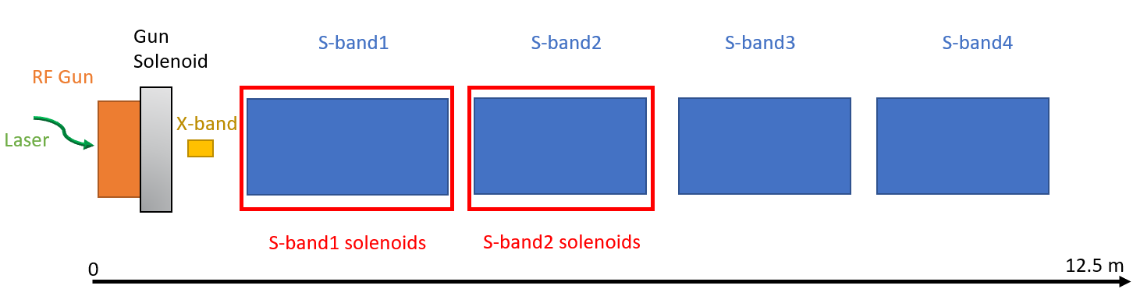
EuPRAXIA@SPARC_LAB full S-band RF injector
A. Giribono et al. https://doi.org/10.1016/j.nima.2018.03.009
Velocity bunching
L. Serafini and M. Ferrario, AIP Conf. Proc. No. 581 (AIP, New York, 2001), p. 87.
M. Ferrario et al., Phys. Rev. Lett. 104, 054801 (2010) 3.
S. G. Anderson et al., Phys. Rev. ST Accel. Beams 8, 014401 (2005)
Courtesy of
D. Alesini

Slide 5
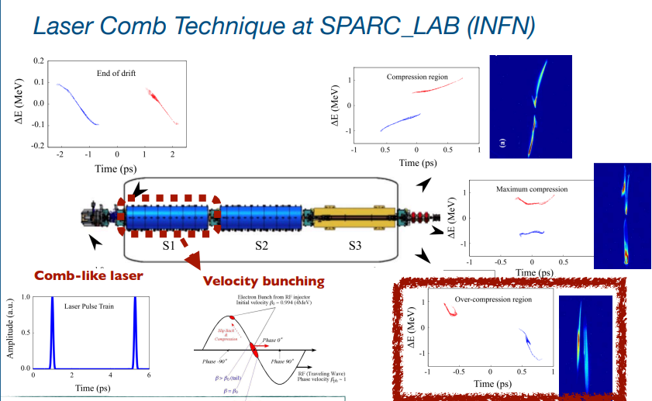
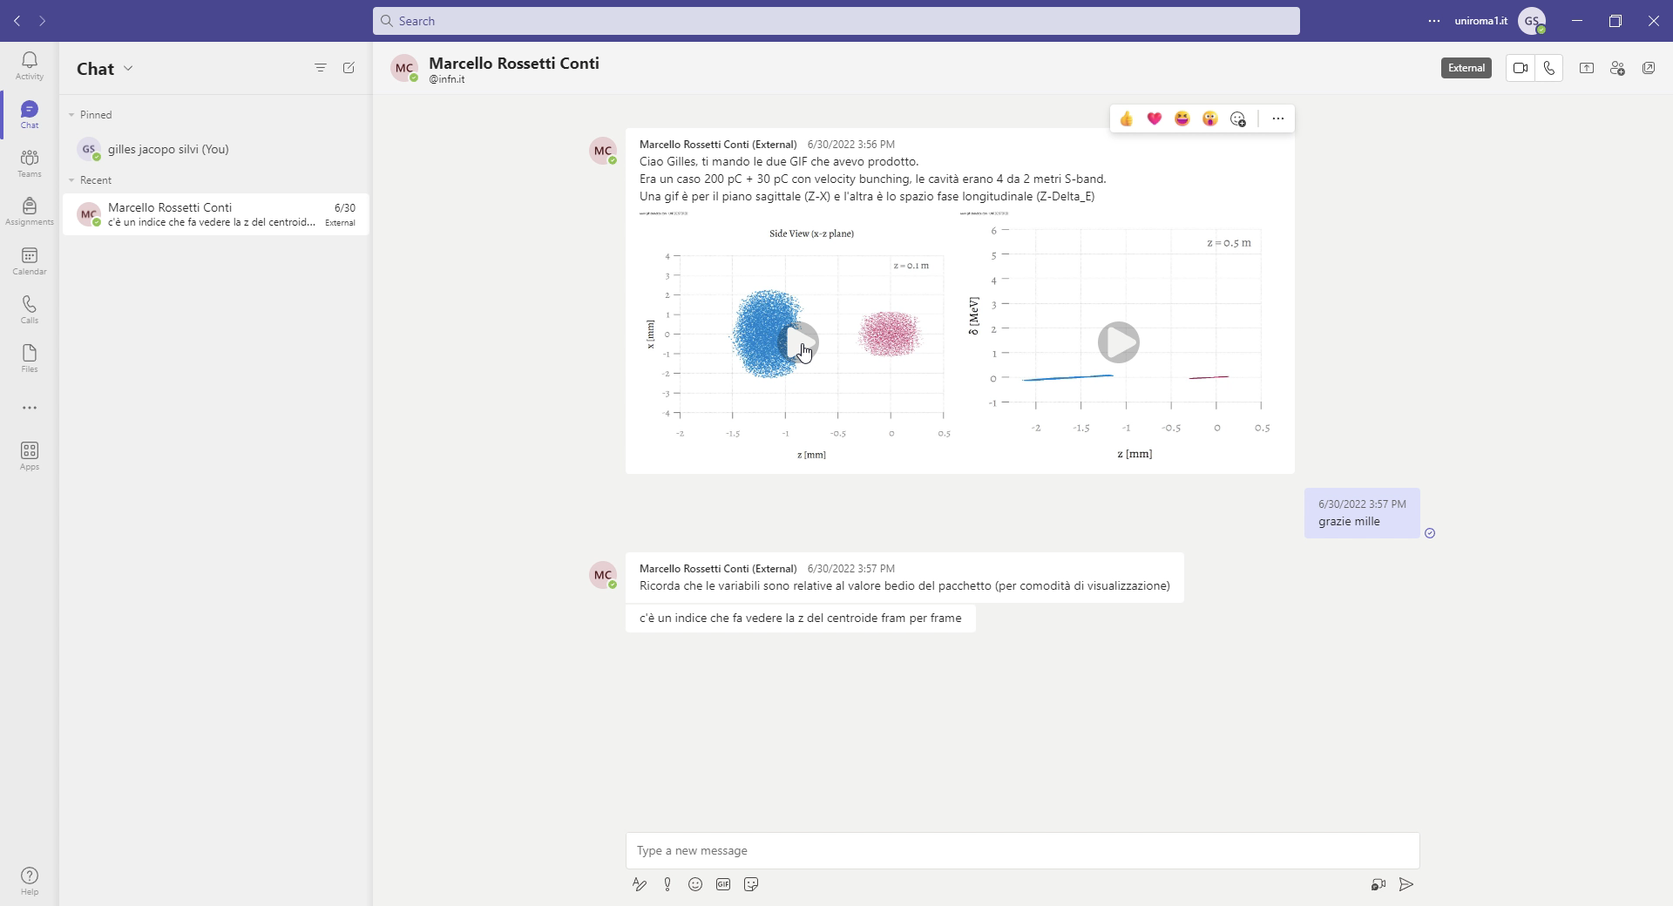

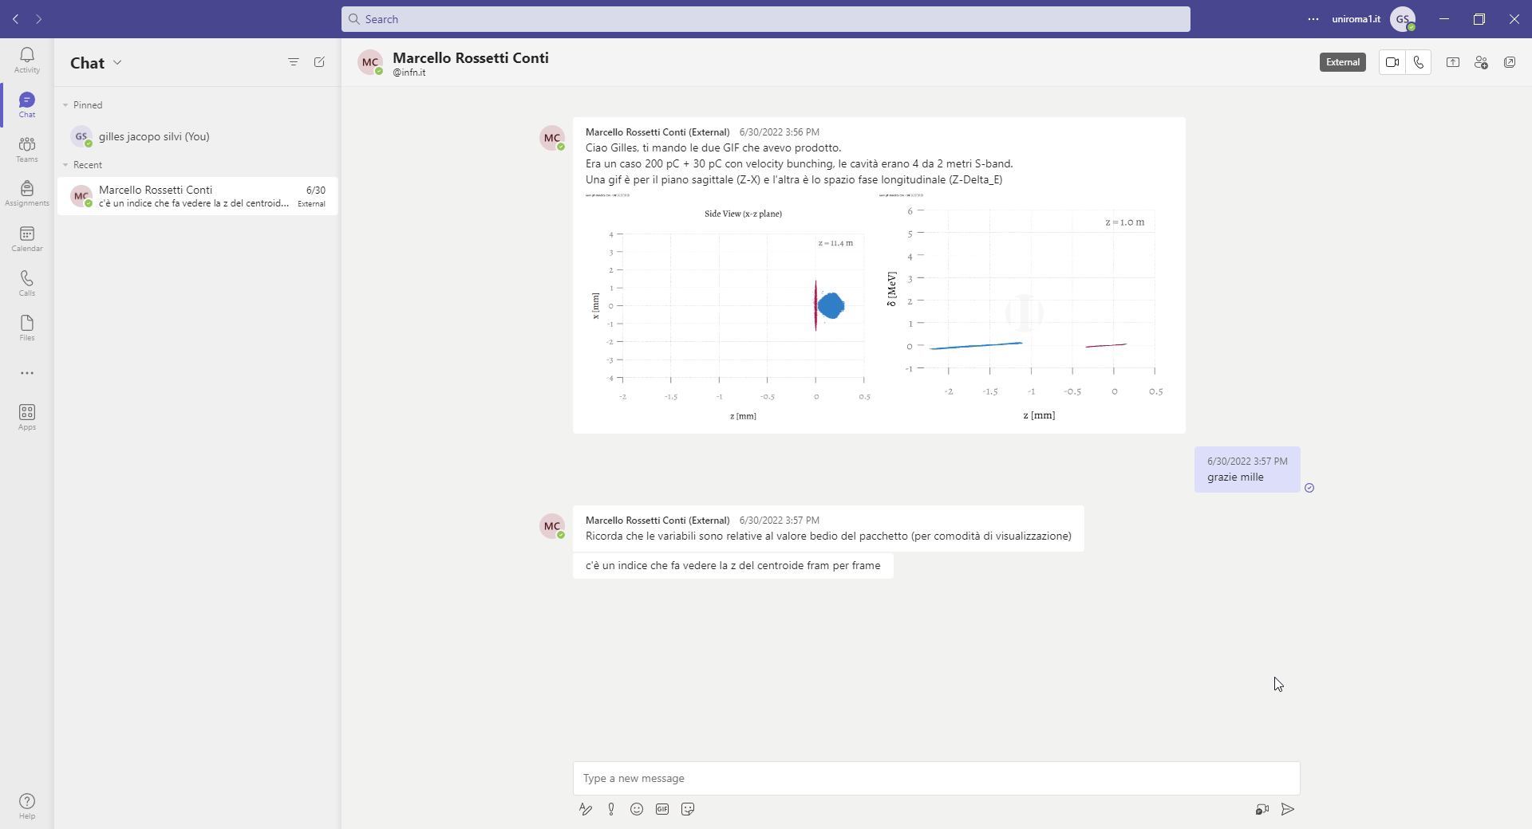
Driver and witness configuration
Courtesy of M. Rossetti Conti
Courtesy of E.Chiadroni

Slide 6
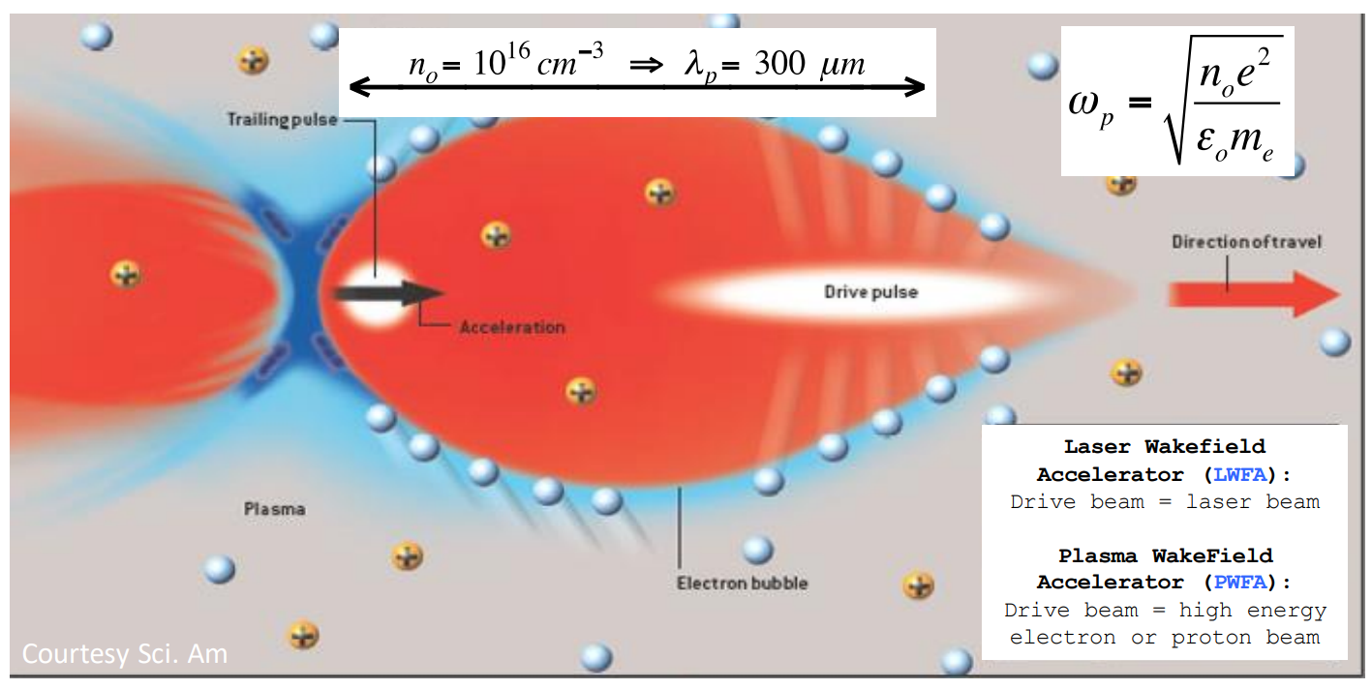
Matching condition in plasma

Slide 7
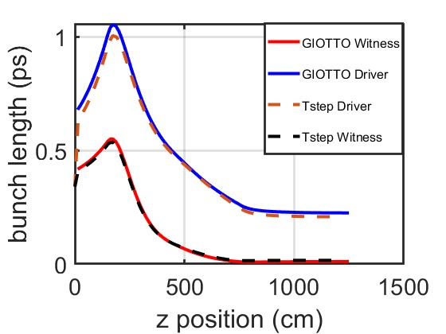
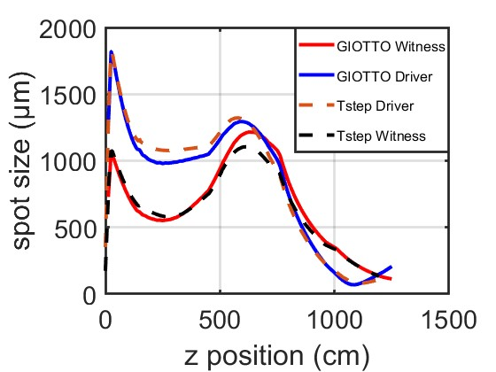
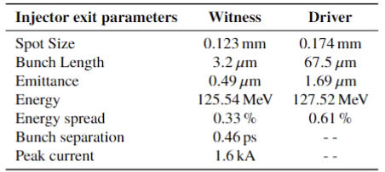
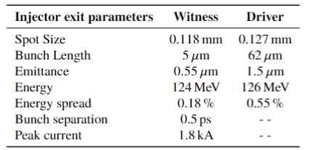
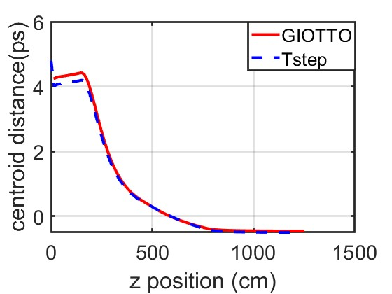
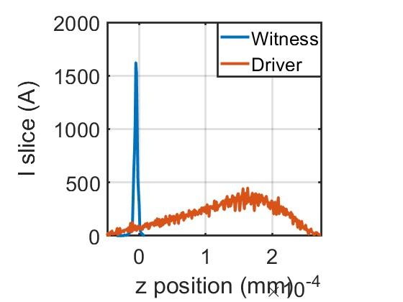


GAs optimization of driver and witness bunches dynamics
Bacci A, Rossetti Conti M and Petrillo V 2016 Giotto: A genetic code for demanding beam-dynamics optimizations
Injector parameters optimized with GIOTTO
Reference Injector parameters

Slide 8
Motivation of an RF injector upgrade
C-band :
Higher achievable cathode, and cavity peak field as high as 160-180 MV/m and 40 MV/m.
Higher efficiency, so it is suitable for applications requiring repetition rates in the 200 Hz÷1 kHz range.
Reduce injector footprint by maintaining high-quality high-brightness beams.

Slide 9

Driver-like beam dynamics
A. Giribono PRAB 26, 083402, 2023
Slice analysis for different degrees of compression for a 200 pC Beam

Slide 10
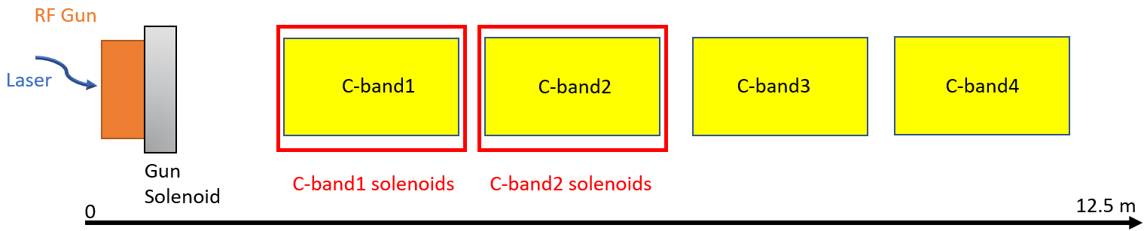
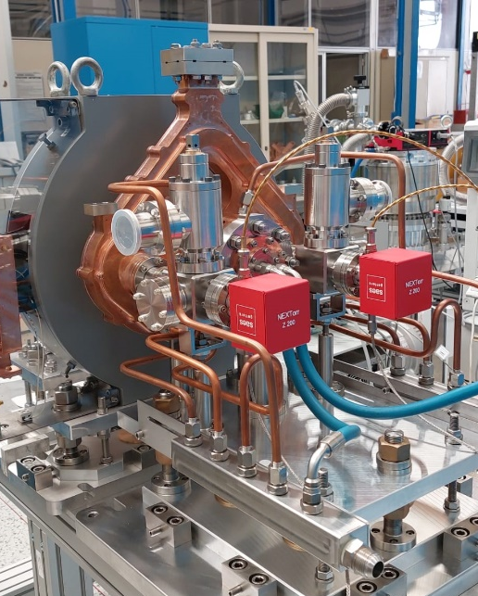
EuPRAXIA@SPARC_LAB full C-band RF injector
Velocity bunching
11.5 m
Emittance compensation solenoids
Courtesy of
F. Cardelli
A. Giribono PRAB 26, 083402, 2023

Slide 11
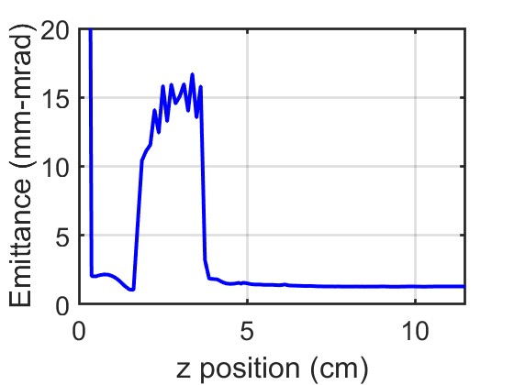
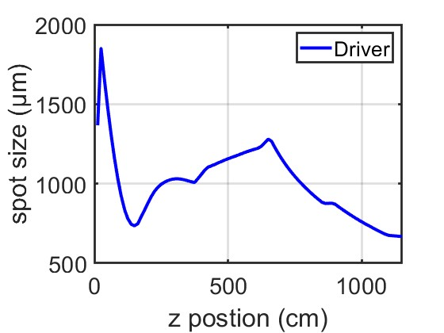
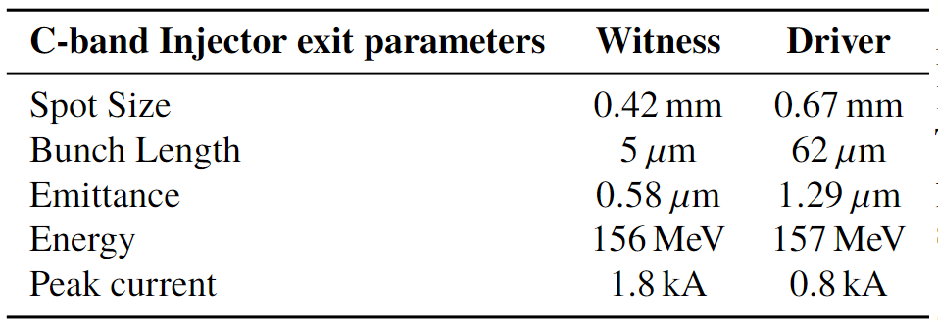

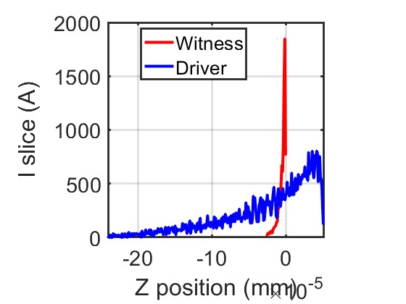
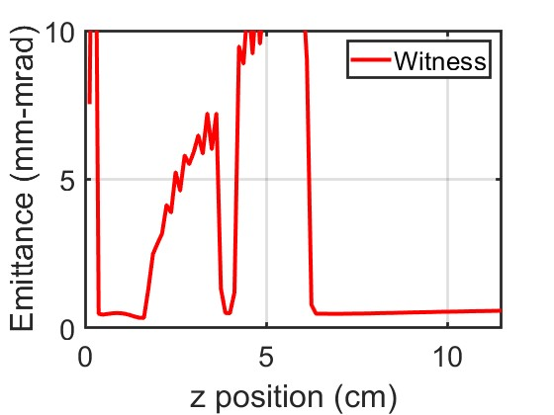
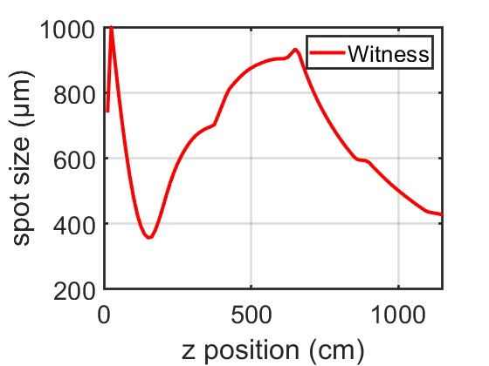

Single bunch simulations
Beam parameters @ injector exit for single bunch simulations

Slide 12
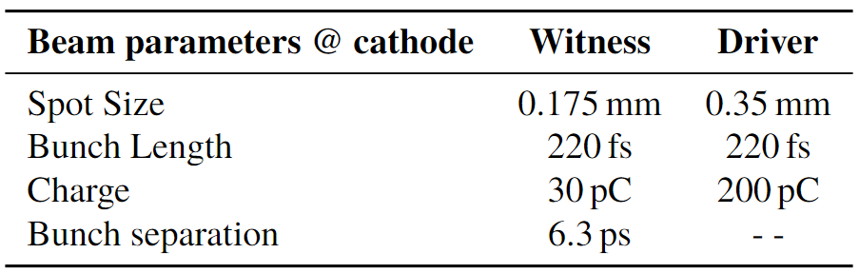
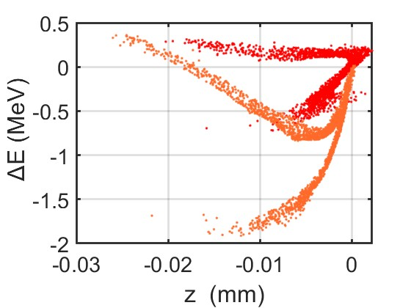
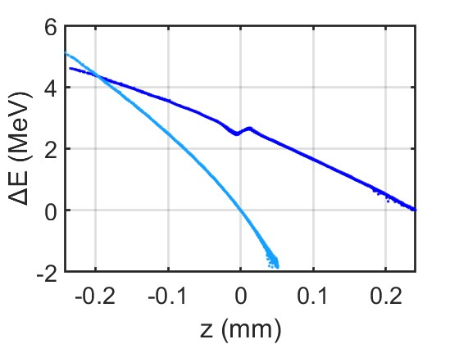
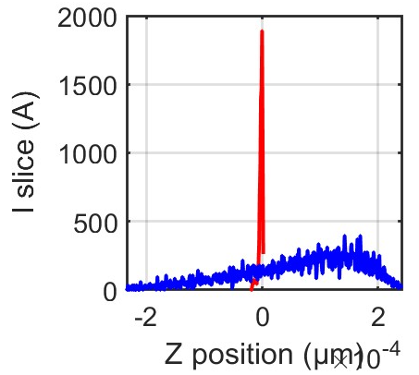
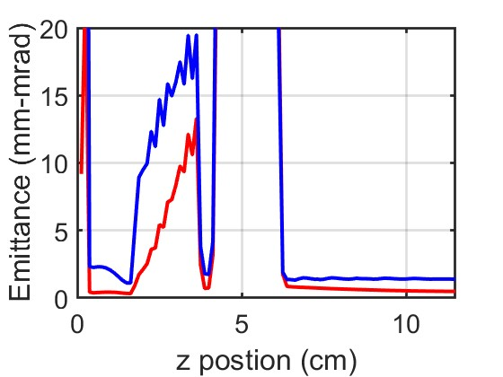
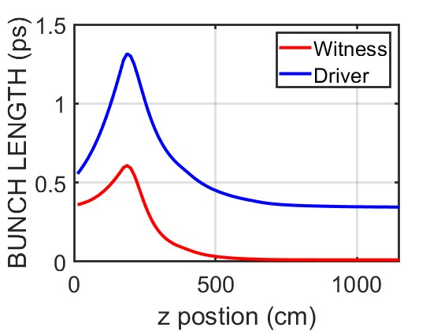
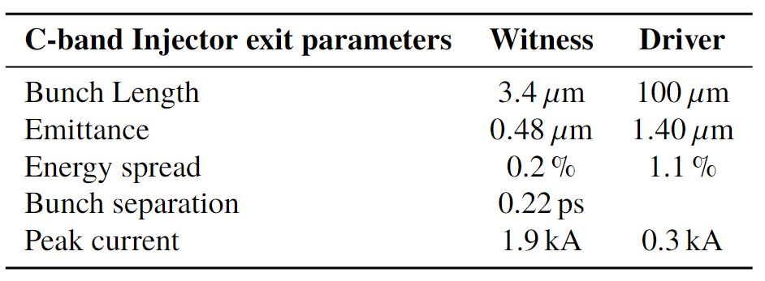
Driver and Witness beam dynamics
Driver comb
Driver
Witness comb
Witness

Slide 13
European Advanced Accelerator Concepts Workshop Elba Island, Italy
Conclusions
Single bunch simulations show that is possible to generate a high-brightness beam with a full C-band injector.
Comb simulations are ongoing, but the preliminary results are promising to think of a proposal for an upgrade for the EuPRAXIA@SPARC_LAB injector going through the high repetition rate high gradient operations.
The optimizations is ongoing working on cathode distributions i.e., charge, separation, and length as well as the degree of compression achievable in the VB structures. Design of a new layout of the injector.
On behalf of the SPARC_LAB collaboration

Slide 14
European Advanced Accelerator Concepts Workshop Elba Island, Italy
Thank you for your attention
Gilles Jacopo Silvi (Sapienza University of Rome - INFN Roma1)
gillesjacopo.silvi@uniroma1.it
On behalf of the SPARC_LAB collaboration

