Slide 1




6th EUROPEAN ADVANCED ACCELERATOR CONCEPTS WORKSHOP
17-23 september 2023, LA BIODOLA BAY (ELBA), ITALY
Dielectric Assist Accelerating (DAA) structures for compact linear accelerators of low energy particles in hadrontherapy treatments
P. Martinez-Reviriego¹, A. Grudiev³, D. Esperante^{1,2}, B. Gimeno^{1,} C. Blanch¹,
N. Fuster-Martínez¹, D. Gonzalez-Iglesias¹, P. Martín-Luna¹, E. Martinez¹,
A. Menendez¹ and J. Fuster¹
1 Instituto de Física Corpuscular (IFIC), CSIC-University of Valencia, Parque Científico, C/ Catedrático José Beltrán, 2 46980 Paterna (Valencia)
2 Electronics Engineering Department, University of València, 46100 Burjassot, Spain
3 CERN, 01631 Meyrin, Switzerland
ACKNOWLEDGEMENT - This presentation has received support from the European Union’s Horizon 2020 Research and Innovation programme under Grant Agreement No 101004730

Slide 2
Outline
Linear accelerators for hadrontherapy treatments
Dielectric Assist Accelerating (DAA) structure design procedure
Comparison for different materials and particle velocity
Multipactor analysis
Electromagnetic performance

Slide 3
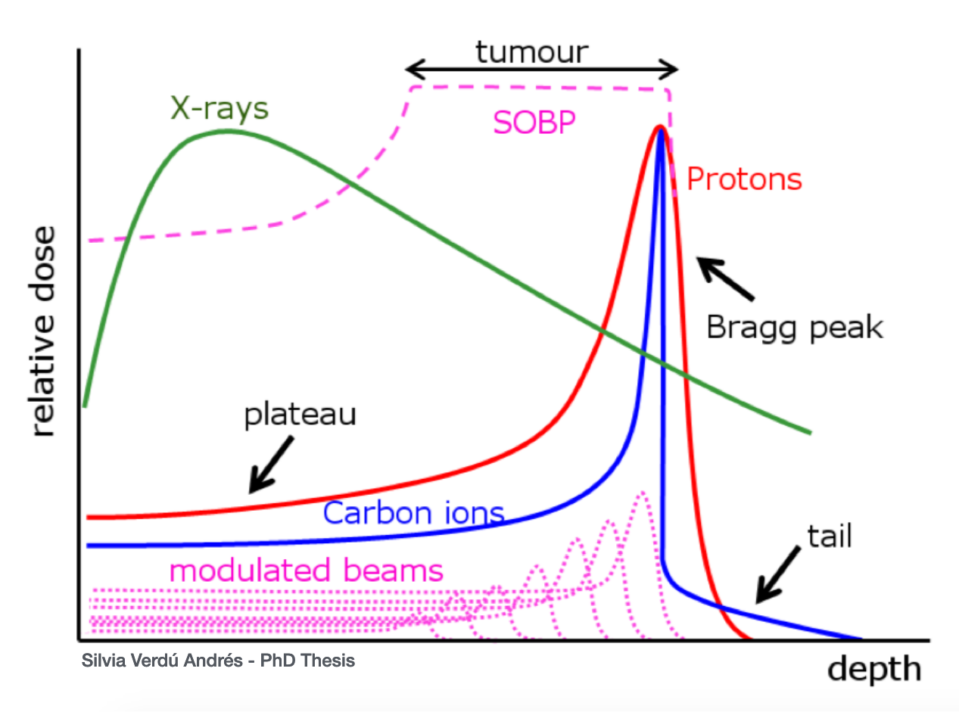
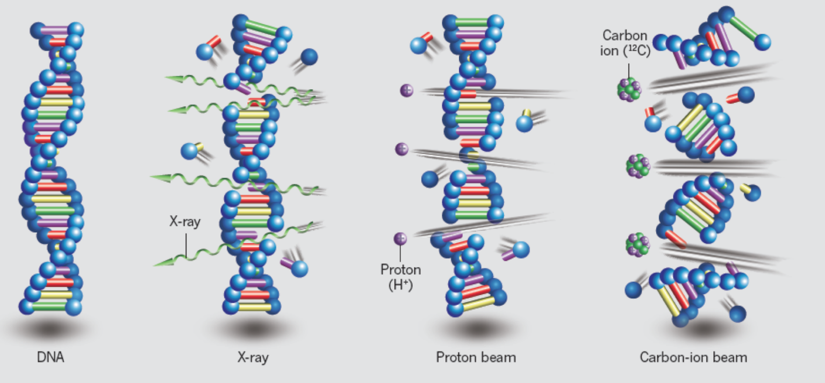
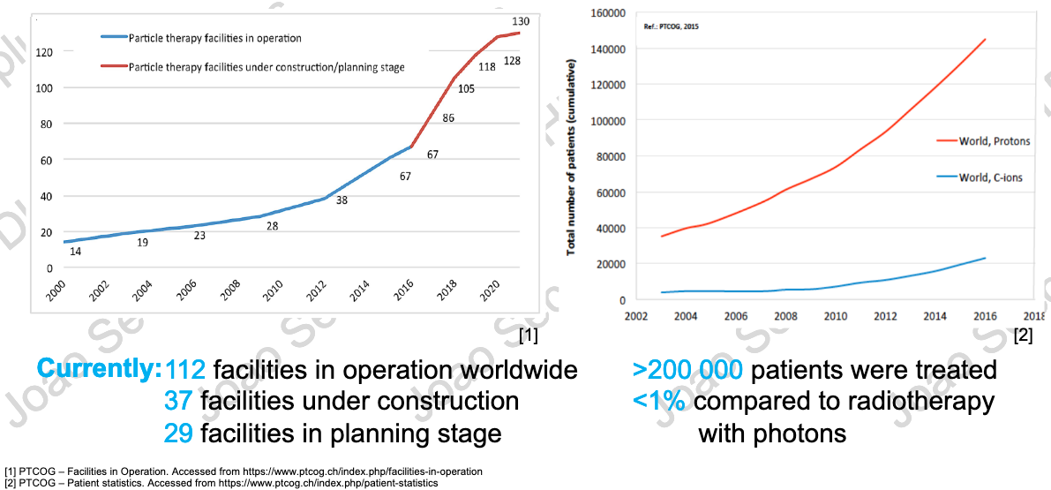
Hadrontherapy
Accelerator | Beam always present during treatment? | Energy variation by electronic means? | Time needed for varying the energy
Cyclotron | Yes | No | 80-100 ms (*)
Synchrotron | No | Yes | 1-2 s
Linac | Yes | Yes | 1-2 ms
Relative Biological Effectiveness (RBE)
Linear Energy Transfer (LET)
Physics challenges for linacs
Compact and efficient accelerators
Marx, V. (2014, April 4). Sharp shooters. 508. Nature, p. 137
Notes:
LET: density of energy deposition along the radiation track.
RBE: measures the effects of the irradiation. Protons = 1.1
Hacer hincapié en órganos móviles

Slide 4
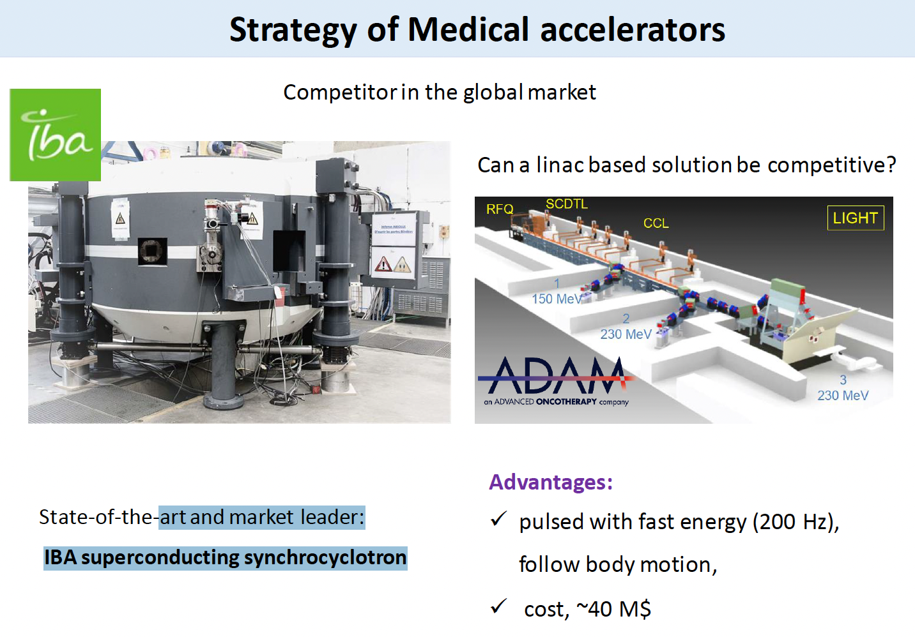

Linear Accelerators for Hadrontherapy
High-Gradient Cavities
Normal Cavities
Backward Travelling Wave (BTW) High Gradient cavity testing at IFIC
ADAM, spin-off of CERN and TERA foundation is developing a proton linear accelerator to be installed in a hospital in England
LINAC Conference 2014,
S. Benedetti et al.
RF DESIGN OF A NOVEL BACKWARD TRAVELLING WAVE LINAC FOR PROTON THERAPY
18-20 MV/m
50 MV/m
proton pulses 2.5us @ 200 Hz
~ 28 m

Slide 5
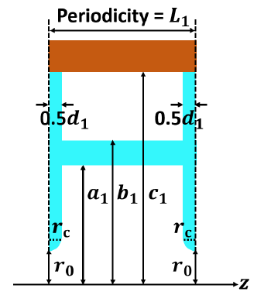
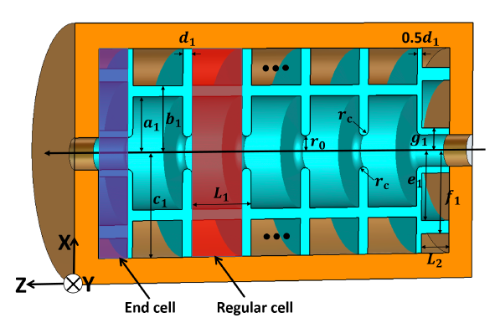
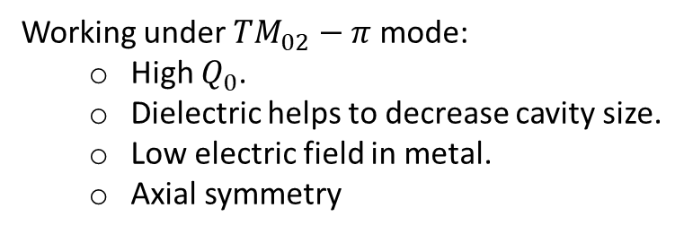
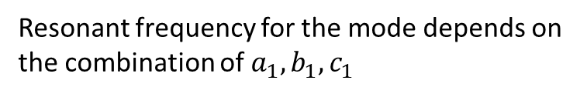
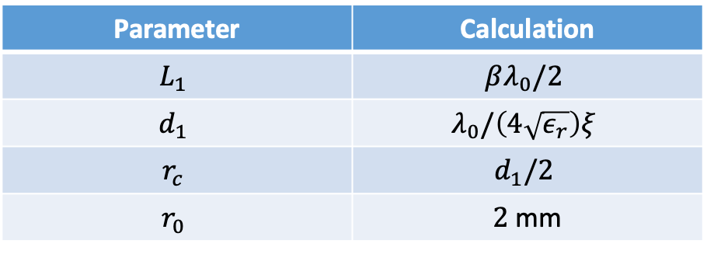
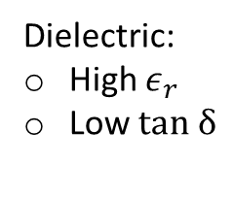

Dielectric Assist Accelerating (DAA) cavity
Low $β$ particles
S-band
Copper
Dielectric:
High $ε_{r}$
Low $tan δ$
Investigations Into X-Band Dielectric Assist Accelerating Structures for Future Linear Accelerators. Yelong Wei, Alexej Grudiev.
Working under $TM_{02}−π$ mode:
  High $Q_{0}$.
  Dielectric helps to decrease cavity size.
  Low electric field in metal.
  Axial symmetry
Parameter | Calculation
$$L_{1}$$ | $$βλ_{0}/2$$
$$d_{1}$$ | $$λ_{0}/\left(4\sqrt{ε_{r}}\right)ξ$$
$$r_{c}$$ | $$d_{1}/2$$
$$r_{0}$$ | $2$ mm
Resonant frequency for the mode depends on the combination of $a_{1}, b_{1}, c_{1}$
Notes:
.

Slide 6
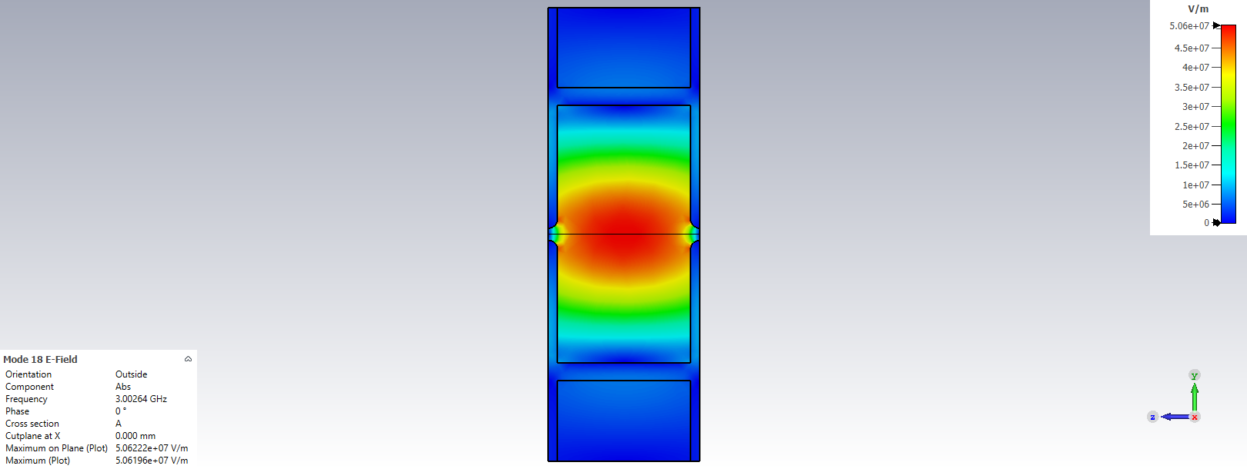
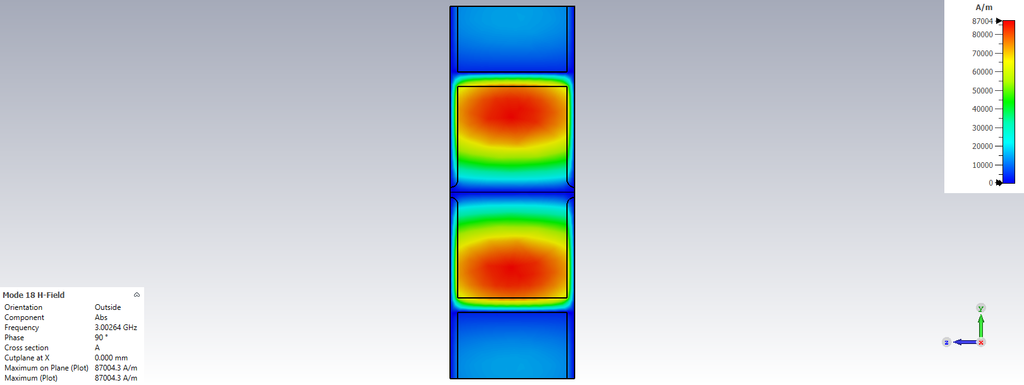
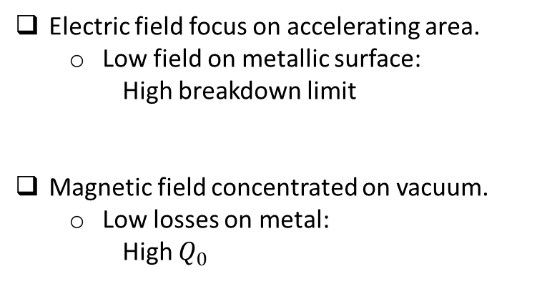
DAA cavity single cell solution
Electric field
Magnetic field
Electric field focus on accelerating area.
  Low field on metallic surface:
  High breakdown limit
Magnetic field concentrated on vacuum.
  Low losses on metal:
    High $Q_{0}$
Notes:
.

Slide 7
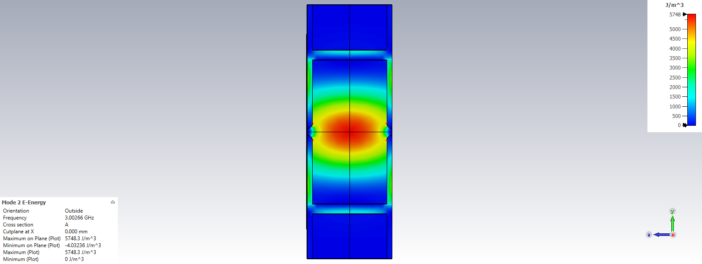








DAA cavity single cell solution
$$D=εE$$
Electric field
Electric Energy
$${E_{∥}}_{,1}={E_{∥}}_{,2}$$
$${D_{⊥}}_{,1}={D_{⊥}}_{,2}$$
$E$ is constant
1st: Parallel boundary
High $D$ inside dielectric
2nd : $D$ is conserved along the dielectric
$D$ is constant
3rd : Perpendicular boundary
High $E$ in vacuum
Notes:
.

Slide 8
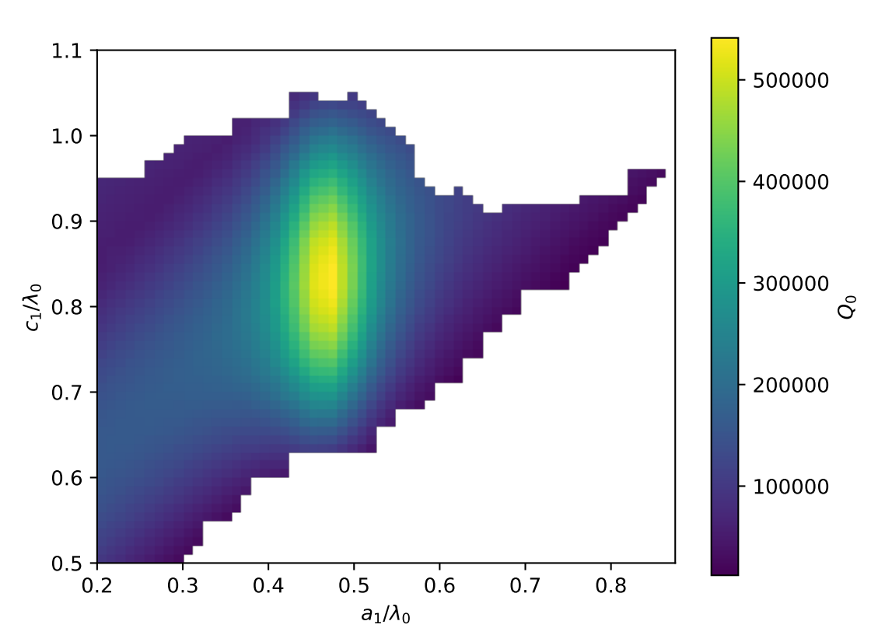
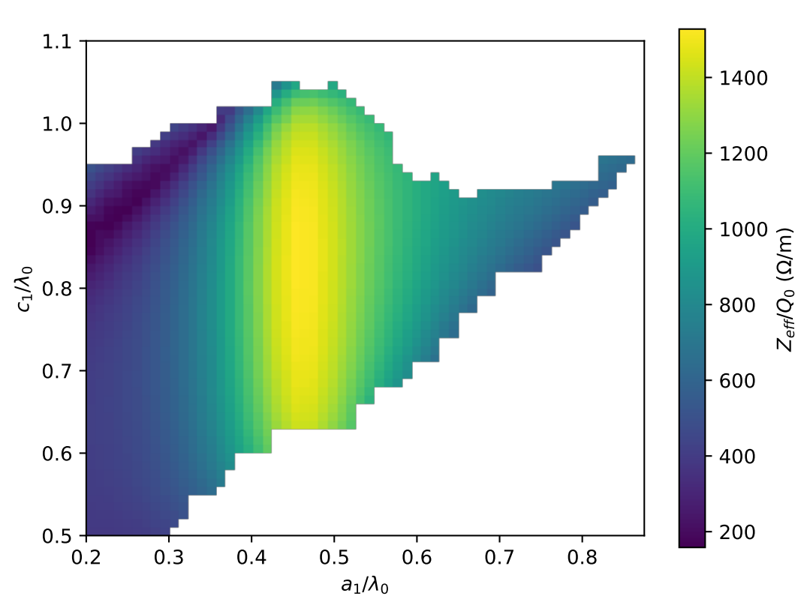
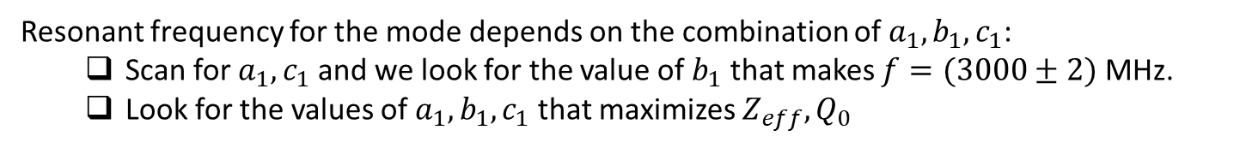
DAA cavity single cell design
Resonant frequency for the mode depends on the combination of $a_{1}, b_{1}, c_{1}$:
  Scan for $a_{1}, c_{1}$ and we look for the value of $b_{1}$ that makes $f=(3000±2)$ MHz.
  Look for the values of $a_{1},b_{1},c_{1}$ that maximizes $Z_{eff}, Q_{0}$
Example for ideal material: $ε_{r}=16.66,$ $\tan{δ=0}$ and $β=0.6$
Notes:
.

Slide 9
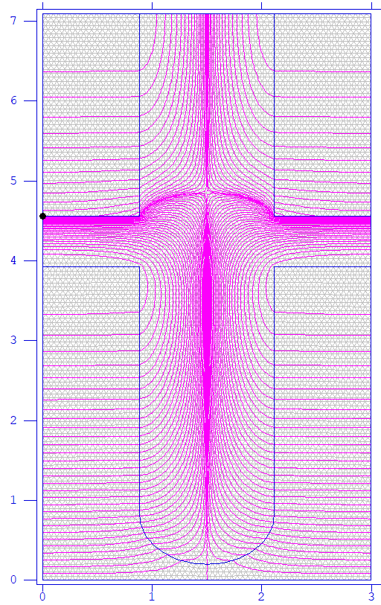
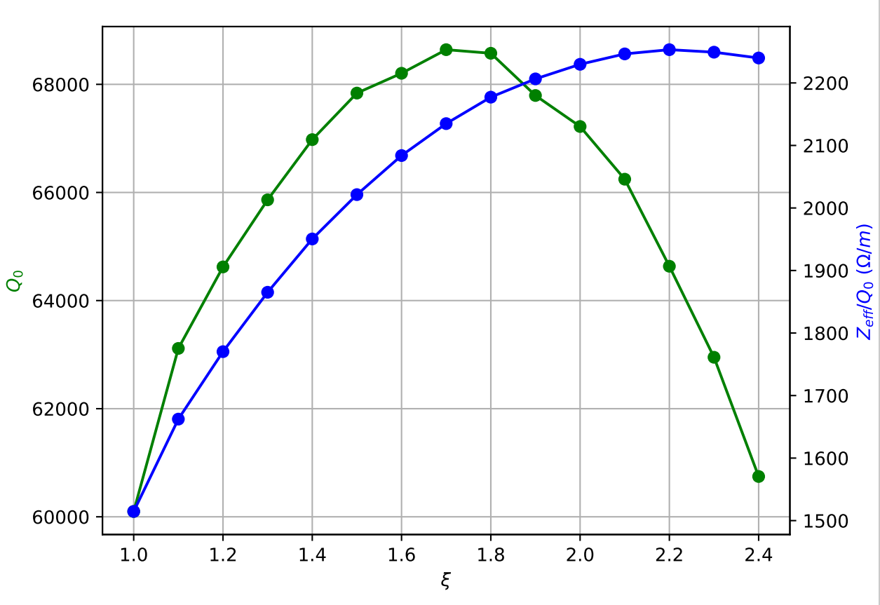
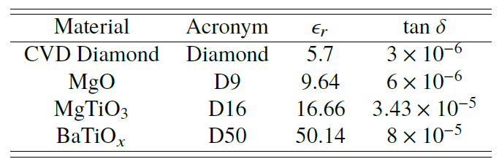





DAA cavity single cell iris optimization
Scan in iris thickness: $d_{0}=λ_{0}/(4\sqrt{ε_{r}})$
$$d_{0}ξ$$
$$ε_{r}=16.66, β=0.6$$
Iris thickness $=d_{0}ξ$
$$β=\{0.4, 0.5, …,1\}$$
High Power Test Results of X-Band Dielectric Disk Accelerating Structures. Ben Freemire
Notes:
.

Slide 10
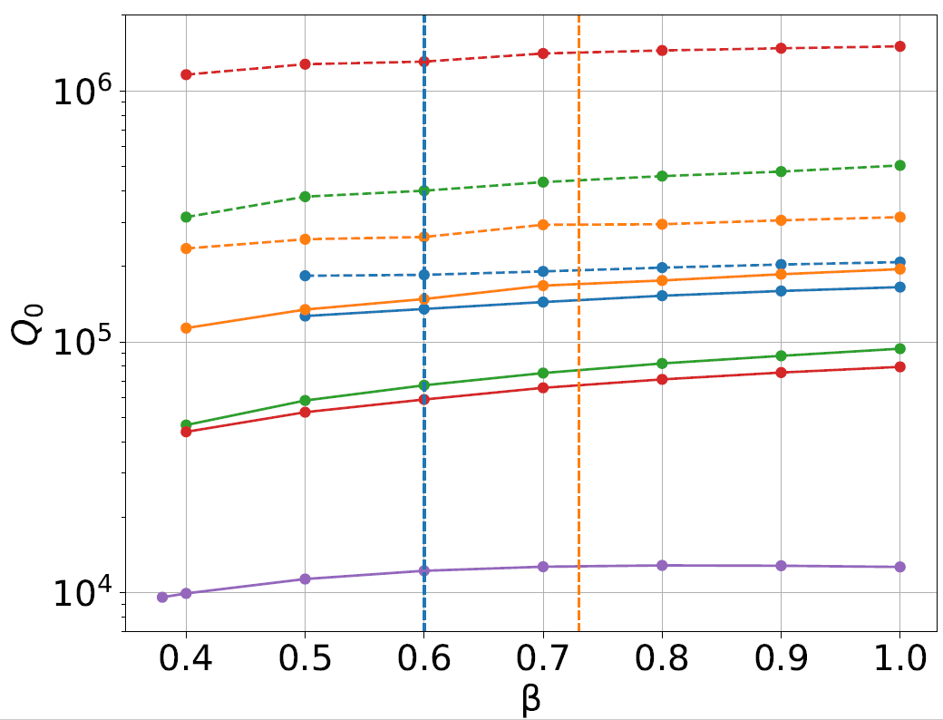
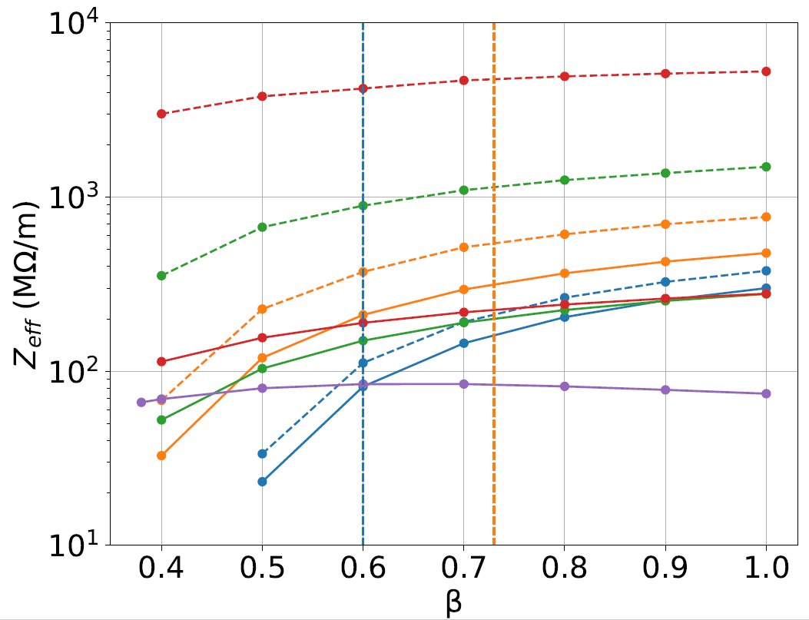
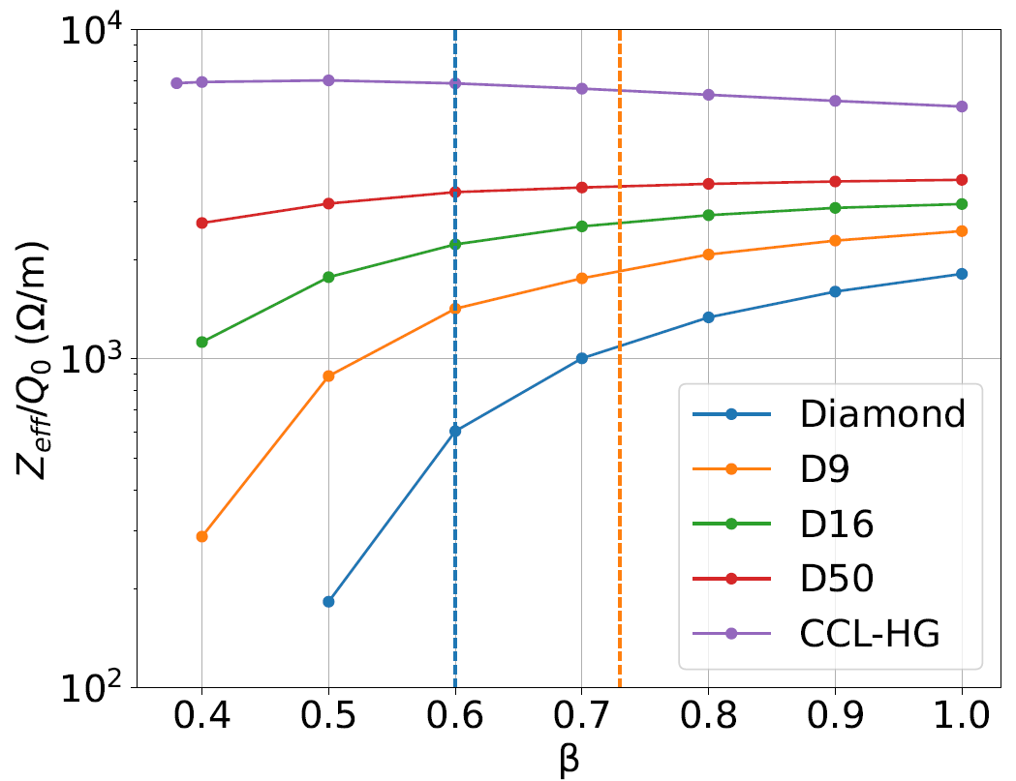


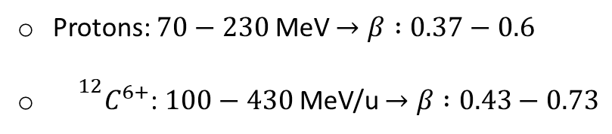
Energy range for hadrontherapy
Protons: $70−230$MeV $→β :0.37−0.6$
${{}^{12}C}^{6+}$: $100−430$MeV/u $→β :0.43−0.73$
Bencini, V. (2020). Design of a novel linear accelerator for carbon ion therapy (Doctoral dissertation, Rome U.).
$$p^{+}$$
$$C^{6+}$$
Real material
Ideal material
Notes:
.

Slide 11
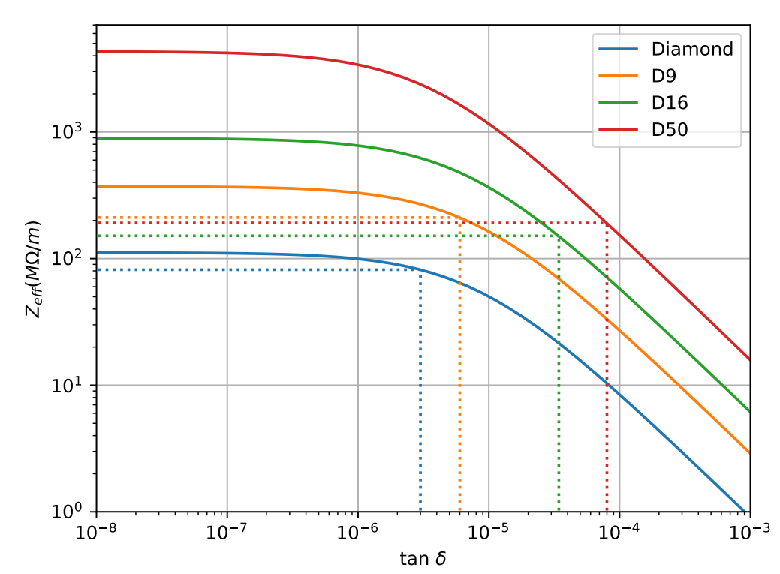
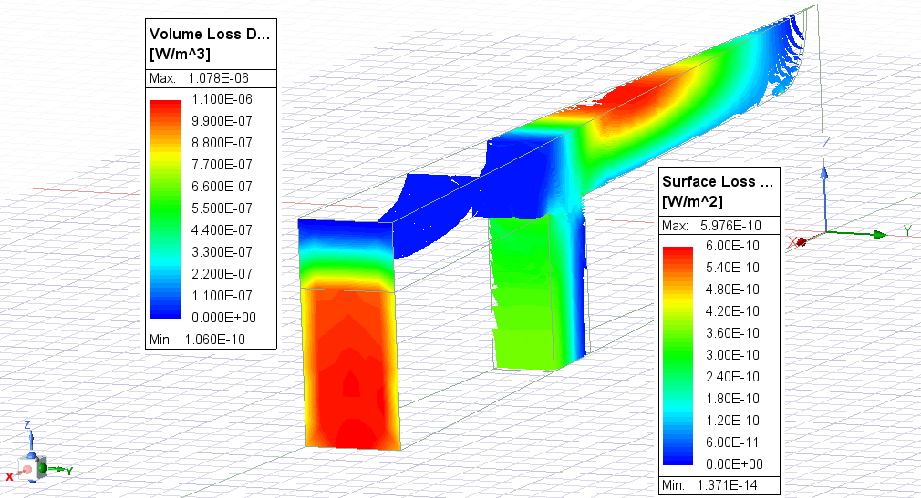
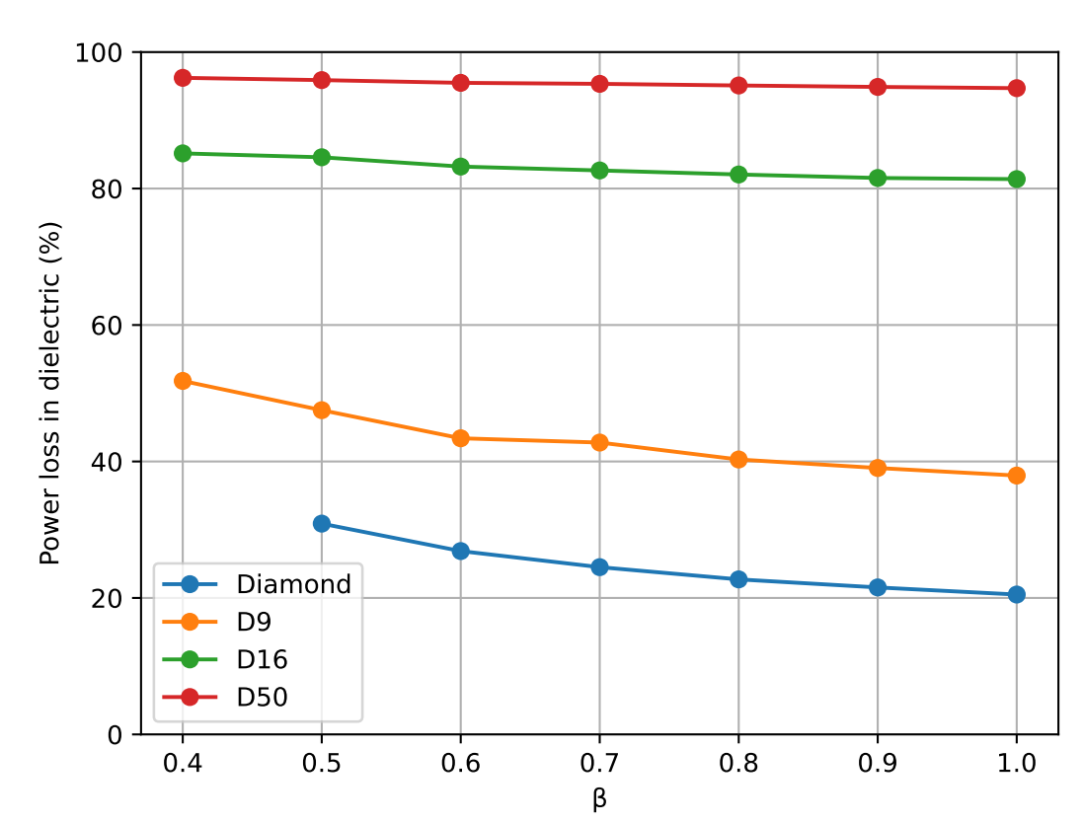
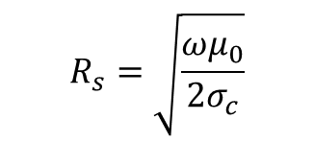
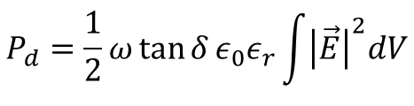
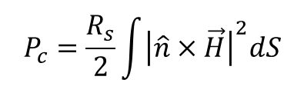
Scan in losses
$$P_{c}=\frac{R_{s}}{2}\int{{\left|\hat{n}×\vec{H}\right|}^{2}dS}$$
$$R_{s}=\sqrt{\frac{ωμ_{0}}{2σ_{c}}}$$
Conductor:
$$P_{d}=\frac{1}{2}ω\tan{δ}ε_{0}ε_{r}\int{{\left|\vec{E}\right|}^{2}dV}$$
Dielectric:
Notes:
.

Slide 12
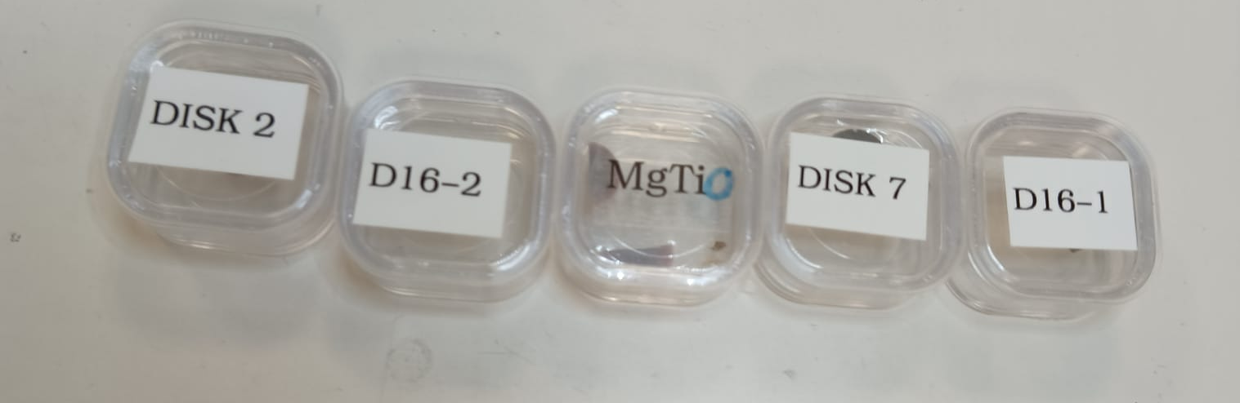
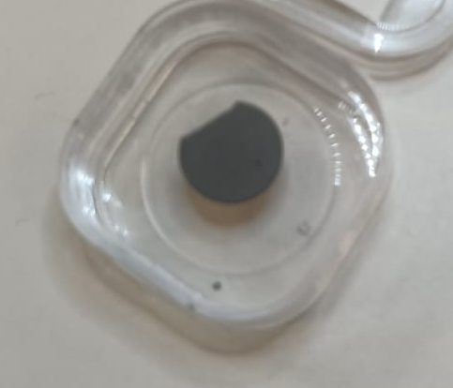
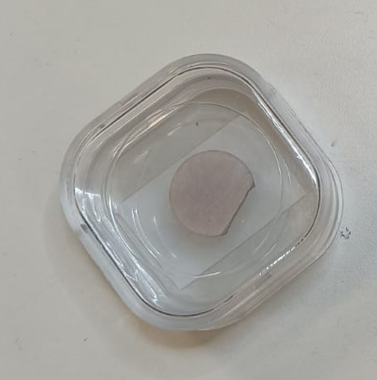
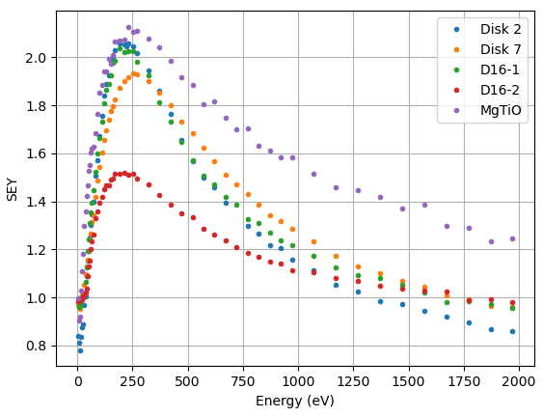
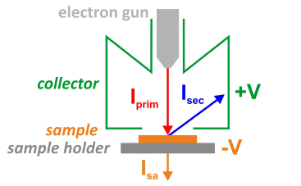


SEY Measurements
DLC Coating
Ceramic
Metals
$$Q=VC$$
Dielectric
$$C=\frac{ε_{r}ε_{0}S}{d}$$
Notes:
a-C -> Amorphous Carbon
DLC -> Diamond-Like Carbon -> above 1 MOhm per square ~500 nm

Slide 13
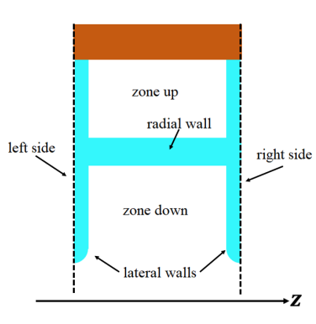
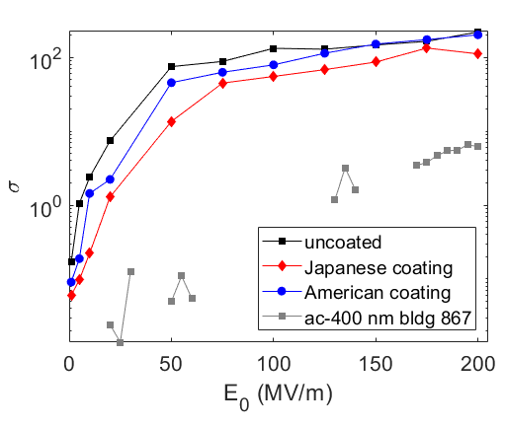
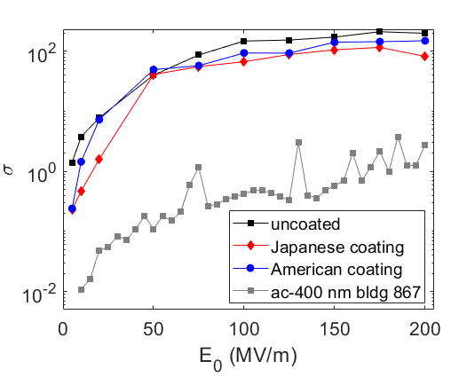
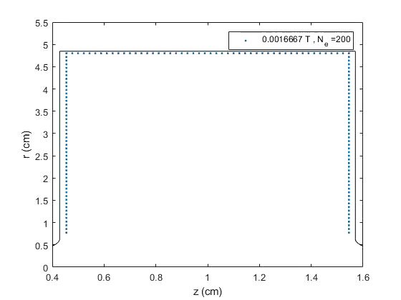
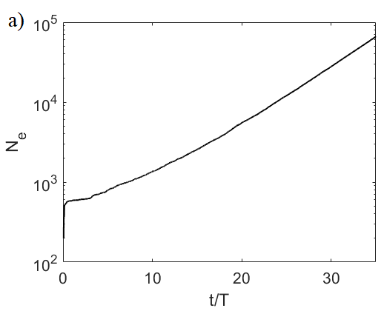
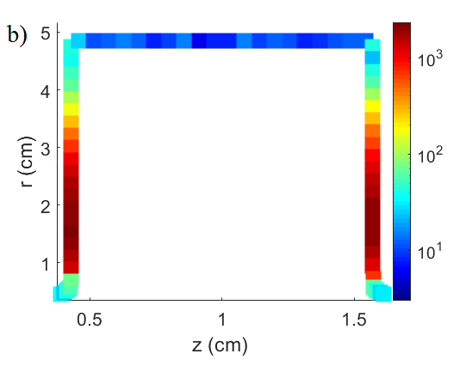
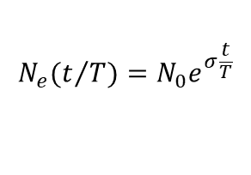
Multipactor in the DAA structure
  Some of the main results of the multipactor simulations in the DAA cell are summarized on this slide
$$N_{e}(t/T)=N_{0}e^{σ\frac{t}{T}}$$
N_{e} , number of electrons
N₀ , initial electron number
growth factor
Courtesy of Daniel Gonzalez-Iglesias
Multipactor growth factor σ as a function of the RF electric field amplitude at the cell axis in the down zone (left) and up zone (right)
Results for E₀ = 1 MV/m (down zone)
a) Number of electrons in the structure as a function of time normalised to the period of the RF signal.
b) Colour map with the number of electrons impacting at each wall position being able to generate two or more secondary electrons.
Multipactor simulation in the down zone for E₀ = 1 MV/m
Notes:
a-C -> Amorphous Carbon
DLC -> Diamond-Like Carbon -> above 1 MOhm per square ~500 nm

Slide 14
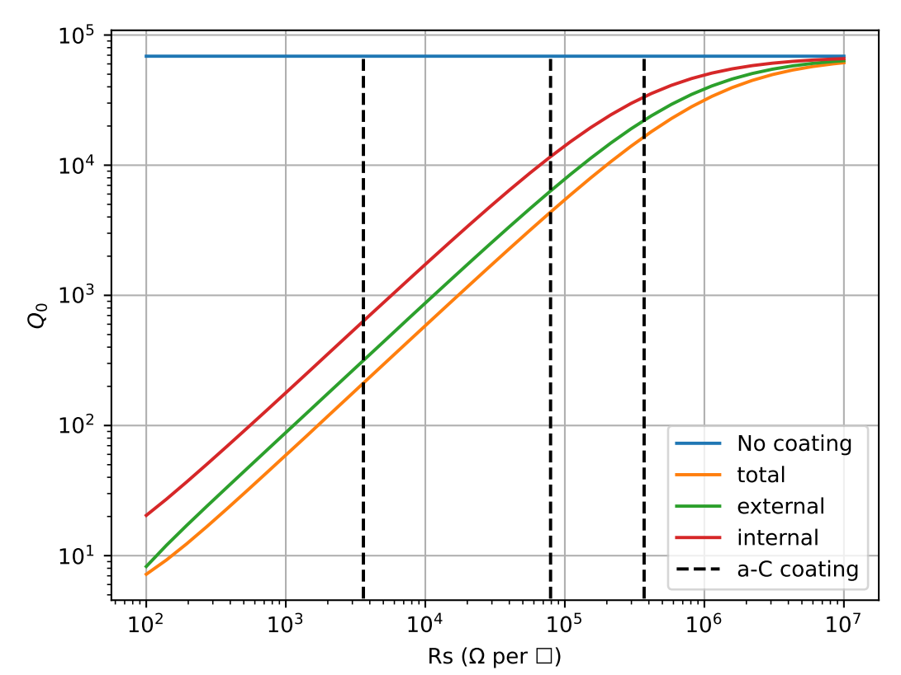
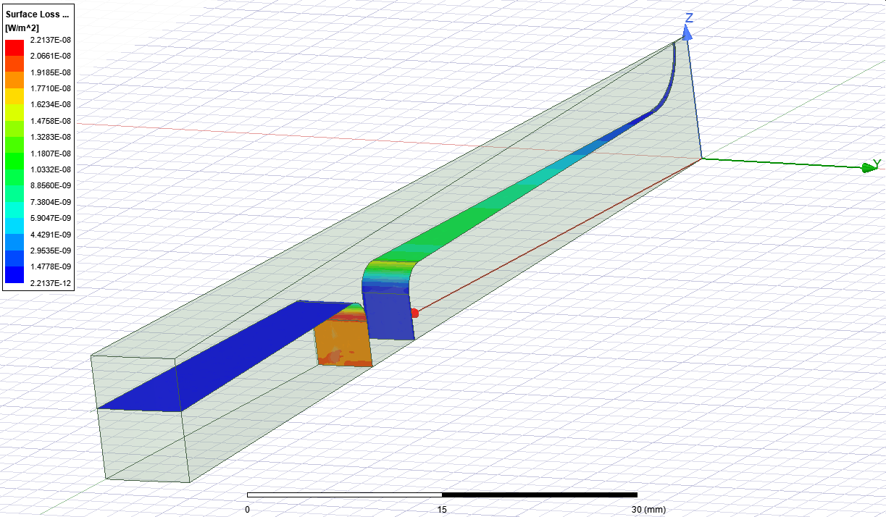
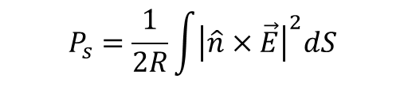
Coating losses
a-C coating can reduce multipactor but it has an impact on electromagnetic performance
Coating losses:
$$P_{s}=\frac{1}{2R}\int{{\left|\hat{n}×\vec{E}\right|}^{2}dS}$$
internal
external
Amorphous and diamond-like carbon coatings for sey reduction of dielectric material for accelerating structure application. A. Grudiev et al. Tech. Rep. 2022.
Notes:
.

Slide 15
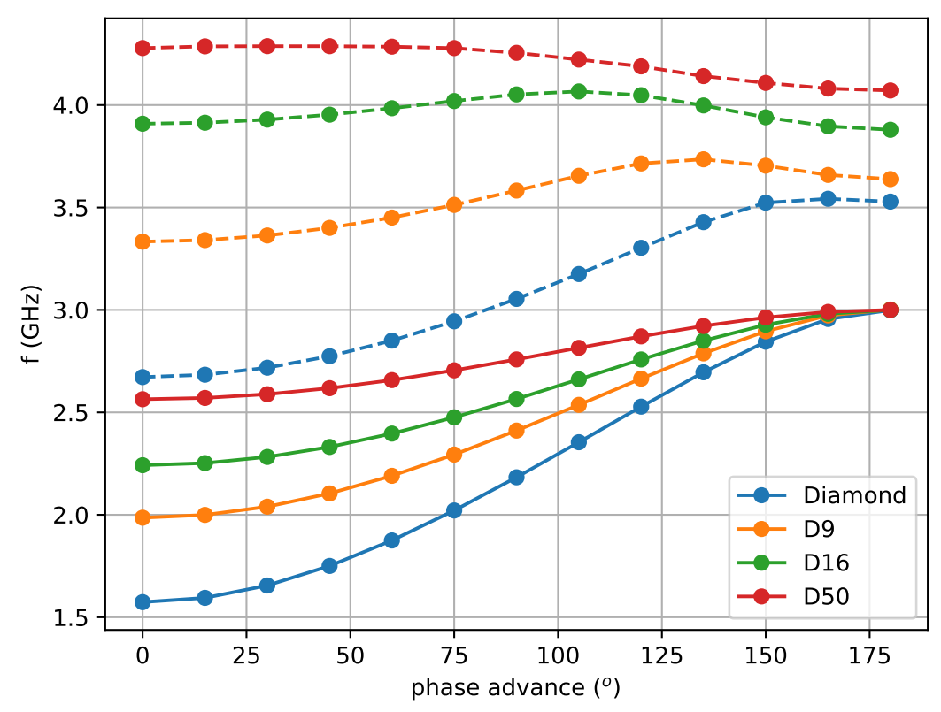
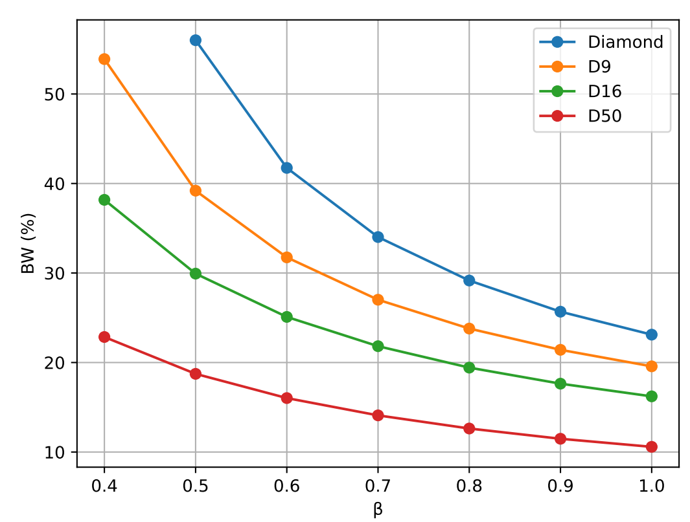
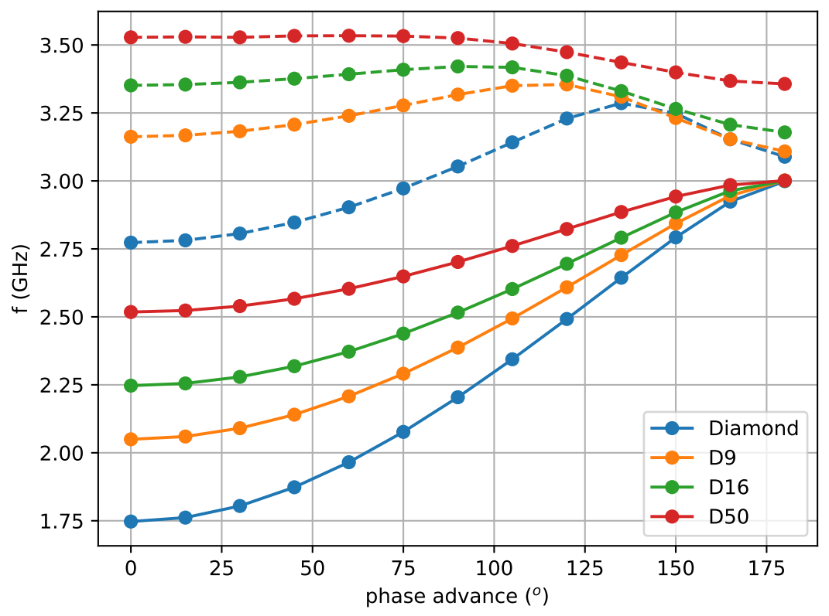

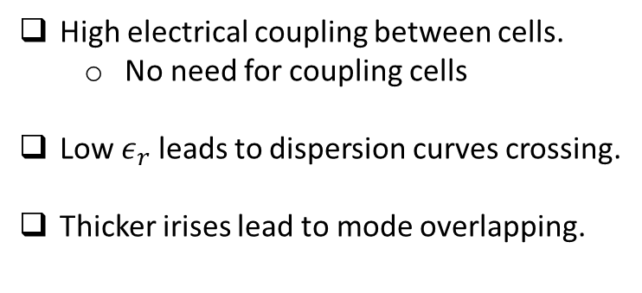



Coupling and dispersion curve
$$BW=\frac{f_{π}−f_{0}}{f_{π}}100\left(\%\right)$$
D16, $β=0.6$
$$ξ=1$$
$$ξ=1.5$$
High electrical coupling between cells.
  No need for coupling cells
Low $ε_{r}$ leads to dispersion curves crossing.
Thicker irises lead to mode overlapping.
Notes:
.

Slide 16
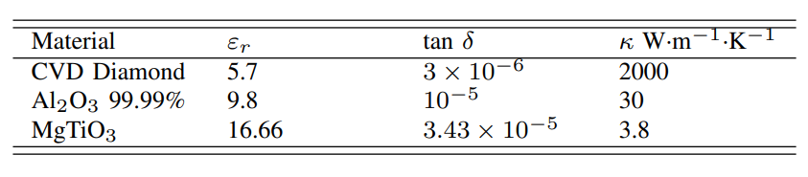




Thermal simulation
Thermal load:
Heat flux: Surface losses in copper.
Heat generation: Volumetric losses in dielectric.
Electromagnetic normalization:
$G∗T=50 MV/m$
DUT = $0,075×{10}^{−3}$
https://www.americanelements.com/magnesium-titanate-12032-30-3
https://www.makeitfrom.com/material-properties/Magnesium-Titanate-IEC-60672-Type-C-320
https://accuratus.com/alumox.html
$$β=0.6$$
Boundary condition: 22 ºC
Notes:
.

Slide 17



Critical points
Triple junction points can lead to instabilities and singularities in electric field in the neighborhood of the point
In the surroundings of the junction, $λ≫L$ so we can use a 2D constant field approach.
Notes:
.

Slide 18






Analytical approach
$$\cot{nα+ε_{d}\cot{n(π−α)}=0}$$
Techaumnat, B., Hamada, S., & Takuma, T. (2002). Effect of conductivity in triple-junction problems. Journal of electrostatics, 56(1), 67-76
$$φ_{g}≈ar^{z}\sin{zθ}$$
$$φ_{d}≈br^{z}\sin{z(π−θ)}$$
$$z=n+jm$$
The contact-point electric field will be infinitely large if $n<1$ and will be zero if $n>1$. A non-zero and non-singular value will exist only if $n=1$.
Notes:
.

Slide 19

Conclusions
  DAA have extremely high $Q_{0}$ and $Z_{eff}$:
    Results are better for high $ε_{r}$ and $β$
    Lower input power needed.
  $Z_{eff}/Q_{0}$ worse than copper structures
    Higher total energy needed.
  Iris length is an important parameter to add in the optimization process.
  Multipactor must be suppressed by coatings with high sheet resistivity.
  Very high coupling between cells
    Modes overlapping can be a problem for low $ε_{r}$ and $β$.
  Very low thermal conductivity can be a source of mechanical problems.
  Triple junction point and sharp corners must be carefully studied to avoid singularities and instabilities.
Notes:
.

Slide 20
Back up

Slide 21




Standing Wave Acceleration Cavities
P _{RF in}
Cylindrical single (or multiple cavities) working on the TM₀₁₀-like mode are used
Figures of merit:
Shunt impedance: efficiency of the acceleration mode.
Quality factor: efficiency to store RF energy .
R/Q: pure geometric qualification factor.
Synchronization condition
0 mode
π mode
  NC cavity R∼1MΩ
  SC cavity R∼1TΩ
E_{z}
z
π mode
  NC cavity Q∼10⁴
  SC cavity Q∼10¹⁰
E_{z}
$β$: particle velocity
d: distance between cells
f_{RF}: RF frequency
c: speed of light in vacuum
$\sim$100 $Ω$
z

Slide 22






HG-CCL Copper structure single cell
Pillbox cavity $TM_{010}$
$β=0.38$, mode $TM_{01}−π$
Electric field
Magnetic field
Electric field
Magnetic field
Optimization
High losses in metallic walls: low RF efficiency.
High peak electric field in metal: field emission and RF breakdown.
Notes:
.

Slide 23




DAA cavity single cell solution
Pillbox cavity $TM_{020}$
DAA mode $TM_{02}−π$
Electric field
Magnetic field
Electric field
Magnetic field
Dielectric and Optimization
Low losses in metallic walls
Low peak electric field in metal.
Notes:
.

Slide 24



DAA cavity single cell CST
Resonant frequency for the mode depends on the combination of $a_{1}, b_{1}, c_{1}$:
  Scan for $a_{1}, c_{1}$ and we look for the value of $b_{1}$ that makes $f=(3000±2)$ MHz.
  Look for the values of $a_{1},b_{1},c_{1}$ that maximize $ZTT, Q_{0}$
In CST the minimum volume to simulate is 1/8 of the total volume using symmetry planes in XY, XZ, YZ.
Then the mode we are interested in is mixed with many modes with no revolution symmetry
Notes:
.

Slide 25

DAA cavity single cell Superfish
Resonant frequency for the mode depends on the combination of $a_{1}, b_{1}, c_{1}$:
  Scan for $a_{1}, c_{1}$ and we look for the value of $b_{1}$ that makes $f=(3000±2)$ MHz.
  Look for the values of $a_{1},b_{1},c_{1}$ that maximizes $ZTT, Q_{0}$
Magnetic wall
Electric wall
Superfish: 2D electromagnetic solver for axial symmetric RF cavities.
  Fast.
  Low computational cost.
  Free.
  Reduce the number of solutions due to the symmetry.
cm
cm
Notes:
.

Slide 26









HFSS Results
D16, $β=0.4, ε_{r}=16.66,\tan{δ=3.43×{10}^{−5}}$
Geometry | SUPERFISH |  |  | HFSS
 | $f$ (MHz) | $$Q_{0}$$ | $Z/Q$ ($Ω/m$) | $f$ (MHz) | $$Q_{0}$$ | $Z/Q$ ($Ω/m$)
edge | 2998.7 | 46949 | 944 | 2998.2 | 47444 | 949
$r=2$ mm | 2999.3 | 47316 | 959 | 2999.1 | 47755 | 960
$$Q_{0}=ω\frac{W}{P}$$
$$W=2W_{e}=2W_{m}=\frac{1}{2}μ_{0}\int{{\left|\vec{H}\right|}^{2}dV}$$
Conductor: $P_{c}=\frac{R_{s}}{2}\int{{\left|\hat{n}×\vec{H}\right|}^{2}dS}$ $R_{s}=\sqrt{\frac{ωμ_{0}}{2σ}}$
Dielectric: $P_{d}=\frac{1}{2}ω\tan{δ}ε_{0}ε_{r}\int{{\left|\vec{E}\right|}^{2}dV}$
Coating: $P_{s}=\frac{1}{2R}\int{{\left|\hat{n}×\vec{E}\right|}^{2}dS}$
Notes:
https://www.sciencedirect.com/topics/engineering/dielectric-loss-tangent

Slide 27





Rounded points
D
AB
$$r$$
$$r=0$$
C
A
CD
B
Notes:
.

Slide 28
SEY Measurements
Coating
Ceramic
DISK 2: Sample 5: MgTiO with one side DLC coated (US vendor).
D16-2: Sample 9: D16 with one side DLC coated (Japan vendor).
MgTiO: Sample 4: MgTi Oxide based Conductive Ceramic uncoated.
DISK 7: Sample 6: MgTiO with one side DLC coated (Japan vendor).
D16-1: Sample 8: D16 with one side DLC coated (US vendor).
Metals
$$Q=VC$$
Dielectric
$$C=\frac{ε_{r}ε_{0}S}{d}$$
Notes:
a-C -> Amorphous Carbon
DLC -> Diamond-Like Carbon -> above 1 MOhm per square ~500 nm

Slide 29

Multipactor in the DAA structure
  Multipactor breakdown is an electron avalanche-like discharge occurring in components operating under vacuum conditions and high-power RF electromagnetic fields
  The onset of multipactor discharge leads to various detrimental effects that degrade the device performance. Thus, this phenomenon poses a significant limitation on the maximum RF power handling capability of devices
  The risk of suffering a multipactor discharge in the DAA structures was analyzed by means of numerical simulations with an in-house developed code based on the Monte-Carlo method
Waveguide wall
Wall collisions
e-
e-
e-
e-
e-
e-
e-
e-
e-
e-
e-
e-
e-
e-
e-
e-
e-
e-
e-
e-
e-
e-
e-
e-
e-
e-
e-
e-
e-
e-
e-
e-
e-
e-
vacuum
e-
0 1 2 3 4 5 6 7 8 9 10
t
d
5 T_{RF}/2
e-
e-
Primary electron (free)
Secondary electron
e-
e-
e-
e-
e-
e-
e-
e-
e-
e-
e-
e-
e-
Waveguide wall
Diagram of the DAA cell
  The simulations explore RF electric field amplitudes in the range E₀ = [0.01, 200] MV/m
  The cell is divided into two zones: up and down, with separate simulations launched for each zone
  In the DAA cell multipactor appears in the range 1-200 MV/m
Courtesy of Daniel Gonzlez-Iglesias
Notes:
a-C -> Amorphous Carbon
DLC -> Diamond-Like Carbon -> above 1 MOhm per square ~500 nm

Slide 30


ANSYS Workbench
Material | MgTiO3 | $Al_{2}O_{3}$ 99.5% | TiO2-doped Al2O3 | CVD Diamond | Copper
Density (g/cm^3) | 3,6 | 3.89 |  | 3.52 | 8,933
Thermal conductivity (W/m·K) | 3,8 | 35 |  | 2000 | 400
Thermal expansion (µm/m·K) | 8,0 | 8.4 |  | 1.0 | 17,7
$$\tan{δ}$$ | $$3.43×{10}^{−5}$$ | $$2×{10}^{−4}$$ | $$1×{10}^{−5}−$$ $$6×{10}^{−6}$$ | $$3×{10}^{−6}$$
$$ε_{r}$$ | 16.66 | 9.8 | 9.64 | 5.7
Ceramic
copper
https://www.americanelements.com/magnesium-titanate-12032-30-3
https://www.makeitfrom.com/material-properties/Magnesium-Titanate-IEC-60672-Type-C-320
https://accuratus.com/alumox.html
Notes:
.

Slide 31

Tolerance studies
Parameter | $\frac{df}{dl}$ (kHz/$μ$m)
material | D9 |  | D16 |  | D50
$$β$$ | 0.4 | 1 | 0.4 | 1 | 0.4 | 1
$$a_{1}$$ | 1.7 | 2.3 | 4.0 | 2.1 | 2.7 | 1.1
$$b_{1}$$ | -11.0 | -42.8 | -28.0 | -51.8 | -53.1 | -63.9
$$c_{1}$$ | -2.0 | -5.5 | -2.2 | -3.6 | -1.3 | -1.4
$$d_{1}$$ | -29.5 | -12.1 | -39.1 | -12.8 | -34.5 | -12.6
$$r_{0}$$ | 1.1 | 1.4 | 1.6 | 1.1 | 2.0 | 0.8
$$L_{1}$$ | -71.3 | -4.8 | -38.8 | -3.1 | -10.3 | -1.2
Notes:
.

Slide 32












Dielectric Disk Loaded Accelerating (DDA) Cavity
$$D16, {β=0.4,ε}_{r}=16.66, tan{δ=3.43×{10}^{−5} }$$
$$gain=1.5, gap=0.3 cm, α={75}^{o}, r=0.2 cm$$
$$d_{1}=\frac{λ_{0}}{4\sqrt{ε_{r}}}ξ$$
$$d_{1}/2$$
Parameter | With nose | Without nose
$$Q_{0}$$ | 21180 | 20299
$Z/Q$ ($Ω/m$) | 2154 | 1234
$Z$ ($MΩ/m$) | 45.6 | 25.0
T | 0.9076 | 0.8055
$$E_{p}/E_{a}$$ | 6.27 | 2.38
$$c_{1}$$
Same $W$
$$α$$
$$r$$
Gap/2
$$r_{0}$$
Notes:
.

