Slide 1



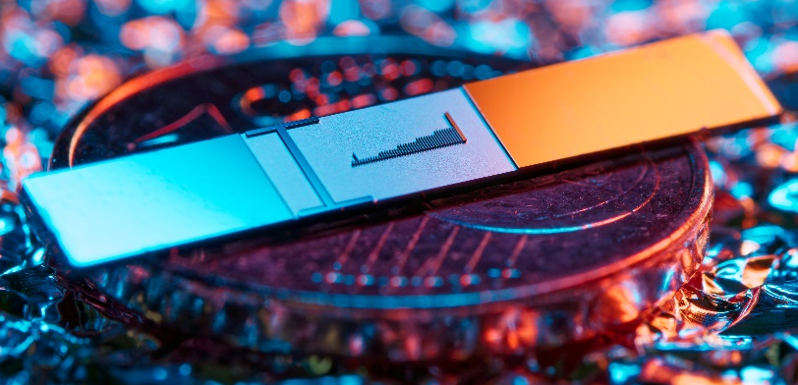
Coherent Nanophotonic Electron Accelerator
Tomáš Chlouba, Roy Shiloh, Stefanie Kraus, Leon Brückner, Julian Litzel and Peter Hommelhoff
Friedrich-Alexander-Universität Erlangen-Nürnberg (FAU)
www.laserphysik.nat.fau.de
tomas.chlouba@fau.de

Slide 2
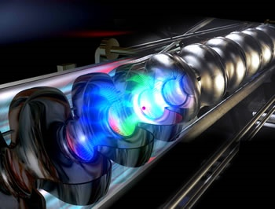
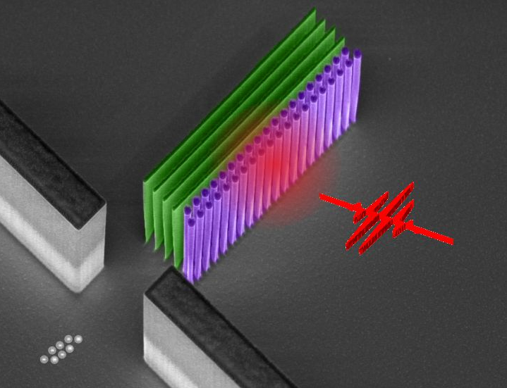
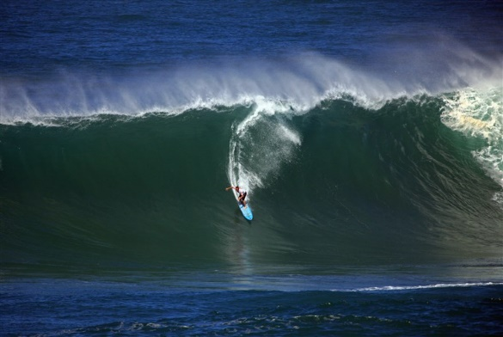
Laser particle accelerators: from RF to laser drive – based on the same operating principle: “structured vacuum”
RF cavity (TESLA, DESY)
Conventional linear
accelerator (RF)
Laser-based dielectric
accelerator (optical)
Based on
(Supercond.) RF cavities
Quartz grating structures
Surface breakdown:
200 MV/m
Damage threshold:
10 GV/m
Peak field limited by
Max. achievable
gradients
100 MeV/m
= 0.1 GeV/m
5 GeV/m
= 5 000 MeV/m
Principle: a nearfield scheme generates the required electromagnetic mode to continuously accelerate charged particles in vacuum – the particle is surfing the mode

Slide 3
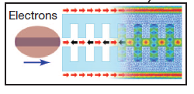
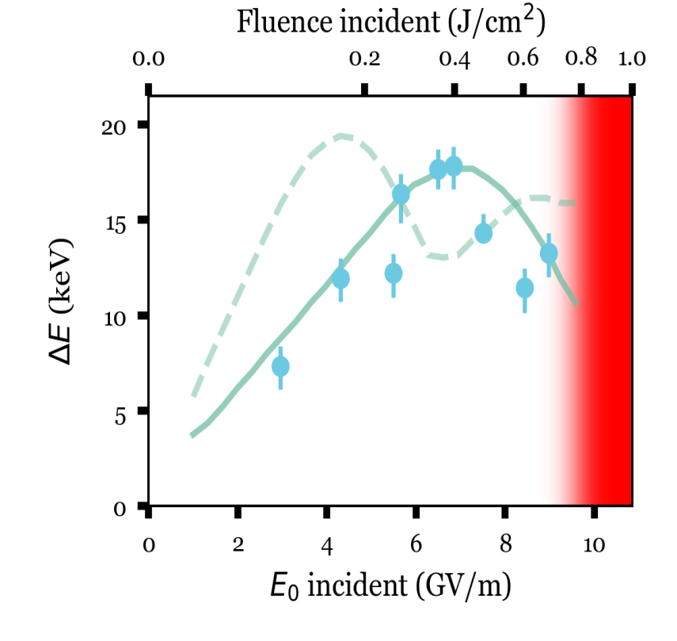
Proof-of-concept experiments
30 keV electron beam of an electron microscope column
60 MeV electron beam at
SLAC’s NLCTA
E. Peralta, K. Soong, R. J. England, E. Colby, Z. Wu, B. Montazeri, C. McGuinness, J. McNeur, K. Leedle, D. Walz, E. Sozer, B. Cowan, B. Schwartz, G. Travish, R. L. Byer, Nature 503, 91 (2013)
Dual-sided silica structure
1st spatial harmonic: > 250 MeV/m
6 MeV electron beam at
UCLA’s Pegasus
1.8 GeV/m peak gradient
D. Cesar, S. Custodio, J. Maxson, P. Musumeci, X. Shen, E. Threlkeld, R. J. England, A. Hanuka, I. V. Makasyuk, E. A. Peralta, K. P. Wootton & Z. Wu, Comm. Phys. 1, 46 (2018)
Single-sided silica structure
3rd spatial harmonic
25 MeV/m
J. Breuer, P. Hommelhoff, PRL 111, 134803 (2013)
Exp. evidence with 600 GHz radiation: K. Mizuno et al., Nature 328, 45 (1987)

Slide 4
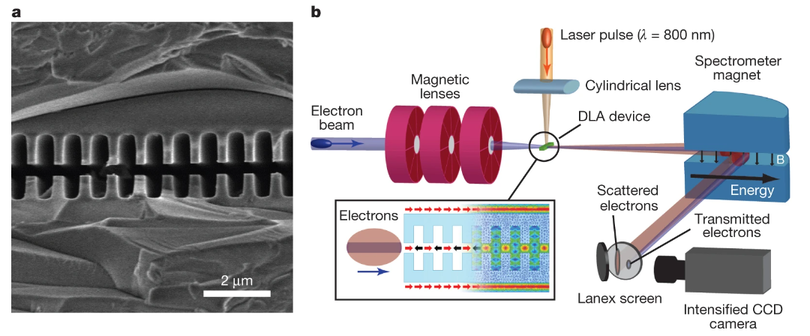
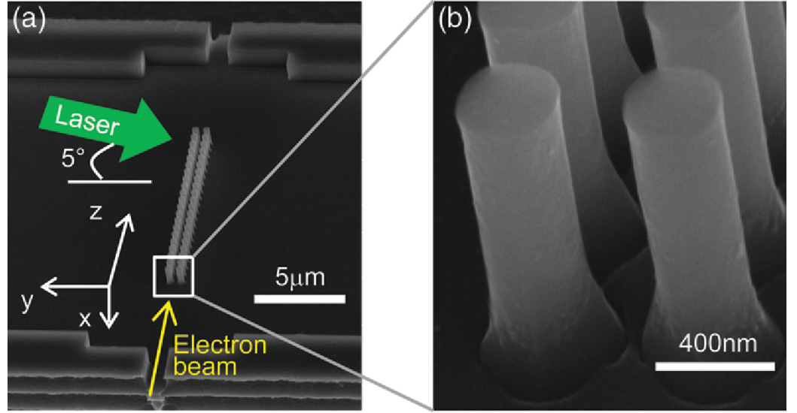
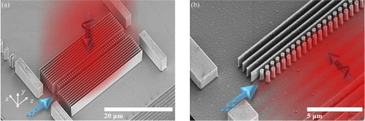
Accelerator structure evolution
2013 – Bonded silica gratings
Peralta, E., Soong, K., England, R. et al. Demonstration of electron acceleration in a laser-driven dielectric microstructure. Nature 503, 91–94 (2013).
2015 – Silicon pillar structures
K. Leedle, A. Ceballos, H. Deng, O. Solgaard, R. Pease, R. Byer, and J. Harris, "Dielectric laser acceleration of sub-100 keV electrons with silicon dual-pillar grating structures," Opt. Lett. 40, 4344-4347 (2015)
2021 – Vertical pumping
R. Shiloh, T. Chlouba, P. Yousefi, and P. Hommelhoff, "Particle acceleration using top-illuminated nanophotonic dielectric structures," Opt. Express 29, 14403-14411 (2021)

Slide 5
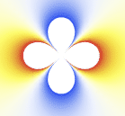
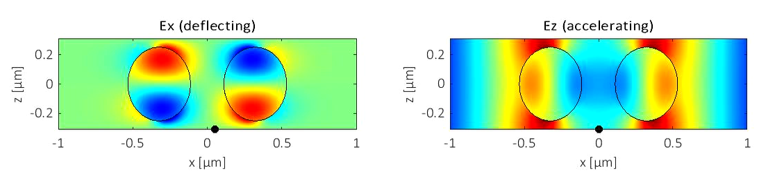
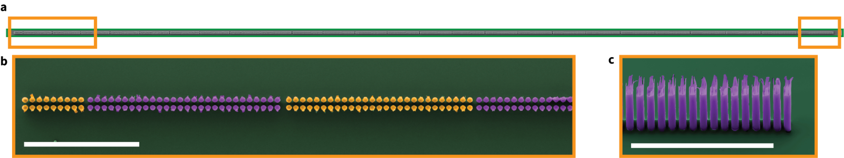
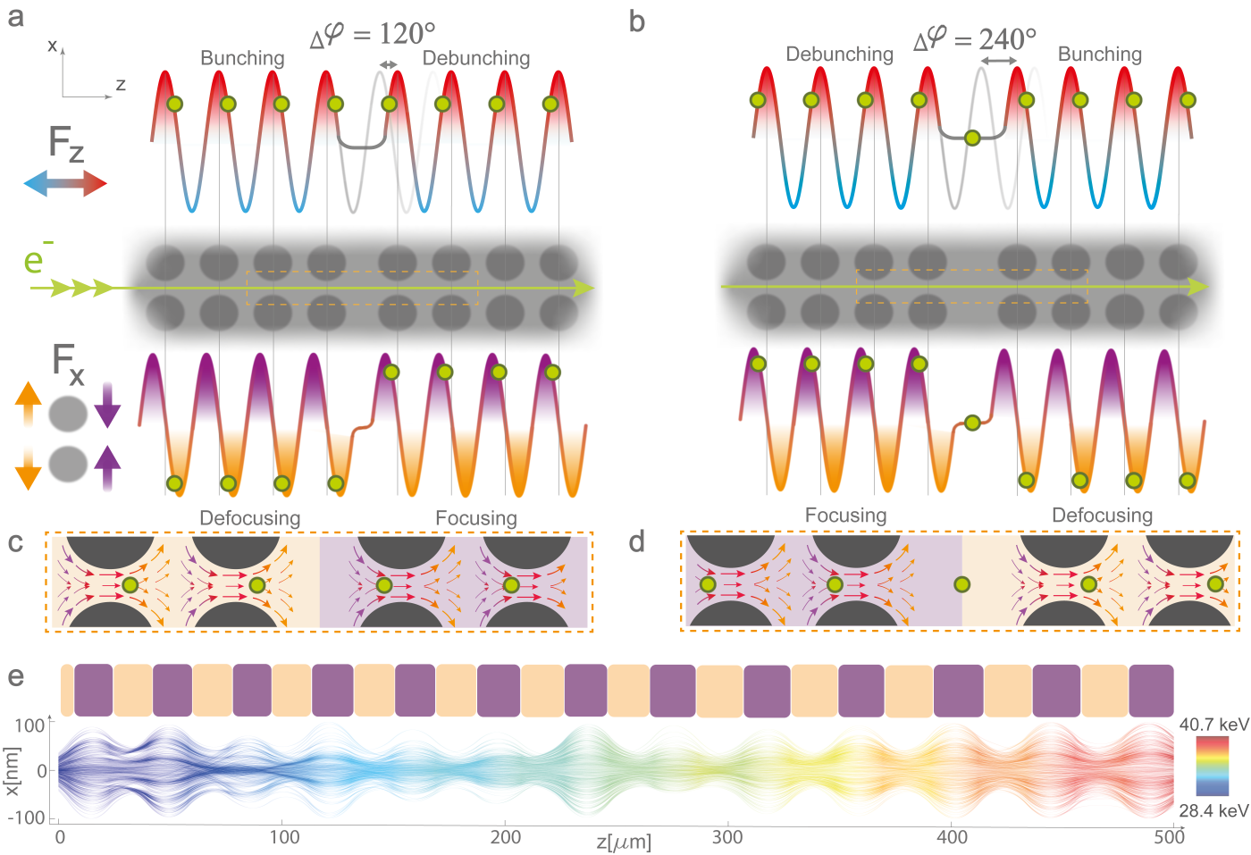
Nearfield profiles
Top view in electron microscope – pillars colored
Standing wave
Combined force
Transverse force
Accelerating force

Slide 6
Guiding – alternating phase focusing
Shiloh, R., Illmer, J., Chlouba, T. et al. Electron phase-space control in photonic chip-based particle acceleration. Nature 597, 498–502 (2021).

Slide 7
Acceleration with APF

Slide 8
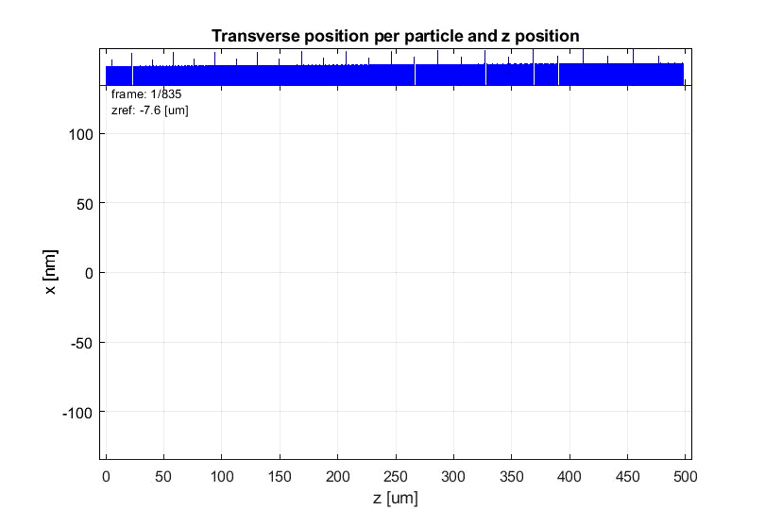
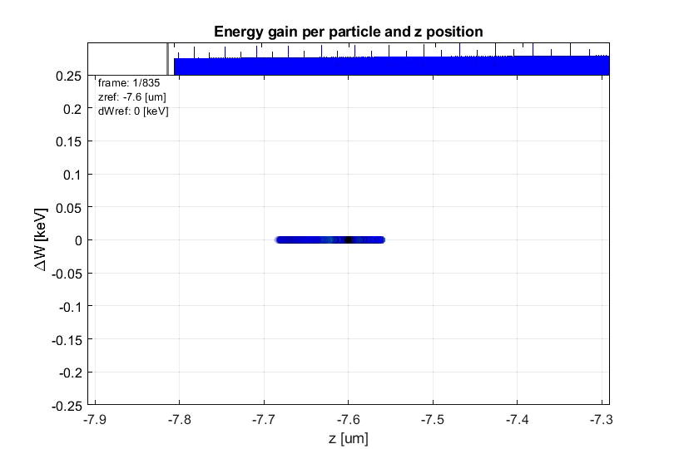
Phase space behaviour
T. Chlouba*, R. Shiloh*, S. Kraus*, L. Brückner*, J. Litzel, P. Hommelhoff, Coherent Nanophotonic Electron Accelerator, accepted for Nature (2023).

Slide 9
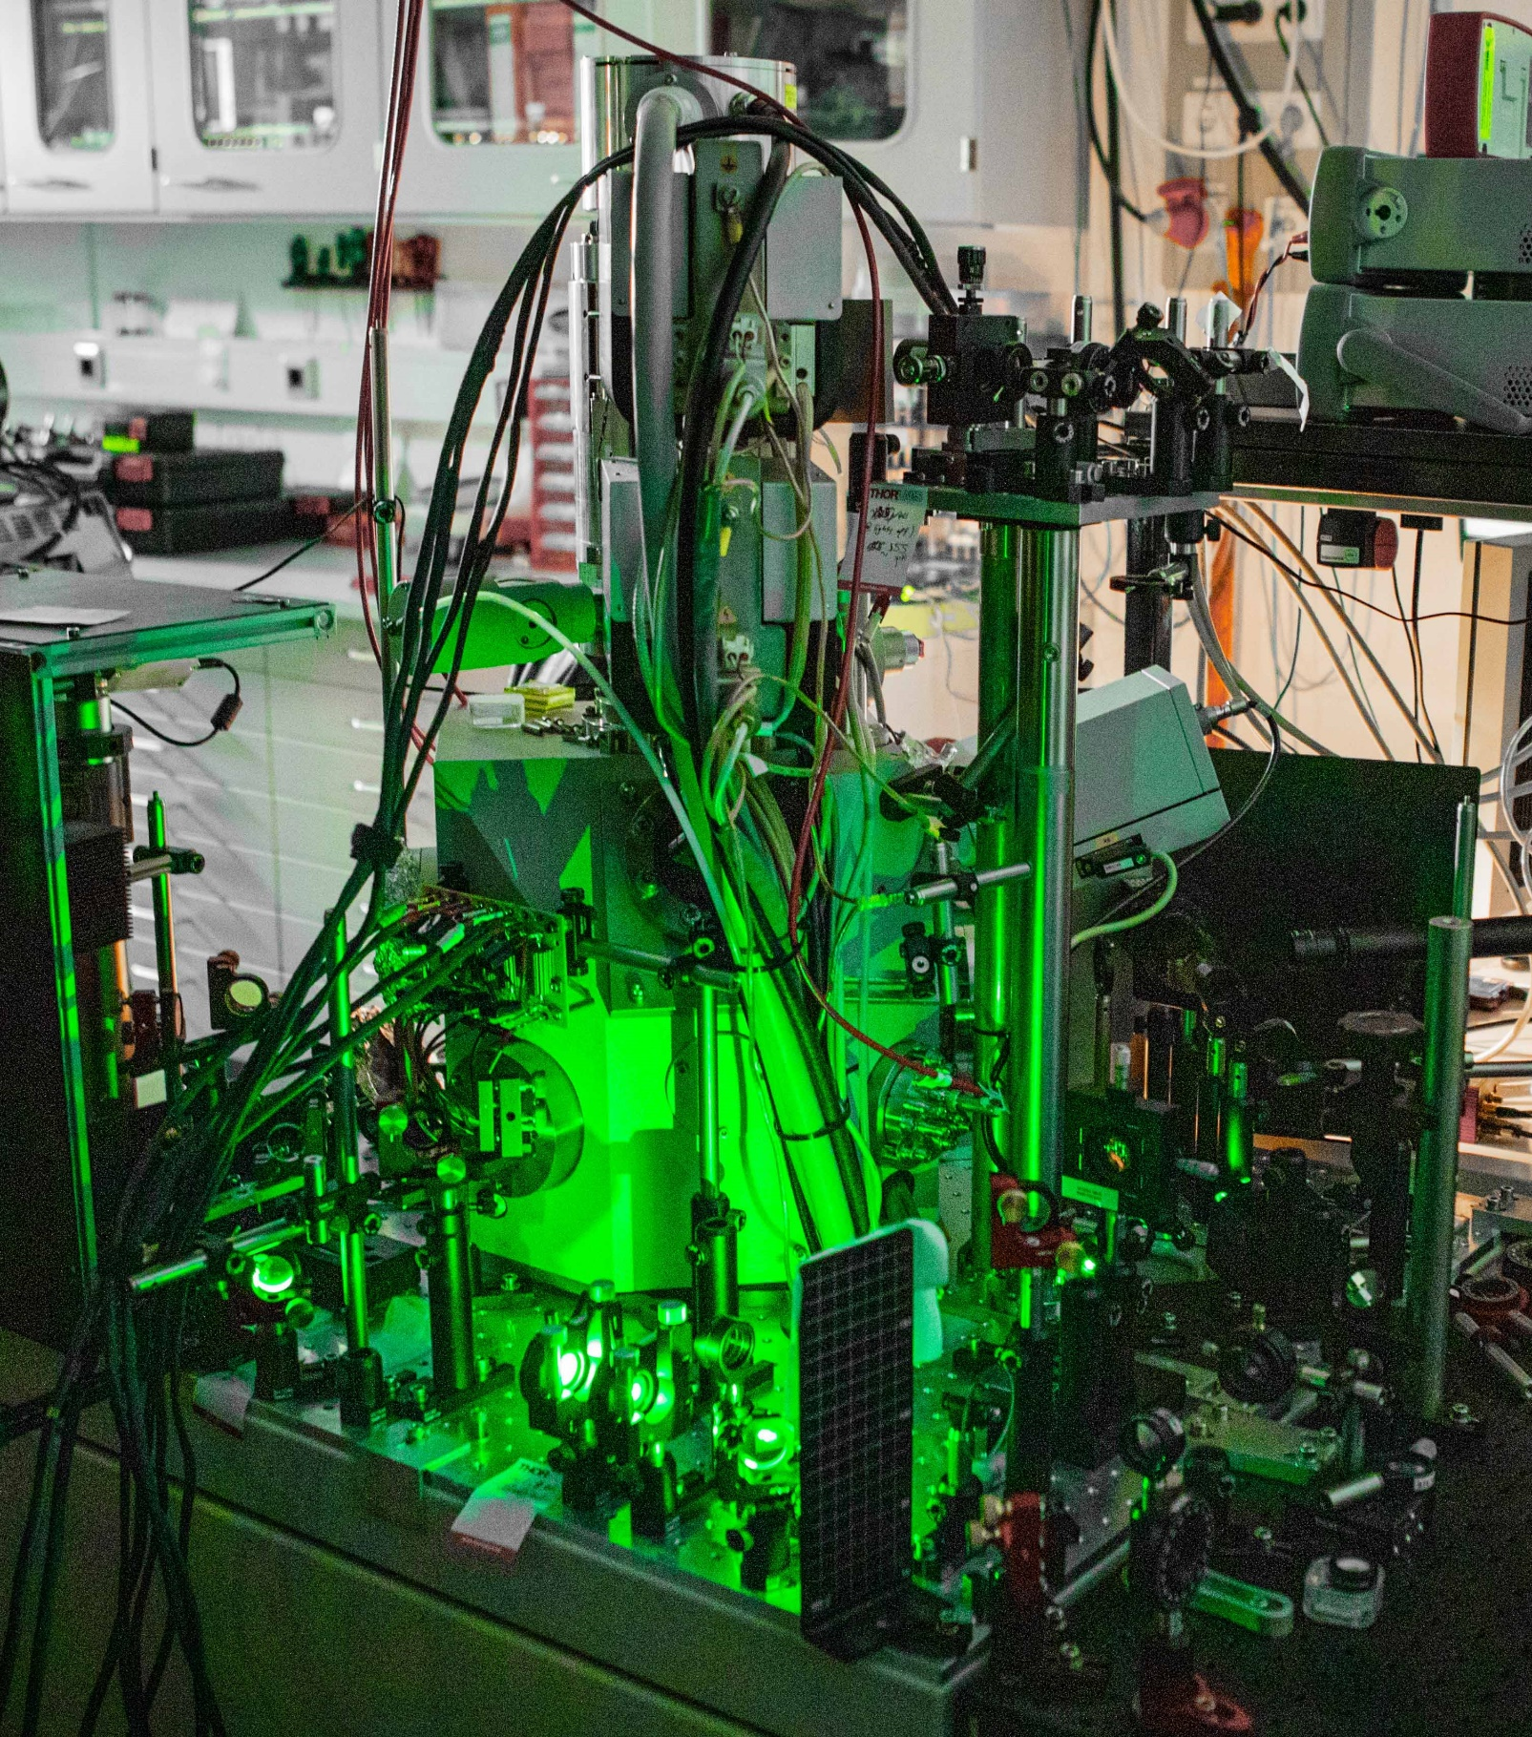
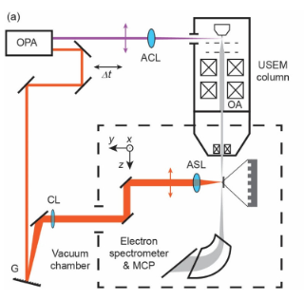
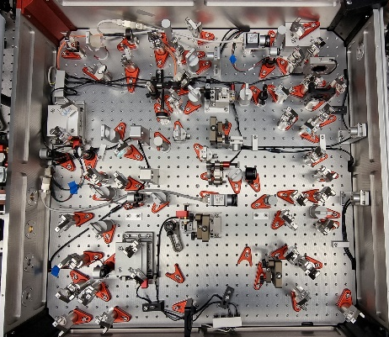
Experimental setup
Scanning electron microscope (SEM) – 0.5 – 30 keV electrons (ß = 0.32)
Electron emission triggered by UV (257 nm) laser pulse
Synchronized with accelerator driving pulse (1.93 μm) inside the chamber
Detection by MCP and magnetic spectrometer
Optical parametric amplifier
Generates required wavelengths
M. Kozák, J. McNeur, N. Schönenberger, J. Illmer, A. Li, A. Tafel, P. Yousefi, T. Eckstein, P. Hommelhoff; Journal of Applied Physics 124 (2018)

Slide 10
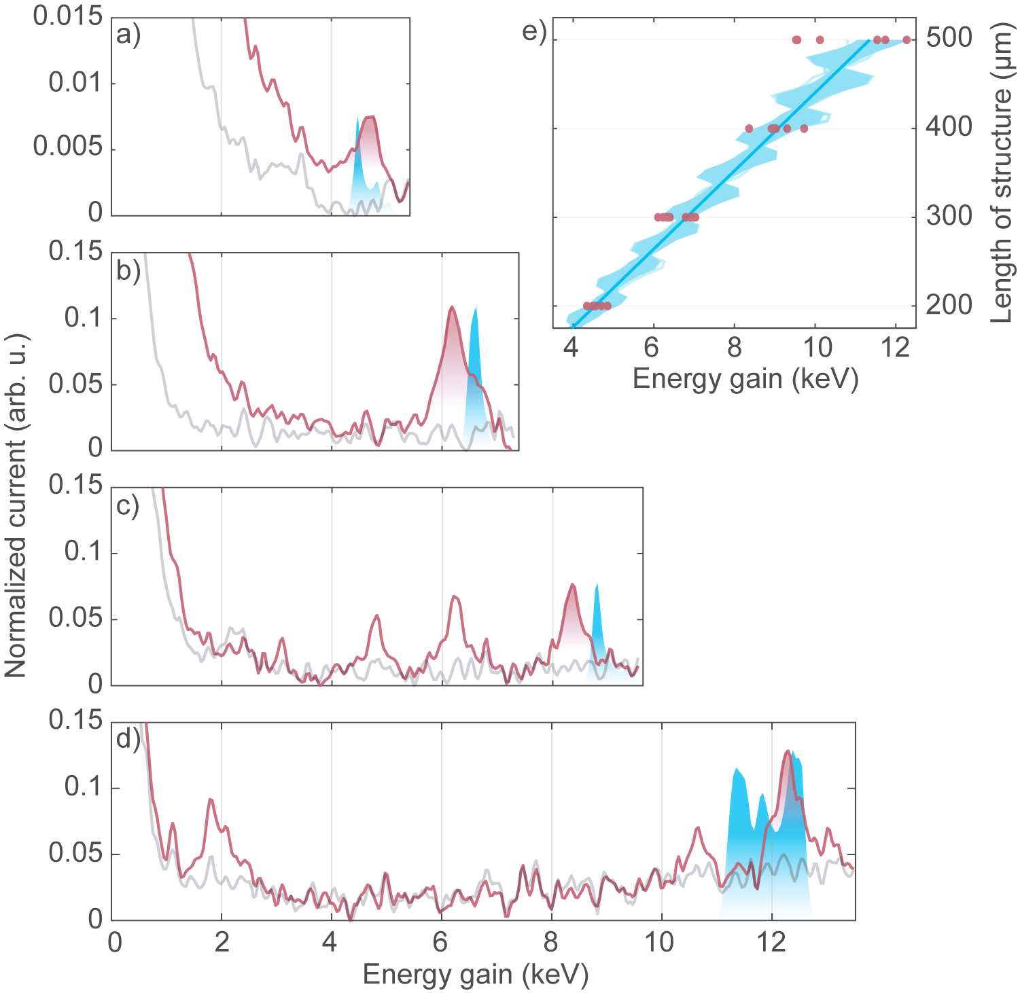
Coherent laser acceleration of electrons - results
Initial beam energy: 28.4 keV (inside of SEM)
200µm
300µm
400µm
Max. energy gain observed: 12.5 keV (45% energy increase)
500µm
T. Chlouba*, R. Shiloh*, S. Kraus*, L. Brückner*, J. Litzel, P. Hommelhoff, accepted for Nature (2023).

Slide 11
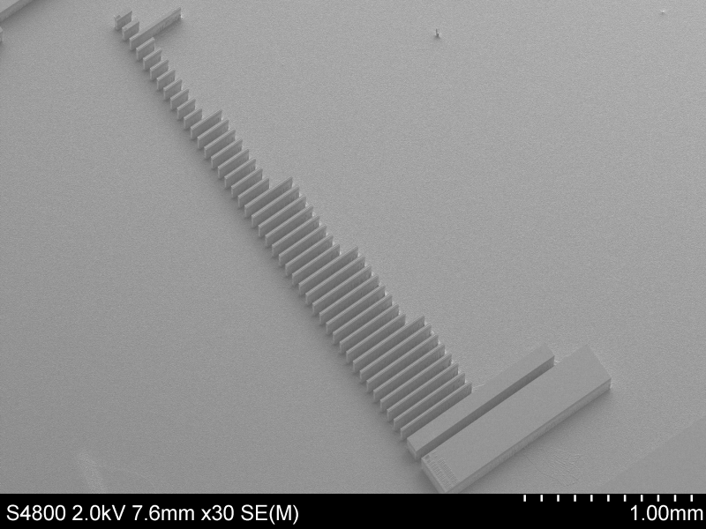
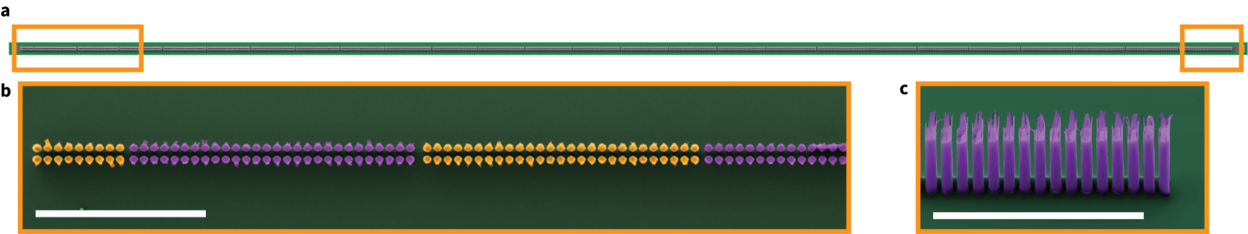
Acceleration structures

Slide 12
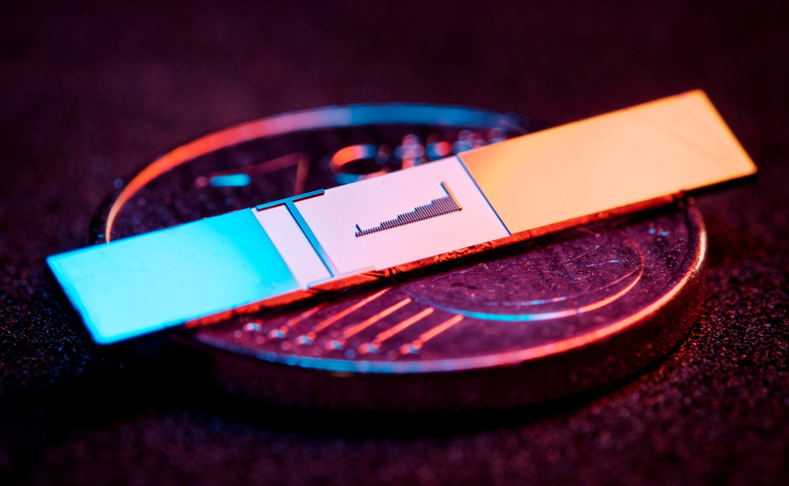
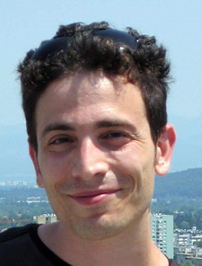

Acceleration structures

Slide 13
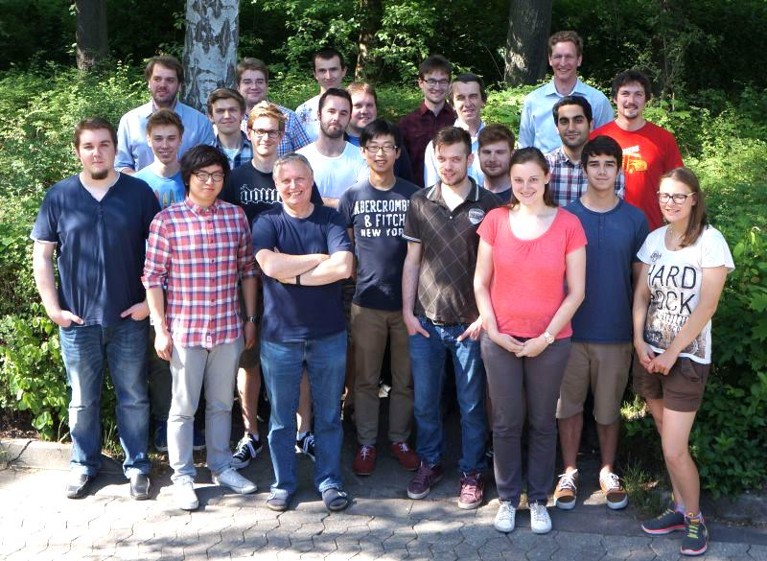
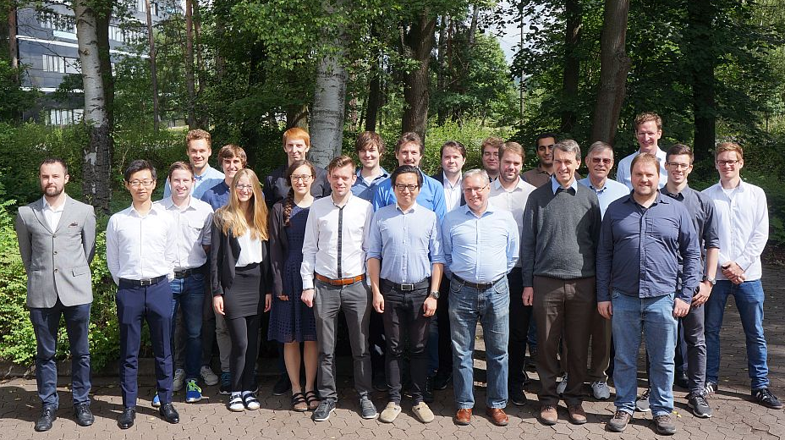
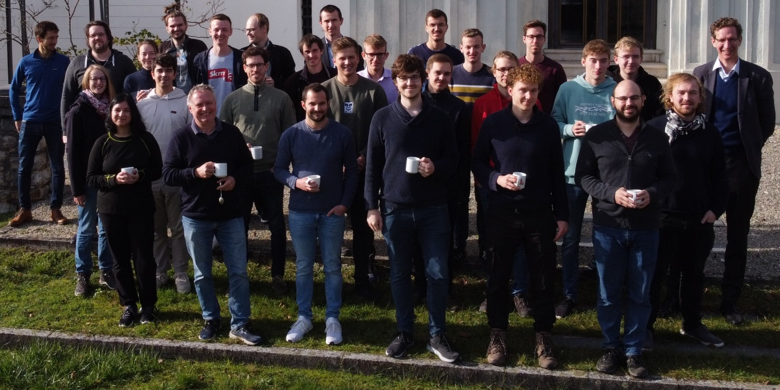
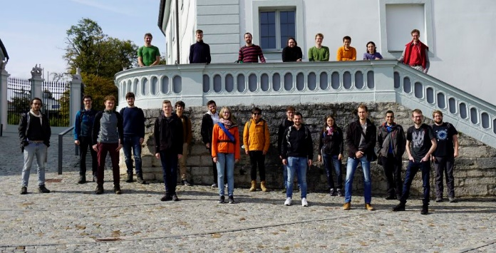













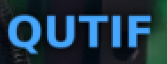
.
Tobias Boolakee
Leon Brückner
Tomás Chlouba
Julian Freier
Jonas Heimerl
Martin Hundhausen
Johannes Illmer
Manuel Konrad
Stefanie Kraus
Julian Litzel
Bastian Löhrl
Felix Lopéz Hoffmann
Matthias Meier
Stefan Meier
Annika Michalak
Jonathan Pölloth
Jürgen Ristein
Roy Shiloh
Franz Schmidt-Kaler
Timo Wirth
Simon Wittigschlager
Open
PhD student and postdoc positions! Pls. get in touch.
FAU’s Laser Physics
Partners/
collaborations:
ACHIP collaboration
iQCE collaboration
J. Rosenzweig, UCLA
I. Franco, Rochester
I. Kaminer, Technion
Ph. Russell, MPL
Th. Fennel, Rostock
A. Leitensdorfer, Konstanz
FAU Applied Physics: H. Weber
M. Kling, LMU/MPQ
R. L. Byer + coll., Stanford / SLAC
C. Lemell, J. Burgdörfer, TU Vienna
M. Stockman^{Ϯ}, Georgia State
G. G. Paulus, Jena
Former members:
PhDs: J. Breuer Ph. Dienstbier M. Förster C. Gerner J. Hammer C. Heide J. Hoffrogge M. Krüger Ang Li M. Schenk M. Seidling T. Paschen A. Tafel N. Schönenberger S. Thomas (Ph. Weber) P. Yousefi R. Zimmermann M. Sirotin
Postdocs: A. Aghajani-Talesh P. Dombi M. Kozák J. McNeur Y. Morimoto T. Higuchi
Master students: D. Ehberger T. Eckstein M. Eisele R. Fröhlich U. Häusler R. Heinreich S. Heinrich H. Kaupp A. Kirchner M. Knauft A. Liehl L. Maisenbacher J. Martinek A. Mittelbach F. Najafi C. Nauk H. Ramadas T. Sattler E. Schmidt J.-P. Stein H. Strzalka Y.-H. M. Tan Di Zhang
Former members (master thesis, PhDs; postdocs):
A. Aghajani-Talesh J. Breuer P. Dombi D. Ehberger M. Eisele M. Förster R. Fröhlich J. Hammer S. Heinrich J. Hoffrogge H. Kaupp M. Kozák M. Krüger A. Liehl J. McNeur
L. Maisenbacher F. Najafi H. Ramadas T. Sattler Ella Schmidt M. Schenk L. Seitz J.-P. Stein H. Strzalka Y.-H. M. Tan S. Thomas Di Zhang
achip.fau.de

