Slide 1
Extended Interaction Length Laser-Driven Acceleration in a Tunable Dielectric Structure
Sophie Crisp
EAAC 2022
September 19th, 2023
Notes:
Add the logos

Slide 2
Acknowledgements
Thank you to:
Pietro Musumeci (UCLA)
Alexander Ody (UCLA)
Joel England (SLAC)
Kenneth Leedle (Stanford)
David Cesar (SLAC)
Eric Cropp (UCLA/LBNL)
Andrew Fisher (UCLA)
Maximillian Lenz (UCLA)
ACHIP grant from the Gordon and Betty Moore Foundation: GBMF4744
U.S. Department of Energy Grant No. DE-AC02-76SF00515
National Science Foundation Graduate Research Fellowship Program under Grant No. DGE-165060
Notes:
Stanford, SLAC logos

Slide 3
Outline
Motivation: Why Dielectric Laser Accelerators
Experimental Setup: Structure, optics, beamline
Results: >1 mm interaction length in a tunable structure
Future: Soft tunable DLA… with 1 MeV energy gain

Slide 4
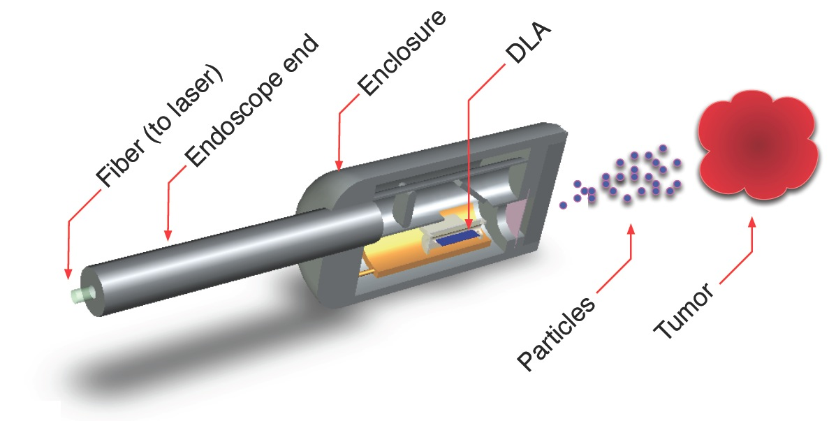
The Case for Smaller Accelerators
Many applications for a compact, ultrafast source:
Catheterized high energy electron source
UED/UEM Source
Compact incoherent x-ray source
Why DLA?
Silicon manufacture is ubiquitous
High damage threshold leads to GeV/m gradients
Laser technology readily available
England et al., Rev. Mod. Phys. 86, 1337 (2014)
England et al., “Dielectric Laser Accelerators”, Snowmass AF6 Meeting (2020)
Notes:
DLA Features:
Compactness (cm Scale)
Efficiency (solid state lasers)
Bunch Format (fC charge, MHz rep rate)
Attosecond Time Scale – intrinsic optical bunching
DLA for HEP:
Works for positrons, better bremsstrahlung, efficiency
https://indico.fnal.gov/event/45651/contributions/197917/attachments/134830/166994/Snowmass_AF6_DLA_England.pdf
Linear Collider:
Key Advantages of Dielectric Laser Accelerator
Linear acceleration mechanism in a static structure with vacuum channel.
Critical technologies (laser development, nanofab) already near LC requirements.
Unique bunch format (fC charge at 10 to 50 MHz rep rate) with beamstrahlung loss ~ 1%
High fiber laser efficiencies (30 to 50% wallplug) facilitate modest power consumption.
tors (DLA) for e+e- linear collider (LC):
Primary Challenges for a DLA Collider:
Small beam apertures à challenge with regard to wakes, halo, and long-distance transport.
Need high-rep (10 – 50 MHz) low charge (fC) normalized emittance (< 1 nm) e- and e+ sources.
Funding for this area of research is not directly focused on HEP applications.
Takeaway Points:
DLA has compelling advantages that position it as a competitive LC technology
Requirements of a LC impose major technical challenges for all advanced concepts
DLA’s challenges are distinct from other concepts but not necessarily less surmountable

Slide 5
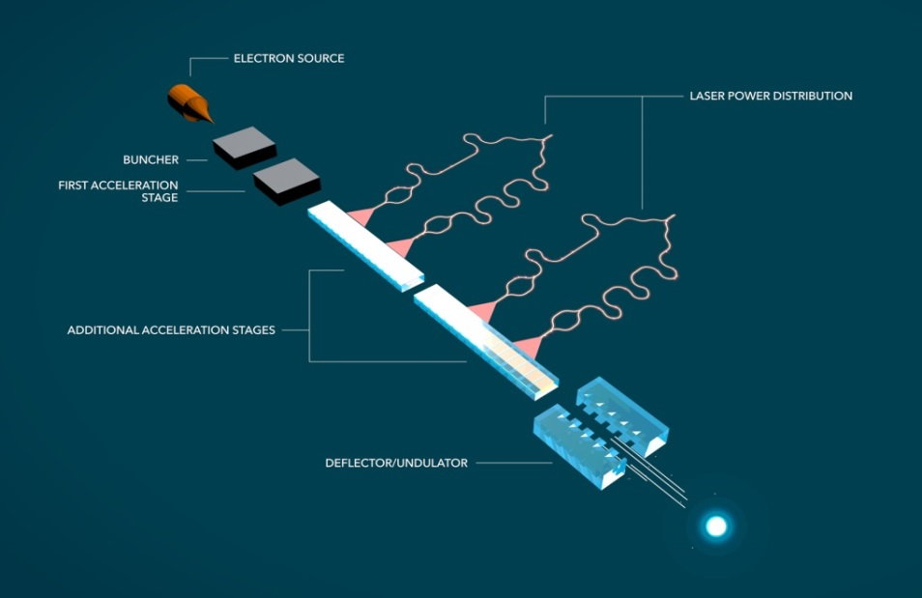
Overview of a Dielectric Laser Accelerator
Hirano et al., “A compact electron source for the dielectric laser accelerator”, Appl. Phys. Lett. (2020)
Schonenberger et al., “Generation and Characterization of Attosecond Microbunched Electron Pulse Trains via Dielectric Laser Acceleration”, Phys. Rev. Lett. 123, 264803 (2019)
Black et al., “Net Acceleration and Direct Measurement of Attosecond Electron Pulses in a Silicon Dielectric Laser Accelerator”, Phys. Rev. Lett. (2019)
Niedermayer et al., “Three Dimensional Alternating-Phase Focusing for Dielectric-Laser Electron Accelerators”, Phys. Rev. Lett., 125, 164801 (2020)
Sapra et al., “On-chip integrated laser-driven particle accelerator”, Science, 367, 6473 (2020)
From SLAC newsroom: “$13.5M Moore Grant to Develop Working ‘Accelerator on a Chip’ Prototype” (November 19, 2015)
Notes:
Aim to achieve entirely on-chip electron source to relativistic electron
So far, each step is being researched independently
Relativistic regime demonstration remains critical to demonstrate scalable accelerator
This is a quick overview of the final concept design of a Dielectric Laser Accelerator. The idea is that you have an entirely on chip electron source by way of nanotips, then a buncher and first accel stage. The buncher and first accel are separated because in the non-relativistic regime maintaining the laser field in sync with the electrons as they swiftly accelerate is extremely difficult. In fact, the part of ACHIP tasked with pursuing this regime is aiming for energy doubling within the next year, from around 100 to 200 keV, but this will merely be a proof of concept for future non-relativistic work. After this, the relativistic regime will require a complex waveguide system to allow power distribution to the accelerator structure. The actual relativistic acceleration component is the subject of this presentation, but research into power distribution is also ongoing.
In Practice, the relativistic structures we are going to talk about today are mostly dual grating structures, illuminated on top by a pulse front tilted IR laser. This PFT provides the necessary phase velocity matching, such that a slice of the electrons travelling through the structure will feel the effects of the laser pulse. These structures tend to be judged by their total energy gain, their ability to couple the incoming laser power to the electron acceleration, and finally when dynamic effects come into play, by their capture rate.

Slide 6
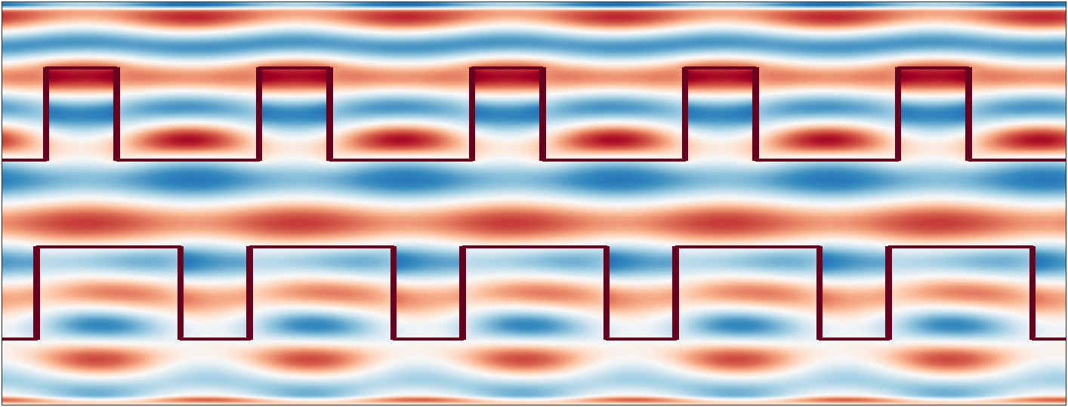
What is a Dielectric Laser Accelerator?
Dual grating (or dual pillar) dielectric structure
Driven by a laser
Excites an evanescent accelerating field of the form
Energy gain limited by the phase matching condition:
$k_{g}−\frac{ω_{l}}{cβ}+$ $\frac{ω_{l}}{c}\sin{θ_{I}}=0$ (ballistic)
Key dimensions:
Structure gap of order of the drive wavelength
Laser wavelength close (or equal) to structure wavelength
Ultrashort (~100fs) laser pulse
$$θ_{PFT}$$
E₀
$$θ_{I}$$
k₀
y
e-
z
Gap
$$λ_{g}$$
Offset

Slide 7
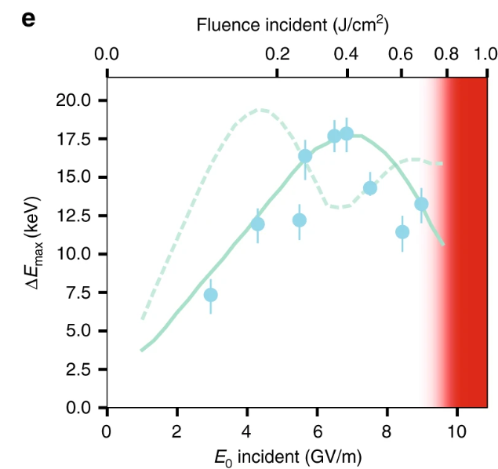
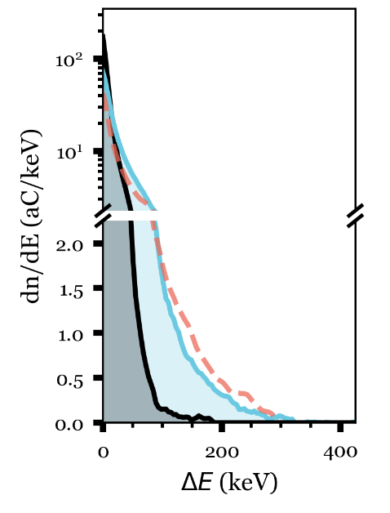
Previously, Record Energy Gain, Gradient Reached at UCLA
Laser, 45fs
1.8 GeV/m Peak Gradient
315 keV energy gain
700 um Interaction Length
$$θ_{PFT}$$
E₀
k₀
y
e-
z
g (= 400, 800 nm)
D. Cesar et al. Opt. Exp., 2018
D. Cesar et al. Communications Physics, 2018
Notes:
PFT imperative to accelerating over long length scales. Previously, 315keV was measured. We seek to reach 1MeV, which will require a much longer interaction. Longer interactions require a number of changes, some simple, like increasing the energy via a new laser, and some more complicated, obtaining a structure longer than 1mm with the requisite gap, 800 nm, and compensating for dynamic effects in this energy regime.
Our goal is to extend this interaction length beyond 1mm, and towards 2cm. This requires

Slide 8
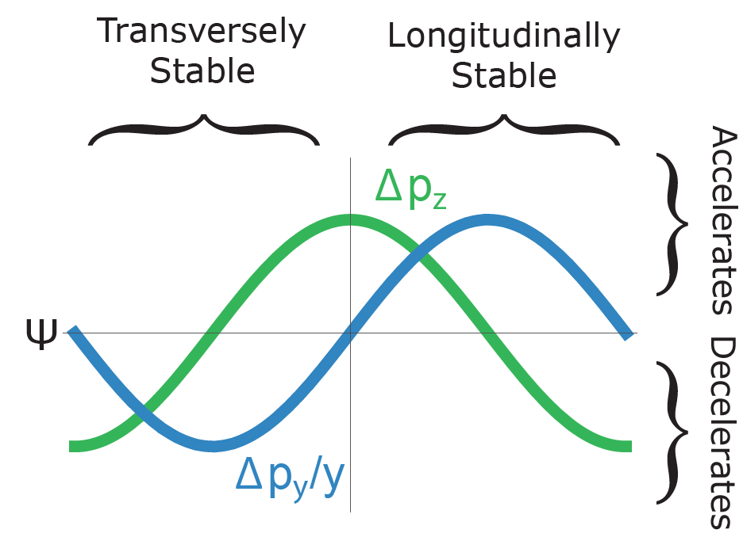
Limiting Factors for MeV Energy Gain
Total structure length
Laser-electron interaction time
Dynamic effects – over longer lengths, e- will defocus
$$θ_{PFT}$$
E₀
$$θ_{I}$$
k₀
y
e-
z
Gap
1mm
$$λ_{g}$$
Offset

Slide 9
Extending Structure Length Proved Non-Trivial
Thin film interference shows bonding was non-uniform, introducing many microns of separation

Slide 10
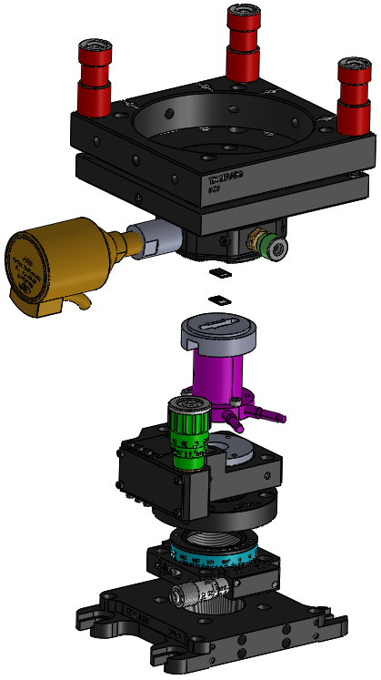
4mm Tunable Structures Have Been Assembled
Course x’, z’, y
Commercial gratings are mounted entirely independently
Lower grating is mounted on a 3-piezo stage with 12um total travel, to nm precision alignment
Fine z
Course x
4mm
Fine y, x’, z’
(12um range)
4mm
Coarse y
y
y’
z
x
Cite ipac proceedings
Notes:
Explain why we’ve gone down the route of assembling the structures ourselves – difficulty of bonding the structures; only functional structures were Peralta’s
Flatness established via coarse cage alignment and 3 12 um range PI piezos by removing visible fringes
Lack of fringes indicates <0.02 mrad flatness, 20 nm deviation along 1 cm window

Slide 11
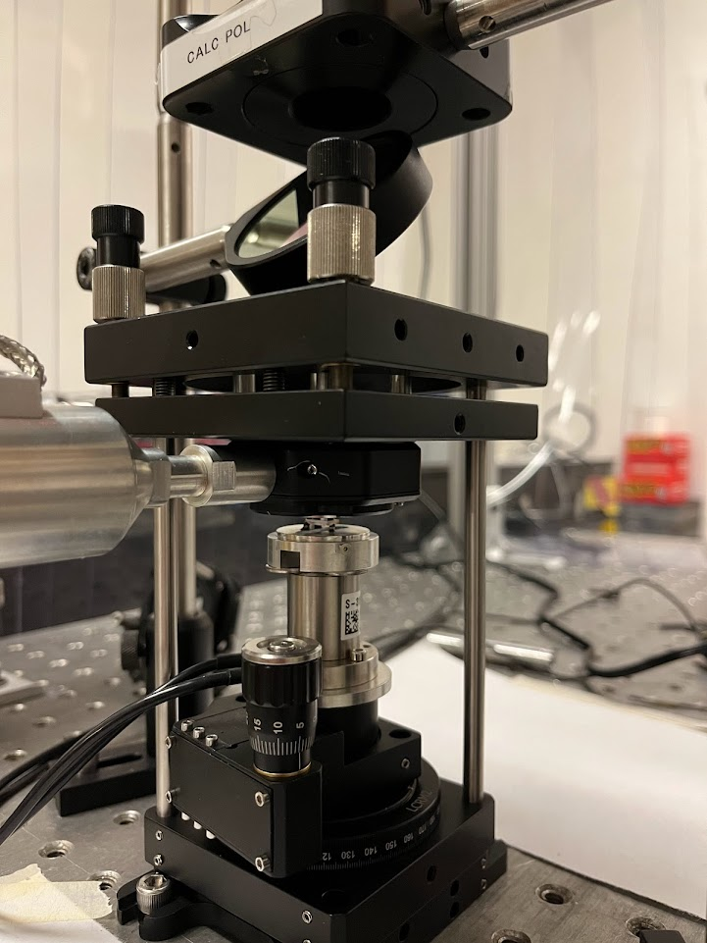
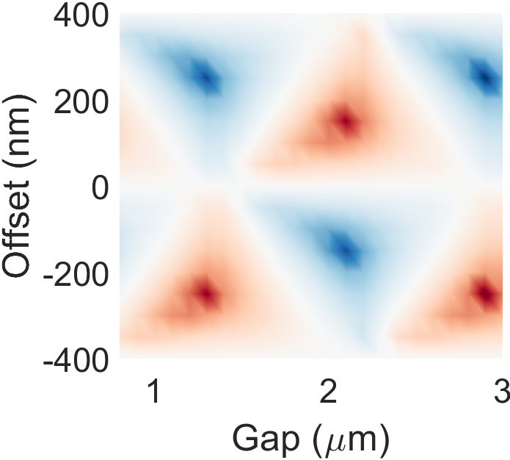
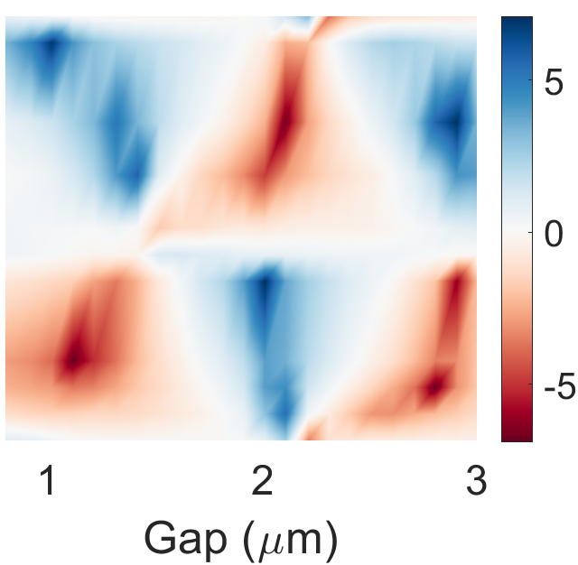
Structures are Characterized Optically
635 nm diode laser characterization
Diffraction based diagnostic using the ratio of m = $±$ 1 diffraction orders
Notes:
Only two plots, plus structure factor sim (define structure factor)

Slide 12
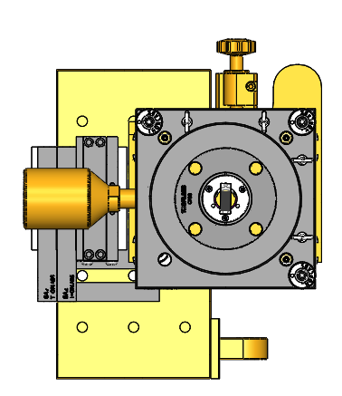
Experiments Take Place at the Pegasus Beamline
Vacuum Chamber
ICCD
YAG
Screen
Quad
Triplet
Quad
Doublet
Gun
Solenoid
Solenoid
LINAC
Dipole
e⁻
e⁻
6 MeV
DLA Stage
DLA Stage

Slide 13
Experiments Take Place at the Pegasus Beamline
Vacuum Chamber
ICCD
YAG
Screen
Quad
Triplet
Quad
Doublet
Gun
Solenoid
Solenoid
LINAC
Dipole
e⁻
e⁻
6 MeV
DLA Stage
DLA Stage
Key Parameters:
1 pC
$σ_{x}=100 μm$
6 MeV

Slide 14
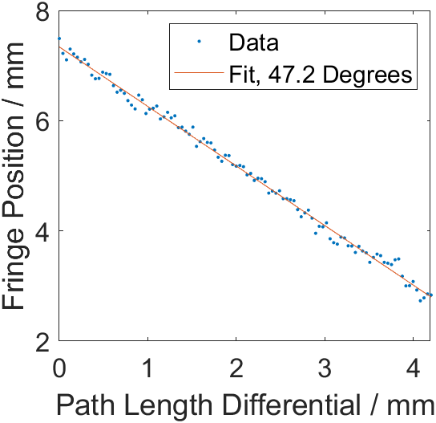
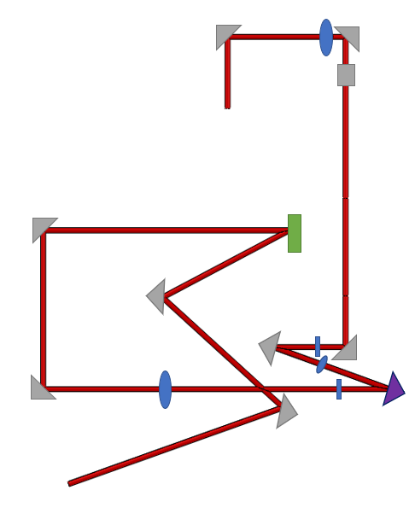
Pulse Front Optical System is Employed
Vacuum Chamber
ICCD
YAG
Screen
Vacuum Chamber
Quad
Triplet
Quad
Doublet
Gun
Solenoid
Solenoid
LINAC
Dipole
e⁻
e⁻
6 MeV
DLA Stage
3 Imaging Planes
Not pictured: parallel flat laser line
enables interferometric measurement of PFT
Grating
600 ln/mm
Fringe Position
Piezo
Mirror
Laser
HWP + PBS
D. Cesar et al. NIM A, 2018
Notes:
Optical system features:
600 ln/mm imaged in 2.08:1 configuration to enable 44.3 degree pulse front tilt
3 imaging planes: PFT grating, piezo mirror, dla interaction point

Slide 15
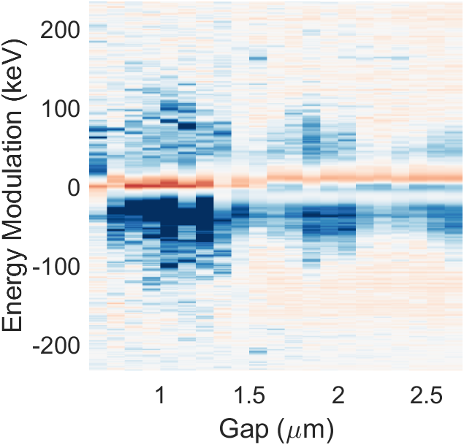
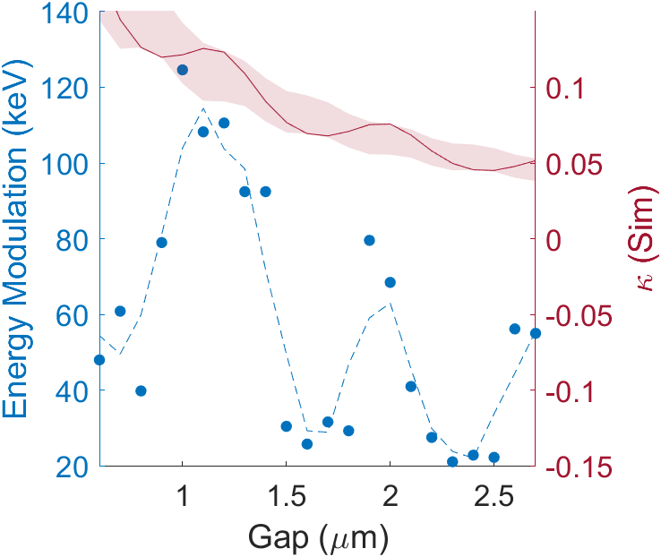
Structures are tunable on the nm scale
FOM (Laser On – Laser off / noise)
Peak depletion
Clear transmission depression at periodic gaps

Slide 16
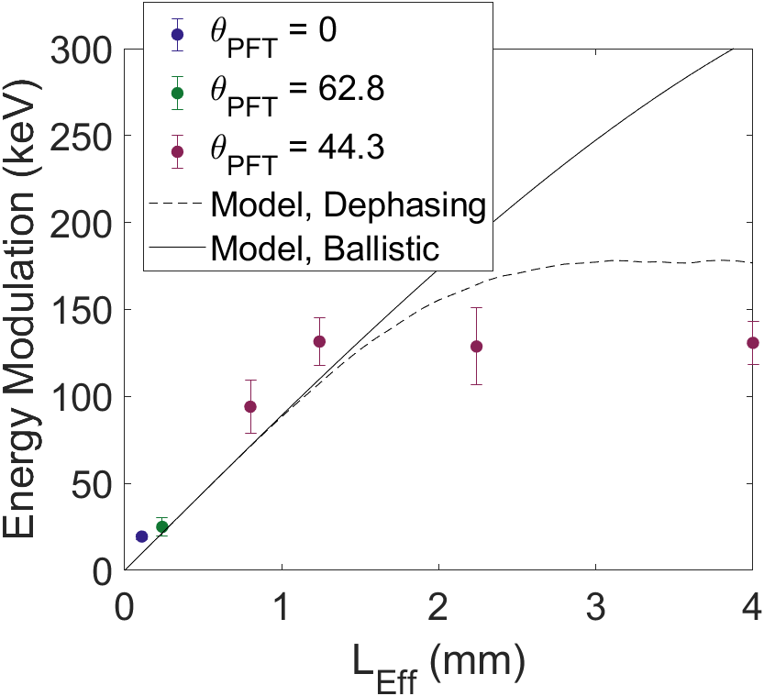
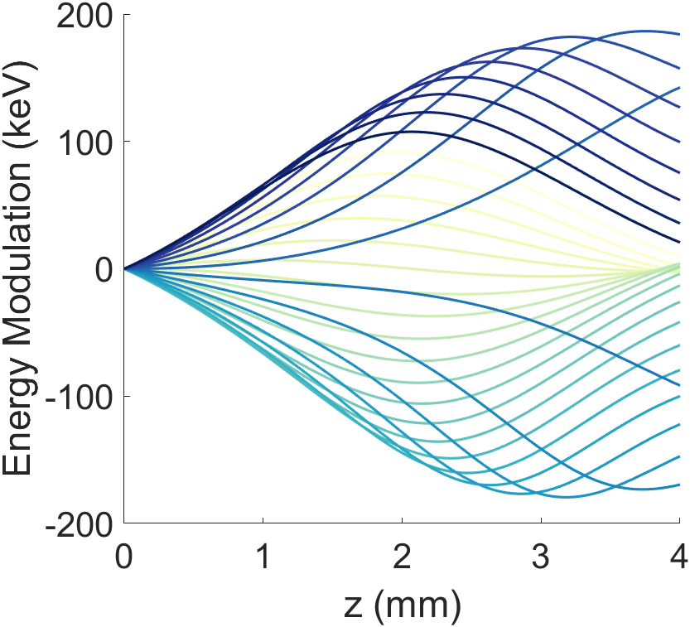
Observed energy gain over up to 1.24 mm

Slide 17
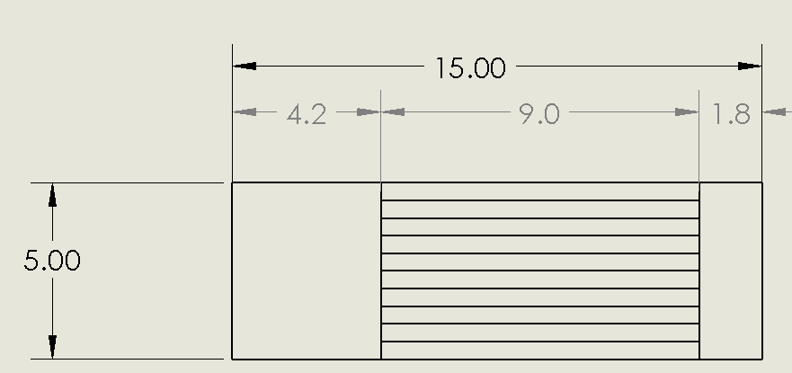
What is Next? The Journey to 1 MeV
Optical system – implementing phase control (just swap a mirror for an SLM)
Structure – custom gratings have already been obtained, mounting in progress
4 mm -> 5 mm
Asymmetric structures
Laser

Slide 18
Conclusion
Demonstrated nm-scale tunable structures
Optical diagnostic allows for out of vacuum structure building
Piezo mounting allows for in-situ tuning for maximal modulation
Demonstrated longest (to our knowledge) interaction in a DLA
On the way:
Implementation of Soft Tuning to Address Dephasing and Defocusing

Slide 20
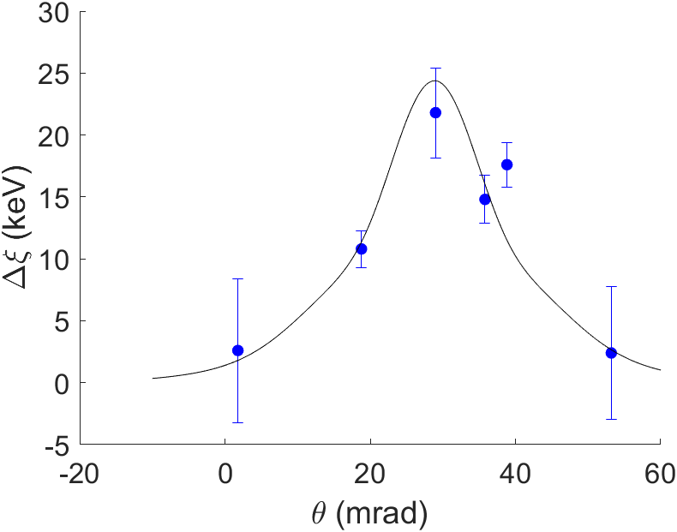
Phase Matching in the Ballistic Model
E₀
k₀
$$θ$$
$k_{g}−\frac{ω_{l}}{cβ}+$ $\frac{ω_{l}}{c}\sin{θ}=0$
For a 780 nm laser and 800nm grating, phase advance over a grating period is satisfied by $θ=29$mrad

Slide 21
Structure Parameters
Parameter | Value
Grating Periodicity | 800nm
Tooth Height | 855 nm
Tooth Width | 536 nm
Gap Size | 800nm->6um

Slide 22
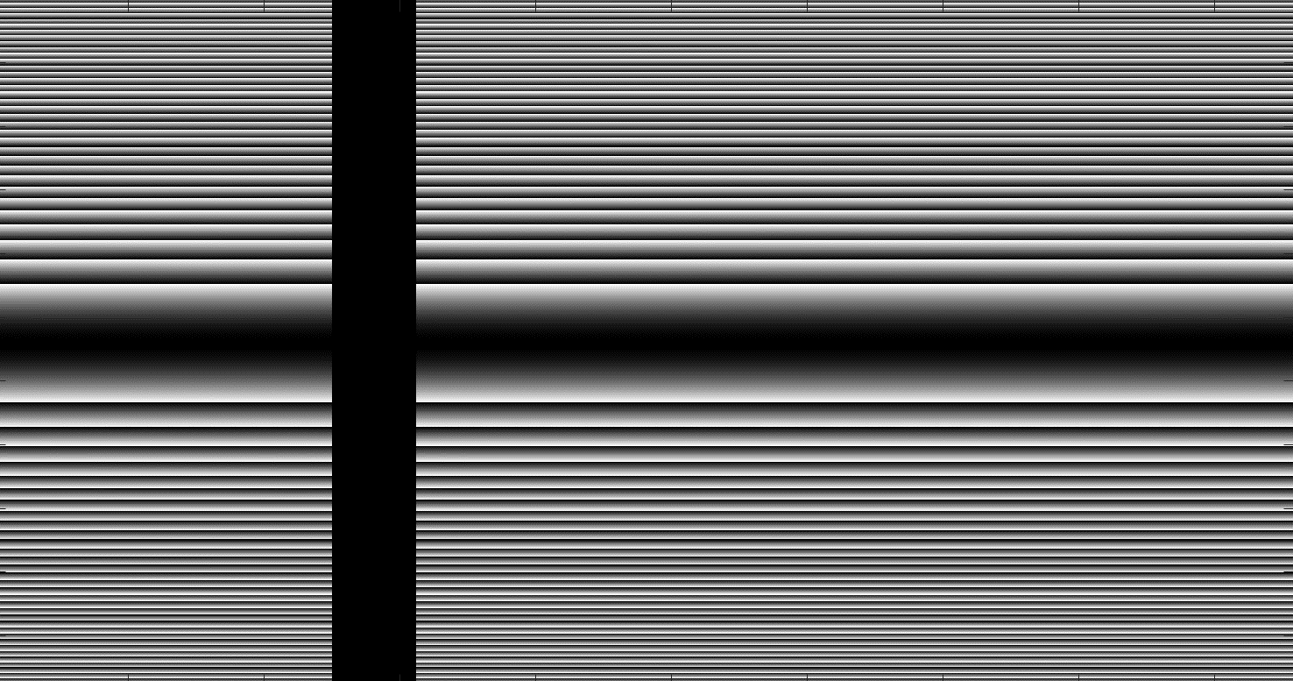
Soft Tuning of Phase and Amplitude
Grating profile is imaged onto spatial light modulation (SLM), and then sample plane, for requisite pulse front tilt
Liquid crystal mask is imaged in the electron travel direction, so any profile can be transported to the electrons
By not imaging in the transverse dimension, we can introduce amplitude modulation
Drift
Fresnel Lens
Grating
Lens
SLM
20mJ
Ti:Sapphire
12 m
Transport
DLA Plane
Telescope

Slide 23
Alternate phase focusing allows acceleration over mm-scale interactions
Spatial Harmonic based simulation code to test possible phase and amplitude modulation
Based on Ody, A et al., NIMA, 1013, 165635 (2021) and Niedermayer et al., Phys. Rev. Lett., 121, 214801 (2018)
Parameter | Value
Initial Energy | 6.5 MeV
Emittance | 0.5 nm
Laser Wavelength | 780 nm
Peak Field | 2 GV/m
Buncher Length | 0.15 mm
Resonant Phase | -$π$/4
Energy Gain | 4.8 MeV
Percent Capture | <7%
Notes:
Ody, A et al., NIMA, 1013, 165635 (2021)
Site uwe, too
If there is no phase modulation, capture rate is 0; some particles are focused, but none reach the top energy

Slide 24
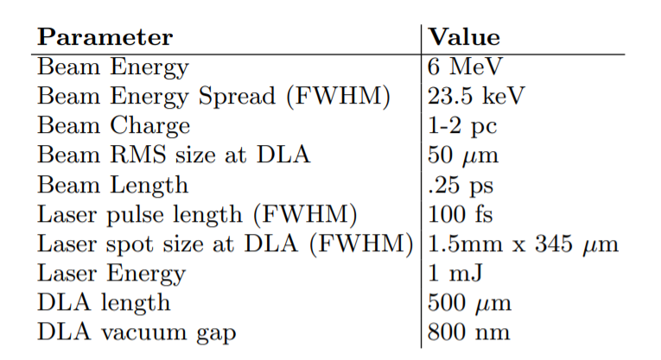
Modulation Recovered using Peralta Dual Grating Structures
Mismatched: 780nm laser wavelength, 800nm grating wavelength
E₀
k₀
$$θ$$
Phase matching condition
$k_{g}−\frac{ω_{l}}{cβ}+$ $\frac{ω_{l}}{c}\sin{θ}=0$
satisfied here by $θ=29$mrad
600MeV/m gradient established, with a structure factor of 0.18
Notes:
Delta csi
Maximum Incident Intensity = 193 mJ/cm^2
For this experiment, the phase matching condition
$k_{g}−\frac{ω_{l}}{cβ}+$ $\frac{ω_{l}}{c}\sin{θ}=0$
is satisfied by $θ=29$mrad
By operating at an angle 10mrad below this, the Kerr effect saturation occurs at higher incident field
$$ΔΦ= n_{2}Ik_{0}d$$
600MeV/m gradient established, with a structure factor of 0.18

