Slide 1
Current status and future development of high-power lasers at FSU Jena and HI-Jena
Malte C. Kaluza
Helmholtz-Institute Jena, Germany
Friedrich-Schiller-University Jena, Germany
6th EAAC, September 19th 2023

Slide 2
Outline
High-power lasers: indispensable research tool for developing & realizing novel particle-acceleration scenarios
Adapt laser infrastructure to intended applications:
own in-house laser development program @ HI-Jena and IOQ Jena
Currently operating high-power lasers at HI-Jena/IOQ Jena:
  JETi200 and POLARIS
  stand-alone probe pulse laser JETi ONE
Future plans:
  synchronization of existing 3 ultra-short high-power laser systems for
  multi-beam experiments in new target area
  program for laser-development of
  ultra-short, >1 TW laser system @ 2.4 µm

Slide 3
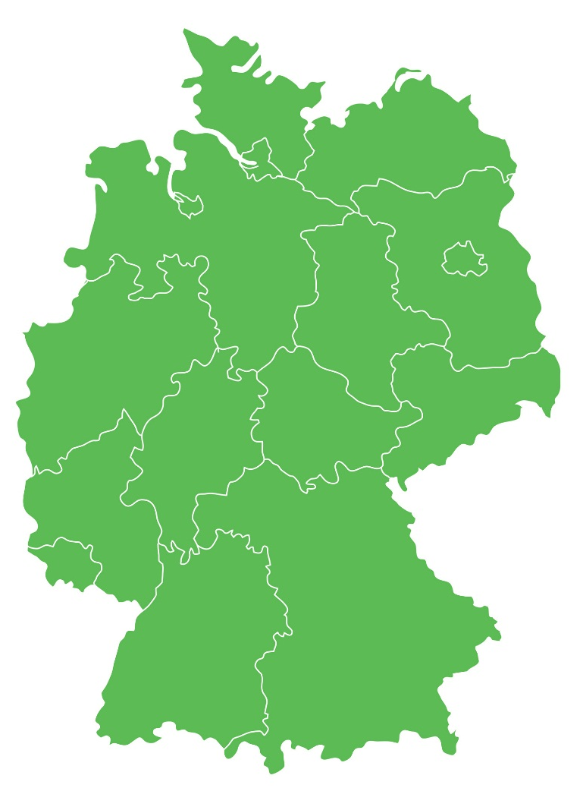

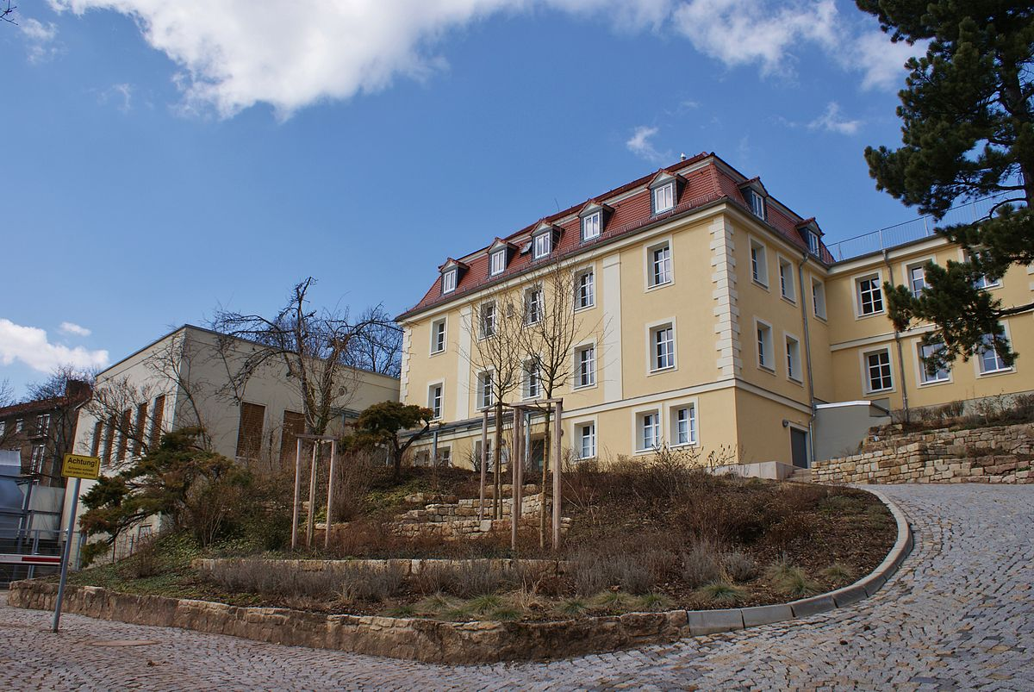




Helmholtz-Institute Jena and IOQ Jena
Close collaboration between HI-Jena
and Institute of Optics and Quantum
Electronics, FSU Jena
Notes:
Thomas Stöhlker, Friedrich Schiller Universität, GSI parental instute accounting/ legal department done via GSI /mothership, but local administration -> head Thomas
Additional partner institutes are the Helmholtz centers DESY and HZDR.

Slide 4
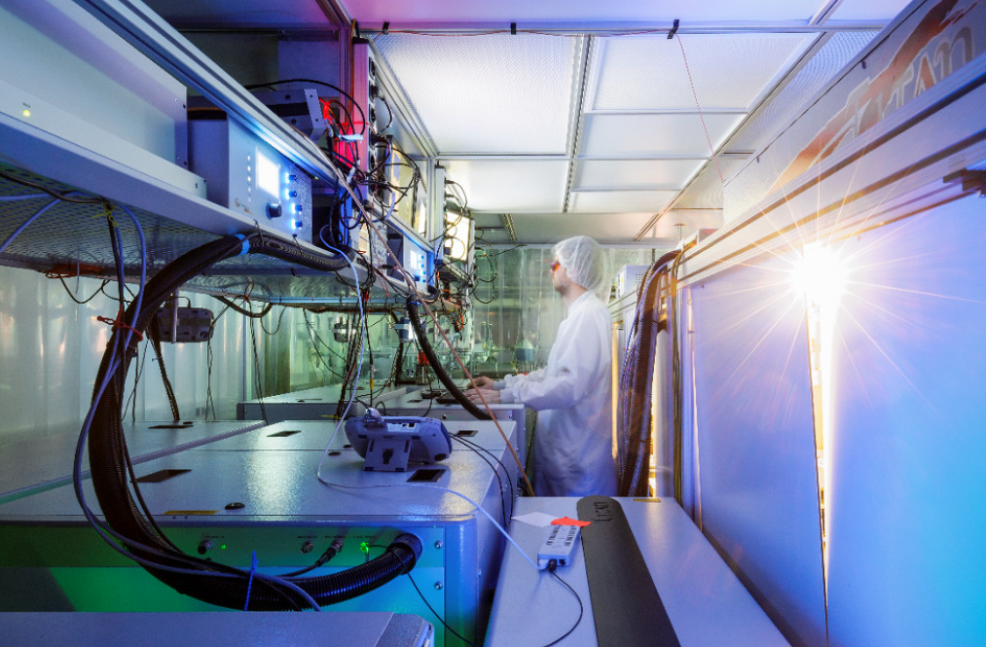
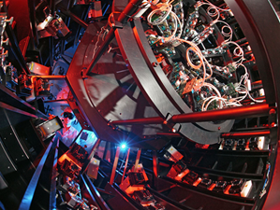
High intensity lasers @ HI Jena & IOQ (2023)
JETi200
POLARIS
Wavelength: 800 nm
Energy on target: 5 J
Pulse duration: 17 fs
Peak power: 300 TW
Repetition rate: 5 Hz
Wavelength: 1030 nm
Energy on target: 16.7 J (54 J)
Pulse duration: 98 fs
Peak power: 170 TW
Repetition rate: 1/50 Hz
Large-scale research program carried out with each laser, both systems equipped with their own few-cycle probing systems.

Slide 5
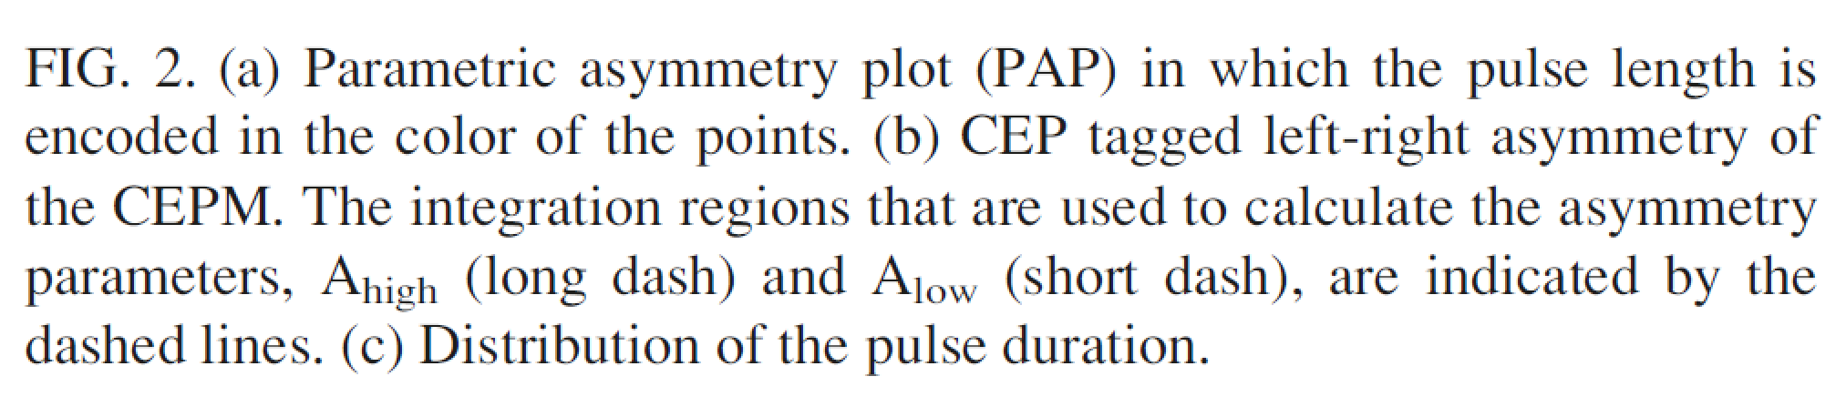
Short Probe Pulses for Few-Cycle Microscopy
Generation & characterization of synchronized few-cycle probe pulses
Neither feasable nor economic for multi 100 TW and PW class laser systems.
De-couple main laser pulse and probe beam completely.
M.B. Schwab et al. APL 103, 191118 (2013)
D. Adolph et al. APL 110, 081105 (2017)

Slide 6

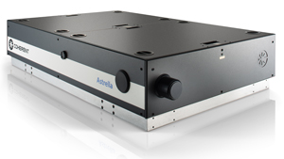
High intensity lasers @ HI Jena & IOQ (2023)
JETi200
JETi ONE
POLARIS
Wavelength: 800 nm
Energy on target: 5 J
Pulse duration: 17 fs
Peak power: 300 TW
Repetition rate: 5 Hz
Wavelength: 0.8-7 µm
Energy on target: 0.5 mJ
Pulse duration: few cycle
Peak power: 0.1 TW
Repetition rate: 1 kHz
Wavelength: 1030 nm
Energy on target: 16.7 J (54 J)
Pulse duration: 98 fs
Peak power: 170 TW
Repetition rate: 1/50 Hz
Goal: synchronization of all lasers <20 fs (rms)

Slide 7
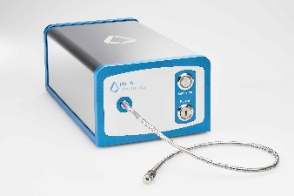



State of the art synchronization < 20 fs (2025)
MASTER oscillator @ 1550 nm
(lowest noise)
stabilized optical fiber links
JETi ONE
JETi200
POLARIS
New 140 m² Target Area

Slide 8
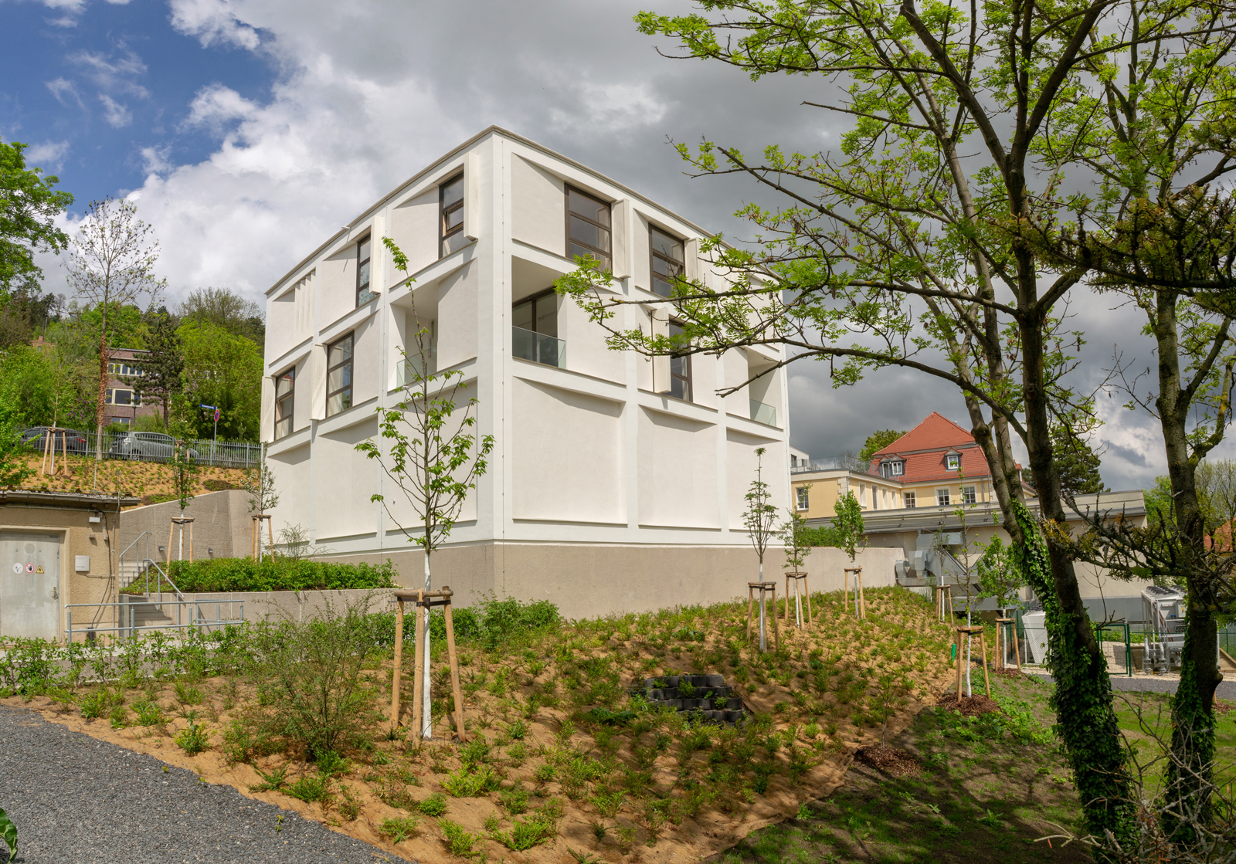


HI Jena extension
New 140 m² Target Area

Slide 9
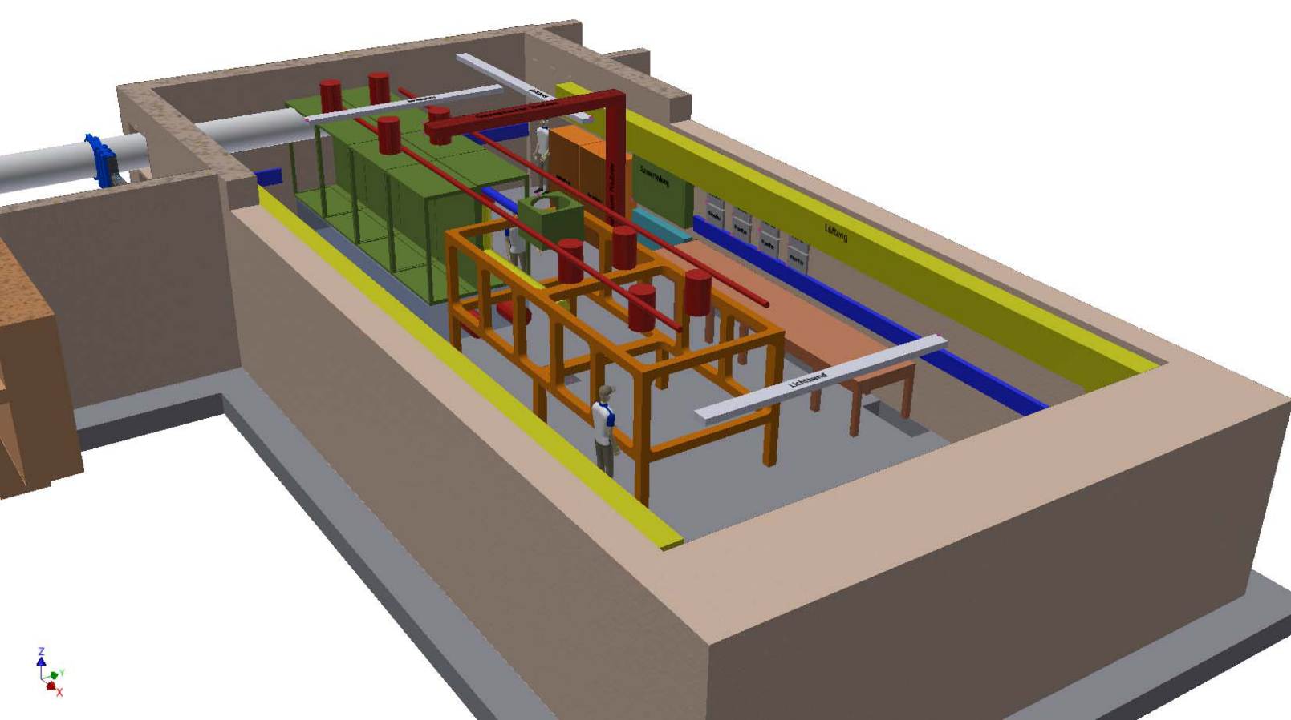
New Target Area
Beam shaping chamber
6 m x 2 m x 2 m
Experimental chamber
6 m x 2.5 m x 1 m
17 m
8 m

Slide 10
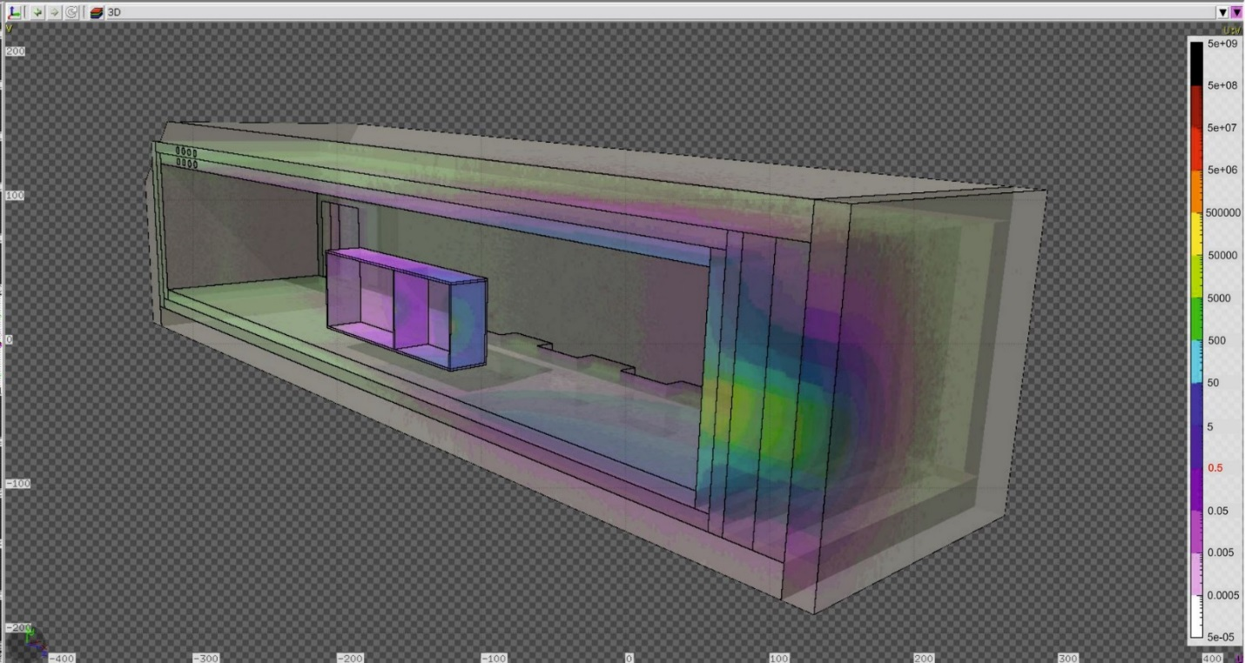
Radiation safety calculations: 10 GeV electrons
Electron beam
10 GeV

Slide 11
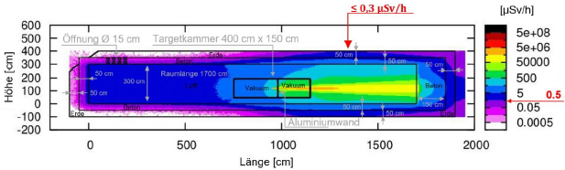
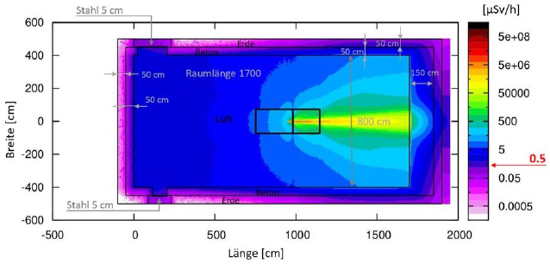
Radiation safety calculations: 250 MeV protons
Background radiation

Slide 12
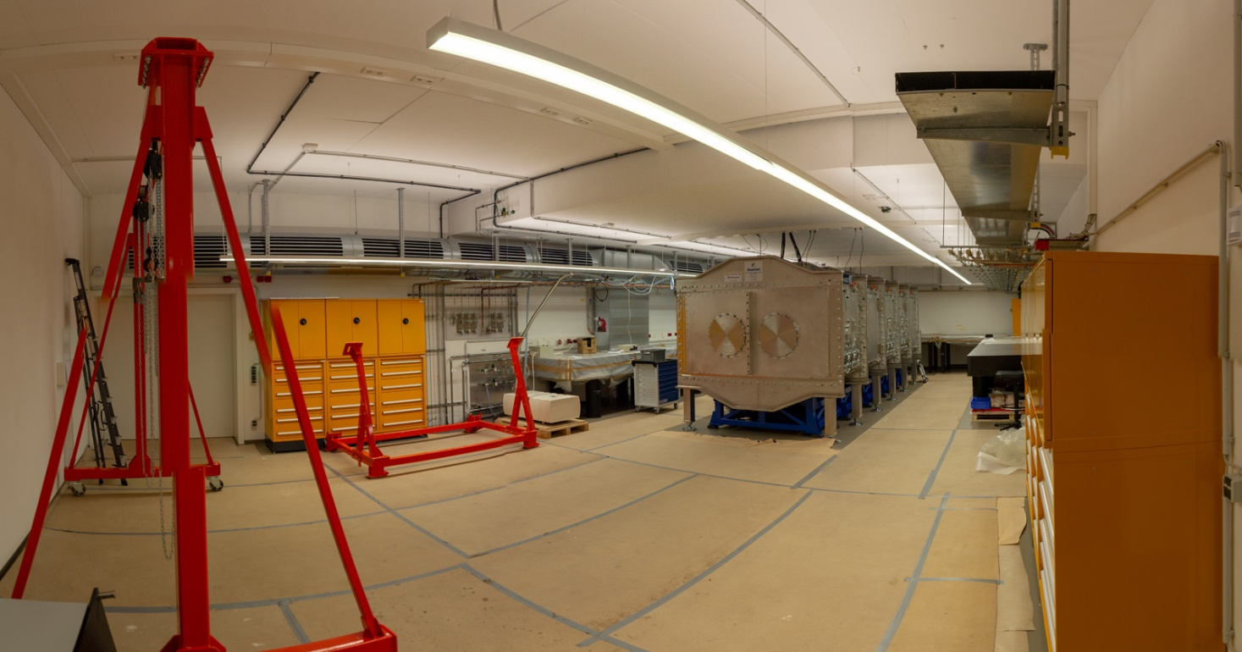

New Target Area (May 2023)
Experimental target chamber by
6 m x 2.5 m x 1 m

Slide 13
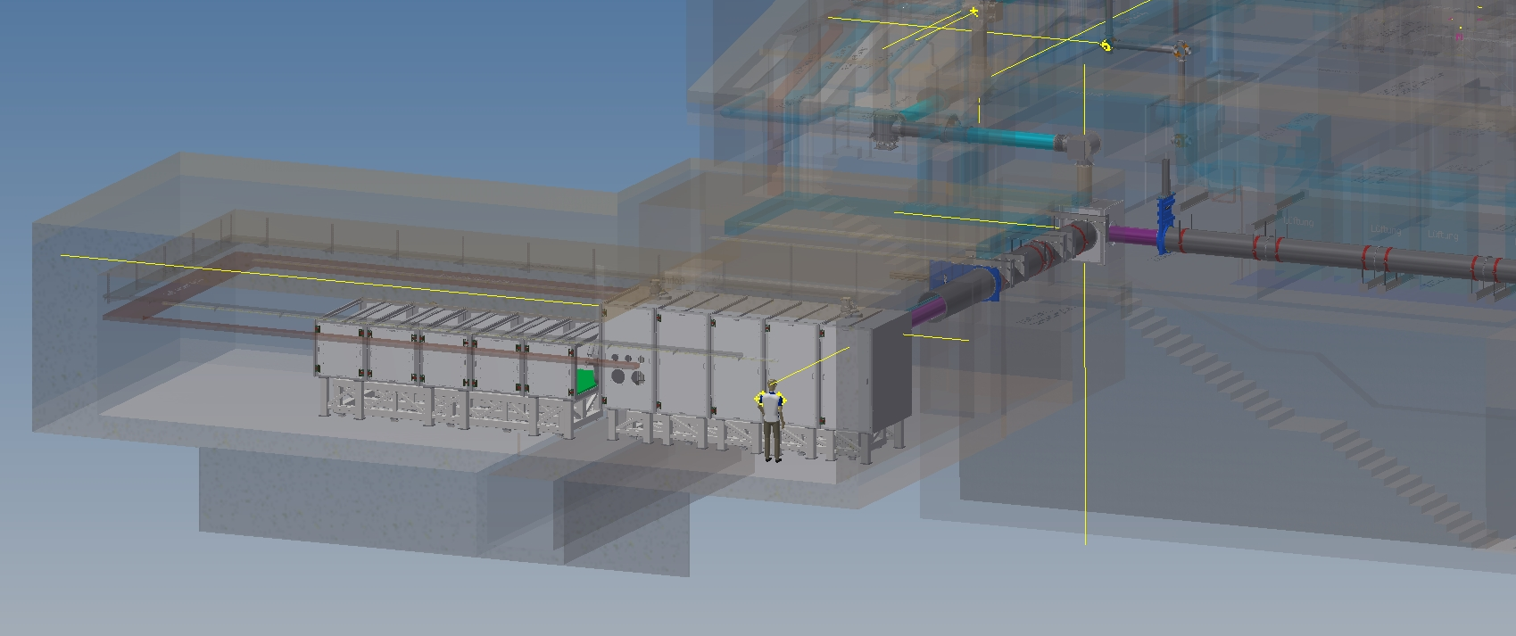
Target Area Fraunhofer -TAF
Experimental chamber
6 m x 2.5 m x 1 m
Beam-shaping chamber
6 m x 2 m x 2 m

Slide 14
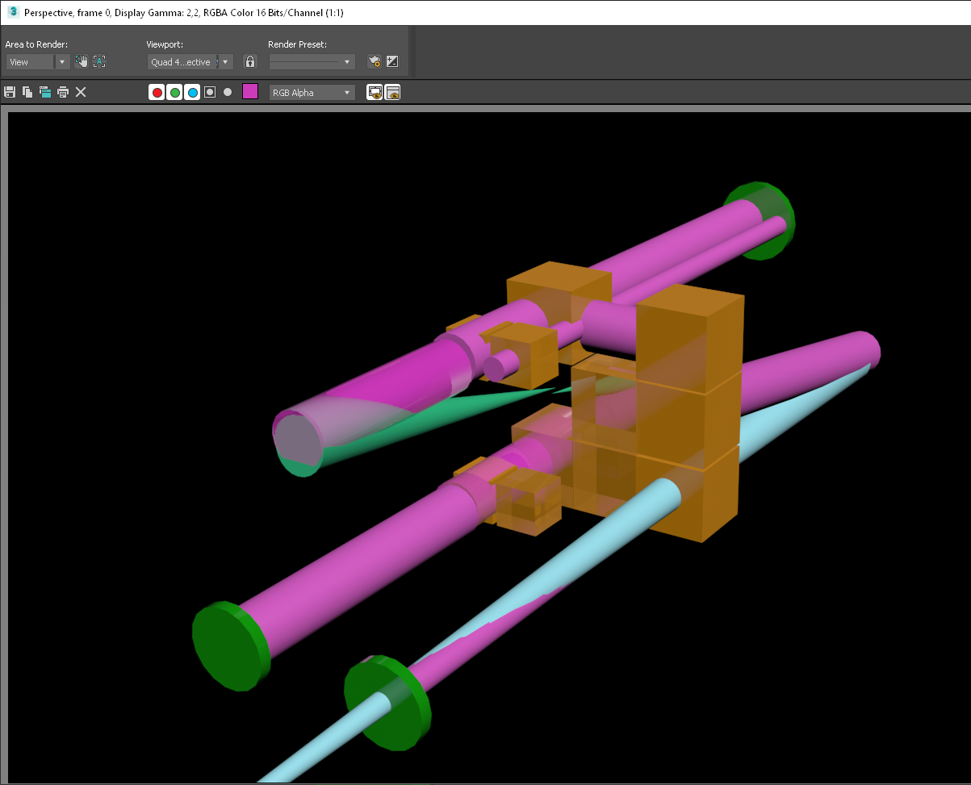
Beam-shaping chamber
Beam-shaping chamber with
switch yard capabilities:
double plasma mirror for POLARIS or JETi200
long focal length (up to 17 m) option for POLARIS or JETi200
pulse shortening stage to decrease pulse duration and increase peak power
POLARIS: < 30 fs
JETi200: < 10 fs
sp.kard
s.fix
b.fix
b.fix
s.fix
b.fix

Slide 15
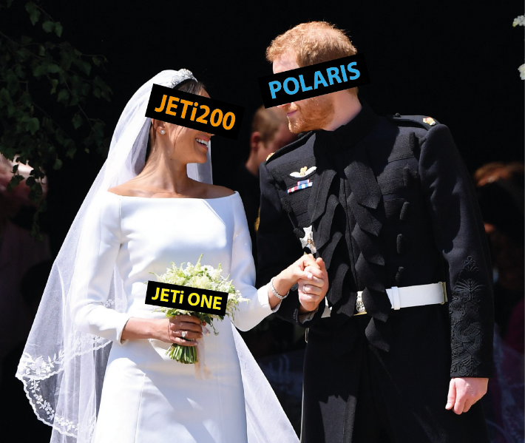
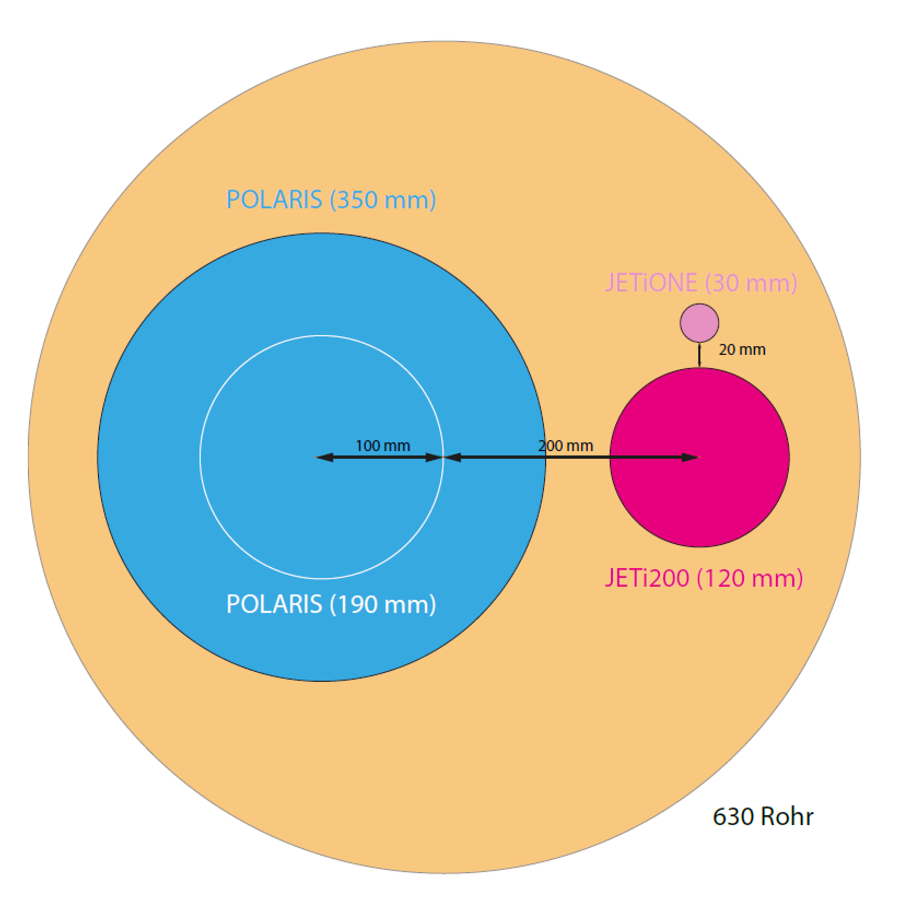
Target Area Fraunhofer -TAF
JETi 200
JETi ONE
POLARIS
wedding chamber
Experimental chamber
6 m x 2.5 m x 1 m
Beam-shaping chamber
6 m x 2 m x 2 m
Spatial and temporal overlap between POLARIS and JETi 200 laser pulses needs to be ensured.

Slide 16
Summary & Outlook I
Major upgrades for all laser systems at HI Jena are under way.
First combined experiments in new target area in 2025.
Active space time stabilization is needed due to long beam paths and separat building for laser systems and target area.
Implement Machine Learning techniques to compensate jitter and drift and overcome the challenge of the wide range of repetition rates.

Slide 17
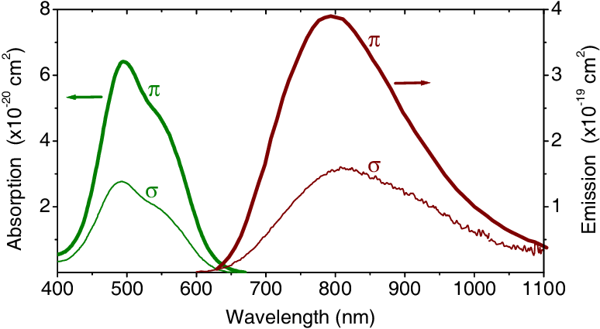
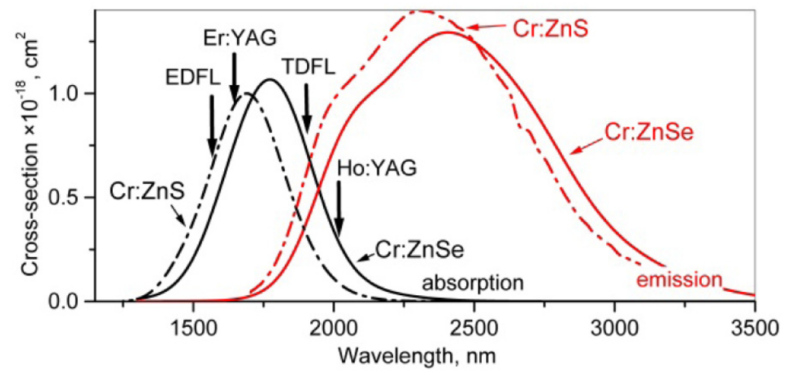
High-power laser development at 2.4 µm
Comparison:
Ti:Sapphire
Cr:ZnS or Cr:ZnSe
Peak absorption: 6x10⁻²⁰ cm² @ 500 nm
Peak emission: 39x10⁻²⁰ cm² @ 800 nm
Fluorescence lifetime: 3.2 μs
Peak absorption: 100x10⁻²⁰ cm² @ 1700 nm
Peak emission: 130x10⁻²⁰ cm² @2400 nm
Fluorescence lifetime: 5.5 μs

Slide 18
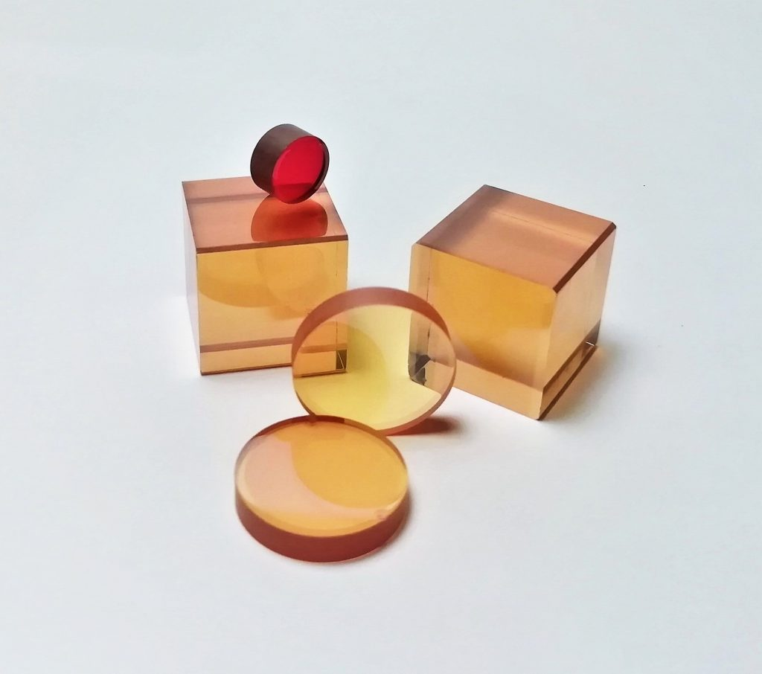
High-power laser development at 2.4 µm
Cr:ZnS or Cr:ZnSe
Vibronic broadening
ceramic and mono crystalline available
doping concentrations: 6x10¹⁸ /cm³
good thermal properties
refr. index n = 2.44 @ 2400 nm
Goal: 100 mJ in 100 fs → 1TW
saturation fluence + LIDT:
CPA with >100 ps stretching
Peak absorption: 100x10⁻²⁰ cm² @ 1700 nm
Peak emission: 130x10⁻²⁰ cm² @2400 nm
Fluorescence lifetime: 5.5 μs

Slide 19
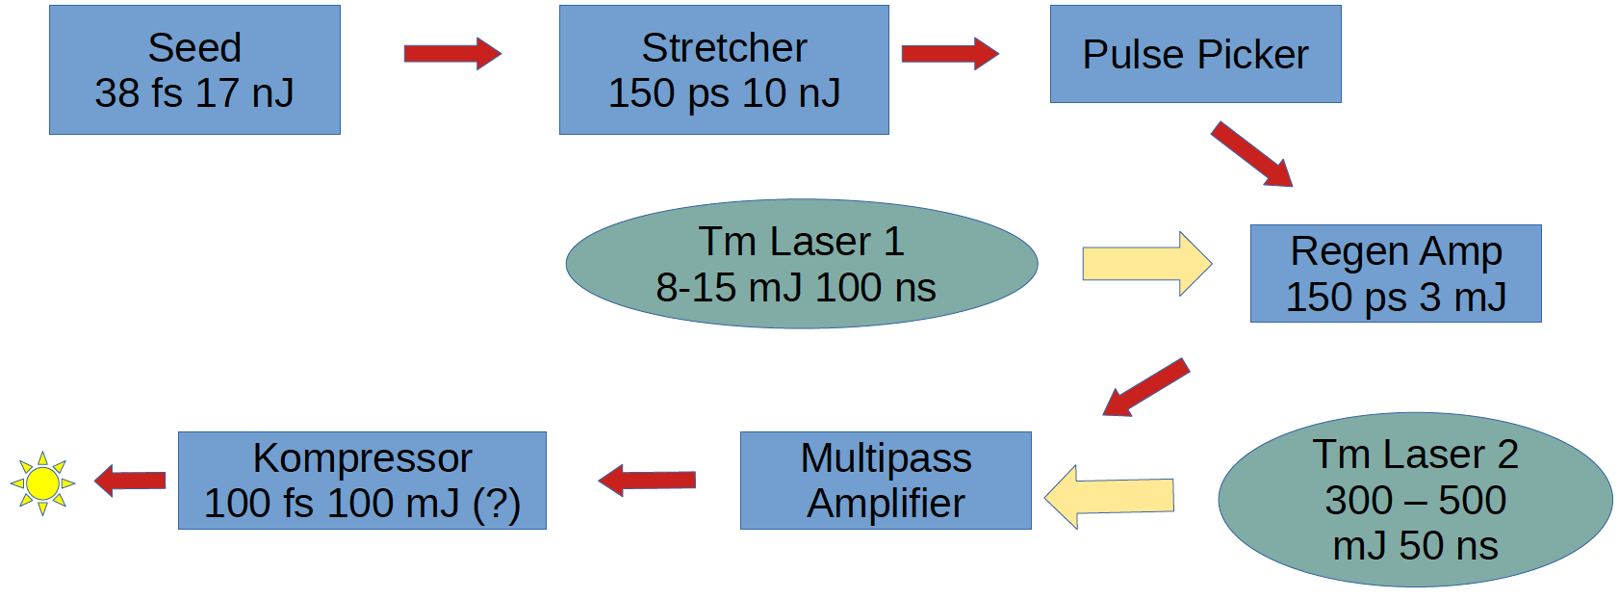
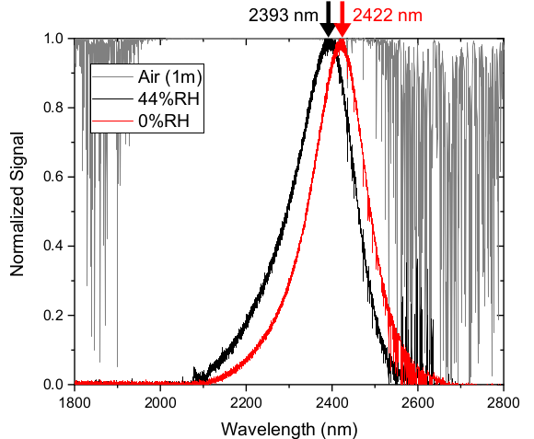
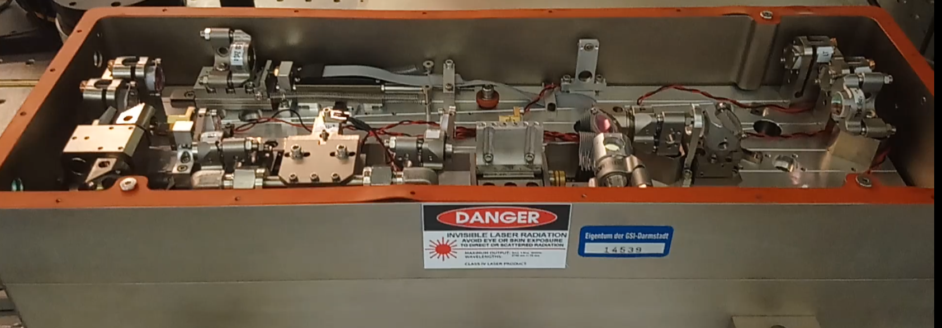
High-power laser development at 2.4 µm
Planned setup:
Seed laser:
Cr:ZnSe based Kerr Lens mode locked Erbium fiber pumped laser head
Central wavelength: 2.4 µm
Pulse duration: 38 fs
Pulse energy: 17 nJ
Rep rate: 79 MHz

Slide 20
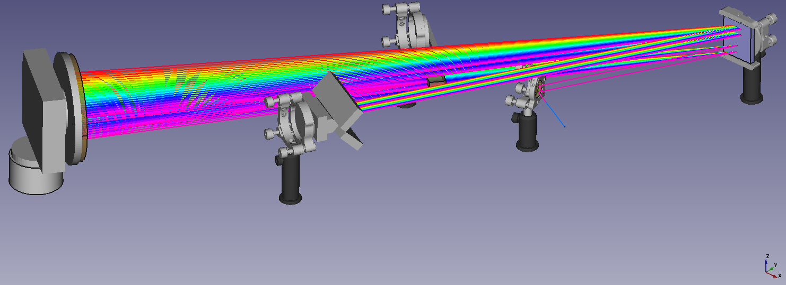
High-power laser development at 2…4 µm
Pulse stretcher: is currently setup
Stretching factor: 38 fs -> 150 ps
Grating efficiency: 90% per pass (65% overall)

Slide 21
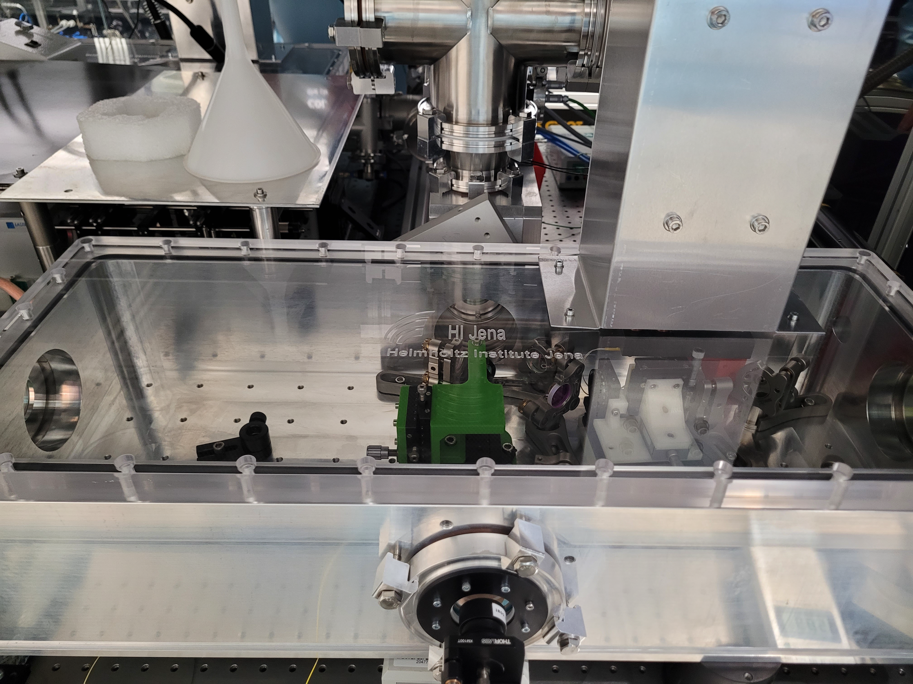
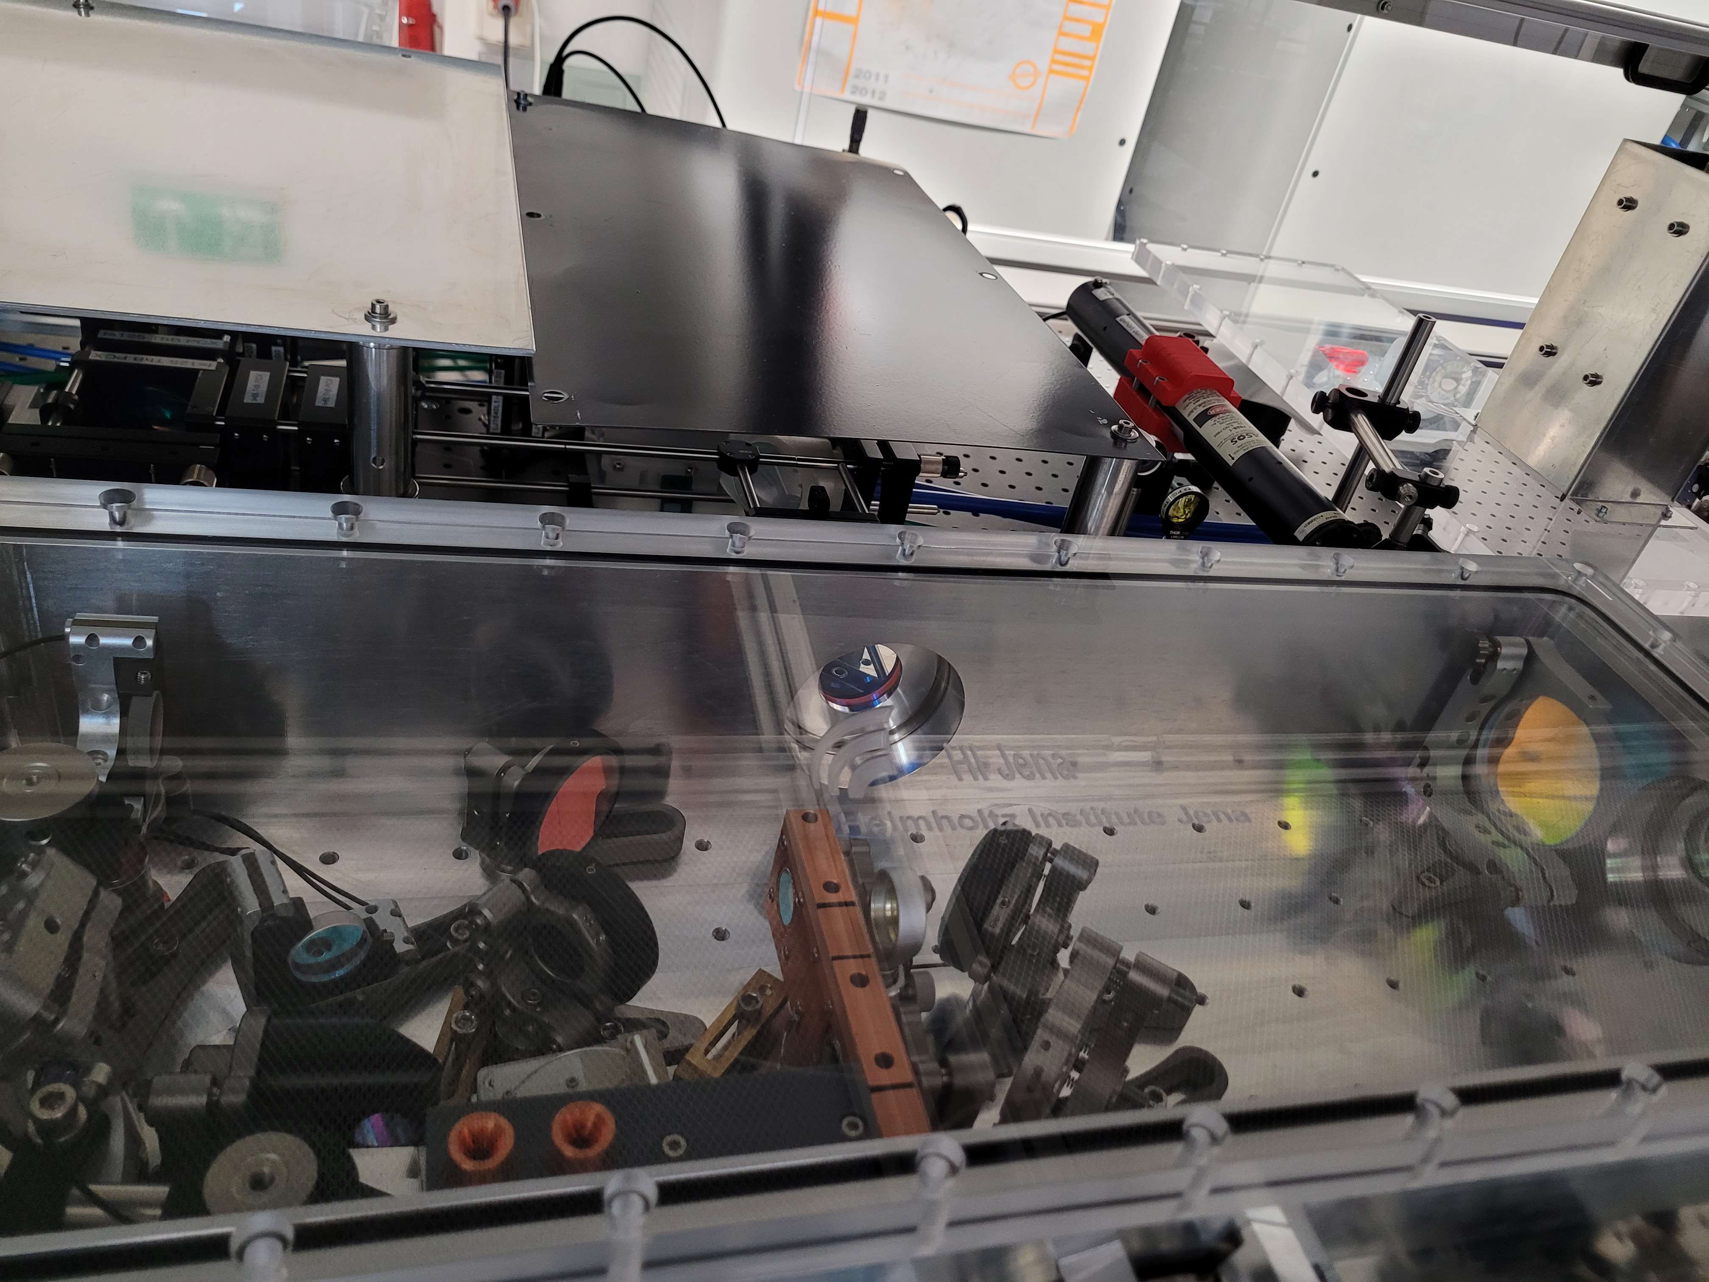
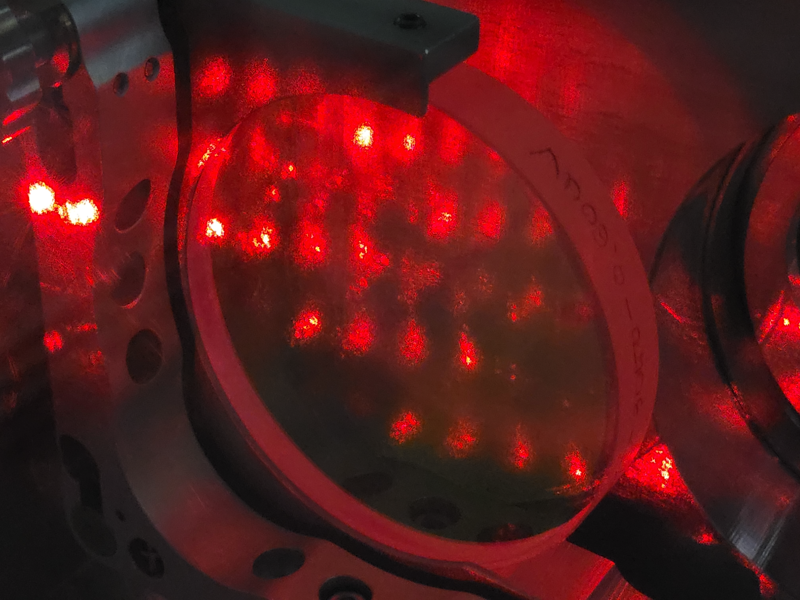
High-power laser development at 2.4 µm
Tm:YAG-pump lasers (2 stages):
Pump laser for first CPA amplifier:
Diode-pumped, cryogenically cooled Tm:YAG
pulse energy: 15 mJ
pulse duration: 100 ns
1883 nm wavelength
Pump laser for second CPA amplifier:
pulse energy: 300 mJ
pulse duration: 100 ns
1883 nm wavelength

Slide 22
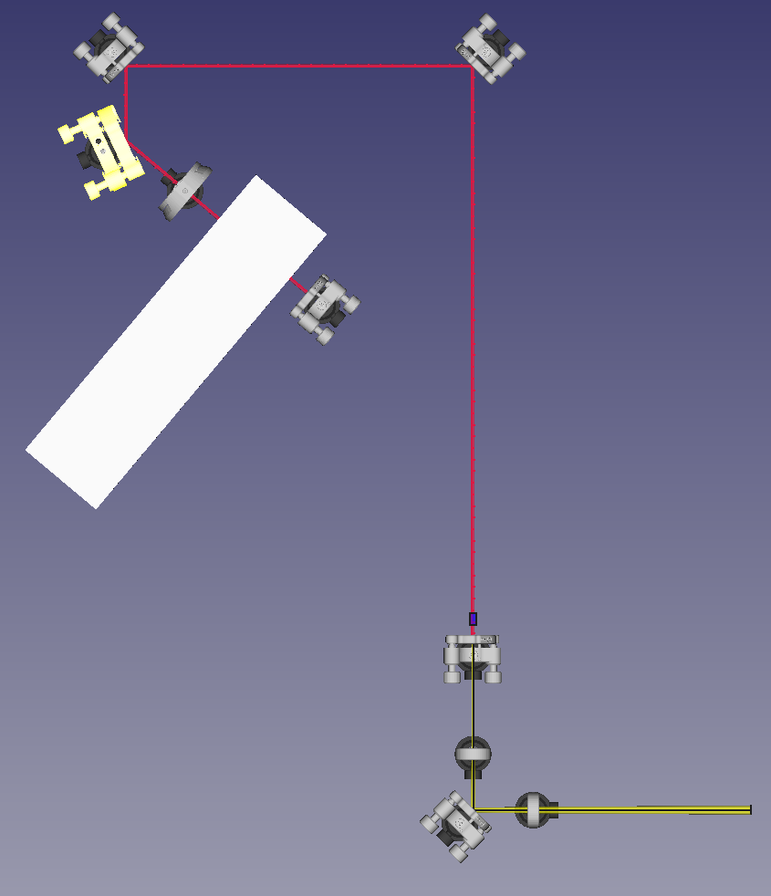
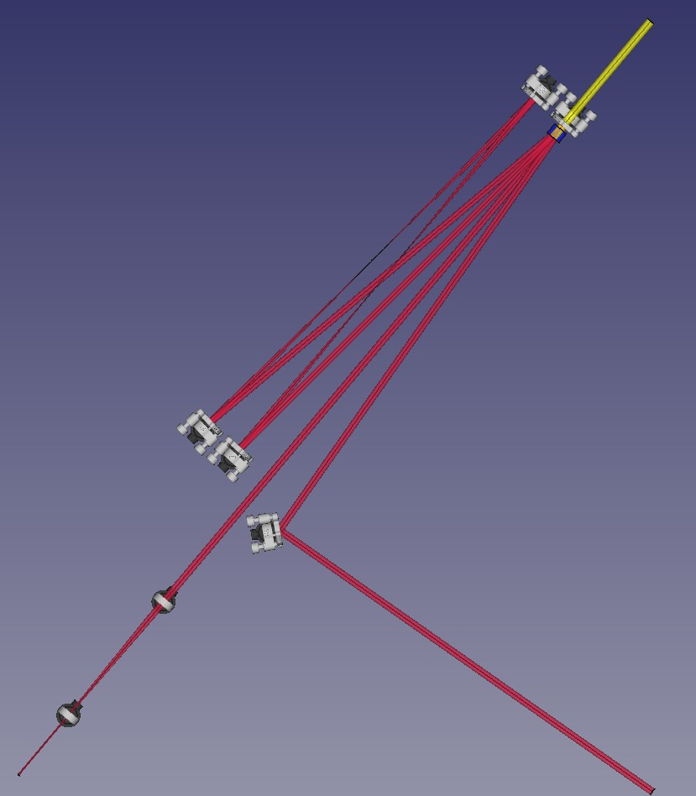
High-power laser development at 2.4 µm
First (regenerative) amplifier:
Second (multi-pass) amplifier:
pump laser
Relay-imaging setup
in/out TFP
Cr:ZnSe
crystal
Pockels cell
Cr:ZnSe
crystal
pump laser
output
input + telescope
mode size A = 5 mm²
pump: 15 mJ from Tm:YAG @ 1883 nm in 100 ns
simulated output @ 2.4 µm: 4 mJ
Mode size A = 75 mm²
Pump: 300 mJ from Tm:YAG
Sim. output @ 2.4 µm:
120 mJ

Slide 23
Summary & Outlook II
All components and technology available for a 1 TW, 2.4 µm laser system based on Cr:ZnSe pumped with Tm-doped ns fiber laser @ 1883 nm
Stretcher and pulse picker ready by end 2023
Both amplifiers and compressor ready by end 2024

Slide 24
Thanks to all Collaborators
A. Sävert
P. Hilz
M. Hornung
D. Hollatz
A. Kessler
T. Köhler
H. Wöhl
F. Schorcht
M. Zepf
C. Anschütz
J. Körner
J. Reiter
D. Klöpfel
J. Hein
Thank you for your attention!

