Slide 1



EuPRAXIA laser requirements and current conceptual design issues
6th European Advanced Accelerator Concepts Workshop
17–23 Sept 2023
Hotel Hermitage, La Biodola Bay, Isola d'Elba, Italy
ESFRI
Leonida Antonio GIZZI (CNR, Pisa, Italy)
with
Paul CRUMP, (FBH, Germany)
Luca LABATE, (CNR, Pisa, Italy)
Guido TOCI (CNR, Firenze, Italy)
http://eupraxia-project.eu

Slide 2
Outline
EuPRAXIA laser requirements
Overall layout
Thermal management options
Modelling
Pump lasers
Summary

Slide 3


The EuPRAXIA Project
With the inclusion in ESFRI and the approval of the Preparatory Phase Project, EuPRAXIA must rapidly move from the conceptual design to a viable technical design of the laser driver.
R. W. Assmann, M. K. Weikum, T. Akhter, D. Alesini, A. S. Alexandrova, M. P. Anania, N. E. Andreev, I. Andriyash, M. Artioli, A. Aschikhin, T. Audet, A. Bacci, I. F. Barna, S. Bartocci, A. Bayramian, A. Beaton, A. Beck, M. Bellaveglia, A. Beluze, A. Bernhard, A. Biagioni, S. Bielawski, F. G. Bisesto, A. Bonatto, L. Boulton, F. Brandi, R. Brinkmann, F. Briquez, F. Brottier, E. Bründermann, M. Büscher, B. Buonomo, M. H. Bussmann, G. Bussolino, P. Campana, S. Cantarella, K. Cassou, A. Chancé, M. Chen, E. Chiadroni, A. Cianchi, F. Cioeta, J. A. Clarke, J. M. Cole, G. Costa, M. -E. Couprie, J. Cowley, M. Croia, B. Cros, P. A. Crump, R. D’Arcy, G. Dattoli, A. Del Dotto, N. Delerue, M. Del Franco, P. Delinikolas, S. De Nicola, J. M. Dias, D. Di Giovenale, M. Diomede, E. Di Pasquale, G. Di Pirro, G. Di Raddo, U. Dorda, A. C. Erlandson, K. Ertel, A. Esposito, F. Falcoz, A. Falone, R. Fedele, A. Ferran Pousa, M. Ferrario, F. Filippi, J. Fils, G. Fiore, R. Fiorito, R. A. Fonseca, G. Franzini, M. Galimberti, A. Gallo, T. C. Galvin, A. Ghaith, A. Ghigo, D. Giove, A. Giribono, L. A. Gizzi, F. J. Grüner, A. F. Habib, C. Haefner, T. Heinemann, A. Helm, B. Hidding, B. J. Holzer, S. M. Hooker, T. Hosokai, M. Hübner, M. Ibison, S. Incremona, A. Irman, F. Iungo, F. J. Jafarinia, O. Jakobsson, D. A. Jaroszynski, S. Jaster-Merz, C. Joshi, M. Kaluza, M. Kando, O. S. Karger, S. Karsch, E. Khazanov, D. Khikhlukha, M. Kirchen, G. Kirwan, C. Kitégi, A. Knetsch, D. Kocon, P. Koester, O. S. Kononenko, G. Korn, I. Kostyukov, K. O. Kruchinin, L. Labate, C. Le Blanc, C. Lechner, P. Lee, W. Leemans, A. Lehrach, X. Li, Y. Li, V. Libov, A. Lifschitz, C. A. Lindstrøm, V. Litvinenko, W. Lu, O. Lundh, A. R. Maier, V. Malka, G. G. Manahan, S. P. D. Mangles, A. Marcelli, B. Marchetti, O. Marcouillé, A. Marocchino, F. Marteau, A. Martinez de la Ossa, J. L. Martins, P. D. Mason, F. Massimo, F. Mathieu, G. Maynard, Z. Mazzotta, S. Mironov, A. Y. Molodozhentsev, S. Morante, A. Mosnier, A. Mostacci, A. -S. Müller, C. D. Murphy, Z. Najmudin, P. A. P. Nghiem, F. Nguyen, P. Niknejadi, A. Nutter, J. Osterhoff, D. Oumbarek Espinos, J. -L. Paillard, D. N. Papadopoulos, B. Patrizi, R. Pattathil, L. Pellegrino, A. Petralia, V. Petrillo, L. Piersanti, M. A. Pocsai, K. Poder, R. Pompili, L. Pribyl, D. Pugacheva, B. A. Reagan, J. Resta-Lopez, R. Ricci, S. Romeo, M. Rossetti Conti, A. R. Rossi, R. Rossmanith, U. Rotundo, E. Roussel, L. Sabbatini, P. Santangelo, G. Sarri, L. Schaper, P. Scherkl, U. Schramm, C. B. Schroeder, J. Scifo, L. Serafini, G. Sharma, Z. M. Sheng, V. Shpakov, C. W. Siders, L. O. Silva, T. Silva, C. Simon, C. Simon-Boisson, U. Sinha, E. Sistrunk, A. Specka, T. M. Spinka, A. Stecchi, A. Stella, F. Stellato, M. J. V. Streeter, A. Sutherland, E. N. Svystun, D. Symes, C. Szwaj, G. E. Tauscher, D. Terzani, G. Toci, P. Tomassini, R. Torres, D. Ullmann, C. Vaccarezza, M. Valléau, M. Vannini, A. Vannozzi, S. Vescovi, J. M. Vieira, F. Villa, C. -G. Wahlström, R. Walczak, P. A. Walker, K. Wang, A. Welsch, C. P. Welsch, S. M. Weng, S. M. Wiggins, J. Wolfenden, G. Xia, M. Yabashi, H. Zhang, Y. Zhao, J. Zhu & A. Zigler
EuPRAXIA Conceptual Design Report
The European Physical Journal Special Topics 229, 3675–4284 (2020); https://doi.org/10.1140/epjst/e2020-000127-8

Slide 4
The EuPRAXIA project
The EuPRAXIA project aims at the construction of an innovative compact electron accelerator using laser- and electron-beam-driven plasma wakefield acceleration;
EuPRAXIA foresees the implementation of a laser wakefield accelerator (LWFA) at the 1-5 GeV target energy and a repetition rate of 20-100 Hz, requiring the most advanced and robust ultrashort pulse laser technologies available to date;
The Design Study project was carried out initially by 16 laboratories and universities from 5 EU member states within the European Union’s Horizon 2020 programme;
A Conceptual Design Study has addressed the development of a ultrashort pulse laser system (pulse durations in the range of tens of fs) and energies up to 100 joules, yielding a PW scale peak power, targeting a repetition rate of up to 100 Hz, a performance never achieved so far
EuPRAXIA was included in the ESFRI Roadmap (2021) and a Preparatory Phase project is ongoing.

Slide 5
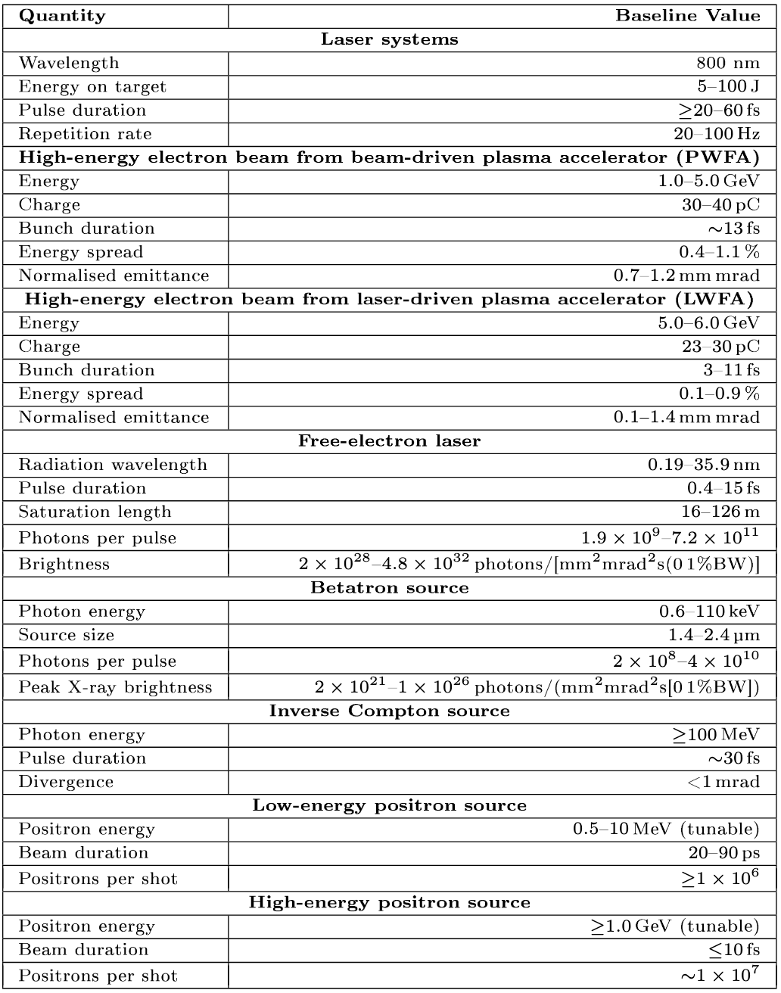
The EuPRAXIA project: main specs

Slide 6
RATIONALE OF LASER DRIVER DESIGN STUDY
In the EuPRAXIA project, several alternative technological approaches were considered and down-selected, to provide the required laser driver performances.
We based the design on Chirped Pulse Amplification (CPA) in Ti:Sapphire, pumped by all-solid state green lasers (i.e. diode pumped, frequency doubled Yb or Nd lasers)
Thermal management related to the handling of high pump average power was the most complex aspect in the design, requiring out-of-the-box thinking and original solutions
Optimization of energy extraction was also an issue, aimed to reduce pump energy requirements and waste heat production.
Three laser systems envisaged, to drive three stages:
Laser Plasma Injector at 150 MeV (LPI 150MeV)
- Laser Plasma Injector/Accelerator at 1 GeV (LPI 1GeV)
- Laser Plasma Accelerator at 5 GeV (LPA 5GeV)
For each system, two levels of performances considered:
P0: low energy, 20 Hz rep rate
P1: high energy, 100 Hz rep rate

Slide 7
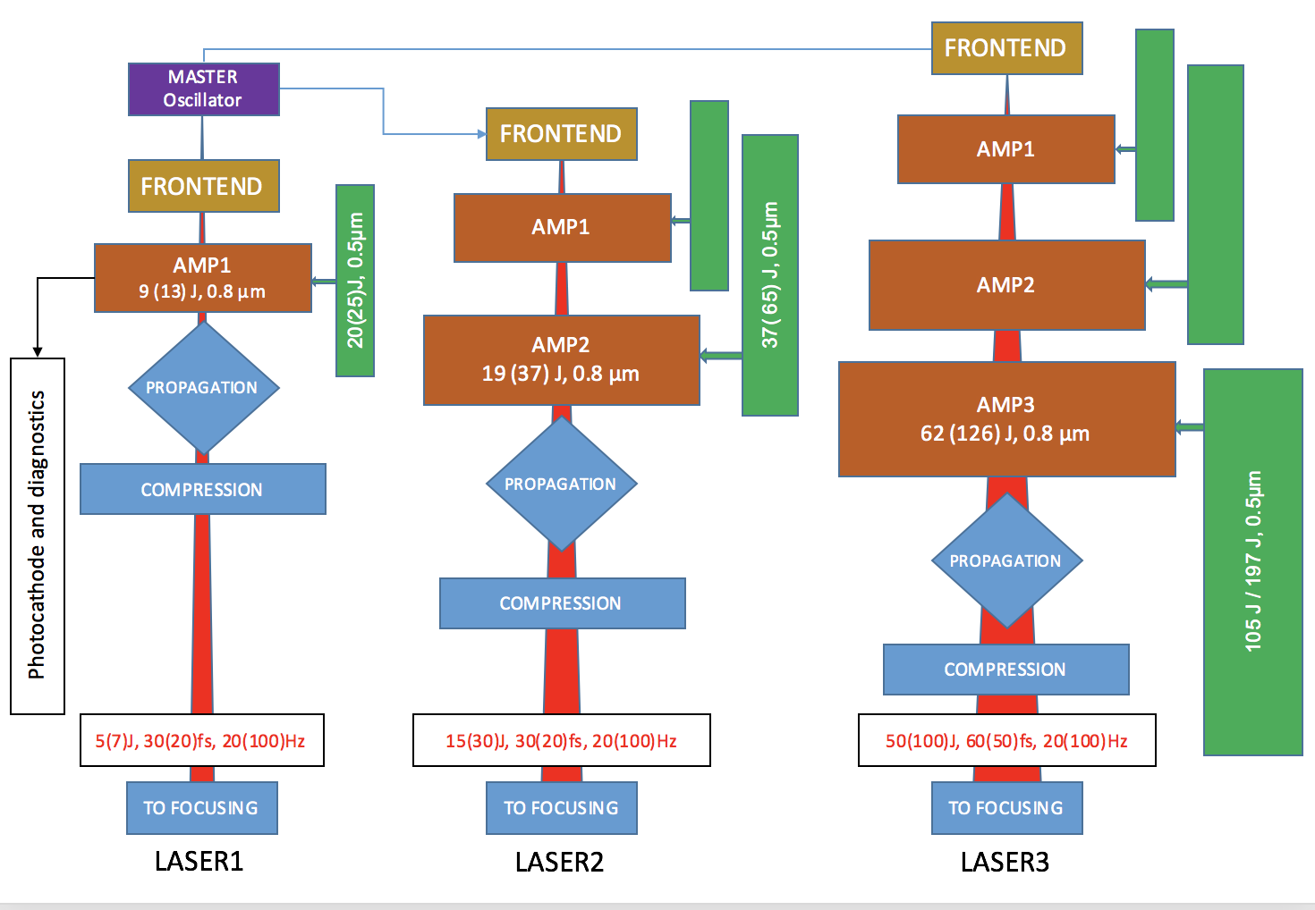
GENERAL ARCHITECTURE
Laser 1
Laser 1
Modularity of amplification stages:
LPI 150 MeV ⇒ Laser1
LPI 1 GeV ⇒ Laser1 + Laser2
LPA 5 GeV ⇒ Laser1 + Laser2 + Laser3
adjustments on pulse duration/bandwidth
Synchronization: common master oscillator
Pulse duration/wavelength tailoring : separate front end
Scalability: possibility to upgrade from P0 to P1 performance levels without a major changes
Laser 1
Laser 2
Laser 2
Laser 3
LPI 150 MeV
LPI 1 GeV
LPA 5 GeV

Slide 8
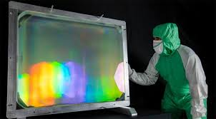
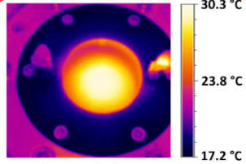
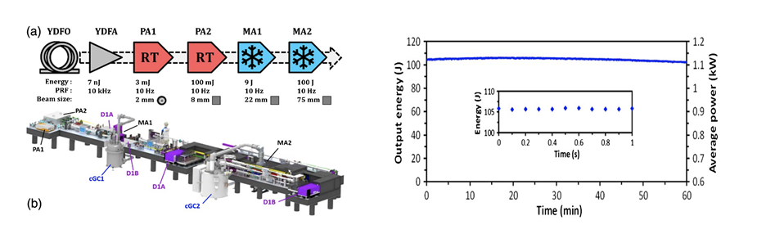
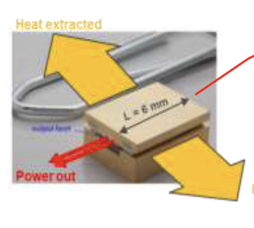
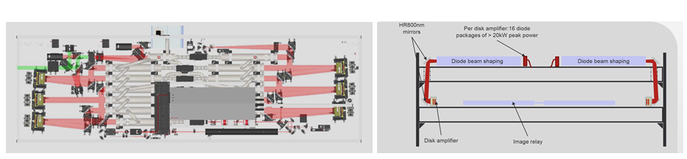
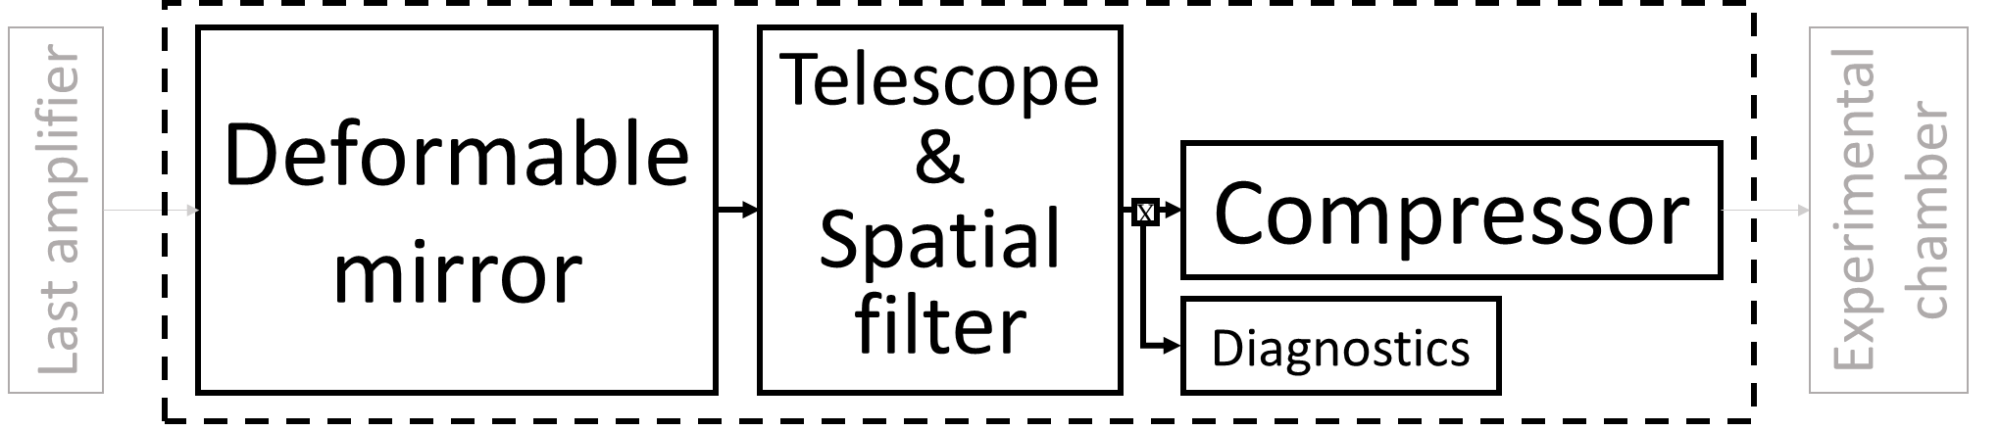
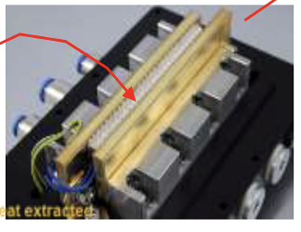
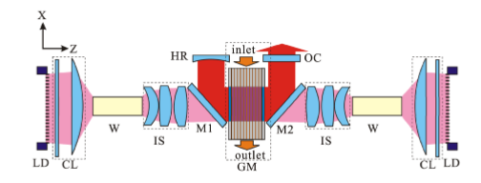

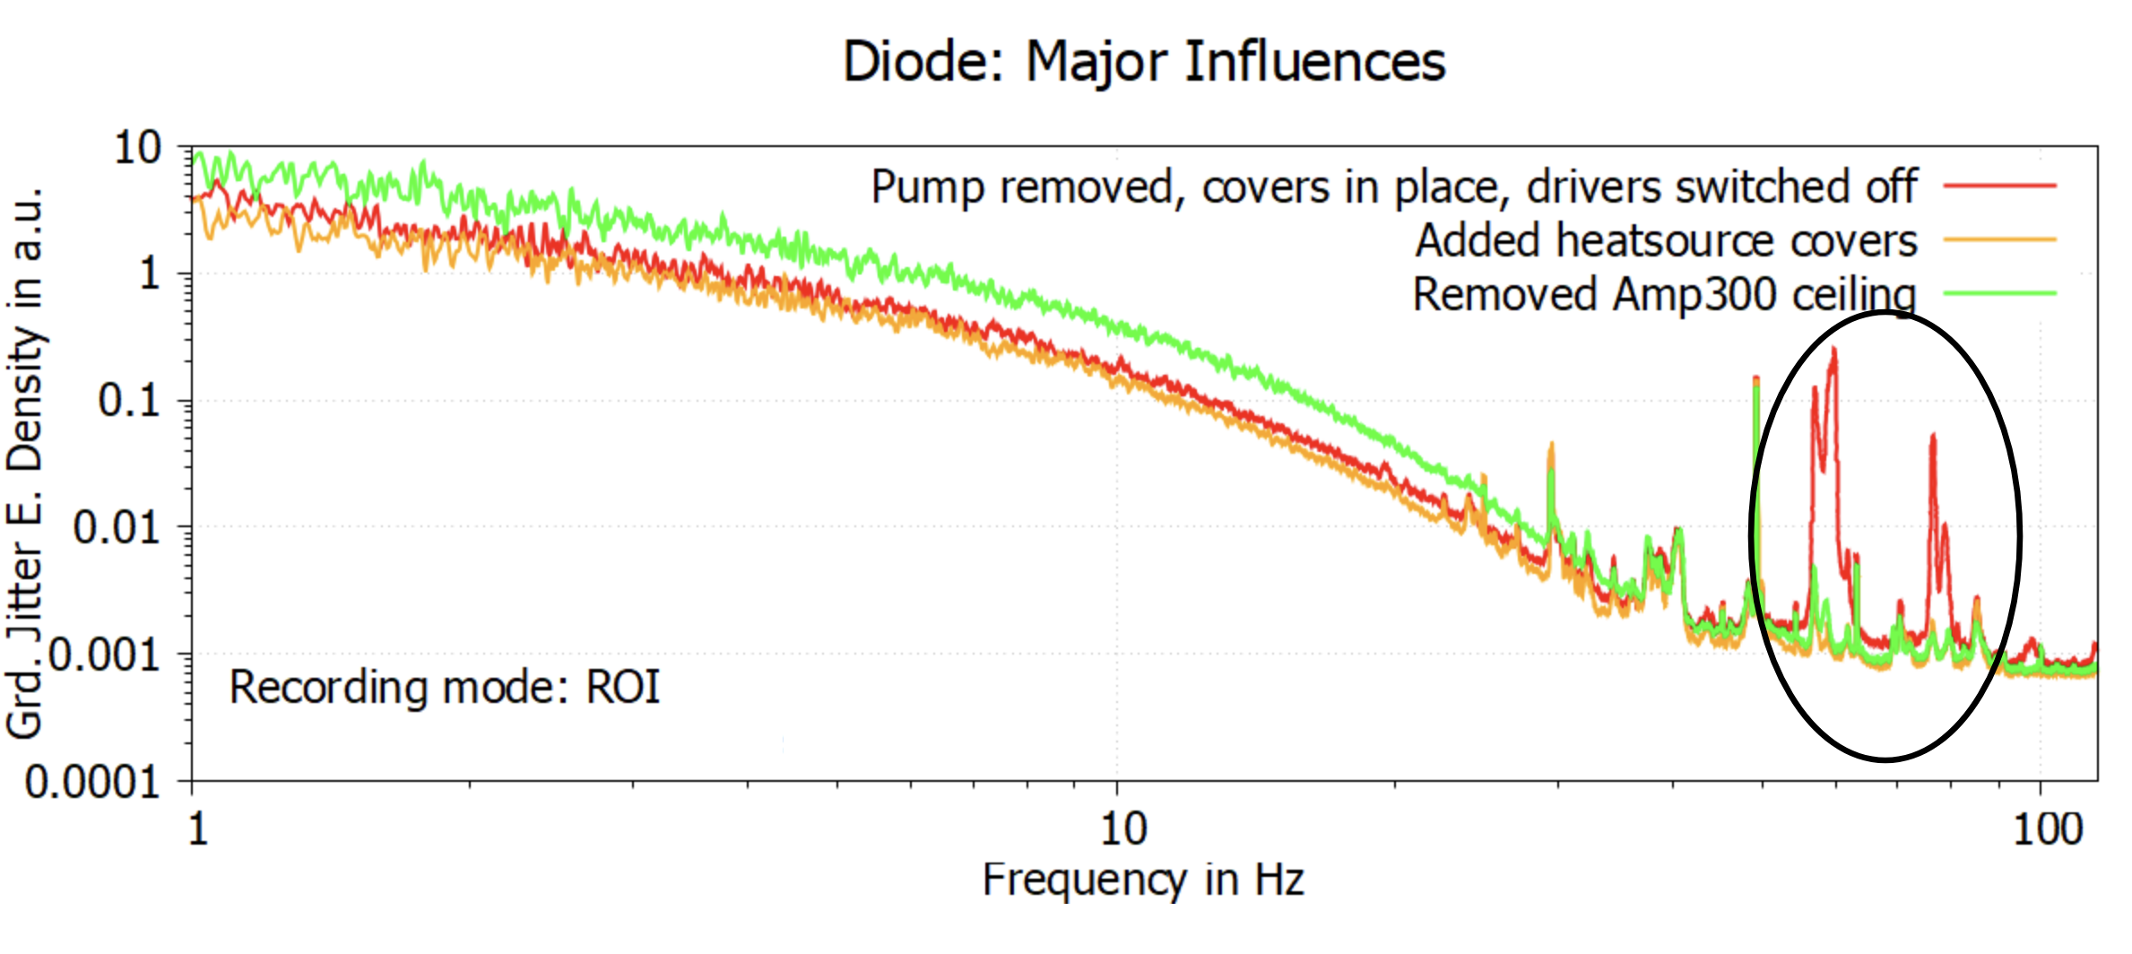
Underpinning EuPRAXIA Laser development
High repetition rate (100 Hz) will speed up R&D of pending issues for Ti:Sa laser TDR
THERMAL
MANAGEMENT OF
POWER AMPLIFIERS
AMPLIFIER GEOMETRY
TRANSMISSION
VS. REFLECTION
DPSSL PUMP
SOURCES
TECHNOLOGY
DIODE LASERS EFFICIENCY,
BRIGHTNESS AND
LIFETIME
COMPRESSOR AND TRANSPORT: THERMAL AND MECHANICAL STABILITY
Multipass transmission
Gold -> MD, MLD, MMLD
reduction of the thermal load
cooling of residual heat
control of thermal effects
DiPOLE 100 (STCF)
WATER/GAS COOLING
Multipass reflection
P-60 technology (Amplitude)
Currently no solution for full system specs (P1): development
Main challenges: large optics, mechanical stability, beam quality control, pointing stability
Prototyping needed
Prototyping needed
Needs development

Slide 9
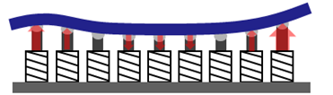
Transport to target
Main challenges: large optics, mechanical stability, cooling of gratings, beam quality control …

Slide 10
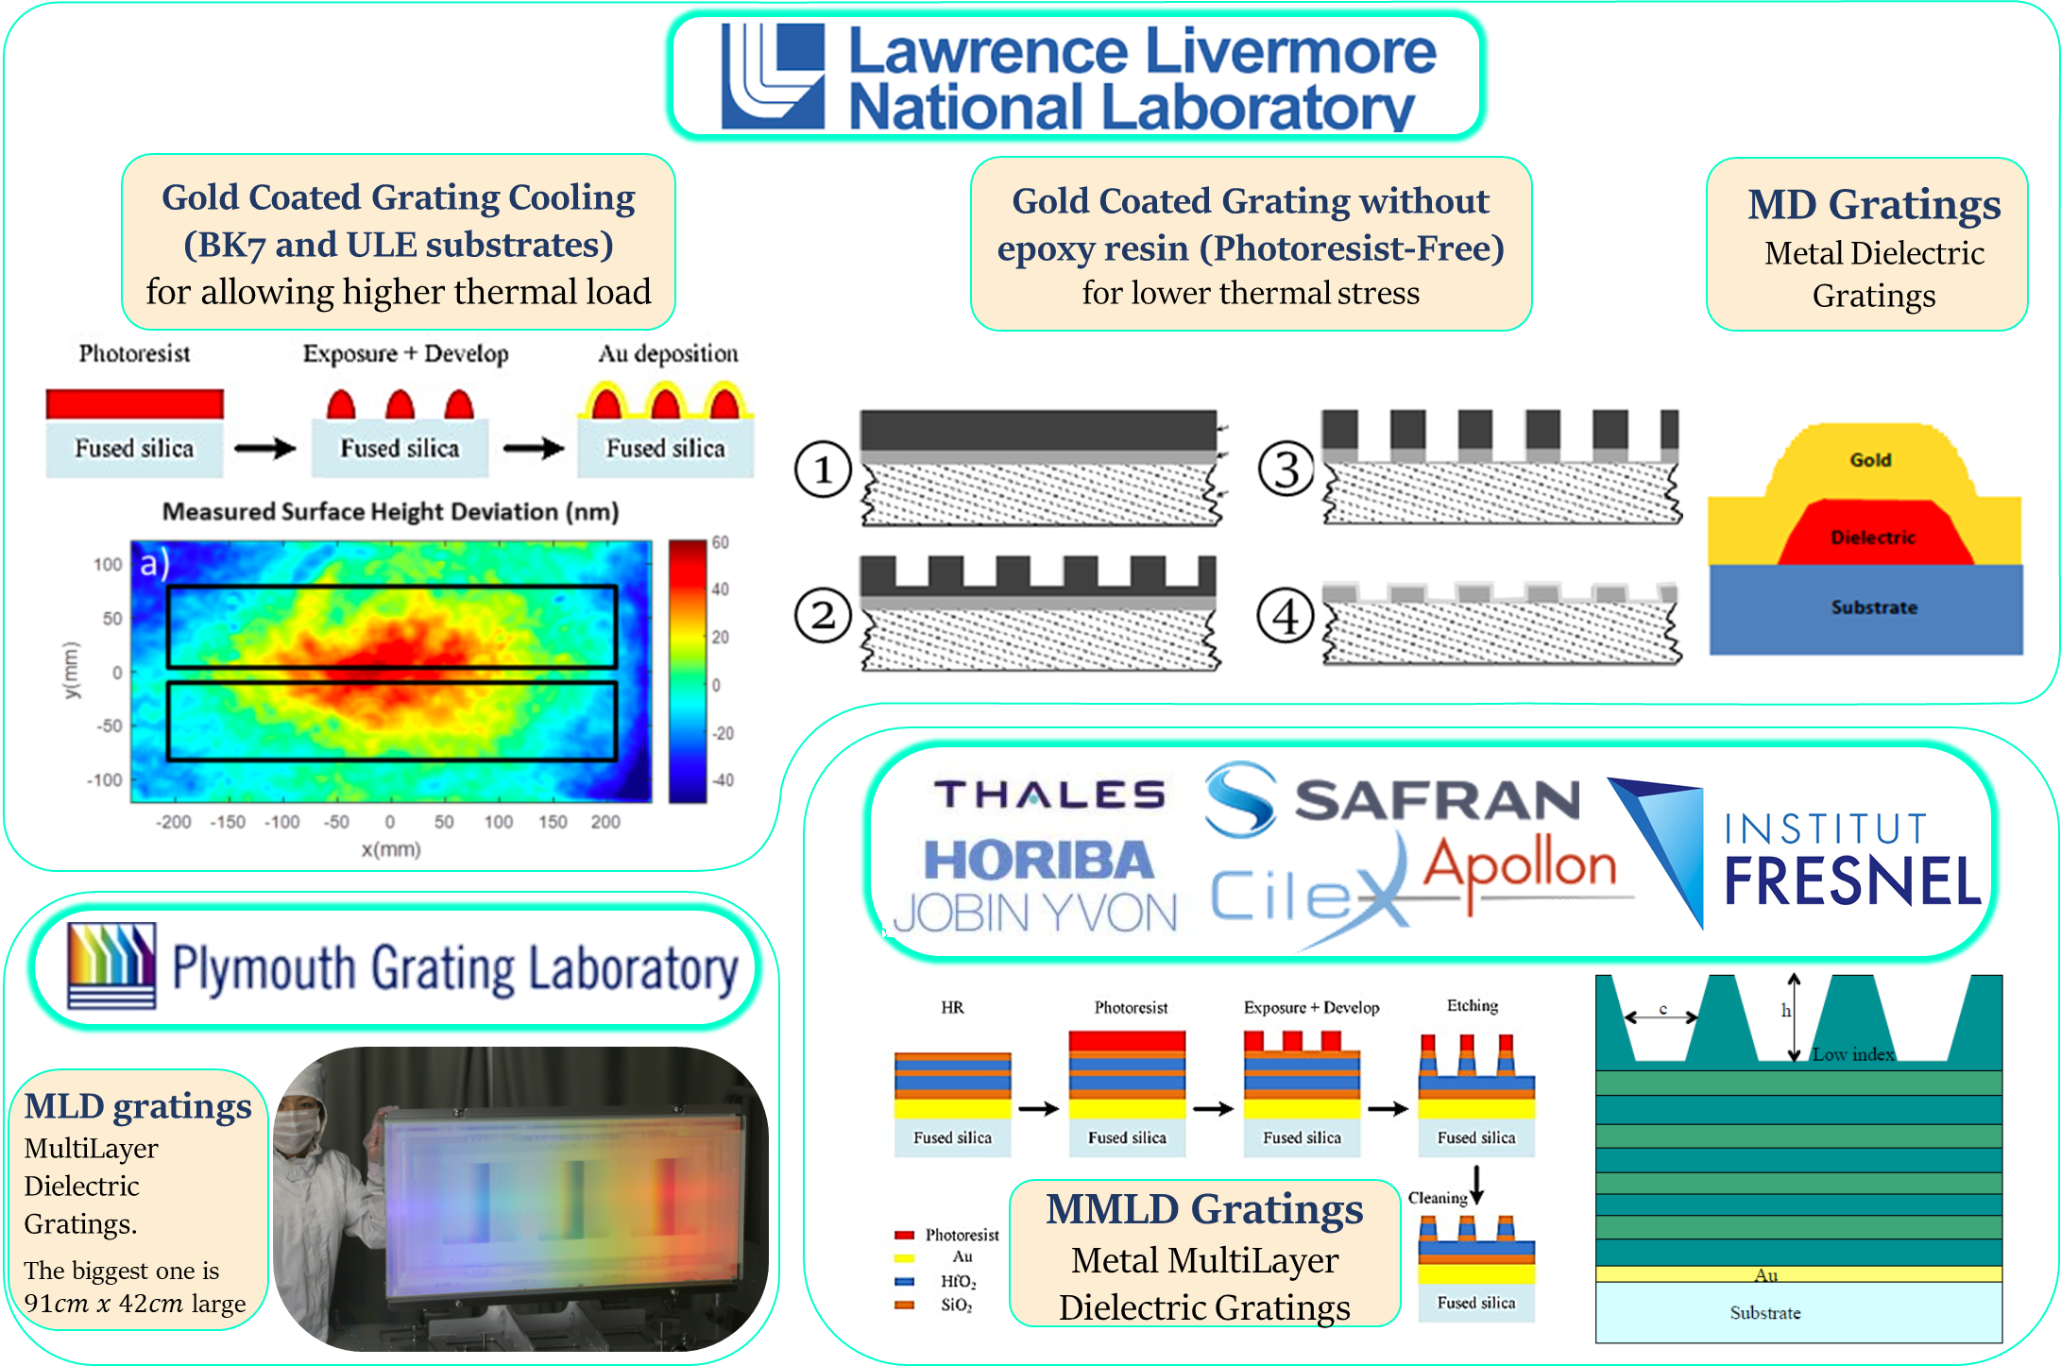
Compressor: grating technology
Different technologies under evaluation to address main issues with higher repetition rate. Strategy includes reduction of the thermal load at high average power, cooling of residual heat and control of thermal effects on compression quality.

Slide 11
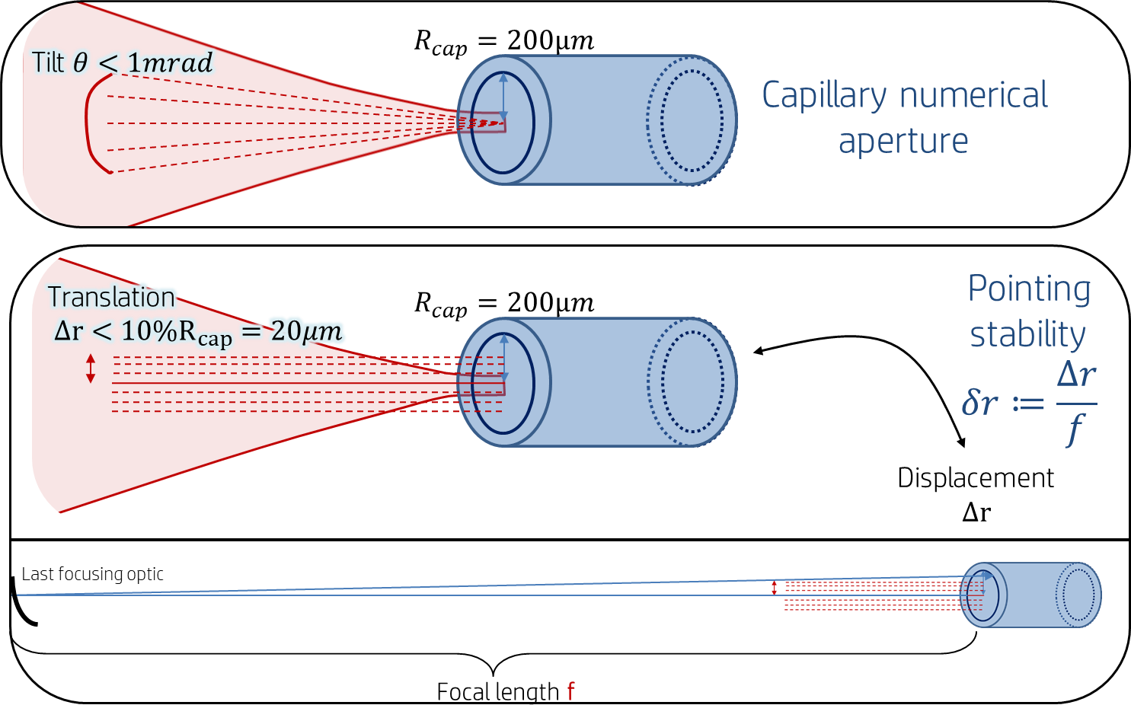
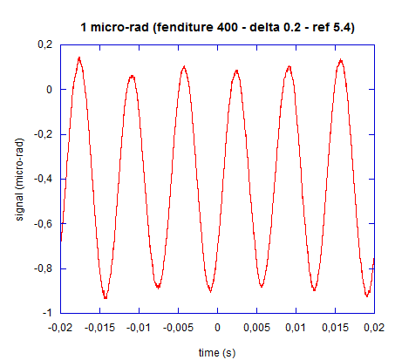
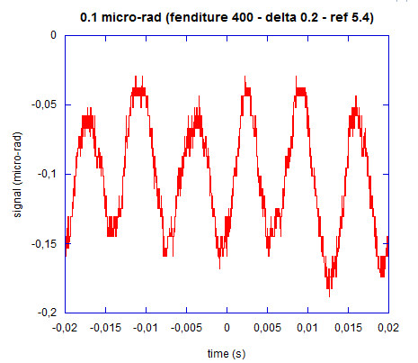
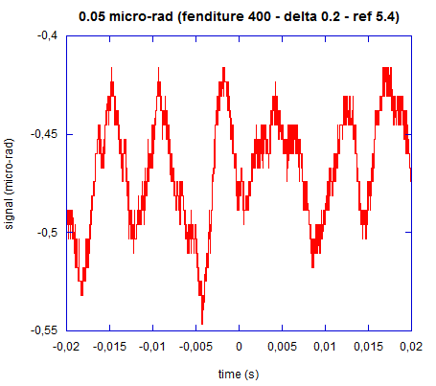
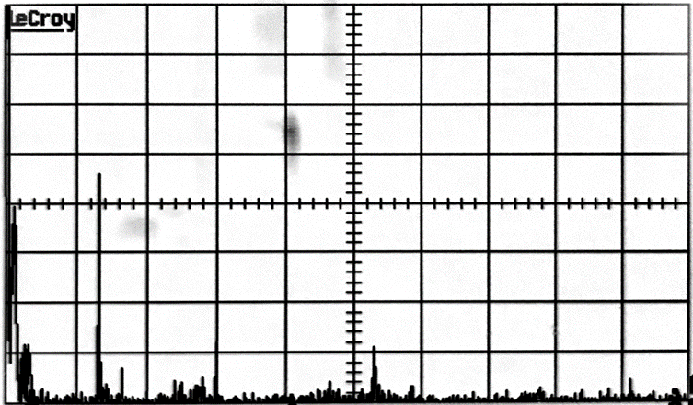
Beam Pointing Stability
Eupraxia requirements for beam pointing stability are extremely demanding. Both passive and active control will be required. Prior to the implementation of control strategies, tools are being developed to measure pointing stability performances at EuPRAXIA facilities and labs.
0,1 µrad
1 µrad
50 nrad
Laser angular fluctuations footprints at 150 Hz
Environmental angular noise of about 30 nano-rad
We already detect
<100nrad fluctuations
Z. Mazzotta, F. Mathieu
in collaboration with
S. Cialdi, D. Cipriani, S. Capra
of Università degli studi di Milano.
up to the MHz regime and more
64
~40nrad
48
~10nrad
32
Angular fluctuation (nrad)
Spectral analysis of the laser fluctuation.
16
0
100
200
300
400
500
Frequency (Hz)

Slide 12
AMPLIFICATION CHAIN: REQUIREMENTS
LASER 1 - Injector 150 MeV
Parameter | Label | P0 | P1
Wavelength (nm) | λ_{1 (nm)} | 800 | 800
Maximum energy on target (J) | E_{target} | 5 | 7
Maximum output energy (J) | E_{out} | 8.8 | 12.5
Energy tuning resolution (% of targeted value) | dE | 7 | 5
Total output energy (incl. Diagnostic beams) | E_{tot} | 7 | 10
Pulse length (FWHM) (fs) | τ₁ | 30 | 20
Repetition rate (Hz) | f₁ | 20 | 100
Requirement on energy stability (RMS) % | σ_{<E>} | 1 | 0.6
LASER 2 - Injector 1 GeV
Parameter | Label | P0 | P1
Wavelength (nm) | λ_{2 (nm)} | 800 | 800
Maximum energy on target (J) | E_{target} | 15 | 30
Maximum output energy (J) | E_{out} | 18.8 | 37.5
Energy tuning resolution (% of targeted value) | dE | 7 | 5
Shortest pulse length (FWHM) (fs) | τ₂ | 30 | 20
Repetition rate (Hz) | f₂ | 20 | 100
Requirement on energy stability (RMS) % | σ_{<E>} | 1 | 0.6
LASER 3 - Driver 5 GeV
Parameter | Label | P0 | P1
Wavelength (nm) | λ_{2 (nm)} | 800 | 800
Maximum energy on target (J) * | E_{target} | 50 | 100
Maximum output energy (J) | E_{out} | 62.5 | 125
Energy tuning resolution (% of targeted value) | dE | 7 | 5
Shortest pulse length (FWHM) (fs) | τ₂ | 60 | 50
Repetition rate (Hz) | f₂ | 20 | 100
Requirement on energy stability (RMS) % | σ_{<E>} | 1 | 0.6
Maximum output energy: (Energy on Target)/(Compressor Efficiency)
Compressor efficiency assumed 80%
Seed energy: 1.5 J

Slide 13
AMPLIFIERS MODULAR ARCHITECTURE
Foreseen I/O energy and pump requirements
LPI 150 MeV
From the
front end
LASER1
E_{out} 8.8 J (P0) / 12.5 J (P1)
To the
compressor
E_{pump}: 19.2J (P0)/ 25.7 J (P1)
From the
front end
LPI 1GeV
LASER1
E_{out} 8.8 J (P0) / 12.5 J (P1
LASER2
E_{out} 18.8 J (P0) / 37.5 J (P1)
To the
compressor
E_{pump}: 37.2J (P0)/ 65.2 J (P1)
LPA 5GeV
From the
front end
LASER1
E_{out} 8.8 J (P0) / 12.5 J (P1)
LASER2
E_{out} 18.8 J (P0) / 37.5 J (P1)
LASER3
E_{out} 62.5 J (P0) / 125 J (P1)
To the
compressor
E_{pump}: 105J (P0)/ 197 J (P1)
Three main modules: LASER1, LASER2, LASER3
LASER1: stand-alone for LPI 150 MeV
LASER2: output stage for LPI 1 GeV, second stage for LPA 5GeV
LASER3: high energy stage for LPA 5GeV
Two levels of performance : P0 and P1

Slide 14
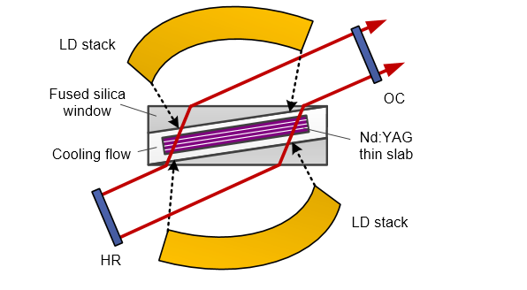
THERMAL MANAGEMENT
Expanding knowledge base for water cooled with "through" propagation: some examples
Water cooled Ti:Sa amplifier (“Active Mirror” configuration) under development at ELI-HU (After V. Cvhykov et al. , Opt. Lett, 41, 3017, 2016)
Fluid (D₂O ) cooled 3 kW Nd:YAG laser, 20 kW CW pump power, D₂O (After X. Fu et al. , Opt. Express, 22, 18421 (2014)
Fluid (Siloxane ) cooled Nd:YLF laser, 5 kW CW pump power (After Z. Ye et al. , Opt. Express, 24, 1758 (2016)

Slide 15
AMPLIFICATION MODULES: CONCEPTUAL LAYOUT
Two possible solutions envisaged, determined by thermal management considerations
Common features: - gas cooling found to be insufficient at the given power density
- face cooling of gain elements by water flow (longitudinal cooling)
- gain volume split in some sub-elements to increase cooling surface
- multi-step pumping for parasitic laser management
1 – Multipass amplification scheme in transmission
Input beam
Water flow
Steering mirror
Ti:Sapphire
crystals
Pump beam
Steering mirror
Ouput beam
Window
Window
Pump recycling
mirror
Water flow
Pump
recycling mirror
Steering mirror
Water flow
Steering mirror
Double side, double pass pumping
Crystal split in 2 elements, face cooled by water flow, to increase cooling surface
Multipass amplification (4 to 6 depending on stages)
Absorption layer on crystal sides for parasitic lasing suppression

Slide 16
AMPLIFICATION MODULES: CONCEPTUAL LAYOUT
Two possible solutions envisaged, determined by thermal management considerations
Common features: - face cooling of gain elements by water flow (longitudinal coling)
- gain volume split in some sub-elements to increase cooling surface
- multi-step pumping for parasitic laser management
2 – Multipass amplification scheme in reflection (“Active mirror”)
Input beam
Ouput beam
Pump
recycling
mirrors
Multipass mirrors
Pump
beam
Absorber
Ti:Sapphire
crystal
Cooling flow
Cooling flow
Reflective coating
(cooled side)
Ti:Sapphire crystals
Multi-pass pumping scheme to ensure effective pump absorption
Overall pump energy equally divided among the 4 elements
Overall gain length split in 4 elements, water cooled on the back side
Multiple reflections required to obtain efficient energy extraction
Absorption layer on crystal sides for parasitic lasing suppression

Slide 17
CRITICAL DESIGN CROSSROAD
Which geometry is better?
Multipass reflection
Multipass transmission
Input beam
Ouput beam
Input beam
Water flow
Steering mirror
Pump
recycling
mirrors
Pump beam
Ti:Sapphire
crystals
Pump
beam
Steering mirror
Absorber
Ouput beam
Ti:Sapphire
crystal
Window
Window
Pump recycling
mirror
Steering mirror
Water flow
Water flow
Steering mirror
Pump
recycling mirror
Cooling flow
Cooling flow
Reflective coating
(cooled side)
Pro’s
Simpler scheme (up to 2 sub-crystals, single pump path)
Broader cooling surface available
Less sensitive to mechanical vibrations
Less sensitive to parasitic reflections (contrast issues)
Con’s
Aberrations from fluid turbulences
Very critical design of the fluid ducts
Pro’s
No aberration from cooling fluid
Modularity
Con’s
Less cooling capability
More complex set-up (up to 3 units required , pump splitting)
More sensitive to mechanical vibrations
Possible issues from parasitic reflections (pulse contrast)
Both schemes equally studied in the preliminary design: equivalent perfomances from simulations
Critical aspects (i.e. optical aberrations from cooling fluid) beyond numerical simulations capabilities
Dedicated experimental development (i.e. realization and testing of small scale pilot devices) is required to address this design choice

Slide 18
EXAMPLE OF LAYOUT FOR TRANSMISSION AMPLIFIERS
y
x
Amplification path
6 passes configuration, bow-tie geometry
Angle between passes ~ n x 1.2° (n=1,2,3)
Footprint length: ~ 4 mt (Laser 1)
~ 5 mt (Laser 2)
~ 8 mt (Laser 3)
(to avoid beam superimposition)
z
Ti:Sa
Pumping path (single pump source, split in 2 pulses)
y
First pulse
Each pump pulses passes twice through the crystals
Pumping from both sides to reduce peak fluence and parasitic lasing
Extraction During Puming (EDP) implementation
The pump pulse must be split before of the injection; one of the pulses goes through a delay line to implement the EDP
z
x
Ti:Sa
Second pulse (from a delay line)
Off-plane angular multiplexing of the pump beams to have more pump “gates” available
z
y
x
Pump angular multiplexing: 2 pumping “gates” required for each pump laser

Slide 19
PUMP TIMING AND EDP ENERGY RIPARTITION
Seed pulse
Seed pulse (at t=0)
Amplified pulse
Second pump pulse (after delay line)
1° Pump pulse
First pump
pulse
2° Pump pulse
Stored energy
0
t_{r}
2t_{r}
3t_{r}
4t_{r}
5t_{r}
t
Pump pulse absorption time ~10 ns
t_{r}: pulse round trip time between passes
(12 ns, 15 ns, 18 ns respectively for Laser 1, Laser2 and Laser3
The delay line of the second pump pulse has to to provide the proper delay between the two pulses.

Slide 20
EXAMPLE OF LAYOUT FOR REFLECTION AMPLIFIERS
y
Amplification path
z
x
3 disks, 2 double passes configuration
Half angle between passes ~ 1.2°-2.4 °
Footprint length: ~ 3 mt (Laser 1)
~ 5 mt (Laser 2)
~ 8 mt (Laser 3)
(to avoid beam superimposition)
Footprint width < 1.5 m
Straightforward extension to 4 disks
Ti:Sa
Ti:Sa
Ti:Sa
Mirror
Delay line
Pumping path (single pump source)
y
Pump pulse energy is distributed among the disks by beamsplitters (or waveplates+polarizers)
Each pump pulse passes twice through the crystals
EDP implementation
The arrival of the pump pulse is synchronized with the arrival of the amplified pulse by means of fixed delay lines (equal path length) . Energy repartition between the passes is achieved by fine tuning of the delay
z
x
Beamsplitter
Delay line
Beamsplitter
Delay line
z
Off-plane pump injection to avoid beam path occlusions
One injection “gate“ for each pump source
y
x

Slide 21
PUMP TIMING AND EDP ENERGY RIPARTITION
Seed pulse (at t=0)
Seed pulse
f₁
f₂
Disk 1
Pump pulse
0
6t_{r}
t
Stored energy
Disk 2
f₁
f₂
0
t_{r}
5t_{r}
t
f₁
f₂
Disk 3
0
2t_{r}
4t_{r}
t
t_{r}: pulse round trip time between passes
(12 ns, 15 ns, 18 ns respectively for Laser 1, Laser2 and Laser3
The delay lines of the pump between the disk ensures synchronization of pump arrival with the seed pulse. Fraction f₁ of pump pulse energy is available for 1° pass amplification, fraction f₂ for the 2° pass.
The ratio f₁/f₂ can be adjusted by finely tuning the delay between the pump and the seed pulse

Slide 22
NUMERICAL SIMULATION OF AMPLIFICATION MODULES
The amplification stages were numerically simulated (MIRO - CEA)
The code allows for the simulation of amplification of ultrashort pulses, accounting for GVD, nonlinear effects, spectral narrowing effects and so on
The different amplification stages were extensively analyzed in the different architectures (transmission vs reflection scheme)
Simulations for the two architectures implemented:
same overall gain length, number of passes
same doping level
same overall pump energy
same beam cross section
We obtained:
- Very similar energy extraction performance for the two schemes
- Very similar sensitivity of output energy vs seed, pump energy
Results are summarized in the following slides
vs.

Slide 23
AMPLIFICATION MODULES: AMP 1
Crystal clear aperture ∅ (cm) | 6 cm | Crystal thickness (cm, overall) | 1.2
Doping level (%Wt.) | 0.075 | Absorption coefficient (cm-1) | 1.2
Performance level P0
Pump energy (J) | 19.2 | Pump beam diameter (cm, FWHM) | 5.0
Pump fluence at crystal surfaces (J/cm²) | 0.76 | Absorbed pump energy (%) | 94%
Seed pulse energy (J) | 1.5 | Seed beam diameter (cm, FWHM) | 4.7
Output energy | 8.9 | Extraction efficiency | 38.7%
Output beam diameter (cm FWHM) | 4.5 | Output beam peak fluence (J/cm2) | 0.55
EDP scheme | 65% 1st pass, 35% 4th pass | Max G_{T} | ∼ 15 (before the 4th pass)
S_{pump} (ΔE_{out}/ΔE_{pump}) | 0.53 | S_{seed} (ΔE_{out}/ΔE_{seed}) | 2.4
Performance level P1
Pump energy (J) | 25.7 | Pump beam diameter (cm, FWHM) | 5.0
Pump fluence at crystal surfaces (J/cm2) | 1.01 | Absorbed pump energy (%) | 94%
Seed pulse energy (J) | 1.5 | Seed beam diameter (cm, FWHM) | 4.7
Output energy (J) | 12.7 | Extraction efficiency | 43.6%
Output beam diameter (cm FWHM) | 4.6 | Output beam peak fluence (J/cm²) | 0.765
EDP scheme | 65% 1st pass, 35% 4th pass | Max G_{T} | ∼ 30 (before the 4th pass)
S_{pump} (ΔE_{out}/ΔE_{pump}) | 0.58 | S_{seed} (ΔE_{out}/ΔE_{seed}) | 2.67
6 passes amplification scheme

Slide 24
AMPLIFICATION MODULES: AMP 2
Crystal clear aperture ∅ (cm) | 10 | Crystal thickness (cm, overall) | 2.0
Doping level (%Wt.) | 0.05 | Absorption coefficient (cm-1) | 0.79
Performance level P0
Pump energy (J) | 37.2 | Pump beam diameter (cm, FWHM) | 9.0
Pump fluence at crystal surfaces (J/cm²) | 0.425 | Absorbed pump energy (%) | 96%
Seed pulse energy (J) | 6.25 | Seed beam diameter (cm, FWHM) | 8.0
Output energy (J) | 19.1 | Extraction efficiency | 35.0%
Output beam diameter (cm FWHM) | 8.0 | Output beam peak fluence (J/cm²) | 0.38
EDP scheme | 60% 1st pass, 40% 3rd pass | Max G_{T} | ∼ 6 (before the 3rd pass)
S_{pump} (ΔE_{out}/ΔE_{pump}) | 0.45 | S_{seed} (ΔE_{out}/ΔE_{seed}) | 1.8
Performance level P1
Pump energy (J) | 65.2 | Pump beam diameter (cm, FWHM) | 9.0
Pump fluence at crystal surfaces (J/cm²) | 0.75 | Absorbed pump energy (%) | 96%
Seed pulse energy (J) | 8.75 | Seed beam diameter (cm, FWHM) | 8.0
Output energy (J) | 37.5 | Extraction efficiency | 44.1%
Output beam diameter (cm FWHM) | 8.3 | Output beam peak fluence (J/cm²) | 0.72
EDP scheme | 60% 1st pass, 40% 3rd pass | Max G_{T} | ∼ 14 (before the 3rd pass)
S_{pump} (ΔE_{out}/ΔE_{pump}) | 0.53 | S_{seed} (ΔE_{out}/ΔE_{seed}) | 1.49
6 passes amplification scheme

Slide 25
AMPLIFICATION MODULES: AMP 3
Crystal clear aperture ∅ (cm) | 16 cm | Crystal thickness (cm, overall) | 3.2
Doping level (%Wt.) | 0.03 | Absorption coefficient (cm-1) | 0.47
Performance level P0 (6 passes)
Pump energy (J) | 105 | Pump beam diameter (cm, FWHM) | 14.0
Pump fluence at crystal surfaces (J/cm²) | 0.51 | Absorbed pump energy (%) | 96%
Seed pulse energy (J) | 18.8 | Seed beam diameter (cm, FWHM) | 12.8
Output energy (J) | 62.4 | Extraction efficiency | 41.5%
Output beam diameter (cm FWHM) | 12.8 | Output beam peak fluence (J/cm²) | 0.49
EDP scheme | 65% 1st pass, 35% 3rd pass | Max G_{T} | ∼ 18 (before the 1st pass)
S_{pump} (ΔE_{out}/ΔE_{pump}) | 0.53 | S_{seed} (ΔE_{out}/ΔE_{seed}) | 1.64
Performance level P1 (4 passes)
Pump energy (J) | 197 | Pump beam diameter (cm, FWHM) | 14.0
Pump fluence at crystal surfaces (J/cm²) | 0.95 | Absorbed pump energy | 96%
Seed pulse energy (J) | 37.5 | Seed beam diameter (cm, FWHM) | 12.8
Output energy (J) | 126.0 | Extraction efficiency | 44.9%
Output beam diameter (cm FWHM) | 13.0 | Output beam peak fluence (J/cm²) | 1.08
EDP scheme | 65% 1st pass, 35% 3rd pass | Max G_{T} | ∼ 20 (before the 3rd pass)
S_{pump} (ΔE_{out}/ΔE_{pump}) | 0.54 | S_{seed} (ΔE_{out}/ΔE_{seed}) | 1.4

Slide 26
EXAMPLES OF SIMULATION RESULTS
Input/output spectrum (AMP3, P1)
Input/output beam profile (AMP3, P1)
Output energy vs. number of passes (AMP3, P1, transmission / reflection schemes)
Output energy vs. pump pulse energy (AMP1, P0)

Slide 27
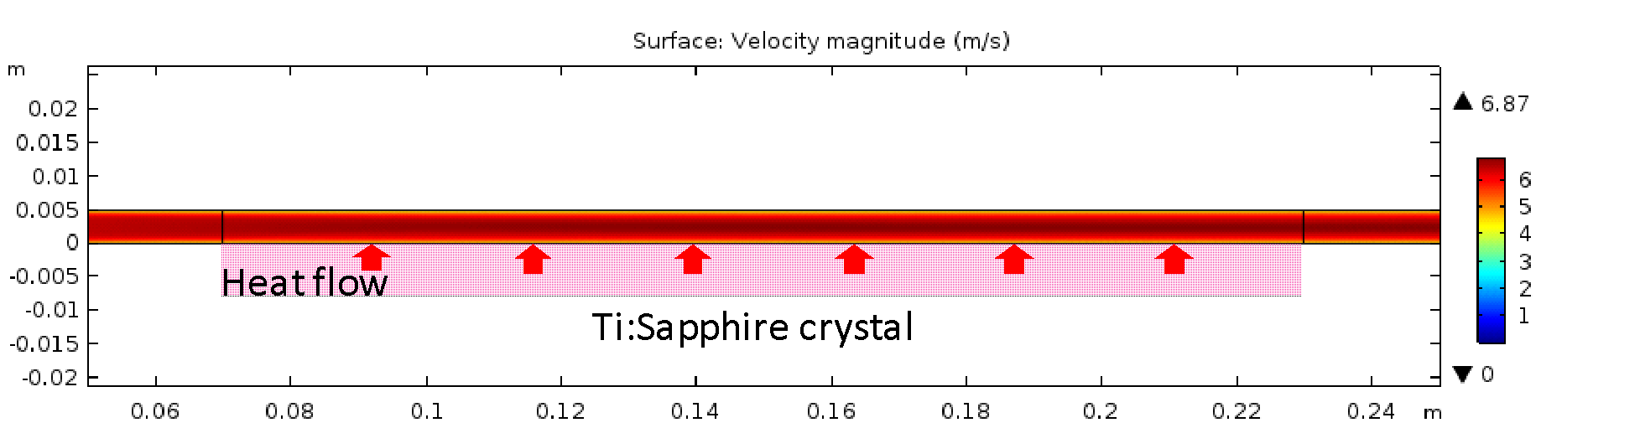
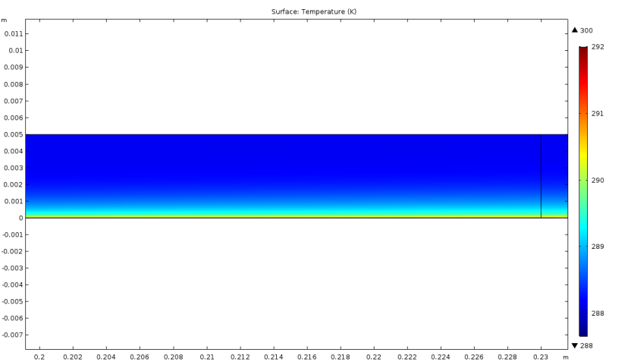
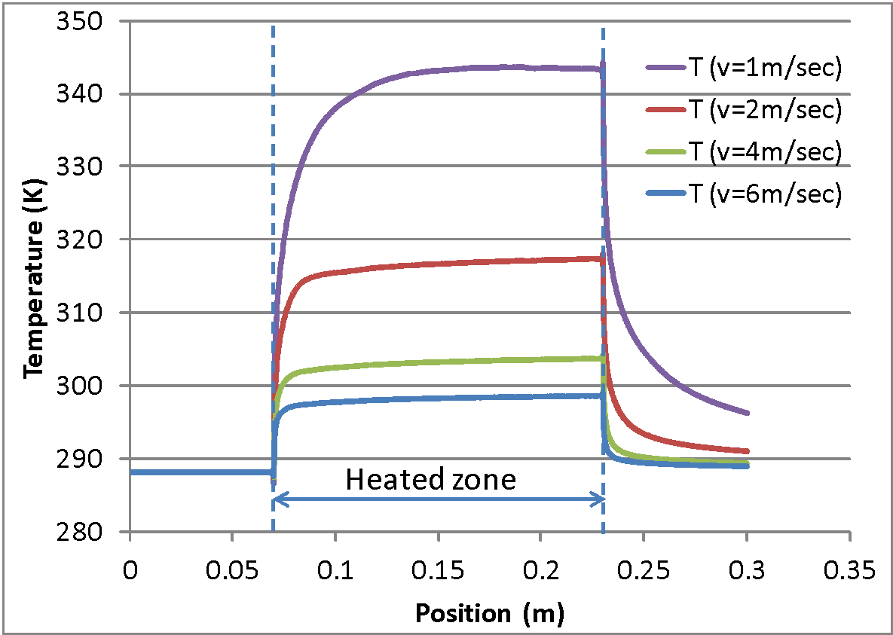
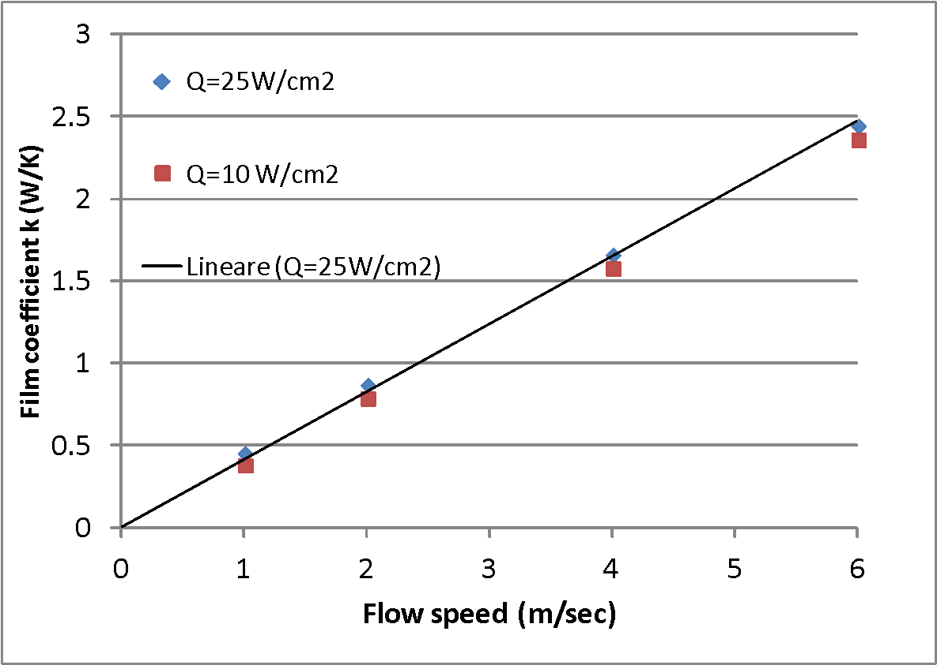
FLUID-DYNAMICS SIMULATIONS
Water cooling of disk amplifiers: modelling physics
Simulation software: COMSOL multiphysics (ver. 4.2 and 5.2)
Finite Element Analysis approach
Numerical solution of the Navier-Stokes equations for mass and energy transport
Low Reynolds k-ε solution method
Thermal coupling with boundary layer at the channel walls (heated Ti:Sa crystal)
Time-averaged simulation (i.e. time-dependent turbulences not modelled)
Velocity magnitude distribution
Temperature distribution
Example:
channel thickness 5 mm, flat channel walls
inlet flow speed 6 m/sec,
heat input 25 W/cm² (AMP3 at P1 performance level)
heated length 160 mm (AMP3 pump beam ∅);
temperature dependence of water properties
water input temperature 15 °C
mesh ∼ 128000 elements
292
Water flow direction
291
290
289
288
Temperature of Ti:Sa surface at different inlet flow speed
Water inlet temperature 15°C (288.15 K)
Heat input 25 W/cm2, Channel heigth 5 mm
Effective film coefficient (heat exchange coefficient between water and heated wall for different flow speed and heat input levels

Slide 28
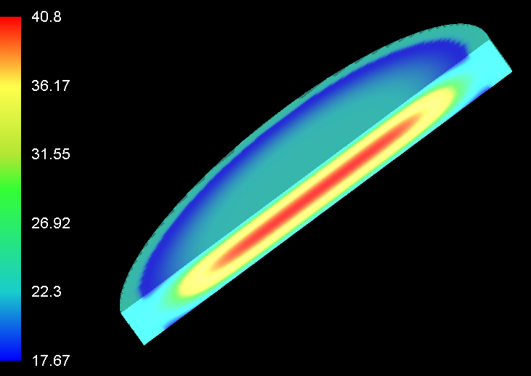
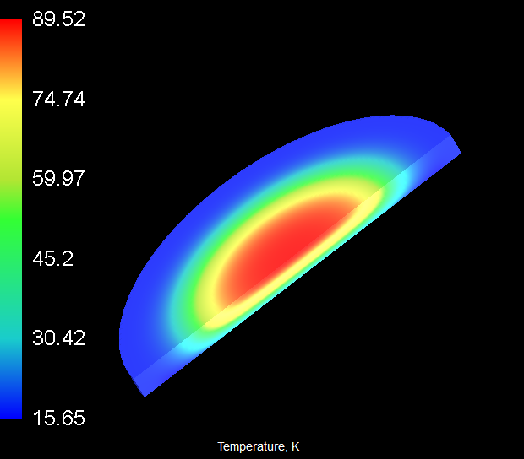
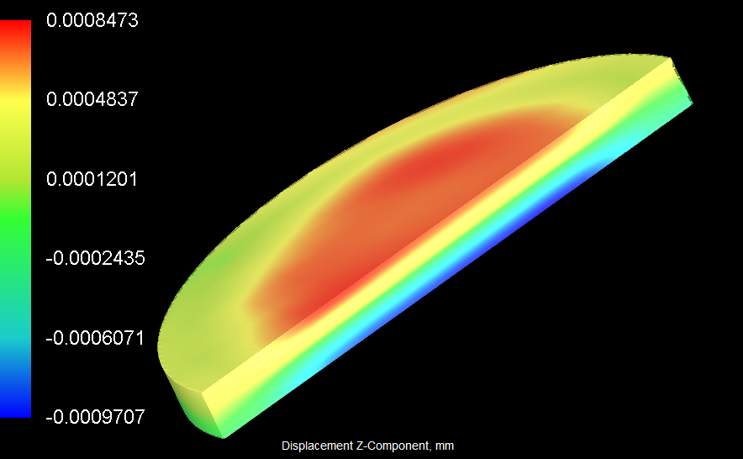
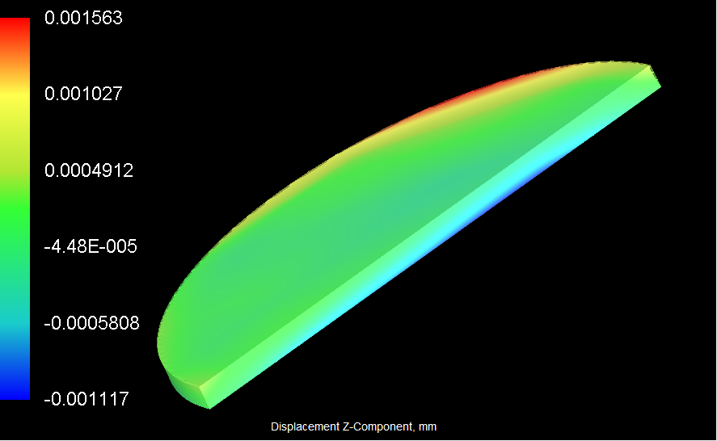
THERMOMECHANICAL SIMULATIONS
Temperature distribution
Temperature distribution for AMP3 transmission disk (left, 1.6 cm thickness) and AMP3 reflection disk (right 1.3 cm thickness) at P1 pump level
Peak T: 40.8 °C
Peak T: 89.5 °C
Deformation distribution
Phase modification requires Adaptive Optics compensation
Axial displacement distribution (mm) for AMP3 transmission disk (left, 1.6 cm thickness) and AMP3 reflection disk (right 0.8 cm thickness) at P1 pump level
Modelling: Finite Element Analysis (FEA)
Optical path difference (OPD)
OPD in microns resulting from thermal expansion and thermooptic effect. Parabolic fit and higher order aberrations also shown. Left: AMP3 transmission disk; right AMP3 reflection disk at P1 pump level

Slide 29
PUMP SOURCES TECHNOLOGIES
DiPOLE 100 (STCF)
Cryogenically operated Yb:YAG, diode pumped
100J @1030 nm , 10 Hz demonstrated
Energy stabilty 1% RMS (few hours of operation)
60 J SHG @ 515 nm, 10 Hz expected
Possible upgrades include:
IR Output energy 150 J
SHG output > 100 J
PRF 100 Hz @ 10 J
P-60 technology (Amplitude)
Nd:YAG Disk Amplifier Heads (DAH), liquid cooled.
Current design: flashlamp pumping
Scalable design (n. of DAH units): P20, P30…
Design specificatons (6 DAH):
~80 J @ 1064 nm, 10 Hz
60 J @ 532 nm, 10 Hz
Possible developments
- Diode pumping
- 50 Hz rep rate

Slide 30
DIMENSIONING OF PUMP SOURCES ARRAYS
P0 performance level
Issue: P0 operation regime has a pulse repetition rate of 20 Hz.
The two available pump sources have a repetition rate of only 10 Hz.
To circumvent this problem (until higher rep rate devices are developed) we considered to use two (or two sets) of pump sources and shot them interleaved, so that repetition rate of the pump pulses arriving to the amplifiers id effectively doubled.
Issue: Pump energies higher than about 60 J (as needed by the AMP3 module) require more than a single pump source.
This calls for specific arrangements to multiplex the input from several pump units to the amplification crystals.
P1 performance level
Issue: P1 operation regime considers a pulse repetition rate of 100 Hz, along with higher energies than P0. Currently no solutions for pump sources are available to meet these requirements.
Speculatively, we have considered the availability of a system similar to Amplitude P60 but operating at 50 Hz (conversion to diode laser pumping of the flashlamp pumped P60) with the same output energy of 60 J/pulse in the green.
Again, reaching 100 Hz requires the time interleaving of a pair of twin sources. This analysis did not include the DiPOLE 100 system, as no developments are currently planned toward a high energy, high rep rate system.

Slide 31
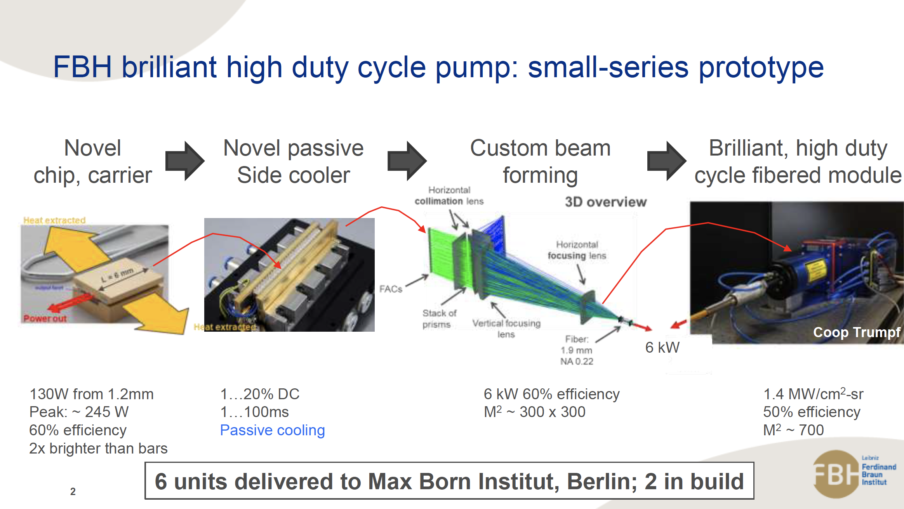
Diode laser developments

Slide 32
MAIN OUTPUTS OF THE EUPRAXIA DESIGN STUDY
Requirements on energy, pulse duration, stability etc set by the LPA working point
Design based on CPA in Ti:Sapphire, dictated by requirements vs. time scale
Thermal management issues addressed by means of liquid cooling
Main developments required:
Prototyping of Ti:Sa amplifiers: fluid cooling (choice between reflection/transmission amplifier): possibly by means of pilot devices
Addressing 100 Hz pump lasers developments
Thermal management of compressor gratings
Stability (pointing & more) and active control
Driver pulse temporal shaping and synchronization
Construction
Integration Issues

Slide 33
The end
Thank you!

