Slide 1
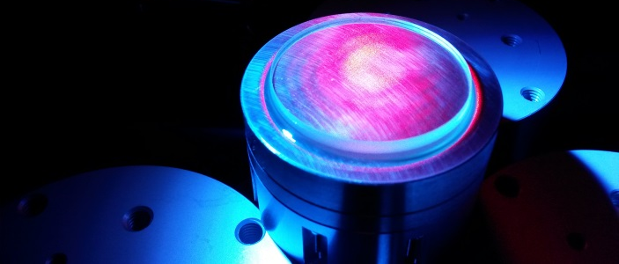
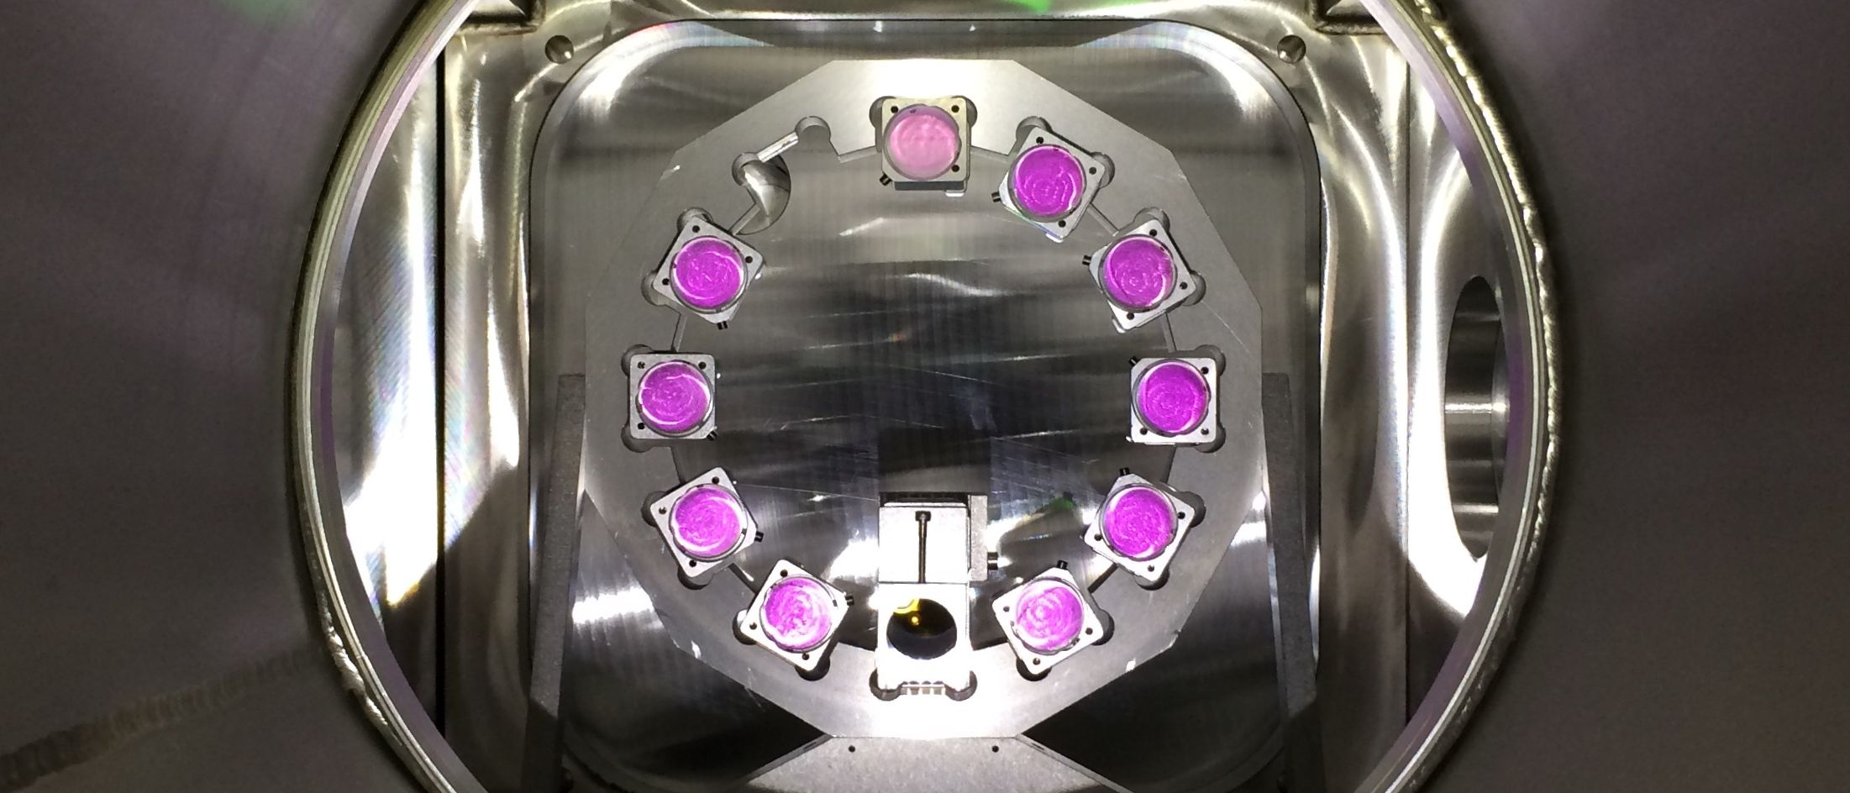
Joule-class Yb:YAG lasers for driving plasma-modulated plasma accelerators
by Mathias Krüger
A. Münzer and S. Karsch, S. Hooker and R. Walczak

Slide 2
kPAC - kHz Plasma Accelerator Collaboration
Concept of a Plasma-Modulated Plasma Accelerator (P-MoPA) [1]:
Collaboration with University of Oxford / Group of S. Hooker
Ultimate goal: 1 kHz, >1 J drive pulses for 0.5 GeV electron bunches
Modulator: ps-scale laser pulse converted to burst of fs-scale pulses
Accelerator: burst of pulses used as kHz driver for wakefield acceleration
Medium: cm-scale plasma waveguide
Good scalability with energy and average power (> 1 kHz, > 1J)
[1] Phys. Rev. Let. 127, 184801 (2021)
Notes:
Low energy 100 mJ sub 100 fs driving wakefield (1-2%)
Followed by high energy picosecond beam, travels in the wakefield
Modulated spectrally
Temporally still smooth

Slide 3
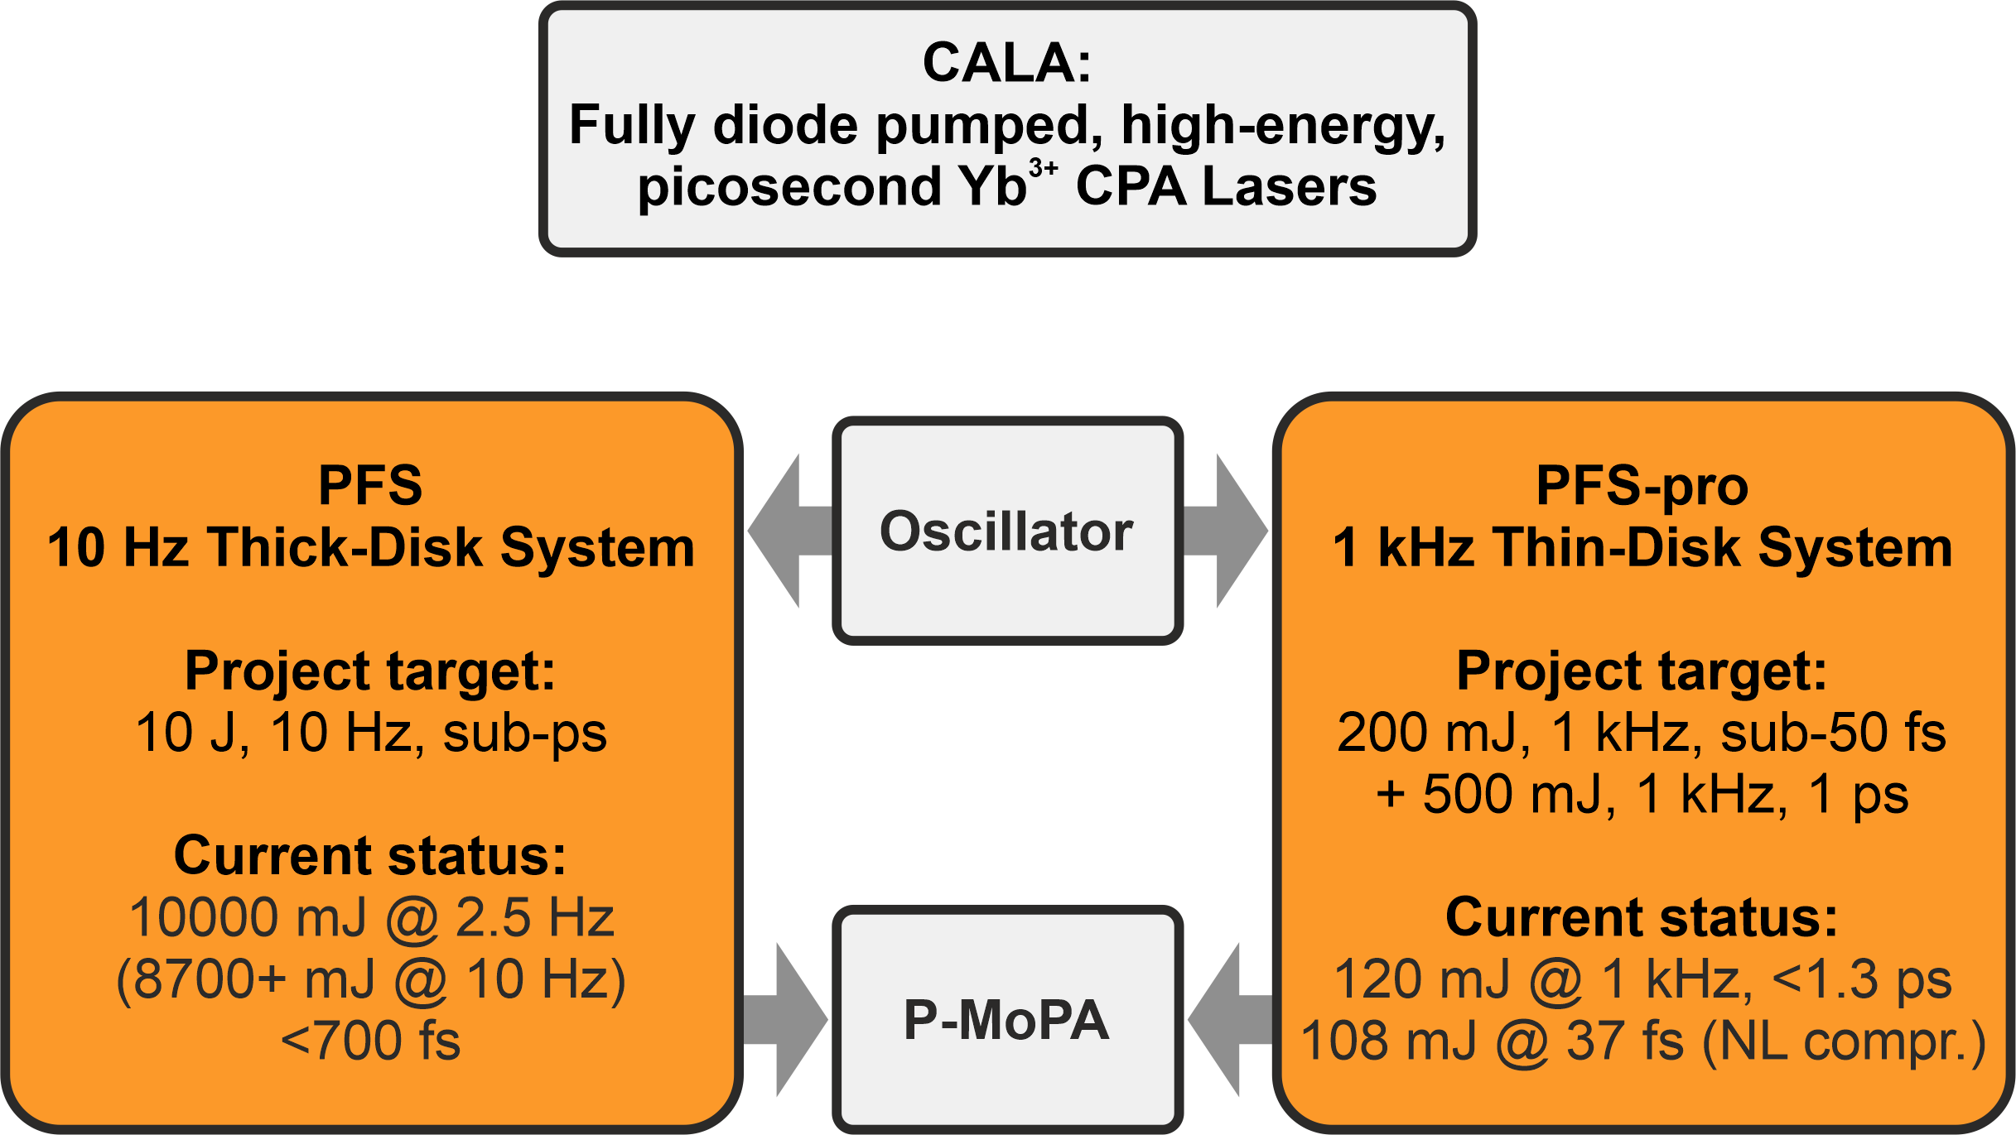
PFS and PFS-pro at CALA
Notes:
Kurze Kachelübersicht PFS – PFS pro mit Kerndaten der beiden Systeme gegenübergestellt / \

Slide 4
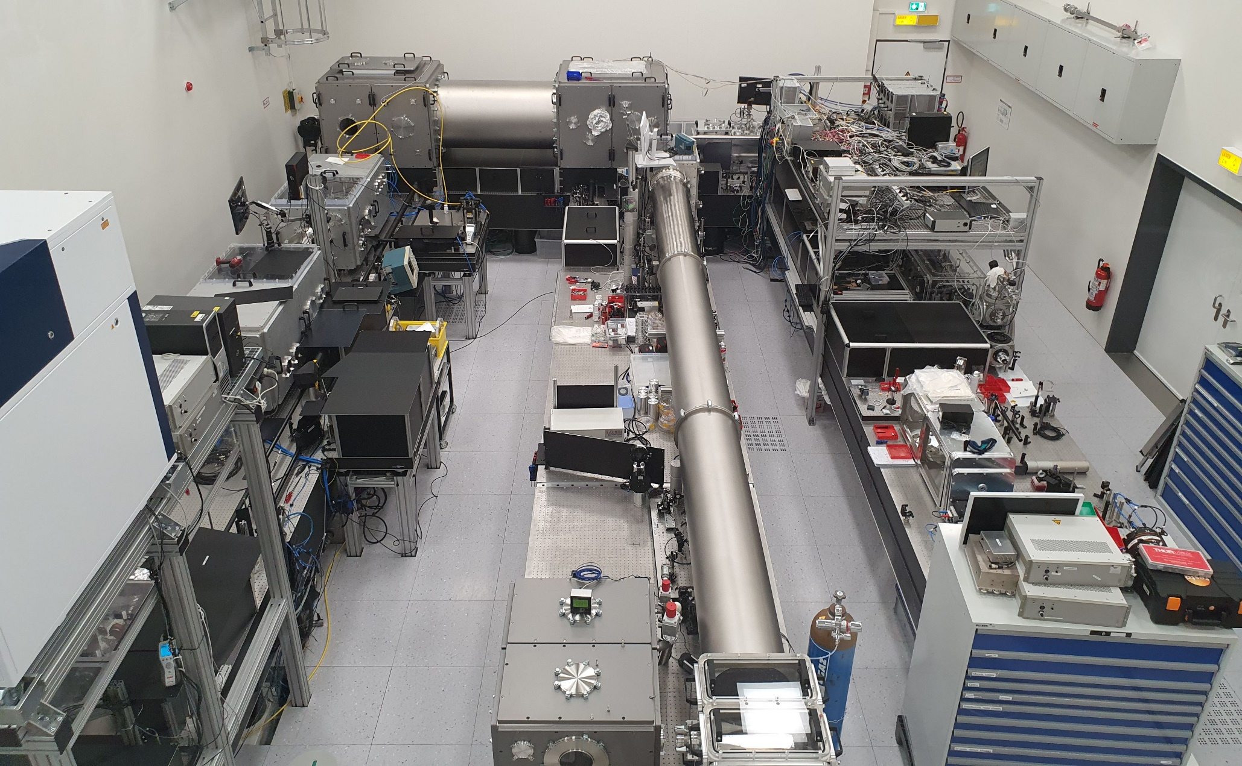
PFS and PFS-pro at CALA
PFS
(10 Hz)
PFS-pro
(1 kHz)
Notes:
Bild ändern mit Frontalaufnahme aus Kontrollraum, Kästen mit farbiger Füllung einfügen für PFS und PFS pro

Slide 5
The PFS System
(10 J, 10 Hz, <700 fs)
Notes:
Nur Einleitungsfolie

Slide 6
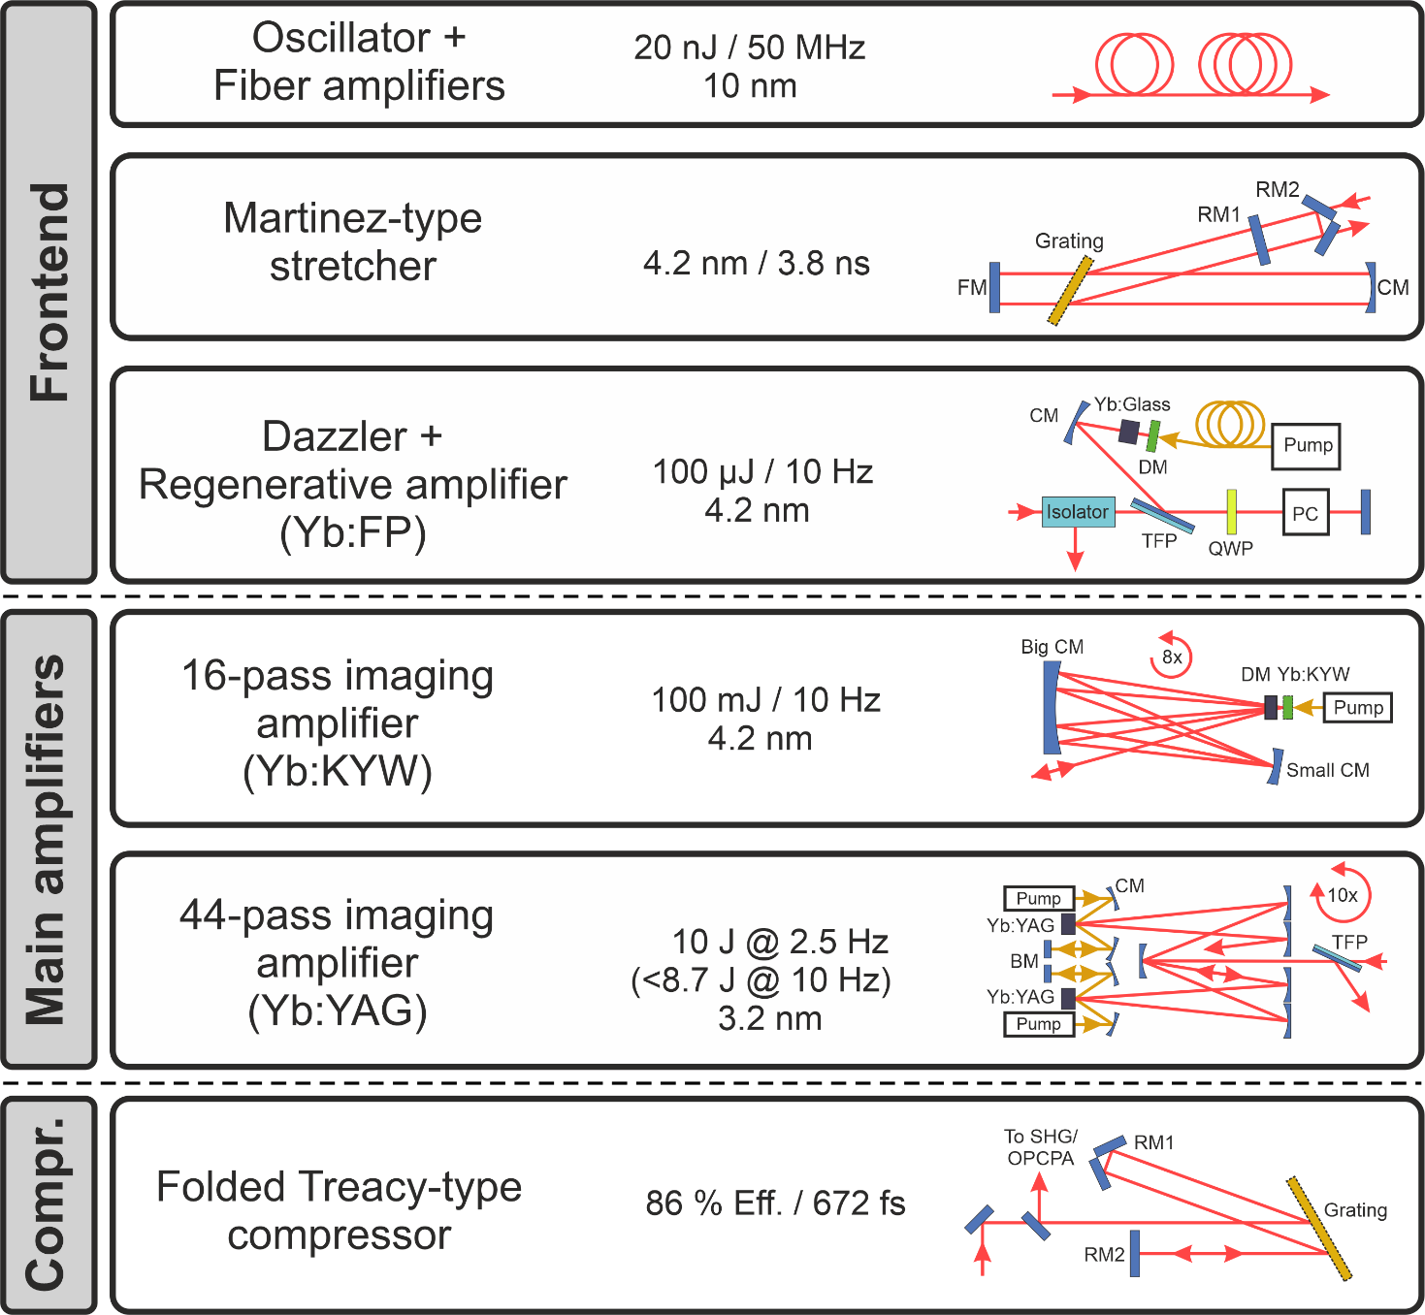
The 10 Hz PFS System
Notes:
Übersicht zu PFS mit Kenndaten der Verstärker
-> Farben der letzten beiden Boxen ändern!

Slide 7
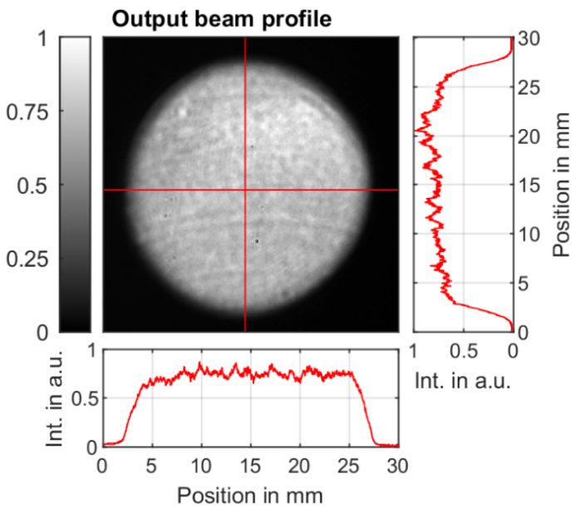
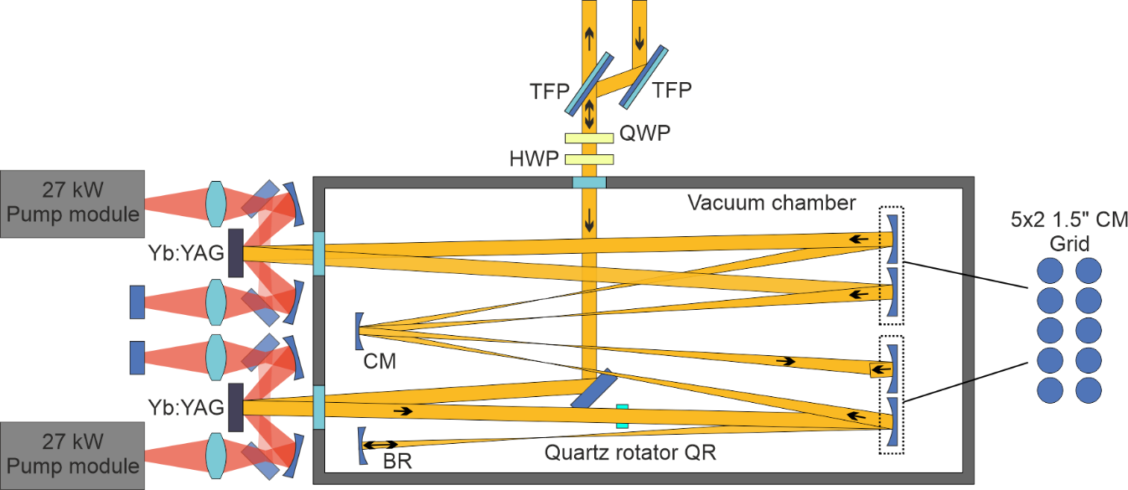
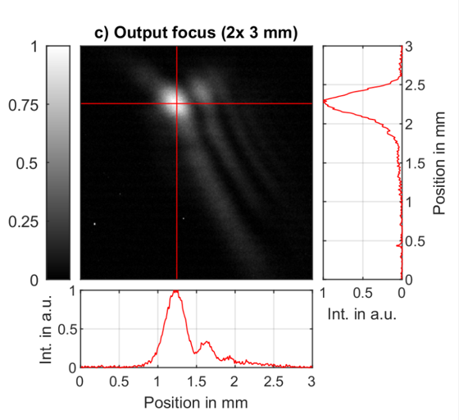
The 10 Hz PFS System
Main amplifier key figures:
Concept: 44 pass, double Type 2 imaging [2]
Gain medium: 2x D38x3 mm 2% Yb:YAG @ 20°C cooling
Pump per medium: 27 kW @ 940 nm, 1 ms, 10 Hz
Output: 8.7 J +- 0.5 % @ 10 Hz, 60 mJ seed
[2] J. Körner, Applied Sciences, vol. 6, no. 11, 2016
Notes:
Leistungsdaten des komprimierten Lasers inklusive NF Beam profile, FROG

Slide 8
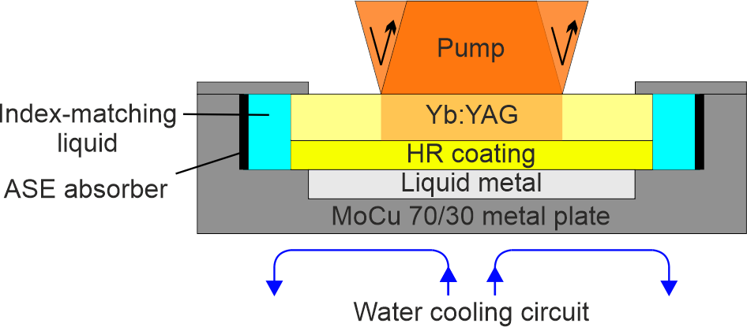
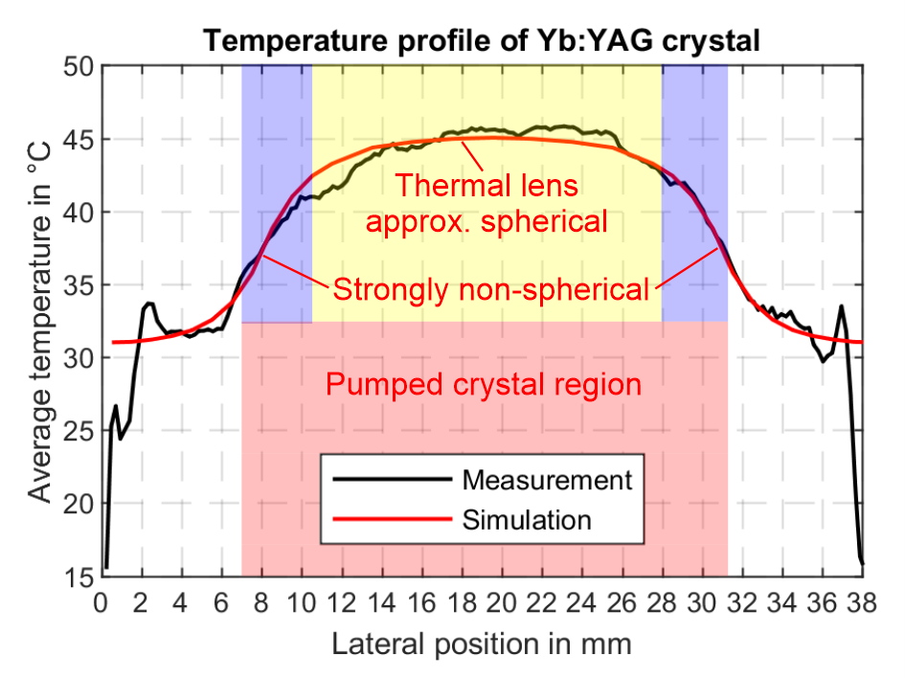
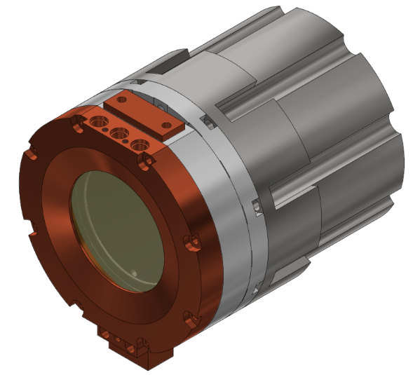
The 10 Hz PFS System
Thermal lens / LIDT limited operation:
Cooling: Active mirror, liquid metal interfaced water cooling @ 20°
Issue: Too efficient cooling, steep thermal gradients at 10 Hz // 270 W pumping
Solution: Modified heatsink design with negligible gradients
Notes:
Leistungsdaten des komprimierten Lasers inklusive NF Beam profile, FROG

Slide 9
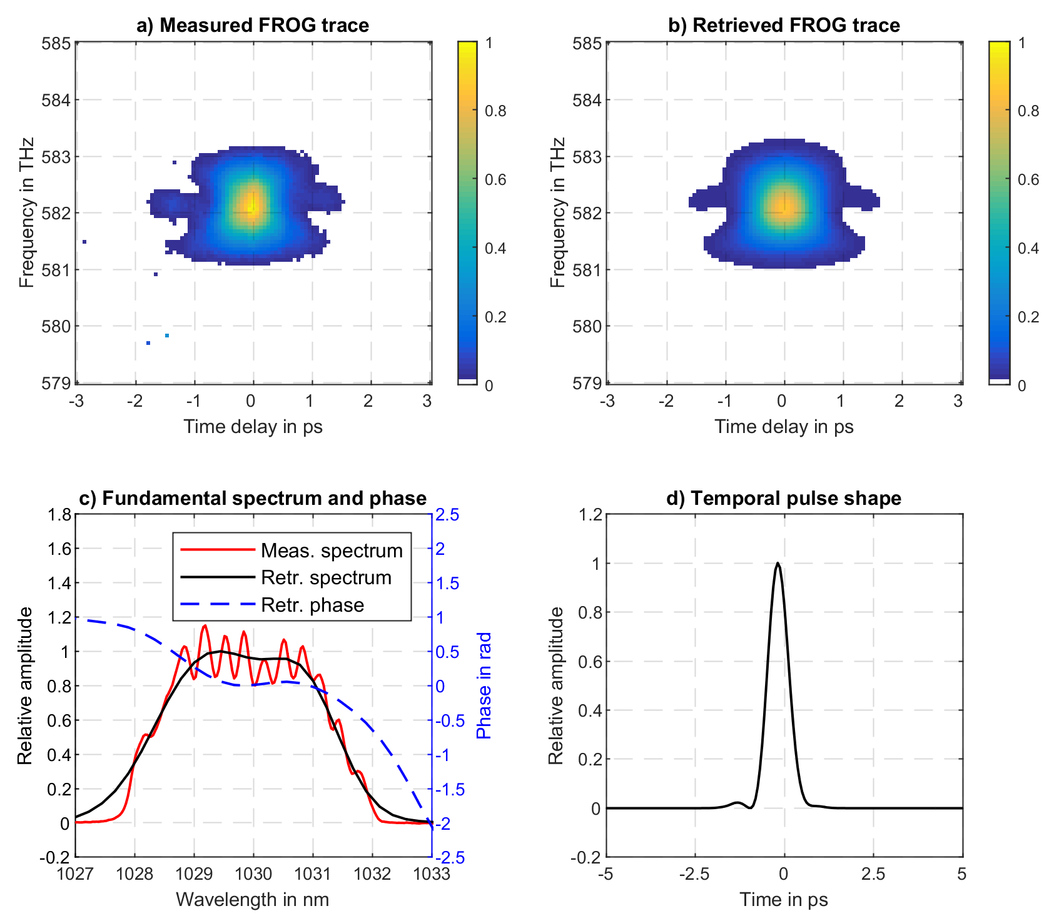
The 10 Hz PFS System
Compression:
>3.1 nm bandwidth @ 10 J, 2.5 Hz
86 % compressed to 672 fs
FL: 652 fs
G-error: 6%
Notes:
Leistungsdaten des komprimierten Lasers inklusive NF Beam profile, FROG

Slide 10
The PFS-pro System
(120 mJ, 1 kHz, 1.3 ps/37 fs)
Notes:
Nur Einleitungsfolie

Slide 11
The 1 kHz PFS-pro System
Notes:
Prinzipieller Aufbau des Systems in Kacheln, von links nach rechts, sodass auf folgenden Folien jede Kachel beleuchtet werden kann und der entsprechende Teil des Lasers beschrieben werden kann

Slide 12
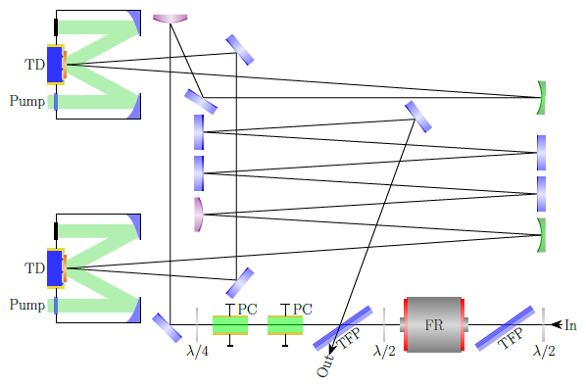
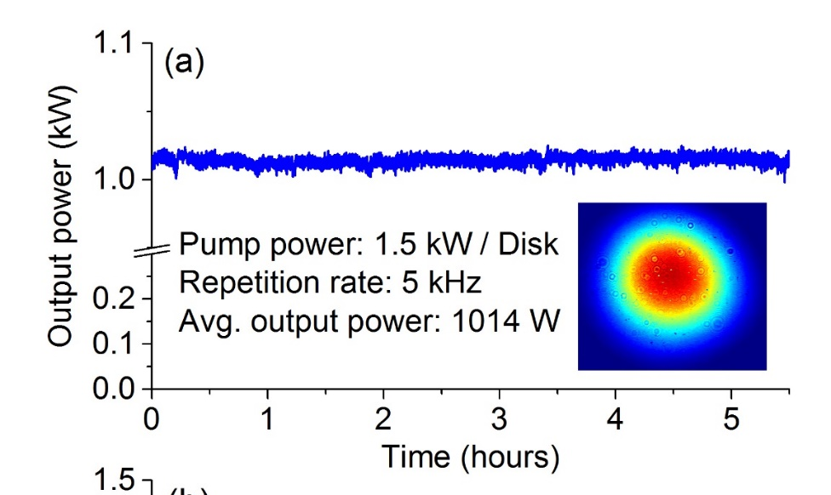
The 1 kHz PFS-pro System
Main amplifier key figures:
Concept: Ring type regenerative amplifier
Gain medium: 2x Yb:YAG Thin-Disks (TRUMPF GmbH)
Pump per medium: 1.5 kW @ 969 nm, CW/1 kHz
Output @ 5 kHz: 200 mJ // 1000 W
Output @ 1 kHz: 120 mJ // 120 W, non-optimized)
0.3 % RMS power stability over 5h
Notes:
Regen

Slide 13
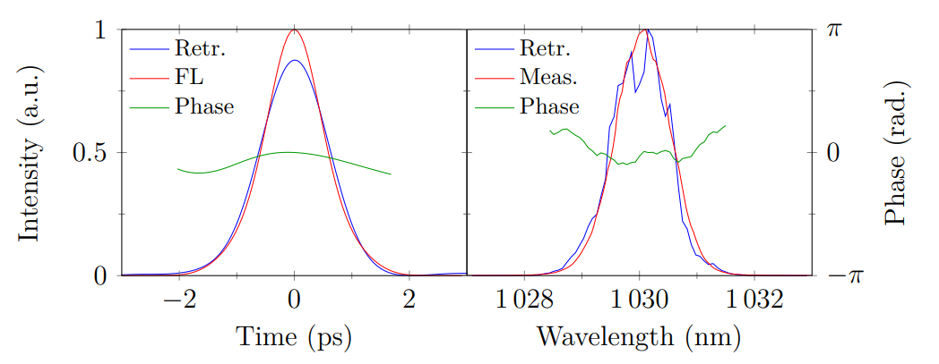
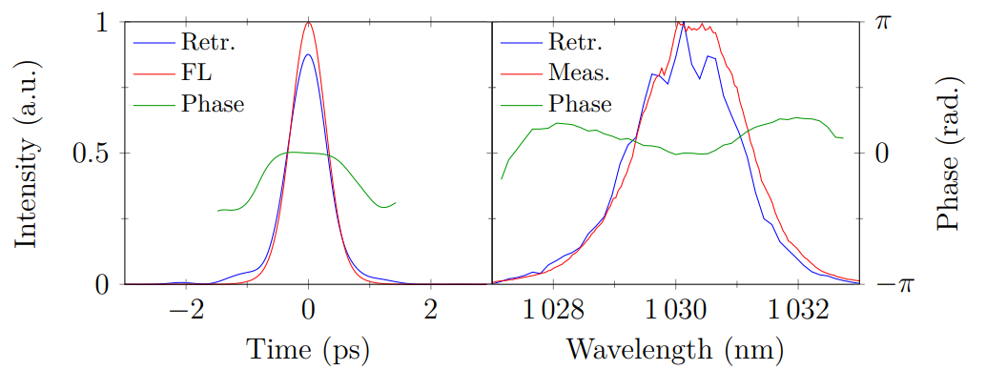
The 1 kHz PFS-pro System
Compression:
Grating compressor 94% eff.
Normal operation (no PreAmp):
1.1 nm FWHM
1.3 ps
Broadband operation with old PreAmp:
2 nm FWHM
750 fs
Notes:
Kompression

Slide 14
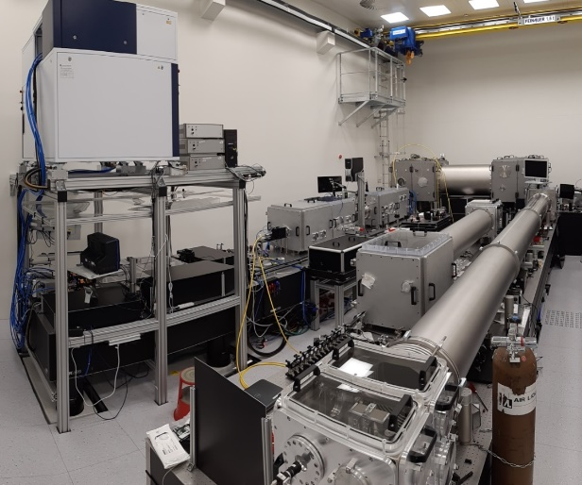
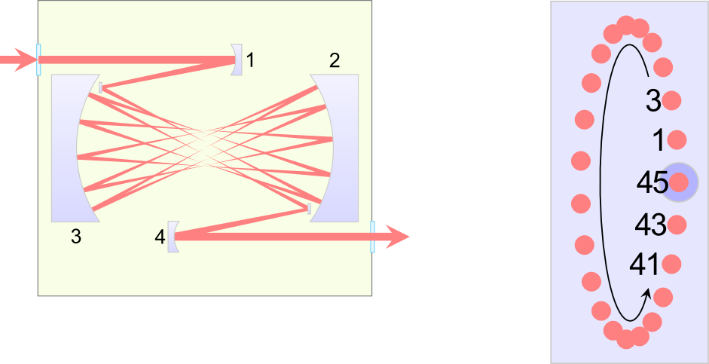
The 1 kHz PFS-pro System
Multipass Cell (Herriott Cell):
Nonlinear broadening by self-phase-modulation in gas (Argon, Helium)
Resonator-like, up to 45 roundtrips
8 m long chamber for 100+ mJ
Beam on
Mirrors 2/3
Foci
Input pulses
8 m
Broadened pulses
Notes:
HC

Slide 15
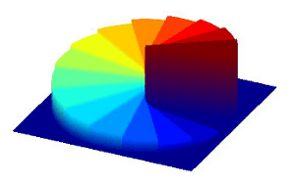
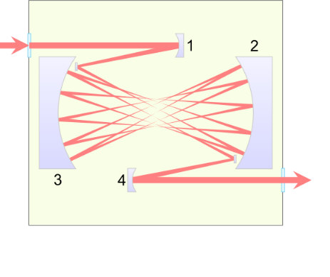
The PFS-pro System
Multipass Cell (Herriott Cell):
Use of TEM11 mode via vortex phase plates
2x bigger beam size with 2.5x less peak intensity
Less ionization and LIDT issues, more throughput
250 mBar Argon
560W (112 mJ)
1.3 ps
TEM00
Focus at 540W
(108 mJ)
>70% of Energy
within 1/e²
Vortex phase plate
(SiO2 plates with a vortex surface)
TEM11*-like
Notes:
HC

Slide 16
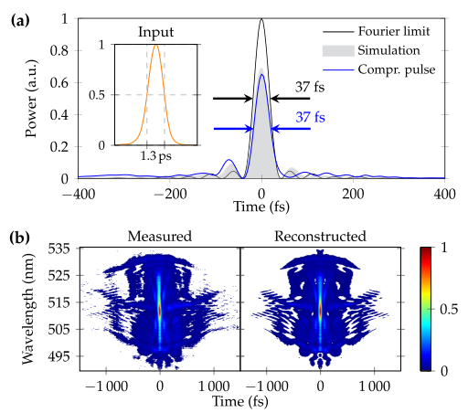
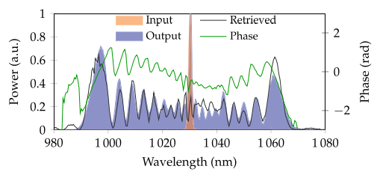
The 1 kHz PFS-pro System
HC output and compression [3]:
On record 108 mJ @ 5 kHz, ~75 nm, 96% eff.
Compression of low energy fraction in CM compressor to 37 fs
12 bounces on 4“ mirrors with -500 fs²
[3] Vol. 46, No. 5 / 1 March 2021 / Optics Letters
Notes:
HC

Slide 17
The PFS lasers for kPAC
Notes:
Nur Einleitungsfolie

Slide 18
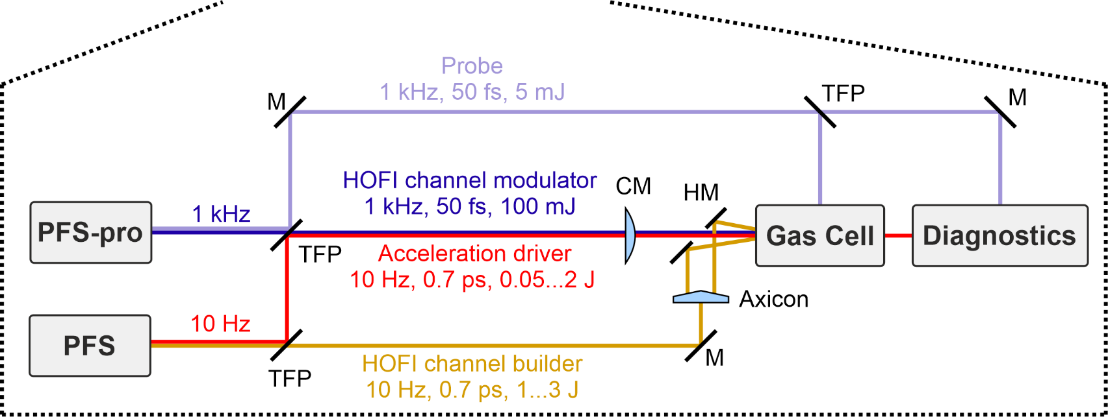
kPAC @ CALA
Concept of P-MoPA experiment at CALA:

Slide 19
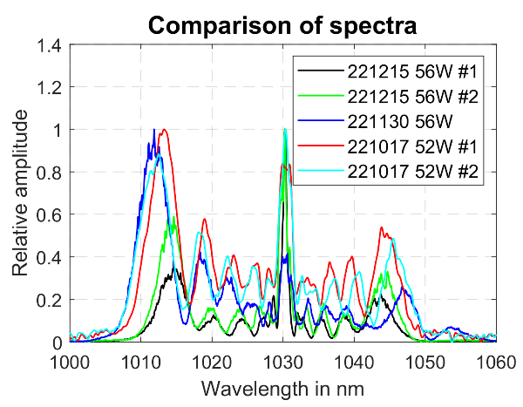
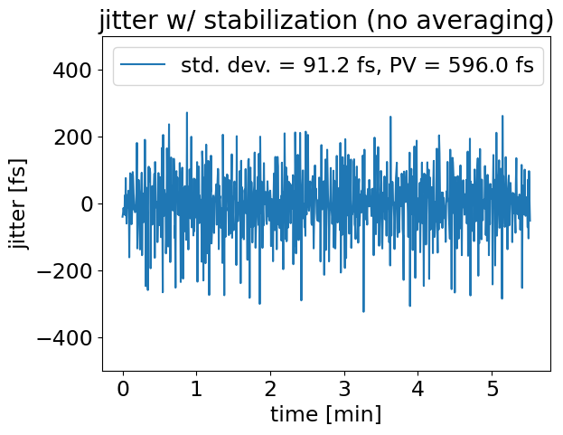
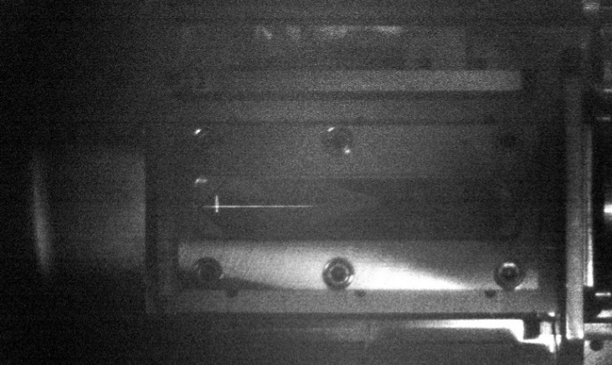
First results of kPAC
First results:
Pointing fluctuation: 10-30 % of respective focus diameter
Timing jitter: 92 fs Std. Dev
Stability of Herriott Cell: +-10 % bandwidth over 10 months (no maintenance)
Spectral stability Herriott Cell
Timing jitter PFS / PFS-Pro
First hydrogen plasma channel

