Slide 1
Pulse characterisation technique for multi-pulse laser plasma wakefield accelerators
Speaker: Wei-Ting Wang
Position: PhD student
Institute: University of Oxford

Slide 2
Outline
Introduction
Why PMoPA
Pulse train generation
How to characterise pulse trains
From SSA to FROG
Requirements for the device
Experimental setup
Phase retrieval results
Outlook
PMoPA and pulse characterisation
Summary

Slide 3
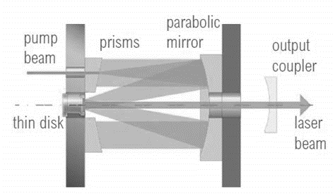
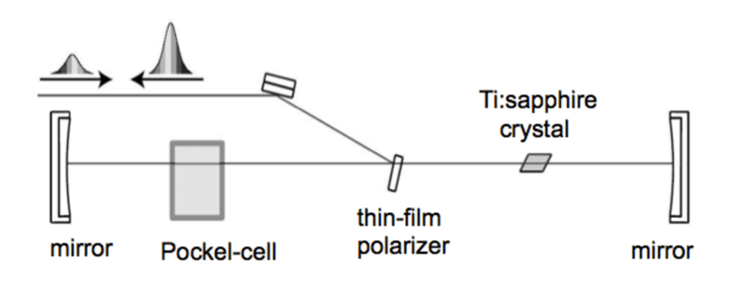
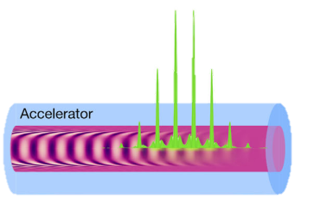
Why P-MoPA?
Inefficient laser systems ($η<1\%,$ $\sim$ Hz)
Efficient laser systems ($η>20\%, \sim$kHz)
Ti:sa
crystal
Yb:YAG
disk
~ Hz
~ 10s fs
~ 1k Hz
~ 1 ps
P-MoPA
Pulse spacing
$\sim$200 fs
Conventional LWFA
Wakefields
Laser pulse
Notes:
Problem of Ti:sa, quantum conversion efficiency and heat
Feature of laser pulses

Slide 4
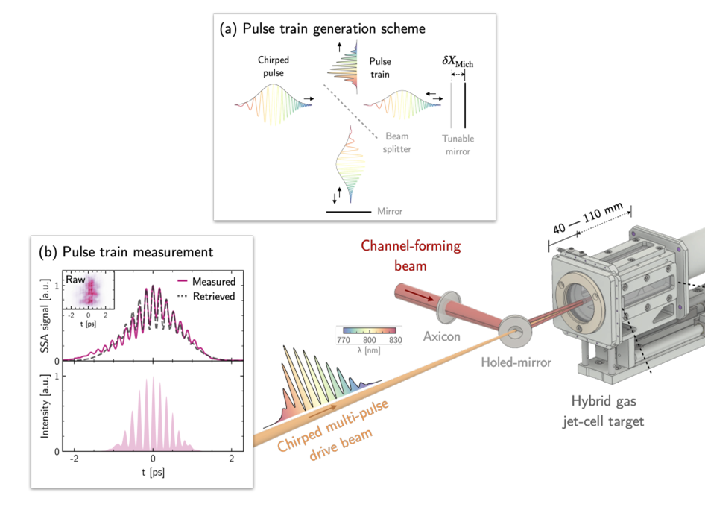
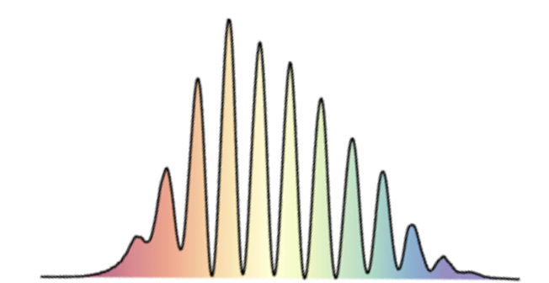
Pulse train generation for proof of principle experiment
high peak power
Single pulse
Pulse
Generation
Pulse
Measurement
GDD
control
Grating pair compressor
Delay time
control
Michelson interferometer
A. J. Ross et al., Observation of resonant excitation of plasma waves in a plasma channel. Internal communication. (To be submitted).

Slide 5
From SSA to FROG
Single-shot autocorrelator
Single-shot blind FROG
NLO
NLO
Beam
Splitting
Beam
Splitting
Imaging Spectro-meter
Camera
Experimental
SSA signal
Experimental FROG trace
Phase retrieval algorithm
Spectrum
Pulse train
Simulated
SSA signal
Spectrum
Delay time
Pulse train
Physical model
Spangenberg et al., Time domain ptychography.
PHYSICAL REVIEW A 91, 021803(R) (2015).

Slide 6
Requirements for characterisation of multi-pulse trains
Pulse train properties
Nonlinear crystal
Type-1 BBO
Cut angle: ${44}^{°}$
Temporal window: 12 ps
Number of pulses: 10 - 15
Pulse spacing: 100 fs - 200 fs
Pulse duration (FWHM): 1 ps – 3 ps
Required temporal window: $≥$6 ps
Spectral and temporal resolution
Imaging spectrometer
Grating: 1200 l/mm
Focal length: $≤$ 100 mm
Detector size: 2/3”
Resolution: 0.03 nm
Required points to resolve one cycle: $≥$10
Temporal resolution: 10 fs – 20 fs
Spectral resolution: $≤$ 0.35 nm
Spectral window: $≥$104.5 nm

Slide 7
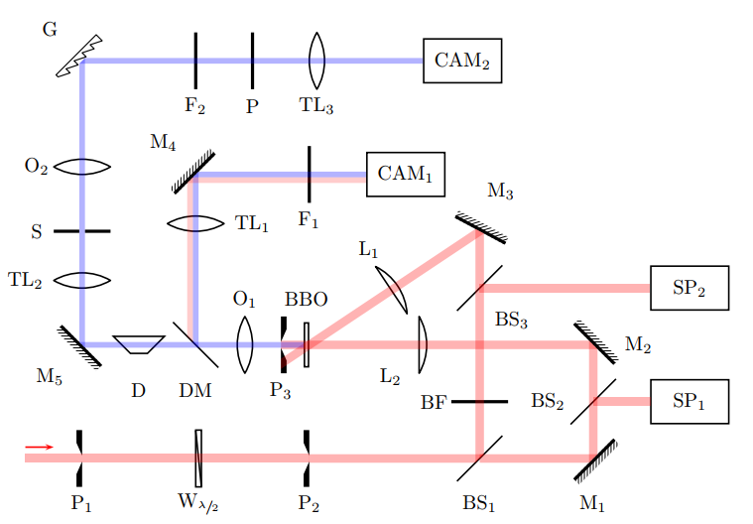
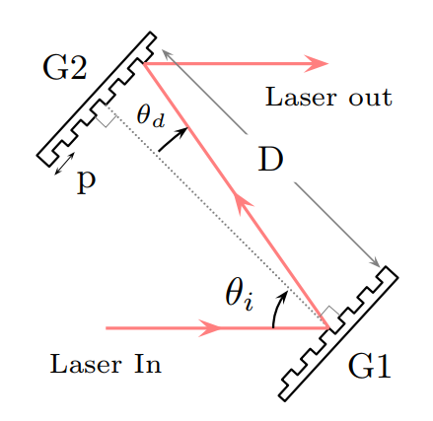
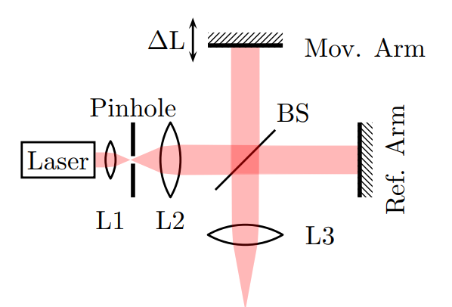
Proof of principle experiment
Grating
Compressor
Michelson
Interferometer
Imaging spectrometer
Line-array
spectrometer
Chirping
Temporal
interference
Self-referenced cross-correlator
2 mJ, at 790 nm, at 1 kHz

Slide 8
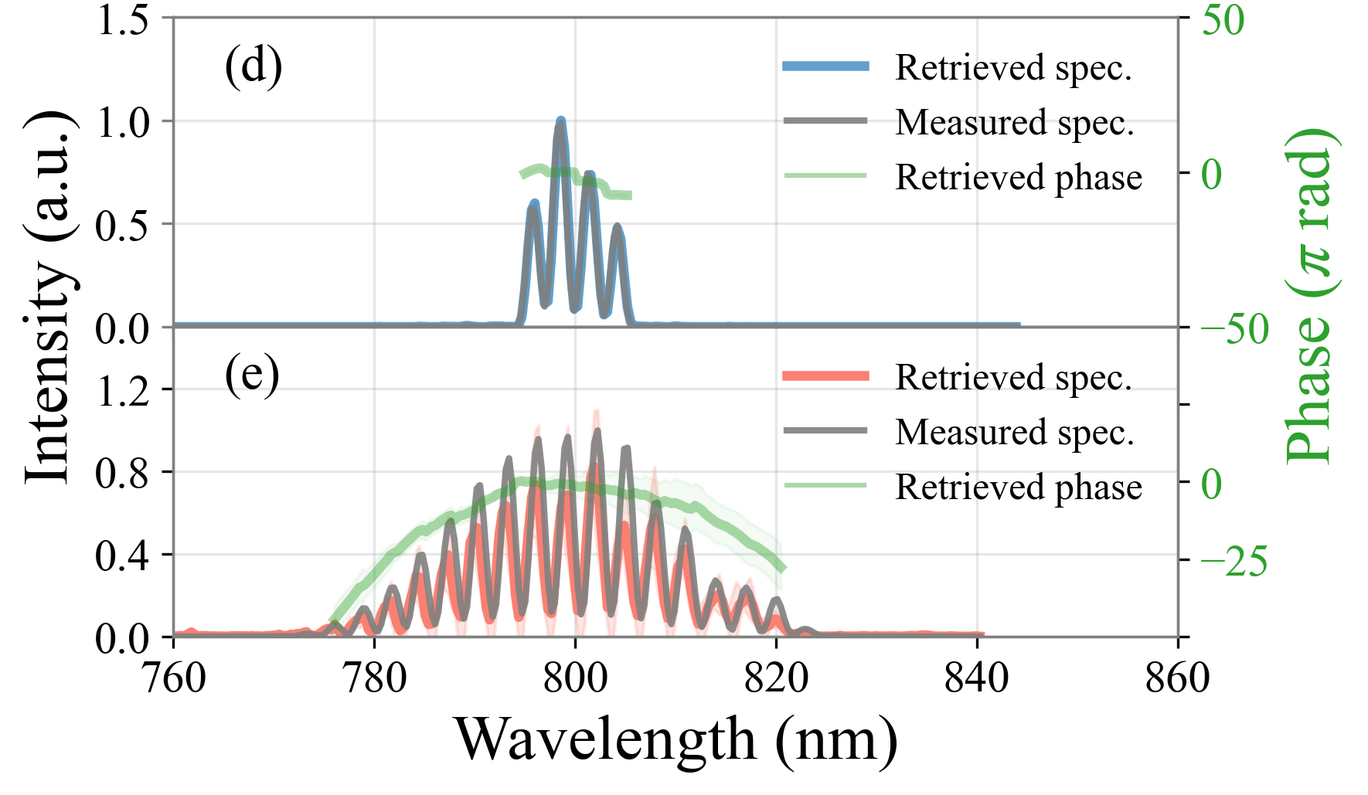
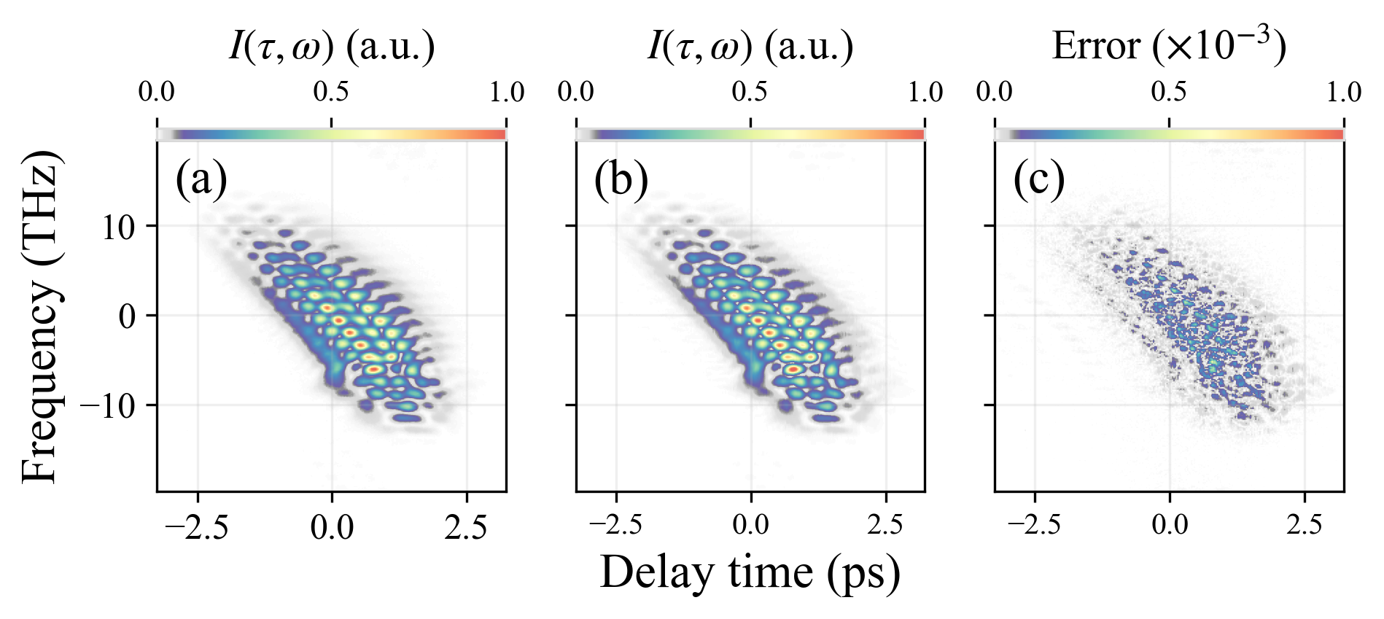
Pulse retrieval results
Retrieved FROG trace
Retrieved spectrum
(a) Measured
(b) Retrieved
(c) Error
(d) RMS $σ$of filtered spectrum: $\sim$ 8 %
(e) RMS $σ$ of pulse train spectrum:$\sim$22 %
FROG $σ$: 9$×{10}^{−3}$

Slide 9
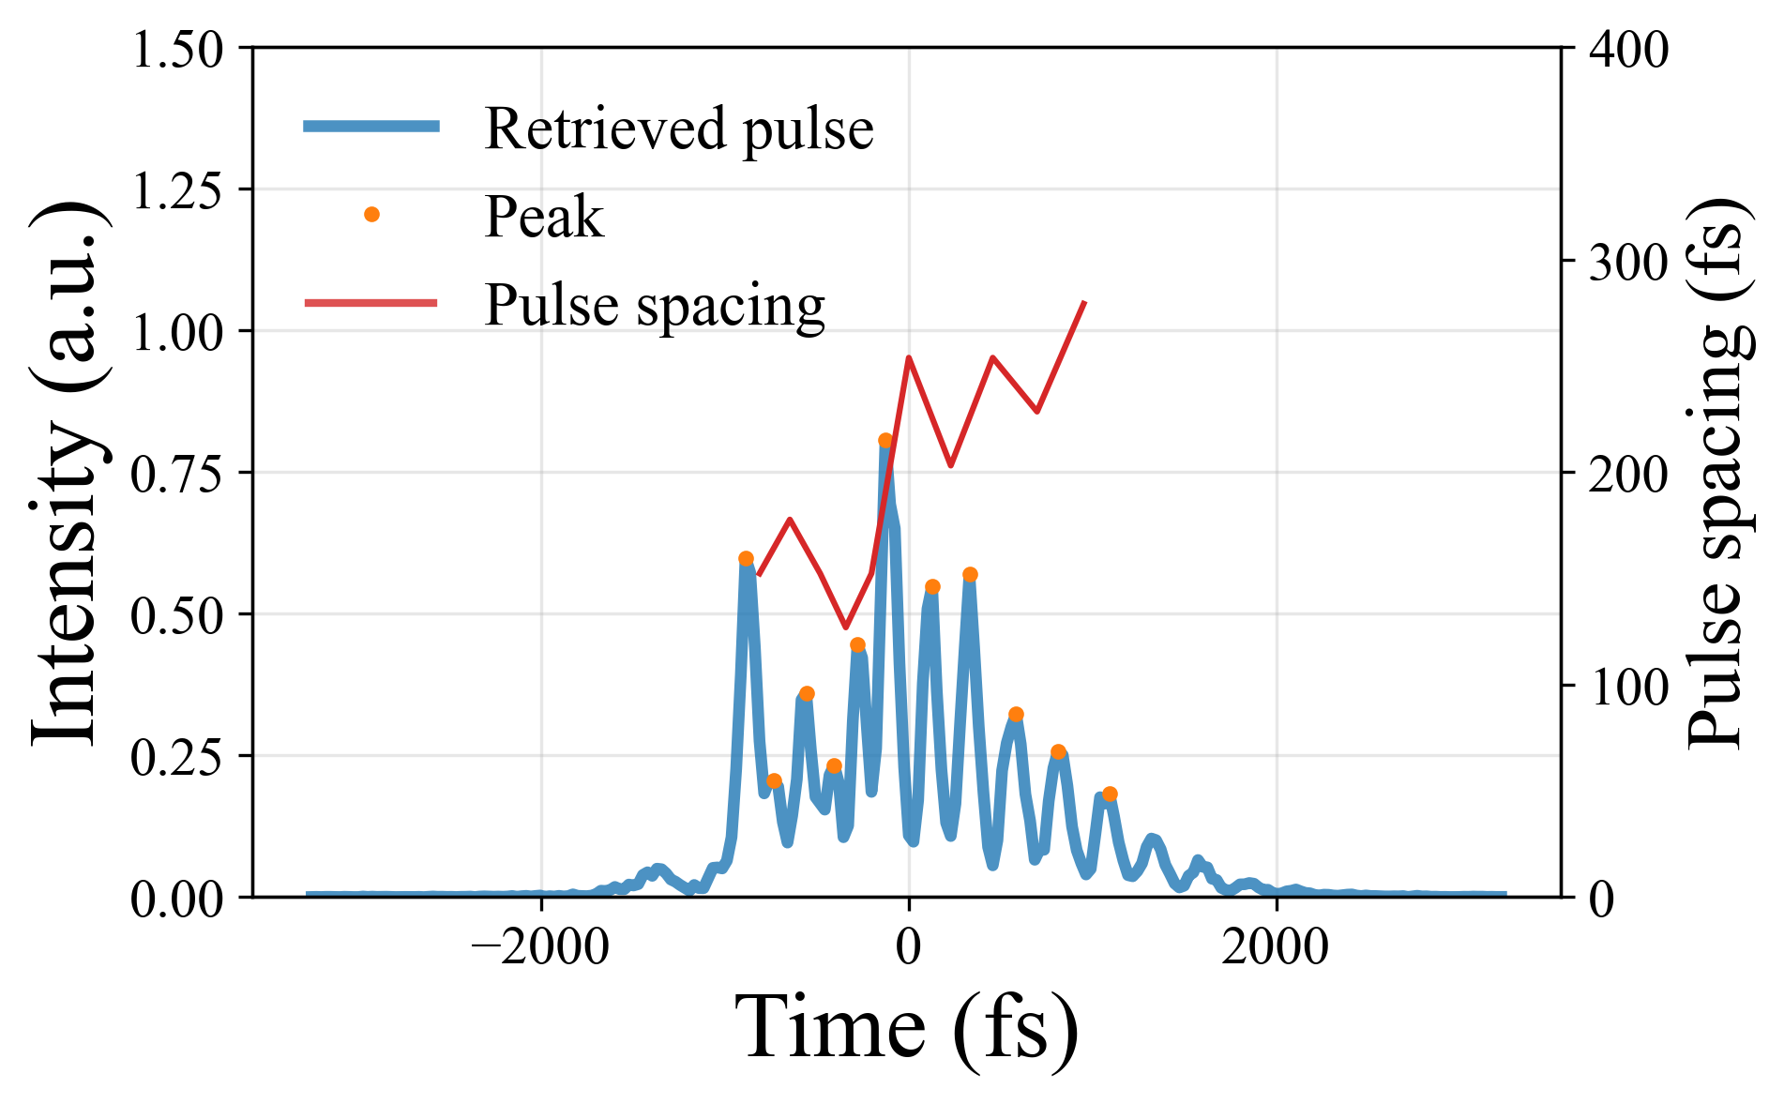
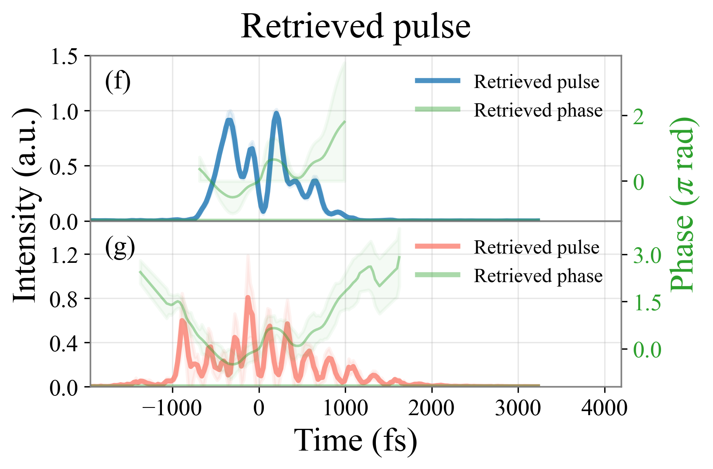
Pulse retrieval results
Pulse structure
Retrieved pulse
280 fs
Filtered
Reference
160 fs
Input
Avg. pulse spacing: $\sim$200 fs
Non-uniformity $δ$: $\sim$10 fs
Time-bandwidth product (TBP) of (g): $\sim$13
Number of pulses in (g): $\sim$11
$$δ=\frac{\sum{(∆t_{n}−∆t_{n−1})}}{N_{peak}−1}$$

Slide 10
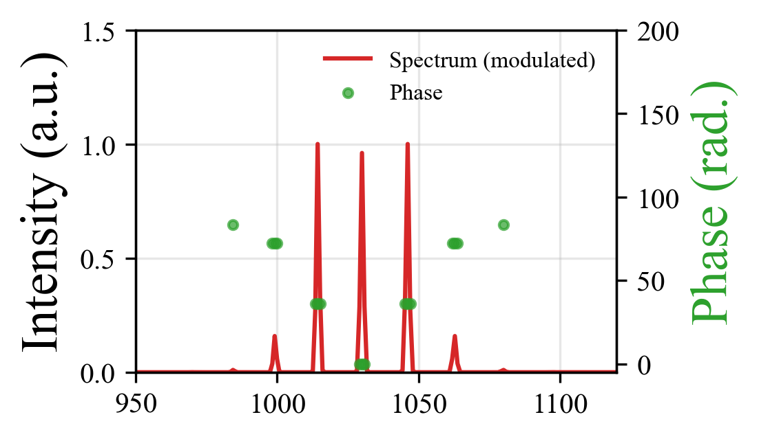
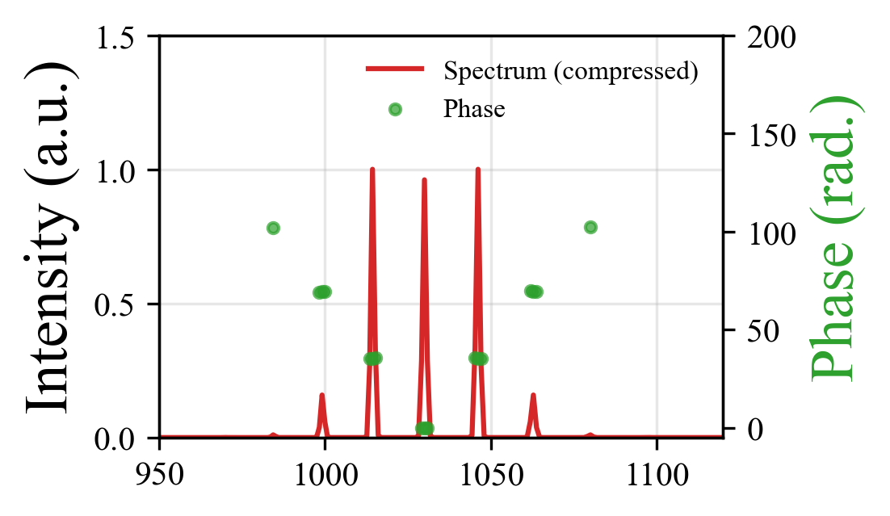
Outlook: P-MoPA concept
Modulated
pulse
Compressed
pulse
More challenging to measure pulse train since spectrum is discontinuous!
3. Characterisation
4. Acceleration
O. Jakobsson et al.,
PHYSICAL REVIEW LETTERS 127, 184801 (2021).
1. Modulation
2. Compression

Slide 11
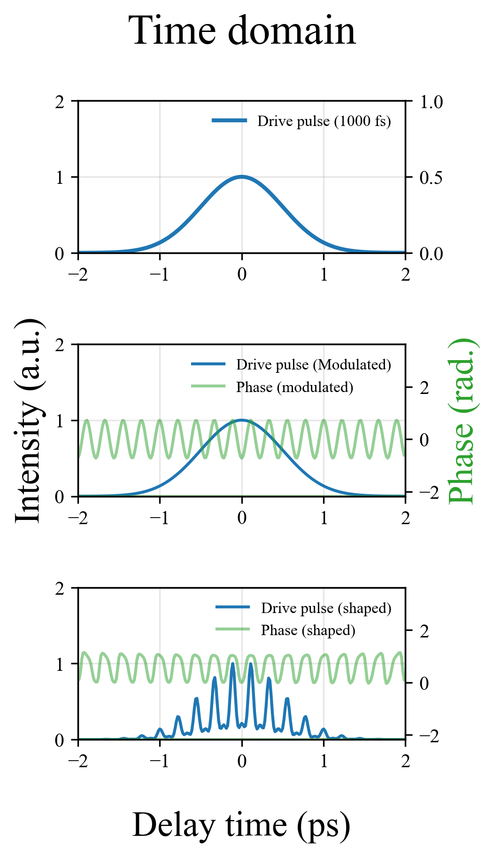
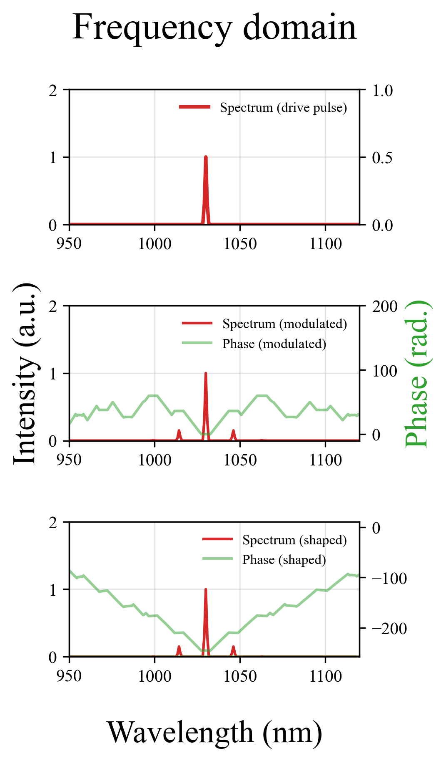
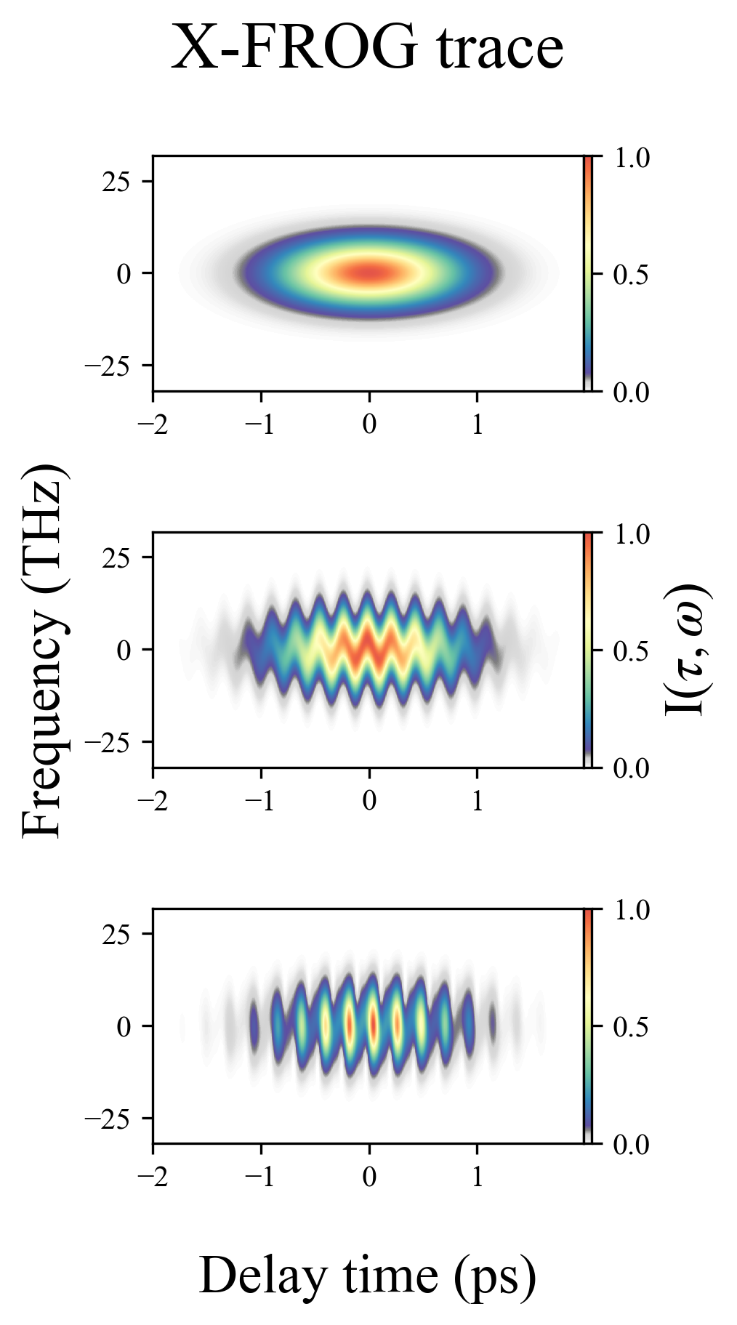
Outlook: P-MoPA pulse train
Pulse
Spectrum
Phase
Input pulse
Smooth pulse
Smooth spectrum
After modulation
Smooth pulse
Spectral sidebands
After compression
Pulse train
Spectral sidebands

Slide 12
Summary
We have demonstrated a single shot FROG device for MP-LWFA.
11 pulses with avg. pulse spacing of 200 fs were retrieved.
Image quality of the FROG trace is a key limitation.
More challenging pulse characterisation in P-MoPA.
We are investigating reliable pulse diagnostic techniques for P-MoPA.

Slide 13
Backup slides

Slide 14
Pulse characterisation for MP-LWFA
 | Self referenced | Cross referenced
Time | Auto-correlation | Cross-correlation
Frequency | SPIDER (Spectral phase interferometry for direct electric-field reconstruction) | Spectral interferometry
Time-frequency joint | FROG (Frequency resolved optical gating) | Cross-correlation FROG
Antoine Monmayrant et al., J. Phys. B: At. Mol. Opt. Phys. 43 (2010) 103001.

Slide 15
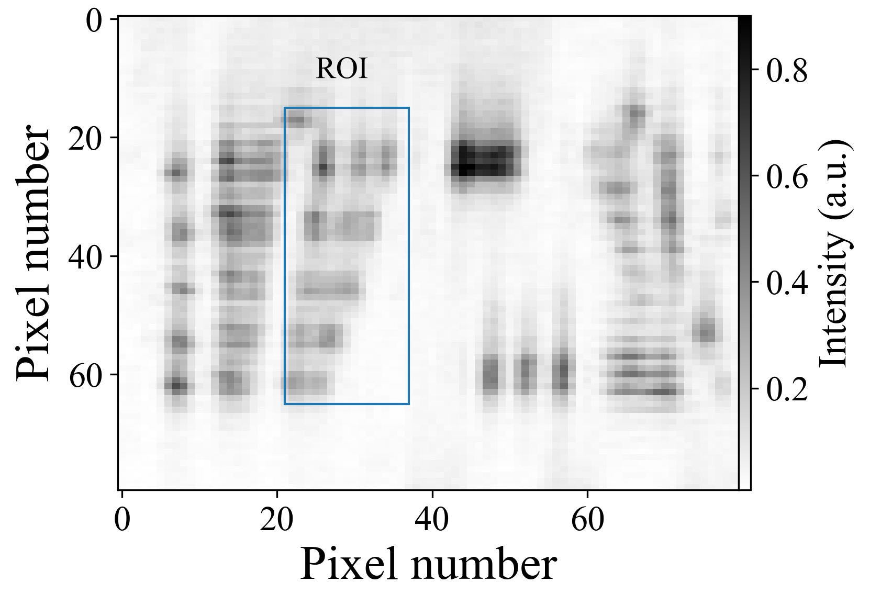
Resolution of imaging system
Imaging system
Resolution testing
Calibration
Manual delay stage
Auto-convolution
Temporal calibration
Spectral calibration
Grating
Spot size: 15 mm
Focal length: 75 mm
Focused spot size: 5 $μm$
True resolution: 7 $μm$ at 405 nm
$$dt$$
$\sim$ 16 fs
$$dλ$$ $\sim$ 0.06 nm

