Slide 1
Laser development for LWFA and future plans
Laura Corner
laura.corner@liverpool.ac.uk
Cockcroft Institute, University of Liverpool

Slide 2
Outline
LWFA requirements
Some promising technologies
Future plans at Liverpool/Cockcroft in LWFA

Slide 3
Applications for particle accelerators
Laser plasma wakefield acceleration is a promising technology for high gradient particle acceleration - source of compact, perhaps cheaper accelerators - 10 GeV/few cm.
But only with high efficiency drive systems – rf klystrons 40 – 50%, prototypes up to 80 or 90%.
What’s a perfect laser driver?
High peak power
High average power
High rep rate
Short pulse length
High efficiency
Excellent beam quality
800 nm? 1 μm? CO₂ @ 10μm?
How short?
Wavelength?
Multi-pulse? Modulation of ps pulses? External injection? MOPA? Different injection & acceleration stage lasers?
kHz? 100s kHz? MHz?
Lasing medium?
How high rep rate?
One that works!!
What’s out there?
Luminosity – collider running time
3

Slide 4
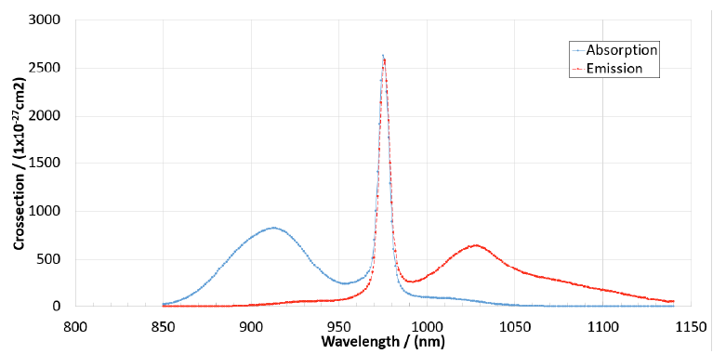
Fibre lasers
quantum
defect
Fibre lasers:
Yb – low quantum defect.
Direct diode pumping nir (@976nm).
Optical-optical 80%.
WPE 40%.
Single mode – efficiency at focus (intensity!)
Air/water cooled.
Yb:glass
Current laser drivers for LWFA:
High peak power (100s TW/PW systems, J, <100 fs)
Low repetition rates ~ 1Hz (low average power)
Inefficient – expensive to run
Fibre lasers:
High repetition rates (> kHz)
Low pulse energy (~ mJ)
Single fibres considered limited to < 10GW peak power (Schimpf et al. J. Opt. Soc. Am. B. 27 20151 (2010))
Can we use this technology to make both high peak and average power lasers?
Make many low energy pulses into one high energy pulse – coherent combination
4
4

Slide 5
Tiled aperture
5

Slide 6
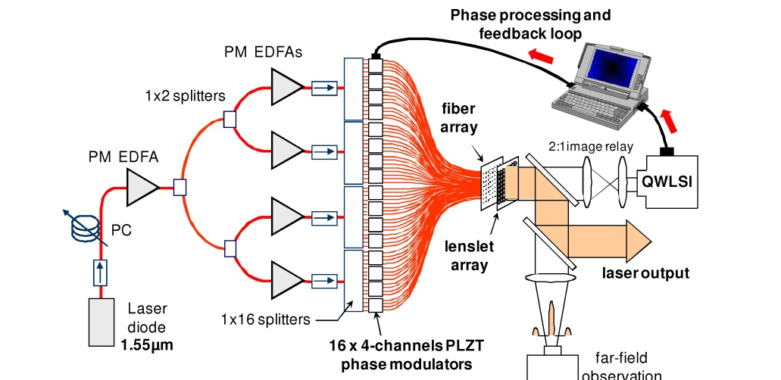
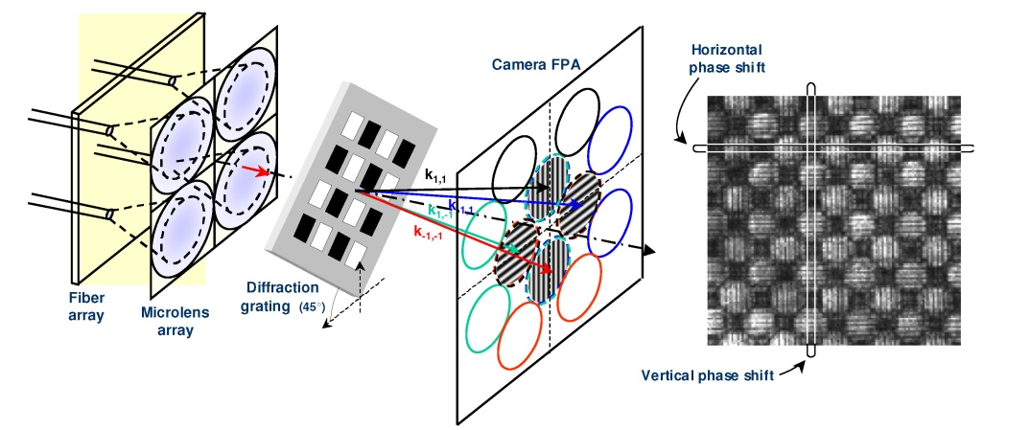
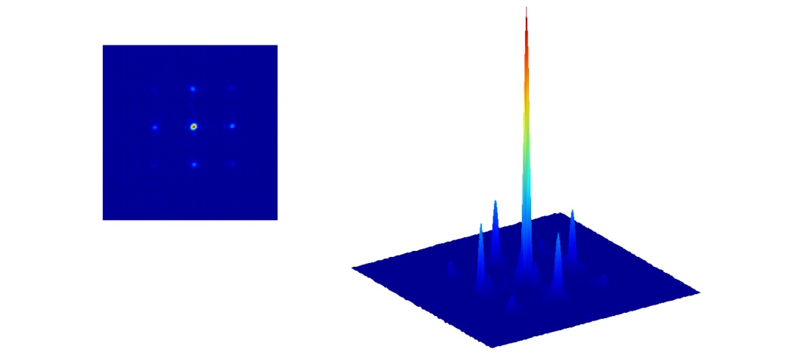
Tiled aperture combination
Bourderionnet et al.,
Op Exp 19, 17053 (2011)
Signal split and amplified in 64 cw fibres with integrated phase modulators.
Light collected in microlens array.
Phase between adjacent fibres analysed in quadriwave lateral shearing interferometer.
34% beam in central lobe (cf 44% theoretical).
6

Slide 7
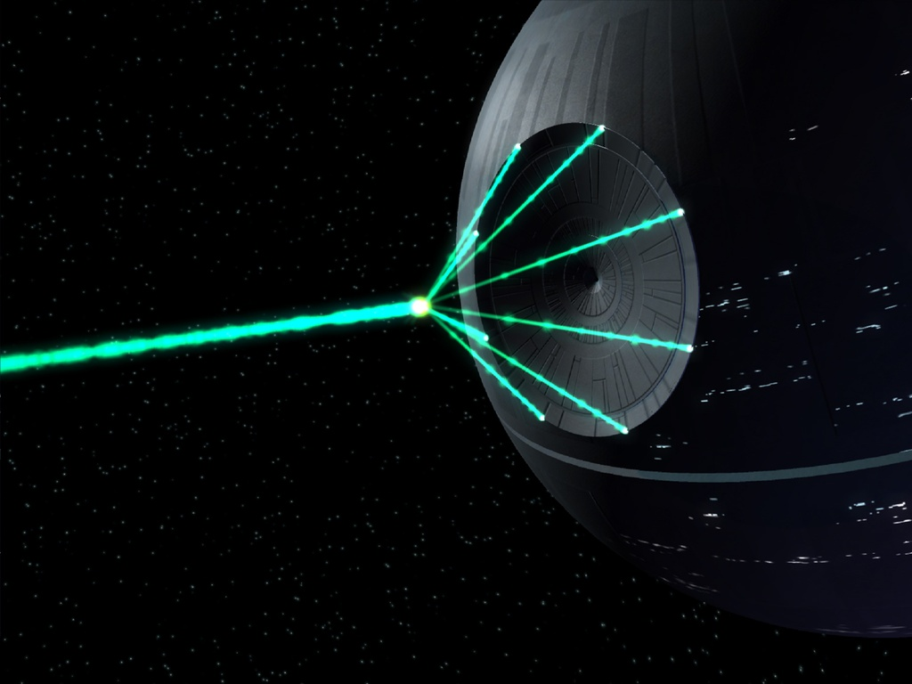
Filled aperture combination
Binary tree example – polarisation combination and locking
Limits of beam splitter based combining:
Müller et al., Opt. Exp. 29, 27900 (2021)
7
7

Slide 8
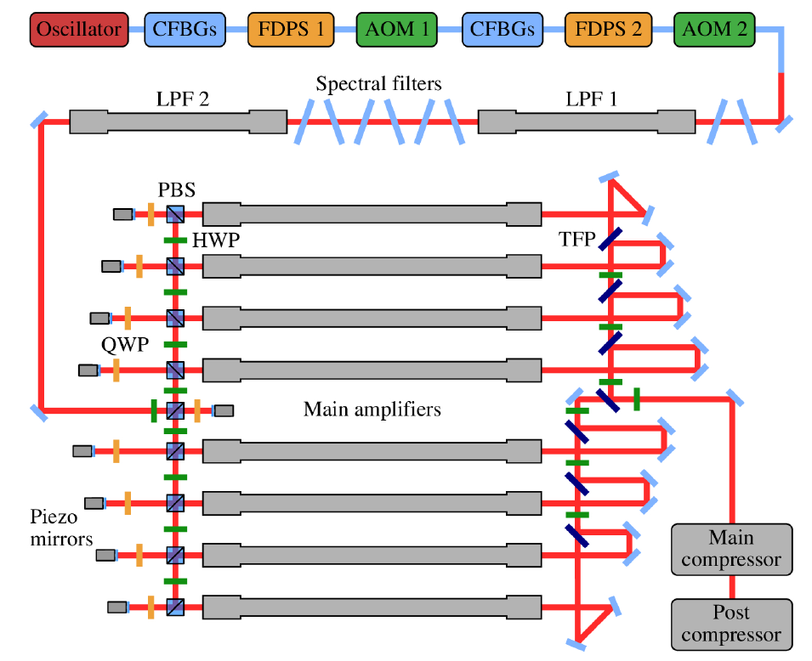
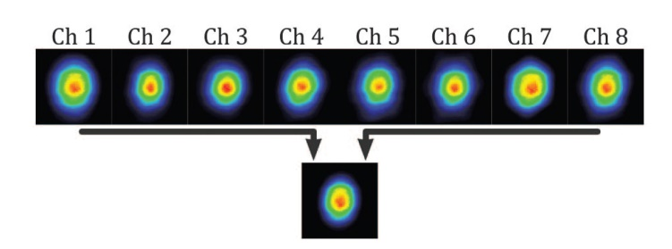
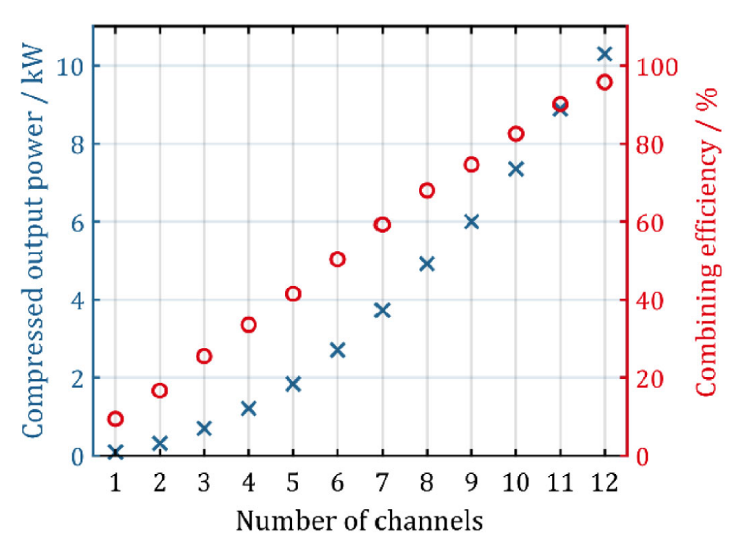
Polarisation combination
Müller et al., Opt. Letts. 41, 3439 (2016)
Stark et al.,
Opt. Letts. 46, 969 (2021)
Müller et al., Opt. Letts. 45, 3083 (2020)
Seed split and amplified in large pitch photonic crystal fibres.
Polarisation – piezo mirror phase control.
1 MHz, 1.1mJ, 1kW, 8 fibres (2016).
80MHz, >10kW, 254fs, 12 fibres (2020).
100kHz, 10mJ, 1kW, 120fs, 16 fibres (2021).
Does not scale gracefully to > 1000 fibres.
8

Slide 9
Commercial systems
9
9

Slide 10
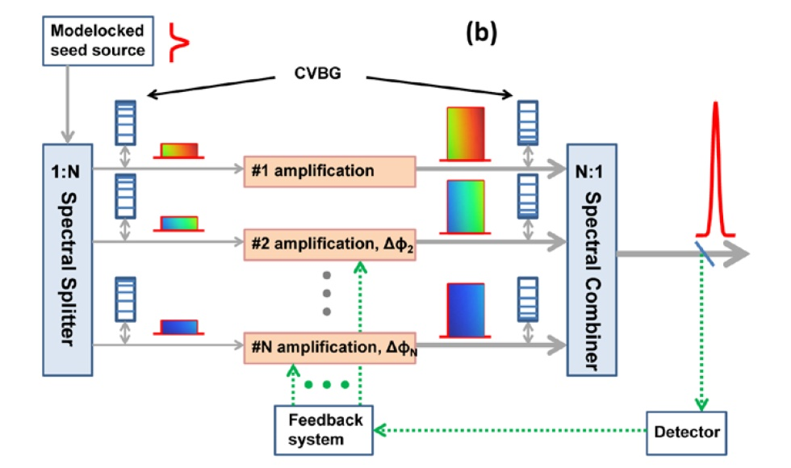
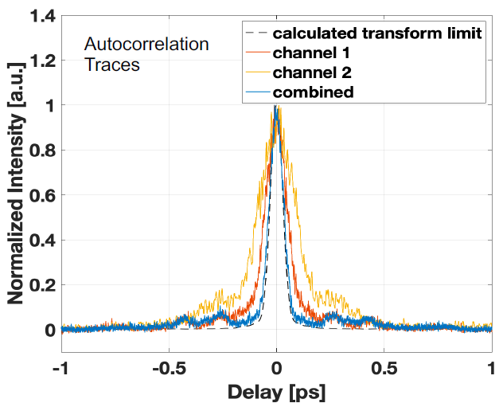
Spectral combination
Chang et al., Opt. Exp. 21, 3897 (2013)
Seed split spectrally with filters and amplified in different fibre channels.
Amplified pulses combined on spectral filters and compressed.
54fs combined – S. Chen, AAC, 2022.
10
10

Slide 11
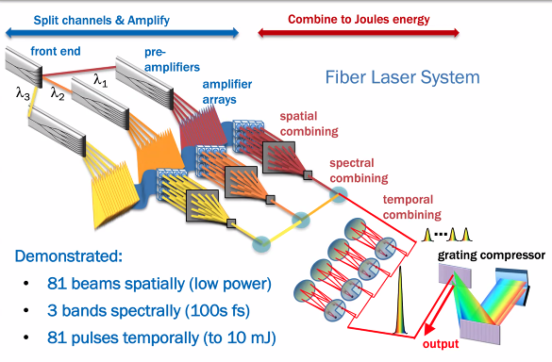
Do everything! k-BELLA
Fibre
https://bella.lbl.gov/kbella/
Concept: R. Wilcox, A. Galvanauskas, W. Leemans
https://www2.lbl.gov/LBL-Programs/atap/Report_Workshop_k-BELLA_laser_tech_final.pdf
11
11

Slide 12
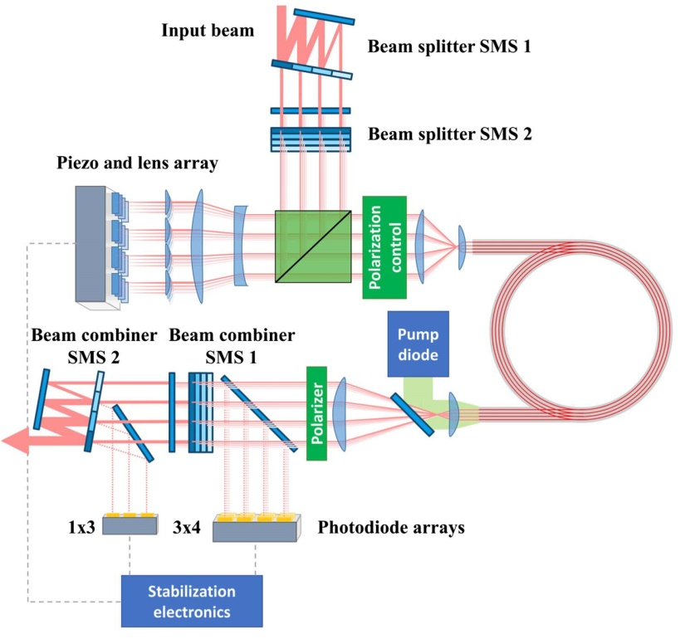
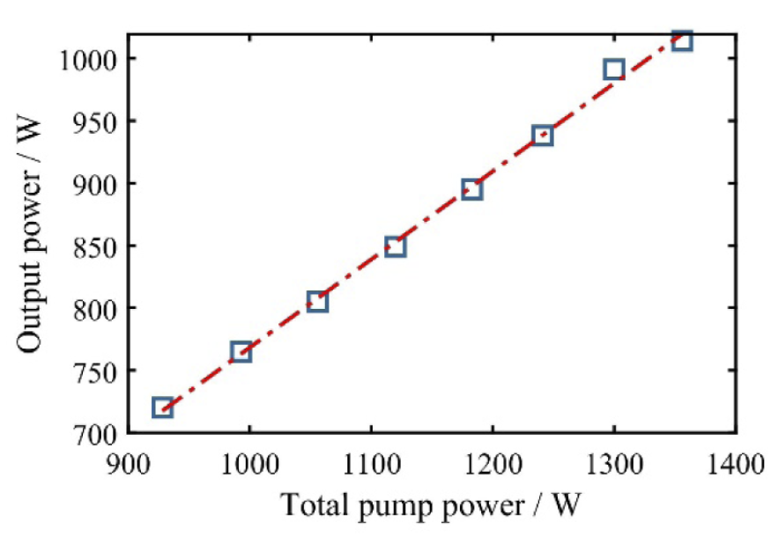
Multicore fibres
Klenke et al.,
Opt. Letts. 43, 1519 (2018)
Efficiency!
Use multicore fibre.
Less phase difference to correct.
Fewer channels.
ps pulses – 70W, 40ps.
fs pulses – 500W & 600mJ, 500fs.
Klenke et al., Opt. Letts. 47, 345 (2021)
12
12

Slide 13
New FEBE upgrade and laser
CLARA
Phase 1
CLARA
Phase 2
CLARA
FEBE
100 TW Class Laser
PI Laser:
Variable longitudinal pulse shape
Variable Bunch Compressor
Variable R56
Low T566
FEBE Mask
Flexible design
Linac 1
Linac 2
Linac 3
Linac 4
FEC1
FEC2
FEBE Arc
Variable R56
FEBE Hutch
RF Gun:
100 Hz
250 pC
4th Harmonic
Cavity
Dechirper
See also talk T. Pacey Wed afternoon
Electron energy up to 250MeV.
Funding received for 100TW laser – space to upgrade to 250TW.
New shielded area with 2 vacuum chambers for experiments.
Fig. courtesy T. Pacey, ASTeC

Slide 14
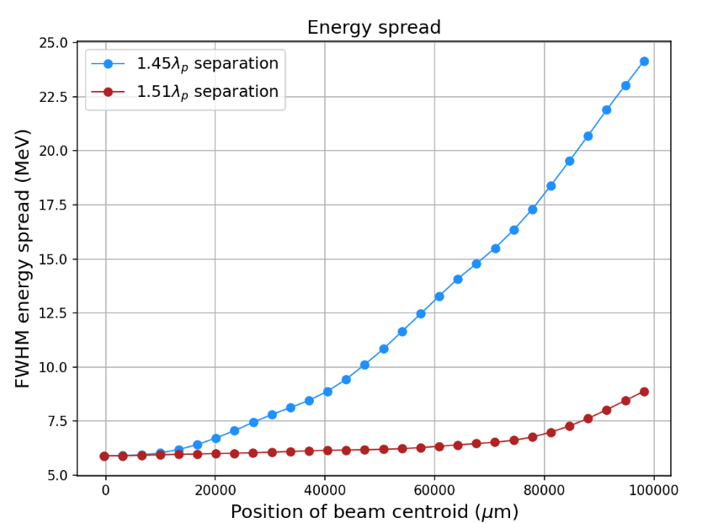
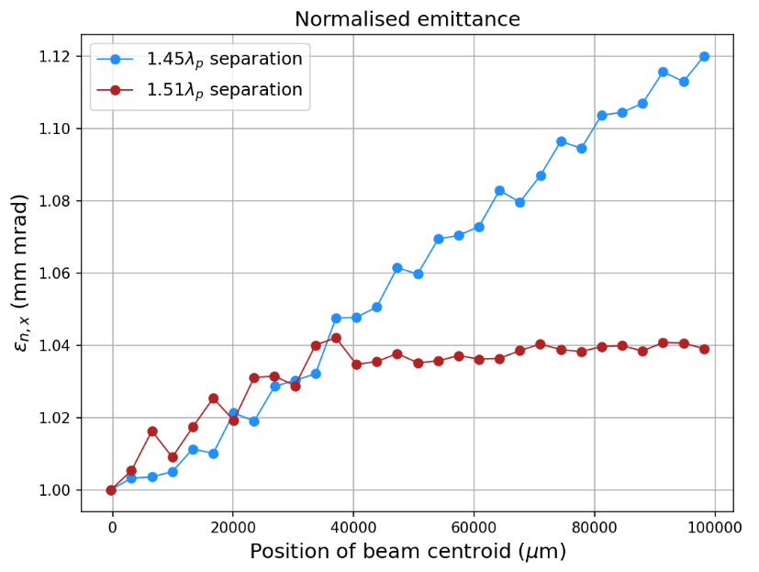
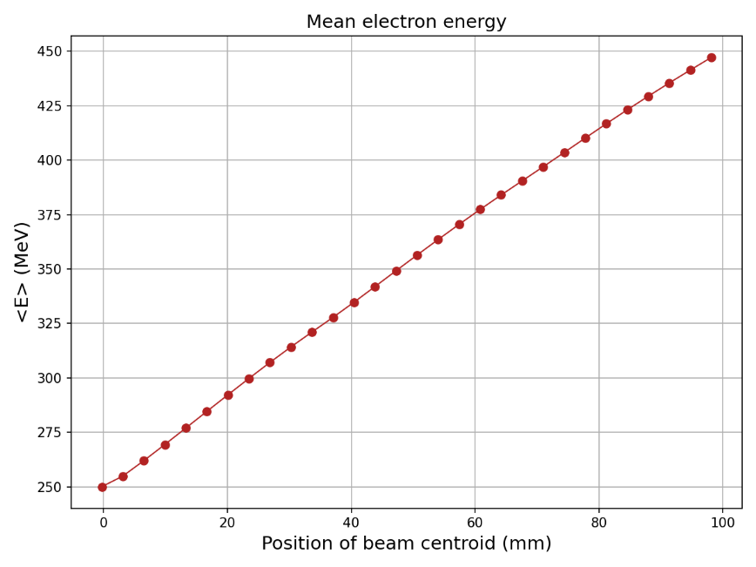
Fibre laser driver simulations
What can we do with a different (efficient!) laser?
Fibre laser: 2J, 150fs,
250MeV to 450MeV in 100mm.
Gradient 2 GV/m.
Energy spread: FWHM 2.4% - 3.5%.
Emittance: 1 mm mrad – 1.04 mm mrad.
Simulations not optimised!
FEBE high rep rate photocathode @ 400Hz – can we make this laser?
Combined fibres have shown 120fs, 10mJ pulse energy and
20% measured WPE.
Simulations: Jonathan Christie
14

Slide 15
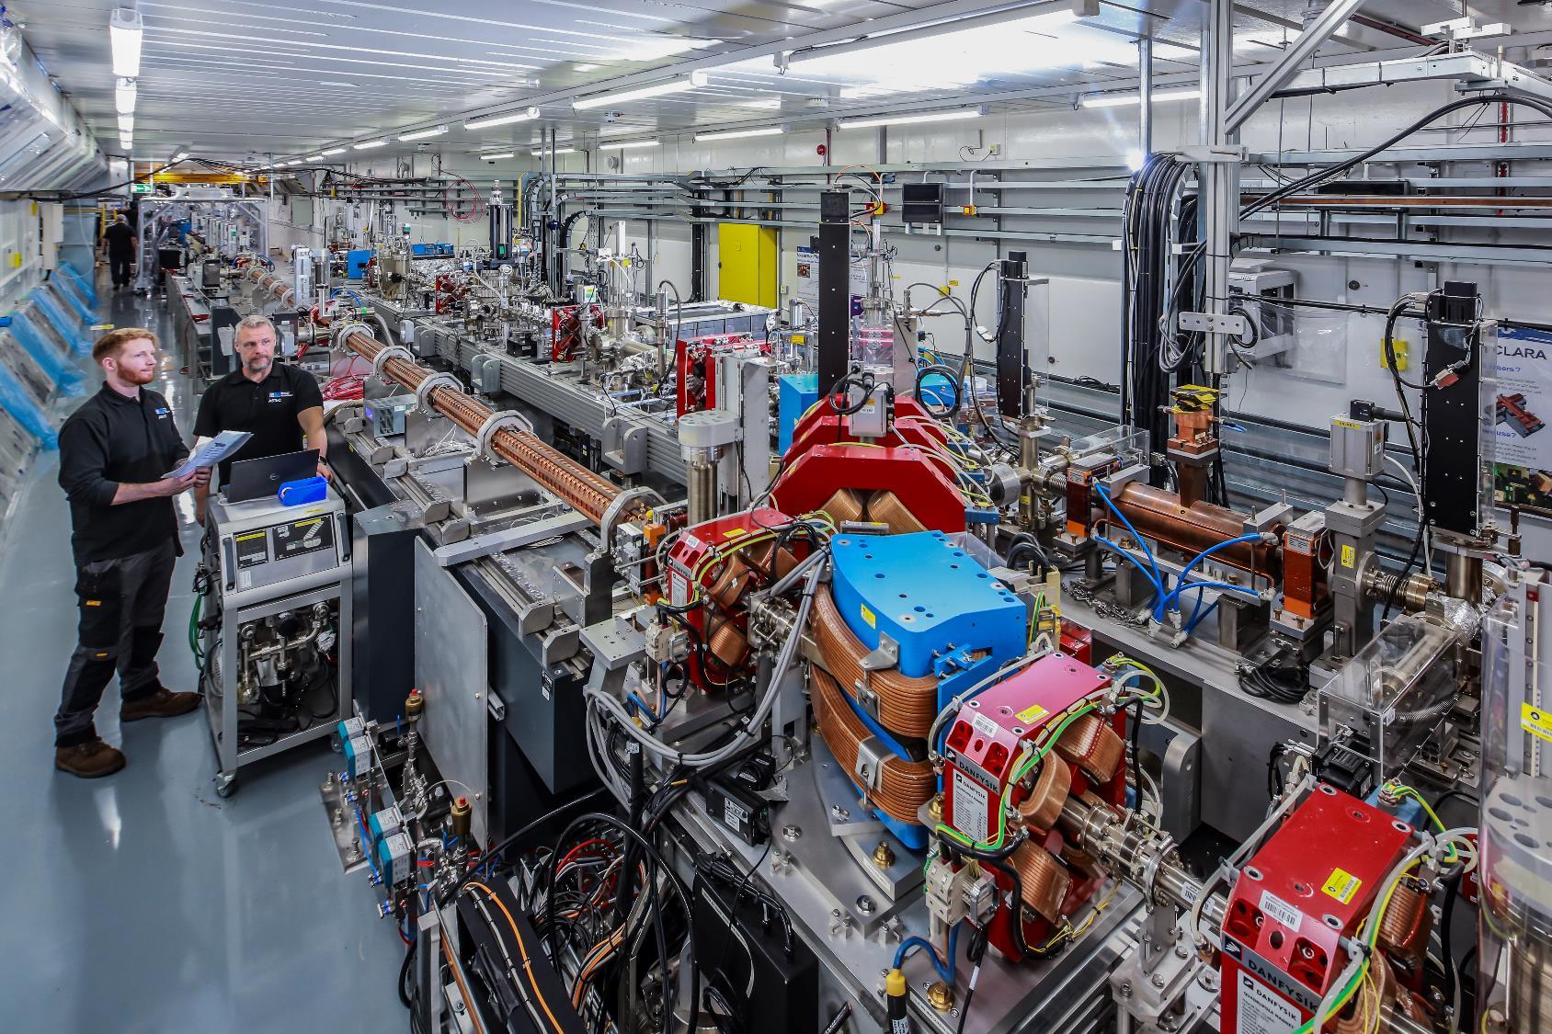
Future plans @ CLARA – H3 beams project
STFC funding call for innovative accelerator projects.
H3 beams – high quality, high brightness beams for high energy physics.
Aim to address of quality and stability of LWFA electron beams.
£4M, 4 yr proposal – only bid put through to full proposal stage after initial outline call.
Exploit CLARA upgrade.
UK wide research synergies – THz acceleration and manipulation, beamline design, LWFA, external injection, guiding, target design, diagnostics.
Proposal: use THz beam manipulation to create phase-locked fs electron bunch injected into laser driven plasma wake.
Fig: T. Pacey

Slide 16
CLARA, FEBE & H3 Beams Schematic Overview
Laser transfer arm
FEBE → CLARA
100 TW FEBE Laser
Energy Emittance Diagnostics:
250 – 600 MeV
Bunch
Shaping
Mask
Transverse Matching into FEBE
FEBE Shielded Hutch
FEC1
FEC2
Variable
Bunch
Compressor
Transverse
Deflecting
Cavity
FEBE
Arc
CLARA
Beam
~150 MeV
Longitudinal
& Timing
Diagnostics
Permanent
Magnet
Focusing & Capture
Triplets
High Gradient
Plasma
Cell
THz
Driven
Streaker
Suite of
Energy and Emittance Diagnostics:
0.6 - 1 GeV
Linac 04:
250 MeV
THz
Modulation
Chamber
≈60 m
CLARA:
Stable Beam
Phase-Lock
Compress
Accelerate
Characterise
Fig. S. Jamison

Slide 17
Conclusions
Need to move beyond Ti:sapp for plasma acceleration > 100Hz.
Fibre combination promising (commercialised) technology.
Can accelerate electrons at gradients > 1GeV/m in simulation with realistic fibre laser parameters.
New CLARA facility ideal for advanced acceleration experiments.
H3 beams project to exploit synergies in UK research to produce high quality LWFA beams.

Slide 18
Back Up

Slide 19
External Injection Experiments at CLARA:
Motivation
Laser wakefield acceleration (LWFA) has produced extremely high accelerating gradients and energies (10GeV), but issues with stability, energy spread, repeatability, emittance.
CERN Expert Panel Roadmap (https://e-publishing.cern.ch/index.php/CYRM/issue/view/146) identifies both quality and staging as milestones for credible LWFA.
External injection of high quality, low energy electrons into plasma wakefield: high gradient acceleration w/o loss of quality in simulation.
Experiments @ CLARA (Daresbury Laboratory) – test injection & acceleration experimentally (few expts.so far Amiranoff et al. PRL 81, 995, 1998, Wu et al., Nature Physics 17, 801, 2021).
Investigation of staging without problems of capturing low quality beams from LWFA first stage.
CLARA near-unique facility in the world – accelerator, laser, experimental area.

Slide 20
Beam parameters
Offered parameters to evolve, based on development time
‘Day 1’ → Nominal → R&D
Offered parameters to evolve, based on development time
‘Day 1’ → Nominal
Parameter | High charge | Low charge
Energy [MeV] | 250 | 250
Charge [pC] | 250 | <20
RMS t [fs] | 50 | ≤50
σ_{E}/E [%] | 1 | <1
RMS x [µm] | 50 | 1
RMS y [µm] | 50 | 1
ε_{N} x @ 250 MeV [µm] | <5 | 1
ε_{N} y @ 250 MeV [µm] | 2 | <1
Parameter | High charge | Low charge
Energy [MeV] | 250 | 250
Charge [pC] | 250 | 20
RMS t [fs] | 100 | 50
σ_{E}/E [%] | <5 | <1
RMS x [µm] | 100 | 20
RMS y [µm] | 100 | 20
ε_{N} x @ 250 MeV [µm] | 5 | 2
ε_{N} y @ 250 MeV [µm] | 5 | 2
R&D: dedicated effort required beyond normal operations, and/or new diagnostic technology required

Slide 21
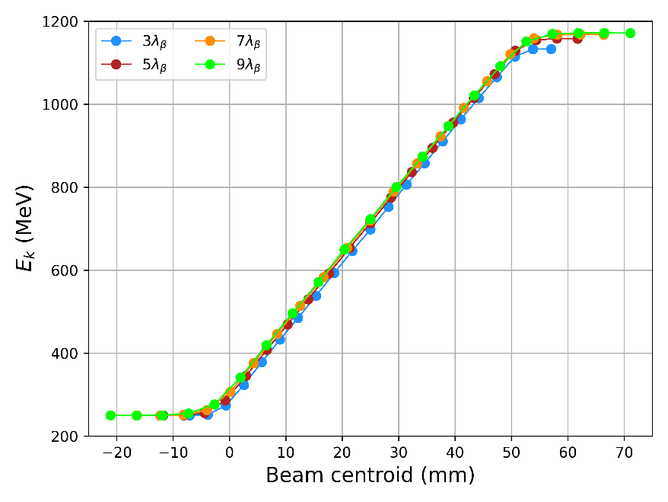
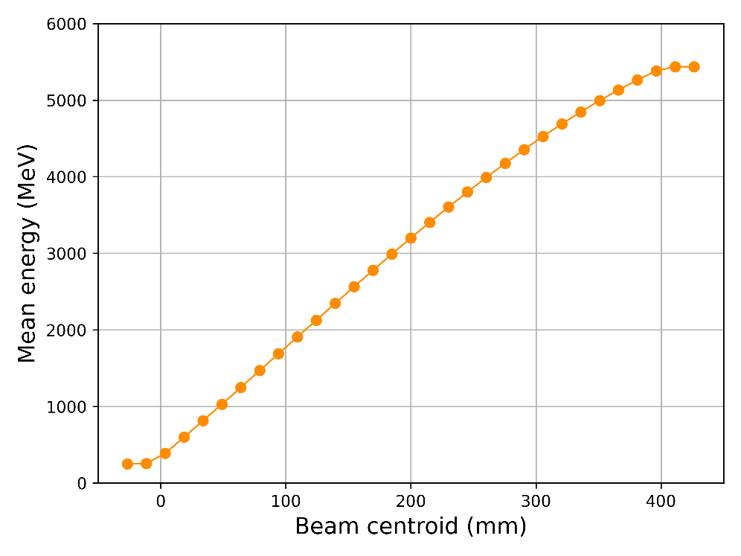
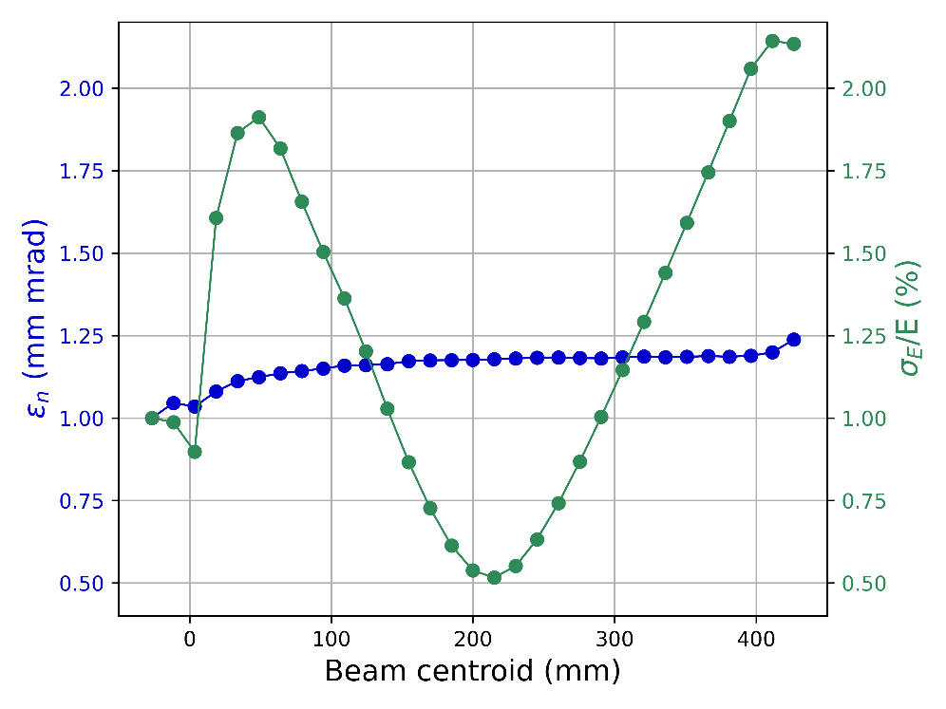
External injection experiments at FEBE
100TW
250TW
250TW
250TW | Pre-interaction | Post-interaction
Charge (pC) | 5 | 5
Central energy (MeV) | 250 | 5436
Energy spread (RMS) | 1% | 2.13%
σ_{x} (µm) | 5 | 2.27
σ_{z}/c (fs) | 5 | 5
ε_{n} (mm mrad) | 1.0 | 1.24
100TW: 1GeV in 80mm – 2GeV in 140mm.
250TW: 5GeV in 400mm.

