Slide 1


Rooting out the gremlins - stable LWFA operation at the PW frontier
Stefan Karsch^{1,2}
¹ Centre for Advanced Laser Applications, LMU Munich ² Max-Planck Institute for Quantum Optics

Slide 2
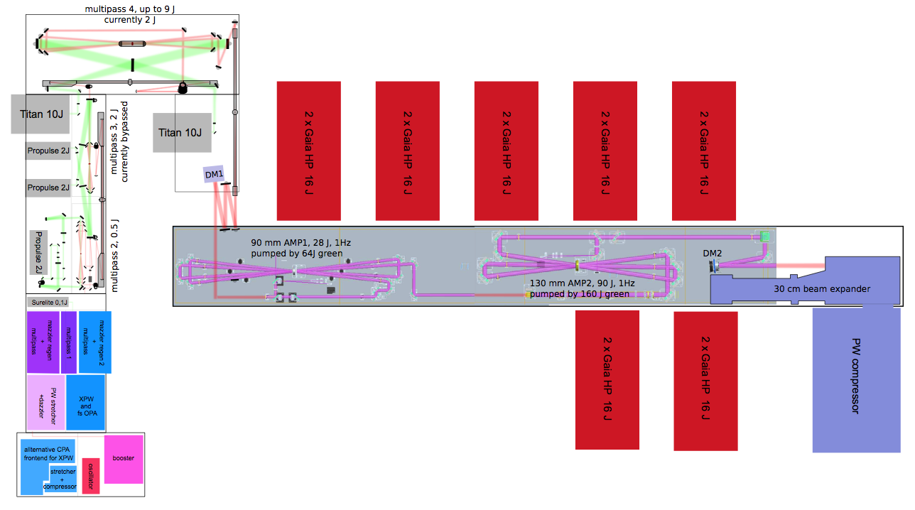
ATLAS-3000 at CALA: Schematic system layout
ATLAS-3000 main amplifier
by THALES LAS
90 J, 1 Hz,
14 x 16J GAIA HP pump lasers
Up to 60 J
25-30 fs
1 Hz
“Apochromatic” lens telescope supplied by Thales
ATLAS-300 homebuilt system:
up to 300 TW, 25 fs, 5 Hz Ti:Sa laser
2 frontends:
ps booster, sat. absorber + Amplitude stretcher & regen
double CPA, XPW + fs-OPA + Amplitude stretcher & regen
Homebuilt beam expander & compressor

Slide 3
ATLAS-3000: on-paper performance
near field
far field
contrast
log(intensity)
I_{max}(f/22) = 4x10¹⁹
spatial
[mm]
geom. Strehl: > 0.93
real Strehl: > 0.75
ns contrast > 10¹⁰
ps contrast ~ 10⁸
spectro-
temp.
Δλ > 65 nm

Slide 4
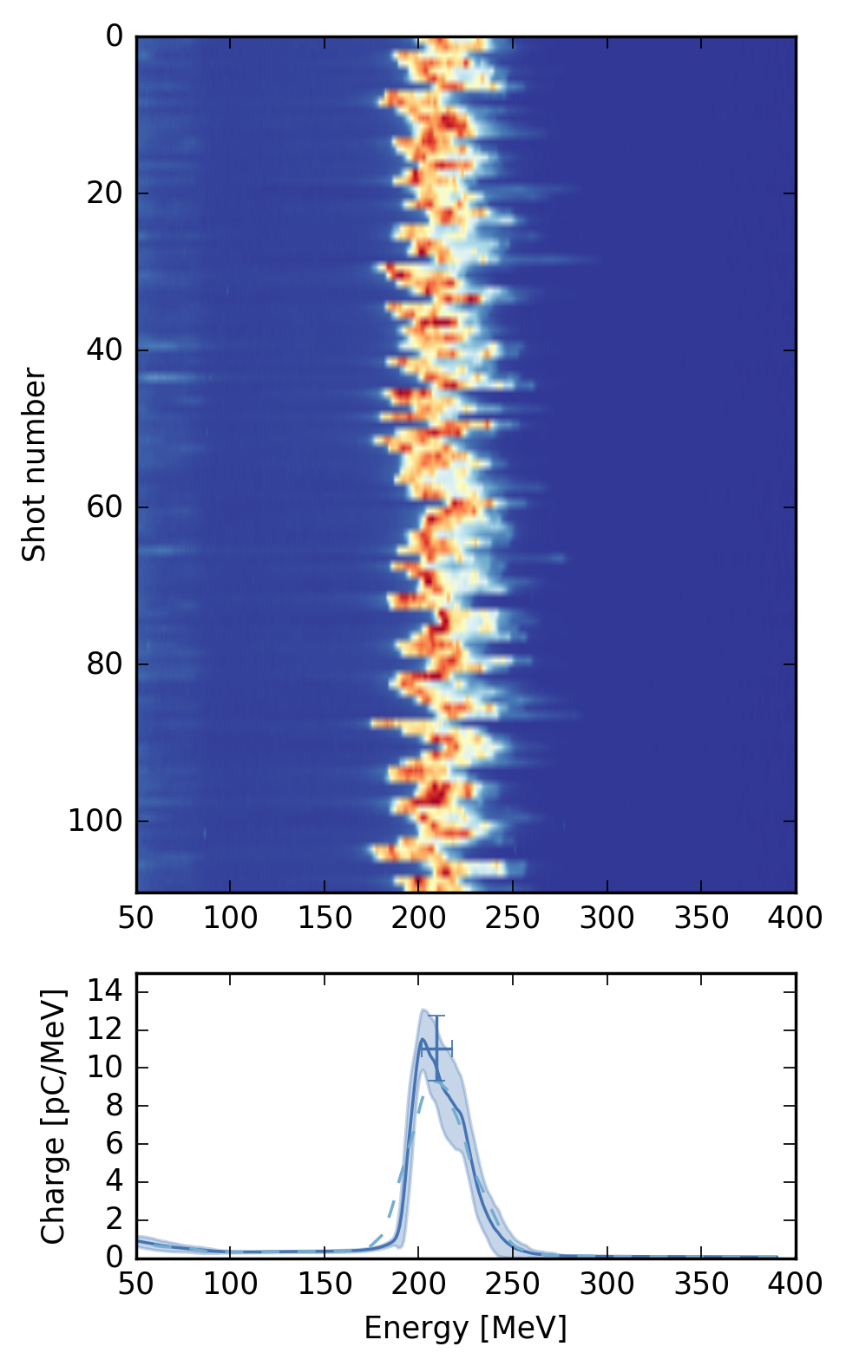
First laser wakefield acceleration results: LWFA by shock-front injection
old laser, 80 TW on target
f/22, 5 mm gas jet
upgraded laser, 250 TW on target
f/22, 5 mm gas jet
Similar experiment
Stability ?

Slide 5
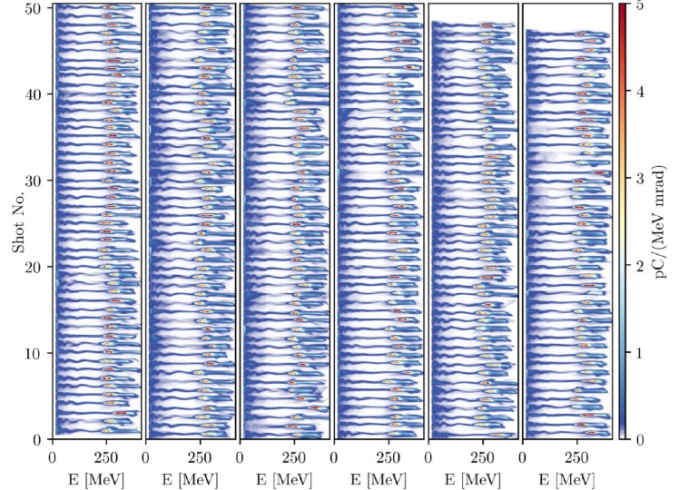
A few hours after turning on pump lasers…
Optimized spectrum…
Optimized near field…
Optimized energy…
Optimized near field…
Optimized energy…
First step:
f/33
Cheap trick: mixed gas for ionization-assisted shock injection

Slide 6
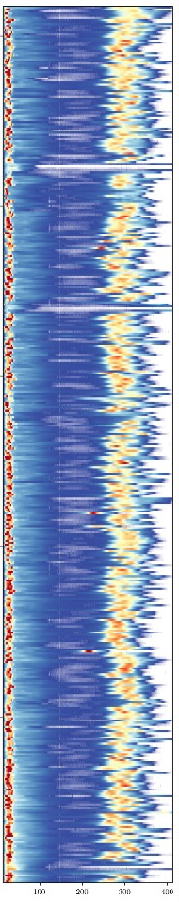
Correlations ? … not clear

Slide 7
Hidden parameters?

Slide 8
Spatio-Temporal Couplings (STCs) by chromatic optics (beam expander telescopes)
Chromatic lens causes pulse front curvature (PFC)
Off-center bundle in chromatic lens causes PFC and pulse front tilt (PFT)
PFT
PFC
PFT
PFC
“A(po)chromatic lenses are free from PFT/PFC“ ⇒
Triplet lens expander between AMP1 and AMP2 is designed apochromatic within lambda/50
Yet still detect PFT after beam shift ⇒ expander in practice is not free from STCs
Replace “perfect“ lens telescope by reflective expander

Slide 9
Suppression of STCs improves electron performance (pure hydrogen)
Lens expander, aperture after compressor 8J on target, f/33
no expander, no aperture
8J on target, f/33

Slide 10
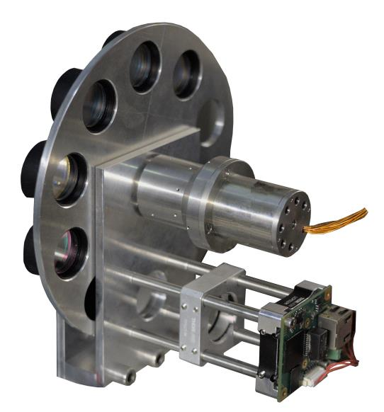
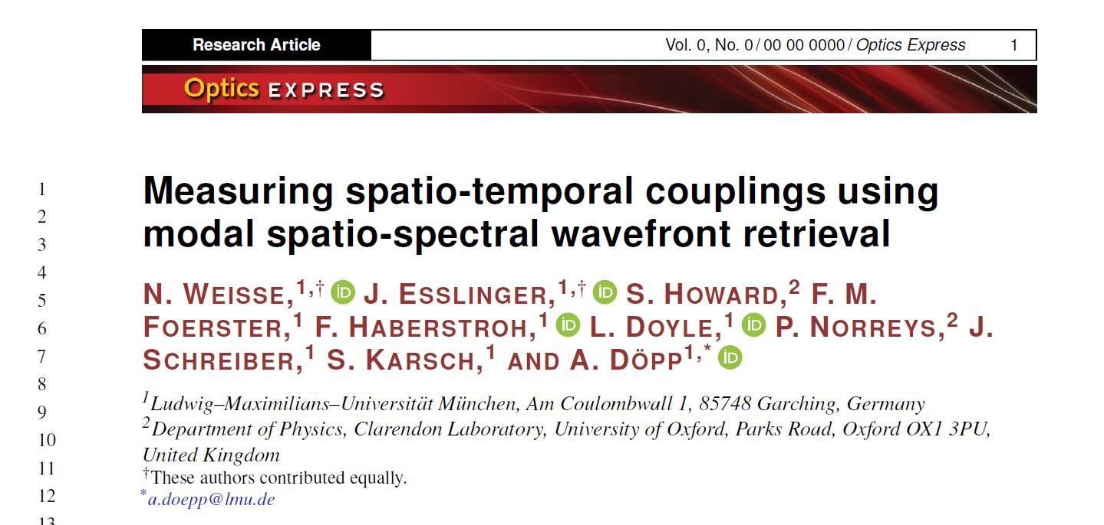
Falcon device:
Spectrally resolved Shack-Hartmann-wavefront sensor
Measurement of Spatio-Temporal Couplings by spectral wavefront retrieval
Take 10 images per filter position to average out pointing jitter

Slide 11
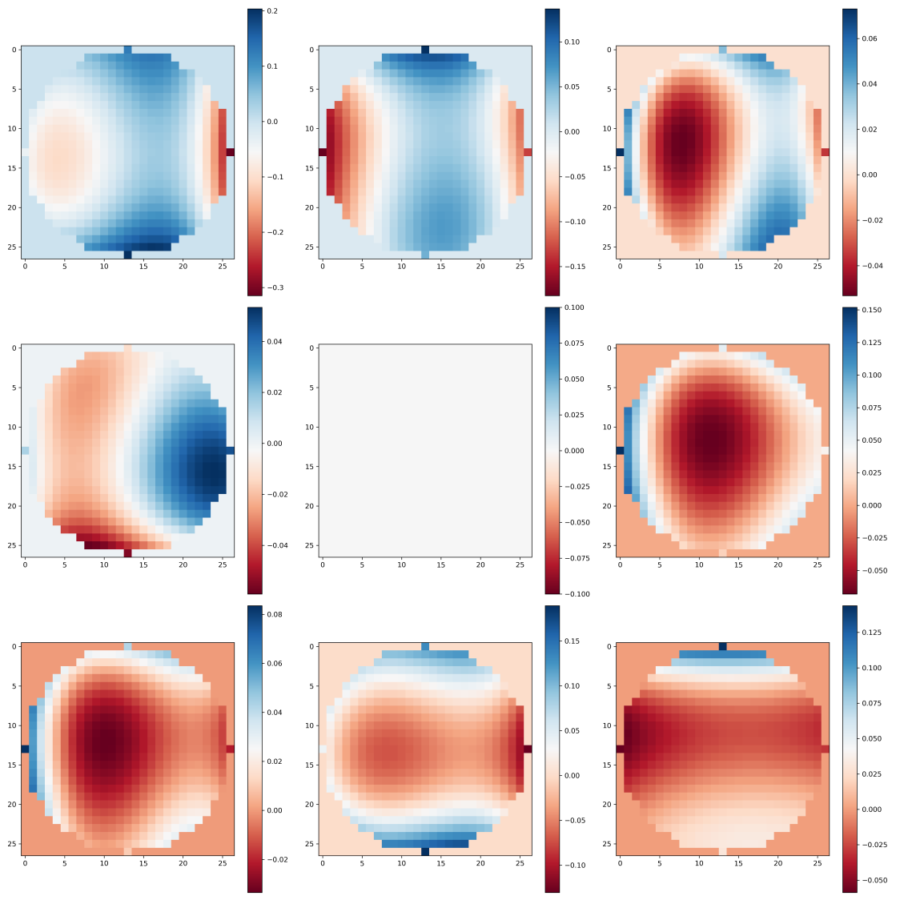
760 nm
770 nm
780 nm
PtV <0.2 λ
 | 8.5.23 | 11.5.23 | 15.5.23
Pulse front tilt µrad/nm | -2.6e-6 | -2.0e-5 | -7.7e-6
Pulse front tip µrad/nm | -7.7e-6 | -6.2e-5 | -1.1e-4
790 nm
800 nm
810 nm
820 nm
830 nm
840 nm

Slide 12
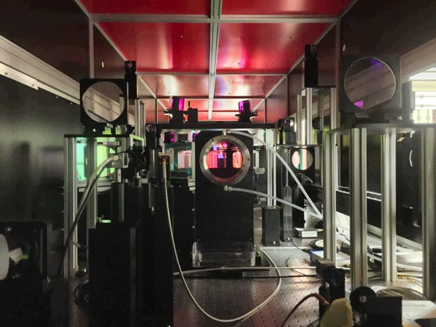
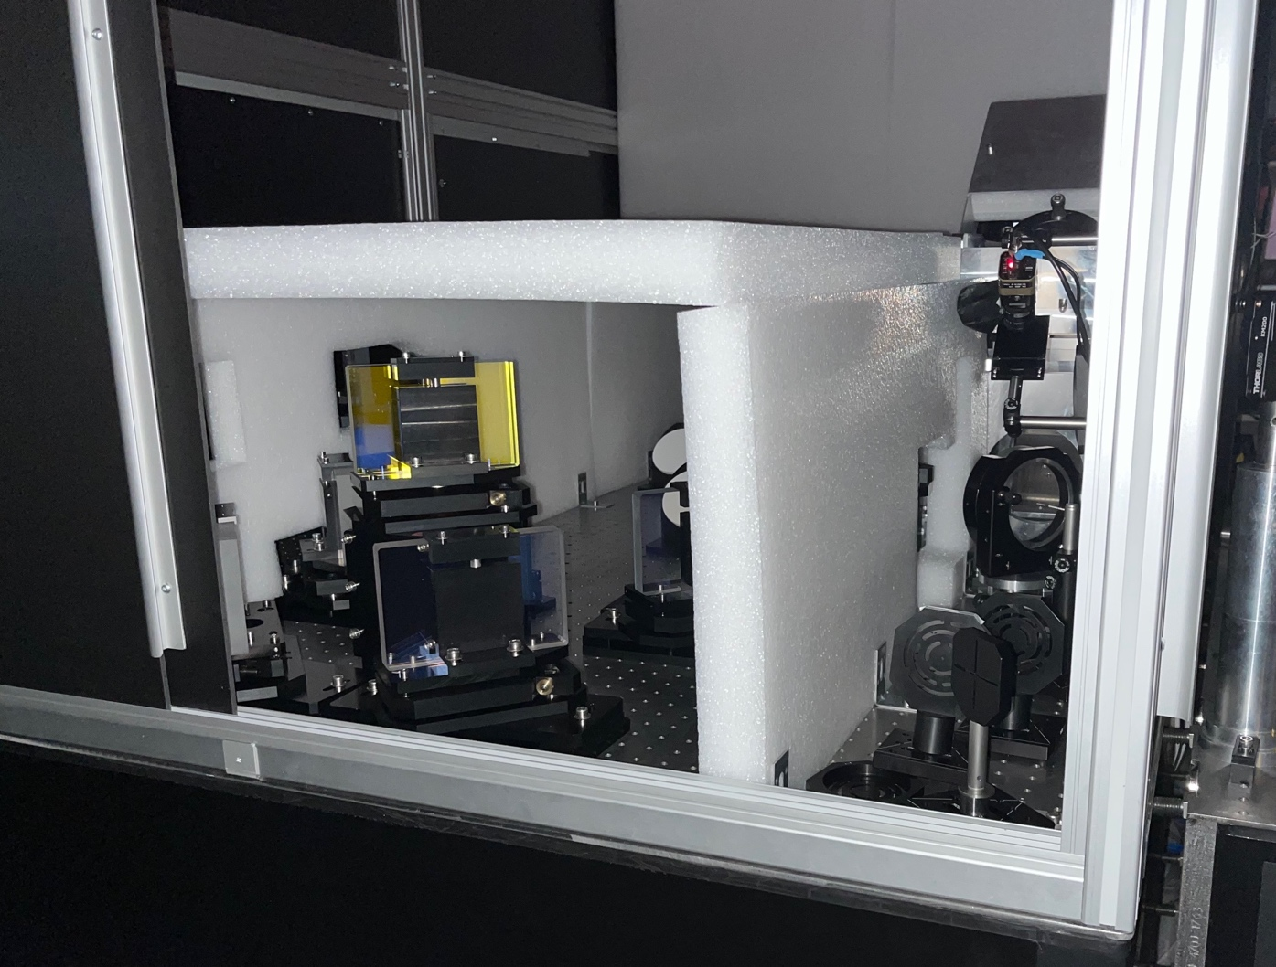
Pointing and fluence variations by air turbulence (after eliminating heat sources):
Moving from 100 TW to PW: as beam size and optical path increase, so does susceptibility to air turbulence.
σ_{F} = 10.1%
σ_{F} = 3.9%
σ_{F} = 10.1%
Recently: more foam walls:
⟹ σ_{F} = 2.8%
(shot-to-shot energy variation < 1%)

Slide 13
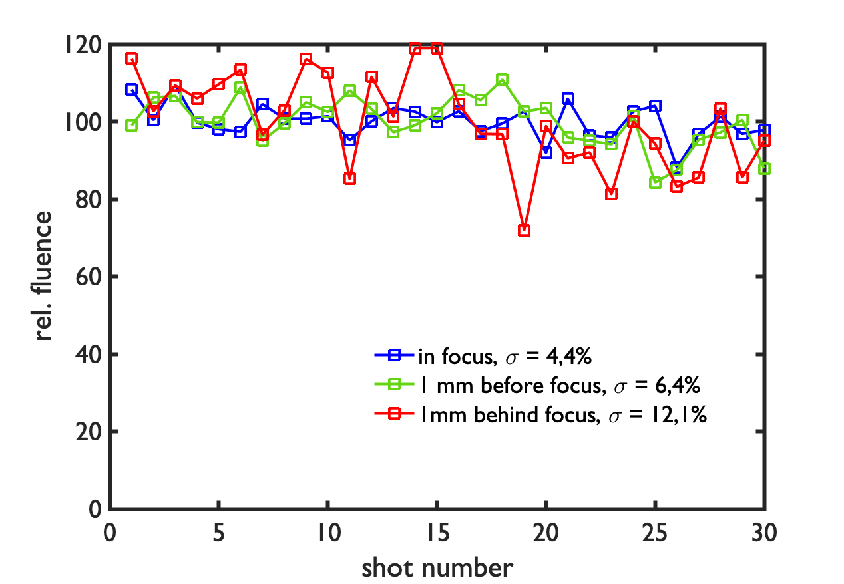
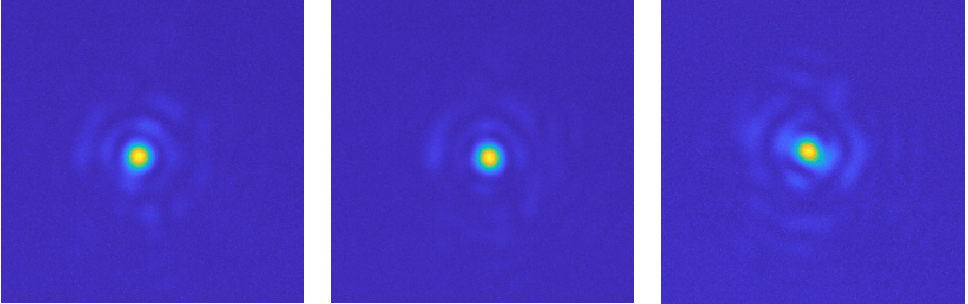
Out-of-focus, fluence variations increase:
Shot-to-shot peak fluence variation
(from focus camera)
f/22
Target density gradient
w = 15 µm
L_{R} = 1 mm
L_{R} = 1 mm
fluence fluctuates much stronger out-of-focus than at focus
Self-focusing at target gradient is sensitive to intensity fluctuations
Probable cause: air turbulence in laser housing

Slide 14
Going from 6m focal length, f/33 to 10 m focal length, f/55:

Slide 15
Long term focus drift seems to saturate after several hours after pump laser start
Homemade active stabilization ongoing (A. Döpp)
Shot-to-shot pointing will take a bit longer…
f = 50 cm → 1 µm = 2mrad

Slide 16
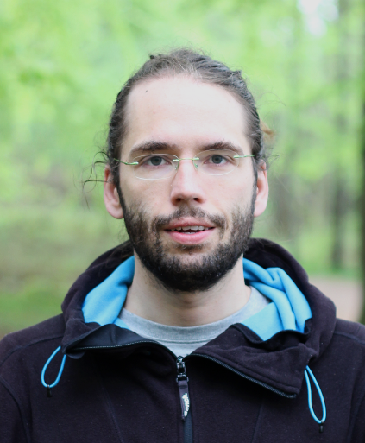
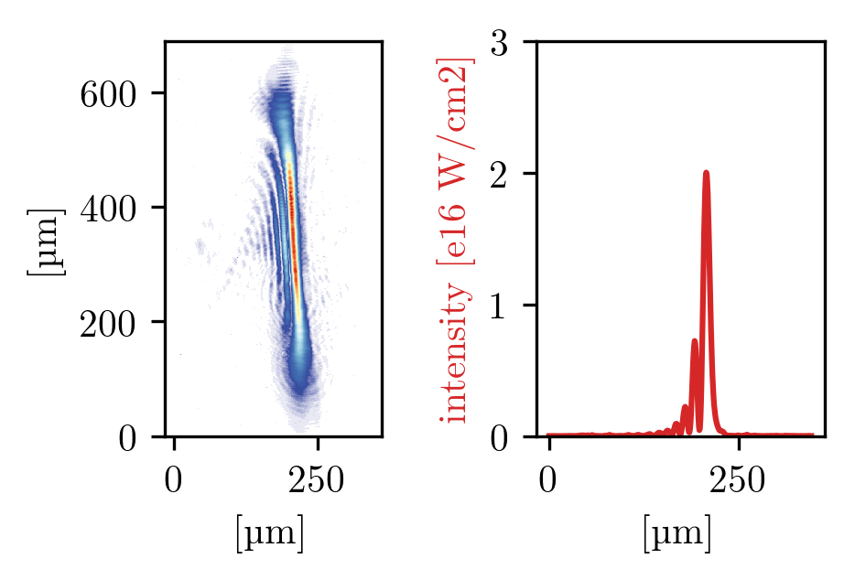
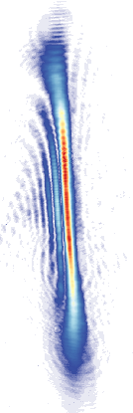
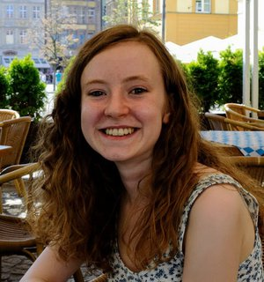
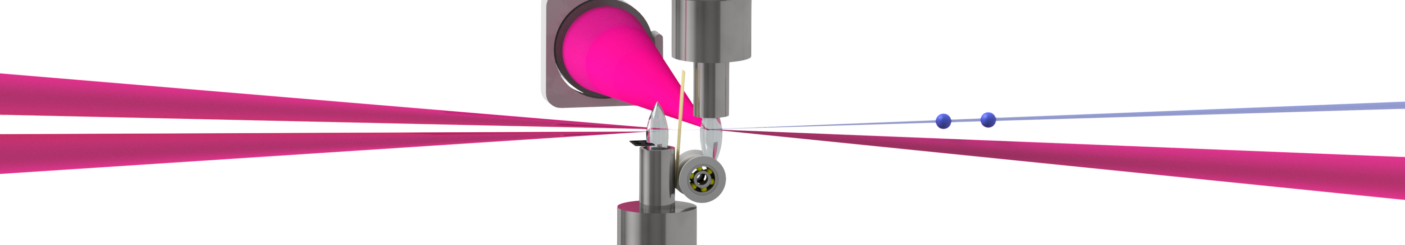
Better injection control: Hydrodynamic optical field ionized shocks
Independent control of:
injection position → final energy
shock height → charge
plateau density → acceleration gradient
e⁻
M. Foerster
0 ns
2 ns
density
Background
density
H2
-50 µm +50 µm
Plasma simulation support from Oxford (A. Ross)
Injector beam
PWFA
Witness-driver pair
LWFA

Slide 17
HOFI shock stability
Supersonic wire shocks
HOFI shocks

Slide 18
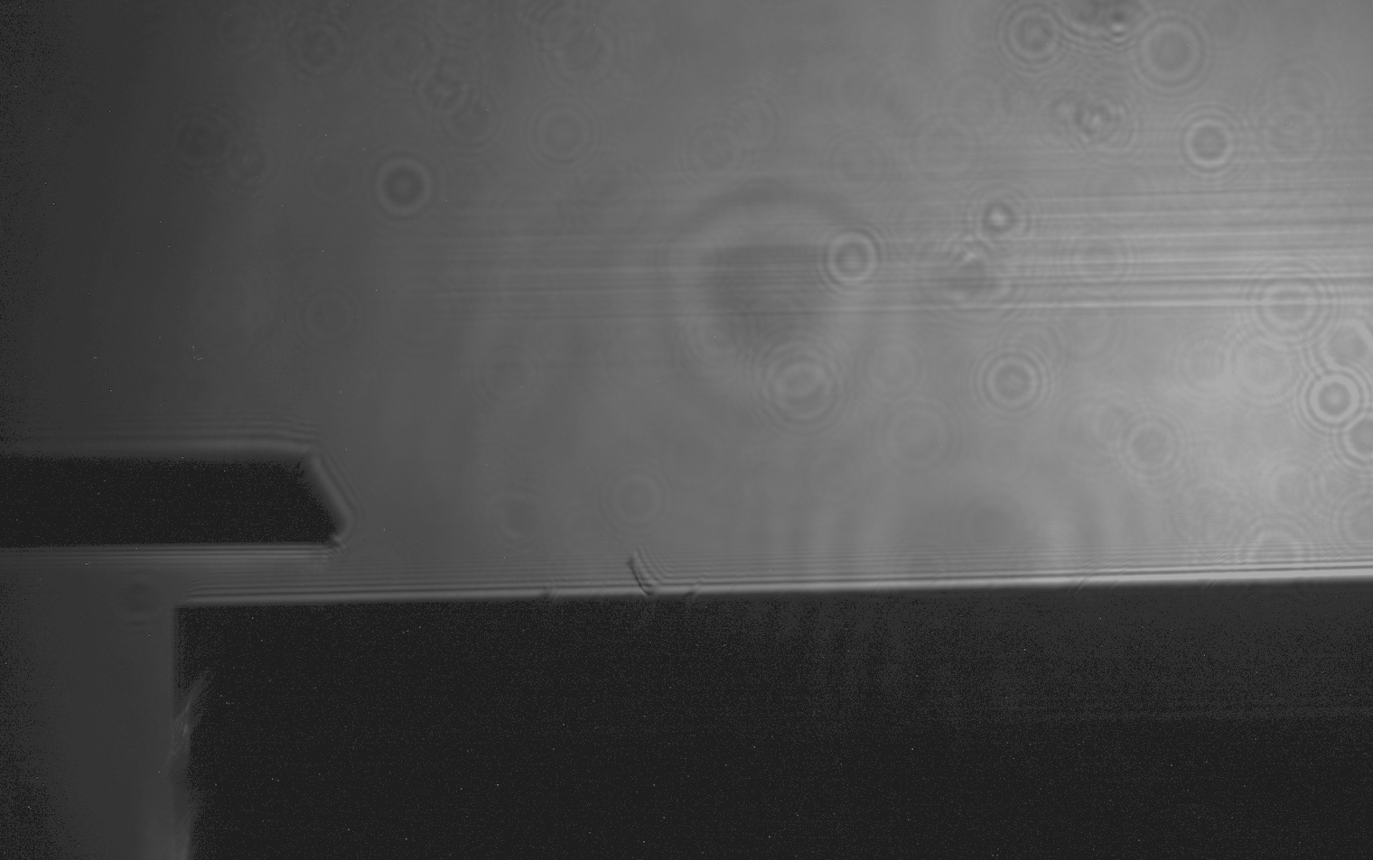
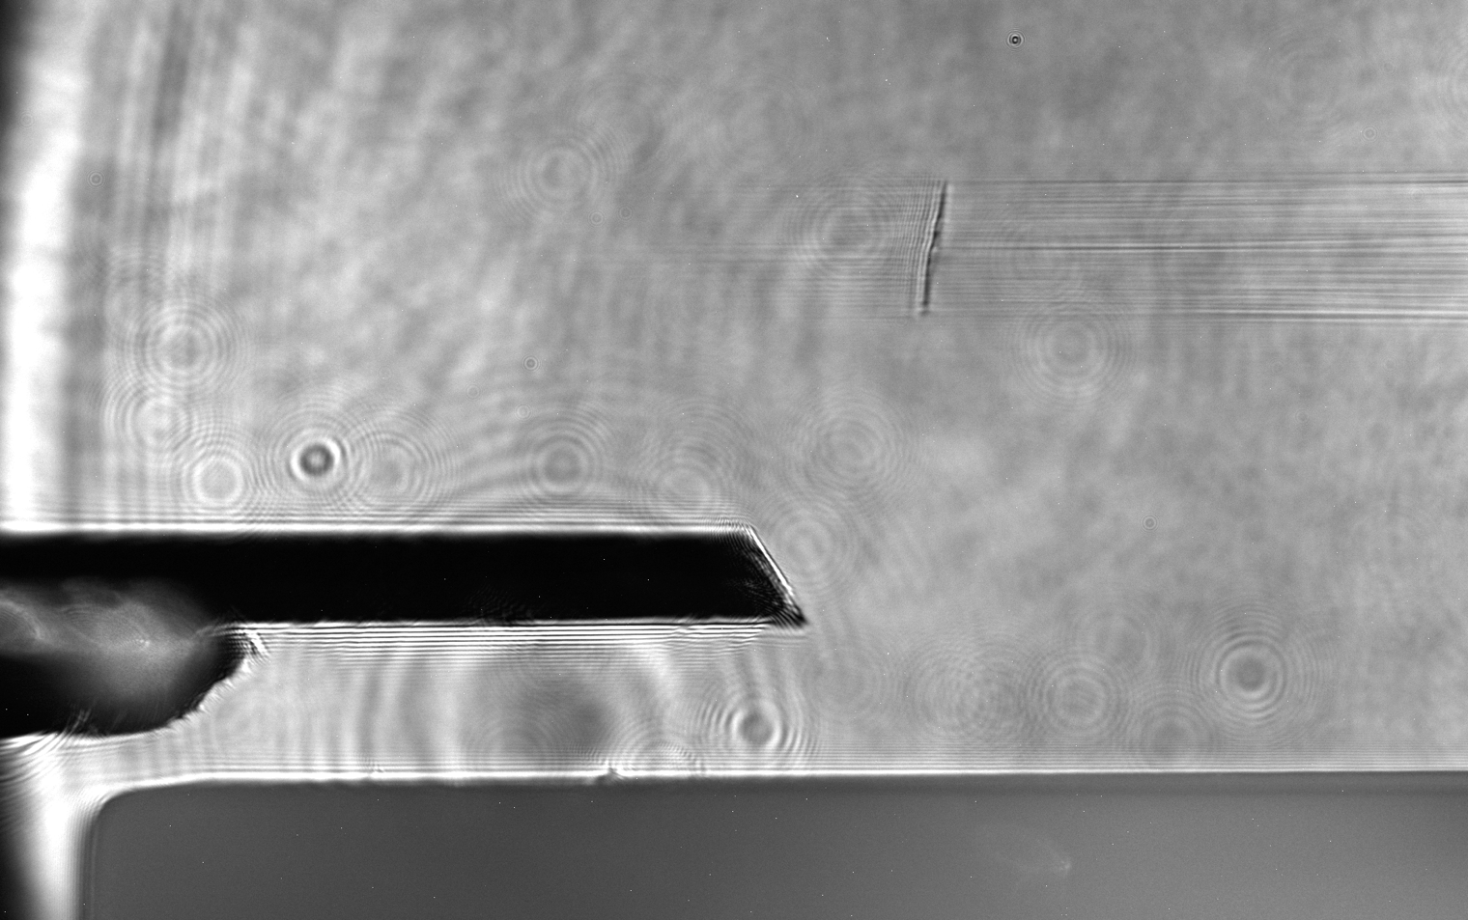
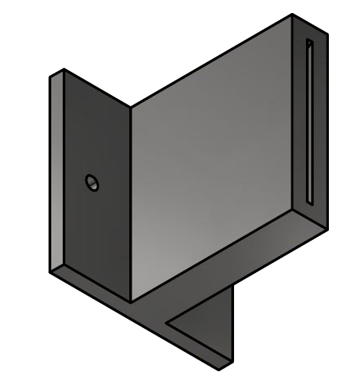
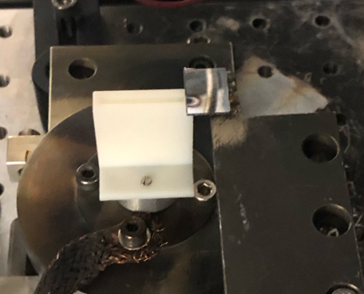
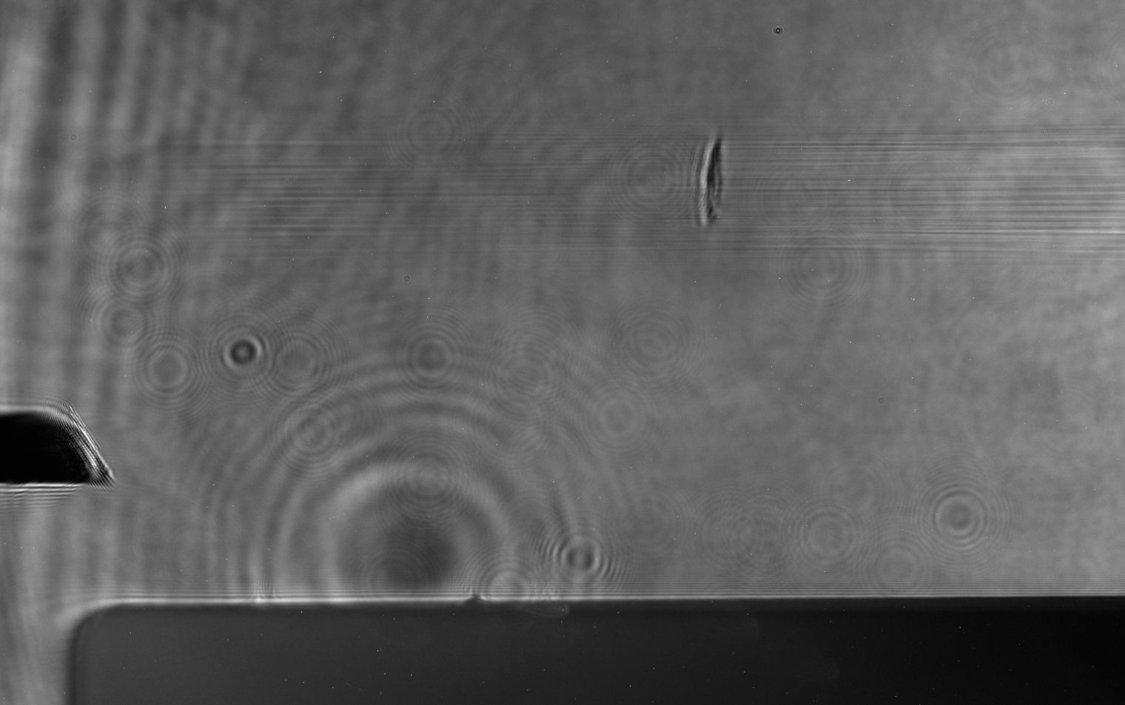
Monoenergetic GeV beams
20 mm slit nozzle target, f/55
Blade to produce shock
LWFA drivie laser beam
Optical shock inducing laser beam

Slide 19
Expt.
Hunting for correlations: Shot-to-shot diagnostics
Laser
energy, spectrum,
phase, duration,
pointing
wavefront
…
near field,
far field
cams
spectrum, near field,
energy
plasma: interferometry, beam pointing,
shock position
input pointing
e-beam: energy, pointing,
charge

Slide 20
Hunting for correlations: Analysis ongoing…
electron energy vs. wavefront
electron energy vs. pulse duration
Run 13
Run 19
target moved downstream by 400 µm = 1/3 Z_{R}
400 shots each, relying on statistical fluctuations

Slide 21
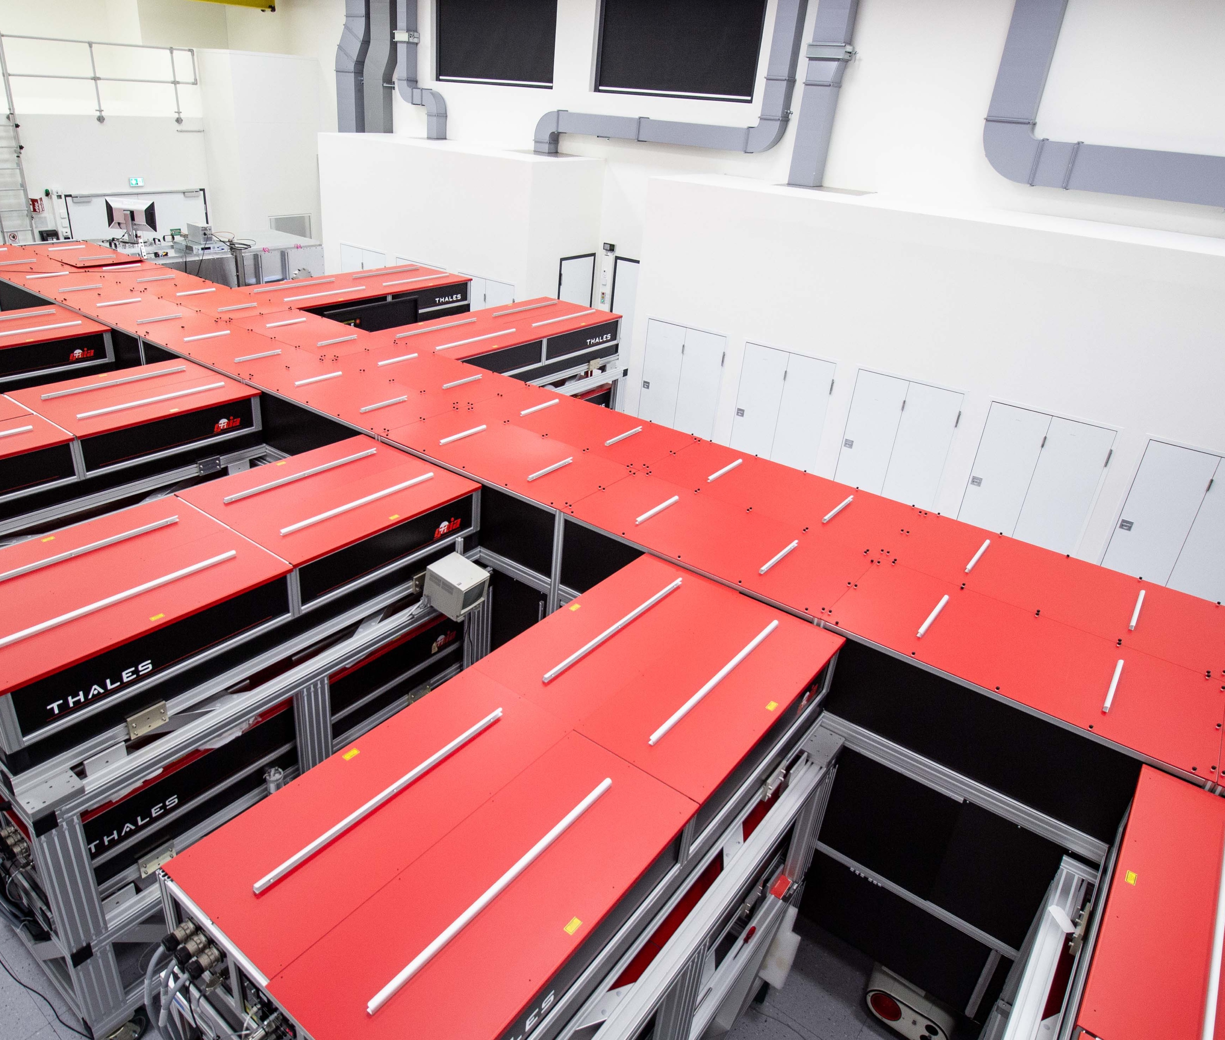


Thank you for your attention!
Stefan Karsch, Andreas Döpp, Moritz Foerster, Hao Ding, Max Gilljohann, Johannes Götzfried, Sabine Schindler, Florian Haberstroh, Katinka v. Grafenstein, Faran Irshad, Enes Travac, Albert Schletter
Hybrid Data

Slide 22
We are hiring :
CALA postdoctoral fellowship
(see https://pulse.physik.uni-muenchen.de)
PHD positions
Thank you for your attention!
Btw: We are hiring, too…

Slide 23
Optimization parameters
Pareto front vs. single objective optimization
…currently successfully implemented in the experiment... stay tuned!

Slide 24
Self injection
~30 pC over 1 GeV
Blade induced shock injection
~90 pC, 600 MeV
Optically induced shock injection
~100 pC,
1 GeV

Slide 25
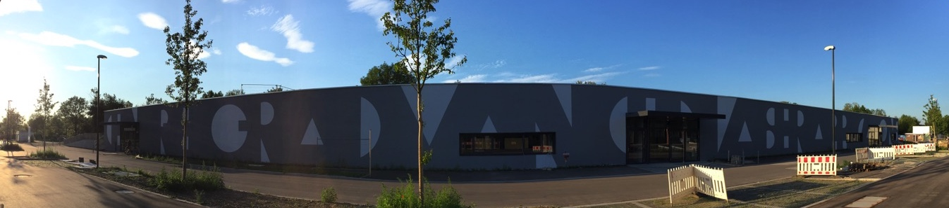
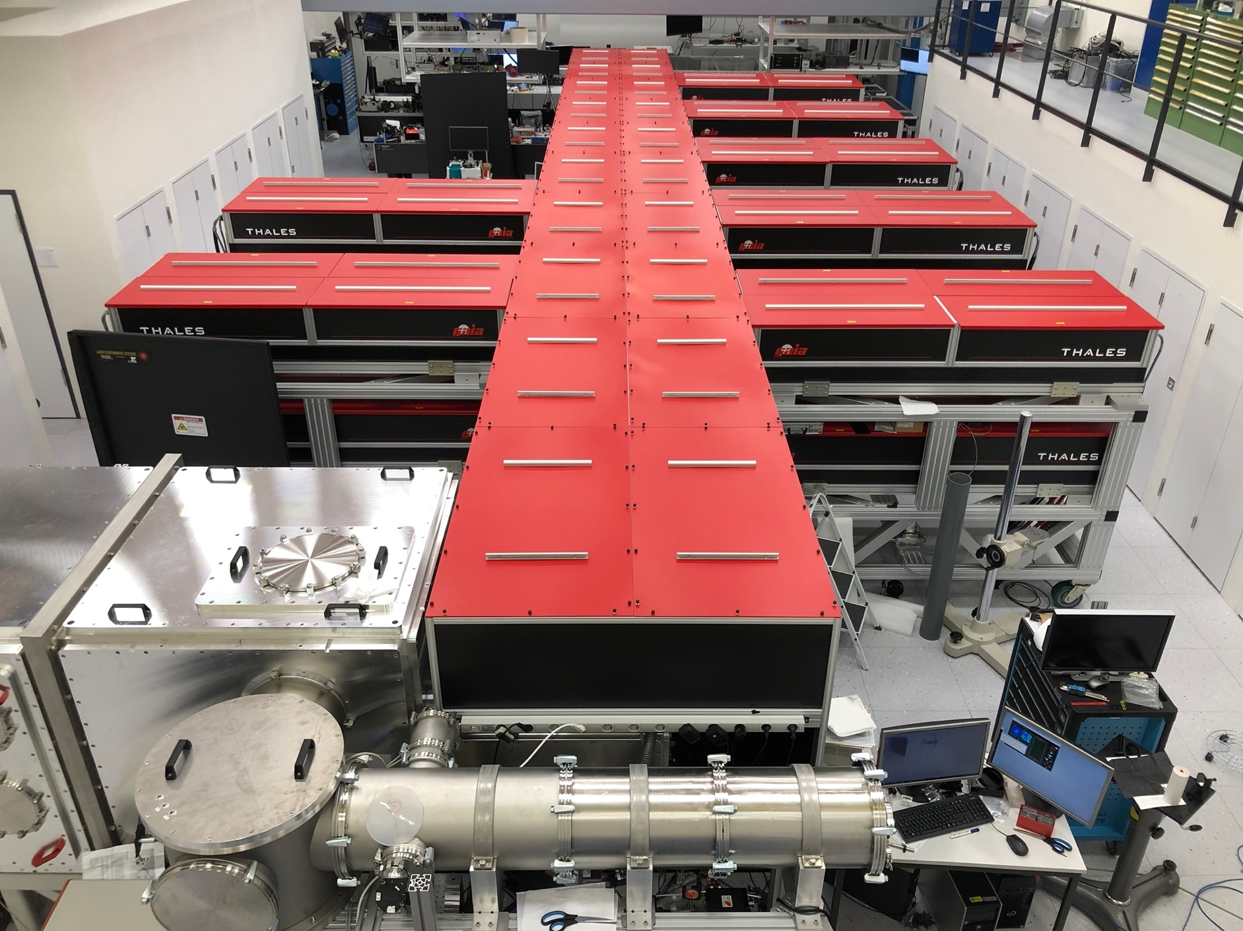
Centre for Advanced Laser Applications (CALA)…
…is operated by the Ludwig-Maximilians-Universität München (LMU)
… serves three university user groups
… hosts approx. 40 staff members
… houses two laser systems, ATLAS-3000 and PFS-pro
… and five experimental beamlines

Slide 26
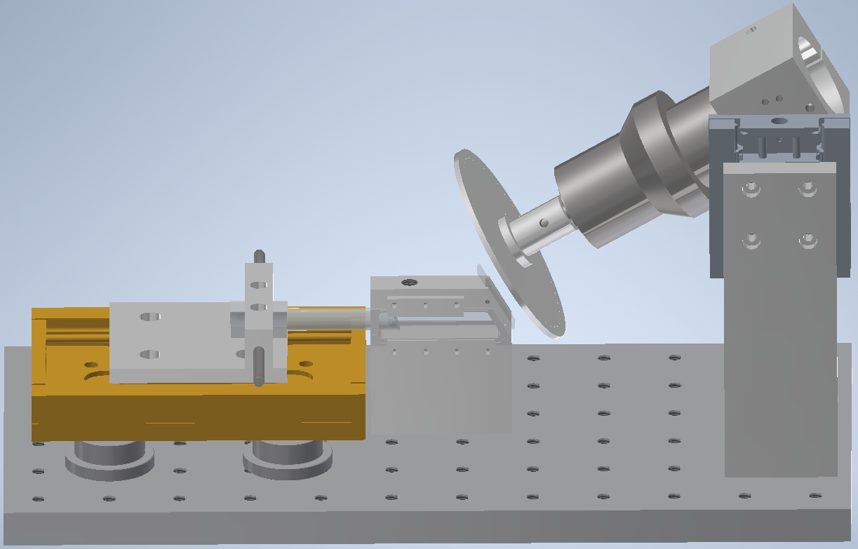
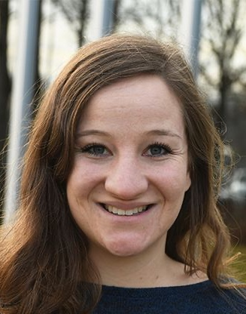
Multi-GeV beams
25 mm gas cell target, f/55
gas inlet
LWFA driving laser beam
K. v. Grafenstein
Optical shock driver
~10 pC over
2 GeV
Self injection
~25 pC at
1 GeV
Optically induced shock injection
f/37

Slide 27
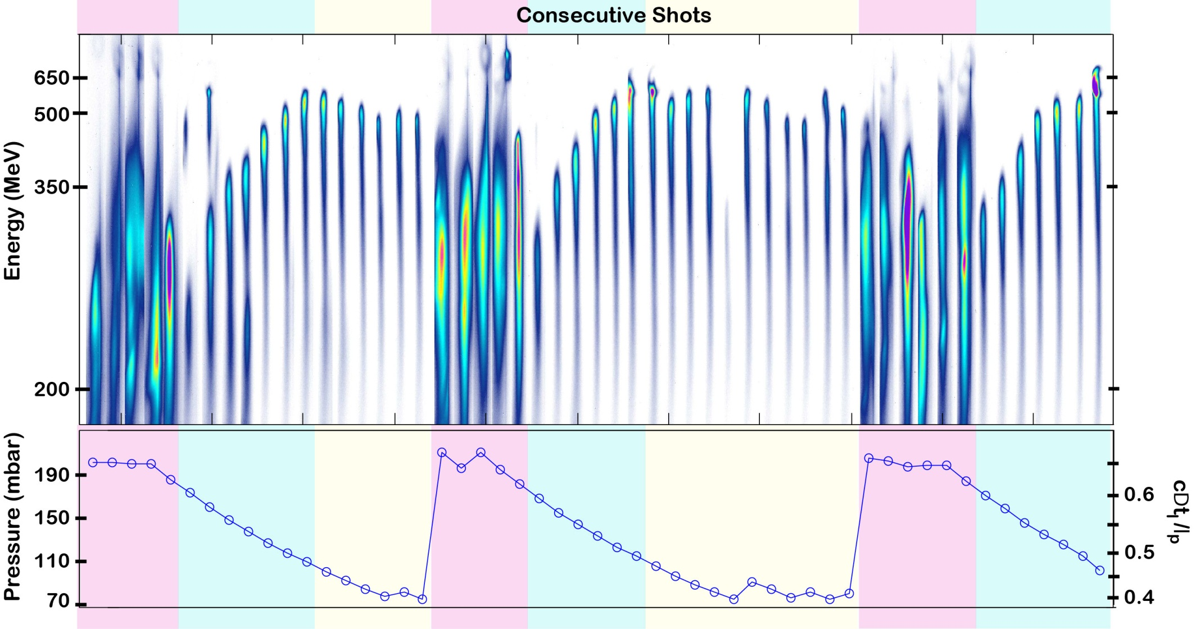

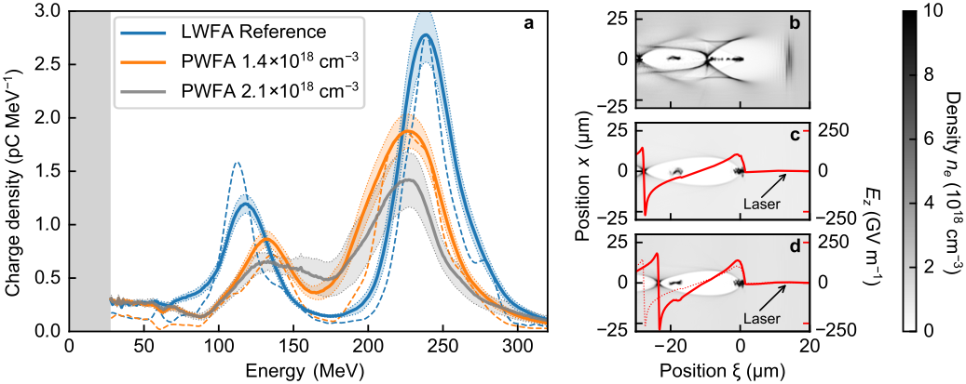


Hybrid LWFA-PWFA
First experimental clues (ca. 2010):
Hybrid accelerator & plasma photocathode concept
nC LWFA electron bunches
Plasma waves driven by LWFA electrons
Dual bunches from a single LWFA
2.5 mrad FWHM
External injection of witness beam
Internal injection of witness beam (supersonic shock)
HOFI shocks: High stability and beam quality from hybrid accelerator
> 1 nC, ~0.5 J
< 10 fs, ~ 100 kA
S. Corde et al., Phys. Rev. Lett. 107 215004 (2011)
SW. Chou et al., Phys. Rev. Lett. 117 144801 (2016)
B. Hidding et al., Phys. Rev. Lett. 104 195002 (2010)
B. Hidding et al., Phys. Rev. Lett. 108 035001 (2012)
J. Couperus-Cabadag et al., Nat. Comm. 8, 487 (2017)
J. Götzfried, A. Döpp et al. Phys. Rev. X 10, 041015 (2020)
M. Gilljohann, H. Ding et al. Phys. Rev. X 9, 011046 (2019)
S. Schöbel et al., New J. Phys. 24, 083034 (2022)
J. Wenz et al. Nat. Photonics. 13, 263 (2019)
T. Kurz, T. Heinemann et al. Nat. Comms. 12, 2895 (2021)
J. Couperus et al. Phys.Rev.Research 3, L042005 (2021)
M. Foerster et al. Phys.Rev.X 12, 041016 (2022)

Slide 28
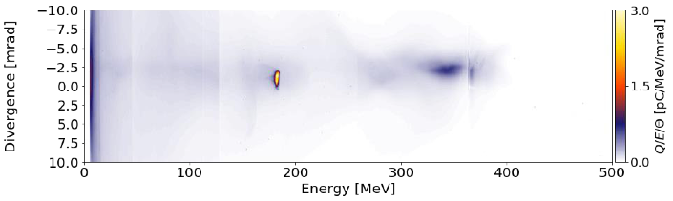
Latest preliminary results:
GeV-scale hybrid
Implementation of Trojan horse scheme (HZDR)

Slide 29
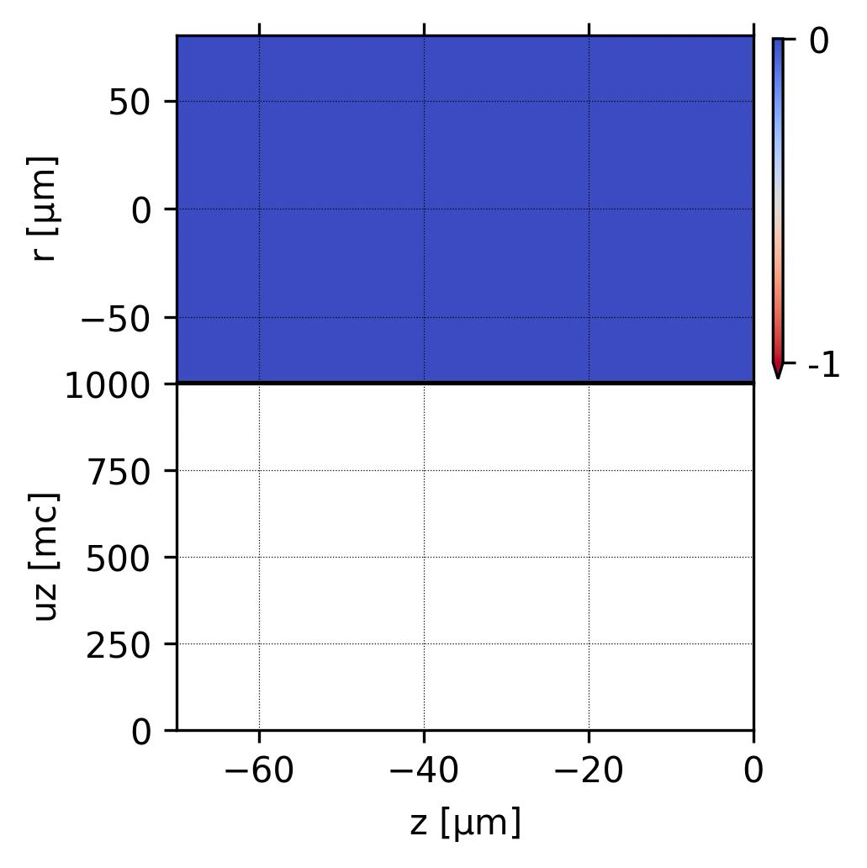
Simulation: laser wakefield acceleration (LWFA)
500 MeV
50 µm
375 MeV
radius
0 µm
energy
250 MeV
125 MeV
50 µm
propagation direction
propagation direction

