Slide 1
The effect of exit plasma scale-length and plasma mirrors on electron beams from a laser wakefield accelerator
EAAC 2023 | 20 September
Michael Backhouse
R. J. Shalloo, N. C. Lopes, J. C. Wood, M. J. V. Streeter, K. Poder, S. Alatabi, N. Bourgeois, E. Gerstmayr, J. -N. Gruse, D. R. Symes, P. P. Rajeev, S. V. Rozario, S. P. D. Mangles, G. Sarri, and
Z.. Najmudin

Slide 2
Laser wakefield acceleration (LWFA)
A common implementation of LWFA uses the intensity gradient of a short pulse, focused laser to drive a high amplitude plasma wave
The plasma wave can support electric field gradients in excess of 100GV/m:
  Linear within the bubble
  Strong transverse focusing for electrons
Compact acceleration of high quality electron beams to GeV energies is possible
What limits energy gain?
20/09/2023

Slide 3
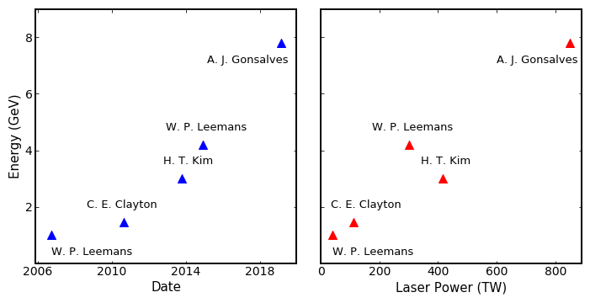
The limits of single stage acceleration
Peak electron energy records
Exponential increase in record energy over last 15 years
Energy gains largely driven by increasing laser power
Multi-stage acceleration decouples peak laser power and peak electron energy
Simple principle – challenging to implement effectively
A. J. Gonsalves et al. (2019)
W. P. Leemans et al. (2014)
H. T. Kim et al. (2013)
C. E. Clayton et al. (2010)
W. P. Leemans et al. (2006)

Slide 4
LWFA staging challenges
“Staging in LWFA: challenges and prospects” Thursday 17:45 WG10
Shorter term
Longer term
Effective driver coupling
High capture efficiency
Achieving a large energy boost
kHz repetition rate
Emittance preservation
Low average energy spread
[1]
Multi-stage acceleration demonstrated in 2016^{[2]}
  200MeV energy level
  3.5% capture efficiency
[1] Plasma Wakefield Accelerator Research 2019 – 2040, P.W.A.S.C. (2019)
[2] S. Steinke et al. (2016)

Slide 5
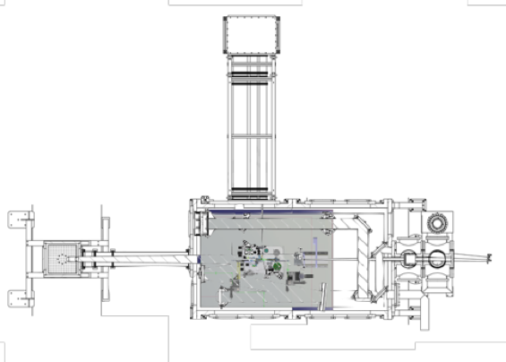
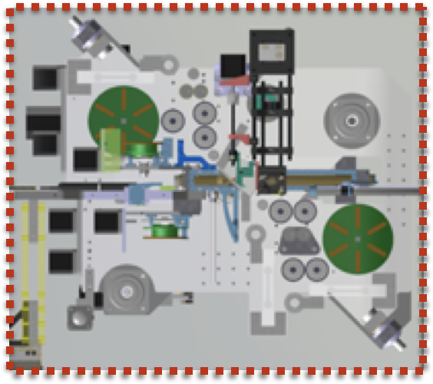
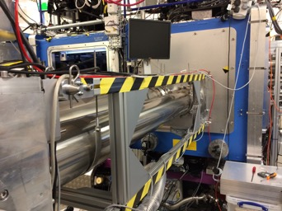
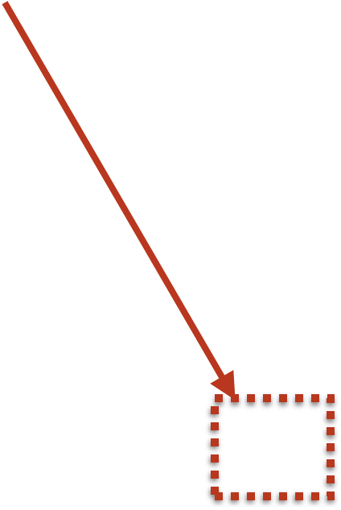
Gemini staging setup

Slide 6
Gemini staging setup

Slide 7
Single cell experiments
Laser Energy | 10.9±0.2J
Pulse length FWHM | 45±2fs
Central wavelength | 800nm
Mean spot FWHM | 40.9±0.9μm
Energy FWHM | 39±2%
Intensity | 9.2±0.7 x 10¹⁸ W cm⁻²
Vacuum a₀ | 2.07±0.08
Plasma density | 2.0±0.5 x 10²⁴ m⁻³

Slide 8
Beam profile measurements
Beam profile measurements were taken in three configurations:
  Extraction tape (ET)
  Hole (H)
  Injection tape (IT)

Slide 9
Electron spectrometer measurements
Mean divergence dropped from 6.13 ± 0.13mrad to 3.38 ± 0.07mrad
Shot-to-shot divergence fluctuations dropped from 12.4±1.3% to 4.7 ± 1.2%
Gradual decrease in divergence over time as more shots were taken
Effects were persistent at energies up to 2GeV

Slide 10
Electron spectrometer measurements
Mean divergence dropped from 6.13 ± 0.13mrad to 3.38 ± 0.07mrad
Shot-to-shot divergence fluctuations dropped from 12.4±1.3% to 4.7 ± 1.2%
Gradual decrease in divergence over time as more shots were taken
Effects were persistent at energies up to 2GeV
Tape/Plasma mirror increasing divergence
Plasma scale length/ramp reducing divergence
What is the cause?

Slide 11
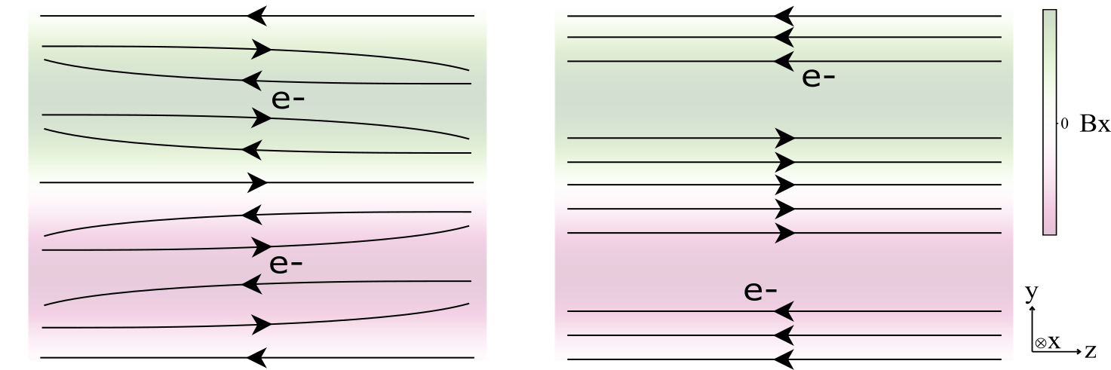
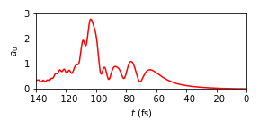
Magnetic fields in the thin plasma mirror
Magnetic fields generated in foils placed at the end of gas jets have been shown to increase electron beam divergence ^{[1]}
Fields are generated by laser-driven current self-amplification
kT μm scale magnetic fields in the front surface of the tape
Simulations needed for our experimental situation
~100 femtoseconds
Simulation snapshot
Injected laser pulse
B-field generation mechanism
[1] G. Raj et. al. Phys. Rev. Research 2, 023123 (2020)

Slide 12




3D PIC simulations: integrated B fields
0° incidence
45° incidence
𝜌
$$B_{x}$$
$$B_{y}$$
Strong peak integrated magnetic fields during irradiance
Slightly weaker in the 45-degree geometry due to ‘washing out’ effect
$$B_{x}$$
$$B_{y}$$

Slide 13
3D PIC simulations: integrated B fields
0° incidence
45° incidence
𝜌
$$B_{x}$$
$$B_{y}$$
Modest increase in transverse momentum spread of incident electron beam
Plasma mirror fields probably not having a strong effect in our experiment
Effects may be important for ultra-low emittance beams
$$B_{x}$$
$$B_{y}$$

Slide 14


Plasma scale length: gas leaking through hole
Simulations of gas leaking through the hole in the thin tape were performed
An exponential ramp was formed, with a scale length that is proportional to the size (radius) of the hole
Plasma scale length
$$∝$$
Aperture size

Slide 15
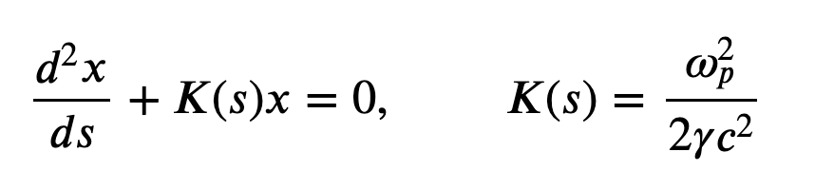
Plasma scale length: LWFA simulations
LWFA simulations were run using experimental parameter inputs (laser spot, density profiles) with ramp scale length as a variable parameter
Transverse electron motion in the bubble (simplified)
The electrons oscillation amplitude increase while their transverse momentum decreases, leading to a larger, more collimated beam
How does this compare to the experimental divergence measurements?

Slide 16
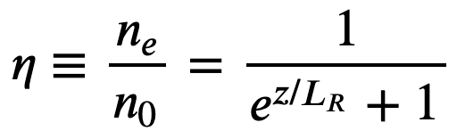
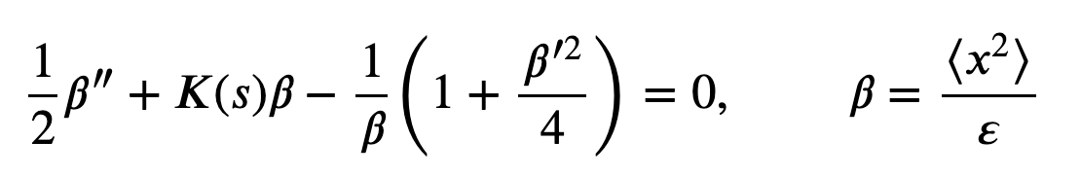
Plasma scale length: LWFA simulations
Simulations were run for a range of scale lengths, from 0mm to 0.5mm
The simulated ramp shape for a 1mm hole produced a divergence reduction that matched experimental measurements
The solution of the envelope equation,
matched the simulation results for a geometric beam emittance of 12.5nm

Slide 17
Emittance preservation
Even with ~100% energy spread, the longer density ramps preserve the emittance for a few mm
The ramps are long enough to be adiabatic, or slow varying compared to the electron oscillation wavelength
  The beta-function remains matched at a range of energies
Could this be exploited for beam transport?

Slide 18
Prospects: all plasma beam transport
Plasma ramps
Stage 1
Stage 2
Advantages:
Ultra-high average gradient
Beta-function remains matched
Small beta function in plasma mirror
Eases alignment requirements
Challenges:
Driver intensity maintenance…
Energy spread…
No room for passive correction schemes…

Slide 19
Summary
Multi-stage LPA acceleration is one of the key goals of the field
In an experiment towards this goal, it was found that the electron beam divergence was strongly reduced by the formation of a hole in the thin plasma mirror terminating the gas cell
Strong magnetic fields in the plasma mirror scatter the beam, but this effect is small for our experimental conditions
A density ramp can account for the observed change and is able to preserve the emittance if the ramp is long enough
All-plasma beam transport was proposed
THANK YOU FOR LISTENING!

