Slide 1
Evaluation of
the transfer matrix
of a plasma ramp with squared cosine shape
via an approximate solution of Mathieu differential equation
Evaluation of
the transfer matrix
of a plasma ramp with squared cosine shape
via an approximate solution of Mathieu differential equation
Stefano Romeo stefano.romeo@lnf.infn.it
Island of Elba 2023-09-18
6th European Advanced Accelerator Concepts Workshop

Slide 2
Outline: Plasma transport line optimization
Emittance preservation inside plasma is difficult, since in order to balance the extreme focusing field inside plasma the beam needs to be focused up to few micrometers/sub micrometer scale
$$σ_{0}=\sqrt[4]{\frac{2}{γ}}\sqrt{\frac{ε_{n}}{k_{p}}}$$
Guide
Vacuum
Capillary
$$β_{0}=\frac{\sqrt{2γ}}{k_{p}}$$
High sensitivity to transverse instability!
Plasma channel
Electrode
A PLASMA RAMP CAN HELP TO RELAX MATCHING CONDITIONS!!!
Courtesy of A. Biagioni
Evaluation of ramp transfer matrix
At the edge of discharge capillaries, regions with a gradually decreasing plasma density form, connecting the plasma plateau to the vacuum
Analytical solution:
Find a general rule for a suitable shape
Which plasma ramp?
These regions are commonly referred to as plasma ramps
Numerical solution:
For any working point perform several simulation scans
Island of Elba 2023-09-18
Stefano Romeo stefano.romeo@lnf.infn.it
6th European Advanced Accelerator Concepts Workshop

Slide 3
Theory: Plasma focusing strength
$$β^{′′}(z)+2k_{ext}^{2}\left(z\right)β\left(z\right)=\frac{2}{β\left(z\right)}+\frac{{[β^{′}\left(z\right)]}^{2}}{2β(z)}$$
Envelope equation
Neglecting constants, the focusing force inside a plasma ramp depends only from the plasma density, with the energy taken as a parameter
$$k_{ext}^{2}\left(z\right)=\frac{k_{p}^{2}(z)}{2γ }$$
Ion column model
(only the particles inside the bubble)
Plasma focusing strength?
$$k_{ext}^{2}\left(z\right)=\frac{e^{2}}{2ε_{0}m_{e}c^{2}}\frac{n_{p}(z)}{γ}=f(z;γ)$$
$β(z)=\frac{\sqrt{2γ}}{k_{p}}$
$α\left(z\right)=0$
$γ\left(z\right)=\frac{1}{β\left(z\right)}$
$β^{′′}\left(z\right)=0$
Matching conditions on the plateau
Island of Elba 2023-09-18
Stefano Romeo stefano.romeo@lnf.infn.it
6th European Advanced Accelerator Concepts Workshop

Slide 4
Method: Hill’s Equation
$$y^{′′}\left(z\right)+f\left(z\right)y\left(z\right)=0$$
Hill’s Equation
$C^{2}\left(0\right)β_{0}+\frac{S^{2}\left(0\right)}{β_{0}}=β_{0}$
${C^{′}}^{2}\left(0\right)β_{0}+\frac{S^{′2}\left(0\right)}{β_{0}}=\frac{1}{β_{0}}$
$−C\left(0\right)C^{′}\left(0\right)β_{0}−\frac{S\left(0\right)S^{′}\left(0\right)}{β_{0}}=0$
$β^{′′}\left(0\right)=0$
Liouville’s Theorem
$$k_{ext}^{2}\left(z\right)=f\left(z\right)∝n_{p}(z)$$
Negligible deceleration
$f(z)$ is a continuous and derivable function
$$\left[\begin{matrix}β(z) \\ α(z) \\ γ(z)\end{matrix}\right]=\left[\begin{matrix}C^{2} & −2CS & S^{2} \\ −CC′ & CS^{′}+C^{′}S & −SS′ \\ C^{′2} & −2C^{′}S^{′} & {S^{′}}^{2}\end{matrix}\right]\left[\begin{matrix}β_{0} \\ 0 \\ \frac{1}{β_{0}}\end{matrix}\right]$$
The computation is performed over the inverse matrix in order to have simplified matching conditions
Island of Elba 2023-09-18
Stefano Romeo stefano.romeo@lnf.infn.it
6th European Advanced Accelerator Concepts Workshop

Slide 5
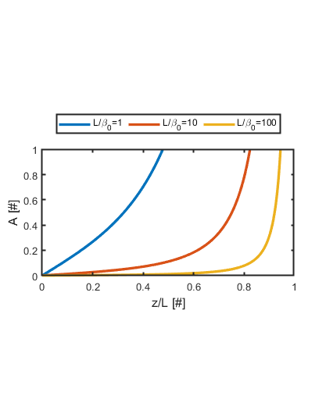
Framework: Squared Cosine plasma ramp
Solutions are continuous and derivable
One solution is even, the other is odd
If $f\left(z\right)$ is even Hill’s equation becomes a symmetric differential equation
THE CHOICE
$$f\left(z\right)=\frac{1}{β_{0}^{2}}\cos^{2}\left(\frac{πz}{2L}\right)$$
Realistic ramp
No discontinuity at any derivative order
Partially concave, partially convex
Never adiabatic
Ramps with an even functional form guarantee the possibility to respect matching conditions
$$𝒜=\frac{1}{4f^{3/2}(z)}\left|\frac{df(z)}{dz}\right|$$
We can normalize the solutions such as
$C\left(0\right)=1$ and $S^{′}\left(0\right)=1$
Island of Elba 2023-09-18
Stefano Romeo stefano.romeo@lnf.infn.it
6th European Advanced Accelerator Concepts Workshop

Slide 6
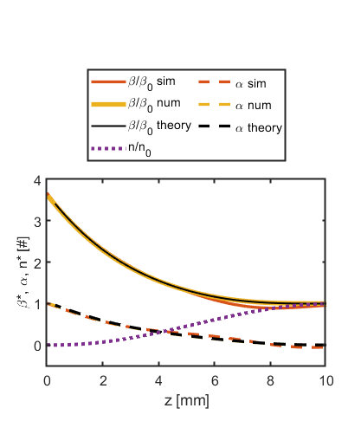
Expansion: Mathieu Equation
Hill’s Equation
Mathieu Equation
$$y^{′′}\left(z\right)+\frac{1}{β_{0}^{2}}\cos^{2}\left(\frac{πz}{2L}\right)y(z)=0$$
$$y^{′′}\left(ξ\right)+\frac{2L^{2}}{π^{2}β_{0}^{2}}\left[1+cos(2{ξ)}\right]y(ξ)=0$$
Even and odd normalized Mathieu Functions
$$C(z)=\frac{Ce_{n}\left(\frac{2L^{2}}{π^{2}β_{0}^{2}},−\frac{L^{2}}{π^{2}β_{0}^{2}},\frac{πz}{2L}\right)}{Ce_{n}\left(\frac{2L^{2}}{π^{2}β_{0}^{2}},−\frac{L^{2}}{π^{2}β_{0}^{2}},0\right)}$$
$$S(z)=\frac{2L}{π}\frac{Se_{n}\left(\frac{2L^{2}}{π^{2}β_{0}^{2}},−\frac{L^{2}}{π^{2}β_{0}^{2}},\frac{πz}{2L}\right)}{ Se_{n}′\left(\frac{2L^{2}}{π^{2}β_{0}^{2}},−\frac{L^{2}}{π^{2}β_{0}^{2}},0\right)}$$
Island of Elba 2023-09-18
Stefano Romeo stefano.romeo@lnf.infn.it
6th European Advanced Accelerator Concepts Workshop

Slide 7
Simplify: Normalized transfer matrix
Normalization
$$R=\frac{L}{{πβ}_{0}} \\ c_{n}=C\left(\frac{π}{2}\right)=\frac{Ce_{n}\left(2R^{2},−R^{2},\frac{π}{2}\right)}{Ce_{n}\left(2R^{2},−R^{2},0\right)} \\ s_{n}=\frac{S\left(\frac{π}{2}\right)}{β_{0}}=2R\frac{Se_{n}\left(2R^{2},−R^{2},\frac{π}{2}\right)}{ Se_{n}′\left(2R^{2},−R^{2},0\right)} \\ {c′}_{n}=C^{′}\left(\frac{π}{2}\right)β_{0}=\frac{1}{2R}\frac{Ce_{n}′\left(2R^{2},−R^{2},\frac{π}{2}\right)}{Ce_{n}\left(2R^{2},−R^{2},0\right)} \\ {s′}_{n}=S′\left(\frac{π}{2}\right)=\frac{Se_{n}′\left(2R^{2},−R^{2},\frac{π}{2}\right)}{ Se_{n}′\left(2R^{2},−R^{2},0\right)}$$
Extraction
Geometric factor
$$\left[\begin{matrix}β_{1}/β_{0} \\ α_{1} \\ γ_{1}β_{0}\end{matrix}\right]=\left[\begin{matrix}c^{2} & −2cs & s^{2} \\ −cc′ & cs^{′}+c^{′}s & −ss′ \\ c^{′2} & −2c^{′}s^{′} & {s^{′}}^{2}\end{matrix}\right]\left[\begin{matrix}β_{2}/β_{0} \\ α_{2} \\ γ_{2}β_{0}\end{matrix}\right]$$
Normalized transfer matrices
Injection
$$\left[\begin{matrix}β_{2}/β_{0} \\ α_{2} \\ γ_{2}β_{0}\end{matrix}\right]=\left[\begin{matrix}{s′}^{2} & −2ss′ & s^{2} \\ −c^{′}s′ & cs^{′}+c^{′}s & −cs \\ c^{′2} & −2cc′ & c^{2}\end{matrix}\right]\left[\begin{matrix}β_{1}/β_{0} \\ α_{1} \\ γ_{1}β_{0}\end{matrix}\right]$$
Island of Elba 2023-09-18
Stefano Romeo stefano.romeo@lnf.infn.it
6th European Advanced Accelerator Concepts Workshop

Slide 8
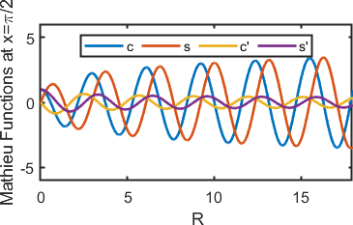
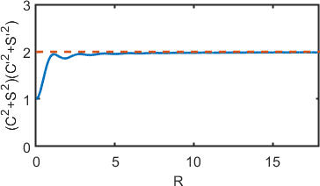
Approximation: Behavior of Mathieu functions
Sinusoidal behavior
Phase delay between Mathieu functions and their first derivative
The product $\left(c_{n}^{2}+s_{n}^{2}\right)\left({c^{′}}_{n}^{2}+{s^{′}}_{n}^{2}\right)$ saturates for $R≫1$
Transfer matrix is unimodular (Liouville’s theorem)
$$c_{n}≈a R^{b}\cos\left(2R+ω\right)$$
$$s_{n}≈a R^{b}\sin\left(2R+ω\right)$$
$${c′}_{n}≈−\frac{1}{a}\frac{1}{\cos^{2}{ω}−\sin^{2}{ω}}R^{−b}\sin\left(2R−ω\right)$$
$${s′}_{n}≈\frac{1}{a}\frac{1}{\cos^{2}{ω}−\sin^{2}{ω}}R^{−b}\cos\left(2R−ω\right)$$
Island of Elba 2023-09-18
Stefano Romeo stefano.romeo@lnf.infn.it
6th European Advanced Accelerator Concepts Workshop

Slide 9
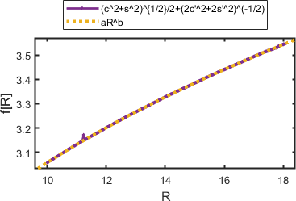
Alignment: Evaluation of the constants
$$c_{n}≈\sqrt{3} R^{\frac{1}{4}}\cos\left(2R+\frac{π}{8}\right)$$
$$s_{n}≈\sqrt{3} R^{\frac{1}{4}}\sin\left(2R+\frac{π}{8}\right)$$
$${c′}_{n}≈−\sqrt{\frac{2}{3}} R^{−\frac{1}{4}}\sin\left(2R−\frac{π}{8}\right)$$
$${s′}_{n}≈\sqrt{\frac{2}{3}} R^{−\frac{1}{4}}\cos\left(2R−\frac{π}{8}\right)$$
$$\left(c_{n}^{2}+s_{n}^{2}\right)\left({c^{′}}_{n}^{2}+{s^{′}}_{n}^{2}\right)={\left(\frac{1}{\cos^{2}{ω}−\sin^{2}{ω}}\right)}^{2}≈2$$
$$ω=\frac{π}{8}$$
$$\frac{1}{2}\sqrt{c_{n}^{2}+s_{n}^{2}}+\frac{1}{2}\sqrt{\frac{2}{{c′}_{n}^{2}+{s′}_{n}^{2}}}=aR^{b}$$
$$a=\sqrt{3} \\ b=\frac{1}{4}$$
Island of Elba 2023-09-18
Stefano Romeo stefano.romeo@lnf.infn.it
6th European Advanced Accelerator Concepts Workshop

Slide 10
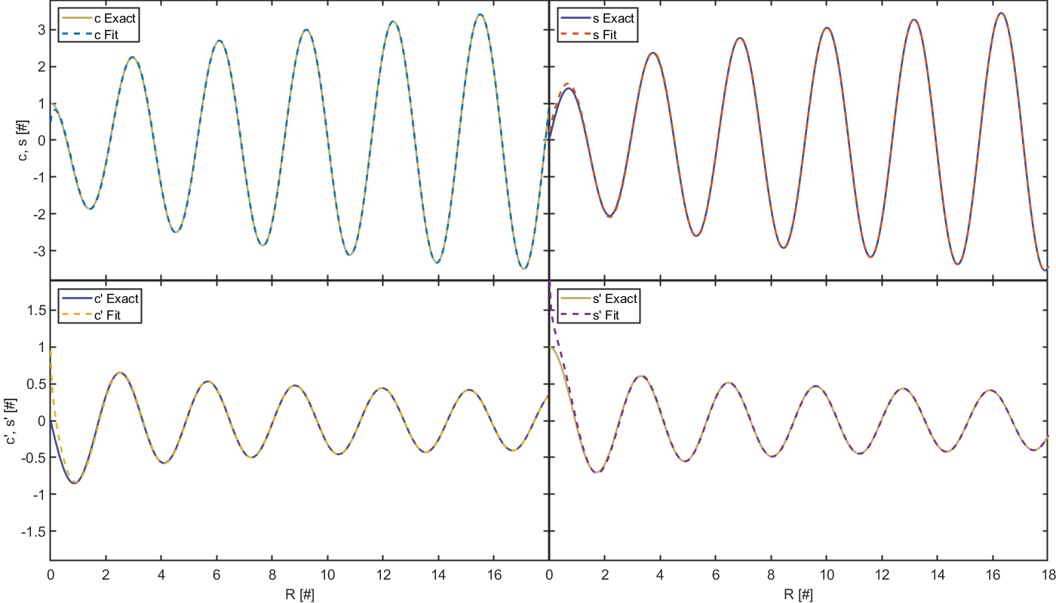
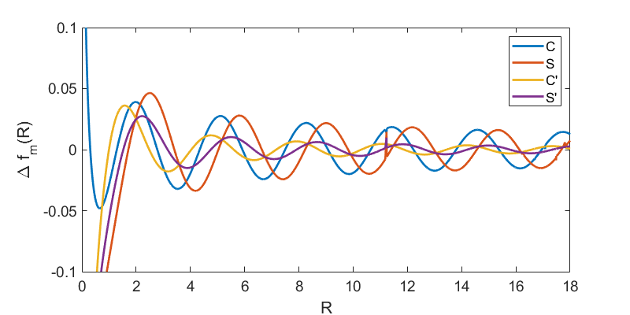
Check: Numerical vs. Analytical Approximation
Island of Elba 2023-09-18
Stefano Romeo stefano.romeo@lnf.infn.it
6th European Advanced Accelerator Concepts Workshop

Slide 11
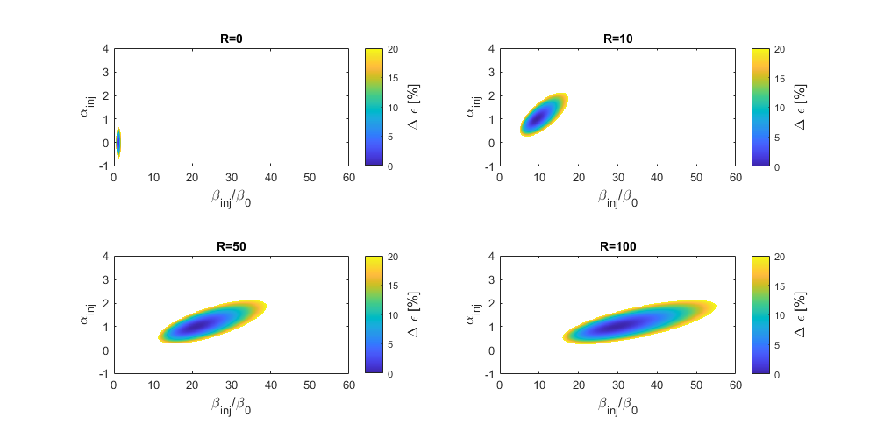
Application: Stabilizing effect of the ramp
Transfer matrix
$$\left[\begin{matrix}β^{∗} \\ α \\ γ^{∗}\end{matrix}\right]=M\left[\begin{matrix}β_{inj}/β_{0} \\ α_{inj} \\ γ_{inj}β_{0}\end{matrix}\right]$$
Mehrling-Floettmann equation for emittance growth
$$ε_{n,fin}=\frac{ε_{n,inj}}{2}\left(\frac{1+α^{2}}{β^{∗}}+β^{∗}\right)$$
Mehrling, T., et al. "Transverse emittance growth in staged laser-wakefield acceleration." Physical Review Special Topics-Accelerators and Beams 15.11 (2012): 111303.
Island of Elba 2023-09-18
Stefano Romeo stefano.romeo@lnf.infn.it
6th European Advanced Accelerator Concepts Workshop

Slide 12
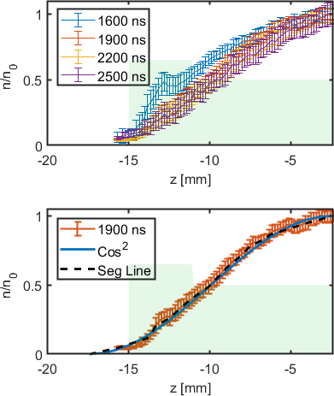
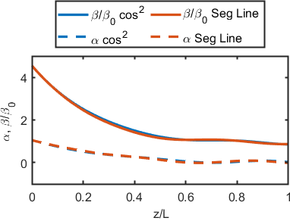
Perspective: Experimental ramps
Plasma ramps with squared cosine shape were actually realized at the plasma lab of SPARC_LAB facility by means of tapered capillaries
The measured shapes were replied in numerical simulations by means of segmented lines and tested in comparison with analytical squared cosine shape
The results are consistent with the expectations
Island of Elba 2023-09-18
Stefano Romeo stefano.romeo@lnf.infn.it
6th European Advanced Accelerator Concepts Workshop

Slide 13
Conclusion: Summary
We opted for a purely analytical approach trying to evaluate the transfer matrix of a plasma ramp
We concluded that a ramp with a symmetric form could simplify the problem
We opted for a ramp with a squared cosine shape
We evaluated that this ramp is never adiabatic and its application lead to Mathieu Equation
We compared the solution of the Mathieu Equation with actual envelope evolution
We deduced that the ramp transfer matrix can be normalized to a geometric parameter
We found an analytical approximation that allows to write the transfer matrix in a simple way
We opted for a purely analytical approach trying to evaluate the transfer matrix of a plasma ramp
We concluded that a ramp with a symmetric form could simplify the problem
We opted for a ramp with a squared cosine shape
We evaluated that this ramp is never adiabatic and its application lead to Mathieu Equation
We compared the solution of the Mathieu Equation with actual envelope evolution
We deduced that the ramp transfer matrix can be normalized to a geometric parameter
We found an analytical approximation that allows to write the transfer matrix in a simple way
Tons of applications on their way!
Tons of applications on their way!
Island of Elba 2023-09-18
Stefano Romeo stefano.romeo@lnf.infn.it
6th European Advanced Accelerator Concepts Workshop

Slide 14
Thank you for the attention!
Thank you for the attention!
Stefano Romeo stefano.romeo@lnf.infn.it
Island of Elba 2023-09-18
6th European Advanced Accelerator Concepts Workshop

Slide 15
Very special thanks to those who collaborated with me in the realization of this work
Angelo Biagioni
Lucio Crincoli
Alessio Del Dotto
Massimo Ferrario
Anna Giribono
Gianmarco Parise
Andrea Renato Rossi
Gilles Jacopo Silvi
Cristina Vaccarezza
Very special thanks to those who collaborated with me in the realization of this work
Angelo Biagioni
Lucio Crincoli
Alessio Del Dotto
Massimo Ferrario
Anna Giribono
Gianmarco Parise
Andrea Renato Rossi
Gilles Jacopo Silvi
Cristina Vaccarezza
Stefano Romeo stefano.romeo@lnf.infn.it
Island of Elba 2023-09-18
6th European Advanced Accelerator Concepts Workshop

