Slide 1



All-optical GeV electron bunch generation in a laser-plasma accelerator via truncated-channel injection
A Picksley¹, J Chappell¹, E Archer¹, N Bourgeois², J Cowley¹, DR Emerson³,
L Feder¹, XJ Gu³, O Jakobsson¹, AJ Ross¹, W Wang¹, R Walczak¹, SM Hooker¹
¹John Adams Institute for Accelerator Science and Department of Physics, University of Oxford
²Central Laser Facility, STFC Rutherford Appleton Laboratory
³Scientific Computing Department, STFC Daresbury Laboratory
This work was supported by the UK Science and Technology Facilities Council (STFC UK) [grant numbers ST/P002048/1, ST/R505006/1, ST/S505833/1, ST/V001655/1]; the Engineering and Physical Sciences Research Council [EP/R513295/1, EP/V006797/1]. This material is based upon work supported by the Air Force Office of Scientific Research under award number FA9550-18-1-7005.

Slide 2


Contributors
SM Hooker
R Walczak
Experiment led by A Picksley (BELLA)
Data analysis led by A Picksley and J Chappell
E Archer
John Adams Institute for Accelerator Science, University of Oxford​
J Cowley
L Feder
O Jakobsson
A Ross
W Wang
N Bourgeois
Rutherford Appleton Laboratory​
DR Emerson
XJ Gu
STFC Daresbury Laboratory
The authors would also like to acknowledge useful discussions with Rémi Lehe.

Slide 3
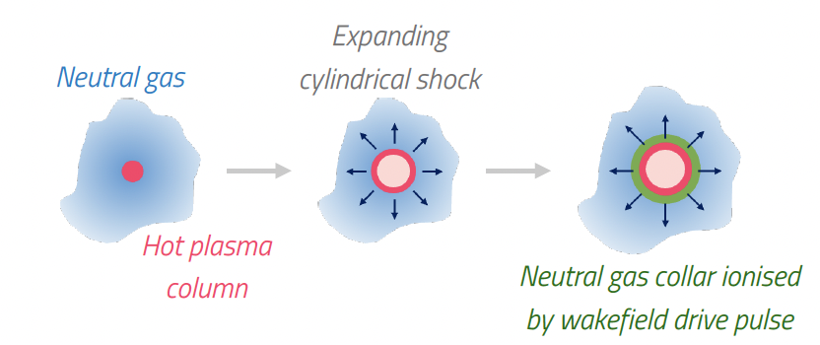
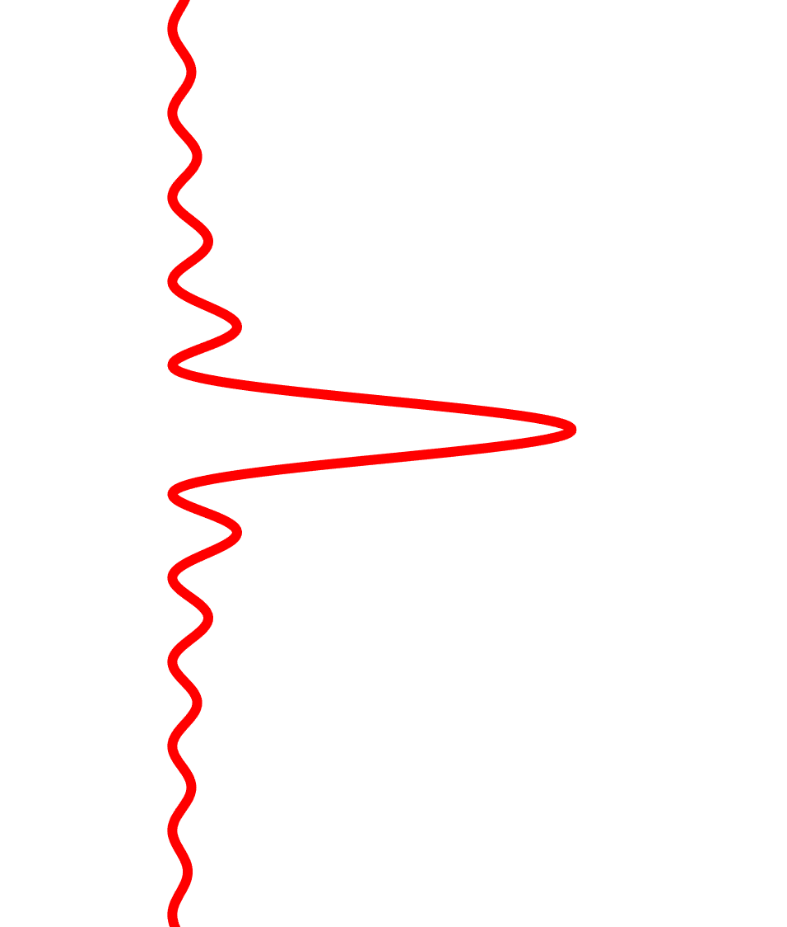
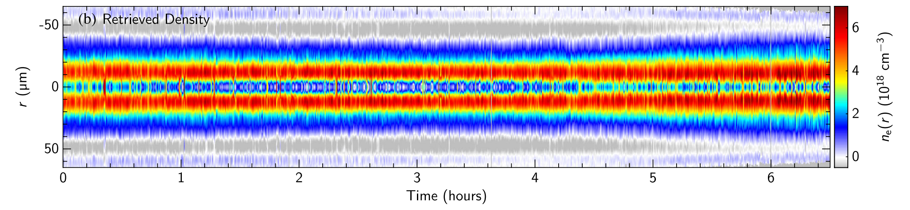
Multi-GeV stages require high-power laser pulse propagation over $\sim 10$cm lengths in low density ($\sim {10}^{17}$ cm⁻³) plasma
Plasma channels generated by hydrodynamic optical field ionisation¹⁻⁴ (HOFI) can achieve low on-axis densities and can be extended to the meter-scale via conditioning⁵⁻⁸.
Axicon
Line focus forming long plasma column
Bessel Beam
Neutral gas (dashed)
kHz ready since they are freestanding, hence immune
to damage⁹
[1] N. Lemos et al., PoP 20 (2013)
[2] S. M. Hooker et al., AAC Workshop (2016)
[3] R. J. Shalloo et al., PRE 97 (2018)
[4] Morozov et al., PoP 25 (2018)
[5] R. J. Shalloo et al., PRAB 22 (2019)
[6] B. Miao et al., PRL 125 (2020)
[7] A. Picksley et al., PRE 102 (2020)
[8] L. Feder et al., PRR 2 (2020)
[9] A. Alejo et al., PRAB 255 (2022)
Electron density
1

Slide 4
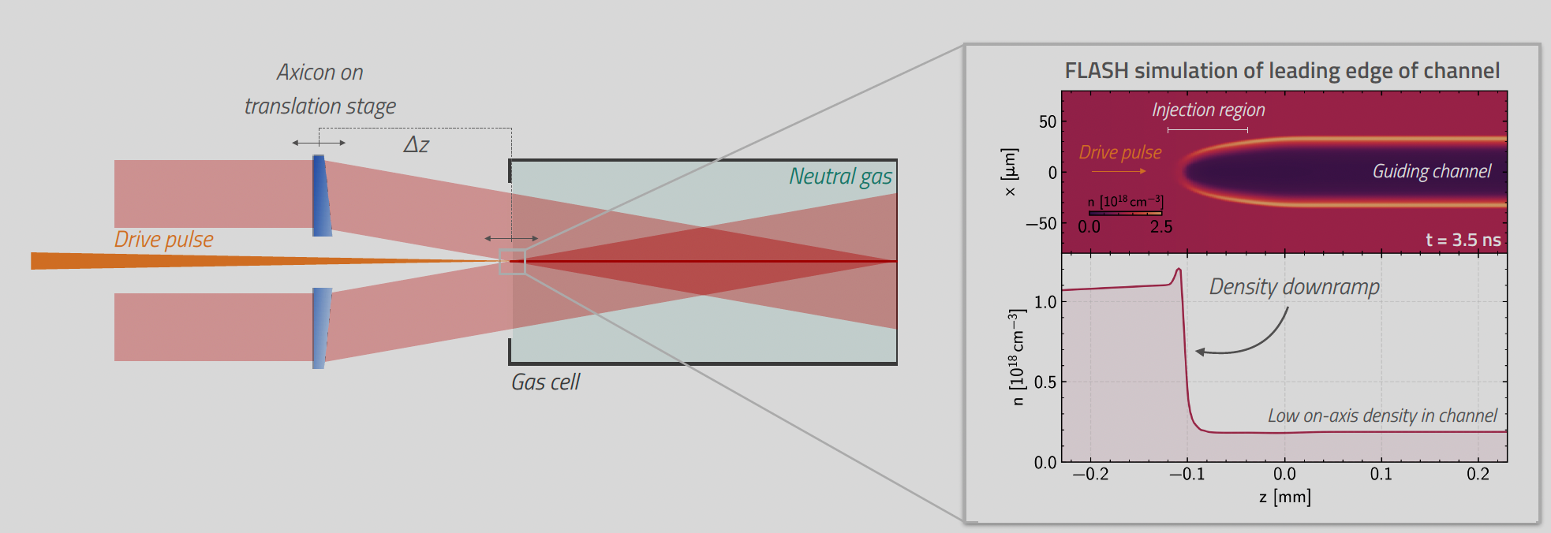
Dark current free electron beams require operation in quasi-linear regimes, such as in plasma channels
However, we then need an alternative mechanism to inject electrons
Longitudinal sculpting (truncation) of the plasma channel by delaying the start of the axicon focus creates a controlled density down-ramp which promotes injection
This leaves short zone of neutral gas between cell entrance and start of channel
2

Slide 5
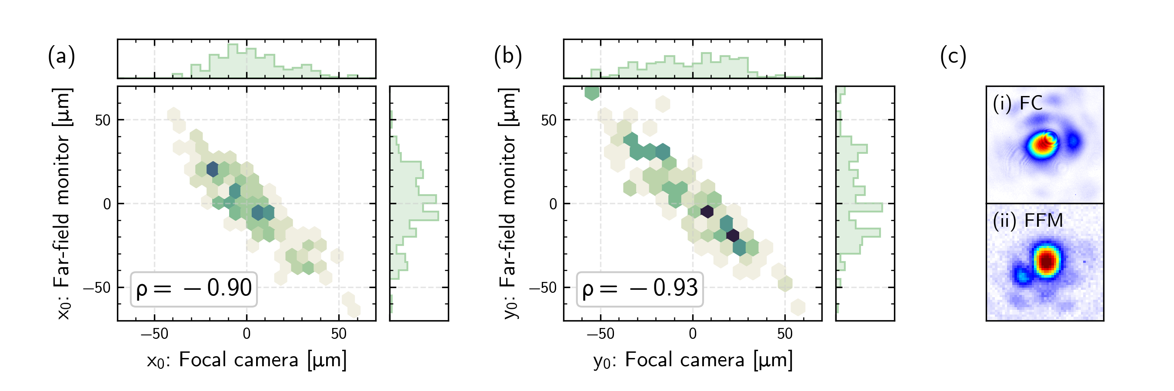
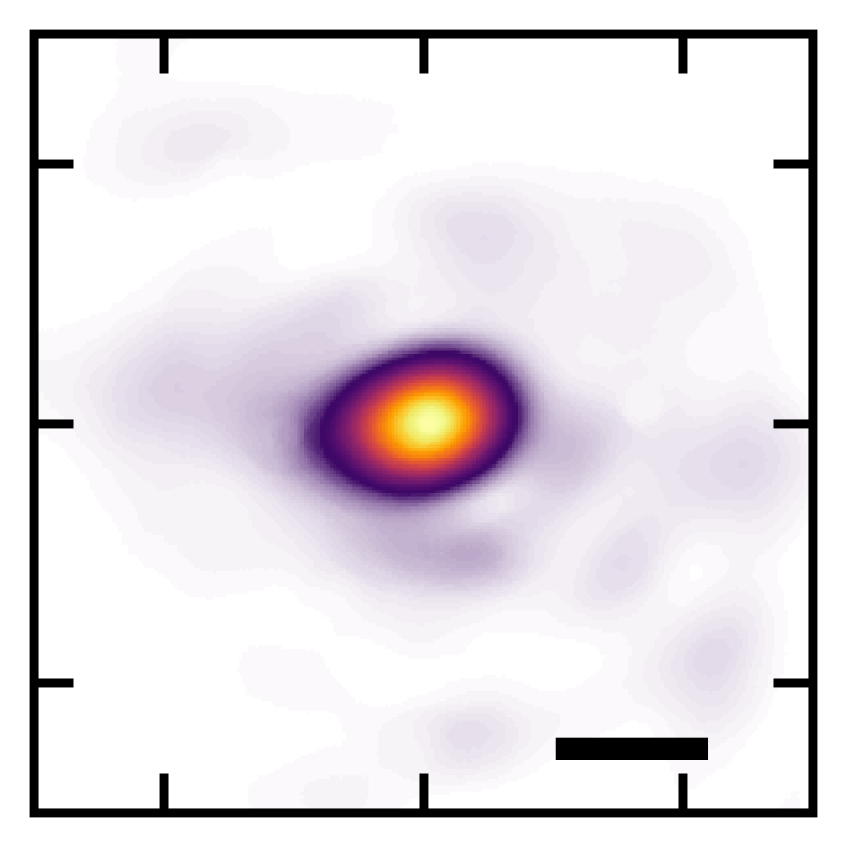
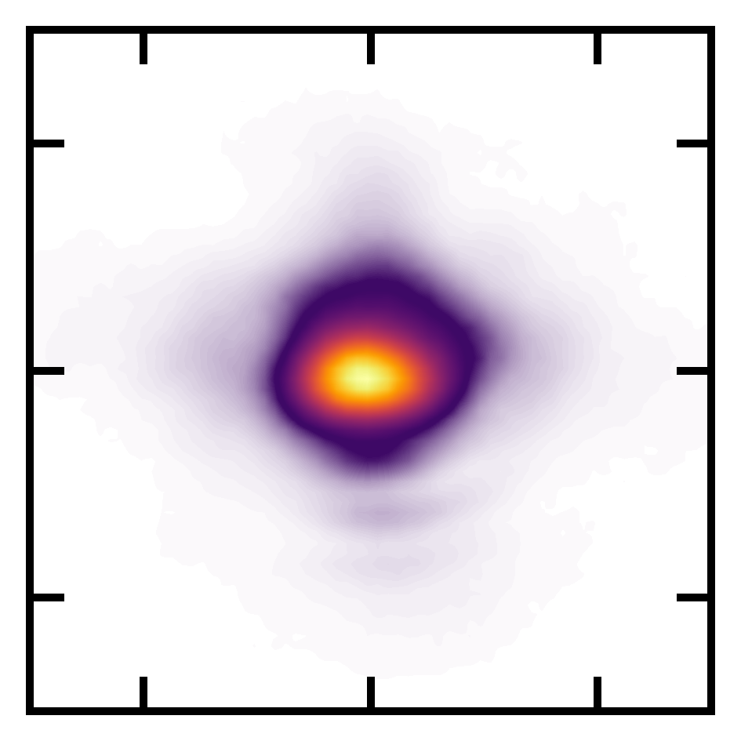
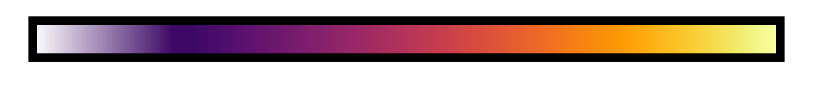
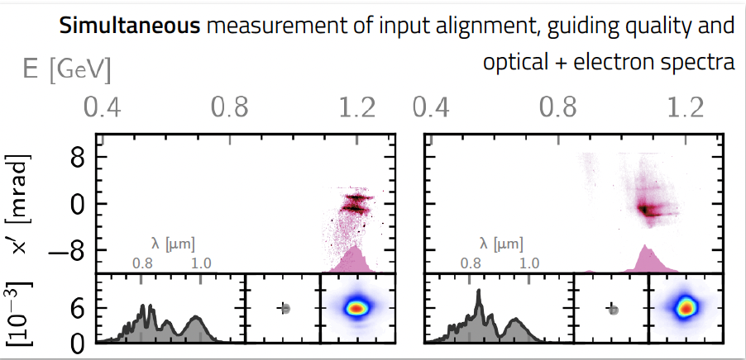
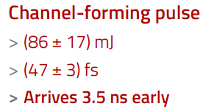
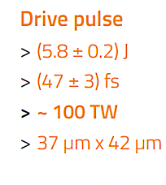
2
Input
Guided
Optical spectrometer + mode imager
50 μm
e⁻
0
1
Fluence (norm.)
Magnetic spectrometer
1
Input mode diagnostic
Hybrid Gas Jet-Cell
Axicon
1
2
110 mm
98% H₂, 2% N₂
f/40 off-axis parabola
3

Slide 6
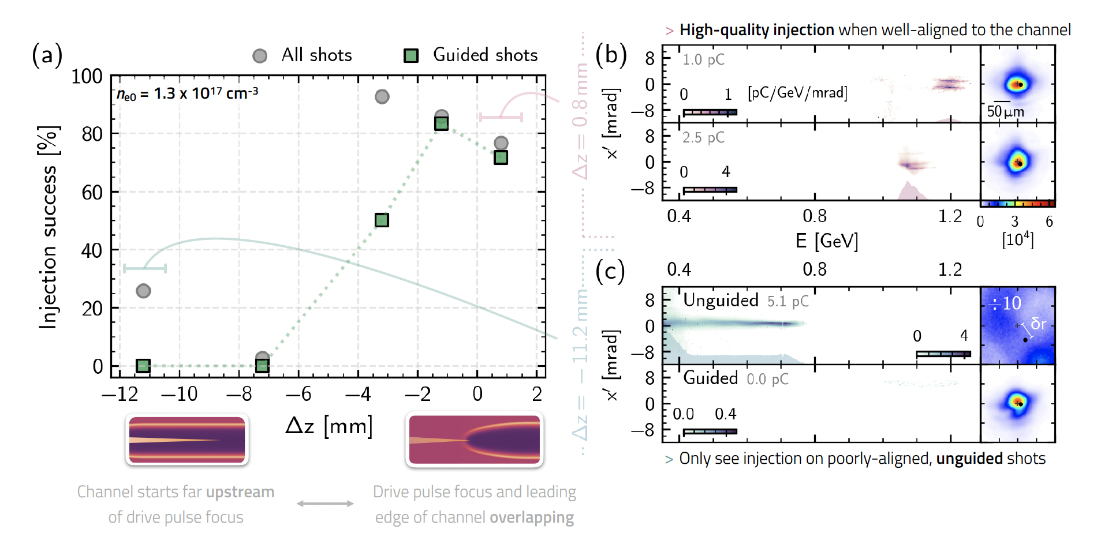


$∆z=0.8$ mm
$∆z=−11.2$ mm
Channel starts far upstream of drive pulse focus
Drive pulse and start of channel overlapping
Electron injection triggered as the drive pulse focus is overlapped with the start of the channel
4

Slide 7
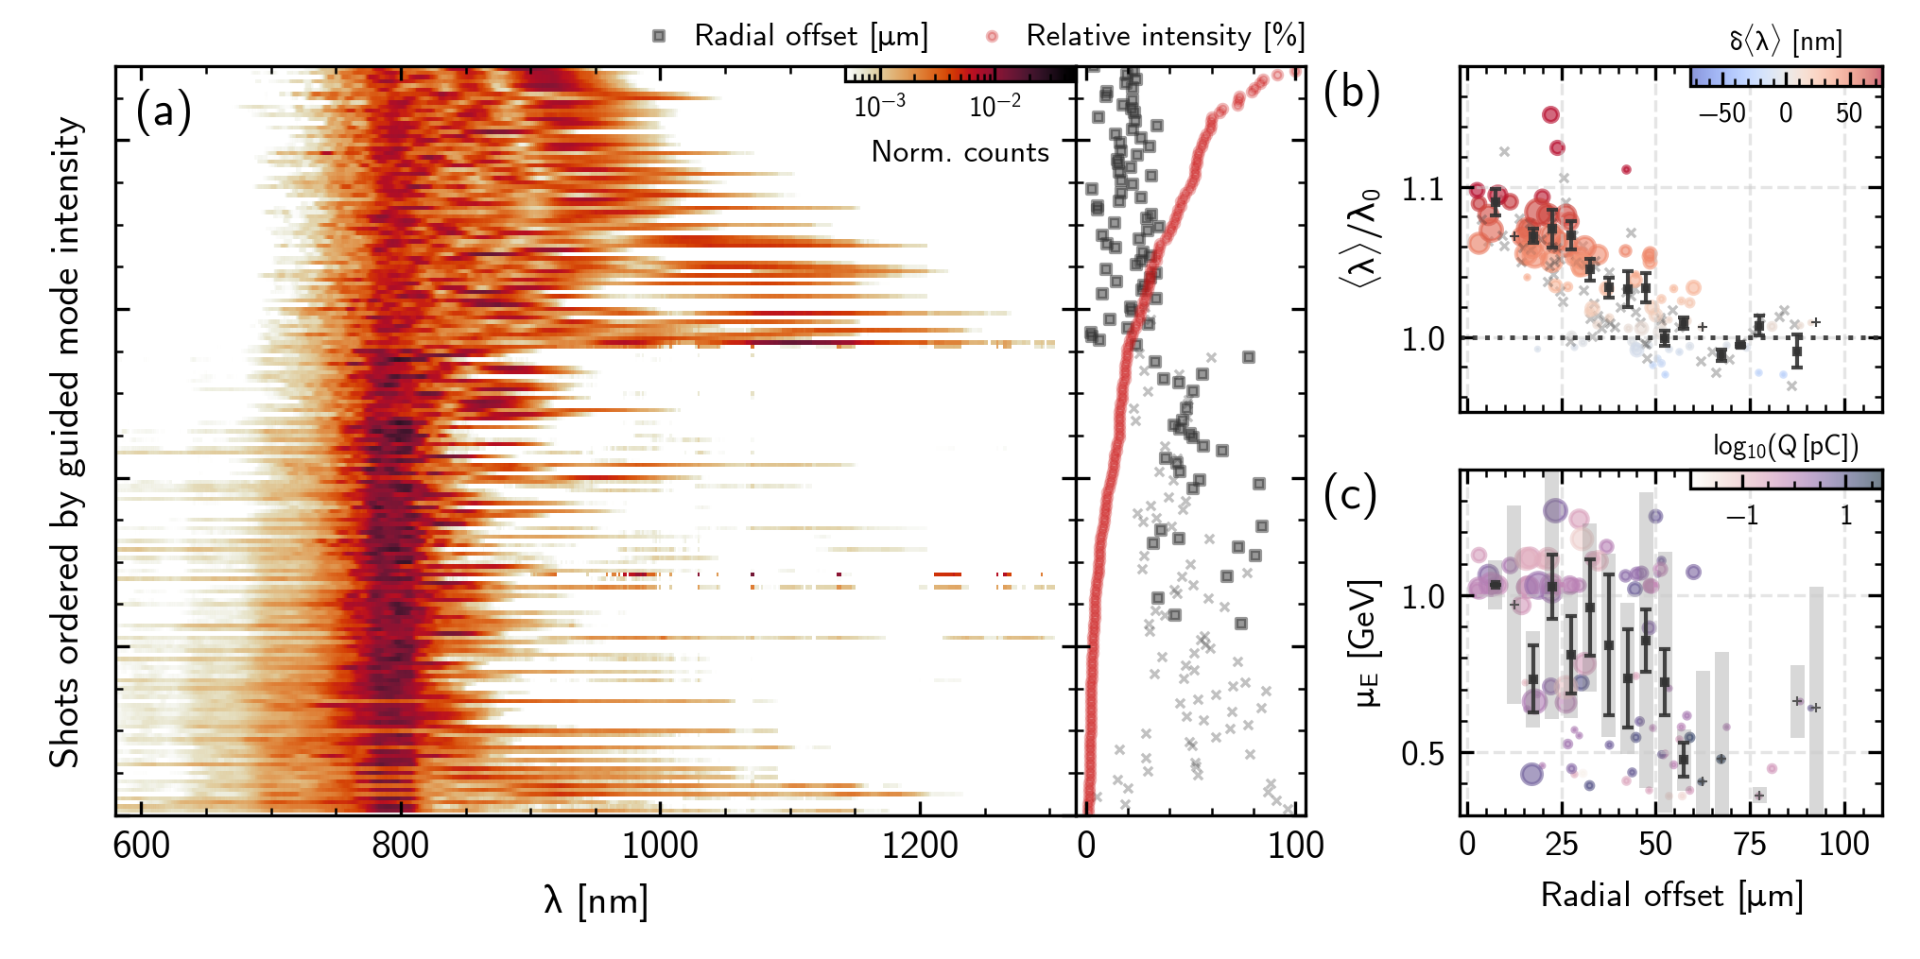
Optical spectra of the guided pulse after 110 mm propagation
Injection of high-quality electron bunches occurs when well-aligned and have the best guiding
Improved radial offset: good guiding, significant red-shifting from wakefield generation
Large radial offset: poor guiding, significant blue-shifting from propagation in- and ionisation of neutral gas
Increasing guided mode intensity
5

Slide 8
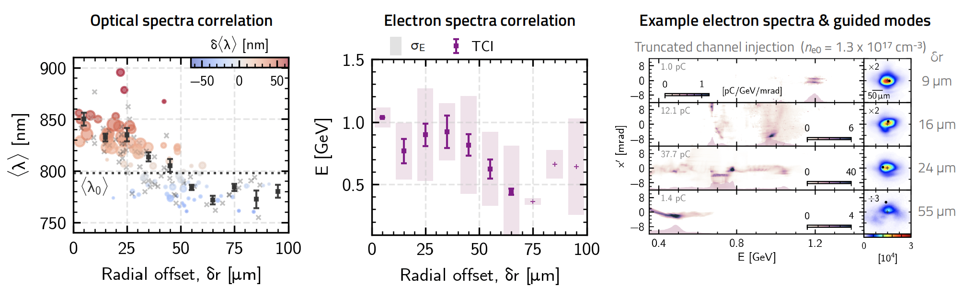

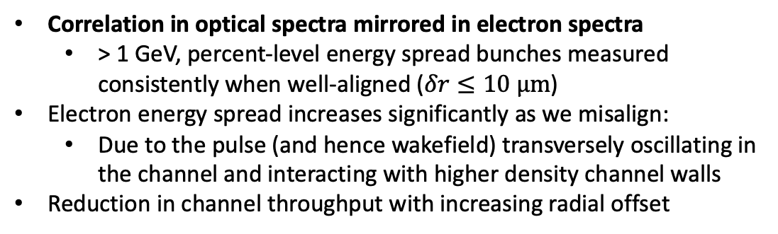
Truncated Plasma Channel
$$n_{e0}=\left(1.3±0.1\right)×{10}^{17} cm^{−3}$$
Well-aligned
Correlation in optical spectra mirrored in electron spectra
  > 1 GeV, percent-level energy spread bunches measured consistently when well-aligned ($δr≤10 μm$)
Electron energy spread increases significantly as we misalign:
  Due to the pulse (and hence wakefield) transversely oscillating in the channel and interacting with higher density channel walls
Reduction in channel throughput with increasing radial offset
Misaligned
6

Slide 9
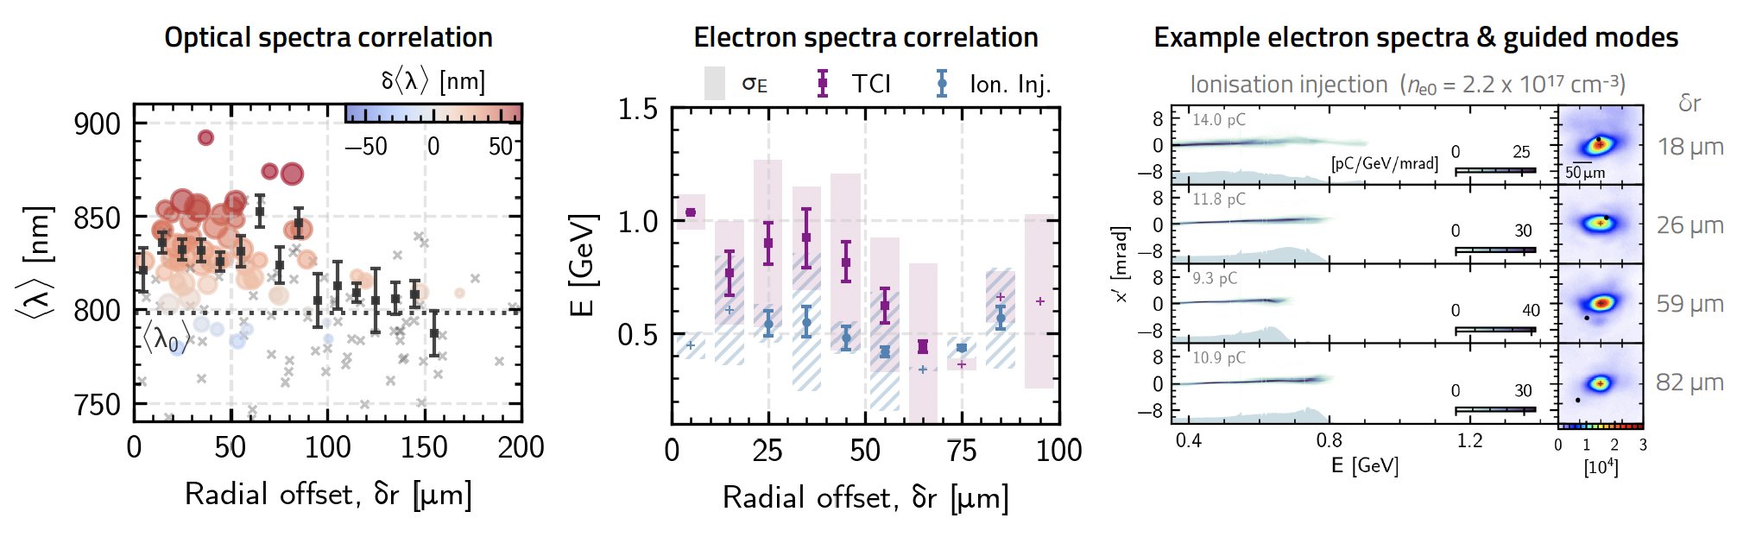

Pure Ionisation Injection
$$n_{e0}=\left(2.2±0.1\right)×{10}^{17} cm^{−3}$$
Well-aligned
Channel moved upstream relative to drive laser focus and on-axis density increased to trigger significant ionisation injection
Guiding quality and electron acceleration less sensitive to alignment, but lower peak throughput/energies and effectively 100% energy spread
Able to guide and inject for larger radial offsets due to channel being formed over whole length of target
Misaligned
7

Slide 10
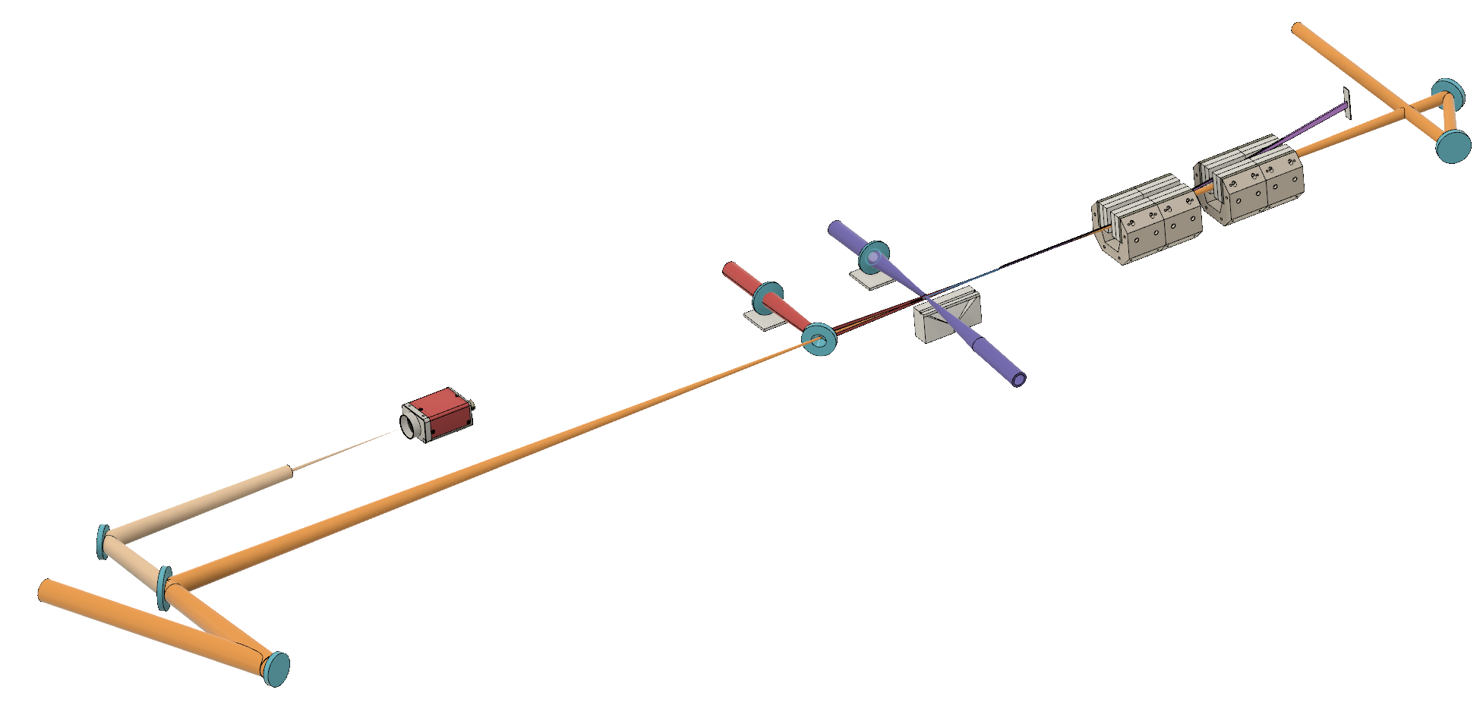
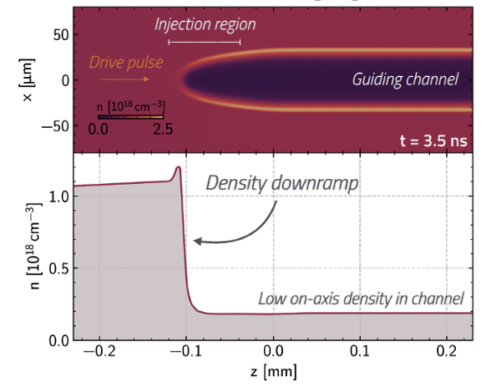

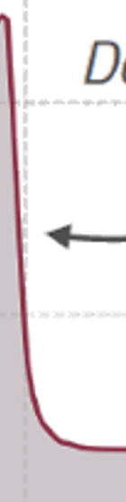
Alternative: Transverse Injector
Optical spectrometer + mode imager
More recently, we performed another Gemini experiment with an additional transverse channel-forming ‘injector’ pulse
  Astigmatic focus used to form plasma sheet
  This sheet expands to create two sharp density ramps
Collaboration with LMU
S Karsch and J Lin
e⁻
Magnetic spectrometer
PRELIMINARY
Astigmatic lens
We wanted to investigate whether it was possible to combine this ‘optical-shock’ technique¹ (related to the plasma torch idea²⁻³) with a longitudinal guiding channel
Slit nozzle gas jet
Axicon
40 mm
[1] K. v. Grafenstein et al., Scientific Reports 13 (2023)
[2] G. Wittig et al., PRAB 18 (2015)
[3] D. Ullmann et al., Physical Review Research 3 (2021)
98% H₂, 1% Ar
Data analysis is ongoing but here we present some preliminary findings
Edited schematic not simulation
f/20 off-axis parabola
8

Slide 11
Longitudinal channel only
Guiding of laser but no charge injected
PRELIMINARY
Can reliably inject tens of pC
No guiding and lower energy gain
Transverse channel only
Longitudinal guiding structure means we can accelerate to higher peak energies
Both channels
Transverse HOFI channel can be used to inject higher charge bunches and still allows the laser to propagate and guide / drive a wake
9
Notes:
Here I will show exemplary espec and exit mode data for the condition where we have just the longitudinal channel, just the transverse channel and for both channels
Firstly
Note: not optimised for truncated channel injection
With both the transverse and longitudinal channels, we can trigger injection while still being able to guide the laser such that we can reach higher peak energies
And these energy gains are comparable to those achieved with truncated channel injection where we had about 1 GeV over 110 mm, here we have half of that in 40 mm so this energy gain is actually quire favourable

Slide 12

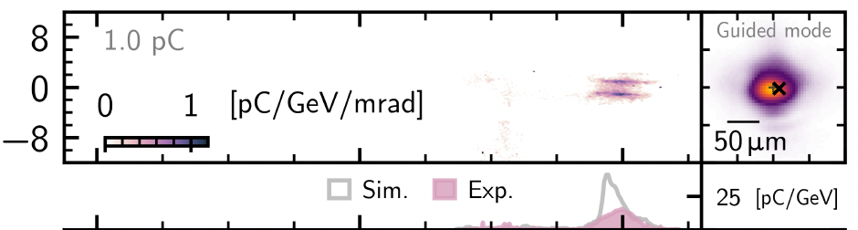
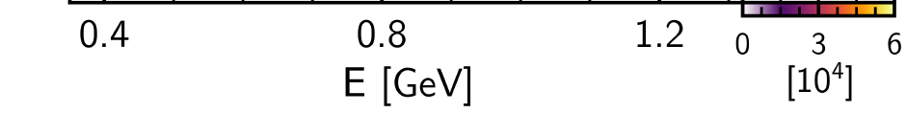
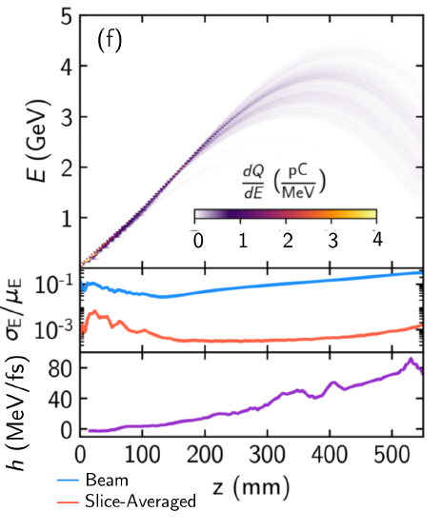
Outlook
Demonstrated a simple scheme to generate high-quality electron bunches in low-density plasma channels
PIC simulations:
  Agree with experimental results
  Electron energy was limited by the target length (110 mm), not by dephasing
  4 GeV, sub-percent-level energy spread observed in simulation after 400 mm propagation for experimentally measured laser parameters
Early indications that using a transverse channel can increase amount of charge injected, without obstructing laser propagation
Route to few-GeV, low energy spread bunches with 100 TW laser system — potentially ideal for current and future LWFA-FEL experiments
10

