Slide 1



Full Energy Beam Exploitation at CLARA: Opportunities for Advanced Accelerator Experiments
Thomas Pacey
E.W. Snedden D. Angal-Kalinin, A.R. Bainbridge, A.D. Brynes, S.R. Buckley, D.J. Dunning, J.R. Henderson, J.K. Jones, K.J. Middleman, T.J. Overton, A.E. Pollard, Y.M. Saveliev, B.J.A. Shepherd, and P.H. Williams, @ STFC ASTeC
M. Colling, B. Fell, G. Marshall, @ STFC TD.

Slide 2
Outline
CLARA & Full Energy Beam Exploitation (FEBE) Overview
FEBE Infrastructure supporting plasma acceleration
Instrumentation & Diagnostics
Potential types of experiments

Slide 3

Overview of CLARA & FEBE

Slide 4
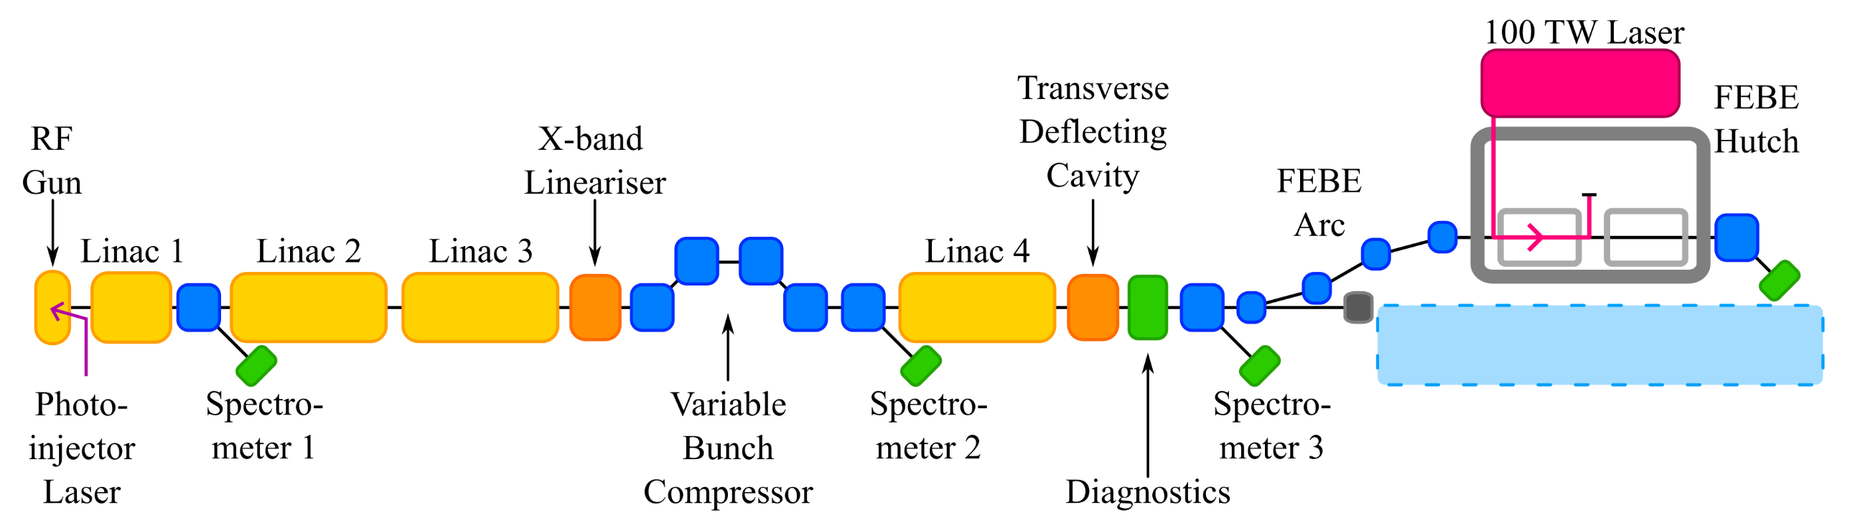
CLARA & FEBE Overview
PHASE 1:
50 MeV,
250 pC, 10 Hz
User area Beam Area 1 (BA1)
Beam exploitation,
inc. novel acceleration
Notes:
CLARA is FEL test facility at Daresbury Lab North West England
Full Energy Beam Exploitation

Slide 5
CLARA & FEBE Overview
PHASE 1:
50 MeV,
250 pC, 10 Hz
User area Beam Area 1 (BA1)
Beam exploitation,
inc. novel acceleration
PHASE 2:
250 MeV ASSEMBLED & INSTALLED OFFLINE
2022/23: Installation
2023/24: Commissioning
FEBE:
SHIELDED USER FACILITY
Branch line to shielded hutch
Flexible user exploitation space
100 TW class laser
Straight-on:
FEL technology development
NOT YET FUNDED
Tied to UKXFEL CDR and decision on next stages
Notes:
CLARA is FEL test facility at Daresbury Lab North West England
Full Energy Beam Exploitation

Slide 6
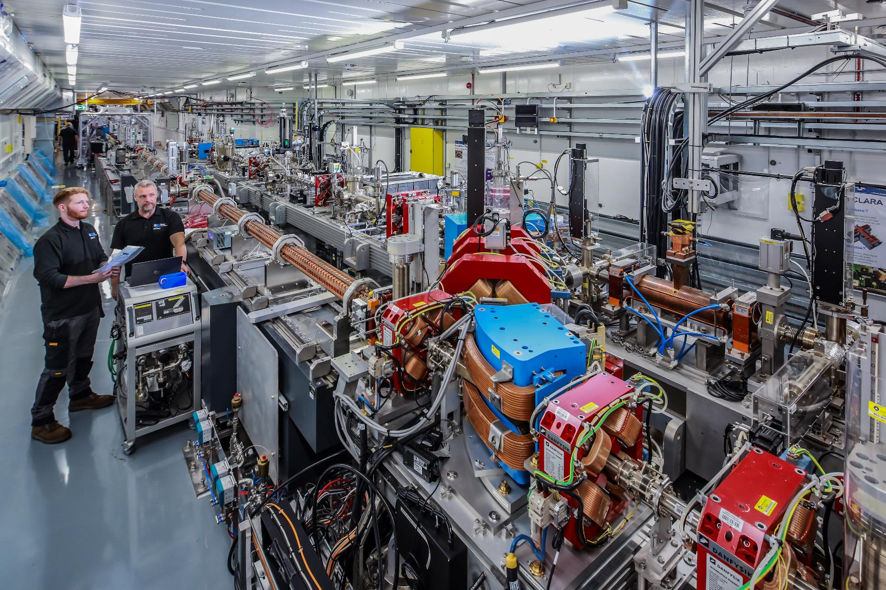
CLARA Now

Slide 7
Previous exploitation at CLARA
Exploitation with 35 MeV electrons and with 10 TW class laser
Competitive access periods
  October 2018- April 2019 and October 21 – April 2022
Oversubscribed by factor of 2
Approximately 50 % of shifts ‘21-’22 awarded were for advanced acceleration concepts, including dielectric wakefield acceleration laser wakefield acceleration, THz acceleration, and plasma diagnostics.
See Poster by Ed Snedden (Tuesday Session)

Slide 8
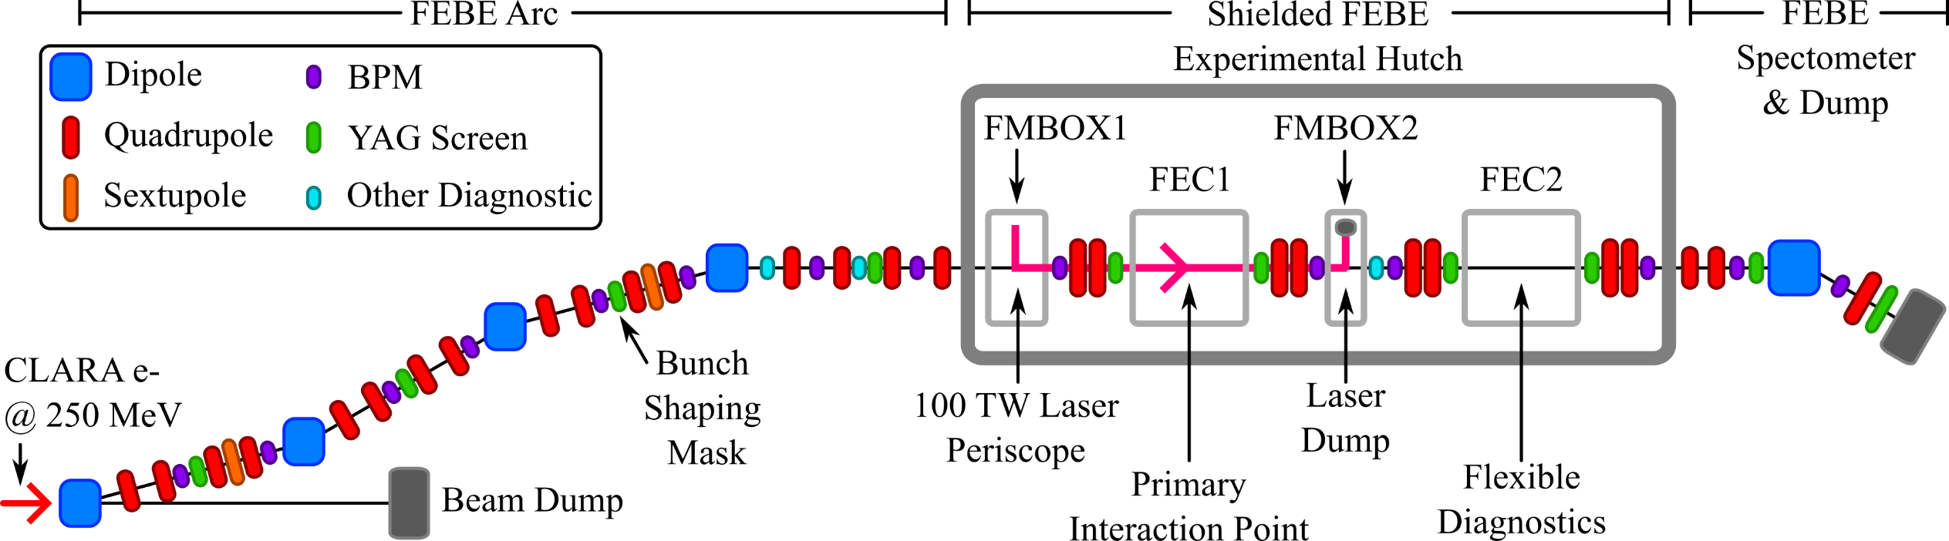
FEBE Beamline & Hutch
Up to 250 MeV
250 – 600 MeV
Highly instrumented beamline supports
- Setup & characterisation
- Feedback systems
250 MeV – 2 GeV

Slide 9
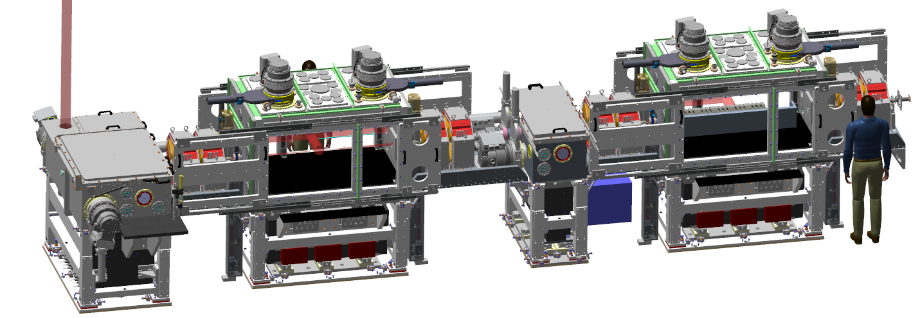
FEBE Chambers
Flexible platform for novel acceleration studies
2 identical chambers: Double IP configuration
Dedicated laser in-out coupling chambers
Accelerated beam up to 2 GeV possible in hutch
Up to
600 MeV
Laser from roof
CLARA
250 MeV e-
Chamber #1
Primary IP
~1.5m length
Chamber #2
Flexible array of diagnostics
T Pacey – CLARA Opportunities for Advanced Accelerators - EAAC 2023, Elba, Italy

Slide 10
Beam parameters – “Day 1”
Parameter | High charge | Low charge
Energy [MeV] | 250 | 250
Charge [pC] | 250 | 5
RMS t [fs] | 100 | 50
σ_{E}/E [%] | <5 | <1
RMS x [µm] | 100 | 20
RMS y [µm] | 100 | 20
ε_{N} x [µm] | 5 | 2
ε_{N} y [µm] | 5 | 2
Important: all parameters to be confirmed through measurement using appropriate diagnostics.
T Pacey – CLARA Opportunities for Advanced Accelerators - EAAC 2023, Elba, Italy
10
Notes:
Why 5 and have low charge

Slide 11
Beam parameters – Future potential
Parameter | High charge | Low charge
Energy [MeV] | 250 | 250
Charge [pC] | 250 | 5 → <5
RMS t [fs] | 100 → 50 | 50 → <50
σ_{E}/E [%] | <5 → 1 | <1
RMS x [µm] | 100 → 50 | 20 → ~1
RMS y [µm] | 100 → 50 | 20 → ~1
ε_{N} x [µm] | 5 → <5 | 2 → 1
ε_{N} y [µm] | 5 → <1 | 2 → <1
  R&D: Meeting these parameters will require upgraded and/or new diagnostics
T Pacey – CLARA Opportunities for Advanced Accelerators - EAAC 2023, Elba, Italy
11
Notes:
Shown through simulation and achieving optimal machine performance

Slide 12
Infrastructure supporting plasma acceleration

Slide 13
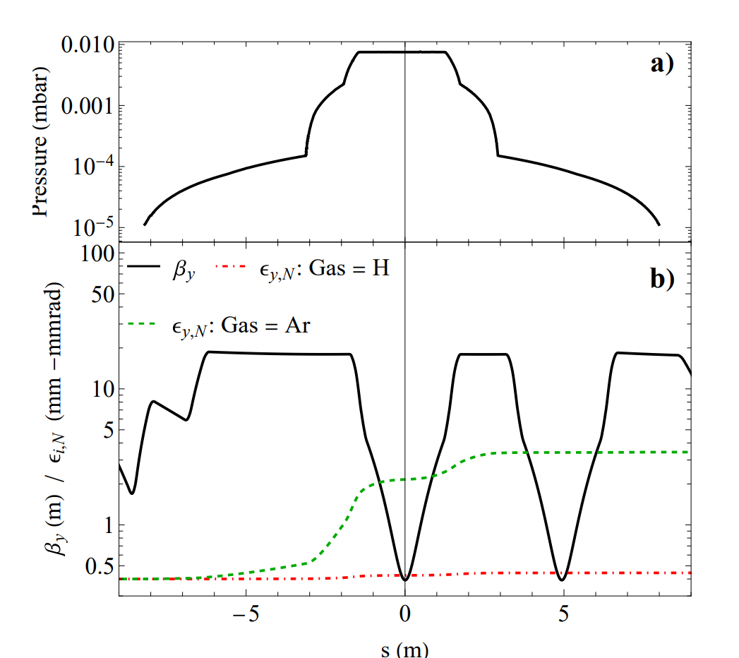
Gas Management
Invested in large volume turbos on experimental chambers & mirror boxes – 6 at ~ 2000l/s
Upstream irises and apertures to reduce gas propagation
Negligible modelled emittance growth for Hydrogen,
  Limited growth for heavier species, e.g. Argon

Slide 14
Beam driven acceleration
Benefitting from high quality beam designed for FEL R&D
Flexible delivery and fine control of longitudinal phase space:
  Variable R56 in chicane compressor & in FEBE arc
  Dielectric wakefield dechirper
Dielectric dechirper

Slide 15
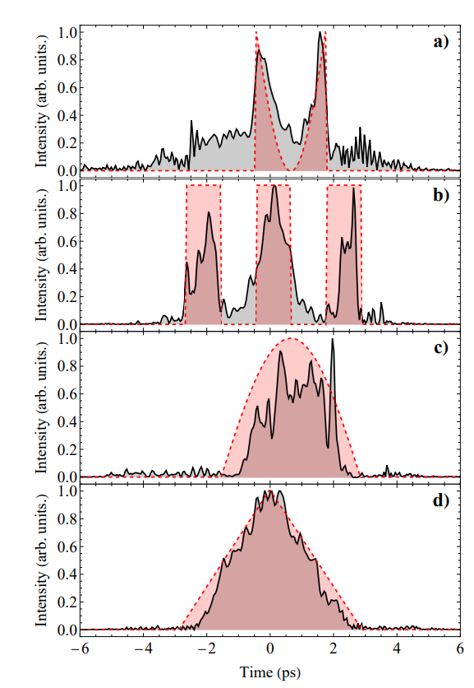
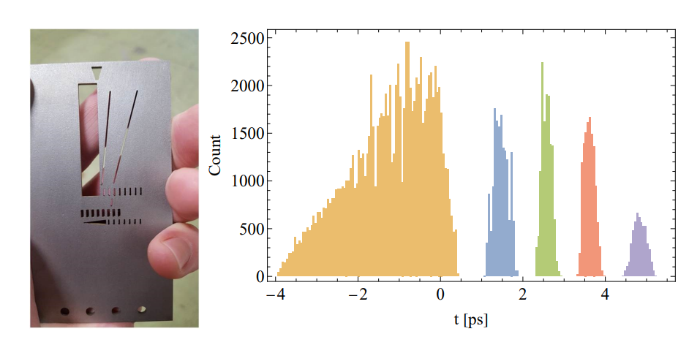
Electron beam pulse shaping
Photoinjector Laser longitudinal shaping
  Machine Learning driven
  Large number of possibilities
Tungsten mask in FEBE Arc
  Configurable and changeable
  Drive-witness, pulse trains…all possible

Slide 16
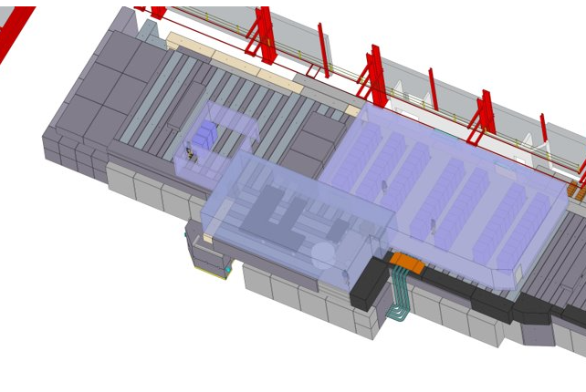
FEBE Laser
120 TW, 5 Hz laser
(Arco, Amplitude).
The laser is housed immediately on top of the FEBE hutch
Photons to target via a shielded periscope.
Installation scheduled for second half of 2024,
Laser ready for exploitation at the beginning of 2025.
Laser control room
CLARA
250 MeV e-
FEBE hutch
Laser room

Slide 17
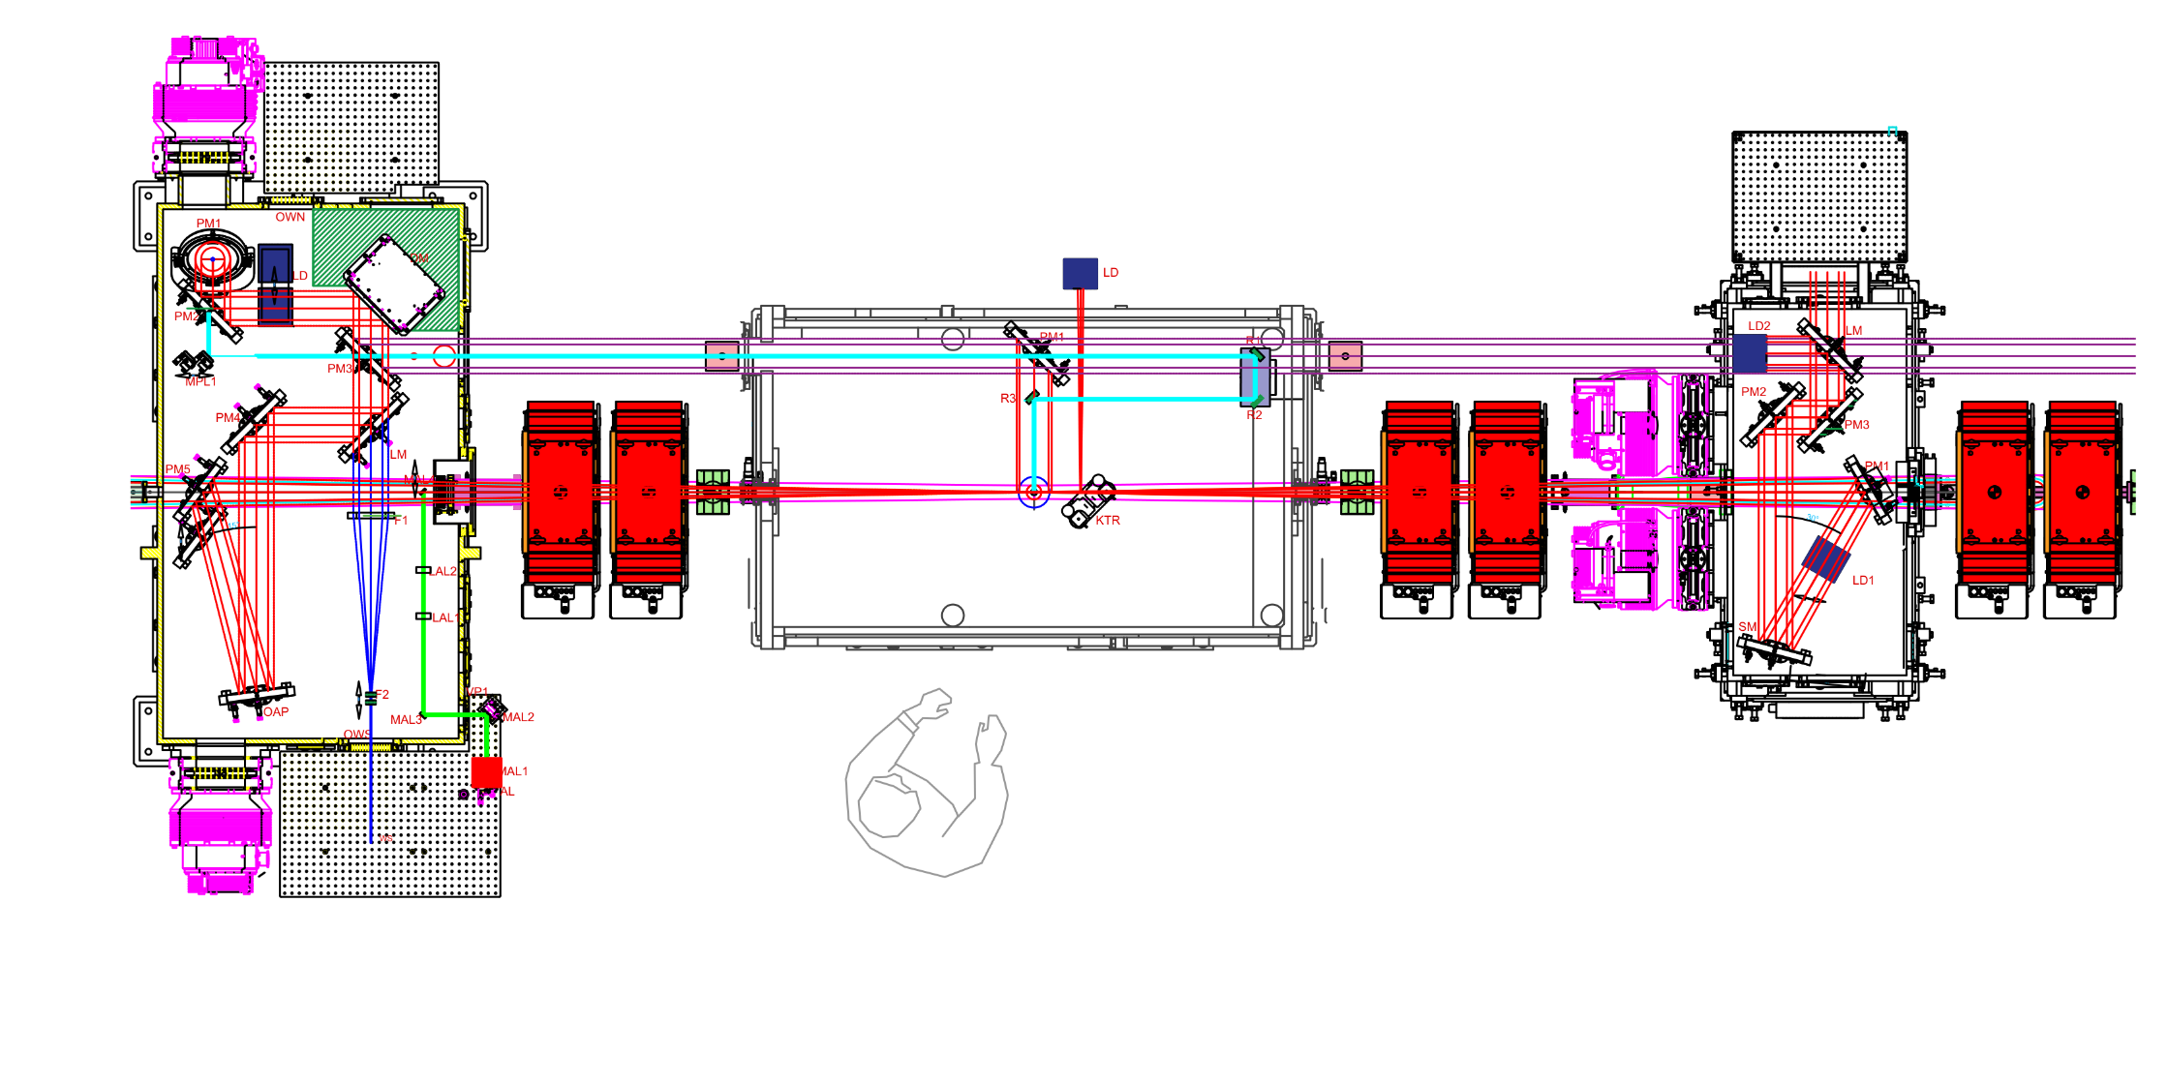
Laser delivery to IP
Input from laser room periscope
Deformable mirror
Probe line
e⁻ @ 250 MeV
IP1
Dump
OAP
Wavefront
Sensor
FMBOX1
FEC1
FMBOX2

Slide 18
Diagnostics & Instrumentation

Slide 19
Laser synchronization & TOA jitter measurement
FEBE laser oscillator will be optically synchronized to the CLARA optical clock:
Ultralow noise optical clock (complete)
Stabilized <10 fs over 24 hr (design and testing complete)
Two-colour laser-laser locking ( testing underway, all-fibre upgrade design in progress¹)
On track to provide <10fs locking of FEBE laser to optical reference
Beam arrival monitor (BAM) R&D:
Targeting 10fs arrival time measurement @20 pC with cone pick-ups design²
  Installation and commissioning in early 2024
Collaboration with DESY & THM to deliver low charge BAM based on PCB substrate and rod pick-ups³
Push 10 fs @<5pC beam charge with low charge BAM.
1 – THPA073 IPAC23
2 – PhysRevSTAB.18.012801
3 – IBIC2021 WEPP19

Slide 20
6D Diagnostics R&D across FEBE beam line
Diagnostics undergoing active R&D
All supplemented by well developed diagnostics, e.g. BPMs, YAGs, ICTs
Dielectric streaker & EO
BAM
CSR
ML based Virtual diagnostics
CTR/CDR
OTR: <5um spot size
OTR based emittance
PM spectro-meter
High dynamic range
charge

Slide 21
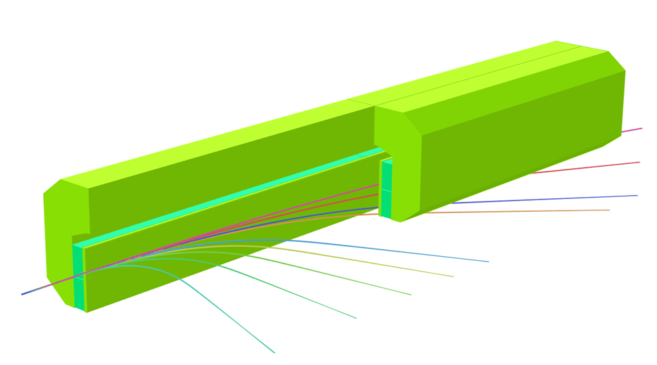
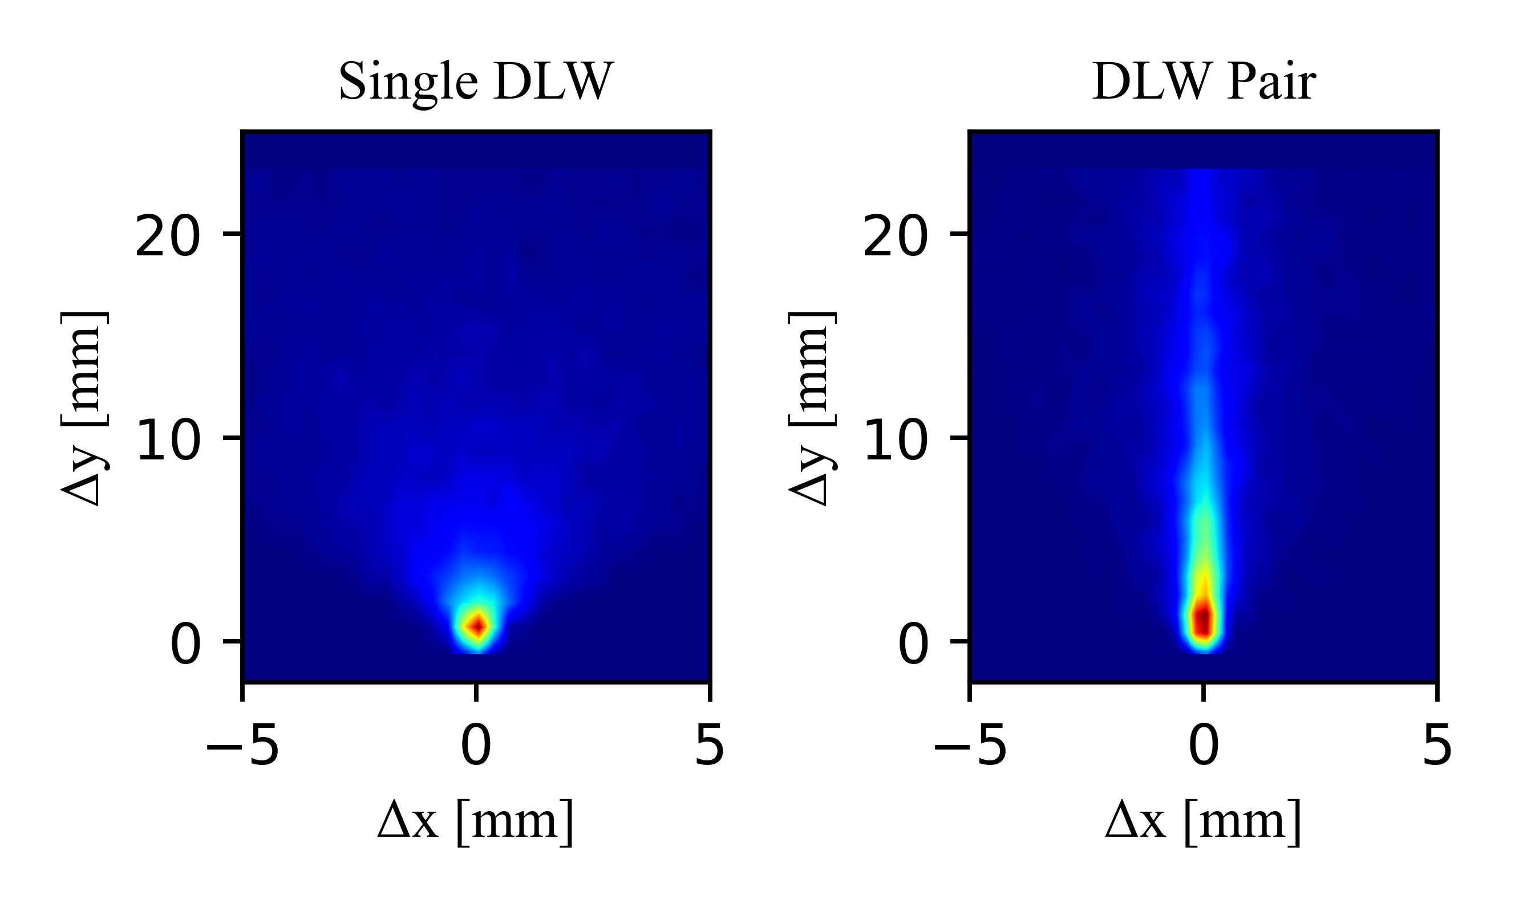
FEBE Chamber options
2 options, more in R&D
Dielectric wakefield streaker
Passive, robust, single shot bunch length measurement
RMS estimate or full profile reconstruction
Broadband, <50 fs > 1 ps
Resolution improved using pairs orthogonally orientated plates
Permanent Magnet Spectrometer
Can be deployed in second chamber for commissioning beams with energy > 600 MeV
Energy range 50 MeV - 2 GeV
Upstream quad. doublet + correctors for matching into dipole
Modular design, 200mm blocks, 5 modules for 2 GeV

Slide 22
Potential
Experiments:
Putting options
together
Only ideas/examples!
Many potential possibilities!
Suggestive, not prescriptive!

Slide 23
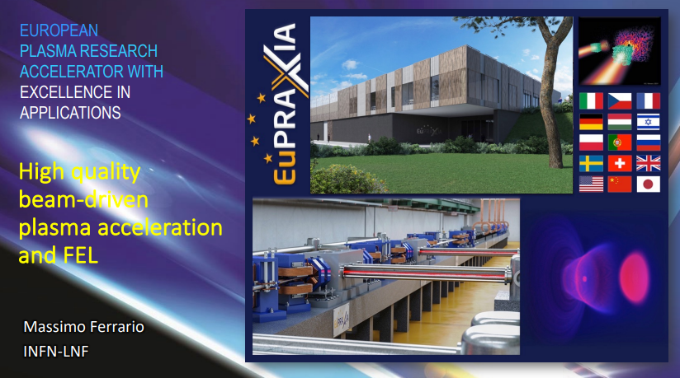
Future areas of interest
R&D challenges
ASTeC R&D will be guided by challenges to establish a plasma FEL user facility (e.g. those targeted through EuPRAXIA). ASTeC will consider a plasma-booster option for one of the UK XFEL beam lines.
Plasma FEL R&D Challenges
Emittance, tolerances and mitigation of instabilities | Hybrid, new or alternative schemes
Efficiency, including drive beam and laser issues | Low emittance beam sources (including positrons)
Energy spread | Plasma stability / repeatability (including targets)
Maximum bunch intensity / charge | Synchronization systems, other support systems
Simulation code development and outreach | Controls systems and optimisation (including machine learning)
ASTeC with our users would be well placed to contribute to many of these areas.

Slide 24
External injection - LWFA
Witness beam stability & Staging challenges
120 TW laser
Spectrometer up to 600 MeV
Ultrashort electron pulse
Bunch Length & Emittance Diagnostics

Slide 25
External injection LWFA
High energy gain & energy stability
120 TW laser,
Short focal length
Ultrashort electron pulse
2 GeV spectrometer
& dump

Slide 26
PWFA staging
Witness beam stability & Staging challenges
PMQ matching triplets
PMQ matching triplets
Spectrometer up to 600 MeV
Drive-witness CLARA pulse
Emittance diagnostics

Slide 27
Plasma based beam manipulation & instrumentation
CLARA beam
250 MeV
Low emittance
Plasma ignition
Laser based diagnostics
Bunch Length & Emittance Diagnostics

Slide 28
Summary
FEBE represents a step change in our infrastructure and potential to perform advanced acceleration experiments
Flexibility is at the heart of the design to support & futureproof for our community.
  Have the potential to exploit this for strategically important R&D
FEBE will leverage the full CLARA R&D project
  FEL quality beam, synchronisation, modelling, controls, machine learning optimisation, etc.
Beam commissioning starts in 2024
First exploitation in 2025 – more information to come in 2024
thomas.pacey@stfc.ac.uk edward.snedden@stfc.ac.uk
T Pacey – CLARA Opportunities for Advanced Accelerators - EAAC 2023, Elba, Italy

Slide 29
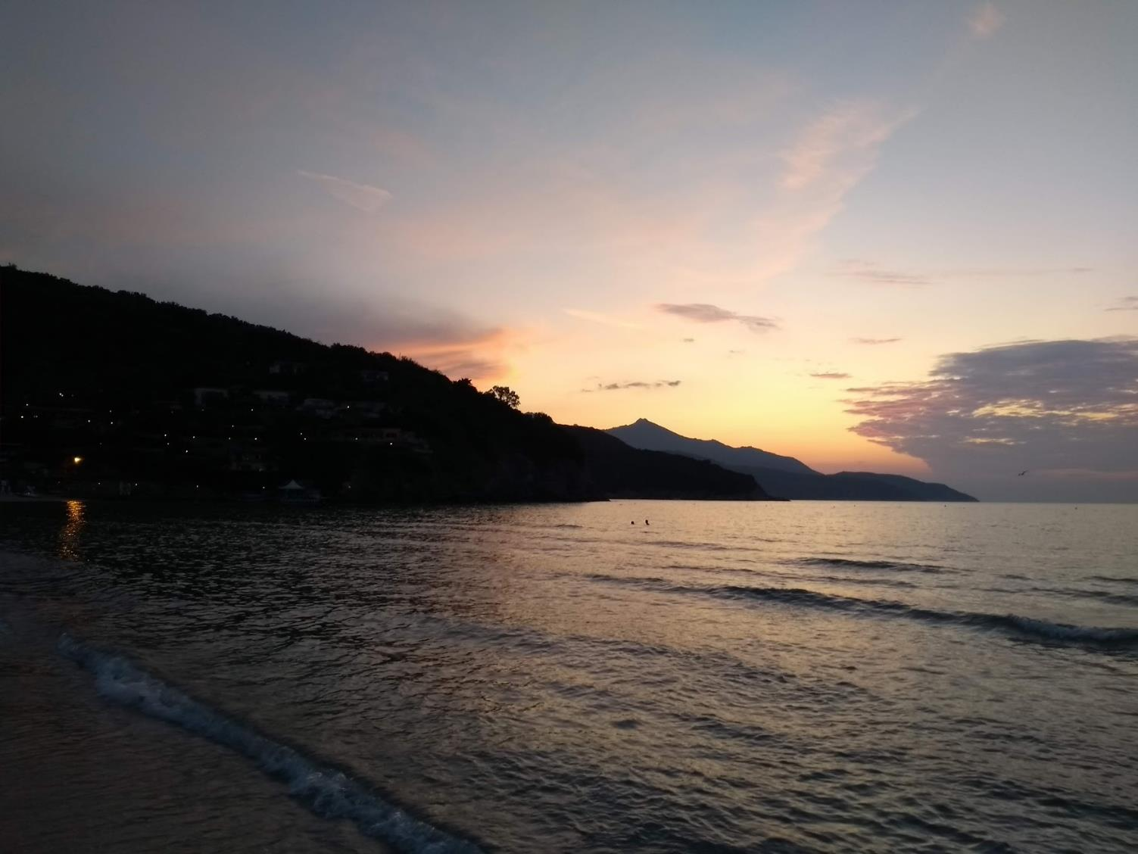
Acknowledgements
Special thanks to:
CLARA Team, across ASTeC and STFC Technology Dept.
EAAC’23 Organisers and Scientific Committee

Slide 30

