Slide 1
Viktoriia Zakharova
on behalf of E-300 collaboration
"Electron beam self-focusing and X-ray radiation in a self-ionised plasma wakefield accelerator"
Laboratoire d’Optique Appliquée
UMR 7639

Slide 2
Outline
Context: PWFA and betatron radiation
Part 1: betatron radiation and self focusing in self-ionised H2
Part 2: towards emittance preservation in E-300 two-bunch PWFA experiment

Slide 3
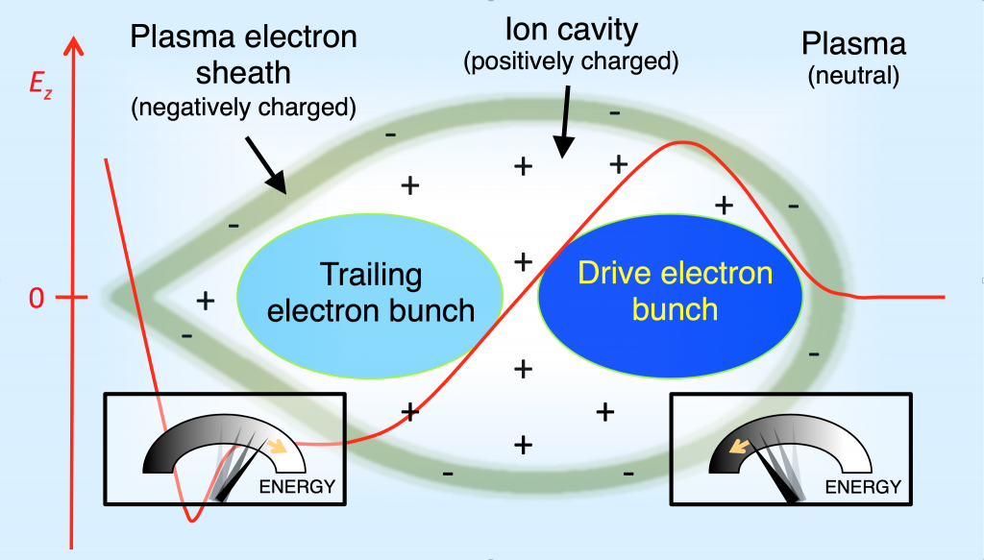
Introduction
PWFA technique is a promising alternative to conventional accelerators
beam quality preservation is not yet achieved for large energy gains
emittance growth due to mismatched propagation of the beam in the plasma
betatron radiation as a complementary non-destructive diagnostic to direct emittance measurement methods

Slide 4
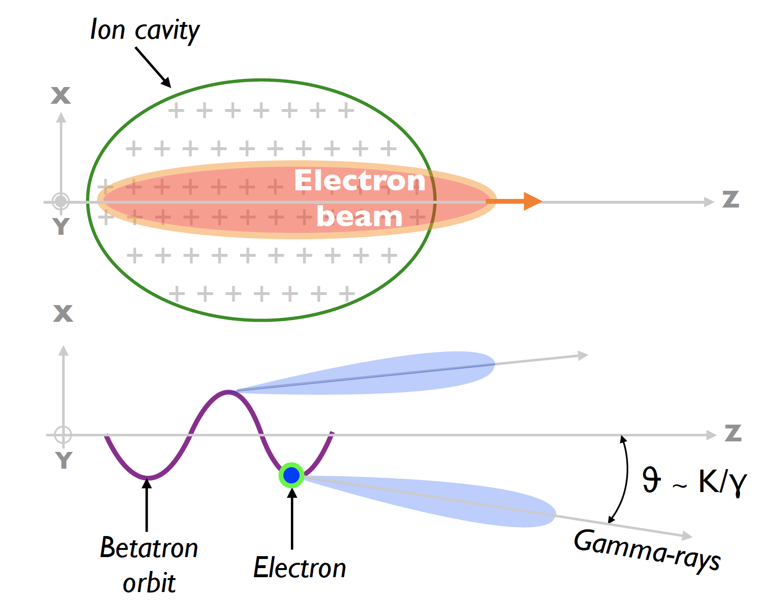
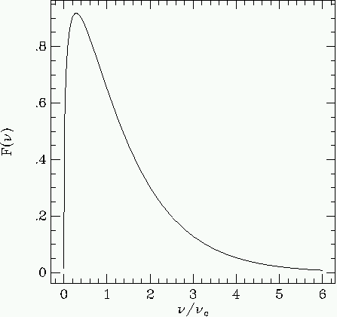
Betatron radiation
betatron radiation emitted by the beam electrons due to the transverse forces
synchrotron-like photon energy spectrum
K = γ*θ ~ 20
1/γ = 50 urad
Betatron radiation with high-K wiggler
Synchrotron spectrum showing the characteristic peak emission at 0.29 n_{c}
Notes:
K = gamma * theta = 20 ( theta is of order of mrad, 1/gamma is 50 urad)

Slide 5
Betatron radiation and self focusing
in self-ionised H2

Slide 6
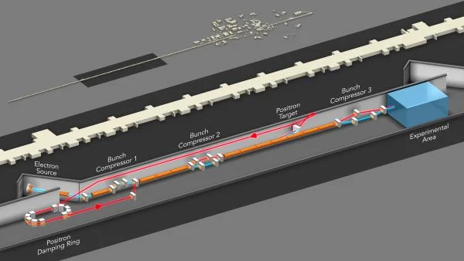
E-300 experiment at FACET-II (2022)
plasma accelerator was operated in a self-ionised hydrogen
electron beam of 10 GeV 1.6 nC had ionised the H2 gas
bright betatron X-rays in the 10-100 keV range were emitted
FACET-II uses the middle third of the 2-mile-long LINAC. It sends a beam of electrons (blue line) from the electron source (left) to the experimental area (right), where it arrives with an energy of 10 GeV

Slide 7
E-300 experiment at FACET-II (2022)
plasma accelerator was operated in a self-ionised hydrogen
electron beam of 10 GeV 1.6 nC had ionised the H2 gas
bright betatron X-rays in the 10-100 keV range were emitted
FACET-II uses the middle third of the 2-mile-long LINAC. It sends a beam of electrons (blue line) from the electron source (left) to the experimental area (right), where it arrives with an energy of 10 GeV

Slide 8
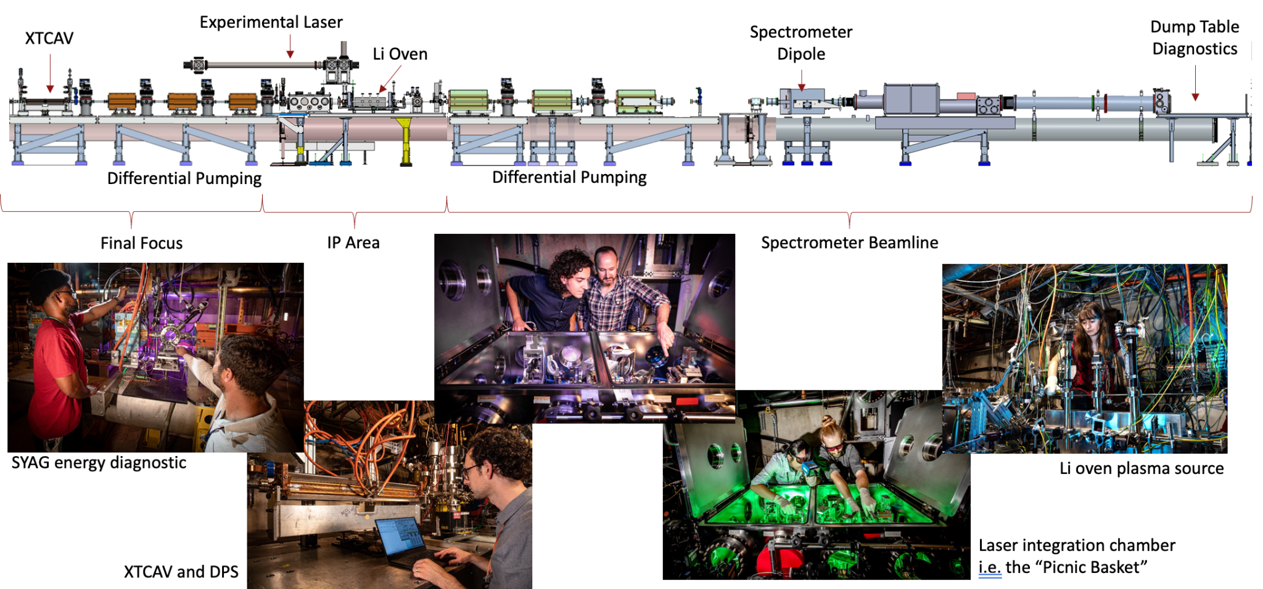
E-300 experiment at FACET-II (2022)
Filled with H2
FACET-II uses the middle third of the 2-mile-long LINAC. It sends a beam of electrons (blue line) from the electron source (left) to the experimental area (right), where it arrives with an energy of 10 GeV
Notes:
put the same text as before

Slide 9
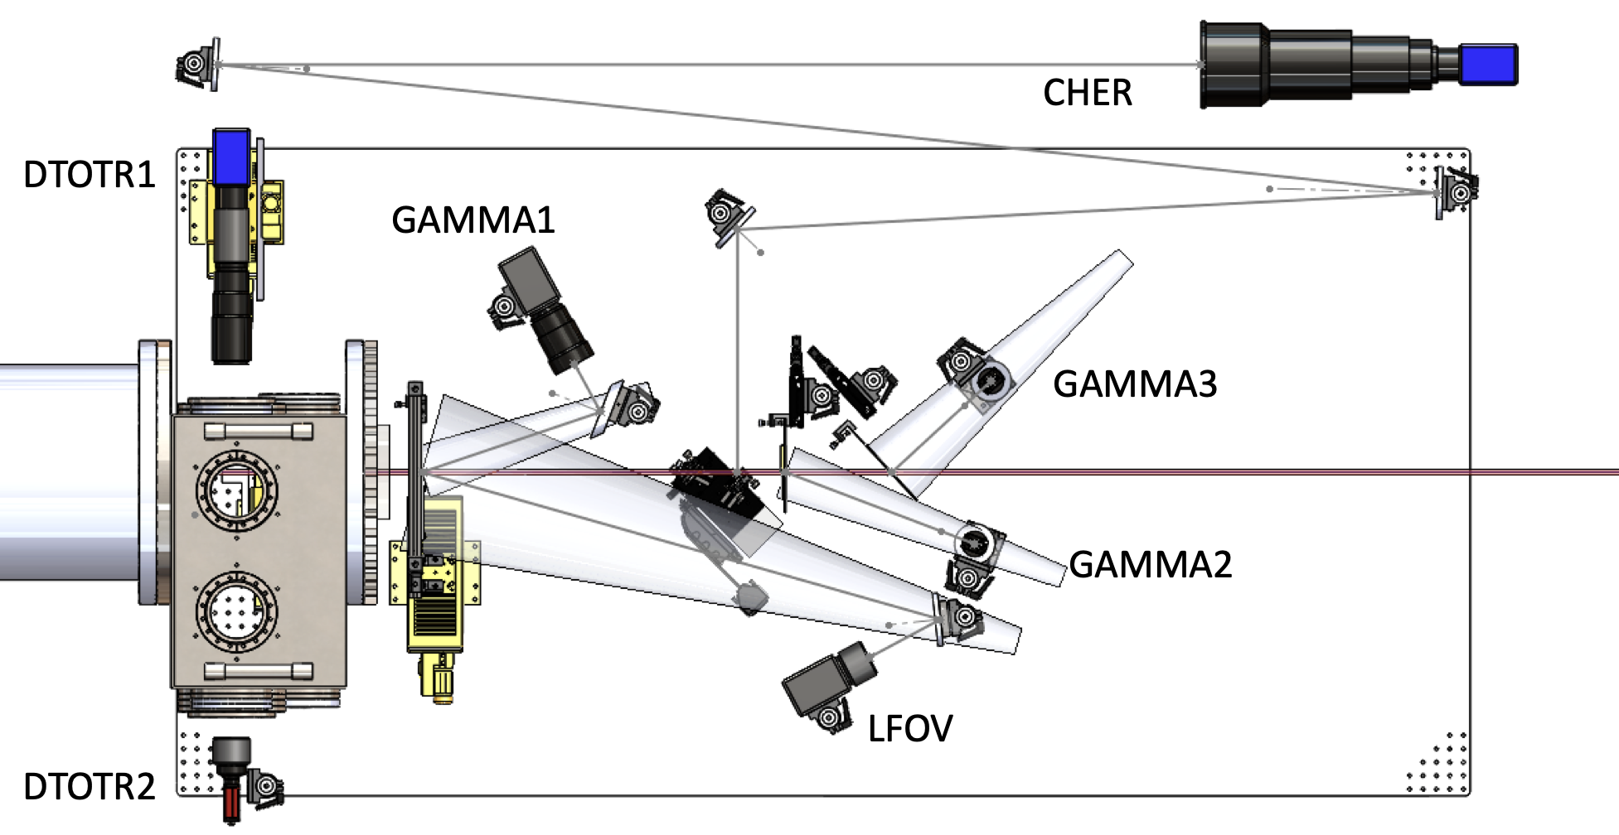
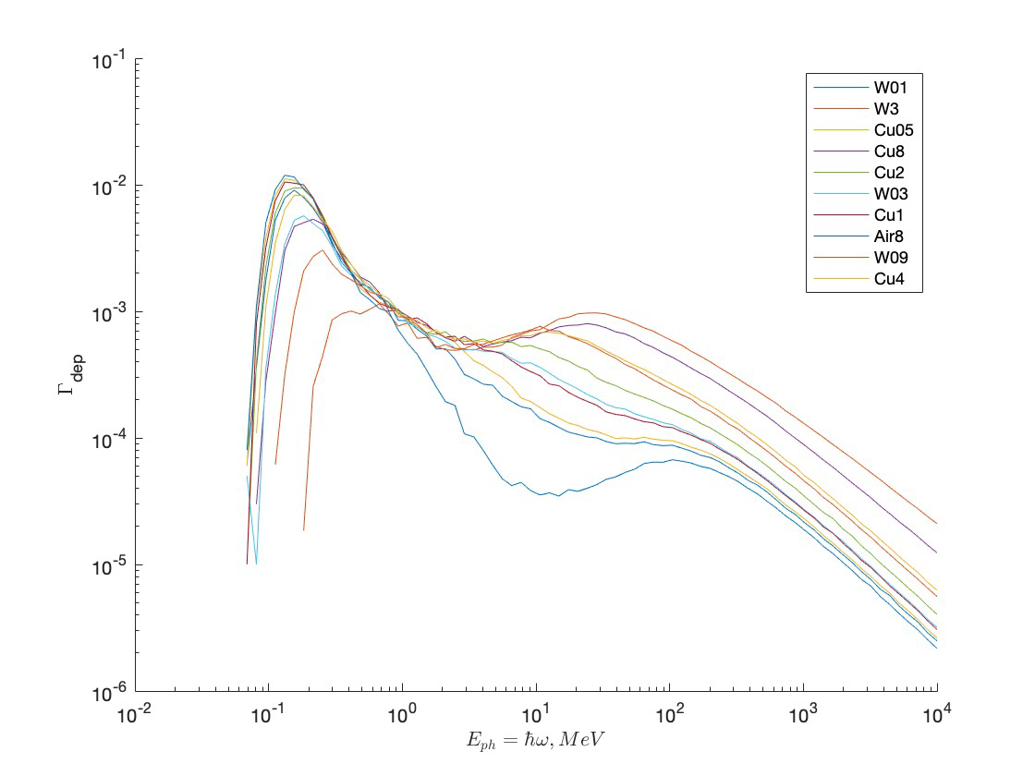
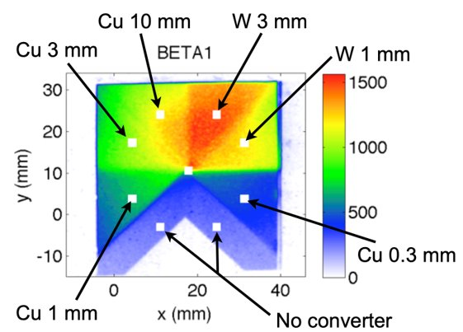
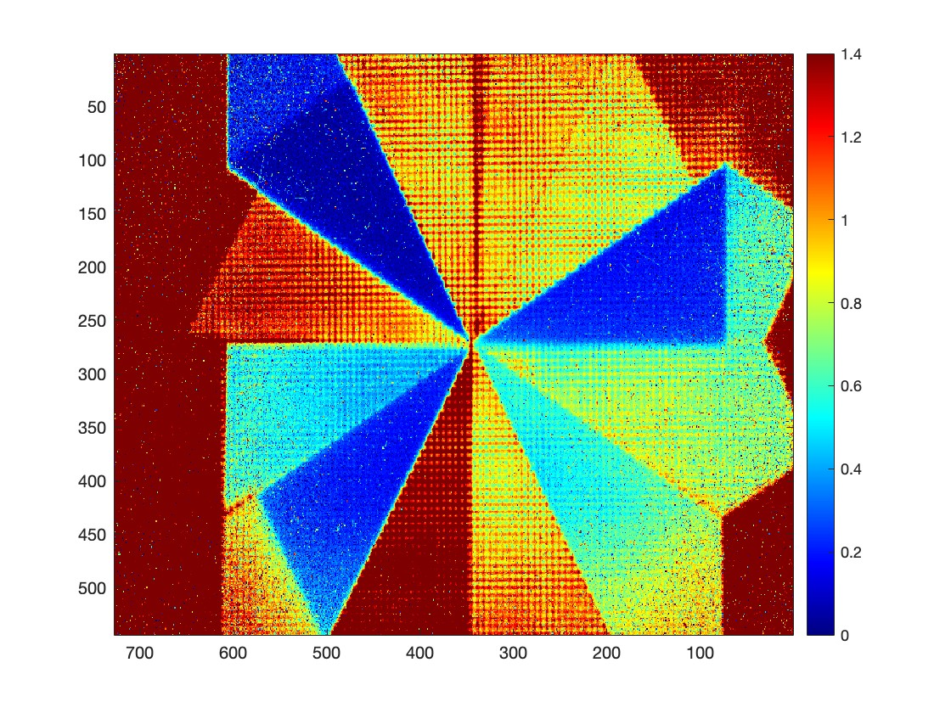
E-300 experiment at FACET-II (2022)
FACET-II dump table. The red line represents the gamma-ray path. Credits to D. Storey
GAMMA1 detector provides information about the integrated radiated energy and its angular distribution
GAMMA2 gives the information on the emitted x-ray (or gamma) spectra
converter is placed right before the scintillator
W 3mm
Cu 0.5 mm
W 0.1mm
Cu 8mm
Spectral responses of GAMMA2 simulated via GEANT4 behind each filter/converter (deposited energy fraction as a function of incident photon energy).
No filter
Hierarchy between filters inverted
from FACET-I (20GeV, left) to FACET-II (10 GeV, right)

Slide 10
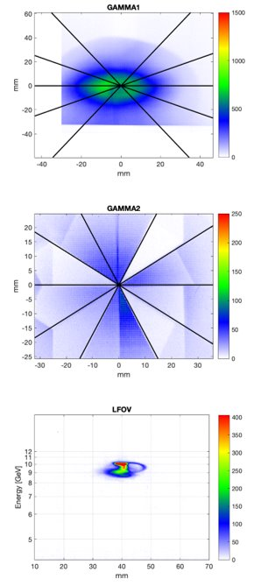
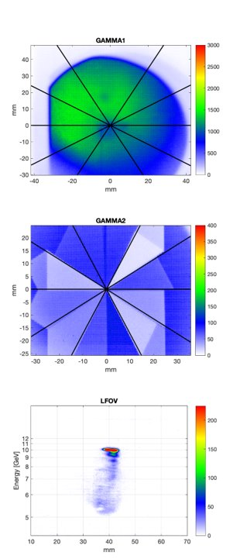
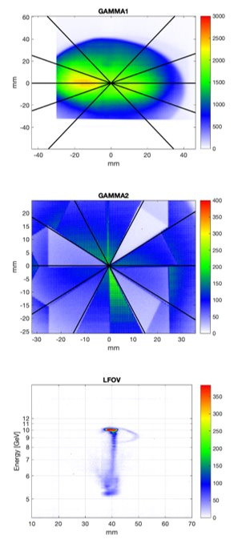
2022 experimental data for different pressures
0.08 Torr 0.3 Torr 1.5 Torr
Angular profile
Filter/converter measurement
Electron spectrum
Notes:
electron data

Slide 11
Data analysis and theoretical calculations
spectral responses behind each filter were obtained with GEANT4
betatron signal behind each converter was extracted from the experimental data
synchrotron spectra with different critical energies were used for comparison
best fits were chosen
Spectral responses of GAMMA2 simulated via GEANT4 behind each filter/converter (deposited energy fraction as a function of incident photon energy).
Notes:
below 1 MeV - filter (absorption), above 1 MeV - converter (convert one type of radiation to another, secondary particles are borned)

Slide 12
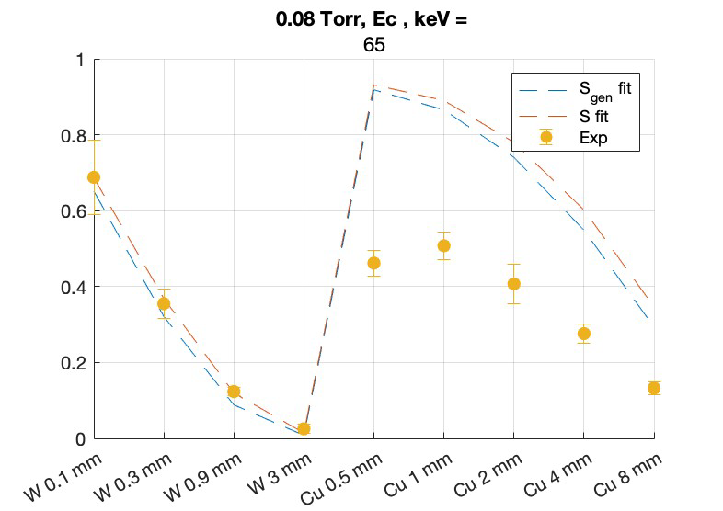
Results
generalised synchrotron function is derived to consider electron deceleration
difference between S and Sgen is quite small
agreement is OK for W but there is a significant discrepancy for Cu
FACET-II betatron signals (yellow dots) for each GAMMA2 converter together with regular and generalised synchrotron signals
Notes:
electron data

Slide 13
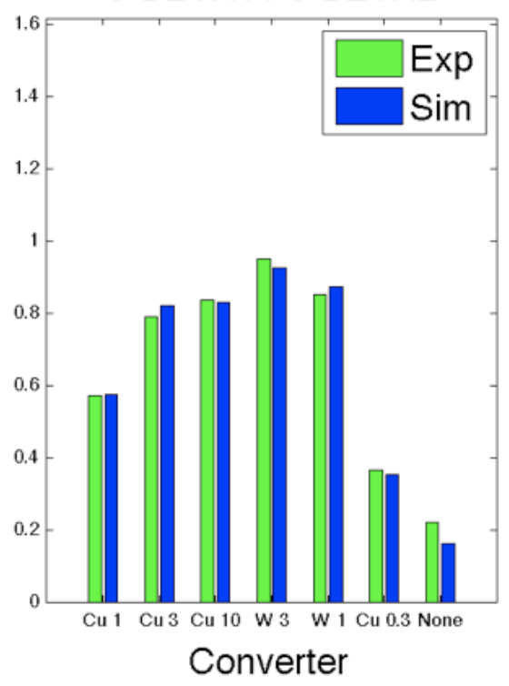
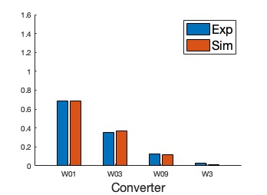
FACET-I data: better agreement
2022: good agreement for W
problem with Cu filters
Betatron signals (Exp) for each GAMMA2 converter together with the synchrotron signals (Sim) normalised to the GAMMA1 signal
Left side: FACET-I, pressure = 7 Torr, critical energy of the synchrotron spectra = 9 MeV
Right side: FACET-II, pressure = 0.08 Torr, critical energy of the synchrotron spectra = 65 keV

Slide 14
Evidence for self-focusing of the electron beam
non-ionised H2 gas in the beginning
ionisation is caused by large peak current and density of the beam
ionisation → transverse force caused by ions → focusing to a smaller size → higher beam charge density → higher ionisation
non-invasive calculation of the beam size due to betatron measurements:
For FACET I (7 Torr): 1.9 um from divergence and 2.4 um from the critical energy -> focusing from the vacuum beam size of 20-30 um to 2 um in the blowout cavity
For FACET II (0.08 Torr): 5.8 um beam size from the critical energy -> self focusing is proved under different conditions
Notes:
explain how self-focusing is happening (feedback loop)

Slide 15
Towards emittance preservation in E-300 two-bunch PWFA experiment

Slide 16
Ultimate goals of E-300
achieving simultaneously:
high extraction efficiency
driver depletion
energy doubling of the trailing bunch
low energy spread
emittance preservation
long plasma (≈0.5m)
key measurements:
electron energy spectra
dedicated emittance diagnostic: single shot butterfly method and multi-shot dispersive quad scan
betatron radiation as a complementary diagnostic

Slide 17
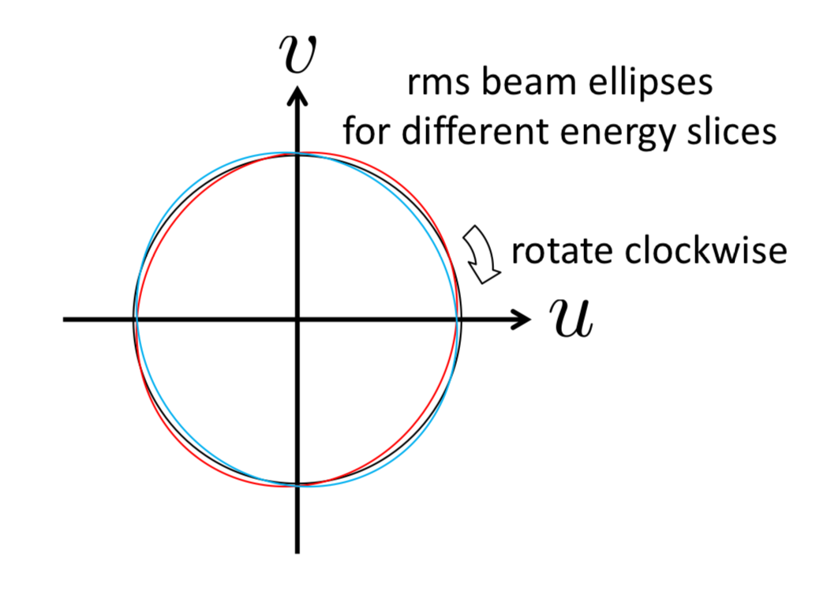
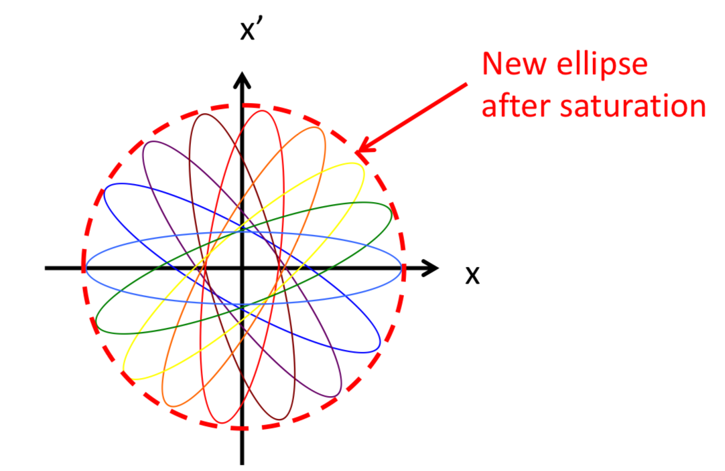
Mismatched propagation and emittance growth
energy spread of the beam → each electron undergoes betatron oscillations with slightly different frequency → cause emittance growth when mismatched
Credits to M. Litos
non-linearities in the focusing force also lead to a strong emittance growth when mismatched

Slide 18
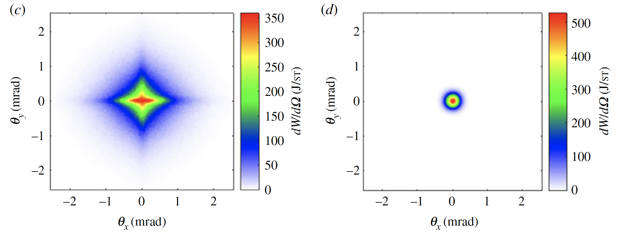
Mismatched propagation and betatron radiation
Mismatched propagation:
as energy slices dephase, beam envelope eventually stops oscillating; remains at largest size of betatron oscillations
for the same initial emittance the mismatched case causes higher amplitudes of betatron oscillations
higher amplitudes of oscillations lead to increase of radiated energy and critical energy
Matched propagation:

Slide 19
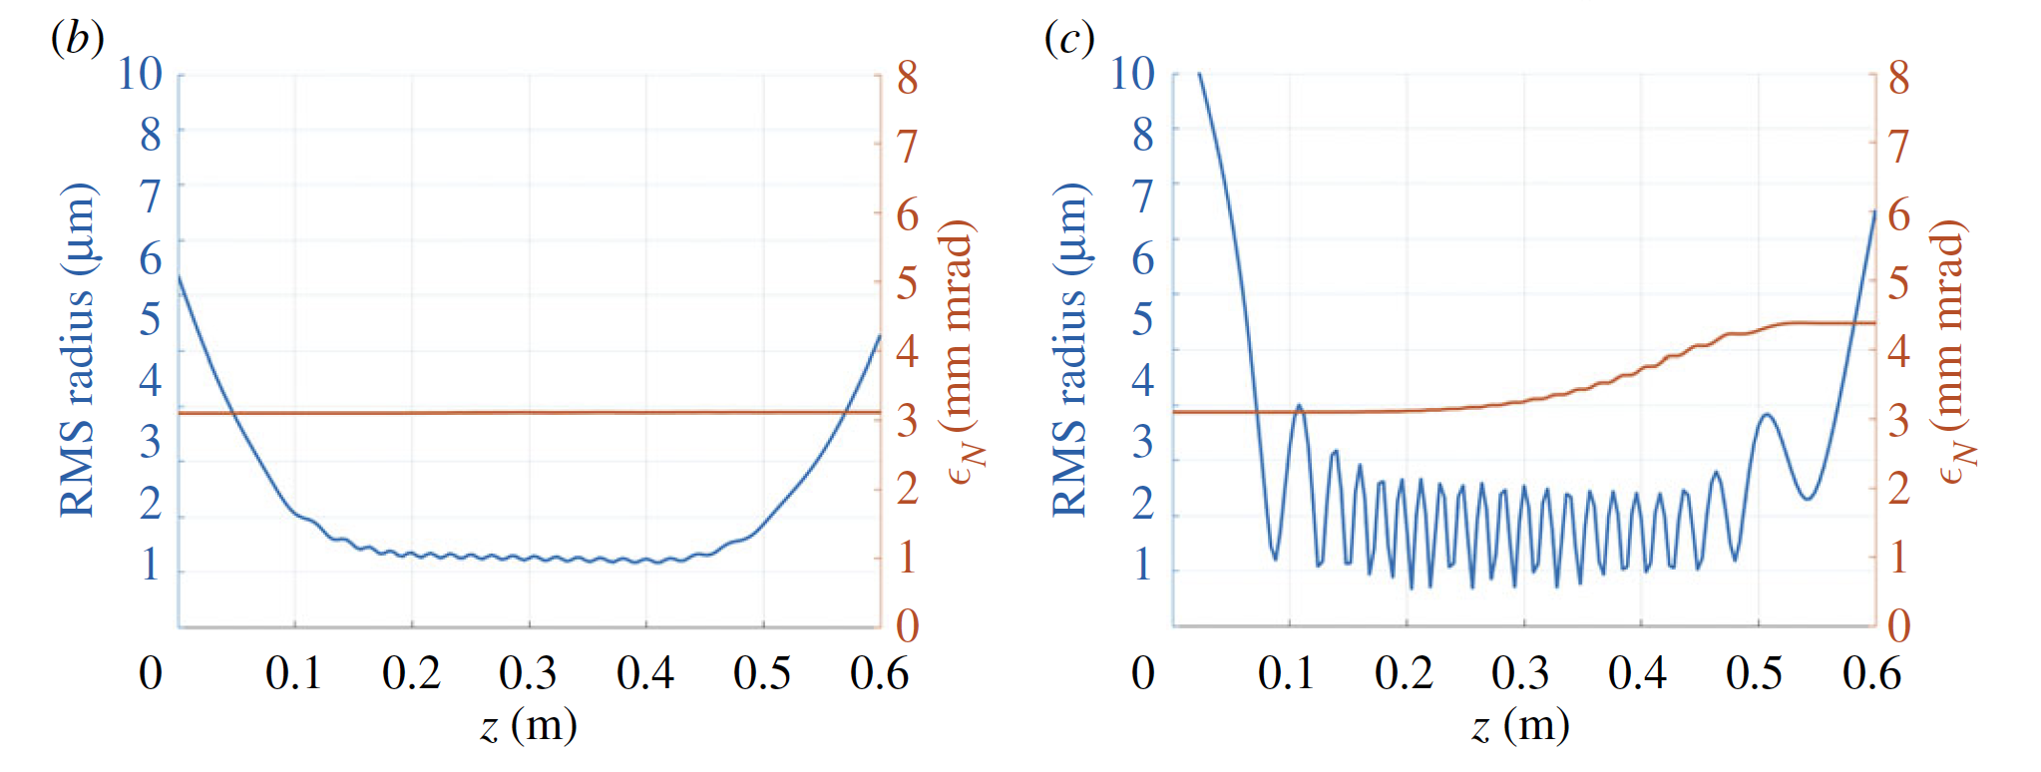
Correlation between radiated energy and emittance growth
PIC simulations using FACET-II experimental parameters. Credits to P. San-Miguel Claveria
RMS radius (in blue) and mean normalized emittance ( in orange) for matched (b) and mismatched (c) cases
Minimizing betatron radiation corresponds to minimum emittance growth due to mismatch
Beam envelope beating clearly correlates with observation of the emittance growth

Slide 20
Imperfections/misalignments and betatron radiation
(a)/(b) Angular distribution of the betatron radiation emitted by both beams when no offset VS 7μm offset along the x-axis in the trailing was induced. (c) Energy spectrum of the betatron radiation emitted by both bunches for three different offset values.
betatron radiation: total radiated energy, divergence and photon energy increase with trailing offset
minimizing betatron radiation corresponds to the optimal case where beam electrons have the smallest possible oscillation amplitude (matched case, no spatial or angular offset)
Credits to P. San-Miguel Claveria

Slide 21
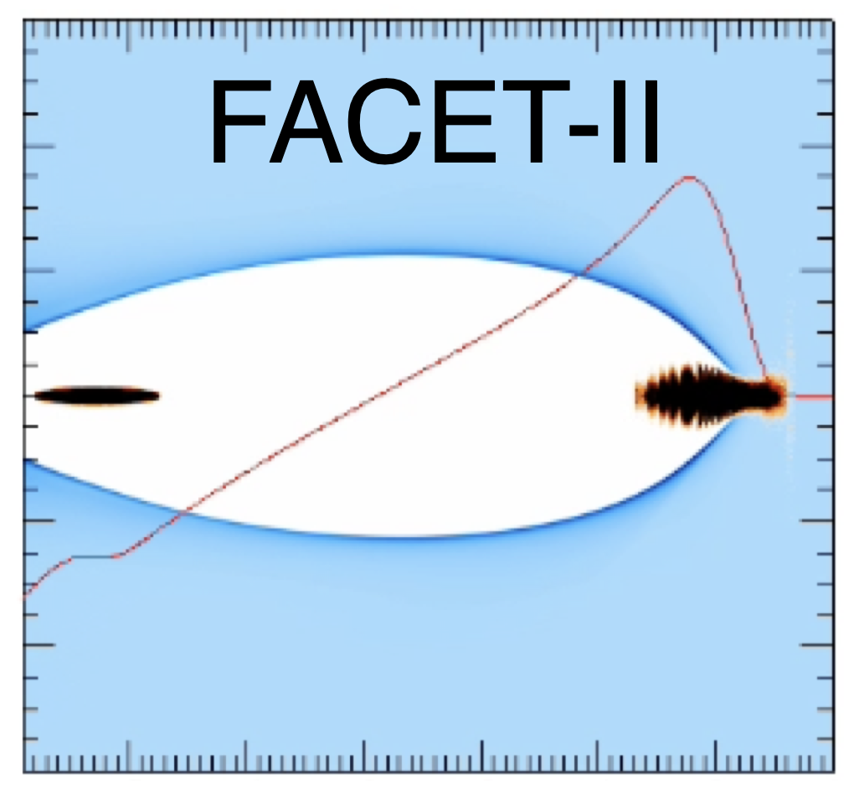
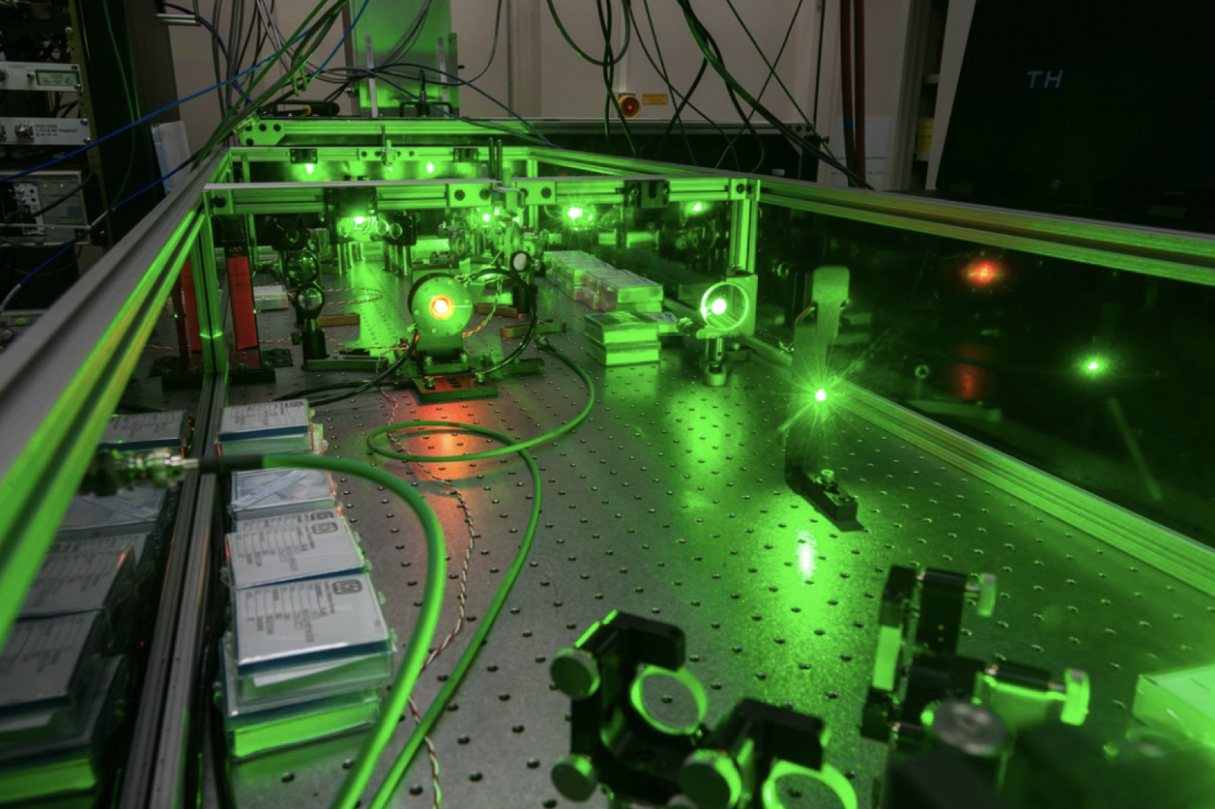
Goals and changes for the future experiment
Changes with respect to 2022 E-300 experiment
move to Li
laser-ionised plasma
single bunch then double bunch
→ very different physics compared to 2022
Next steps:
driver depletion in Li (single bunch)
demonstrate correlation between matching and betatron radiation (single bunch)
double bunch PWFA, without reaching all goals yet
show that trailing betatron radiation can be obtained from drive only and drive+trailing signals
demonstrate correlation between trailing emittance and trailing betatron radiation
Notes:
oven / laser / double bunch pictures

Slide 22
Summary
betatron radiation as a complementary diagnostics
data processing of 2022 FACET-II data
comparison with 2013 FACET-I data
self-focusing of the electron beam in a self-ionised H2
betatron radiation and emittance growth
e-300 betatron goals and changes

Slide 23
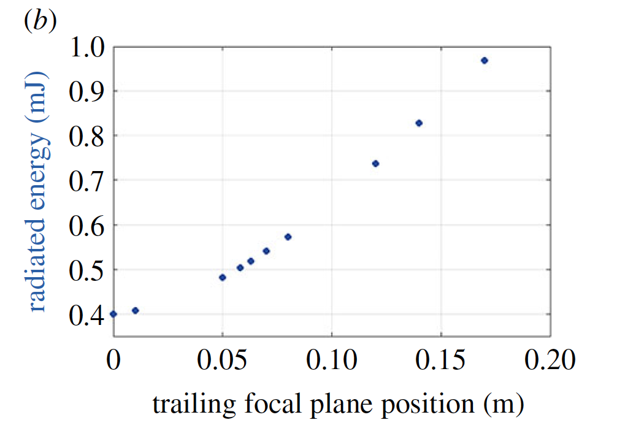
Backup
Total radiated energy from the trailing and drive bunches
total radiated energy, divergence and photon energy increase with trailing offset
Credits to P. San-Miguel Claveria

