Slide 1
Bright attosecond electron beams and brilliant gamma ray sources with the Resonant Multi-Pulse Ionization Injection
Paolo Tomassini
Head of the ELI-NP Simulation Group
ELI-NP, Magurele, LDED, Romania
In collaboration with:
L.A. Gizzi (CNR-INO, Pisa, Italy)
Nasr Hafiz (ELI-ALPS, Szeged, Hungary)
Lecz Zsolt (ELI-ALPS, Szeged, Hungary)
Domenico Doria (ELI-NP, Magurele, Romana)

Slide 2
Outlook
The two-color ionization injection and the Resonant Multi Pulse Ionization Injection (ReMPI) schemes
Earlier results with ReMPI
Attosecond high-brightness beams with ReMPI and 250TW Ti:Sa systems
4. Towards Compton/Thomson sources
5. Conclusions

Slide 3
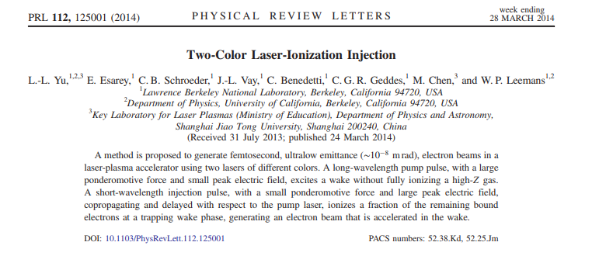
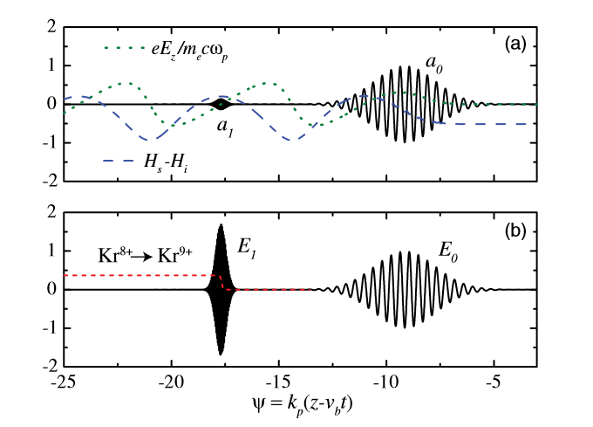
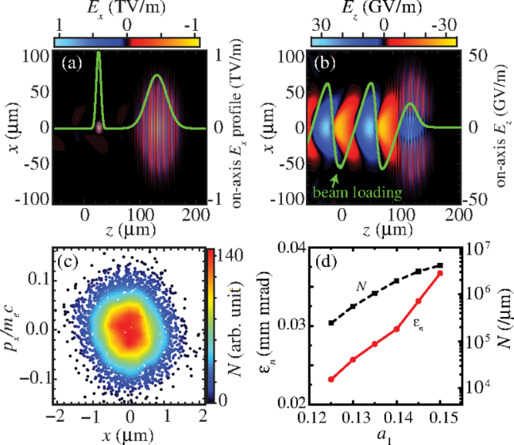
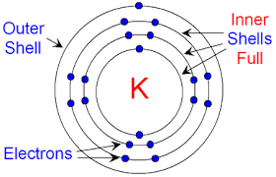
The two-color ionization injection
It uses two lasers systems:
A long wavelength (λ>5 μm) pulse excites the plasma wave and the short wavelength one (λ<=0.4 μm) extracts electrons by field ionization from an high-Z dopant.
It allows for very low emittance bunches (few tens of nm rad).
However, to date, its experimental feasibility is limited from the lacking of commercial high power, ultrashort and long wavelength laser systems.

Slide 4
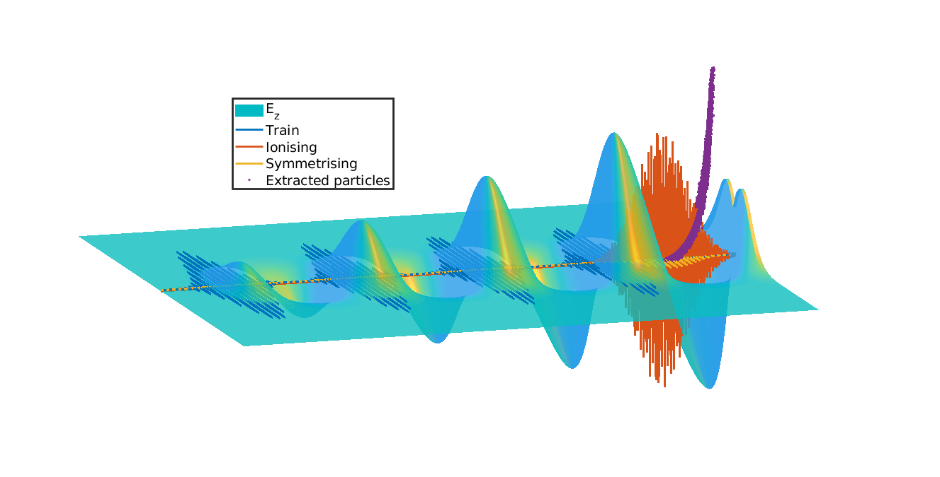
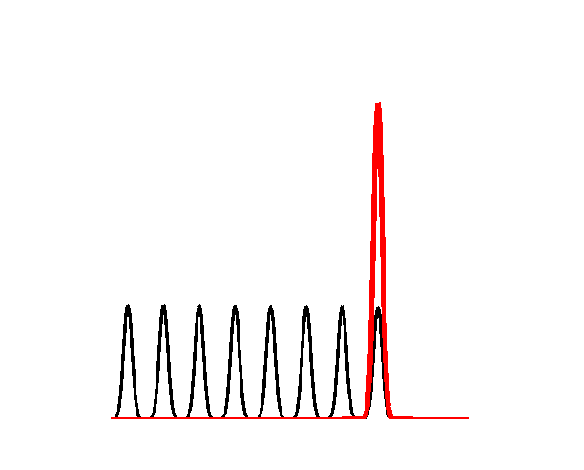
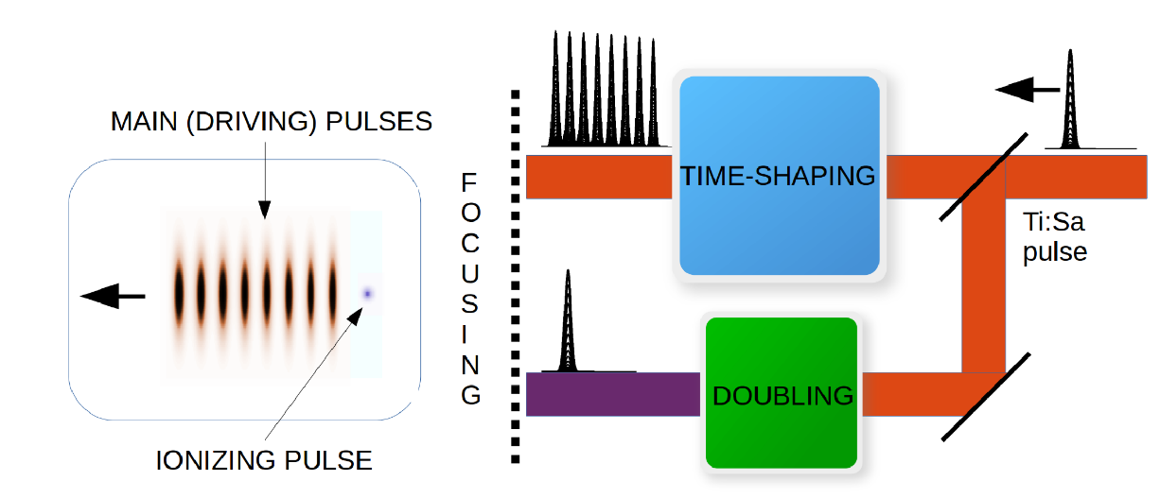
The Resonant Multi-Pulse Ionization injection (ReMPI
ReMPI requires one short-pulse (e.g Ti:Sa) laser system. It works also with multiple lases systems
Since a unique very large-amplitude Ti:Sa pulse would fully ionize the atoms (Ar8+ in our selected example), the pulse is shaped as a resonant sequence of sub-threshold amplitude pulses.
Ionization Threshold

Slide 5
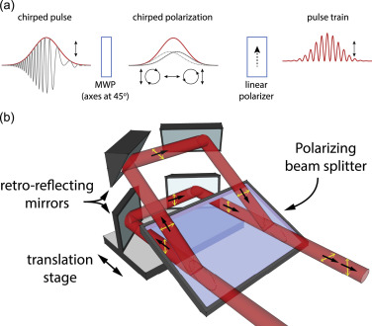
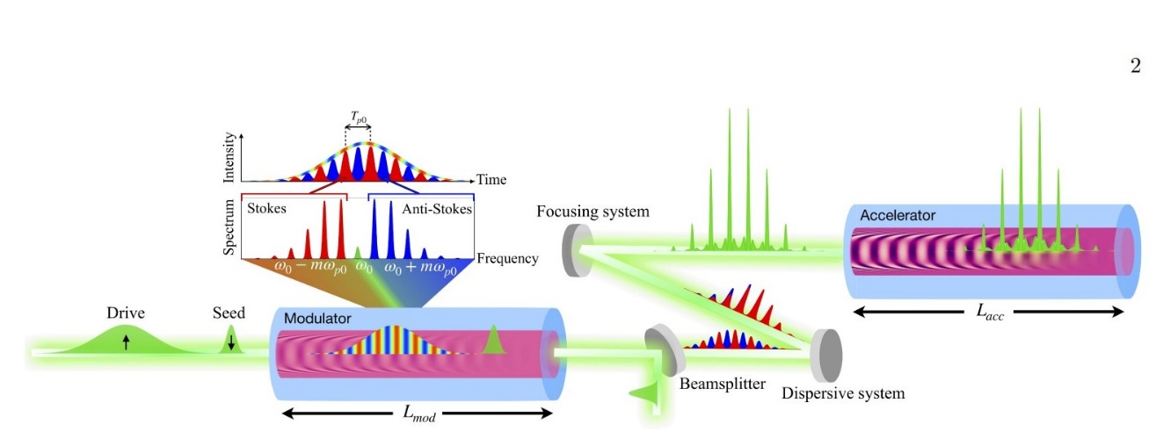
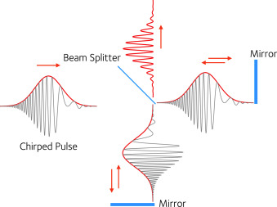
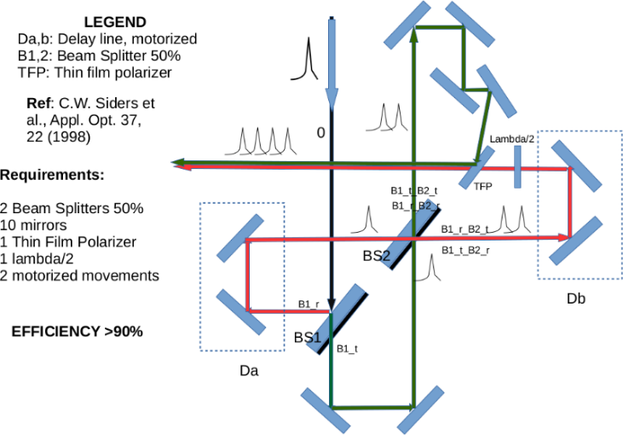
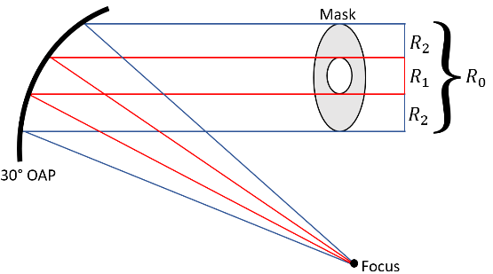
Active work on multi-pulse generation
The multi-pulse approach to LWFA has been proposed so far [D. Umstadter et al, PRL 72, (1994)]. A multi-pulse train can generate plasma waves with larger amplitude than those driven by a single pulse with the same energy.
[J. Cawley et al, PRL 2017]
[R.J. Shallow et al, NIM A 2016]
[O. Jakobsson, et al. PRL 127 (2021)]
Three pssible
pulse-shaping
schemes have
been proposed
very recently
Progress towards resonantly-driven, high-repetition-rate GeV-scale plasma accelerators
Simon Hooker
Observation of resonant wakefield excitation by pulse trains guided in long plasma channels
Linus Feder
held on Monday afternoon, WG1
Older methods include either multiple beam-splitters setup or phase masks
[G. Vantaggiato et al., NIMA 2018]
[A. Marasciulli et al., CLEO conf. 2021]
[W. Siders et al., Appl. Opt, 37 (22) 1998]

Slide 6
Trapping conditions
Conserved Hamiltonian in 1D+QSA
[E.Esarey & M. Pillov, PoP 2 1432 (1995)]
WEAK
Weak (standard) trapping threshold
Strong trapping threshold
STRONG
[Tomassini et al.; Phys. Plasmas 24 (2017)]
Strong trapping condition is more demanding than
the standard «weaker» one

Slide 7
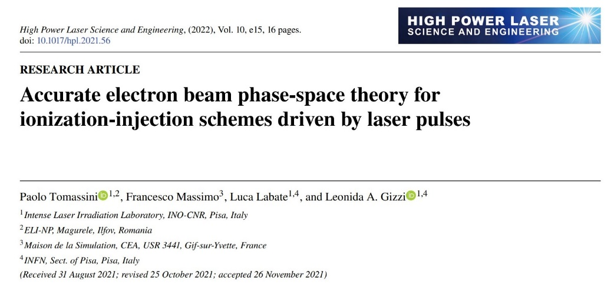
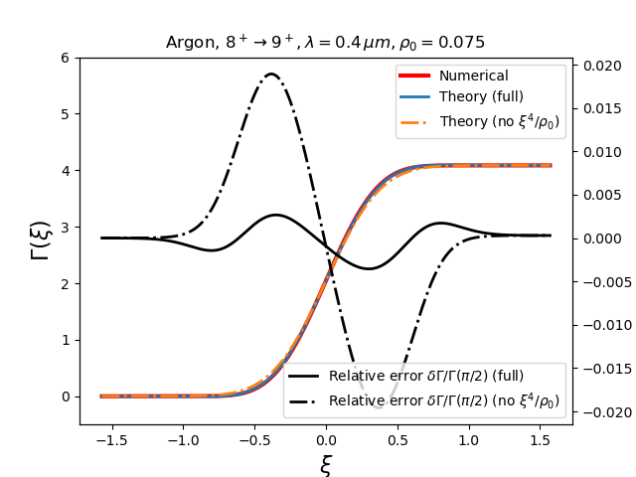
Highly accurate model for the extracted electron statistics
Highly accurate modeling of the 6D phase-space for tunnel-ionisation extracted electrons (ADK theory).
Single-cycle detailed description of the phase-space and whole bunch emittance
Also valid in the deep-saturation regime
Detailed presentation of the theory
held on Monday afternoon, WG3
ADK rate rewritten as in
[P. Tomassini et al., PoP 24, 103120 (2017)]

Slide 8
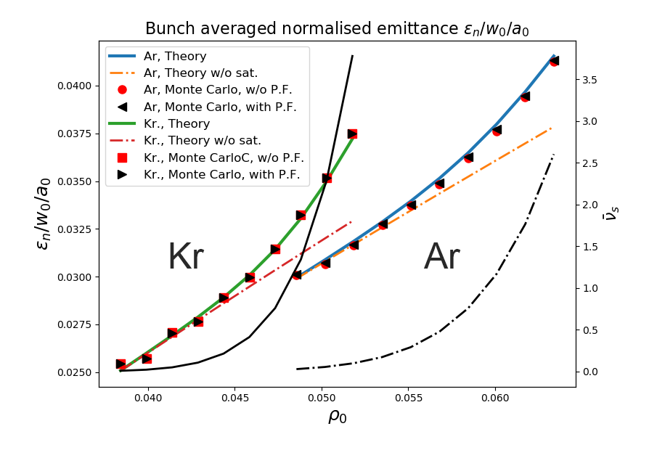
Advanced theory outcomes for a whole electron beam
P. Tomassini et al, HPLSE 10 e15 (2022)
Minimum obtainable «thermal»
normalised emittance

Slide 9
Outlook
The two-color ionization injection and the Resonant Multi Pulse Ionization Injection (ReMPI) schemes
Earlier results with ReMPI
Attosecond high-brightness beams with ReMPI and 250TW Ti:Sa systems
4. Towards Compton/Thomson sources
5. Conclusions

Slide 10
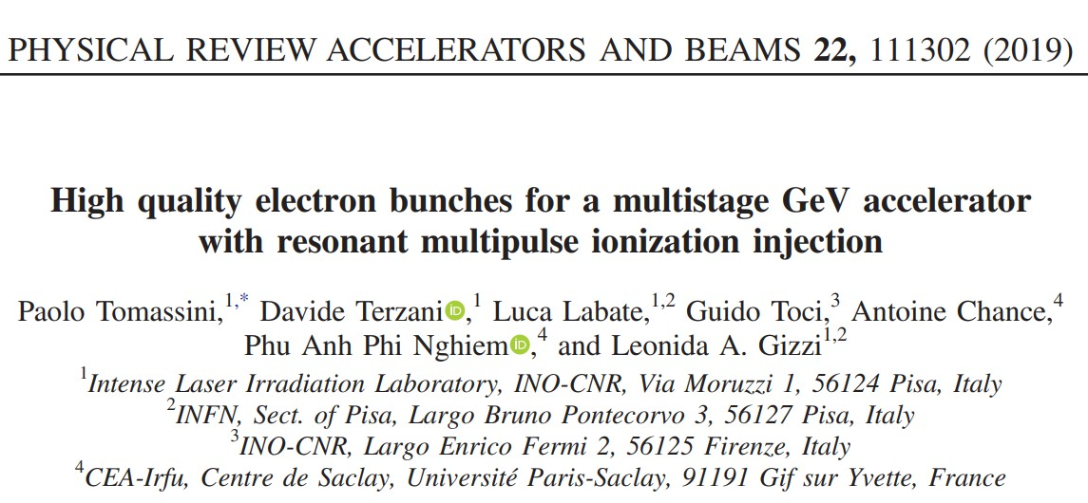
ReMPI is flexible. Examples of earlier works
Injector for multistage LWFA
Single stage 5GeV accelerator
30pC, 150MeV, 1.6% , 0.23 μmrad
30pC, 5GeV, 1% (proj) , 0.04% (slice) 0.08 μmrad
ReMPI
Beams for FEL or Thomson backscattering X/gamma
Beams for Thomson Back Scattering sources
30pC, 4.5GeV, 0.9% (proj) , 0.03% (slice) 0.08 μmrad
5pC, 1GeV, 0.8% (proj) , 0.08 μmrad
Brilliant X-ray Free Electron Laser driven by Resonant Multi
Pulse Ionization Injection accelerator, P. Tomassini et al.
Proc. FEL conference 2022
High-quality electron bunch production for high-brilliance
Thomson Scattering sources
P. Tomassini et al., SPIE 2017
https://doi.org/10.1117/12.2266938

Slide 11
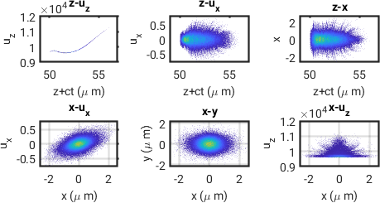
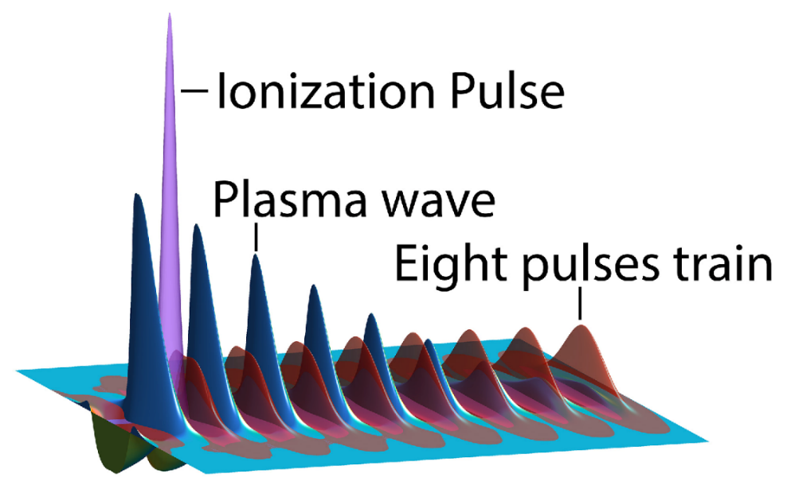
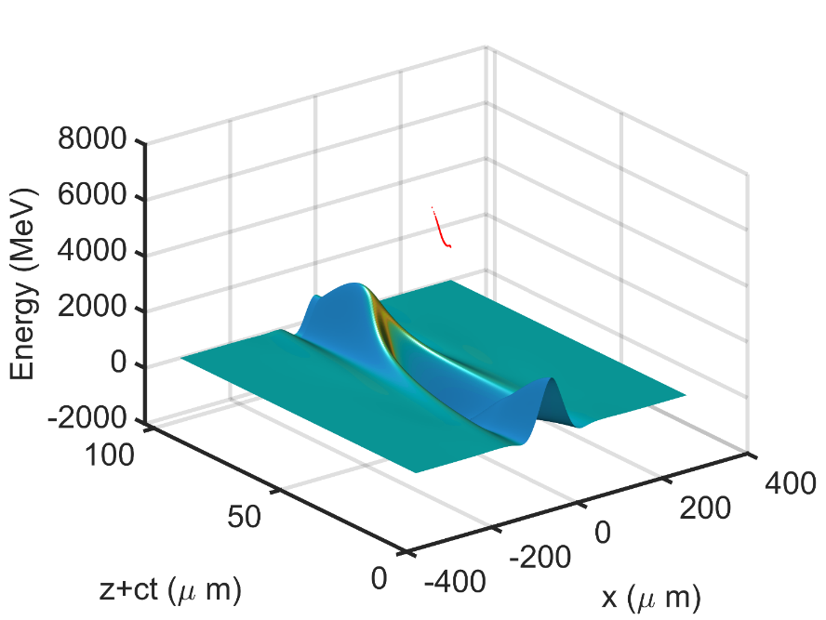
High-brightness 5GeV beams for EuPRAXIA
P. Tomassini et al., High-quality 5GeV electron bunches with the resonant multi-pulse ionization injection, PPCF P 62 (2020) 014010
R. Assman et al., EuPRAXIA CDR , EPJ 229, 675 (2020)2020)
Projected beam quality
1PW Ti:Sa driver
Projected
dE/E | ε_n | Q | I peak
0.9% (92% of the charge) 1.8 % (tail included) | 0.085 mm mrad | 32 pC | 3.5 kA

Slide 12
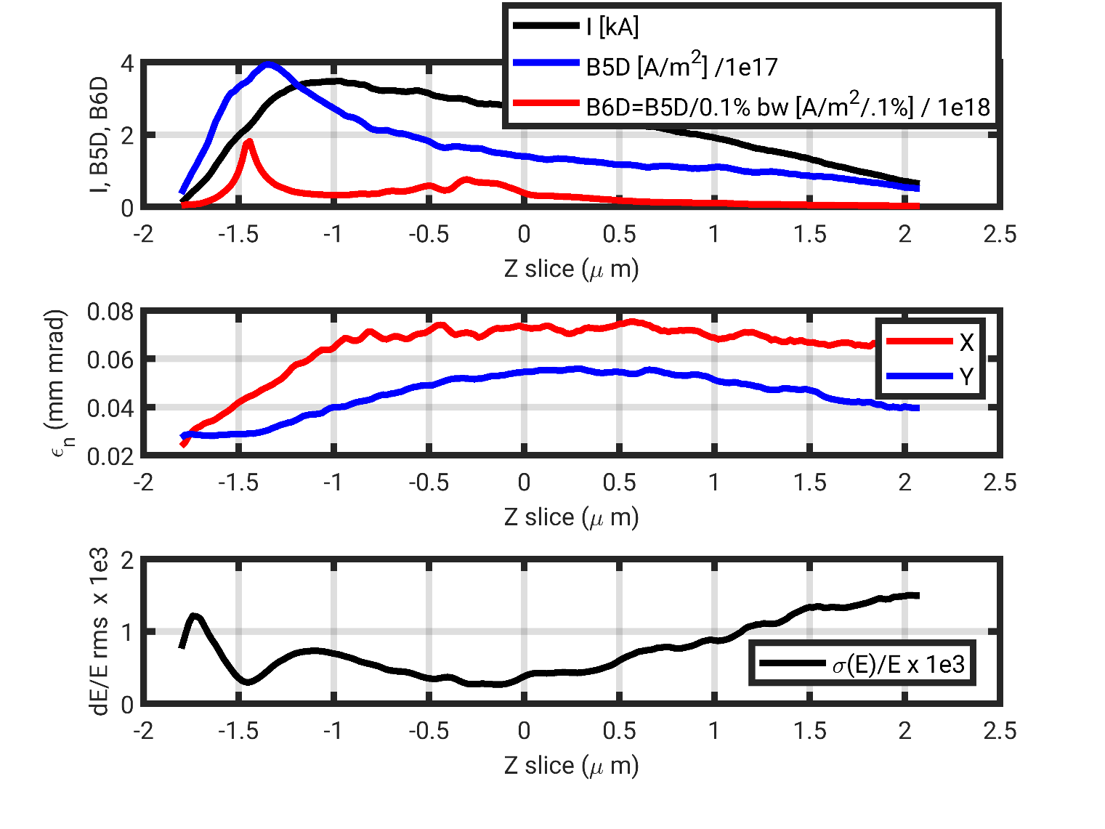
High-brightness 5GeV beams for EuPRAXIA
Slice analysis
dE/E SLICE | ε_n SLICE | Q | I peak
0.05% (min) | <0.08 mmmrad | 30 pC | 3.5 kA
/1e18
The slice analysis is FEL oriented
and reveals outstanding peak values
Peak
Slice averaged
About 90% of the slices have σ(E)/E<0.1%

Slide 13
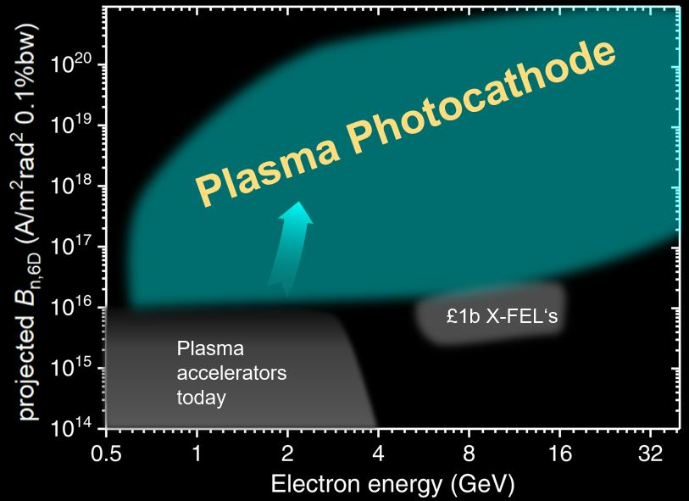
High-brightness 5GeV beams for EuPRAXIA
PROJECTED 6D brightness
https://pwfa-fel.phys.strath.ac.uk
SLICE 6D brightness
ReMPI (peak)
The slice analysis is FEL oriented and reveals outstanding peak and slice average values
ReMPI (slice avg)
ReMPI (projected)
Peak
Slice averaged

Slide 14
Outlook
The two-color ionization injection and the Resonant Multi Pulse Ionization Injection (ReMPI) schemes
Earlier results with ReMPI
Attosecond high-brightness beams with ReMPI and 250TW Ti:Sa systems
4. Towards Compton/Thomson sources
5. Conclusions

Slide 15
Where we want to go: high-brightness 1.7GeV ultrashort beams with 250TW Ti:Sa
Examples of (projected) Beam Brightness performances
https://pwfa-fel.phys.strath.ac.uk
Projected beam brightness
1PW 8 pulses
3fs, 4kA
0.23PW 2 pulses
300/600as, 7/14kA
300/600as high-brightness 1.7GeV beam with 200 TW Ti:Sa laser

Slide 16
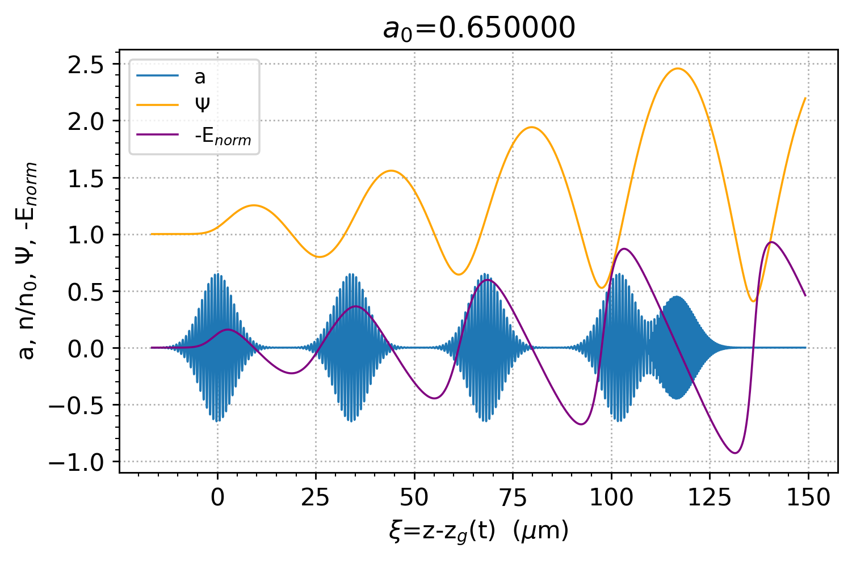
Fine tuning of the beam length in two-color/ReMPI/trojan-horse schemes
In Two Color and ReMPI ionization injection schemes the extraction of the electrons from
the dopant occurs in a controlled way. By tuning the distance between the node of the
accelerating gradient and the peak of the ionization pulse we can vary the length of the
trapped beam.
@ trapping
@ extraction
16

Slide 17
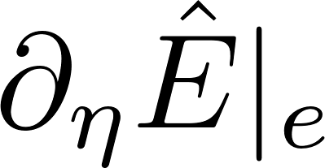
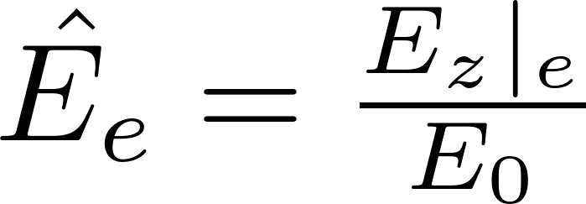
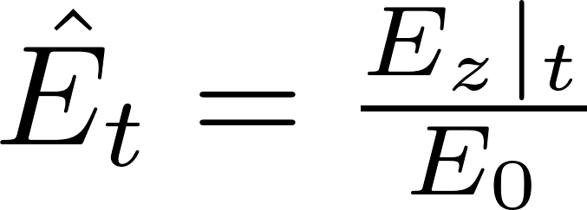
Fine tuning of the beam length in two-color/ReMPI/trojan-horse schemes
By tuning the distance between the node of the accelerating gradient and the peak of the
ionization pulse we can vary the length of the trapped beam.
We consider the electrons extracted by field ionization by
the pulse of FWHM length cT. In the case of unsaturated
regime the extraction coordinate is a random gaussian
variable of variance
The rms trapping positions can be evaluated in the limit
as
A more deltailed model including 3D effects is available on P. Tomassini et al., “Attosecond pulses from Ionization Injection Wake Field Accelerators”, DOI 10.20944/preprints (submitted)
17

Slide 18
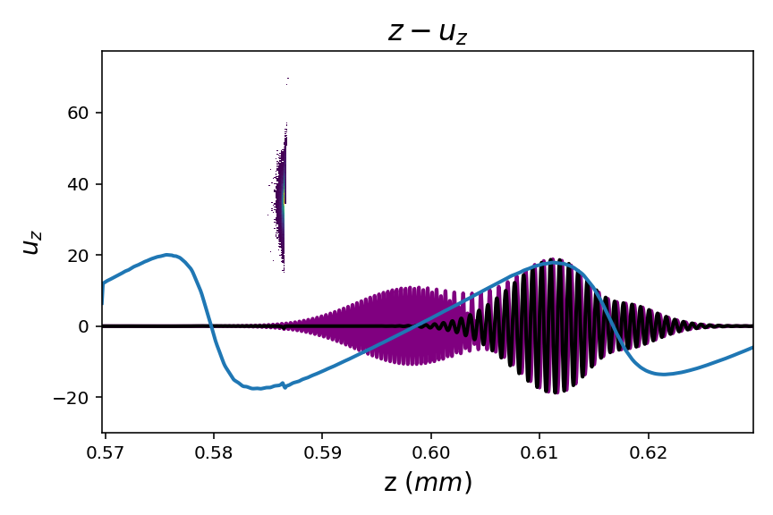
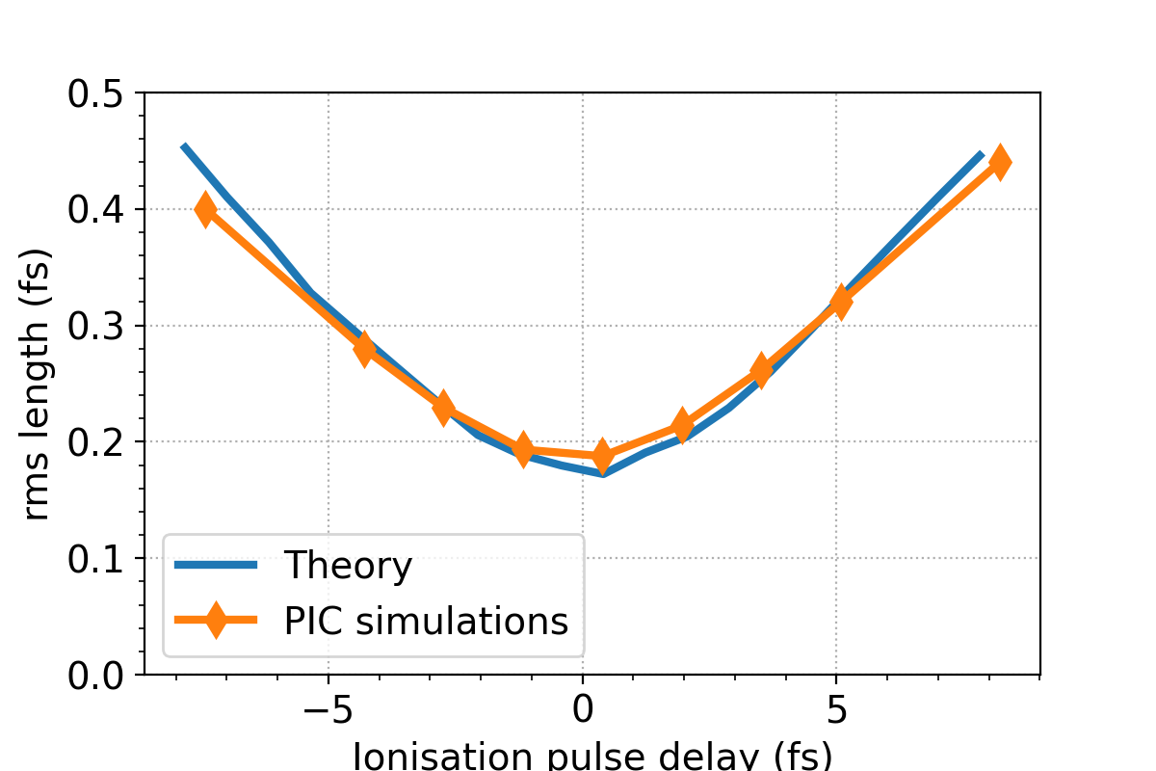
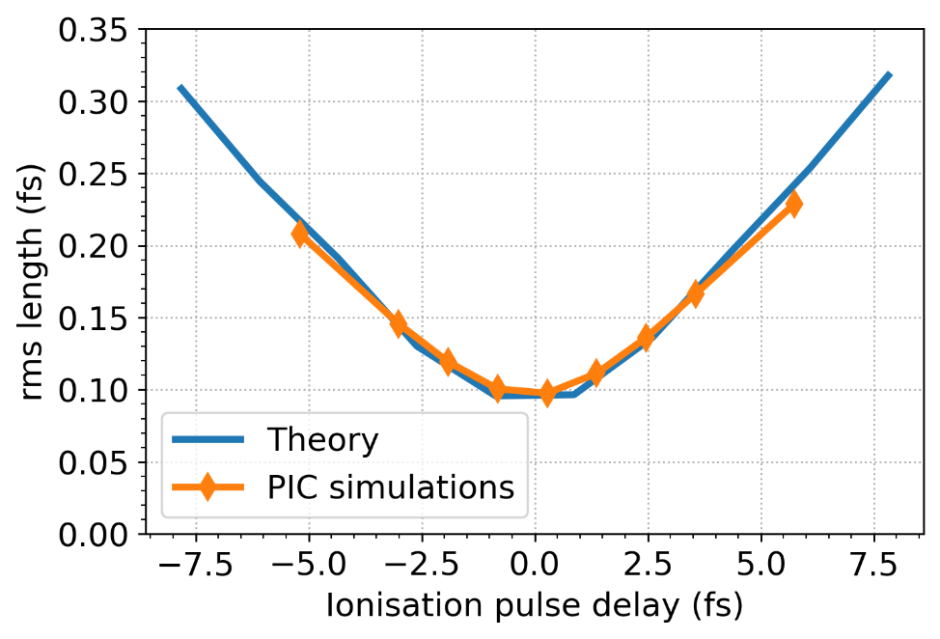
Fine tuning of the beam length in two-color/ReMPI/trojan-horse schemes
Scan of the beam length as a function of the ionization pulse position. The “zero position”
corresponds to a delay which places the pulse on the node of the accelerating gradient
SINGLE Ti:Sa 200TW laser system, Circularly Polarised pulses
4x 23fs FWHM pulses, w0=45 μm , total 5J on TEM00,
1x 25fs or 18fs FWHM ionization pulse in II harmonics, w0=3.5 μm
100%Ar (8+) plasma, n0=5e17 1/cm^3
PIC simulations with the quasi-3D FB-PIC code. Resolution λi/24 and λi/8 in the longitudinal and transverse directions
Post compressed
Ti=25fs
Ti=18fs
Timing
jitter
below
3fs rms

Slide 19
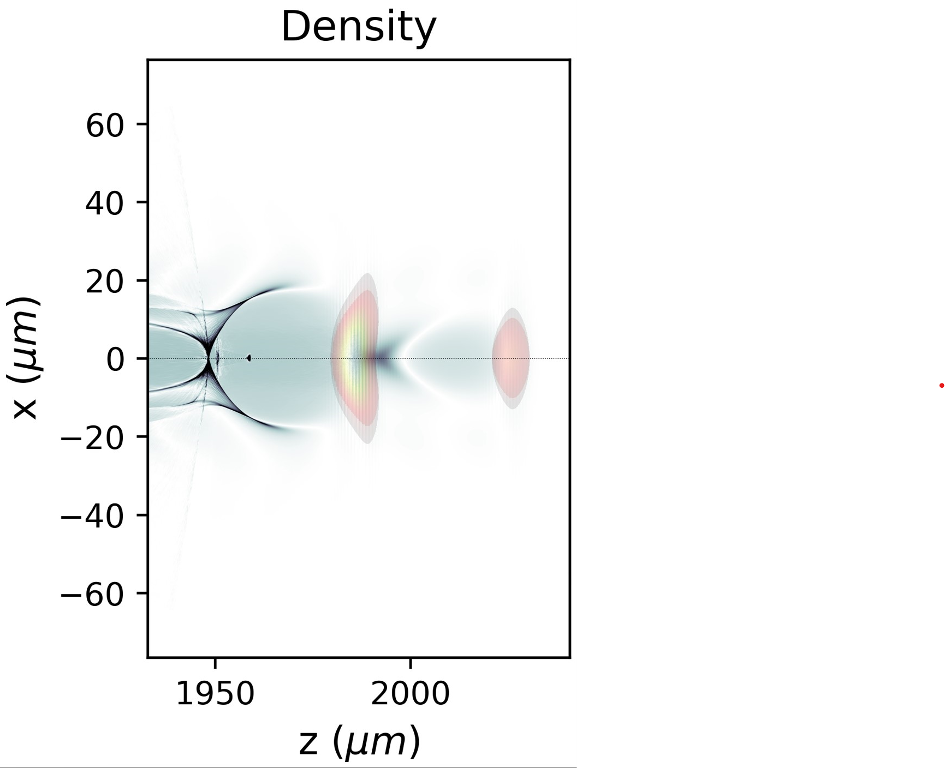
Simplifying ReMPI
The first FEL compliant version of ReMPI for 5GeV suffered from “gigantism”.
Eight pulse, with complex evolution due to the propagation into an evolving wakefield
8 pulses
30 pC
(1PW, EuPRAXIA )
P. Tomassini et al., High-quality 5GeV electron bunches with the resonant multi-pulse ionization injection, PPCF P 62 (2020) 014010
P. Tomassini et al., BRILLIANT X-RAY FREE ELECTRON LASER DRIVEN BY RESONANT MULTI-PULSE IONIZATION INJECTION ACCELERATOR,
proc. FEL 2022 conference, Trieste.
(200TW)
5-30 pC
2 pulses
P. Tomassini et al., High-Brightness e-beams with the ReMPI scheme employing two driver pulses, in preparation

Slide 20
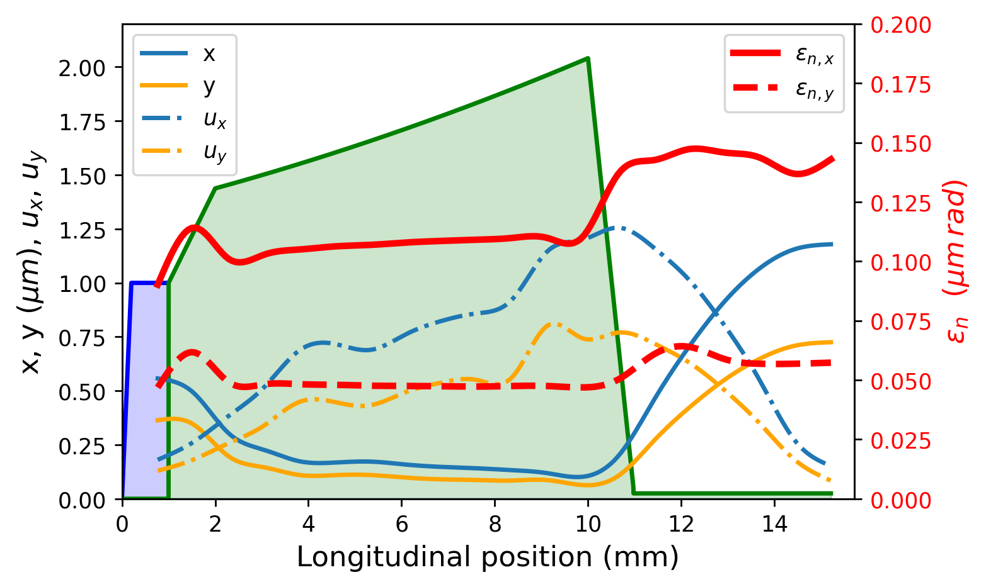
Flexible attosecond source
SINGLE Ti:Sa 200TW/300TW laser system, Circularly Polarised pulses
2x 23fs FWHM pulses, w0=30 μm , total 4.2J on TEM00,
1x 30fs FWHM ionization pulse in III harmonics, w0=3.5 μm, on TEM00, 20mJ
100%Ar (8+) plasma, n0=0.75e18 1/cm^3,
1mm plateau + 100He 10mm accelerating
structure, guided pulse with radially
parabolic density profile
Plasma lens after the downramp to reduce
beam divergence

Slide 21
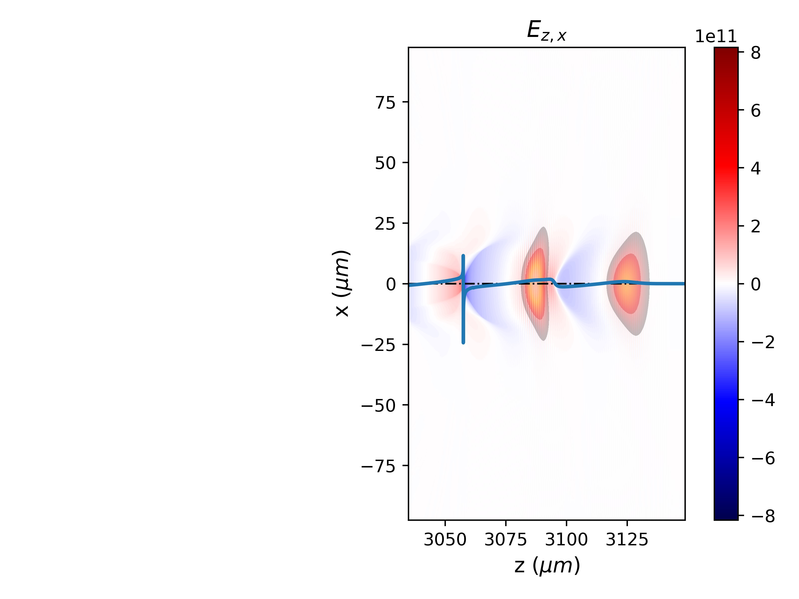
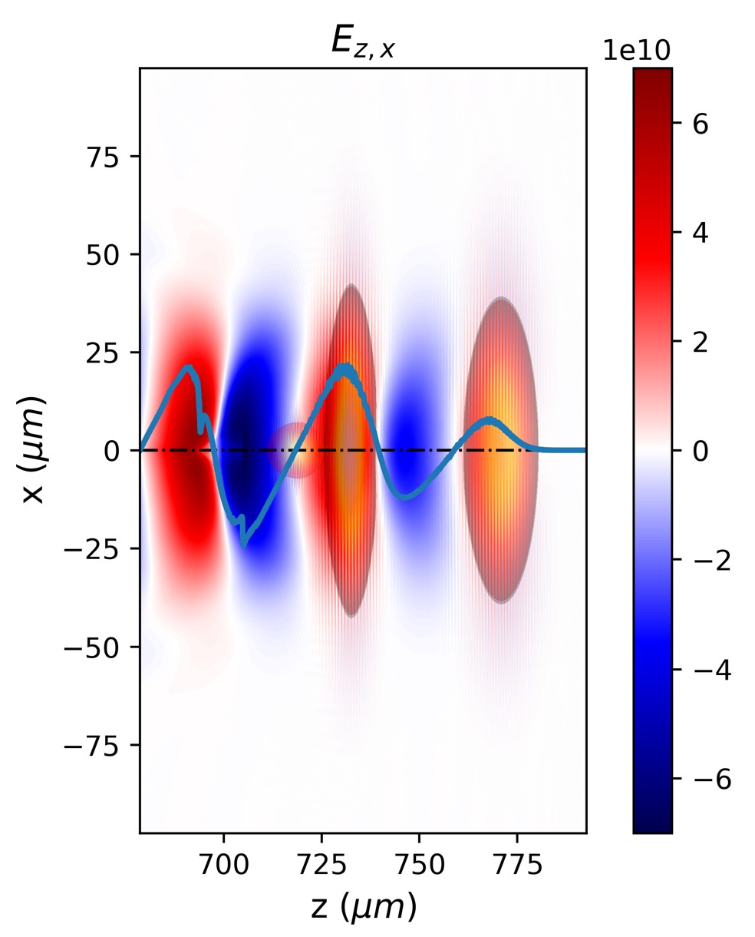
Flexible attosecond source
Ionization pulse

Slide 22
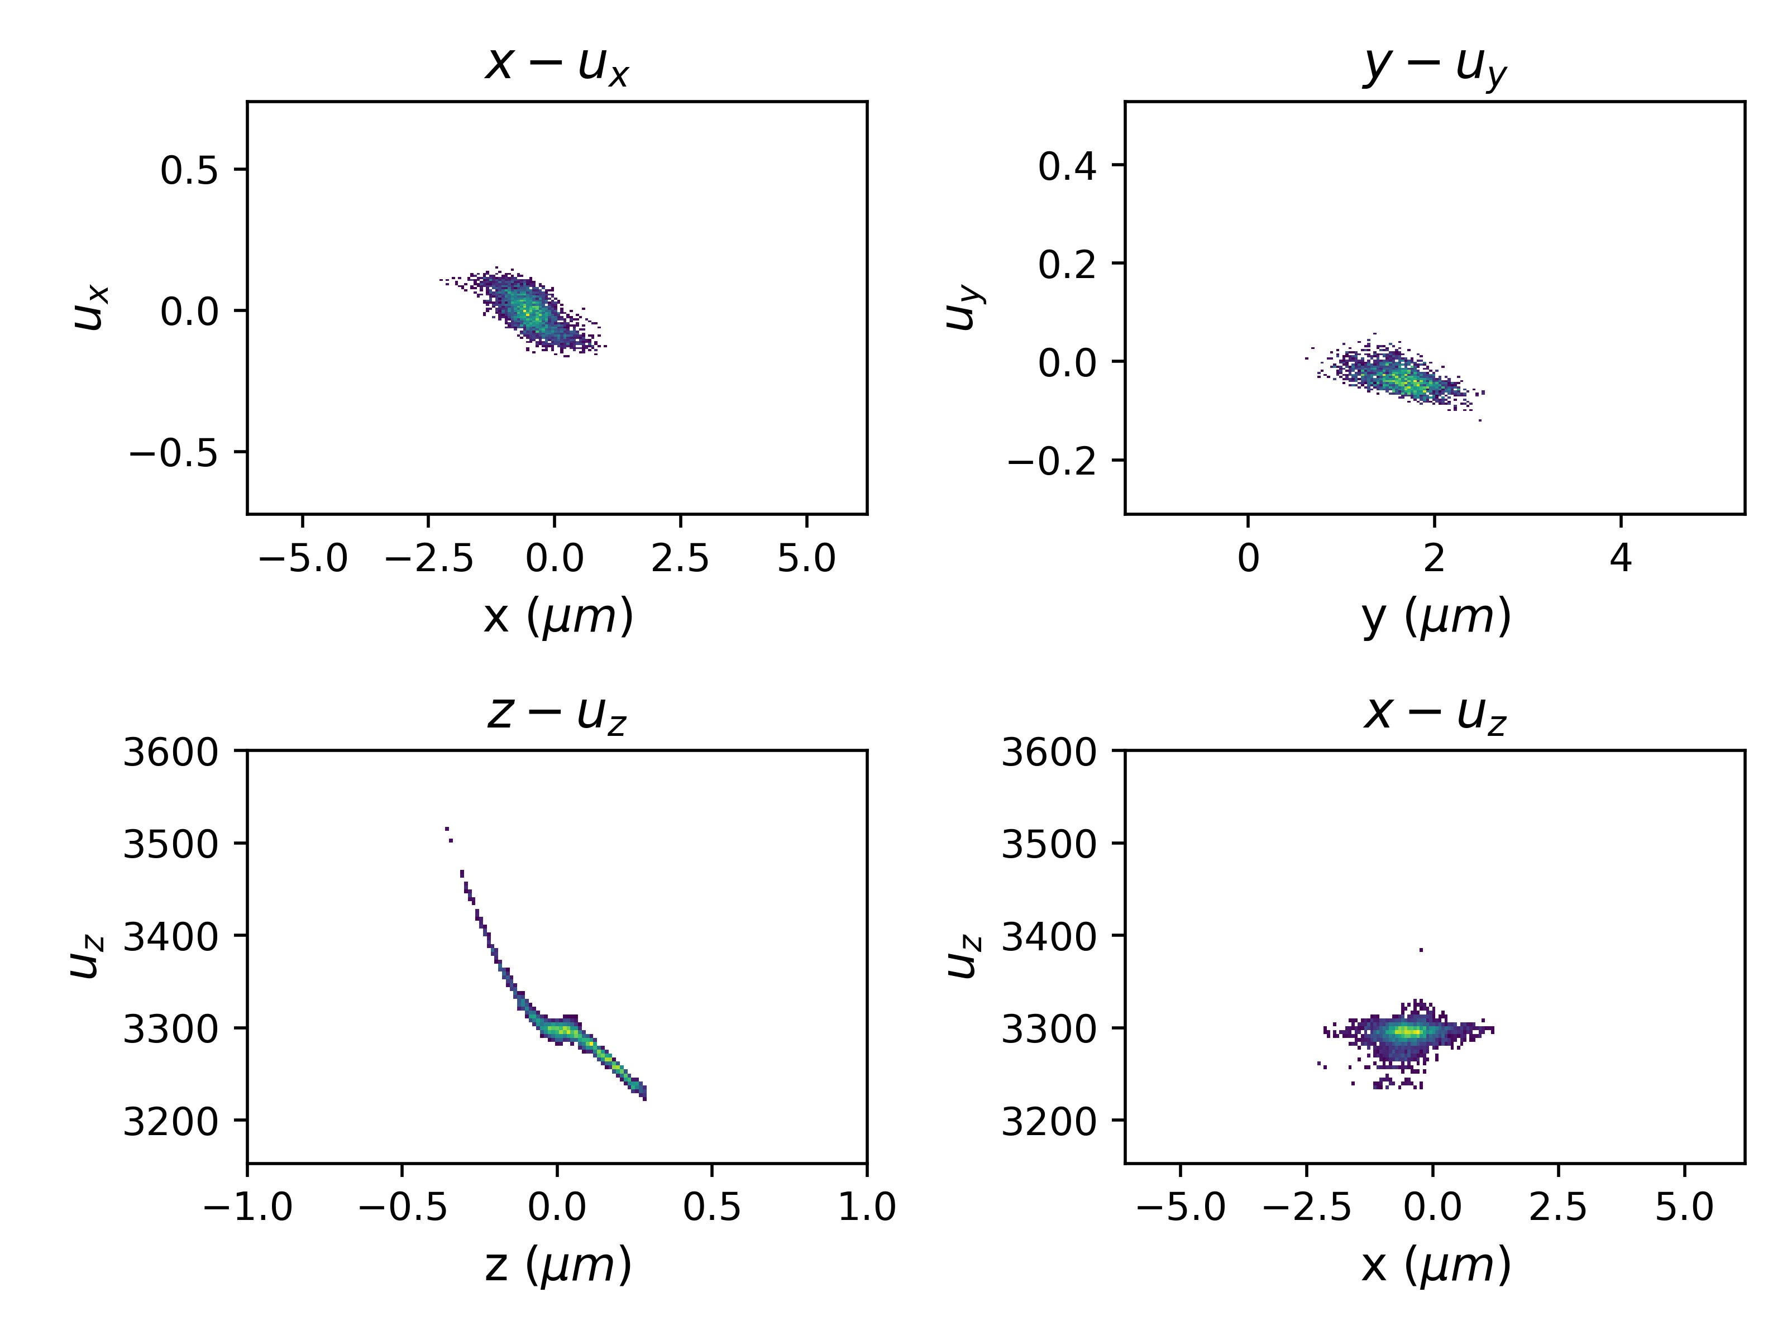
Flexible attosecond source
Q=18pC
Final beam phase space
The downramp shape needs to be optimized

Slide 23
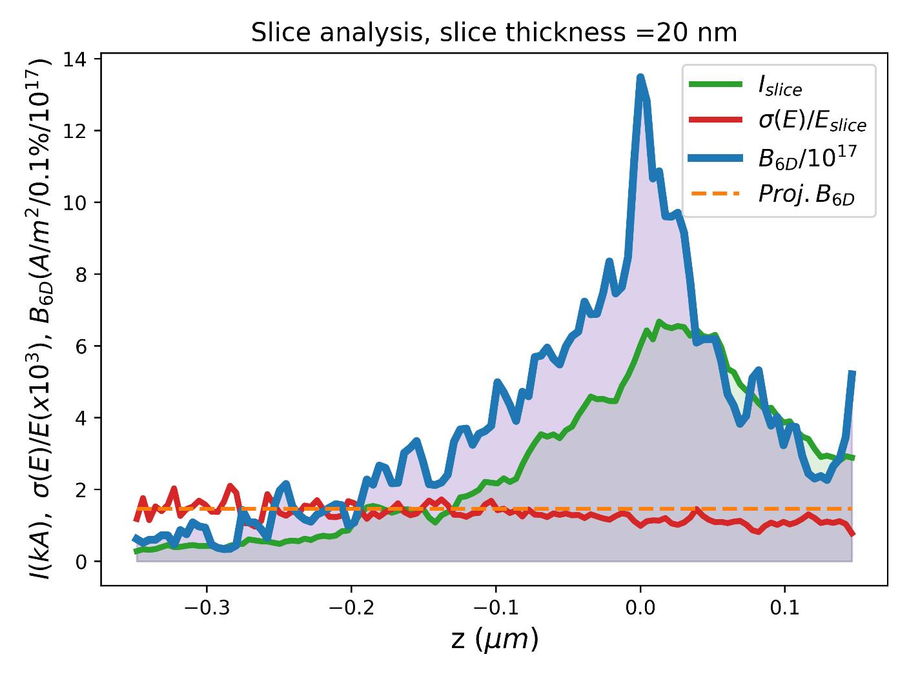
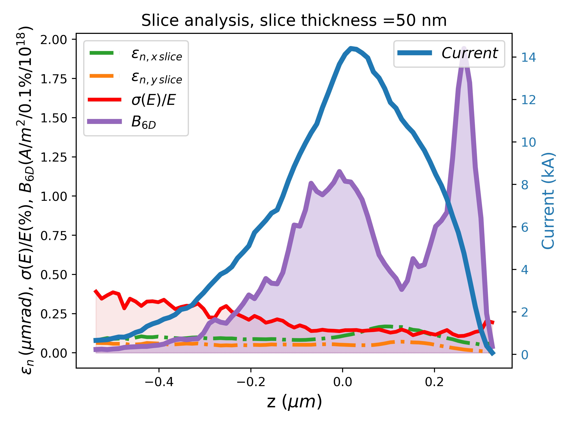
Flexible attosecond source
Duration (rms) | Projected Brighthess 6D | δE/E (rms)
250 as |  | 0.6%
Duration (rms) | Projected Brighthess 6D | δE/E (rms)
600 as |  | 0.7%
FEL-oriented
Q=6pC
Q=18pC
Thomson BS oriented

Slide 24
Outlook
The two-color ionization injection and the Resonant Multi Pulse Ionization Injection (ReMPI) schemes
Earlier results with ReMPI
Attosecond high-brightness beams with ReMPI and 250TW Ti:Sa systems
4. Towards Compton/Thomson sources
5. Conclusions

Slide 25
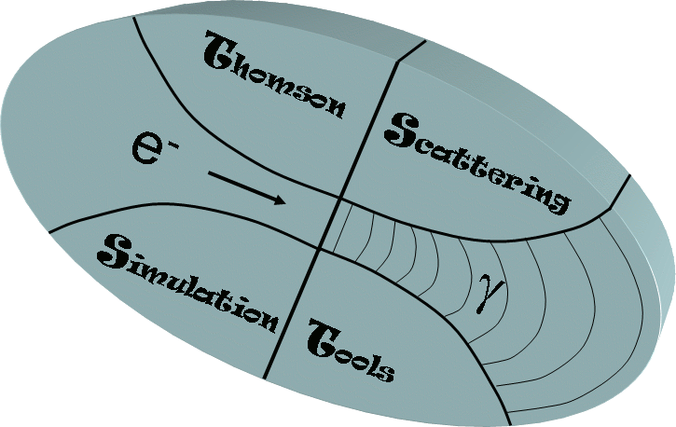
Attosecond long X/γ sources with the Thomson backscattering process
Projected beam quality
σ(E)/E | Q | σ(u perp.) | σ( x perp.) | σ( z long.)
0.7% | 18pC | 0.12 | 0.15 μm | 0.2μm
Counterpropagating pulse Yb:YAG (1.053 μm)
Energy | Duration | W0 | A0
1J | 2ps | 12.5 μm | 0.2
Normalized acceptance
EXTREMELY USEFUL parameter
Thomson Scattering Simulation Tools (TSST) is a semi-analytic code employing the analytic Thomson Scattering theory in [P. Tomassini et al., Appl. Phys. B 80 (2005)]

Slide 26
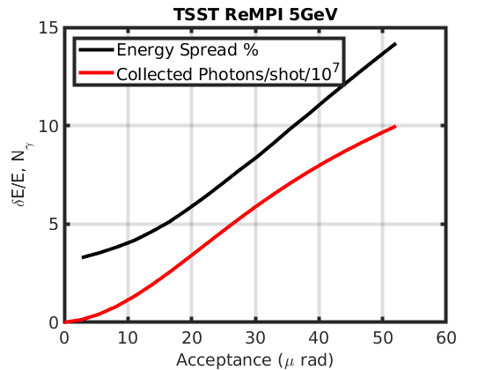
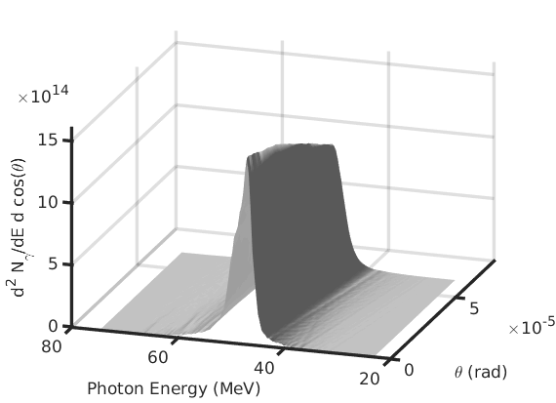
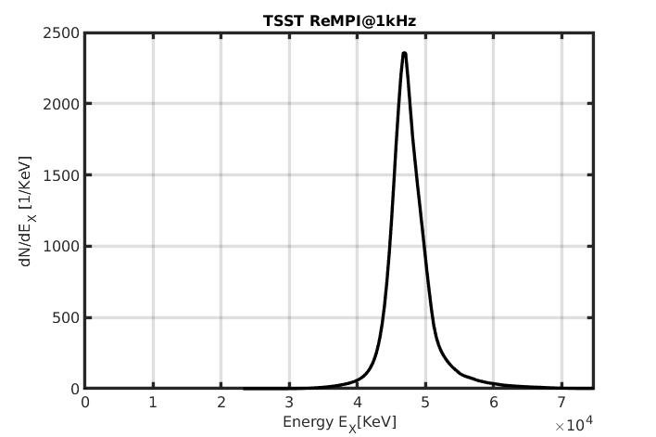
Attosecond long X/γ sources with the Thomson backscattering process
45MeV
600 as source
1x10⁷ ph/shot
0 30 60 90 120 150 175
Acceptance (μrad)
The peak brilliance is

Slide 27
Conclusions
ReMPI needs a pulse shaping with (approximately) equal intensity pulses. This is not straightforward . Any collaboration on this side is welcome
ReMPI is very flexible and it can be employed to generate high-brightness e-bunches
By tuning the delay between the ionization pulse and the driver, the beam length can be adjusted in a wide interval. 100’s as bunches can be generated in this way
The time jitter between the ionization and the driver pulses is a critical parameter.
A few fs rms jitter are acceptable for attosecond bunches generation
The simplified scheme with two driver pulses and short-ultrashort e-beams should still be explored, for now only “high density -> low energy” working points have been optimized. For them, a full transport + undulator analysis is needed
An experimental demonstration of the two-pulses case is now on the table at CNR-INO and ELI-NP (collaborations with Victor Malka, Nasr Hafiz and other colleagues started on this purpose)

Slide 28
Acknowldgments
Past and present collaboration with:
INFN-LNF
INFN-MI/PI
ENEA
ELI-ALPS
WEIZMANN
We also warmly thank:
Luca Serafini, Vittoria Petrillo (their support in LWFA-PWFA and ICS in the last twenty years)
Matt Zepf, Dino Jaroszynski (their help on multi-pulse generation)
Francesco Massimo, Manuel Kirchen (their help with their PIC codes)
Thank you for your attention!

