Slide 1
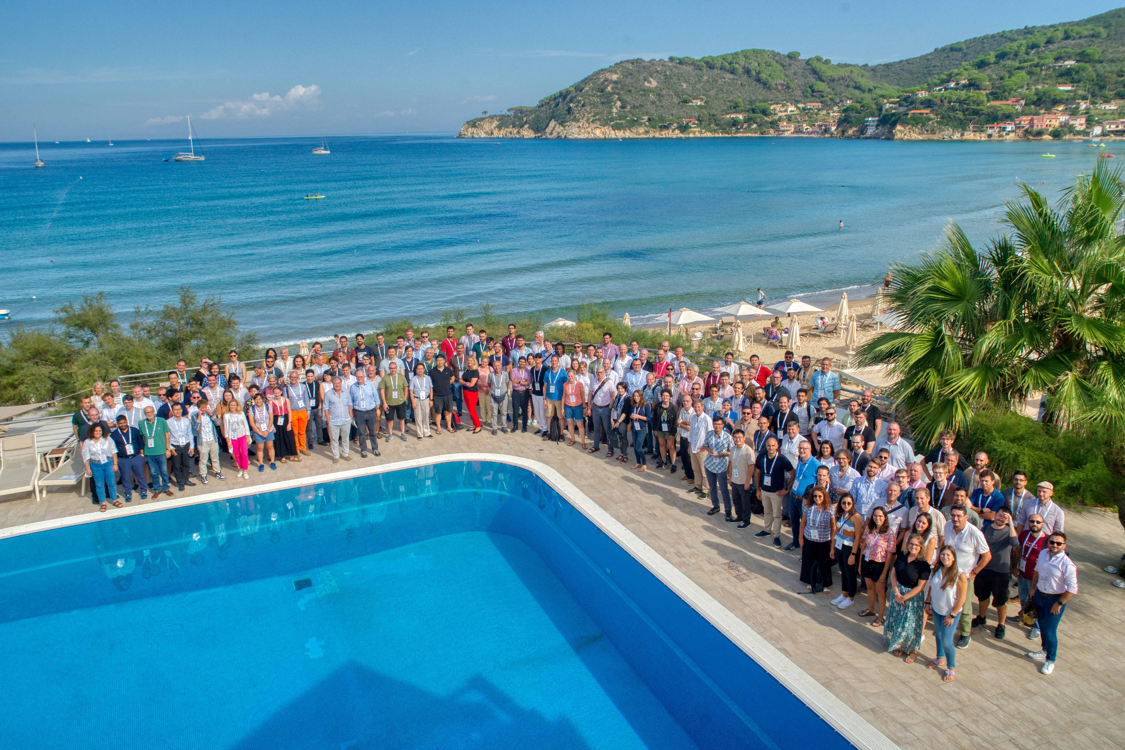
EAAC 2023 Closing Remarks
Ralph Assmann (GSI) Massimo Ferrario (INFN)
17–22 Sept. 2023 Hotel Hermitage, La Biodola Bay, Isola d'Elba, Italy

Slide 2
IFAST = Innovation Fostering in Accelerator Science and Technology
EU Project May 2021 – April 2025, Coordinator M. Vretenar
WP6: Novel Particle Accelerators Concepts and Technologies
Contains European Network for Novel Accelerators (EuroNNAc4) = Sponsor of EAAC

Slide 3
Our Sponsors

Slide 4
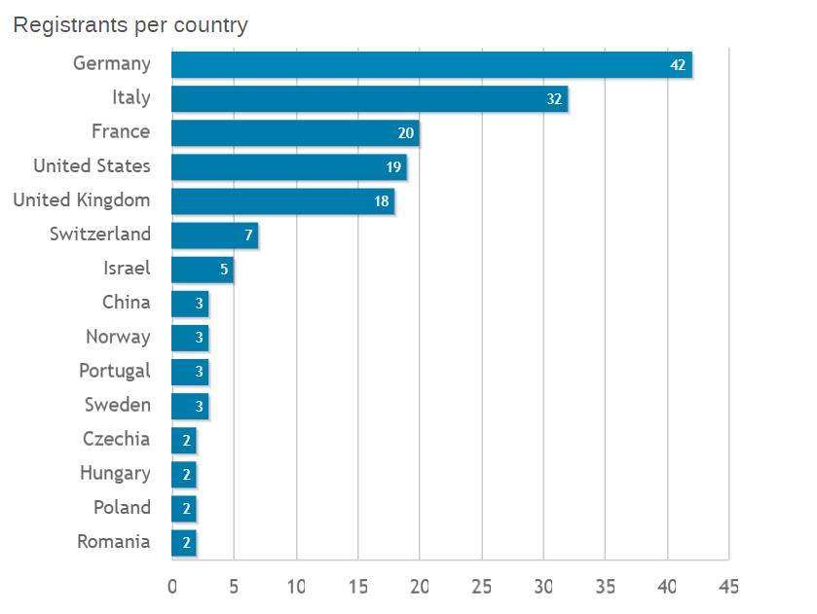
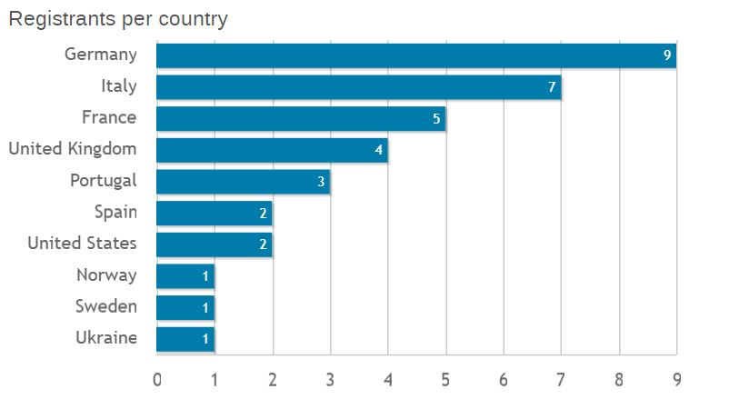
198 Participants
Delegates
163 Delegates
35 Student Grants

Slide 5
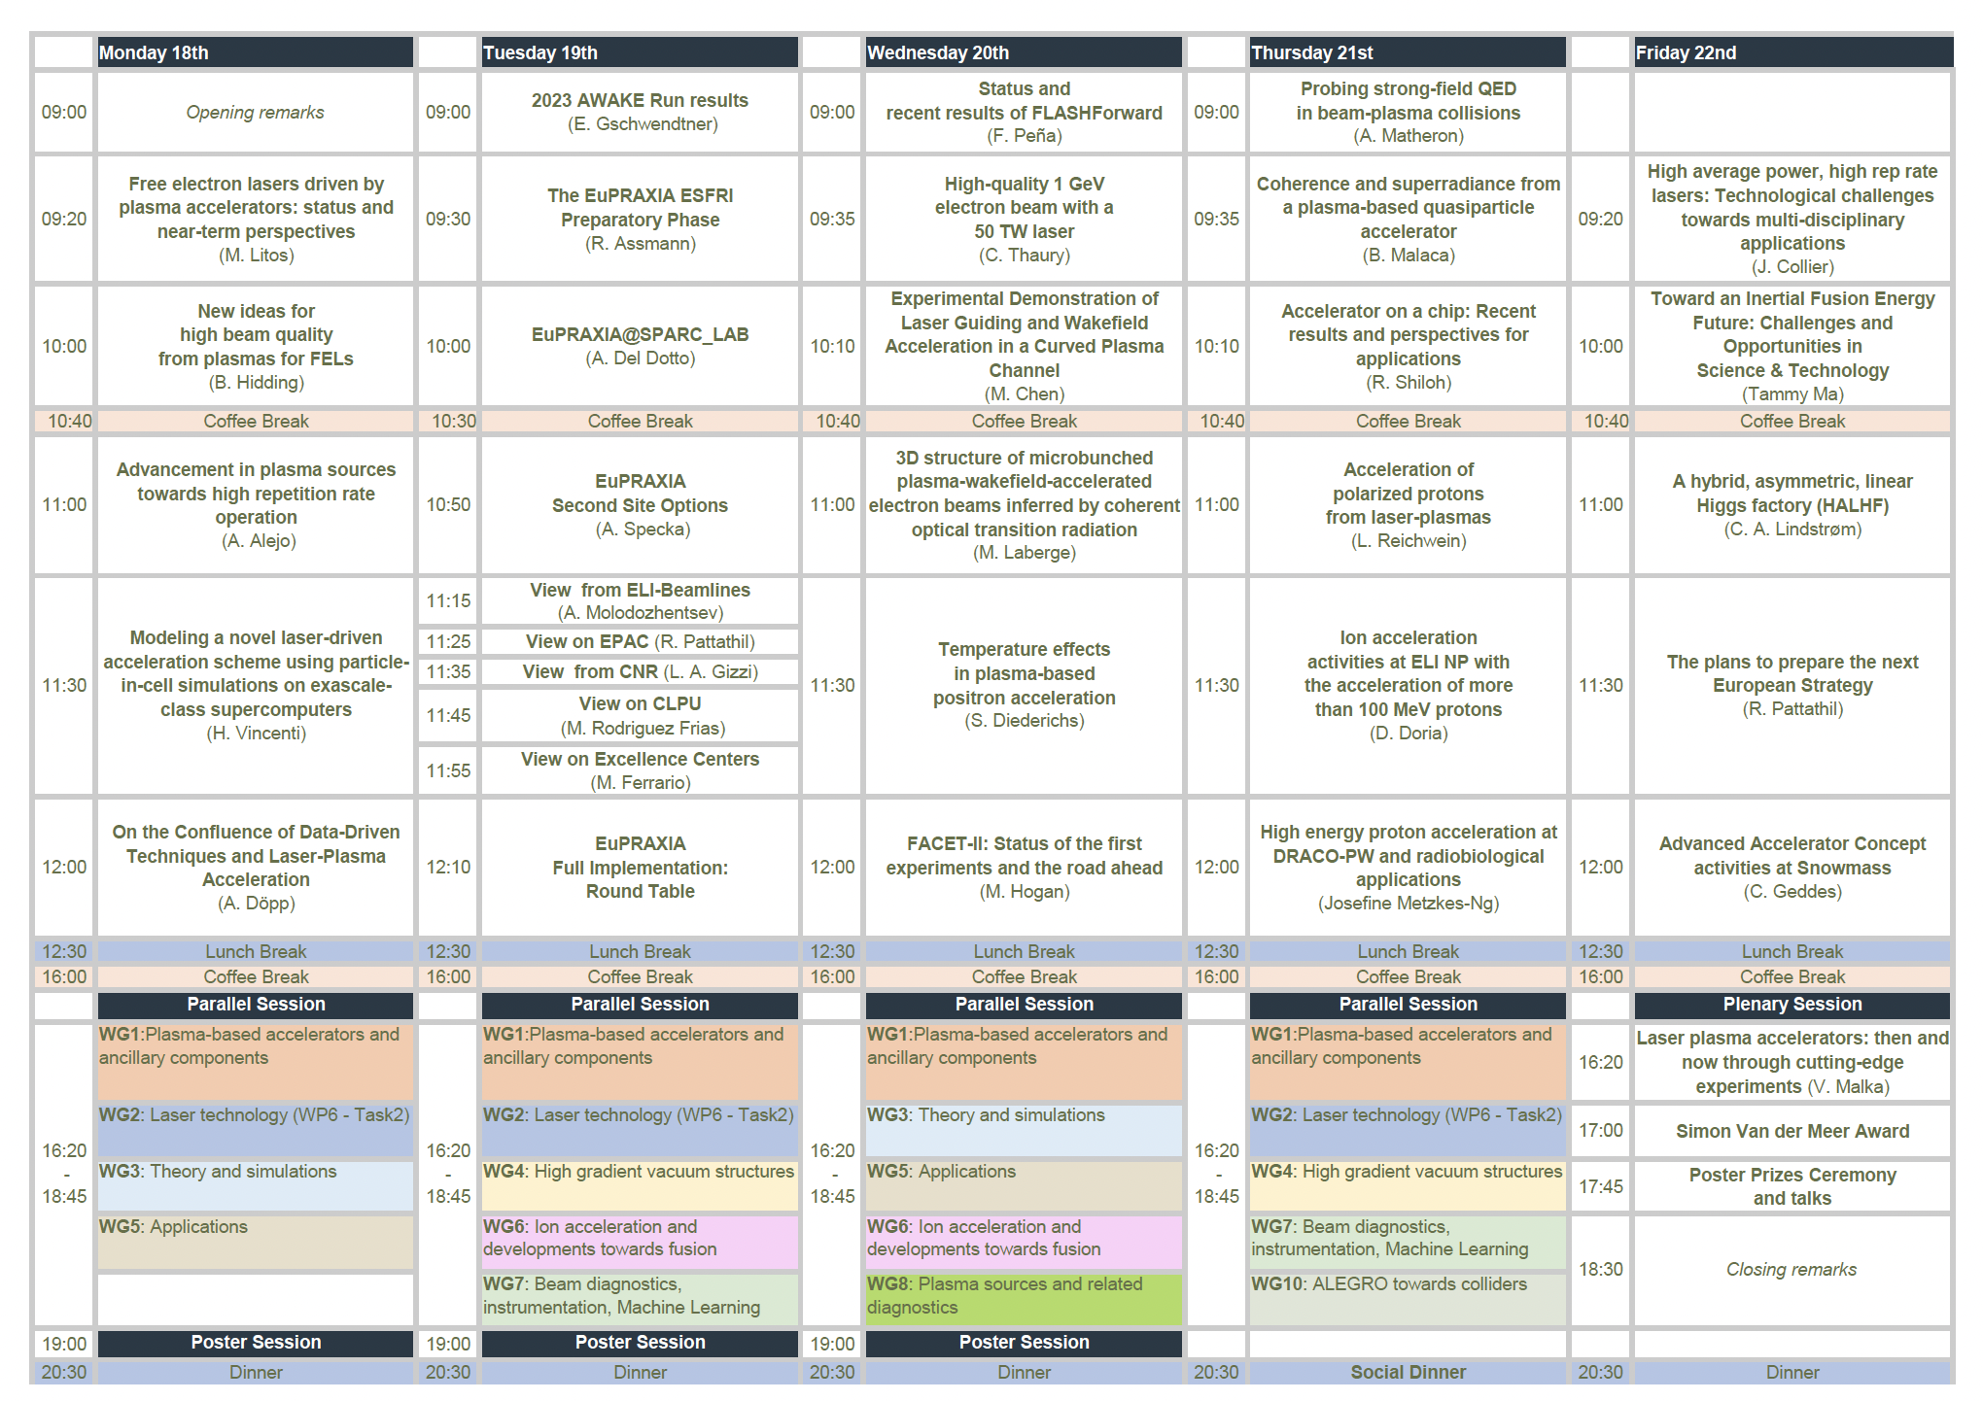
Programme Committee
Enrica Chiadroni,
(University of Roma, La Sapienza), Ralph Assmann (INFN & GSI), Massimo Ferrario (INFN), Angelo Biagioni (INFN) Marco Borghesi (Queens University) Sara Casalbuoni (EuXFEL) Min Chen (Shangai University) Gilles Cheriaux (CNRS) Brigitte Cros (Paris Saclay) Paul Crump (FBH-Berlin) Mariastefania De Vido (STFC) Andreas Doepp (LMU Munchen) Leonida A. Gizzi (INO-CNR) Bernhard Holzer (CERN) Rasmus Ischebeck (PSI) Malte Kaluza (Jena) Damien Minenna (CEA) Andrea Mostacci (Sapienza University) Rajeev Pattathil (STFC) Riccardo Pompili (INFN) James Rosenzweig (UCLA) Andrea Renato Rossi (INFN) Gianluca Sarri (QUB) Christophe Simon-Boisson (Thales) Arnd Specka (Ecole Polytechnique) Sami Tantawi (SLAC) Maxence Thevenet (DESY) Roman Walczak (JAI) Louise Willingale (Michigan University) Matthew Zepf (Jena Univ.)

Slide 6
Total contributions: 209
Plenary: 31 (5 short presentation in EuPRAXIA round table, 2nd sites + excellence centers)
Parallel: 112
WG1: 24
WG2: 19
WG3: 13
WG4: 9
WG5: 12
WG6: 12
WG7: 9
WG8: 7
WG10: 7
Poster participants: 31
Poster students: 35

Slide 7
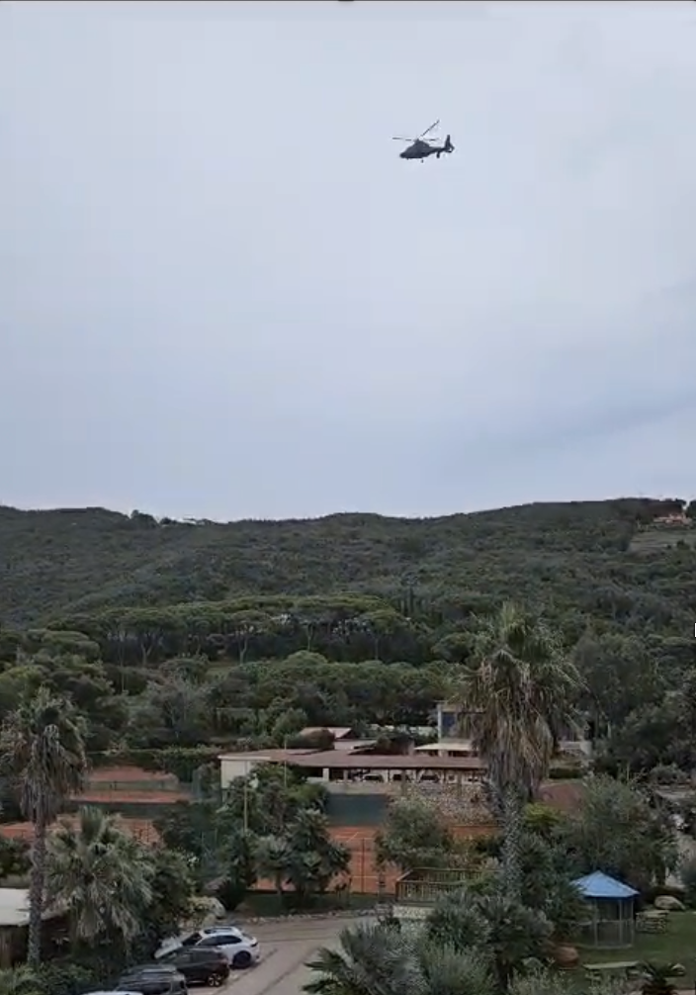
Many thanks Ralph for all what you did for EuPRAXIA!!
And see you soon !!
Fake News

Slide 8
Proceedings
Proceedings will be published in Journal of Physics: Conference Series
There manuscripts will undergo a peer review
The proceedings will be available under Open Access
Submission deadline: one month from now, i.e. October 23
All recipients of the Student Grant are expected to submit a manuscript
We will ask you to review papers
Rasmus Ischebeck

Slide 9
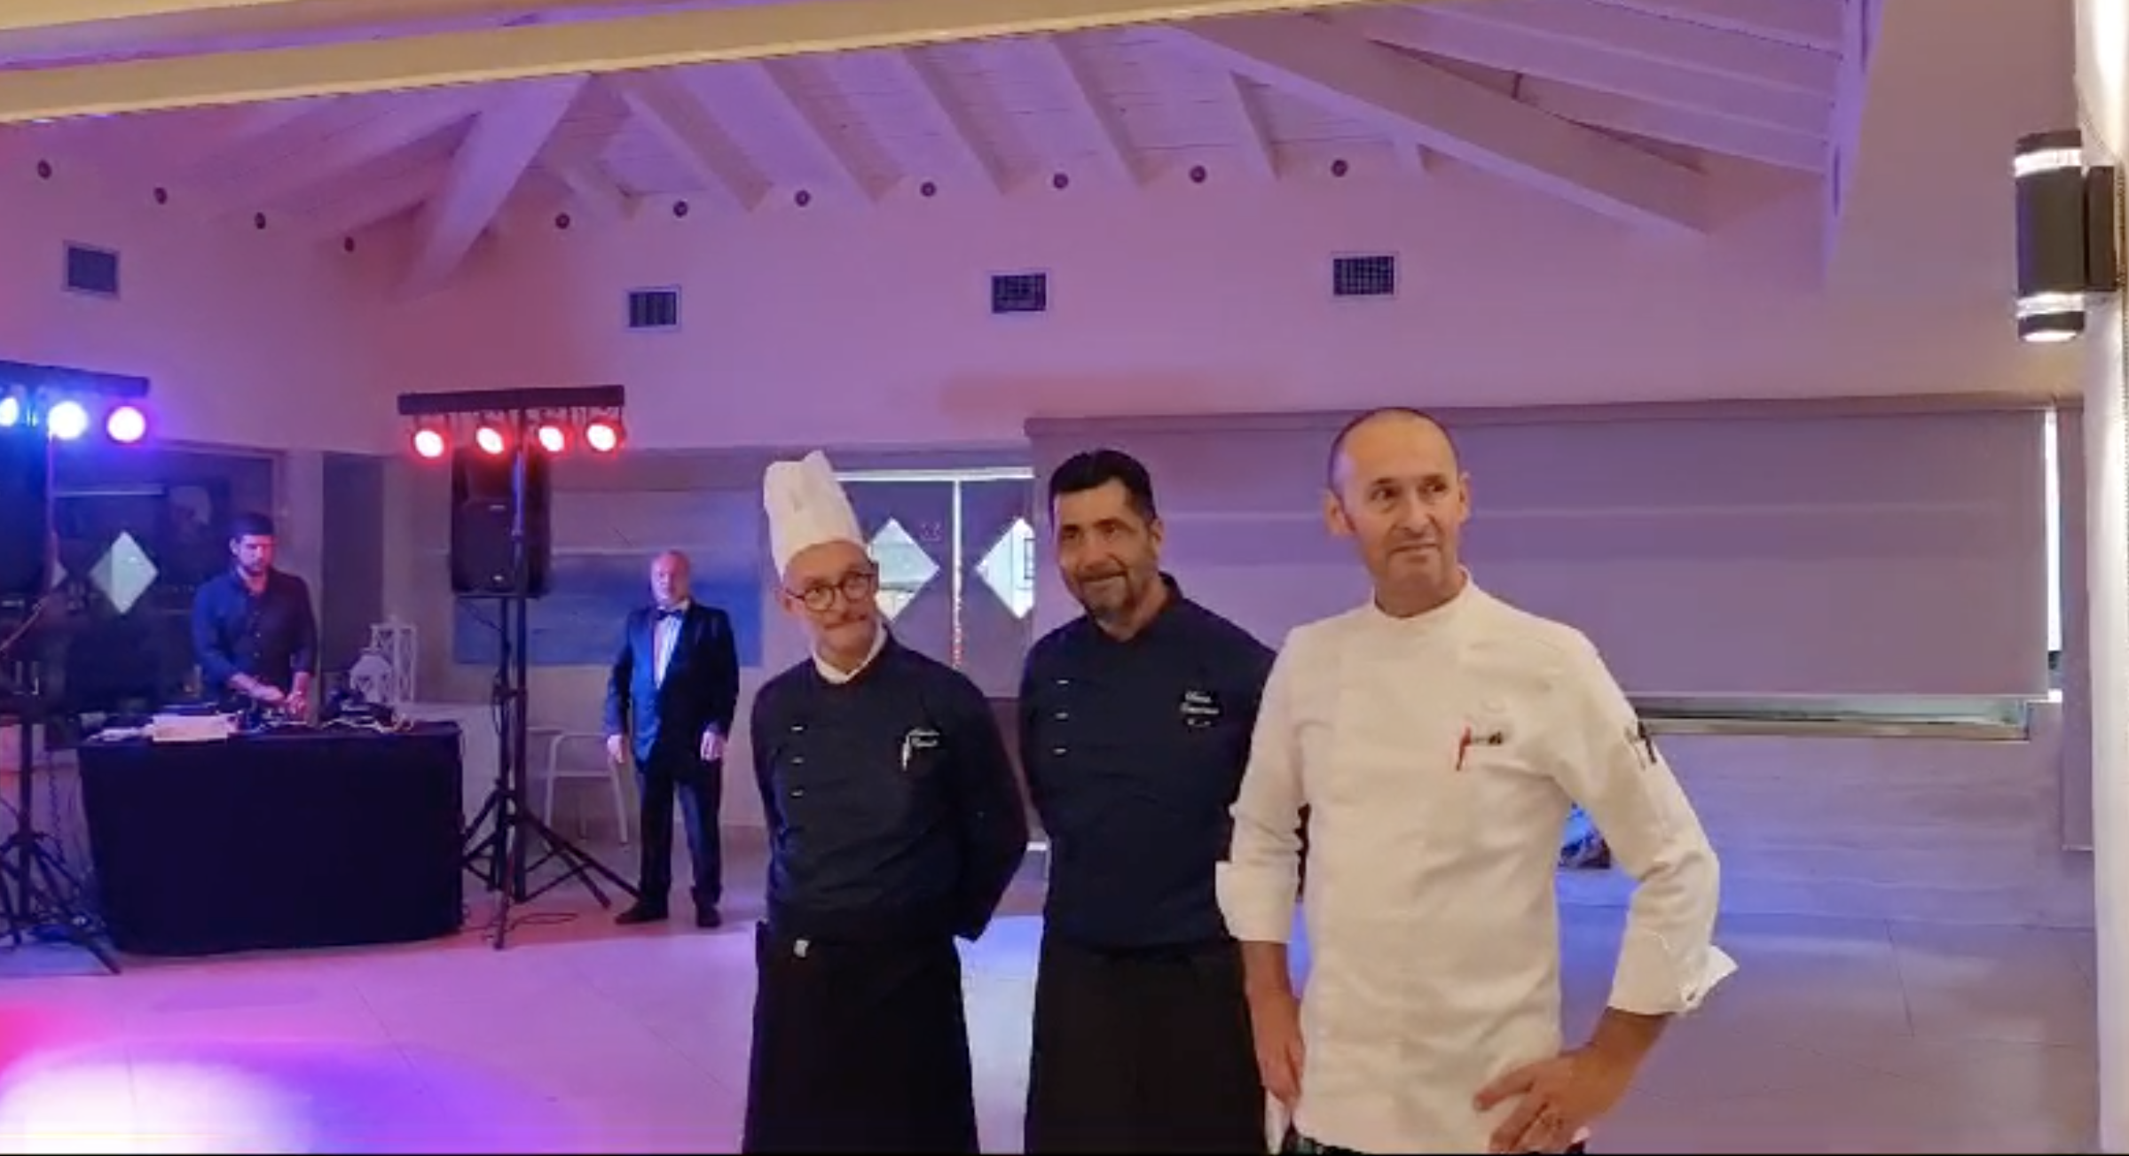
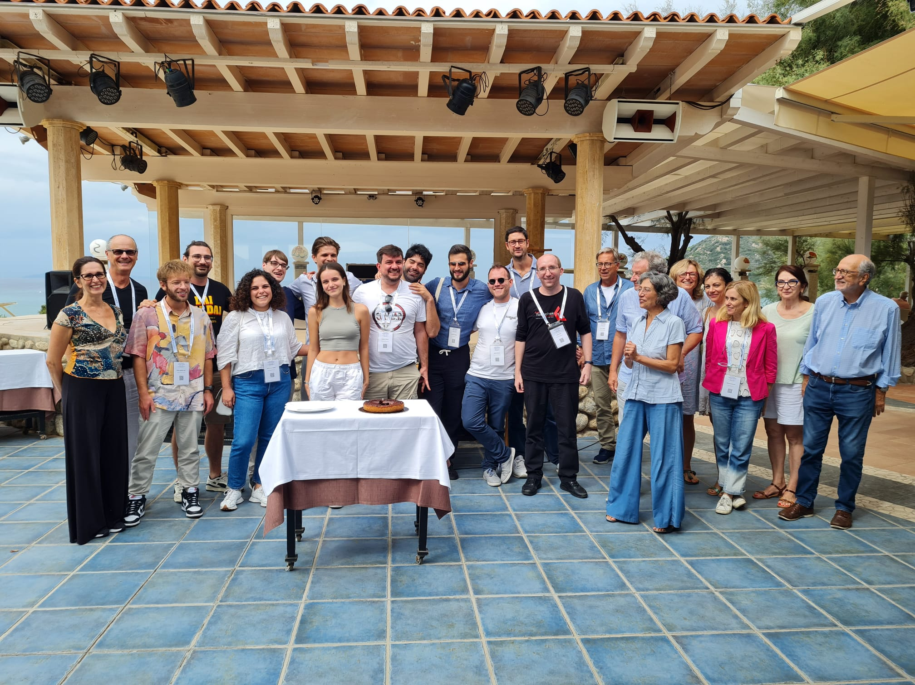
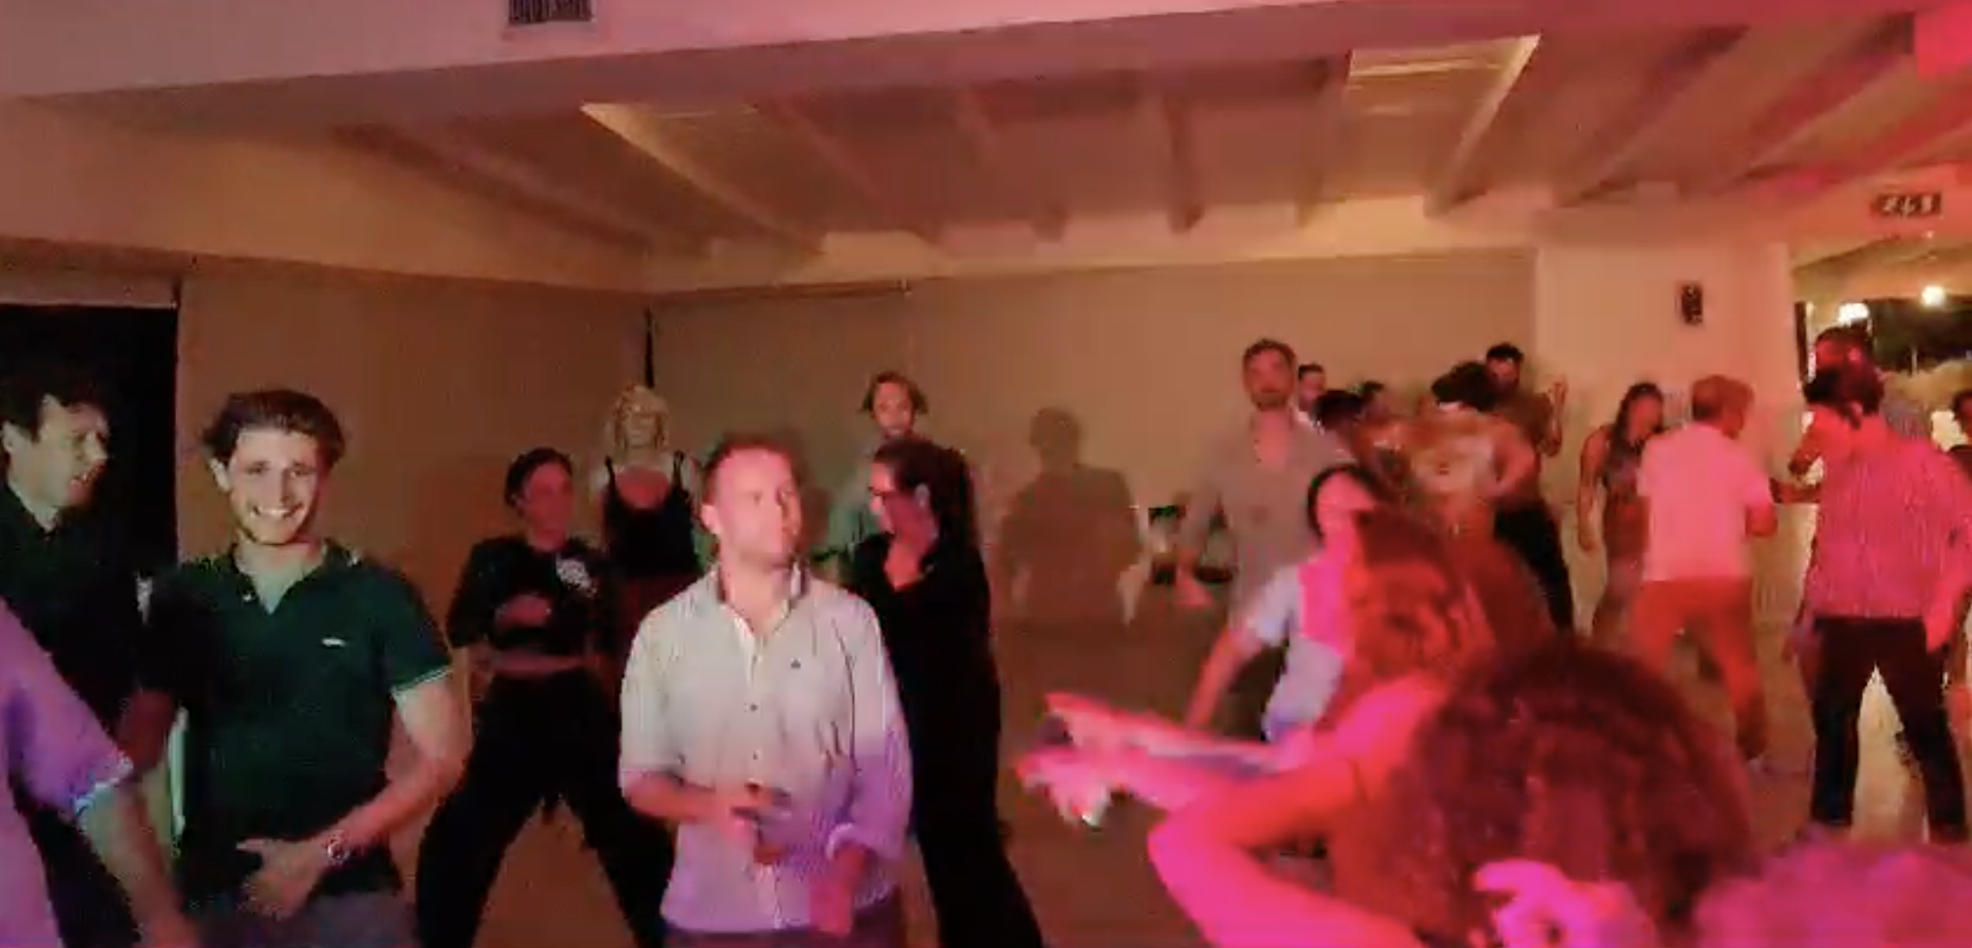
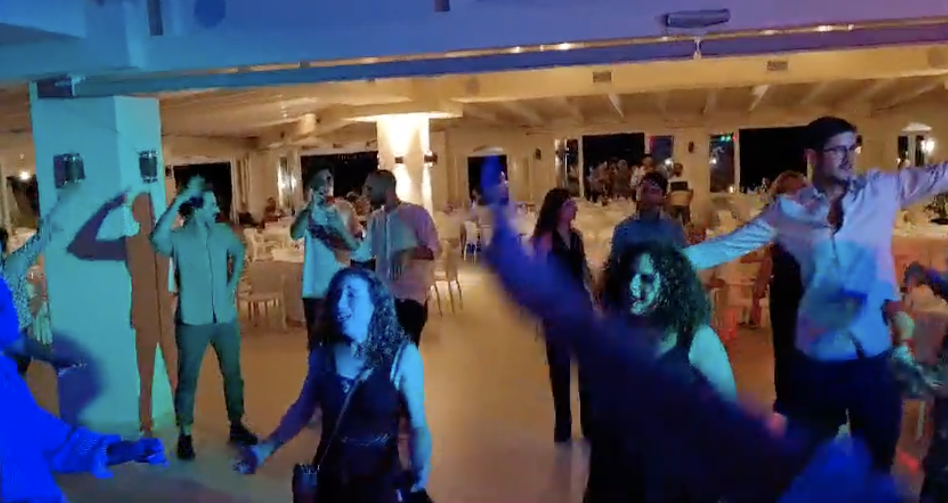

Slide 10
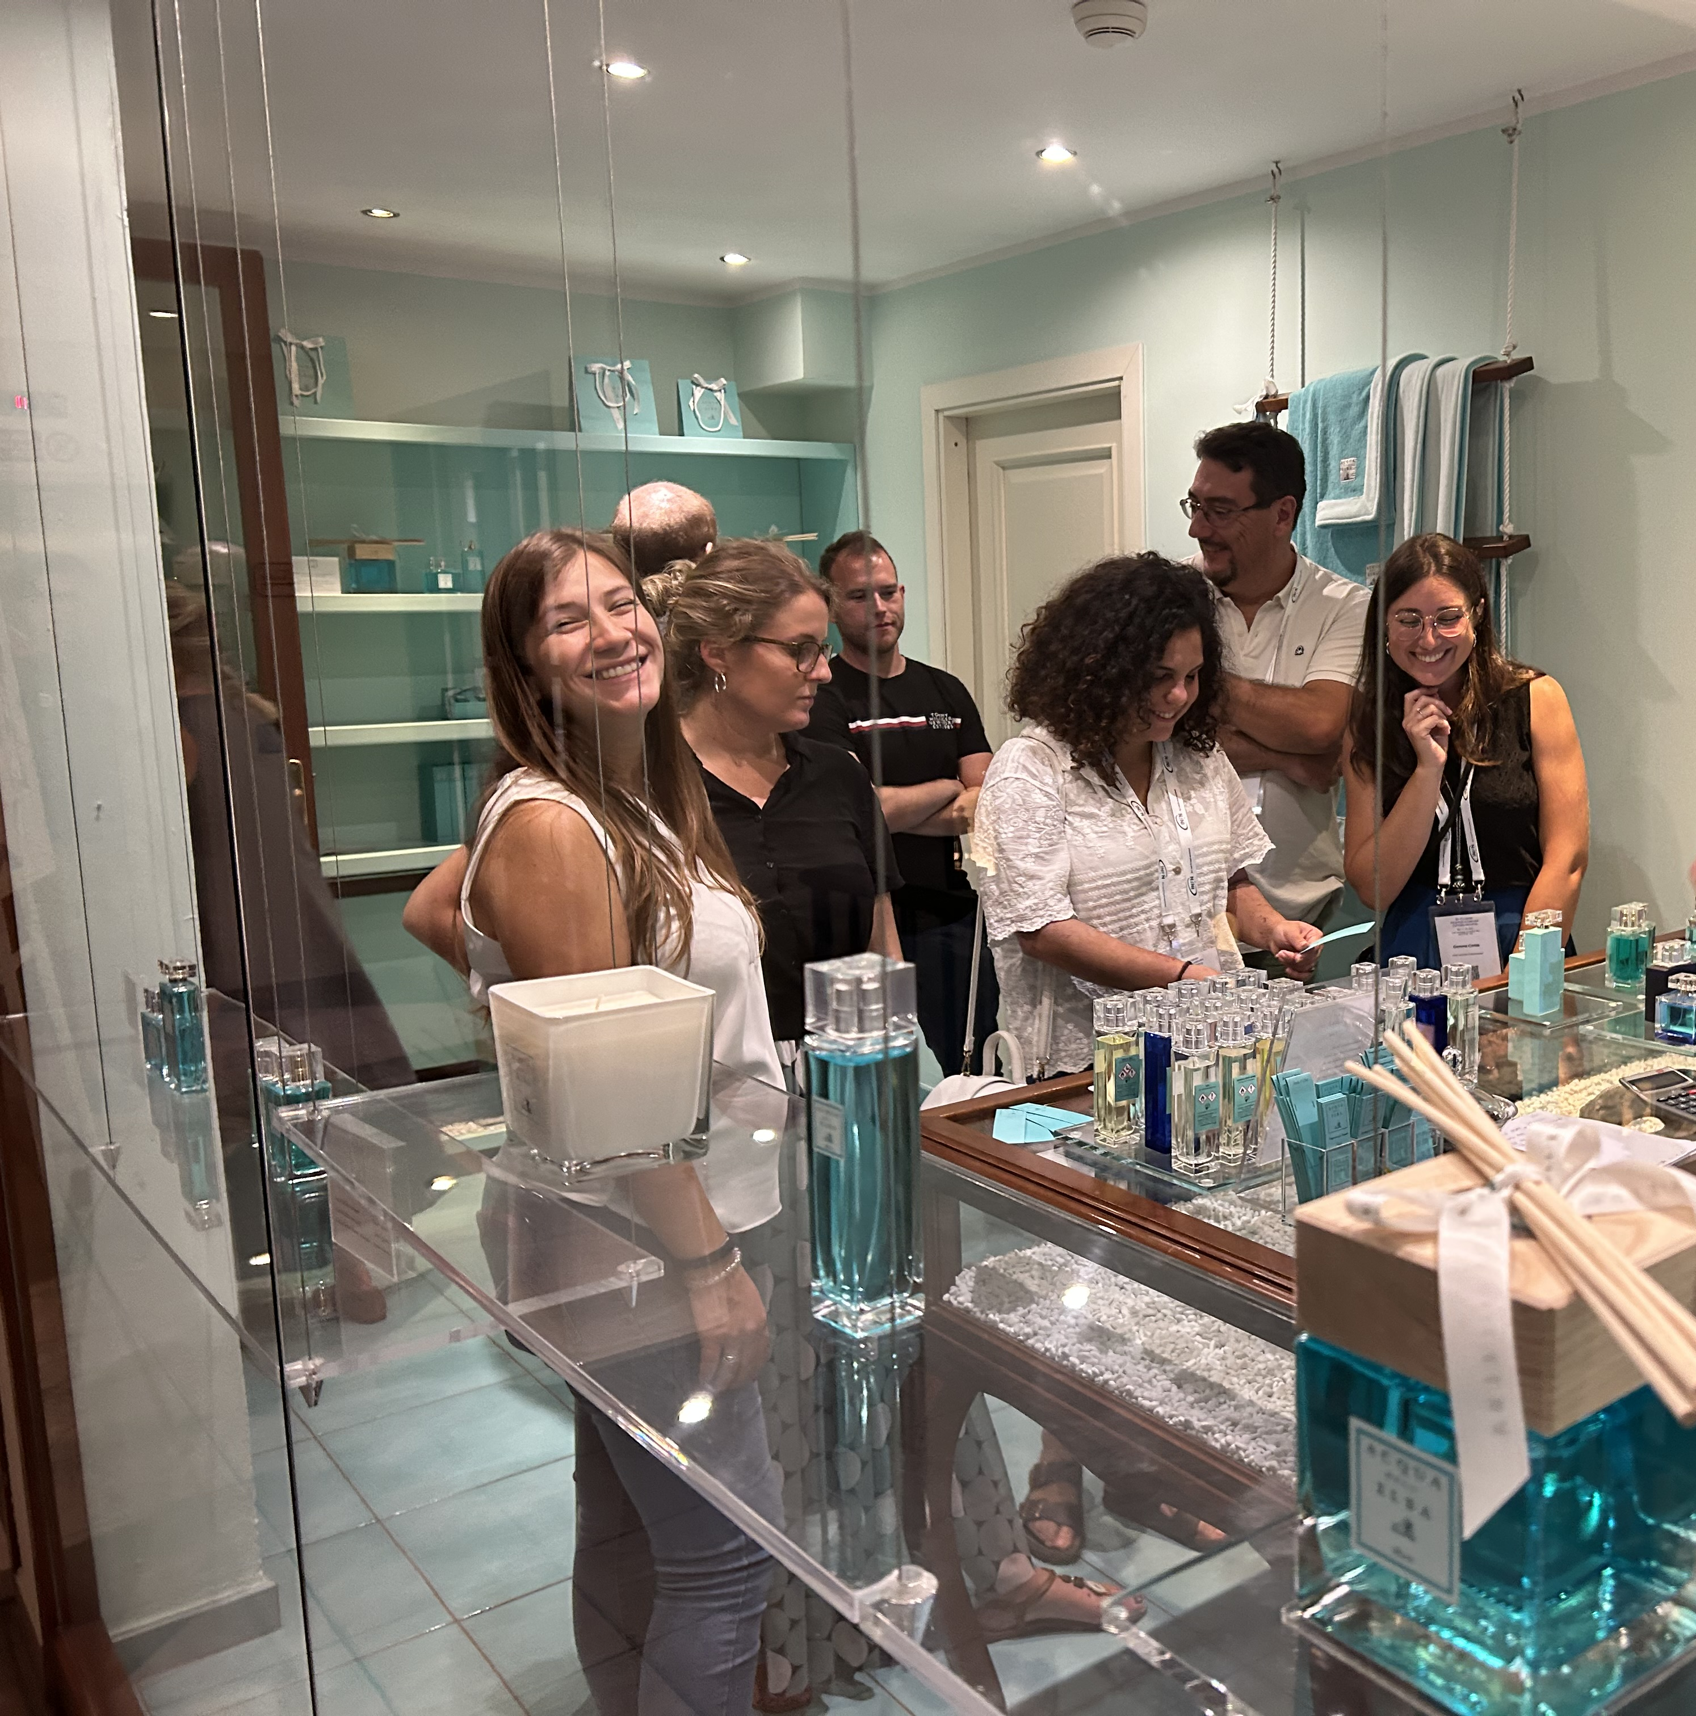
Local Organizing Committee
Gemma Costa (INFN - LNF, Italy) Lucio Crincoli (INFN - LNF, Italy) Martina Del Giorno (INFN - LNF, Italy) Maurizio Garzella (INFN - Pisa, Italy)
Nicola Giannini (INFN - Pisa, Italy) Lucia Lilli (INFN - Pisa, Italy) Gabriele Lo Re (INFN - Pisa, Italy) Andrea Quattrini (INFN - LNF, Italy) Valeria Rosicarelli (INFN - LNF, Italy) Fabio Villa (INFN - LNF, Italy) Giulia Vinicola (INFN - LNF, Italy

Slide 11
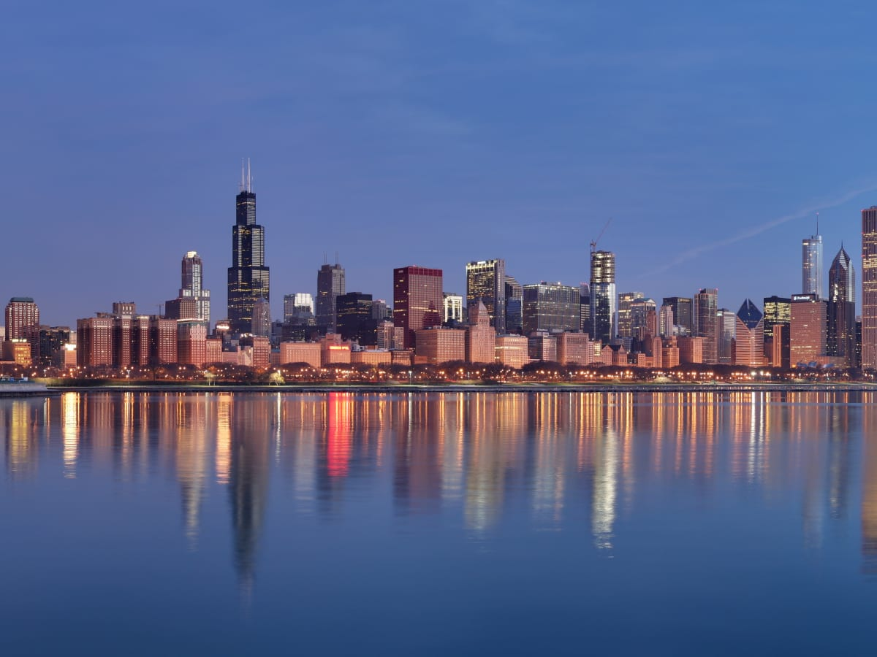
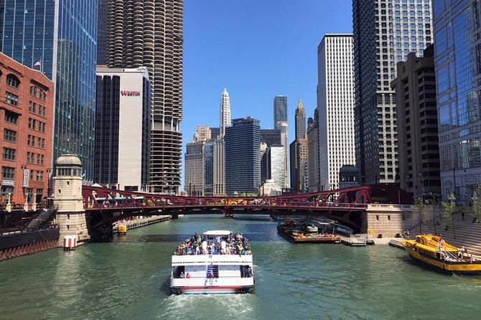
Join us in Chicagoland
summer of 2024
Chicago
Architectural Boat Tour
Jul 21 – 26, 2024
NIU Naperville Conference Center
https://indico.fnal.gov/event/59618/
Birthplace of the skyscraper

Slide 12
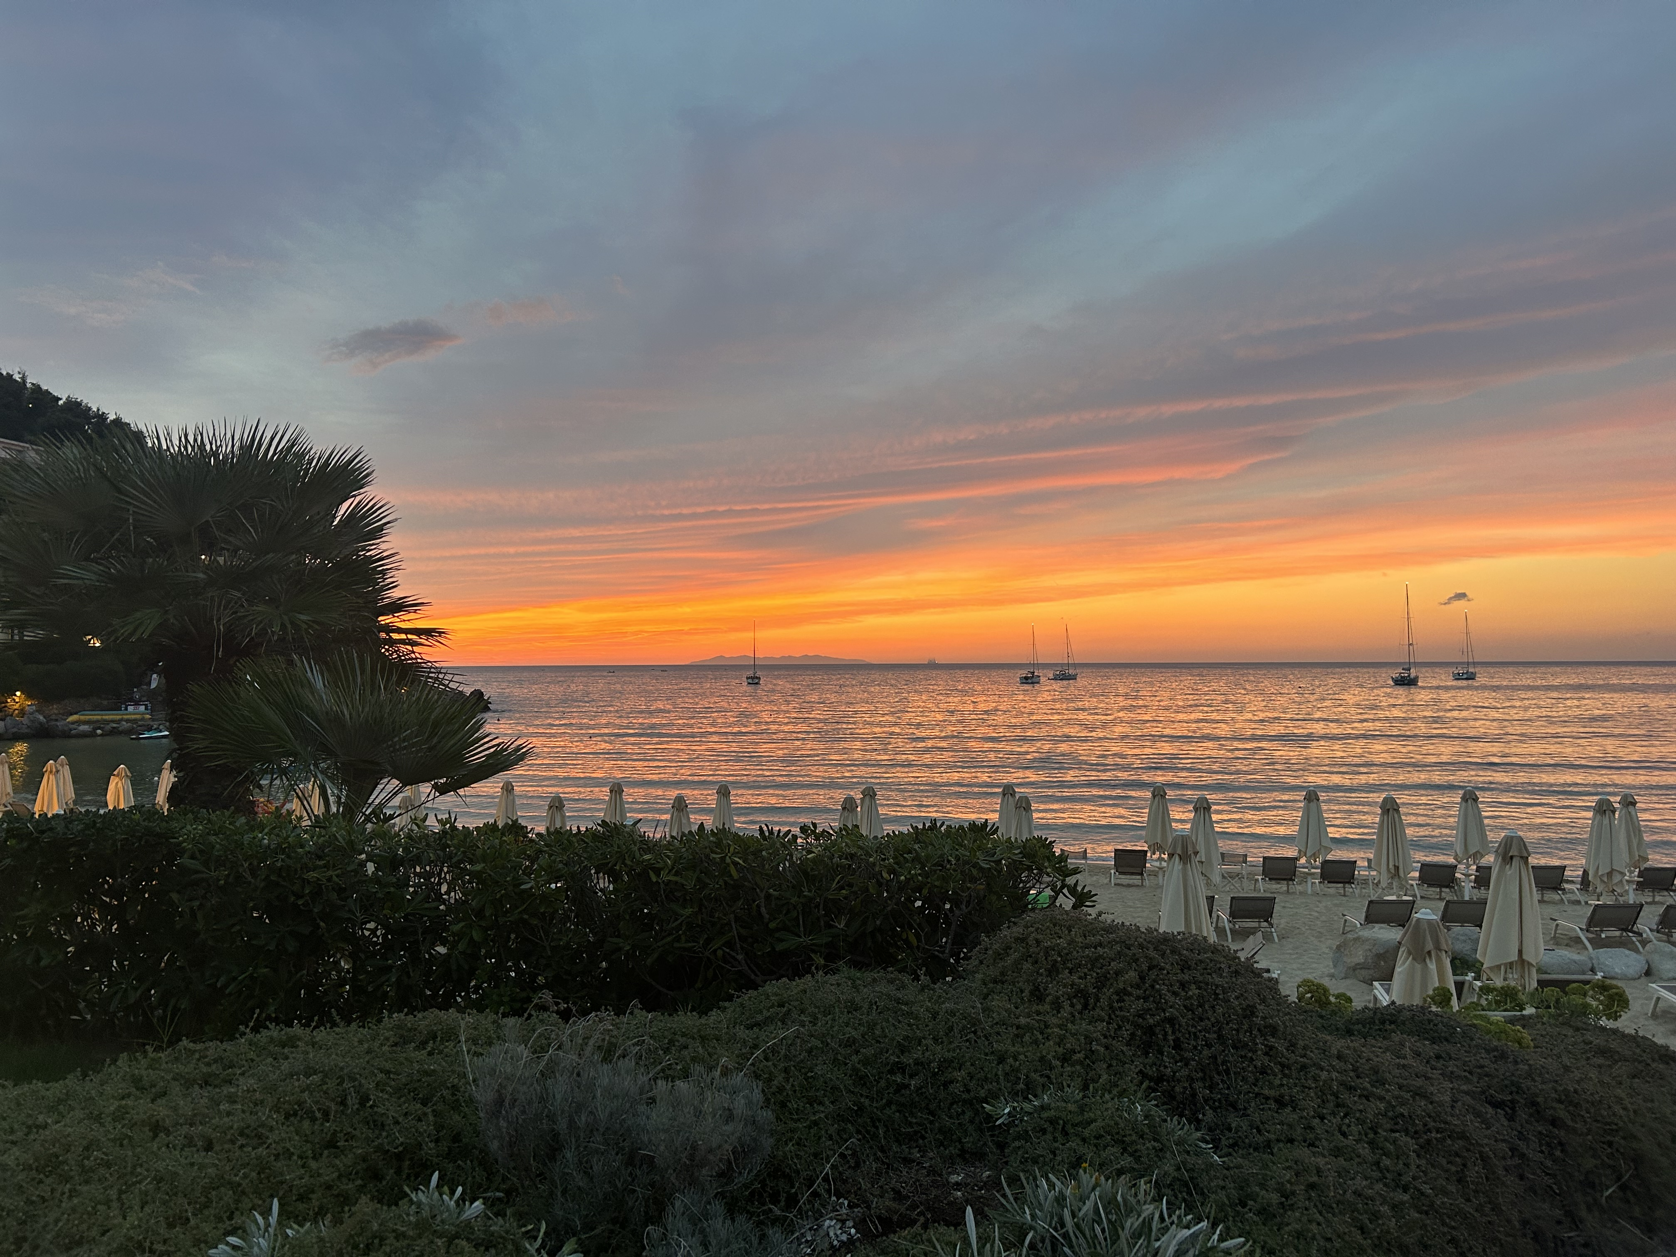
Looking forward to seeing you all at EAAC 2025!

