Slide 1
Welcome to EAAC 2023
Ralph Assmann (GSI, DESY until 31.8.2023) Massimo Ferrario (INFN)
18.9.2023

Slide 2
IFAST = Innovation Fostering in Accelerator Science and Technology
EU Project May 2021 – April 2025, Coordinator M. Vretenar
WP6: Novel Particle Accelerators Concepts and Technologies
Contains European Network for Novel Accelerators (EuroNNAc4) = Sponsor of EAAC

Slide 3
Tasks of WP6 – Novel Particle Accelerators Concepts and Technologies
Task 1 (RA + M. Ferrario): Novel Particle Accelerators Concepts and Technologies (NPACT – EuroNNAc4) M1 – M48 Sub-task leaders: B. Holzer (CERN), D. Minenna (CEA), A. Specka (CNRS), R. Walczak (Oxford) → Many thanks to Phi Nghiem from CEA who retired since the EAAC21! → Welcome to Damien Minenna from CEA!
Task 2 (Leo Gizzi): Lasers for Plasma Acceleration (LASPLA) M1 – M48
Task 3 (Cedric Thaury): Multi-scale Innovative targets for laser-plasma accelerators (MILPAT) M1 – M32
Task 4 (Francois Mathieu): Laser focal Spot Stabilization Systems (L3S) M1 – M36

Slide 4
Tasks of WP6 – Novel Particle Accelerators Concepts and Technologies
Task 1 (RA + M. Ferrario): Novel Particle Accelerators Concepts and Technologies (NPACT – EuroNNAc4) M1 – M48 Sub-task leaders: B. Holzer (CERN), D. Minenna (CEA), A. Specka (CNRS), R. Walczak (Oxford) → Many thanks to Phi Nghiem from CEA who retired since the EAAC21! → Welcome to Damien Minenna from CEA!
Task 2 (Leo Gizzi): Lasers for Plasma Acceleration (LASPLA) M1 – M48
Task 3 (Cedric Thaury): Multi-scale Innovative targets for laser-plasma accelerators (MILPAT) M1 – M32
Task 4 (Francois Mathieu): Laser focal Spot Stabilization Systems (L3S) M1 – M36
THANKS to Rasmus Ischebeck from PSI for acting as co-editor of EAAC 2023 proceedings with Damien!

Slide 5
EAAC is an iFAST/EuroNNAc Deliverable
We provide funding to the EAAC workshop, in particular rooms, proceedings, student grants, van der Meer prize award, … (about 350,000 € since 2013, the first EAAC)
PLEASE acknowlege EU funding support on posters, papers, … (see acknowledgement on my title slide)

Slide 6
Changes for EAAC Ahead
EAAC 2023 is the last EAAC that is sponsored by EuroNNAc/iFAST, which will end its project lifespan by Spring 2025.
So far we financed the European Network for Novel Accelerators (EuroNNAc) through the CERN coordinated EuCARD, EuCARD2, ARIES, iFAST projects with EU funding
EuroNNAc future beyond 2025 to be defined (founded in 2011 at CERN by RA), including EU sponsoring for EAAC → EAAC 2025 !?
RA left DESY end of August 23, now in charge of GSI „Accelerator Operation and Development“ area. Focus work back on RF accelerator infrastructure, possibly staying connected through Frankfurt Goethe University research group.

Slide 7
Outlook to AAC 2024
Please save the date!
https://indico.fnal.gov/event/59618/

Slide 8
EAAC 2023 → Back at Elba, fully in person!
Remember 2021…

Slide 9
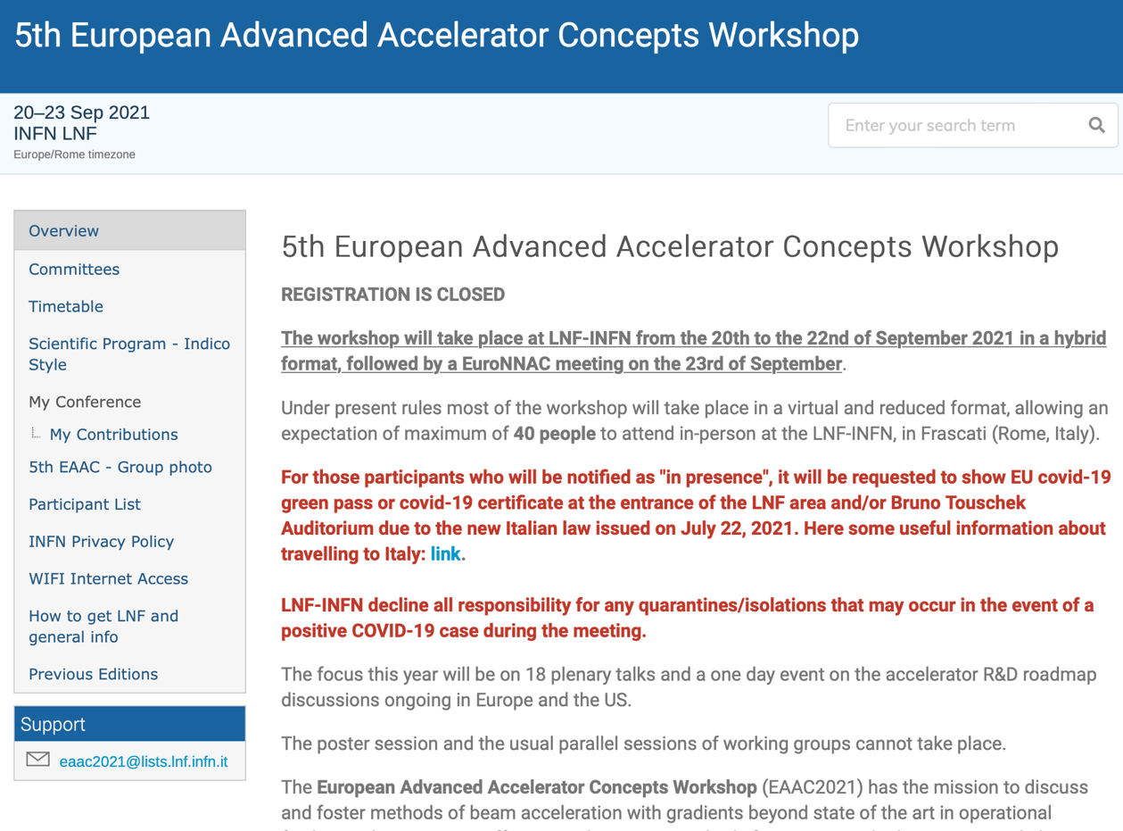
EAAC Workshop 2021 European Advanced Accelerator Concepts Workshop 5th Edition
Hybrid

Slide 10
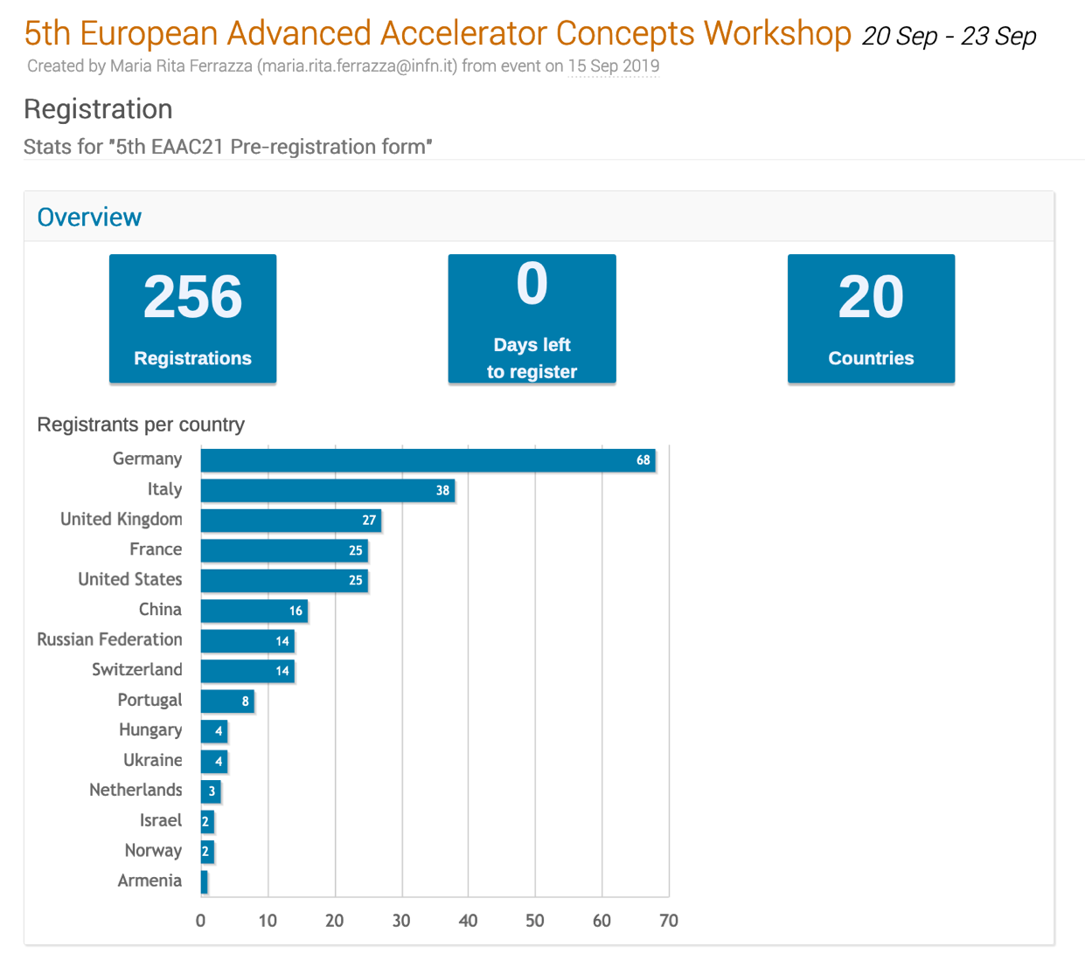
EAAC Workshop 2021 European Advanced Accelerator Concepts Workshop 5th Edition
Hybrid

Slide 11
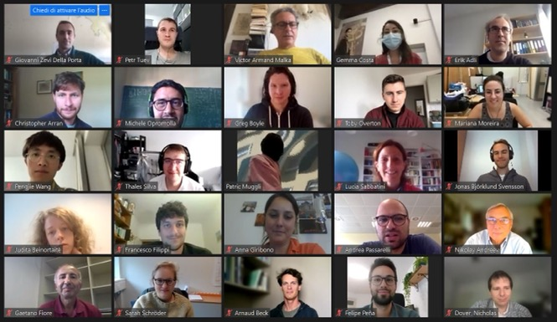
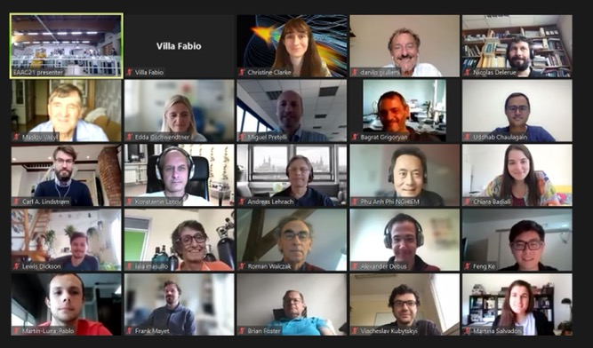
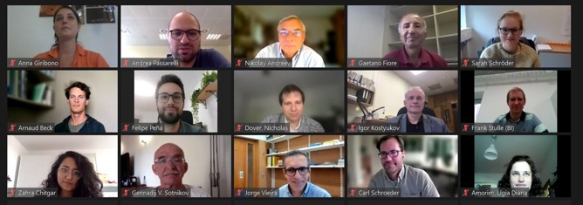
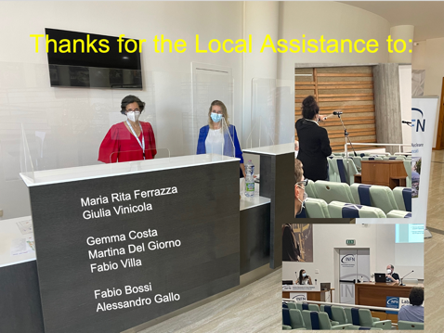
EAAC Workshop 2021 European Advanced Accelerator Concepts Workshop 5th Edition
Hybrid

Slide 12
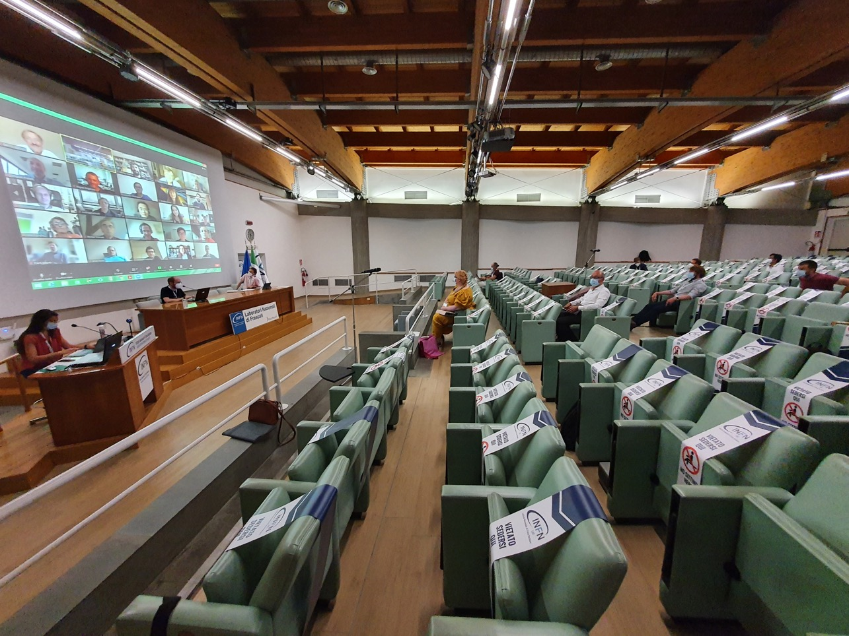
EAAC Workshop 2021 European Advanced Accelerator Concepts Workshop 5th Edition
Hybrid

Slide 14
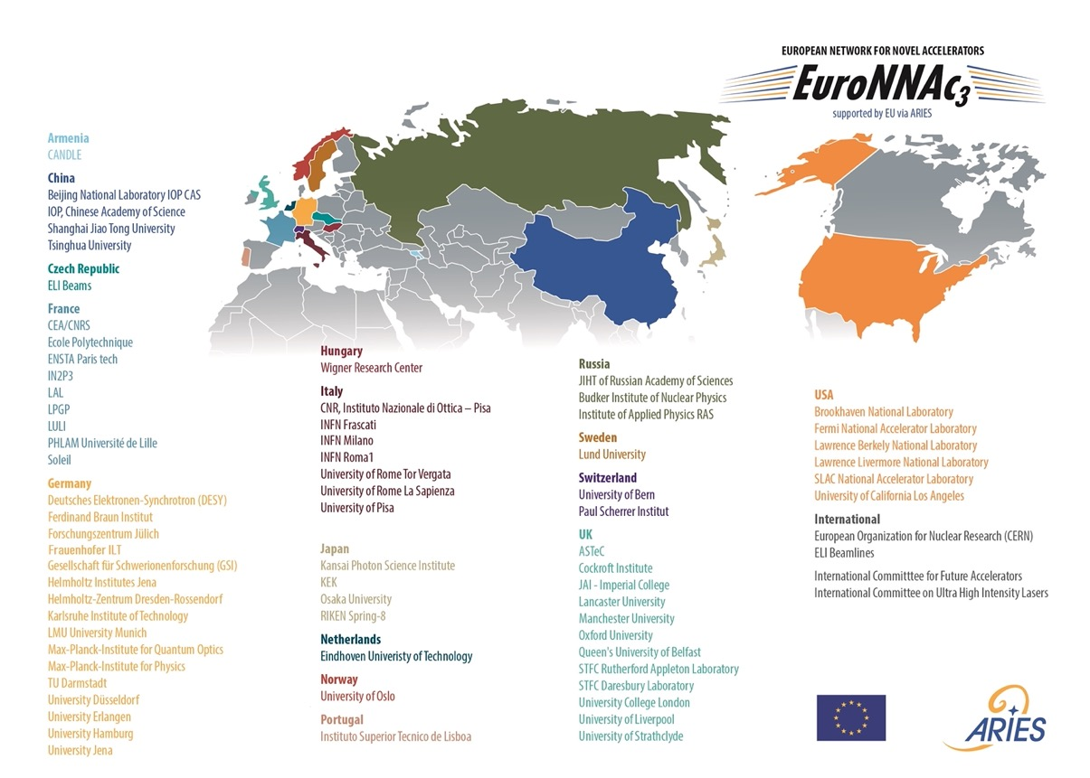
EuroNNAc → International Advisory Committee IAC for EAAC23

Slide 15
IAC EAAC23
International Advisory Committee
Erik Adli (University of Oslo) Marco Borghesi (QUB) Markus Büscher (Jülich, Forschungszentrum) Min Chen (SJTU) Alessandro Cianchi (Tor Vergata University of Rome) Jim Clarke (STFC UKRI) Laura Corner (University of Liverpool) Marie-Emmanuelle Couprie (SOLEIL) Brigitte Cros (LPGP CNRS Université Paris Saclay) Thomas Feurer (University of Bern) Cameron Geddes (Lawrence Berkeley National Laboratory) Danilo Giulietti (INFN) Leonida Antonio Gizzi (CNR) Edda Gschwendtner (CERN) Constantin Häfner (Fraunhofer ILT) Bjorn Manuel Hegelich (University of Texas) Mark Hogan (SLAC) Bernhard Holzer, (CERN) Peter Hommelhoff (FAU) Tomonao Hosokai (University of Osaka)
Arie Irman (HZDR) Rasmus Ischebeck (PSI) Chan Joshi (UCLA) Malte Christoph Kaluza (University of Jena)
Stefan Karsch (University of Munich) Andreas Lehrach (RWTH Aachen University) Yutong Li (Institute of Physics, Chinese Academy of Sciences) Vladimir N Litvinenko (Stony Brook University)
Wei Lu (Tsinghua University) Andreas Maier (DESY) Victor Malka (Weizmann Institute of Science) Philippe Martin (CEA) Howard Milchberg (University of Maryland) Damien Minenna (CEA) Catalin Miron (CEA Paris-Saclay) Andrea Mostacci (La Sapienza University of Rome) Zulfikar Najmudin (Imperial College London) Jens Osterhoff (DESY) Rajeev Pattathil (STFC) Alexander Pukhov (Heinrich Heine University Düsseldorf) Andrea Renato Rossi (INFN) Gianluca Sarri (QUB) Ulrich Schramm (HZDR) Carl B. Schroeder (LBNL) Zheng-Ming Sheng (Shanghai Jiao Tong University) Arnd Specka (LLR) Hyyong Suk (GIST) Daniel Symes (STFC) Toshiki Tajima (University of California at Irvine) Jorge Vieira (University of Lisbon) Roman Walczak (University of Oxford) Louise Willingale (University of Michigan) Arie Zigler (Hebrew University of Jerusalem)

Slide 16
10 Years EAAC → Forza EAAC 2023!
Warm welcome on behalf of the organizers, the EuroNNAc network and the iFAST management!
Enjoy EAAC 2023!

Slide 17
Great applause for Enrica Chiadroni
→
The outstanding program committee chair of this EAAC
and chair of first session…

