Slide 1



Toward start-to-end modeling
of plasma-based colliders
with the Exascale
Particle-In-Cell code WarpX
Jean-Luc Vay
Lawrence Berkeley National Laboratory
On behalf of the WarpX team
LBNL, LLNL, SLAC
6th European Advanced Accelerator Concepts workshop (EAAC2023)
Hotel Hermitage, La Biodola Bay, Isola d'Elba, Italy
September 17-23, 2023
+ contributors external to ECP from labs,
universities & industry in USA, Europe & Asia
AM

Slide 2
Outline
US DOE Exascale Computing Project (ECP) & WarpX
Modeling of sources
Modeling of chains of stages
Modeling of the interaction point
Stitching it altogether
Outlook: toward a community ecosystem

Slide 3
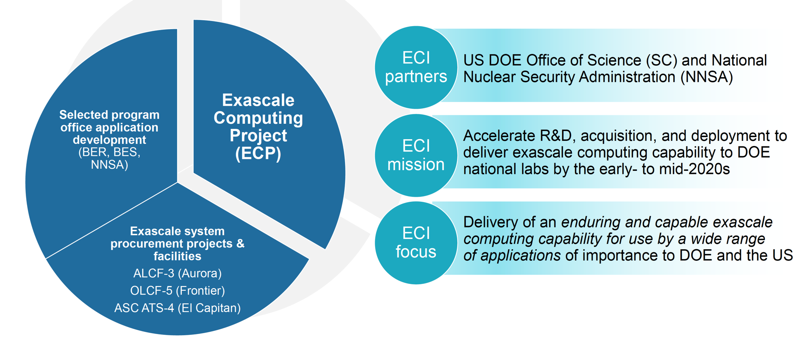
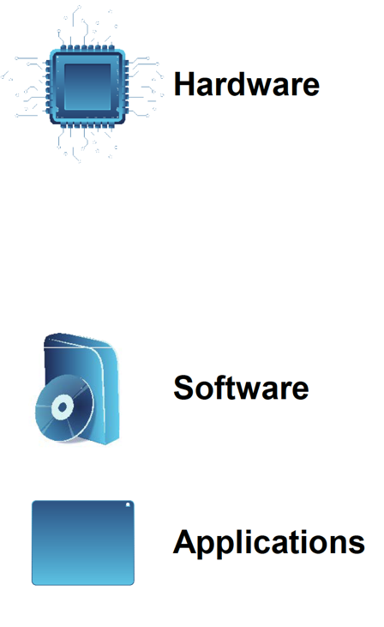


U.S. DOE Exascale Computing Initiative (ECI) – 2016-2023
Exascale Computing Initiative
Delivers 5x performance of 200 petaflop Summit (ORNL)
Software stack for broad spectrum of apps & workloads
Wide range of apps that deliver high-fidelity solutions faster to more complex problems
D. Kothe – April 30, 2019

Slide 4
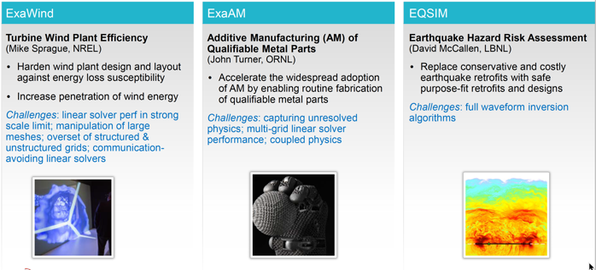
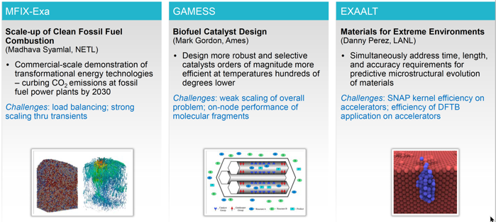
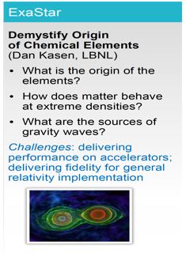
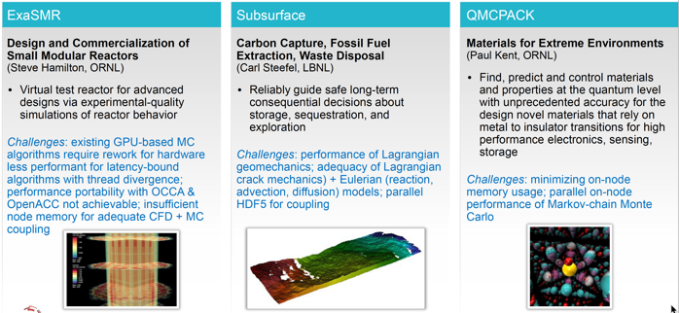
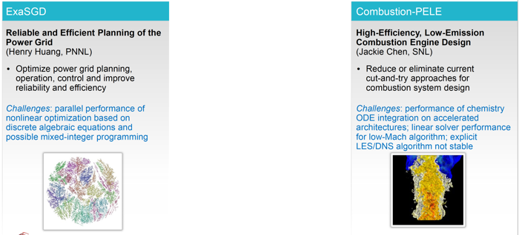
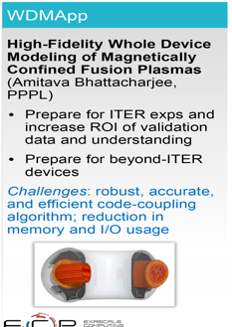
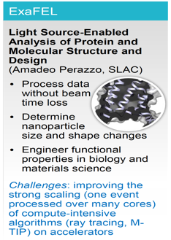
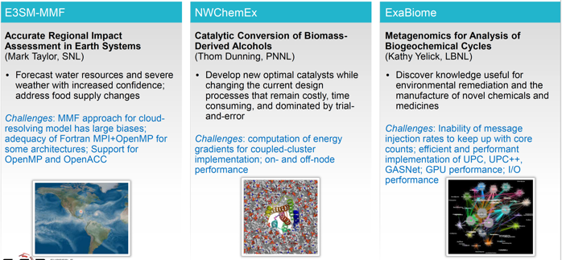
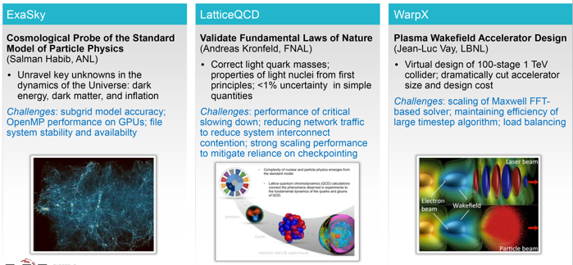
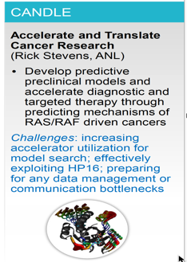
WarpX among 21 applications selected to cover broad range of science

Slide 5
Challenge of the ECP WarpX Project:
Go from modeling 1 or 2 plasma stages
to tens of stages
in 3D from first principles
Particle-In-Cell on fastest/largest supercomputers
with advanced algorithms

Slide 6
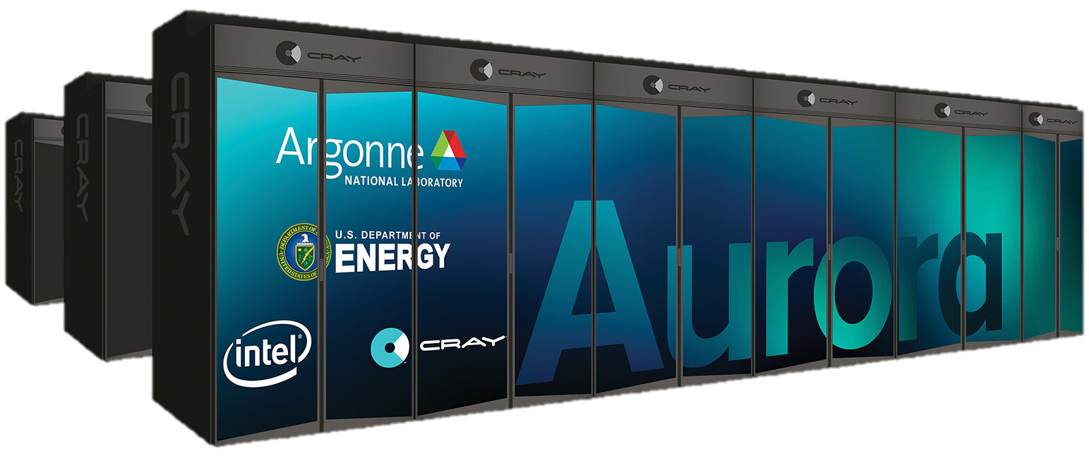

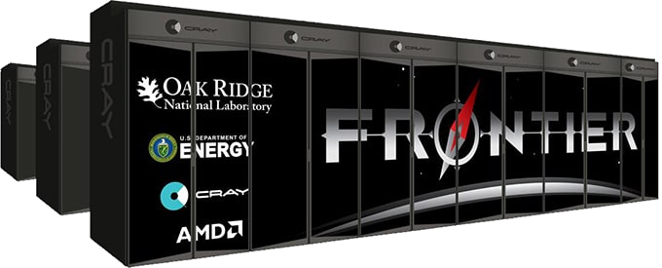
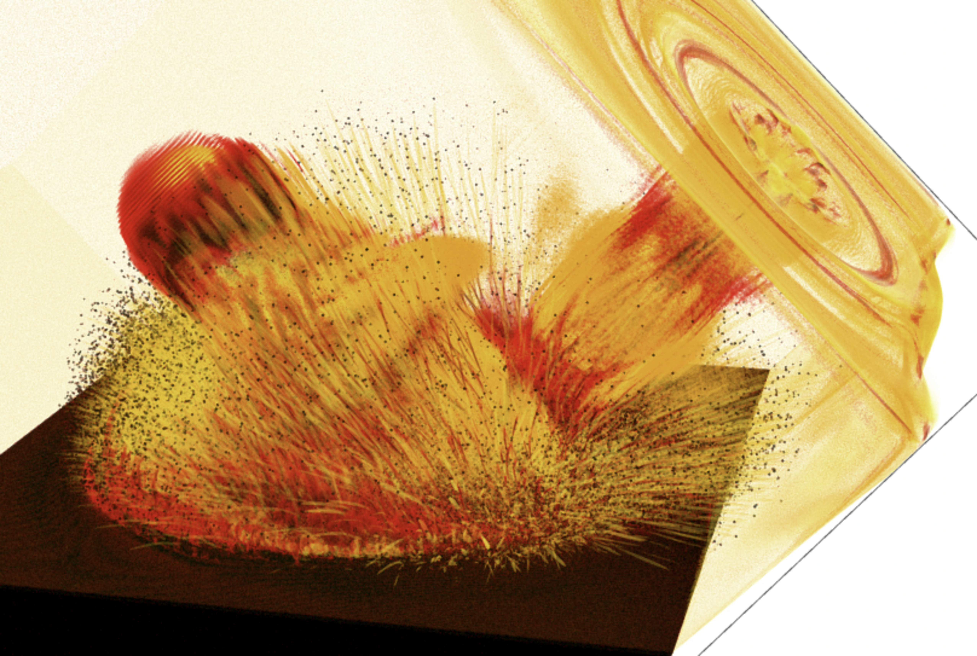
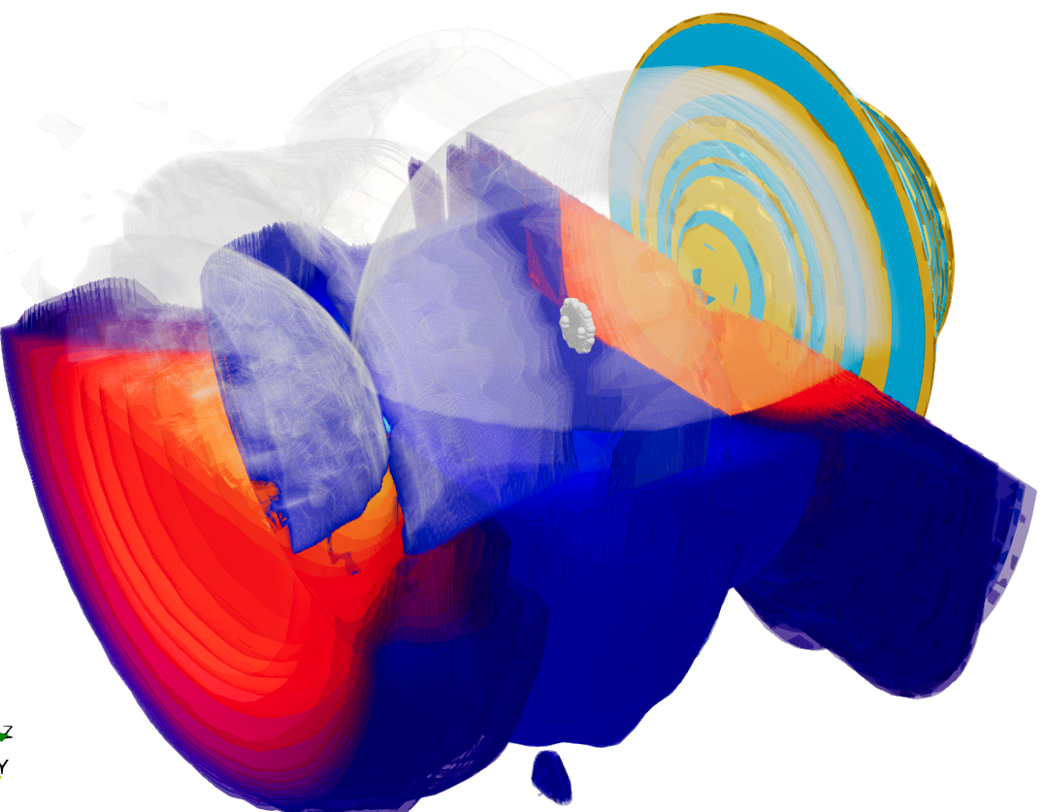
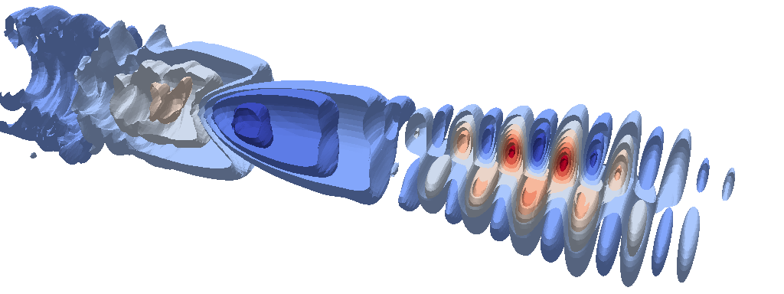
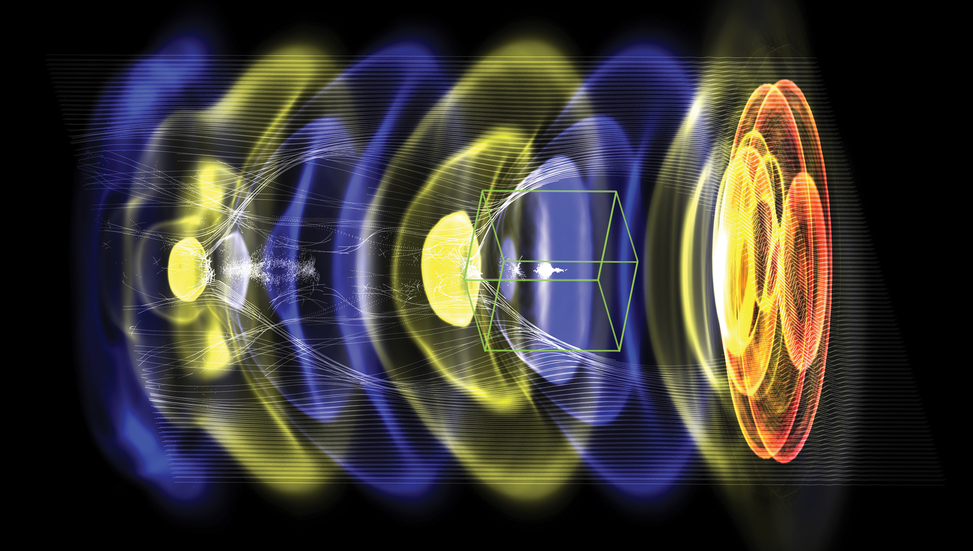

Timeline for Exascale project WarpX
From initial code coupling to ensemble of chains of multi GeV-scale stages
Original
2030 -
Collider designs
Modeling of chain of 50-100 multi-GeV-scale plasma accelerator stages
2023
Modeling chain of 20-50 multi-GeV-scale plasma accelerator stages
2022
Modeling chain of 10-20 multi-GeV-scale plasma accelerator stages
2021
Modeling chain of 5-10 multi-GeV-scale plasma accelerator stages
2020
2019
Modeling chain of 3 multi-GeV-scale plasma accelerator stages
2018
Modeling a single multi-GeV-scale plasma accelerator stage
2017
Modeling of single plasma accelerator stage with static mesh refinement
2016
Initial coupling of AMReX and Warp/PICSAR
Notes:
Instructions:
Summarize milestone-based plan for next 3 years

Slide 7
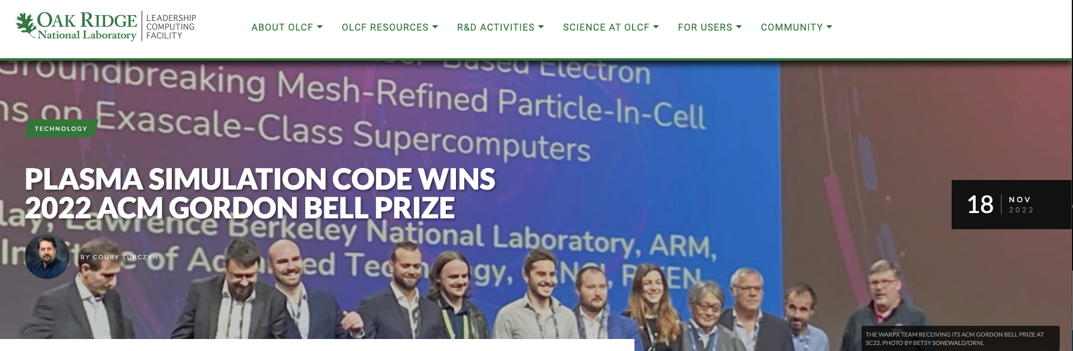
Timeline for Exascale project WarpX
From initial code coupling to ensemble of chains of multi GeV-scale stages
Revised
2030 -
Collider designs
Modeling of chain of 15-30 multi-GeV-scale plasma accelerator stages
2023
Modeling of novel plasma e- beam injection scheme
2022
Modeling chain of 10-20 multi-GeV-scale plasma accelerator stages
2021
Modeling chain of 5-10 multi-GeV-scale plasma accelerator stages
2020
2019
Modeling chain of 3 multi-GeV-scale plasma accelerator stages
2018
Modeling a single multi-GeV-scale plasma accelerator stage
2017
Modeling of single plasma accelerator stage with static mesh refinement
2016
Initial coupling of AMReX and Warp/PICSAR
Notes:
Instructions:
Summarize milestone-based plan for next 3 years

Slide 8
Modeling of sources

Slide 9
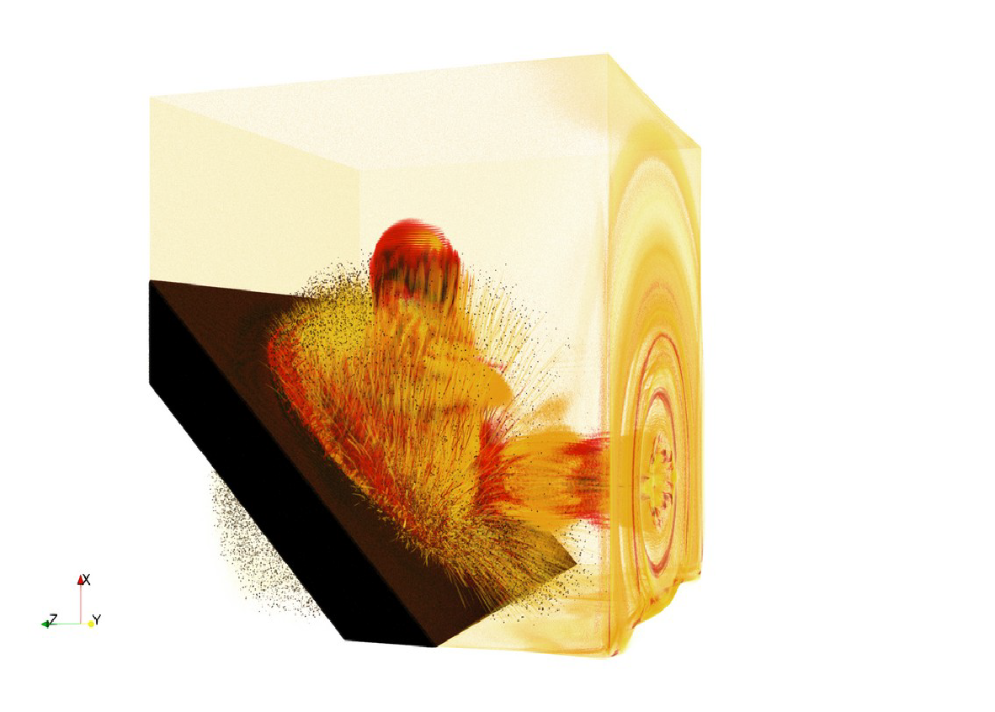
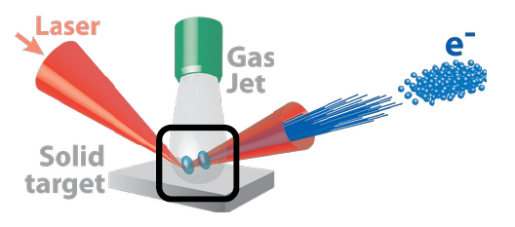

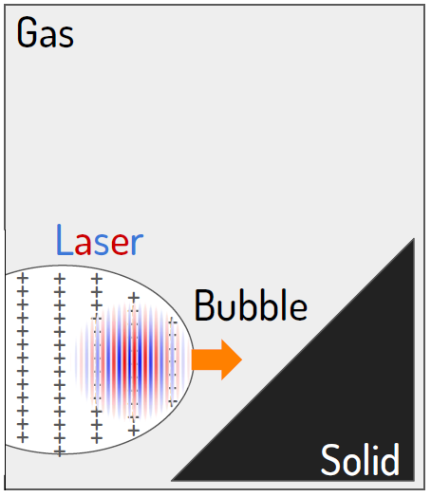
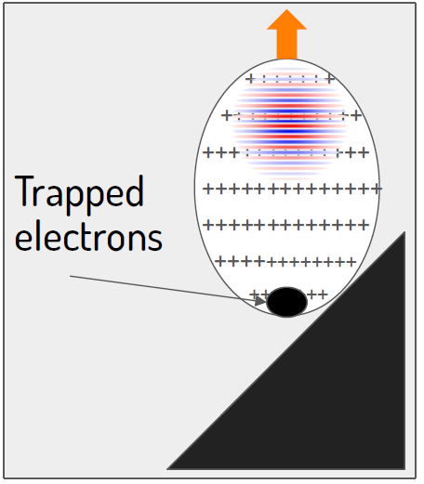
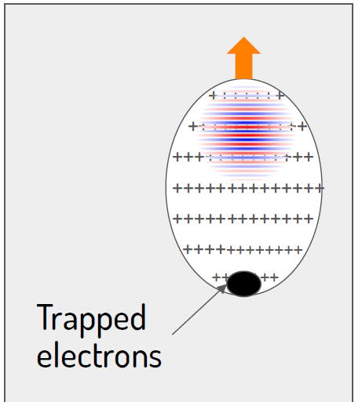

Two-stage injection+acceleration w/ plasma mirror
Fedeli L, Huebl A, Boillod-Cerneux F, Clark T, Gott K, Hillairet C, Jaure S, Leblanc A, Lehe R, Myers A, Piechurski C, Sato M, Zaim N, Zhang W, Vay J-L, Vincenti H.
“Pushing the Frontier in the Design of Laser-Based Electron Accelerators with Groundbreaking Mesh-Refined Particle-In-Cell Simulations on Exascale-Class Supercomputers.”
SC22. 2022 ACM Gordon Bell Prize winners.
1/
2/
3/
1st stage
Interaction with the plasma mirror
2nd stage

Slide 10
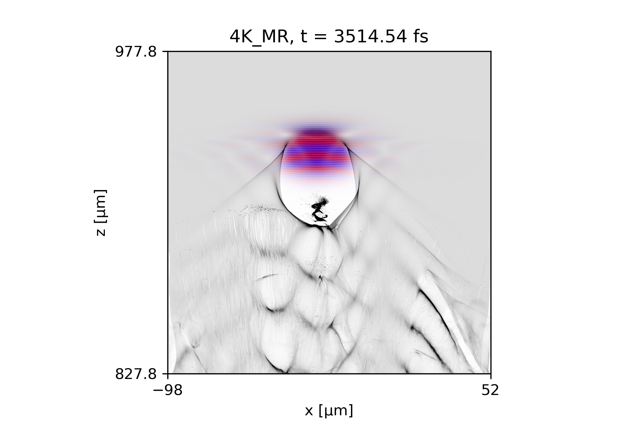

Good agreement between simulations and first experiments
Large scale simulations + LOA experimental results: ➔ we can expect nC charge at GeV-level with % energy spread with a PW-class laser.

Slide 11
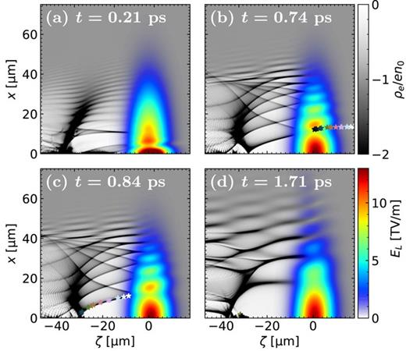
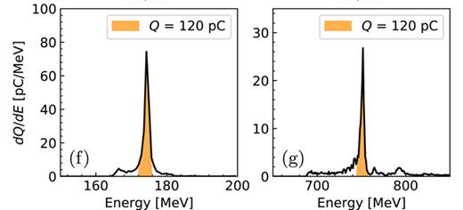
or injection induced by coaxial laser interference
Wang J, Zeng M, Li D, Wang X, Lu W, Gao J., “Injection induced by coaxial laser interference in laser wakefield accelerators”, Matter and Radiation at Extremes 7, 054001 (2022).

Slide 12
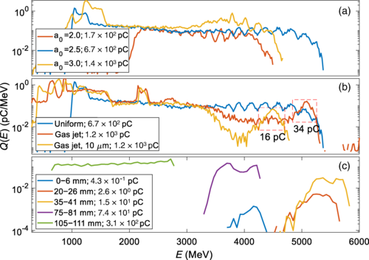
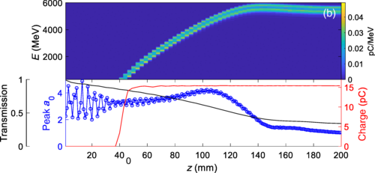
or multi-GeV e- bunches from an all-optical laser wakefield accelerator
Miao B, Shrock JE, Feder L, Hollinger RC, Morrison J, Nedbailo R, Picksley A, Song H, Wang S, Rocca JJ, Milchberg HM. “Multi-GeV electron bunches from an all-optical laser wakefield accelerator”, Physical Review X 12, 031038 (2022).

Slide 13
Modeling of chains of plasma stages

Slide 14
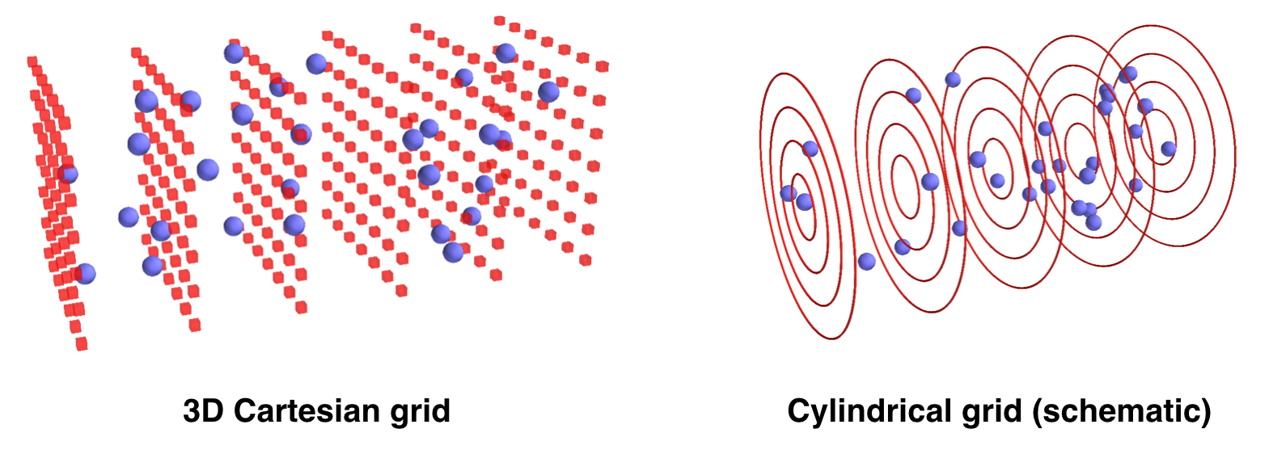





Focus has been on developing best algorithms & code in 3D
WarpX
High-order particle shape
Moving window
Single source CPU & GPU
Dyn. LB for CPU & GPU
Mesh refinement
Boosted frame
Spectral Maxwell solver
PIConGPU²
PICADOR
WarpX³
Geometries
1D3V, 2D3V,
3D3V and
RZ (quasi-
cylindrical)
Multi-Physics Modules beyond standard PIC
ionization, Coulomb collisions, QED processes, Maxwell’s Eq. in matter, embedded boundaries
Advanced Algorithms
mesh refinement, Maxwell spectral solvers, boosted frame, Galilean frame, …
Smilei
Epoch
VPIC¹
Code*
Osiris
✓ | ✓ | ✓ | ✓ | ✓ |  | ✓
✓ | ✓ | ✓ | ✓ | ✓ |  | ✓
 |  | ✓ | ✓ |  | ✓ | ✓
 |  |  |  |  |  | ✓
 |  |  |  |  |  | ✓
 | ✓ |  |  |  |  | ✓
 |  |  |  |  |  | ✓
¹ Gordon Bell Finalist 2008
² Gordon Bell Finalist 2013
³ Gordon Bell Winner 2022
Open source
ecp-warpx.github.io

Slide 15
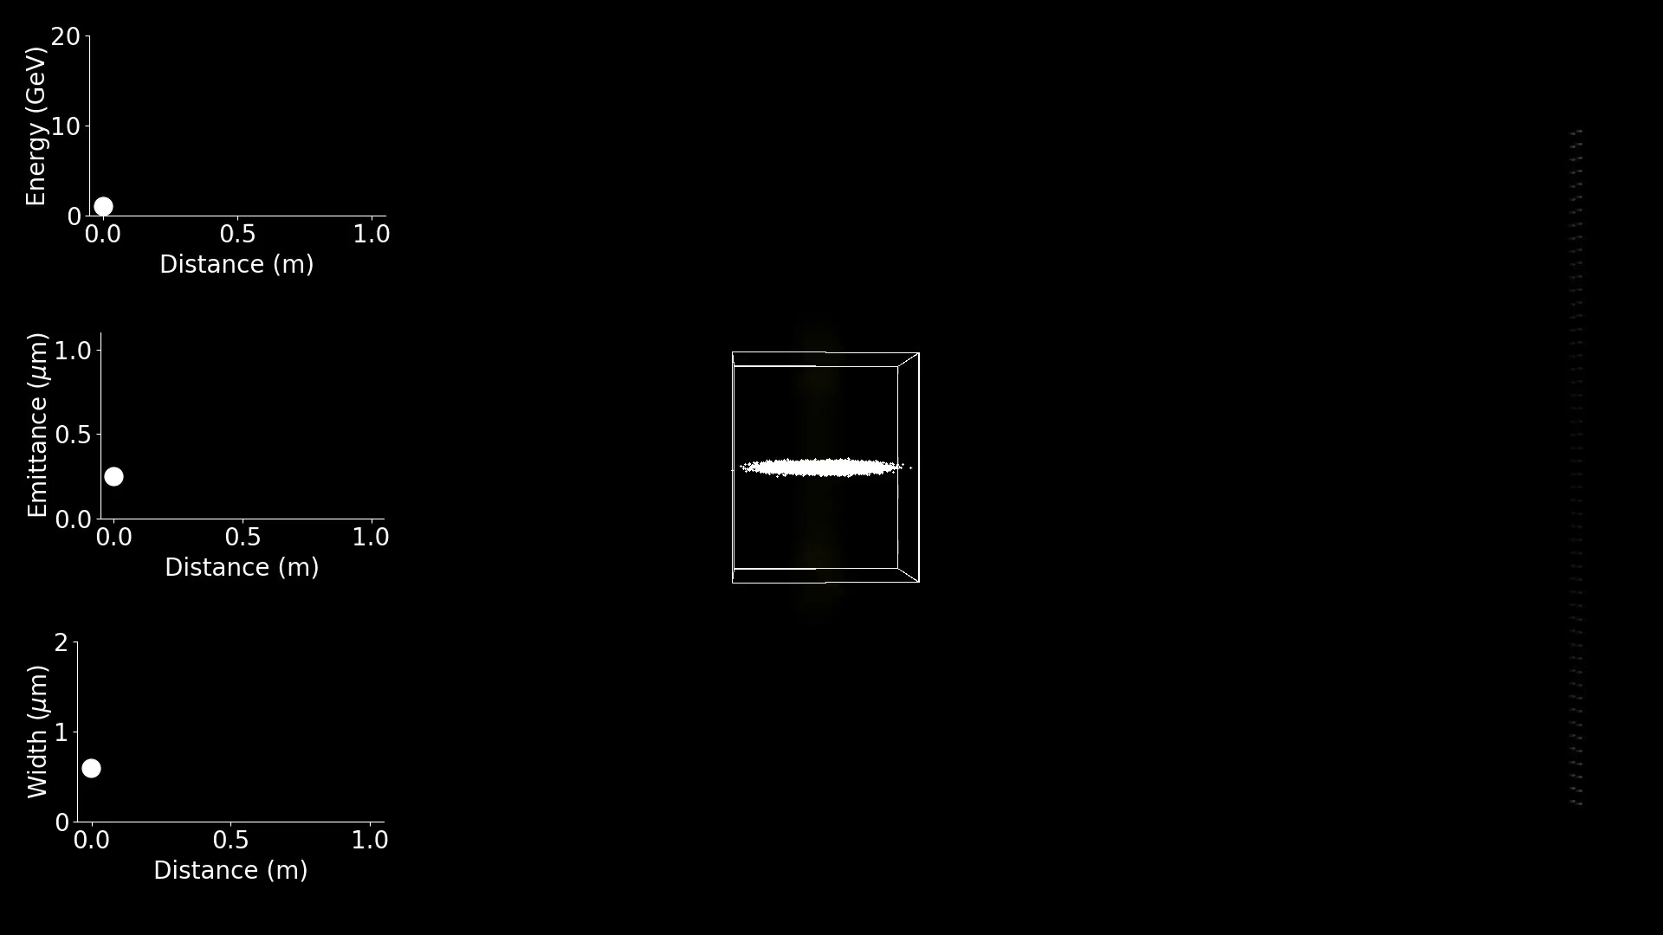
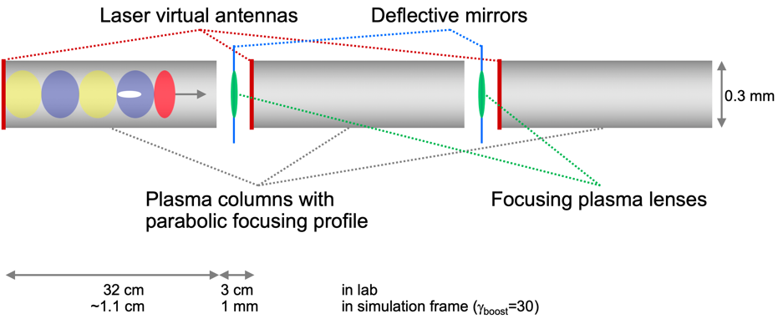
Layout
Started with chain of 3 multi-GeV LWFA accelerator stages
2019
Plasma lenses to focus e⁻ beam between stages
Simulation: D. Amorim; Movie: M. Thevenet
Movie from boosted frame data. Aspect ratio different from lab.
Focus was on numerics: performance, numerical convergence, etc.
Focus was not on science, e.g., emittance preservation ➔ some tuning of plasma lens amplitude performed but not optimized.

Slide 16
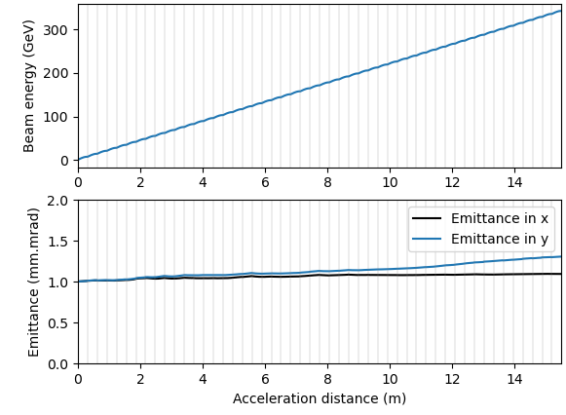
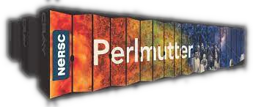
Can now do simulations of chains of 50 multi-GeV LWFA stages
2023
stage number
1
10
20
30
40
50
LWFA lattice:
Length plasma columns: 28cm
Gaps: 3cm
Plasma lens model: linear thick lens (3 mm) w/ “residence correction”
Electron beam:
Charge: -1 fC
Size: 0.75 μm x 0.75 μm x 0.1 μm
Emittance: 1 mm.mrad
Grid size/resolution:
128 x 128 x 17664
2 μm x 2 μm x 0.01 μm
Computer: 256 GPUs for 8h on Perlmutter (NERSC)
On the fly focusing lens tuning using e- beam Twiss parameters enables emittance preservation.
Work in collaboration with A. Ferran Pousa (DESY)

Slide 17
Timeline for Exascale project WarpX
From initial code coupling to ensemble of chains of multi GeV-scale stages
Re-Revised
2030 -
Collider designs
Modeling of chain of 50-100 multi-GeV-scale plasma accelerator stages
2023
Modeling of novel plasma e- beam injection scheme
2022
Modeling chain of 10-20 multi-GeV-scale plasma accelerator stages
2021
Modeling chain of 5-10 multi-GeV-scale plasma accelerator stages
2020
2019
Modeling chain of 3 multi-GeV-scale plasma accelerator stages
2018
Modeling a single multi-GeV-scale plasma accelerator stage
2017
Modeling of single plasma accelerator stage with static mesh refinement
2016
Initial coupling of AMReX and Warp/PICSAR
Notes:
Instructions:
Summarize milestone-based plan for next 3 years

Slide 18
RZ solver w/ novel algorithms for faster/bigger/longer simulations
WarpX
Geometries
1D3V, 2D3V,
3D3V and
RZ (quasi-
cylindrical)
Multi-Physics Modules beyond standard PIC
ionization, Coulomb collisions, QED processes, Maxwell’s Eq. in matter, embedded boundaries
Advanced Algorithms
mesh refinement, Maxwell spectral solvers, boosted frame, Galilean frame, …
Algorithms developed for 3D simulations are also being implemented in axisymmetrical (+ azimuthal Fourier decomposition) for modeling:
faster
at higher resolution
longer chains of plasma accelerator stages
Open source
ecp-warpx.github.io

Slide 19
Modeling of the interaction point

Slide 20

Snowmass21 is motivating beam-beam crossing studies
As part of the Snowmass process, the HEP field expressed a desire for lepton colliders at the 10 TeV-scale.
For high luminosity, these machines will operate in regimes with large beamstrahlung.
Well-established codes like GUINEA-PIG and CAIN will fail in the ultra-high beamstrahlung regime because they do not account for the effect of pair-plasmas on the colliding beams.

Slide 21
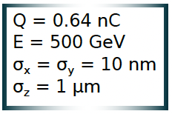
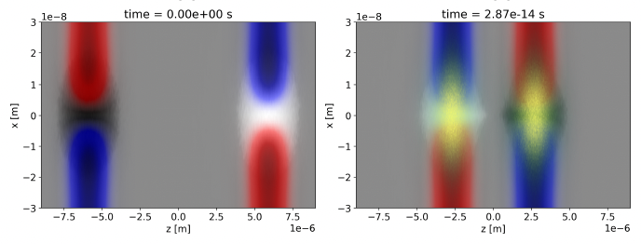
WarpX can be used to model the crossing of two beams
Example: crossing of possible LWFA collider electron and positron bunches
*
electrons
positrons
photons
WarpX simulations by A. Formenti
WarpX can study the impact of beamstrahlung and
beam disruption on the luminosity of colliders
*Beam parameters from

Slide 22
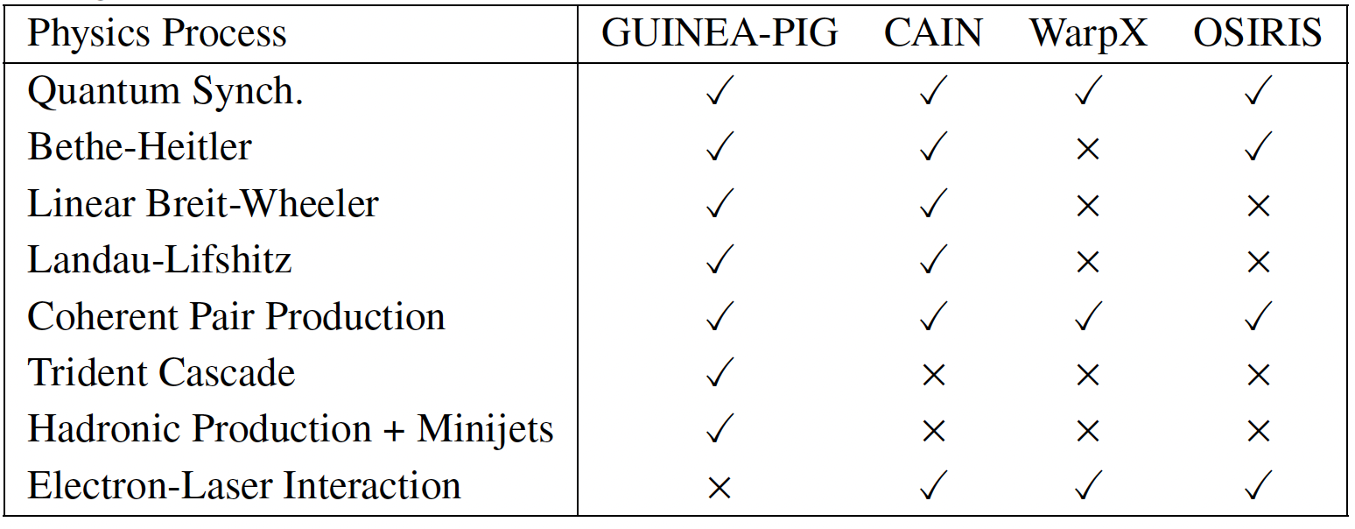
Two types of codes have been used for IP beam crossing
GUINEA-PIG, CAIN: beam-beam codes with 2D Poisson solves of beam slices for EM fields effects
OSIRIS, VLPL, WarpX: Electromagnetic Particle-In-Cell codes with 3D Maxwell solves for EM field effects
T. Barklow, S. Gessner, M. Hogan, C.-K. Ng, M. Peskin, T. Raubenheimer, G. White, E. Adli, G. Jiawei Cao, C. A. Lindstrøm, K. Sjobak, S. Barber, C. Geddes, A. Formenti, R. Lehe, C. Schroeder, D. Terzani, J. van Tilborg, J.-L. Vay, E. Zoni, C. Doss, M. Litos, I. Lobach, J. Power, M. Swiatlowski, L. Fedeli, H. Vincenti, T. Grismayer, M. Vranich and W. Zhang,
“Beam delivery and beamstrahlung considerations for ultra-high energy linear colliders”, JINST 18, P09022 (2023).

Slide 23
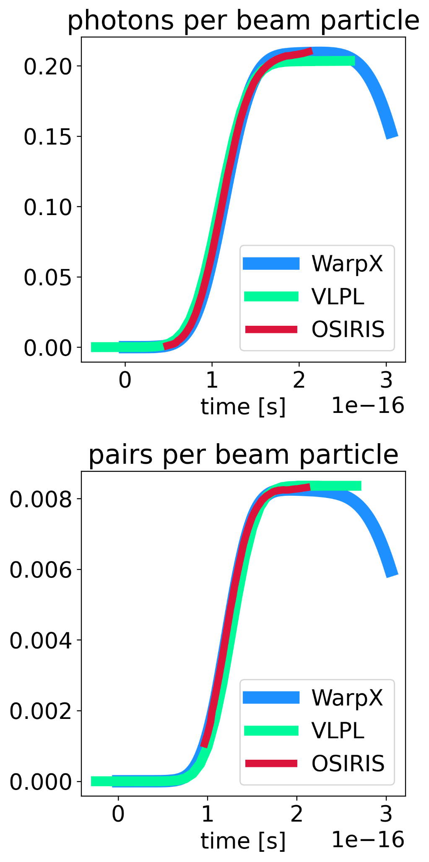
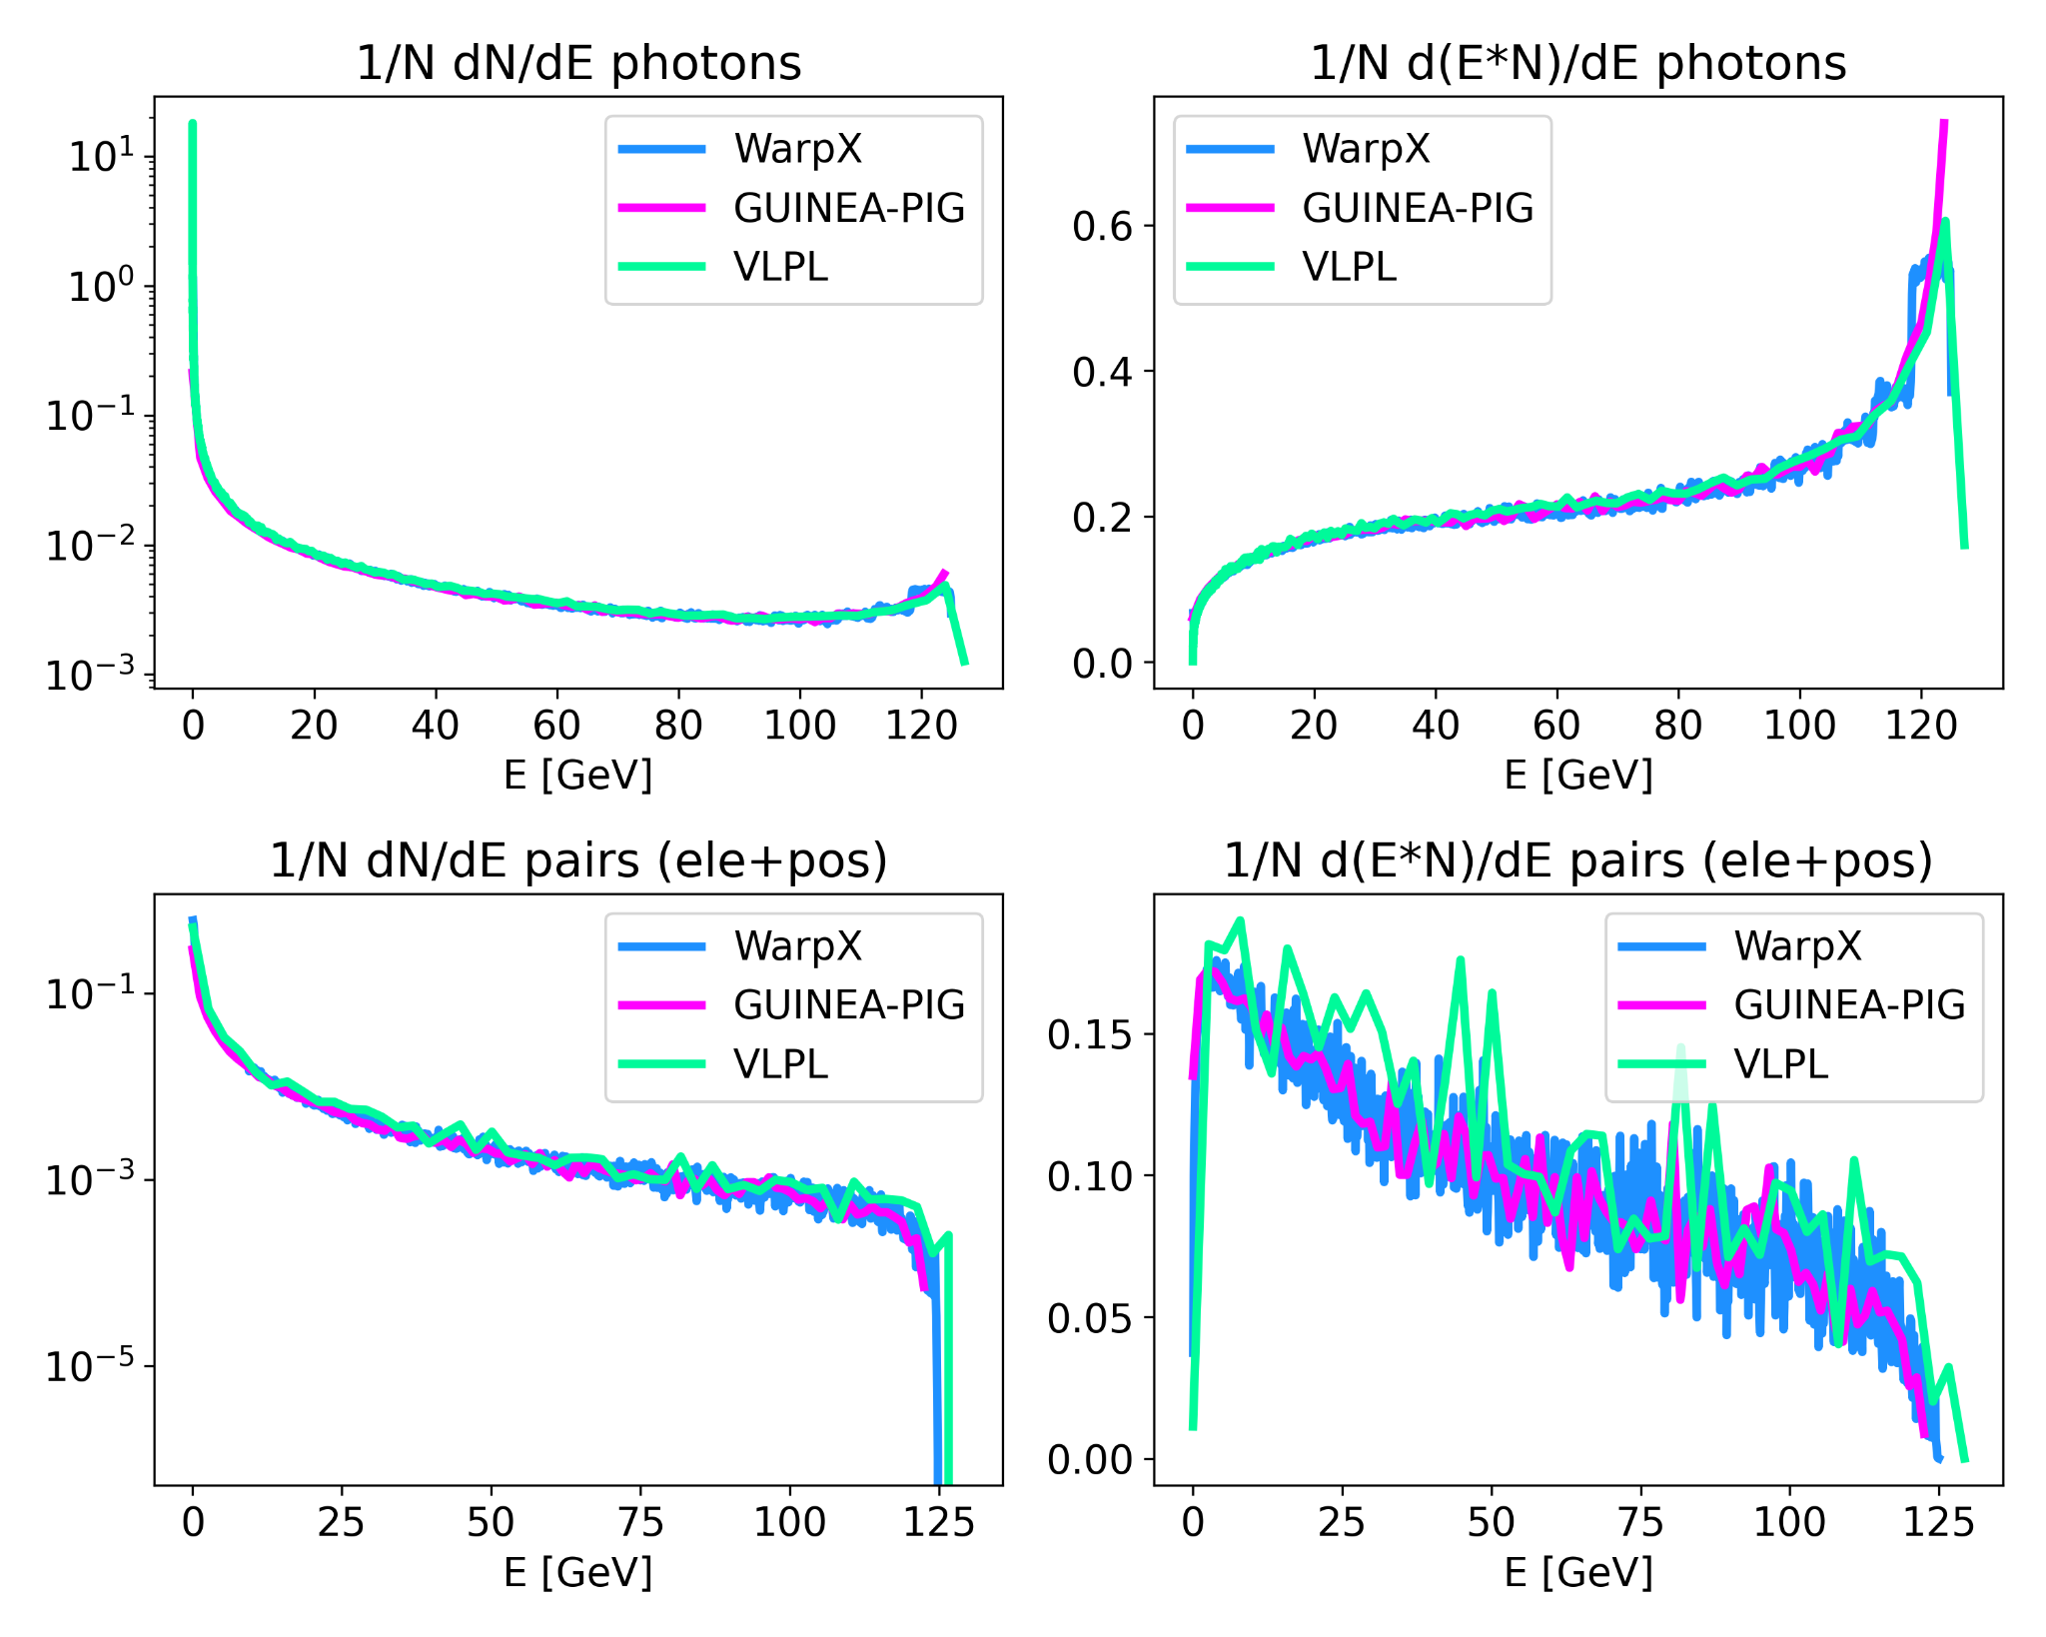
Code comparisons: WarpX | OSIRIS | VLPL | GUINEA-PIG
electron-positron collision @ 250 GeV COM, 0.14 nC, round beams σ = 10 nm

Slide 24
Two types of codes have been used for IP beam crossing
GUINEA-PIG, CAIN: beam-beam codes with 2D Poisson solves of beam slices for EM fields effects
OSIRIS, VLPL, WarpX: Electromagnetic Particle-In-Cell codes with 3D Maxwell solves for EM field effects
WarpX includes 3D and 2D Poisson solvers & can combine advantages of beam-beam and EM PIC codes:
can capture efficiently fields from relativistic beams as with beam-beam codes
can capture electron-positron pair plasmas as with PIC codes
no Courant time step limitation of standard EM PIC codes when using Poisson solvers
T. Barklow, S. Gessner, M. Hogan, C.-K. Ng, M. Peskin, T. Raubenheimer, G. White, E. Adli, G. Jiawei Cao, C. A. Lindstrøm, K. Sjobak, S. Barber, C. Geddes, A. Formenti, R. Lehe, C. Schroeder, D. Terzani, J. van Tilborg, J.-L. Vay, E. Zoni, C. Doss, M. Litos, I. Lobach, J. Power, M. Swiatlowski, L. Fedeli, H. Vincenti, T. Grismayer, M. Vranicℎ and W. Zhang,
“Beam delivery and beamstrahlung considerations for ultra-high energy linear colliders”, JINST 18, P09022 (2023).

Slide 25
Stitching it all together

Slide 26
Handing out particles and fields from one simulation to the next
…
…
…
…
Generation
Acceleration
Beams crossing
Acceleration
Generation
Generation
Full PIC in the lab frame or moderate boosted frame relativistic factor (e.g., γ=5)
Acceleration
Full PIC in high boosted frame relativistic factor (e.g., g=60) or quasistatic
Beam crossing
Full PIC in combination of beam & center of mass frames
Connections
Record e⁻ and e⁺ beams (and fields if transition within a stage) histories at a given location.
Inject beams in next simulation; if within a stage, inject fields using (a) virtual antenna if in boosted frame full PIC, (b) LASY* library if using quasistatic.
*M. Thévenet, “LASY: an open-source Python library for easy interfacing of laser pulses between experiments and simulations”, Poster session, Tue., September 19, 2023, EAAC23.

Slide 27
Outlook: toward a community ecosystem

Slide 28














WarpX is part of the Beam pLasma & Accelerator Simulation Toolkit
Open Source
blast.lbl.gov
Applications:
- BeamBeam3D
- FBPIC
- HiPACE++
- Impact/ImpactX
- LW3D
- Posinst
- Wake-T
- WarpX
--------
- ARTEMIS
- GEMPIX
Libraries:
- ABLASTR
- LASY
- openPMD-api
- PICSAR-QED
- PICMI
- Optimas
…
BLAST is a multi-institutional international collaboration

Slide 29


BLAST is part of U.S. collaboration on plasma accelerators modeling
Collaboration for Advanced Modeling of Particle Accelerators

Slide 30
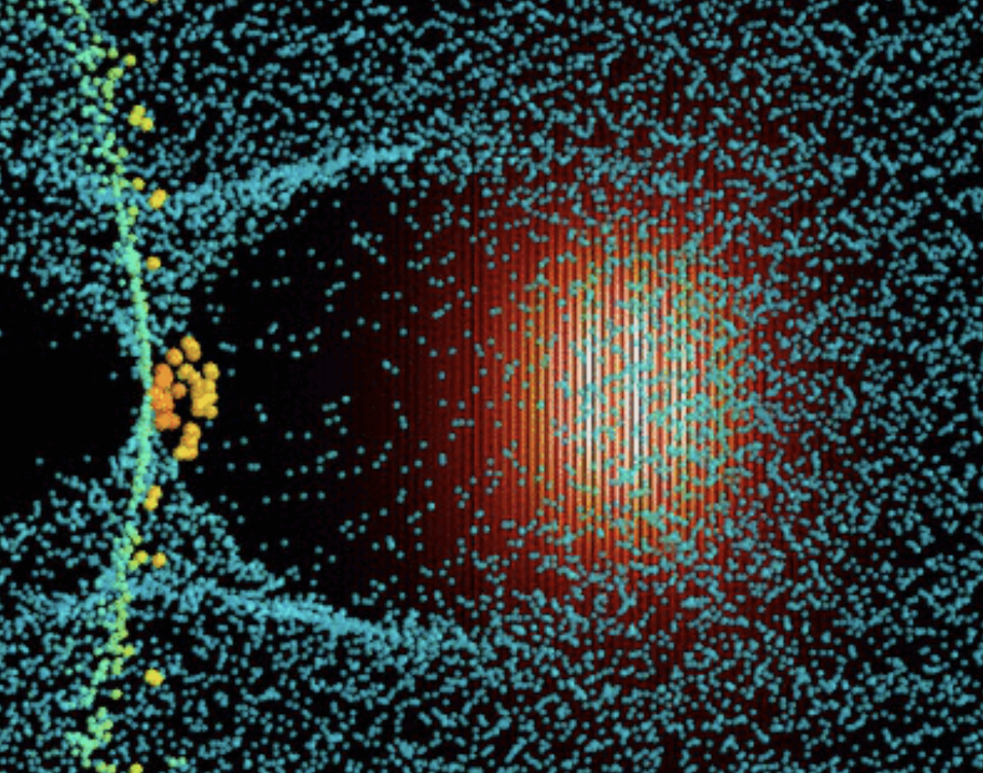
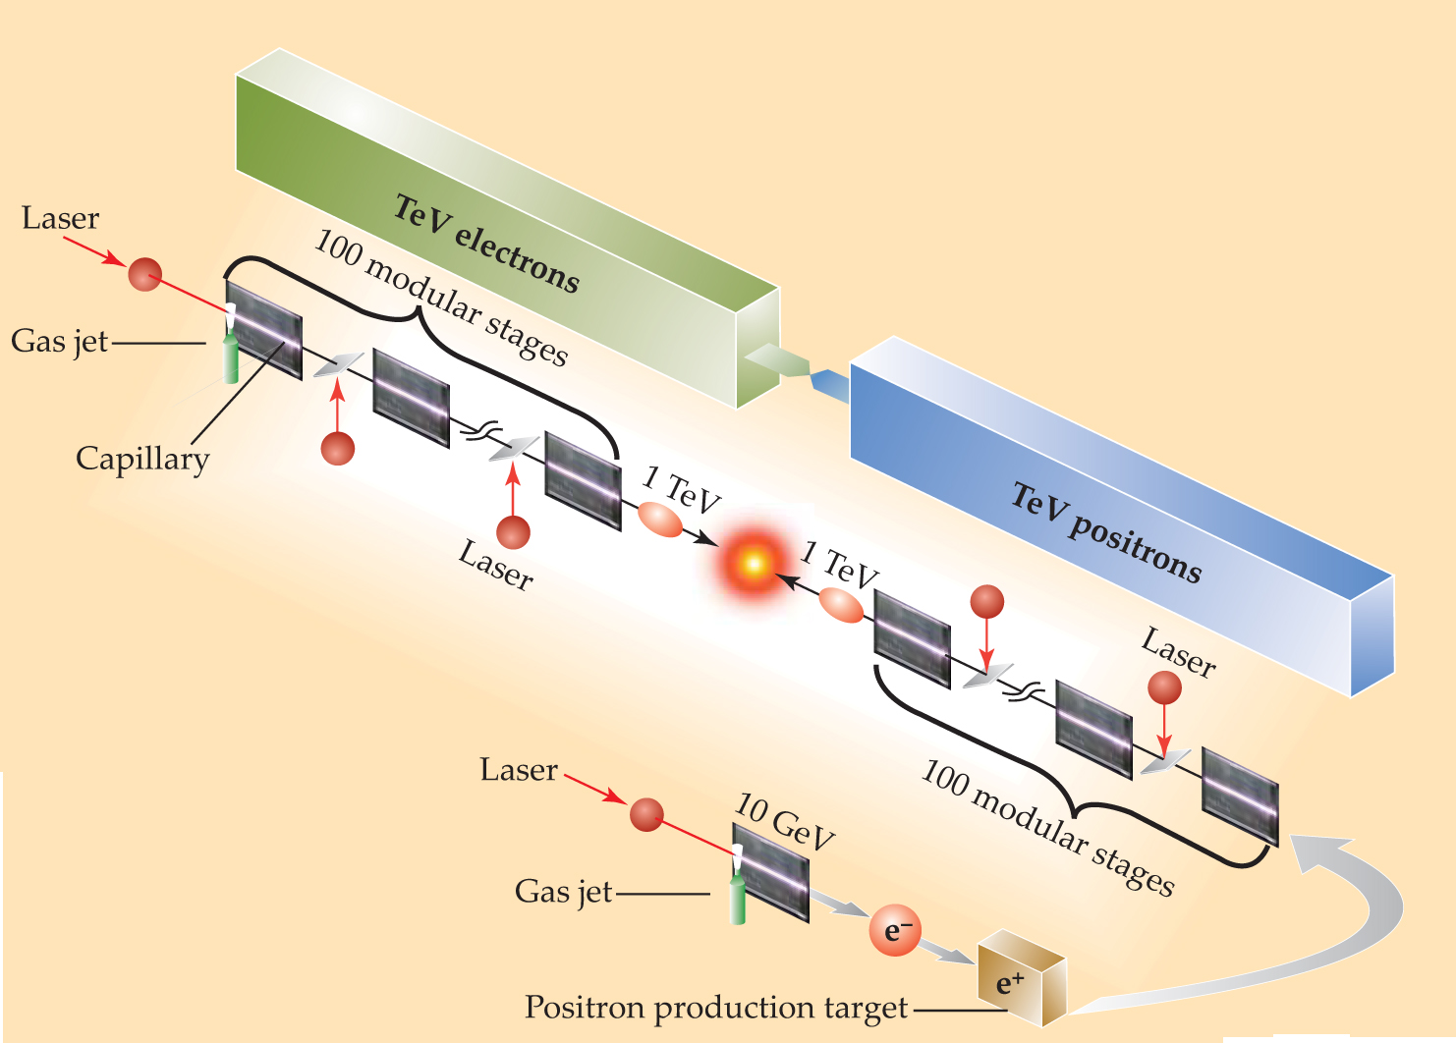
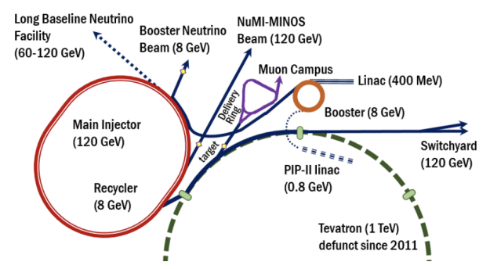
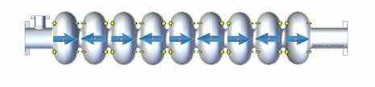
CAMPA is to boost accelerator research & designs
Plasma accelerators use a driver laser or particle beam to displace electrons in a plasma, creating a “wakefield” to accelerate particles with very large gradients > 1GV
Overarching purpose of CAMPA: accelerate and expand the scope of discoveries from high energy physics (HEP) particle accelerators by enabling the design of accelerators that are significantly more compact and cheaper to build and run
Main goals:
(i) develop HPC accelerator & beam modeling capabilities to design the full range of systems required
(ii) develop community simulation ecosystems that seamlessly integrate accelerator elements to facilitate the design and control of the next-generation of particle accelerators
Emphasis: design of advanced plasma-based colliders and the conventional accelerators in the Fermilab complex, enabling DUNE to access previously unreachable parameters of the Standard Model neutrino sector
RF cavities in metallic vacuum tube
gradient constrained by breakdown
< 100 MV
Very synergistic with ALEGRO

Slide 31
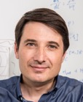

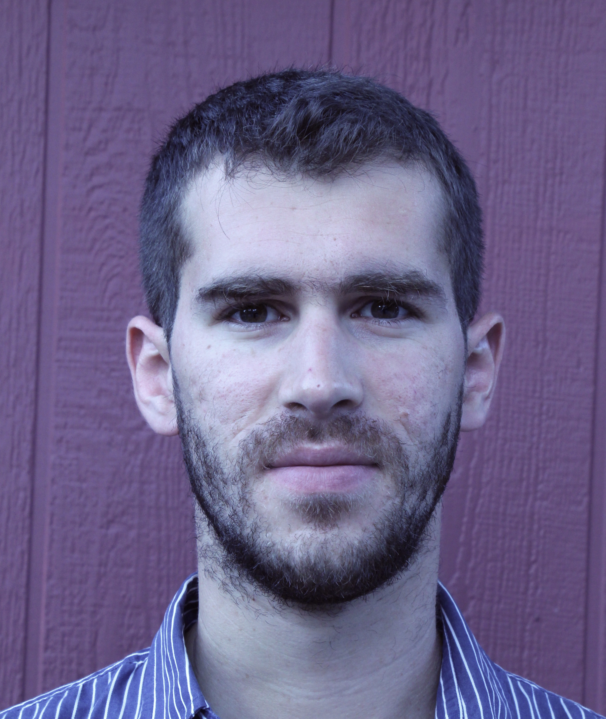






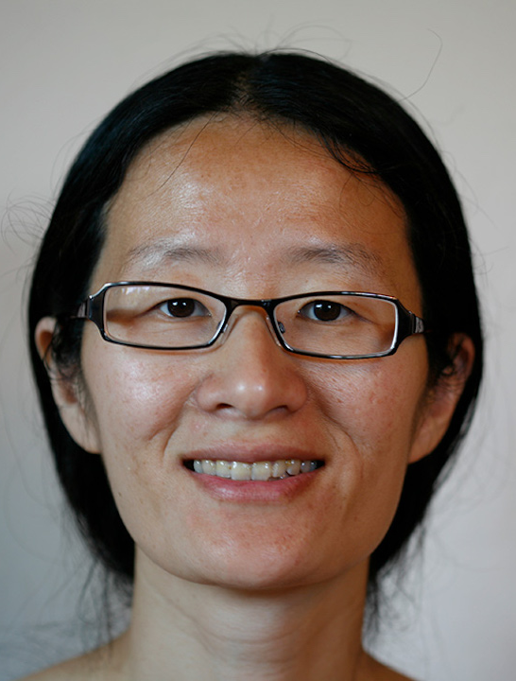



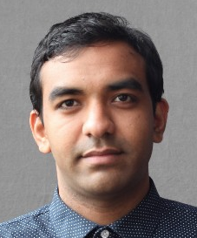
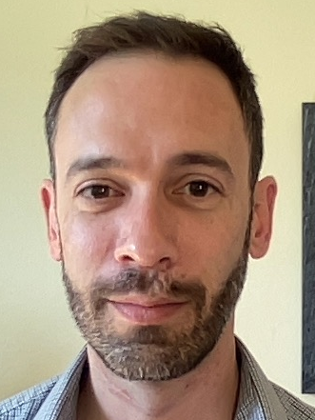


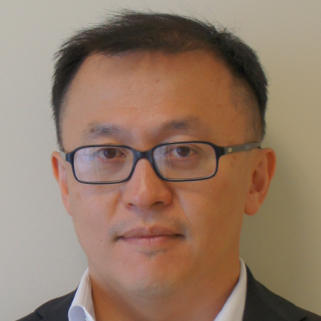

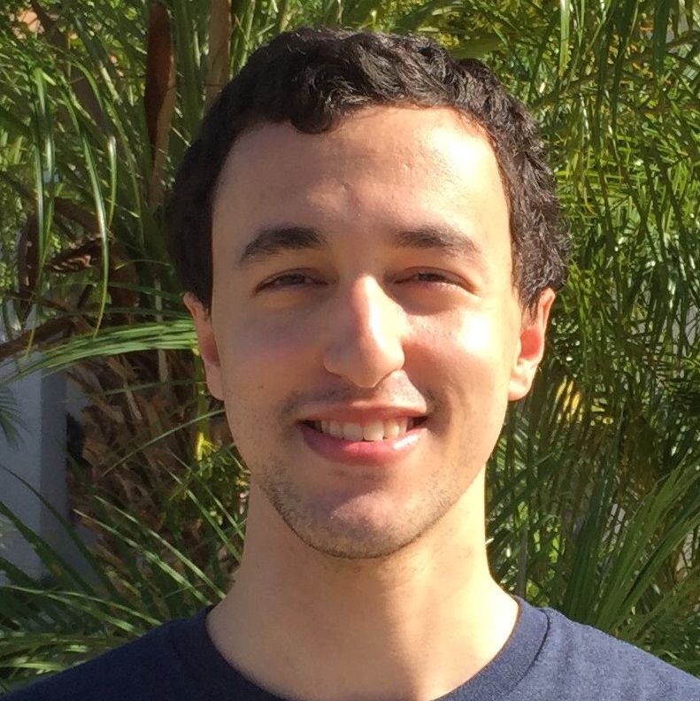









The team
  Accelerator modeling [PI: JL Vay]
  AMReX, I/Os [coPI: A. Almgren]
  Conventional accelerator modeling [coPI: E. Stern]
  Plasma accelerator modeling [coPI: W. Mori]
  Machine learning for accelerators [coPI: A. Edelen]
  Optimization (libEnsemble, POPAS) [coPI: J. Larson]
  ADIOS I/Os [coPI: N. Podhorszki]

Slide 32

Applications software portfolio
Wake-T^{1,2}
FBPIC²
HiPACE++²
ImpactX¹
WarpX²
QPAD²
QuickPIC²
OSIRIS²
Synergia¹
2D-RZ
2D-RZ
3D
3D
3D
¹Conventional accelerators ²Plasma-based accelerators

Slide 33















Community Accelerator Simulations Ecosystem (CASE)
Particle-In-Cell
Modeling Interface
Code A
open Particle Mesh Data standard
Code B
...
C A S E
WarpX/FBPIC
HiPACE++
Wake-T
ImpactX
Osiris
QuickPIC
QPAD
Synergia

Slide 34





PICMI enables (90%) same input script with different codes
WarpX
(momentum-conserving gather)
PWFA FACET Example
WarpX
WarpX (γ=10)

Slide 35




Platform for Optimization of Particles Accelerators at Scale (POPAS)
POPAS

Slide 36

End goal: integrated ecosystem w/ on-the-fly tuning for collider design
Idealized laser/plasma profiles,
no collisions,…
Experimental laser/plasma profiles + collisions + …
Speed
Fidelity
Fast
&
as
accurate
as
possible
Reduced physics
Full physics
Accurate
&
as
fast
as
possible
Reduced models
First principles
1D-1V
3D-3V
Low resolution
High resolution
Surrogates
Including from AI/ML
Hybrid Fluid-PIC
Quasistatic
PIC
PIC

Slide 37
To conclude
We look forward to
further develop our open-source community codes and ecosystems with our partners, and
put them at the service of future plasma-based colliders design with ALEGRO and other international efforts.

Slide 38
Funding and Computing Support
This research was supported in part by the Exascale Computing Project (17-SC-20-SC), a collaborative effort of two U.S. Department of Energy organizations (Office of Science and the National Nuclear Security Administration) responsible for the planning and preparation of a capable exascale ecosystem, including software, applications, hardware, advanced system engineering and early testbed platforms, in support of the nation’s exascale computing imperative, and by the CAMPA collaboration, a project of the U.S. Department of Energy, Office of Science, Office of Advanced Scientific Computing Research and Office of High Energy Physics, Scientific Discovery through Advanced Computing (SciDAC) program. This work was also performed in part by the Lawrence Berkeley National Laboratory under U.S. Department of Energy Contract No. DE-AC02-05CH11231, Lawrence Livermore National Laboratory under Contract No. DE-AC52–07NA27344 and SLAC National Accelerator Laboratory under Contract No. AC02–76SF00515.
This research used resources of the Oak Ridge Leadership Computing Facility, which is a DOE Office of Science User Facility supported under Contract DE-AC05-00OR22725, and the National Energy Research Scientific Computing Center (NERSC), a U.S. Department of Energy Office of Science User Facility located at Lawrence Berkeley National Laboratory, operated under Contract No. DE-AC02-05CH11231.

Slide 39
Thank You!
Questions?

