Slide 1
STAGING IN LWFA – CHALLENGES AND PROSPECTS
EAAC 2023 | 21 September
Michael Backhouse
Jonathan Wood and Zulfikar Najmudin

Slide 2
MOTIVATION
1

Slide 3
LWFA peak energy records
The past two decades produced continually advancing electron beam peak energies
The LWFA peak energy record is currently 7.8GeV (2019)
The maximum energy is intrinsically coupled to laser energy, and by the resonance condition, power
What laser would be needed for 1 TeV electron energy?

Slide 4
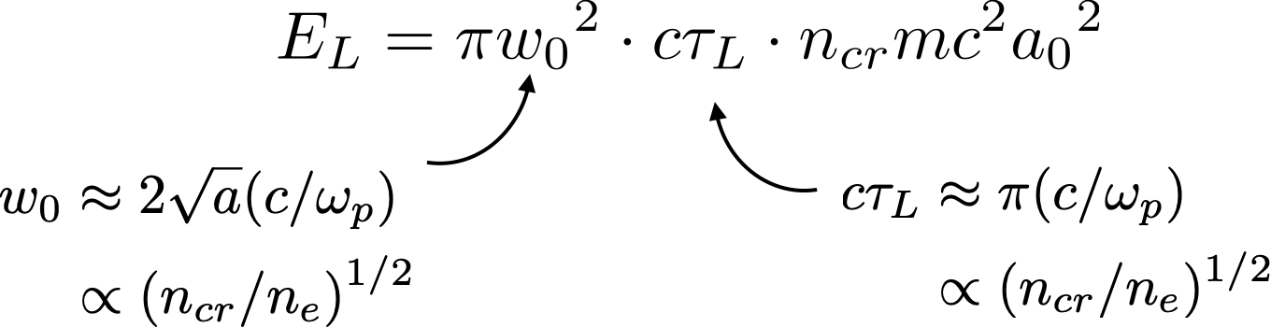
Laser energy versus electron energy gain
The energy in the laser pulse is its volume multiplied by the energy density
The energy gain is then

Slide 5
Laser energy for single-stage 1 TeV
1 MeV
85 µJ
100 MeV
85 mJ
10 GeV
85 J
1 TeV
85 kJ
10 MeV
2.5 mJ
1 GeV
2.5 J
100 GeV
2.5 kJ

Slide 6
Acceleration length for single-stage 1 TeV
This would require up to 1 km of plasma for the dephasing length, with an average accelerating gradient of 1GV/m.

Slide 7
Focal spot size for single-stage 1 TeV
Matching the focal spot size to the bubble radius, predicts a 10 cm spot size

Slide 8
Focal length for single-stage 1 TeV
Finally, assuming a fluence of 0.1J cm⁻² , achieving this spot size would require a 10km focal length

Slide 9
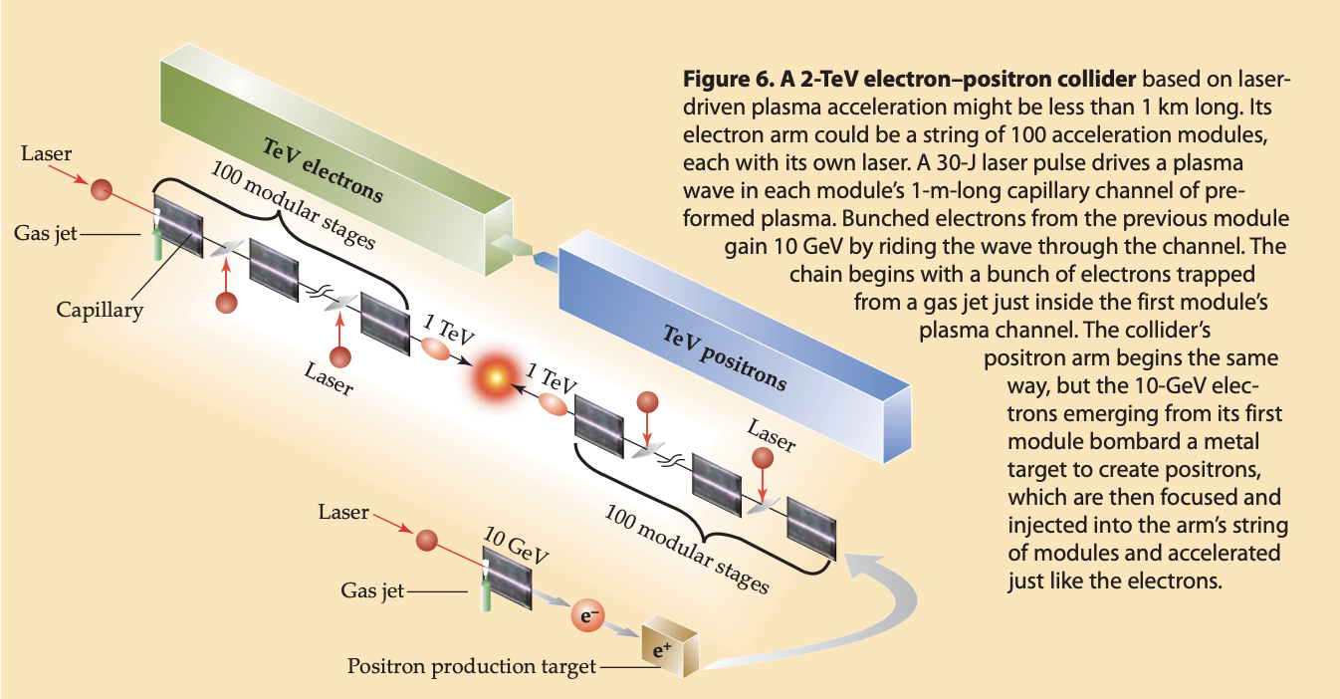
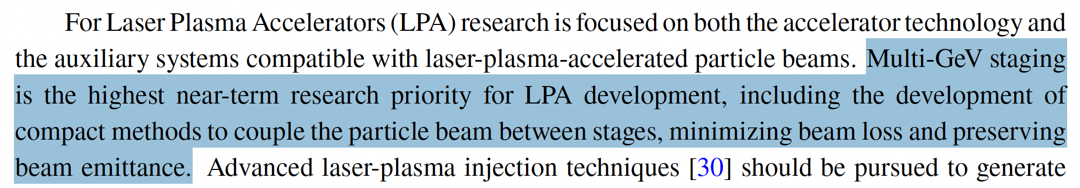
Multi-stage LWFA acceleration
W. Leemans and E. Esarey Laser-driven plasma-wave electron accelerators Physics Today 62 (3), 44–49 (2009)
“Report of the Accelerator Frontier Topical Group 6 on Advanced Accelerator Concepts for Snowmass 2021” (2022)

Slide 10
CHALLENGES
2

Slide 11
Short term and longer term challenges
Shorter term
(next 3 years?)
Longer term
(3-15 years?)
Effective driver coupling
High capture efficiency
Achieving a large energy boost
kHz repetition rate
Emittance preservation
Low average energy spread

Slide 12
Short term and longer term challenges
Shorter term
(next 3 years?)
Longer term
(3-15 years?)
Laser coupling experiments
Laser technology advances
Effective driver coupling
High capture efficiency
Achieving a large energy boost
kHz repetition rate
Emittance preservation
Low average energy spread
Alignment on the scale of the plasma wavelength
Alignment on the scale of the electron bunch

Slide 13
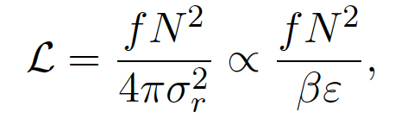
The luminosity problem
LHC luminosity = 10³⁴ cm⁻² s⁻¹, achieved with MHz frequencies (colliding bunch trains).
Linear colliders are restricted to kHz, so need more charge (nC) and lower emittance (100nm) to compensate
Emittance generally only increases, so emittance preservation is a priority

Slide 14
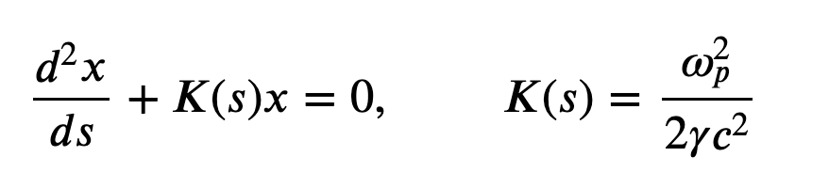
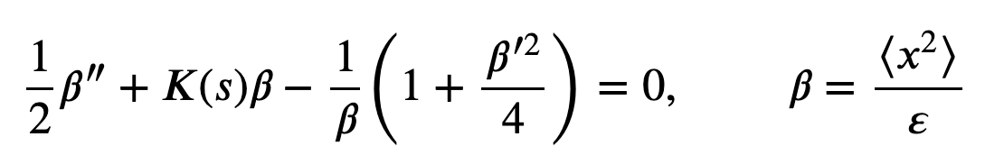
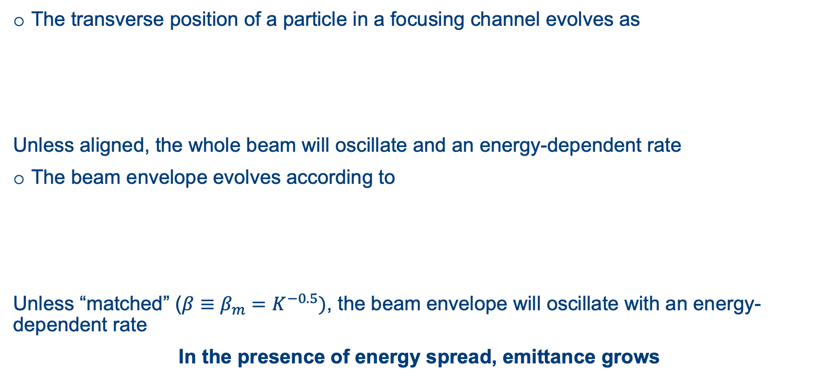
Emittance growth from betatron motion
The transverse position of a particle in a focusing channel evolves as
Unless aligned, the whole beam will oscillate and an energy-dependent rate
The beam envelope evolves according to
Unless “matched” ($β≡β_{m}=K^{−0.5})$, the beam envelope will oscillate with an energy-dependent rate
In the presence of energy spread, emittance grows

Slide 15
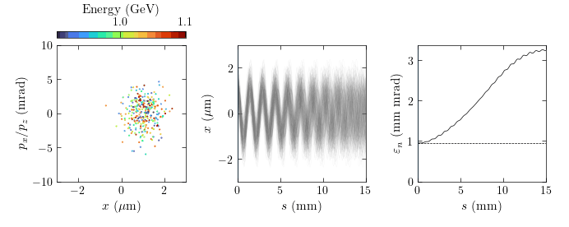
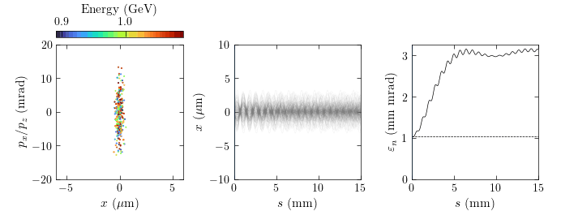
Emittance growth from betatron motion
Emittance can grow due to misalignment and betafunction mismatch
Matching the beam means we need to have almost perfect:
  Beam position
  Beam pointing
  Beta function
  Beta function derivative

Slide 16
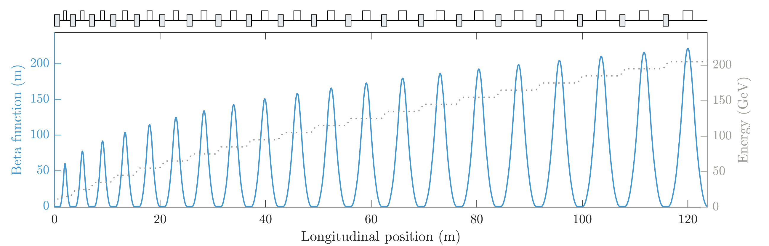

Beam optics – but at what cost?
Beam optics can be used in between stages to refocus the beam
However, advantage of high gradient acceleration is undermined
  Beam optic lengths will also scale unfavorably with $\sqrt{γ}$ - this problem worsens with stage number
Do we want to trade gradient for emittance?
  If not, we need compact coupling methods
C. Lindstrøm “Staging of plasma-wakefield accelerators” Phys. Rev. Accel. Beams 24, 014801 (2021)

Slide 17
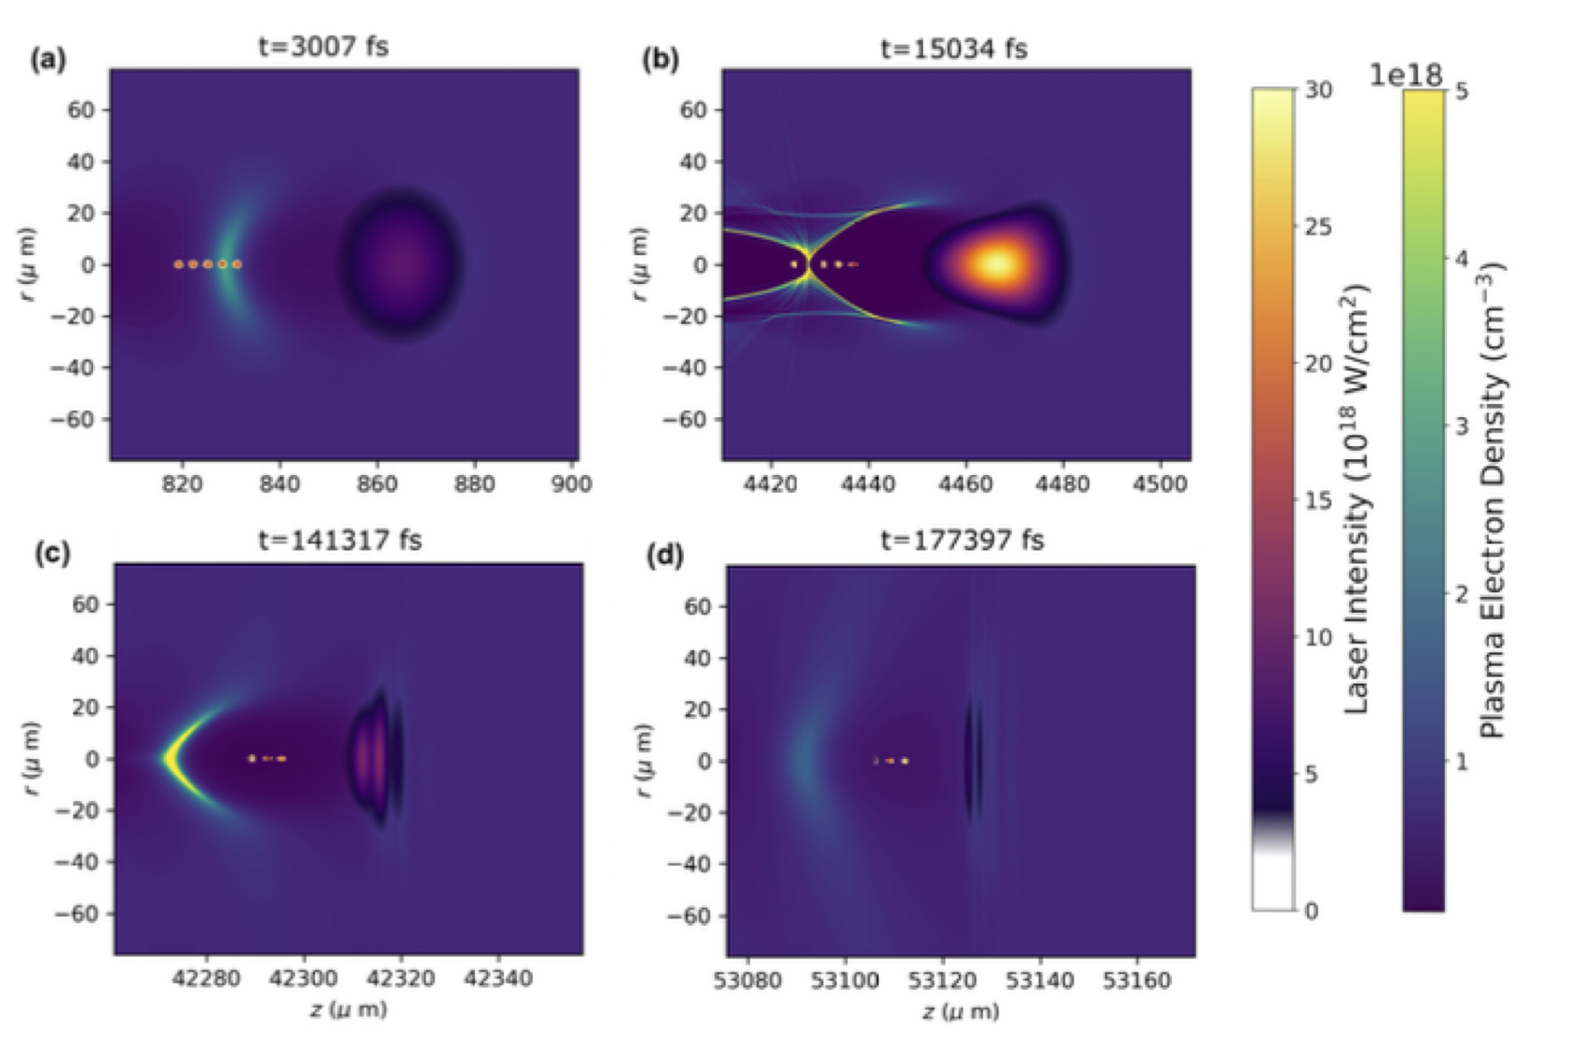
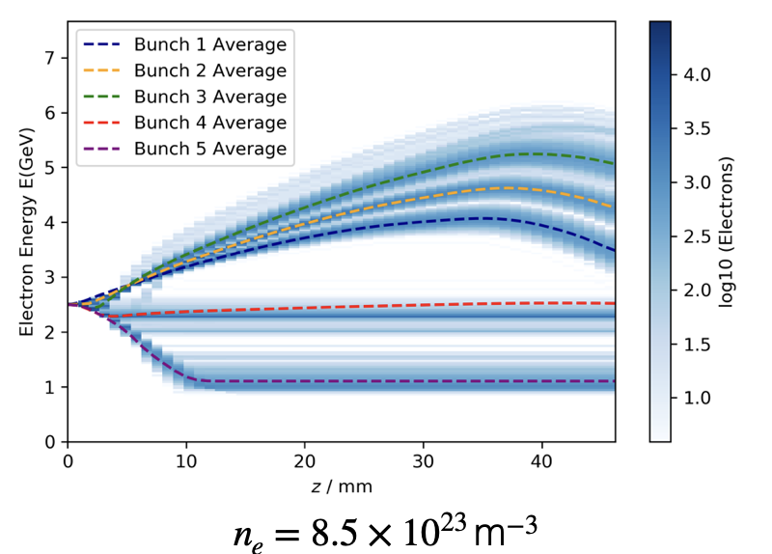
Synchronisation: Large energy gain
Simulations have been run injecting 5 micro-bunches into a second accelerator stage
Energy gain is extremely sensitive to injection phase, particularly at the back of the bubble
Laser pulse evolution must also be considered
Y. Cao, R. J. Shalloo, M. J. V Streeter, and Z. Najmudin, Staging of Laser Wakefield Acceleration in the Nonlinear Self-Guided Regime, in preparation(2023).

Slide 18
Synchronisation: Energy stability
State-of-the-art synchronization is on the order of 10fs
Averaging over multiple shots, energy stability equates to energy spread
  Maintaining 1% level energy spread after 100 stages requires ~ 0.1fs jitter!
  Is multiple orders of magnitude improvement possible?
  Can the system be made more inherently stable?

Slide 19
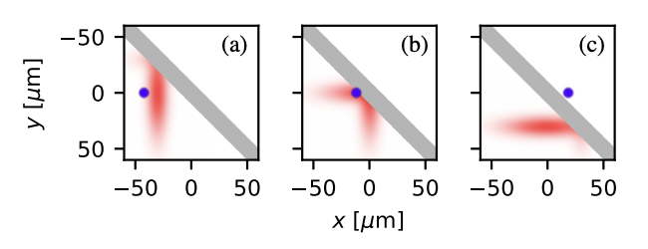
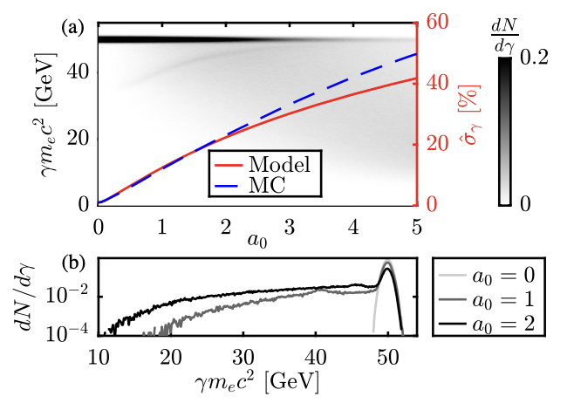
Driver coupling challenges
The depleted laser pulse needs to be decoupled from the optical axis.
If done at high intensities, the electron bunch can undergo inverse Compton scattering when interacting with the reflected pulse
This results in an increase in the energy spread of the electron beam
The intensity of the laser during this interaction needs to be considered
M. J. V. Streeter and Z. Najmudin “Compton recoil effects in staging of laser wakefield accelerators“ Phys. Rev. Accel. Beams 23, 071602 (2020)

Slide 20
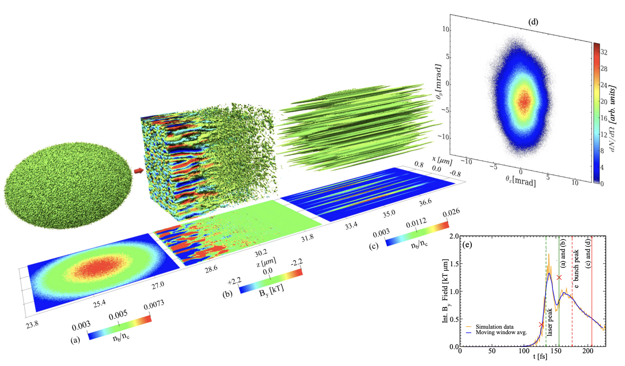
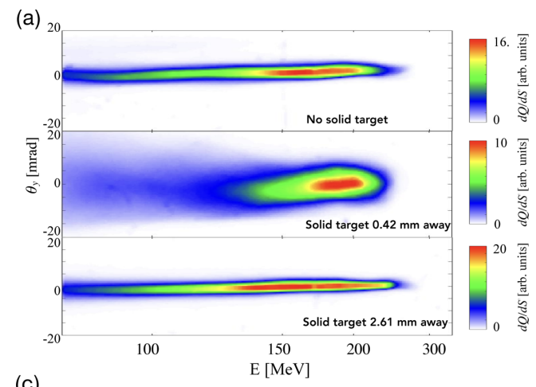
Driver coupling challenges
Magnetic fields generated in the plasma mirror by the current filamentation instability can reach >1000 tesla, with sub-micron wavelengths
These fields can scatter electrons, increasing the beam emittance.
G. Raj et al. “Probing ultrafast magnetic-field generation by current filamentation instability in femtosecond relativistic laser-matter interactions” Phys. Rev. Research 2, 023123 (2020)

Slide 21
EXPERIMENTAL PROGRESS
3

Slide 22
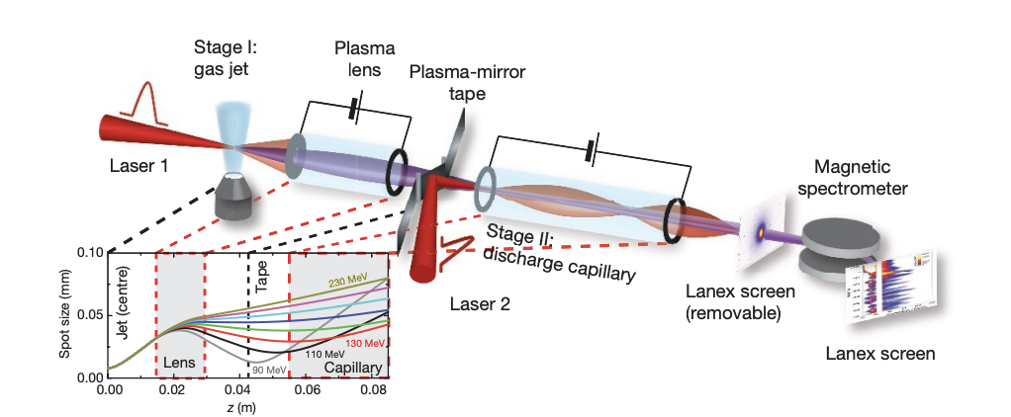
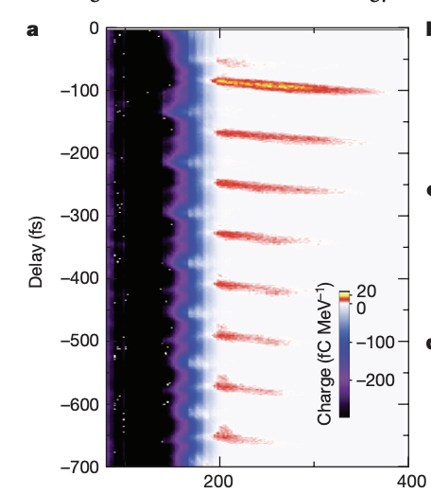
Proof-of-principle experiment (2016)
In 2016, staging of two independent laser wakefield accelerators was achieved.
Energy gains of up to 100MeV were achieved with 3% of the electrons accelerated in the first stage being captured in the second
S. Steinke et al. “Multistage coupling of independent laser-plasma accelerators” Nature volume 530, pages 190–193 (2016)

Slide 23
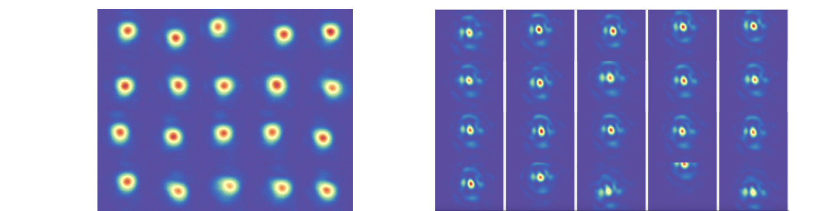
Plasma mirror reflectivity
Cell 1
Injection
Initial acceleration
Beam extraction
Cell 2
Compact laser coupling
Charge capture
Energy boost
Extraction tape
Injection tape
Beam 1
Beam 2
Focal spot images

Slide 24
Plasma mirror reflectivity
Reflectivity within FWHM
Intensity in cell 2
Total reflectivity
Total reflectivity varied between 40% and 70% as the laser energy changed
70% reflectivity for energy within FWHM
% energy within FWHM
J. Gruse, N. C. Lopes, R. J. Shalloo, and A. Alejo, Reflection from Plasma Mirrors at High Intensity for Driving Laser Wakefield Accelerators, in preparation (2023)

Slide 25
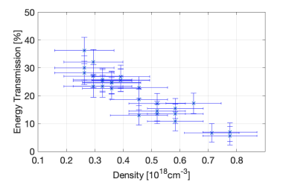
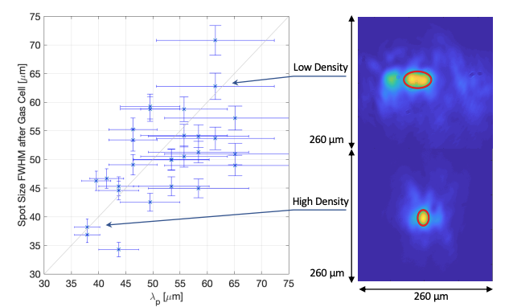
Guiding of the reflected pulse
Demonstrated self-guiding of the reflected laser pulse over a range of relevant plasma densities
The guided pulse retained quality was similar to that of the input beam.
J. Gruse, N. C. Lopes, R. J. Shalloo, and A. Alejo, Reflection from Plasma Mirrors at High Intensity for Driving Laser Wakefield Accelerators, in preparation (2023)

Slide 26
Beam divergence
70% reduction in divergence when shooting through a hole vs the tape
Shot-to-shot divergence stability improved from 12% to 5%
M. Backhouse, R. J. Shalloo, N. C. Lopes, J. C. Wood, M. J. V. Streeter, K. Poder, S. Alatabi, N. Bourgeois, E. Gerstmayr, J. -N. Gruse, D. R. Symes, P. P..Rajeev, S. V. Rozario, S. P. D. Mangles, G. Sarri, and Z.. Najmudin, in preparation (2023)

Slide 27
Density ramp
The ramp reduces the focusing forces of the wake gradually, reducing ultimate beam divergence
Magnitude of reduction predicted by simulations matches experimental measurements
Emittance growth suppressed in the ramp
M. Backhouse, R. J. Shalloo, N. C. Lopes, J. C. Wood, M. J. V. Streeter, K. Poder, S. Alatabi, N. Bourgeois, E. Gerstmayr, J. -N. Gruse, D. R. Symes, P. P..Rajeev, S. V. Rozario, S. P. D. Mangles, G. Sarri, and Z.. Najmudin, in preparation (2023)

Slide 28




Angled plasma mirror effect on beam divergence
Magnetic field generated in the tape scatter the beam, but the effect is smaller than the ramp
Effect is weak due to laser depletion and the angle of the field structure
0° incidence
45° incidence
𝜌
$$B_{x}$$
$$B_{y}$$
$$B_{x}$$
$$B_{y}$$
M. Backhouse, R. J. Shalloo, N. C. Lopes, J. C. Wood, M. J. V. Streeter, K. Poder, S. Alatabi, N. Bourgeois, E. Gerstmayr, J. -N. Gruse, D. R. Symes, P. P..Rajeev, S. V. Rozario, S. P. D. Mangles, G. Sarri, and Z.. Najmudin, in preparation (2023)

Slide 29
PROSPECTS
4

Slide 30
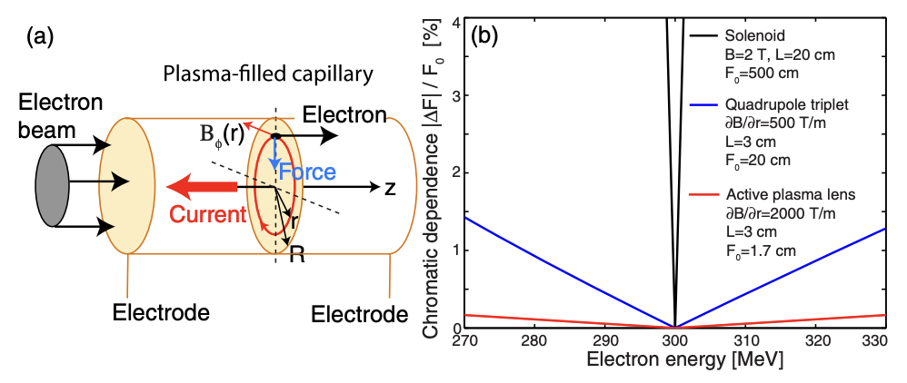
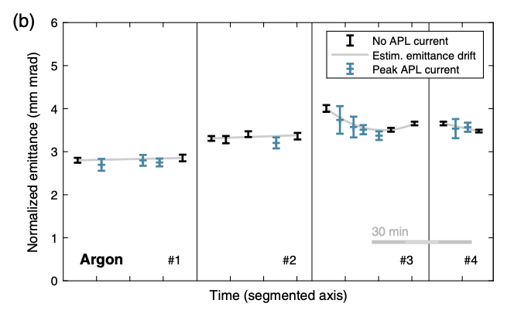
Active plasma lenses (APL)
APLs offer a compact method for refocusing the beam into subsequent stages
High gradient, axisymmetric, tunable
  Charge capture
  Beta function matching
Emittance preservation has been demonstrated
Wakefield generation poses issues for high charge electron beams
J. van Tilborg et al. “Active Plasma Lensing for Relativistic Laser-Plasma-Accelerated Electron Beams” Phys. Rev. Lett. 115, 184802 (2015)
C. A. Lindstrøm et al. “Emittance Preservation in an Aberration-Free Active Plasma Lens”, Phys. Rev. Lett. 121, 194801 (2018)

Slide 31
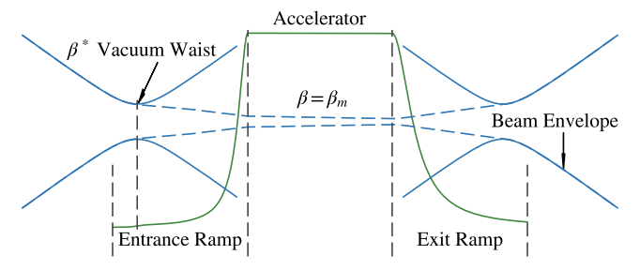
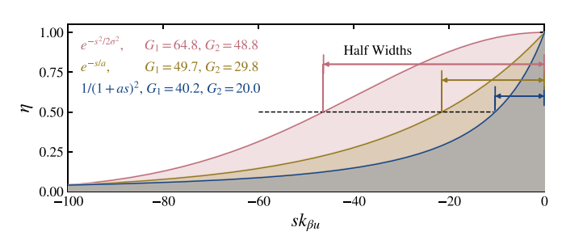
Plasma density ramps
Plasma density ramps will be a vital tool for electron beam coupling:
  Provide beam collimation, facilitating transport and capture
  They increase the acceptable beta-function of a stage
  They increase alignment tolerances
Key questions:
  How to maintain driver intensity in long (cm scale) ramps?
  How can we produce tailored ramps?
R. Ariniello “Transverse beam dynamics in a plasma density ramp” Phys. Rev. Accel. Beams 22, 041304 (2019)
R. Ariniello “Chromatic transverse dynamics in a nonlinear plasma accelerator” Phys. Rev. Research 4, 043120 (2022)

Slide 32
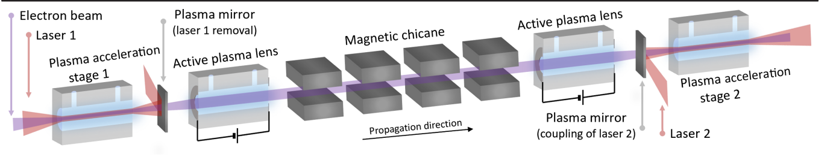
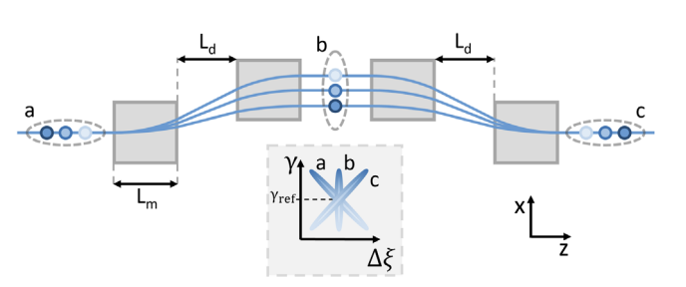
Magnetic chicanes for energy spread correction
A. Ferran Pousa, A. Martinez de la Ossa, R. Brinkmann, and R. W. Assmann, “Compact Multistage Plasma-Based Accelerator Design for Correlated Energy Spread Compensation” Phys. Rev. Lett. 123, 054801 (2019)
In the absence of perfect beam loading, each stage will introduce correlated energy spread
The use of magnetic chicanes has been suggested to flip the electron bunch longitudinally before entering the second stage, which would ideally then undo the applied chirp.

Slide 33
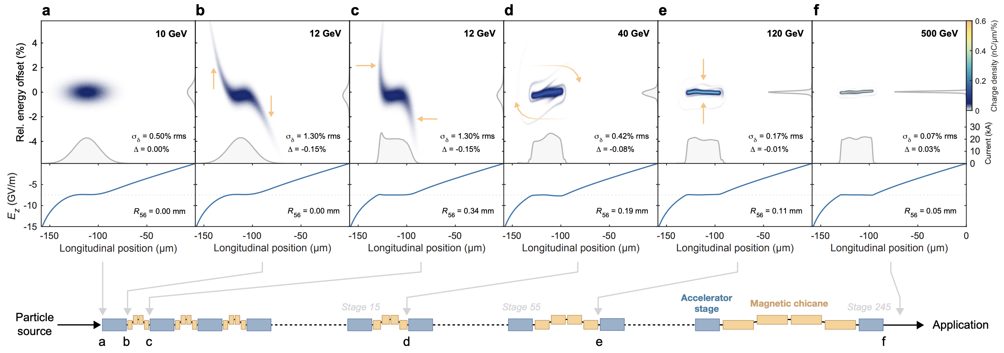
Improving tolerances
Source: Carl A. Lindstrøm “Self-correcting longitudinal phase space in a multistage plasma accelerator” arxiv (2021)
Using a similar scheme, it has been shown that a sequence of such chicanes provides a self-correction mechanism, increasing tolerances to timing jitter, energy, and initial current profile
This also works for laser drivers with dephasing, although the achievable minimum energy spread is reduced

Slide 34
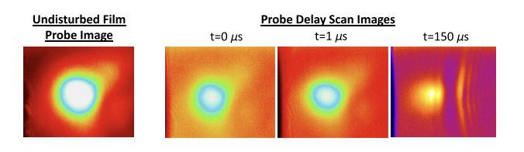
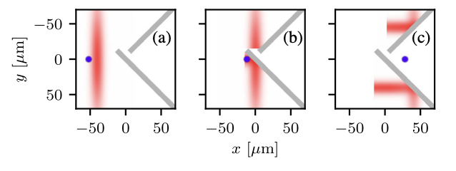
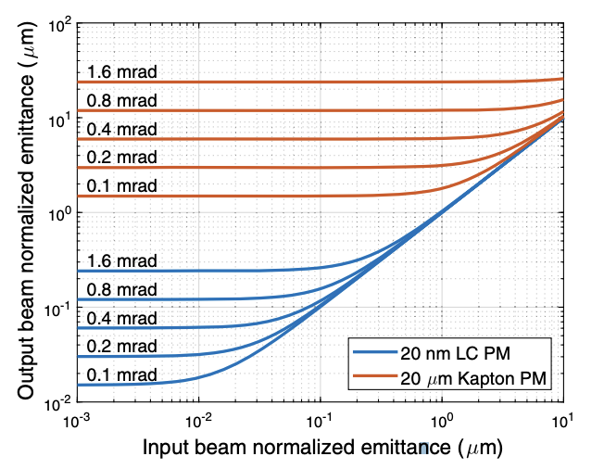
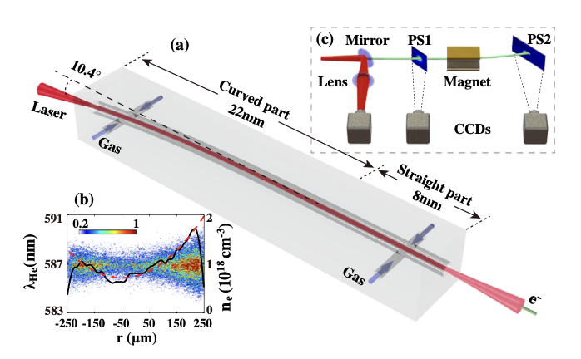
Driver coupling
20nm thin plasma mirror to mitigate scattering
ICS mitigation strategies
M. J. V. Streeter and Z. Najmudin
“Compton recoil effects in staging of laser wakefield accelerators“ Phys. Rev. Accel. Beams 23, 071602 (2020)
Curved plasma channel demonstration
Xinzhe Zhu et al. “Experimental Demonstration of Laser Guiding and Wakefield Acceleration in a Curved Plasma Channel” Phys. Rev. Lett. 130, 215001 2023
A. Zingale et al. “Emittance preserving thin film plasma mirrors for GeV scale laser plasma accelerators” Phys. Rev. Accel. Beams 24, 121301 (2021)

Slide 35
Summary
For LWFA staging, the most pressing near term challenge is to demonstrate high charge capture and large energy gain.
Following this, the main challenge will be to demonstrate emittance preservation. This requires:
  Beta-function matching
  Increased alignment precision
Prospects include:
  Active plasma lenses for high-gradient focusing,
  Density ramp exploitation
  Magnetic chains for energy stability
  Exotic plasma mirrors and curved channels for driver coupling
THANK YOU FOR LISTENING

