Slide 1


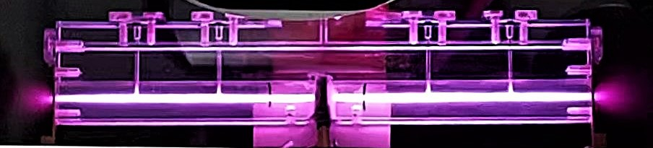




Segmented plasma discharge capillary for staged particle acceleration
6° European Advanced Accelerator Concepts workshop, 17 – 23rd September 2023 La Biodola Bay, Isola d'Elba, Italy
Lucio Crincoli
On behalf of the SPARC_LAB collaboration

Slide 2
Outline
Introduction
Plasma discharge capillaries at SPARC_LAB
Segmented capillary
Design and experimental setup
Design and experimental setup
Testing and characterization
Integrated capillary for focusing and acceleration
Electron beams acceleration and focusing at SPARC_LAB
Conclusions
Testing and characterization
Applications
Lucio Crincoli | 6° European Advanced Accelerator Concepts workshop

Slide 3
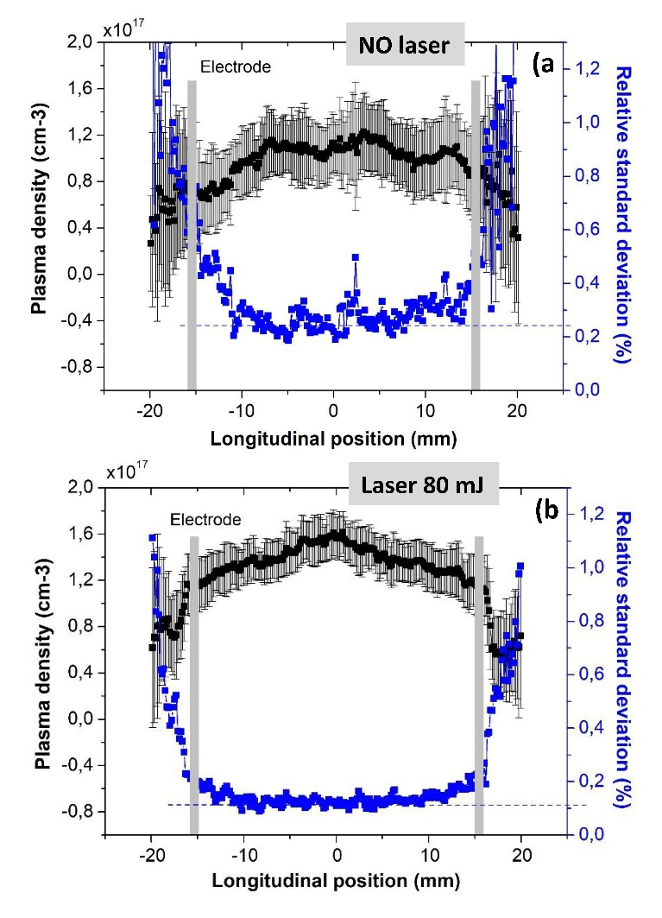
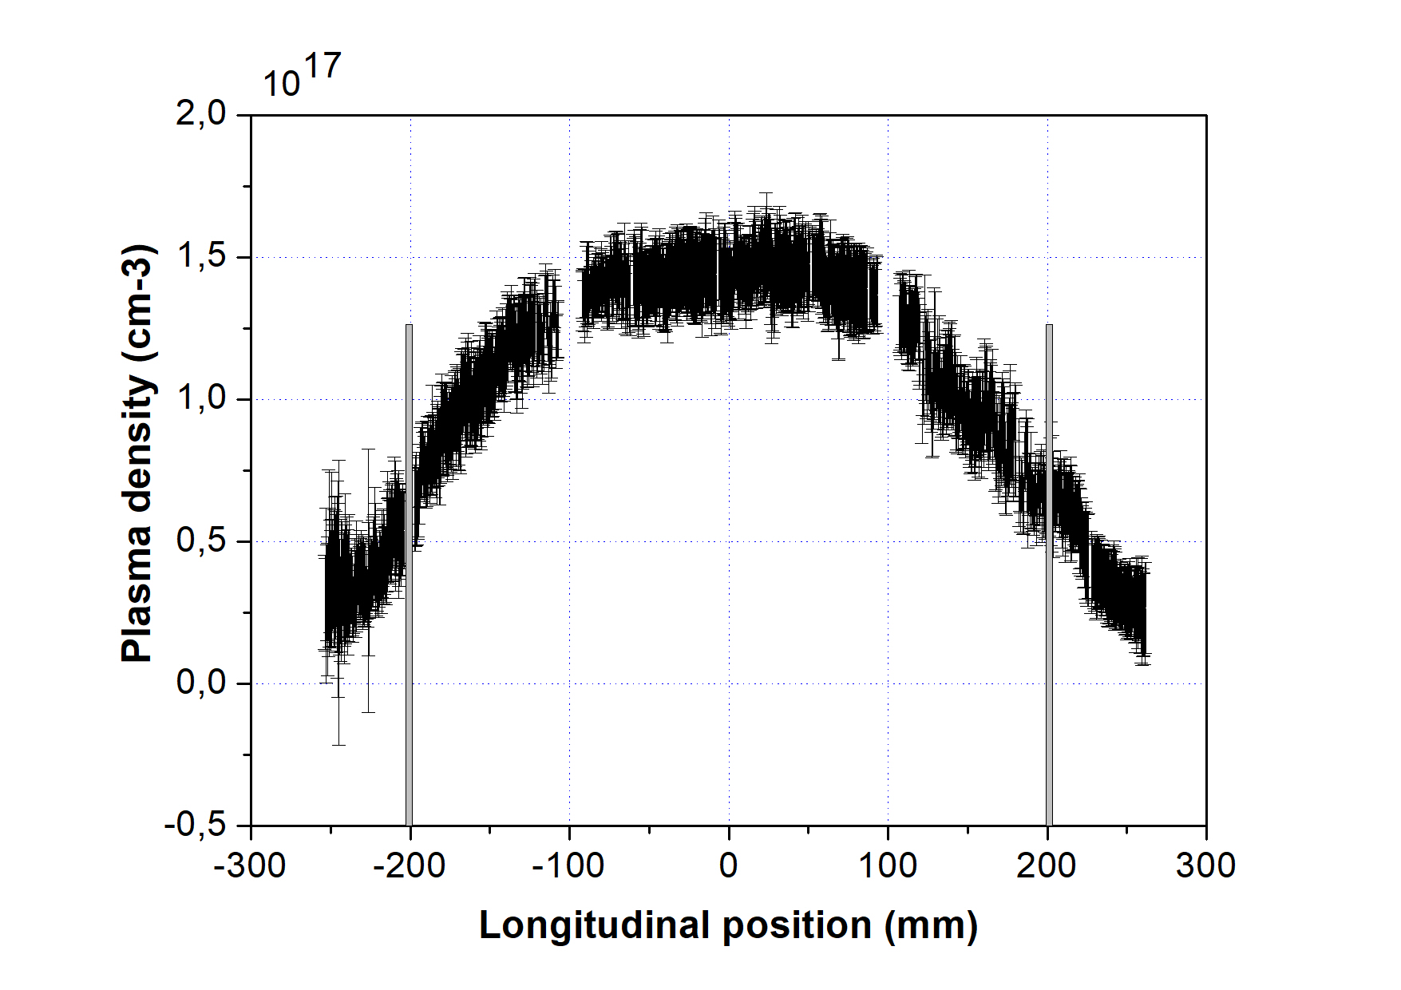
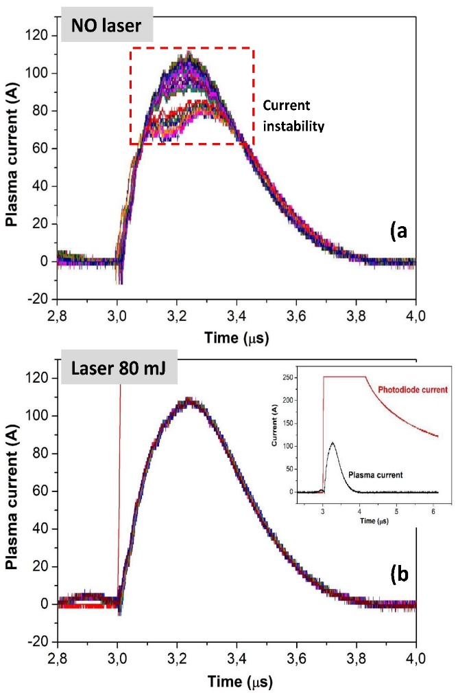
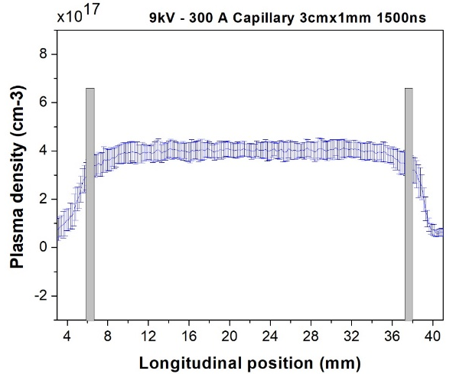
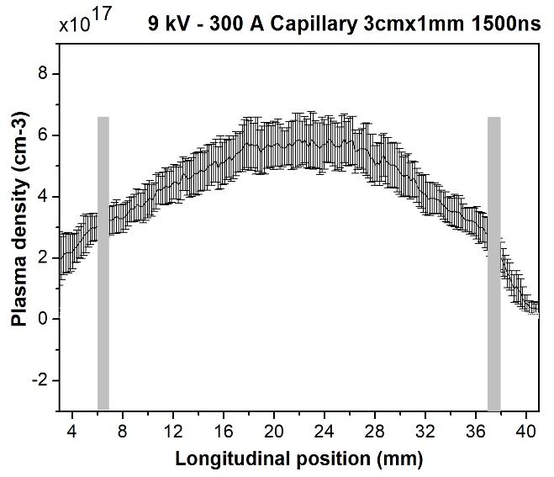
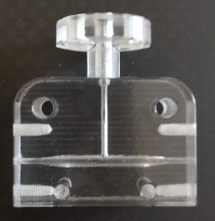
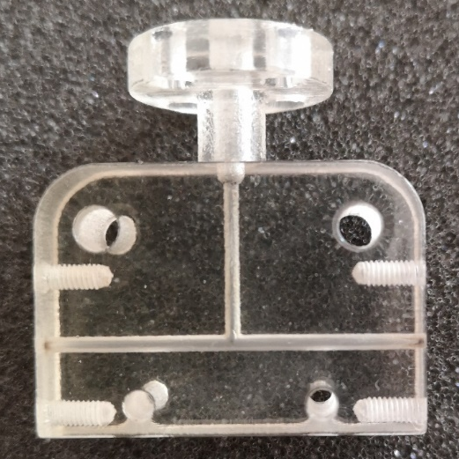
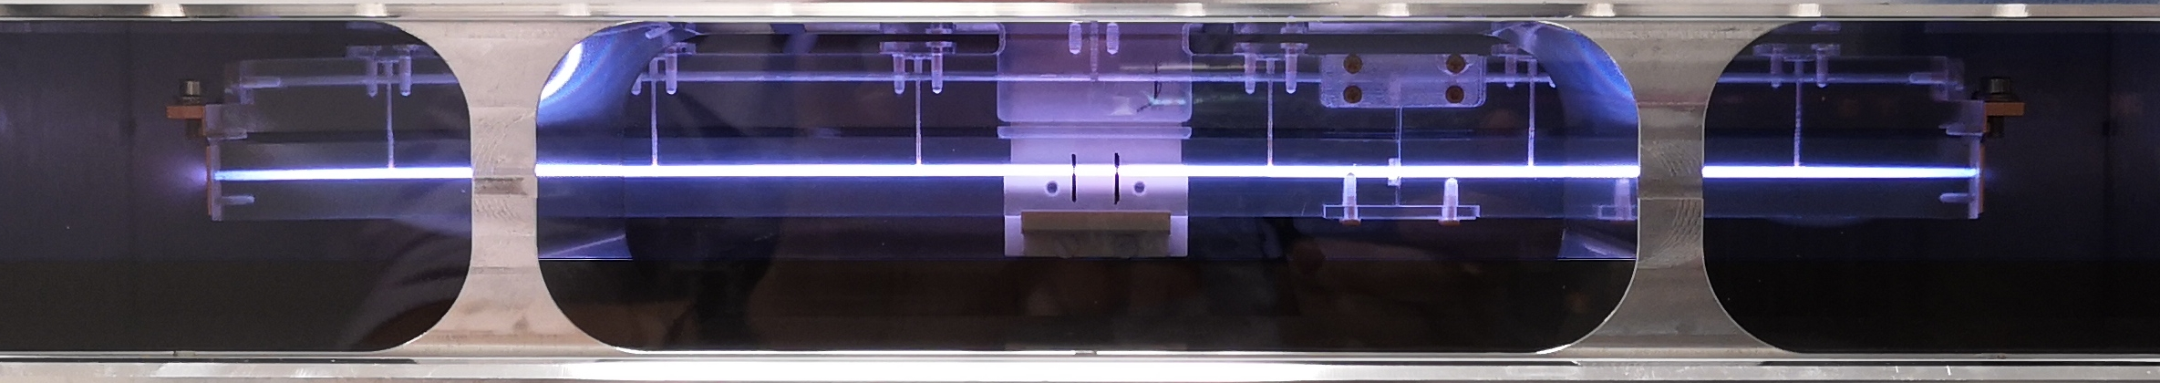
Plasma discharge capillaries at SPARC_LAB
Plasma discharge capillaries R&D
Plasma density profile modulation
Shot-to-shot stability
Very long sources for EuPRAXIA (m-scale)
Cigar shape
1.4mm/1mm
Linear shape
1mm
A Biagioni et al 2021 Plasma Phys. Control. Fusion 63 115013
Lucio Crincoli | 6° European Advanced Accelerator Concepts workshop

Slide 4
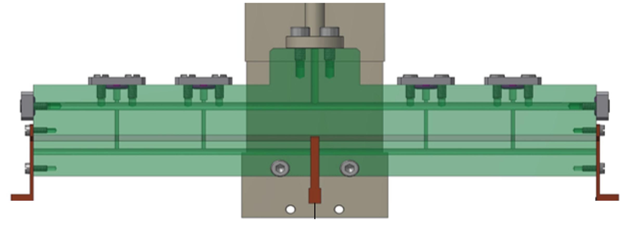
Segmented capillary
Independent plasma discharges
Parallel HV circuits
Modulation of longitudinal plasma density profile
Cheap and compact m-scale sources
HV
HV
Lucio Crincoli | 6° European Advanced Accelerator Concepts workshop

Slide 5
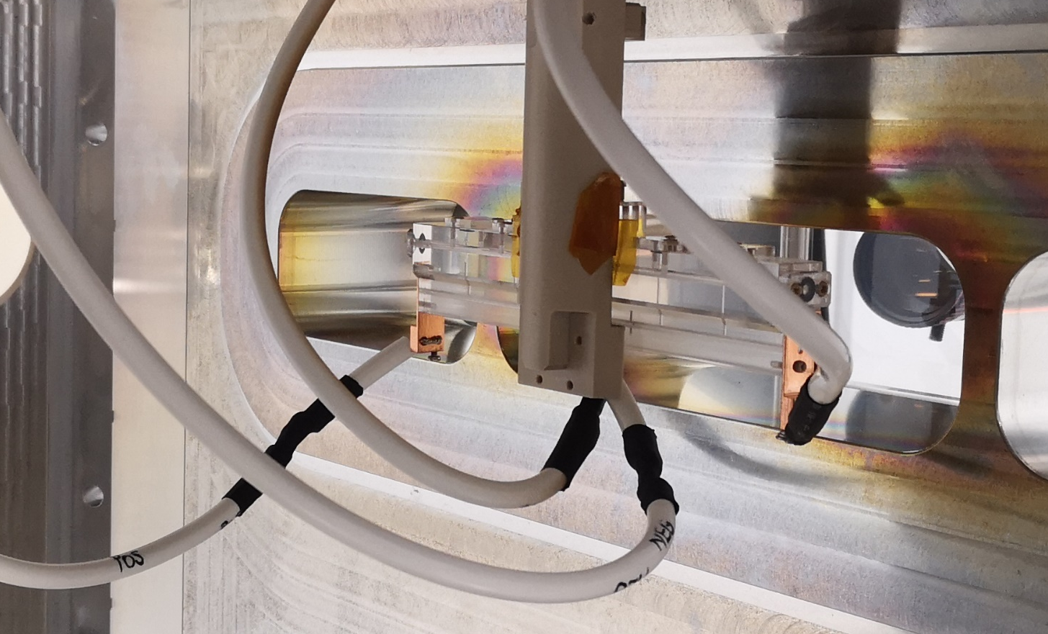
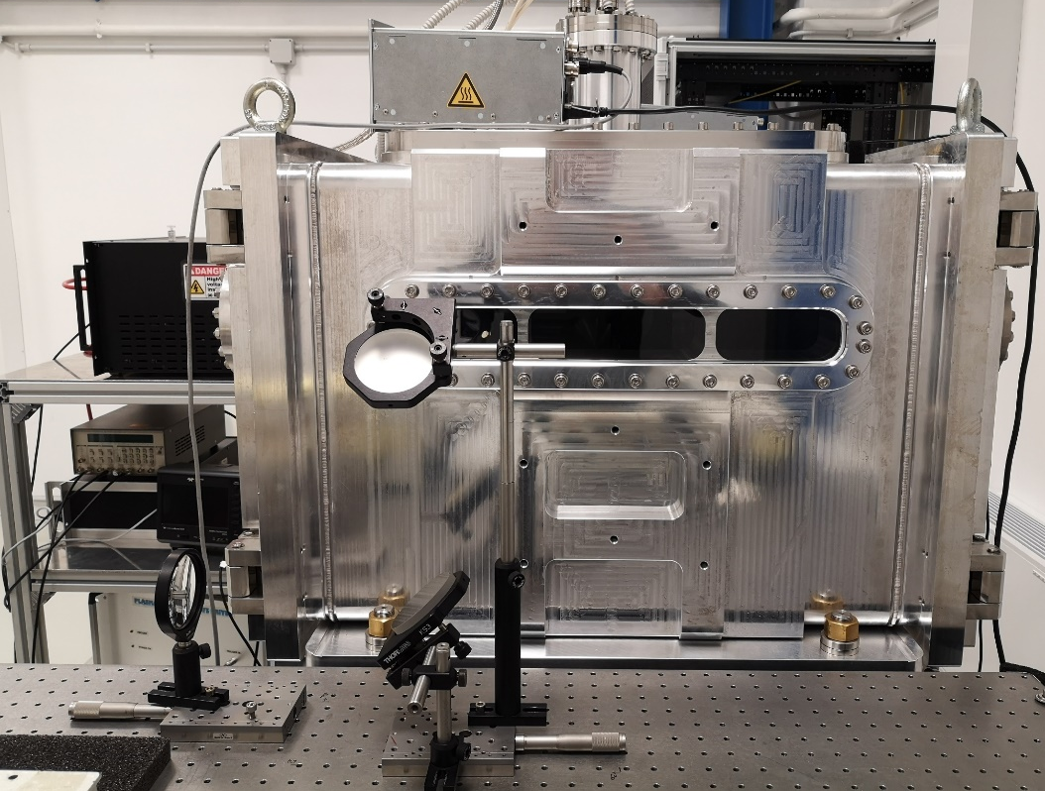
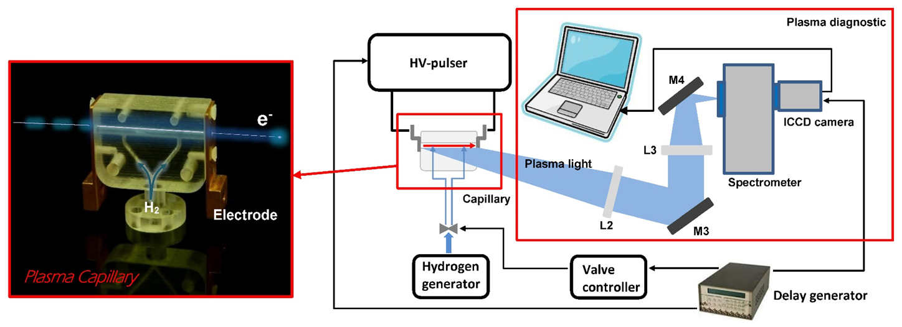
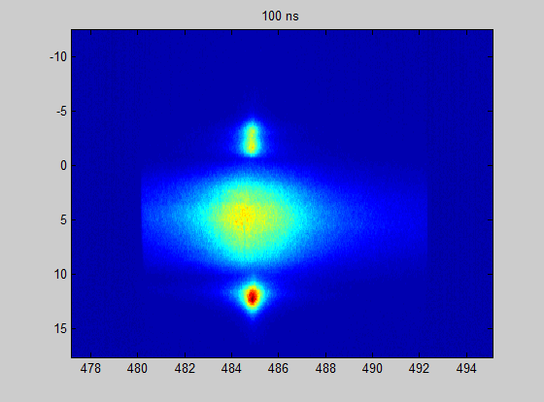
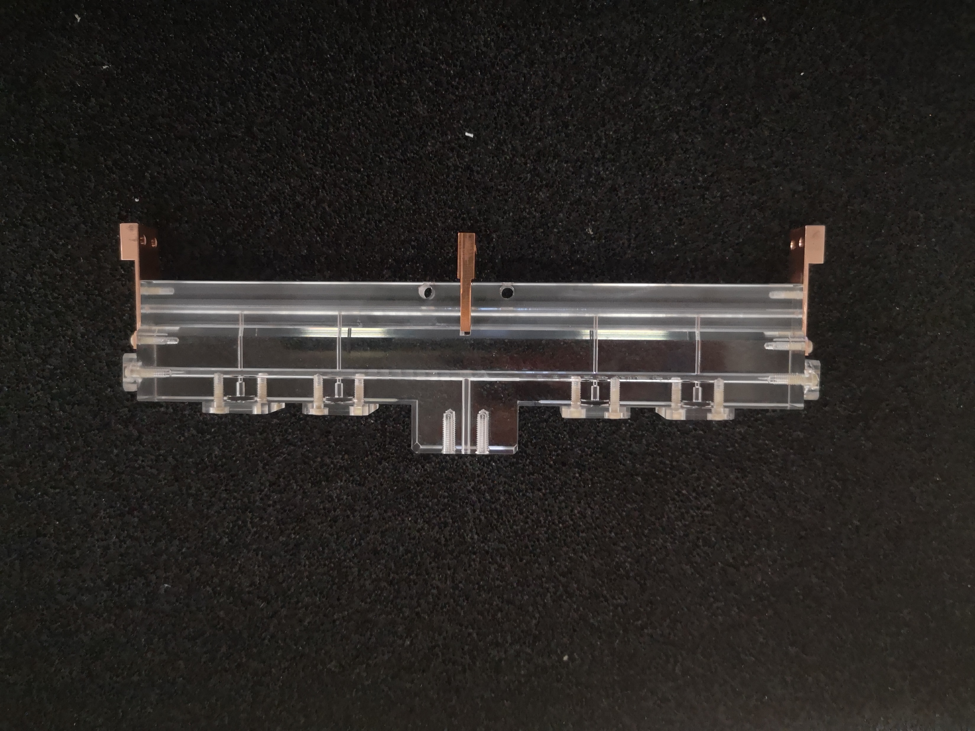
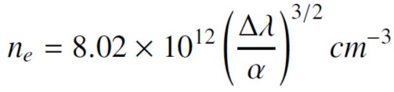
Segmented capillary: Design and experimental setup
Capillary features
2 segments 8 cm long
2 mm diameter
Common grounded electrode
Experimental setup
2 HV generators and pulsers, one fo r each segment
5-20 kV voltage pulses
H2, N2, Ar neutral gas
10-50 mbar 1 Hz pulsed injection
Delay generator for discharge synchronization
Balmer β line
Position (mm)
Δλ
Electrode
shadow
Capillary
Plasma
channel
Plasma plume
λ (nm)
Lucio Crincoli | 6° European Advanced Accelerator Concepts workshop

Slide 6
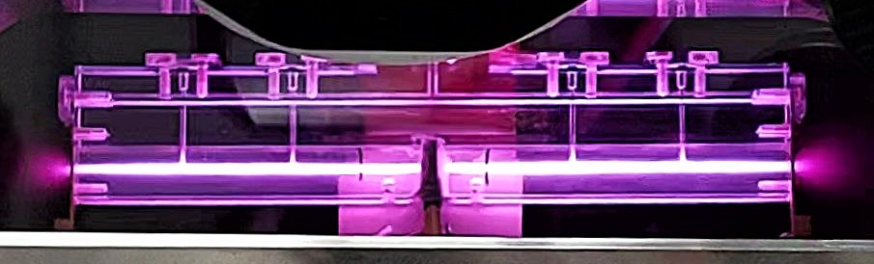
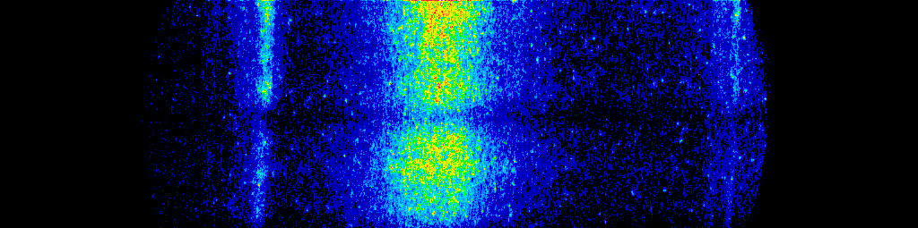
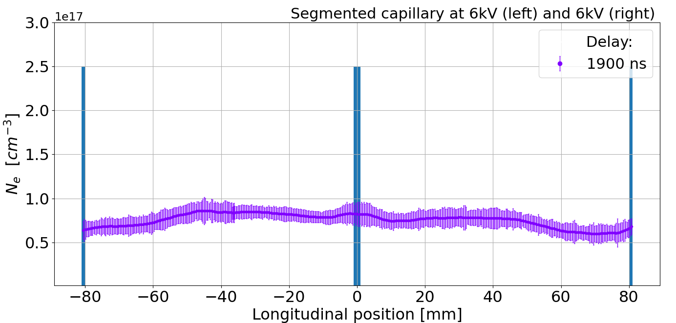
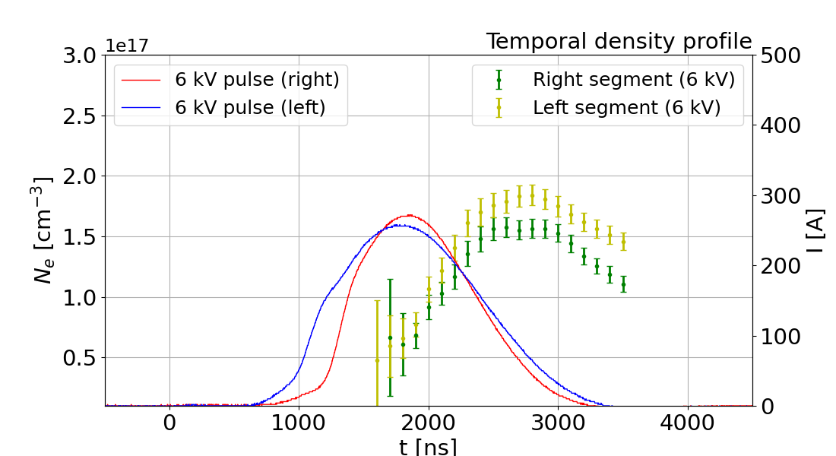
Segmented capillary: Testing and characterization
1st test
Goal
Uniform density profile
Test settings
Left segment: 6 kV
Right segment: 6 kV
Results
Symmetric distribution until 2000 ns
Density gradient after 2000 ns
6 kV
6 kV
H_{β} Balmer spectral line acquired by ICCD camera
Central electrode
Lucio Crincoli | 6° European Advanced Accelerator Concepts workshop
6

Slide 7
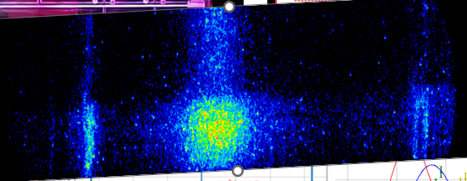
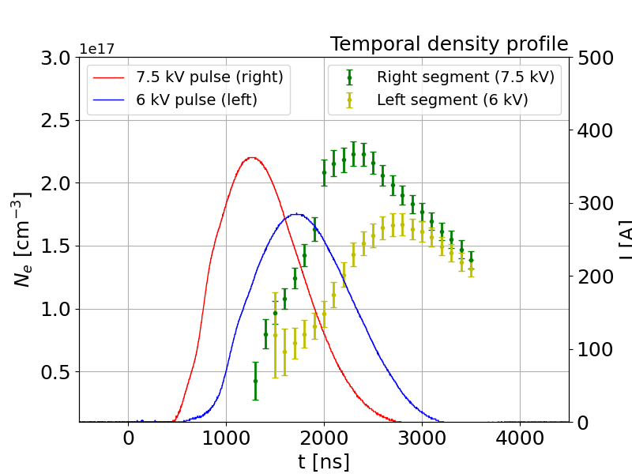
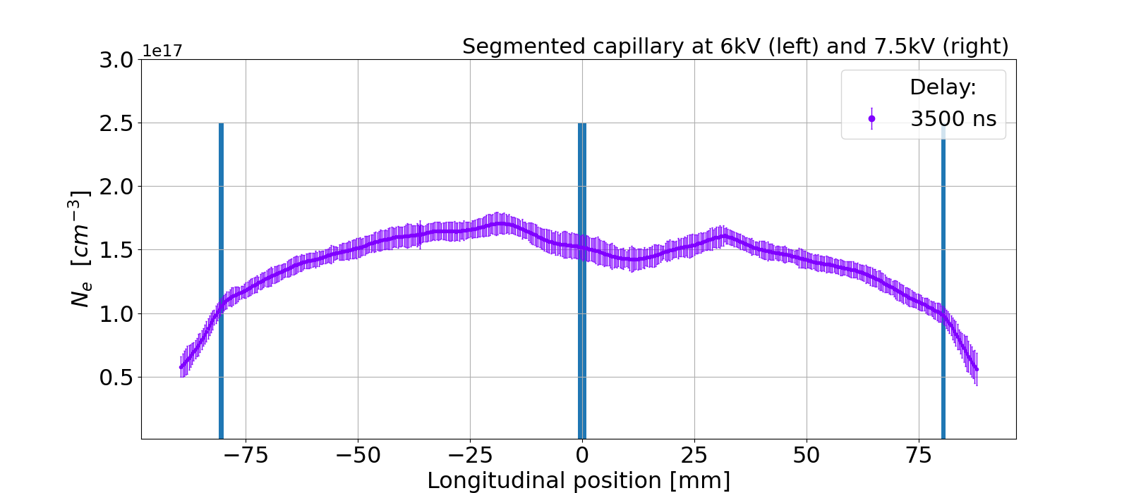
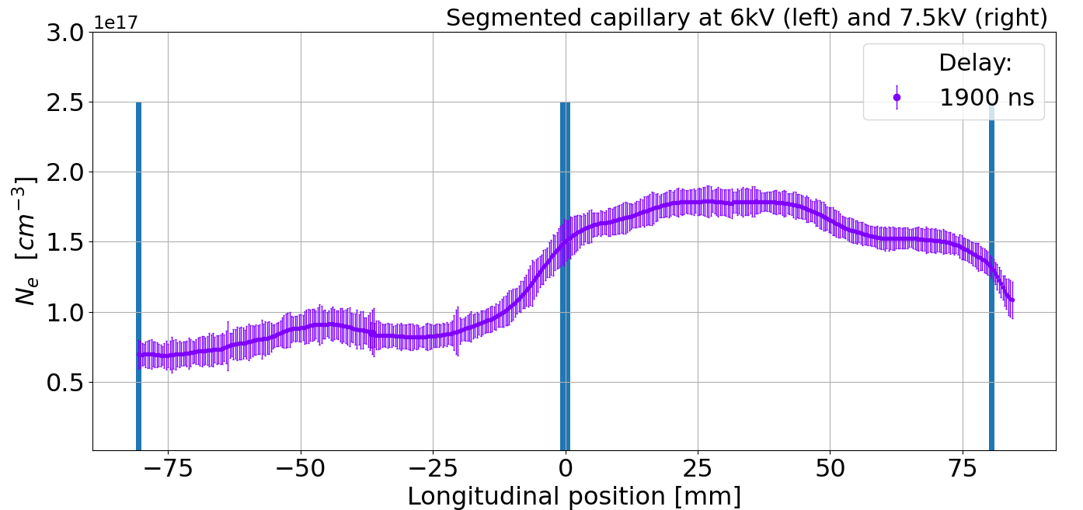
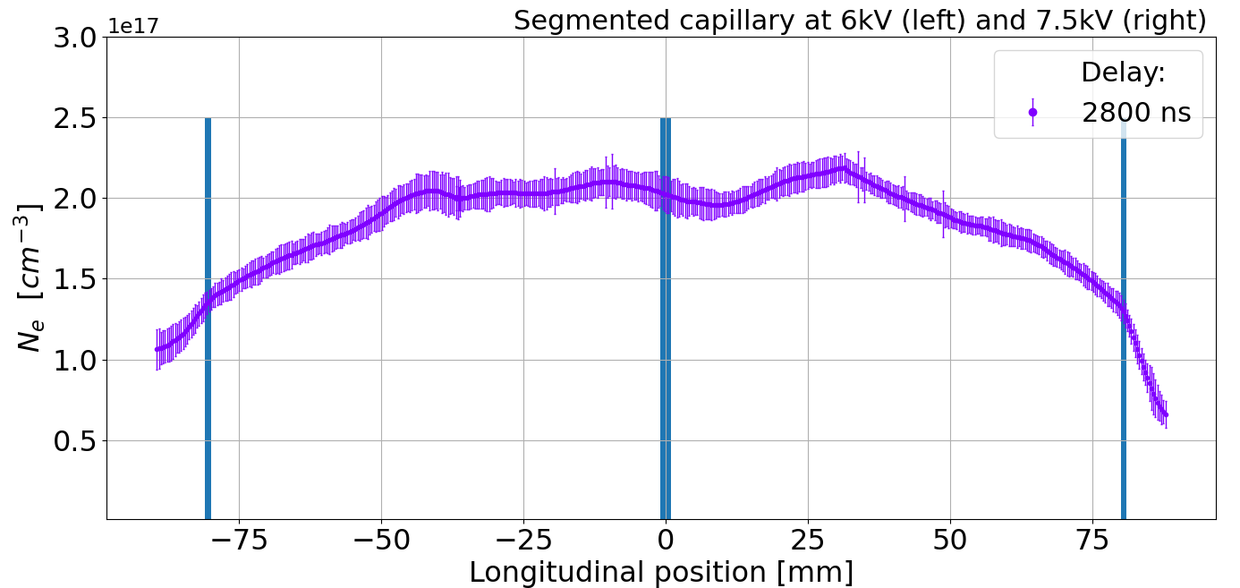
Segmented capillary: Testing and characterization
2nd test
Goal
Steep density gradient at segments crossing
Test settings
Left segment: 6 kV
Right segment: 7.5 kV
Results
Density gradient at until 2500 ns
Symmetric distribution after 2500 ns
6 kV
7.5 kV
H_{β} Balmer spectral line acquired by ICCD camera
Central electrode
Lucio Crincoli | 6° European Advanced Accelerator Concepts workshop
7

Slide 8
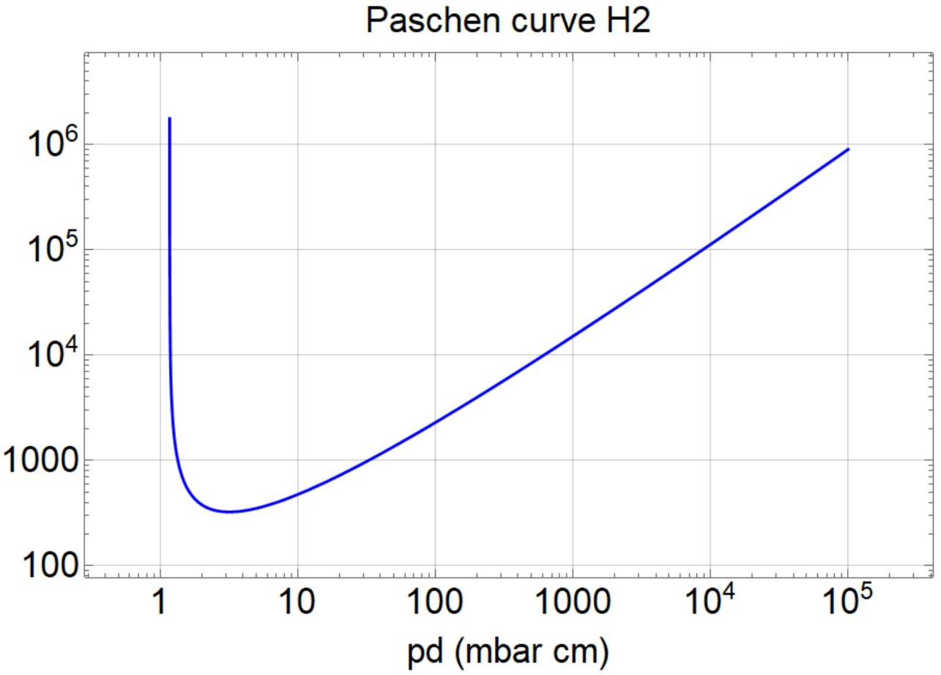
Segmented capillary: Applications
m-scale sources:
Continuous vs segmented channels
Vb (V)
16 cm capillary
Single segment
  16 cm, 20 mbar
2 segments
  8 cm, 20 mbar
70 kV
14 kV
6 kV
3 kV
EuPRAXIA 5 GeV case (1.5 GV/m)
Single segment
  3 m, 20 mbar
7 segments
  40 cm, 20 mbar
16 cm
40 cm
8 cm
3 m
Lucio Crincoli | 6° European Advanced Accelerator Concepts workshop
8

Slide 9
Integrated capillary for staged focusing and acceleration
APL1
PWFA
APL2
HV
Mixer
Lucio Crincoli | 6° European Advanced Accelerator Concepts workshop

Slide 10
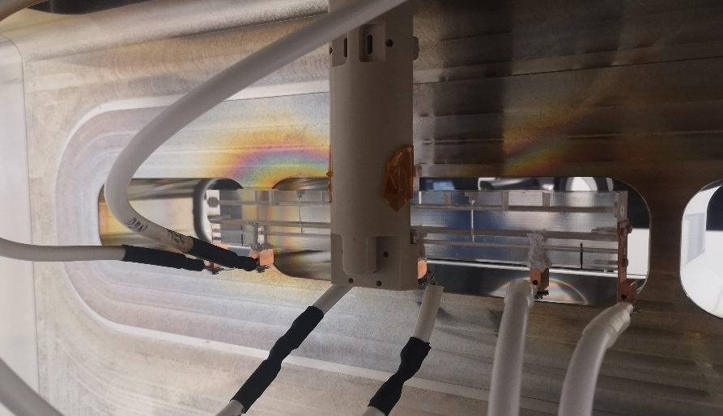
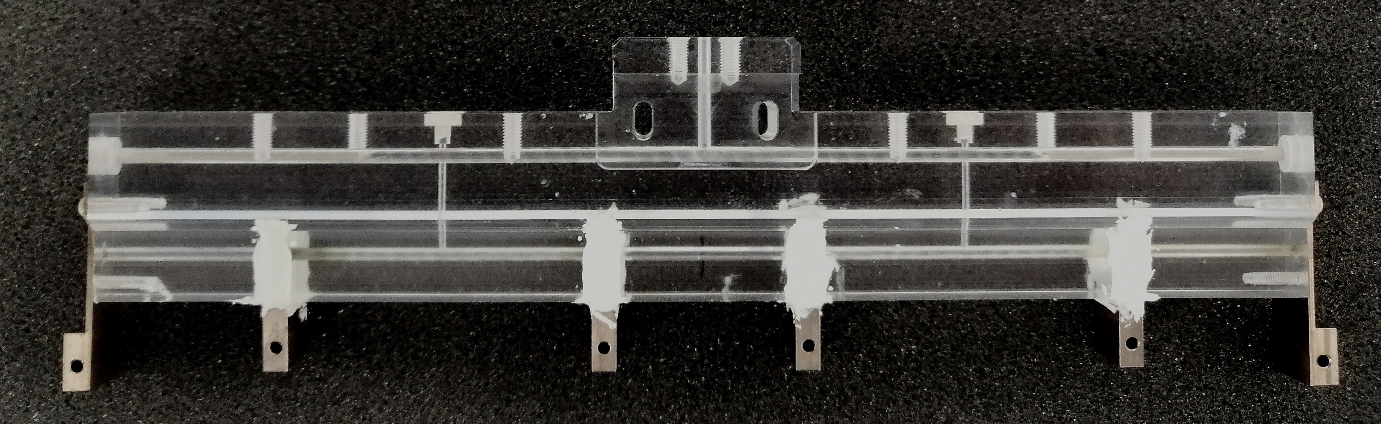
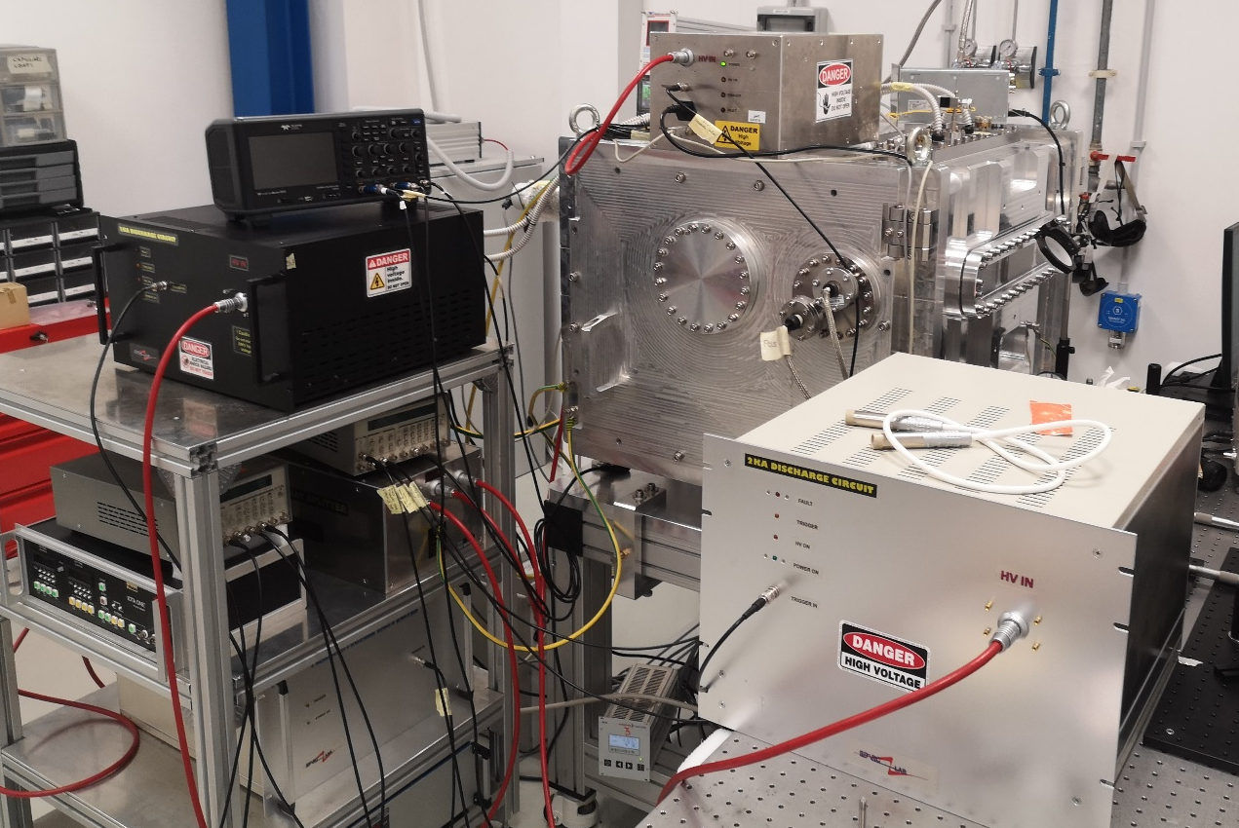
Integrated capillary: Design and experimental setup
Design
3 segments, each 3 cm long
  2 active plasma lenses
  1 accelerating stage
5 cm long drifts
2 Inlets in the drifts
2 mm diameter
APL1
ACC
APL2
Experimental setup
1 High voltage generator
HV mixer feeding 3 parallel pulsers
Alternating polarization
HV pulser
HV pulser
HV pulser
HV generator
Mixer
Lucio Crincoli | 6° European Advanced Accelerator Concepts workshop

Slide 11
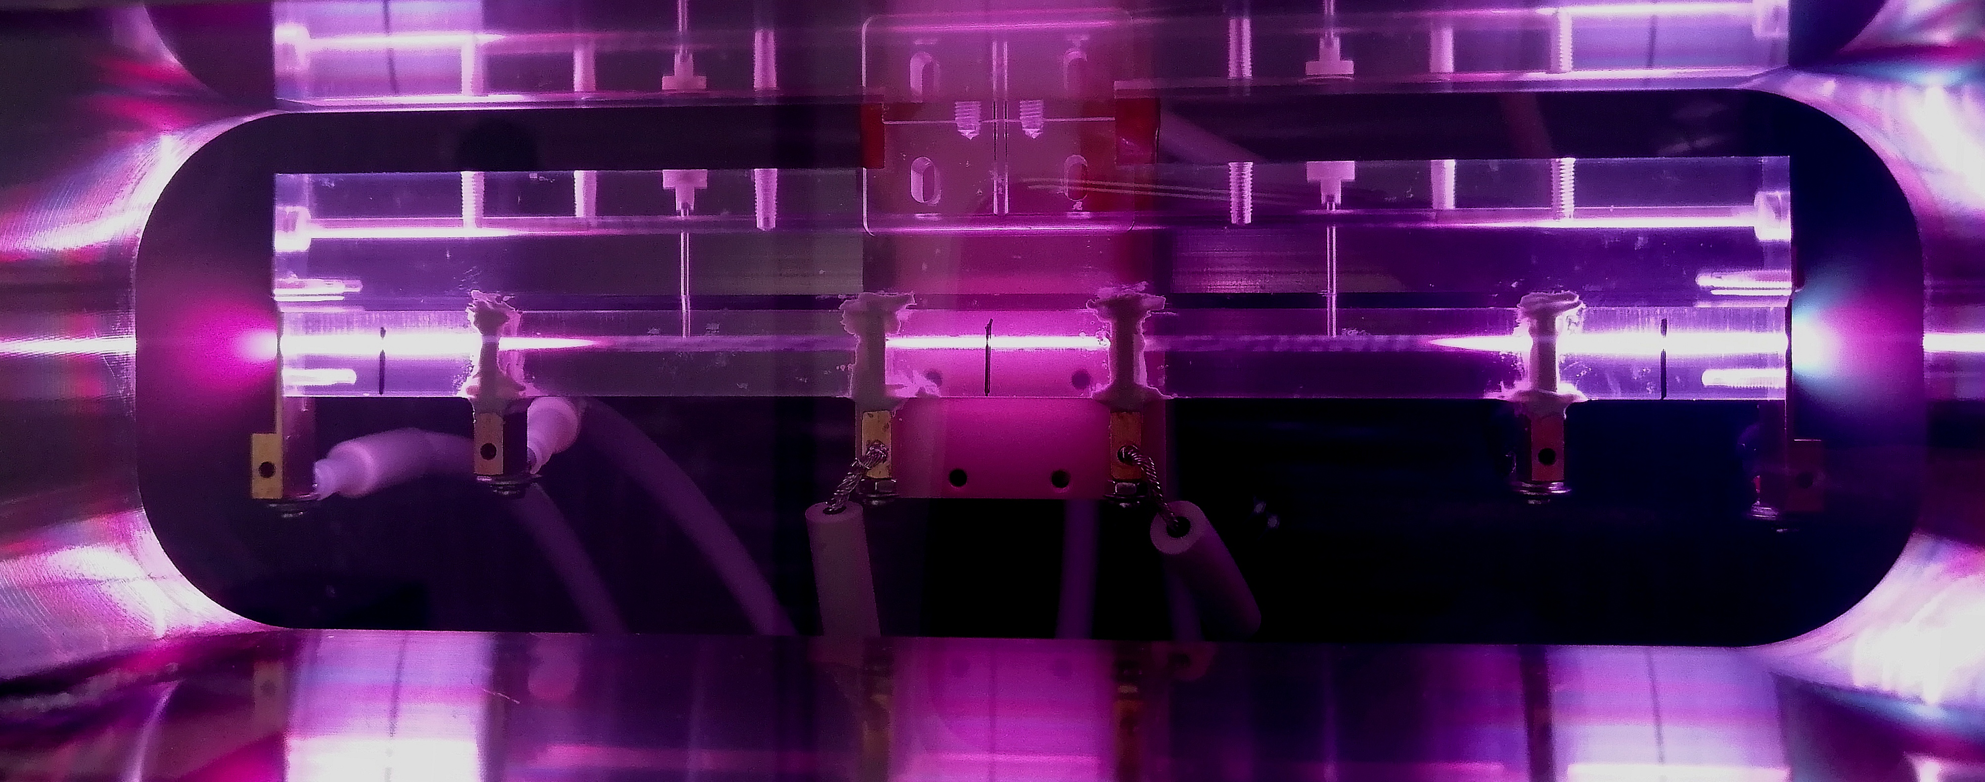
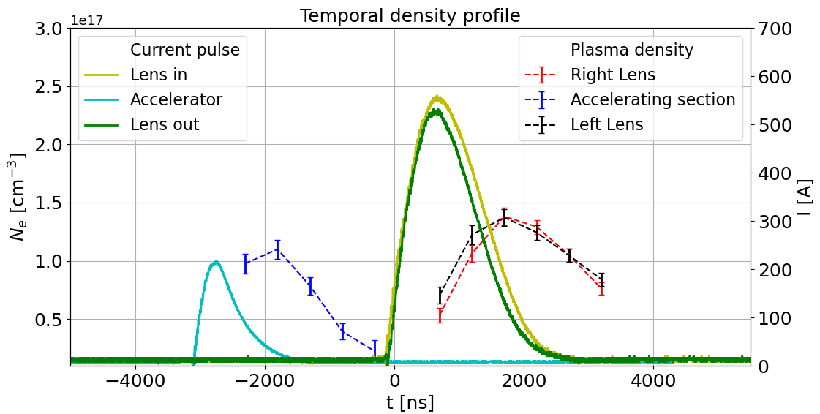
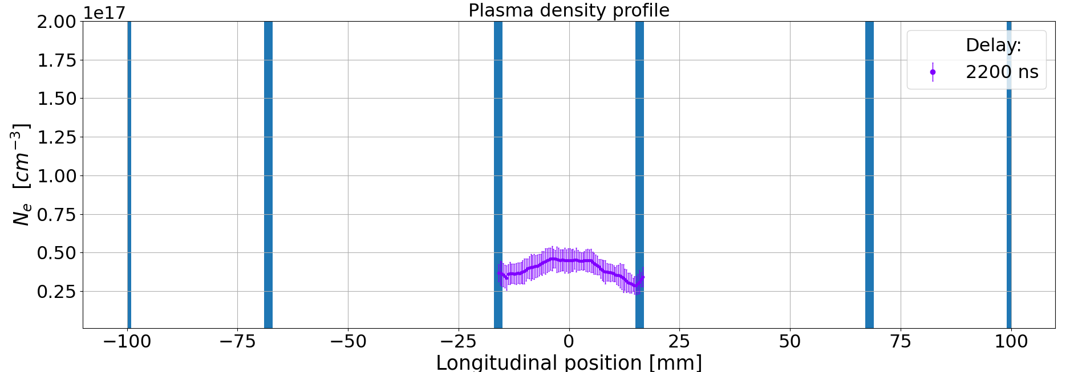
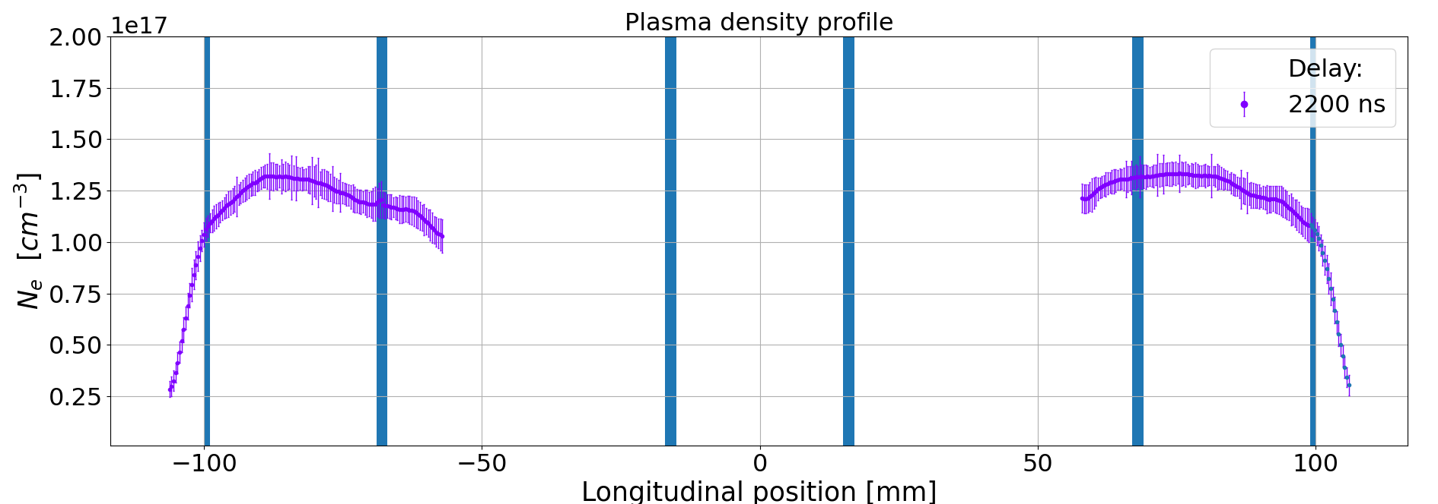
Integrated capillary: Testing and characterization
Operating properties
Discharges synchronization
  Lenses synchronized with the beam entrance
  Central discharge applied 3 µs before for plasma acceleration
10 kV voltage resulting in:
  500 A on the lenses
  250 A in the accelerator
Internal drifts behave like spacers
Lucio Crincoli | 6° European Advanced Accelerator Concepts workshop
11

Slide 12
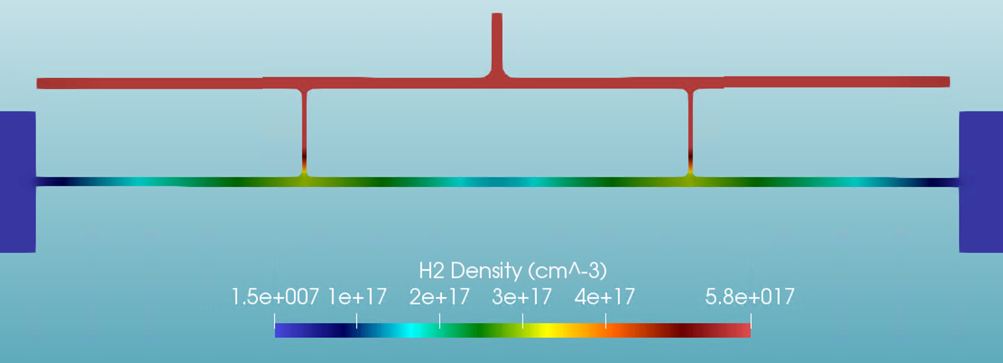
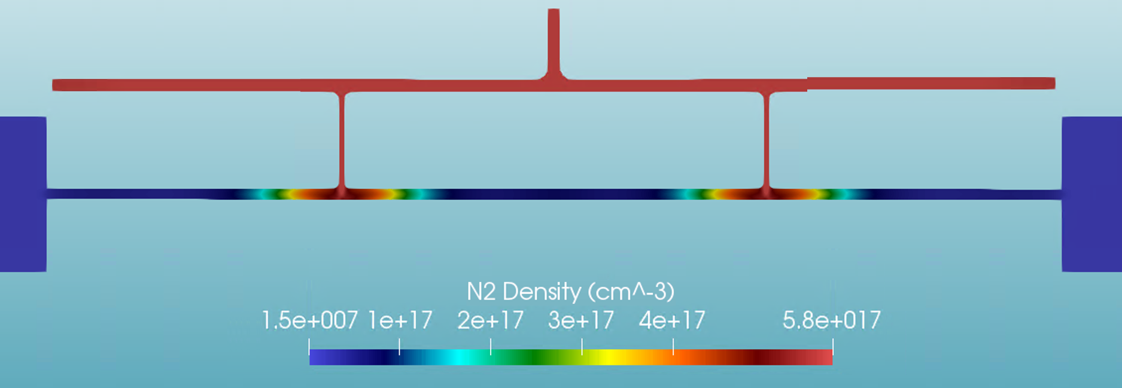
Integrated capillary: Testing and characterization
Crosstalk
Central discharge triggers the side ones
Voltage dependence
Gas species dependence:
  Worse with nitrogen
  Better with hydrogen
Electrode sputtering
Lucio Crincoli | 6° European Advanced Accelerator Concepts workshop
12

Slide 13
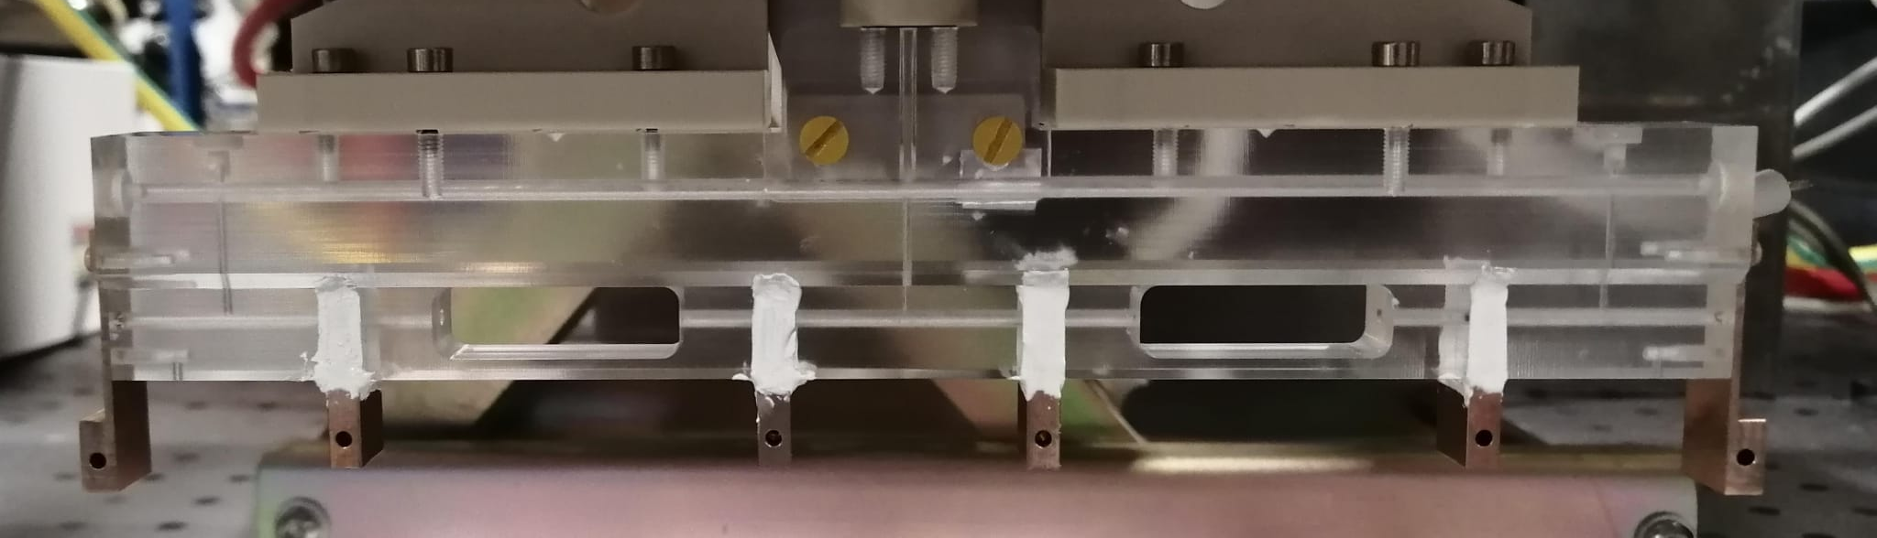
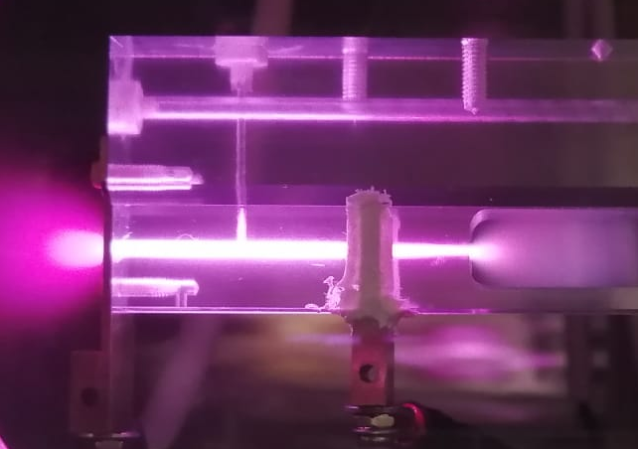
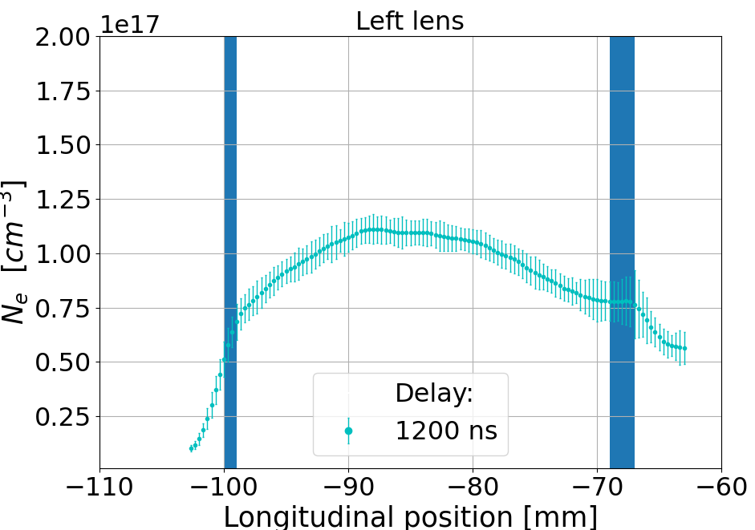
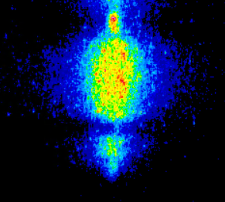
Integrated capillary: Testing and characterization
Upgraded version
Inlets directly injecting in the stages
Open drifts to reduce electrical conductivity
Tungsten-copper electrodes
Reduced crosstalk
H_{β} Balmer spectral line acquired by ICCD camera
Lucio Crincoli | 6° European Advanced Accelerator Concepts workshop
13

Slide 14
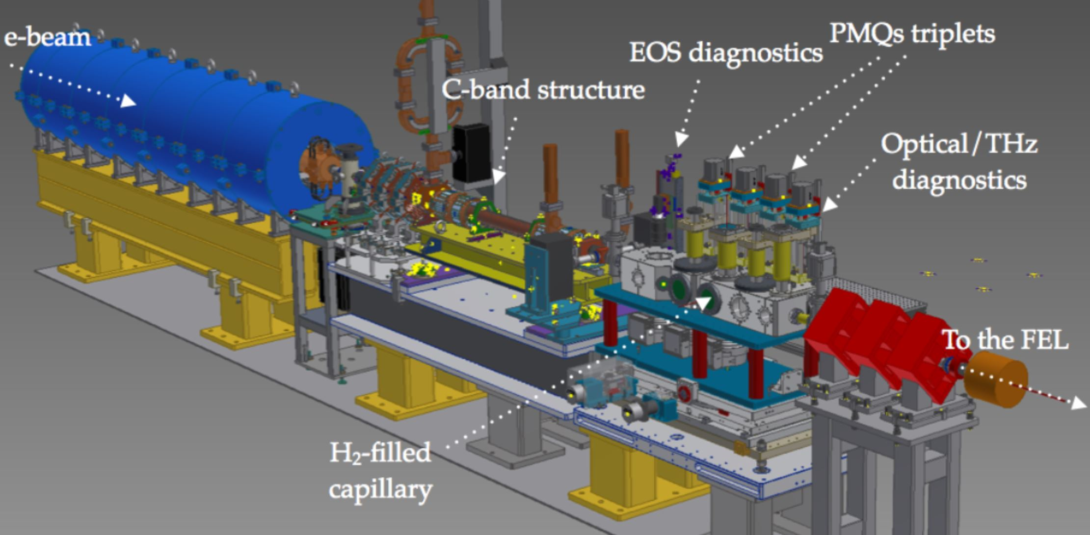
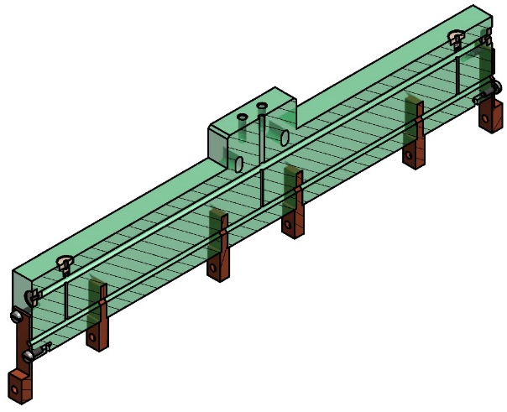
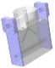
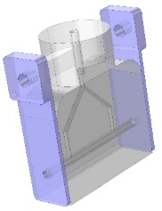
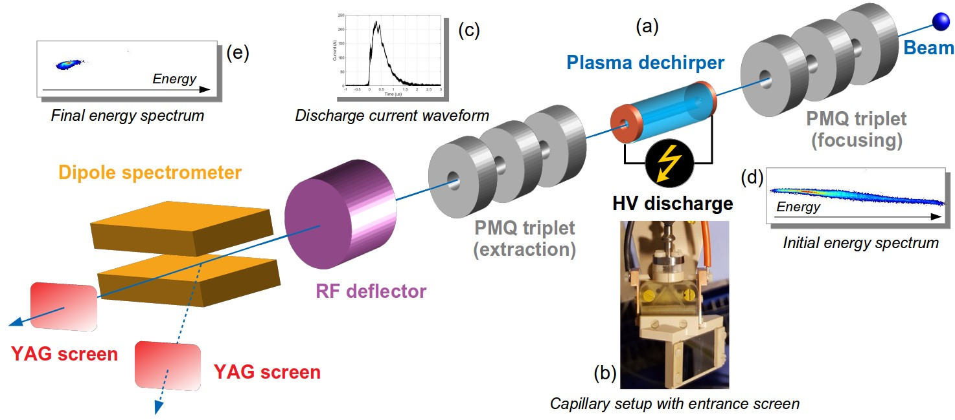
Integrated capillary: staged focusing-acceleration at SPARC_LAB
PMQs triplets
EOS diagnostics
e-beam
Electron beam focusing and acceleration at SPARC_LAB
C-band structure
Optical/THz diagnostics
To the FEL
H2 filled capillary
Active plasma lens
Acelerating
section
Integrated plasma module
Focusing
lens
Plasma capillary
Plasma capillary
Extraction
lens
Lucio Crincoli | 6° European Advanced Accelerator Concepts workshop
14

Slide 15
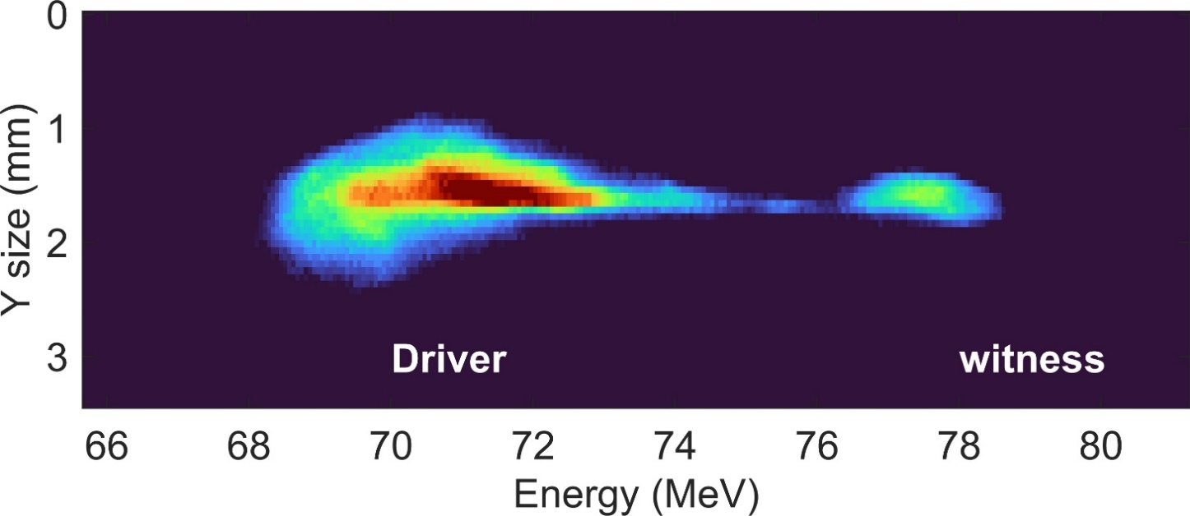
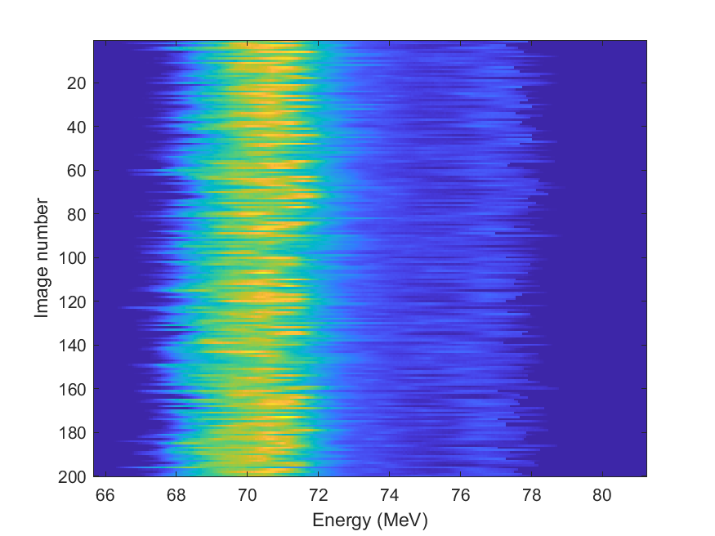
Integrated capillary: staged focusing-acceleration at SPARC_LAB
200 consecutive shots taken with accelerated beam
200 pC driver – 50 pC witness
Plasma density for acceleration: 2x10¹⁵ cm⁻³
133 MV/m accelerating gradient
Stable accelerated beam
Riccardo Pompili’s talk - Thursday WG1
Lucio Crincoli | 6° European Advanced Accelerator Concepts workshop
15

Slide 16
Conclusions
Segmented capillary:
  Independent plasma discharges
  Modulation of longitudinal plasma density profile
    Steep density gradient
    Uniform plasma channel
  m- scale sources
Integrated capillary:
  Staged focusing-acceleration of e- beams
  133 MV/m accelerating gradient
Lucio Crincoli | 6° European Advanced Accelerator Concepts workshop
16

Slide 17
Thank you for the attention
6° European Advanced Accelerator Concepts workshop, 17 – 23rd September 2023 La Biodola Bay, Isola d'Elba, Italy

