Slide 1
Optical Probing of Ultrafast Laser-Induced Transitions from Solid to Overdense Plasma
Y. Azamoum^{1,2}, G. A. Becker², S. Keppler^{1,2}, G. Duchateau³, S. Skupin⁴, M. Grech⁵, F. Catoire⁶, I. Tamer^{1,2}, M. Hornung^{1,2}, and M. C. Kaluza^{1,2}
¹Helmholtz Institute Jena, Germany.
²Institute of Optics and Quantum Electronics, Jena, Germany.
³CEA, CESTA, Le Barp, France
⁴Institut Lumière Matière, Université Lyon 1 - CNRS, Villeurbanne, France.
⁵LULI, CNRS, CEA, Sorbonne Université, IP Paris, Palaiseau, France.
⁶Université de Bordeaux-CNRS-CEA, CELIA, France.
Notes:
Logos : HIJ, FSU, ILM, LULI, CEA le Barp, U bordeaux
Highlight collaboration
13 min → 13 slides

Slide 2
Outline
Motivation
- Laser-driven ion acceleration
Methods
- Experiment: Single-shot space & time – resolved probe transmission - Modeling: Strategies
Results
- Ionization processes
- Plasma dynamics
Outlook
Notes:
Motivation: Ion acceleration in the relativistic transparency Regime
Outline: giving a summary of something
Outlook: point of view in general

Slide 3
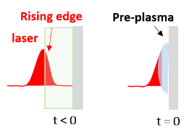
Motivation
Laser-driven ion acceleration
Optimize accelerated ion beams in relativistic laser-ultrathin foil interaction
How?
Predict & control target behavior
Insight into pre-plasma evolution
Why?
Surface Interaction
Volumetric Interaction
pre-plasma
m_{e} → γ m_{e}
ω_{p} < ω_{L}
n_{e} $\sim$γ n_{c}
laser
E
laser
+
e-
laser
+
e-
+
e-
e-
+
e-
+
e-
+
µm
nm
RIT
nm
TNSA
RPA Light Sail
Target Normal Sheath Acceleration
Radiation pressure Acceleration
Relativistic-Induced Transparency
Optimize pre-plasma conditions
Avoid pre-plasma formation
Transparency of an overdense plasma at peak arrival
Mora, PRL 90, 185002 (2003)
Keppler et al., PRR 4, 013065 (2022)
Esirkepov et al., PRL 92, 175003 (2004)
Palaniyappan et al., Nature Physics 8, 763 (2012)
Notes:
Ensure occurrence of RIT
What is the state of the target before the fs-peak of the pulse?
x Too low, peak transmitted
x Too high less or no penetration
High power laser → Unique Rising Edge → Unique Pre-plasma
We propose here a method/strategy to reach a qualitively a good description of the transition from Solid to plasma
Example: Typical plasma formation during rising edge
-----------------------------------------------------------------------------------------------------------------------
1- Simple schemes: TNSA, RPA, RIT (ion acceleration from volume, basic understanding)
2- Preplasma either by rising edge or preplasma by controlled pre-pulse, for instance pre-expanded target
-----------------------------------------------------------------------------------------------------------------------
Focus only nanofoils → RIT
Ion acceleration → RIT
Plasma dynamics (space & time)
Investigation of initial stage of formation
Impact of this stage on the plasma state before the arrival of the relativistic peak
-----------------------------------------------------------------------------------------------------------------------
References are required
-----------------------------------------------------------------------------------------------------------------------
Remove Polaris from TNSA scheme
-------------------------
Choose protons or ions

Slide 4
Motivation
Laser-driven ion acceleration
Optimize accelerated ion beams in relativistic laser-ultrathin foil interaction
How?
Predict & control target behavior
Insight into pre-plasma evolution
Why?
Surface Interaction
Volumetric Interaction
pre-plasma
m_{e} → γ m_{e}
ω_{p} < ω_{L}
n_{e} $\sim$ γ n_{c}
laser
E
laser
+
e-
laser
+
e-
+
e-
e-
+
e-
+
e-
+
µm
nm
RIT
nm
TNSA
RPA Light Sail
Target Normal Sheath Acceleration
Radiation pressure Acceleration
Relativistic-Induced Transparency
Optimize pre-plasma conditions
Avoid pre-plasma formation
Transparency of an overdense plasma at peak arrival
Mora, PRL 90, 185002 (2003)
Keppler et al., PRR 4, 013065 (2022)
Esirkepov et al., PRL 92, 175003 (2004)
Palaniyappan et al., Nature Physics 8, 763 (2012)
Capture the target conditions before peak arrival!
What if one could describe the initial stage of plasma formation?
Plasma predictions at peak arrival closer to reality
Notes:
Ensure occurrence of RIT
What is the state of the target before the fs-peak of the pulse?
x Too low, peak transmitted
x Too high less or no penetration
High power laser → Unique Rising Edge → Unique Pre-plasma
We propose here a method/strategy to reach a qualitively a good description of the transition from Solid to plasma
Example: Typical plasma formation during rising edge
-----------------------------------------------------------------------------------------------------------------------
1- Simple schemes: TNSA, RPA, RIT (ion acceleration from volume, basic understanding)
2- Preplasma either by rising edge or preplasma by controlled pre-pulse, for instance pre-expanded target
-----------------------------------------------------------------------------------------------------------------------
Focus only nanofoils → RIT
Ion acceleration → RIT
Plasma dynamics (space & time)
Investigation of initial stage of formation
Impact of this stage on the plasma state before the arrival of the relativistic peak
-----------------------------------------------------------------------------------------------------------------------
References are required
-----------------------------------------------------------------------------------------------------------------------
Remove Polaris from TNSA scheme
-------------------------
Choose protons or ions

Slide 5
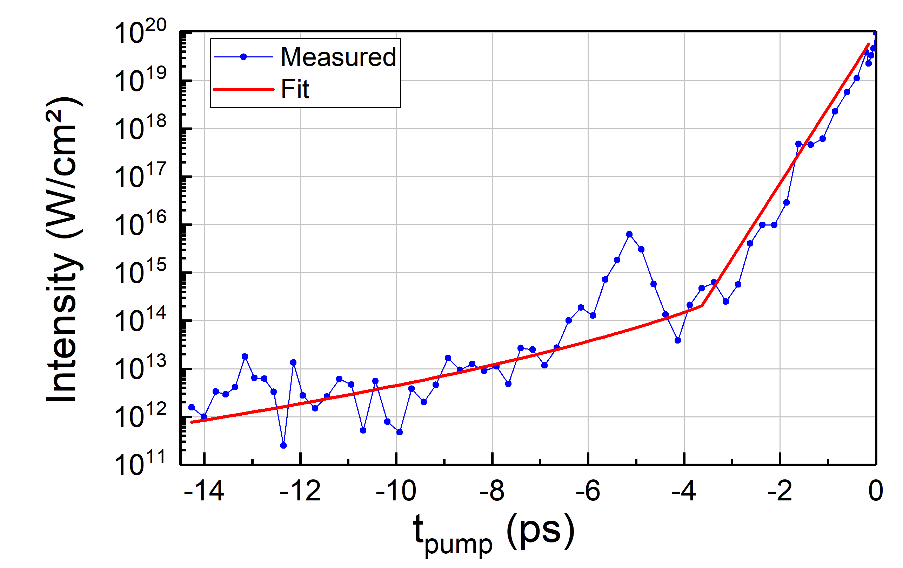
Motivation
Laser-driven ion acceleration
Relativistic Peak
Pre-plasma
Artifact
x Pre-defined
x Strong Assumptions/ Approximations
x Solid-to-plasma transition not described
Notes:
What is the state of the target before the fs-peak of the pulse?
Strong assumptions/ approximations
Like hydrodynamic code:
→ Multi-fs : ionization charge state (how is this calculated?), density profile?, temperature? Particle distributions

Slide 6
Motivation
Laser-driven ion acceleration
Relativistic Peak
Predictions?
Pre-plasma
Artifact
x Pre-defined
x Strong Assumptions/ Approximations
x Solid-to-plasma transition not described
Birth of plasma
Notes:
What is the state of the target before the fs-peak of the pulse?
Strong assumptions/ approximations
Like hydrodynamic code:
→ Multi-fs : ionization charge state (how is this calculated?), density profile?, temperature? Particle distributions

Slide 7
Motivation
Laser-driven ion acceleration
Relativistic Peak
Predictions?
Pre-plasma
Artifact
x Pre-defined
x Strong Assumptions/ Approximations
x Solid-to-plasma transition not described
Birth of plasma
Notes:
What is the state of the target before the fs-peak of the pulse?
Strong assumptions/ approximations
Like hydrodynamic code:
→ Multi-fs : ionization charge state (how is this calculated?), density profile?, temperature? Particle distributions

Slide 8
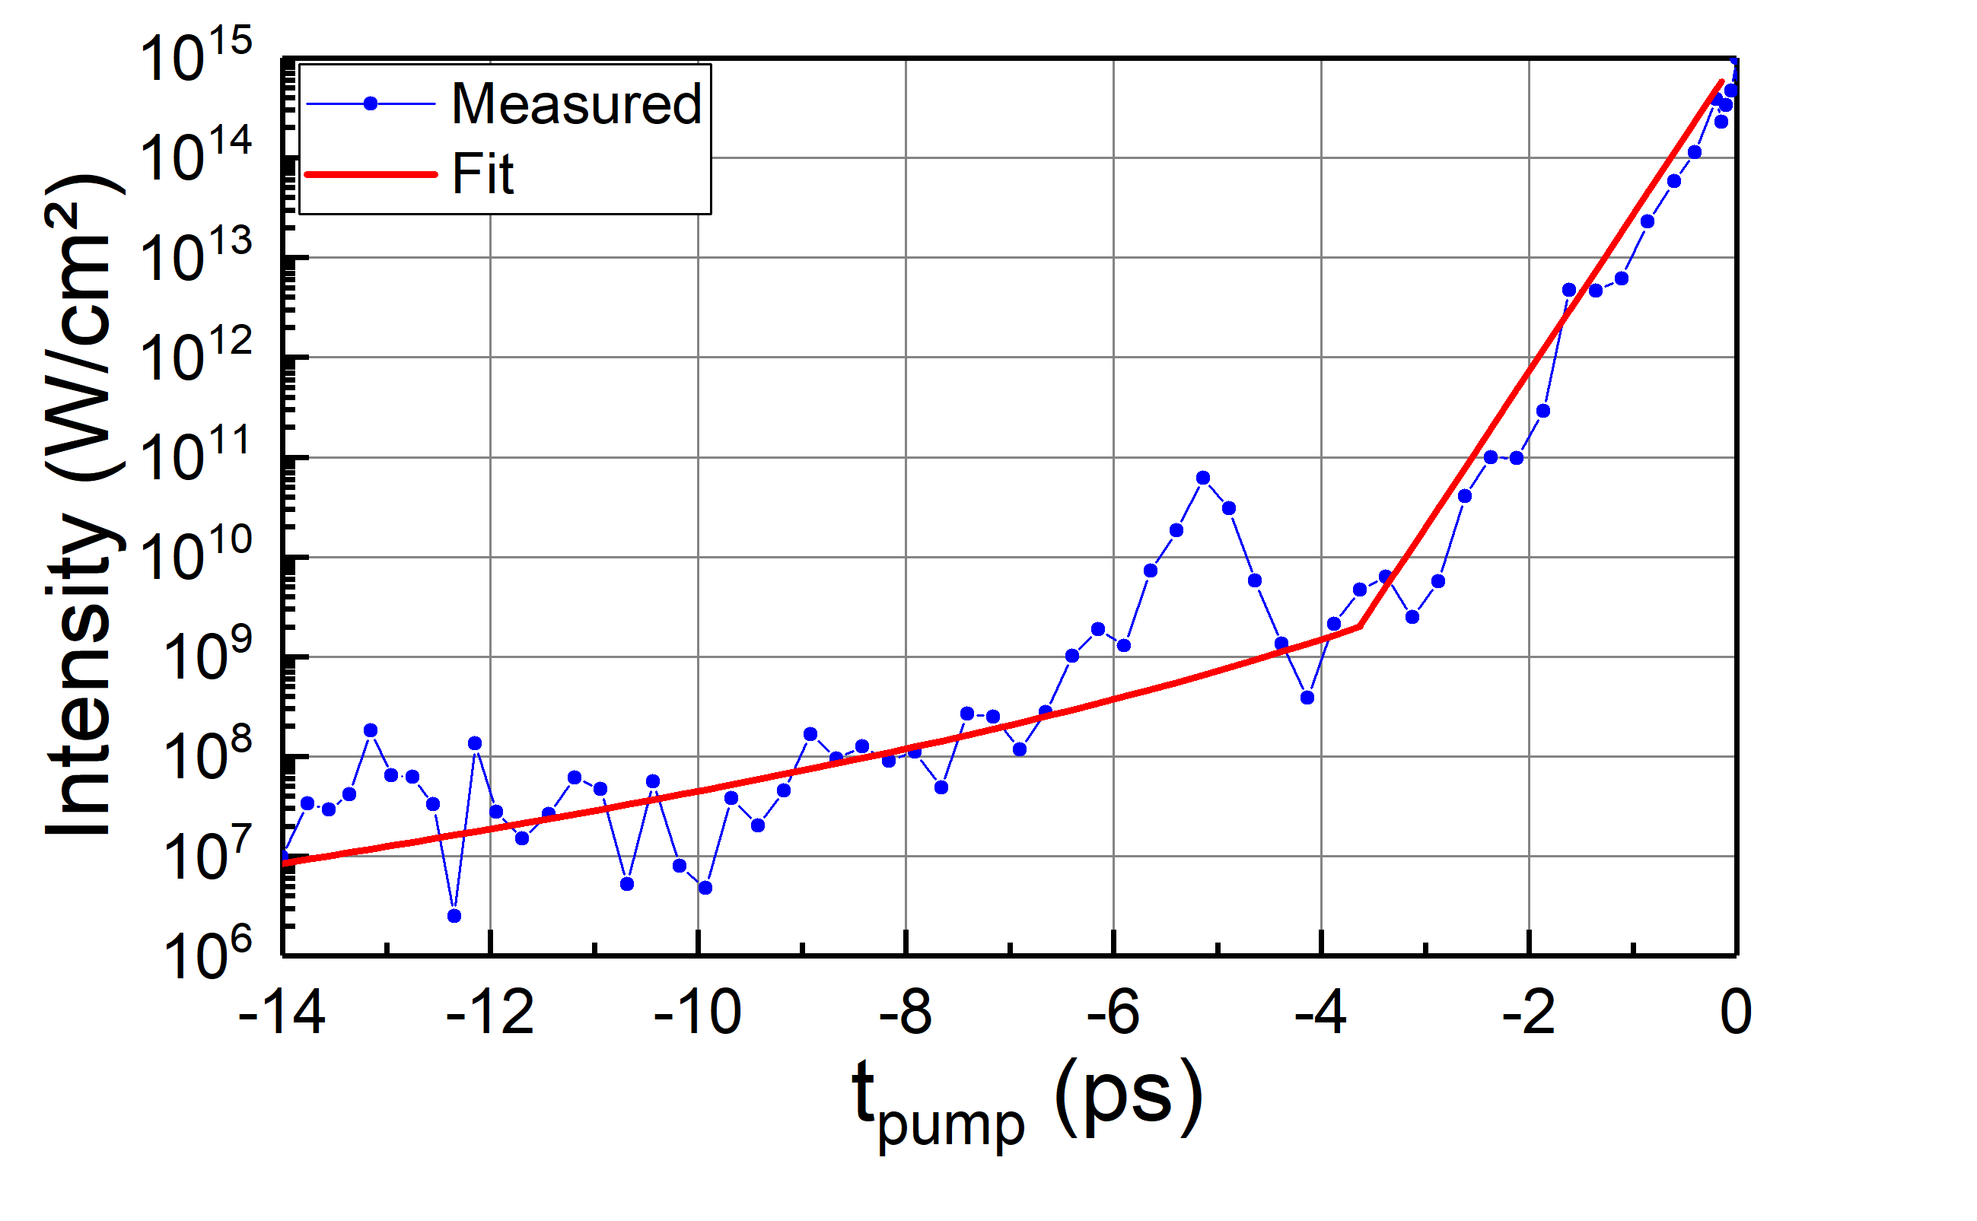
Methods
Experiment: Laser - NanoFoil DLC Interaction
Chirped NOPA* probe pulse
Δλ $\sim$150 nm, λ_{c} ≈ 840 nm
*
Expected
pre-plasma
Artifact
low-energy/defined focus
Polaris pump pulse
λ_{c} ≈ 1030 nm
1D spatially-resolved
imaging spectrometer
DLC
*Tamer et al., Opt. Express, 28, 19034 (2020).
Notes:
Animation of the setup
Show only 10 nm transmission curve and then the others
Time axis is arbitrary
Wavelength calibration into time in additional slides
Setup nopa 40 cm x 40 cm , photo? Indicates that is developed in our group.
Setup est flou …
pulse energy range: 3 - 30 mJ, pulse duration ~ 150 fs
Well-known pump focus profile
Probe: 12 µJ, 11 fs → 6 ps, I = 10^10 W/cm², slightly focused into region 100 µm diameter, spectrum in additional slides
---
- Need to specify the dynamic numbers of transmission
→ to link with the tilte → ultrafast
-> T from 90% to 10 %
Shots:
Use of Optical tunneling to probe overdense plasma state
Skin depth ~ c/wpe
ne = 5 nc → sd ~ 57 nm
ne = 371 nc → sd ~ 7 nm

Slide 9
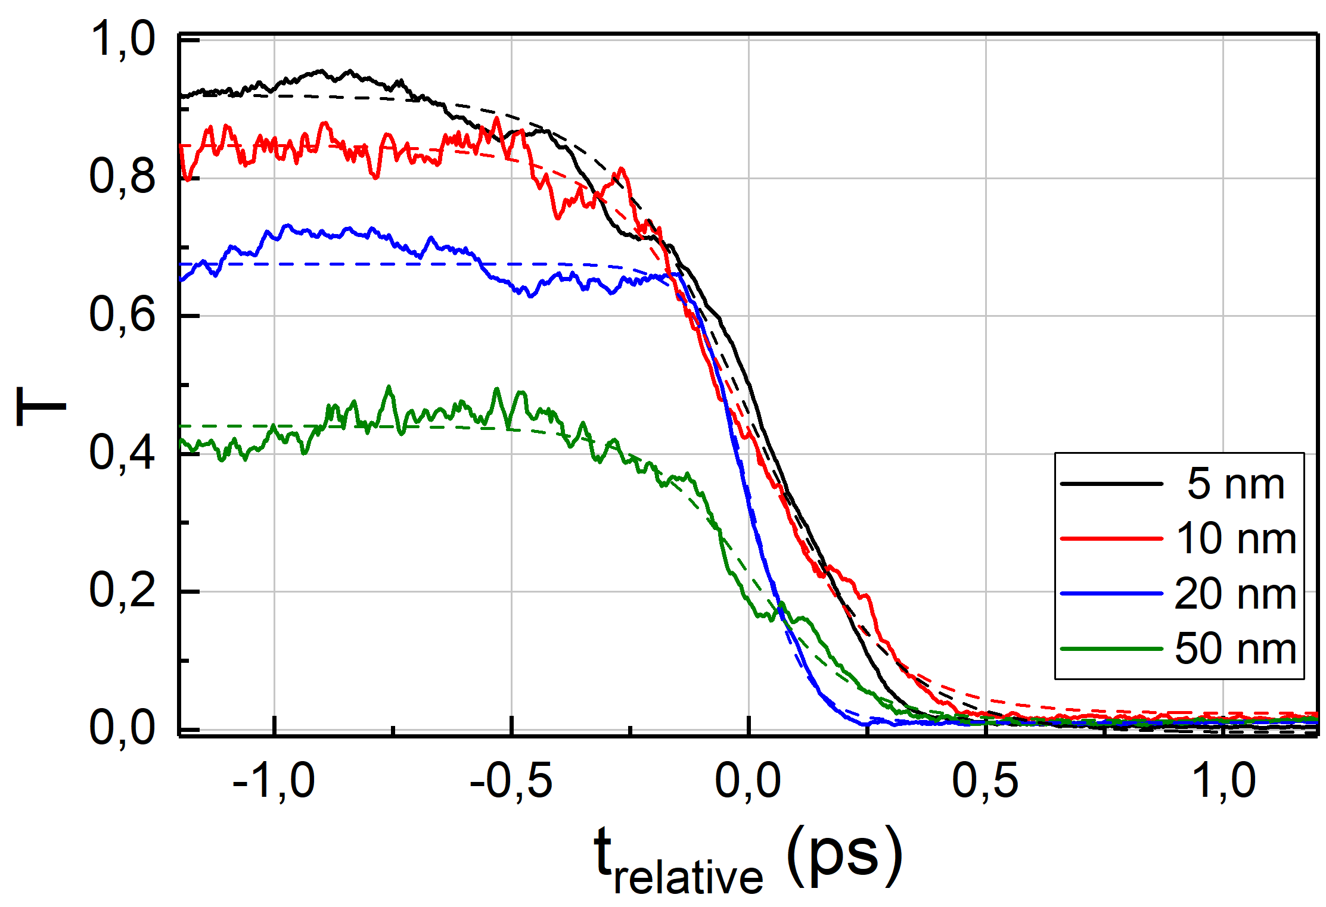
Methods
Experiment: Laser - NanoFoil DLC Interaction
Chirped NOPA* probe pulse
Δλ $\sim$150 nm, λ_{c} ≈ 840 nm
*
Expected
pre-plasma
Artifact
low-energy/defined focus
Polaris pump pulse
λ_{c} ≈ 1030 nm
1D spatially-resolved
imaging spectrometer
DLC
Single-shot 1D space & time-resolved probe transmission
Y = 0 µm
n_{e} < n_{c}
n_{e} > n_{c}
τ _{90-10%} $\sim$ 400…700 fs
t_{relative} (ps)
Modeling
*Tamer et al., Opt. Express, 28, 19034 (2020).
Notes:
Animation of the setup
Show only 10 nm transmission curve and then the others
Time axis is arbitrary
Wavelength calibration into time in additional slides
Setup nopa 40 cm x 40 cm , photo? Indicates that is developed in our group.
Setup est flou …
pulse energy range: 3 - 30 mJ, pulse duration ~ 150 fs
Well-known pump focus profile
Probe: 12 µJ, 11 fs → 6 ps, I = 10^10 W/cm², slightly focused into region 100 µm diameter, spectrum in additional slides
---
- Need to specify the dynamic numbers of transmission
→ to link with the tilte → ultrafast
-> T from 90% to 10 %
Shots:
Use of Optical tunneling to probe overdense plasma state
Skin depth ~ c/wpe
ne = 5 nc → sd ~ 57 nm
ne = 371 nc → sd ~ 7 nm

Slide 10
Methods
Modeling
Interaction Model
Maxwell Solver + Optical Tunneling
n_{e}(t)
T (t)*
Artifact
Notes:
Need to implement the new curve of cold target transmission
Transmission profiles calculated for a central probe wavelength 800 nm
****** SIM param ***********************************************************************
Tsim = 2 ps, Lsim = 2 µm,
Δt = 5 × 10⁻⁴ fs, Δz = 0.16 nm
Solid density carbon foils: , rho = 2,13 g/cm³, n_{a}~ 63 n_{c}
*****************************************************************************************
Density profiles in supplementary
*****************************************************************************************
- 50 nm described dynamic ok but not for the lower thicknesses
Remove technical details of simulation
Need estimation of transmission dynamics in case of cold target
With the modeling also
What Multiple Rate Equation means?
Need to correct transmission of cold target in smilei
Why a PIC code is required? Plasma kinetics why?
Plasma expansion seems to play a role in 5 nm case as a fully ionized target cannot block the probe light

Slide 11
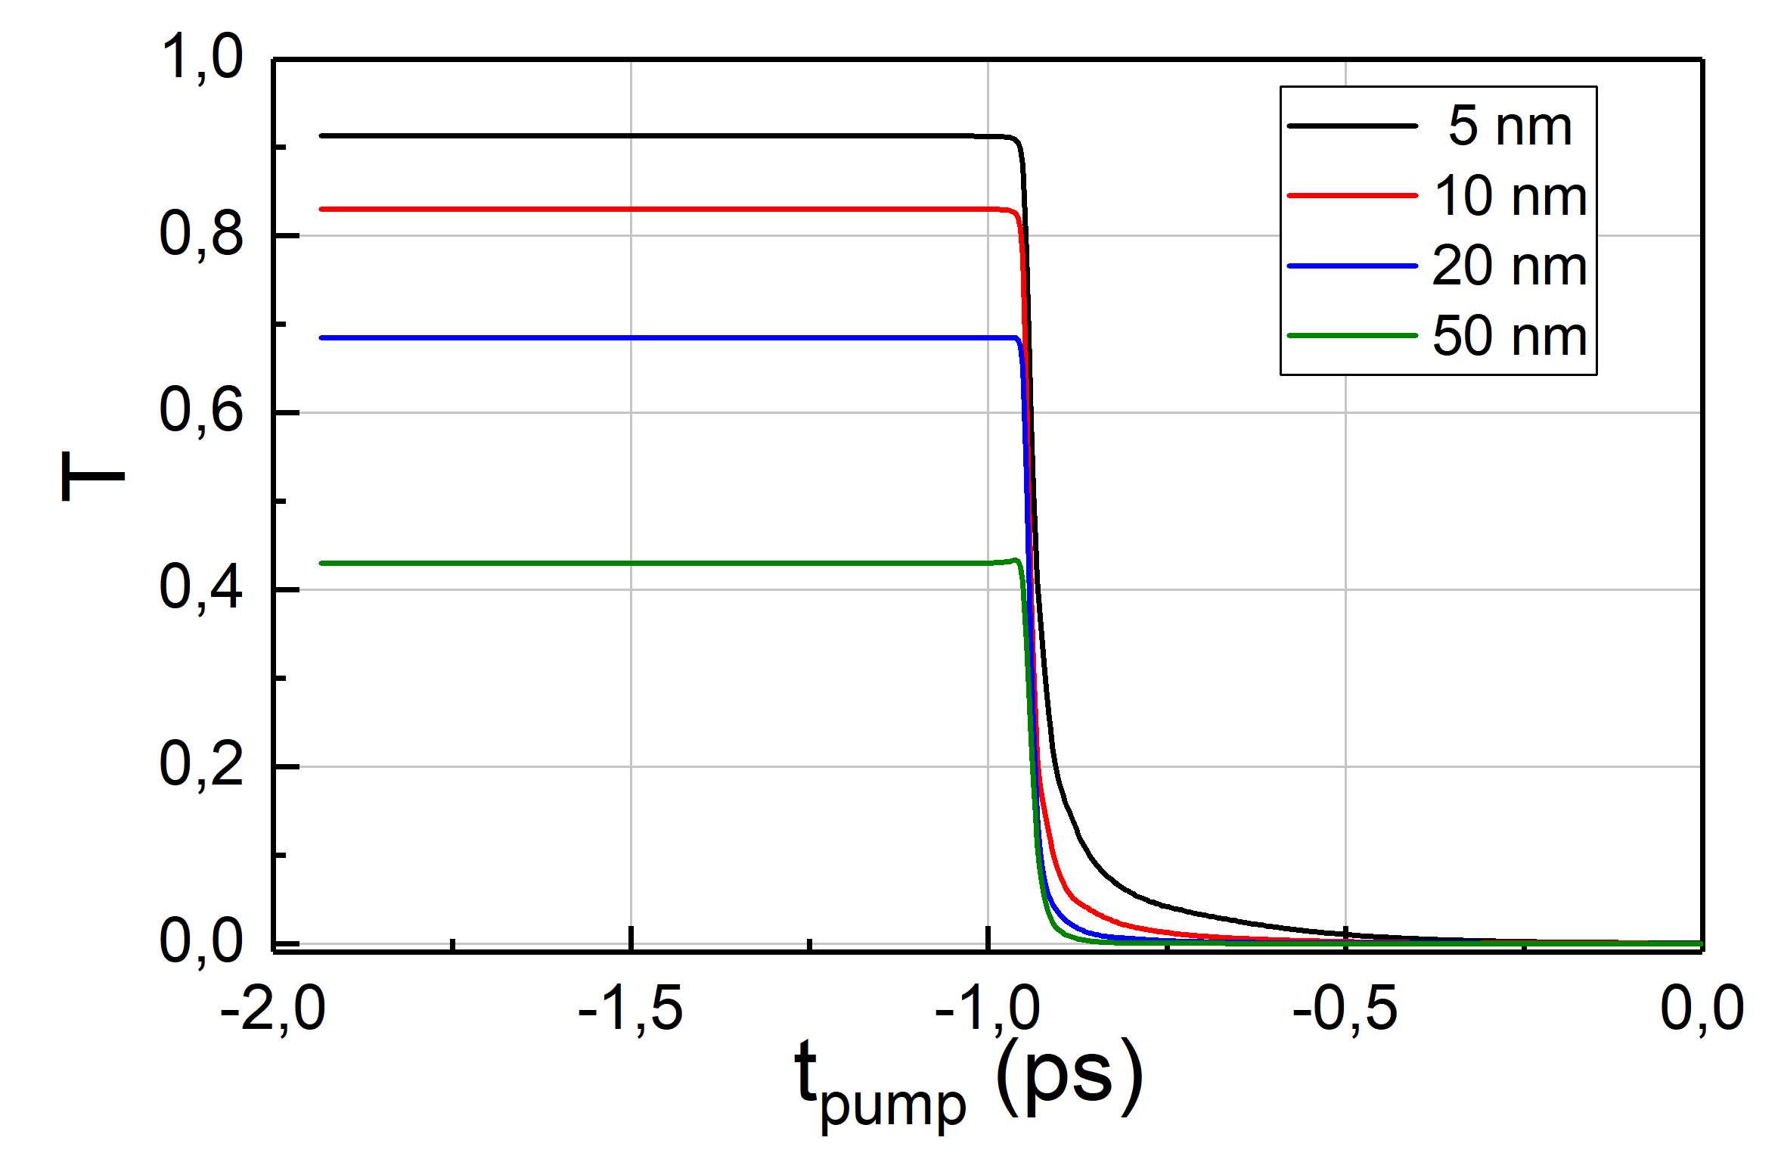
Methods
Modeling: PIC
Interaction Model
Maxwell Solver + Optical Tunneling
n_{e}(t)
T (t)*
PIC
Artifact
n_{solid} carbon nm-slabs
SMILEI 1D
TI, CI
n_{e}, n_{Cα+} (z, t),
spectra, ...
(2)
Pump’s rising edge
No e⁻s
I_{TI} $\sim$10¹³ W/cm²
(2)
Ionization of solid not supported
Atomic description
*λ_{probe} = 800 nm
MRE: Multiple Rate Equation
MPI: MultiPhoton Ionization
TI: Tunnel Ionization
CI: Collisional Ionization
Notes:
Need to implement the new curve of cold target transmission
Transmission profiles calculated for a central probe wavelength 800 nm
****** SIM param ***********************************************************************
Tsim = 2 ps, Lsim = 2 µm,
Δt = 5 × 10⁻⁴ fs, Δz = 0.16 nm
Solid density carbon foils: , rho = 2,13 g/cm³, n_{a}~ 63 n_{c}
*****************************************************************************************
Density profiles in supplementary
*****************************************************************************************
- 50 nm described dynamic ok but not for the lower thicknesses
Remove technical details of simulation
Need estimation of transmission dynamics in case of cold target
With the modeling also
What Multiple Rate Equation means?
Need to correct transmission of cold target in smilei
Why a PIC code is required? Plasma kinetics why?
Plasma expansion seems to play a role in 5 nm case as a fully ionized target cannot block the probe light

Slide 12
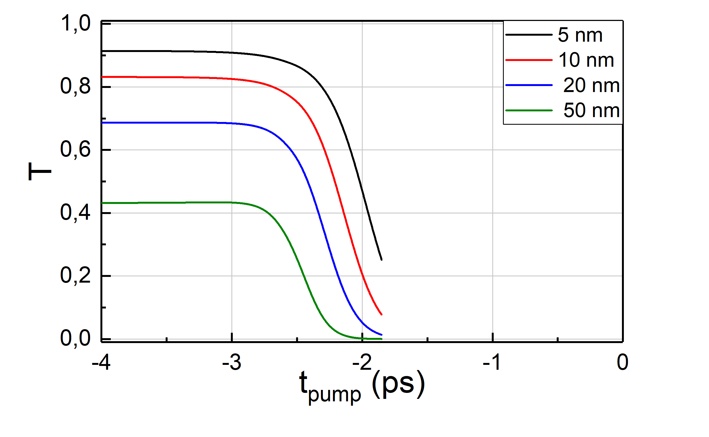
Methods
Modeling: PIC
Interaction Model
Maxwell Solver + Optical Tunneling
n_{e}(t)
T (t)*
Solid State Interaction (SSI)
PIC
Artifact
MRE¹, MPI + TI + CI + Avalanche
band gap² E_{g} $\sim$ 1.1 eV
Pump rising edge
Homogeneous plasma slab
n_{solid} carbon nm-slabs
SMILEI 1D
TI, CI
n_{e}, n_{Cα+} (z, t),
spectra, ...
(1)
(2)
Pump’s rising edge
No e⁻s
I $\sim$ 10¹² W/cm²
I_{TI} $\sim$10¹³ W/cm²
(1)
$\sim$100 n_{c}
(2)
?
n_{e} > 100 n_{c} not supported
Inner shells’ ionization not supported
Ionization of solid not supported
Atomic description
*λ_{probe} = 800 nm
MRE: Multiple Rate Equation
MPI: MultiPhoton Ionization
TI: Tunnel Ionization
CI: Collisional Ionization
Hybrid Model?
¹Rethfeld, PRL, 92, 187401, (2004).
²Tauc et al. Physica Status Solidi, 15, 627, (1966).
Notes:
Need to implement the new curve of cold target transmission
Transmission profiles calculated for a central probe wavelength 800 nm
****** SIM param ***********************************************************************
Tsim = 2 ps, Lsim = 2 µm,
Δt = 5 × 10⁻⁴ fs, Δz = 0.16 nm
Solid density carbon foils: , rho = 2,13 g/cm³, n_{a}~ 63 n_{c}
*****************************************************************************************
Density profiles in supplementary
*****************************************************************************************
- 50 nm described dynamic ok but not for the lower thicknesses
Remove technical details of simulation
Need estimation of transmission dynamics in case of cold target
With the modeling also
What Multiple Rate Equation means?
Need to correct transmission of cold target in smilei
Why a PIC code is required? Plasma kinetics why?
Plasma expansion seems to play a role in 5 nm case as a fully ionized target cannot block the probe light

Slide 13
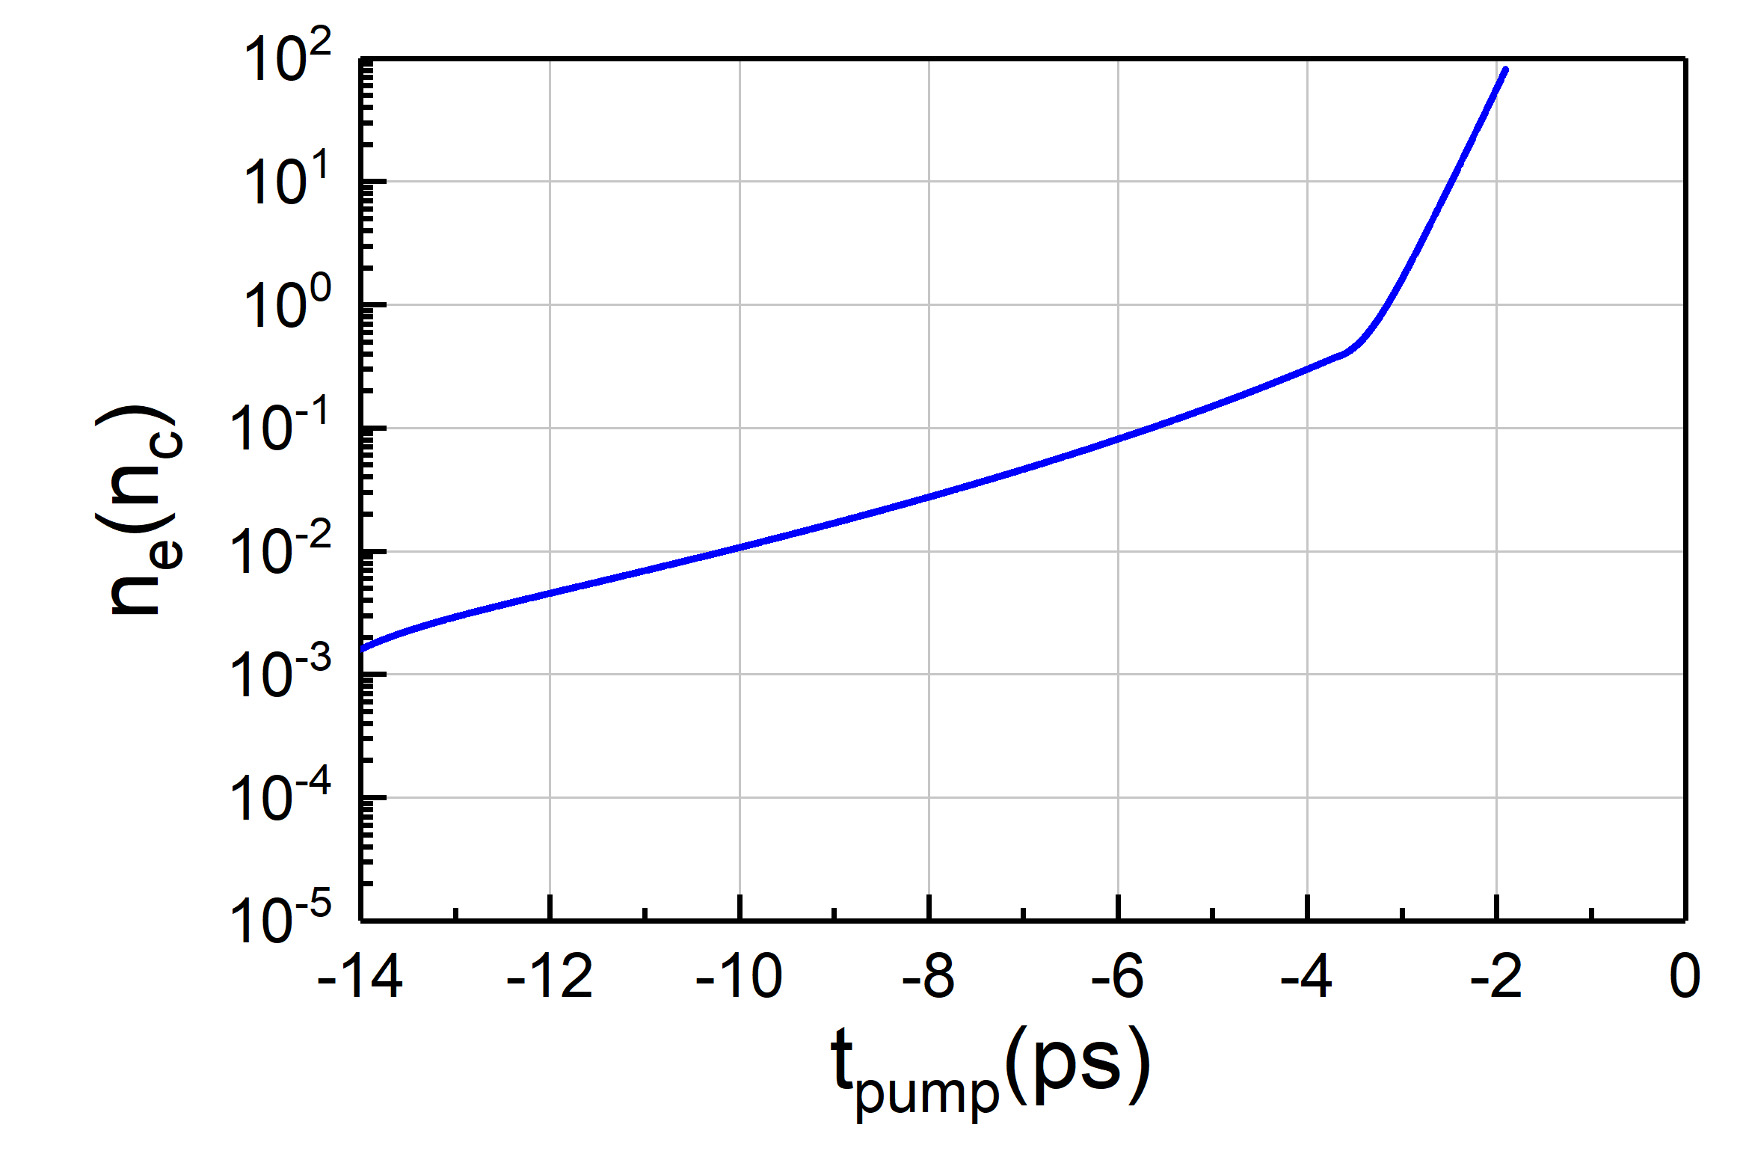
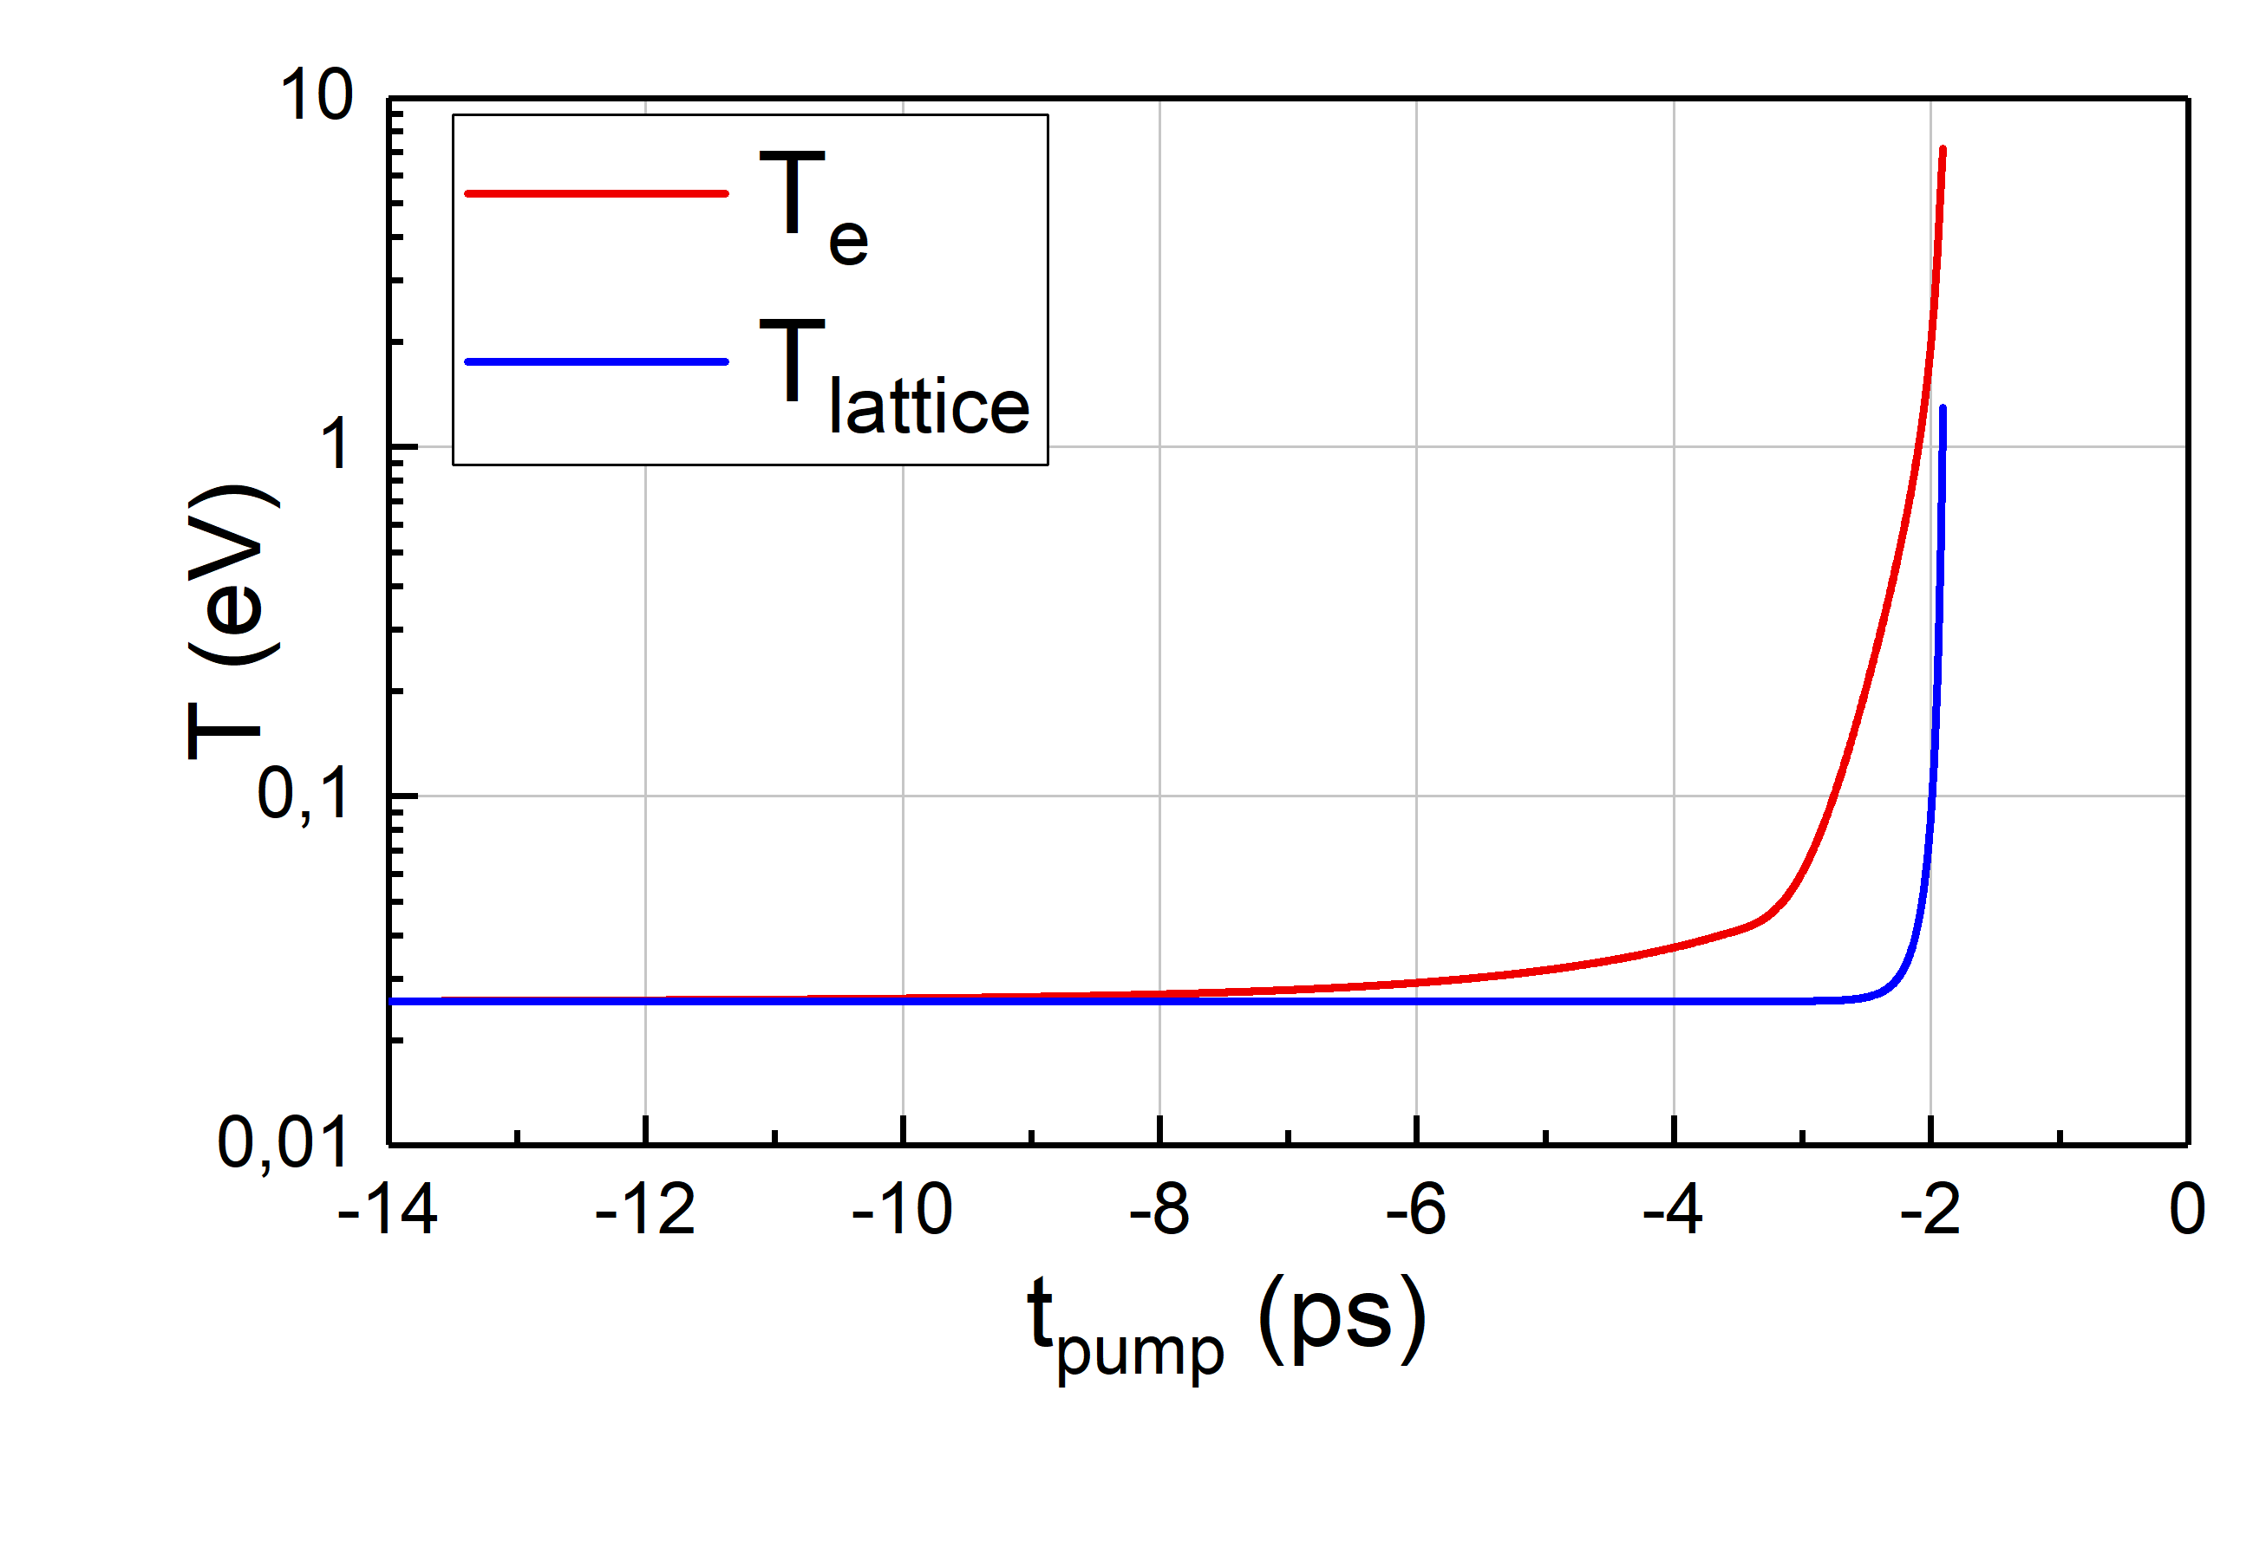
Methods
Modeling: Hybrid
Bridge the codes?
Melting² , T_{lattice-melting} ≈ 0. 35 eV
Two-Step Interaction model (TSI)
Step 1: SSI | Step 2: PIC
 | Homogeneous plasma slab @ t_{pump-melting}, I ~ 10¹² W/cm² T_{e-melting} $\sim$ 4.6 eV, n_{e-melting} $\sim$ 73 n_{c ,} Mixture of C¹⁺ & C²⁺
n_{e-melting} $\sim$73 n_{c}
T_{e-melting} $\sim$4.6 eV
TTM model
T_{lattice-melting} $\sim$ 0.35 eV
t_{pump-melting}
TTM: Two-Temperature Model
²J. Narayan and A. Bhaumik, APL Materials, 3, 100702, (2015).
Notes:
Melting definition?
(n_{C1+} =53 n_{c} & n_{C2+} = 10 n_{c} )
How TTM model works? How this includes the temporal intensity profile of the pump?
In TTM you need ne calculated from SSI
${\text{n}\text{ = ƞ}}_{DLC}\text{+}\text{i} {\text{κ}}_{DLC}$
n= 2.65$\text{+}\text{i}\text{ 0.5}$

Slide 14
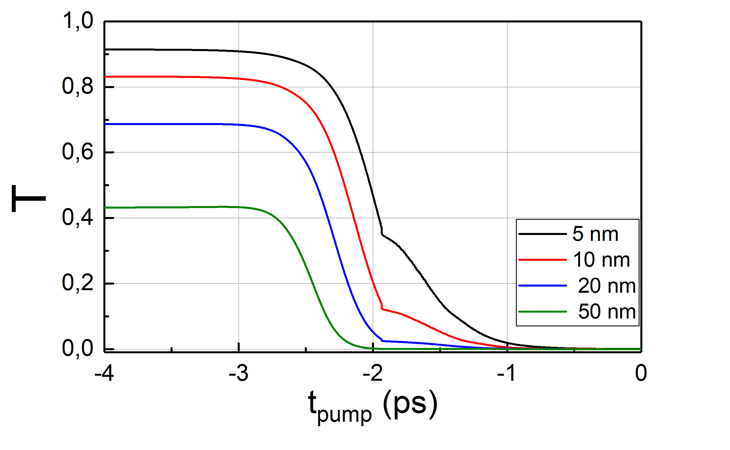
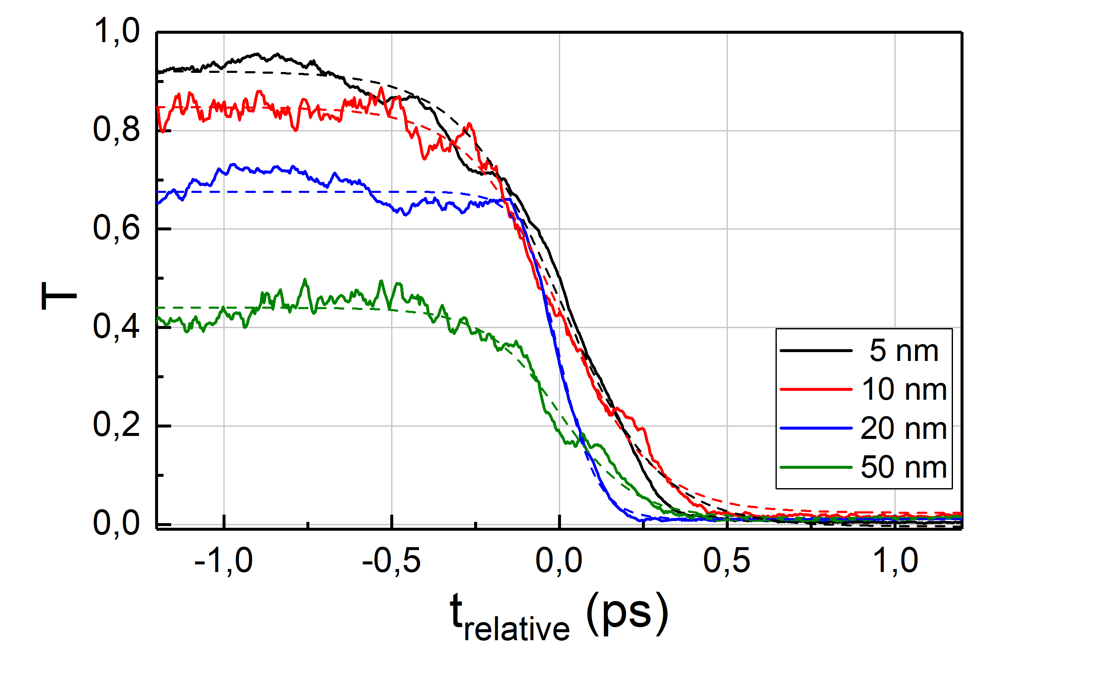
Methods
Modeling: Hybrid
Bridge the codes?
Melting² , T_{lattice-melting} ≈ 0. 35 eV
Two-Step Interaction model (TSI)
SSI
Step 1: SSI | Step 2: PIC
 | Homogeneous plasma slab @ t_{pump-melting}, I ~ 10¹² W/cm² T_{e-melting} $\sim$ 4.6 eV, n_{e-melting} $\sim$ 73 n_{c ,} Mixture of C¹⁺ & C²⁺
n_{e-melting} $\sim$73 n_{c}
PIC
T_{e-melting} $\sim$4.6 eV
TTM model
T_{lattice-melting} $\sim$ 0.35 eV
t_{pump-melting}
TTM: Two-Temperature Model
²J. Narayan and A. Bhaumik, APL Materials, 3, 100702, (2015).
Notes:
Melting definition?
How TTM model works? How this includes the temporal intensity profile of the pump?
In TTM you need ne calculated from SSI
${\text{n}\text{ = ƞ}}_{DLC}\text{+}\text{i} {\text{κ}}_{DLC}$
n= 2.65$\text{+}\text{i}\text{ 0.5}$

Slide 15
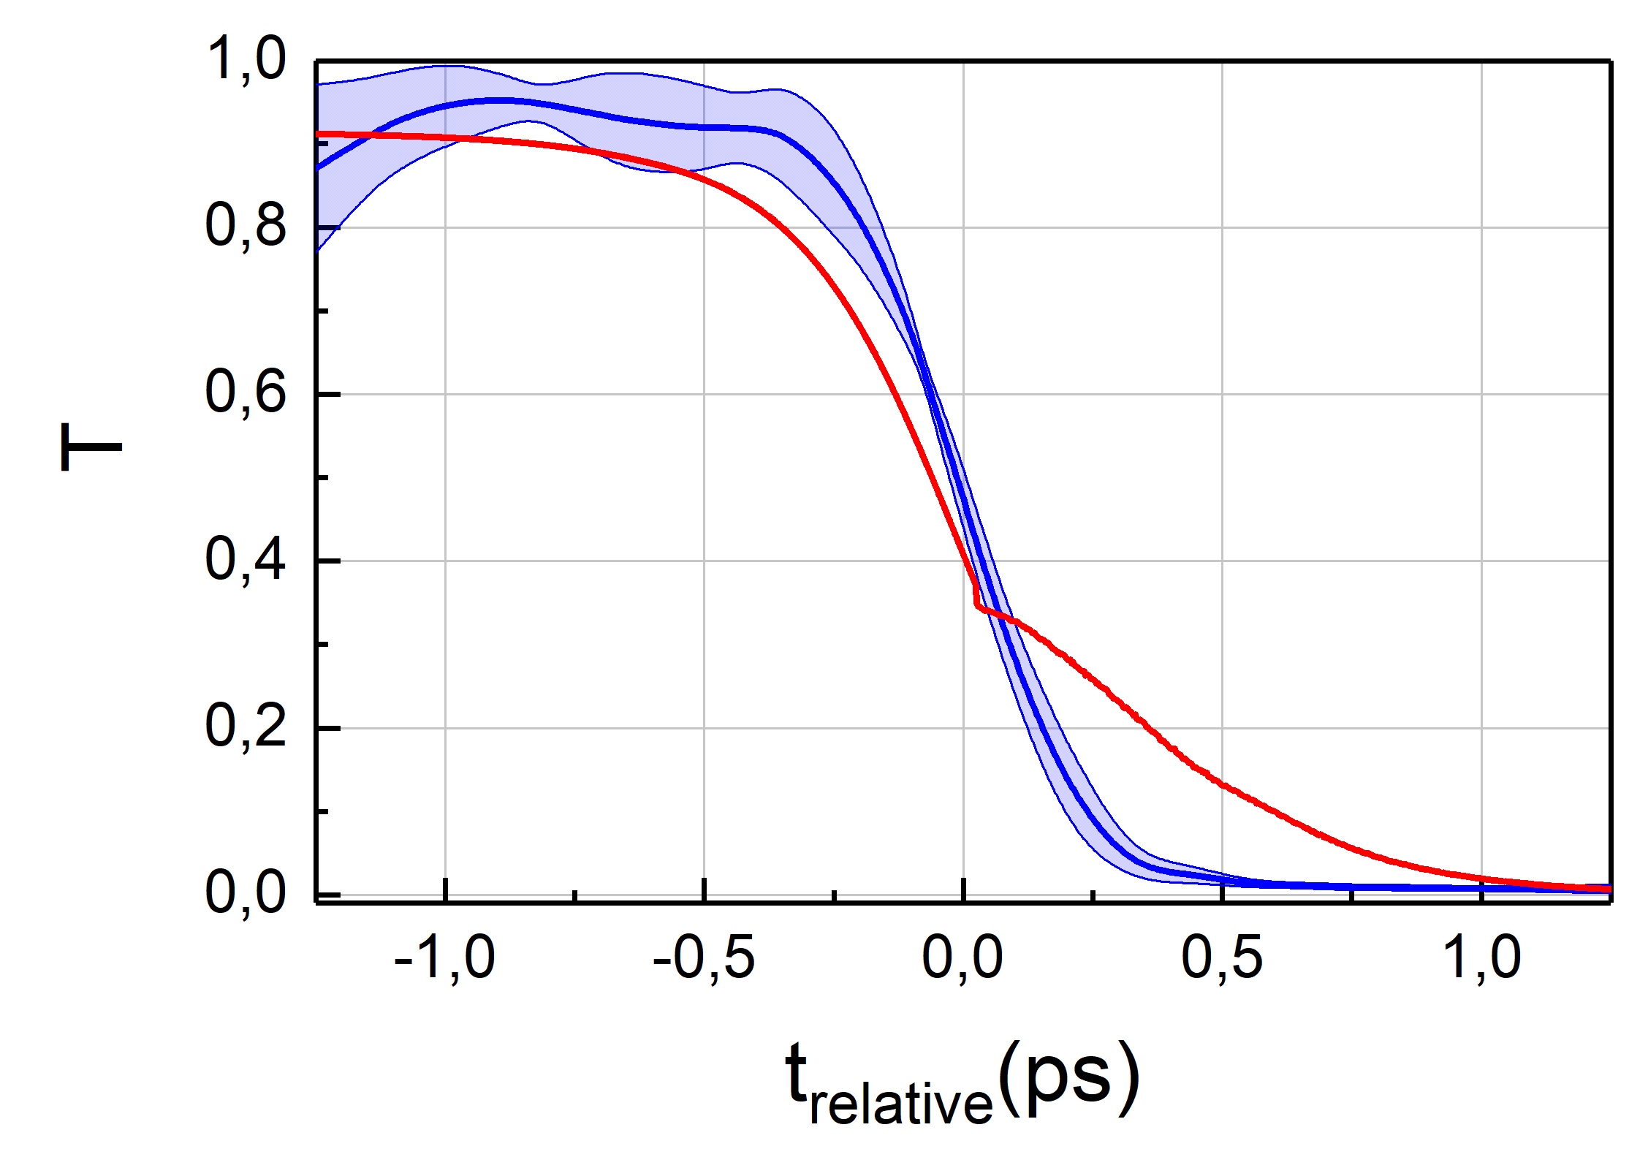
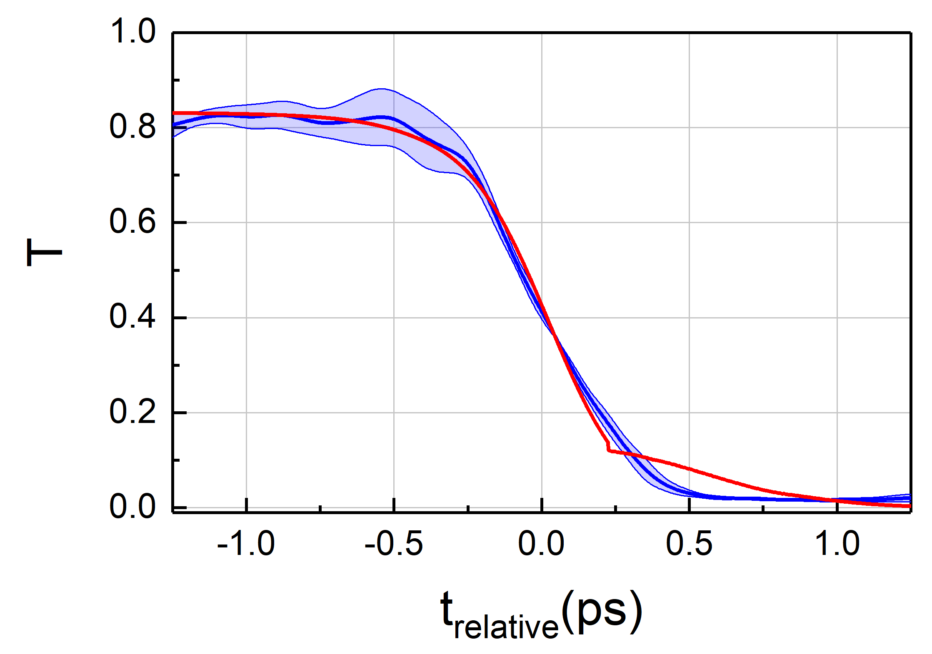
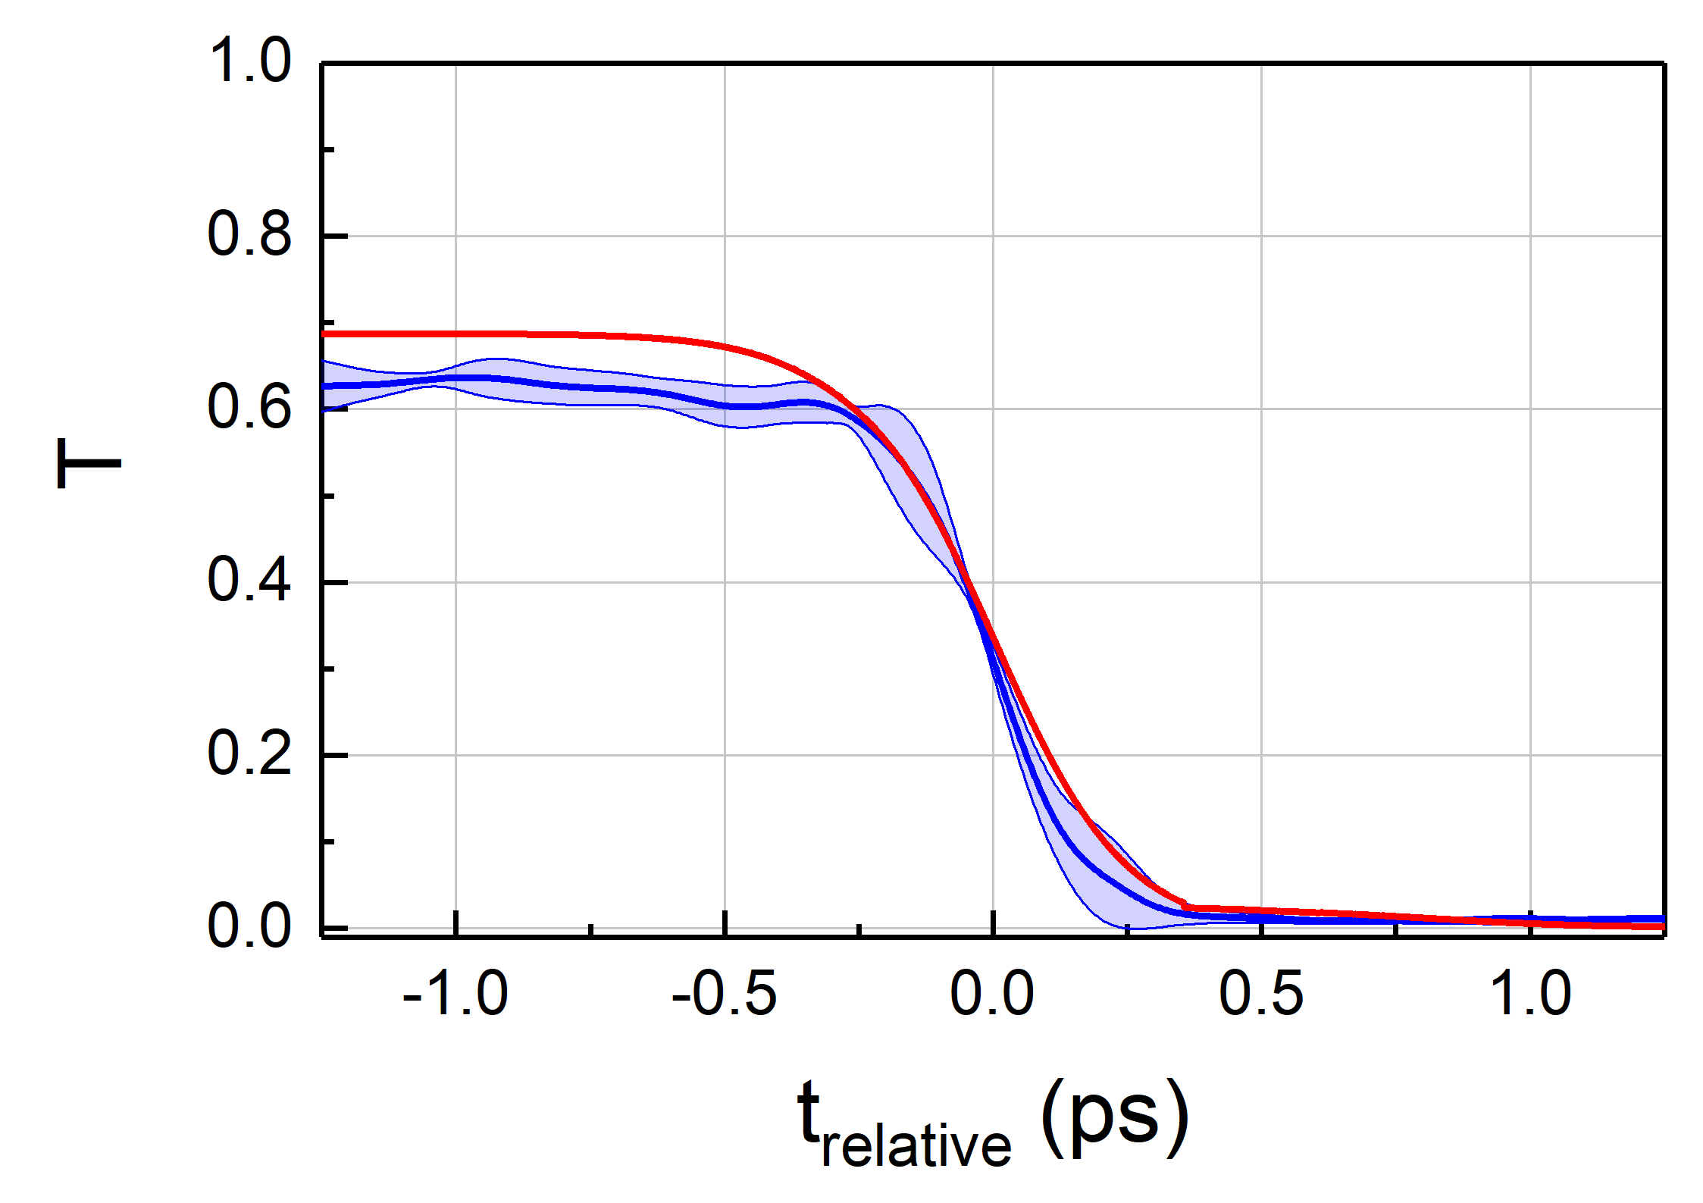
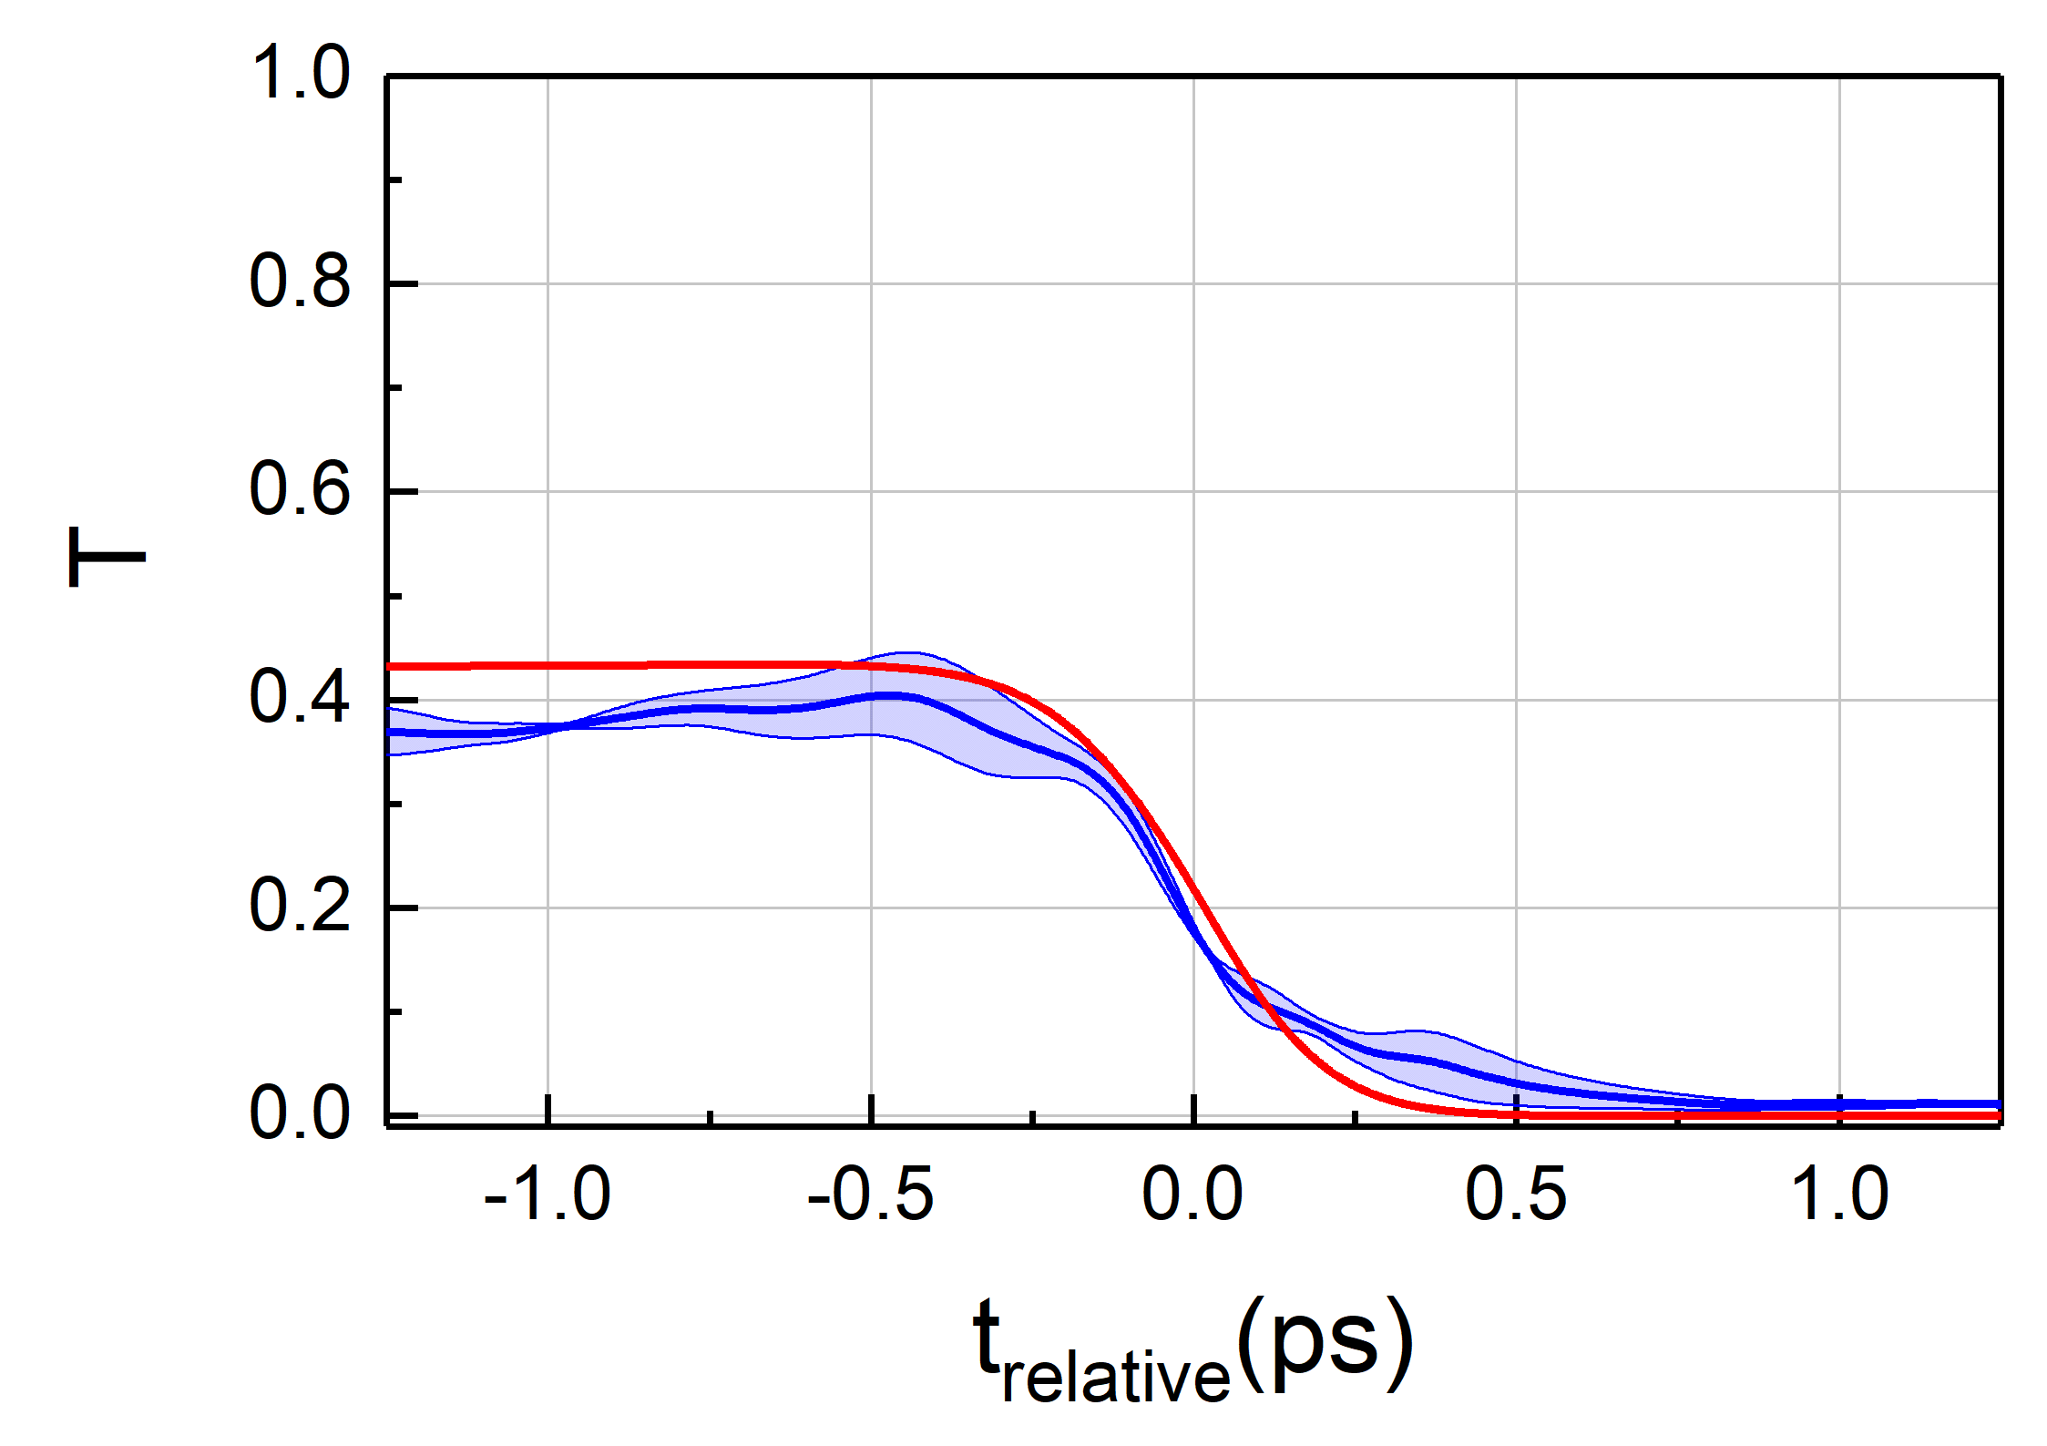
Results
Ionization processes
5 nm
Good agreement: simulation vs. experiment
TSI model required for targets ≤ 10 nm
Initial phase: ionization of solid
Final phase: plasma expansion (transmission $\sim$0)
10 nm
PIC
PIC
Insight into ionization processes:
20 nm
50 nm
Step 1: SSI | Step 2: PIC
MPI dominates Free e⁻ by MPI CI $\sim$ 1% | CI dominates Free e⁻ at I < 10¹³ W/cm² (≈ I_{TI})
TI does not play a role
PIC
PIC
TSI model
Measured, I $\sim$ 10¹⁵ – 10¹⁶ W/cm²
Notes:
Despite these discrepancies, one can still access to plasma parameters
Plot without TI for 5 and 50 nm available
Redo experimental curves and simulation in a new project Origin.
Skin depth vs homogeneous ionization?
Good agreement between simulation and experiment
Transmission dynamic does not change over one order of magnitude intensity
Replace Time to relative time
Transmission at pristine target value, measured with shimazo-spectrometer
Add log scale plots in supplementary
We do not care much about absolute transmission values
Is it reasonable to get 1% transmission as zero transmission in experiment? Otherwise need to check noise level?
Target thickness uncertainty:
5, 10 & 20 nm : +/- 20 %
50 nm: +/- 15%
Transmission of pristine target and calculated transmission
Indicate of PIC code contribution
Electrons not sufficiently heated → they do not induce collisional ionization
Include log scale images
Discussion from the paper: inhomogeneous ionization in case of thicker foils
Skin depth and ne-minimum to have target larger that skin depth

Slide 16
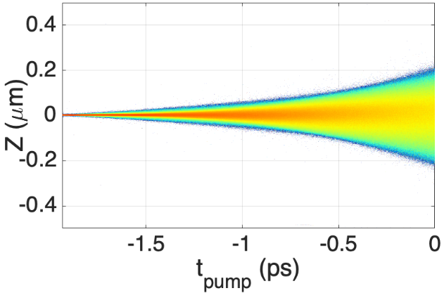
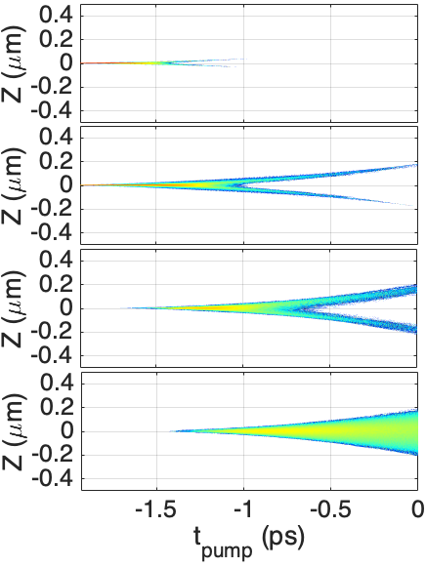
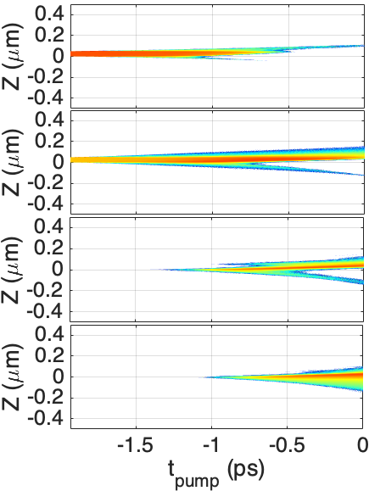
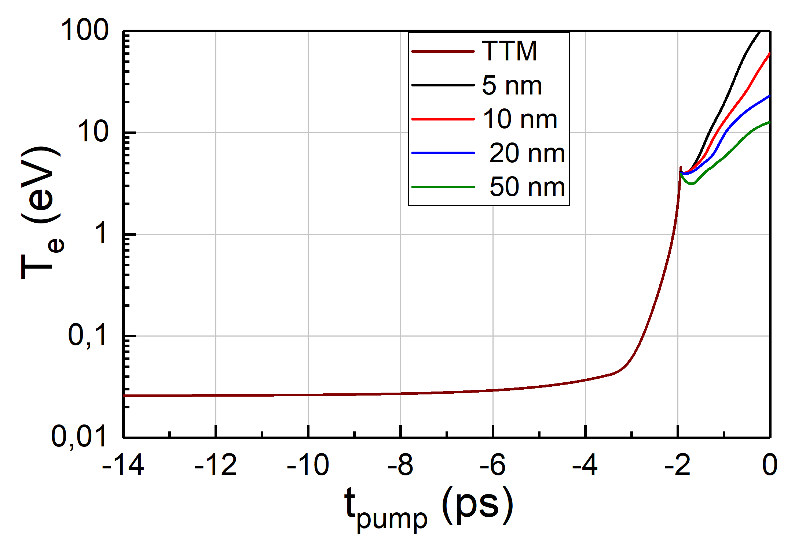
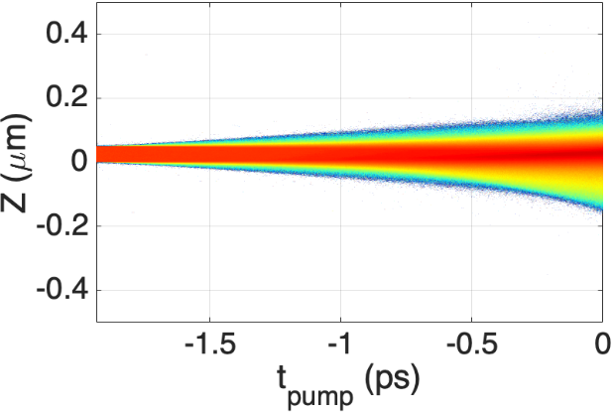
Results
Plasma dynamics
Densities
Temperature
5 nm
n_{e}
5 nm
50 nm
C¹⁺
C¹⁺
$\sim$73 n_{c}
_{Pump laser}
C²⁺
C²⁺
L_{final}$\sim$80 nm
(x 16 target thickness)
50 nm
n_{e}
C³⁺
C³⁺
Homogeneous plasma slab
C⁴⁺
C⁴⁺
L_{final} $\sim$20 nm
Target front z = 0 µm
L: density scale length, n_{e}(z) = n_{e0} e^{-z/L}
Solid density n_{a} = 63 n_{c,}
Fully ionized target n_{e} = 378 n_{c}
10³
10²
10¹
10⁰
10⁻¹
10⁻²
10⁻³
Density (n_{c})
Spatio-temporal dynamics of overdense plasma described by Two-Step-Interaction model (combination of SSM and PIC)
Plasma properties before peak arrival described
Input for realistic description of high-intensity interaction of ultra-thin targets
Notes:
Need ne starts at -14 ps, fully ionized target :
We also get : in addition to transmission, the absorption and reflection plots for people who are measuring these parameters
- electron density vs carbon density with charge state
- Te only
Plasma expansion values
5 nm, ne0 = 10 nc, L = 16 x target thickness, 50 nm , ne0 = 90 nc, L = 20 nm = 0,4 x target thickness, ne(x) = ne0 x exp(-x/L)
Show first 5 nm symetry structure
then 50 nm to highlight the assymetry to take into account
Include contrast curve for pump time axis

Slide 17
Outlook
Solid-to-Overdense Plasma Transition described with a simple approach:
Overdense plasma dynamics
Interplay of ionization processes
Towards detailed pre-plasma conditions for relativistic laser-solid interaction
Experiment
Modeling
Laser – DLC nano-foil interaction
Single-shot space-time resolved probe transmission
Original Two-Step Interaction
Solid State Model + PIC code
onset development: kinetics
Y. Azamoum et al., submitted (2023), http://arxiv.org/abs/2309.00303
Notes:
Logos : HIJ, FSU, ILM, LULI, CEA le Barp, U bordeaux
Implement : user-defined ionization rate in smilei as a next step.
Method for characterisation of pre-expanded foils

Slide 18
Acknowledgments
Yasmina Azamoum
Georg A. Becker
Sebastian Keppler
Issa Tamer
Marco Hornung
Guillaume Duchateau (CEA)
Stefan Skupin (ILM)
Mickael Grech (LULI)
Fabrice Catoire (CELIA)
&
Y. Azamoum et al., submitted (2023), http://arxiv.org/abs/2309.00303
Thank you for your attention!
Notes:
End presentation in compact format
Logos
Aknowledgments

