Slide 1

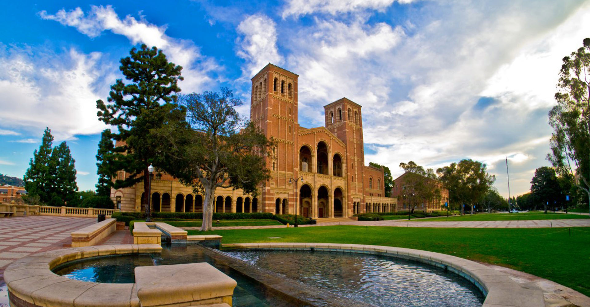

Advanced beam diagnostics development at UCLA Pegasus Laboratory
P. Musumeci
UCLA Department of Physics and Astronomy
EAAC, Elba Island, September 19th 2023

Slide 2






Acknowledgements
UCLA Pegasus Laboratory group
P. Denham, M. Lenz, S. Crisp, A. Fisher, D. Garcia. Graduate students.
B. Schaap. Postdoc
GSM collaborators
    G. Andonian, N. Burger (Radiabeam), N. Cook (Radiasoft)
Funding sources
  DOE Accelerator Stewardship DE-SC0009914.
  NSF Accel Science PHY-1734215

Slide 3
Outline
Single-shot advanced beam diagnostics at UCLA Pegasus
Gas sheet monitor for ultra-intense beams
Superradiant Compton radiation from sub-fs electron bunches

Slide 4
Advanced beam diagnostics
Advanced accelerator beamlines often characterized by extreme beam parameters.
  Multi kA peak currents, sub-fs bunch lengths, nm - emittance
Approaching the limit of beam diagnostics
New ways to extract information and measure beam properties should be developed
  Complement information from traditional beam diagnostics
  Explore interaction with ultrafast lasers/gas/plasma
  Single-shot, non destructive are huge bonus
  Can take advantage of AI/ML for beam parameter reconstruction (virtual or ML-augmented diagnostics)

Slide 5

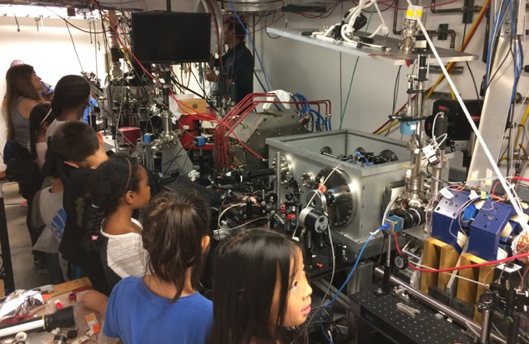

High peak brightness beam research at UCLA Pegasus Laboratory
3-14 MeV highly-flexible student-run university-size accelerator beamline optimized for pC beams
High brightness electron beams:
  High resolution ultrafast electron diffraction
  Single shot imaging / UEM
  THz acceleration
  High efficiency THz FEL
J Maxson, et al., Direct measurement of sub-10 fs relativistic electron beams with ultralow emittance. Phys. Rev. Lett., 118 154802 (2017)
D. Cesar, et al., Demonstration of single-shot picosecond time-resolved MeV electron imaging. Phys. Rev. Lett., 117, 024801 (2016)
E. Curry et al. Meter-scale THz-driven acceleration of a relativistic electron beam. Phys. Rev. Lett. 120, 094801 (2018)
A. Fisher, Y. Park et al. High efficiency single pass THz FEL. Nature Photonics, 16, 441 (2022)
Notes:
One of the few/only MeV high brightness beamlines in a university. Much different environment than National Laboratory
Education and outreach (here is me trying to explain to 4th graders what is it that we do).
Focus on low charge high brightness beam research.
Don’t have time to show highlights here, just point you to the list of recent publications from the laboratory

Slide 6
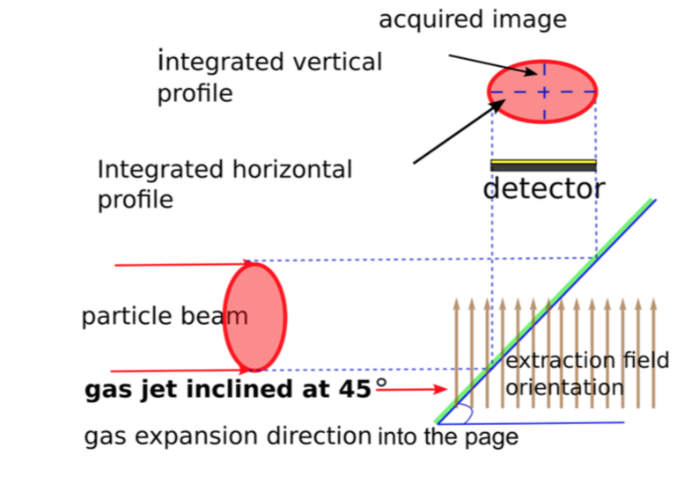
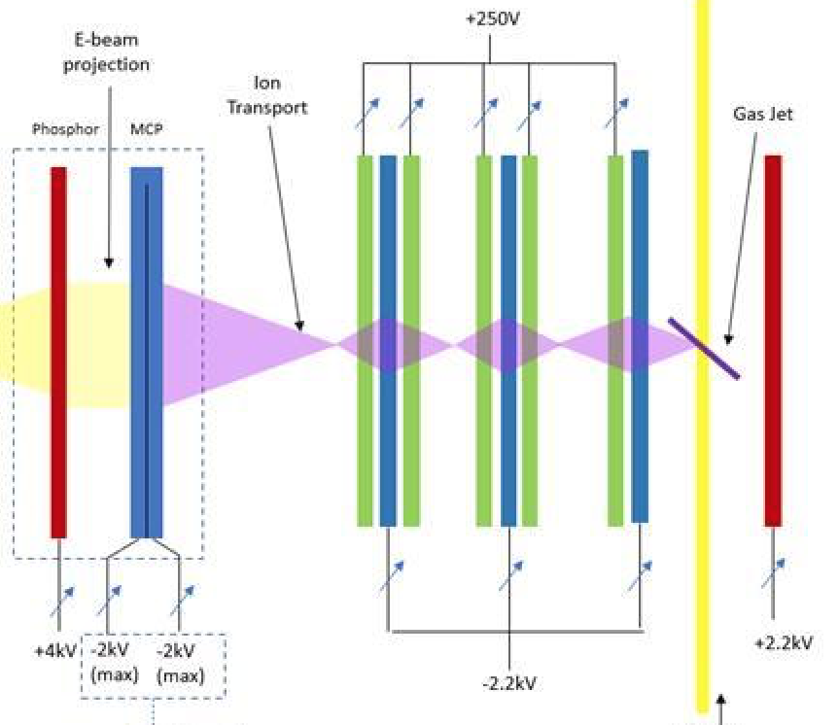
Gas Sheet Monitor - GSM
Non destructive measurement of charge distribution (transverse profile) of high-intensity beams
Concept well developed in rings (residual gas ionization, light detection)
Single-shot, regenerative diagnostic initially aimed at FACETII – multi kA beams
“Gas sheet ionization viewscreen”
  Generate a gas sheet, or “curtain” @ 45˚ with nozzles and beam skimmers
  Relativistic electron beam ionizes neutral gas
  Ions imaged by an “ion microscope”
  Resolve high-intensity beams with reconstruction algorithm
  Field ionization vs/ impact ionization
  Y. Hashimoto, et al, Proc. PAC 2001, Chicago, USA (2001)
  V. Tzoganis, et al, PRAB 20, 062801, 2017

Slide 7
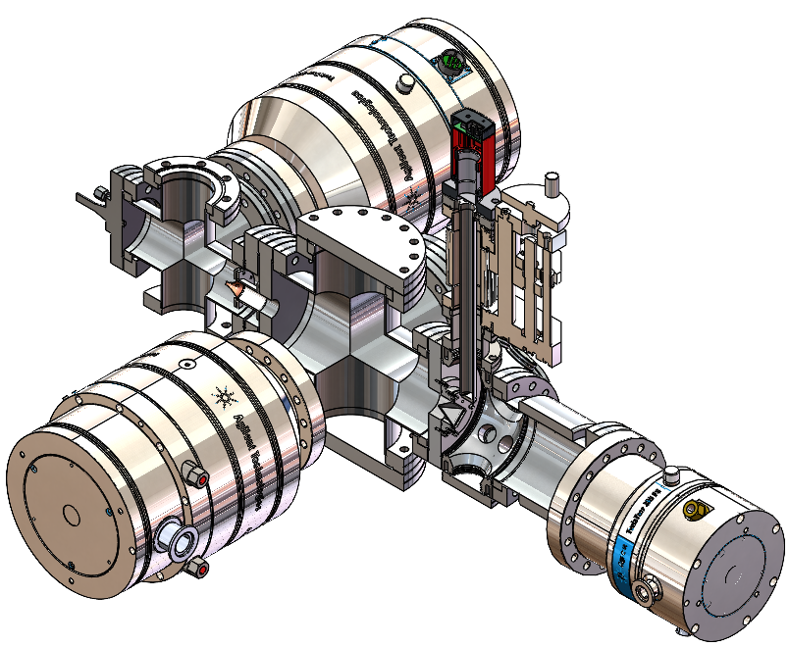
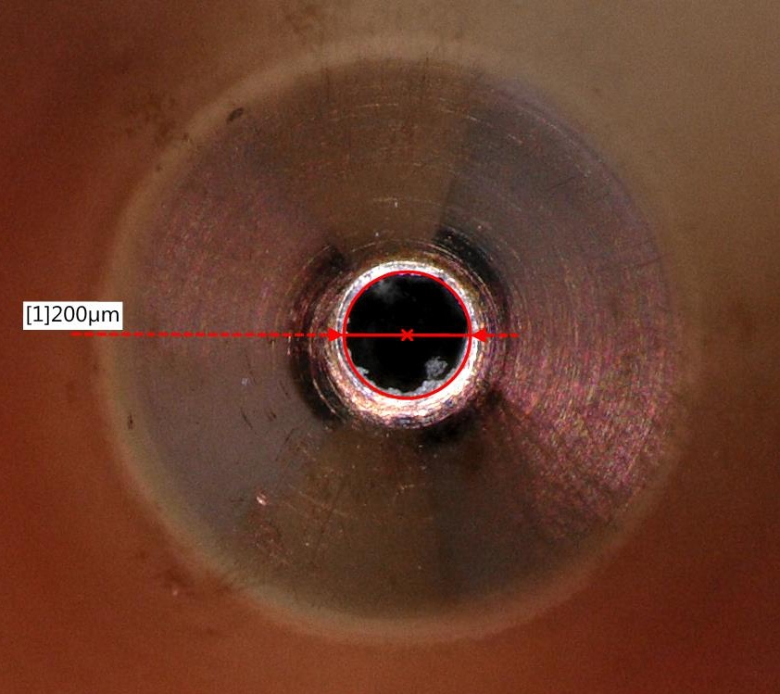
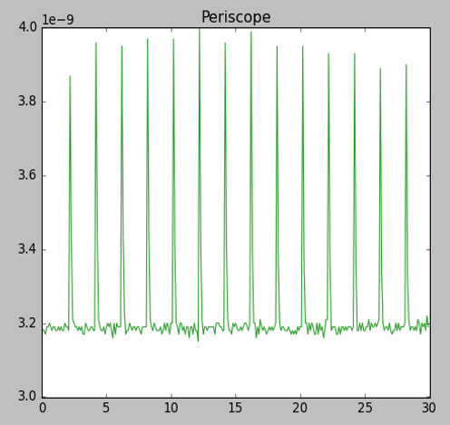
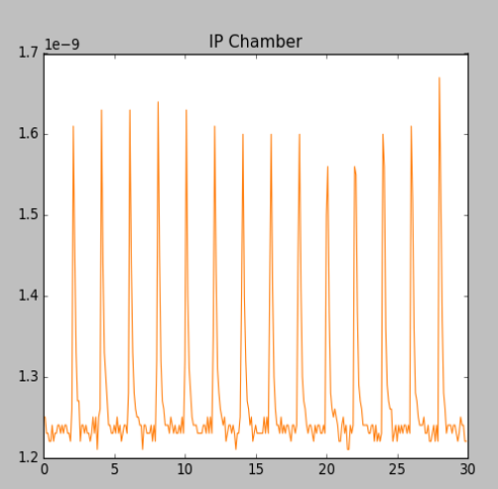
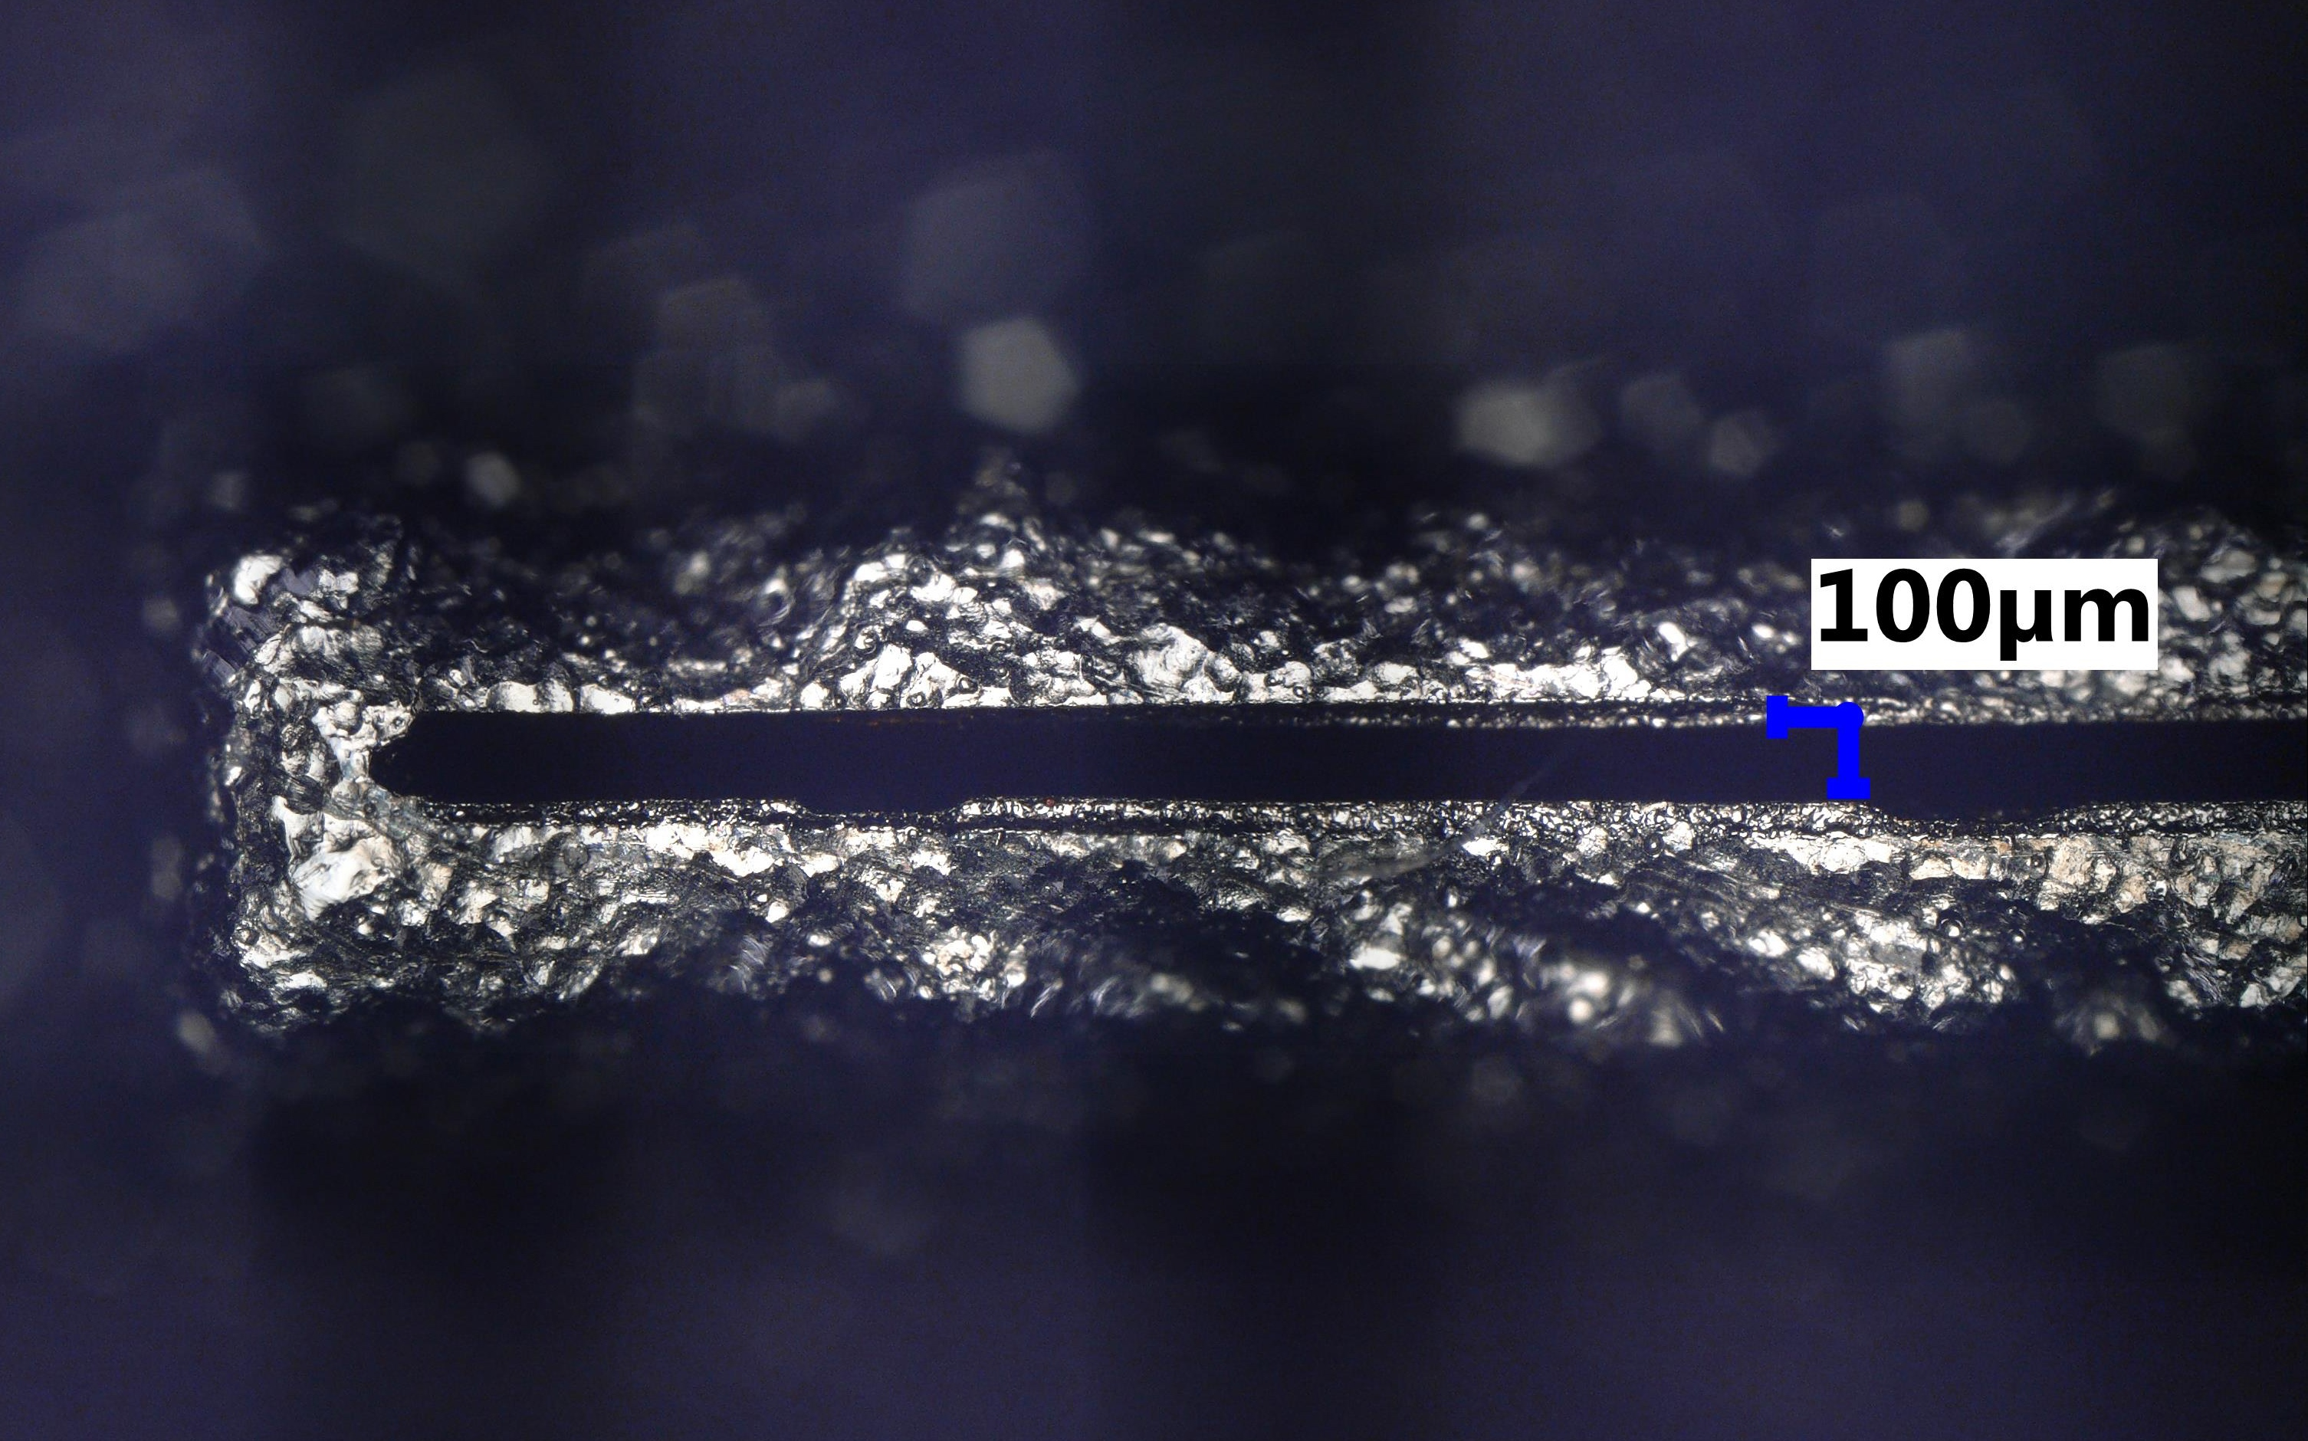
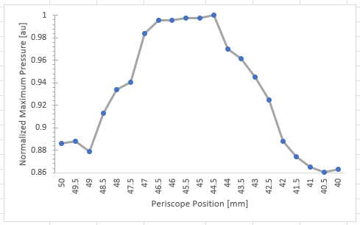
Gas Sheet Generation
“Fast” valve + nozzle (40-400µs, <kHz)
Fast recovery of vacuum after gas sheet operation (N₂)
Various skimmer sizes (200µm → 4mm) to shape gas profile
At UCLA, in operation in combination with advanced photocathodes in RF gun 4 m upstream
Diagnostic Configuration
Periscope
Gas Flow
Vacuum Readings @ 0.5 Hz
IP cube
E-beam
‘Shaper’ (rectangular 100µm x 8mm)
Diagnostic Configuration (no imaging)
Gas dump
Gas Profile at Diagnostic

Slide 8
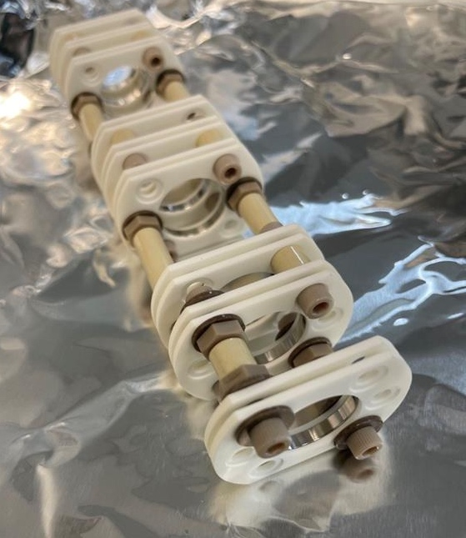
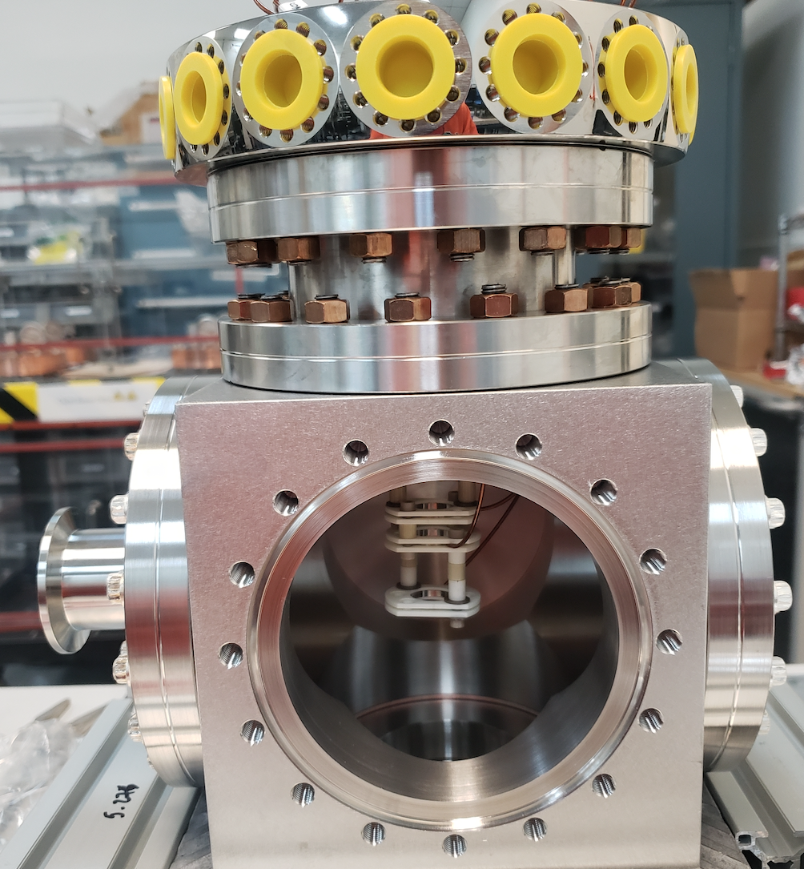
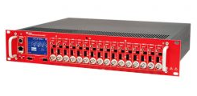
Ion Extraction Column
Transport and magnify generated ion beam to Micro-Channel Plate (MCP) detector
Simulated fields and ion beam transport (Superfish + GPT)
Fine-tune magnification imaging ability with ions from laser field ionized gas
Design magnification: 4x
Individual controllable lenses offer flexibility.
  Velocity mapping mode
  Electron detection (laser streaking of ionized electrons ?)

Slide 9
Commissioning at UCLA Pegasus
Benchmark GSM with well-diagnosed electron beams
Mainly impact ionization gives beam footprint
Two main outputs: oscilloscope trace and ion MCP image
Time-of-arrival gives q/m for ions. N2+ and N2++ detected
Pegasus Beam
σ_{x} = σ_{y} = 40 µm
σ_{z} = 200 µm
Q = 0.1nC
Gas Sheet
n_{N2} = 10¹⁴ cm⁻³
L_{N2} = 3 mm
θ = 45˚

Slide 10
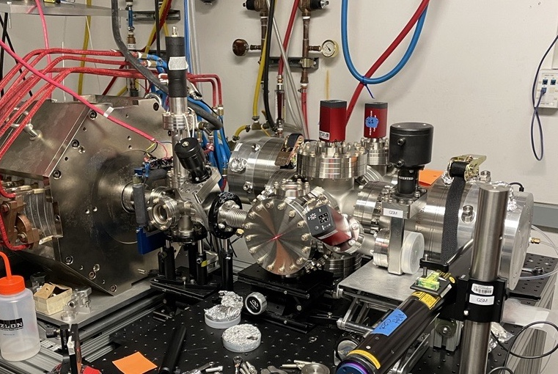
Imaging and transverse profile results
Skimmer removed -> gas jet, not 45 degree curtain. Only one dimension is relevant
Set up lenses for imaging (M up to 4)
Velocity mapping configuration also demonstrated
Vary solenoid and measure transverse spot size
GSM installed on Pegasus beamline
Ionization yield increase due to overlap between input beam and gas jet
Field ionization contribution minimal in this setup, but should be next step.

Slide 11
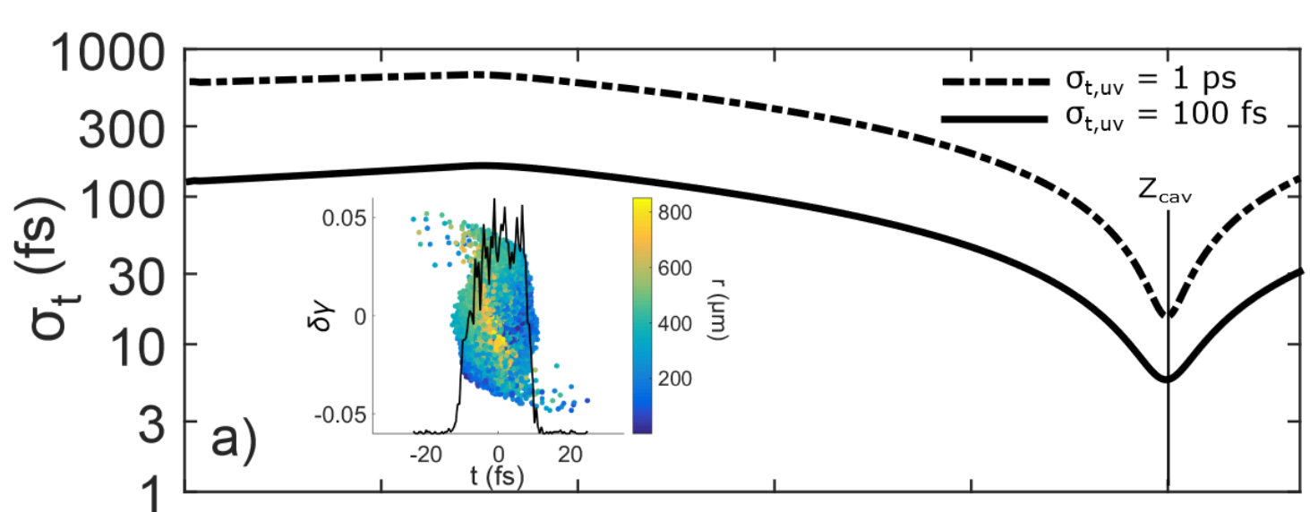
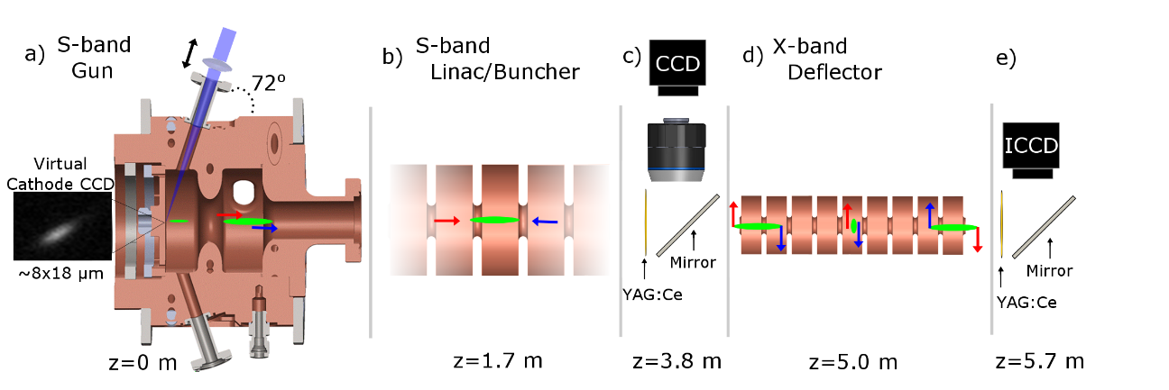
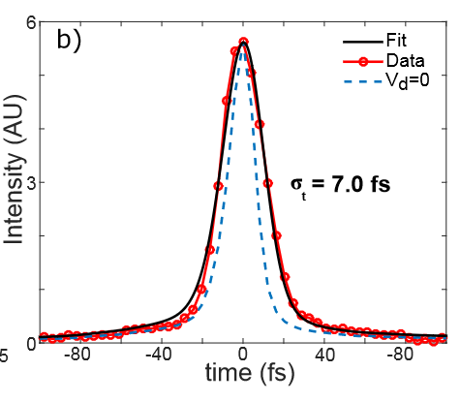
Sub-10fs RF compression at few MeV energies
Demonstrated sub 10fs RF compression at Pegasus.
Shorter initial pulse achieved shortest focus.
What are the limitations?
  How do optimal bunch lengths scale with beam and RF parameters?

Slide 12

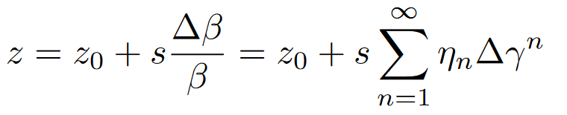

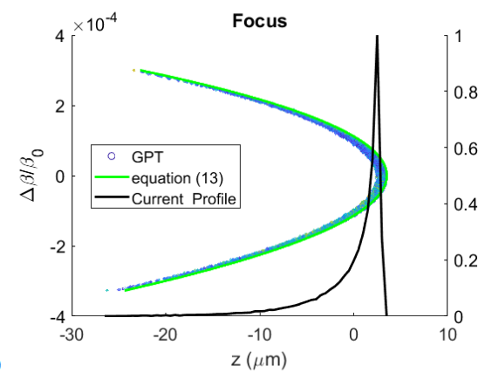
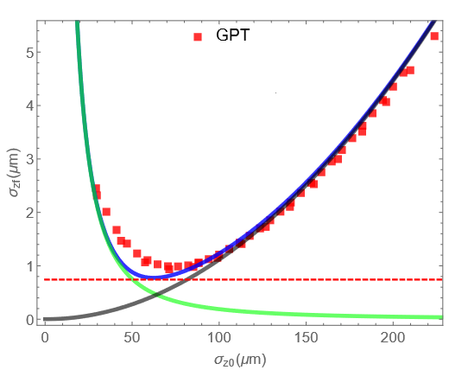
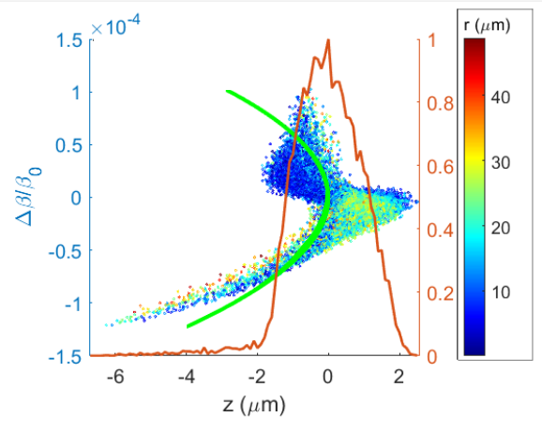
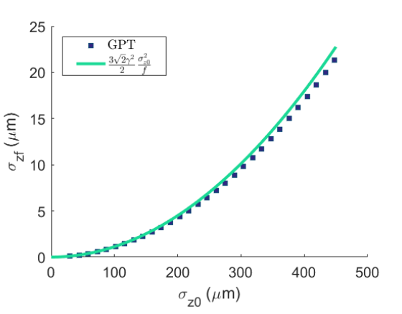
Non linear effects in RF compression
RF curvature
Vacuum dispersion
Longitudinal emittance growth
  Distortions manifest as a ramped current profile
  Adding space charge favors longer bunches and increases emittance growth. Minimum bunch length is a compromise of all effects.
Ballistic bunching is inherently non-linear.
Denham and Musumeci,
arXiv:2106.02102 (2021)

Slide 13
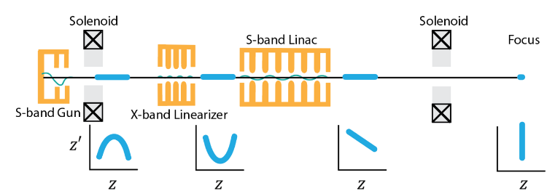
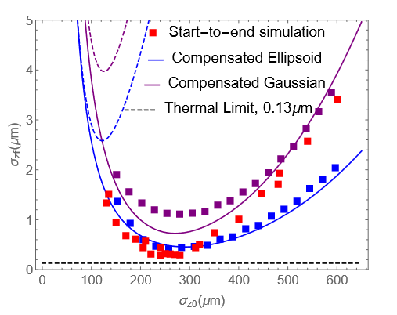
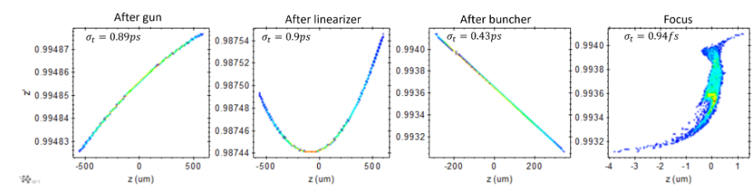
Higher harmonic compensation for sub-fs bunching
Deceleration in 3rd harmonic cavity removes higher order curvature.
Compensation allows longer bunch lengths to be used to relax space charge effects.
10^6 electrons – 160 fC bunches

Slide 14

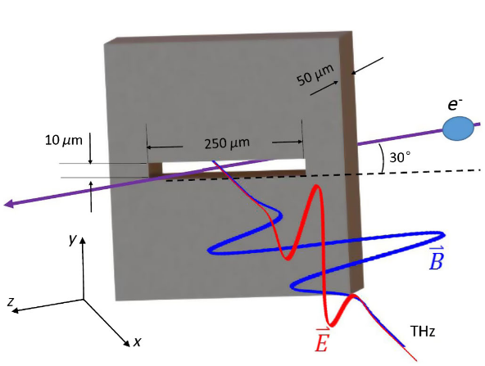
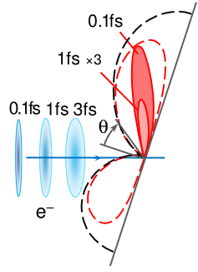
How to measure sub-fs electron bunch lengths ?
RF techniques.
  RF deflecting cavity--Resolution limited by cavity frequency and screen resolution.
THz streaking
  Sensitive to timing jitter
  Limited availability of THz power
Laser techniques.
  Laser Induced energy modulations in DLA
Radiative techniques.
  Optical transition radiation—coherence factor suppressed by transverse extent of the bunch.
  Different geometries enhance optical coherence
  Undulator radiation would work, but how to tune undulator radiation to visible range ?
$$σ_{y}$$
$$θ$$
L. Zhao, et al. Phys. Rev. X 8, 021061
M.V. Tsarev and P. Baum 2018 New J. Phys. 20 033002

Slide 15

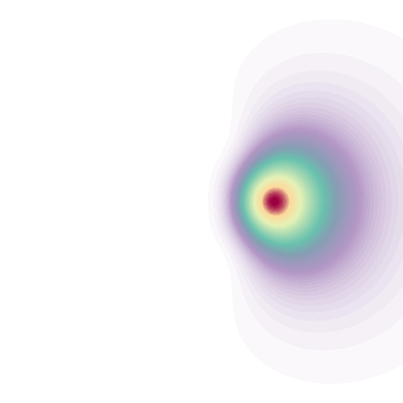






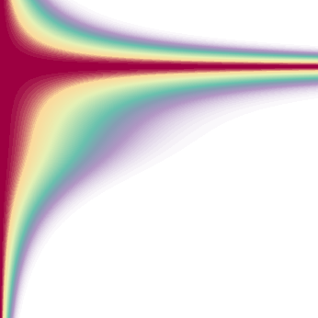

Superradiant Compton Scattering
Laser-based electromagnetic undulator
Tune period using angle of incidence
Shallow angle interaction
Intensity pattern
Radiated frequency from shallow angle interaction
Single electron radiation
Bunching factor
Superradiant radiation

Slide 16
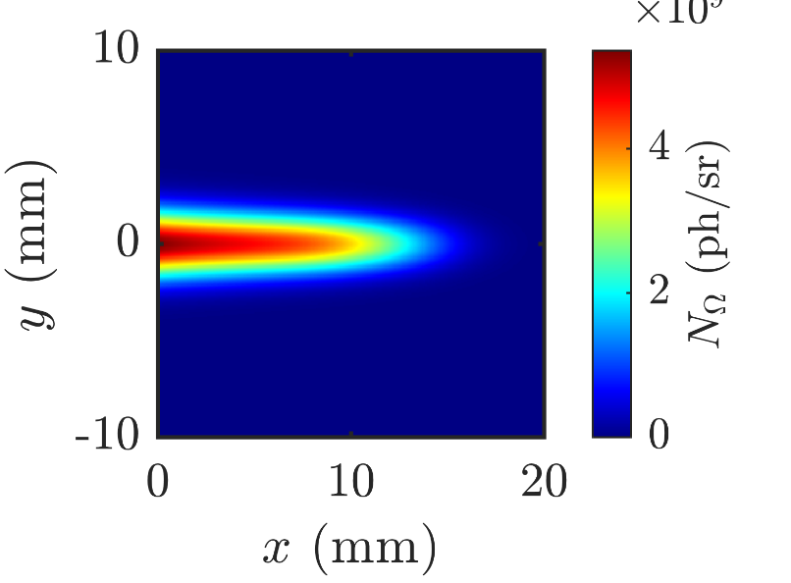
Interaction point geometry
Electron beam parameters
Beam charge | 100 fC
Kinetic energy | 3 MeV
Relative energy spread | 1.6%
Bunch length | 350 nm
Waist size | 20 μm
Norm trans. emittance | 20 nm-rad
Vacuum box
Final mirror
Electron beam
Outcoupling mirror
Entrance window
Outcoupling window
Focusing lens
Spatial filter
Laser beam parameters
Wavelength | 800 nm
Pulse energy | 20 mJ
Pulse length | 100 fs
Waist size | 30 μm
Angle of incidence | 10 degrees
Detector

Slide 17
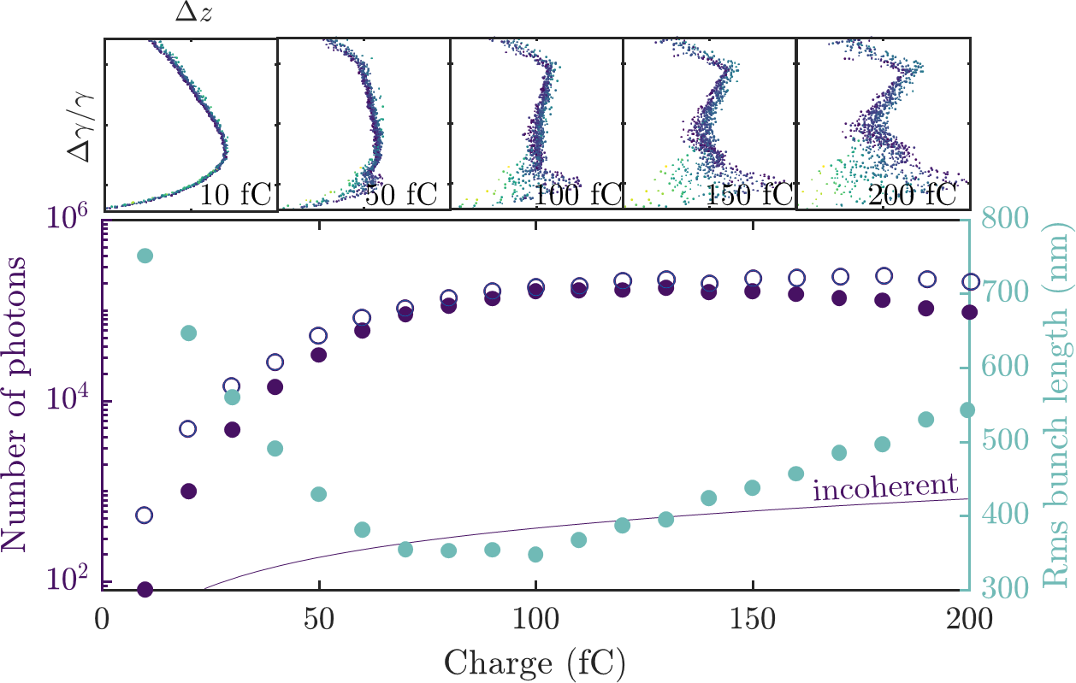
Expected photon yield
20 mJ – 800 nm drive laser
Magneto (Matlab-based GDF Numerical Electromagnetic Toolbox based on Lienard-Wiechert expressions
Spatial and spectral filtering to remove main laser
calculated using Lienard Wiechert fields from particle trajectories
calculated using analytical model presented in: Schaap et al. NJP, 24(3), 033040 (2022)

Slide 18
Advanced beam diagnostics at UCLA PEGASUS
Gas Sheet Monitor
Superradiant Compton for ultrafast beams
First commissioning of ion microscope based gas-sheet monitor successful
Impact ionization dominated (single and double)
Single-shot, non destructive measurement of charge and transverse profile
Next step is to test with field-ionization beam !
Coherent enhanced from sub-fs electron beams
Shallow angle interaction for tuning emission range
Development of GPT –compatible Lienard-Wiechert code for start-to-end photon yield calculation
Spatial and spectral filtering
Detect coherent enhancement
Reconstruction algorithms to retrieve bunch form factors

Slide 19
Non linear effects in RF compression
Ballistic bunching is inherently non-linear.
RF curvature
Vacuum dispersion
These cause longitudinal emittance growth
  Distortions manifest as a ramped current profile.
Denham and Musumeci,
arXiv:2106.02102 (2021)

Slide 20
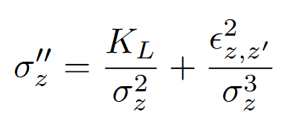
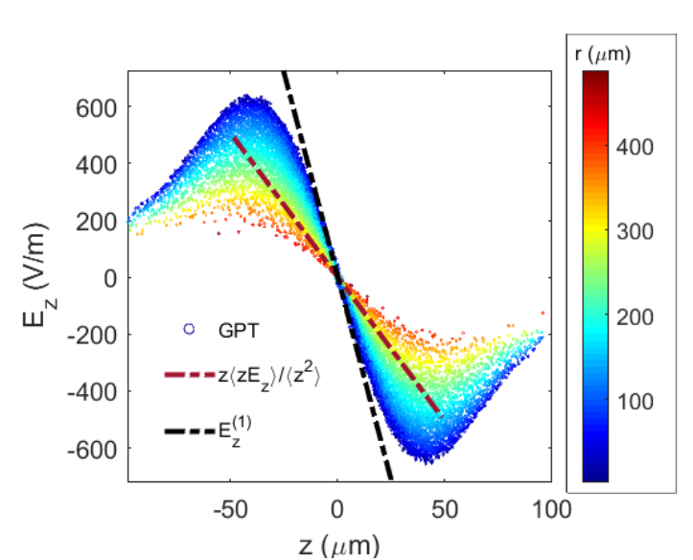
Limitations set by space charge (linear and nonlinear)
Space charge at first order is included using longitudinal perveance
Non-linear space charge forces: e.g., Gaussian induces emittance grows up to ballistic focus. Effect amplified for shorter initial bunches.
  Fine tune initial bunch length for optimum compression—Optimal trade off between space charge and RF effects-- Ideal working point.
$$fixed focal length optimum σ_{zf}∝Q^{1/2}γ^{−3/2}$$
Emittance growth sensitive to electron 3D distribution and its evolution.

