Slide 1
Transverse instabilities induced periodic modulation in laser driven proton beams
Jianhui Bin
Shanghai Institute of Optics and Fine Mechanics, CAS

Slide 2
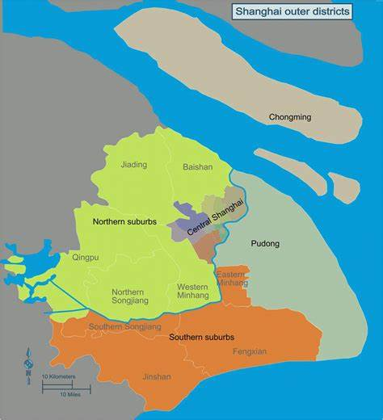
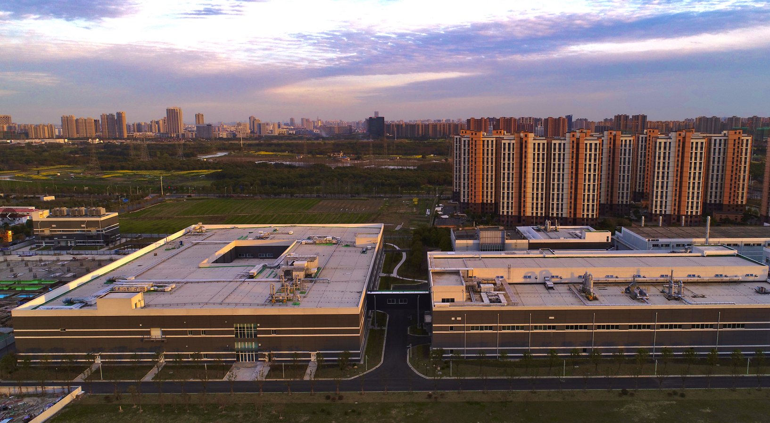
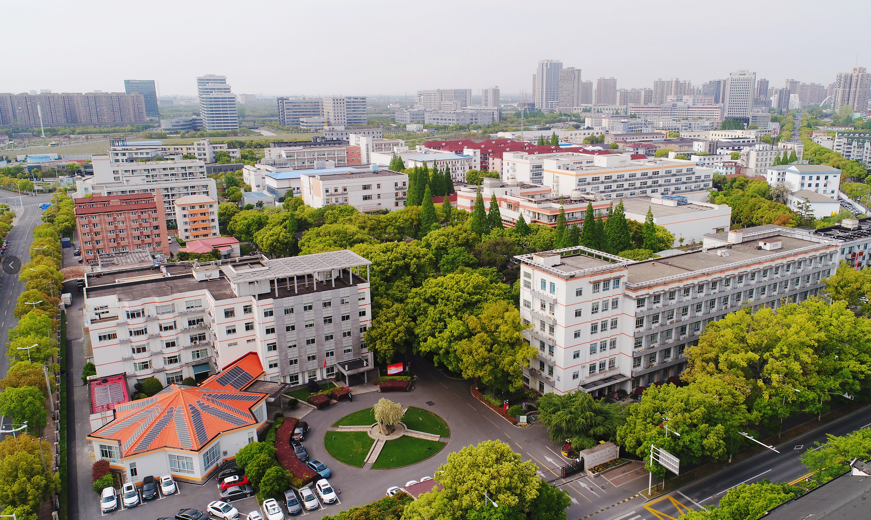
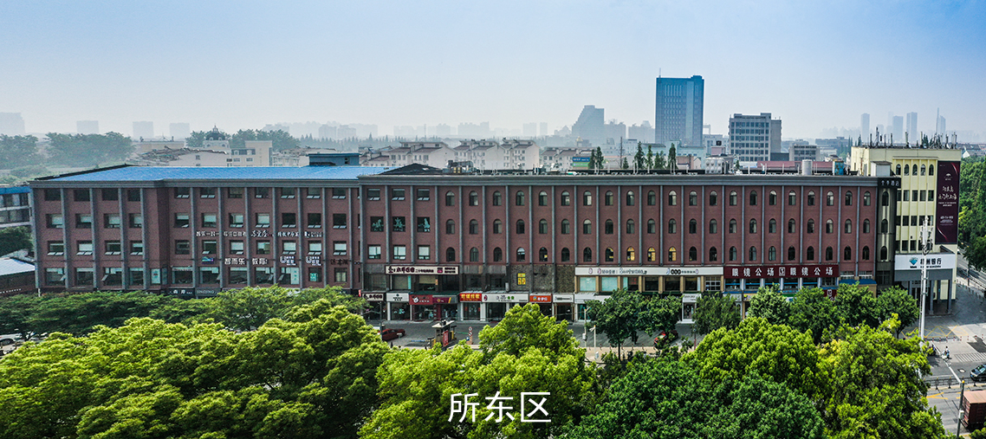
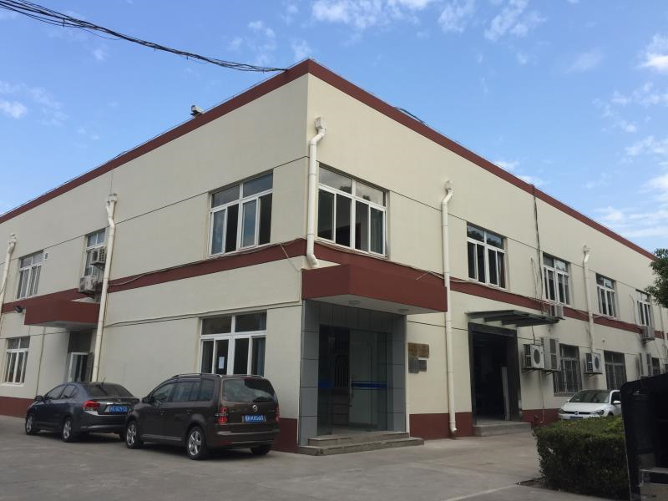
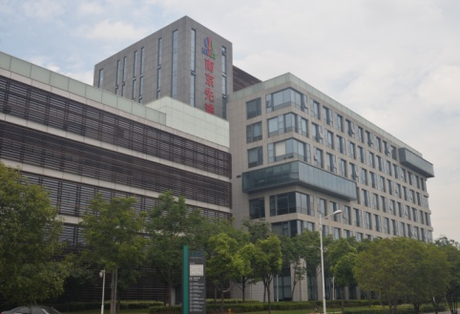
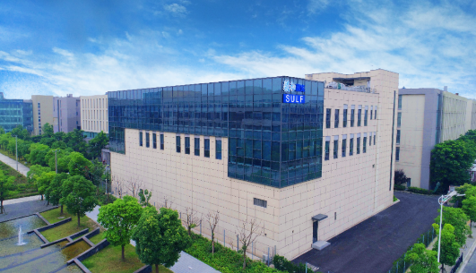
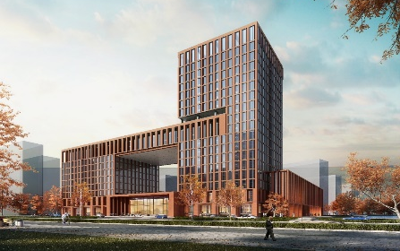
SIOM location
Jiading District (North-West Shanghai)
7 Campuses
North Campus
West Campus（Headquarters)
East Campus
South Campus
Nanjing Institute of Advanced Laser Technology, since 2013
Shanghai Superintense Ultrafast Laser Facility in Pudong, since 2018
Hangzhou Institute of Optics and Fine Mechanics, since 2019

Slide 3
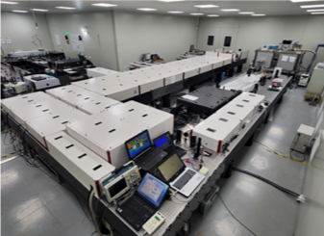
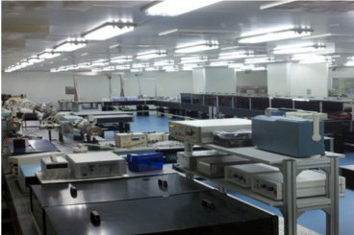
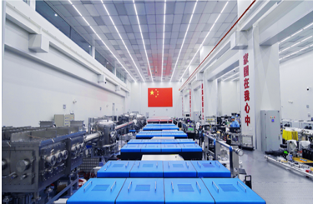
SIOM: three lasers in operation / one in construction
SIOM-200TW laser
6 J
200 TW
1 Hz
0.8 μm
SIOM-1 PW facility
30 J
1 PW
single-shot
0.8μm
SULF (Two beams)
> 250 J / 30 J
10 PW / 1 PW
3 min / 0.1 Hz
0.8 μm / 0.8μm
SEL-100PW facility
1.5 kJ
100 PW
single-shot
0.91 μm

Slide 4
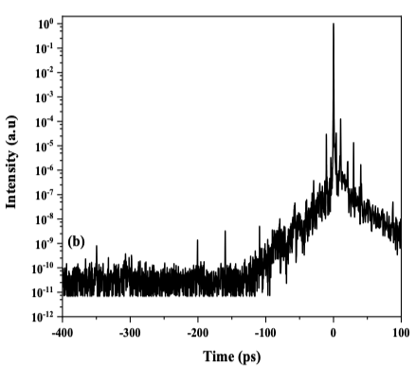
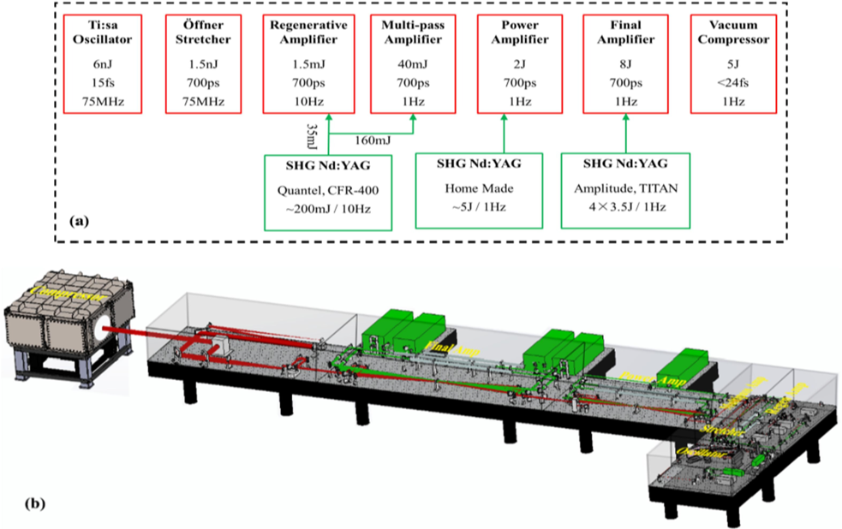
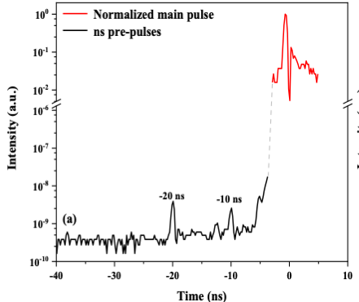
200 TW laser system @ SIOM
ps contrast
Repetition rate | 1 Hz
Energy | 8 J
Peak Power | 200 TW
Pulse duration | 30 fs
Xu, et al., Optics & Laser Tech., 79, 141 (2016)
Wu, et al., Optics & Laser Tech., 131, 106453 (2020)
ns contrast

Slide 5
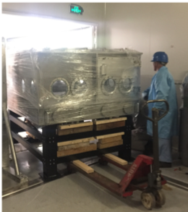
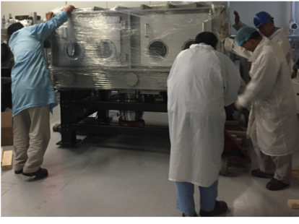
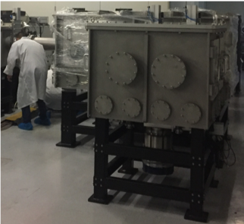
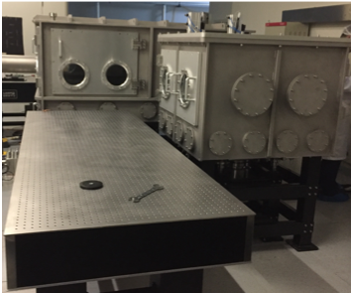
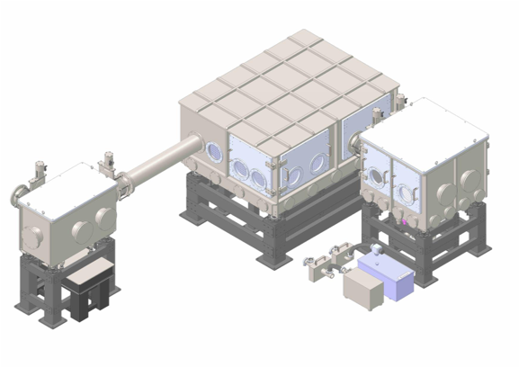
New beamline for laser-driven ion acceleration
Installation, starting from Sep, 2020
Schematic of targets
Final image

Slide 6
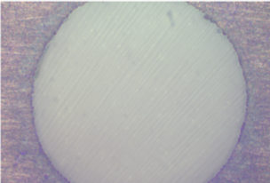
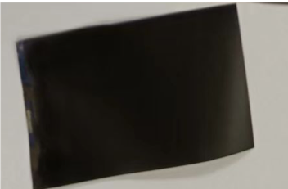
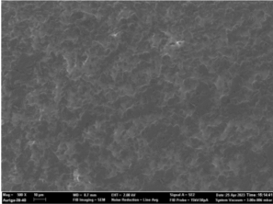
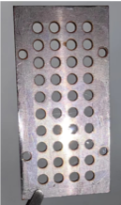
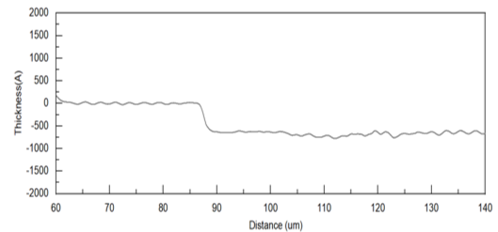
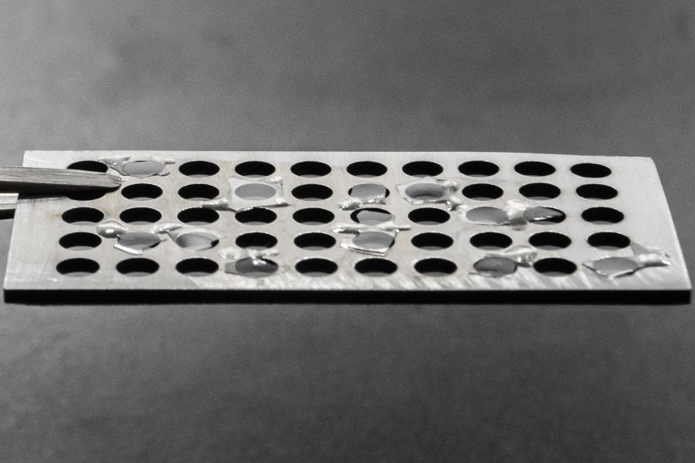
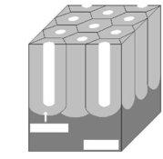
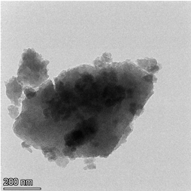
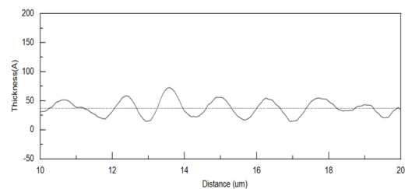
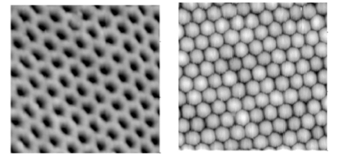
Targetry at SIOM
Formvar
5-500nm
Low density aerogel
10s-100s mg/cc,3-20 μm
Thickness
porous anodic alumina film
0.5g-1.5g/cc, few μm
Dia. ~200nm
AFM images
Uniformity
top-view
bottom-view

Slide 7
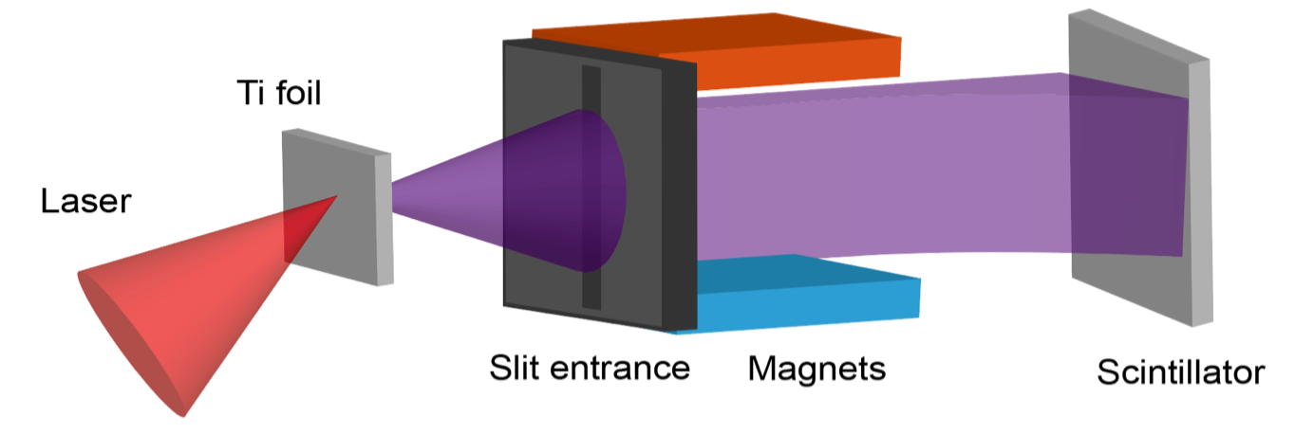
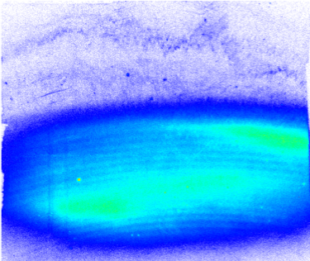
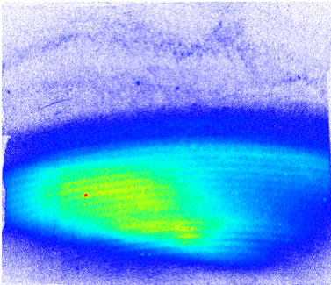
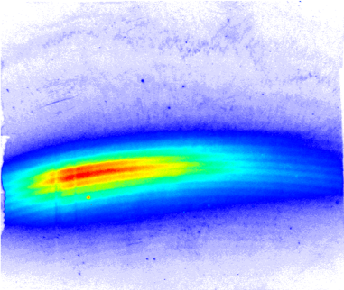
Observed periodic modulation in proton spectrum
1 μm Ti, 30fs laser
1 μm Ti, 150fs laser
1 μm Ti, 300fs laser
Z. Liu, et al., in preparation

Slide 8
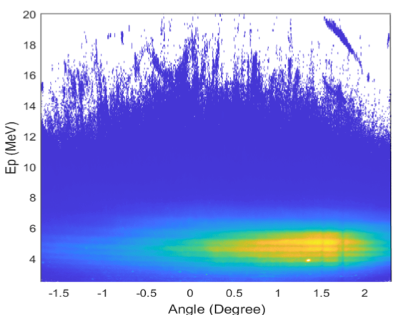
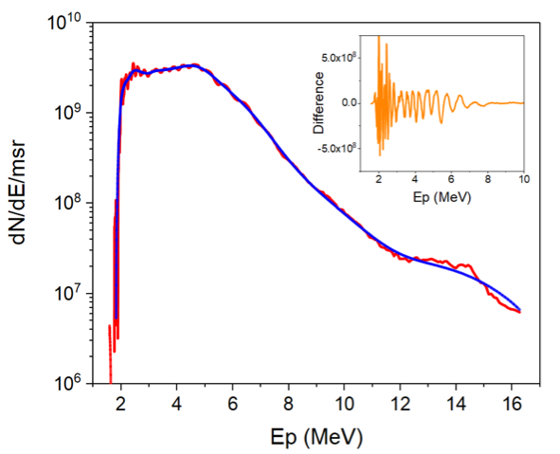
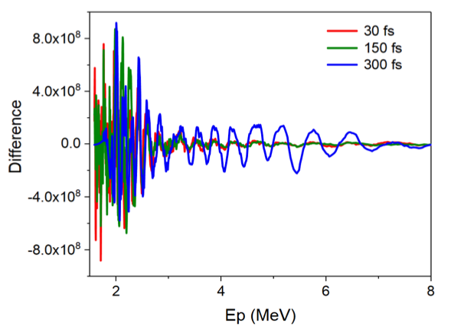
Observed periodic modulation
Processed data
1D spectrum
Clearly seen with angularly resolved energy distribution
Not so clear under 1D condition
Amplitude changed with laser pulse duration
Z. Liu, et al., in preparation

Slide 9
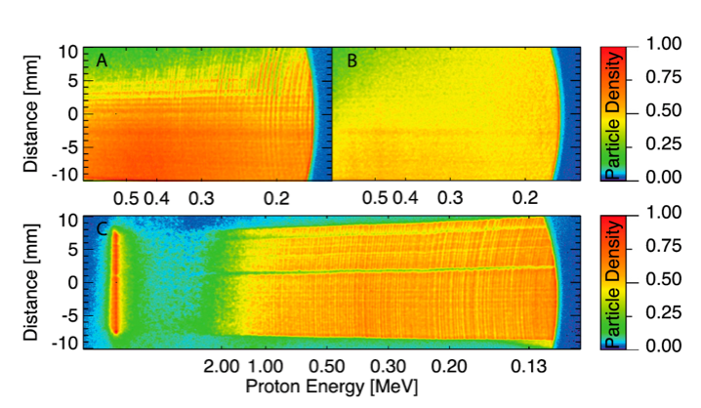
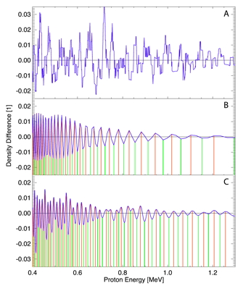
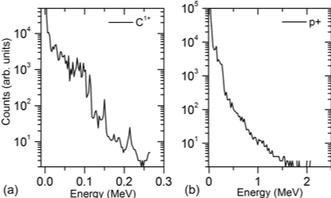
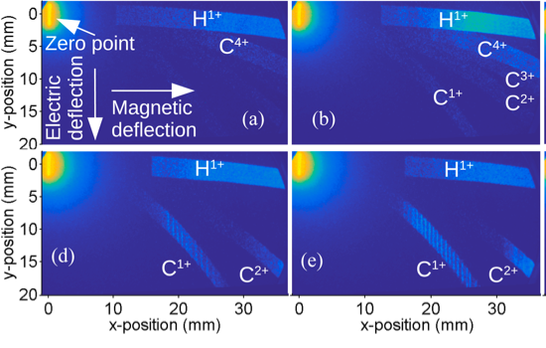
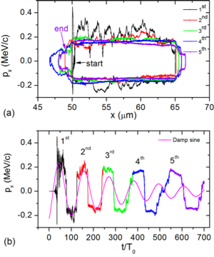
Previous reported results
Observed on carbon spectrum
attributed to certain perturbation on longitudinal acceleration field
Schnuerer, et al., Phys. Plasmas, 20, 103102 (2013)
Observed on carbon spectrum
attributed to the recirculation of hot electrons
Noaman-ul-Haq, et al., Phys. Plasmas, 25, 043122 (2018)

Slide 10
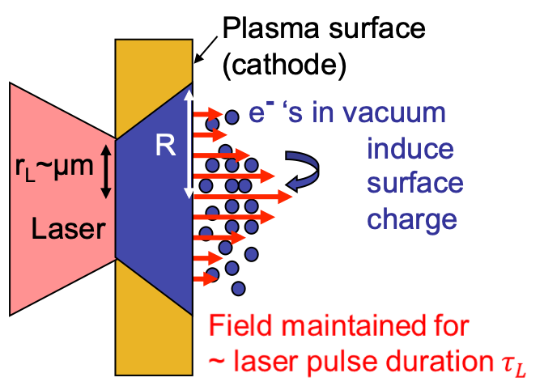
Perturbation on accelerating field?
Electron density distribution
Perturbation on n_{e}
Accelerating field
Perturbation on E_{acc}
Proton/ion spectrum
Purely 1D case, perturbation on longitudinal electron density distribution
2D case, perturbation on transverse electron density distribution
Mora, Phys. Rev. Lett., 90, 185002 (2003)
Schreiber, et al., Rev. Lett., 97, 045005 (2006)
Schnuerer, et al., Phys. Plasmas, 20, 103102 (2013)

Slide 11
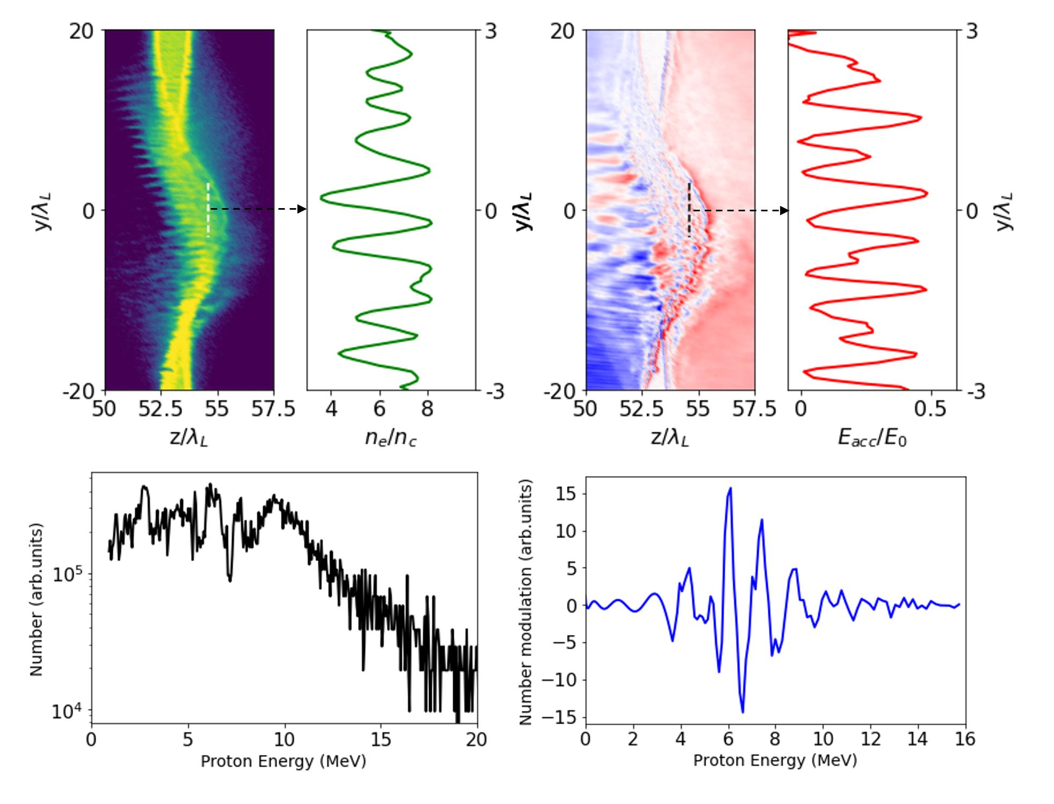
PIC simulation results
350 fs after laser reaching the target
Electron density modulation
~0.8ƛ
Modulated E-field
Proton spectrum
Extracted fluctuation
Electron density modulation induced by transverse instabilities

Slide 12
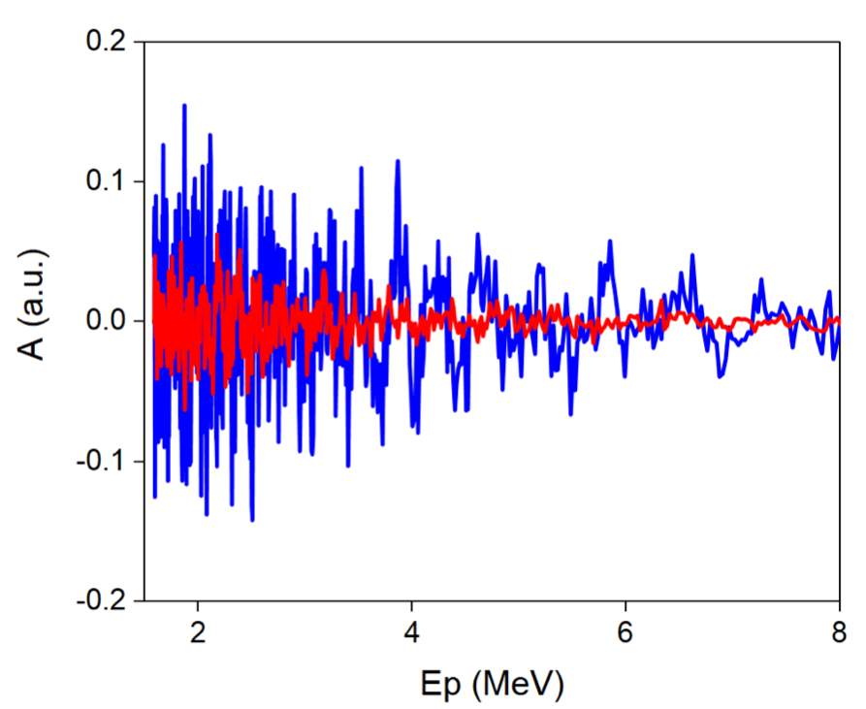
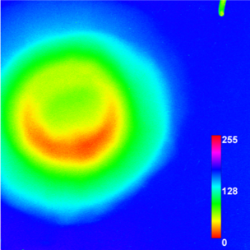
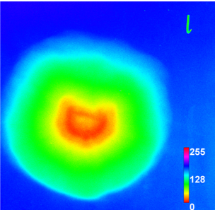
RCF data
Occurs when target turn to transparency

Slide 13
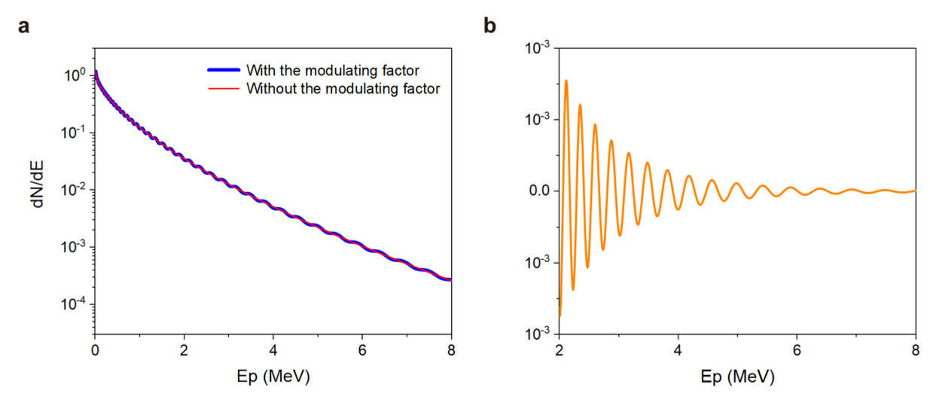
Little math
$$y^{2}∝\left\langle \left.c_{s}\right\rangle \right.t, c_{s}=\sqrt{\frac{Zk_{B}T_{e}}{m_{i}}}$$
$$\left.exp{(}−4ln2∙\frac{y^{2}}{D^{2}})∙(1+a∙sin{(}b∙\frac{2π}{λ}∙y)\right)$$
$$E_{p}∝k_{B}T_{e}$$
An inset of modulation on the transverse electron density distribution can cause the modulation on proton spectrum
Z. Liu, et al., in preparation

Slide 14
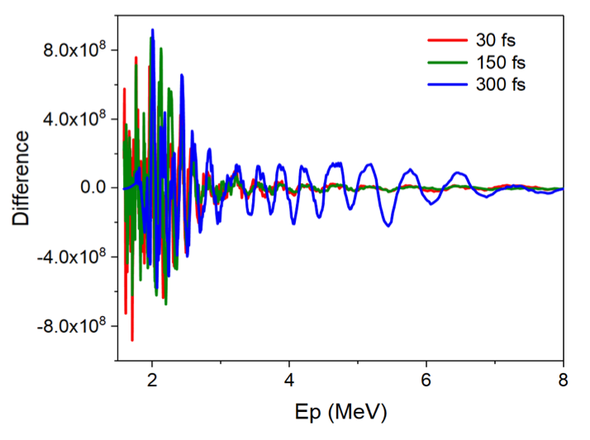
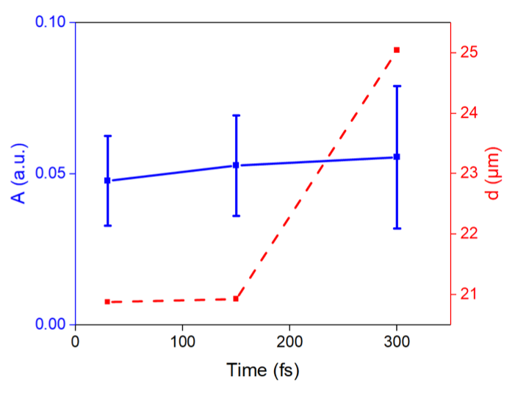
Possible diagnostic for RT instability
Measured modulations from different laser pulse duration
A possible diagnostic tool to trace the development of the RT instability
Z. Liu, et al., in preparation

Slide 15
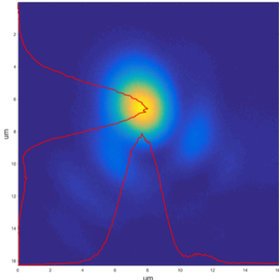
First high rep. rate ion experiments at SIOM
4J, 30fs
5×10²⁰W/cm²
30 degree angle of incidence
WASP @ target normal
Online diag. with scintillator
3μm
2.8μm

Slide 16
First high rep. rate ion experiments at SIOM
Mean cut-off energy～14MeV, standard deviation～10%
R. Qi, J.H. Bin, et al., submitted

Slide 17
Further optimizations of the experimental setup

Slide 18
Long term operation of the system
8 hrs test
Pointing at focus
10 hrs test
Laser energy

Slide 19
New upgrade on ion beamline
Focused on solid target interactions
Toward applications such as material science, high energy density physics, biological studies
200 TW laser
Move to new lab in mid 2023

Slide 20
Lab movement in mid 2023
~43 m
Laser hall
Exp. area
~10 m
Laser hall
~40 m
Experimental area

Slide 21
Summary & Outlook
Summary:
A new beamline for laser-driven ion acceleration @ SIOM
Observed periodic modulation in proton spectrum
High rep. rate proton source
Outlook:
Move to new lab in mid 2023
Explore advanced acceleration scheme
Toward applications such as material science, high energy density physics, biological studies
21

Slide 22
Many thanks to my colleagues
Laser ion acceleration group: Z. Liu, M.K. Zhao, J.Z. Zhuang, R. Qi, W.J. Peng, H.F. Sun, J.F. Chen, H.R. Wang, L.L. Zeng, X.H. Yang, H.W. Wu, H.T. Hu, R.T. Hu, Y. Zhang, J.W. Wang, J.H. Bin
State key laboratory of high field laser physics:
J.Y. Gui, P. Bai, X.J. Yang, Y. Xu, Y.X. Leng, R.X. Li
Laboratory of thin film optics:
F.H. Liu, W.P. Wu
Y.F. Zheng, Y.C. Shao
Laboratory of laser and infrared materials:
Y.F. Li, J. He
22

Slide 23
Ad1
Positions available at different levels:
PhD
Postdoc
Assistant/Associate Professor…
Please contact:
Jianhui.bin@siom.ac.cn
23

Slide 24
Ad2
24

Slide 25
Thank you!

