Slide 1
Efficient Laser ion acceleration from foils and isolated targets
P. Hilz, I. Salahedin, MY. Shi, J. Gebhard, A. Sävert, J. Schreiber, M. Zepf
Helmholtz Insitute Jena, Jena, Germany
LPAW 2023, 08.03.2023

Slide 2
Outline
Three Experiments
Energy on target ≈ 150 J
Max Prot. Energy ≈ 45 MeV
Pulsduration ≈ 500 fs
Energy on target ≈ 0.4 J
Max Prot. Energy ≈ 27 MeV
Pulsduration ≈ 25 fs
Energy on target ≈ 2 J
Max Prot. Energy ≈ 35 MeV
Pulsduration ≈ 25 fs

Slide 3
Outline
Three Experiments
Energy on target ≈ 150 J
Max Prot. Energy ≈ 45 MeV
Pulsduration ≈ 500 fs
Energy on target ≈ 0.4 J
Max Prot. Energy ≈ 27 MeV
Pulsduration ≈ 25 fs
Energy on target ≈ 2 J
Max Prot. Energy ≈ 35 MeV
Pulsduration ≈ 25 fs

Slide 4
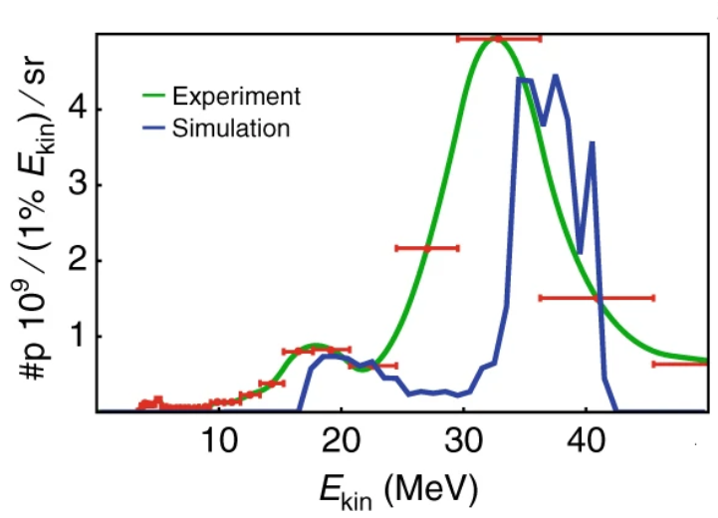
Phelix

Slide 5
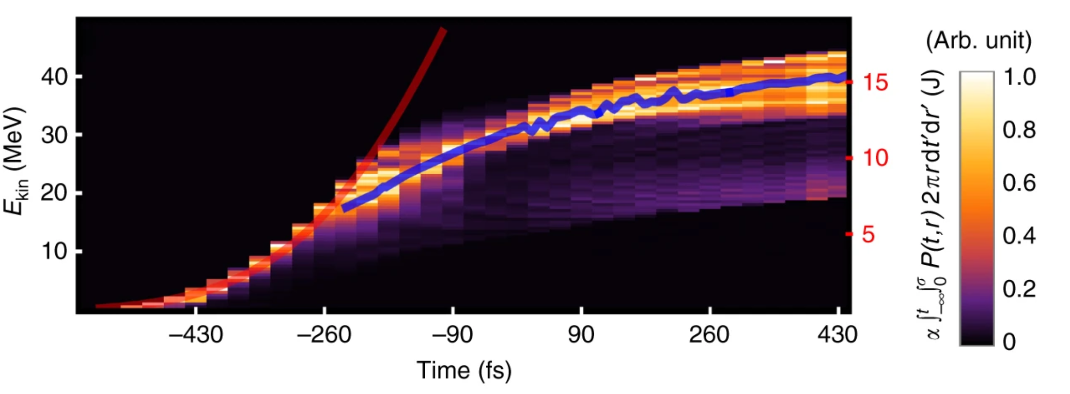
Phelix

Slide 6
Outline
Three Experiments
Energy on target ≈ 150 J
Max Prot. Energy ≈ 45 MeV
Pulsduration ≈ 500 fs
Energy on target ≈ 0.4 J
Max Prot. Energy ≈ 27 MeV
Pulsduration ≈ 25 fs
Energy on target ≈ 2 J
Max Prot. Energy ≈ 35 MeV
Pulsduration ≈ 25 fs

Slide 7
Outline
Three Experiments
Energy on target ≈ 150 J
Max Prot. Energy ≈ 45 MeV
Pulsduration ≈ 500 fs
Energy on target ≈ 0.4 J
Max Prot. Energy ≈ 27 MeV
Pulsduration ≈ 25 fs
Energy on target ≈ 2 J
Max Prot. Energy ≈ 35 MeV
Pulsduration ≈ 25 fs

Slide 8
Paultrap @ JeTi
Solid density sphere
Pre-expanded sphere

Slide 9
Paultrap @ JeTi
Solid density sphere
Pre-expanded sphere

Slide 10
Outline
Three Experiments
Energy on target ≈ 150 J
Max Prot. Energy ≈ 45 MeV
Pulsduration ≈ 500 fs
Energy on target ≈ 0.4 J
Max Prot. Energy ≈ 27 MeV
Pulsduration ≈ 25 fs
Energy on target ≈ 2 J
Max Prot. Energy ≈ 35 MeV
Pulsduration ≈ 25 fs

Slide 11
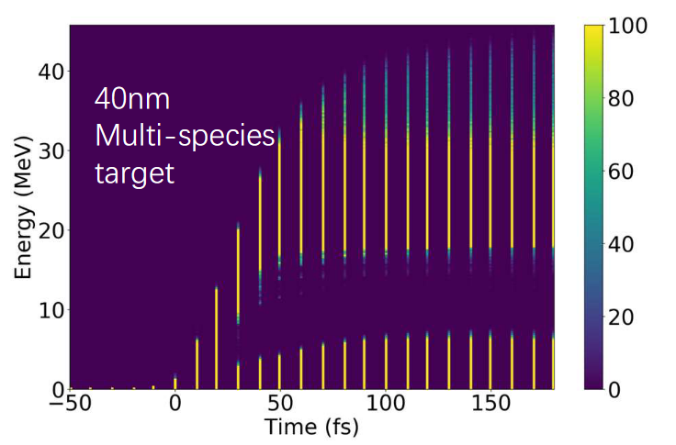
Foil @ JeTi

Slide 12
Interpretation
Many different acceleration mechanisms exist
TNSA
HB
CE
RPA
etc
etc

Slide 13
Interpretation
Many different acceleration mechanisms exist
TNSA
HB
CE
RPA
etc
etc

Slide 14
Interpretation
Many different acceleration mechanisms exist
TNSA
CE
HB
RPA
etc
etc

Slide 15
Interpretation
Many different acceleration mechanisms exist
TNSA
CE
HB
RPA
etc
etc

Slide 16
Interpretation
Many different acceleration mechanisms exist
TNSA
HB
CE
RPA
etc
etc

Slide 17
Interpretation
Many different acceleration mechanisms exist
TNSA
HB
CE
RPA
etc
etc

Slide 18
Interpretation
HB
TNSA
RPA
CE
etc
etc
Forces
Potential

Slide 19
Interpretation
HB
TNSA
RPA
Forces
Potential
CE
etc
etc

Slide 20
Coulomb explosion
CE

Slide 21
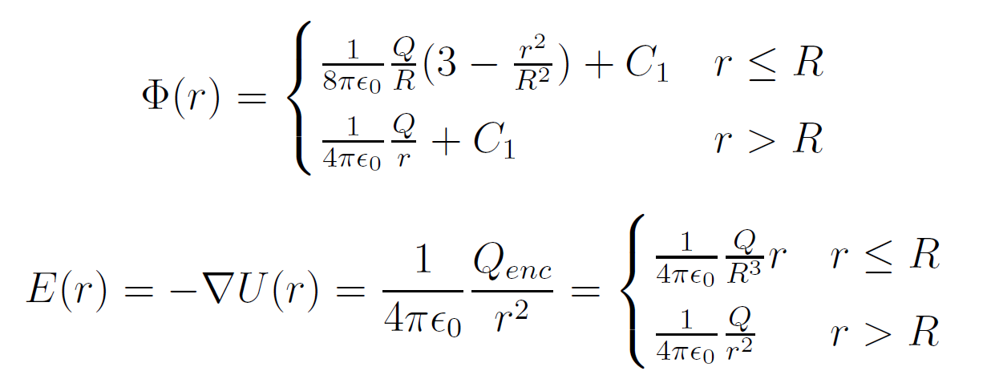
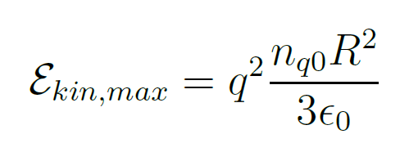
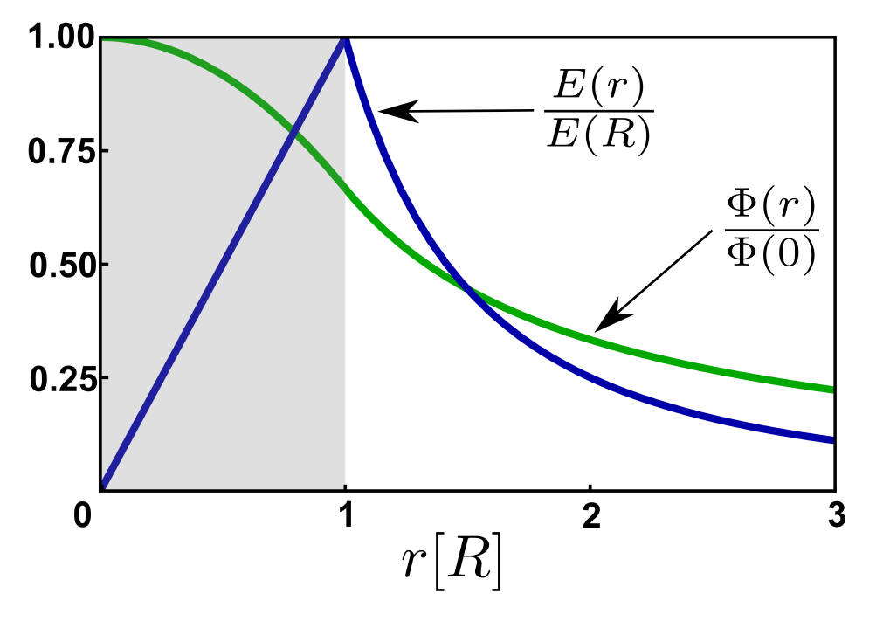
Coulomb explosion
0.5 GeV
1 µm
8.9 J

Slide 22
Coulomb explosion
0.5 GeV
1 µm
8.9 J

Slide 23
Coulomb explosion
0.5 GeV
1 µm
8.9 J

Slide 24
Coulomb explosion
0.5 GeV
1 µm
8.9 J

Slide 25
Coulomb explosion
0.5 GeV
1 µm
8.9 J

Slide 26
Coulomb explosion
0.5 GeV
1 µm
8.9 J

Slide 27
Coulomb explosion

Slide 28
Coulomb explosion

Slide 29
Paultrap @ JeTi
Pre-expanded sphere with more laser energy

Slide 30
Summary
Accelaration after the laser pulse due to stored energy
Highly efficient acceleration possible with different target systems
Timescale for intra pulse expansion motivated (work in progress)

Slide 31
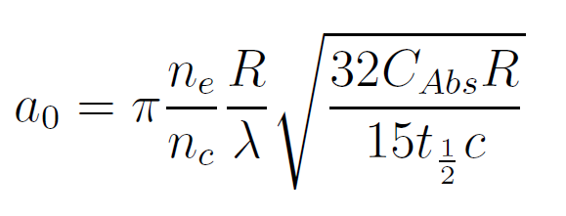
Coulomb explosion

Slide 32
Coulomb explosion

Slide 33
Coulomb explosion

Slide 34
Coulomb explosion

