Slide 1
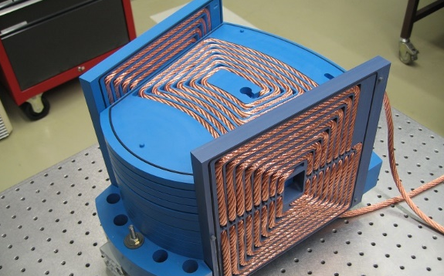
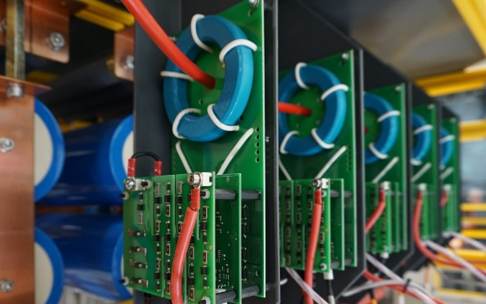
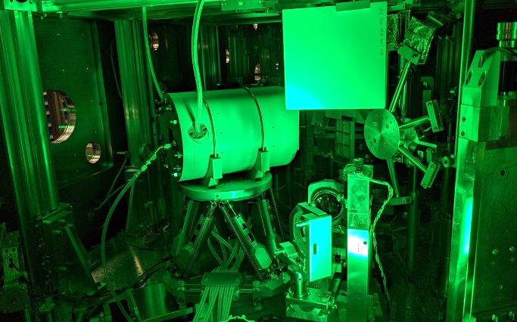
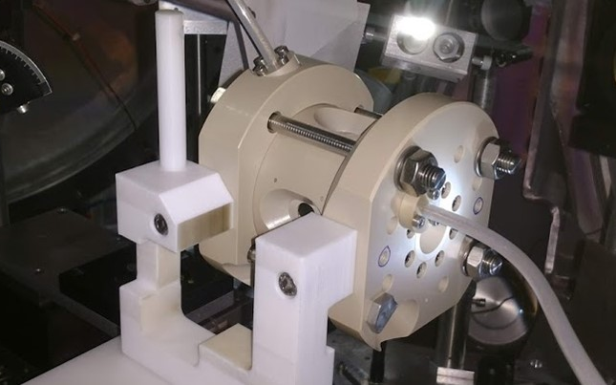
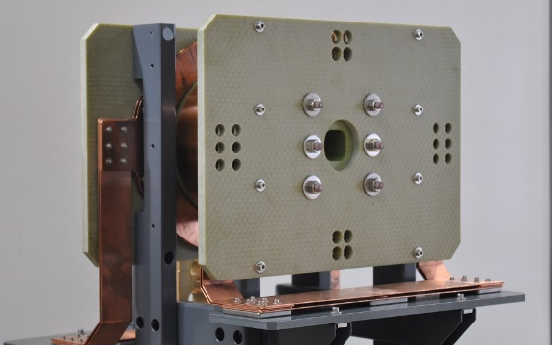
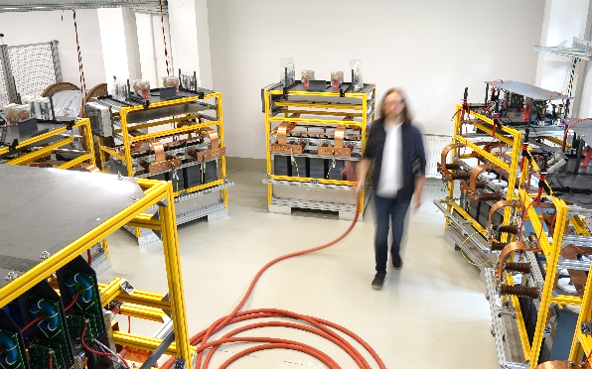
ALBUS – Advanced Laser-driven Beamlines for User-specific Studies
Florian-Emanuel Brack, F. Kroll, E. Beyreuther, M. Reimold, U. Schramm, K. Zeil and J. Metzkes-Ng
6th European Advanced Accelerator Concepts workshop (EAAC 2023) – 20.09.2023 - Isola d'Elba, Italy

Slide 2

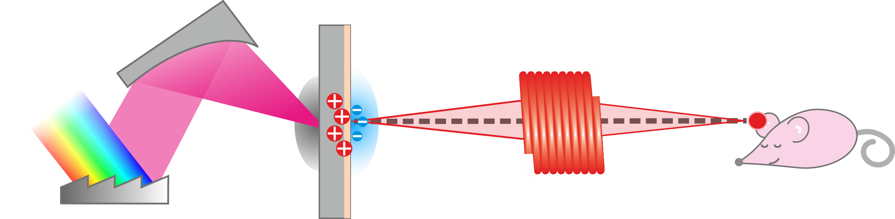
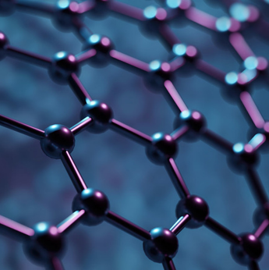

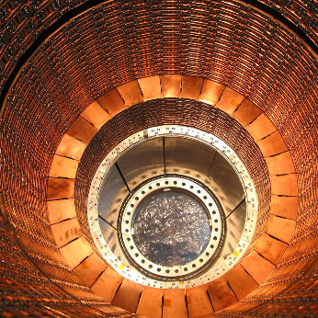
Motivation
Pulsed laser-plasma accelerated particle source paired with pulsed high-field magnets
Medical Sciences
Matter & Materials
HED Physics
Detector Physics

Slide 3
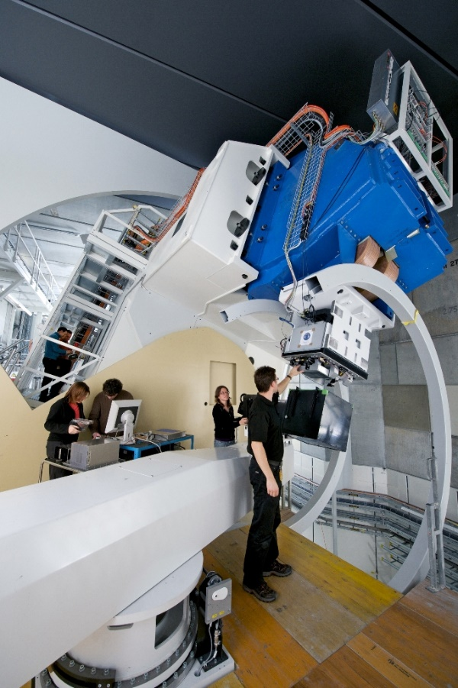
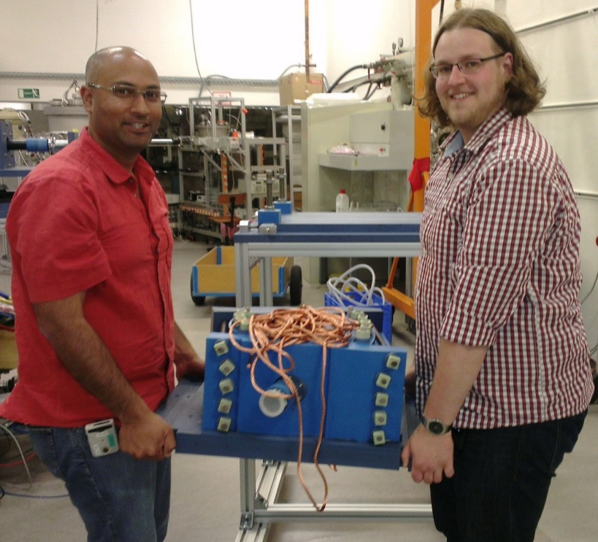
Why pulsed high-field magnets?
Replacing large infrastructure with compact electromagnets
Electromagnet through which a high current flows for a short time, generating a strong magnetic field.
Gantry 2 @ PSI
Prototype of a pulsed
dipole magnet
Notes:
Electromagnet through which a high current flows for a short time, generating a strong magnetic field.

Slide 4
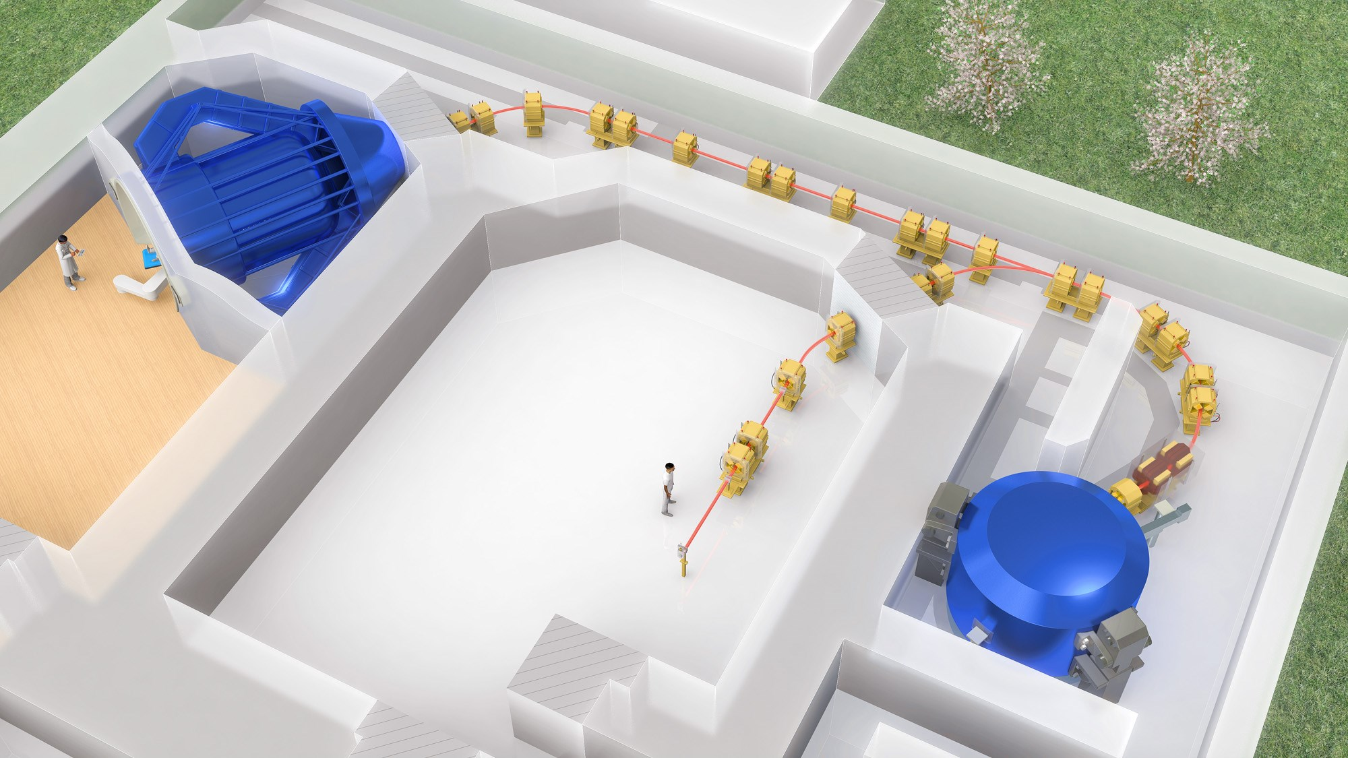
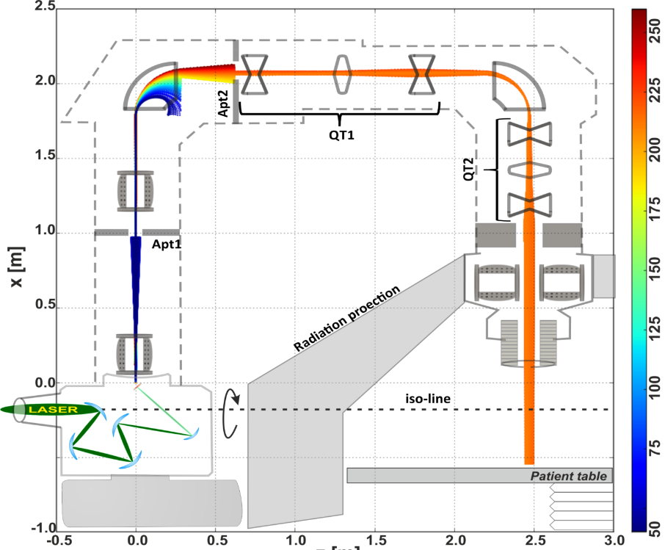

„Infamous“ application case - Radiotherapy
Masood et al., Phys. Med. Biol. 62 (2017)
13 m × 11 m
Height [m]
Energy [MeV]
Beam transport
Solenoid
Gantry
2.40 m
Dipole
Radiation safety
Quadrupole
Cyclotron
Universitäts Protonen Therapie Dresden
Length [m]
Notes:
Spiralförmige Bahn → sehr lang

Slide 5





ALBUS at HZDR
Pulsed power portfolio @ HZDR for beamline optics
Solenoid
Quadrupole
Dipole
p⁺
p⁺
S
N
Dipolemagnet
N
S
p⁺
$$r$$
Pulsed B-field:
1 T → 10 T
20 T
250 T/m
10 T
focal length
focal length
deflection radius
$$f_{S}=\frac{4p^{2}}{q^{2}B^{2}l}$$
$$f_{Q}=\frac{pr}{qlB}$$
$$r=\frac{p}{qB}$$
100
10
10

Slide 6
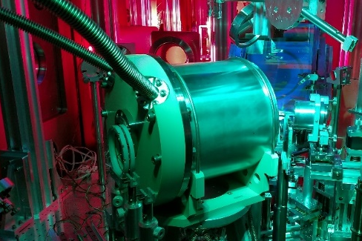


ALBUS at HZDR
Pulsed power portfolio @ HZDR for beamline optics
Solenoid
Quadrupole
Dipole
Pulsed B-field:
1 T → 10 T
20 T
250 T/m
10 T
focal length
focal length
deflection radius
$$f_{S}=\frac{4p^{2}}{q^{2}B^{2}l}$$
$$f_{Q}=\frac{pr}{qlB}$$
$$r=\frac{p}{qB}$$
100
10
10

Slide 7

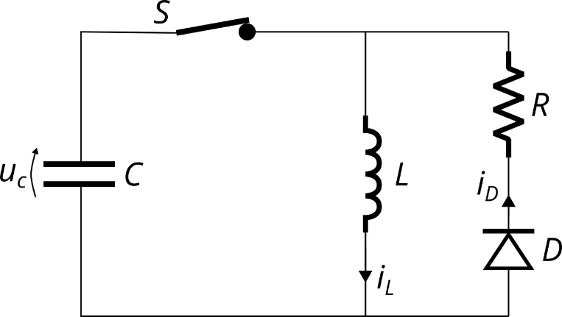
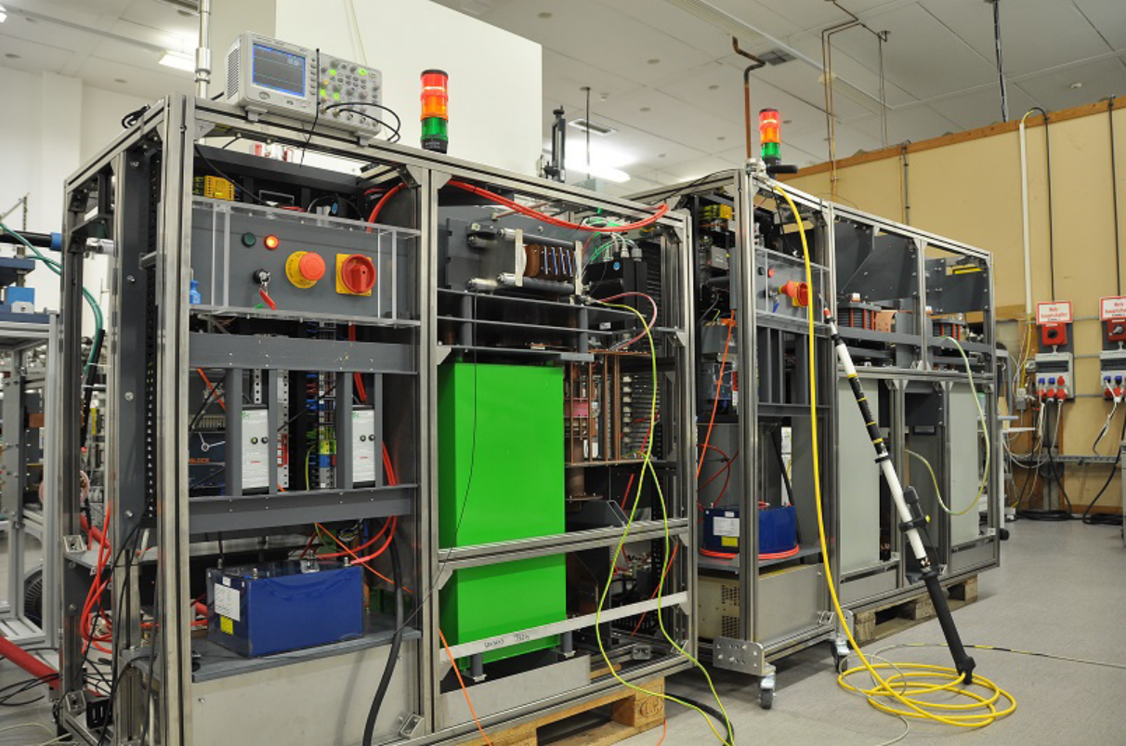
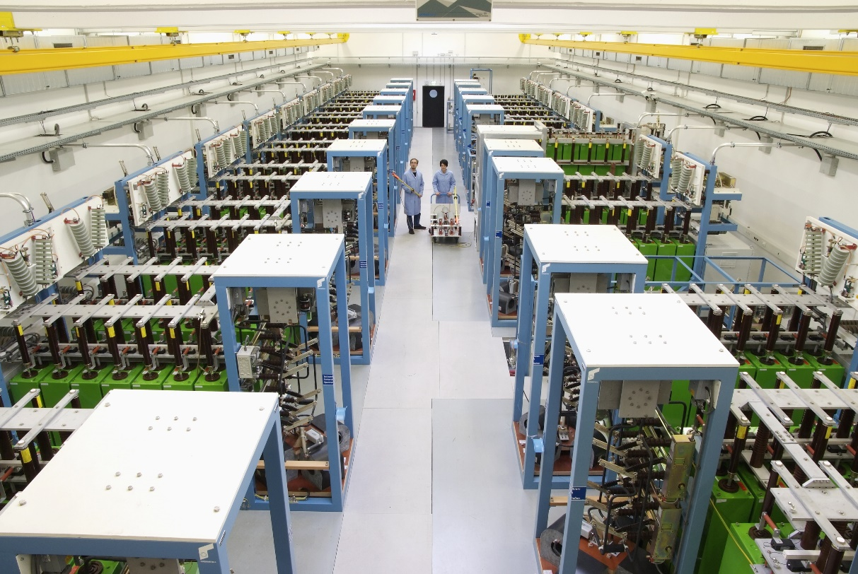
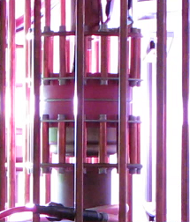
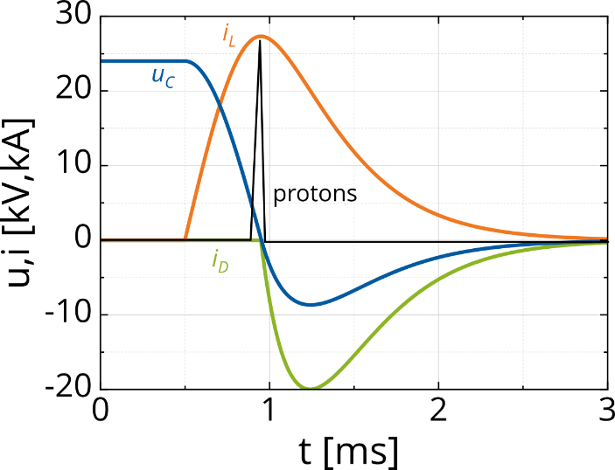
Pulse Generators
Adapting large scale high-field lab equipment to mobile pulse generators
E_{el} = 25 – 94 kJ
f_{rep} < 5 pulses/minute
Modular & compact

Slide 8
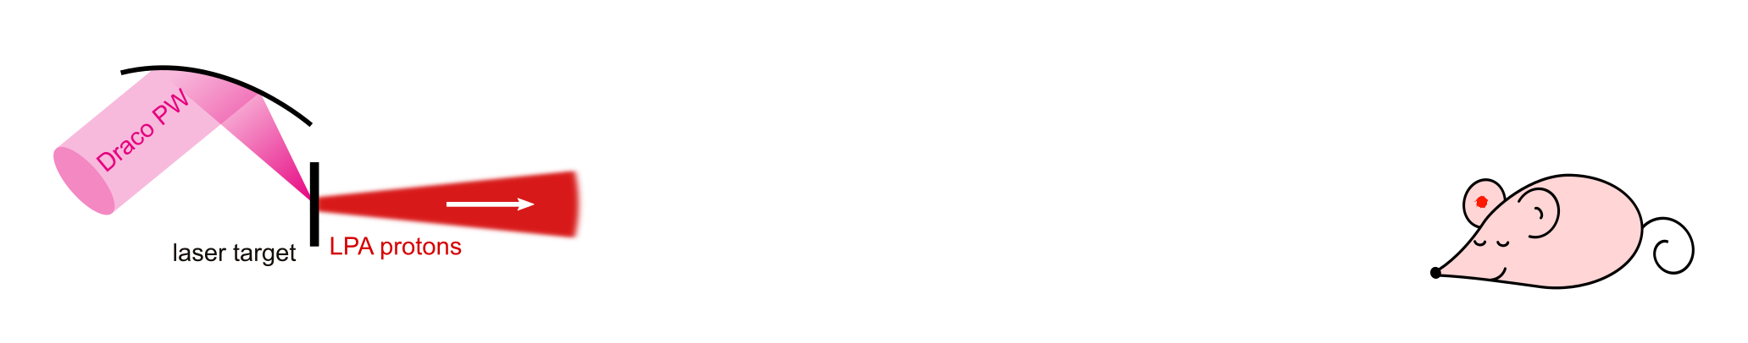
In vivo radiobiology with LPA protons
Brüchner et al., Radiat. Onc., Vol. 9 (2014) Animal study approval DD24-5131/338/35
Kroll et al., Nat. Phys. 18 (2022), 316
Brüchner et al., Radiat. Onc., Vol. 9 (2014) Animal study approval DD24-5131/338/35
Kroll et al., Nat. Phys. 18 (2022), 316
Implementing a beamline meeting strict requirements
human tumour (HNSCC) on mouse ear, spherical (3mm diameter)
endpoint: radiation induced tumor growth delay
Precise dose delivery
Dose per shot
Lateral homogeneity
Depth homogeneity
4 Gy
_{± 10%}
600 mGy
_{330 – 800 mGy}
4 Gy
_{± 5%}
5 mm
Talk by J. Metzkes-Ng
Thu, 12:00
Dose
Dose
Dose
Dose
Time
4 min
shots
-5 % 4 Gy +5 %
Depth
4 mm

Slide 9
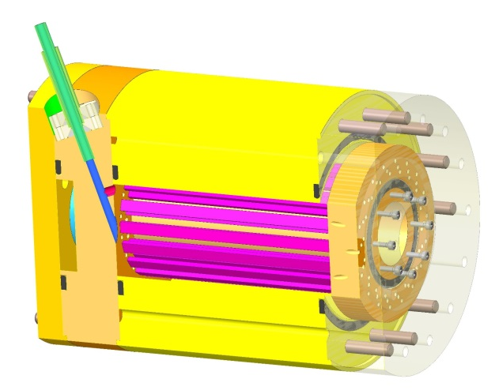
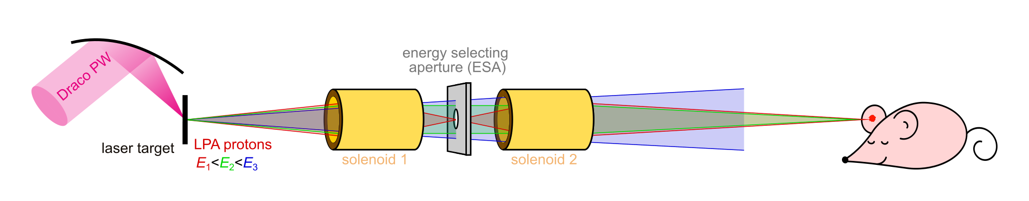
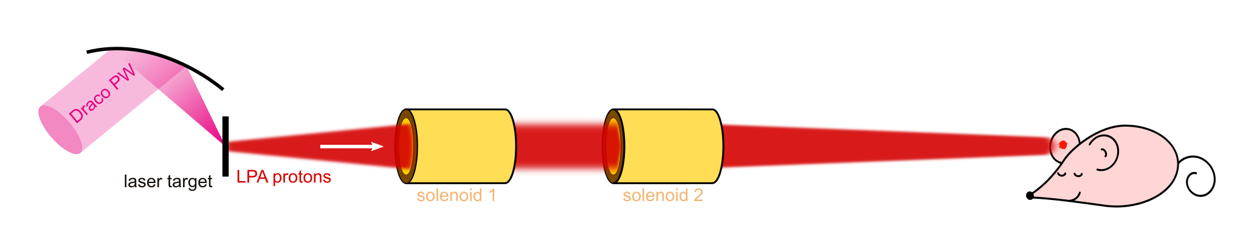
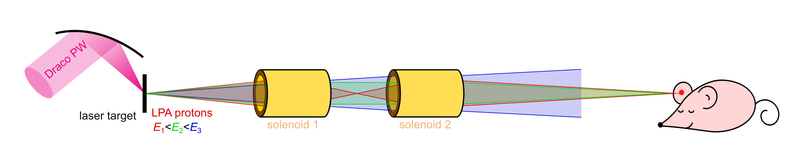
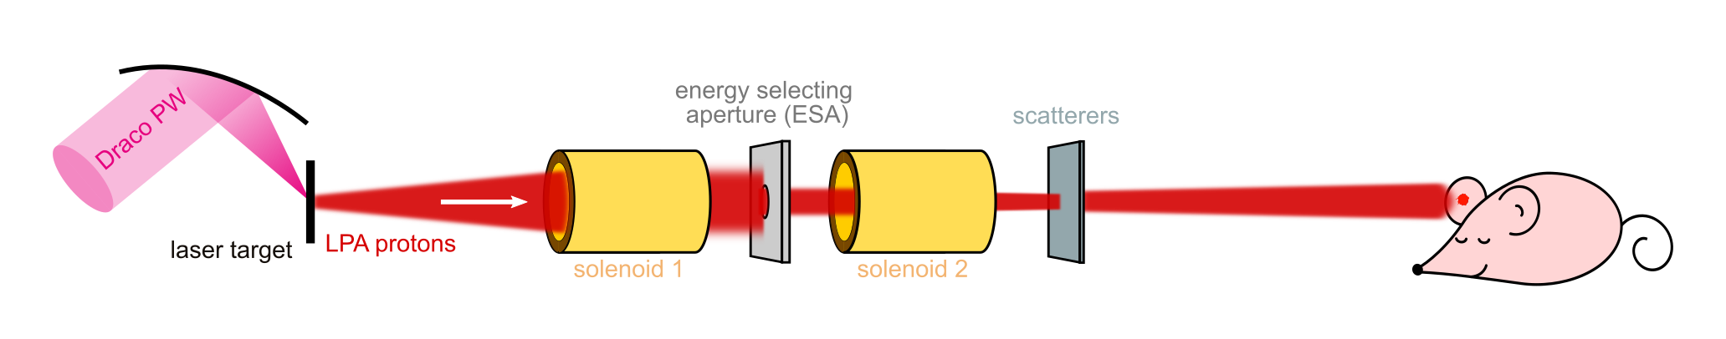
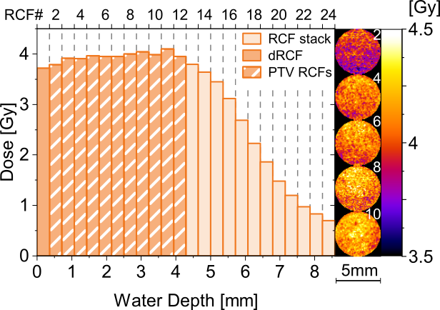
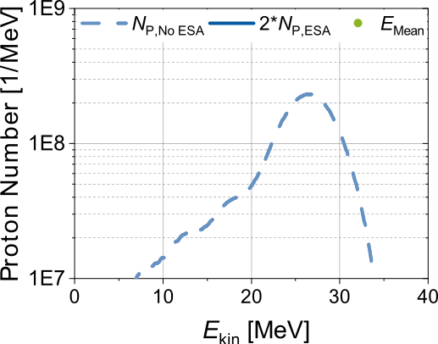
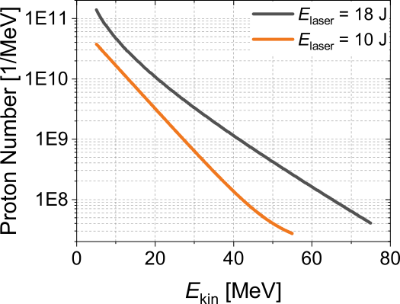
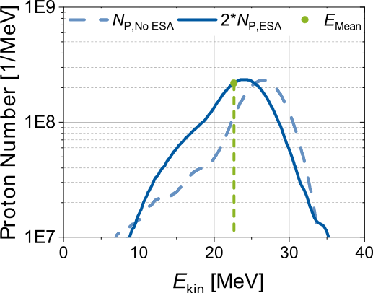
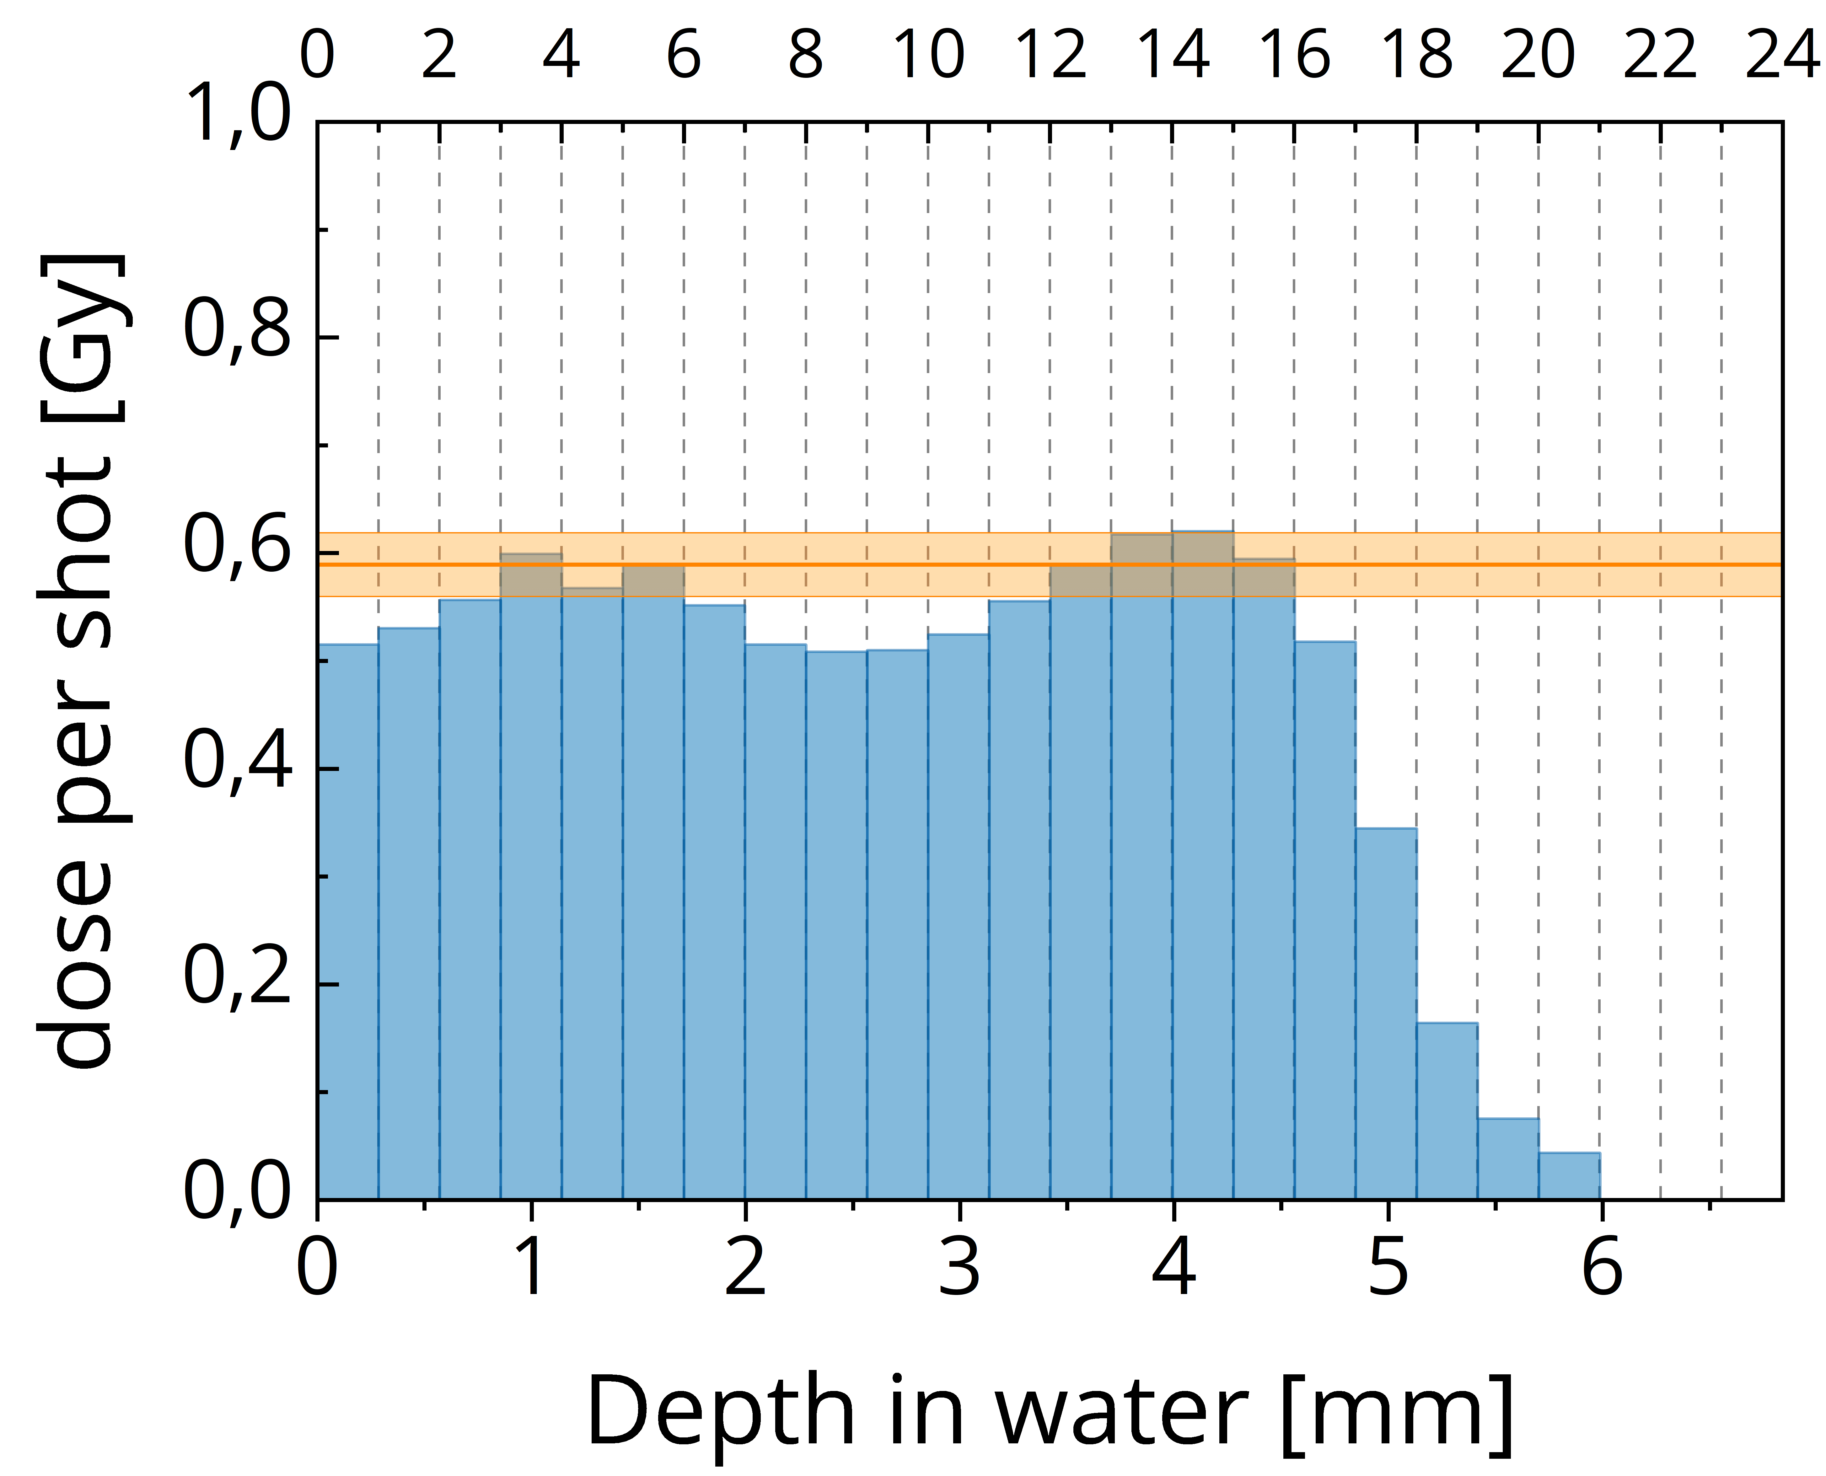
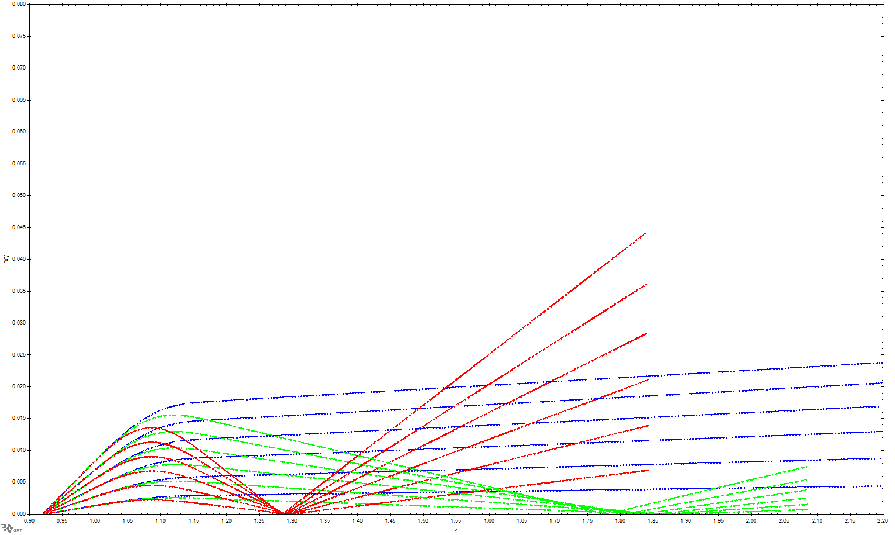
In vivo radiobiology with LPA protons
Brack et al., Sci. Rep. 10 (2020), 9118
Kroll et al., Nat. Phys. 18 (2022), 316
Using the ALBUS-2S (two solenoids) beamline
LPA source
beam transport
delivered dose
Solenoid
20
0
r [mm]
model-conform dose delivery
- 20
E1 < E2 < E3

Slide 10
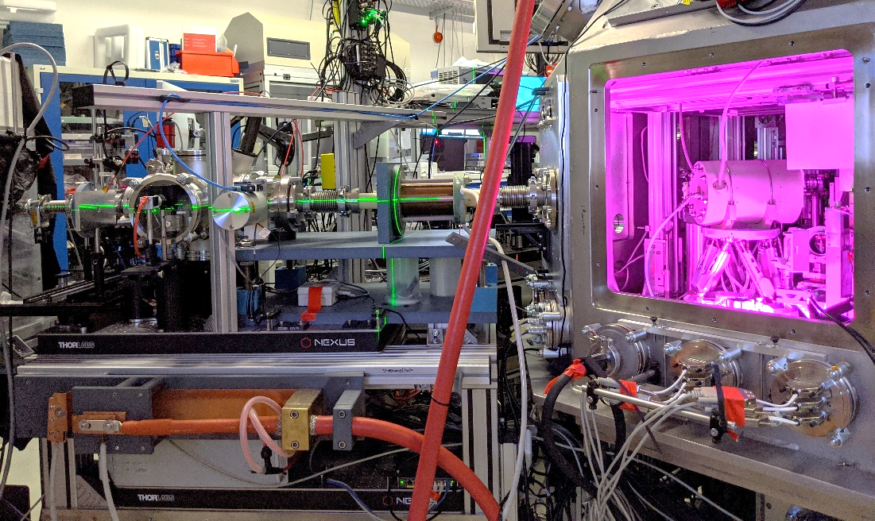
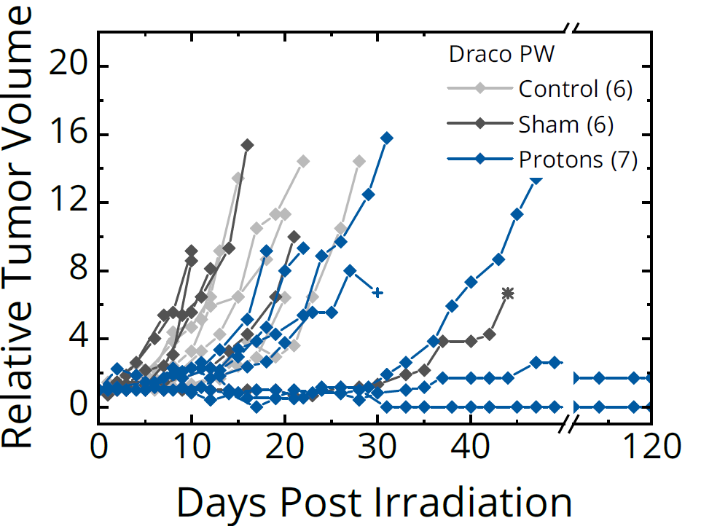
In vivo radiobiology with LPA protons
Brack et al., Sci. Rep. 10 (2020), 9118
Kroll et al., Nat. Phys. 18 (2022), 316
Using the ALBUS-2S (two solenoids) beamline
Talk by J. Metzkes-Ng
Thu, 12:00

Slide 11
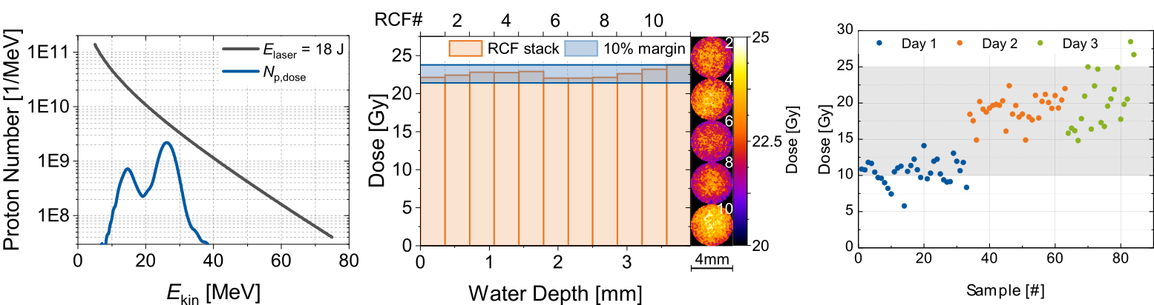
Ultra-high dose rate irradiations at Draco PW
Metzkes-Ng et al., Scientific Reports (in review)
LPA source to investigate the FLASH mechanism with Zebrafish Embryos (ZFE)
Mouse model study did not meet FLASH criteria (ultra-high peak dose rate, but low mean dose rate)
ns-long single-pulse homogeneous dose irradiation with dose ~ 10⁹ Gy/s
      Maximise the single pulse dose-rate while applying homogeneous (depth) dose
  Possible due to adjustable beamline components of ALBUS-2S Beamline
Dose-effect curve within all required limits

Slide 12

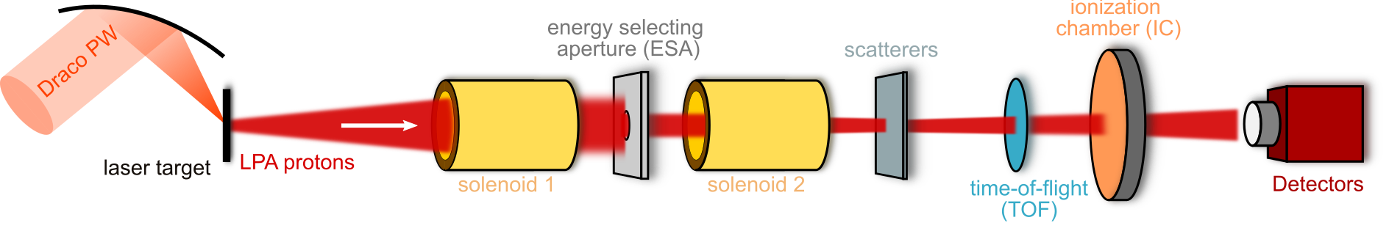
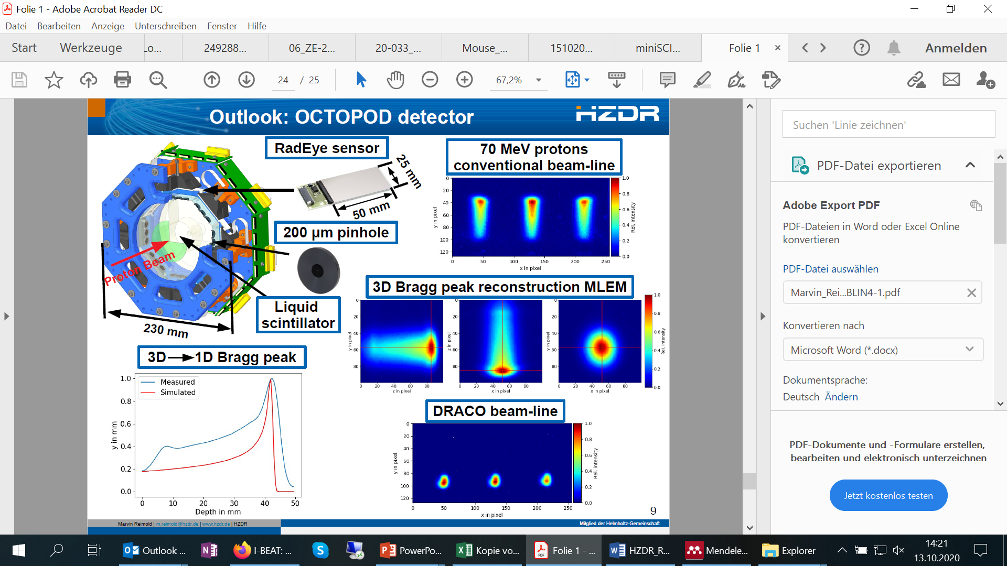
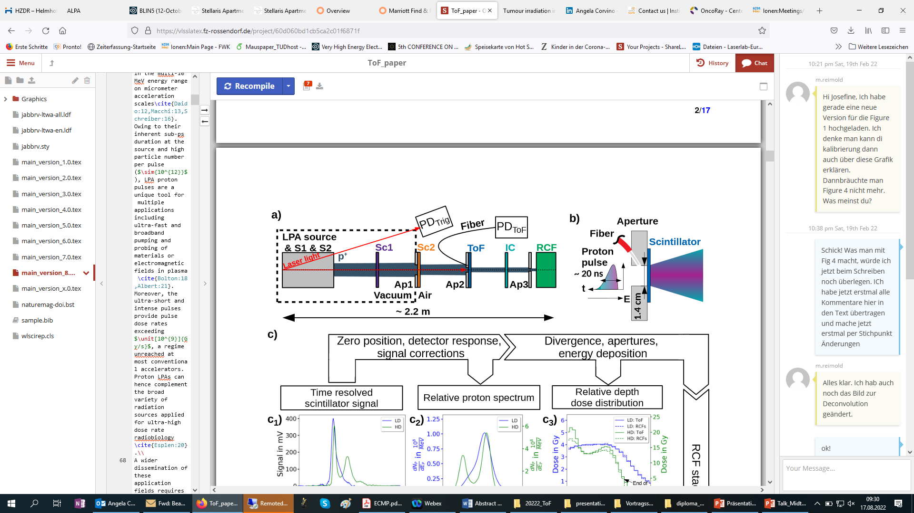
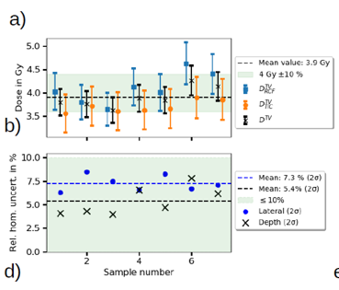
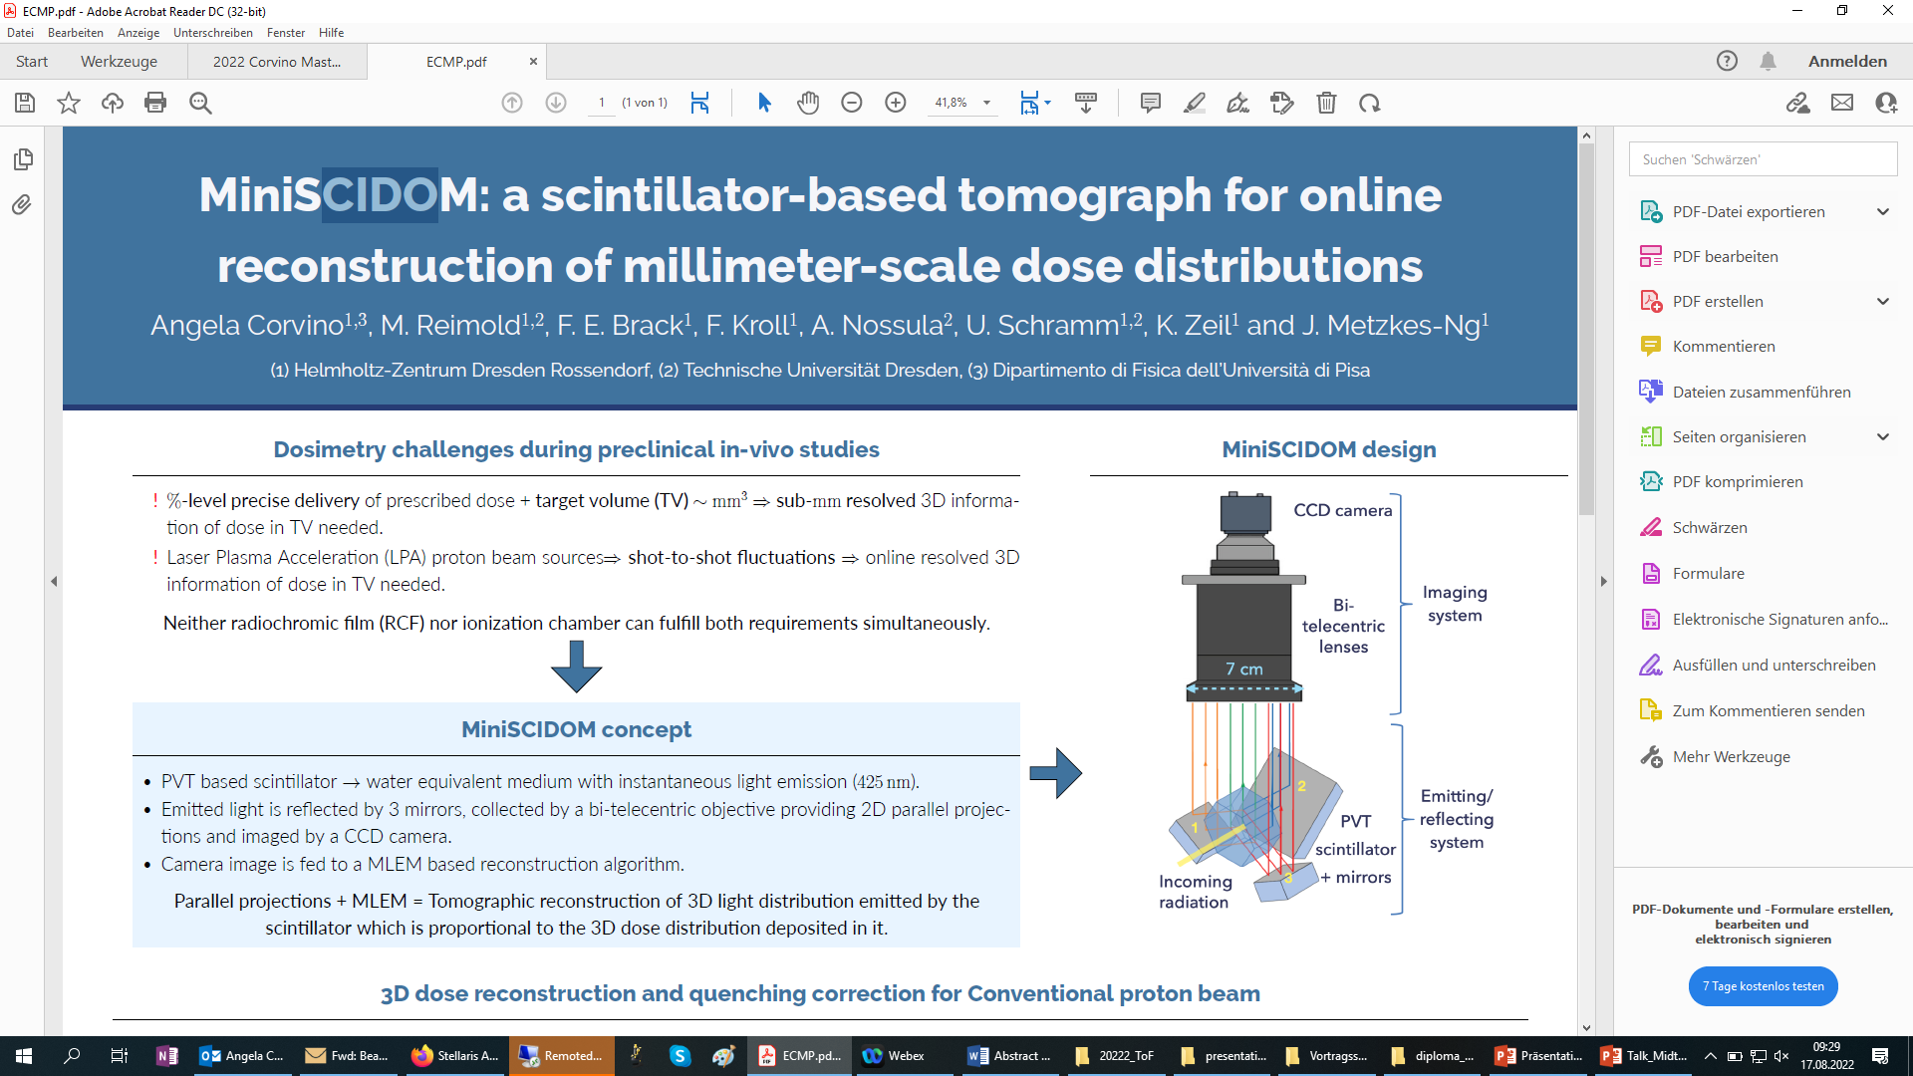
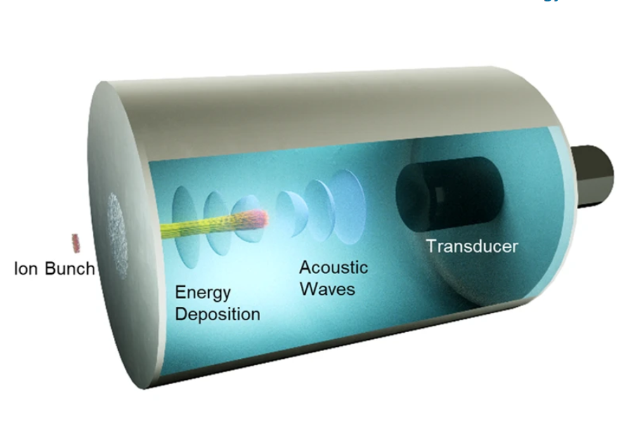
Source-to-sample characterization at ALBUS-2S
Using a beamline as a testbed for new detector developments
OCTOPOD
Time-of-Flight BMS
LPA proton dosimetry
miniSCIDOM
I-BEAT detector
M. Reimold et al.,
HPLSE 1-15 (2023)
M. Reimold et al.,
Sci Rep 12 (2022)
Marvin Reimold et al.,
Phys. Med. Biol. 68 (2023)
HPLSE, in review
D. Haffa et al.,
Sci Rep 9 (2019)

Slide 13


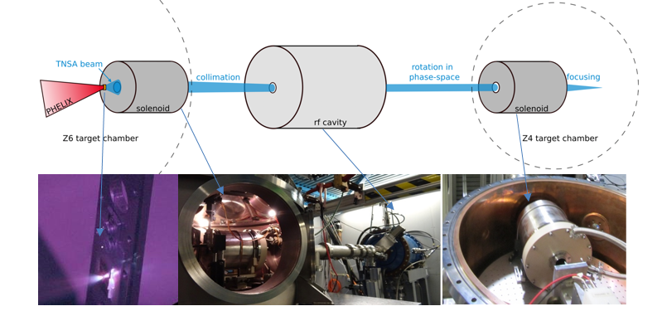
The LIGHT beamline at GSI Darmstadt
Combining conventional and novel LPA acceleration technologies

Slide 14
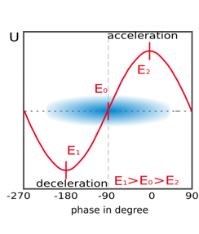
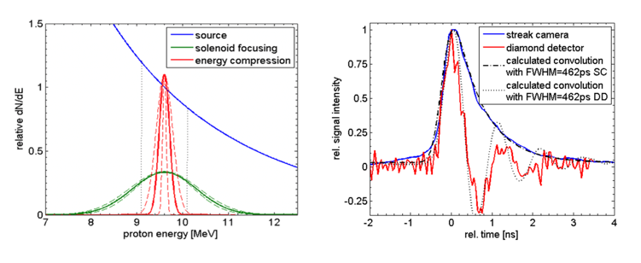
The LIGHT beamline at GSI Darmstadt
Combining conventional and novel LPA acceleration technologies
Generation and investigation highly monoenergetic beams with high flux
Development of suitable detectors
Stopping power measurements of dense, highly ionized plasmas
Potential application as injector into the SIS-18 synchrotron at GSI

Slide 15


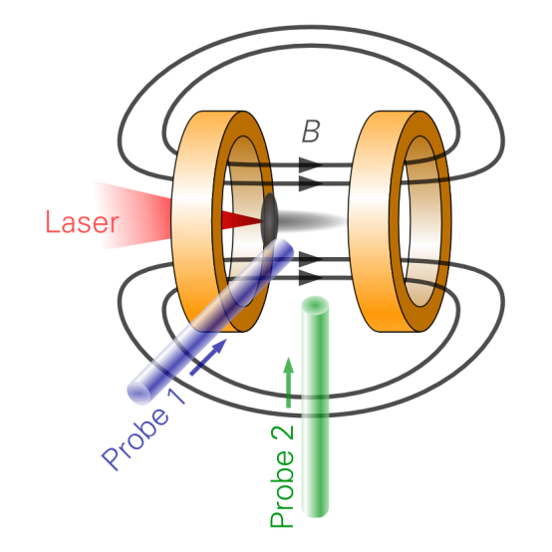
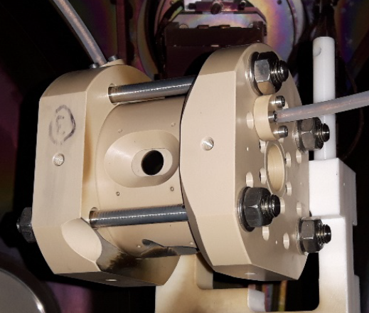
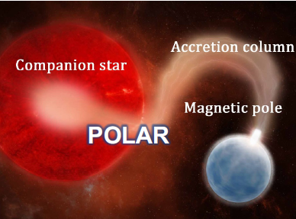
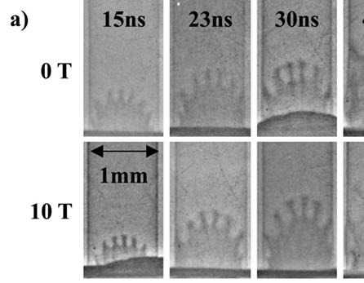
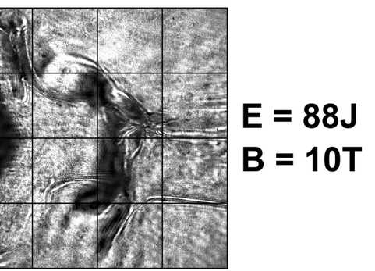
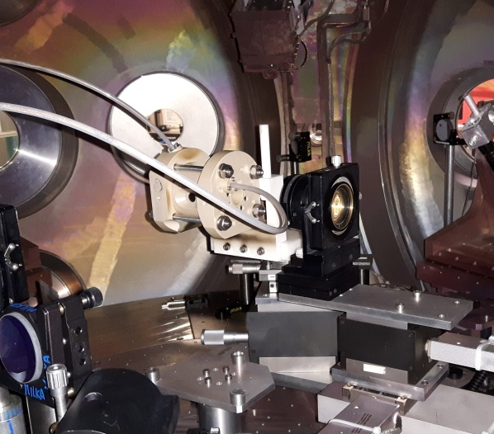



Laboratory astrophysics
Embedding laser-driven plasmas in external high magnetic fields
Probing bores allow for direct plasma observation
2 coils in almost Helmholtz-configuration
  up to <20 Tesla constant for several µs
  longer timescale than plasma processes
Small, vacuum compatible, versatile
Stainless steel version planned for higher B-fields
B-field distribution on axis
Setup at ELFIE
Setup at PALS
Probe 2
Probe 1
ns-Laser
Laser
ps-Laser
Probe
Laser
Probe
Gas Nozzle
Gas Nozzle
Accretion processes
Magnetized RTI
Plasma Jet/shocks
Setup at LULI2000
Mabey et al.,
Astrophys. J. 896 (2020)
Manuel et al.,
MRE 6 (2021)
Bohlin et al.,
PPCF 64 (2022)

Slide 16






Compact air-cooled solenoid magnet (20 T)
Allow higher rep-rate experiments
Layer 3
100
Sim
w/o cooling
80
60
Temperature [°C]
40
100
95
90
85
80
75
70
65
60
20
0
0
2
4
6
8
10
12
14
16
18
Time [h]
60
50
Exp
w/ cooling
40
Temperature [°C]
Cool-down time: ~min
Compact and light-weight PEEK body and housing
30
20
10
0
20
40
60
80
Time [min]

Slide 17



Rep-rate optimized current pulse generator
Energy recovery is key!
Pulse generator
Charger
Thyristor stack
Modular pulse generator design (125 – 750 µF) capable of 10-Hz-operation
Concept of energy recuperation fully tested and prototype assembled
1-Hz-charger under commissioning

Slide 18






ALBUS around Europe
Thank you for your attention

Slide 19
Research using ALBUS technology
Accelerator Physics
Reimold et al.,Phys. Med. Biol. 68 (2023)
Reimold et al., HPLSE 11 (2023)
Gerlach et al., HPLSE 11 (2023)
Reimold et al., Sci. Rep. 12 (2022)
Metternich et al., PRAB 25 (2022)
Kroll et al., Nat. Phys. 18 (2022)
Brack et al., Sci. Rep. 10 (2020)
Haffa et al., Sci. Rep. 9 (2019)
Jahn et al., PRAB 22 (2019)
Jahn et al., NIM-A 909 (2018)
Jahn et al., RSI 89 (2018)
Masood et al., PMB 62 (2017)
Busold et al., Sci. Rep. 5 (2015)
Masood et al., AP-B 117 (2014)
Busold et al., NIM-A 740 (2014)
Busold et al., PRAB 17 (2014)
Busold et al., PRAB 16 (2013)
Laboratory Astrophysics
Perez-Martin et al., HPLSE 11 (2023)
Bohlin et al., PPCF 64 (2022)
Manuel et al., MRE 6 (2021)
Mabey et al., Astrophys. J. 896 (2020)
Mabey et al., Sci. Rep. 9 (2019)
Albertazzi et al., HPLSE 6 (2018)
Albertazzi et al., Science 346 (2014)
Albertazzi et al., RSI 84 (2013)

