Slide 1
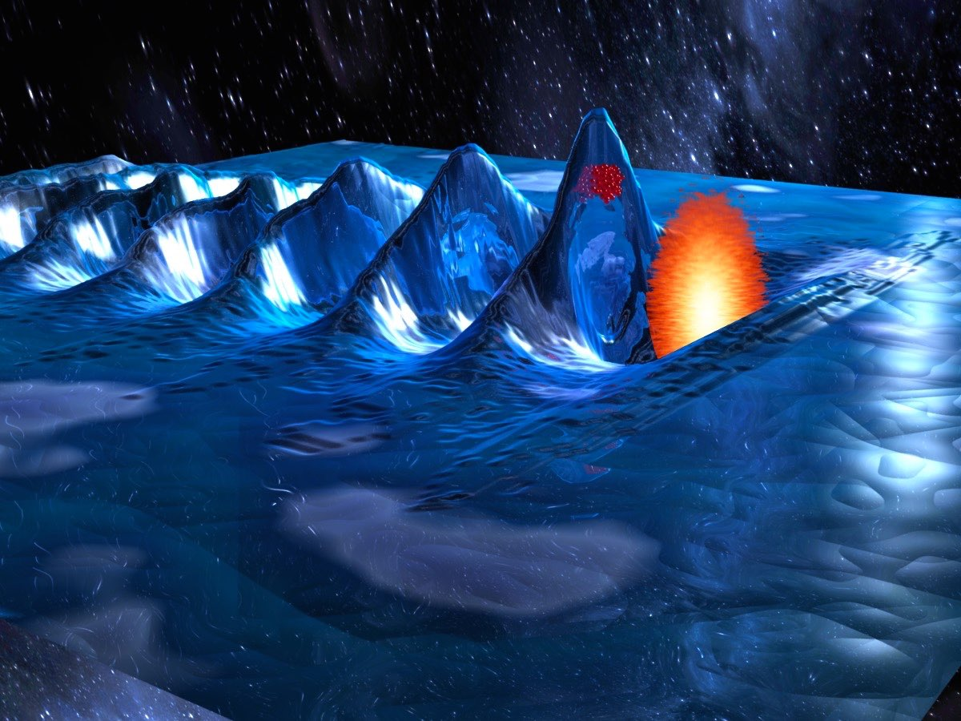
WE I Z MANN
I NST ITUTE
OF SCIENCE
MeVs protons acceleration in near critical imploding gas target
Omri Seemann, Yang Wan, Sheroy Tata, Eyal Kroupp, and Victor Malka
Weizmann Institute of Science, Rehovot, Israel
https://www.weizmann.ac.il/complex/malka/
6th European Advanced Accelerator Concepts workshop (EAAC2023), Elba in Italy, September 17-22 (2023)

Slide 2
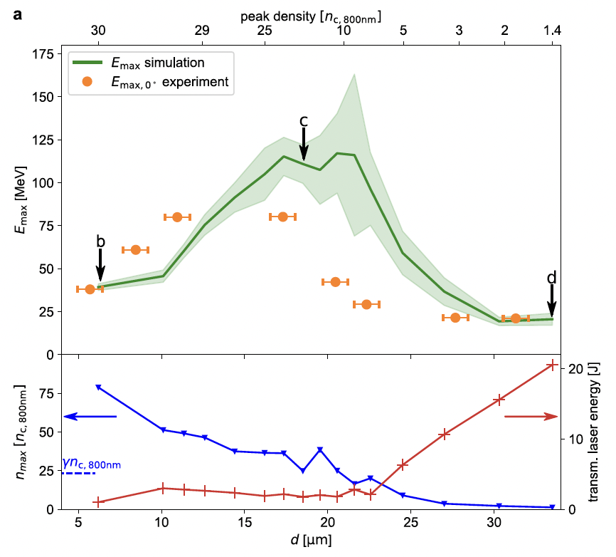
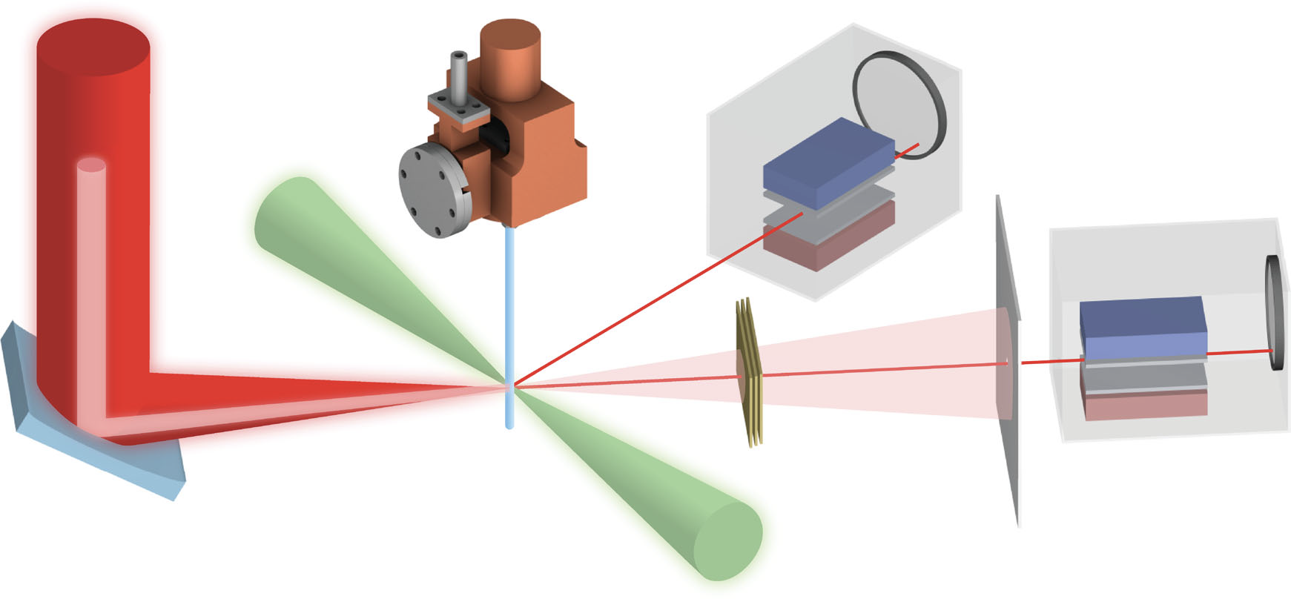
Laser based ions acceleration (thin foil, liquid, cluster, mixt target)
H2 liquid jet irradiated by DRACO PW laser delivering 80 MeV protons
M. Rehwald et al., Nature Communications (2023)
6th European Advanced Accelerator Concepts workshop (EAAC2023), Elba in Italy, September 17-22 (2023)

Slide 3
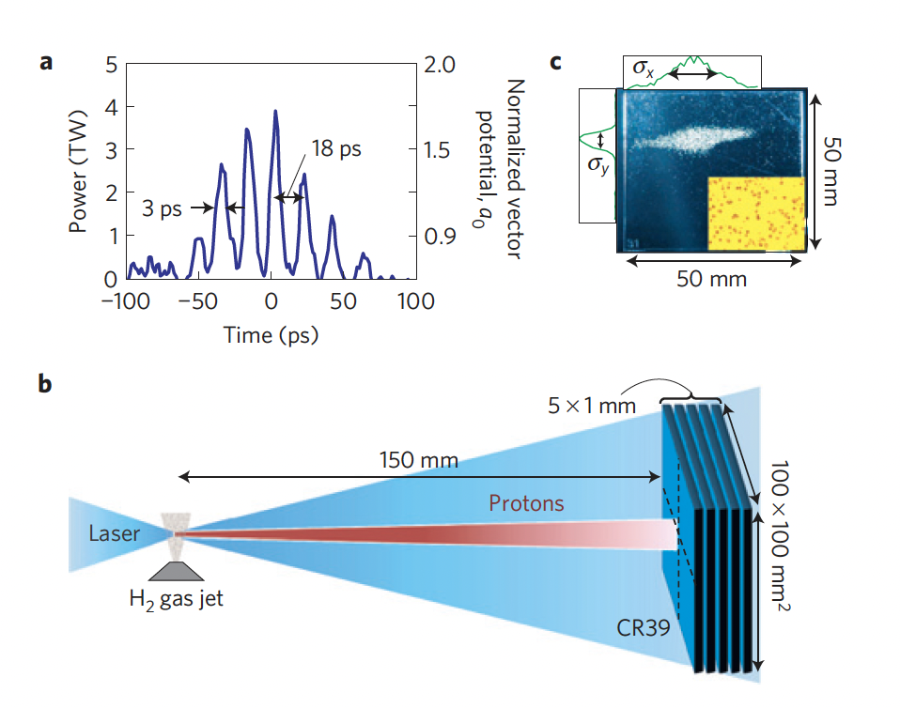
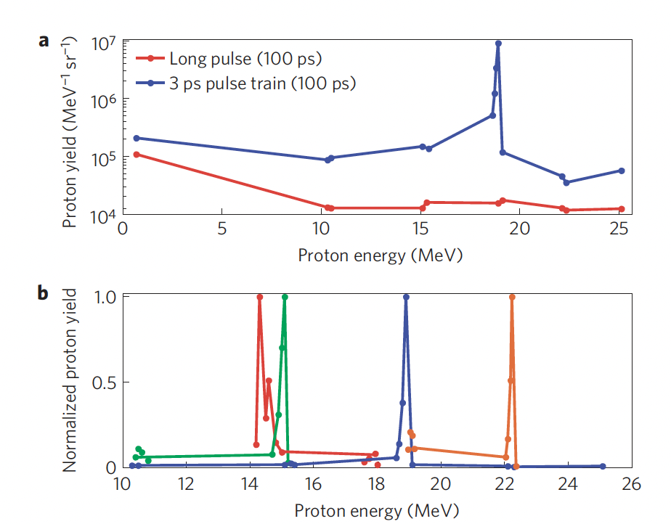
Collisionless shocks @ UCLA
WE I Z MANN
I NST ITUTE
OF SCIENCE
D. Haberberger et al., Nature Phys. 2130 (2011)
6th European Advanced Accelerator Concepts workshop (EAAC2023), Elba in Italy, September 17-22 (2023)

Slide 4
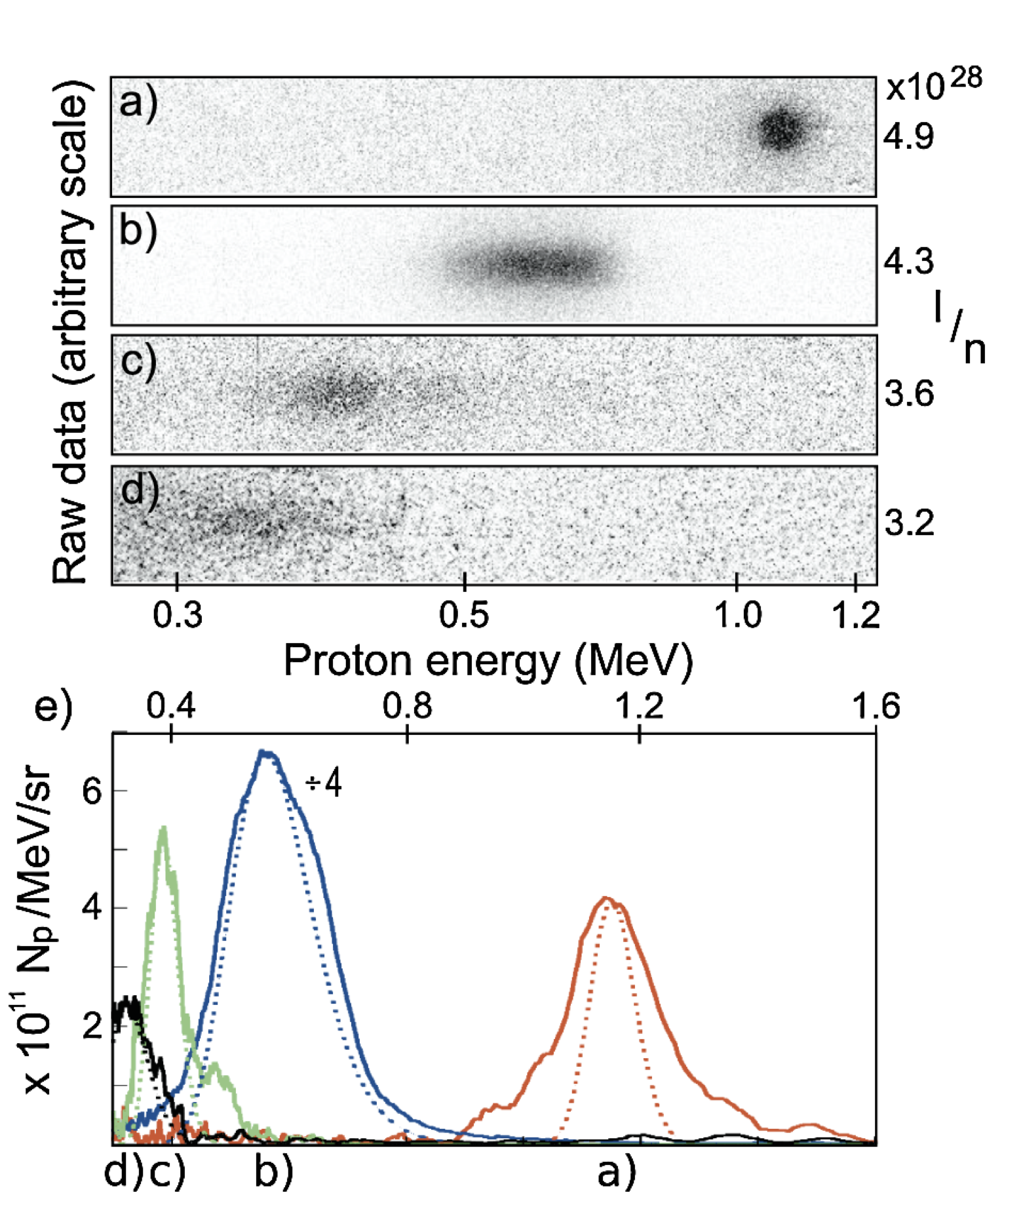
Proton Beams Accelerated by a
Radiation Pressure Driven Shock
WE I Z MANN
I NST ITUTE
OF SCIENCE
2-3 J, 5ps, CO₂ laser, n_{e}=5-10x10¹⁹cm⁻³
Narrow-energy-spread impurity-free proton beams were produced whose energies scale with the ratio of intensity over density (I/n), indicating that the acceleration is due to the shock generated by radiation-pressure driven hole boring of the critical surface
C. A. J. Palmer et al.,
Phys. Rev. Lett. 106, 014801 (2011)
6th European Advanced Accelerator Concepts workshop (EAAC2023), Elba in Italy, September 17-22 (2023)

Slide 5
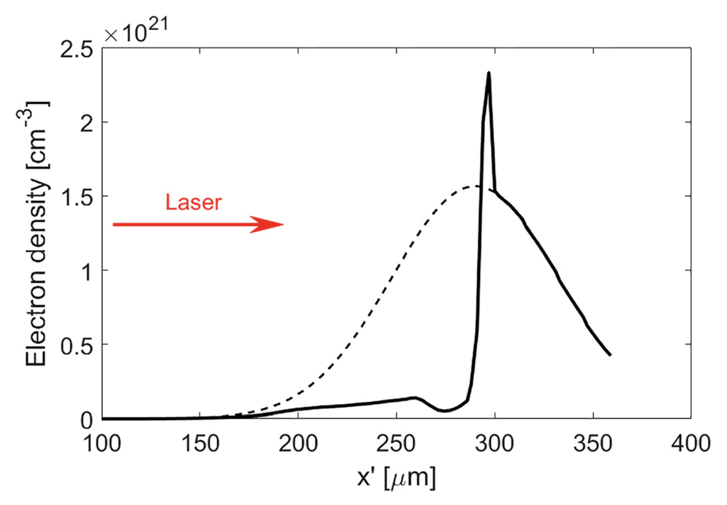
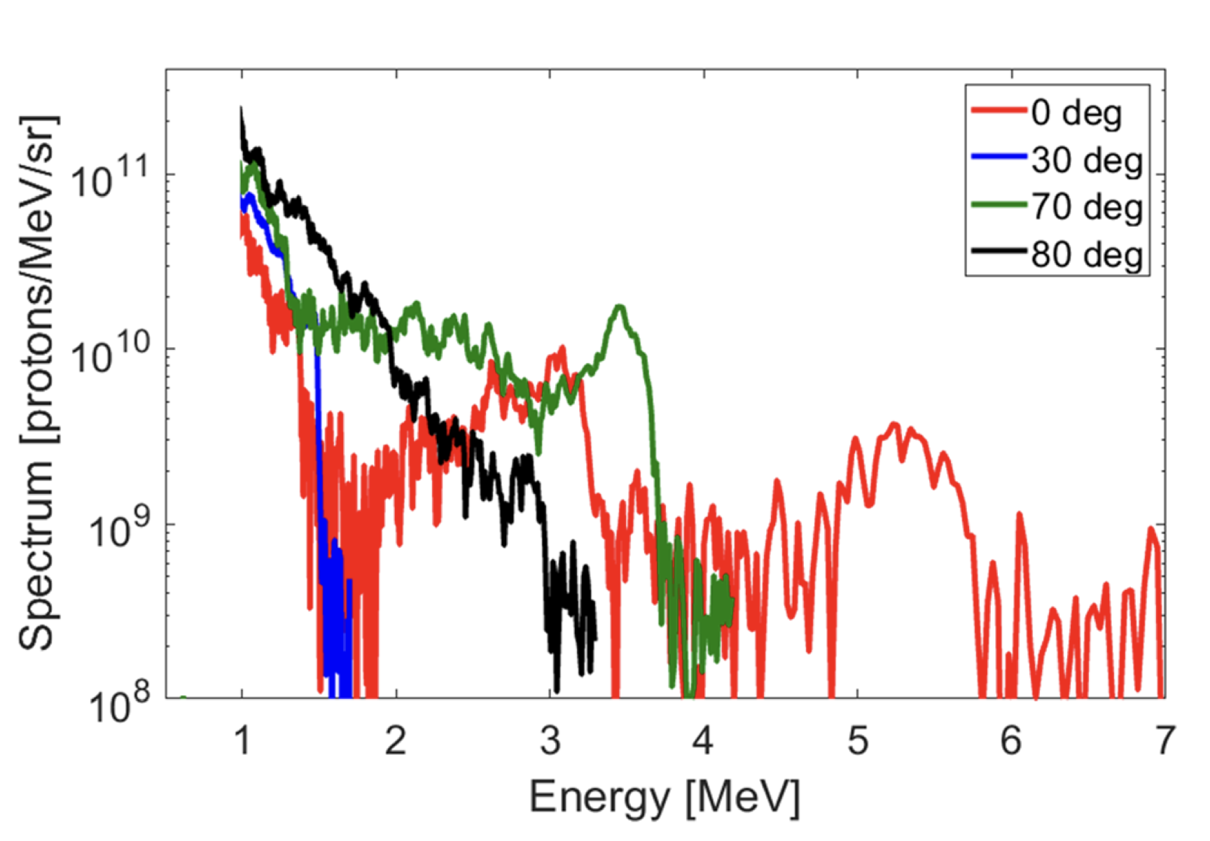
Laser-Accelerated Ions from a
Shock-Compressed
Gas
WE I Z MANN
I NST ITUTE
OF SCIENCE
Up to 6 MeV protons @ LULI PICO2000/60J/1ps laser
P. Puyuelo-Valde et al., Phys. Plasmas 26, 123109 (2019)
6th European Advanced Accelerator Concepts workshop (EAAC2023), Elba in Italy, September 17-22 (2023)

Slide 6
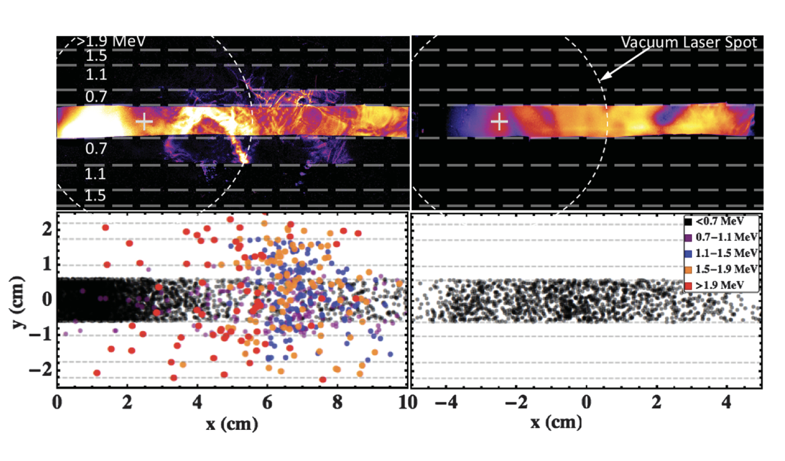
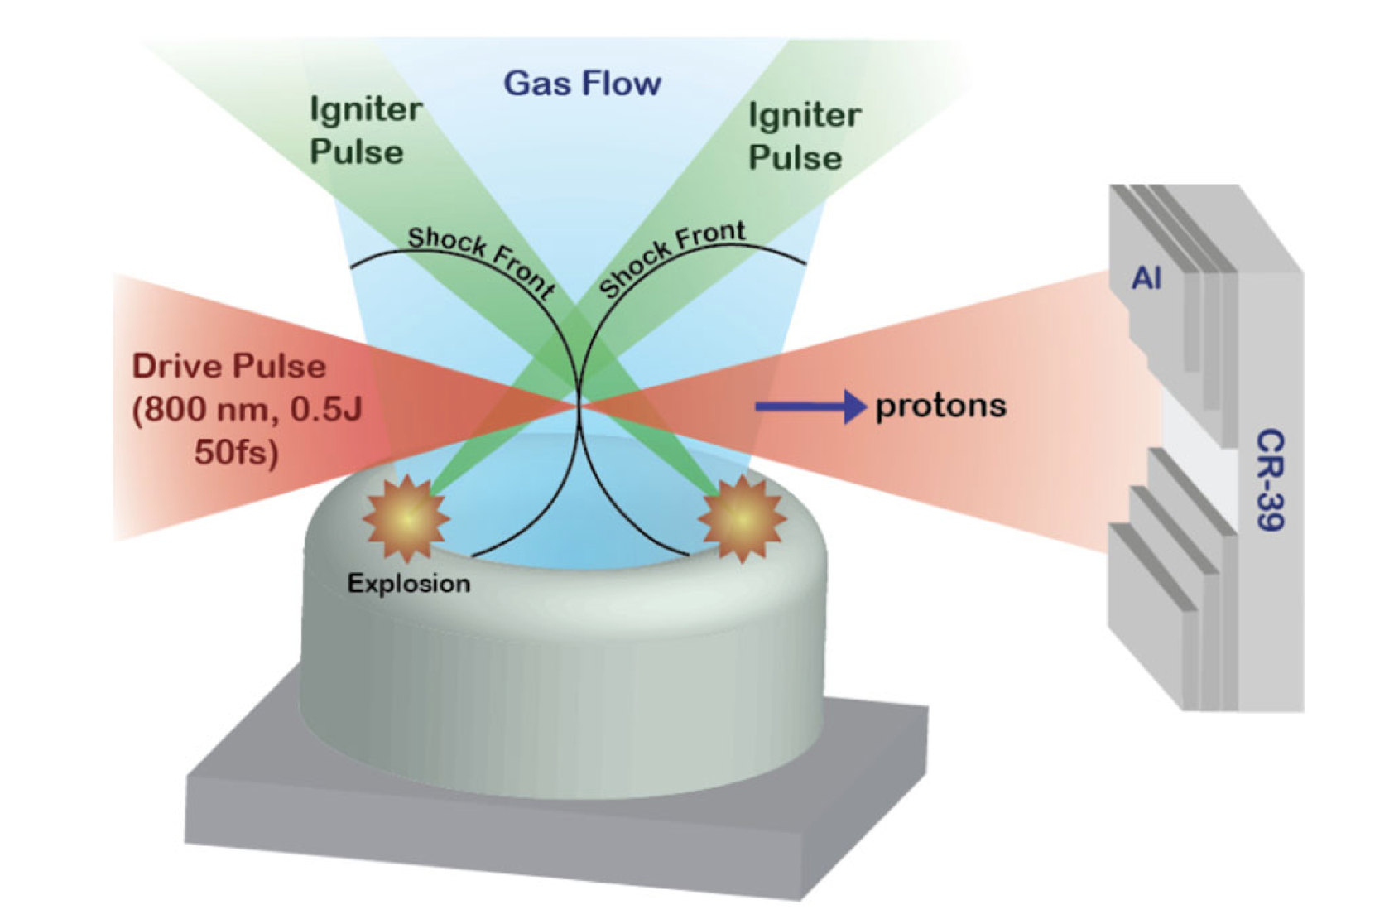
Laser-Accelerated Ions from a Shock-
Compressed Gas Foil
WE I Z MANN
I NST ITUTE
OF SCIENCE
The imploding approach offer the possibility to interact far for the nozzle tip
Well adapted for getting more statistic and for further applications
M.H. Helle et al., Phys. Rev. Lett. 135001 (2016)
6th European Advanced Accelerator Concepts workshop (EAAC2023), Elba in Italy, September 17-22 (2023)

Slide 7
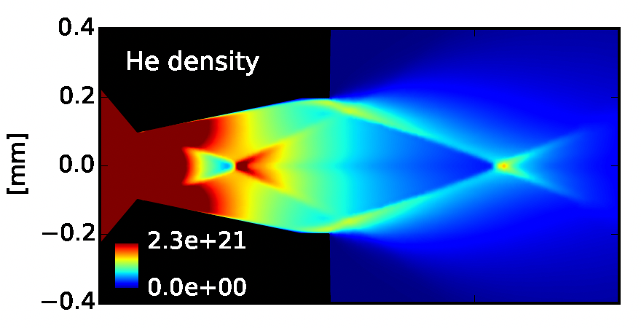
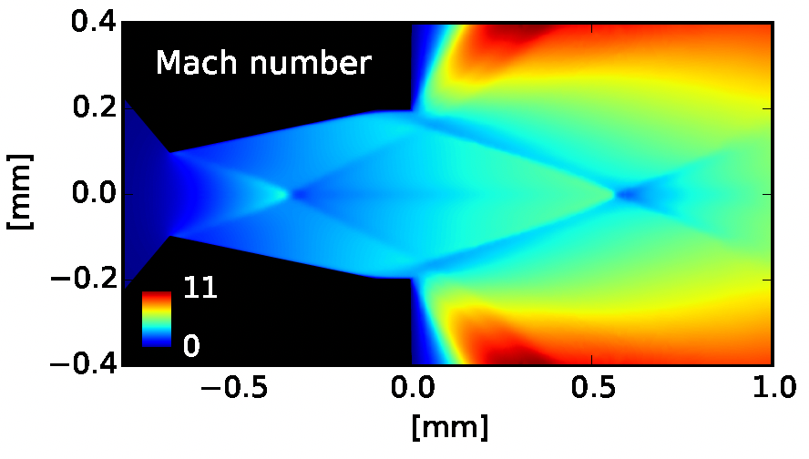
Attempt 1: shock compressed gas
WE I Z MANN
I NST ITUTE
OF SCIENCE
Develop a “shock” nozzle to get overcritical density
Nozzle gas flow
Nozzle gas flow
2.3x10²¹cm⁻³
11
Results :
6th European Advanced Accelerator Concepts workshop (EAAC2023), Elba in Italy, September 17-22 (2023)

Slide 8
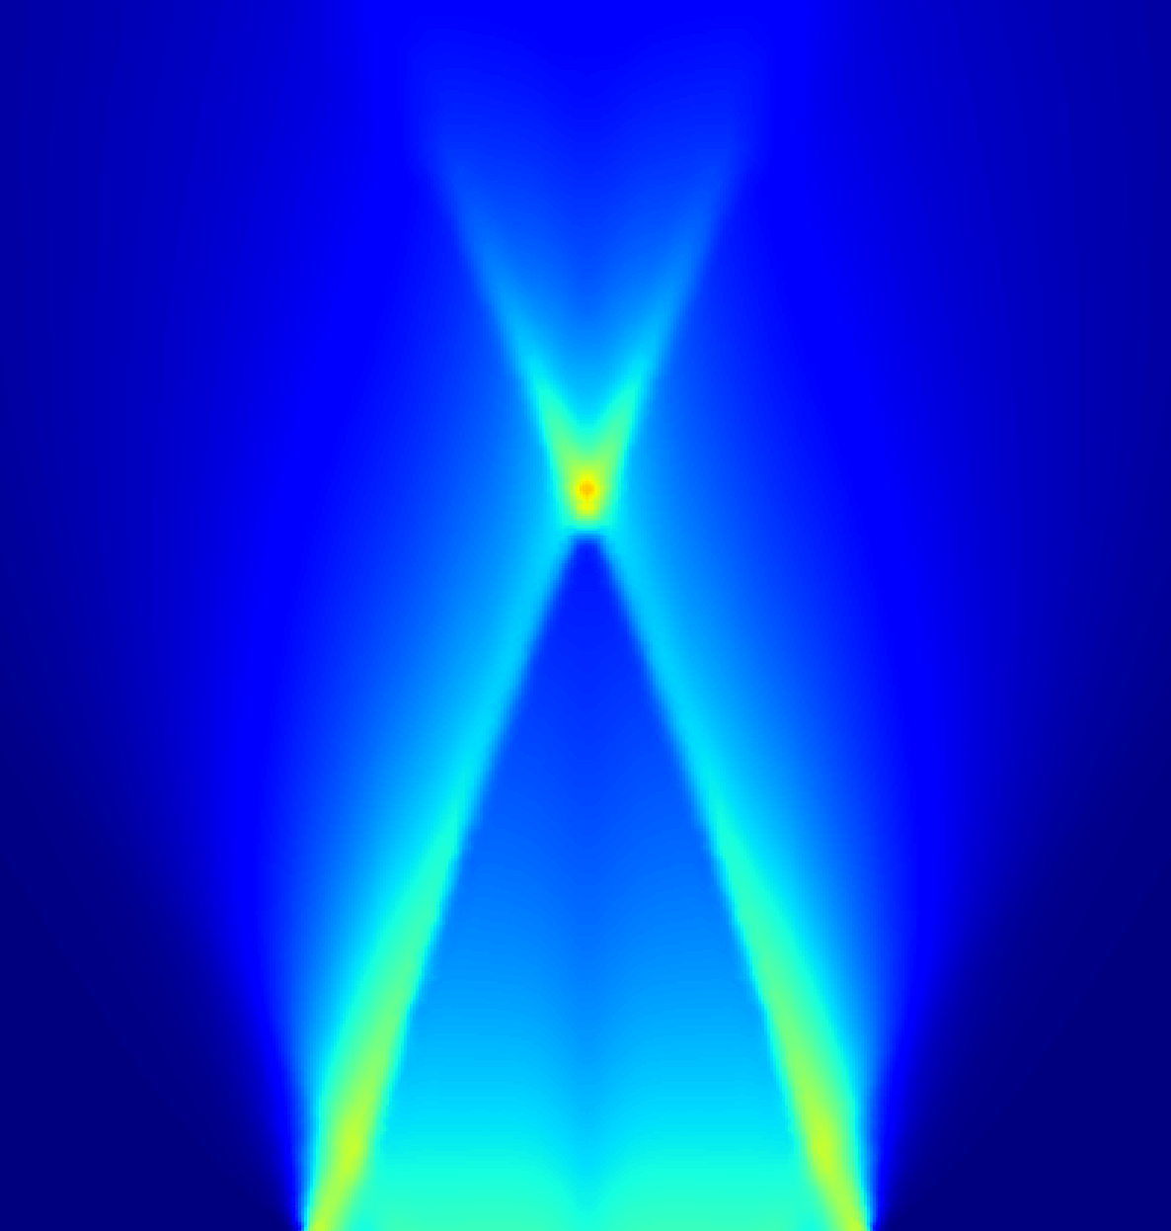
Attempt 2: shock compressed gas
and line focus laser
WE I Z MANN
I NST ITUTE
OF SCIENCE
Develop a “shock” nozzle overcritical density
To remove the unwanted gas to let the intense propagates
Nozzle gas flow
Nozzle gas flow
2.3x10²¹cm⁻³
11
mJ heating
laser pulse along a line focus is propagating
perpendicular
to this plan
.
After ns time scale, the heated plasma expands
Then the short & intense laser pulse propagates freely to the channel
Gas flow
Gas flow
6th European Advanced Accelerator Concepts workshop (EAAC2023), Elba in Italy, September 17-22 (2023)

Slide 9
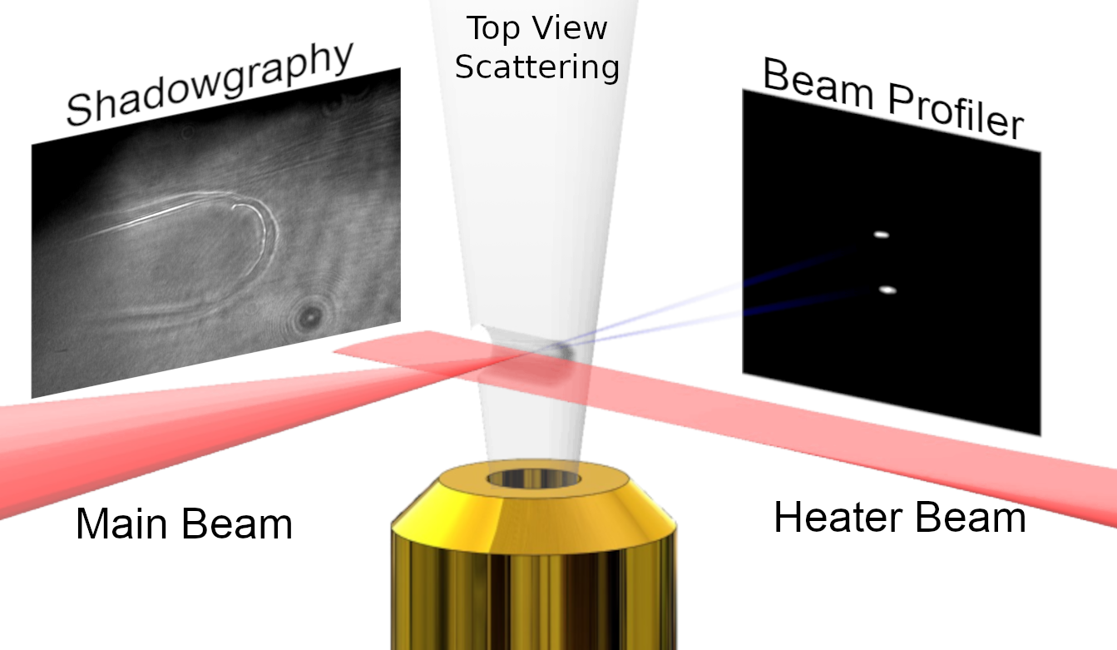
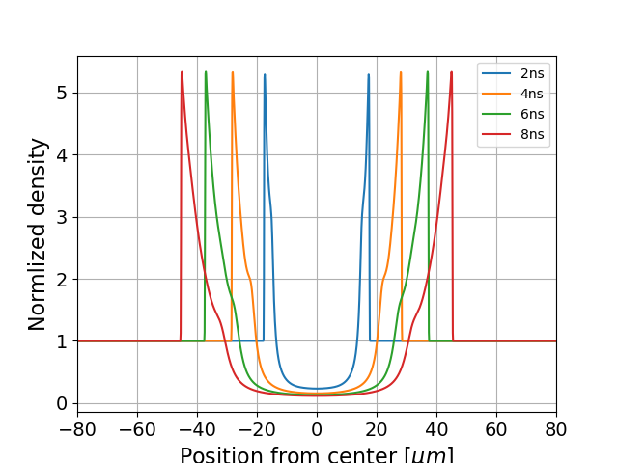
Results : multi e-beams
WE I Z MANN
I NST ITUTE
OF SCIENCE
A line focus beam create a suitable channel separate from the gas by compressed visible region
The intense laser can then
propagating in the slab
channel and reach the
high density part of the
gas target
The introduce astygmatism that elongate the beam that breaks up generating multiple electron beams
O. Seemann et al., Nature Communications (2023)
6th European Advanced Accelerator Concepts workshop (EAAC2023), Elba in Italy, September 17-22 (2023)

Slide 10
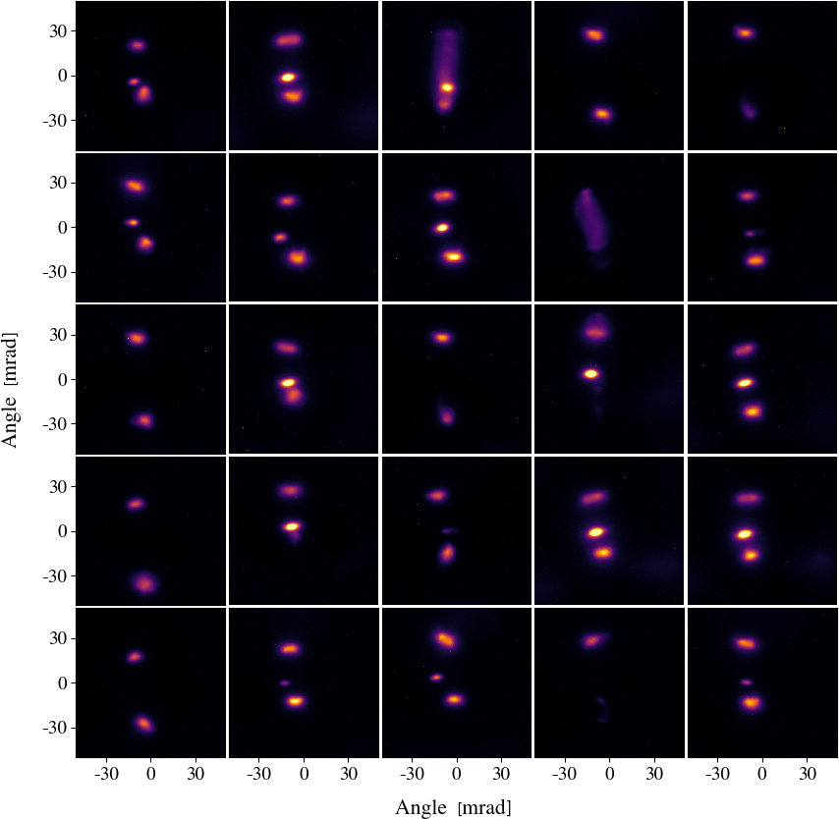
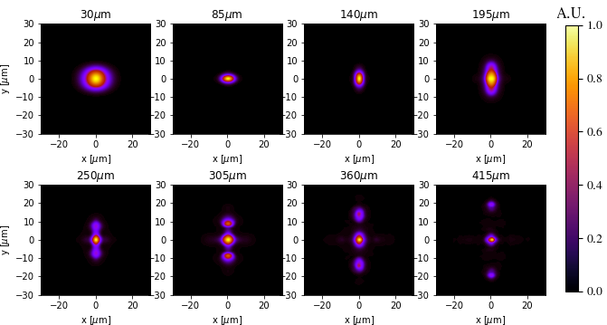
WE I Z MANN
I NST ITUTE
OF SCIENCE
Exp. results versus simulations
Comparison with 3D PIC simulations
Observation of multiple electron bunches accelerated (consecutive shots)
6th European Advanced Accelerator Concepts workshop (EAAC2023), Elba in Italy, September 17-22 (2023)

Slide 11
Attempt 3: shocked nozzle
& double lines
WE I Z MANN
I NST ITUTE
OF SCIENCE
Develop a “shock” nozzle overcritical density
To remove the unwanted gas to let the intense propagates
Nozzle gas flow
Nozzle gas flow
2.3x10²¹cm⁻³
11
mJ heating
laser pulse along a line focus is propagating
perpendicular
to this plan
.
After ns time scale, the heated plasma expands
Then the short & intense laser pulse propagates freely to the channel
Gas flow
Gas flow
6th European Advanced Accelerator Concepts workshop (EAAC2023), Elba in Italy, September 17-22 (2023)

Slide 12
First proton beam !
WE I Z MANN
I NST ITUTE
OF SCIENCE
6th European Advanced Accelerator Concepts workshop (EAAC2023), Elba in Italy, September 17-22 (2023)

Slide 13
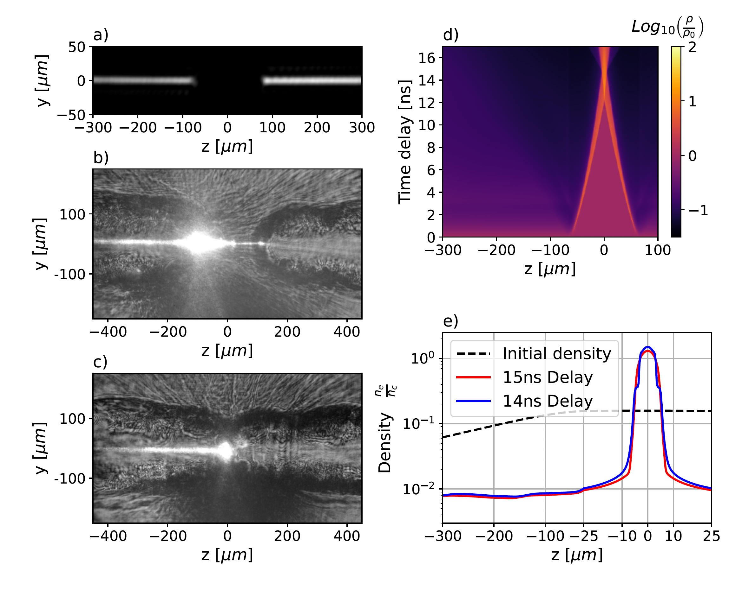
Experimental validity tested
WE I Z MANN
I NST ITUTE
OF SCIENCE
6th European Advanced Accelerator Concepts workshop (EAAC2023), Elba in Italy, September 17-22 (2023)

Slide 14
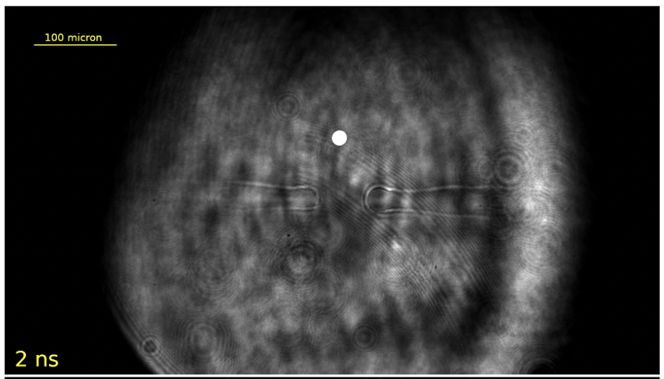
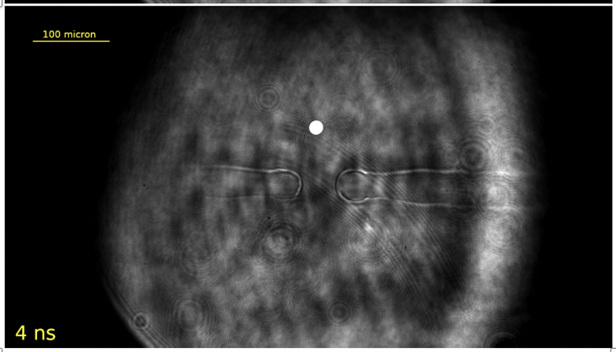
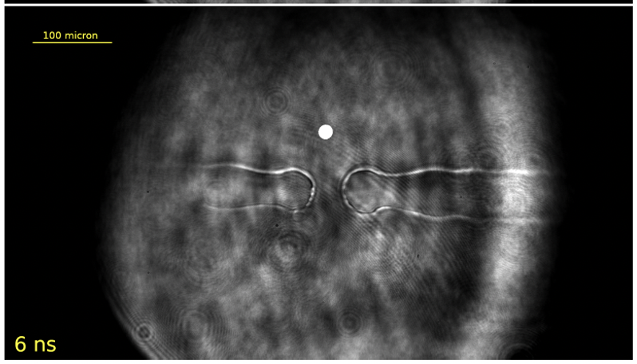
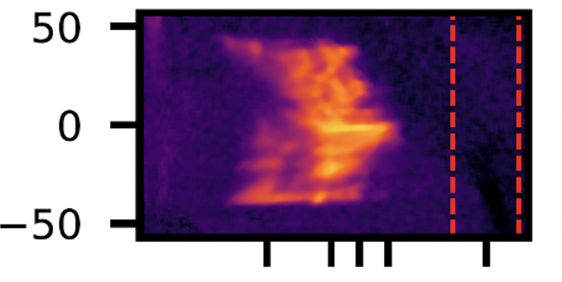
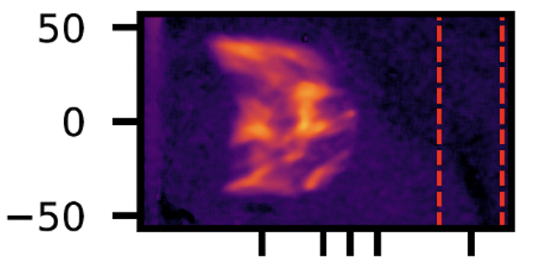
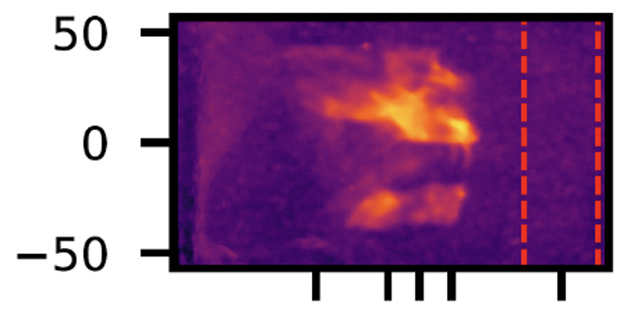
Typical proton spectra
WE I Z MANN
I NST ITUTE
OF SCIENCE
Refractometry images
Protons spectra
50
Angle (mrad)
0
-50
1 2 3 5 slit
1 2 3 5 slit
1 2 3 5 slit
Energy (MeV)
Energy (MeV)
Energy (MeV)
6th European Advanced Accelerator Concepts workshop (EAAC2023), Elba in Italy, September 17-22 (2023)

Slide 15
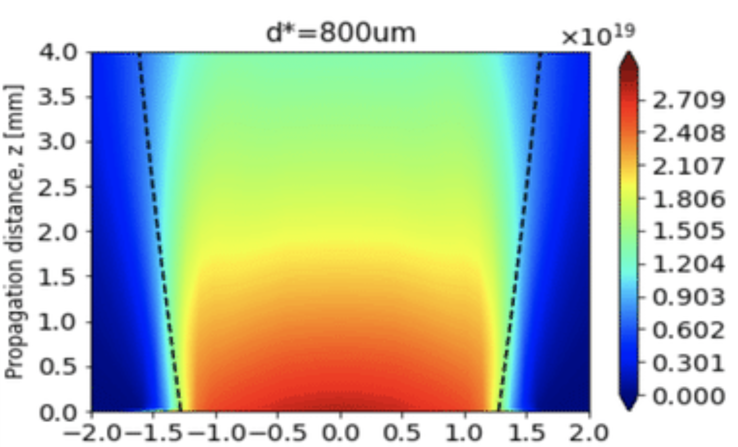
Attempt 4: imploding approach
WE I Z MANN
I NST ITUTE
OF SCIENCE
Use a conventional nozzle
that delivers undercritical
density
Compressed the gas
with Bessels & line focus
Laser beams
The intense laser beam is
now reaching dense and
short scale plasma
X 10¹⁹cm⁻³
4.0
3.5
3.0
2.5
2.0
1.5
1.0
0.5
0.0
- 2.7
- 2.4
- 1.8
- 1.5
- 1.2
- 0.9
- 0.6
- 0.3
- 0.0
- 2.7
- 2.4
- 1.8
- 1.5
- 1.2
- 0.9
- 0.6
- 0.3
- 0.0
gas flow
11
-2.0 -1.5 -1.0 -0.5 0.0 0.5 1.0 1.5 2.0
-2.0 -1.5 -1.0 -0.5 0.0 0.5 1.0 1.5 2.0
-2.0 -1.5 -1.0 -0.5 0.0 0.5 1.0 1.5 2.0
Radius (mm)
Radius (mm)
Radius (mm)
The imploding approach offer the possibility to interact far for the nozzle tip
Well adapted for getting more statistic and for further applications
6th European Advanced Accelerator Concepts workshop (EAAC2023), Elba in Italy, September 17-22 (2023)

Slide 16
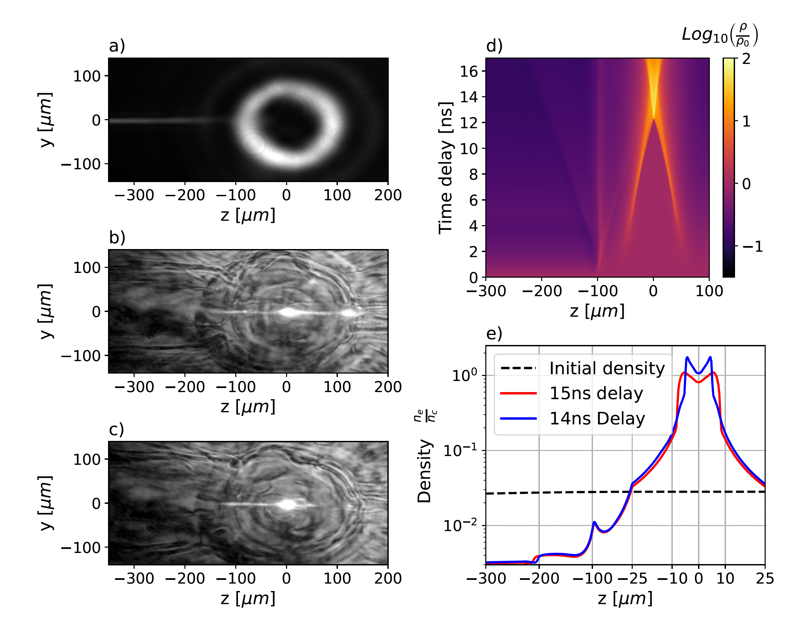
Experimental validation
WE I Z MANN
I NST ITUTE
OF SCIENCE
6th European Advanced Accelerator Concepts workshop (EAAC2023), Elba in Italy, September 17-22 (2023)

Slide 17
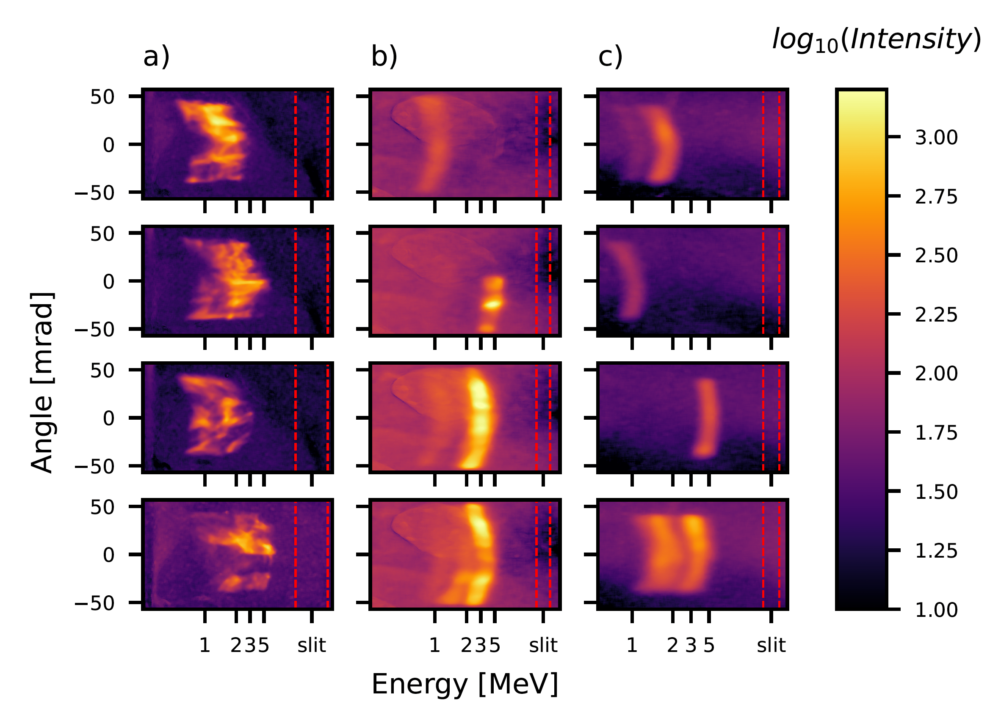
Preliminary results : p beam
WE I Z MANN
I NST ITUTE
OF SCIENCE
Line focused laser
beam (0 degree)
Line and ring focus case (0 and 45 degrees)
6th European Advanced Accelerator Concepts workshop (EAAC2023), Elba in Italy, September 17-22 (2023)

Slide 18
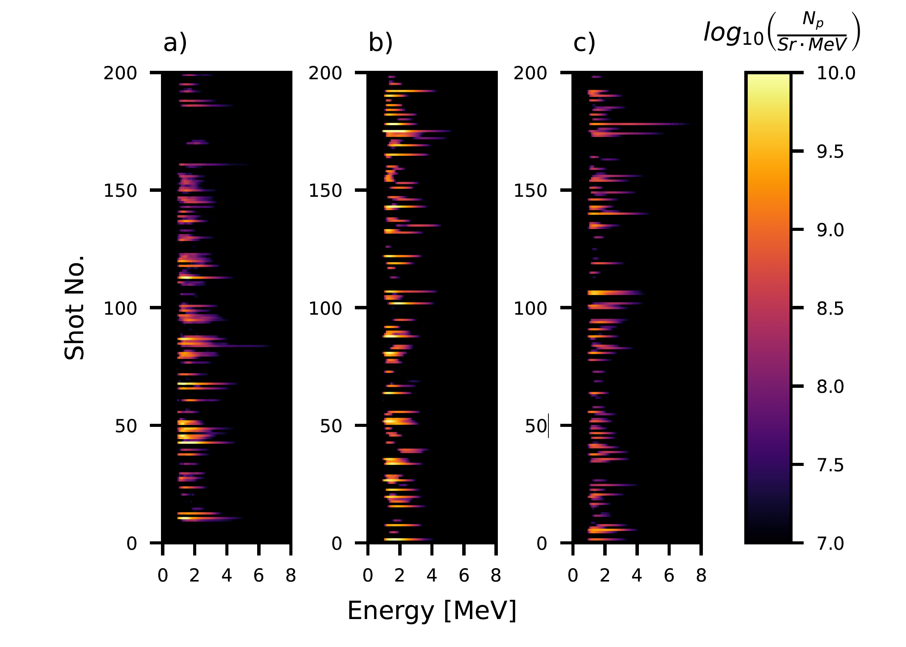
Stable conditions !
WE I Z MANN
I NST ITUTE
OF SCIENCE
Line focused laser
beam (0 degree)
Line and ring focus case (0 and 45 degrees)
6th European Advanced Accelerator Concepts workshop (EAAC2023), Elba in Italy, September 17-22 (2023)

Slide 19
Working plans:
Explore different heater laser beam configurations
Apply the concept with PW/10PW laser
Improved the laser dense gas target coupling for getting more energetic protons
Use D2 gas to generate bright source of neutrons
Use the approach for demonstrating the super betatron regime that should allow an increase of the photon energy
Final Mission:
To create a new standard for laser based ion beam
and new approaches for laser based X ray beam
6th European Advanced Accelerator Concepts workshop (EAAC2023), Elba in Italy, September 17-22 (2023)

