Slide 1
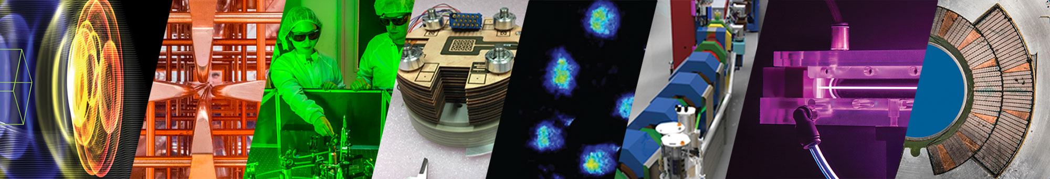
Accelerator Technology & Applied Physics Division
A mid-beta booster for proton beams
D. Terzani, C. Benedetti, S. S. Bulanov, C. Schroeder, E. Esarey
La Biodola (Isola d’Elba)
20/09/2023 (EAAC)
Supported by the Director, Office of Science, Office of High Energy Physics, of the U.S. Department of Energy under Contract No. DE-AC02-05CH11231
This material is based upon work supported by DARPA via Northrop Grumman Corporation

Slide 2
Outline
Motivations
Physics of the snowplow acceleration
Simulation results
Increase the energy gain: density tapering

Slide 3
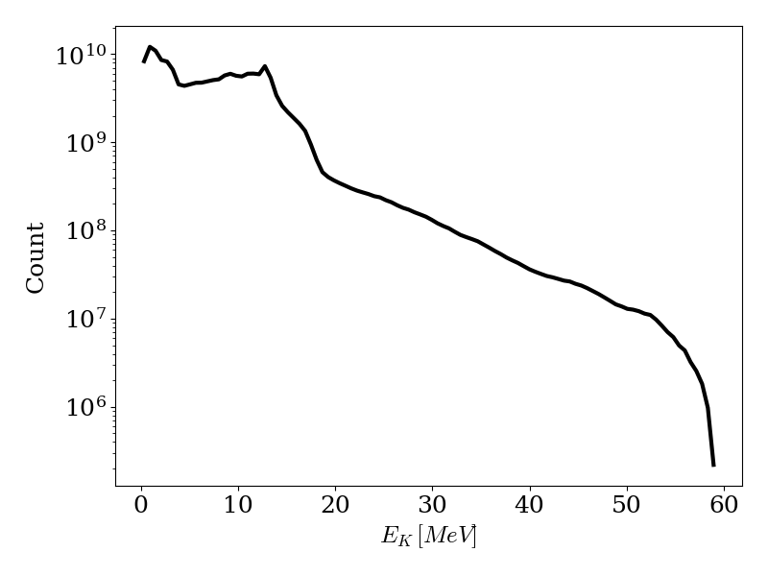
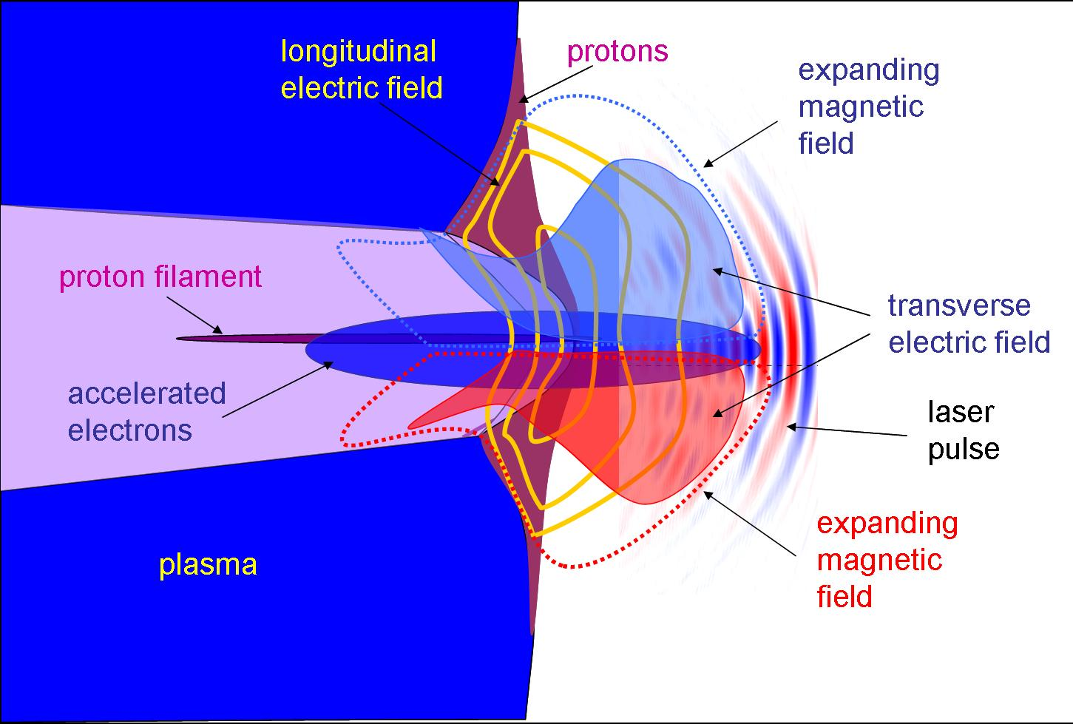
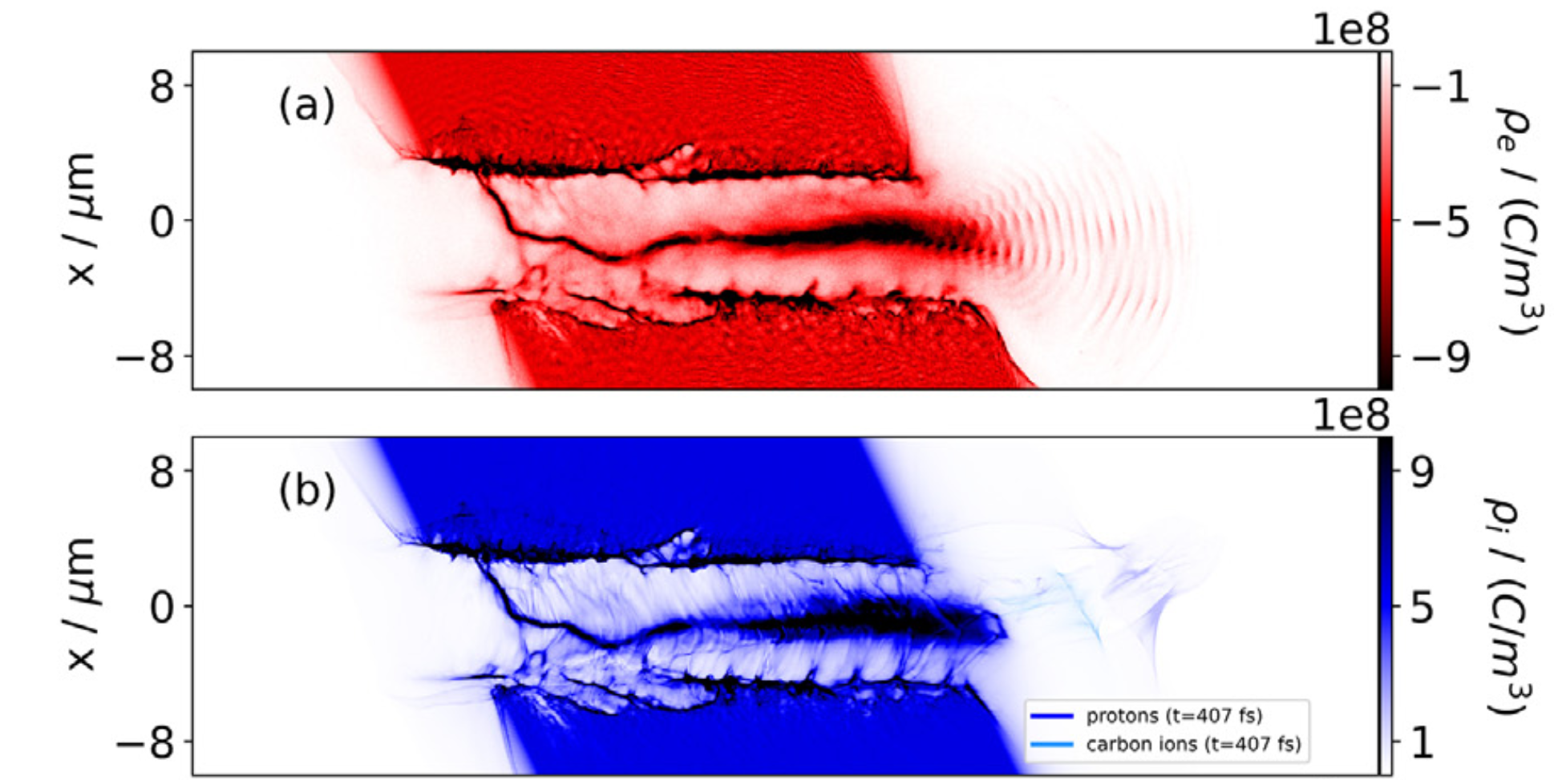

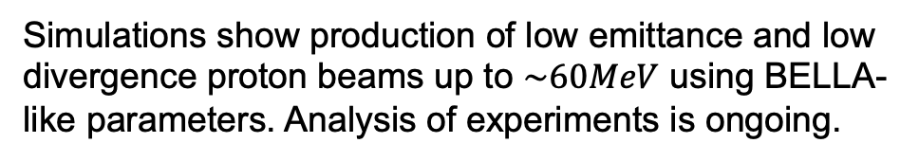
MVA acceleration enables production of 10s MeV proton beams
MVA acceleration regime can be achieved with BELLA-like experimental conditions ($ℇ_{L}≃20−40J, w_{0}≃4μm$)
Simulations show production of low emittance and low divergence proton beams up to $\sim 60MeV$ using BELLA-like parameters. Analysis of experiments is ongoing.
Can we increase the energy to $≳GeV$?
[Park et al., POP, 2019, Hakimi et al, POP, 2020]

Slide 4
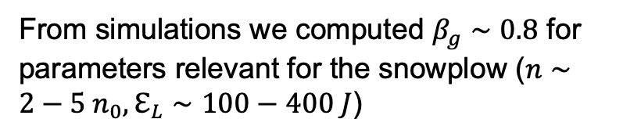
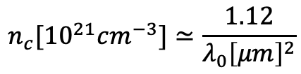

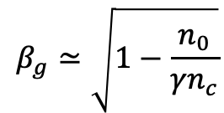
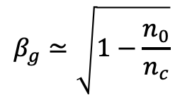
Propagation in near-critical density targets slows down laser pulse
Protons are non relativistic ($β<1$), so we need to slow down the laser pulse that drives the accelerating field
$$n_{0}>n_{c}$$
Relativistic transparency
$$β_{g}≃\sqrt{1−\frac{n_{0}}{n_{c}}}$$
$$β_{g}≃\sqrt{1−\frac{n_{0}}{{γn}_{c}}}$$
From simulations we computed $β_{g}∼0.8$ for parameters relevant for the snowplow ($n∼2−5 n_{0}, ℇ_{L}∼100−400 J$)
High intensity laser pulse can propagate in overcritical density
(i.e., relativistic transparency)
$$n_{c}[{10}^{21}cm^{−3}]≃\frac{1.12}{λ_{0}{\left[μm\right]}^{2}}$$
[Liu et al., PPCF, 2020]

Slide 5
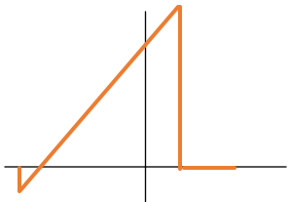

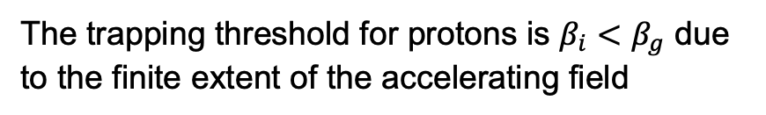
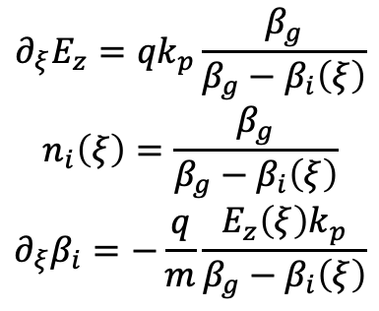
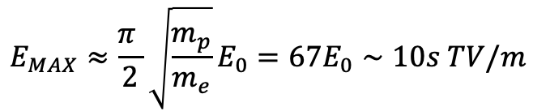


The electric field created by the density spike can reach 10s TV/m
$$n_{e}$$
The field structure moves with the laser at $β_{g}$
Simplified model of electron density
Longitudinal field, $E_{z}$
The ponderomotive force (radiation pressure) pushes the electrons forward until an electrostatic field counterbalances it
$$∂_{ξ}E_{z}={qk}_{p}\frac{β_{g}}{β_{g}−β_{i}\left(ξ\right)}$$
$$n_{i}\left(ξ\right)=\frac{β_{g}}{β_{g}−β_{i}\left(ξ\right)}$$
$$∂_{ξ}β_{i}=−\frac{q}{m}\frac{E_{z}\left(ξ\right)k_{p}}{β_{g}−β_{i}\left(ξ\right)}$$
When the laser pulse completely expels the electrons
Equations for full electron depletion in quasistatic approximation
$$E_{MAX}≈\frac{π }{2}\sqrt{\frac{m_{p}}{m_{e}}}E_{0}=67E_{0}∼10s TV/m$$
The trapping threshold for protons is $β_{i}<β_{g}$ due to the finite extent of the accelerating field
[Shorokhov and Pukhov, 2004; Liu et al., PRL, 2022]

Slide 6
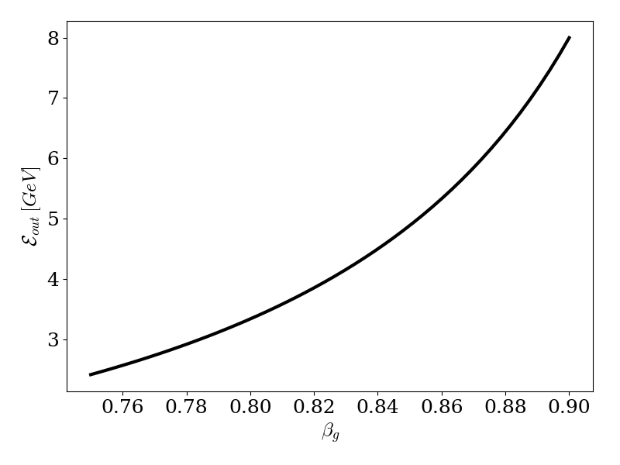
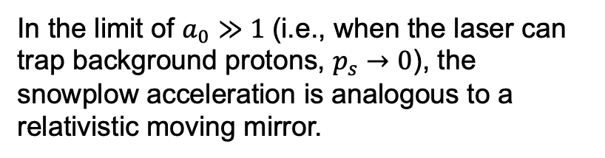
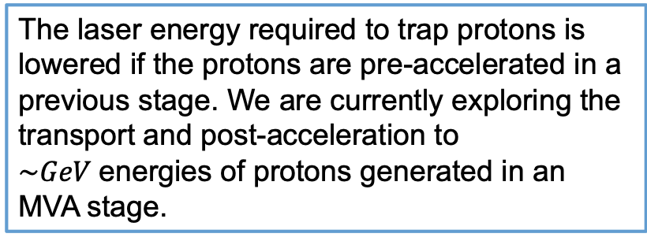
Snowplow field enables proton acceleration up to GeV energies
$$ℇ_{out}=γ_{g}^{2}\left[γ_{s}\left(1+β_{g}^{2}\right)−2p_{s}β_{g}\right]→2γ_{g}^{2}β_{g}^{2}$$
In the limit of $a_{0}≫1$(i.e., when the laser can trap background protons, $p_{s}→0$), the snowplow acceleration is analogous to a relativistic moving mirror.
Typical region of operation for near-critical densities
The laser energy required to trap protons is lowered if the protons are pre-accelerated in a previous stage. We are currently exploring the transport and post-acceleration to $\sim GeV$energies of protons generated in an MVA stage.

Slide 7
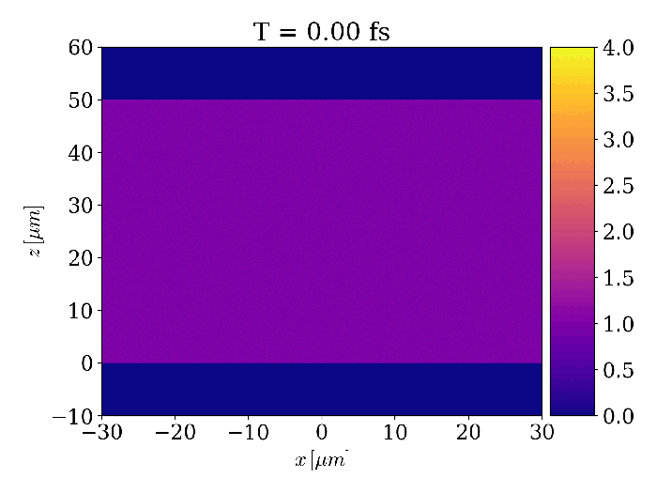

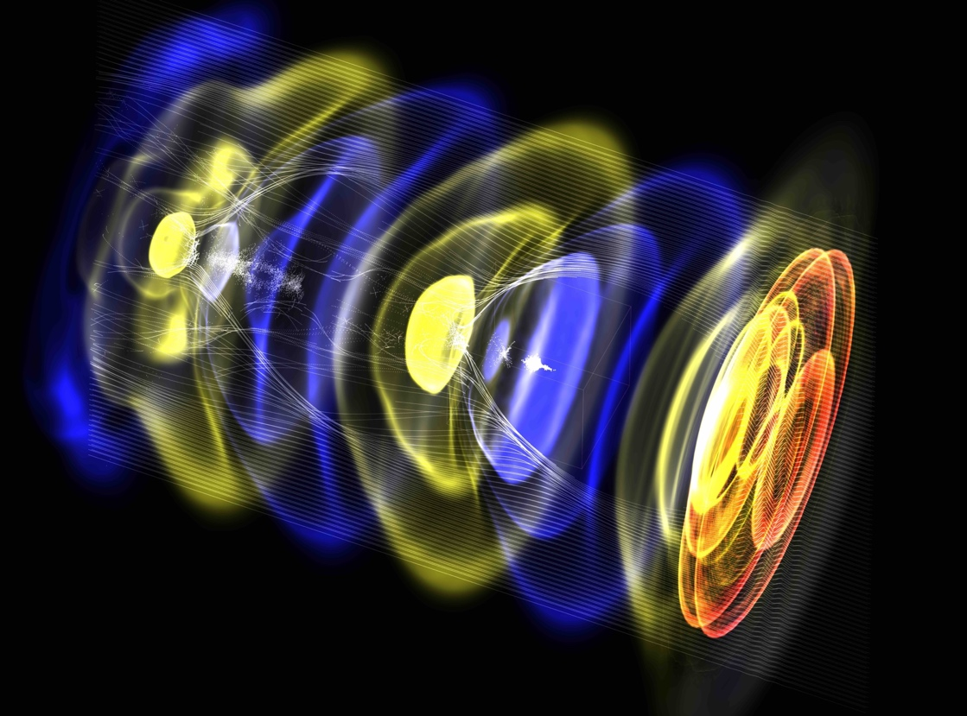




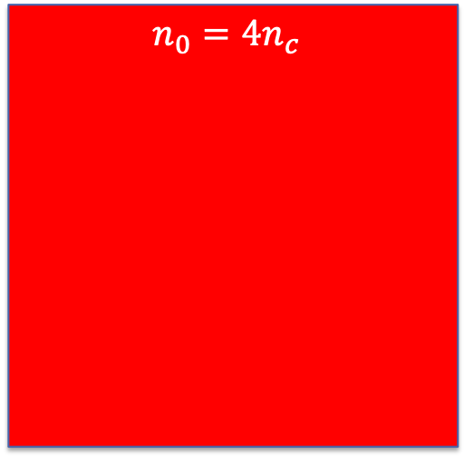
In simulations we analyze the dynamics of test protons in the snowplow
$$n_{0}=4n_{c}$$
Test protons to study phase space of trapped particles
$$E_{0}≃96\sqrt{n_{0}\left[{10}^{18}cm^{−3}\right]}≃8 TV/m$$
$$50μm$$
Electron density
$$a_{0}=100$$
$$w_{0}=4μm$$
$$T_{FWHM}=35 fs$$
$$ℇ_{L}≃400 J$$
Circular pol.
Focused on target center
Simulations are performed using azimuthal decomposition (quasi-3D)
WarpX – open-source particle-in-cell code with advanced algorithms at Exascale
PI: Jean-Luc Vay (LBNL)
>30 contributors internationally
https://ecp-warpx.github.io
Vay, J-L., et al., Nucl. Instrum. Meth. A 909 (2018)
Notes:
what would it take to model a actual MVA distribution into this?

Slide 8
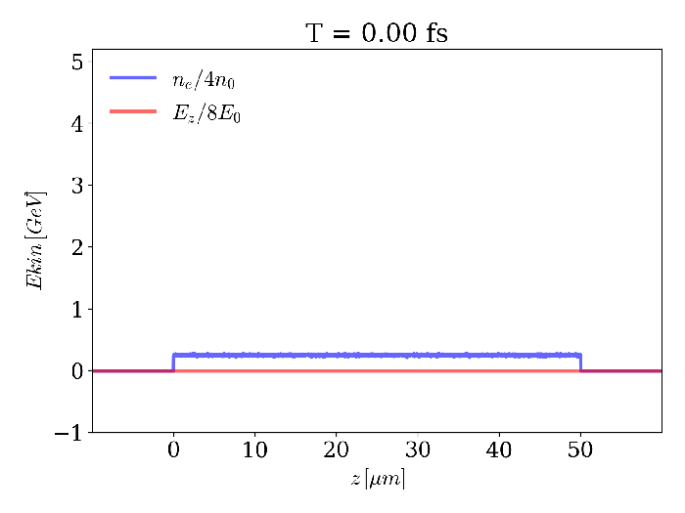
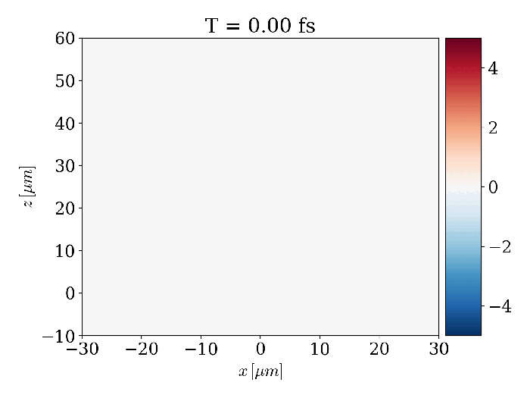
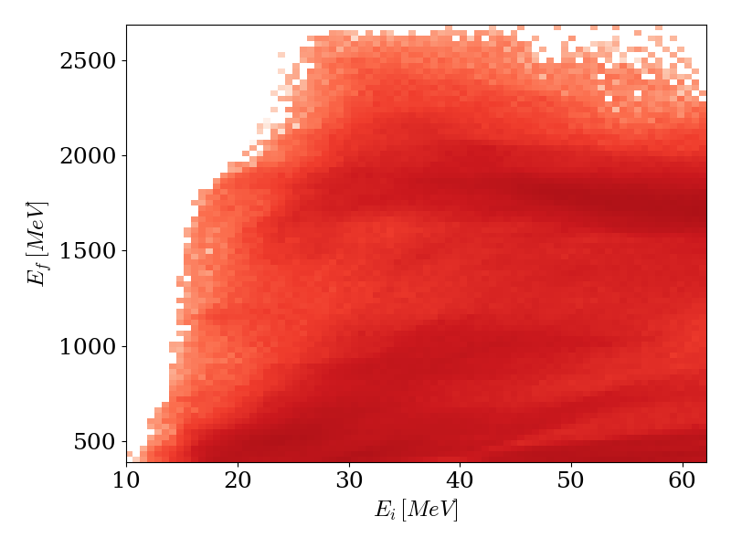
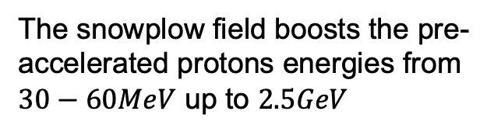
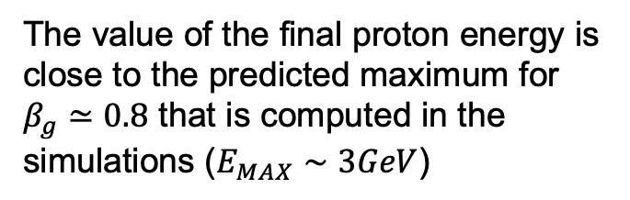
We compute final proton energies of up to 2.5 GeV
Triangular shape of the accelerating field (red) visible in simulations
The snowplow field boosts the pre-accelerated protons energies from $30−60MeV$ up to $2.5GeV$
Electron density
The value of the final proton energy is close to the predicted maximum for $β_{g}≃0.8$ that is computed in the simulations ($E_{MAX}∼3GeV$)
The next step is to investigate schemes to connect the source (MVA) with the snowplow
Accelerating field

Slide 9
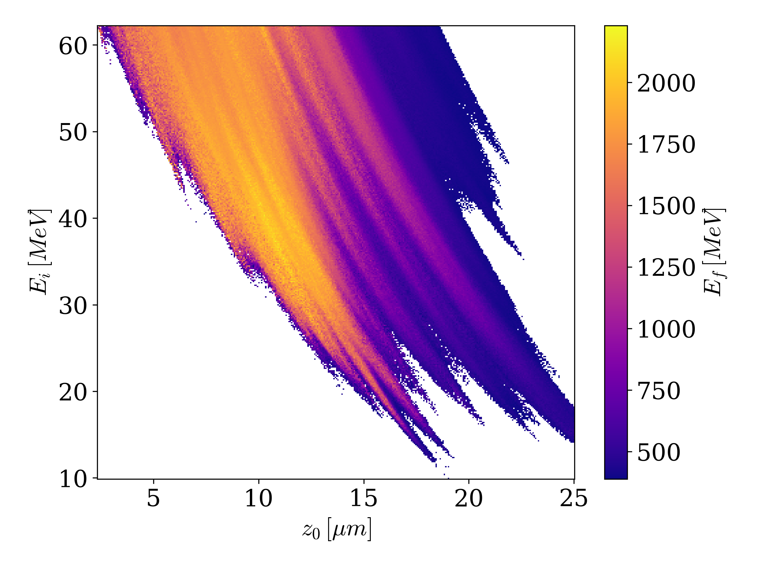
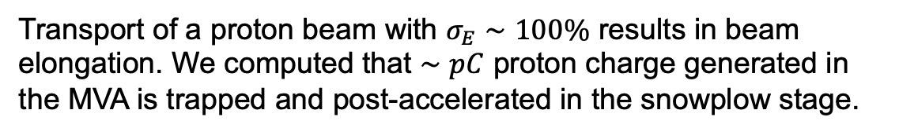
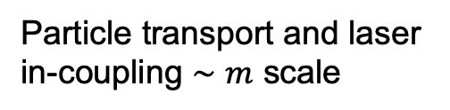
Investigation of the transport process from the MVA to the snowplow
Final energy of the test particles in function of their initial position and energy
Snowplow
MVA
Lens
Particle transport and laser in-coupling $∼m$ scale
[De Chant, PRAB, in preparation]
Transport of a proton beam with $σ_{E}∼100\%$ results in beam elongation. We computed that $∼pC$ proton charge generated in the MVA is trapped and post-accelerated in the snowplow stage.
It is important to study the combined system taking into account realistic parameters for combining the MVA with the snowplow. Identification of solutions to increase the trapped charge is in progress, e.g.
Improvement of the source phase space
Different options of in-coupling mechanism that reduce the distance between the source and the snowplow
Beam chirping/compression and focusing to reduce its spread

Slide 10
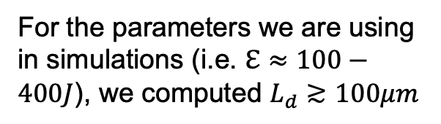
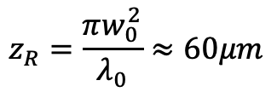
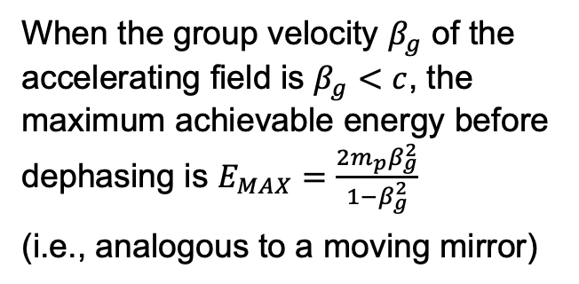

Three main factors limit the final energy of accelerated protons
Laser diffraction
Laser depletion
Proton dephasing
Limited by Rayleigh range
The laser is depleted by the energy exchange with the plasma
The protons outrun the slow-moving snowplow field
$$z_{R}=\frac{πw_{0}^{2}}{λ_{0}}≈60μm$$
$$L_{d}∝a_{0}\frac{n_{c}}{n_{e}}{ cT}_{FWHM}$$
When the group velocity $β_{g}$ of the accelerating field is $β_{g}<c$, the maximum achievable energy before dephasing is $E_{MAX}=\frac{2m_{p}β_{g}^{2}}{1−β_{g}^{2}}$
(i.e., analogous to a moving mirror)
[Hakimi et al, POP, 2020]
For the parameters we are using in simulations (i.e. $ℇ≈100−400J$), we computed $L_{d}≳100μm$
[S. V. Bulanov et al, POP, 2012]

Slide 11
Three main factors limit the final energy of accelerated protons
Laser diffraction
Laser depletion
Proton dephasing
Limited by Rayleigh range
The laser is depleted by the energy exchange with the plasma
The protons outrun the slow-moving snowplow field
$$z_{R}=\frac{πw_{0}^{2}}{λ_{0}}≈60μm$$
$$L_{d}∝a_{0}\frac{n_{c}}{n_{e}}{ cT}_{FWHM}$$
When the group velocity $β_{g}$ of the accelerating field is $β_{g}<c$, the maximum achievable energy before dephasing is $E_{MAX}=\frac{2m_{p}β_{g}^{2}}{1−β_{g}^{2}}$
(i.e., analogous to a moving mirror)
[Hakimi et al, POP, 2020]
For the parameters we are using in simulations (i.e. $ℇ≈100−400J$), we computed $L_{d}≳100μm$
[S. V. Bulanov et al, POP, 2012]

Slide 12
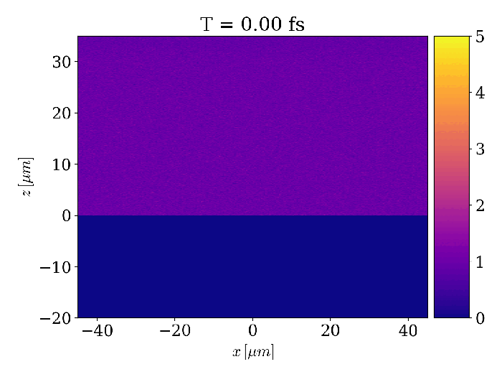
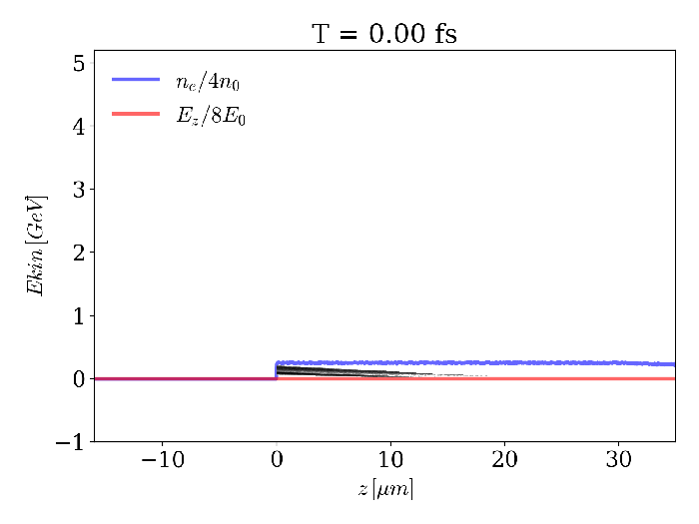
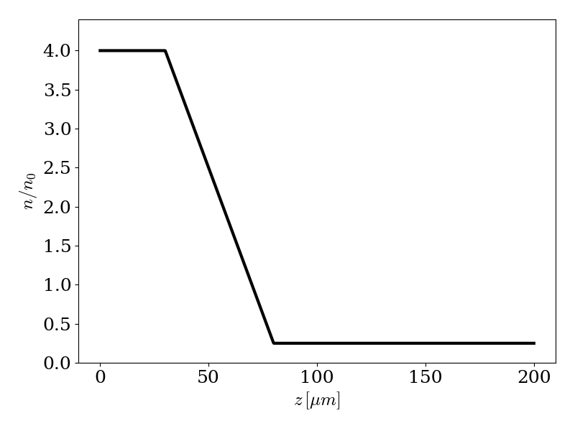
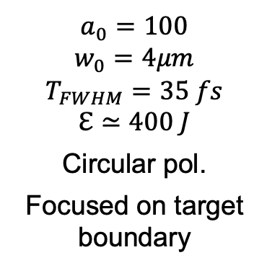
Density tapering increases maximum proton energy
The group velocity of the snowplow accelerating structure increases as the density decreases
$$a_{0}=100$$
$$w_{0}=4μm$$
$$T_{FWHM}=35 fs$$
$$ℇ≃400 J$$
Circular pol.
Focused on target boundary
Tapered density profile
Finding an optimal density profile is work in progress as the laser evolution is very nonlinear

Slide 13

Summary
We analyzed the production of $≳GeV$ proton beams using the snowplow acceleration of pre-accelerated protons (from MVA)
The electric field generated by a snowplow can accelerate protons up to $∼2−3 GeV$ and it is limited by the proton dephasing
Tapering the target density enables higher energy gains, limited by the laser depletion length

