Slide 1
High precision probing of laser-solid interaction with LWFA-generated electron beams
Sebastien Corde, Xavier Davoine, Max Gilljohann, Laurent Gremillet, Alexander Knetsch, Olena Kononenko, Yuliia Mankovska, Aime Matheron, Stylianos Passalidis, Pablo San Miguel Claveria, and the Hybrid Collaboration

Slide 2
Outline
Plasma filamentation
Introduction: laser-solid interaction
Experimental setup
Measured quantities and data analysis
Numerical simulations
Summary
e⁻

Slide 3
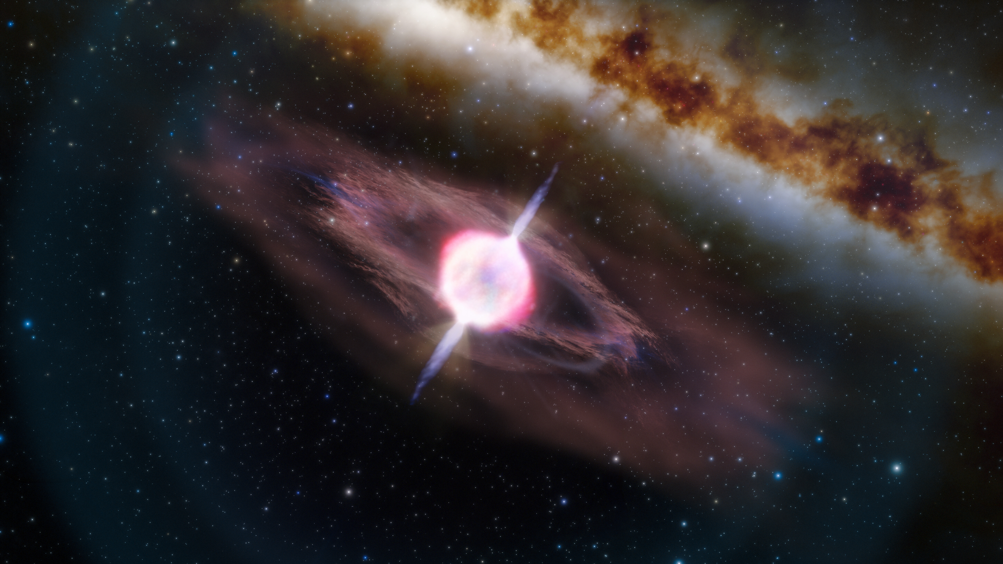
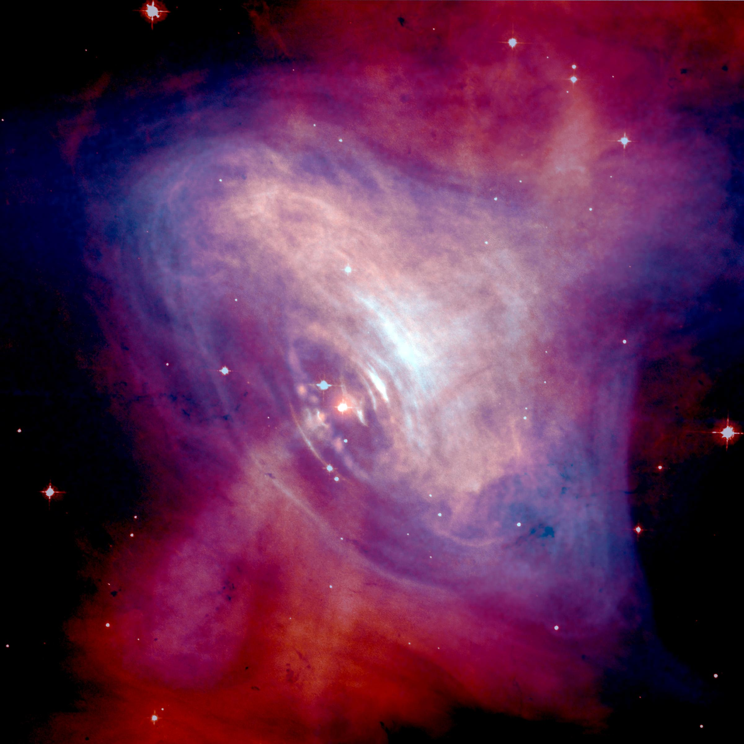
Introduction
Foil
small feature size ($\sim μm$)
short timescale ($<ps$)
$$25μm$$
Gamma ray burst
$$10μm$$
Pump laser
e-
electron filaments
=> strong small-scale fields
Plasma filamentation
expanding electron cloud
=> large-scale fields
Pulsar wind nebula

Slide 4
Experimental setup
Salle Jaune at Laboratoire d’Optique Appliquée
Salle Jaune Ti:Sa laser
charge: ~100 pC
peak energy: ~200 MeV
duration: ~5 fs
size on foil: ~10 μm
LWFA e⁻ as a probe:
sensitive to generated fields
small size ($\sim μm$)
short duration ($\sim fs$)
synchronized to the pump laser
Foil
variable delay
Gas jet
Nozzle
Pump laser
LWFA laser
Interaction
point
99%He
+ 1%N₂
e⁻
LWFA laser
Pump laser
$$37°$$
energy: 1.2 J
focal spot size: 30 μm (fwhm)
pulse length: 30 fs (fwhm)
Gas jet
energy: 1.5 J
focal spot size: 10 μm (fwhm)
pulse length: 30 fs (fwhm)
peak intensity: 1.7⋅10¹⁹ Wcm⁻²
$$1mm$$

Slide 5
Experimental setup
Salle Jaune at Laboratoire d’Optique Appliquée
Nozzle
Foil
e⁻
LWFA laser
Pump laser
Gas jet

Slide 6
Measurable quantities and data analysis
Observed and measured effects on the electron beam:
Increase of the beam divergence
Beam deflection
e⁻ beam
e⁻ beam
before interaction
after interaction
before interaction
after interaction

Slide 7
Numerical simulations
2D PIC simulations (CALDER code) with pre-plasma and probe e⁻:
4M CPU hours
pre-plasma modelled with ESTHER hydro simulations
probe e⁻ included
Large-scale expanding fields
Small-scale fields
Simulations done by S. Passalidis, X. Davoine and L. Gremillet

Slide 8
Simulations done by S. Passalidis, X. Davoine and L. Gremillet
Numerical simulations
Comparison with the experiment

Slide 9
Summary
precise measurement of fields of the laser-solid interaction
good qualitative agreement with simulations
LWFA-generated e- are a suitable probe for small-scale fast processes ($\sim μm$ spatial precision and $\sim fs$ temporal precision)
e⁻

