Slide 1








Towards solid density beams and intense gamma-ray beams
The E332 experiment at FACET-II
Max F. Gilljohann on behalf of the E332 collaboration
E. Adli, I. Andriyash, R. Ariniello, J. Cary, S. Corde, X. Davoine, C. Doss, H. Ekerfelt,
C. Emma, J. Faure, F. Fiuza, E. Gerstmayr, S. Gessner, M. F. Gilljohann, L. Gremillet,
M. Hogan, K. Hunt-Stone, C. Joshi, C. Keitel, A. Knetsch, O. Kononenko, V. Lee, M. Litos,
Y. Mankovska, A. Marinelli, K. Marsh, A. Matheron, S. Montefiori, W. Mori, N. Nambu,
Z. Nie, B. O'Shea, S. Passalidis, J. Peterson, A. Sampath, P. San Miguel Claveria, D. Storey, M. Tamburini, N. Vafaei-Najafabadi, Y. Wu, X. Xu, V. Yakimenko, J. Yan,
V. Zakharova, C. Zhang
loa.ensta-paris.fr
ERC & ANR (UnRIP project, Grant No. ANR-20-CE30-0030).

Slide 2

Dense beams and intense gamma-ray beams
Dense beams & intense gamma bursts very interesting for various applications like
Plasma-based accelerators
High-density beam physics
SF-QED studies
Astrophysics
Focusing electron beams
?
Foil

Slide 3
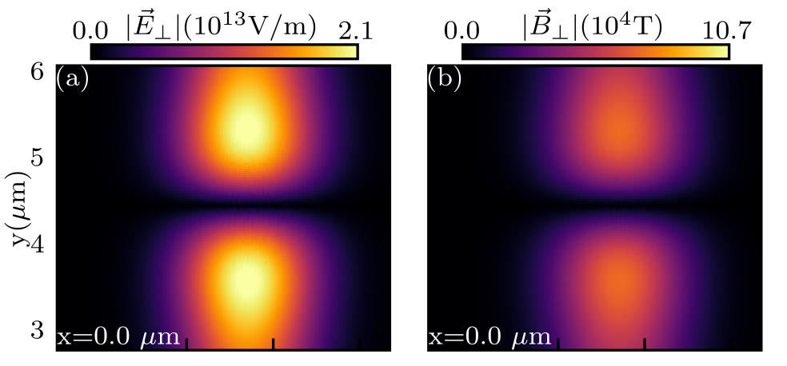
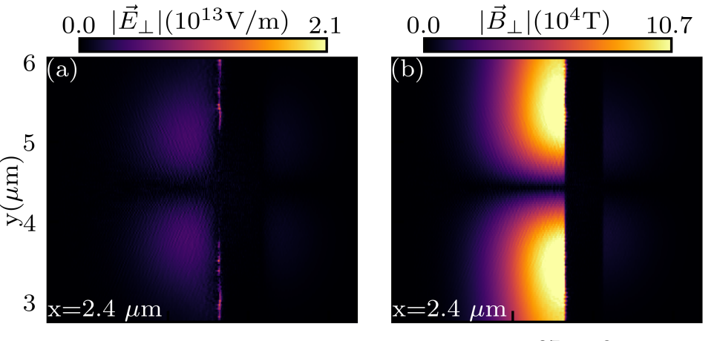
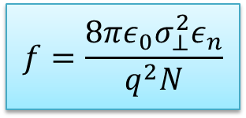
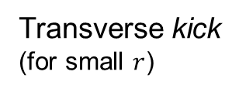
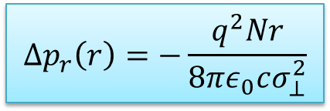
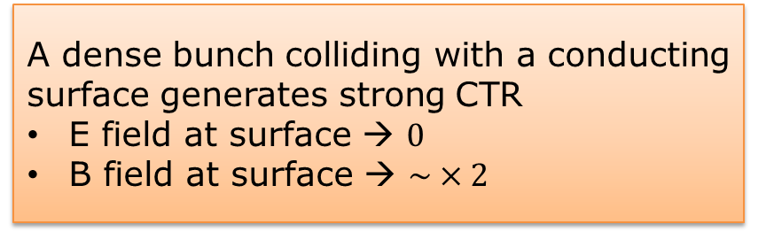
Near Field Coherent Transition Radiation Self Focusing
NF-CTR Focusing
Initial beam fields – electric and magnetic
A dense bunch colliding with a conducting surface generates strong CTR
E field at surface → $0$
B field at surface → $\sim ×2$
Conductor
Transverse kick
(for small $r$)
$$Δp_{r}\left(r\right)=−\frac{q^{2}Nr}{8πε_{0}cσ_{⊥}^{2}}$$
Fields at foil surface
Focusing effect on the bunch
Conductor
Conductor
Conductor
$$f=\frac{8πε_{0}σ_{⊥}^{2}ε_{n}}{q^{2}N}$$
Focal length
Sampath, A. et al. Extremely Dense Gamma-Ray Pulses in Electron Beam-Multifoil Collisions. Phys. Rev. Lett. 126, 064801 (2021).
Corde, S. et al., Beam focusing by near-field transition radiation, https://hal-polytechnique.archives-ouvertes.fr/hal-02937777v2 (2020).

Slide 4
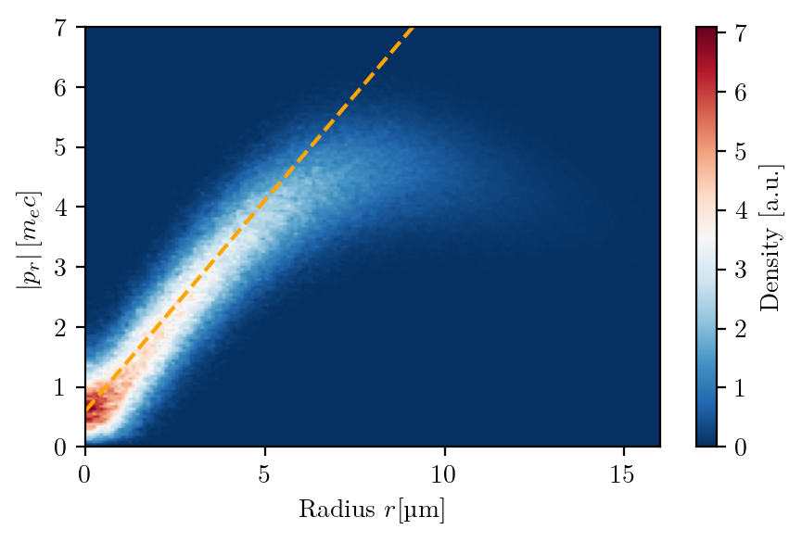
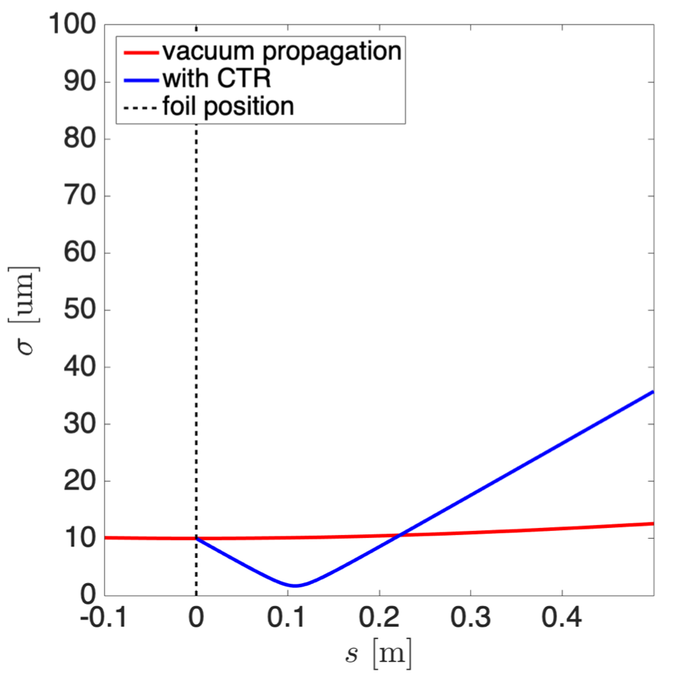
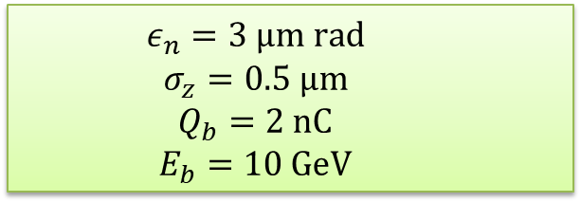



Near Field Coherent Transition Radiation Self Focusing
NF-CTR Focusing
Transverse phase space
Beam size evolution
$$σ_{r}=10 μm$$
$$σ_{r}=5 μm$$
  $$ε_{n}=3 μm rad$$
  $$σ_{z}=0.5 μm$$
  $$Q_{b}=2 nC$$
  $$E_{b}=10 GeV$$
Focuses down to $\sim 2 μm$ rms beam size
Corde, S. et al. https://hal-polytechnique.archives-ouvertes.fr/hal-02937777v2 (2020).

Slide 5
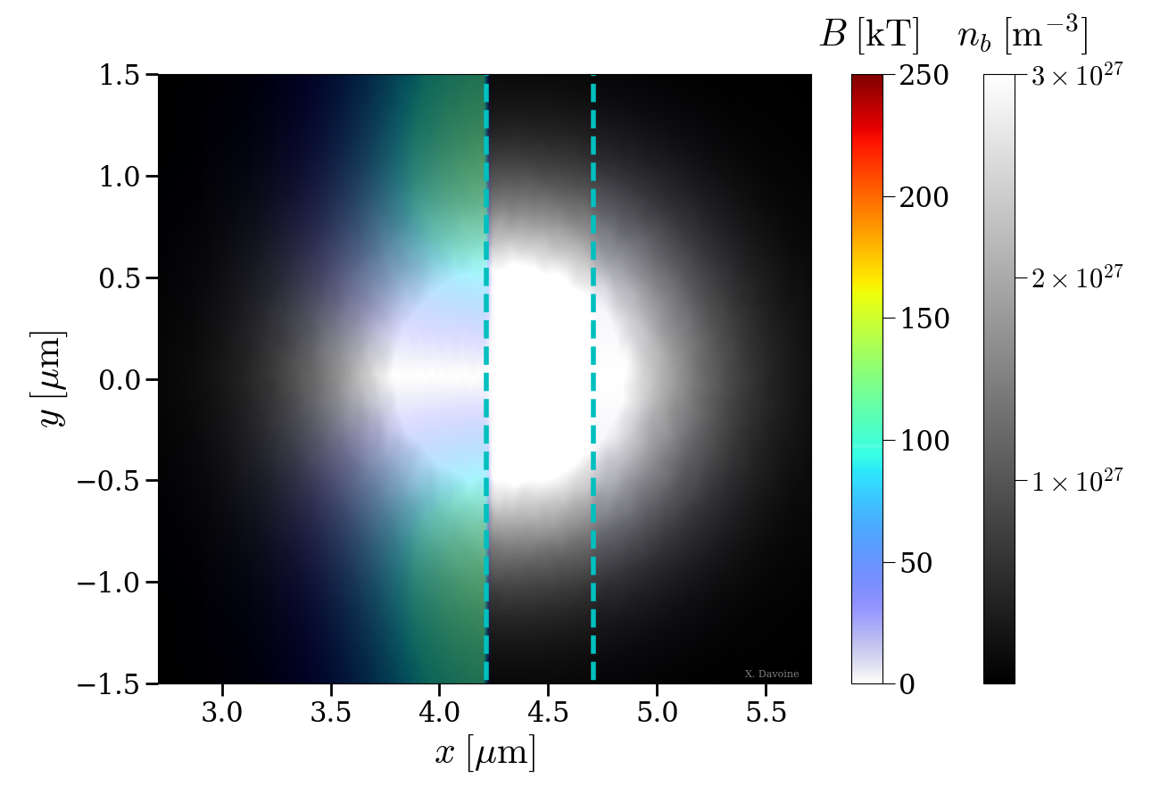
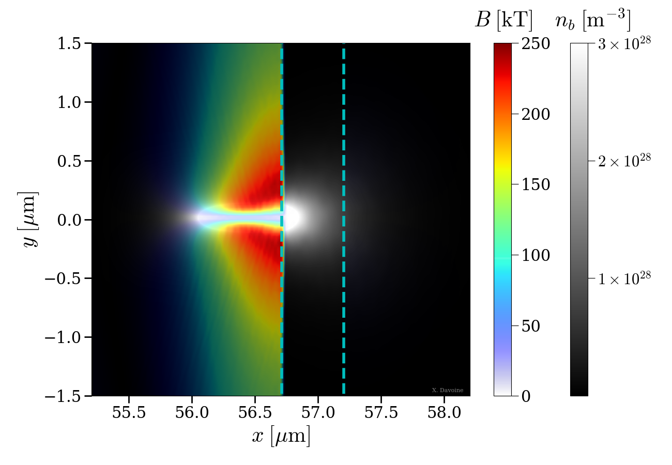
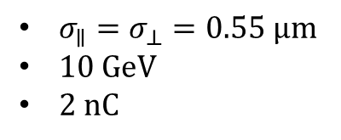
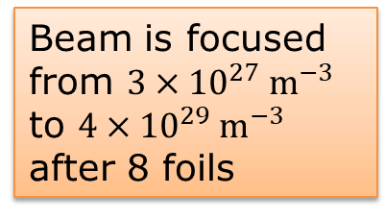
Near Field CTR Self Focusing through multiple foils
Multiple foils
Multiple foils enhance the focusing
Solid density electron beam
CALDER simulations
$σ_{∥}=σ_{⊥}=0.55 μm$
$10 GeV$
$2 nC$
First foil:
6th foil:
Beam is focused from $3×{10}^{27}{ m}^{−3}$ to $4×{10}^{29} m^{−3}$ after 8 foils
Figures by X. Davoine
Sampath, A, PHYSICAL REVIEW LETTERS 126, 064801 (2021)

Slide 6
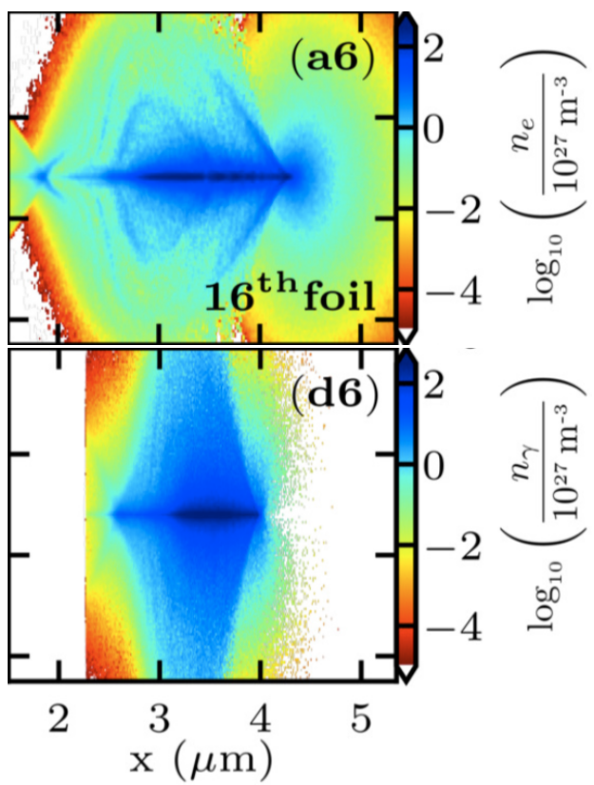
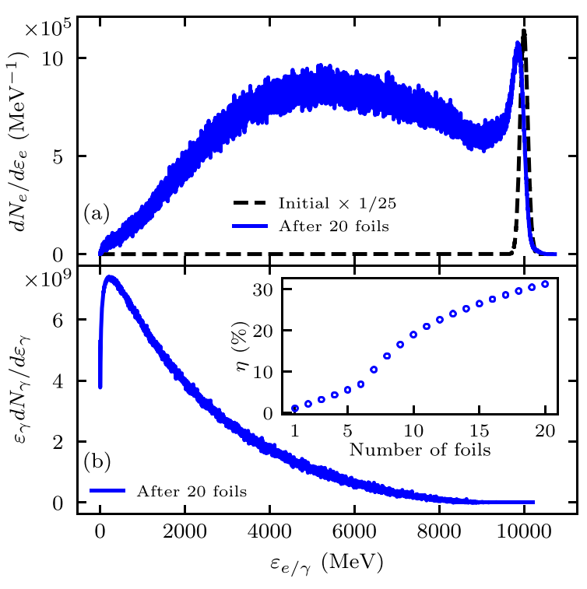







Near Field CTR Self Focusing through multiple foils
Multiple foils
Solid density $γ$-ray beam
Multiple foils enhance the focusing
Solid density electron beam
Gamma ray generation
$$e^{−}$$
$$e^{−}$$
Beam distribution:
  $n_{e}=4×{10}^{29} m^{−3}$
Gamma distribution:
  $n_{γ}=9×{10}^{29} m^{−3}$
  $5 mrad$ aperture
  $4 fs$ FWHM
  $η≈30\%$
$$γ$$
$$η$$
$$γ$$
Sampath, A, PHYSICAL REVIEW LETTERS 126, 064801 (2021)

Slide 7
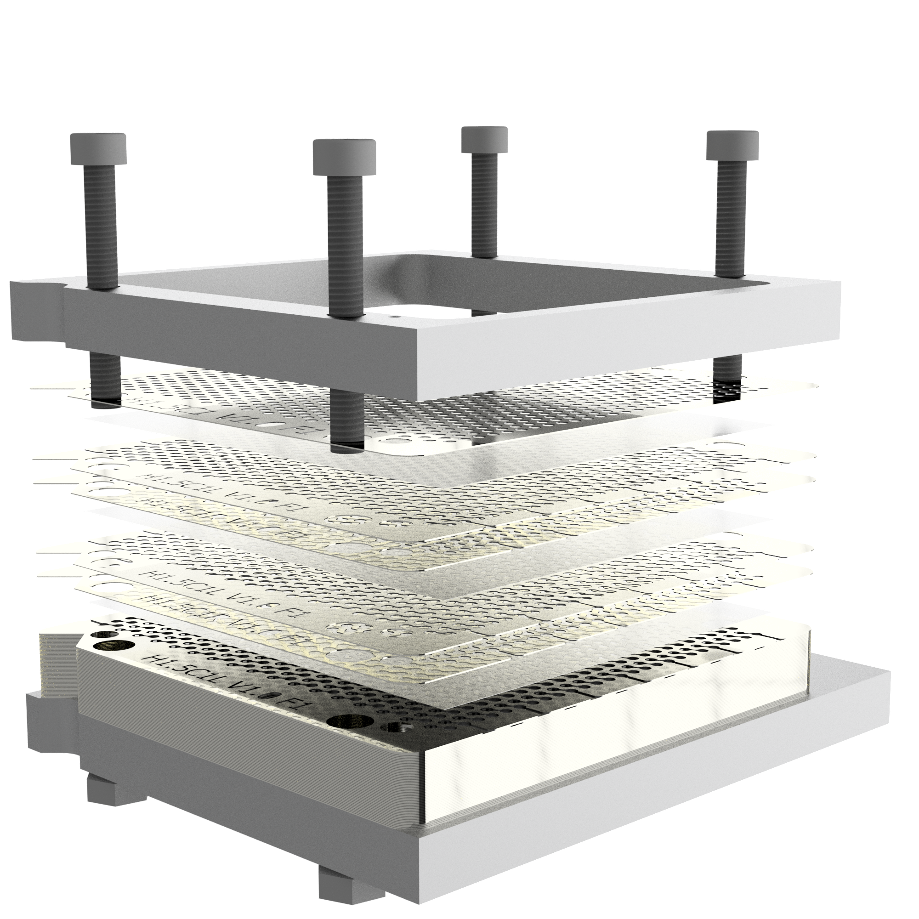
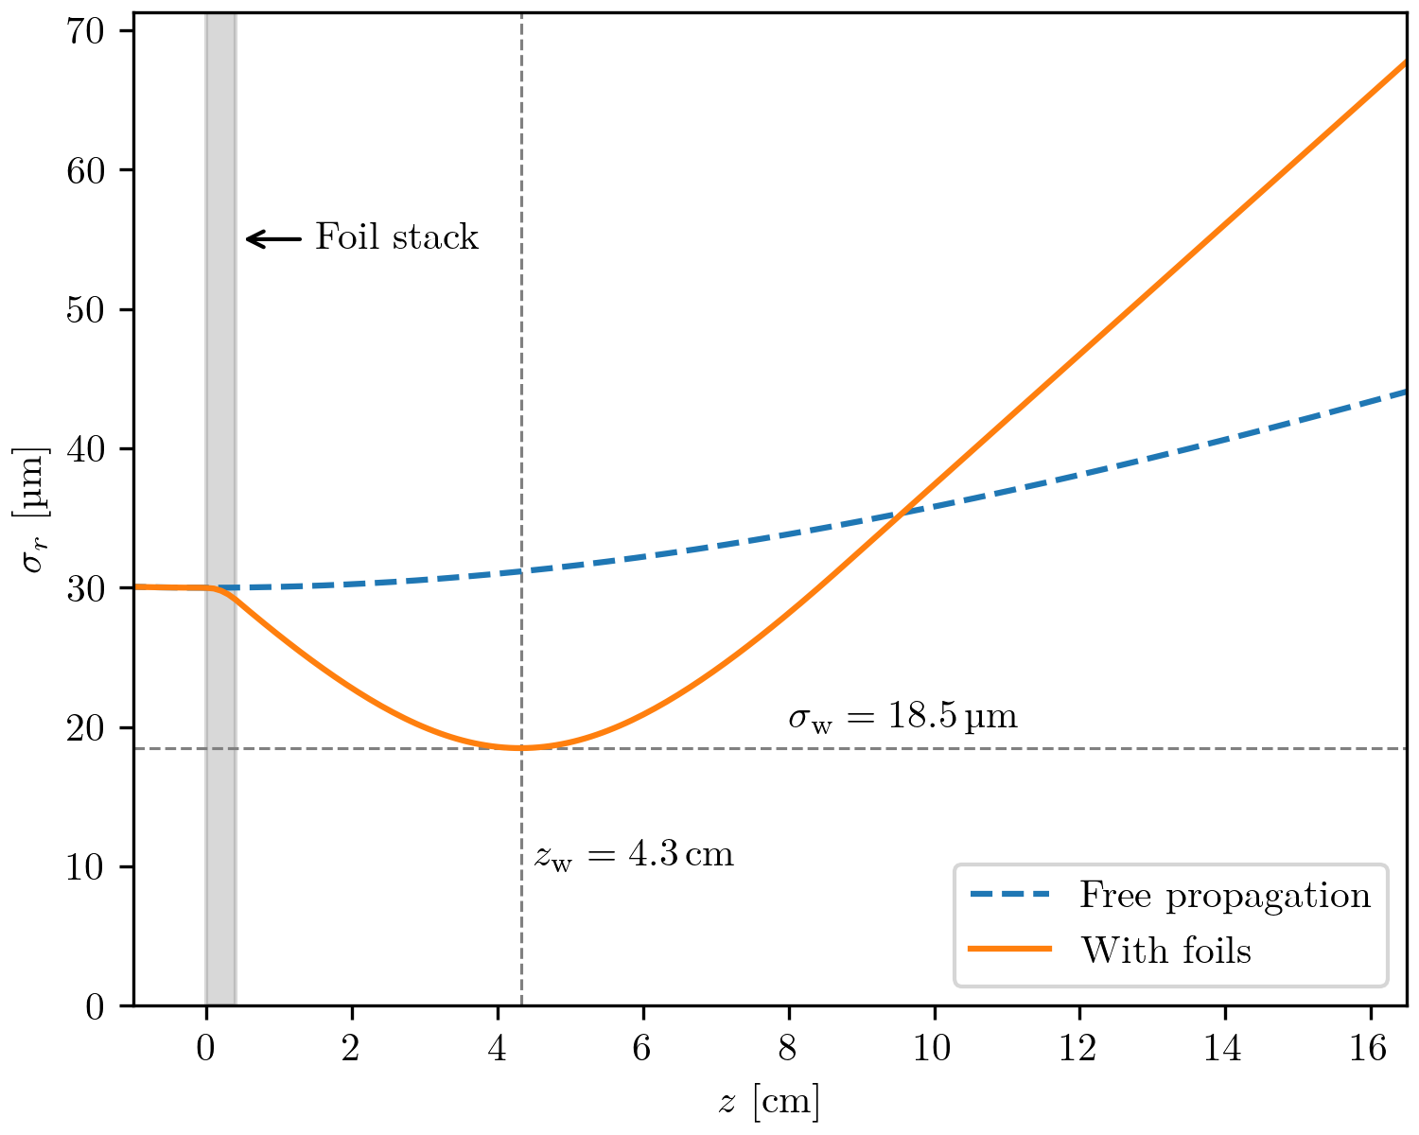
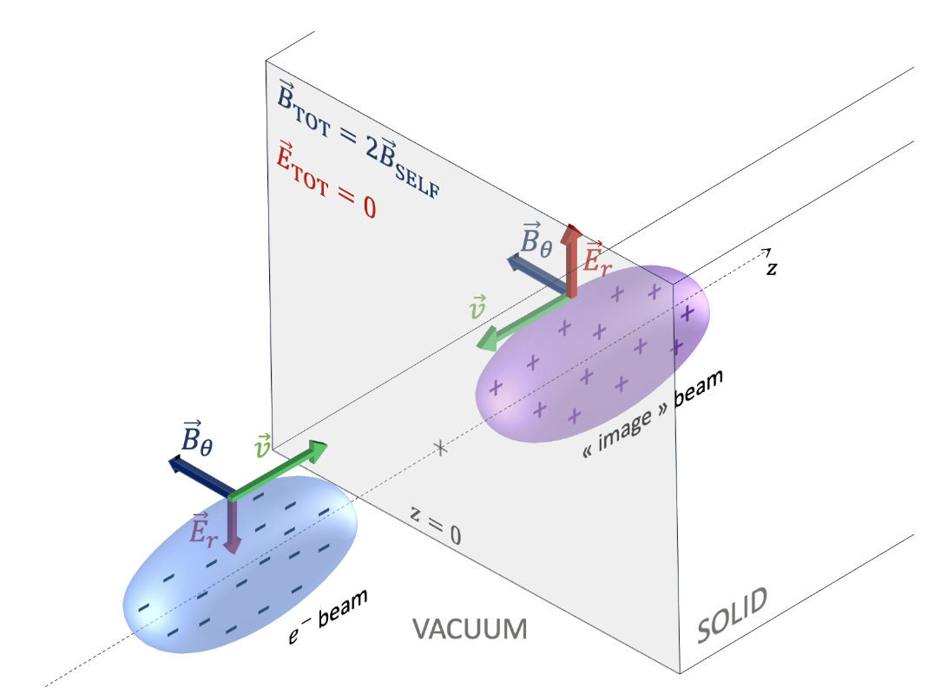
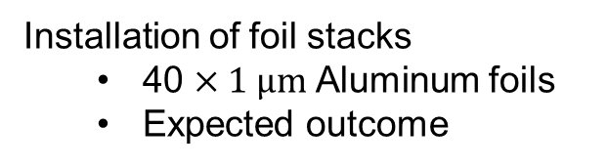
Overview
1
FACET-II experimental area and diagnostics
Installation of foil stacks
  40 $×1 μm$ Aluminum foils
  Expected outcome
2
3
SF-QED studies with beam-plasma collision

Slide 8
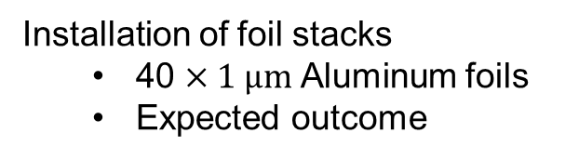
Overview
1
FACET-II experimental area and diagnostics
Installation of foil stacks
  40 $×1 μm$ Aluminum foils
  Expected outcome
2
3
SF-QED studies with beam-plasma collision

Slide 9
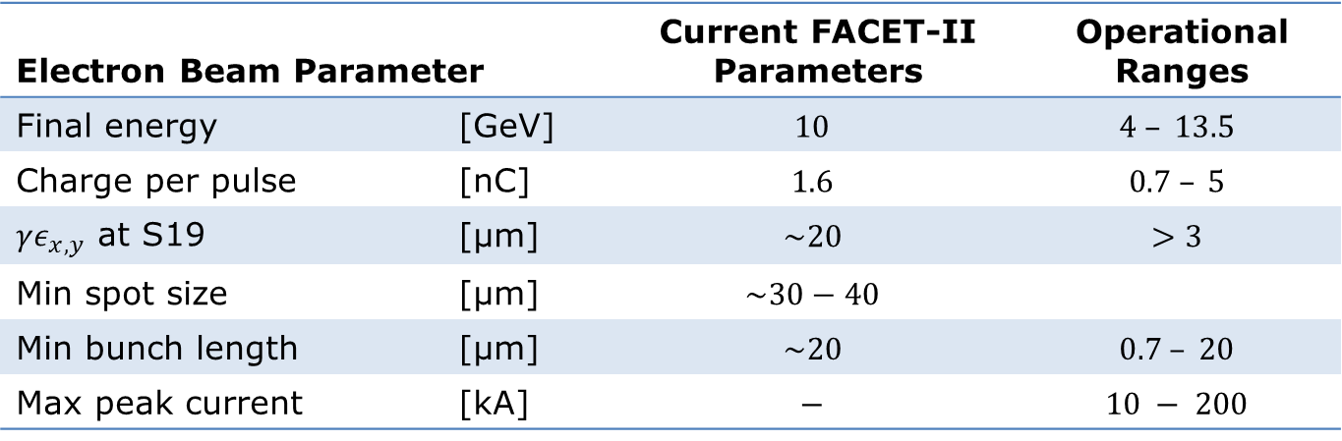
FACET-II Experimental Area
Overview
Beam direction
FACET-II target chamber
“Picknic Basket”
Re-imaging
spectrometer quads
Spectrometer dipole
Nominal 60 mm dispersion
Diagnostics
Gamma & Electrons
Electron Beam Parameter |  | Current FACET-II Parameters | Operational Ranges
Final energy | [GeV] | $$10$$ | $$4 – 13.5$$
Charge per pulse | [nC] | $$1.6$$ | $$0.7 – 5$$
$γε_{x,y}$ at S19 | [µm] | $$\sim 20$$ | $$>3$$
Min spot size | [µm] | $$\sim 30−40$$
Min bunch length | [µm] | $$\sim 20$$ | $$0.7 – 20$$
Max peak current | [kA] | $$−$$ | $$10 − 200$$

Slide 10
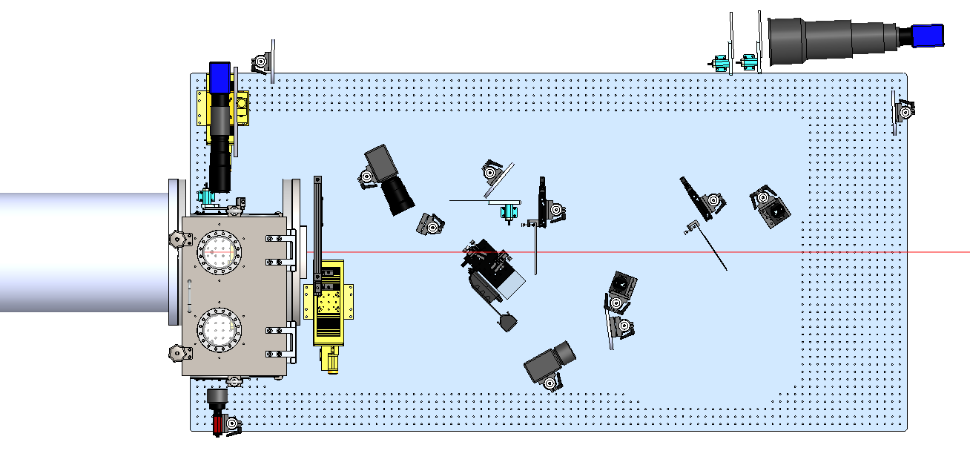
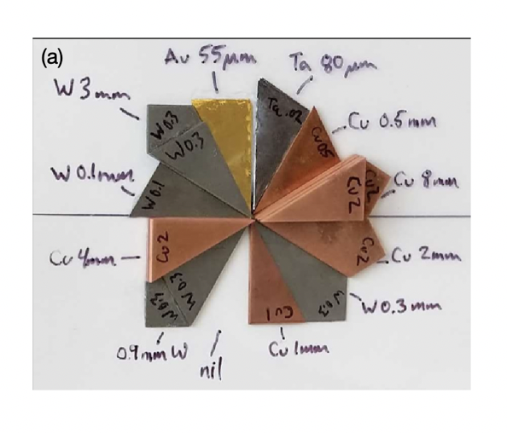
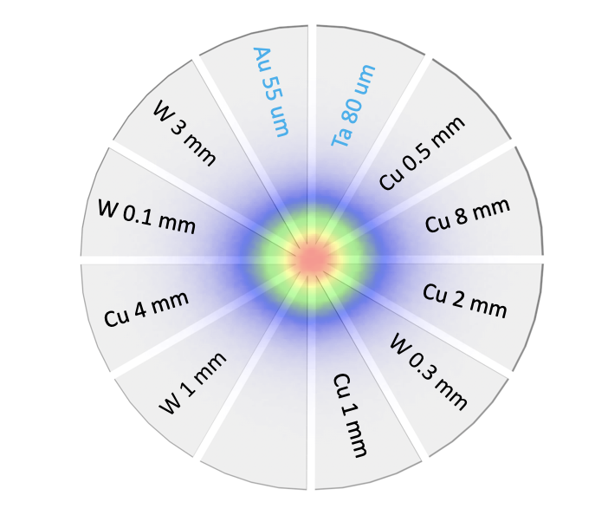
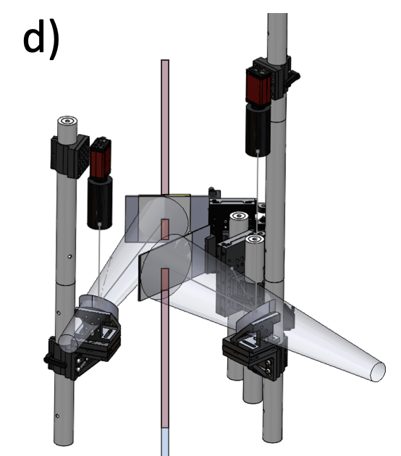
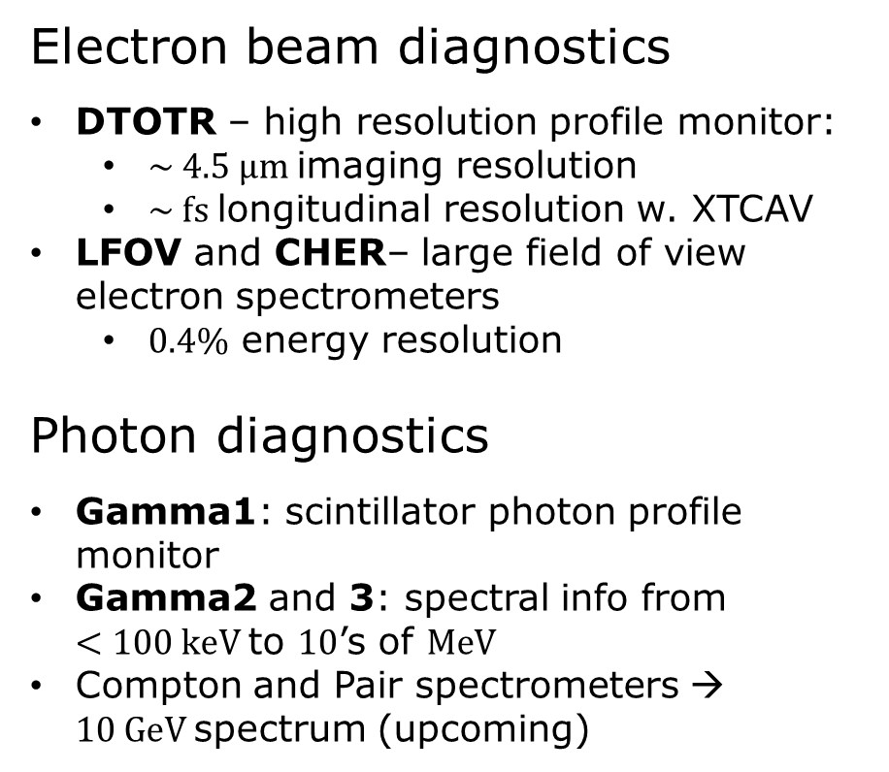
FACET-II Experimental Area
CHER
Diagnostics
DTOTR1
Electron beam diagnostics
DTOTR – high resolution profile monitor:
  $\sim 4.5 μm$imaging resolution
  $\sim fs$longitudinal resolution w. XTCAV
LFOV and CHER– large field of view electron spectrometers
  $0.4\%$ energy resolution
Photon diagnostics
Gamma1: scintillator photon profile monitor
Gamma2 and 3: spectral info from
$<100 keV$to $10$’s of $MeV$
Compton and Pair spectrometers → $10 GeV$spectrum (upcoming)
Gamma3
Beam Direction
Gamma1
Gamma2
LFOV
DTOTR2
Beam & Gamma diagnostic area
Gamma2 and 3 screens

Slide 11
Overview
1
FACET-II experimental area and diagnostics
Installation of foil stacks
  40 $×1 μm$ Aluminum foils
  Expected outcome
2
3
SF-QED studies with beam-plasma collision

Slide 12
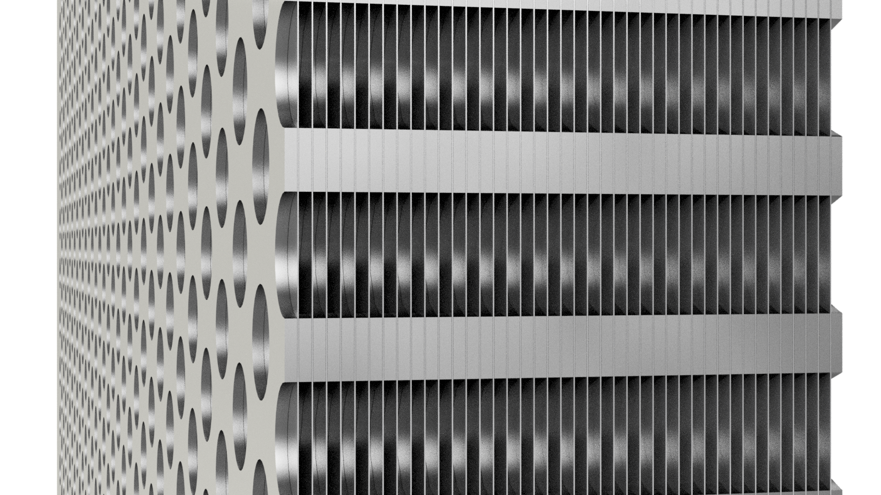

E332 Experimental Setup
New foil target
$1 μm$ thick Al foils
$100 μm$ foil separation
40 foils

Slide 13
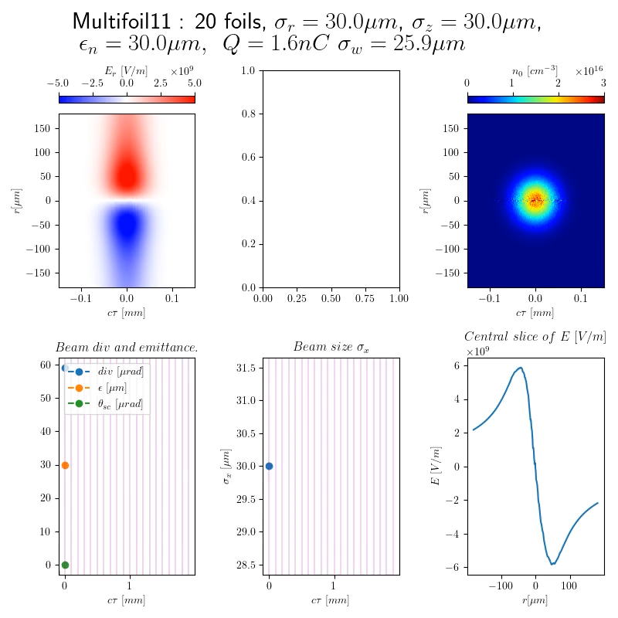
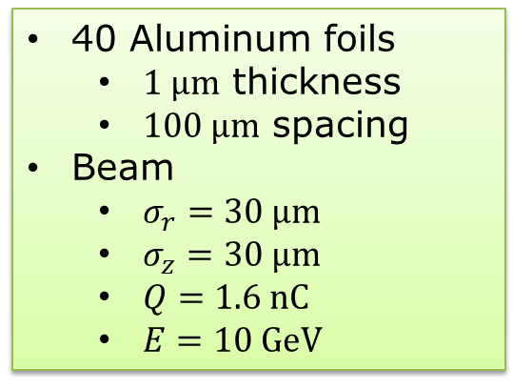
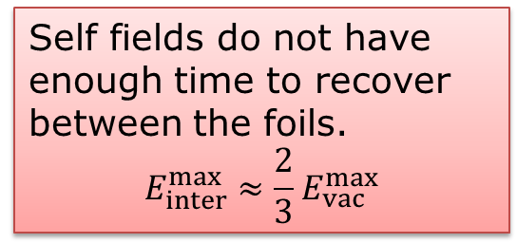
Simulations with Current Beam & Target Parameters
40 Aluminum foils
  $1 μm$ thickness
  $100 μm$ spacing
Beam
  $σ_{r}=30 μm$
  $σ_{z}=30 μm$
  $Q=1.6 nC$
  $E=10 GeV$
First 20 foils
Simulations by A. Matheron with CALDER
Self fields do not have enough time to recover between the foils.
$$E_{inter}^{max}≈\frac{2}{3}{ E}_{vac}^{max}$$

Slide 14
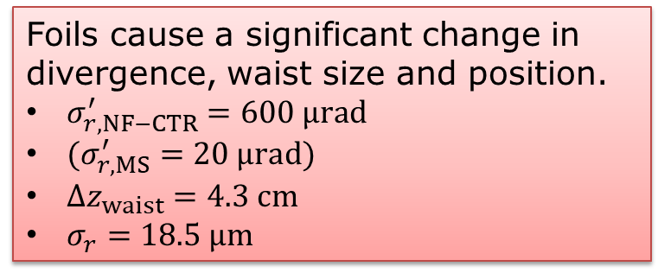
Simulations with Current Beam & Target Parameters
40 foils
40 Aluminum foils
  $1 μm$ thickness
  $100 μm$ spacing
Beam
  $σ_{r}=30 μm$
  $σ_{z}=30 μm$
  $Q=1.6 nC$
  $E=10 GeV$
First measurements coming soon!
Foils cause a significant change in divergence, waist size and position.
$σ_{r, NF−CTR}^{′}=600 μrad$
$(σ_{r,MS}^{′}=20 μrad)$
$Δz_{waist}=4.3 cm$
$σ_{r}=18.5 μm$
Simulations by A. Matheron with CALDER

Slide 15
Overview
1
FACET-II experimental area and diagnostics
Installation of foil stacks
  40 $×1 μm$ Aluminum foils
  Expected outcome
2
3
SF-QED studies with beam-plasma collision

Slide 16
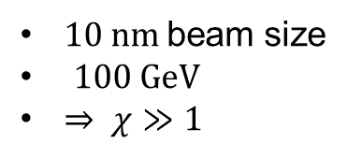
SF-QED Study Opportunities
Nonperturbative QED effects start happening when $χ=\frac{E^{∗}}{E_{cr}}$ approaches $1$
Beam-Beam Collision
Beam-Plasma Collision
Plenary talk by Aimé Matheron
Tomorrow 9:00!
Beam collides with its image
Requires two high-energy and compressed beams
Very sensitive to alignment
‘Beams’ are inherently aligned
V. Yakimenko et al., Phys. Rev. Lett. 122, 190404, 2019:
$10 nm$beam size
$100 GeV$
$⇒ χ≫1$
Matheron, A. et al. Probing strong-field QED in beam-plasma collisions. arXiv:2209.14280

Slide 17





The E332 collaboration
I. Andriyash, S. Corde, M. Gilljohann, A. Knetsch, O. Kononenko,
Y. Mankovska, A. Matheron, P. San Miguel Claveria, V. Zakharova
UMR 7639
C. Keitel, S. Montefiori, A. Sampath, M. Tamburini
X. Davoine, J. Faure, L. Gremillet, S. Passalidis
R. Ariniello, H. Ekerfelt, C. Emma, F. Fiuza, E. Gerstmayr, S. Gessner,
M. Hogan, A. Marinelli, J. Peterson, B. O'Shea, D. Storey, X. Xu, V. Yakimenko
C. Joshi, K. Marsh, W. Mori, N. Nambu, Z. Nie, Y. Wu, C. Zhang
J. Cary, C. Doss, K. Hunt-Stone, V. Lee, M. Litos
E. Adli
J. Yan, N. Vafaei-Najafabadi

Slide 18
Summary
Near Field CTR can result in strong transverse fields at a foil surface boundary that can have a strong impact on the beam:
  Strong self focusing to achieve electron beams of solid-density
  Intense emission of gamma-ray photons
E332 aims to study this effect with the high intensity beams at FACET-II.
As the beam parameters continue to improve we expect to be able to resolve the NF-CTR effect on our diagnostics.
Plenary talk by Aimé Matheron
Tomorrow 9:00!
Nonperturbative SF-QED may be reachable with beam-solid collision.

Slide 19
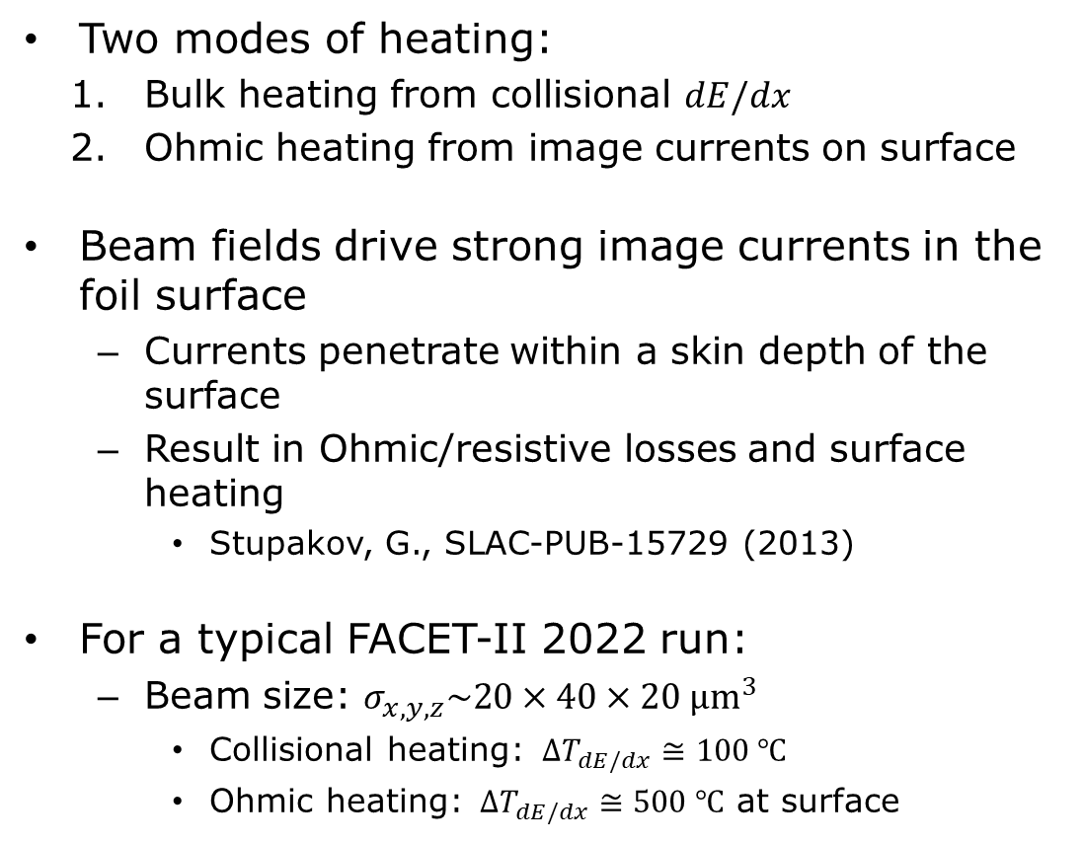
Target Damage
Mechanism
Two modes of heating:
  Bulk heating from collisional $dE/dx$
  Ohmic heating from image currents on surface
Beam fields drive strong image currents in the foil surface
  Currents penetrate within a skin depth of the surface
  Result in Ohmic/resistive losses and surface heating
    Stupakov, G., SLAC-PUB-15729 (2013)
For a typical FACET-II 2022 run:
  Beam size: $σ_{x,y,z}\sim 20×40×20 μm^{3}$
    Collisional heating: $ΔT_{dE/dx}≅100 ℃$
    Ohmic heating: $ΔT_{dE/dx}≅500 ℃$ at surface

Slide 20
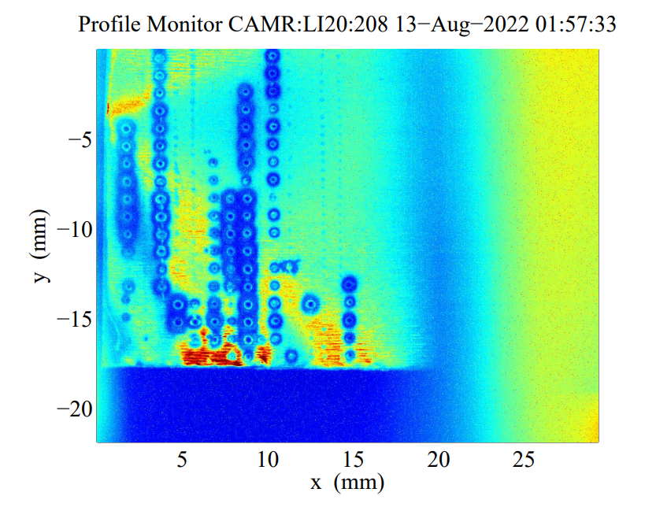
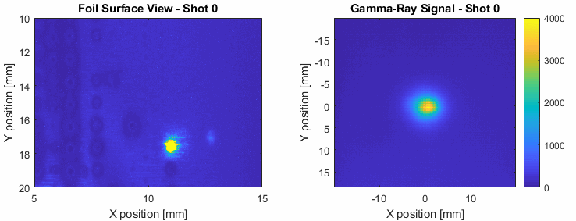

Target Damage
Measurements
FrontView camera
13-Aug-2022 01:57:33
Camera to visualize damage in real time
Gamma diagnostics to measure bremsstrahlung photon signal
General radiation monitors
$0.5 mm$ Aluminum

Slide 21
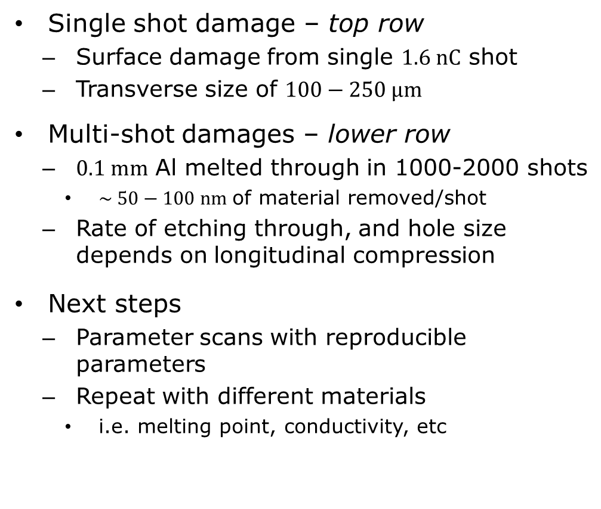
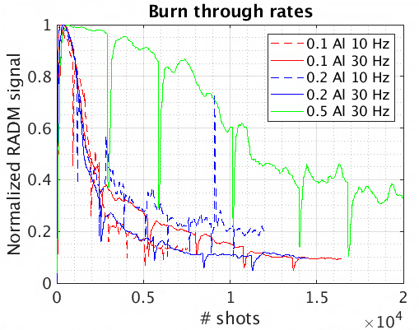
0.25mm
1mm
Target Damage
0.1mm
Measurements
Single shot damage – top row
  Surface damage from single $1.6 nC$ shot
  Transverse size of $100−250 µm$
Multi-shot damages – lower row
  $0.1 mm$ Al melted through in 1000-2000 shots
    $\sim 50−100 nm$of material removed/shot
  Rate of etching through, and hole size depends on longitudinal compression
Next steps
  Parameter scans with reproducible parameters
  Repeat with different materials
    i.e. melting point, conductivity, etc
1mm
0.25mm

