Slide 1
Hydrodynamic Simulations of HOFI channels
Mathis Mewes* mathis.mewesmdi@desy.de
Gregory Boyle
Ángel Ferran Pousa
Rob Shalloo
Jens Osterhoff
Maxence Thévenet
Christopher Arran
Laura Corner
Roman Walczak
Simon Hooker
*Also, University of Hamburg
EAAC23 – 19.09.
Notes:
Today i want to tell you about HOFI channels and how to simulate them.
My work is also published in PRR if you want to read up on more details.

Slide 2
Laser Plasma Accelerators (LPA)
Compact, cheap accelerators using plasma wakefield created by driver laser
Courtesy: Ángel Ferran Pousa
Notes:
In an LPA we shoot a HIGH INTENSITY drive laser pulse through a plasma.
This creates a wakefield in which an electron bunch can be accelerated.
Problem: To keep accelerating, the laser needs to remain focussed

Slide 3
Laser Plasma Accelerators (LPA)
Compact, cheap accelerators using plasma wakefield created by driver laser
Problem: Keep driver laser focused in long acceleration stage
Solution: Hydrodynamic Optically-Field-Ionized (HOFI) channels [1,2,3]
Simulations are essential to understand and predict guiding properties
Vacuum
HOFI channel
Laser
Laser
L_{acc} ~ 2 z_{R}
L_{acc} >> 2 z_{R}
[1] R. J. Shalloo et al., Phys. Rev. E 97, 053203 (2018)
[2] A. Picksley et al., Phys. Rev. Accel. 23, 081303 (2020)
[3] A. Alejo et al., Phys. Rev. Accel. 25, 011301 (2022)
Notes:
To reach the required intensity the driver has to be focused to a very narrow spot, so, in vacuum, it diverges quickly. 10 µm spot Ti:Sa ->Rayleigh = 400 µm
Luckily plasma can be used as optics.
A promising method are HOFI channels, which were experimentally demonstrated in recent years.
To better understand underlying mechanisms and predict the guiding properties, accurate simulations are needed.
These are difficult. To understand why, lets take a look at how HOFI channels work

Slide 4
How does HOFI work?
1.
Background gas
Laser ionizes plasma filament (fs)
Expansion of plasma filament (ns)
Channel guides driver laser (fs)
Plasma filament
HOFI laser
2.
Hydrodynamic expansion
PIC
(M)HD
Laser ionization
HOFI expansion
Discharge/Expulsion
3.
Gas Refill
Wakefield
Kinetic Regime
Hydrodynamic Regime
Guiding channel
Driver laser
Notes:
We need another laser pulse, the HOFI laser, that can just be a portion separated from the driver. With advanced optics (Axicon) it is focused into a gas to ionize a long, thin plasma filament.
Then we have to wait some time for this plasma filament to expand under its own pressure.
Finally this results into an internal structure in the plasma that is suitable to guide the drive laser.
The laser plasma interactions in step 1 and 2 only take fs and happen on a microscopic level. Perfect for PIC.
But the expansion takes ns and is macroscopic and is better represented by HD.

Slide 5
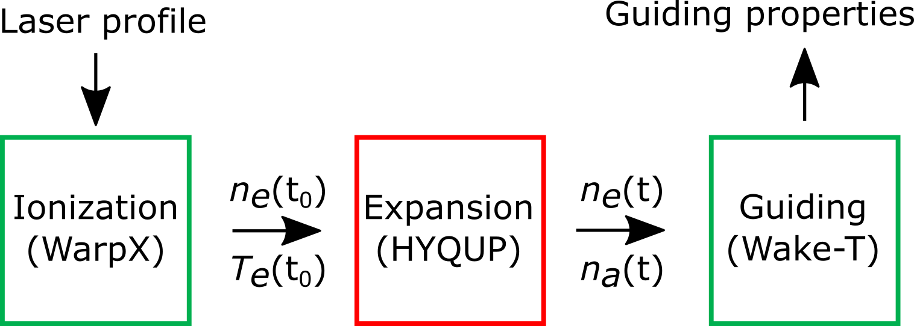
Hydrodynamic Plasma Model
Key:
$ρ$: mass density
$v$: flow velocity
$p$: pressure
$Ι$: Identity matrix
$τ$: viscous stress tensor
$C$: heat capacity
$T$: temperature
$λ$: thermal conductivity
$k_{eh}$: collisional energy transfer
$Q$: heat source
$ω$: mass fraction
$d$: diffusion flux
$R$: reaction mass source
$J$: current density
$σ_{el}$: electrical conductivity
$E$: electric field
$B$: magnetic field
transport coefficients
Flow
$$\frac{∂ρ}{∂t}+ \vec{∇}∙\left(ρ\vec{v}\right)=0$$
$$ρ\frac{∂\vec{v}}{∂t}+ρ\left(\vec{v}∙\vec{∇}\right)\vec{v}=\vec{∇}∙\left(−pΙ+τ\right)$$
Single, quasi-neutral fluid
Two temperatures (2T), separate for electrons from heavy particles (ions, atoms, molecules)
Ionization state tracked via collisional reaction rates and diffusion
No explicit EM fields required
Custom model in COMSOL Multiphysics
Electron energy
Similar for Atoms
$$ρC_{e}\left(\frac{∂T_{e}}{∂t}+\vec{v}∙\vec{∇}T_{e}\right)−\vec{∇}∙\left(λ_{e}\vec{∇}T_{e}\right)−\vec{v}∙\vec{∇}p_{e}=\frac{∂p_{e}}{∂t}−k_{eh}\left(T_{e}−T_{h}\right)+Q^{reac}$$
Species $α$
$$ρ\frac{∂ω_{α}}{∂t}+ρ\vec{∇}∙\left(ω_{α}\vec{v}\right)+\vec{∇}∙{\vec{d}}_{α}=R_{α}$$
Notes:
To fully capture this we actually need a simulation pipeline with 3 distinct simulation steps to cover the HOFI process.
I wont go into detail on the L-P interactions with PIC codes here, and instead focus on the central piece, the Hydrodynamics.

Slide 6
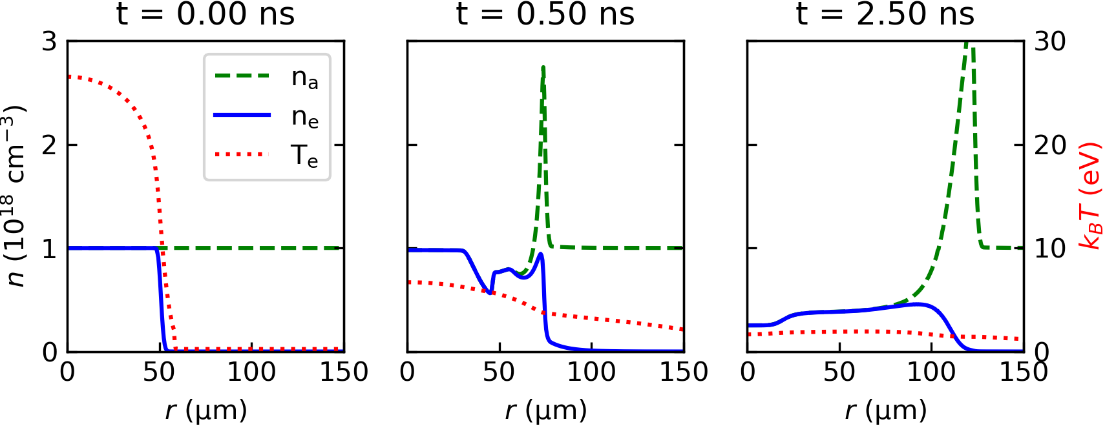
HOFI Expansion
1D radial (~10 min per run)
Homogeneous atomic hydrogen
Ionized by Gaussian HOFI laser
Expansion creates blast wave
$n_{e}$ minimum on axis suitable for guiding
Both $n_{e}$ and $n_{a}$ are important
Collisional Ionization at plasma boundary
Notes:
To keep simulations as simple as possible lets assume an infinitely long, cylindrical HOFI channel. Thats just a 1D-r simulation. And lets reduce it to atomic hydrogen.
Homogeneous Gas + Gaussian HOFI laser → Initial profile
Expansion → blast in neutral gas
After some time we get the dip in on axis that makes a waveguide
For guiding, bothe the electron and the gas density matter. Electrons guide, but gas can be further ionized by a strong guided pulse or an additional conditioning laser.
Previous papers compared the blast to S-T theory.

Slide 7
HOFI Expansion: Sedov-Taylor insufficient
Blast follows S-T geometric trend ( $r_{S−T} ∝ \sqrt{t−t_{0}} \sqrt[4]{E_{0}}$ )
Mismatch of initial energy and physics
Guiding not linked to blast
Notes:
S-T blast theory fails here, missing several key points:
Fittable, due to geometric factor
Energy deposited as thermal
Collisional Ionization
Guiding independent of blast, see later
We have a model, but is it actually right?

Slide 8
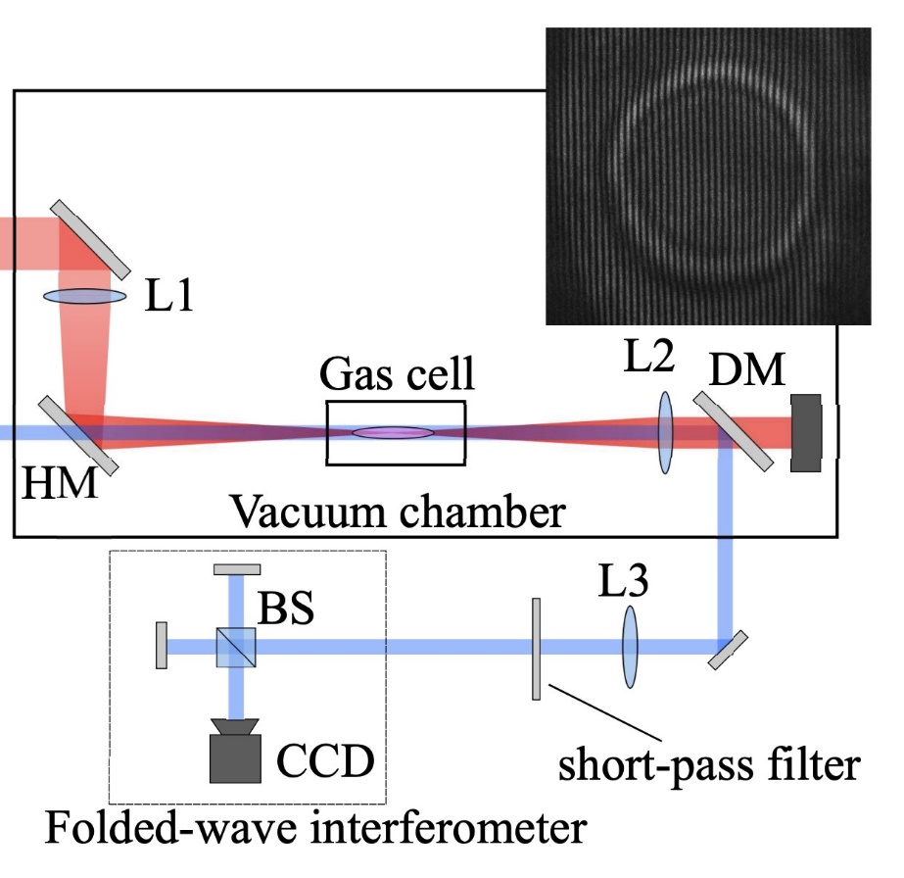
HOFI Benchmark: University of Oxford Experiment
HOFI laser (800 nm) →
Hydrogen-filled gas cell
Phaseshift in probe laser
Longitudinal interferometry → electron density integrated along channel
Probe laser (400 nm) →
Source: R. J. Shalloo et al., Phys. Rev. E 97, 053203 (2018)
Notes:
Create HOFI in a gas cell
Frequency doubled probe laser along HOFI laser axis
picks up phase shift
longitudinal interferometry
Infer longitudinal integrated e-density

Slide 9
HOFI Benchmark: Procedure
Start from experimental 3D intensity profile of HOFI laser in vacuum
Slice wise 1. Simulation step → electron density and temperature
Symmetrize (x,y,z) → (r,z)
Hydrodynamic 1D-r simulation per z slice
Calculate and integrate phase shift over z
Notes:
To start off the simulations we use a measured 3D laser profile.
For each slice use PIC (WarpX) to calculate ionization → Te, ne profiles
Symmetrise to radial simulation by azimuthal average → Initial conditions for 1D-r simulation
Calc phase shift, long integral

Slide 10
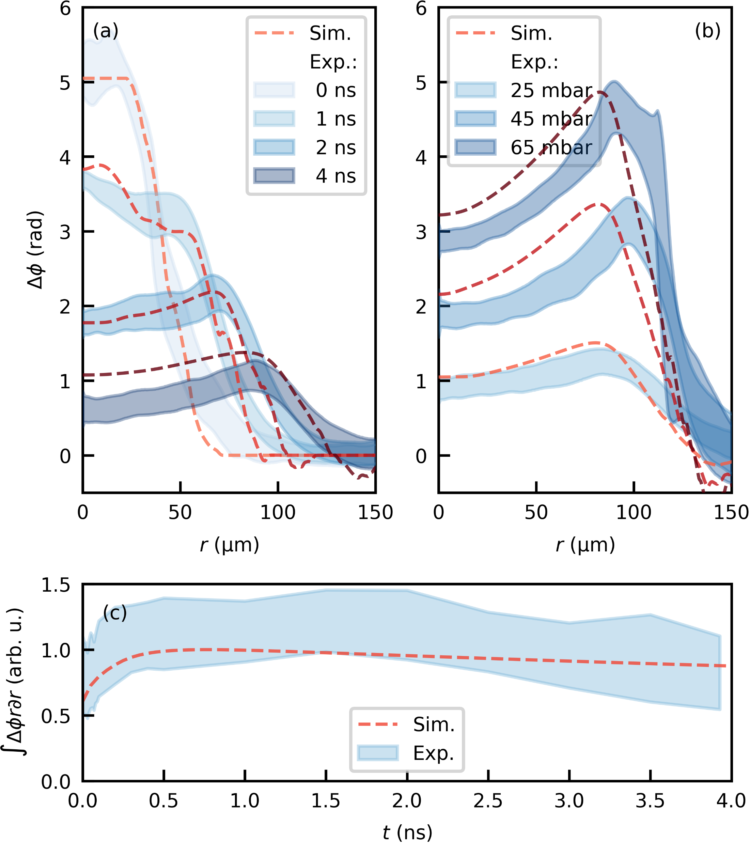
HOFI Benchmark: Good Agreement
Time scan
Buffer pressure: 50 mbar
Pressure scan
Time: 3.93 ns
Slight remaining may be due to
1D reduction
H₂
Phaseshift calibration
HOFI laser refraction
Notes:
Here are the results for two scans, blue is the experiment, red lines the simulation
First a time scan over the expansion at fixed gas pressure.
Very good agreement early on, even internal structure seems to be reasonably good
Some problems at longer delay (Calibration issues?, heavily simplified 1D model)
A gas pressure scan at a fixed time delay also matches up relatively well.
Difference at high p, likely because HOFI laser refraction → wrong initial conditions
Great, we have a functioning code
Lets apply it to something practical now!

Slide 11
HOFI Guiding Properties
Fundamental mode for each time step of expansion
Gaussian-like after ~ 2 ns
Matched spot does not expand with blast
Guiding with only $n_{e}$ similar in 2-8 ns time window
Conditioning prevents leakage and stabilizes
Effective plasma density decreases steadily
Notes:
Lets take a look at our third step now. How do the waveguide properties of the HOFI channel look?
For each time step we take the density profile to run guiding simulations and figure out the matched laser profile and some quality parameters.
We do this for just the electron density, but also assuming a full ionization of everything by conditioning the channel.
First you can see the matched size doesn’t relate to the blast radius at all, again making S-T useless.
To guide a gaussian pulse we have to wait about 2 ns here, the tightest focus being at 3
And CHOFI is generally more stable than HOFI and completely avoids lossiness of the channel.

Slide 12
HOFI is tuneable
Guiding parameters independently tuneable by experimentally accessible parameters
Example: Matched spot size at constant density
Notes:
Finally we can also use this to explore the tunability of HOFI
Using just experimentally accessible parameters we can really achieve a lot here
For example:
Adjust matched spot size for fixed effective plasma density
Change the HOFI spot size and adjust the time delay to the correct density

Slide 13
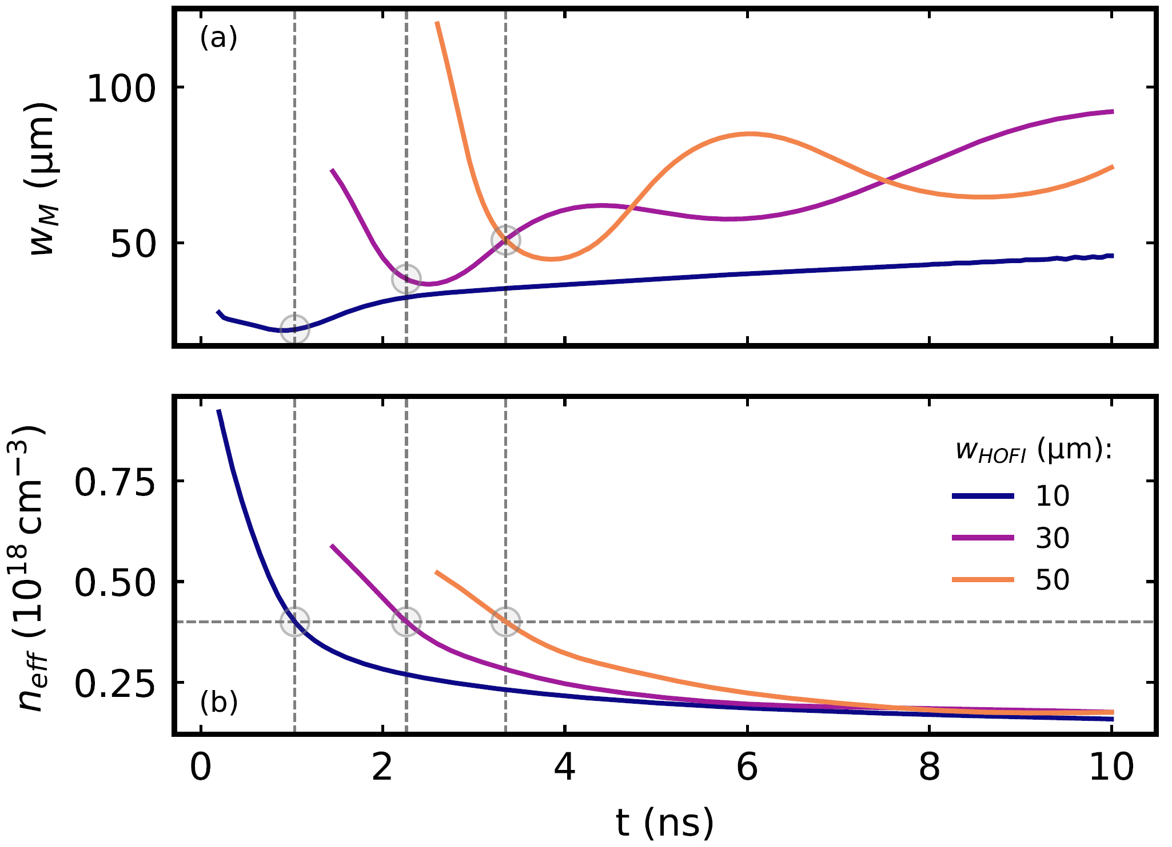
Conclusions
Method for accurate HOFI simulation (Verified with experimental benchmark)
Showed HOFI guiding properties (Not predictable by Sedov-Taylor)
Predicted specific HOFI tunability

Slide 14
Perspective
Advanced HOFI Simulations (2Dxy, 2Dxz)
H₂, Other species
Other plasma sources

Slide 15
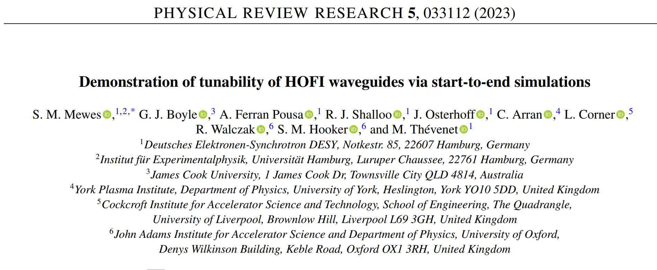
Thank you for your time! Questions?

Slide 16
Energy dependence
Blast radius depends only on total energy
But Initial energy distribution changes early dynamics and guiding properties

Slide 17
Ionization model
WarpX with ADK model + ZLL Corrections
Residual momentum → Electron temperature

