Slide 1
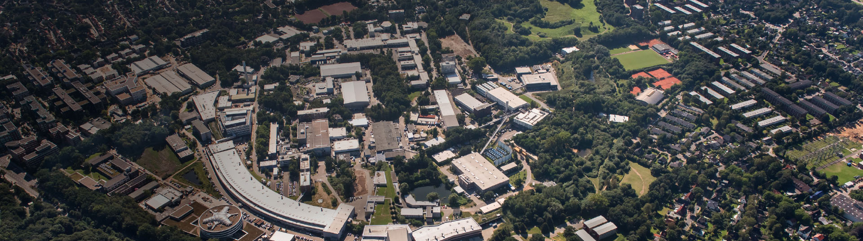
Mesh Refinement in quasi-static codes making plasma acceleration simulations in collider-relevant parameters feasible (and cheap)
Maxence Thévenet – DESY
MPA – plasma acceleration

Slide 2
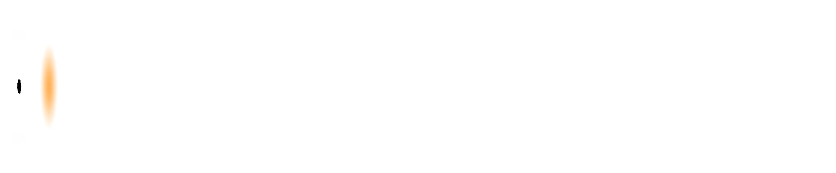
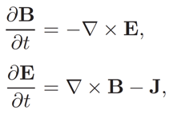
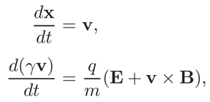
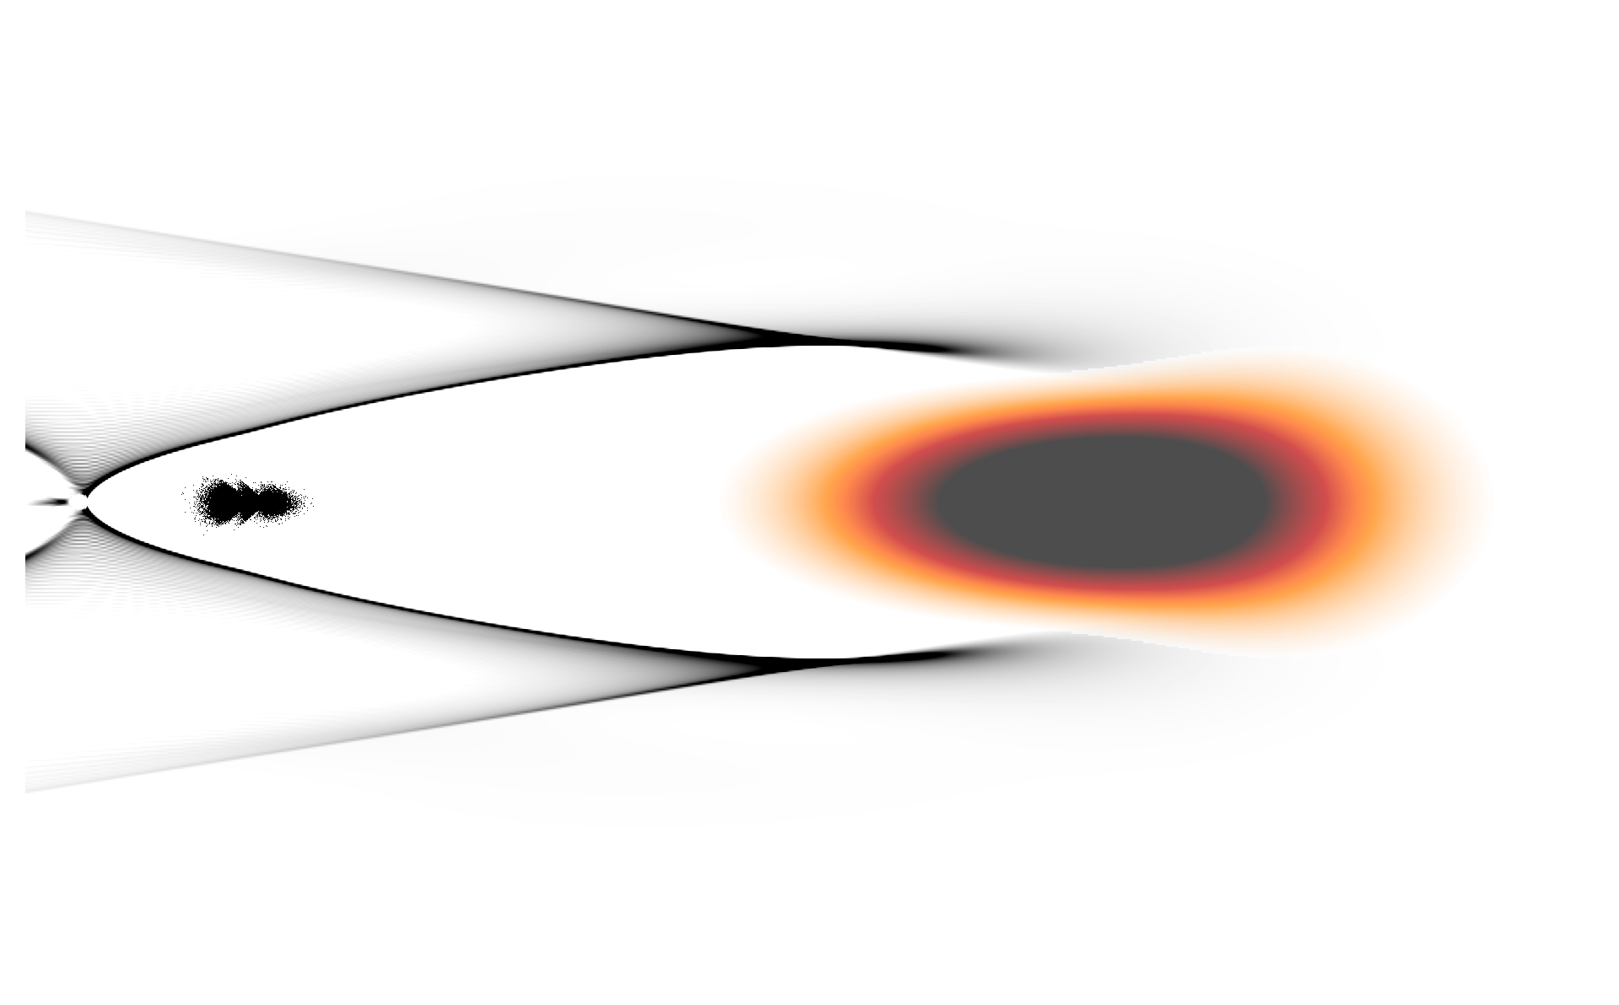
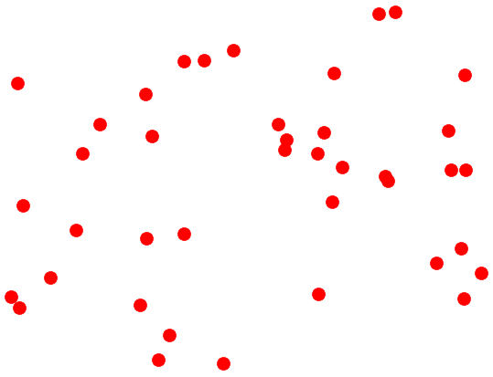
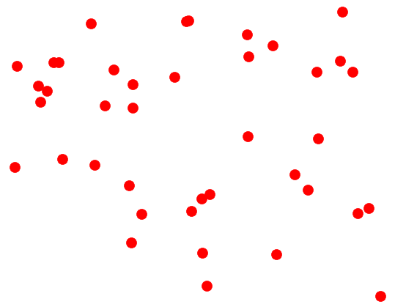
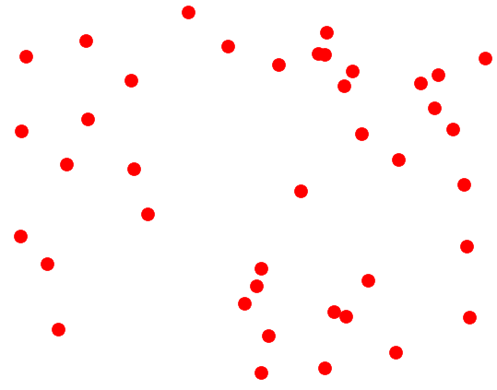
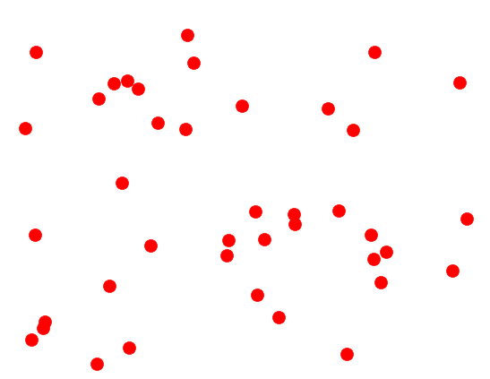


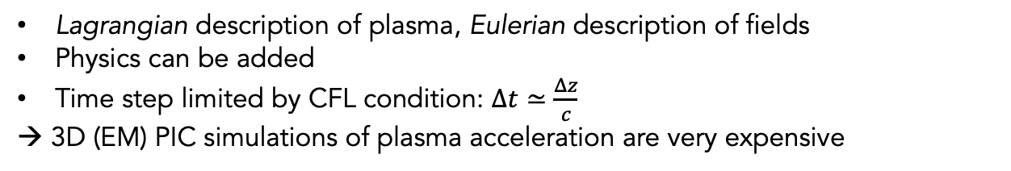


Plasma acceleration is described by kinetic plasma dynamics
Push particles
$x, v=f(E, B)$
Gather fields
$E, B=f(E, B)$
Deposit currents
$J=f(x, v)$
Solve fields
$E, B=f(J)$
Lagrangian description of plasma, Eulerian description of fields
Physics can be added
Time step limited by CFL condition: $Δt≃\frac{Δz}{c}$
→ 3D (EM) PIC simulations of plasma acceleration are very expensive
Regular mesh
Macroparticles

Slide 3

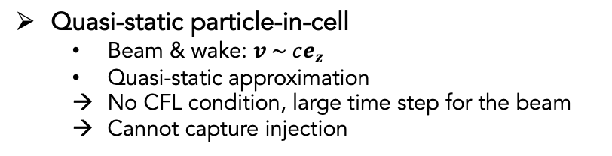



Quasi-static approximation helps simulations of plasma acceleration
Sharp features < 100 nm
Plasma accelerator: 1 m (10,000x)
$$v_{z}≃c$$
Wake: 100 $μ$m
Problem: in PIC the CFL condition limits the time step to $∆t<c∆z$
$$∇_{⊥}^{2}ψ=−\frac{1}{ε_{0}} \left(ρ−\frac{1}{c}j_{z}\right) \\ E_{x}−c B_{y}=−∂_{x}ψ \\ E_{y}+c B_{x}=−∂_{y}ψ \\ ∇_{⊥}^{2}E_{z}=cμ_{0} \left(∂_{x}j_{x}+∂_{y}j_{y}\right) \\ ∇_{⊥}^{2}B_{x}=μ_{0} \left(−∂_{y}j_{z}+∂_{ζ}j_{y}\right) \\ ∇_{⊥}^{2}B_{y}=μ_{0} \left(∂_{x}j_{z}−∂_{ζ}j_{x}\right) \\ ∇_{⊥}^{2}B_{z}=μ_{0} \left(∂_{y}j_{x}−∂_{x}j_{y}\right)$$
Two main methods for larger time steps
Boosted frame method [J.-L. Vay PRL 98, 130405 (2007)]
  Prone to Numerical Cherenkov Instability (NCI)
  Mitigation methods exist [R. Lehe et al., PRE 94 (2016), M. Kirchen et al., Phys. Plasmas 23 (2016), A. Pukhov JCP 418 (2020)]
Quasi-static particle-in-cell
  Beam & wake: $v \sim ce_{z}$
  Quasi-static approximation
  No CFL condition, large time step for the beam
  Cannot capture injection

Slide 4
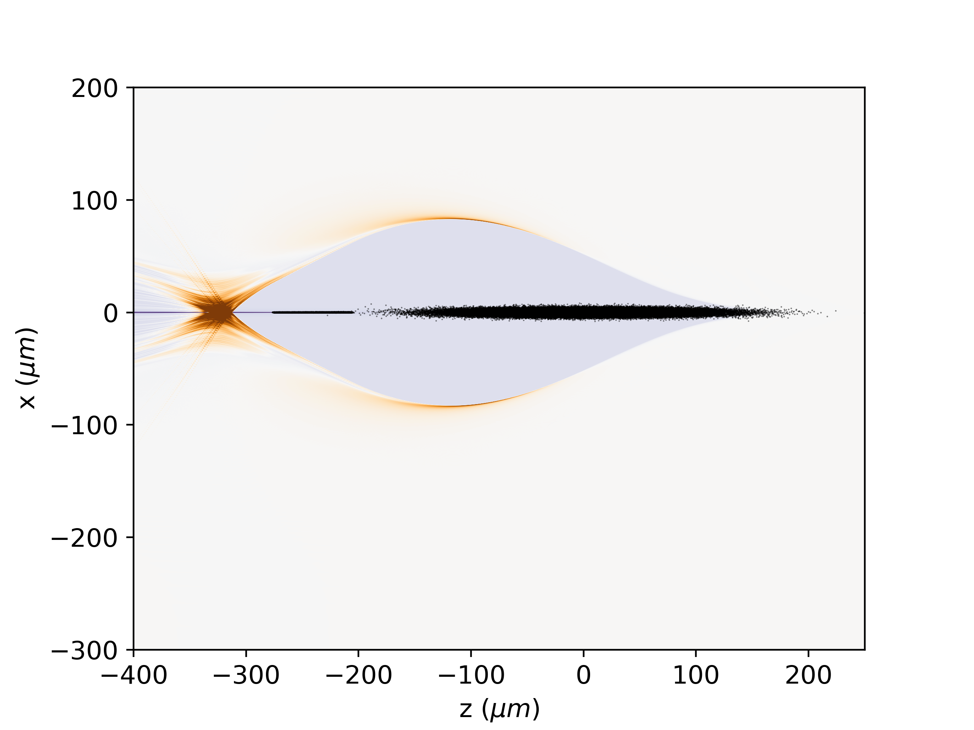
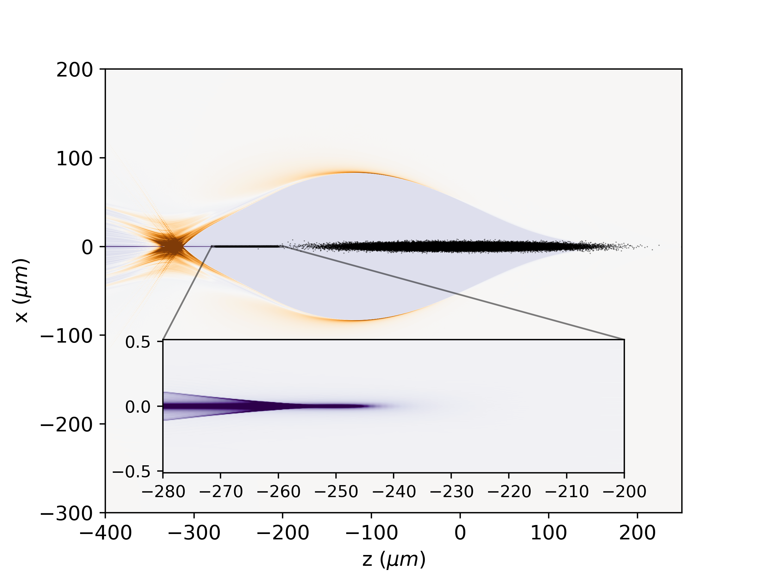
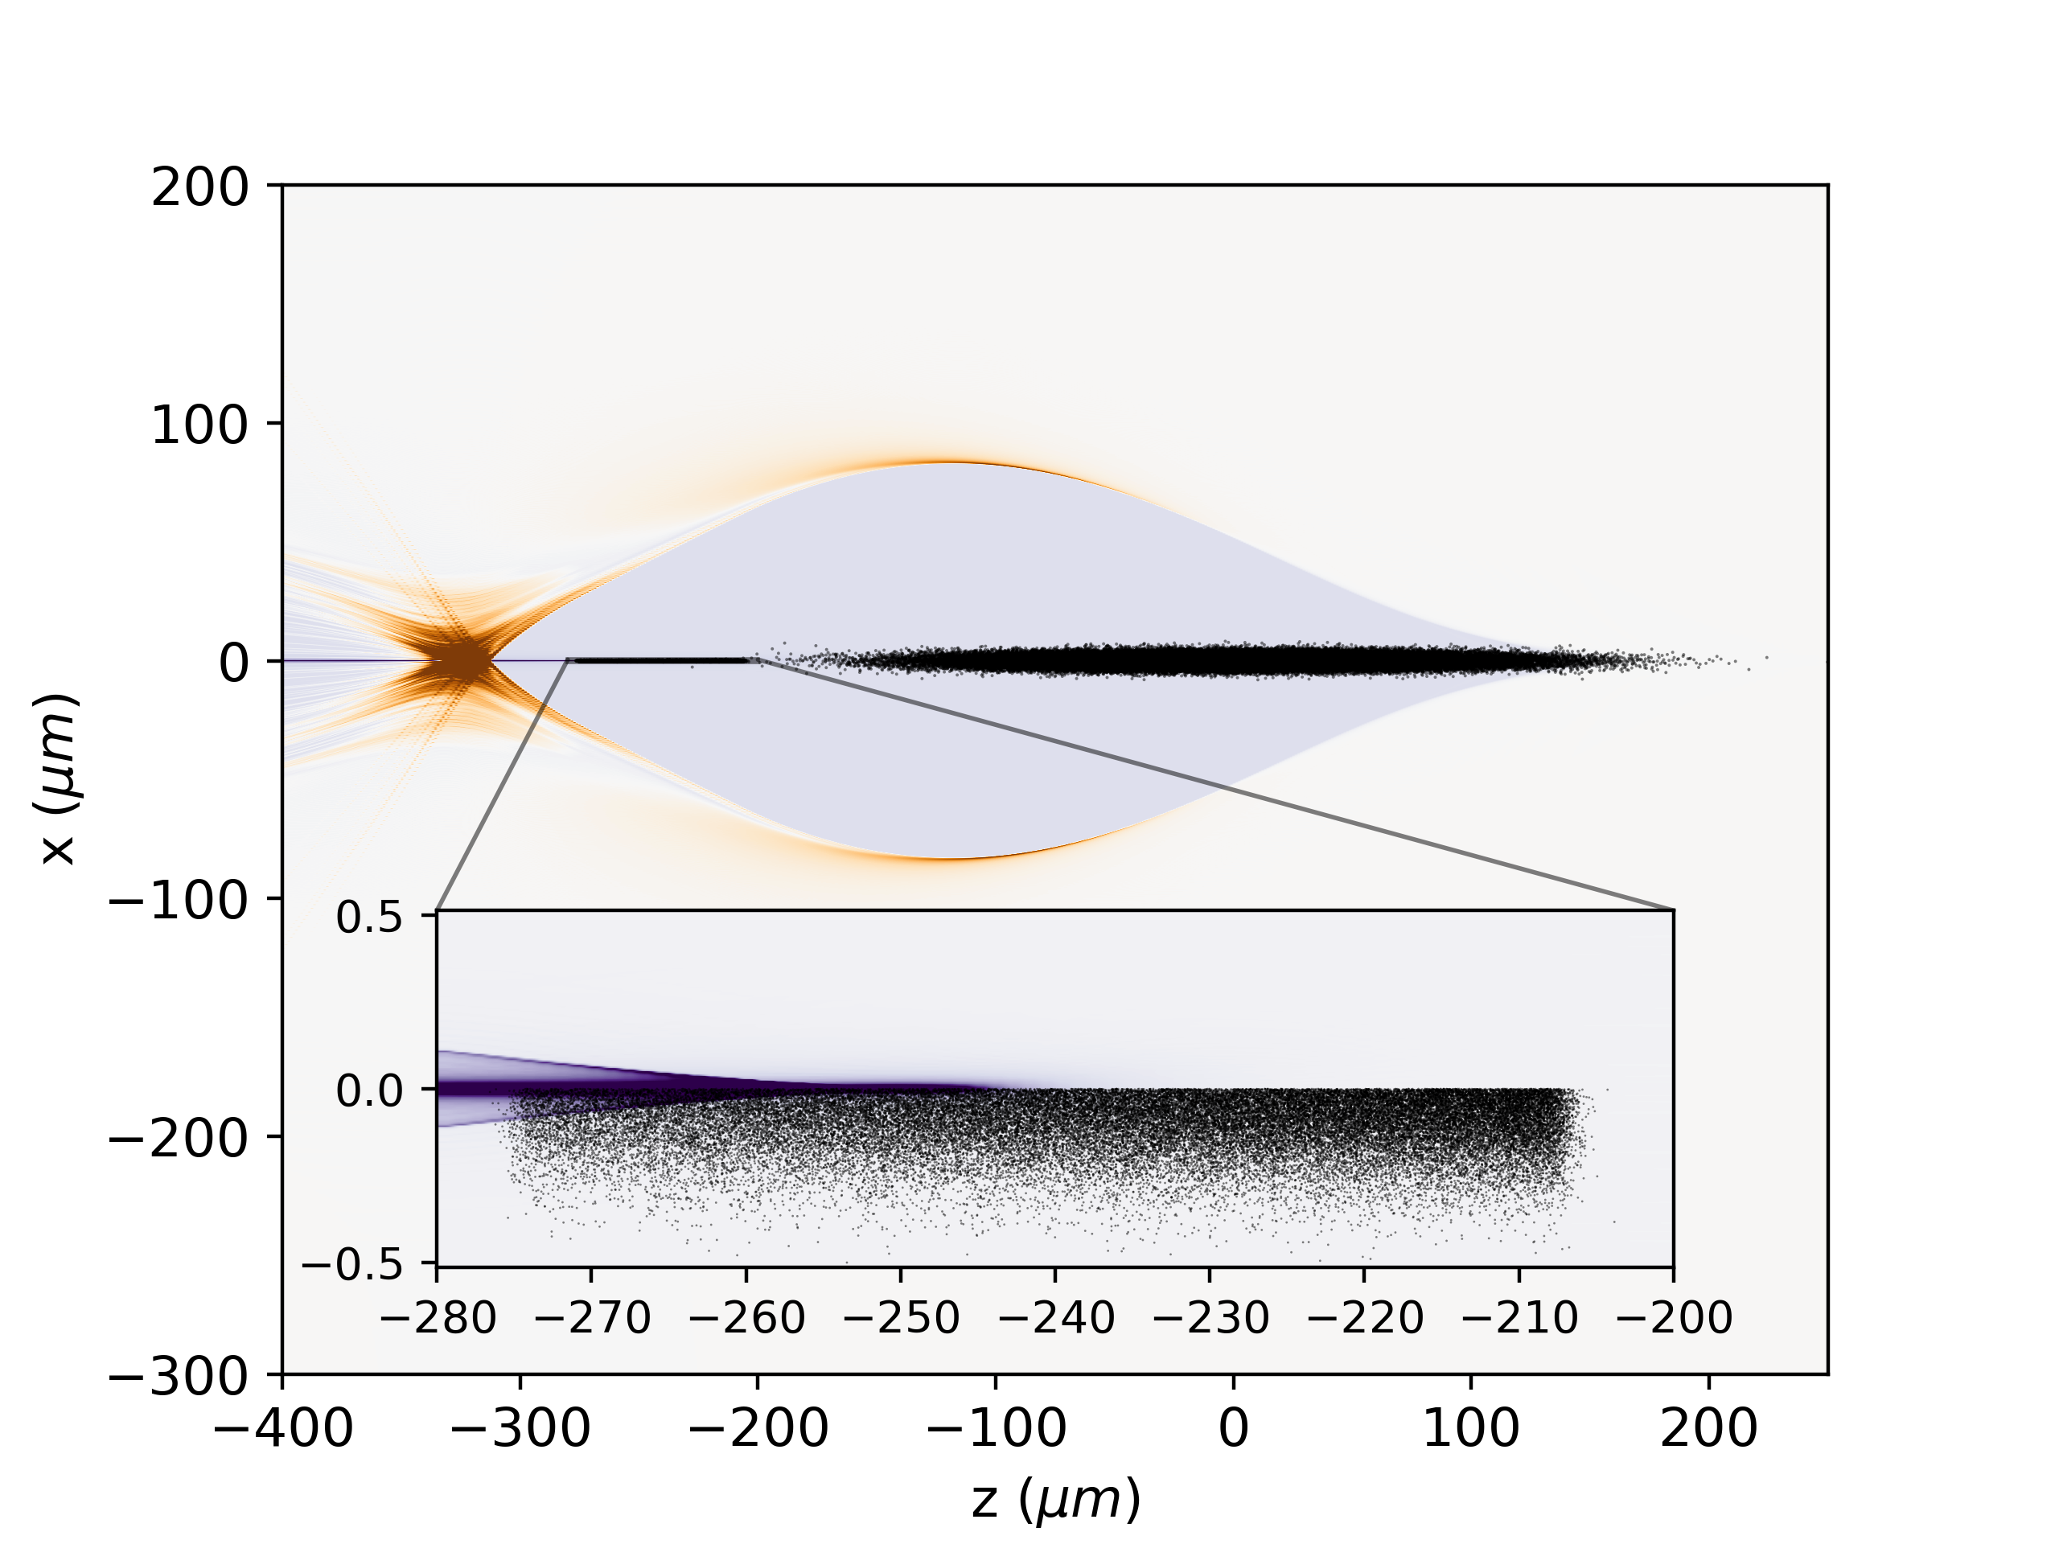


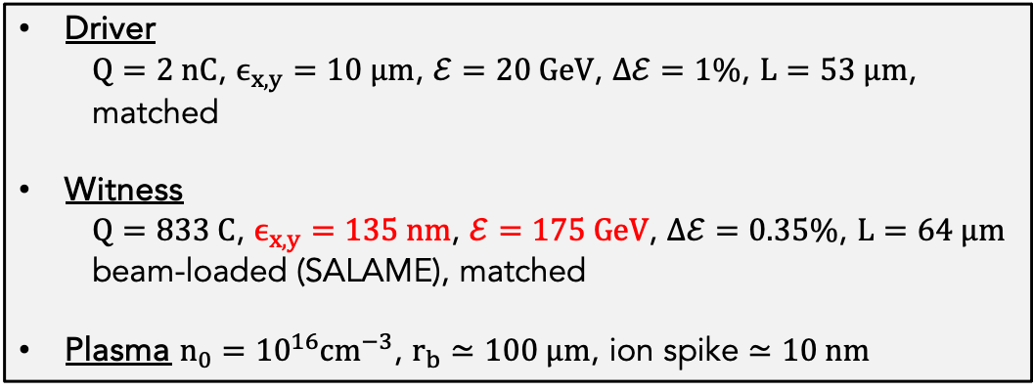
Scale discrepancies can make simulations impractical or unfeasible
Relevant for colliders, consistent with ESPP report
Driver
  $Q=2 nC$, $ϵ_{x,y}=10 μm$, $ℰ=20 GeV$, $Δℰ=1\%$, $L=53 μm$, matched
Witness
  $Q=833 C$, $ϵ_{x,y}=135 nm$, $ℰ=175 GeV$, $Δℰ=0.35\%$, $L=64 μm$ beam-loaded (SALAME), matched
Plasma $n_{0}={10}^{16}cm^{−3}$, $r_{b}≃100 μm$, ion spike $≃10 nm$
Resolution $Δx\left(10 nm\right)≪Δz (1 μm)$
Challenging in EM PIC due to CFL condition
Solutions exist (see presentation by J.-L. Vay)
The method applies to other sources of scale discrepancies (positron acceleration, AWAKE, etc.)
We will discuss mesh refinement in two (open-source) codes
HiPACE++

Slide 5

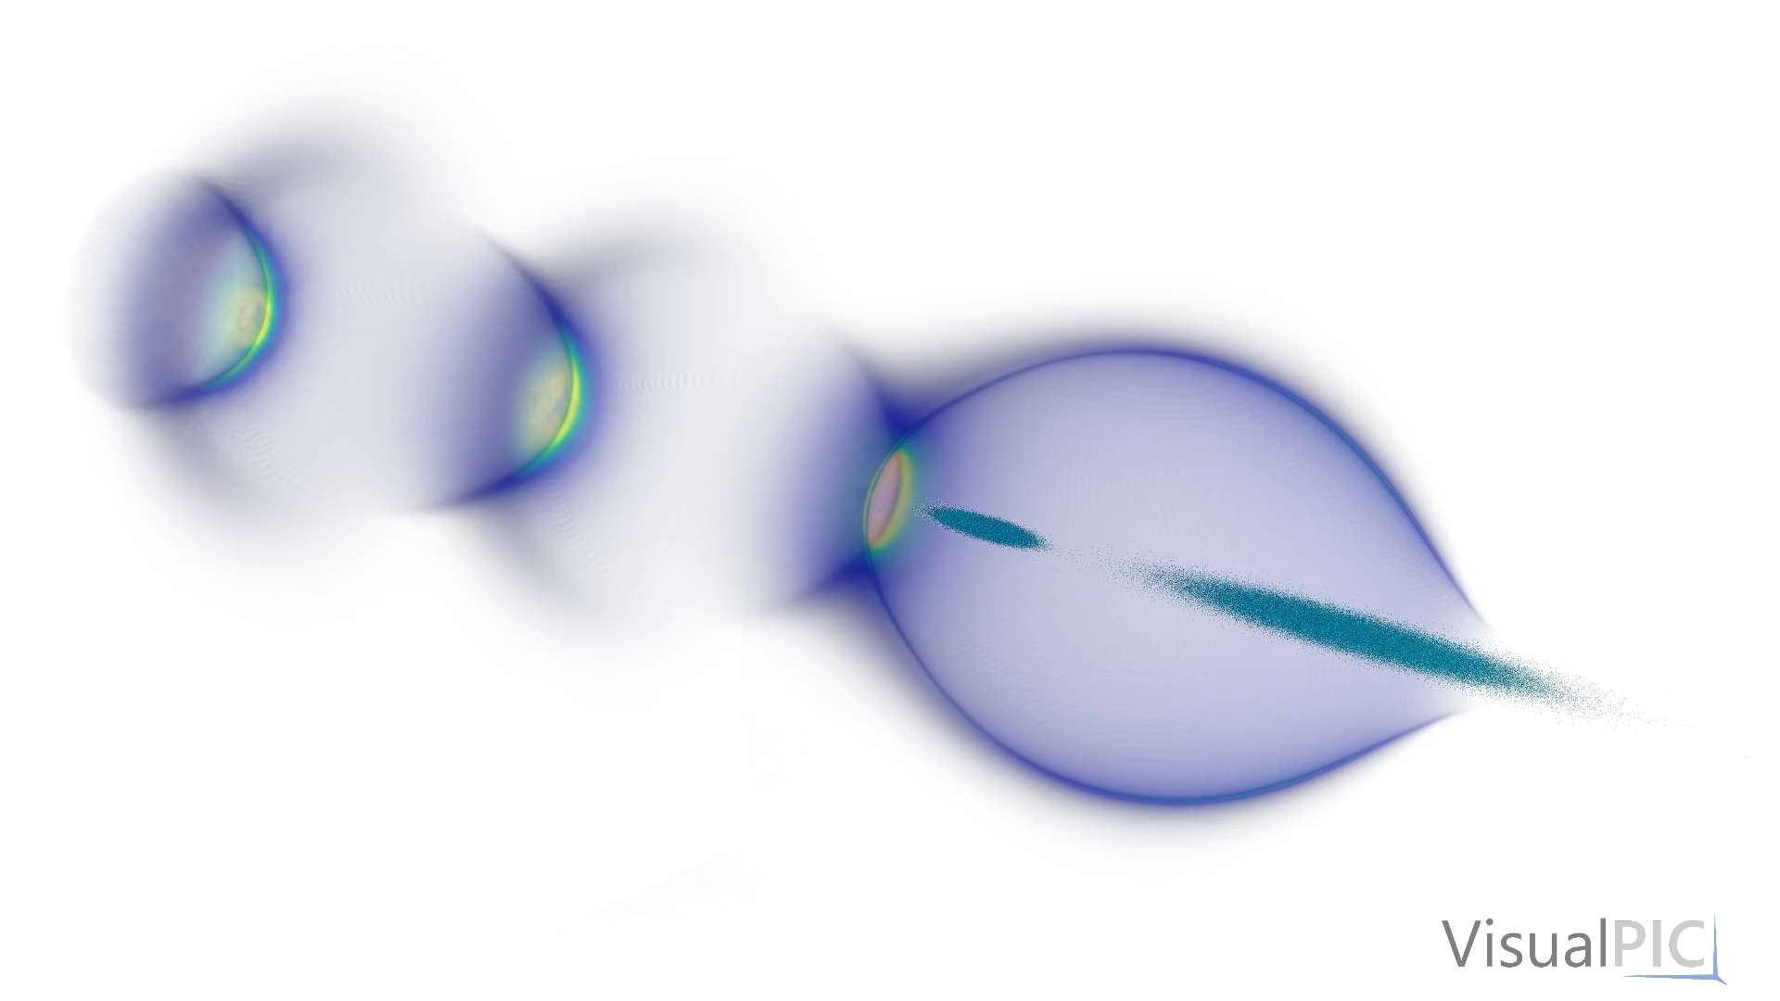

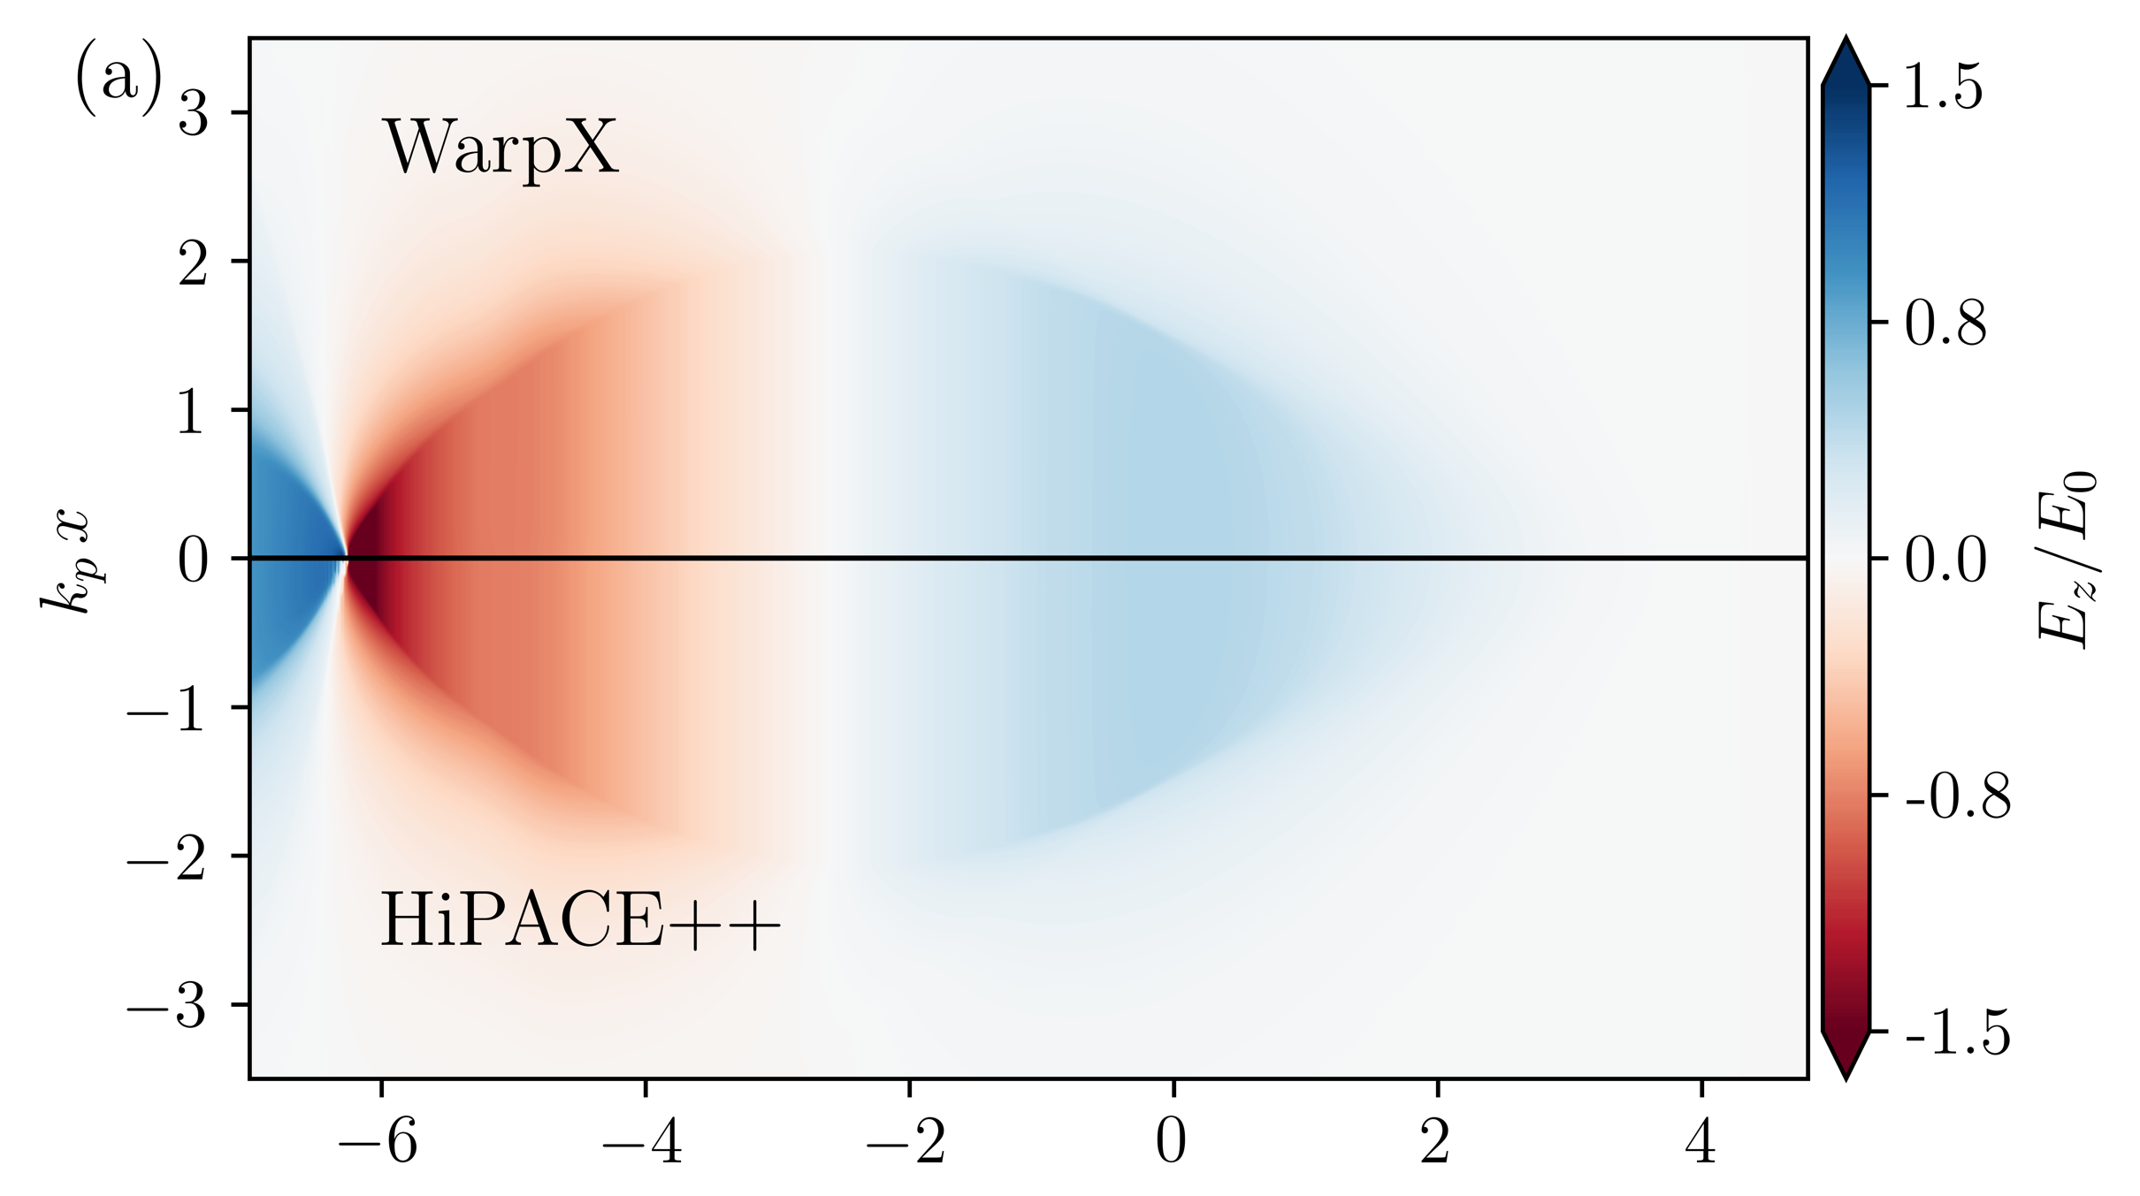

HiPACE++: 3D advanced quasi-static PIC on GPU
Beam-driven or laser-driven plasma acceleration
 | 4 GPUs | 1024 CPU cores
Runtime (seconds) | 6 | 556
Cost (node-hours) | 6 | 11900
Combine performance and usability
Laptop to supercomputer - CPUs/GPUs (powered by AMReX)
Open-source - documented, openPMD, CI
Multi-physics - lasers & beams, collisions, ionization, RR
Advanced methods - explicit solver, in-situ diagnostics, two unit systems, SALAME, adaptive time step, etc.
https://github.com/Hi-PACE/hipace

Slide 6
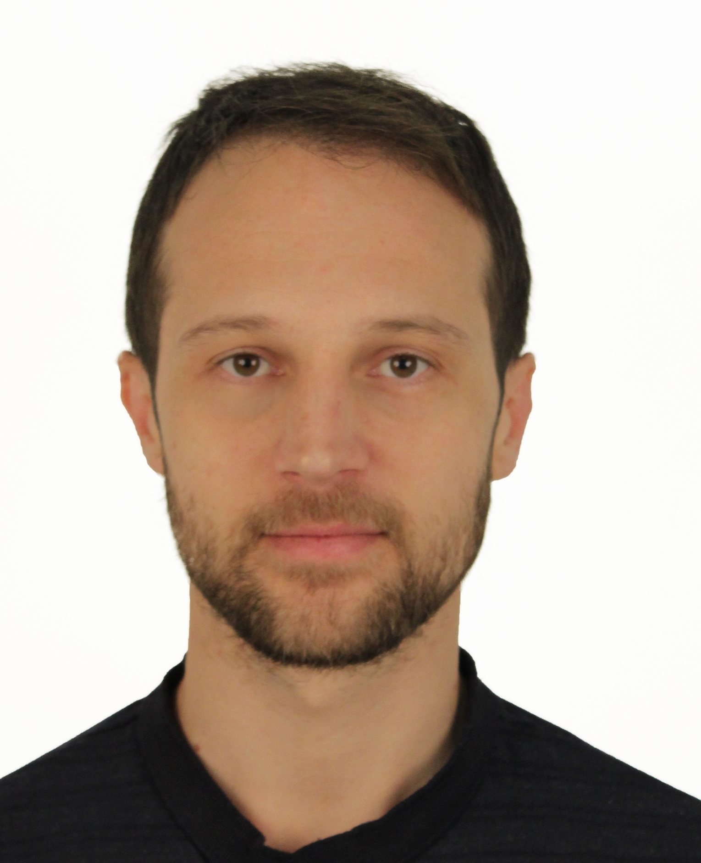
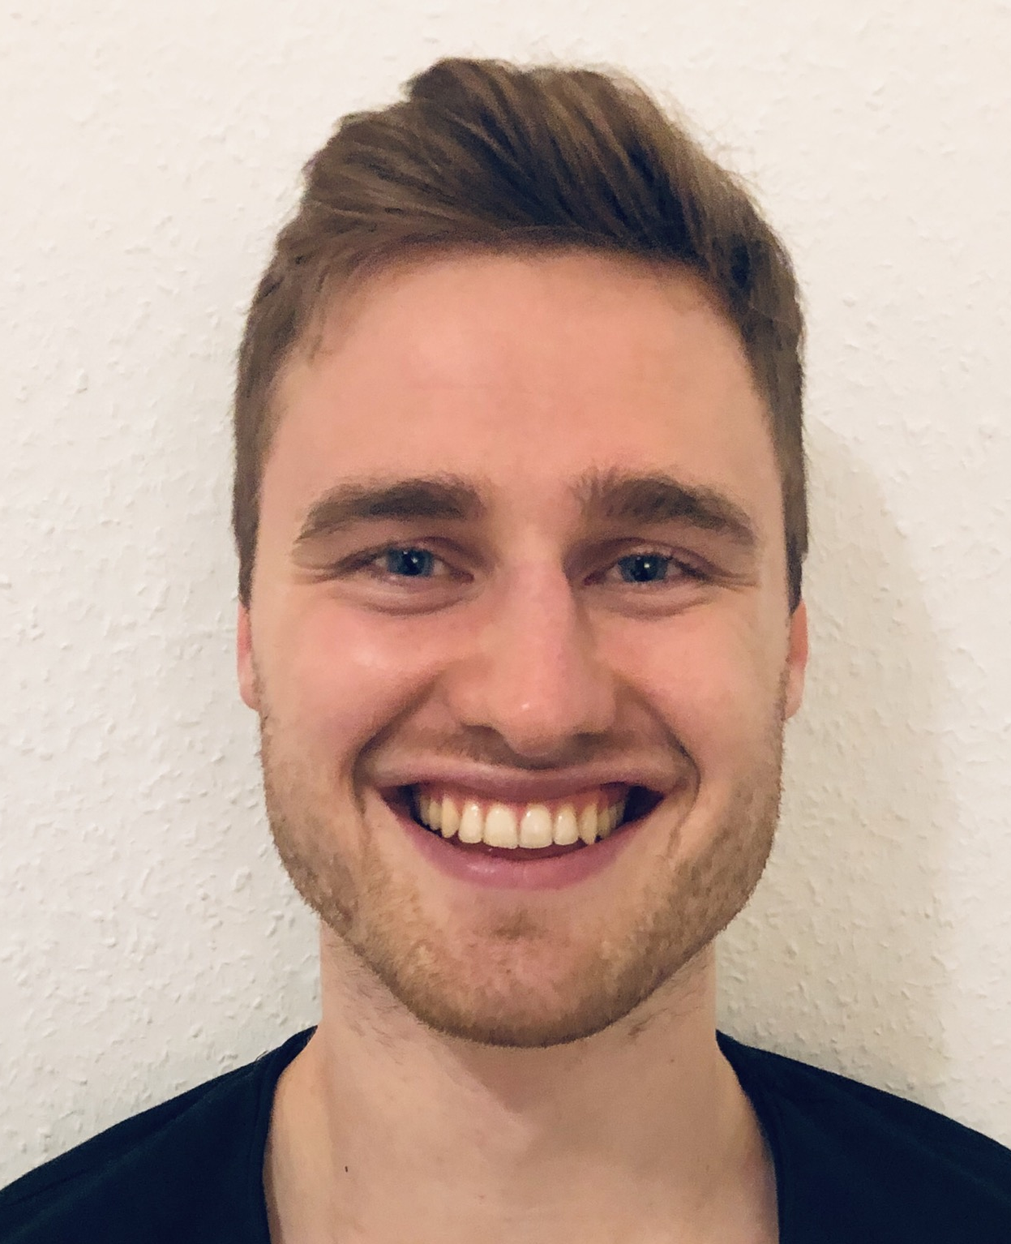
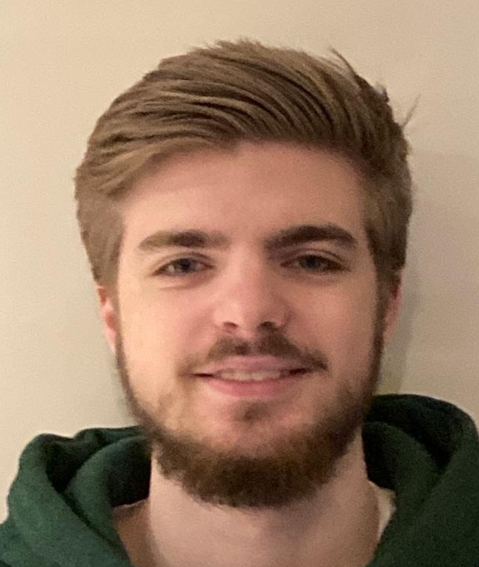
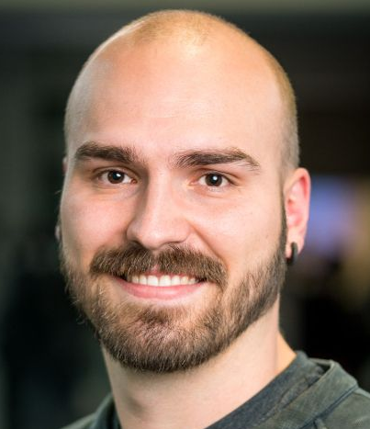
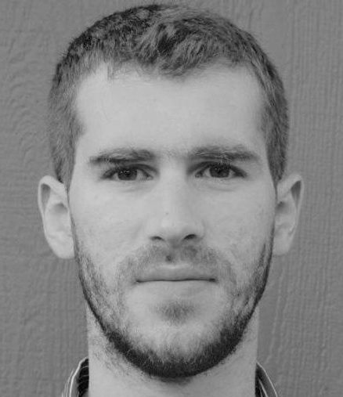
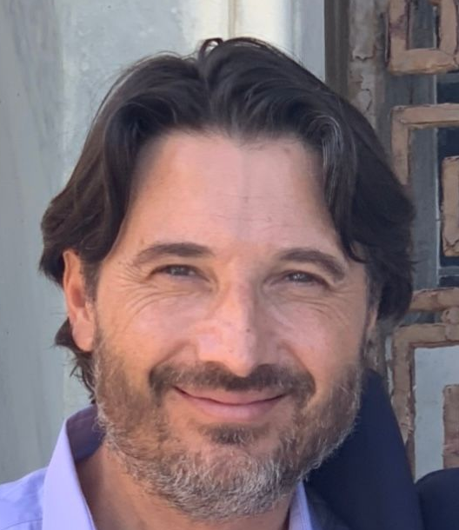
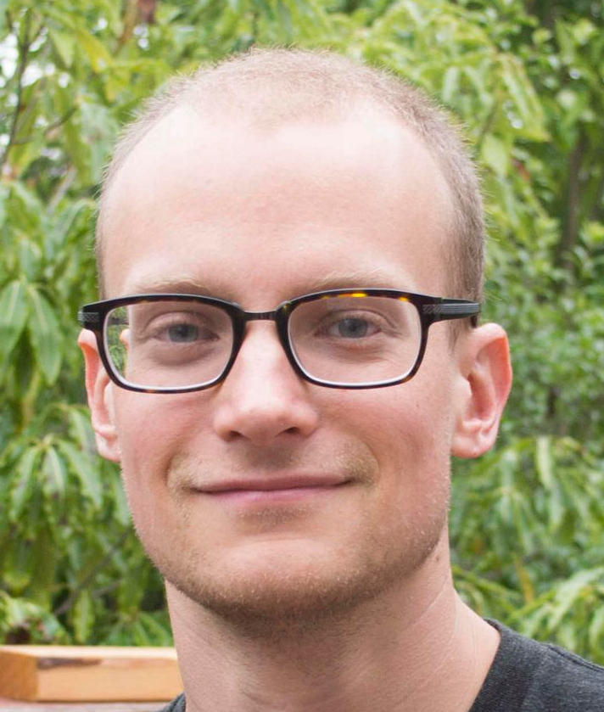
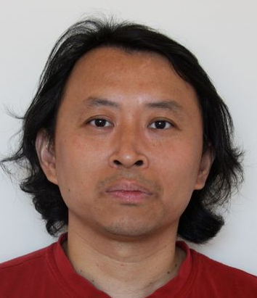



HiPACE++ – The Team
Advanced algorithms and high-performance computing for fast and energy-efficient 3D simulations of plasma acceleration – for everyone
Maxence Thévenet (lead)
Severin Diederichs
Alexander Sinn
Axel Huebl
Rémi Lehe
Jean-Luc Vay
Andrew Myers
Weiqun Zhang
Carlo Benedetti
DESY – MPA
LBNL – AMP
ECP project WarpX
LBNL – AMCR
AMReX developers
LBNL – BELLA
Started mid-2020
International project, open-source
New contributors most welcome!

Slide 7
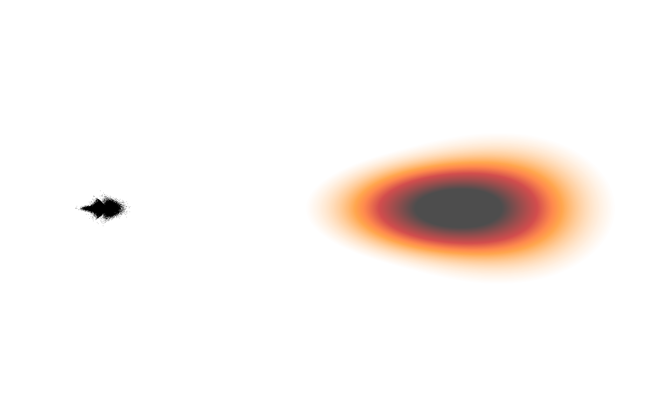
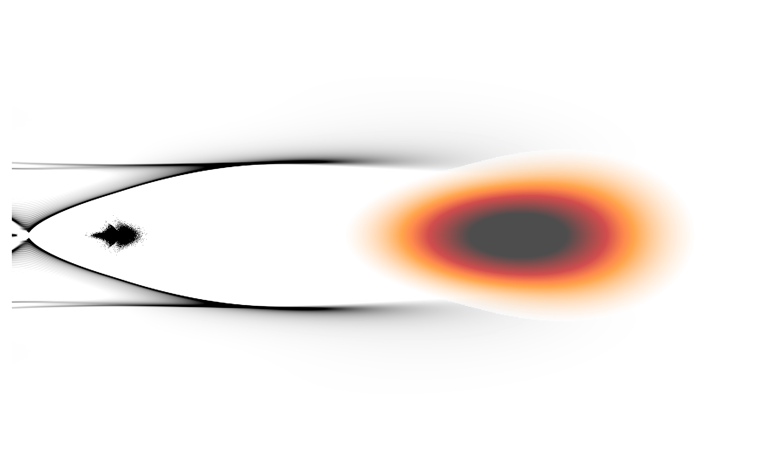
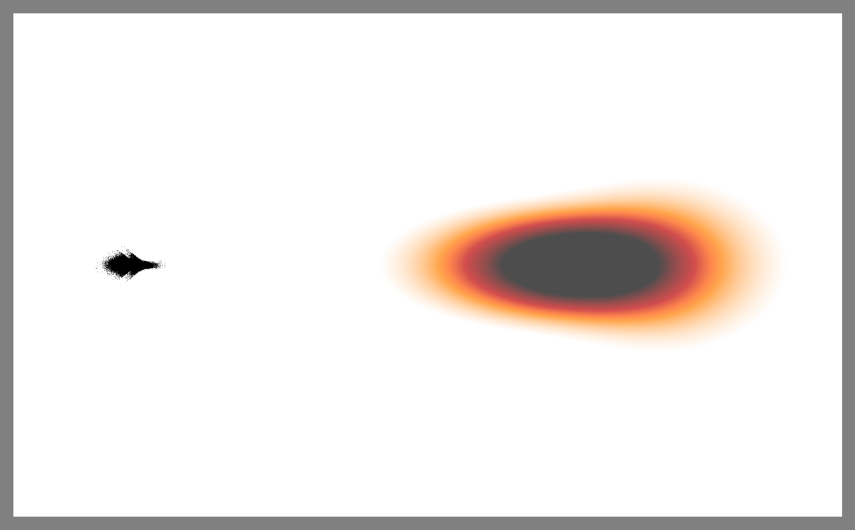
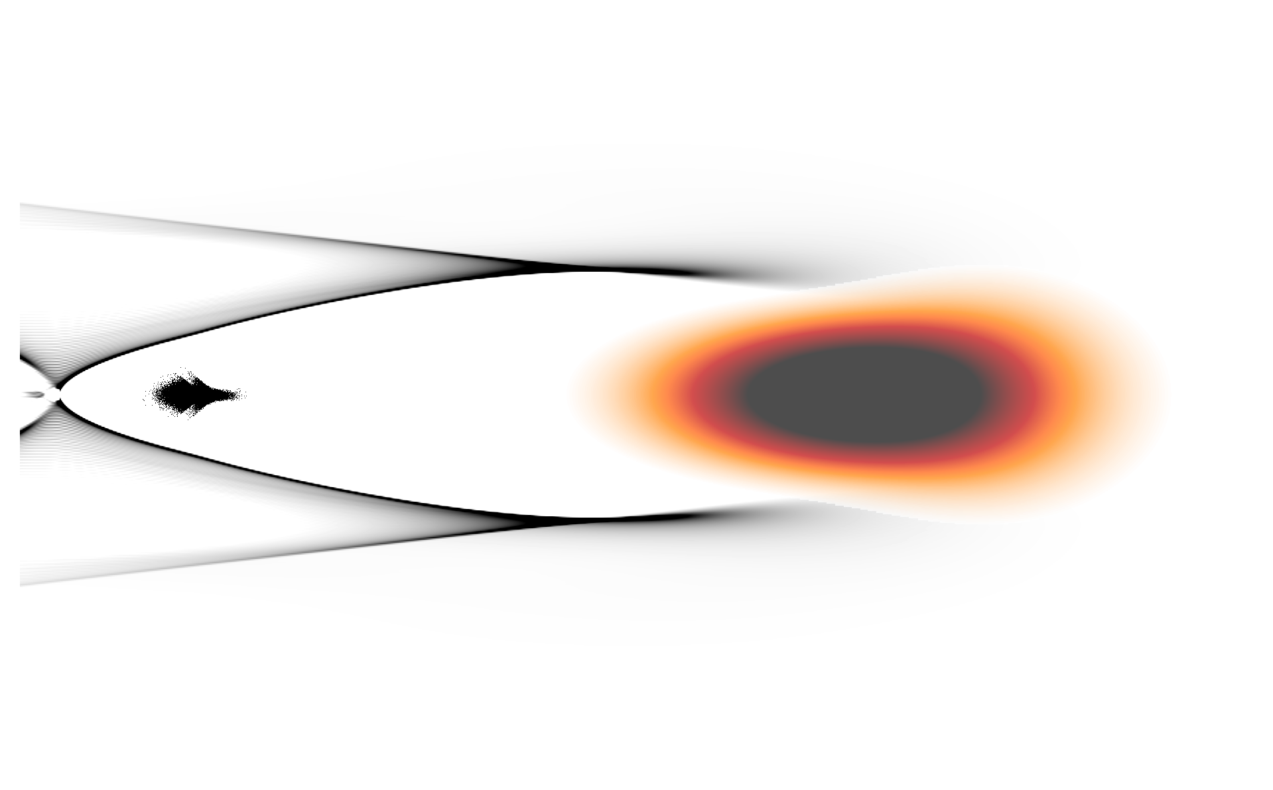

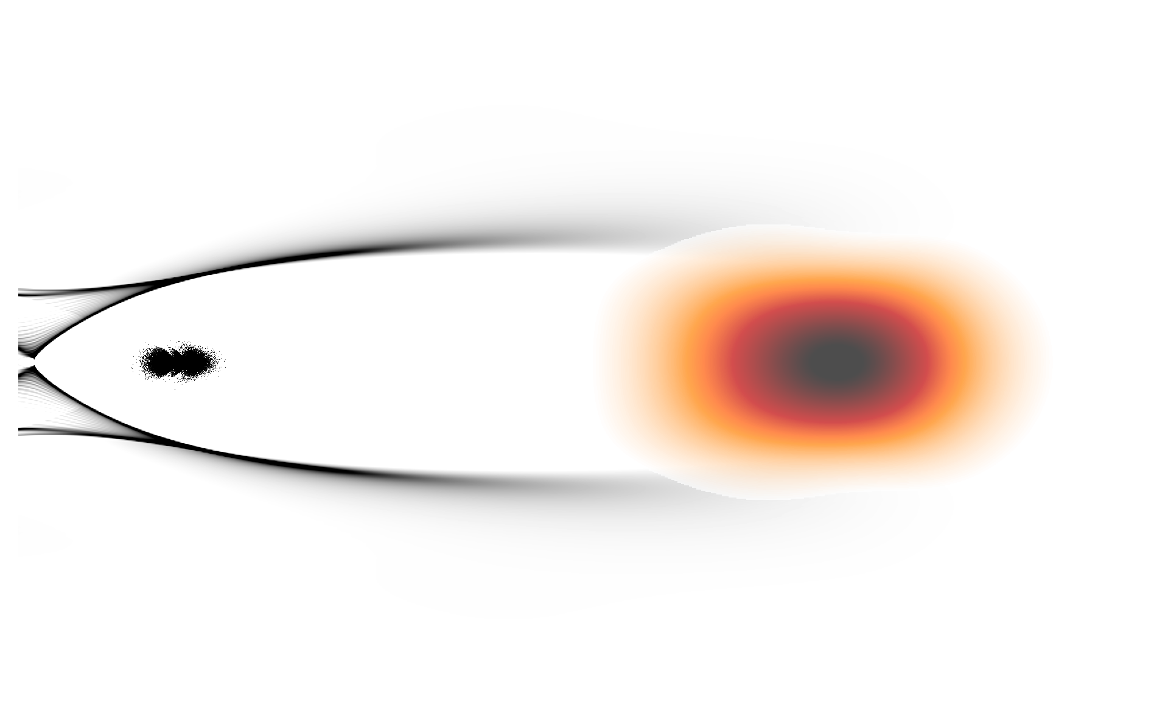


In QS PIC, plasma and laser/particle beams are treated differently
Large $Δt≫Δz/c$
Large $Δt≫Δz/c$
Compute plasma response (expensive)
Advance laser and beams with large $Δt$ (cheap)

Slide 8
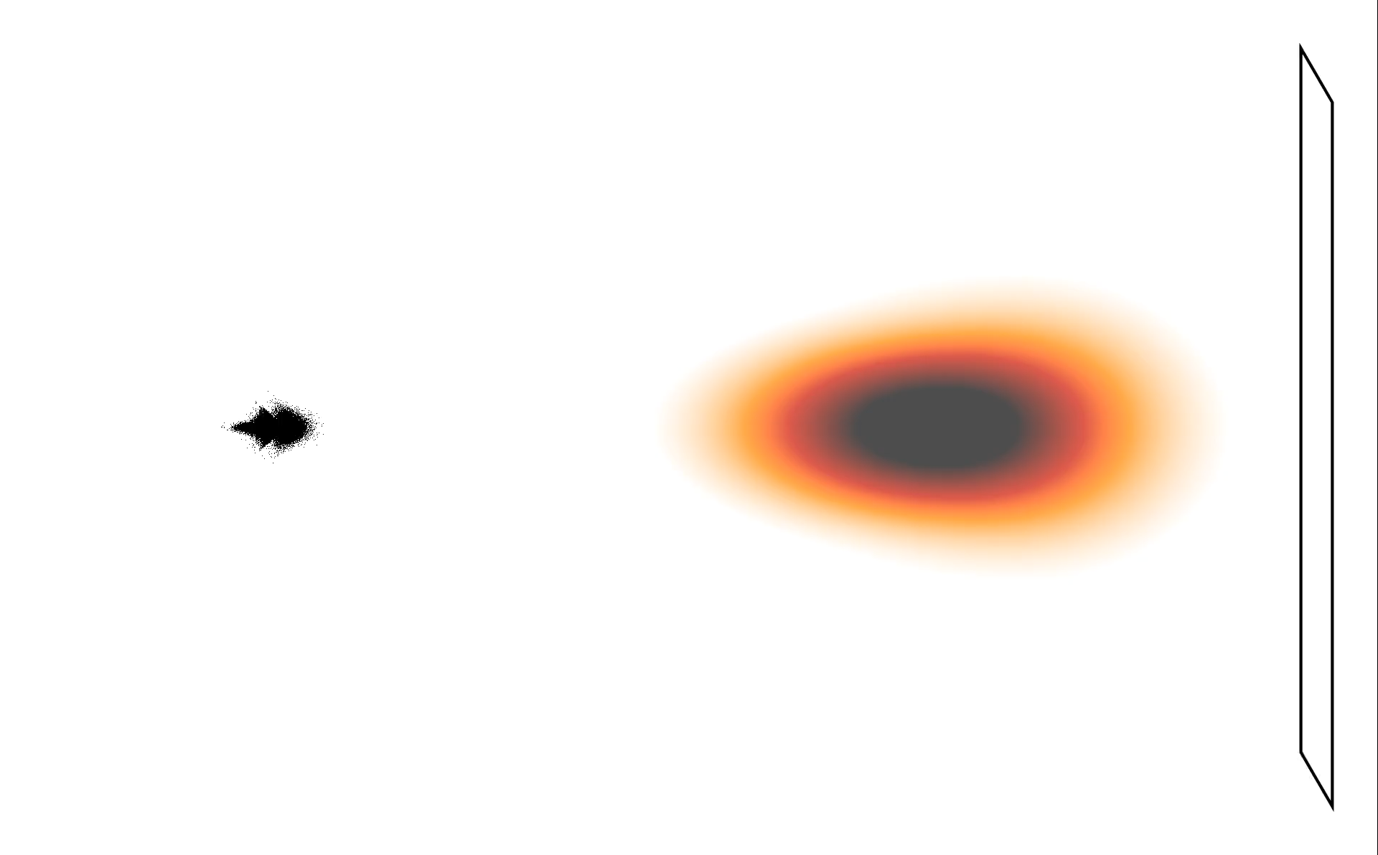
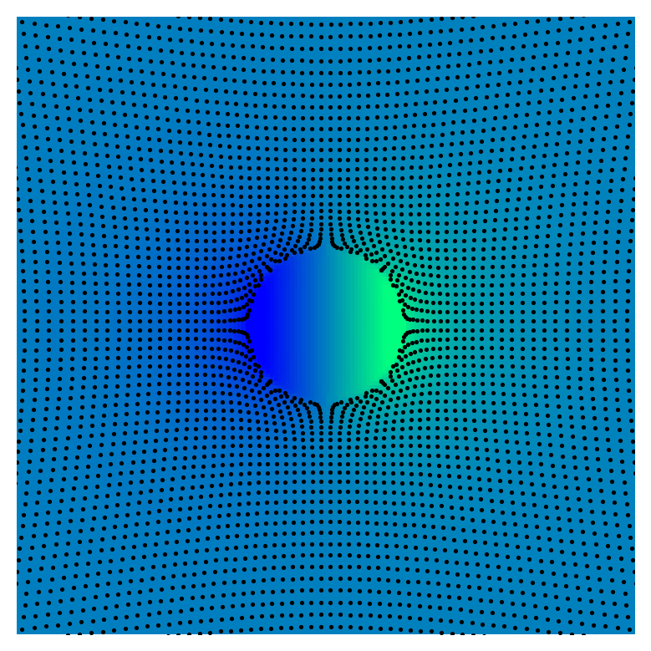
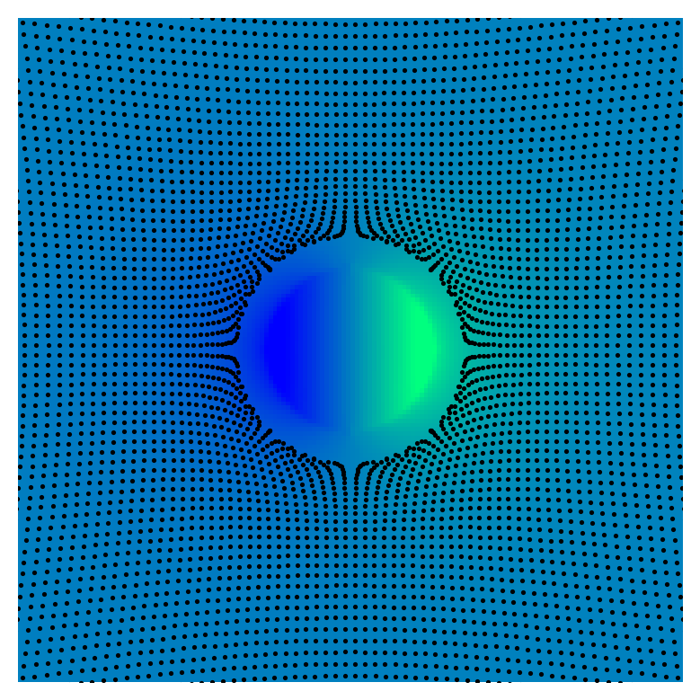
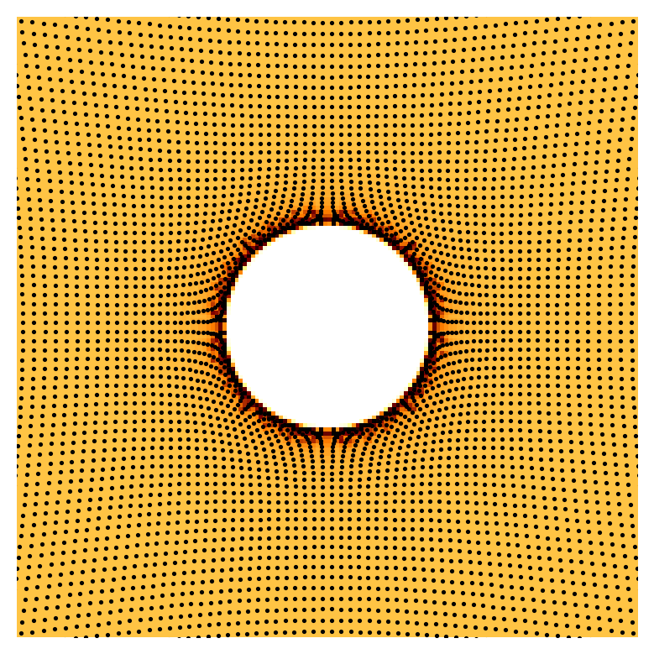
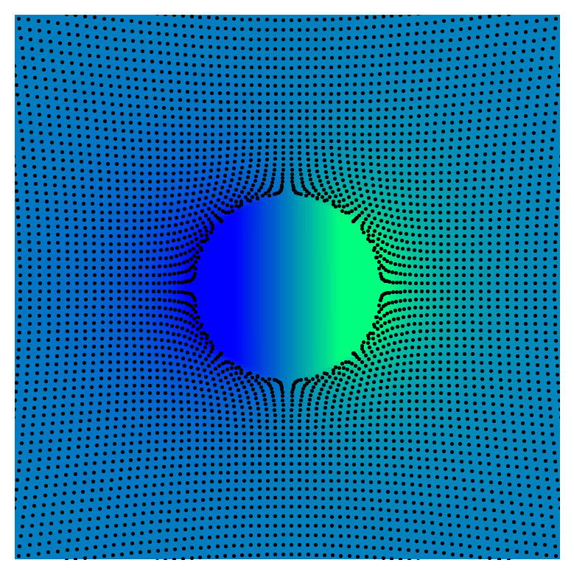



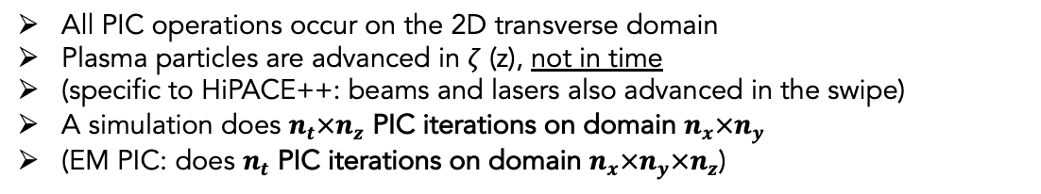


The plasma response is computed with a swipe from head to tile
Push particles
$$x, v=f(E, B)$$
Gather fields
$$E, B=f(E, B)$$
Deposit currents
$$J=f(x, v)$$
Solve fields
$$E, B=f(J)$$
2D slice
Field & particles
Gather fields
Ex
Push particles
Ex
Deposit densities
rho
Solve fields
Ex
All PIC operations occur on the 2D transverse domain
Plasma particles are advanced in $ζ$ (z), not in time
(specific to HiPACE++: beams and lasers also advanced in the swipe)
A simulation does $n_{t}×n_{z}$ PIC iterations on domain $n_{x}×n_{y}$
(EM PIC: does $n_{t}$ PIC iterations on domain $n_{x}×n_{y}×n_{z}$)
y
z
x
$$⊙$$

Slide 9
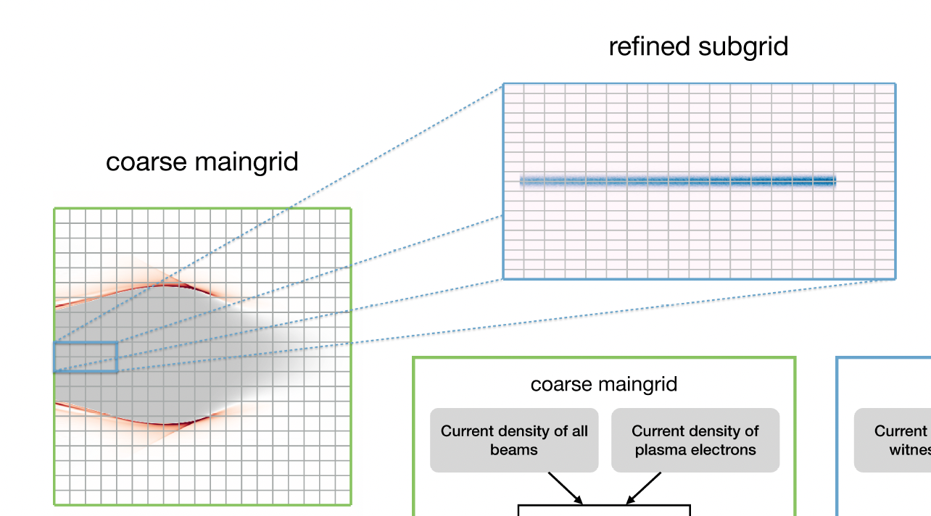
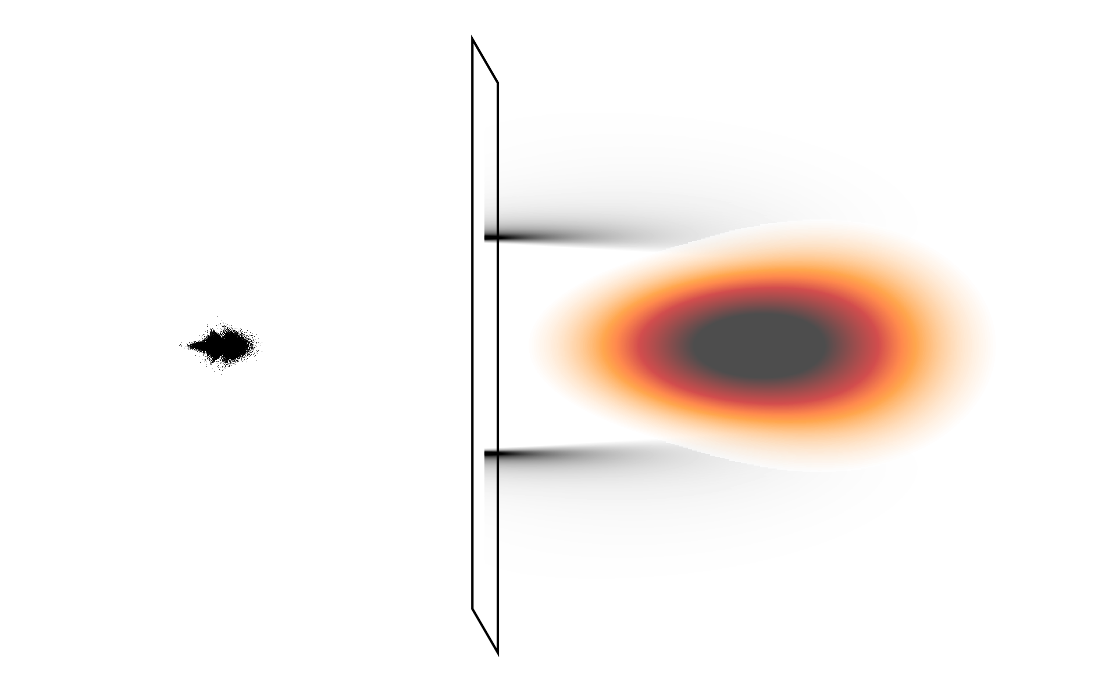
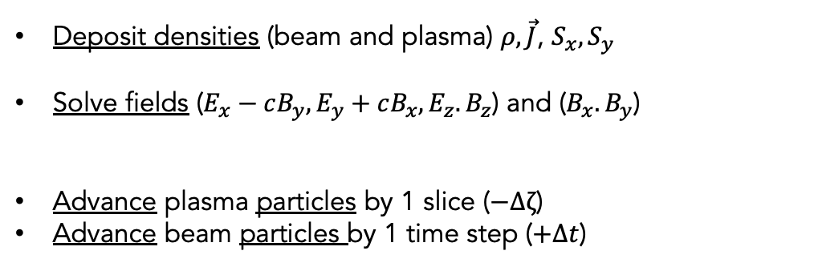
Mesh Refinement in HiPACE++
MR in electrostatic PIC
Severin Diederichs
Alexander Sinn
MR with quasi-static PIC, no crossing
J.-L. Vay et al., Comput. Sci. & Disc. 5, 014019 (2012)
T. J. Mehrling et al., IEEE, AAC (2018)
Deposit densities (beam and plasma) $ρ, \vec{J}$, $S_{x}, S_{y}$
Solve fields ($E_{x}−cB_{y}, E_{y}+cB_{x},E_{z}. B_{z}$) and ($B_{x}. B_{y}$)
Advance plasma particles by 1 slice ($−Δζ$)
Advance beam particles by 1 time step ($+Δt$)
  on all levels
  BC on fine patch, solve, Interpolate in ghost cells
Tag by level

Slide 10
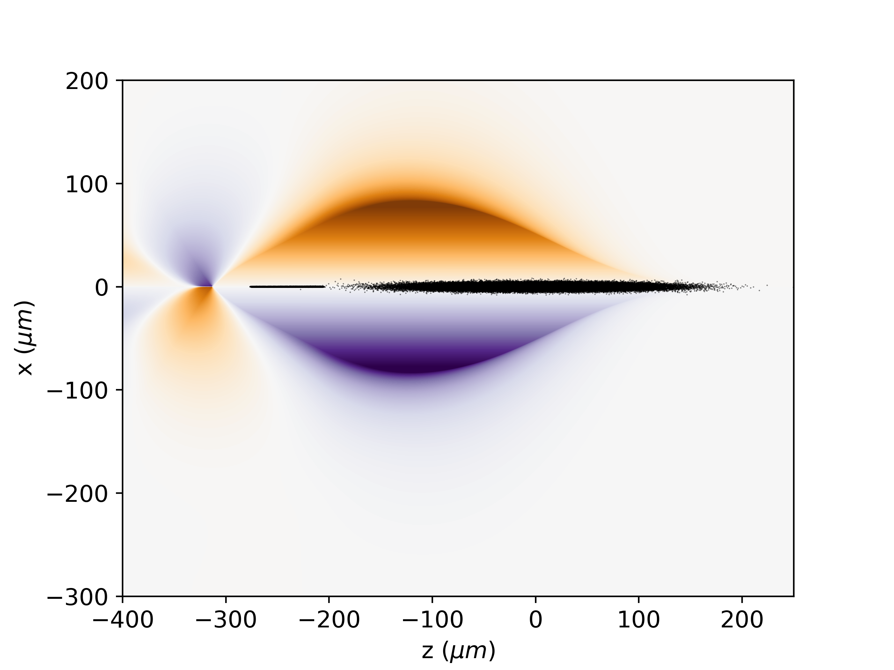
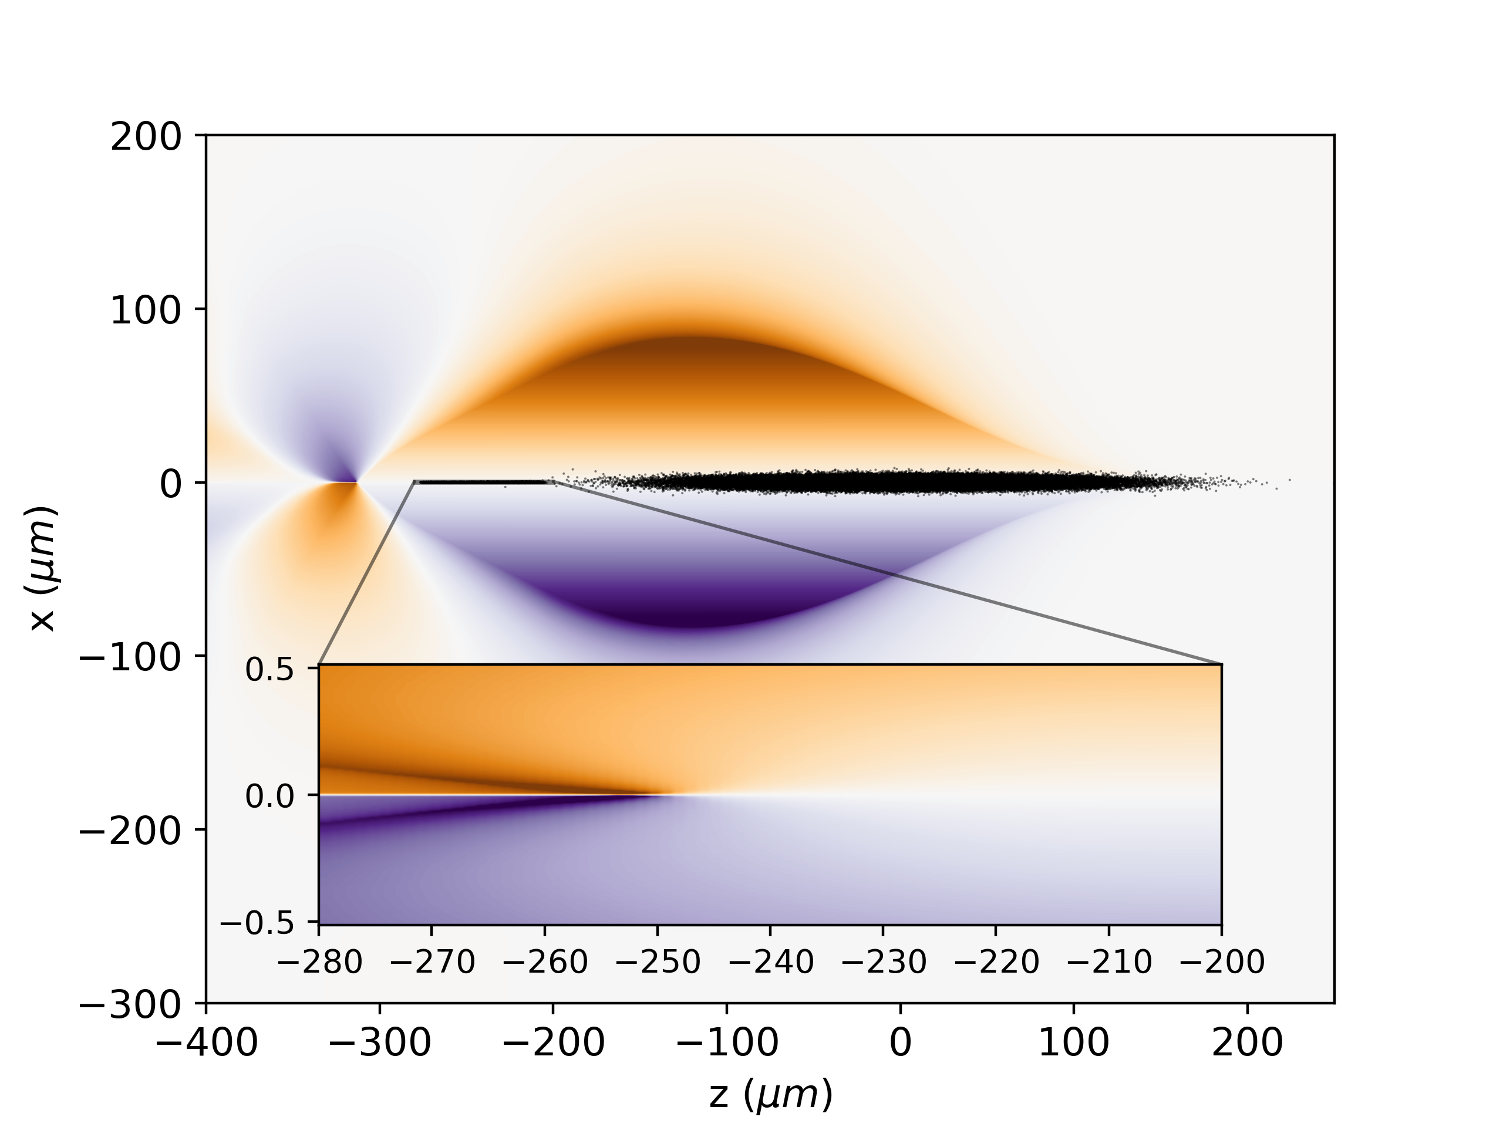
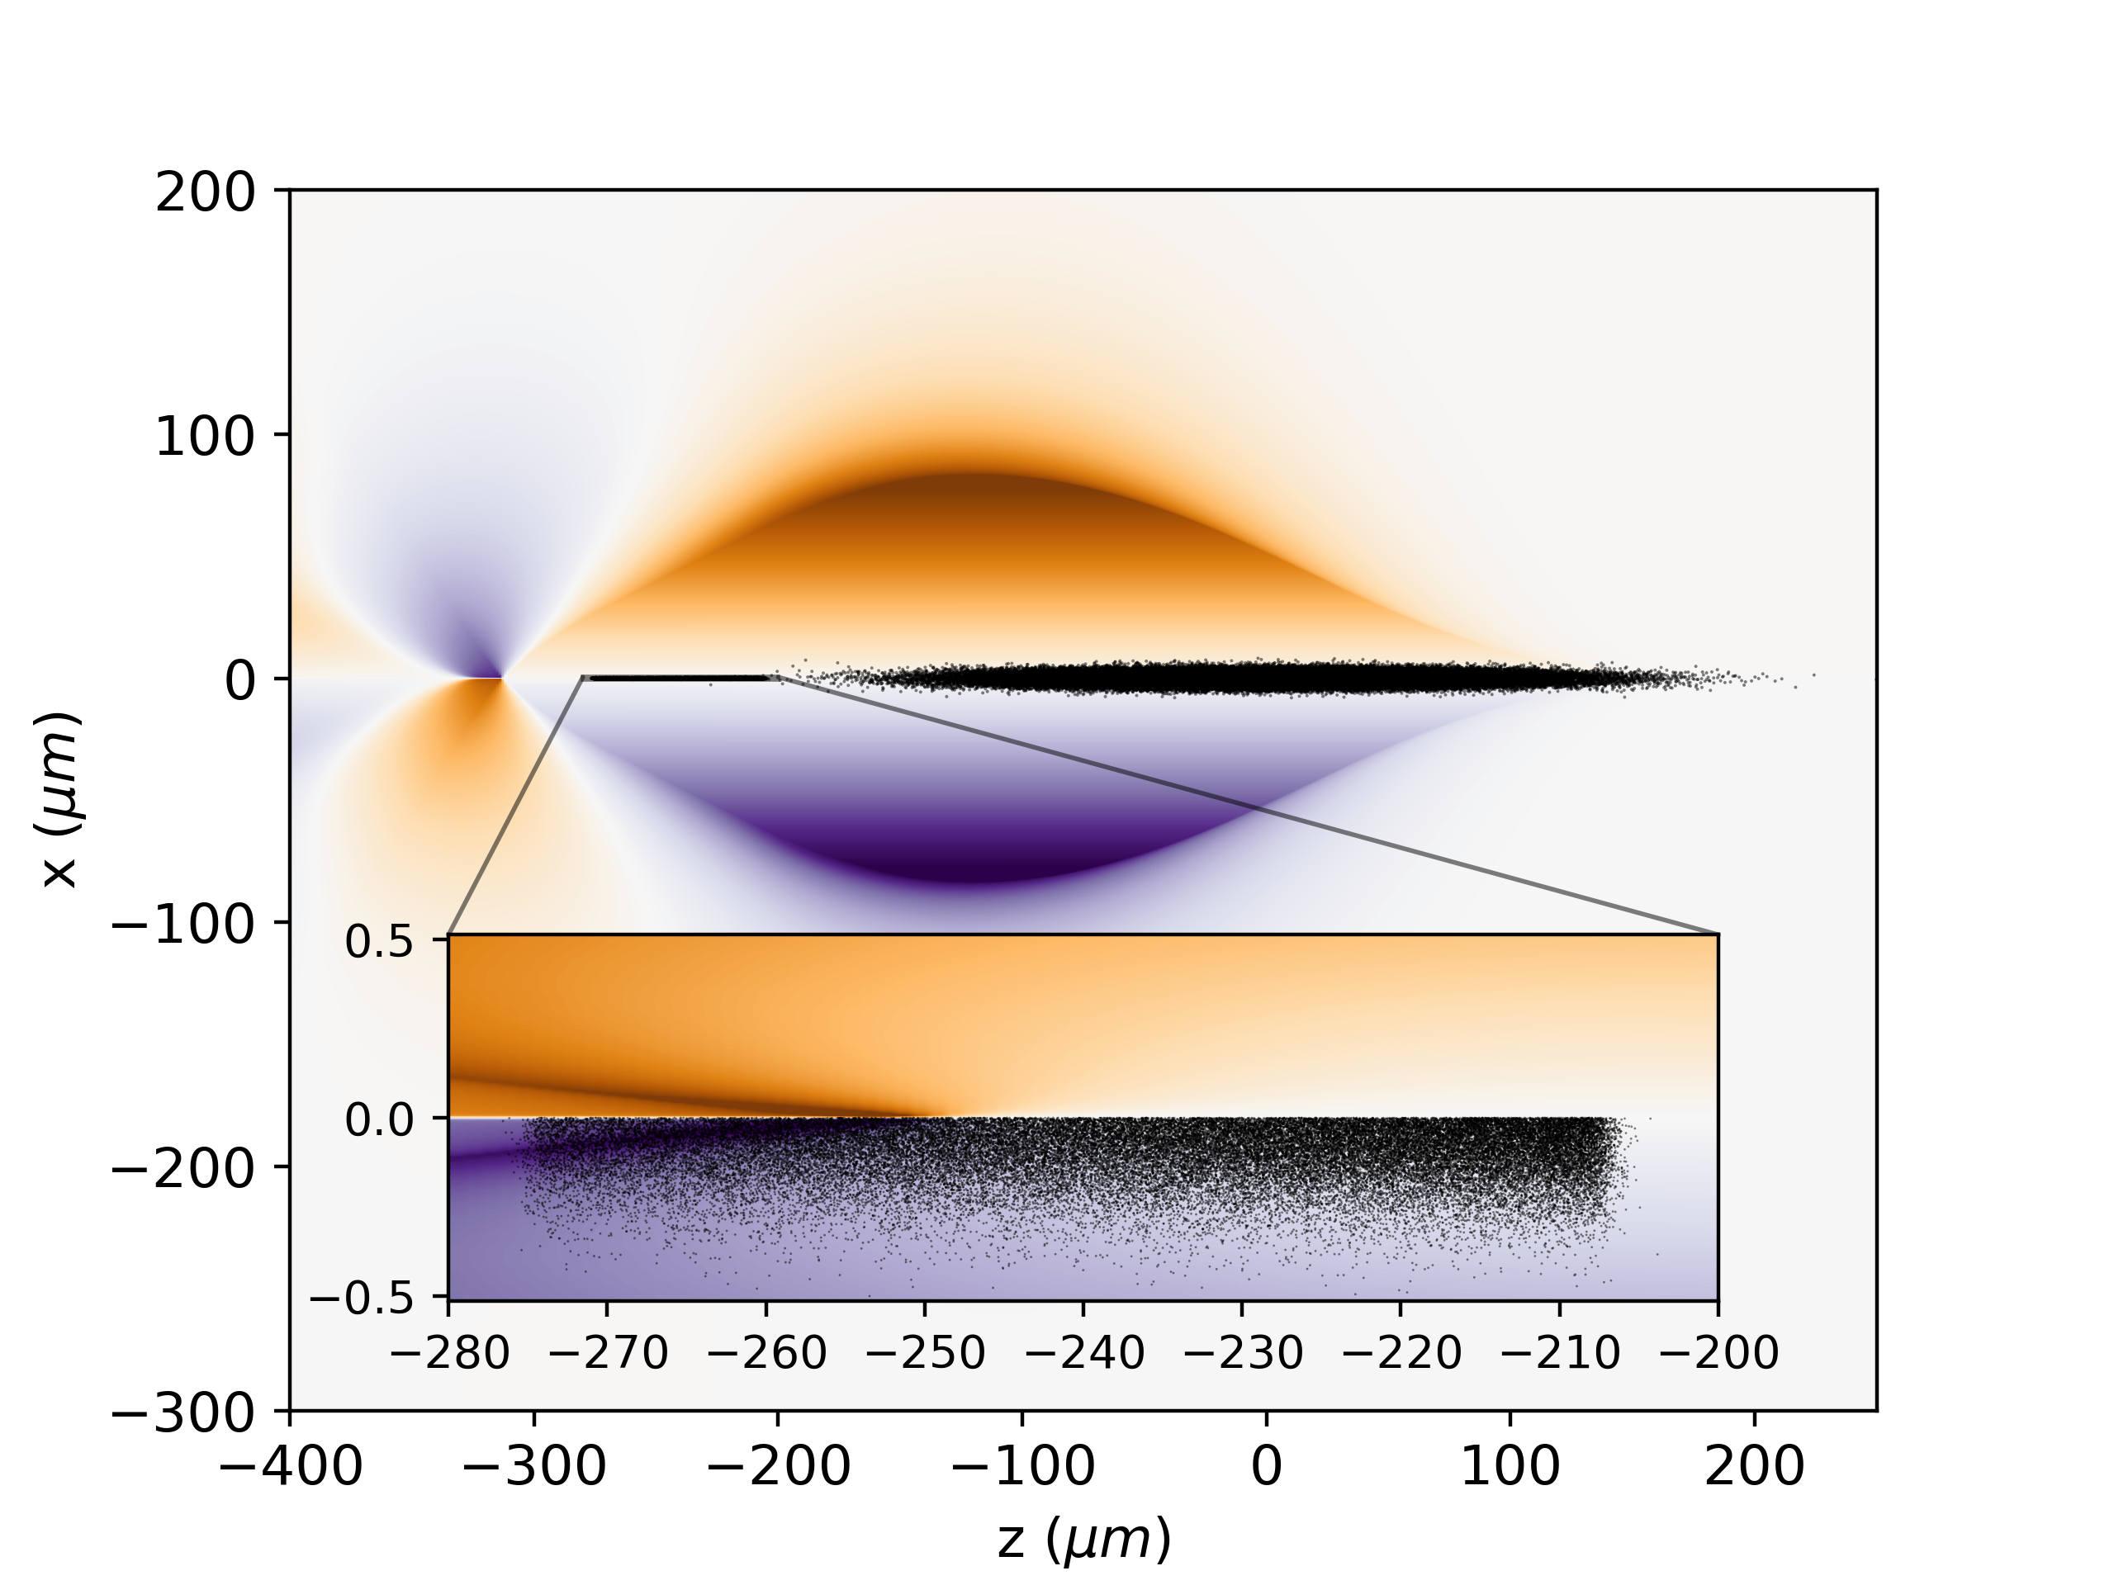
Converged simulations in collider-relevant range are feasible cheap
Fine everywhere = Coarse + MR
MR allows for convergence at modest cost

Slide 11
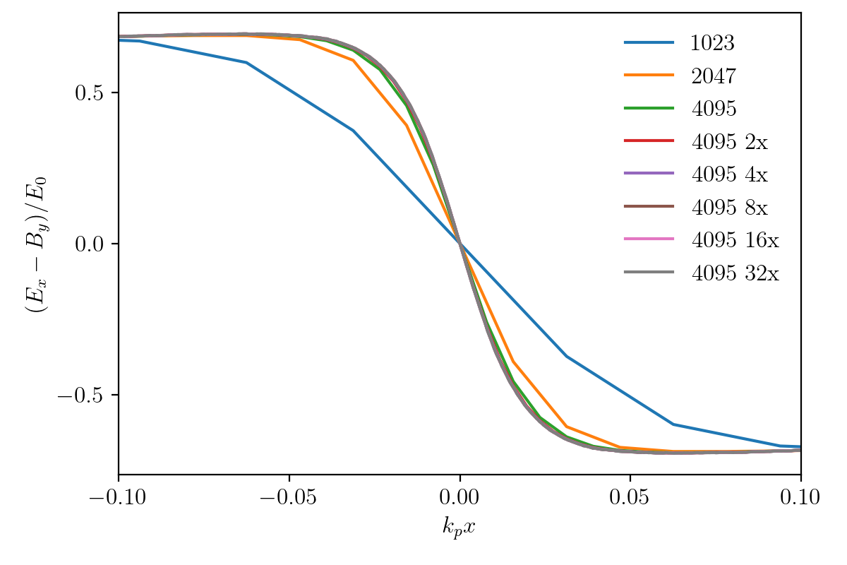
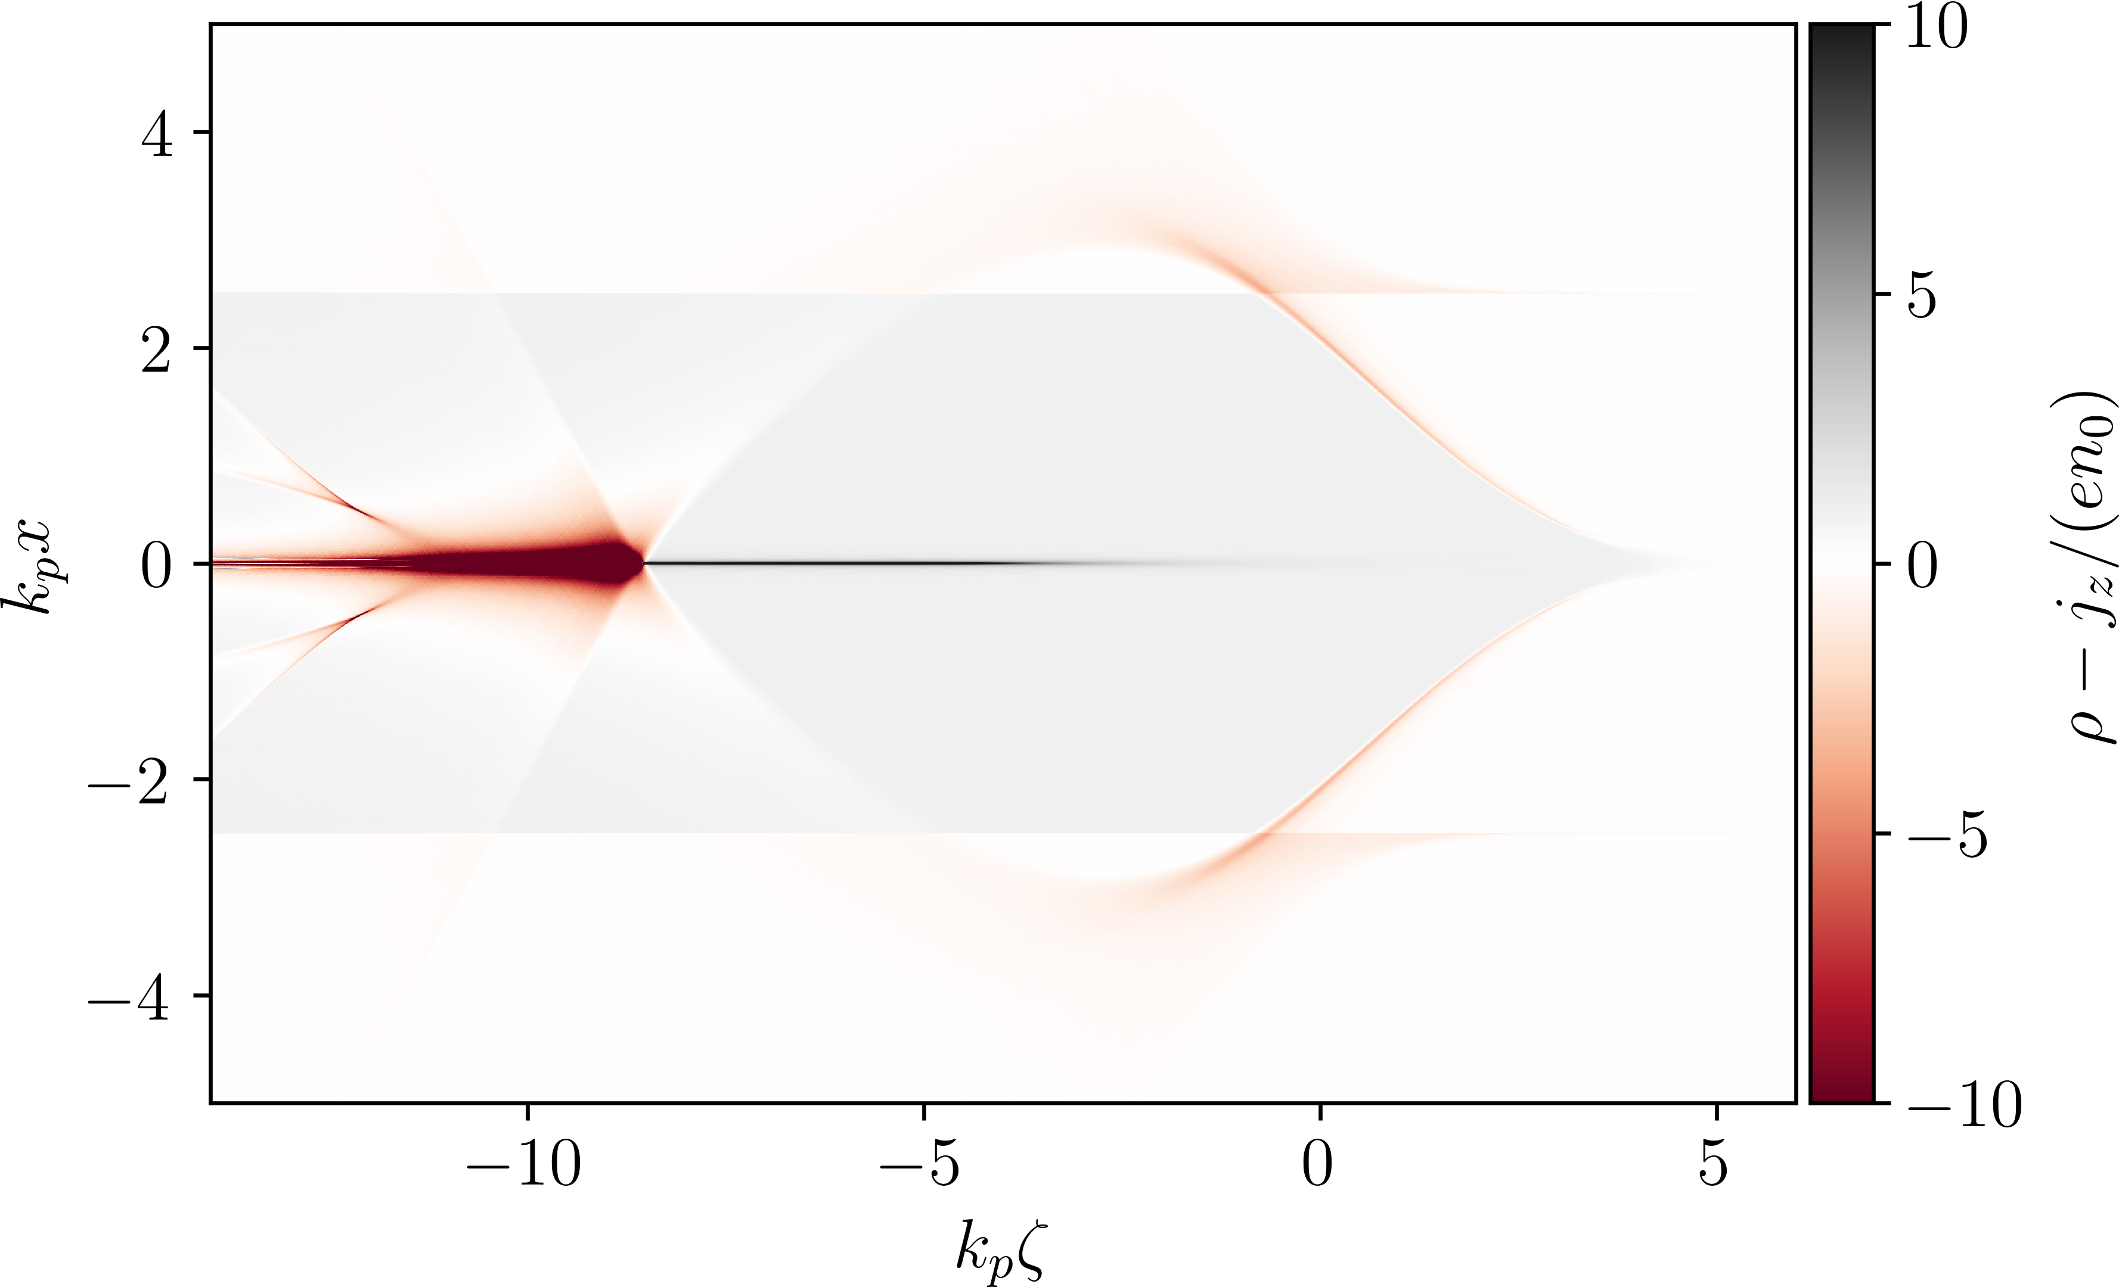
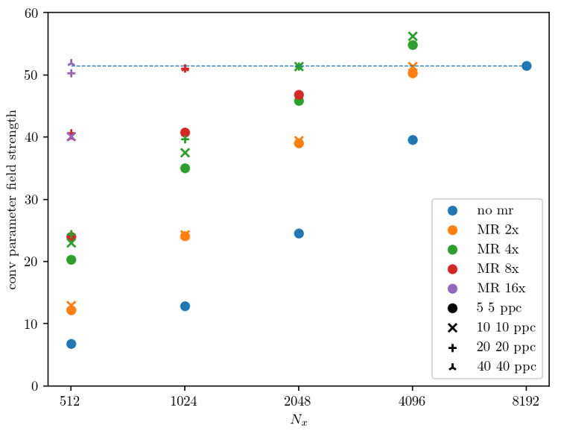
Challenging positron acceleration simulations benefit from MR
level 0 coarse mesh
level 1
fine mesh
e⁻ flow into level 1
ions flow
into level 1
Coarse resolution + MR = fine resolution everywhere
MR allows for convergence at modest cost

Slide 12
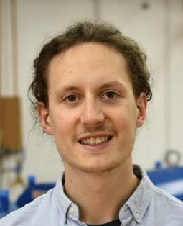
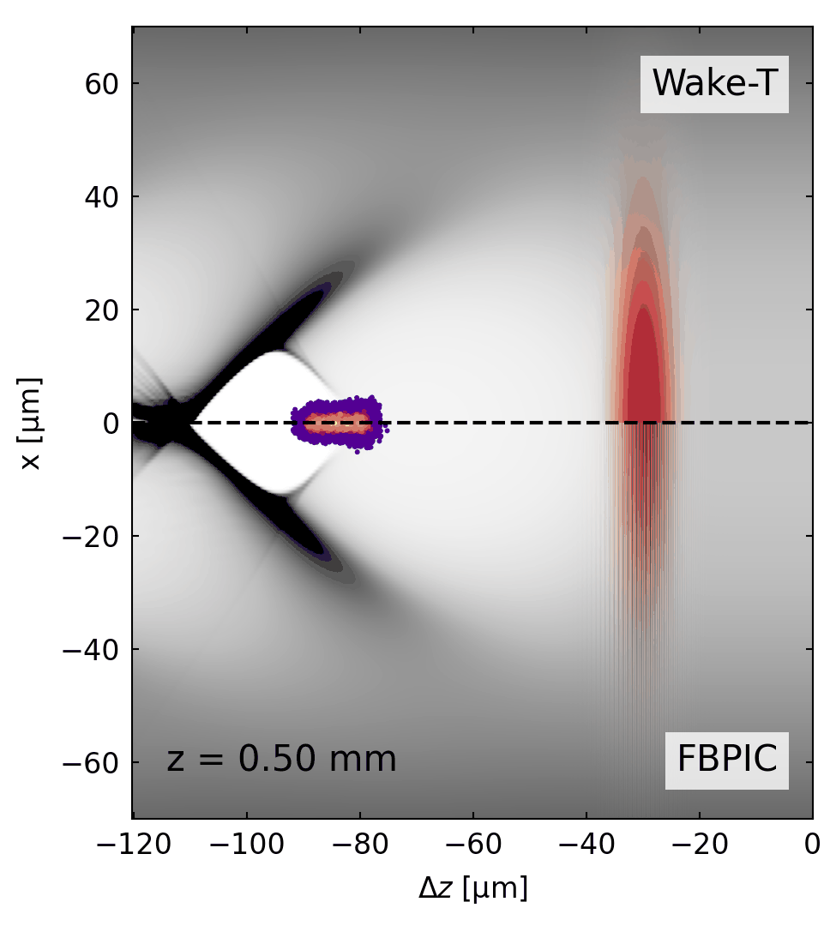
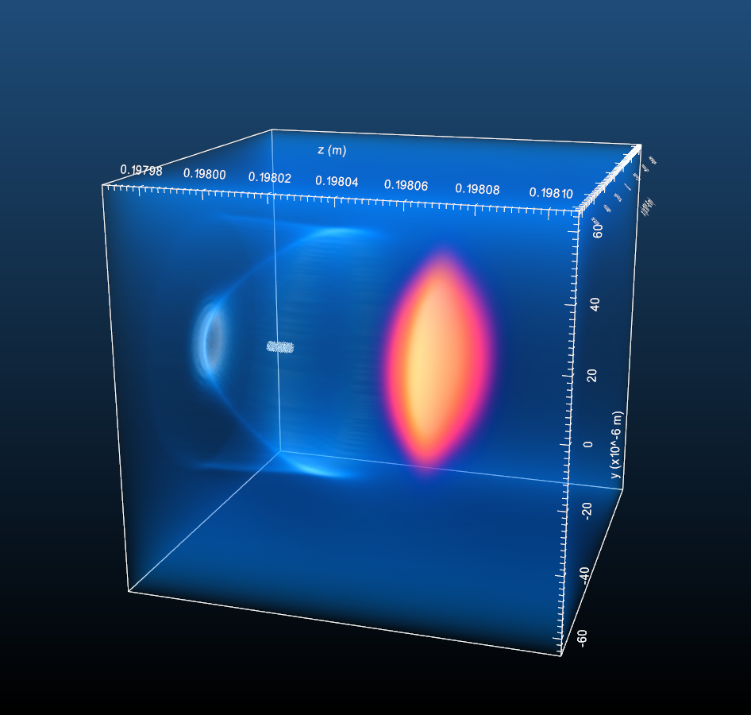
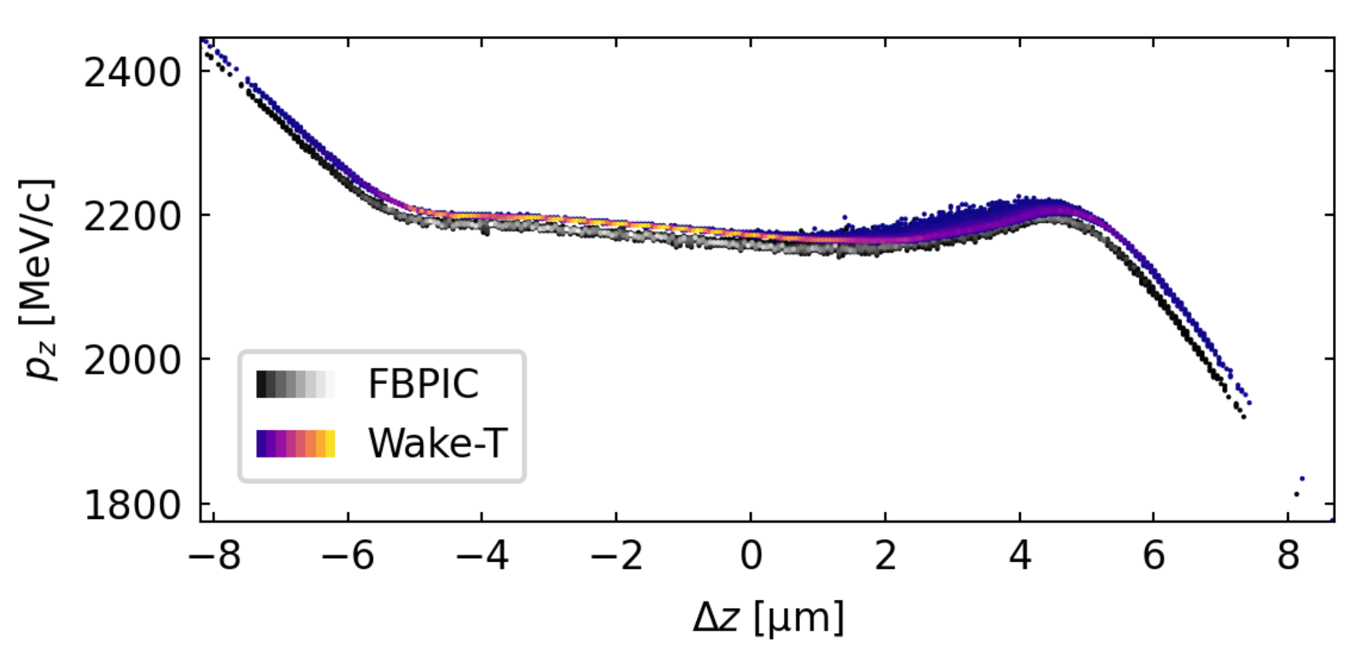
Wake-T: multi-stage axisymmetric simulations on a laptop
Wakefield particle Tracker [1]
2D (RZ) axisymmetric, quasi-static
Particle beam or laser pulse drivers [2]
Gridless model based on explicit solver [3]
Python, open-source, openPMD
Beam optics
1 CPU core, 9 min
Ángel Ferran Pousa
1 A100, 1h
→ Multi-stage simulations within second/minutes on a laptop
https://github.com/AngelFP/Wake-T
https://wake-t.readthedocs.io
[1] A. Ferran Pousa et al., J. Phys.: Conf. Ser. (2019)
[2] C. Benedetti et al., PPCF 60 014002 (2018)
[3] P. Baxevanis and G. Stupakov, PRAB 21 (2018)
A. Ferran Pousa, IPAC 2023

Slide 13

Wake-T: an adaptive grid in a gridless method
Plasma advance does not need a grid
Beam advance uses an adaptive grid

Slide 14



Realistic simulations of collider parameters on a laptop w/ Wake-T
Adaptive grid = fine resolution everywhere
MR allows for convergence at modest cost

Slide 15
HiPACE++ and Wake-T converge to the same (?) result

Slide 16

Conclusion
We implemented mesh refinement in HiPACE++ and adaptive grid in Wake-T.
This allows for converged simulations in collider-relevant parameters.
Full-physics realistic simulations are very affordable.
Perspective
Simplify usage of mesh refinement.
Adress low-hanging fruits for performance optimization.
Interact with the community towards realistic simulations of collider design.
Wait, wait, two more slides!
Acknowledgements
Severin Diederichs, Ángel Ferran Pousa, Alexander Sinn
Carlo Benedetti, Axel Huebl, Rémi Lehe, Andrew Myers, Weiqun Zhang, Jean-Luc Vay

Slide 17




LASY: LAser manipulations made eaSY
From experiment to simulation
From simulation to simulation
Come see
poster #381
(yesterday)
https://github.com/LASY-org/LASY
https://lasydoc.readthedocs.io/en/latest/

Slide 18
A plasma injector for PETRA IV (PIP4)
The team
I. Agapov, S. Antipov, R. Brinkmann, A. Ferran Pousa, S. Jalas, L. Jeppe, M. Kirchen, W. P. Leemans, A. R. Maier, A. Martinez de la Ossa, J. Osterhoff, R. Shalloo, M. Thévenet, P. Winkler
Come see
poster #169
(today)
[1] https://www.desy.de/research/facilities__projects/petra_iv
[2] M. Kirchen et al. PRL 126.17 (2021); LUX PI: A. R. Maier
[3] S. Antipov et al., 24, PRAB 111301 (2021)
[4 ]A. Ferran Pousa et al. PRL 129, 094801 (2021)

Slide 19
Conclusion
We implemented mesh refinement in HiPACE++ and adaptive grid in Wake-T.
This allows for converged simulations in collider-relevant parameters.
Full-physics realistic simulations are very affordable.
Perspective
Simplify usage of mesh refinement.
Adress low-hanging fruits for performance optimization.
Interact with the community towards realistic simulations of collider design.
Thank you for your attention
Acknowledgements
Severin Diederichs, Ángel Ferran Pousa, Alexander Sinn
Carlo Benedetti, Axel Huebl, Rémi Lehe, Andrew Myers, Weiqun Zhang, Jean-Luc Vay

Slide 20
QS PIC even captures depletion
amr.n_cell = 4095 4095 3072
my_constants.Lramp = 0.025
my_constants.Lplateau = .3
my_constants.n0 = 3.7e22
max_step = 15000
hipace.max_time = (0.2+Lramp)/clight
diagnostic.output_period = 200
hipace.depos_order_xy = 2
hipace.dt = adaptive
hipace.nt_per_betatron = 10
hipace.dt_max = 1.e-13
geometry.coord_sys = 0 # 0: Cartesian
geometry.is_periodic = true true false # Is periodic?
geometry.prob_lo = -350.e-6 -350.e-6 -250.e-6 # physical domain
geometry.prob_hi = 350.e-6 350.e-6 110.e-6
beams.names = beam
beam.position_mean = 0. 0. 0.
beam.position_std = 15.e-6 15.e-6 30.e-6
beam.injection_type = fixed_weight
beam.num_particles = 10000000
beam.total_charge = 443.e-12
beam.u_mean = 0. 0. 1000.
beam.u_std = .7 .7 4.
plasmas.names = plasma
plasma.density(x,y,z) = "if(z>0, if(z<Lramp,n0*0.5*(1.-cos(pi*z/Lramp)),n0), 1.e-20)"
plasma.ppc = 1 1
plasma.element = electron
diagnostic.diag_type = xz

Slide 21


LASY: LAser manipulation made eaSY
Realistic/measured laser profiles are critical
Workflow can be cumbersome, with efforts duplication
LASY aims at making this easy
Contributors from DESY, LBNL, LOA, CEA, and more
Written in Python
Envelope model
Support RZ (azimuthal modes) & XYZ
Measured or analytic profiles
Read/write openPMD standard, envelope or field
Propagator powered by Axiprop (I. Andriyash)
Utils (Gerchberg-Saxton algorithm, etc.)
[2] L. T. Dickson et al., Phys. Rev. Accel. Beams 25, 101301 (2022)
https://github.com/LASY-org/LASY
https://lasydoc.readthedocs.io/en/latest/

Slide 22
Plasma acceleration is described by kinetic plasma dynamics
Push particles
$x, v=f(E, B)$
Gather fields
$E, B=f(E, B)$
Deposit currents
$J=f(x, v)$
Solve fields
$E, B=f(J)$
Lagrangian description of plasma, Eulerian description of fields
Physics can be added
Time step limited by CFL condition: $Δt≃\frac{Δz}{c}$
→ 3D (EM) PIC simulations of plasma acceleration are very expensive
Regular mesh
Macroparticles

Slide 23



Recent advances improved accuracy of the field solver
Source terms $∂_{ζ}j_{x/y}$ are difficult to obtain
predictor-corrector solver: the old one
  [Mora & T. Antonsen, Phys. Plasmas (1997), W. An et al., JCP (2013)]
  Not very stable
explicit solver: the new one
  [T. Wang et al., Phys. Plasmas (2017), P. Baxevanis & G. Stupakov, PRAB (2018), T. Wang, et al. PRAB 25.10 (2022)]
  Analytic integration of the source term
  Gives a screened Poisson equation, solved with multigrid solver
$$∇_{⊥}^{2}ψ=−\frac{1}{ε_{0}} \left(ρ−\frac{1}{c}j_{z}\right) \\ E_{x}−c B_{y}=−∂_{x}ψ \\ E_{y}+c B_{x}=−∂_{y}ψ \\ ∇_{⊥}^{2}E_{z}=cμ_{0} \left(∂_{x}j_{x}+∂_{y}j_{y}\right) \\ ∇_{⊥}^{2}B_{x}=μ_{0} \left(−∂_{y}j_{z}+∂_{ζ}j_{y}\right) \\ ∇_{⊥}^{2}B_{y}=μ_{0} \left(∂_{x}j_{z}−∂_{ζ}j_{x}\right) \\ ∇_{⊥}^{2}B_{z}=μ_{0} \left(∂_{y}j_{x}−∂_{x}j_{y}\right)$$
$$∇_{⊥}^{2}B_{⊥}−\frac{n^{∗}}{1+ψ}B_{⊥}=−\left[e_{z} × S\right]$$

Slide 24

Mesh Refinement in HiPACE++
MR in electrostatic PIC
Severin Diederichs
Alexander Sinn
MR with quasi-static PIC, no crossing
Push particles
J.-L. Vay et al., Comput. Sci. & Disc. 5, 014019 (2012)
T. J. Mehrling et al., IEEE, AAC (2018)
Gather fields
Deposit currents
Solve fields
Deposit beam and plasma densities $ρ, \vec{J}$
Solve Poisson fields ($E_{x}−cB_{y}, E_{y}+cB_{x},E_{z}. B_{z}$)
Deposit beam and plasma source terms $S_{x}, S_{y}$
Explicit solve ($B_{x}. B_{y}$)
Advance plasma particles by 1 slice ($−Δζ$)
Advance beam particles by 1 time step ($+Δt$)
  on all levels
  BC on fine patch, solve, Interpolate in ghost cells
Tag by level
  on all levels
  BC of source and B, solve

Slide 25
Converged simulations in collider-relevant range are feasible cheap
Coarse resolution + MR = fine resolution everywhere
MR allows for convergence at modest cost

Slide 26
Realistic simulations of collider parameters on a laptop w/ Wake-T
Coarse resolution + MR = fine resolution everywhere
MR allows for convergence at modest cost

