Slide 1






Latest algorithmic
advances in the
Exascale Particle-In-Cell
code WarpX
Jean-Luc Vay
Lawrence Berkeley National Laboratory
On behalf of the WarpX team
LBNL, LLNL, SLAC
6th European Advanced Accelerator Concepts workshop (EAAC2023)
Hotel Hermitage, La Biodola Bay, Isola d'Elba, Italy
September 17-23, 2023
+ contributors external to ECP from labs,
universities & industry in USA, Europe & Asia
AM

Slide 2
Outline
US DOE Exascale Computing Project (ECP) & WarpX
  Quick overview of WarpX PIC algorithms
Latest algorithmic advances
  time-averaged PIC
  Hybrid alternating Nodal-Staggered PIC
  Particles in Perfectly Matched Layers
  Mesh refinement
Outlook

Slide 3
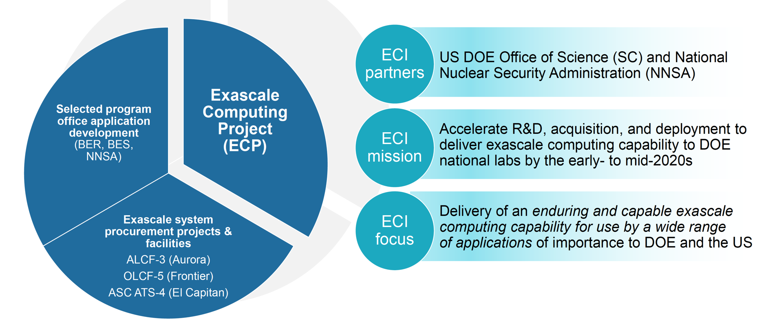
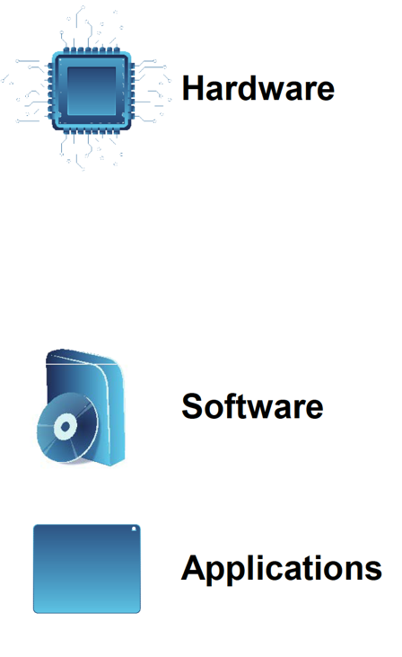
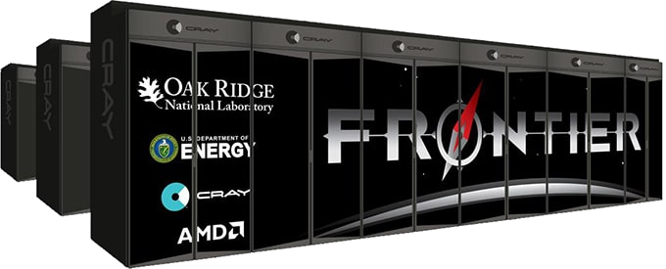
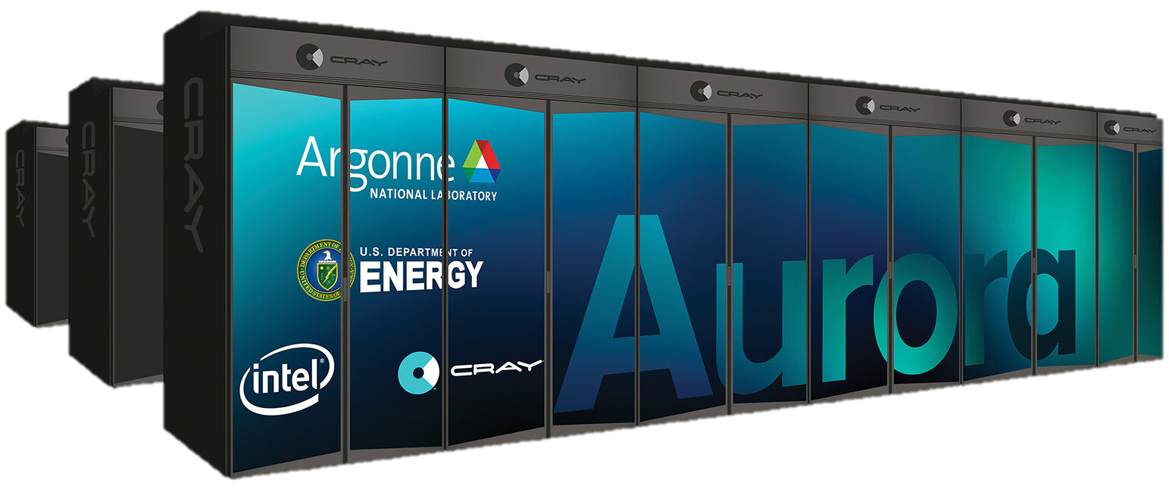


U.S. DOE Exascale Computing Initiative (ECI) – 2016-2023
Exascale Computing Initiative
Delivers 5x performance of 200 petaflop Summit (ORNL)
Software stack for broad spectrum of apps & workloads
Wide range of apps that deliver high-fidelity solutions faster to more complex problems
D. Kothe – April 30, 2019

Slide 4
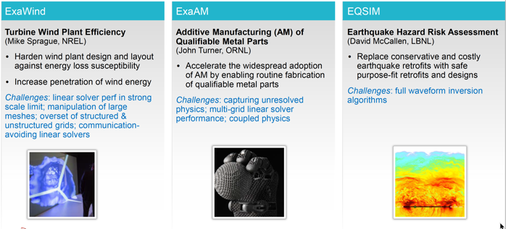
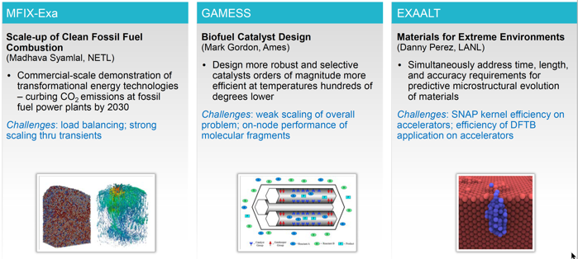
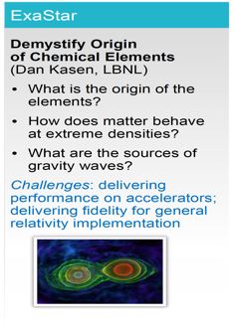
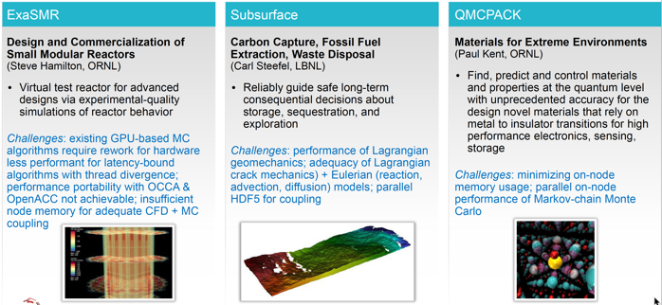
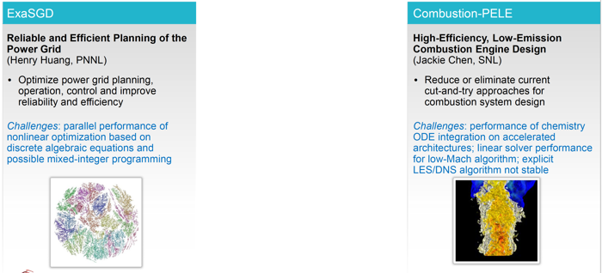
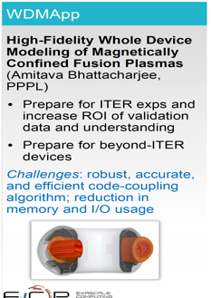
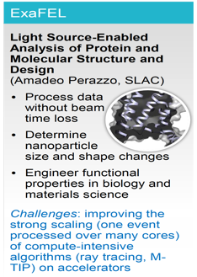
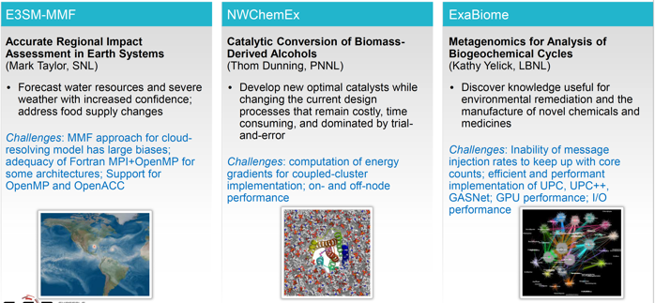
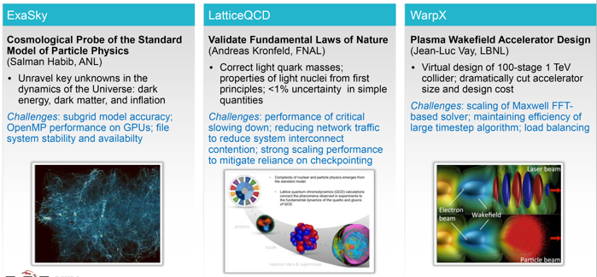
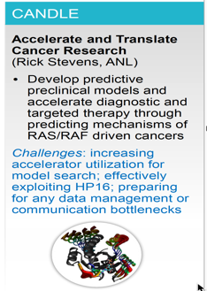
WarpX among 21 applications selected to cover broad range of science

Slide 5
Challenge of the ECP WarpX Project:
Go from modeling 1 or 2 plasma stages
to tens of stages
in 3D from first principles
Particle-In-Cell on fastest/largest supercomputers
with advanced algorithms

Slide 6

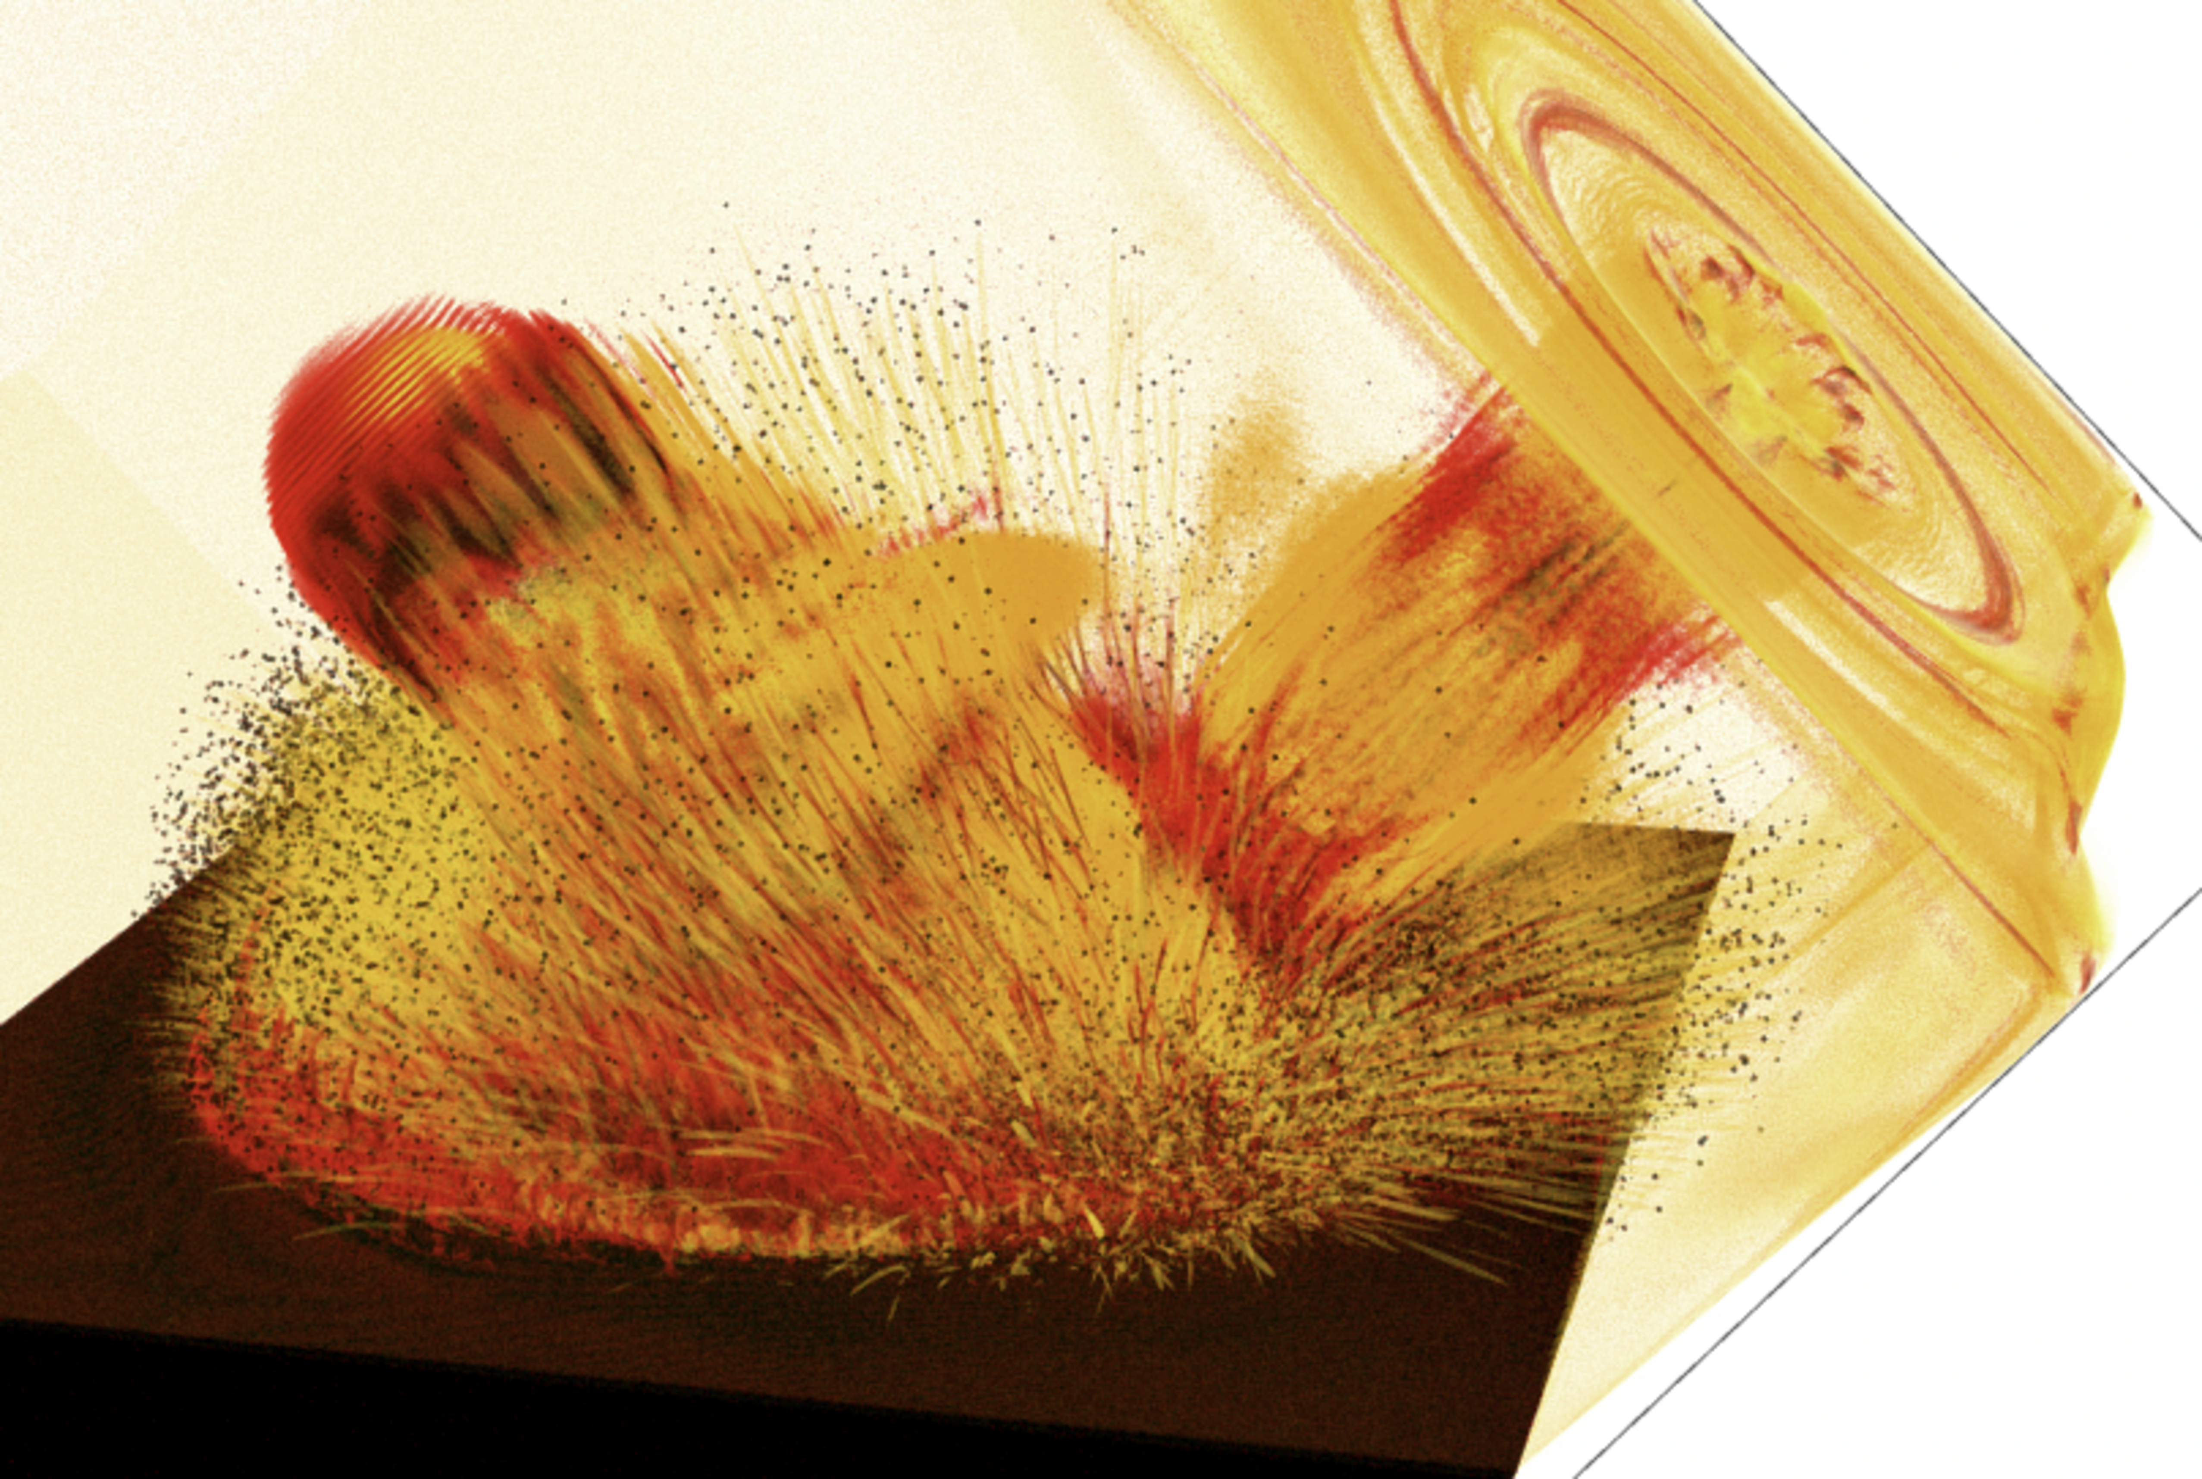
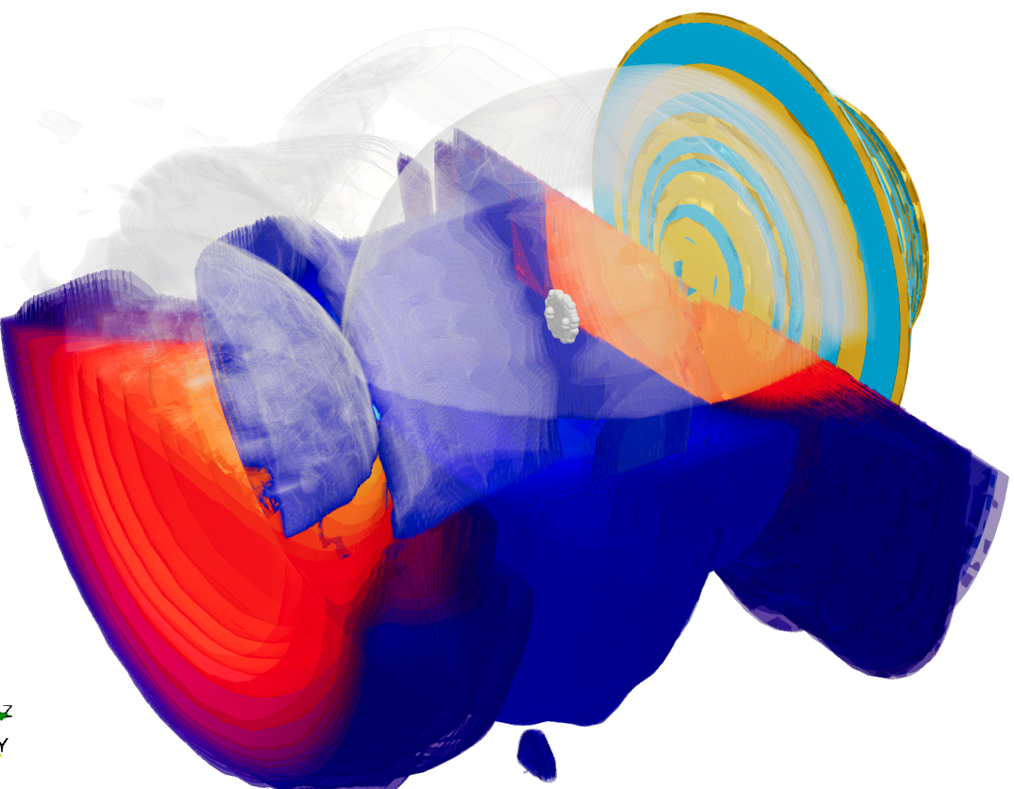
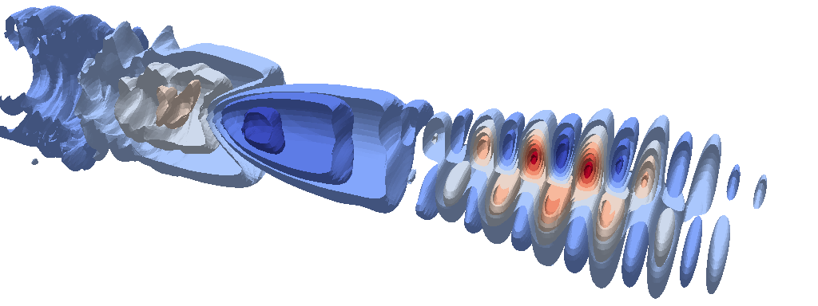
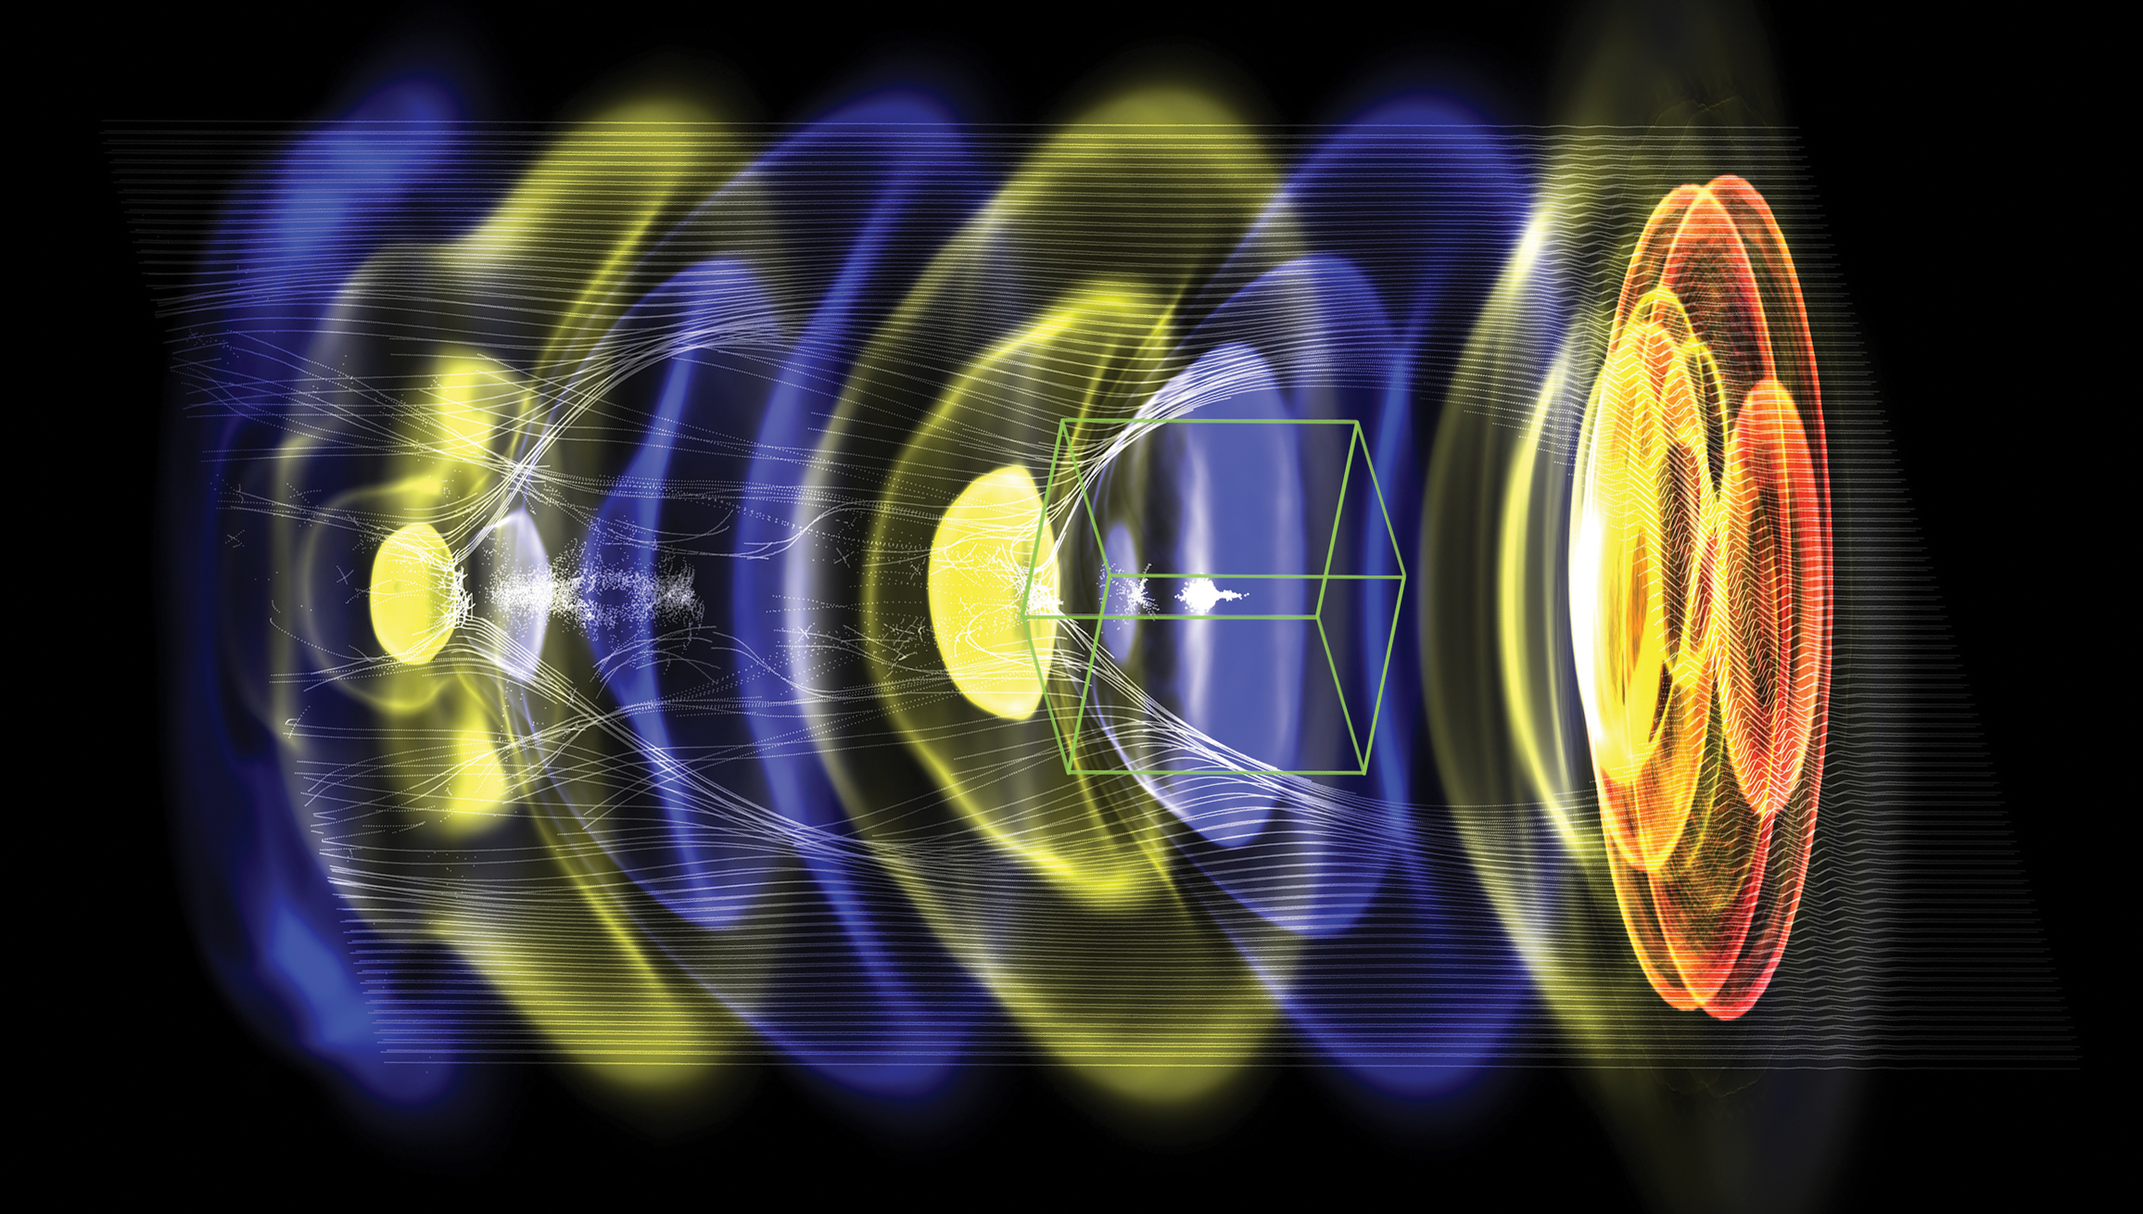

Timeline for Exascale project WarpX
From initial code coupling to ensemble of chains of multi GeV-scale stages
Original
2030 -
Collider designs
Modeling of chain of 50-100 multi-GeV-scale plasma accelerator stages
2023
Modeling chain of 20-50 multi-GeV-scale plasma accelerator stages
2022
Modeling chain of 10-20 multi-GeV-scale plasma accelerator stages
2021
Modeling chain of 5-10 multi-GeV-scale plasma accelerator stages
2020
2019
Modeling chain of 3 multi-GeV-scale plasma accelerator stages
2018
Modeling a single multi-GeV-scale plasma accelerator stage
2017
Modeling of single plasma accelerator stage with static mesh refinement
2016
Initial coupling of AMReX and Warp/PICSAR
Notes:
Instructions:
Summarize milestone-based plan for next 3 years

Slide 7
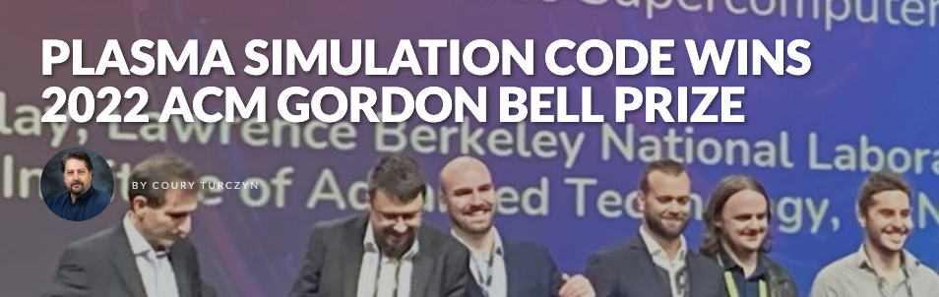
Timeline for Exascale project WarpX
From initial code coupling to ensemble of chains of multi GeV-scale stages
Revised
2030 -
Collider designs
Modeling of chain of 15-30 multi-GeV-scale plasma accelerator stages
2023
Modeling of novel plasma e- beam injection scheme
2022
Modeling chain of 10-20 multi-GeV-scale plasma accelerator stages
2021
Modeling chain of 5-10 multi-GeV-scale plasma accelerator stages
2020
2019
Modeling chain of 3 multi-GeV-scale plasma accelerator stages
2018
Modeling a single multi-GeV-scale plasma accelerator stage
2017
Modeling of single plasma accelerator stage with static mesh refinement
2016
Initial coupling of AMReX and Warp/PICSAR
Notes:
Instructions:
Summarize milestone-based plan for next 3 years

Slide 8
Quick overview of
WarpX PIC algorithms

Slide 9
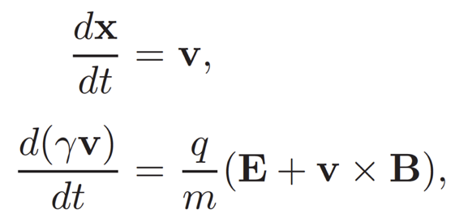
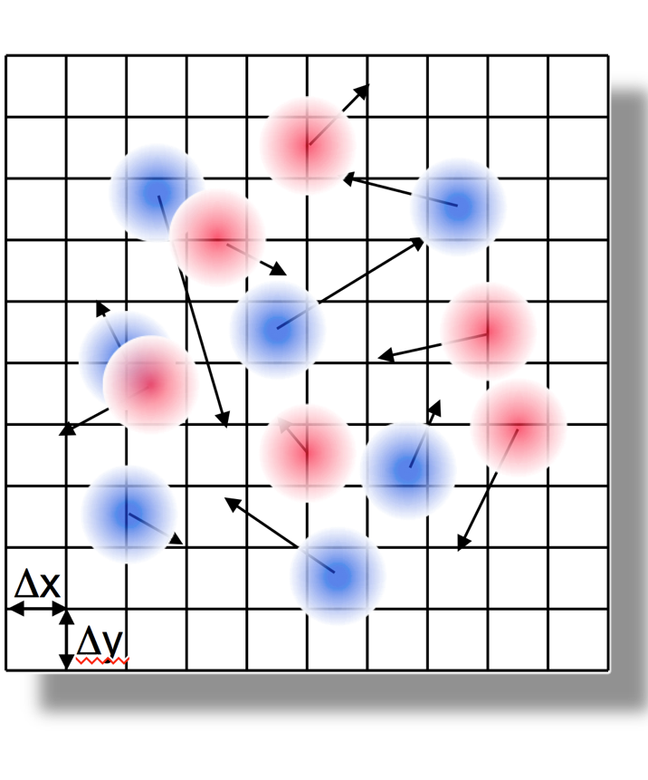
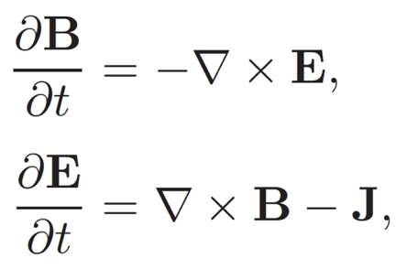
WarpX is an electromagnetic Particle-In-Cell (PIC) code
Lagrangian
charged macroparticles
Newton-Lorentz
-
+
+
Push particles
-
+
-
-
w/ shape factor
-
-
Gather fields
Δt
Deposit sources
+
Eulerian
electromagnetic fields on structured grid
+
w/ shape factor
+
Solve fields
Maxwell*
*Electrostatic+magnetostatic option available at runtime

Slide 10
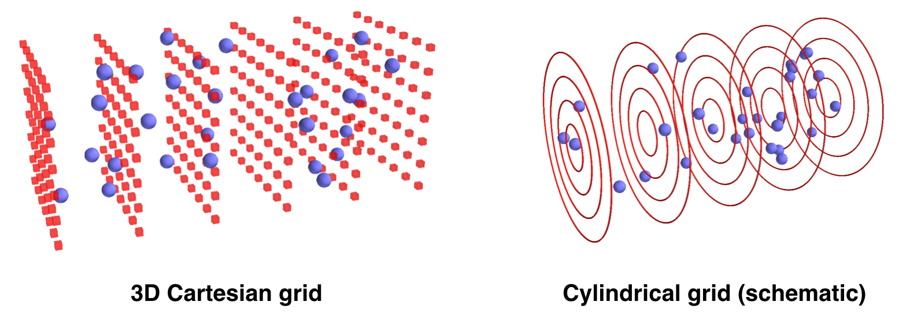





WarpX supports many advanced features: some are unique
High-order particle shape
Moving window
Single source CPU & GPU
Dyn. LB for CPU & GPU
Mesh refinement
Boosted frame
Spectral Maxwell solver
PIConGPU²
PICADOR
WarpX³
Geometries
1D3V, 2D3V,
3D3V and
RZ (quasi-
cylindrical)
Multi-Physics Modules beyond standard PIC
ionization, Coulomb collisions, QED processes, Maxwell’s Eq. in matter, embedded boundaries
Advanced Algorithms
mesh refinement, Maxwell spectral solvers, boosted frame, Galilean frame, …
Smilei
Epoch
VPIC¹
Code*
Osiris
✓ | ✓ | ✓ | ✓ | ✓ |  | ✓
✓ | ✓ | ✓ | ✓ | ✓ |  | ✓
 |  | ✓ | ✓ |  | ✓ | ✓
 |  |  |  |  |  | ✓
 |  |  |  |  |  | ✓
 | ✓ |  |  |  |  | ✓
 |  |  |  |  |  | ✓
¹ Gordon Bell Finalist 2008
² Gordon Bell Finalist 2013
³ Gordon Bell Winner 2022
Open source
ecp-warpx.github.io

Slide 11
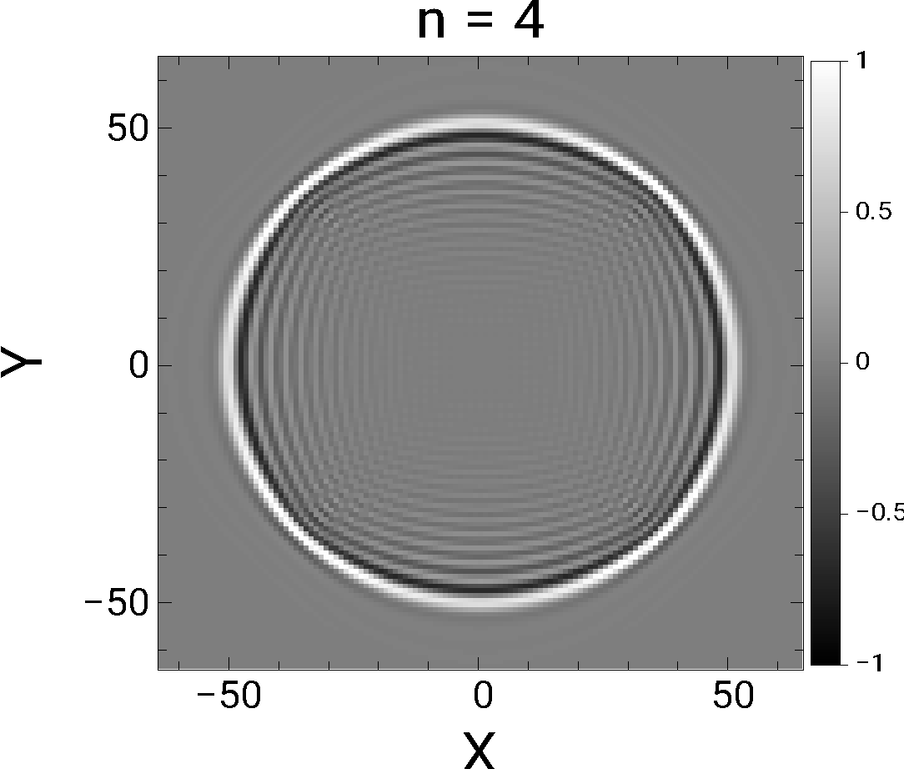

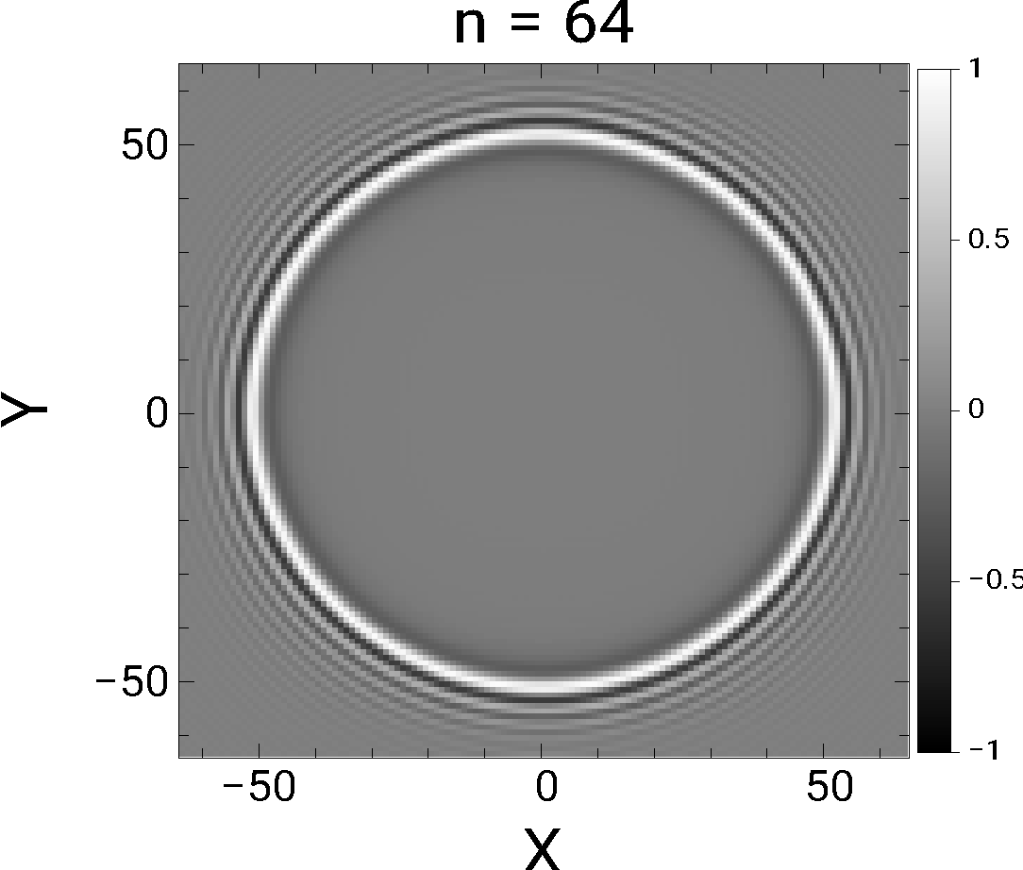
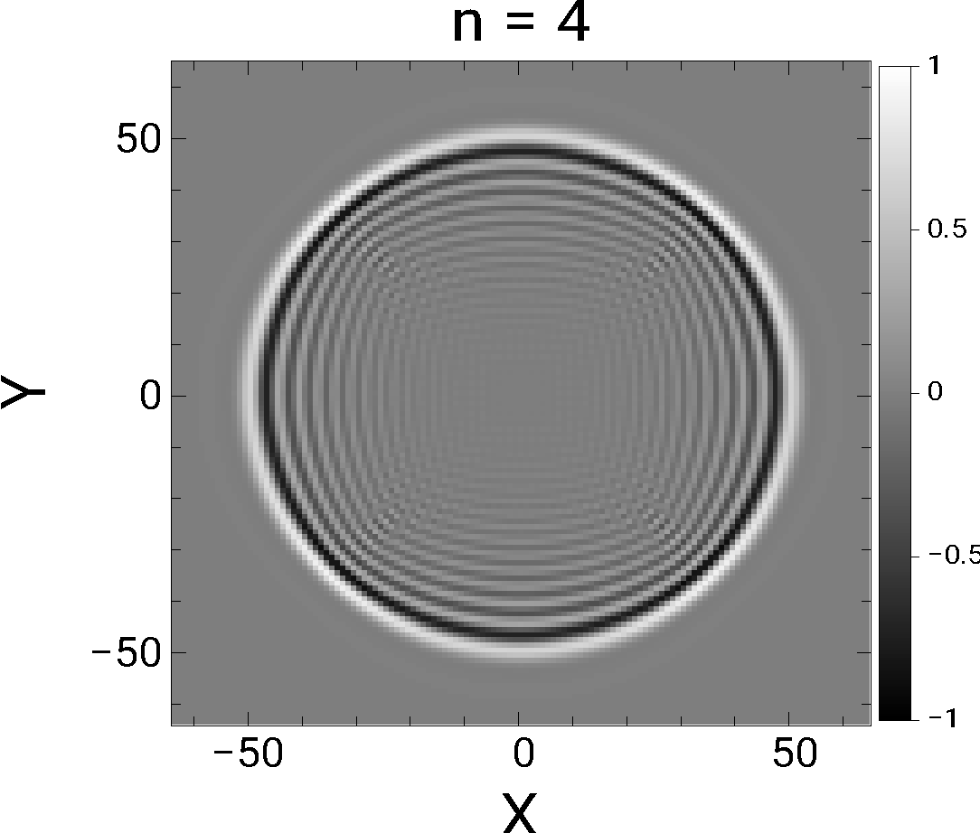
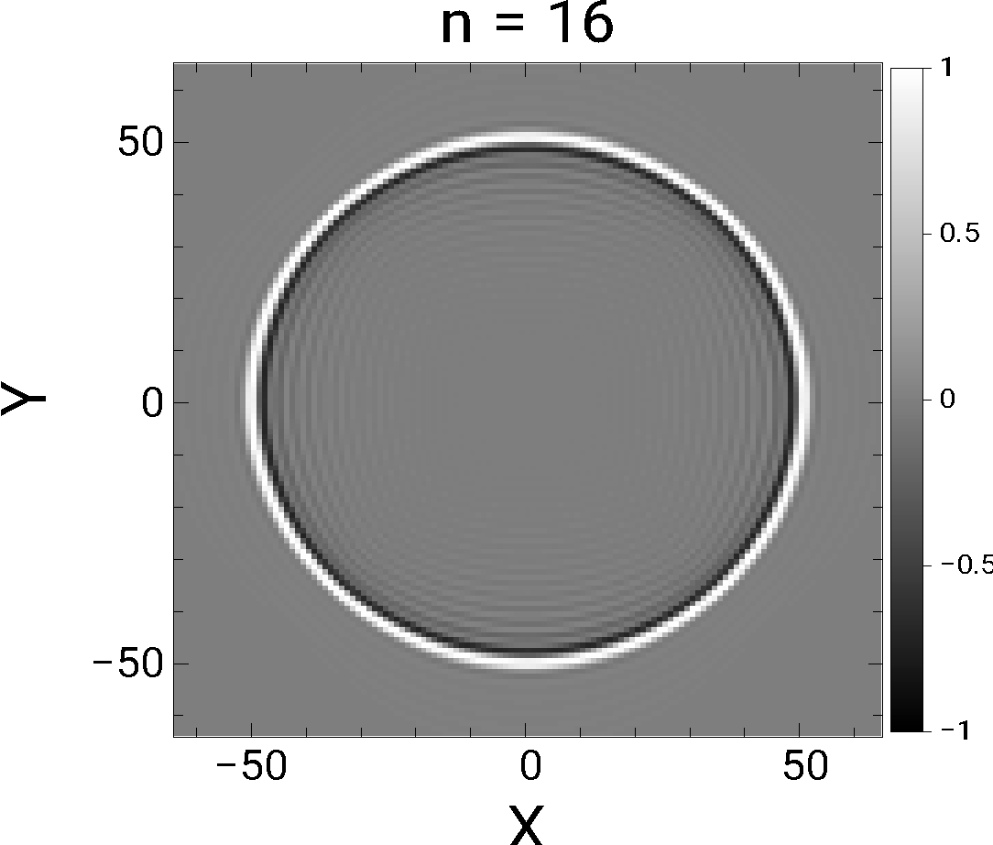

Arbitrary-order Maxwell solver offers flexibility in accuracy
Finite-difference
Higher order
N→∞ = Pseudo-spectral (FFT)
cΔt/Δx~0.45
Kronecker δ pulse
cΔt/Δx~0.045
Accurate but Expensive
(with leapfrog integrator)

Slide 12
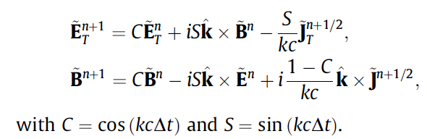

Pseudo-Spectral Analytical Time-Domain¹ (PSATD)
PSATD cΔt/Δx=50
Analytical integration in Fourier space.
No Courant condition
1 time step
Easy to implement arbitrary-order n with PSATD (k=k⚯ ➔ k^{n}).
¹I. Haber,R. Lee,H. Klein & J. Boris,Proc. Sixth Conf. on Num. Sim. Plasma, Berkeley, CA, 46-48 (1973)

Slide 13
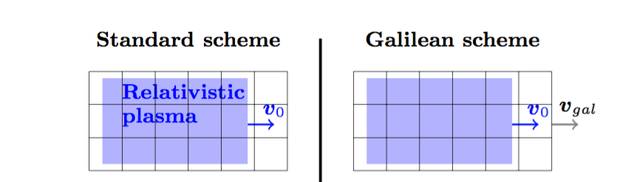
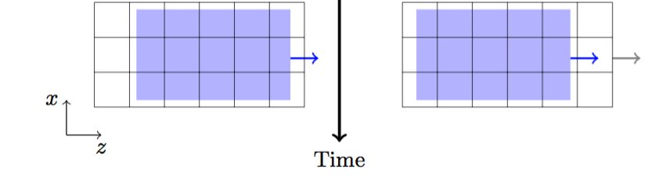

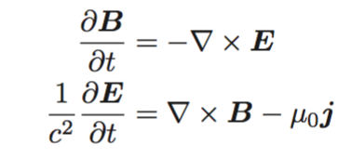
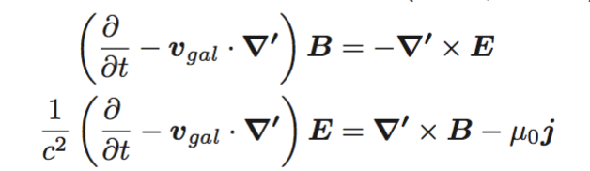



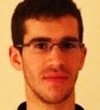
Galilean PSATD PIC controls the numerical Cherenkov instability (NCI)
Standard PSATD PIC
Galilean PSATD PIC
Plasma moves through fixed grid.
Grid follows the relativistic plasma.
+ integrate analytically, assuming
is constant over one timestep.
Original idea by Manuel Kirchen (U. Hamburg)
Concept and applications: Kirchen et al., Phys. Plasmas 23, 100704 (2016)
Derivation of the algorithm by Rémi Lehe (Berkeley Lab):
Lehe et al., Phys. Rev. E 94, 053305 (2016)

Slide 14
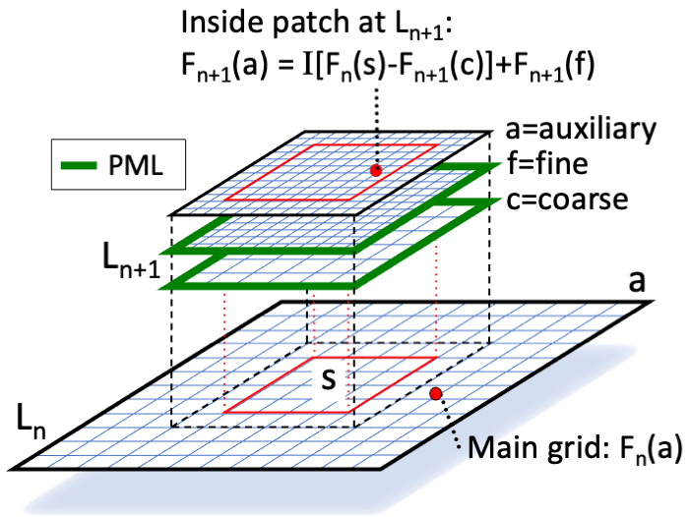
WarpX also implements mesh refinement
Need to avoid spurious:
  self-forces
  wave reflections
  dispersion mismatch
➔
  buffer regions
  multiple grids with PMLs around patches
  subcycling/pseudo-spectral solvers
¹J.-L. Vay, J.-C. Adam, A. Héron, Computer Physics Comm. 164, 171-177 (2004).
²J.-L. Vay, D. P. Grote, R. H. Cohen, & A. Friedman, Computational Science & Discovery 5, 014019 (2012).

Slide 15
Latest algorithmic advances

Slide 16
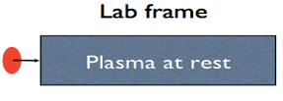
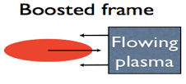

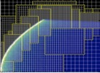
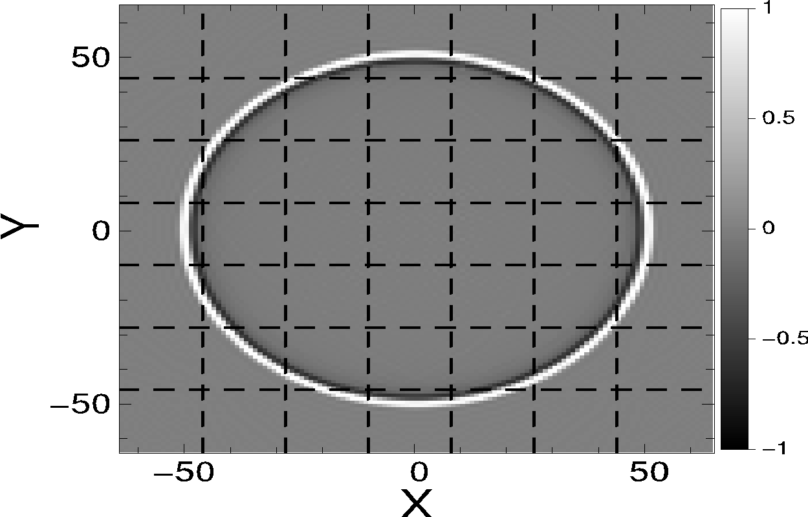

Advanced algorithms & advances in algorithms are needed
Lower # time steps
Optimal Lorentz boosted frame
Time-averaged PIC
Higher accuracy
Spectral (FFT-based) Maxwell solvers (PSATD)
Particles in Perfectly Matched Layers (PML)
(Adaptive) Mesh Refinement
Preserve scalability
PSATD: FFT on local subdomains
Hybrid alternating nodal-staggered PIC
Higher stability
Galilean PSATD suppresses Numerical Cherenkov Instability (NCI)
Lorentz
Transform
Notes:
Instructions:
List any technical, programmatic, or personnel challenges / risks and if / how you plan to manage them

Slide 17
Advanced algorithms & advances in algorithms are needed
Lower # time steps
Optimal Lorentz boosted frame
Time-averaged PIC
Higher accuracy
Spectral (FFT-based) Maxwell solvers (PSATD)
Particles in Perfectly Matched Layers (PML)
(Adaptive) Mesh Refinement
Preserve scalability
PSATD: FFT on local subdomains
Hybrid alternating nodal-staggered PIC
Higher stability
Galilean PSATD suppresses Numerical Cherenkov Instability (NCI)
Lorentz
Transform
Notes:
Instructions:
List any technical, programmatic, or personnel challenges / risks and if / how you plan to manage them

Slide 18
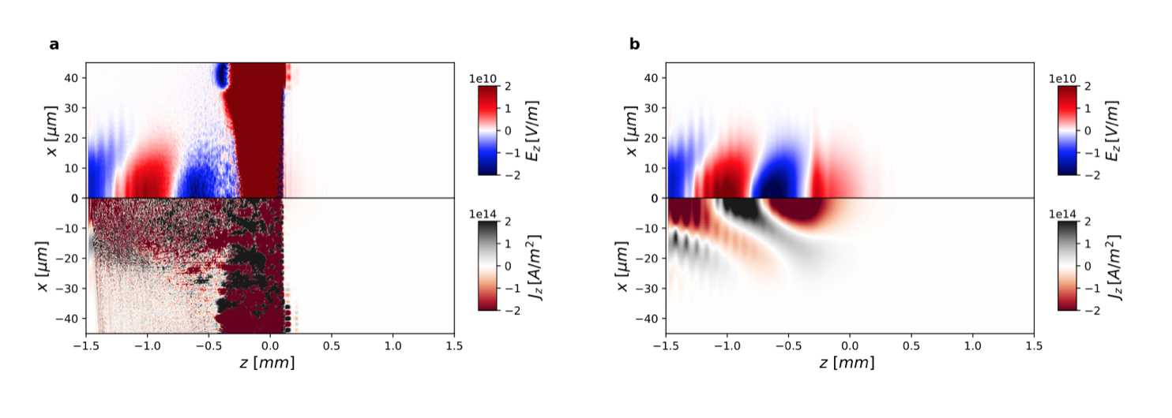
Simulations in boosted frame can be limited by CFL condition
z
Lorentz
Transform
x
Δz<<Δx
Δz>>Δx
Unstable
Attempting to simulate
with Galilean PSATD-PIC
with cΔt=Δz
laser
Notes:
Instructions:
List any technical, programmatic, or personnel challenges / risks and if / how you plan to manage them

Slide 19
Instability with large time step comes from time aliases
Standard PSATD PIC: fields are sampled at each time step ➔ aliasing
Push particles
Gather forces
Deposit currents
iFFT: k➔x
FFT: x➔k
Field solve in k-space
O. Shapoval, et al., Phys. Rev. E 104, 055311 (2021) doi.org/10.1103/PhysRevE.104.055311

Slide 20
Solution is to average analytically fields to gather
Standard PSATD PIC: fields are sampled at each time step ➔ aliasing
Push particles
Takes advantage of PSATD solver to average fields analytically
Gather forces
Deposit currents
iFFT: k➔x
FFT: x➔k
Solution:
Average fields to gather over 1 time step*
The fields that evolve with Maxwell’s equations are untouched (no field damping over time)
Field solve in k-space
O. Shapoval, et al., Phys. Rev. E 104, 055311 (2021) doi.org/10.1103/PhysRevE.104.055311
*proposed by R. Lehe

Slide 21
Averaged PSATD PIC stabilizes simulations at large time steps
Δz=10Δx
Example: cΔt=Δz=10Δx
Δx
Standard Galilean PSATD-PIC
Averaged Galilean PSATD-PIC
Velocity push:
Sampled fields within time step
Averaged field within time step
Unstable
Stable
laser
laser
*O. Shapoval, et al., Phys. Rev. E 104, 055311 (2021) doi.org/10.1103/PhysRevE.104.055311

Slide 22
Advanced algorithms & advances in algorithms are needed
Lower # time steps
Optimal Lorentz boosted frame
Time-averaged PIC
Higher accuracy
Spectral (FFT-based) Maxwell solvers (PSATD)
Particles in Perfectly Matched Layers (PML)
(Adaptive) Mesh Refinement
Preserve scalability
PSATD: FFT on local subdomains
Hybrid alternating nodal-staggered PIC
Higher stability
Galilean PSATD suppresses Numerical Cherenkov Instability (NCI)
Lorentz
Transform
Notes:
Instructions:
List any technical, programmatic, or personnel challenges / risks and if / how you plan to manage them

Slide 23
Staggered vs nodal Maxwell solve pros & cons
Staggered (Yee)
E,B,J
E,B,J
E,B,J
E,B,J
Nodal
E,B,J
E,B,J
E,B,J

Slide 24


Staggered vs nodal Maxwell solve: dispersion relation
Staggered (Yee)
staggered
nodal
E,B,J
E,B,J
E,B,J
E,B,J
order 16
Nodal
E,B,J
E,B,J
E,B,J

Slide 25
Staggered vs nodal Maxwell solve: compactness of stencil support
Staggered (Yee)
nodal
staggered
E,B,J
E,B,J
E,B,J
E,B,J
Nodal
E,B,J
E,B,J
E,B,J

Slide 26
Staggered vs nodal Maxwell solve: stability with domain decomposition
Staggered (Yee)
nodal
staggered
E,B,J
E,B,J
E,B,J
E,B,J
Nodal
E,B,J
E,B,J
E,B,J

Slide 27
Staggered vs nodal Maxwell solve: interpolation errors
Staggered (Yee)
E + v x B
E,B,J
E,B,J
E,B,J
E,B,J
Nodal
E,B,J
E,B,J
E,B,J

Slide 28
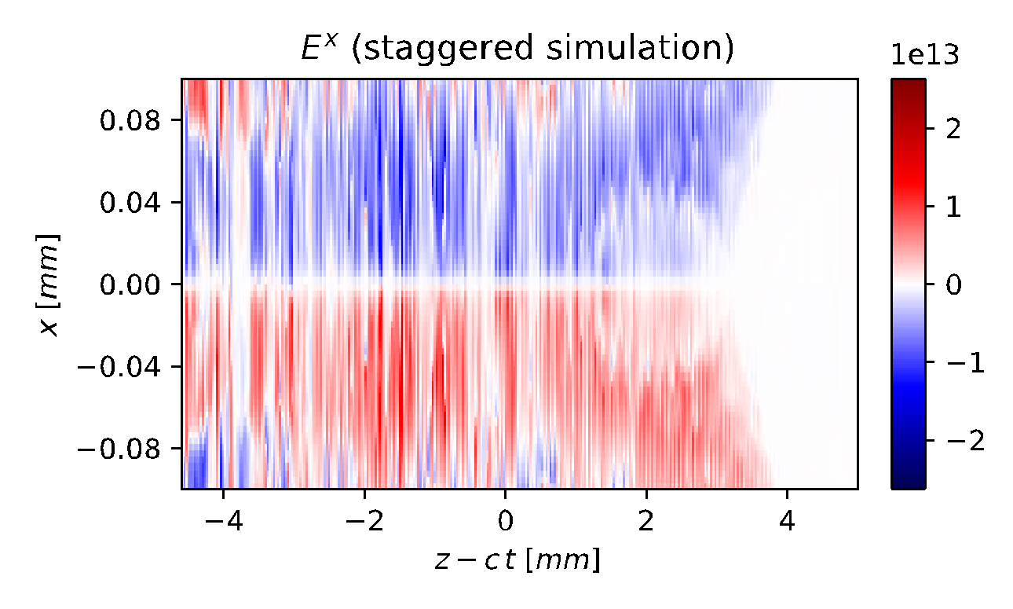
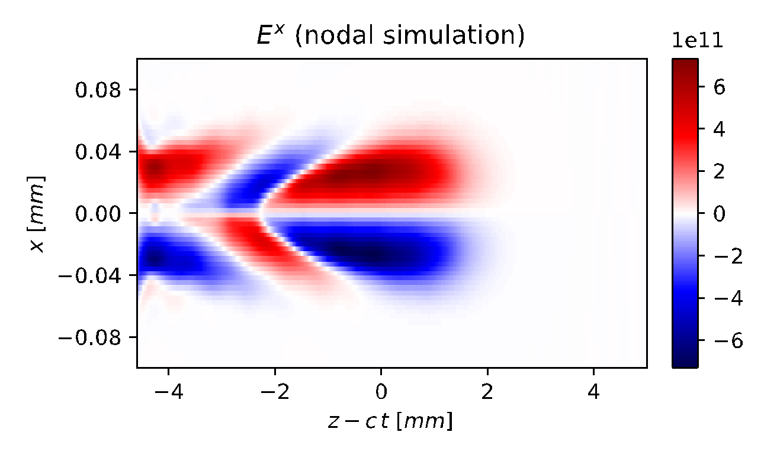
Staggered vs nodal Maxwell solve: numerical Cherenkov instability (NCI)
Staggered - unstable
Staggered (Yee)
laser
E,B,J
E,B,J
Nodal - stable
E,B,J
E,B,J
Nodal
E,B,J
E,B,J
E,B,J

Slide 29


Staggered vs nodal Maxwell solve: summary
Numerical dispersion
Stencil compactness
Stability w/ domain decomposition
Interpolation errors
NCI
Field
solve
Staggered (Yee)
E,B,J
E,B,J
Numerical dispersion
Stencil compactness
Stability w/ domain decomposition
Interpolation errors
NCI
E,B,J
E,B,J
Nodal
Field
gather
E,B,J
E,B,J
E,B,J

Slide 30
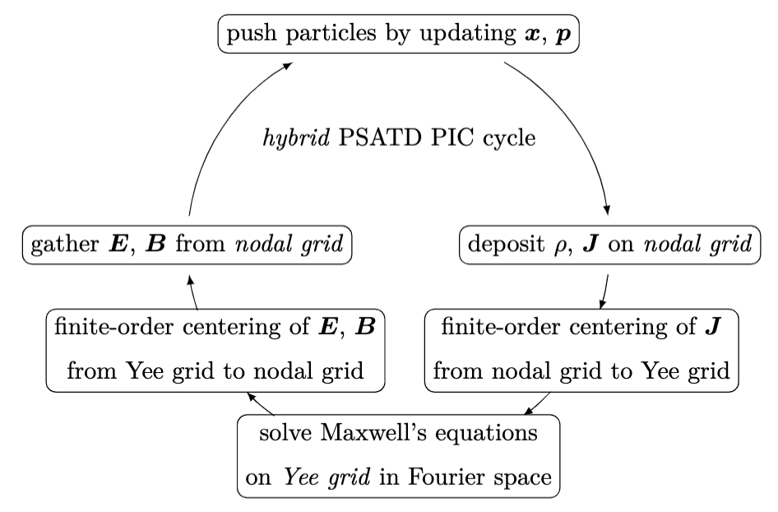
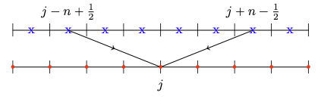
Staggered vs nodal Maxwell solve: retaining advantages of both
Staggered (Yee)
E,B,J
E,B,J
E,B,J
E,B,J
Staggered
Nodal
E,B,J
Nodal
E,B,J
E,B,J

Slide 31
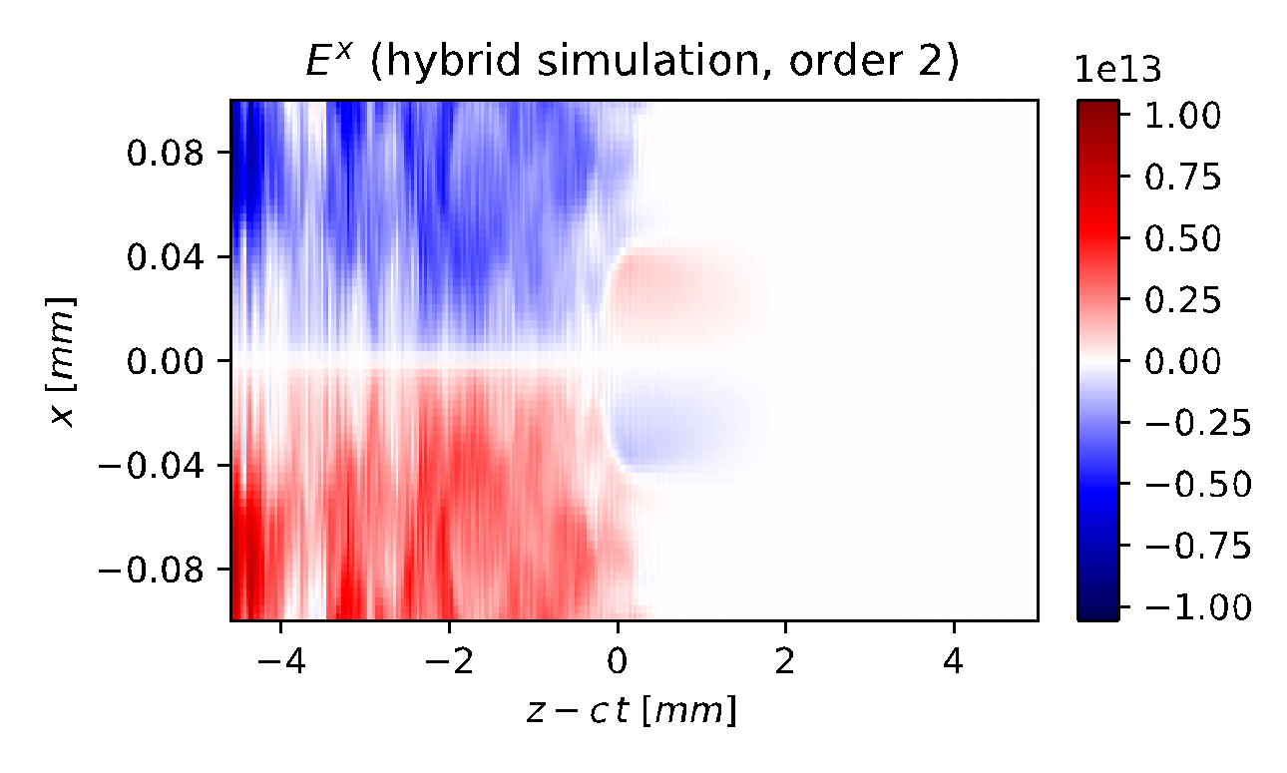
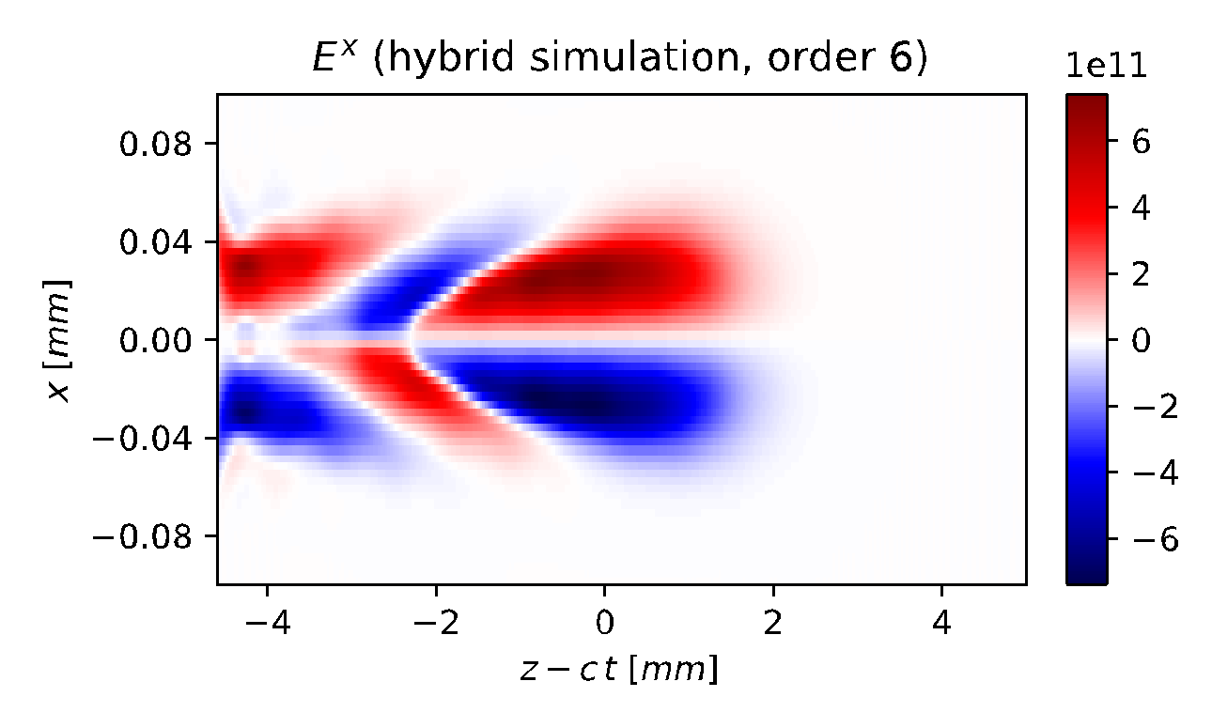
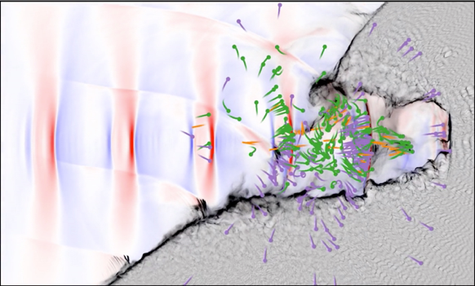
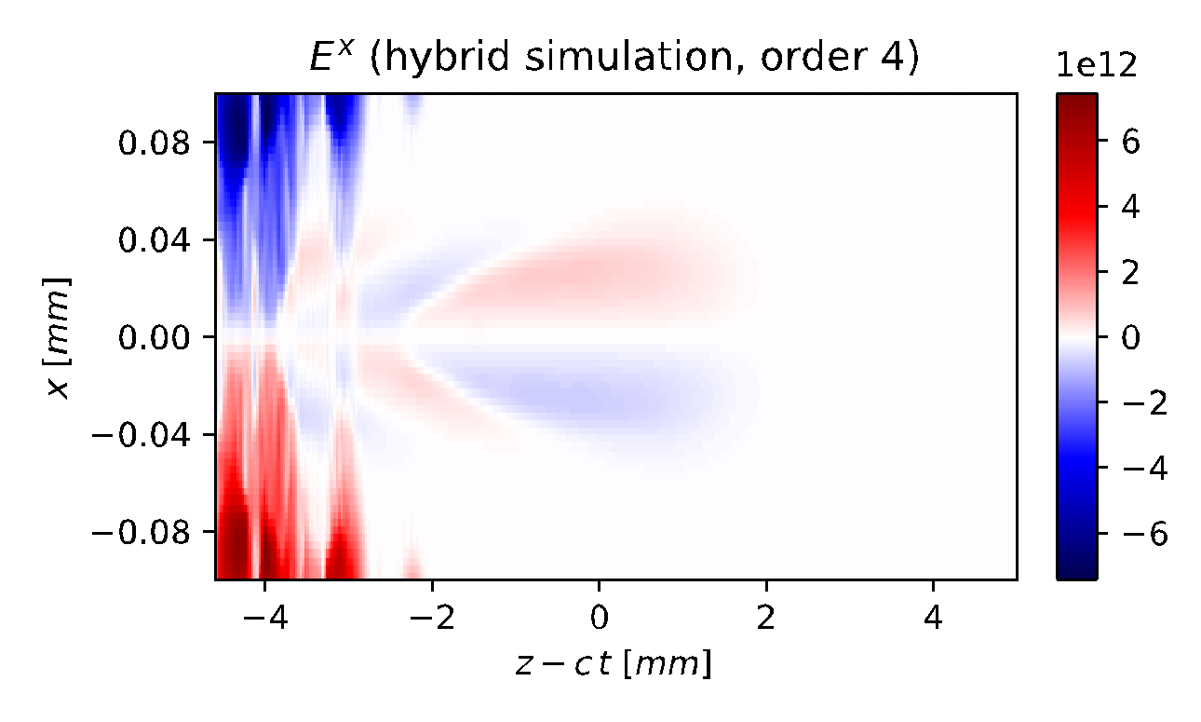
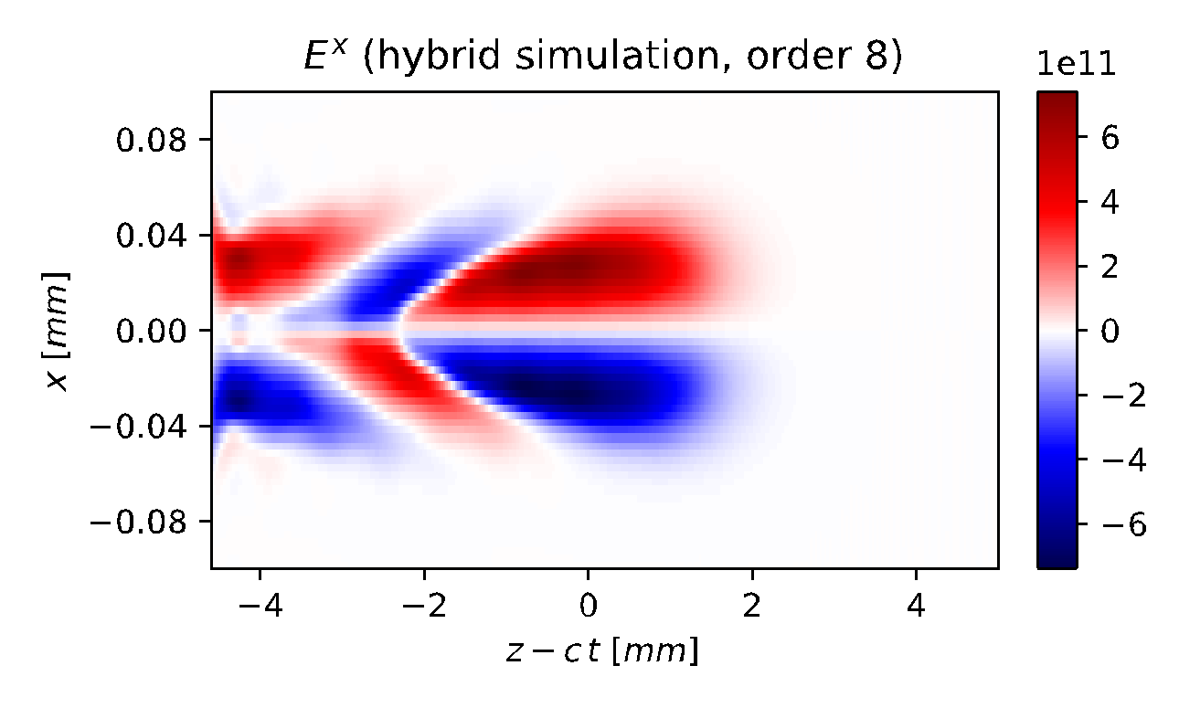
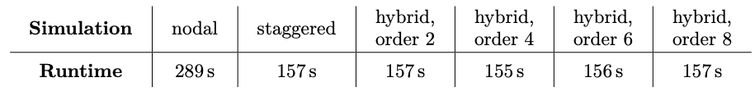
Alternating nodal-staggered PIC loop provides significant speedup
~✕2 speedup simulations of laser-plasma accelerator
~✕10 speedup simulations of high-field physics with QED effects*
Nodal: stable
Alternating: order 2
Alternating: order 6
Mitigates calculation of (E²-c²B²) from staggered grid.
laser
More guard cells
Staggered: unstable
Alternating: order 4
Alternating: order 8
Less guard cells
Alternating
Alternating
Alternating
Alternating
*E. Zoni, et al., Comput. Phys. Comm. 279, 108457 (2022) doi.org/10.1016/j.cpc.2022.108457

Slide 32
Advanced algorithms & advances in algorithms are needed
Lower # time steps
Optimal Lorentz boosted frame
Time-averaged PIC
Higher accuracy
Spectral (FFT-based) Maxwell solvers (PSATD)
Particles in Perfectly Matched Layers (PML)
(Adaptive) Mesh Refinement
Preserve scalability
PSATD: FFT on local subdomains
Hybrid alternating nodal-staggered PIC
Higher stability
Galilean PSATD suppresses Numerical Cherenkov Instability (NCI)
Lorentz
Transform
Notes:
Instructions:
List any technical, programmatic, or personnel challenges / risks and if / how you plan to manage them

Slide 33
Advanced algorithms & advances in algorithms are needed
Lower # time steps
Optimal Lorentz boosted frame
Time-averaged PIC
Higher accuracy
Spectral (FFT-based) Maxwell solvers (PSATD)
Particles in Perfectly Matched Layers (PML)
(Adaptive) Mesh Refinement
Preserve scalability
PSATD: FFT on local subdomains
Hybrid alternating nodal-staggered PIC
Higher stability
Galilean PSATD suppresses Numerical Cherenkov Instability (NCI)
Lorentz
Transform
Notes:
Instructions:
List any technical, programmatic, or personnel challenges / risks and if / how you plan to manage them

Slide 34
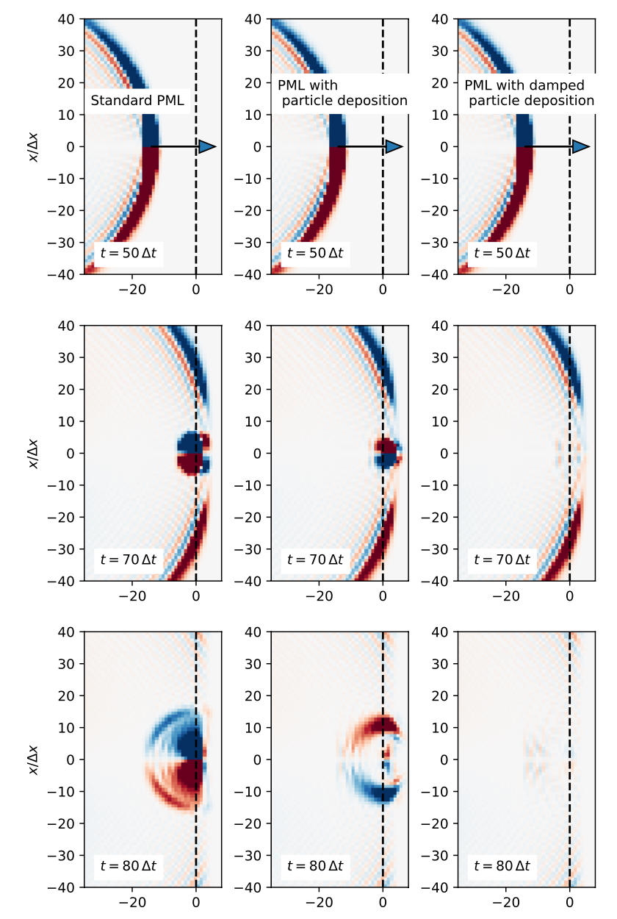


New algorithm to handle particles crossing Perfectly Matched Layers*
Standard PML
Standard Perfectly Matched Layer (PML)
Additional terms are exact solution for absorbing layer for particles crossing PMLs at normal incidence.
*R. Lehe, et al., Phys. Rev. E 106, 045306 (2022) doi.org/10.1103/PhysRevE.106.045306

Slide 35
New algorithm to handle particles crossing Perfectly Matched Layers*
Standard PML
PML w/ deposition
Standard Perfectly Matched Layer (PML)
New terms for particles crossing PML
Additional terms are exact solution for absorbing layer for particles crossing PMLs at normal incidence.
*R. Lehe, et al., Phys. Rev. E 106, 045306 (2022) doi.org/10.1103/PhysRevE.106.045306

Slide 36
New algorithm to handle particles crossing Perfectly Matched Layers*
Standard PML
PML w/ deposition
PML w/ damped deposition
Standard Perfectly Matched Layer (PML)
New terms for particles crossing PML
Additional terms are exact solution for absorbing layer for particles crossing PMLs at normal incidence.
*R. Lehe, et al., Phys. Rev. E 106, 045306 (2022) doi.org/10.1103/PhysRevE.106.045306

Slide 37
Provides efficient absorption of e- ejected transversally in LPA simulations
*R. Lehe, et al., Phys. Rev. E 106, 045306 (2022) doi.org/10.1103/PhysRevE.106.045306

Slide 38
Absorption is less perfect when particles are ejected at a lower angle.
Work is ongoing to extend algorithms to wider range of angles.
*R. Lehe, et al., Phys. Rev. E 106, 045306 (2022) doi.org/10.1103/PhysRevE.106.045306

Slide 39
Advanced algorithms & advances in algorithms are needed
Lower # time steps
Optimal Lorentz boosted frame
Time-averaged PIC
Higher accuracy
Spectral (FFT-based) Maxwell solvers (PSATD)
Particles in Perfectly Matched Layers (PML)
(Adaptive) Mesh Refinement
Preserve scalability
PSATD: FFT on local subdomains
Hybrid alternating nodal-staggered PIC
Higher stability
Galilean PSATD suppresses Numerical Cherenkov Instability (NCI)
Lorentz
Transform
Notes:
Instructions:
List any technical, programmatic, or personnel challenges / risks and if / how you plan to manage them

Slide 40


MR simulation with 4x refinement to simulate LWFA with ion motion
Maxwell Solver : PSATD
Refinement Ratio = 4 4 1
$$Δx_{c}=Δy_{c}=1.56 μm \\ Δx_{f}=Δy_{f}=0.195 μm$$

Slide 41


More than 6x cost saving with 4 4 1 mesh refinement
Transverse lineout of focusing field and ion density at $z=75 μm$ (towards the end of the bubble, where ion motion is prominent)
Transverse electric field
Ions charge density
Without Mesh Refinement
(#Nodes)*(Time)
= 22*0.409 = 9.002
With Mesh Refinement
(#Nodes)*(Time)
= 5*0.269 = 1.345
Computational Cost
Estimates
6.69x less node hours used with MR!

Slide 42
Outlook

Slide 43


Can do now simulations of chains of 50 multi-GeV LWFA stages
LWFA lattice:
Length plasma columns: 28cm
Gaps: 3cm
Plasma lens model: linear thick lens (3 mm) w/ “residence correction”
Electron beam:
Charge: -1 fC
Size: 0.75 μm x 0.75 μm x 0.1 μm
Emittance: 1 mm.mrad
Grid size/resolution:
128 x 128 x 17664
2 μm x 2 μm x 0.01 μm
Computer: 256 GPUs for 8h on Perlmutter (NERSC)
Work in collaboration with A. Ferran Pousa (DESY)

Slide 44




Or high-resolution simulations of a few multi-GeV LWFA stages
Iteration 14800; t = 51.4 ps
E_{z} [V/m]
ρ [C/m³]
Stage 5
Stage 4
LWFA lattice:
Length plasma columns: 32cm
Gaps: 1cm
Electron beam:
Charge: -0.15 nC
Size: 0.6 μm x 0.6 μm x 3 μm
Emittance: 0.25 mm.mrad
Grid size/resolution:
2304 x 2304 x 19456
0.14 μm x 0.14 μm x 0.008 μm
Computer: 49248 GPUs for 12h on Frontier (OLCF)
Stage 3
e⁻ beam
Stage 2

Slide 45
RZ solver w/ novel algorithms for faster/bigger/longer simulations
Geometries
1D3V, 2D3V,
3D3V and
RZ (quasi-
cylindrical)
Multi-Physics Modules beyond standard PIC
ionization, Coulomb collisions, QED processes, Maxwell’s Eq. in matter, embedded boundaries
Advanced Algorithms
mesh refinement, Maxwell spectral solvers, boosted frame, Galilean frame, …
Algorithms developed for 3D simulations are also being implemented in axisymmetrical (+ azimuthal Fourier decomposition) for modeling:
faster
at higher resolution
longer chains of plasma accelerator stages
Open source
ecp-warpx.github.io

Slide 46

















































WarpX: conceived & developed by a multidisciplinary, multi-institution team
Jean-Luc Vay (ECP PI)
Arianna Formenti
Marco Garten
Axel
Huebl
Rémi
Lehe
Ryan
Sandberg
Olga Shapoval
Yinjian
Zhao
Edoardo
Zoni
Ann Almgren
(ECP coPI)
John
Bell
Kevin
Gott
Junmin
Gu
Revathi
Jambunathan
Hannah Klion
Prabhat Kumar
Andrew
Myers
Weiqun
Zhang
AM
David Grote
(ECP coPI)
(NESAP)
a growing list of contributors from labs, universities…
Henri
Vincenti
Luca
Fedeli
Thomas
Clark
Neïl
Zaim
Pierre
Bartoli
Maxence Thévenet
Alexander
Sinn
Marc Hogan
(ECP coPI)
Lixin
Ge
Cho
Ng
(France)
(Germany)
…& private sector
Lorenzo
Giacomel
(Switzerland)

Slide 47
Outlook: Ecosystem is growing
Python: Modules, PICMI interface, Workflows
WarpX
full PIC, LPA/LPI
HiPACE++
quasi-static, PWFA
ARTEMIS
microelectronics
ImpactX
accelerator lattice design
Object-Level Python Bindings
extensible, AI/ML
pyAMReX
PICSAR
QED Modules
ABLASTR library: common PIC physics
AMReX
Containers, Communication,
Portability, Utilities
Diagnostics
I/O
code coupling
FFT
on- or multi- device
Lin.
Alg.
BLAS++
LAPACK++
openPMD
...
Ascent
Desktop
to
HPC
ADIOS2
HDF5
VTK-m
ZFP
MPI
CUDA, OpenMP, SYCL, HIP
Notes:
lead
data-driven (AI/ML) activities
start-to-end
transform community of compete projects into community ecosystem of interoperable modules
competition/duplication
we need them together

Slide 48
Thank You!
Questions?

Slide 49
Funding Support
WarpX: longitudinal electric field in a laser-plasma accelerator
rendered with Ascent & VTK-m
This research was supported by the Exascale Computing Project (17-SC-20-SC), a collaborative effort of two U.S. Department of Energy organizations (Office of Science and the National Nuclear Security Administration) responsible for the planning and preparation of a capable exascale ecosystem, including software, applications, hardware, advanced system engineering and early testbed platforms, in support of the nation’s exascale computing imperative. This work was also performed in part by the Laboratory Directed Research and Development Program of Lawrence Berkeley National Laboratory under U.S. Department of Energy Contract No. DE-AC02-05CH11231, Lawrence Livermore National Laboratory under Contract No. DE-AC52–07NA27344 and SLAC National Accelerator Laboratory under Contract No. AC02–76SF00515.
This research used resources of the Oak Ridge Leadership Computing Facility, which is a DOE Office of Science User Facility supported under Contract DE-AC05-00OR22725, the National Energy Research Scientific Computing Center (NERSC), a U.S. Department of Energy Office of Science User Facility located at Lawrence Berkeley National Laboratory, operated under Contract No. DE-AC02-05CH11231, and the supercomputer Fugaku provided by RIKEN.

Slide 50


Plasma accelerators are challenging to model
Short driver+wake propagates through long plasma
wake
driver
plasma
Many time steps.
E.g., for a 10 GeV LPA scale stage:
~1μm wavelength laser propagates into ~1m plasma millions of time steps needed (even with moving window)
Very small features: Many grid cells.
Simulations (in 2D) can take days for 1 stage (at insufficient resolution for collider beam quality).
For multi-TeV collider, need for ×10s-1000s stages ×10s-1000s (high res. 3D) ×10s (ensembles)!
Need for advanced algorithms and supercomputing!

