Slide 1
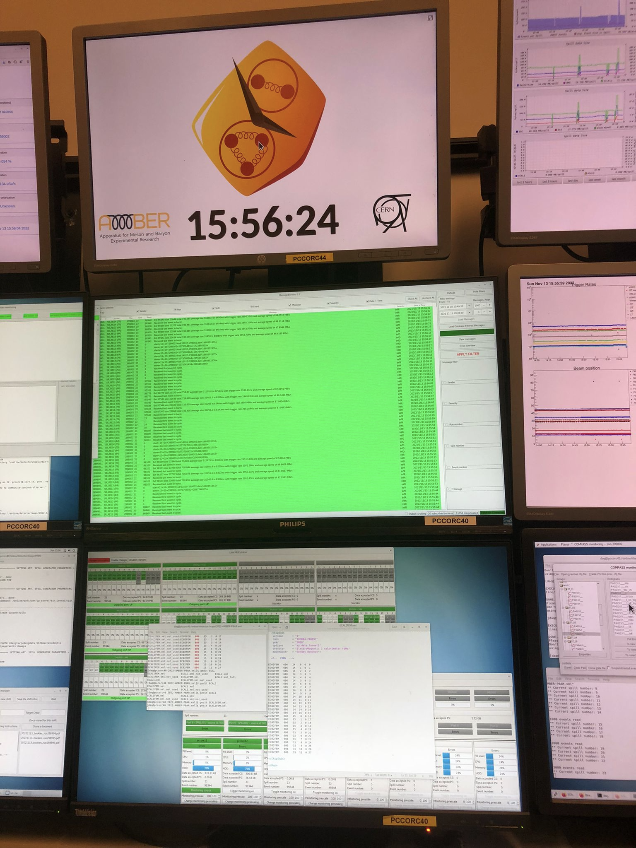
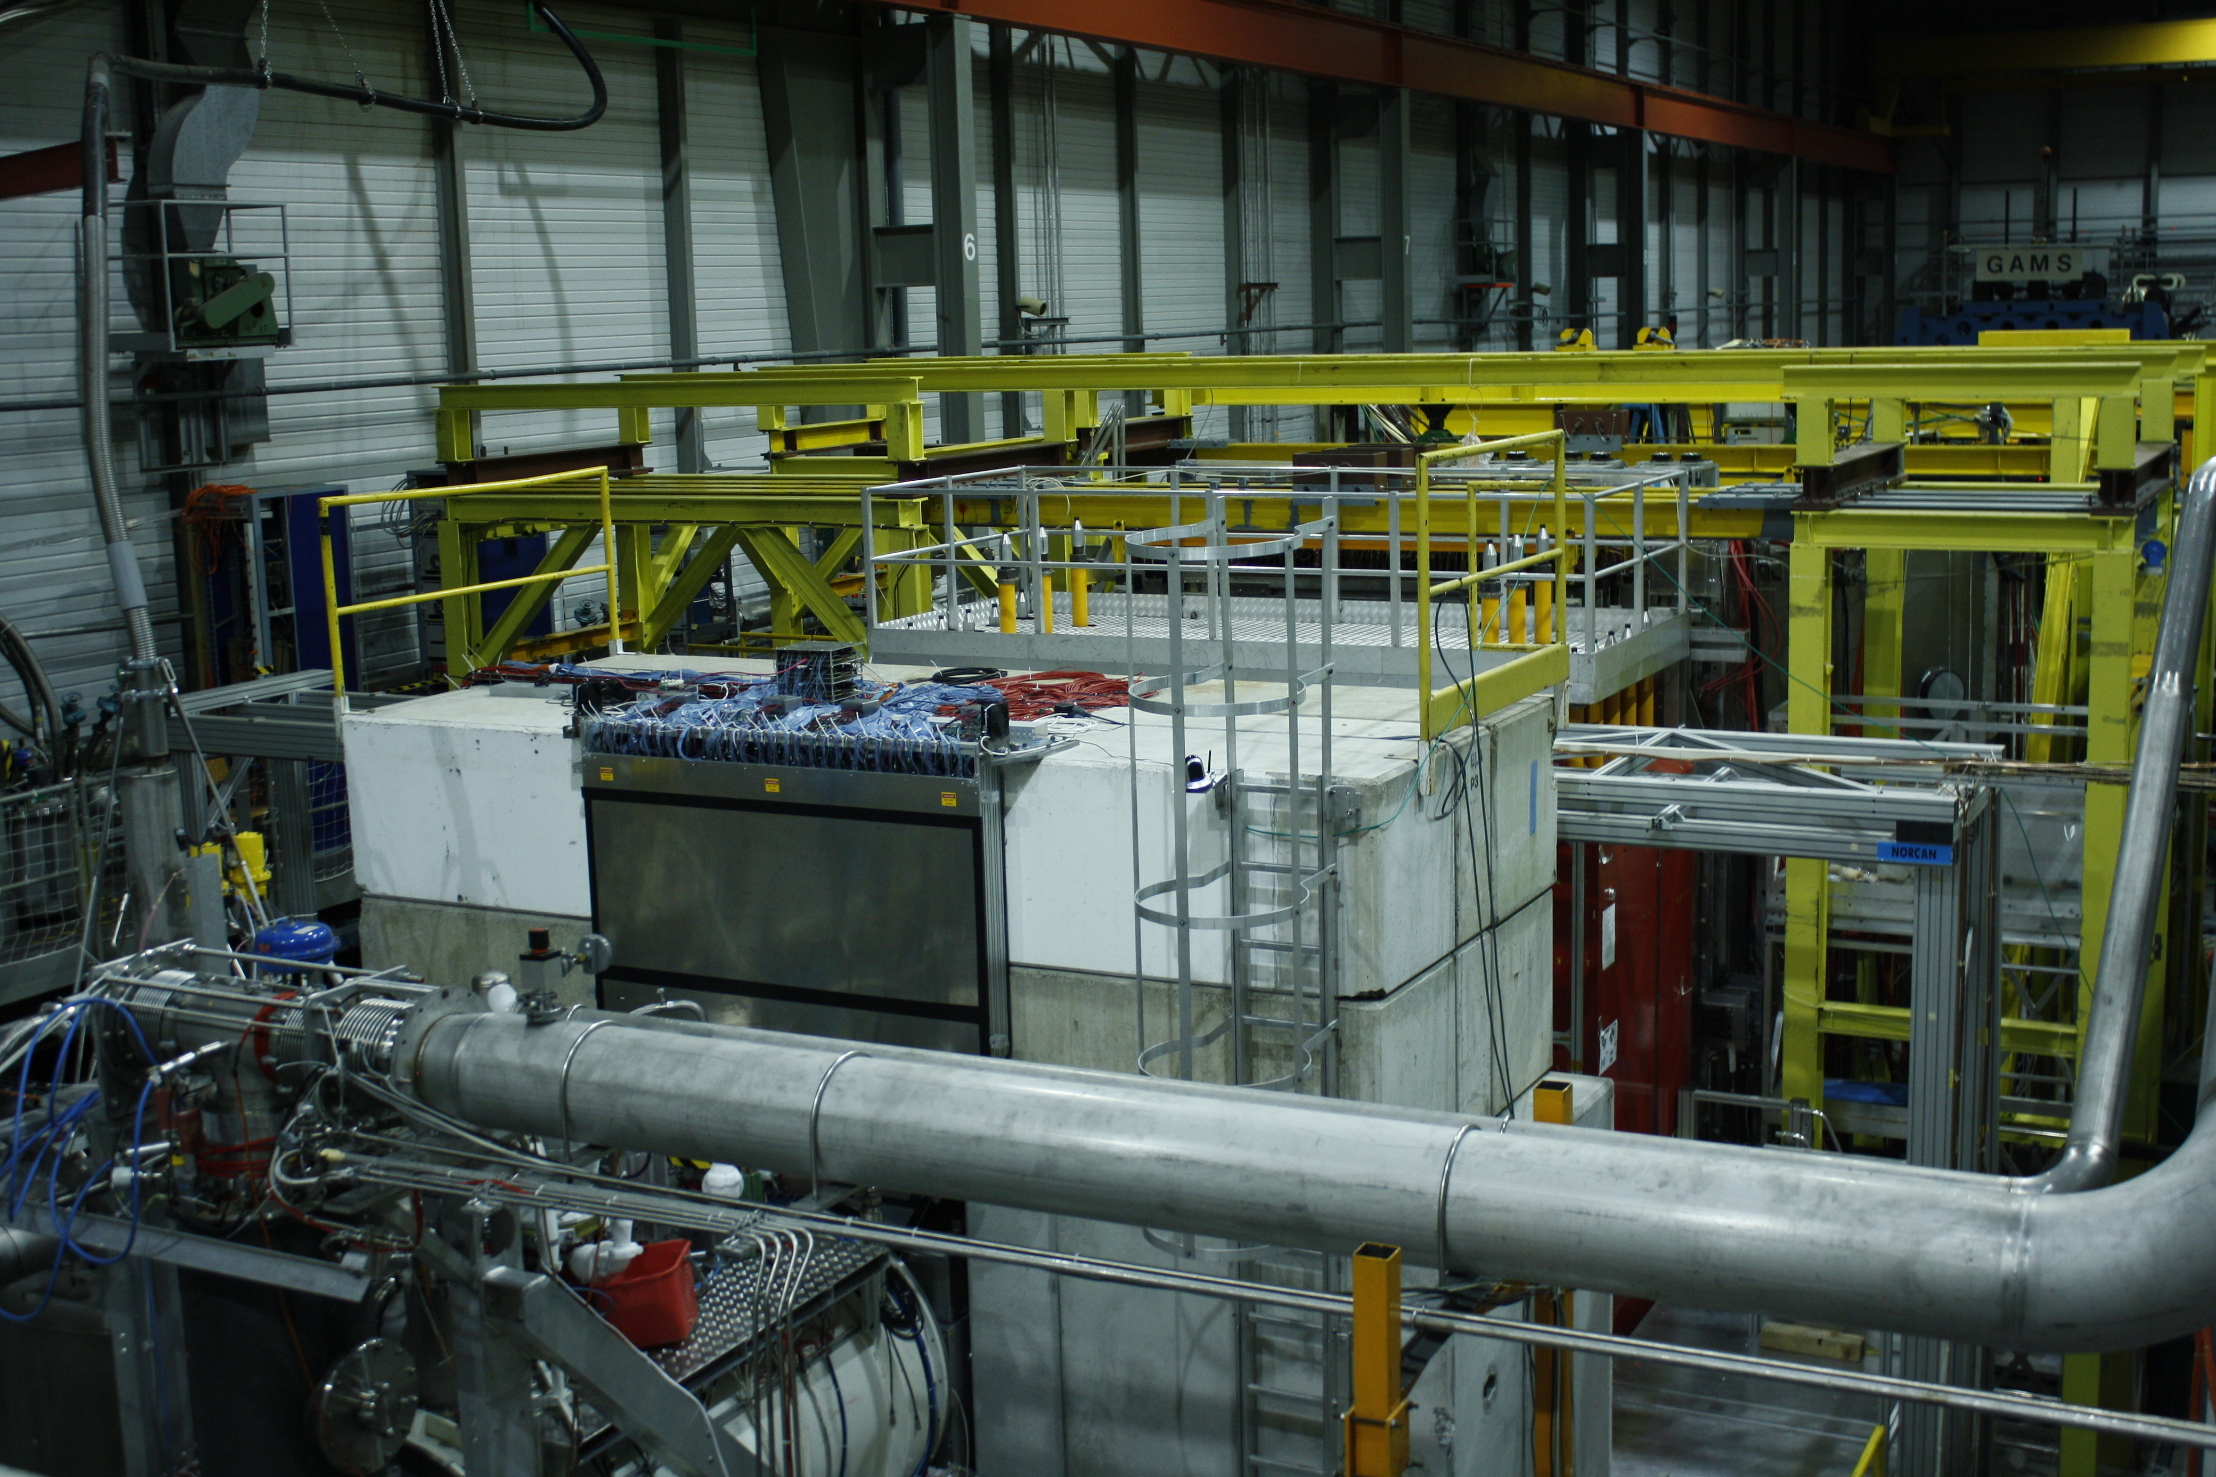
Meeting with SPSC referees 04/05/2023
AMBER – status of 2023 Run preparation and Tentative schedule
Outlook
Hardware Preparation (Moritz/Stefano):
APX
PRM
Extension request (DY high intensity test)
Tentative schedule

Slide 2
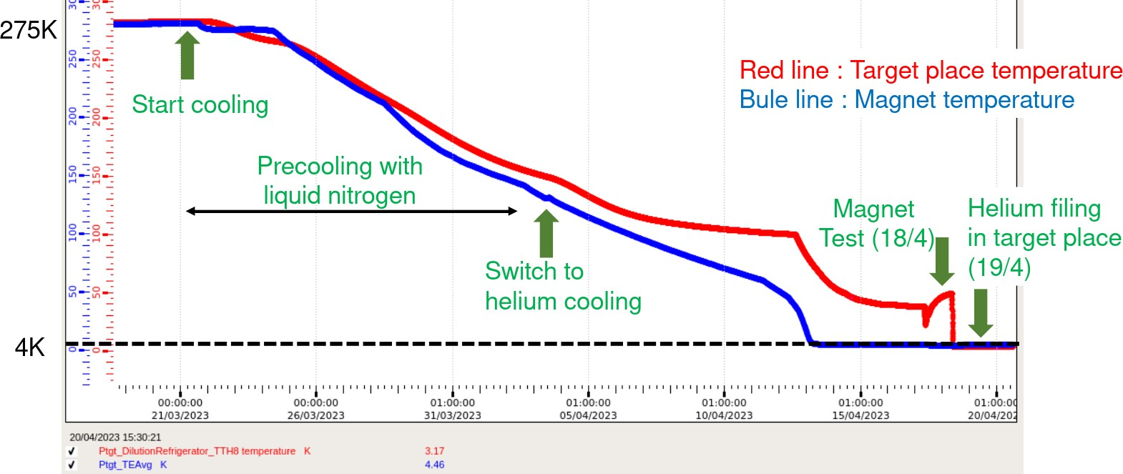
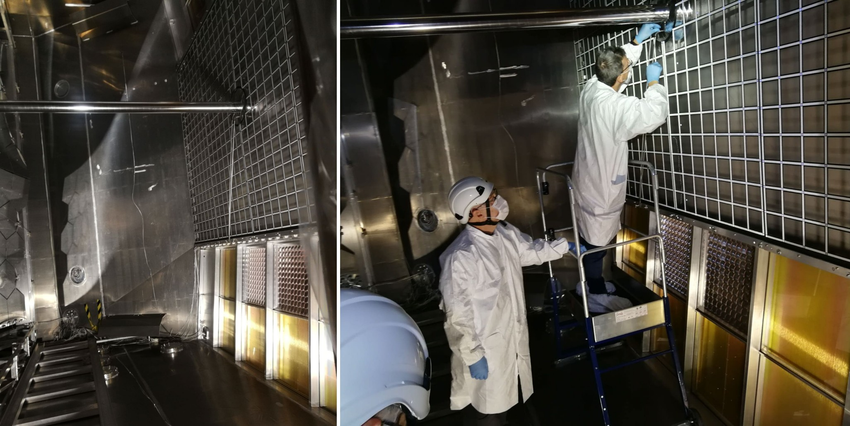
APX Run Preparation Status
Target Status:
Polarized target was successfully adapted as liquid He target. Cooling started 21. March, Filling with He 19. March
→ reached 1.1 K on 21. April.
Pt Magnet was tested on 18. April prior to hibernation.
Working package for rotating and hibernation of pt Target in discussion with EP-DT-DI.
RICH Beam Pipe Removal:
On March 28th the TB recommended the removal of the RICH beam pipe requested by the physics group.
We prepared a procedure document which was discussed and approved by CERN EP Safety.
The RICH was flushed with N2 before April 4th.
On April 19th the operation ws successfully performed.
AMBER TS Report May 2023

Slide 3
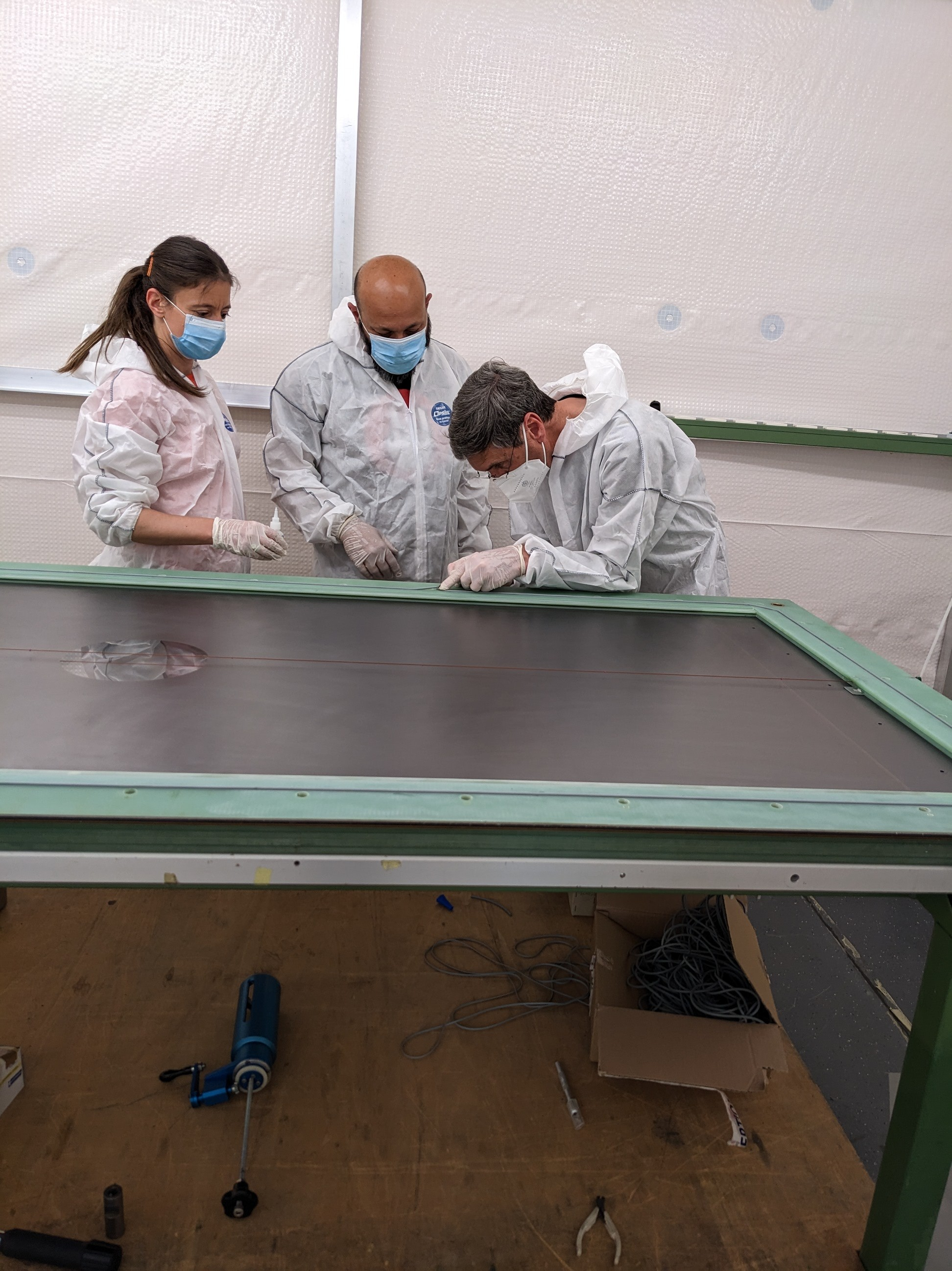
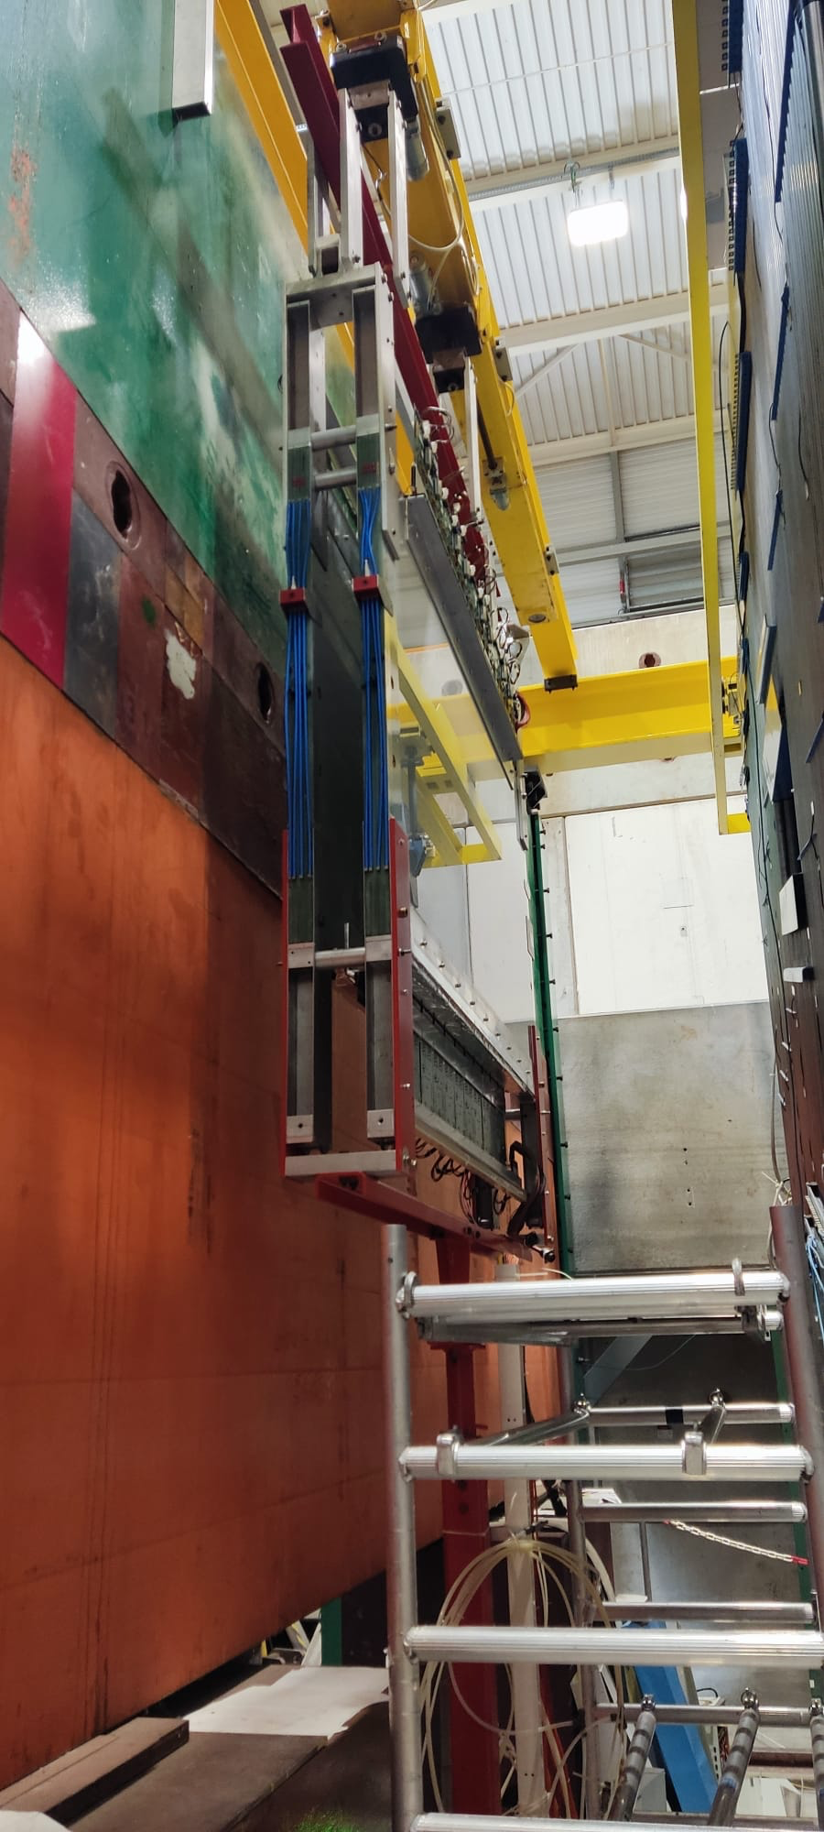
APX Run Preparation Status
Beam line commissioning started on 17. April and was concluded 27th.
After intensive cleanup of area, safety clearance was obtained on 28. April without major problems.
Some problems with the CEDAR detector installation
(alignment, gas system, readout).
→ Performance check for 60 GeV is planned for next week.
One MWPC was refurbished (exchange of mylar windows) RW throughout investigation of the readout problems.
→ Improved but still not fully under control.
BeamKiller installation was improved. RICH filling with radiator gas on 10. May.
First part of electron calibration for calorimeters was performed last weekend.
In general commissioning of the spectrometer went quite smooth with no major problems until now even though the major de-cabling campaign performed during the winter in EHN2.
Spectrometer expected to be ready for physics data taking on 15. May!
AMBER TS Report May 2023

Slide 4
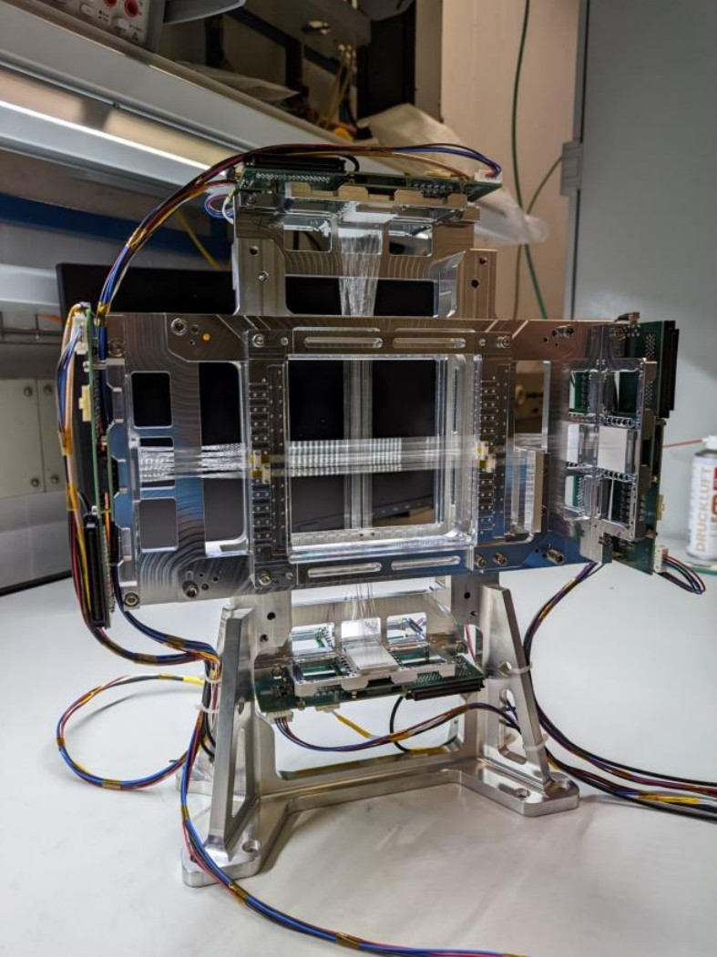
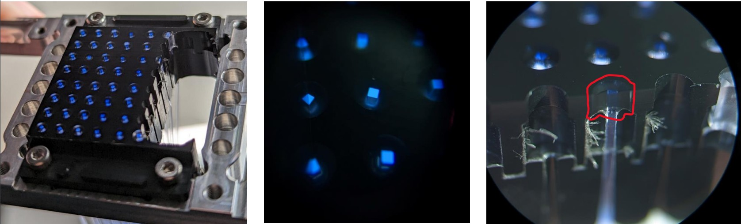
PRM Preparations - UTS - Preparations - Fiber Stations
2022 test of prototype equipped 32 fibers per plane (2X,2Y).
Results showed problems with the uniformity of fiber coupling to the SiPM.
Several lab tests were performed to improve the behavior.
Parasitic test of prototype planed during APX to confirm the new coupling method.
AMBER TS Report May 2023

Slide 5
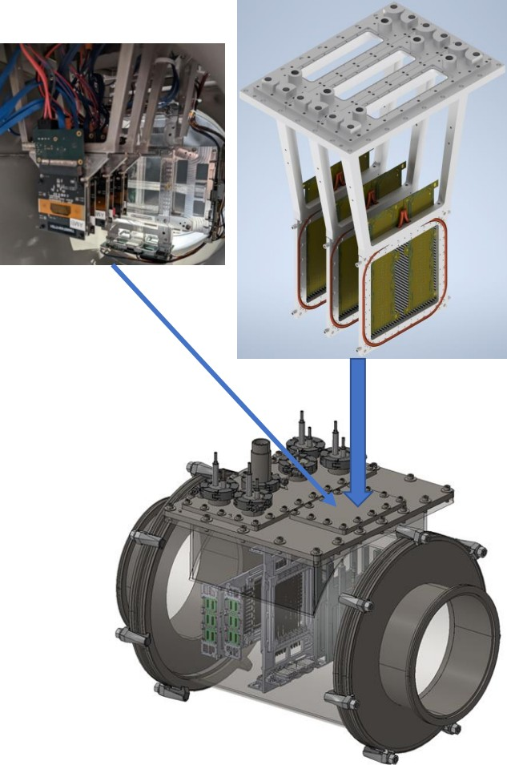
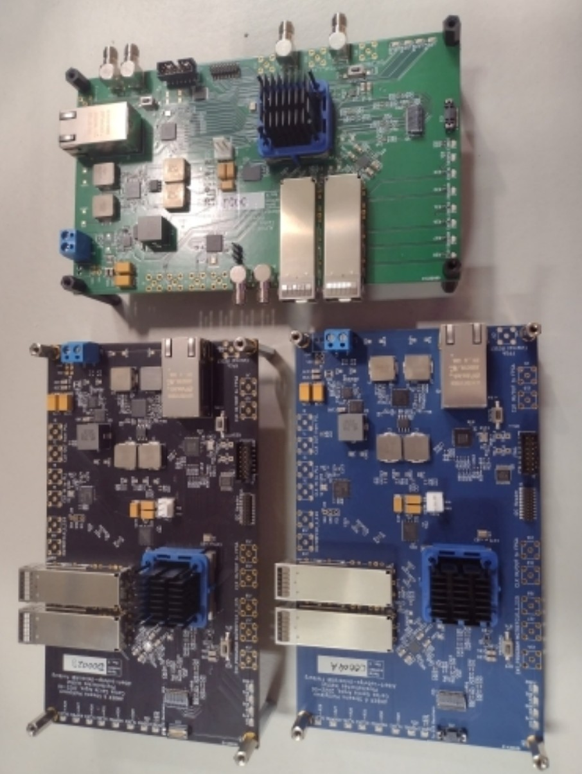
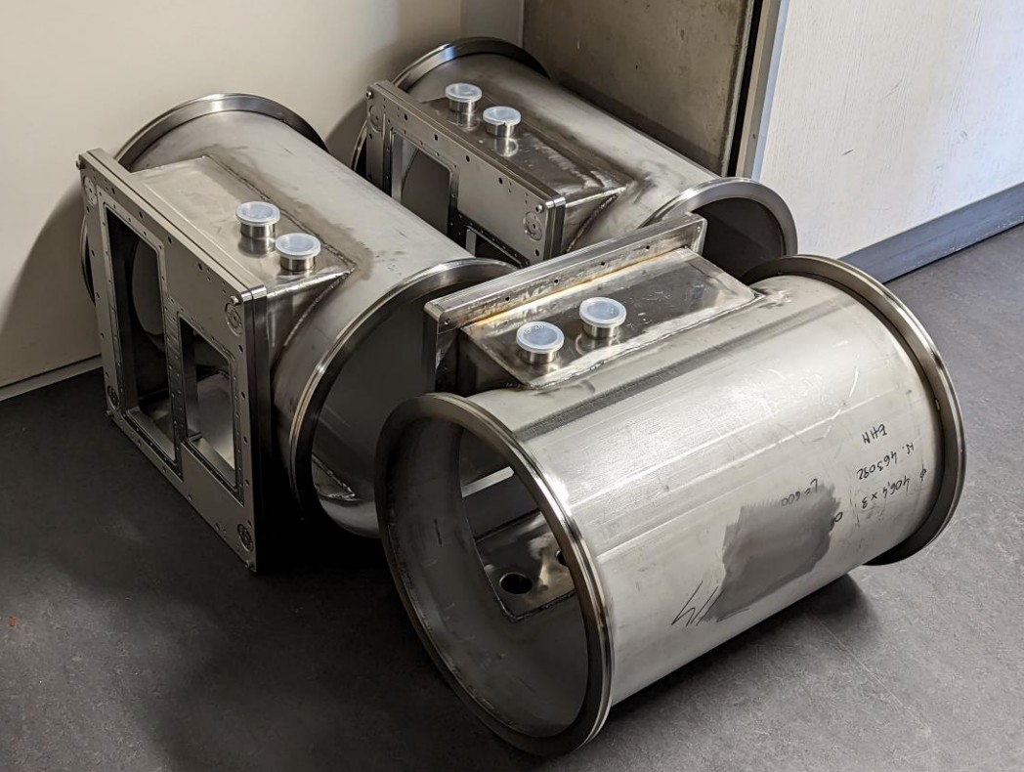
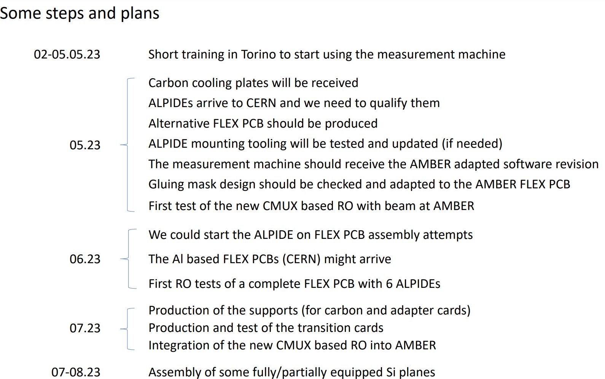
PRM Preparations - UTS - Preparations - Fiber Stations
Glasgow University took lead of the project.
160 ALPIDE sensors ordered.
Production of hardware on-going. Assembly sites will be Glasgow, Daresbury and probably Torino - Training of operators in Torino on-going.
Three iterations of readout boards – 18 boards produced - enough for 4 stations with one plane of 18 ALPIDE sensors each.
5 UTS vessels produced.
AMBER TS Report May 2023

Slide 6
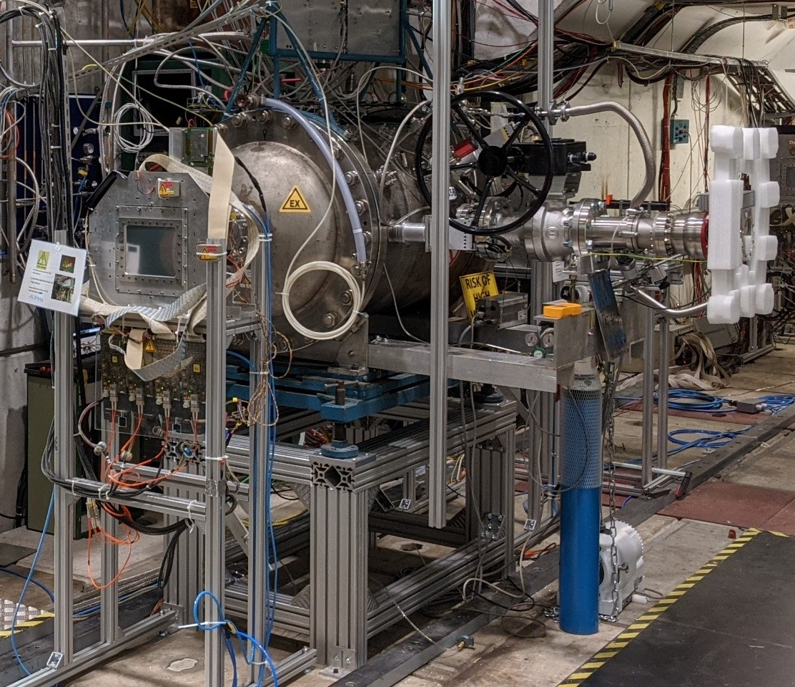
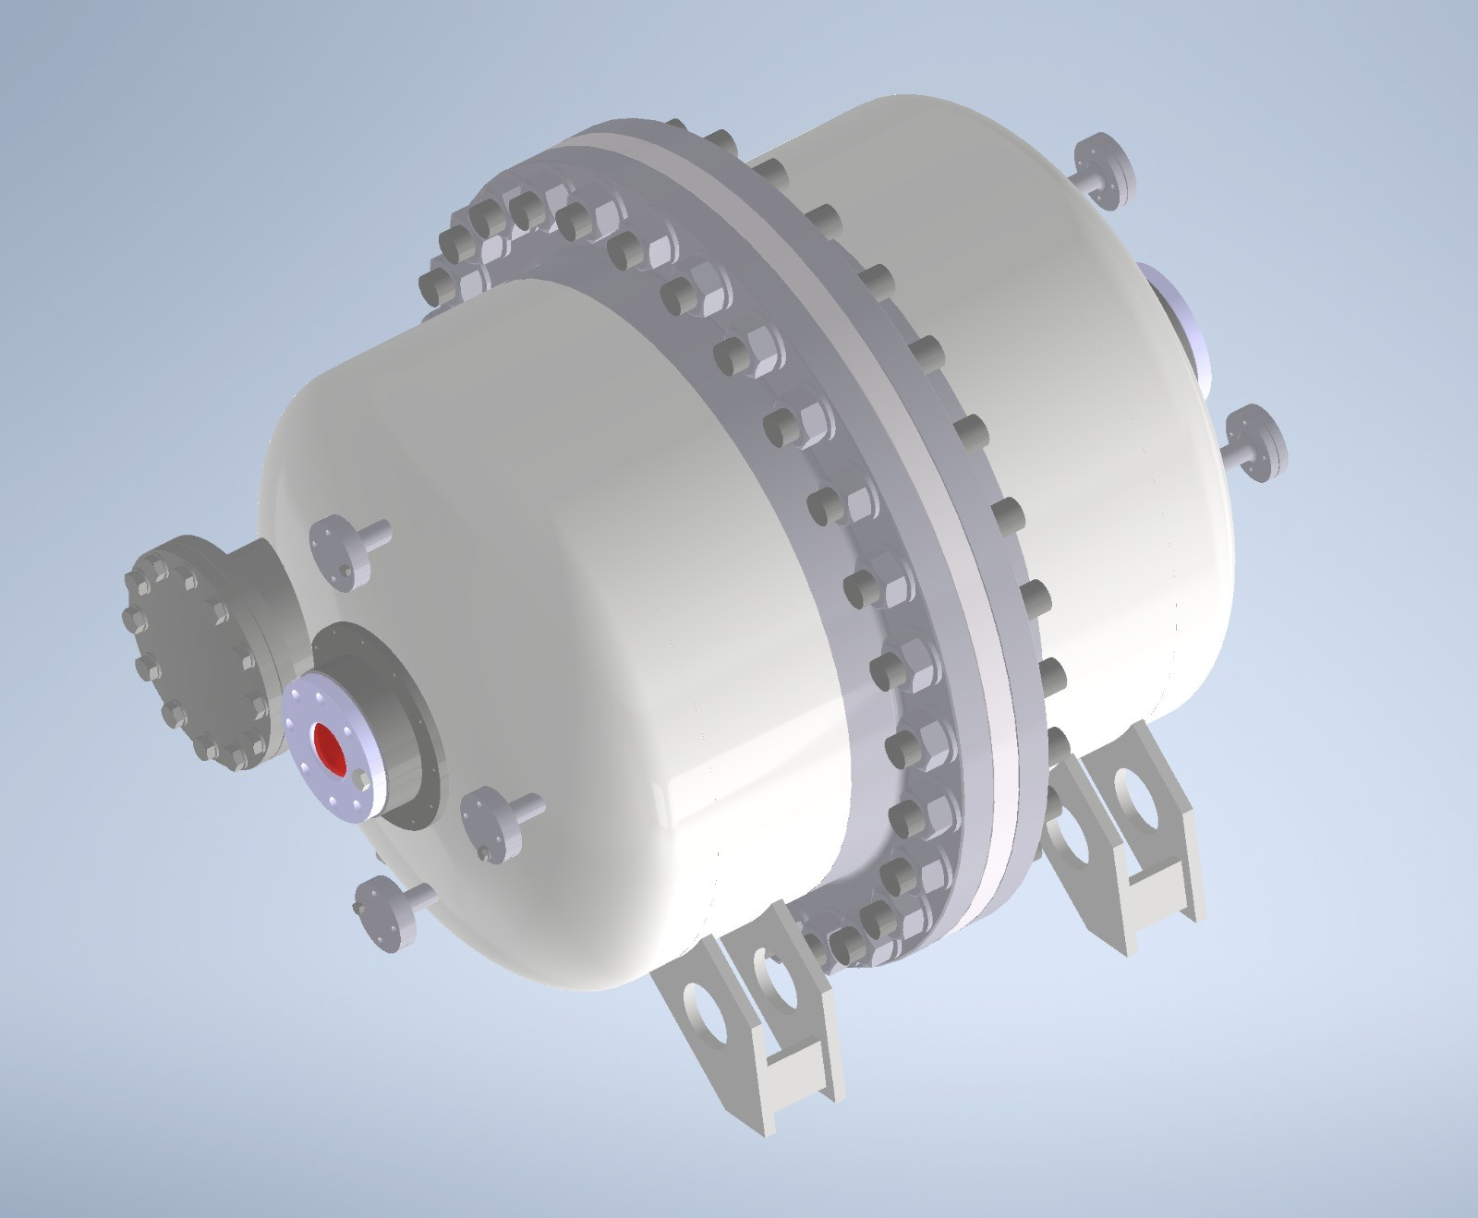
PRM Preparations - TPC
IKAR TPC (2023)
AMBER TPC (2024+)
Hydrogen, 8 bar max. pressure.
Currently at CERN under preparation.
New amplifier under development.
Read-Out will be changed to free-running capable system.
Hydrogen, max 20 bar.
Design phase of vessel is completed.
Several contacts with HSE/EP Safety during design phase.
Currently in production - awaiting construction plans of the company to be confirmed by safety and TU¨V.
Delivery time
AMBER TS Report May 2023

Slide 7
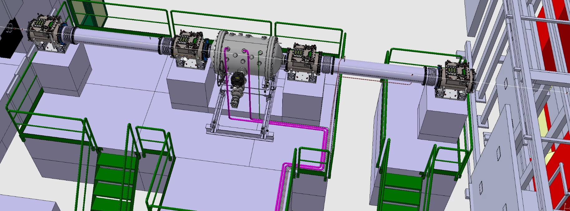
PRM - Setup Integration Work
BE-EA-EC - Planning for re-routing the hydrogen gas system is in end phase.
BE-EA-DC - General integration of setup and He beam pipes.
→ No He beam pipes this year (planned for 2024).
EP-DT-DI - Safety/Gas control system.
EN-AA-AS - Hydrogen detection system.
All installations are done to fit IKAR and AMBER TPC setup (2024+).
AMBER TS Report May 2023

Slide 8
APX running time extension – High Intensity DY test with two NA CEDARS and beam telescope
Plan to perform a short test of the CEDARs PID, using 7x10⁷ particles/second
– 2 nights (~16 hours total), mostly negative beam 190 GeV/c (shortly also positive beam)
– Beam telescope with 3 COMPASS Silicon detectors included (+ SciFIs)
– Spectrometer detectors kept off, magnets SM1 and SM2 on
– He target in place (as for pbar measurement), except if not possible due to RP contraints
– Possibly using beam trigger, and prescaling
– Measurements varying pressure in the CEDARs
Goal of the test:
To test performance of the CEDARS PID in the Drell-Yan running conditions and using high precision
Detectors in the AMBER Beam Telescope (Silicon detectors) for back-tracking in the CEDARs area.
Pre-requisite of the test: both NA CEDARs are installed in the beam line.
Main difficulty: no time for hadron absorber or additional shielding installation. Requires
agreement from RP group (and no access to the Hall and surroundings during test).

Slide 9
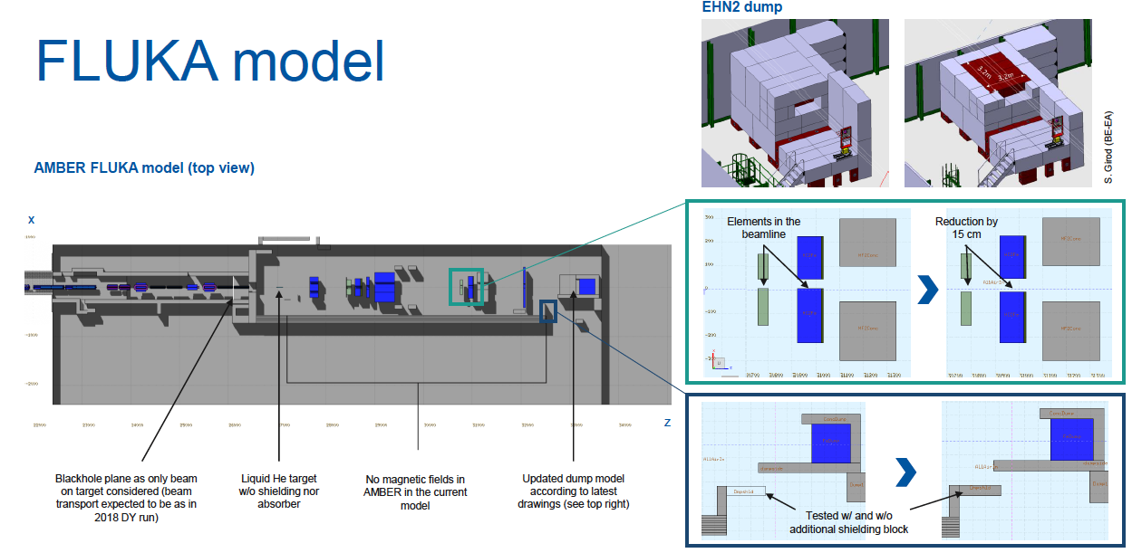
APX running time extension – High Intensity DY test with two NA CEDARS and beam telescope

Slide 10
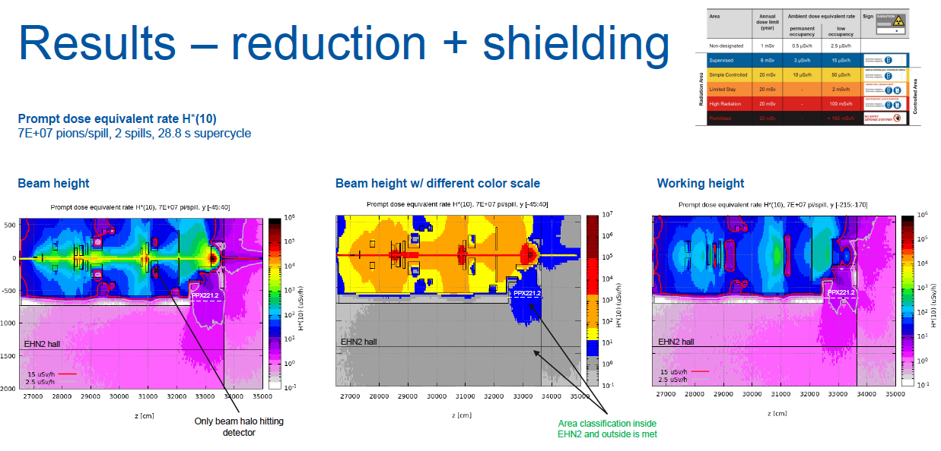
APX running time extension – High Intensity DY test with two NA CEDARS and beam telescope

Slide 11
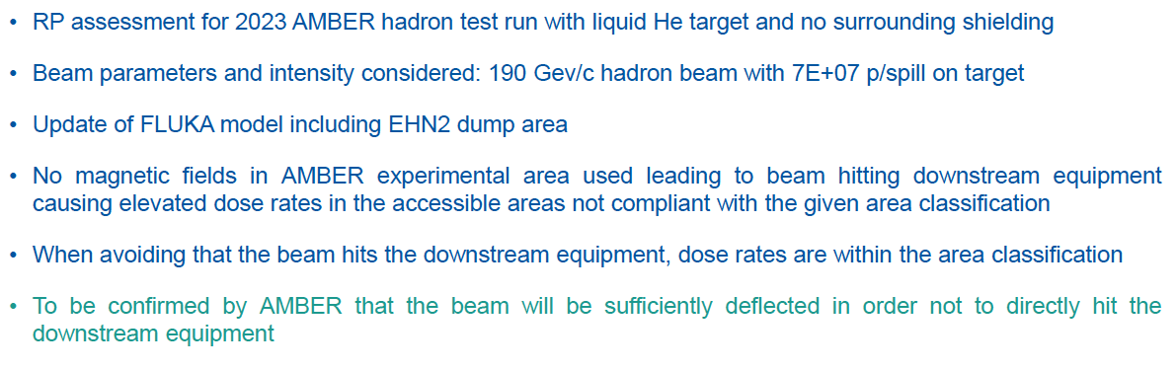
APX running time extension – High Intensity DY test with two NA CEDARS and beam telescope

Slide 12
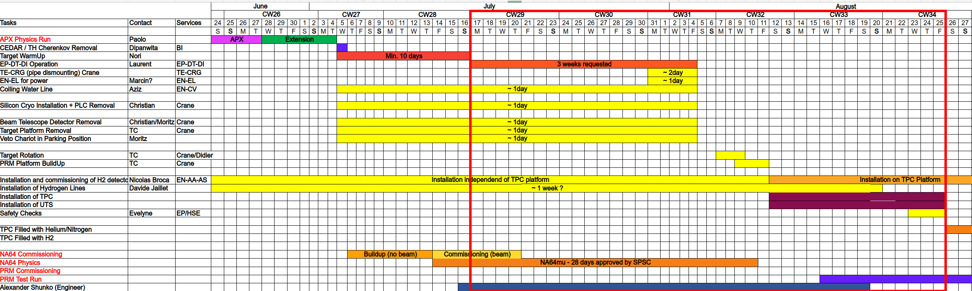
Changeover Phase APX → PRM
Preliminary timetable for change over phase:
At least 10 days are needed after end of APX to warm-up He target.
Working package are defined with EP-DT-DI for target rotation preparation ≈ 3 weeks.
Several other CERN services need access between CW29 and CW34 during CERN working hours to prepare infrastructure for TPC in PPE221.
(EP-DT-DI, EN-EL, TE-CRG, EN-CV, BE-EA-EC, BE-EA-DC, EN-AA-AS, ...)
Overlaps partly with the NA64mu beam-time in EHN2.
AMBER TS Report May 2023

Slide 13
Spares

Slide 14
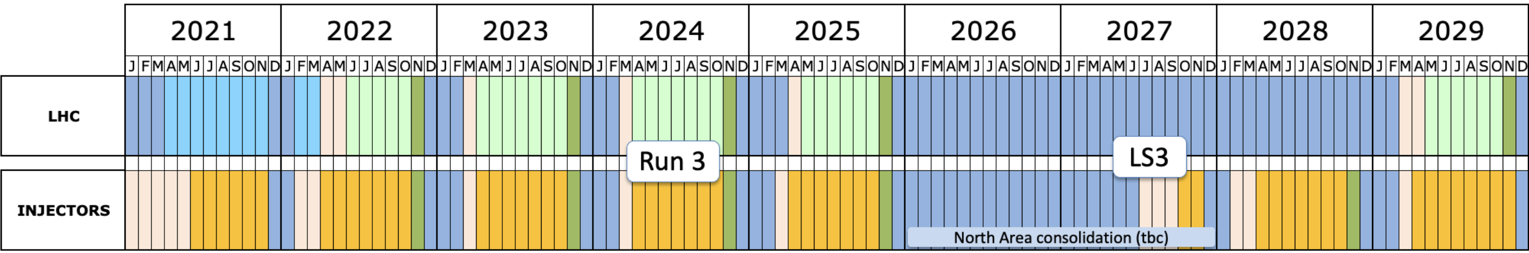
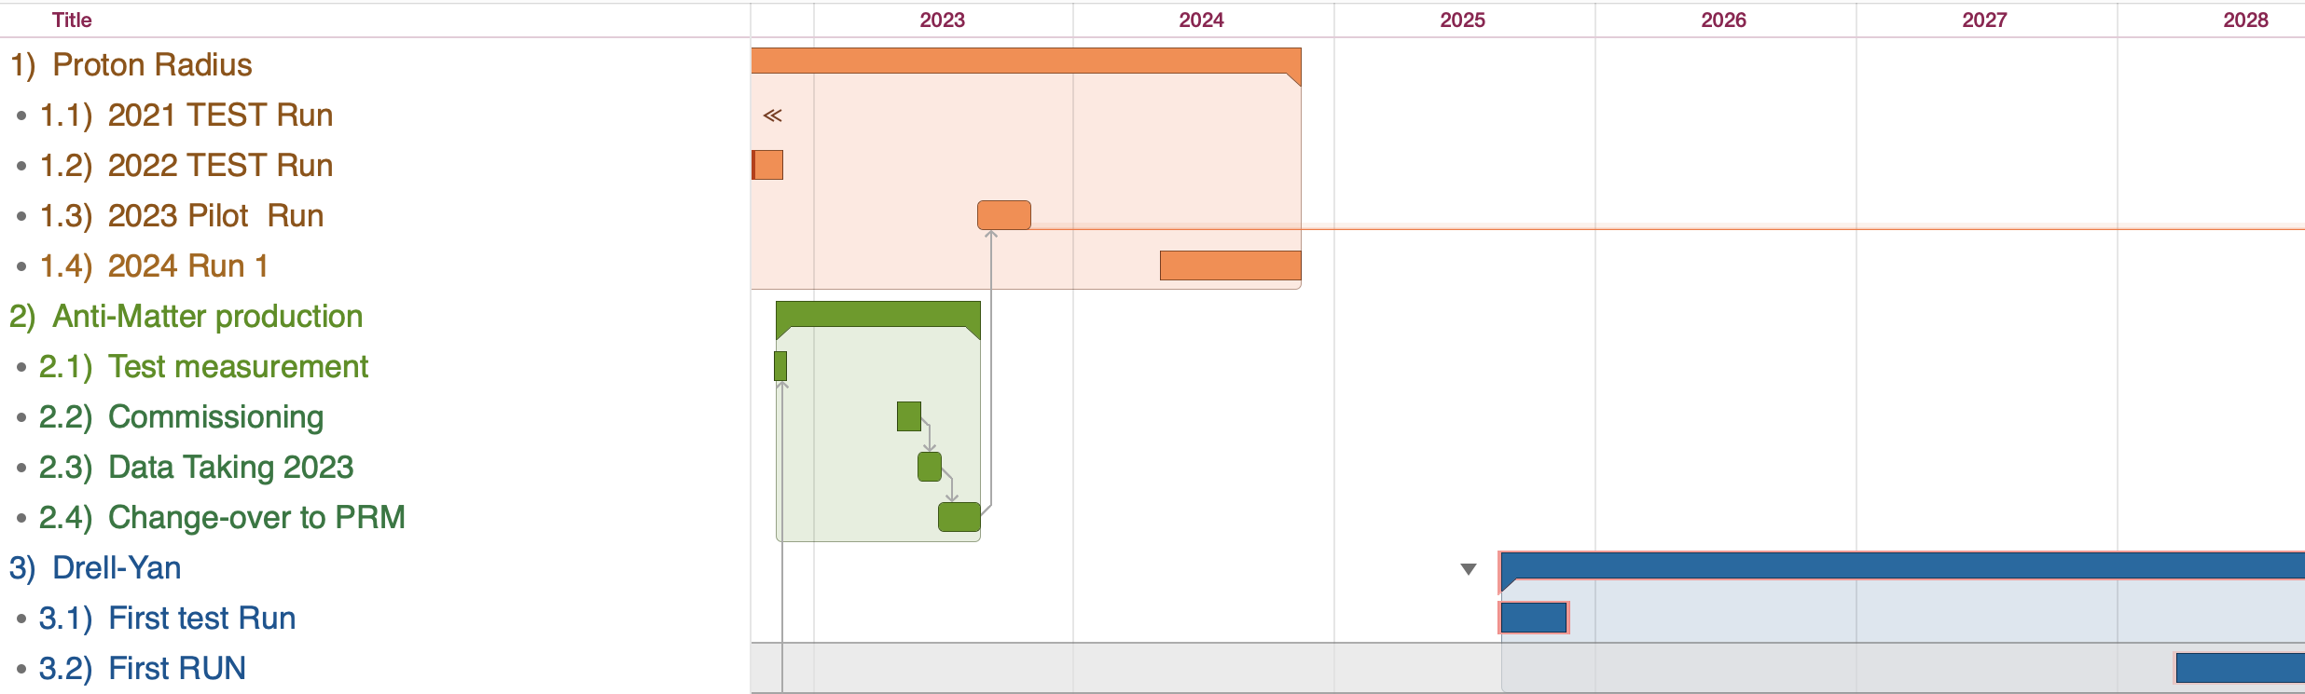
AMBER Phase-1 running plan
Milestones:
May 1st 2023 – Antimatter production Run (Std. DAQ)
Sep. 1st 2023 – PRM pilot (FreeDAQ, very limited setup)
May 1st 2024 – PRM Run (FreeDAQ, limited setup)
Sep. 1st 2025 – DY Pilot (FreeDAQ, all trackers + mu id)
May 1st 2028 – DY Run (Full Spectr. Ex. RICH, Calorimeters)
Approved AMBER Phase-1 Program:
AXS: 2 months
Drell-Yan: 2 years
PRM: 1 + 1 year (conditionally)
Long Shutdown 3

Slide 15
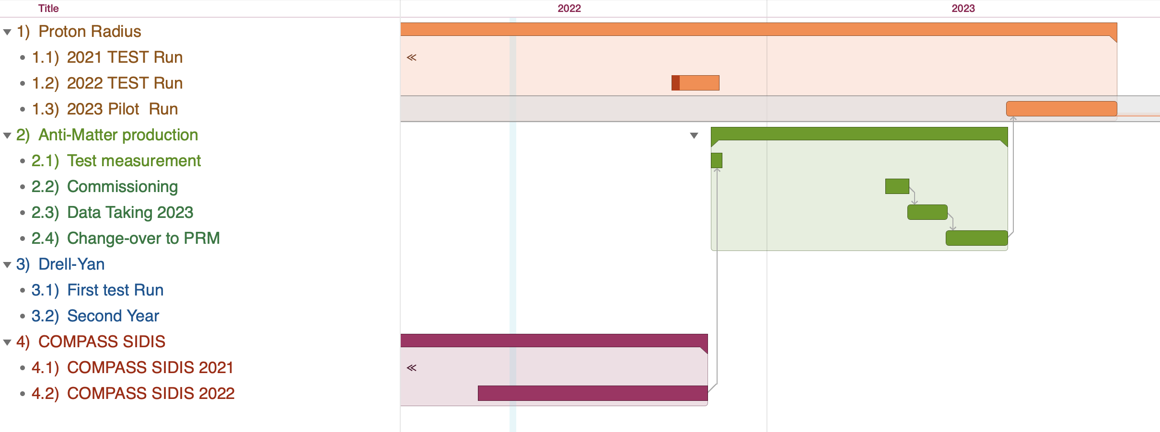
AMBER Running Plan
A inizio del 2022 e’ stata presa un importante decisione da AMBER CB:
La prima misura da effettuare sara’ AXS (inizio del 2023 running time)
Seguera’ PRM

Slide 16
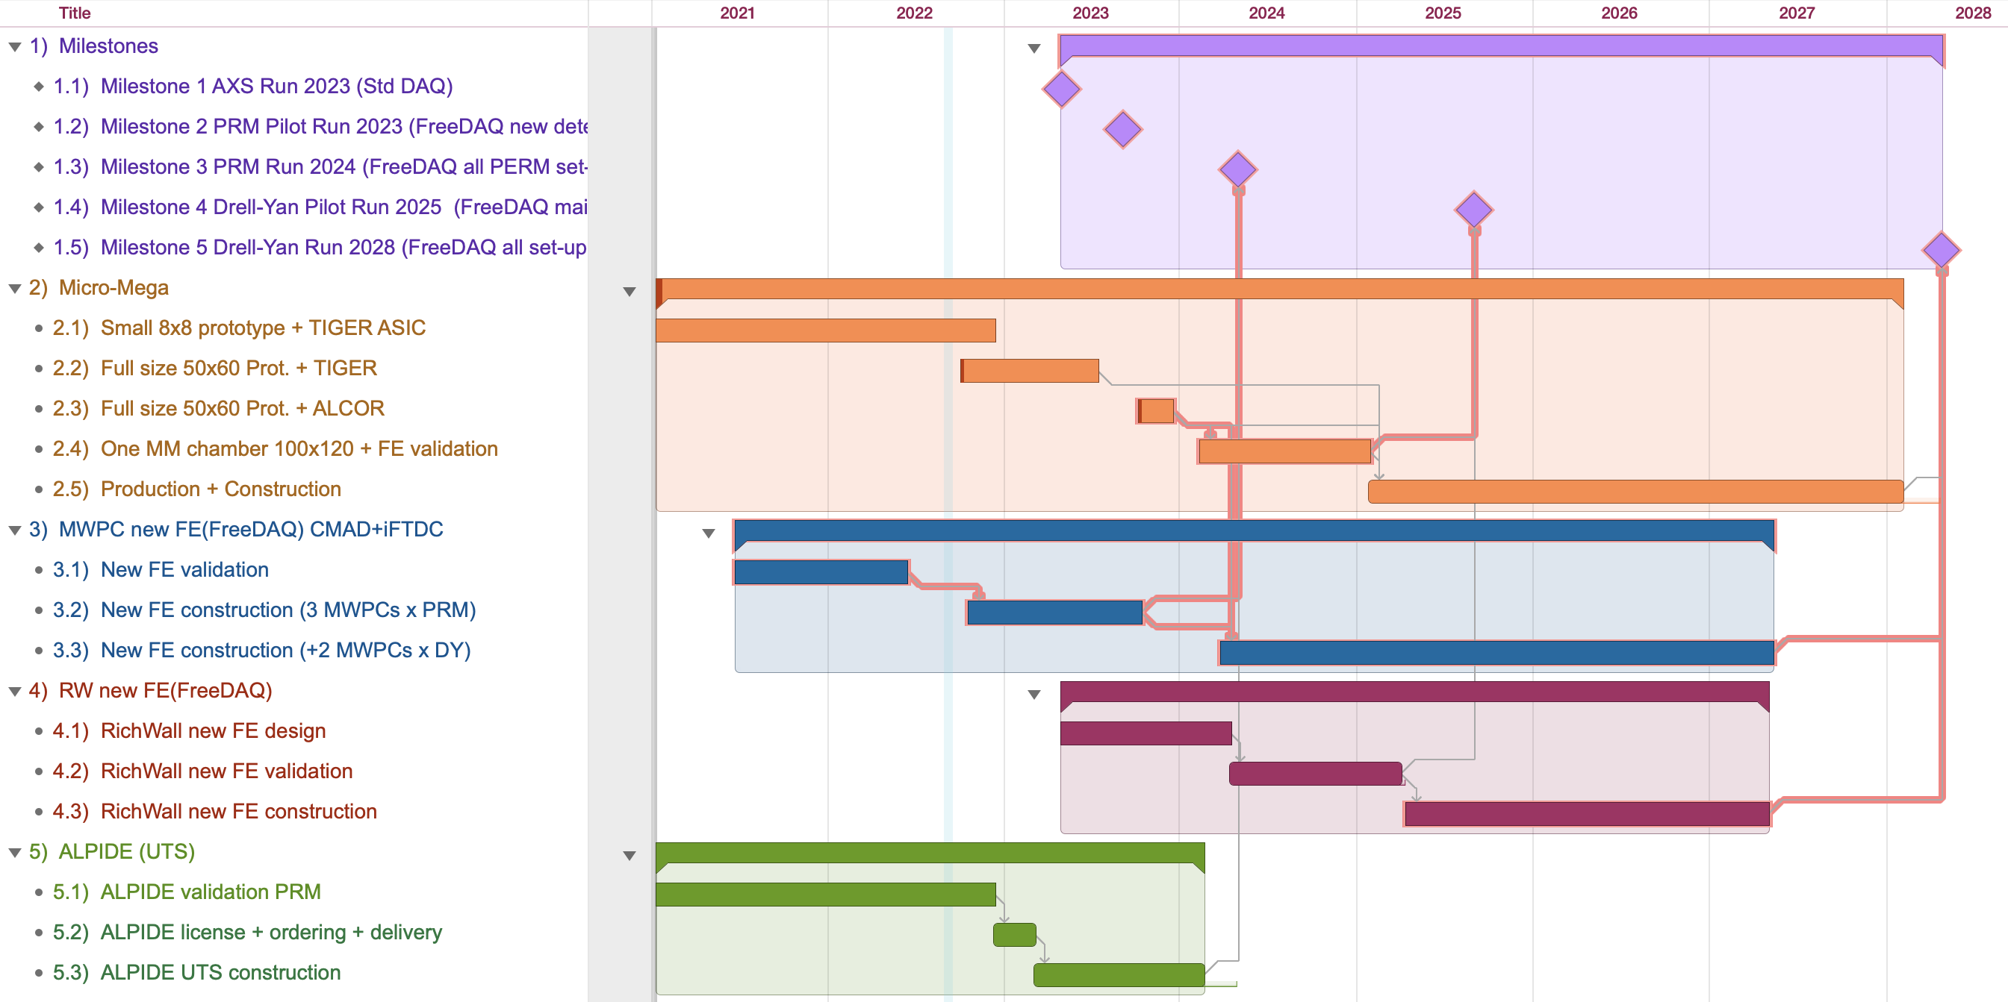
AMBER Phase-1 Torino construction plan
Prototipo mec. + consulting

Slide 17
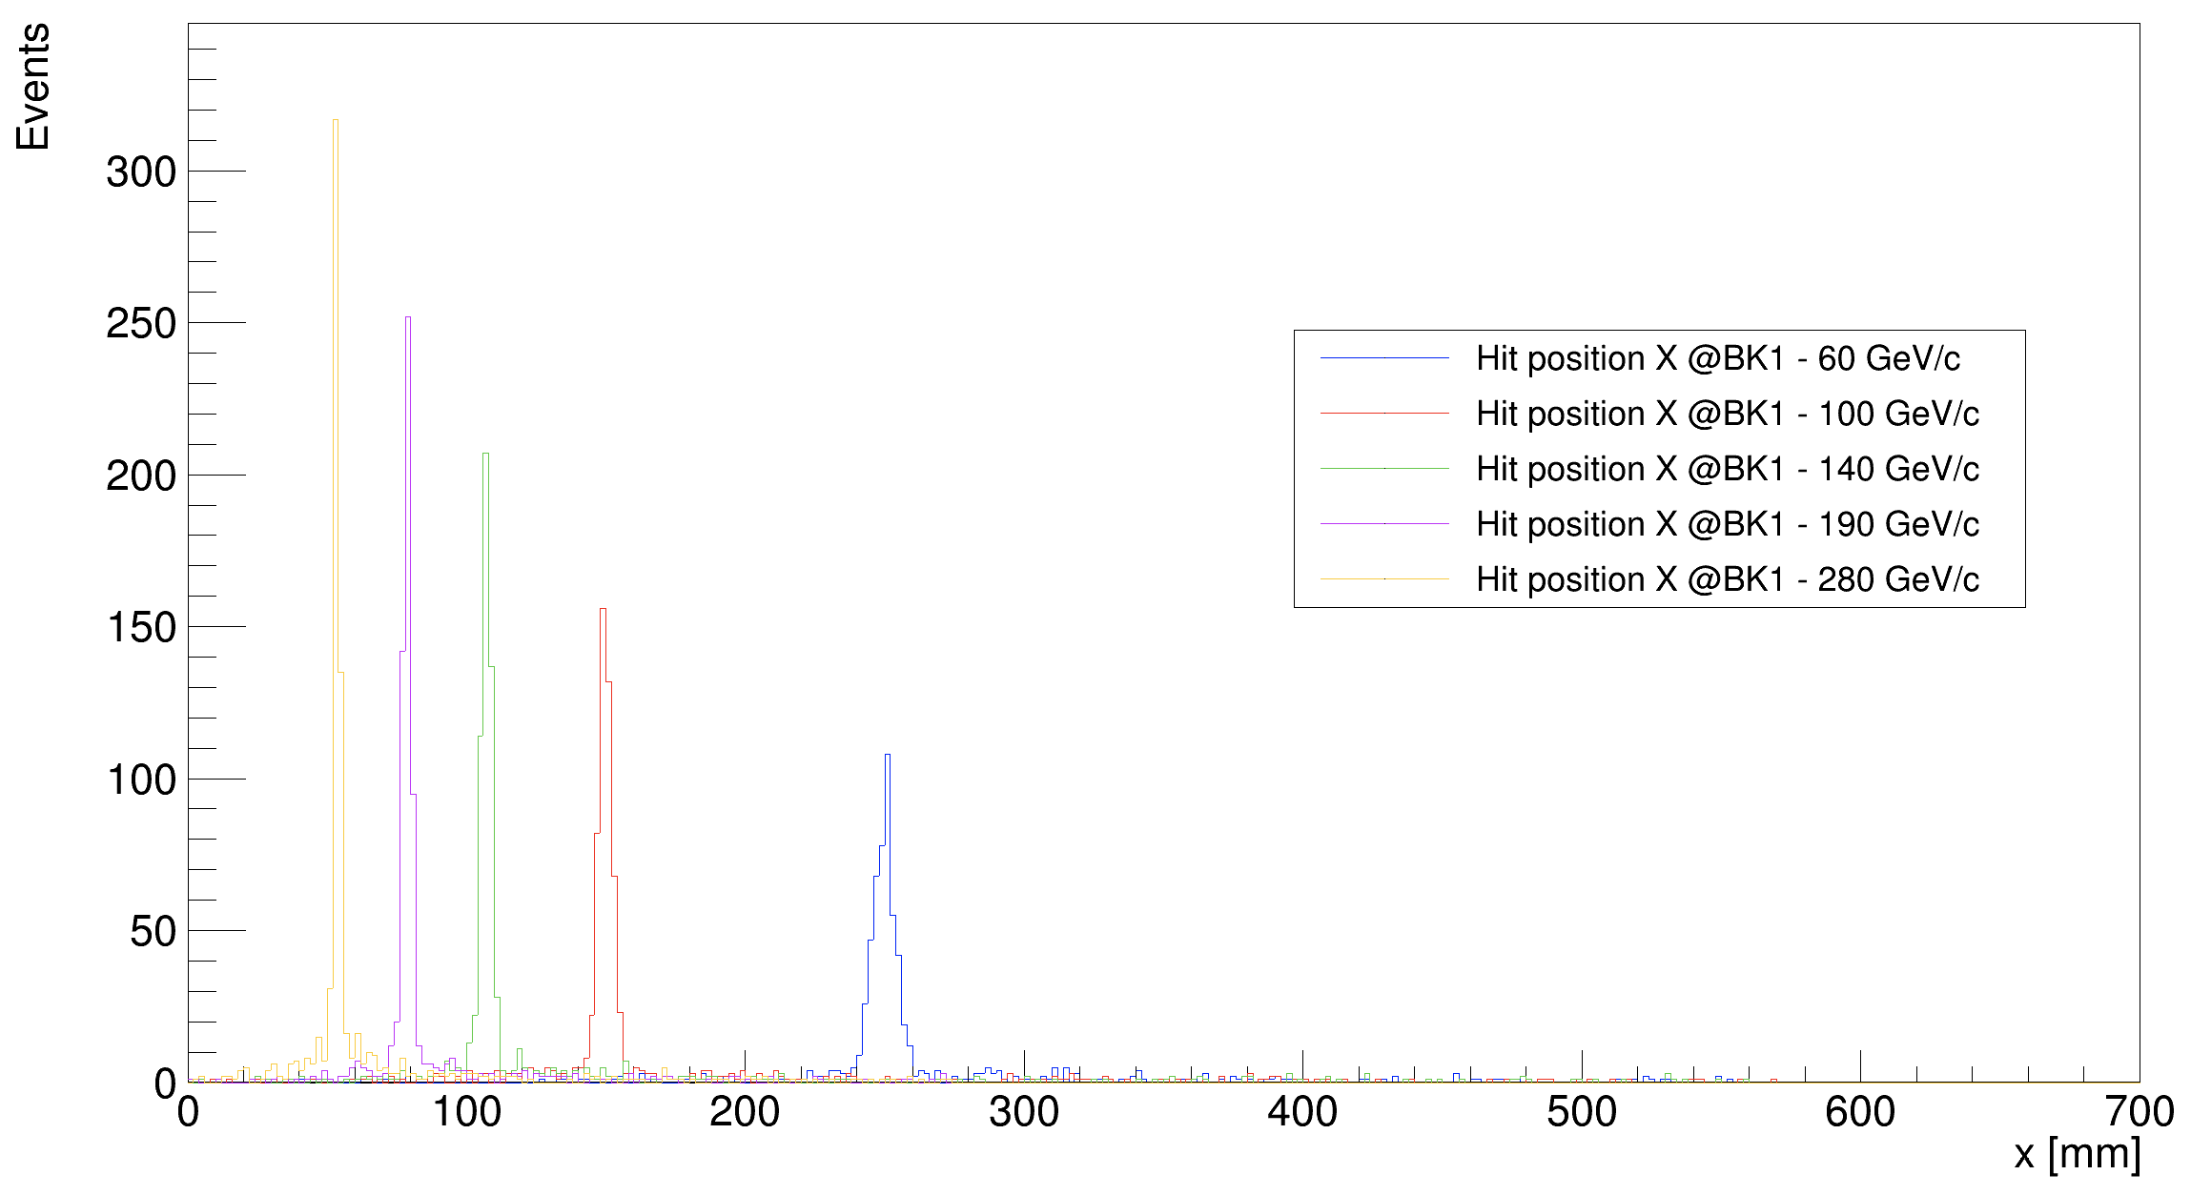
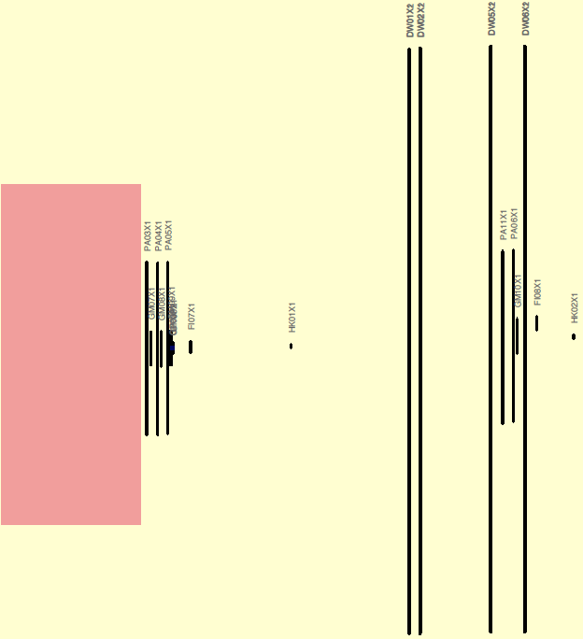
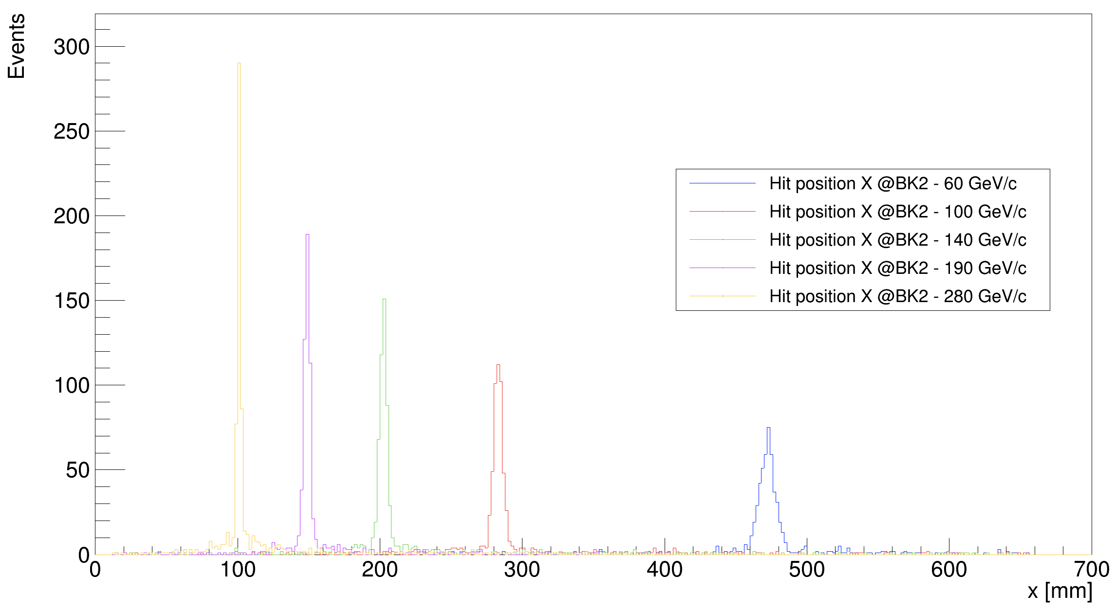
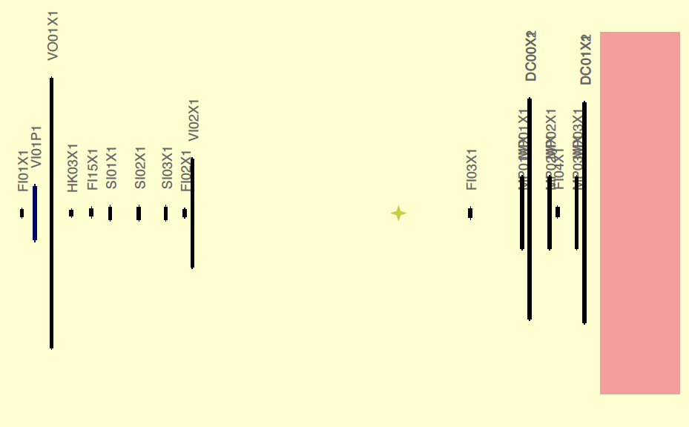
Attivita di Analisi e MC (AXS I) (TO) Trigger elements & beam
How to do the measurement:
beam trigger + hodoscope veto —> ensures that the particle
reaches the experiment within the geometrical target acceptance
beam killers —> remove non-interacting beam particles
Need to scale the magnet current at low beam momenta
Optimal position of the beam killer
For the different beam momentum
All MC results confirmed in May 2022 test

Slide 18
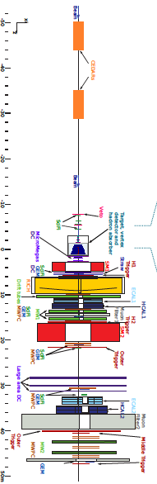
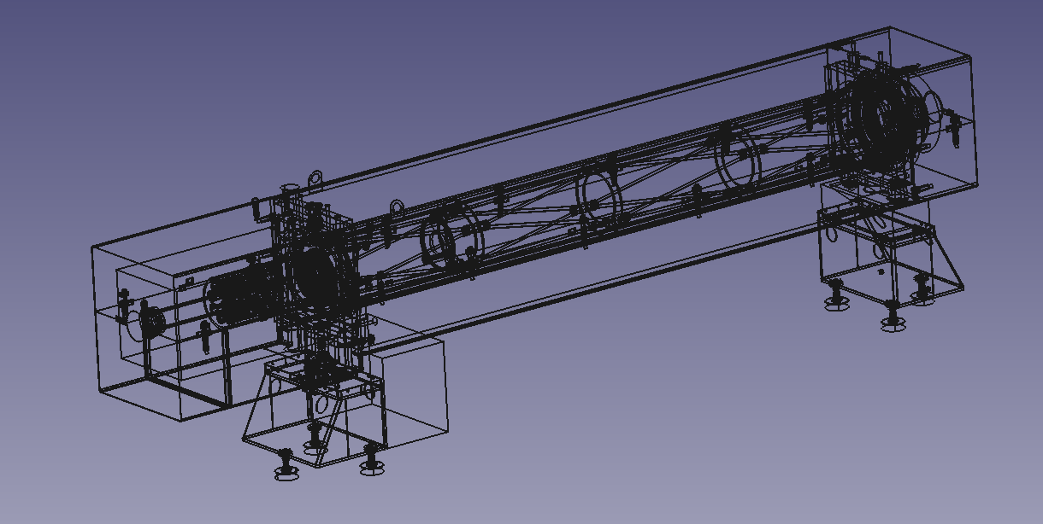
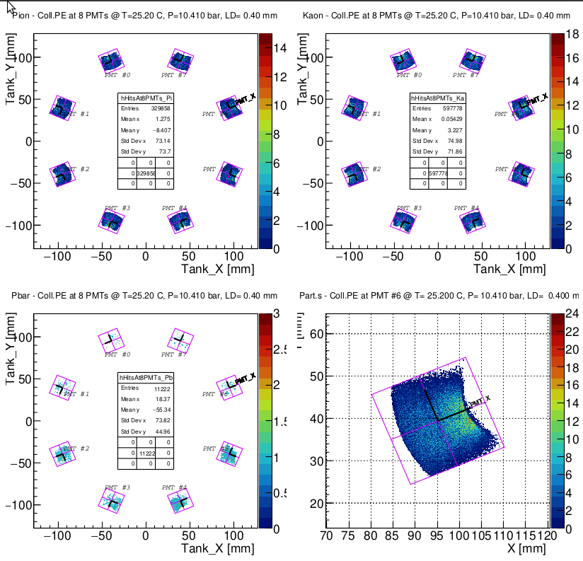
Attivita di Analisi e MC (AXS & DY) CEDARs implementation in Tgeant (TO)
CEDARs (Cherenkov Differential counter with Achromatic
Ring Focus) is an essential part of the beam PID in the AMBER
Experiment (AXS and DY programs).
Recently CEDAR CAD description imported in TGEANT software.
Production and transport of Cherenkov photons in CEDAR is
simulated in a separate code (Flavio Tosello (TO)). This code in
encapsulated now in the TGEANT.
It is extremely useful tool for AXS and DY MC and analysis.
Code validation is nearly finished

Slide 19
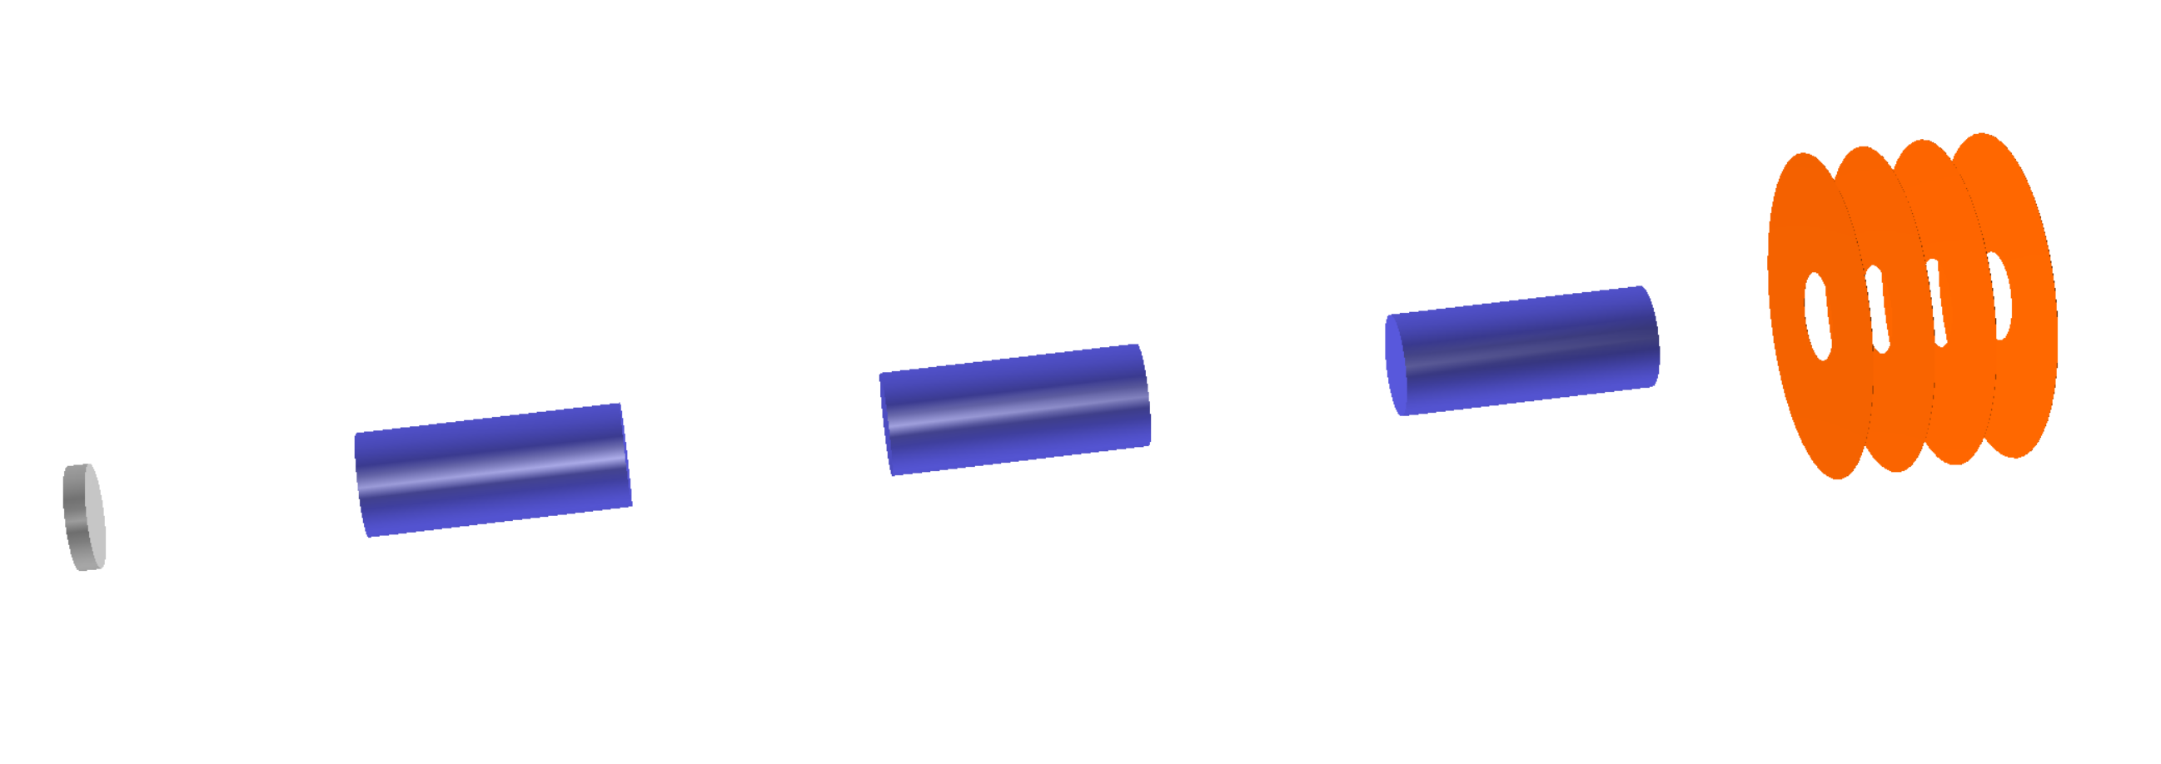
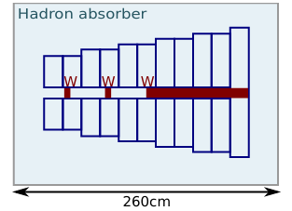
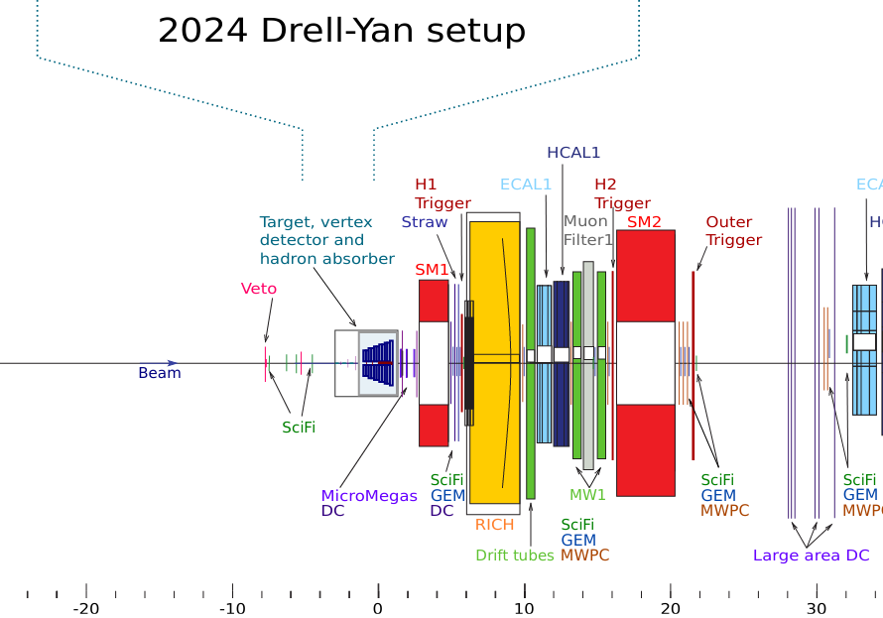
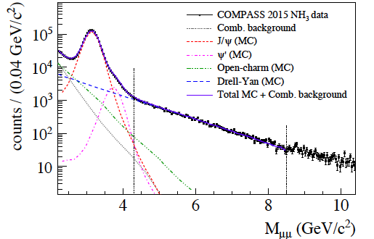
Drell-Yan experiment preparation I
Drell-Yan process is a low cross-section process:
High intensity hadron beam
Hadron absorber to protect Spectrometer from a very high secondary flux
Vertex Detector to compensate loses in resolution because of the absorber in order to improve mass and space resolution

Slide 20
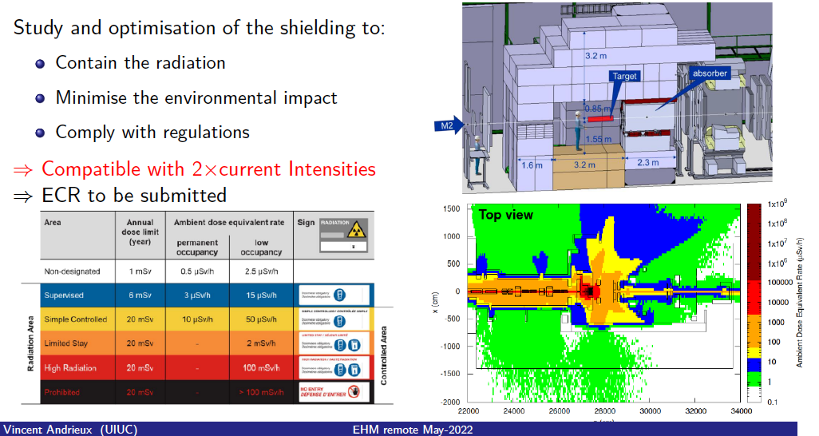
Drell-Yan experiment preparation Toward doubling of the incoming beam intensity (TO)

Slide 21
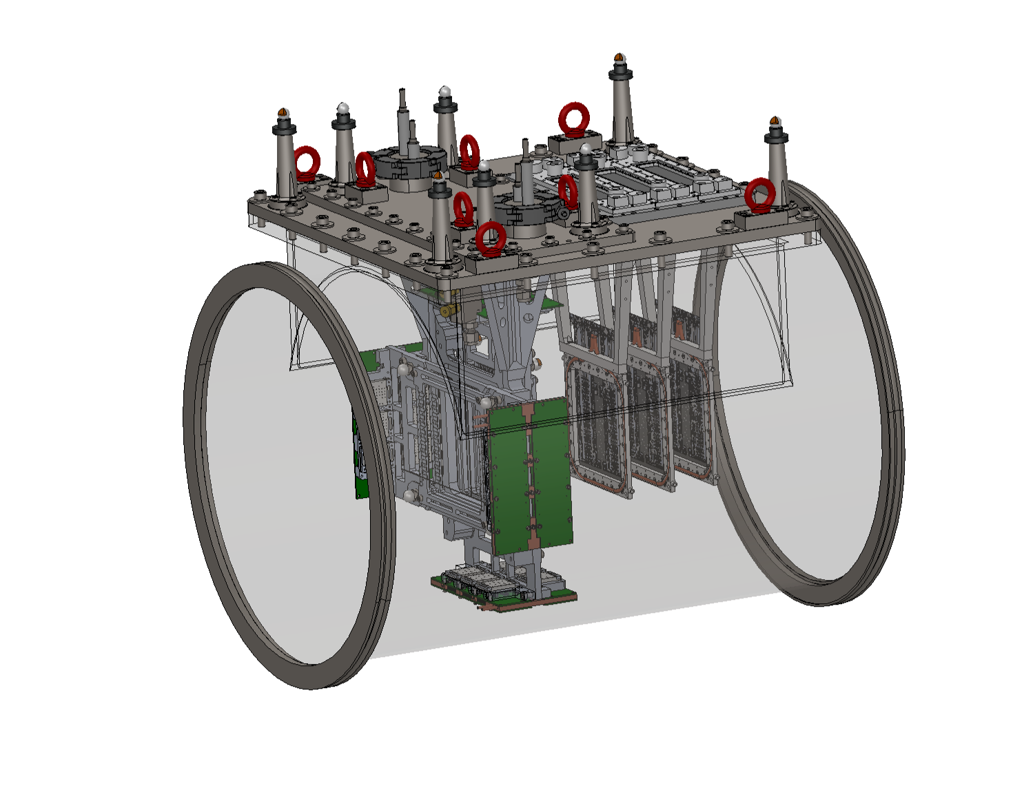
Unified Tracking Station

Slide 22
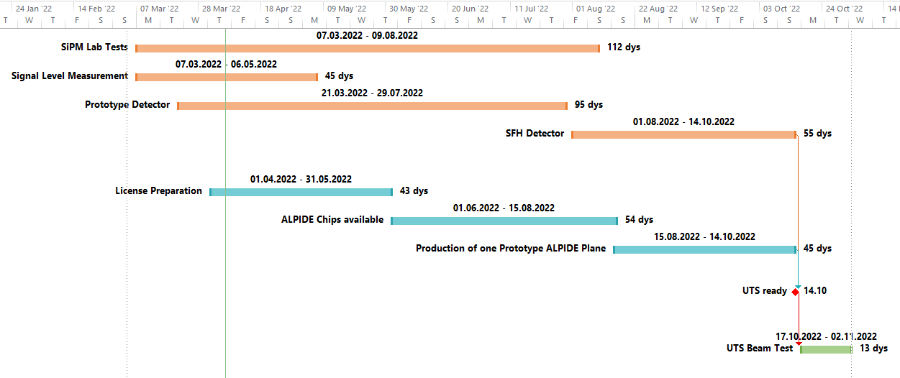
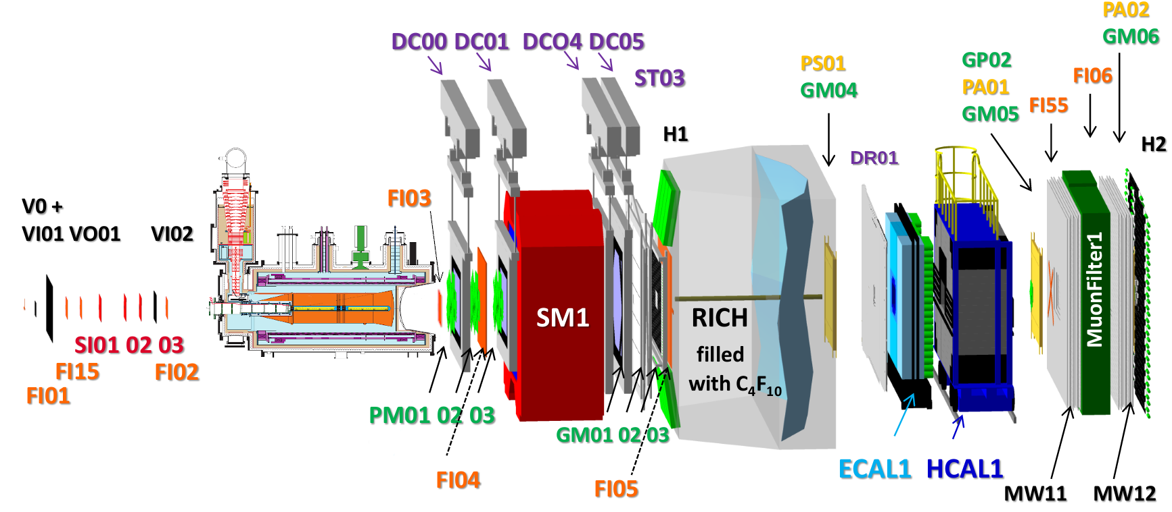
PRM test run 2022 (interleaved with last period of the COMPASS data taking)
COMPASS could take data with a test setup installed upstream of the target region
Possible schedule: last double-week period before AMBER AP week, i.e. end October
Installation of UTS during MD 19. October
Data taking during last repolarization phase ~ end October

