Slide 1
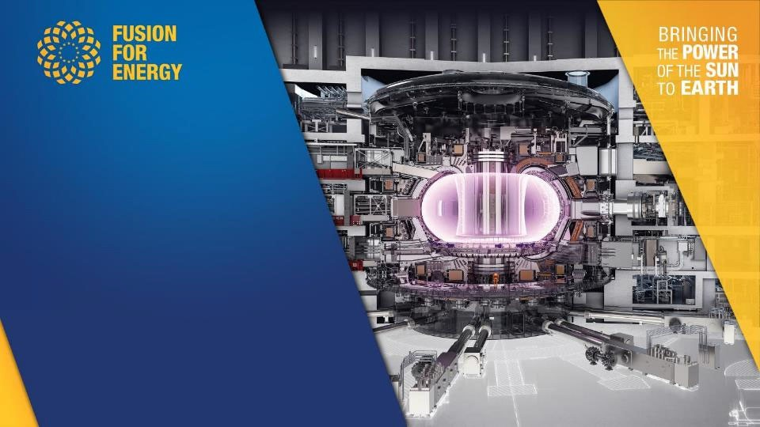

Industrial Opportunities from F4E/ITER
Víctor Sáez
Mehdi Daval
Industrial Opportunity Days Capodimonte, 16th June 2023
Fusion for Energy receives funding from the
European Union budget

Slide 2
Outline
The context for EU fusion industry involvement
Italian participation to date
How to access F4E opportunities
Upcoming opportunities F4E
Upcoming opportunities ITER IO
Industrial Opportunity Days 2023 - Capodimonte - 15-16 June 2023
2

Slide 3
Outline
The context for EU fusion industry involvement
Italian participation to date
How to access F4E opportunities
Upcoming opportunities F4E
Upcoming opportunities ITER IO
Industrial Opportunity Days 2023 - Capodimonte - 15-16 June 2023
3

Slide 4
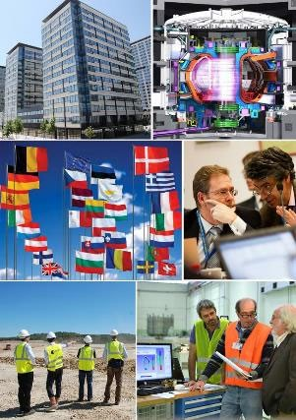
F4E - The European Domestic Agency for ITER
EU public organisation set up in 2007 for 35 years
Headquarter: Offices:
Barcelona, Spain Cadarache, France Garching, Germany Rokkasho, Japan
Staff: 435 (mostly engineers)
Budget: B€ 12+ in 2007-2027 for ITER construction (2008 values)
4
Industrial Opportunity Days 2023 - Capodimonte - 15-16 June 2023
4

Slide 5
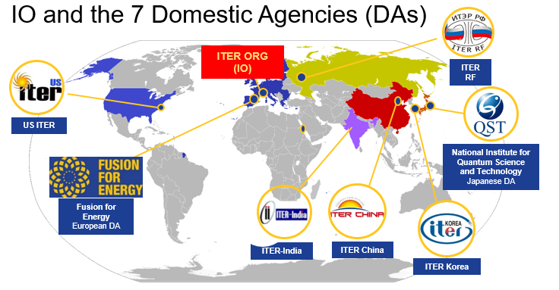

ITER ORG (IO) and Fusion For Energy (F4E)

Slide 6
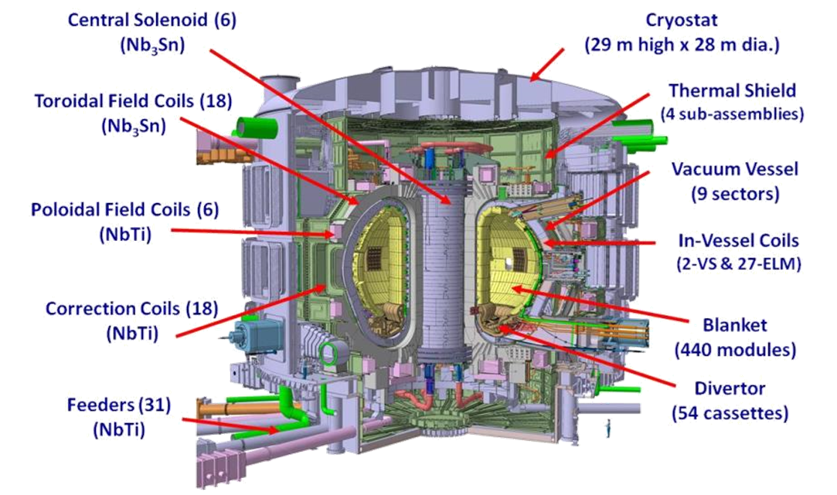
ITER Tokamak
ITER is located in Cadarache, south of France.
F4E responsible to supply for ITER, and also Broader Approach, (DONES, and DEMO projects).
Purposes:
  Fusion Energy released on large scale
  10 times more energy generated than consumed
  Study of “burning plasma” and its long operation
  Testing key technologies for future reactors (DEMO etc.)

Slide 7
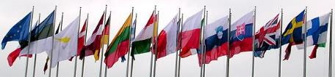





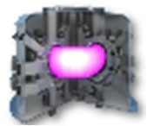









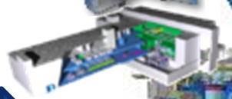
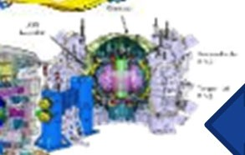

Fusion in Europe: Two Main Pillars (+1)
Energy
Research & Innovation
Industrial Opportunity Days 2023 - Capodimonte - 15-16 June 2023
7

Slide 8





Fusion in Europe: Industrial Involvement
~3.5 billion EUR (2022-2027)
Industrial Opportunity Days 2023 - Capodimonte - 15-16 June 2023
8

Slide 9
Fusion in Europe: Industrial Involvement
5+ Billion EUR
(2020 – 2027)
5+ billion EUR
(2022-2027)
Industrial Opportunity Days 2023 - Capodimonte - 15-16 June 2023
9

Slide 10
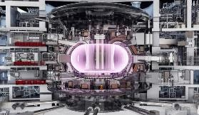
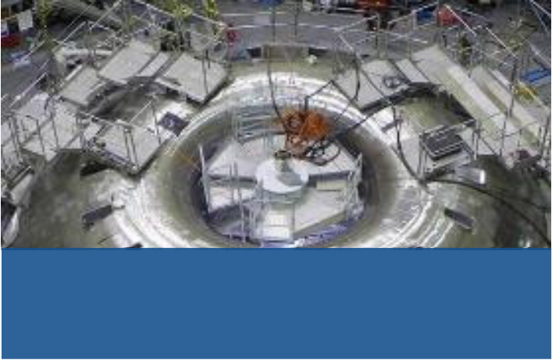
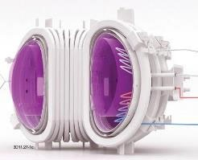
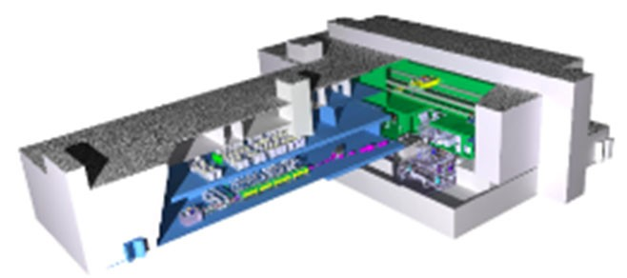


F4E’s Contribution to Fusion Development
ITER: Burning Plasma
BROADER APPROACH
Responsible for Europe’s contribution to ITER
Working with Japan on satellite fusion projects
DONES: Materials Testing
DEMO: Continuous Power
Contributing to design & construction
Demo Orientated NEutron Source
Preparing to build power-generating
Demonstration Fusion Reactor
Industrial Opportunity Days 2023 - Capodimonte - 15-16 June 2023
10

Slide 11









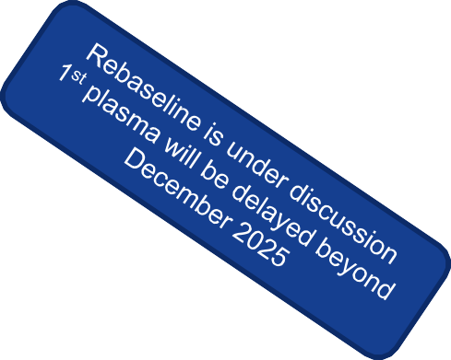


















ITER Schedule
To be updated by LEONARDO
System 2008 2010 2012 2014 2016 2018
Buildings
2020 2022 2024 2026 2028 2030 2032 2034
Control Room
Proc. Arrangement Assembly Hall
F4E Contracts
Tokamak Bldg.
Tritium Bldg.
Proc. Arrangement
First TF Coil
Toroidal Field Coils
F4E Contracts
Last TF Coil
Proc. Arrangement
First PF Coil
Poloidal Field Coils
F4E Contracts
Last PF Coil
Pre-Compress Rings
Proc. Arrangement.
Lower Rings
F4E Contracts
Upper Rings
Vacuum Vessel
Proc. Arrangement
First Sector
F4E Contracts
Proc. Arrangement First Components Delivered
F4E Contracts Start of Construction
Last Sector
LN2 Cryoplant
Ready for Commissioning
ITER Schedule
Industrial Opportunity Days 2023 - Capodimonte - 15-16 June 2023
11

Slide 12
Outline
The context for EU fusion industry involvement
Italian participation to date
How to access F4E opportunities
Upcoming opportunities F4E
Upcoming opportunities ITER IO
Industrial Opportunity Days 2023 - Capodimonte - 15-16 June 2023
12

Slide 13
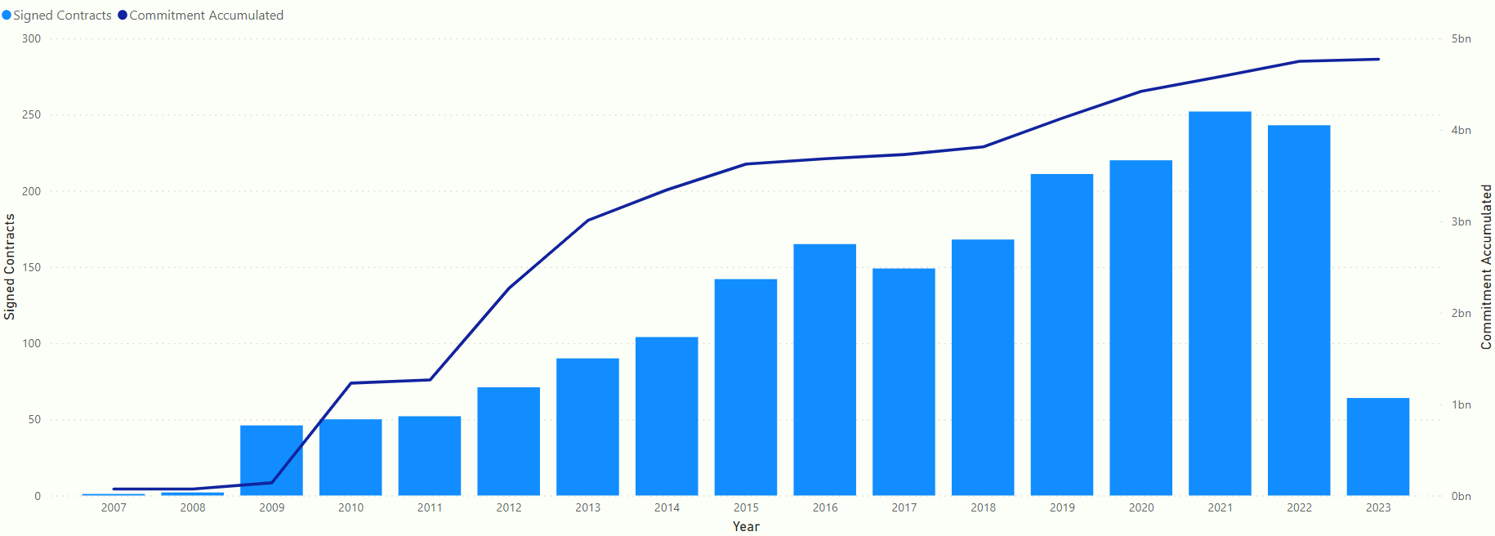

Accumulated commitment
4.77B€
Industrial Opportunity Days 2023 - Capodimonte - 15-16 June 2023
13
Notes:
4.772.000M€

Slide 14
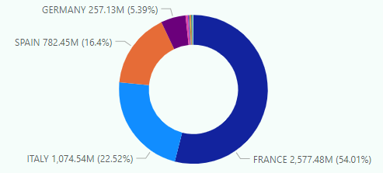
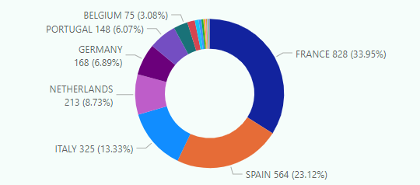
Signed contracts all Member States
Total Value
# of Contracts
Industrial Opportunity Days 2023 - Capodimonte - 15-16 June 2023

Slide 15
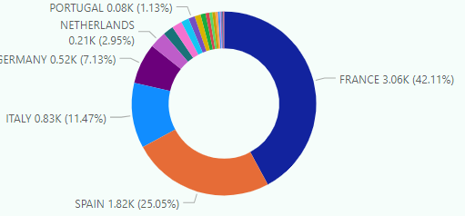
Participation to pre-procurement activities
# of Contracts
Pre-procurement
Industrial Opportunity Days 2023 - Capodimonte - 15-16 June 2023
15

Slide 16
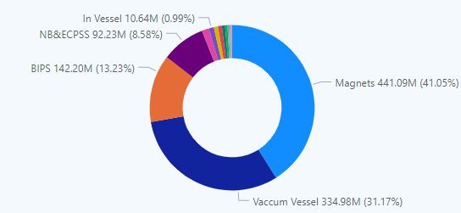
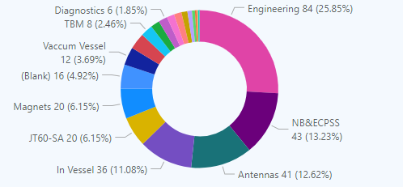
Signed contracts by Italy - Breakdown
# of Contracts
Total Value
Industrial Opportunity Days 2023 - Capodimonte - 15-16 June 2023

Slide 17
Outline
The context for EU fusion industry involvement
Italian participation to date
How to access F4E opportunities
Upcoming opportunities F4E
Upcoming opportunities ITER IO
Industrial Opportunity Days 2023 - Capodimonte - 15-16 June 2023

Slide 18






F4E Rules to Engage with Industry
EU General Financial Regulations
    Transparency
    Equal treatment
    Widest Competition for best quality and price
    Proportionality
    Sound financial management: economy, efficiency and effectiveness
Key Principles of
Public Procurement
Market Analysis Group devoted to exchange with Industry and facilitate the dissemination of business opportunities including the creation of consortia
Industrial Opportunity Days 2023 - Capodimonte - 15-16 June 2023
18

Slide 19
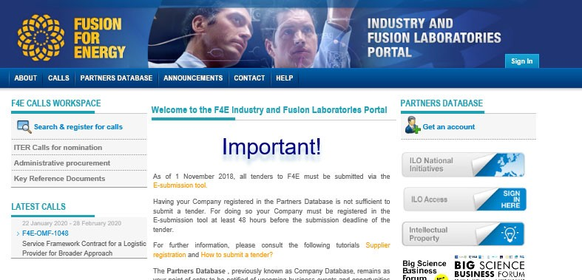
F4E Industry Portal - https://industryportal.f4e.europa.eu
21
New portal version coming soon
Industrial Opportunity Days 2023 - Capodimonte - 15-16 June 2023
19

Slide 20
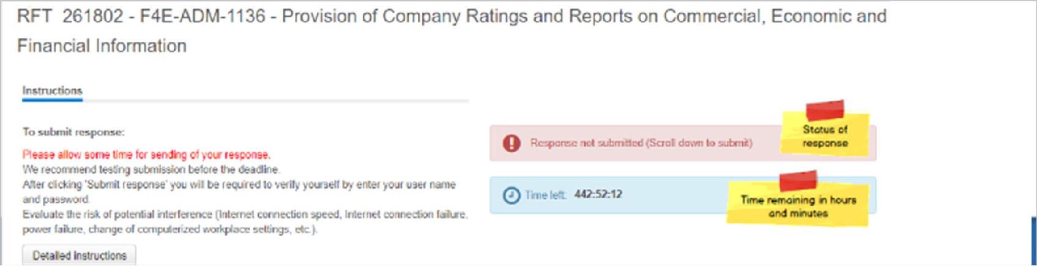
e-Submission and e-Procurement
Electronic submission of tenders:
  EU-Supply: safe, confidential, user friendly, efficient
Electronic implementation of the tender procedure:
  Procurement documentation
  All communication pre and post-submission
Industrial Opportunity Days 2023 - Capodimonte - 15-16 June 2023
20

Slide 21
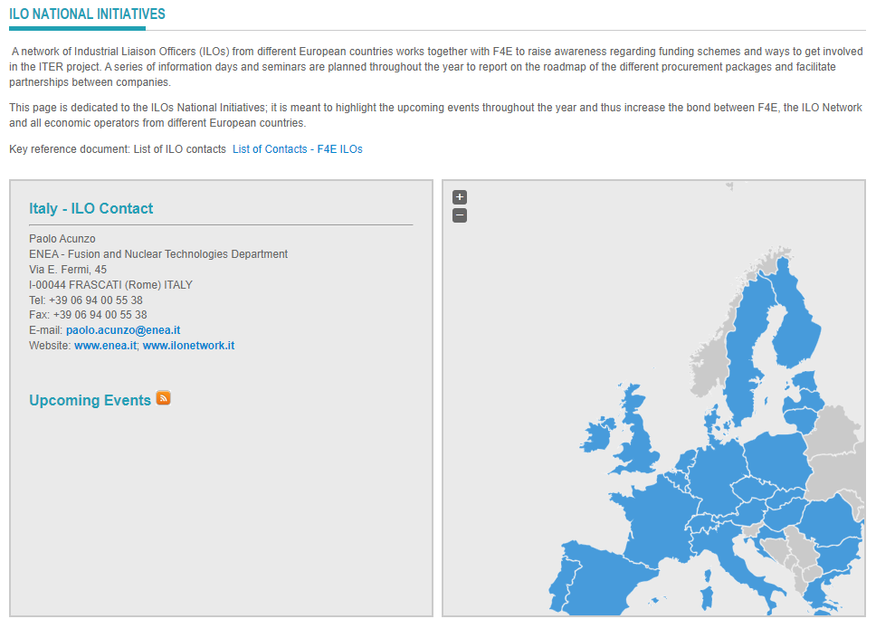
Industrial Liaison Officers (ILO)
Industrial Opportunity Days 2023 - Capodimonte - 15-16 June 2023
21

Slide 22
Outline
The context for EU fusion industry involvement
Italian participation to date
How to access F4E opportunities
Upcoming opportunities F4E
Upcoming opportunities ITER IO
Industrial Opportunity Days 2023 - Capodimonte - 15-16 June 2023
22

Slide 23
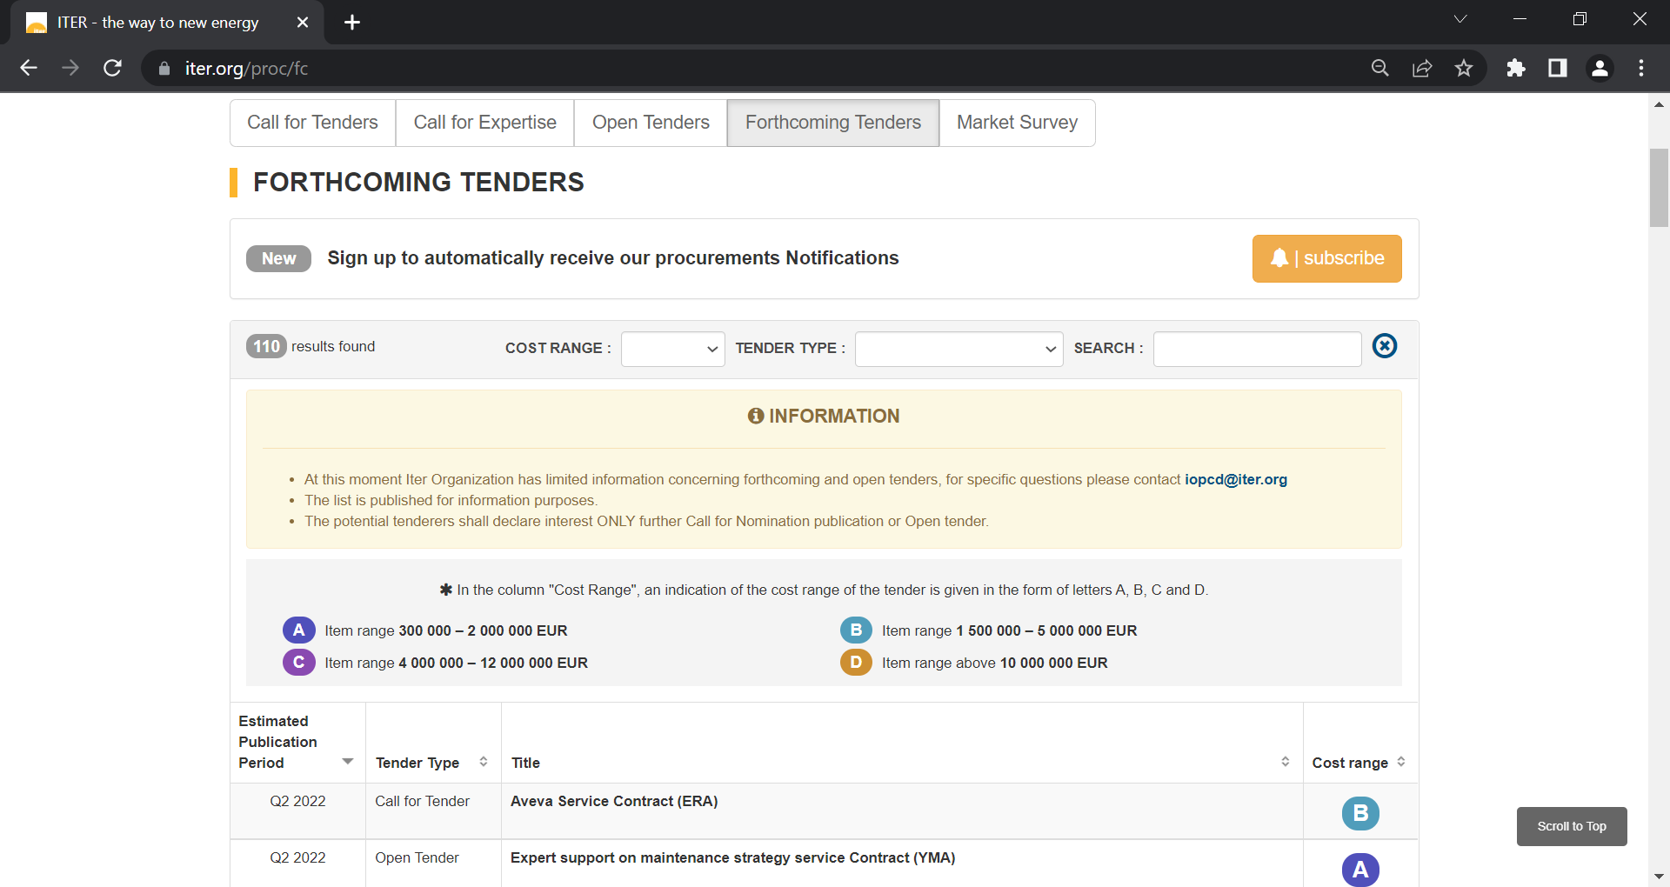
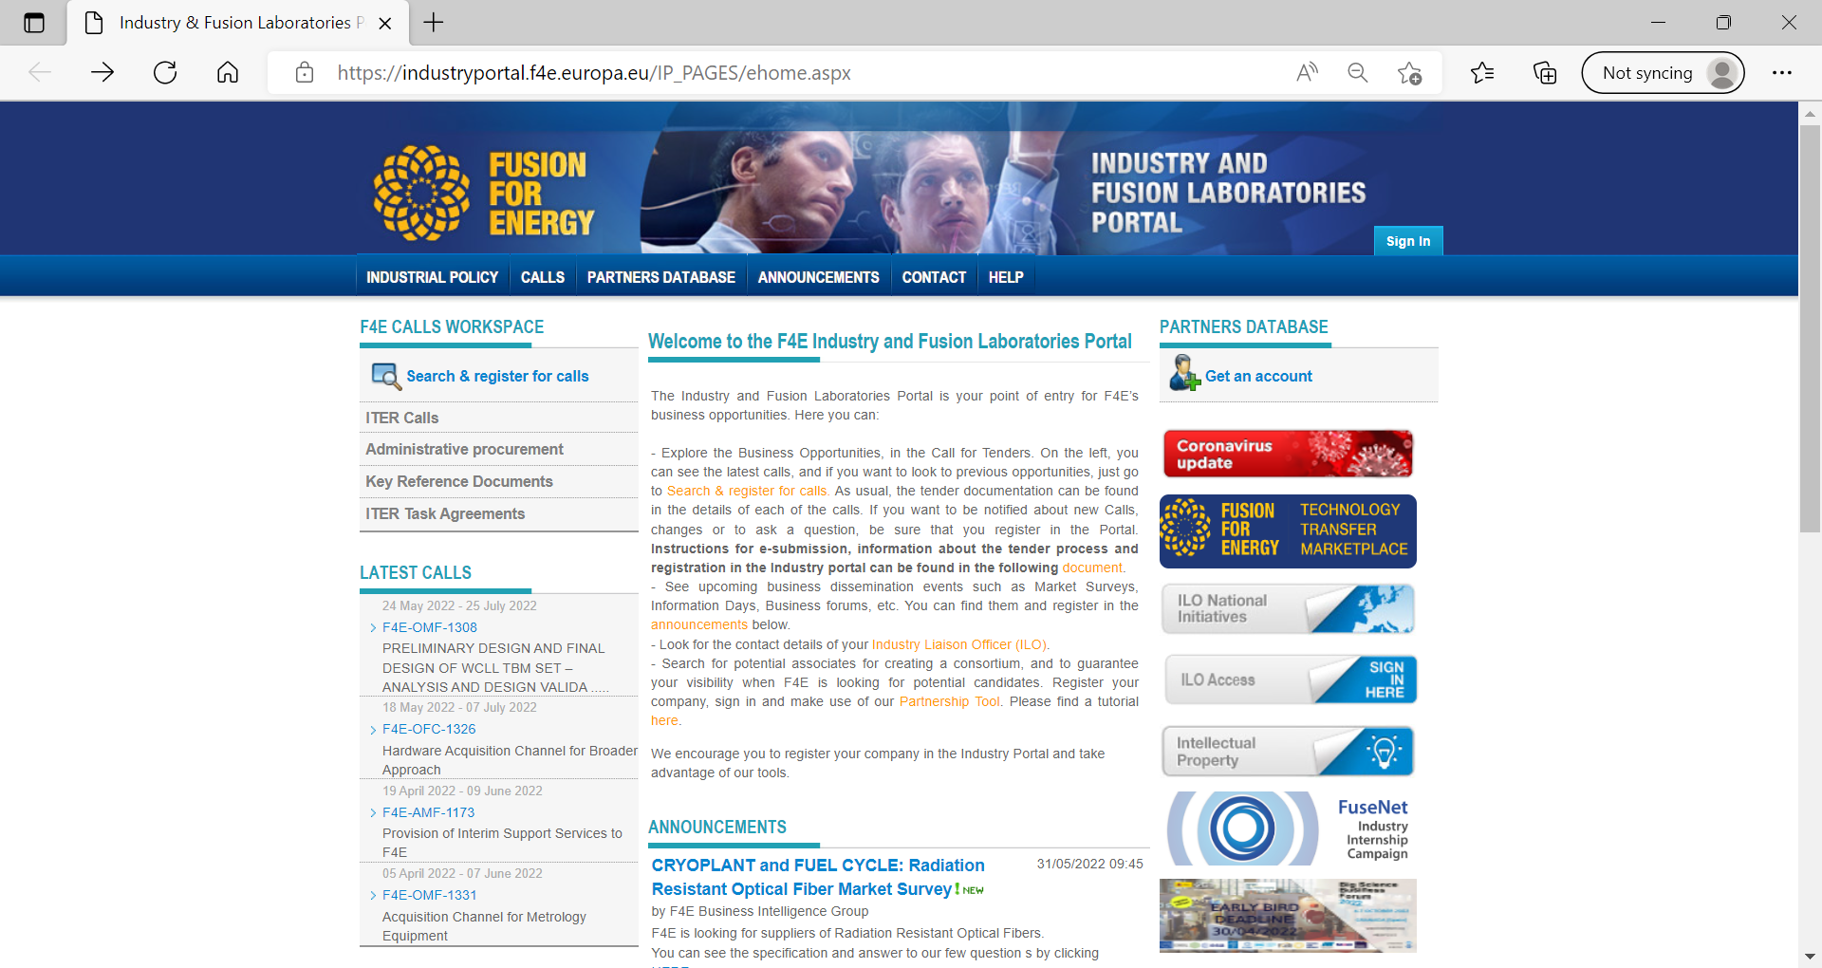

ITER ORG and FUSION FOR ENERGY
https://www.iter.org/proc/fc
https://industryportal.f4e.europa.eu/IP_PAGES/ehome.aspx

Slide 24
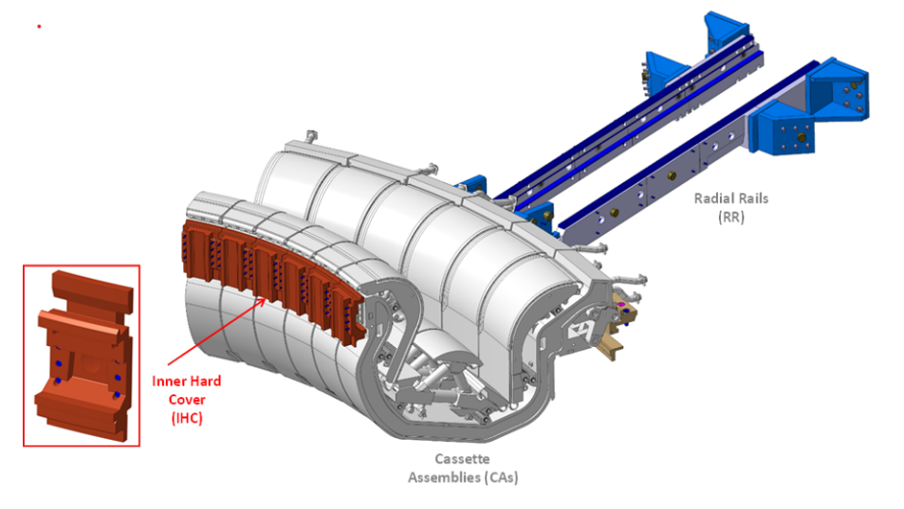
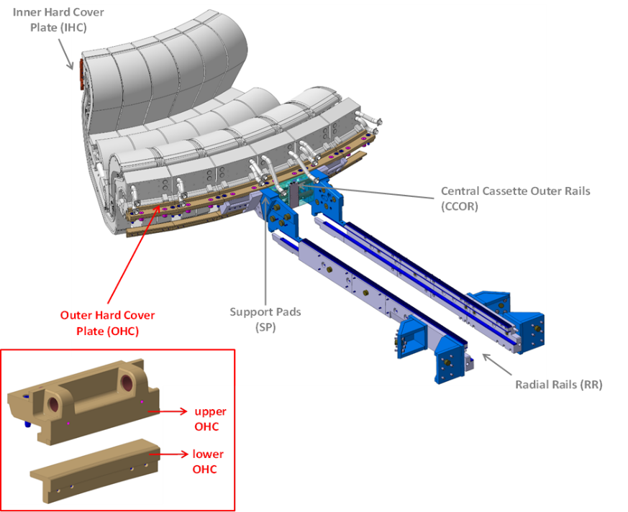
ITER IN-VESSEL
Divertor rails. Cat C.
PA target signature Q1-2024.
Market Survey in Q3 2023.
CFT in Q3 2024.
Contract signature: Q2-3 2025.
Notes:
OPE-1249: for the moment in stand-by as we may provide it with existing contracts.

Slide 25
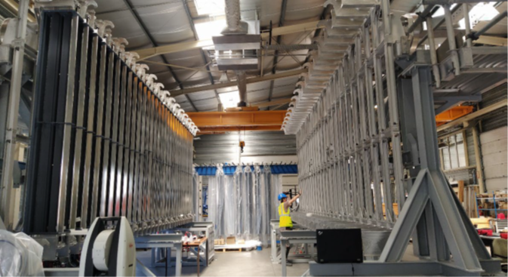

ITER Cryoplant & Fuel Cycle
NB Cryopumps (3 units, cat D)
  500 cryopanels
  >650 thermal shield panels
  Tight tolerances
  Target CFT 2024 (1st contract 2025)
Notes:
OPE-1249: for the moment in stand-by as we may provide it with existing contracts.

Slide 26
ITER Cryoplant & Fuel cycle
Isotope Separation System (cat D)
  Cryogenic distillation of >650 thermal shield panels
  Tight tolerances
=> Target CFT 2024 (1st contract 2026)
Notes:
OPE-1249: for the moment in stand-by as we may provide it with existing contracts.

Slide 27
ITER Heating and Current Drive
OPE-1XXY: Absolute Valve and Fast Shutter. Cat. C. (2 units each)
  Market Survey closed.
  Neutral Beam Passive Magnetic Shielding
  Skills: Fast actuation (<10s); Vacuum tightness (non-SIC) of the valve (metal to metal seal), Manuf. Of nuclear components (SIC-1) for the casing using nuclear code; Stainless Steel welding; NDTs of Austenitic Steel welds.
=> Target CFT: Q4 2023.

Slide 28
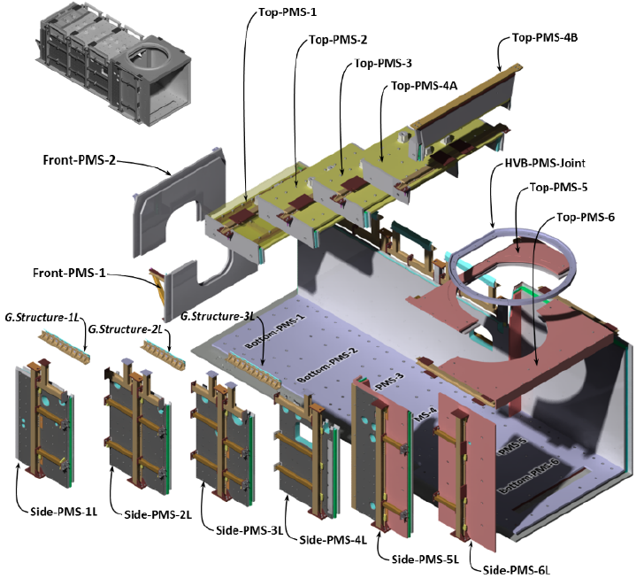
ITER Heating and Current Drive
OPE-1XXY: Passive Magnetic Shielding (PMS) Cat. D. (2 units)
  Steel Plate Material S235 (EN 10025-2) (2 x 400 tons): 1 or 2 additional sample(s) still welcome nowadays for characterization.
  Active Compensation Correction Coils (ACCC) Total 2 x 8 units.
  Skills: Construction and precise assembly (1mm gaps/0.1 mm tolerances) of heavy components (500t) nuclear classified (RCC-MR) + coil design and manufacturing).
  Market Survey to be published.
=> Target CFT: Q4 2023. Market Survey soon.

Slide 29
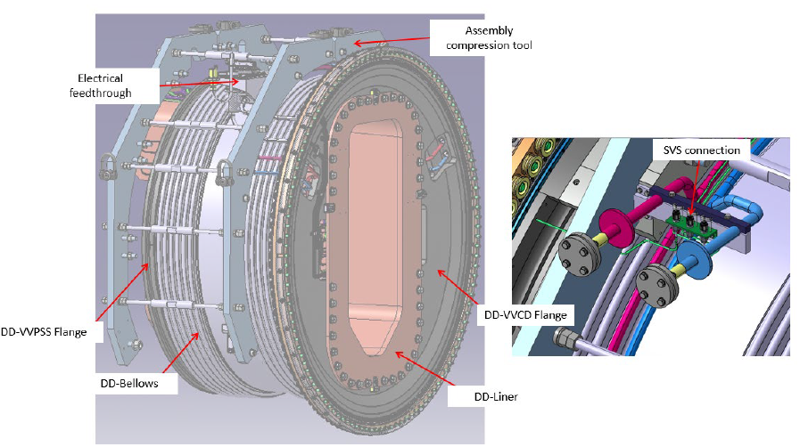
ITER Heating and Current Drive
OPE-1XXY: Drift Duct. Cat. C. (2 units)
  Market Survey done.
  Skills: Nuclear component manufacturing, High Vacuum, Stainless Steel welding, Brazing, NDTs, EBW of CuCrZr.
=> Target CFT: Q4 2024.
L1.4 m x W3.2 x H3 m -Weight ~ 5.7 t

Slide 30
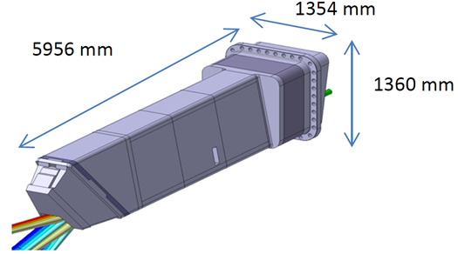
ITER Diagnostics
OFC-1183: Cat. D. 6 Diag PORTS Manufacturing and Assembly. Market Survey ongoing. Target =>CFT: end Q4 2023/Q1 2024.
Upper Port Plug general dimensions
Notes:
1146: Assembly

Slide 31
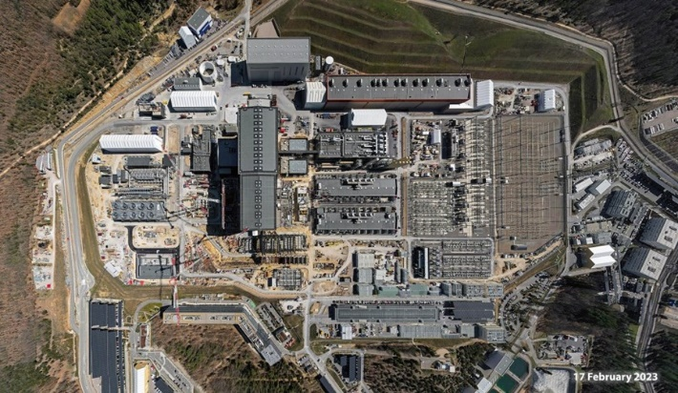
ITER Site and Buildings and Power Supplies
OMF-1487 (TB25): Infrastructure, Mechanical, Electrical, I&C works. Market Survey ongoing. Cat. C. Target CFT Q3-4/2023.
OPE-1496: Architect Engineer II. Market Survey finished. Cat. D. Target CFT 07/2023.
Bird eye ITER site February 2023; © ITER Organization

Slide 32
ITER Remote Handling
OMF-1347: Cat. D Divertor Remote Handling System (DRHS) : Final Design of Cassette Toroidal Mover (CTM) only, and, Manufacturing of CTM and Cassette Multifunctional Mover
  Skills: Design and High precision machining of heavy component (40 t nuclear grade crane). Installation and alignment (140 m crane railway).
  Market Survey closed.
=> Target CFT: Q4-2023/Q1-2024.
Monorail Crane System

Slide 33
BUILDINGS and Infrastructures
TB24 Diesel Generators: 2X 3.5 MW in 6.6 kV (Non-PIC) + tank + civil engineering (container style). Target CFT: 2024 (postponed, expected signature in Q4 2027).
Hot Cell Complex (HCC) Engineering Support. Cat D. and HCC Preliminary Design Contractors. Cat D. Target CFT 2024.
Bird eye ITER site February 2023; © ITER Organization
Hot Cell and Rad Waste Building B21© ITER Organization

Slide 34
ITER Support Activities (Technical Support)
2023
Qualification testing: Cat B Target CFT: Q4 2023.
Seismic, Dynamic and Structural Analyses of ITER Buildings and Mechanical Components Support. (renewal of OMF-1023)Cat. A. Target CFT: Q4 2023.
2024
Nuclear Analysis Support (renewal of OMF-0882): CFT: Q1 2024. Cat. A.

Slide 35
ITER Support Activities (Technical Support)
2024
CAD Design, Dimensional Variation Analysis, General Mechanical and Plant Design Support: (including scope OMF-1058) Cat. B. Target CFT: Q1 2024.
Destructive and ND Testing of Material and Mock-ups: (renewal of OMF-1082). Cat. B. Target CFT: Q2 2024.
I&C Integration Services (renewal of OMF-0989). Target CFT Q2 2024. Cat D.

Slide 36
ITER Test Blanket Module (TBM)
Integration of the EUROFER Steel in the RCC-MRx for Iter TBMs.
5 Work Packages: Cat. D Target CFT: Q3-4 2023.
  Management, Quality, Technical programme and Follow-up with AFCEN SC-MRx; EUROFER Material File; Design Rules & Data for the EUROFER Base Metal and Welded Joints; EUROFER Procurement and Control; EUROFER Welding and Fabrication.
OPE-1502 Supply of EUROFER Steel
  About 30 tons of plates, bars, tubes
  Market Survey soon.
  CFT planned for Q4 2023

Slide 37
Broader Approach
OPE-1405: Integration and testing of the Actively Cooled Divertor units of JT-60SA, estimated contract value: C, Target CFT Q2/3 2023 (Competitive with Negotiation).
OPE-1407: LIPAc Injector Upgrade, estimated contract value A, Target CFT Q2/3 2023 (Competitive with Negotiation) (= Linear IFMIF Prototype Accelerator).
OFC-1433: Engineering Support for BA (2022 – 2026), : estimated contract value A(ceiling FWC); Target CFTQ2 2023; covers activities for all BA projects (Open procedure).

Slide 38
Outline
The context for EU fusion industry involvement
Italian participation to date
How to access F4E opportunities
Upcoming opportunities F4E
Upcoming opportunities ITER IO

Slide 39
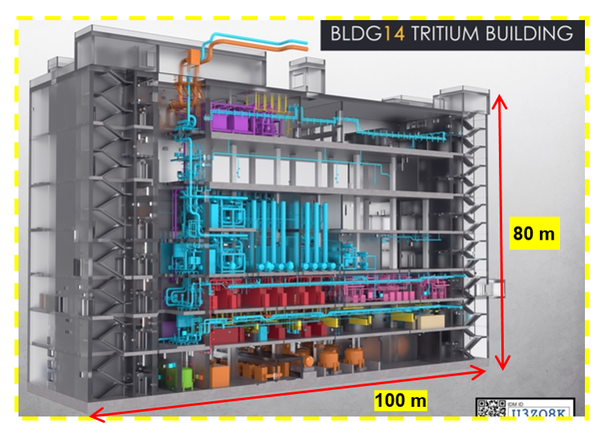
Tokamak Complex Detritiation System
Design and Fabrication contract
To be signed during 2024
Tens of millions of Euros in business volume
Process System in B14
16 catalytic reactors, 8 scrubber columns, 8 blowers organized into 8 separate modules
Piping Network
Connects to 150+ clients
~11km stainless steel piping

Slide 40
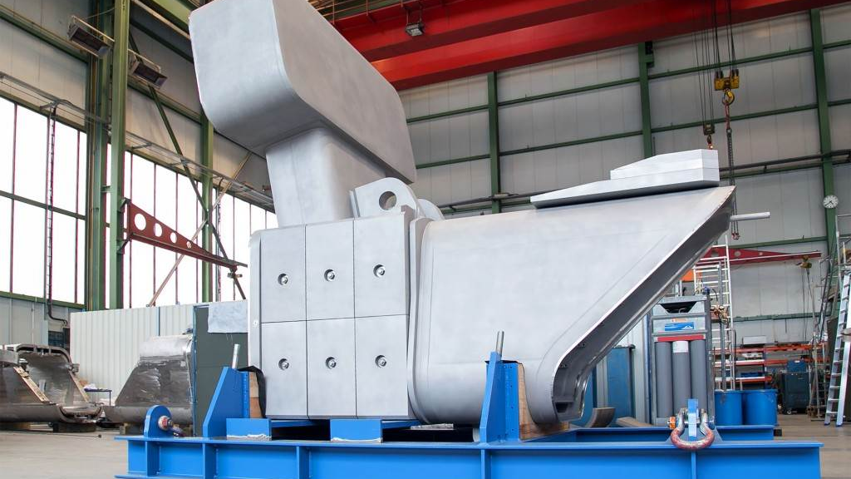
DIAGNOSTICS
Purpose built tools maintenance
Propellant Suppressor prototype
DMS Manufacturing and Supply
Shielding blocks
In- Vessel camera

Slide 41
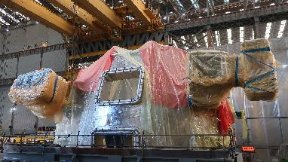
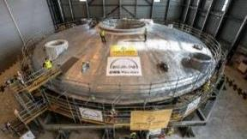
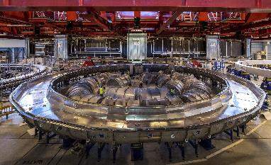
MAINTENANCE & PRESERVATION
Study LT Preservation TKM
Purpose Built Tools Maintenance
Cooling Towers Periodical Cleaning
Site Security System Maintenance
Vacuum Vessel Sector
Cryostat Lid
PF Coil in Cold Testing

Slide 42
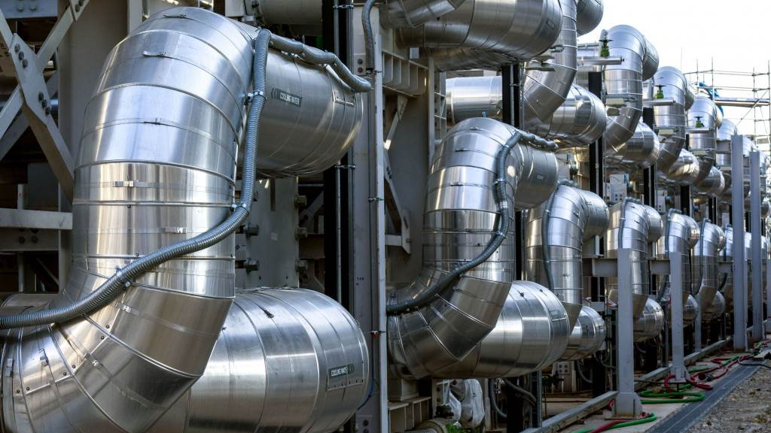
TCWS Supplies
I & C Components (sensors, switches, cubicles,…)
Valves
ESPN equipment (pumps, heat exchangers, pressurizers,…)
Electrical Components (Heaters, SIC breakers, low flow pumps,…)

Slide 43
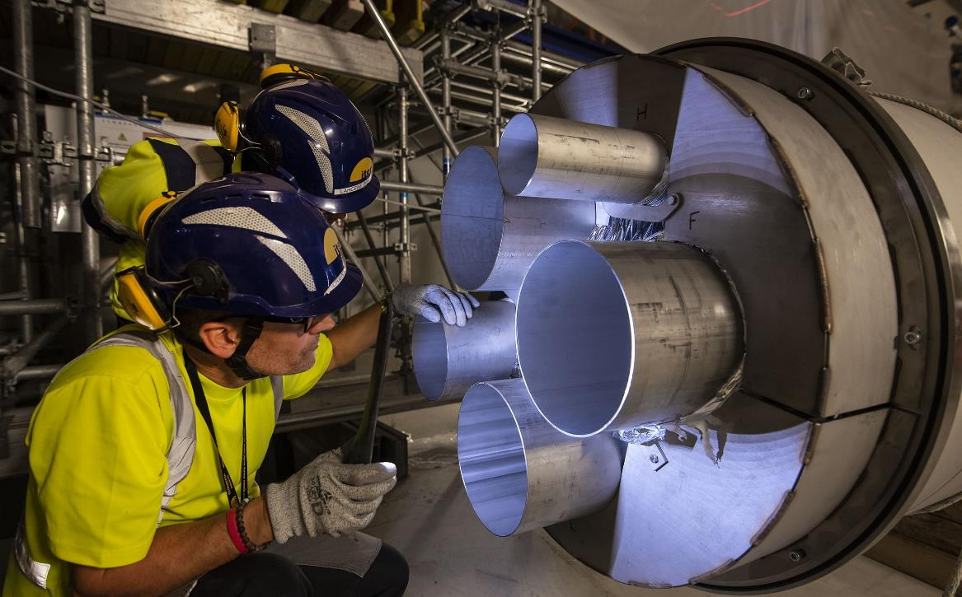
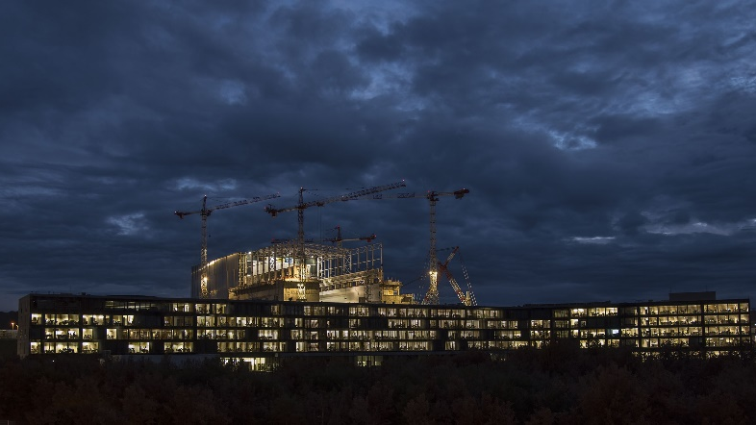
Engineering & Corporate Services
Leak inspection
Specialized Engineering Services for Port Plug Structures
Cable Support Engineering Services
Commissioning Support Engineering Services
Civil & Mechanical Engineering/Services
Maintenance & Preservation of buildings and components
Diagnostic prototypes & devices
TCWS Supplies
Engineering Services
Logistic Services
First Plasma Components
Corporate Services
IT Support services
IT Security Consulting services
SAP Application Maintenance services
Site Emergency services
Maintenance plotters, photocopiers, printers and scanners

Slide 44
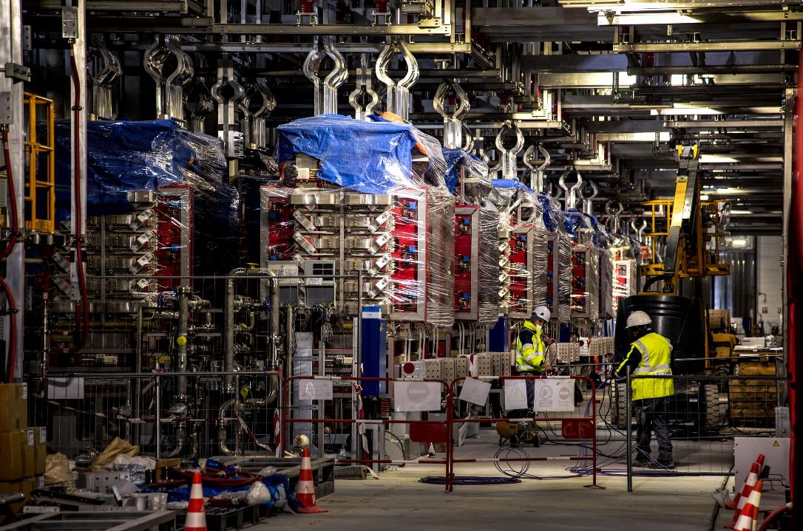
First Plasma Components
Power Converters
Blankets
Neutral beam Port liners
In-Vessel viewing port extension
Divertor instrumentation
Central interlock system

Slide 45
F4E – IO contacts
ITER ORG: ITER-Procurement@iter.org
F4E: mehdi.daval@f4e.Europa.eu
Italy ITER Industry Liaison Officer: (ILO) paolo.Acunzo@enea.it
    ILOs are a network from different European countries that work together with Fusion for Energy to raise awareness regarding funding schemes and ways to get involved in the ITER project. A series of information days and seminars are planned throughout the year to report on the roadmap of the different procurement packages and facilitate partnerships between companies.
    ILOs have permanent contacts with F4E and IO
    More information = https://industryportal.f4e.europa.eu/ip_pages/ilocorner.aspx

Slide 46
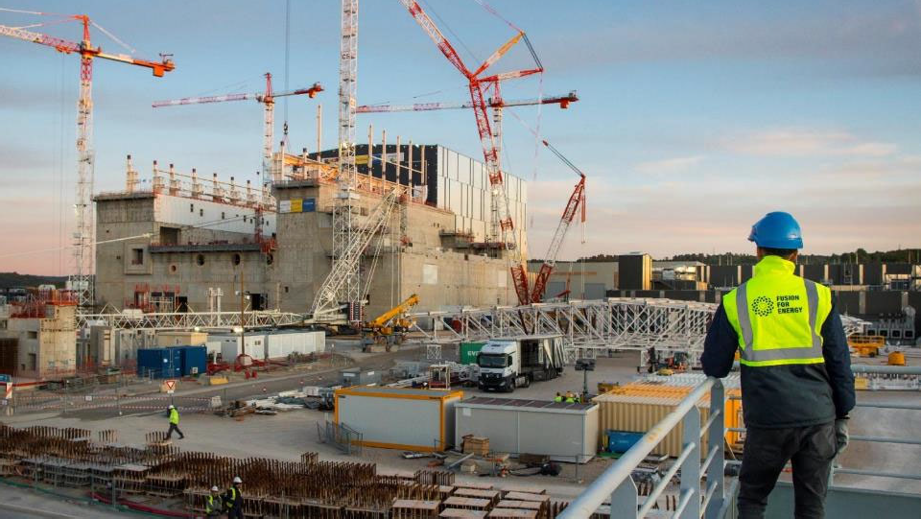
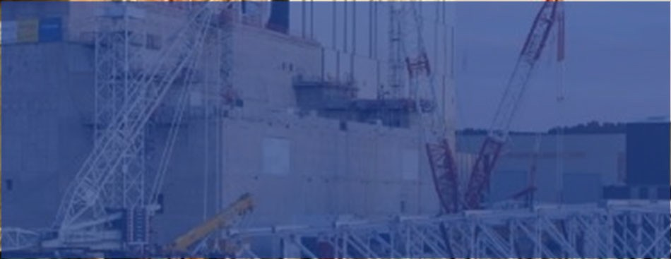
Thank You

