Slide 1
BSBFTrieste2024
IOD – Industry Opportunity Days ‘23
Napoli, 16th June 2023
di Paolo Acunzo, ENEA

Slide 2
BSBFTrieste2024
BSBF – Big Science Business Forum is a business oriented congress which congregates the main European Research Infrastructures, focused on technology and with the aim to be the main meeting point between Research Infrastructures and industry.
BSBF 2024 in Trieste will be the third edition of the event after the
success of the previous edition in Copenhagen (2018) and Granada (2022), where thousands of participants from hundreds of organisations and dozens of countries gathered together to discuss the future prospects of the Big Science Market.

Slide 4
BSBFTrieste2024
BSBF Trieste 2024 structure
Leader of the Italian candidature is the Autonomus Region of Friuli Venezia Giulia. In order to manage all BSBF activities, it has been established an ad hoc specialized structure, called BSBF Trieste 2024 and composed of representatives of:
Autonomus Region of Friuli Venezia Giulia
ILO Network Italia (CNR, ENEA, INAF, INFN)
Area Science Park, Trieste
PromoTurismo FVG
Moreover the BSBF Trieste 2024 candidature is activelly supported by many Italian Ministries (University & Research, Environment & Energy, Foreign Affairs & International Cooperation and Economic Development), the international government association Central European Initiative (CEI), the major national research agencies (CNR, ENEA, INAF, INFN) and many local or trans-border research institutions.

Slide 5
BSBFTrieste2024
BSBF Trieste 2024 supporting organizations
Italian Ministry of University and Research (MUR)
Italian Ministry of Ecological Transition (MITE)
Italian Ministry of Economic Development (MISE)
Italian Ministry of Foreign Affairs and International Cooperation (MAECI)
City of Trieste
Elettra Sincrotrone Trieste
International Centre for Genetic Engineering and Biotechnology (ICGEB)
Istituto Nazionale di Oceonografia e di Geofisica Sperimentale (OGS)
Central European Research Infrastructure Consortium - European Research Infrastructure Consortium (CERIC - ERIC)
KYMA
Joseph Stephan Institute
Center of Excellence for Nanoscience and Nanotechnology (CO Nanocenter)
Central European Initiative (CEI). International Forum for Regional Cooperation

Slide 6
BSBFTrieste2024
BSBF Trieste 2024 overvivew
The spirit of our programme is to consolidate the BSBF brand, involving all eleven Big Science Organizations (BSOs) currently partners and continue the trends seen in Copenhagen and Granada, maintaining the cornerstones of best practice while, at the same time, trying to improve some aspect and introduce our own innovative ideas
3-day event with an industrial exhibition
3 plenary sessions
16 parallel sessions
1 to 1 (B2B-B2C) meetings in parallel
Satellite meetings and side events
Social programme
Visit to research infrastructure in Italy and Slovenia

Slide 7
BSBFTrieste2024
BSBF2024 Programme
As foreseen in the BSBF2022 programme, three plenary sessions will be organized during Day 1 and Day 2 addressing common issues and topics of general interest. These sessions will be moderated by a high-profile facilitator, carefully selected to be able to capture the gist of the event, communicating this to the audience in a short period of time, introducing the plenary session participants and summarizing the main points after each speaker’s talk.
Day 1 Plenary session I: Welcome and presentations from the BSBF partners
Day 2 Plenary session II: Towards a Big Science common market in Europe (NEW)
Day 2 Plenary session III: Closing of BSBF2024

Slide 8
BSBFTrieste2024
BSBF2024 Programme
Plenary session I: Welcome and presentations from the BSBF partners (2nd October, 09h00-13h20)
This session will include a general overview about the current situation, technical challenges and forthcoming opportunities of the eleven Big Science Organization promoters and BSBF institutional partners.
The session will count on BSOs high-level representatives, together with the EU Commissioner, Italian Ministers, President of Region Friuli Venezia Giulia and trans-regional authorities.

Slide 9
BSBFTrieste2024
BSBF2024 Programme
Plenary session II: Towards a Big Science common market in Europe (NEW) (3rd October, 09h00-11h00)
This session intends to present the current situation in the European Big Science market from different perspectives, taking into account industrial experience working for different BSOs, and focusing on a panel discussion involving high-level European representatives on why and how to develop a real Big Science Common Market in Europe.
Call:
BSBF Trieste 2024 will select industries via a call for nominations (BSCM call) open to those companies that gained different tenders from at least two or three BSOs. The industries chosen will be asked to explain the differences in working practices of BSOs and be asked to make suggestions based on their experience on how to establish a Common Market of Big Science. This activity is connected with parallel session C4 on the same day.

Slide 10
BSBFTrieste2024
BSBF2024 Programme
Plenary session III: Closing of BSBF2024 (3rd October 2024, 16h30-19h00)
This session plans to draw some conclusions about the event from different perspectives. This will include experiences from plenary session debates and panel discussions and will take into account next steps in structuring a Common Market of Big Science in Europe. IOC members and institutional stakeholders participating in BSBF Trieste 2024 will be involved in the session.
The conference will be closed with concluding remarks and the passing of the torch ceremony to the representatives who will host the BSBF 2026 edition.

Slide 11
BSBFTrieste2024
BSBF2024 Programme
Following the format of the past BSBF editions, we plan to organize industry-track parallel sessions where the forthcoming opportunities, investment and industrial engagement actions will be presented by representatives of each Big Science Organizations.
BSBF Trieste 2024 has proposed 16 parallel sessions divided in 4 slots (A, B, C, D) in two days (2 and 3 October 2024), according to the following list.

Slide 12
Parallel sessions A (Day 1, 14h15-16h15)
A1 Opportunities for Big Science in Central Europe (NEW)
A2 Robotics and remote handling systems
A3 Diagnostics, detectors, sensors, optics and instruments
A4 Affiliated Big Science Organizations (ABSOs) I
Parallel sessions B (Day 1, 16h30-18h30)
B1 SME involvement (SMEs) and key aspects for Procurement
B2 Superconductivity and superconducting magnets
B3 Complex buildings, construction and its safety related systems
B4 Affiliated Big Science Organizations (ABSOs) II
Parallel sessions C (Day 2, 11h20-13h20)
C1 Electrical, power electronics, electromechanical and RF systems
C2 High precision, small and large mechanical components
C3 Instrumentation and control systems
C4 Industrial experiences towards BSCM - Big Science Common Market (NEW)
Parallel sessions D (Day 2, 14h15-16h15)
D1 tbc
D2 Vacuum, cryogenic and leak detection technologies
D3 Basic material technologies and advanced manufacturing techniques
D4 ICT challenges: Information and Communication Technologies

Slide 13
BSBFTrieste2024
Focus – ABSOs
BSBF Trieste 2024 plans to give the floor to selected affiliated Big Science Organizations, as it was carried out in the first and second BSBF edition. It will be given the chance to the ABSOs selected to present themselves and their industrial opportunities during 2 parallel sessions (A4, B4) and relevance throughout different BSBF tools (website dedicated section, Programme book, etc.)
Call:
BSBF Trieste 2024 will conduct a call for affiliated Big Science Organisations (ABSOs call) following the criteria and methodology already adopted.

Slide 14
BSBFTrieste2024
Focus – SMEs
In parallel we intend to organize a SME session, where pre-selected SMEs active in the Big Science market will have the opportunity to explain their activities to an audience of technical representatives from Big Science organizations, including affiliated members.
As in the 2022 edition, a call for SME poster will be conducted prior to the event. In the same way we confirm parallel sessions dedicated to SME’s involvement (B1), focusing on the key aspects for procurement in order to facilitate SMEs participation in the Big Science domain.
Call:
According to the past experience, PERIIA in collaboration with BSBF Trieste 2024 will organise a new edition of SME’s Track (SMEs Track call) in close collaboration with BSBF Trieste 2024.

Slide 15
BSBFTrieste2024
Focus – Technology Transfer
According with the results of the past, a new edition of Technology Transfer Track (TT Track call) will be launched with some innovations. For examples it will be requested to the applicants to submit industrial posters on relevant experiences and possible applications in Big Science domain.
As in the past a specific section of BSBF2024 website on Technology Transfer will be implemented. Moreover a dedicated exhibition of the selected posters will be organized during the Forum in Trieste in order to disseminate best practices and incentive discussion on the topic among enterprises and research infrastructures.
Call:
BSBF Trieste 2024 will organise the dedicated website section and a new edition of Technology Tranfer Track (TT Track call) in collaboration with interested BSOs and PERIIA Network.

Slide 16
BSBFTrieste2024
Focus – New
Parallel session A1 Opportunities for Big Science in Central Europe (2nd October, 14h15-16h15)
The city of Trieste is located in a strategic position between Eastern and Western Europe and benefits from a combination of geographical and historical factors that makes BSBF2024 a unique edition.
Moreover Trieste hosts the Central European Initiative (CEI), the international body committed to support continental integration through regional cooperation among its member States:
Albania, Bosnia Herzegovina, Bulgaria, Croatia, Czech Republic, Hungary, Italy, Moldova, Montenegro, North Macedonia, Poland, Romania, Serbia, Slovakia, Slovenia and Ukraine;
This session wishes to open the door of Big Science to new stakeholders from those countries, encouraging next collaborations and opportunities.

Slide 17
BSBFTrieste2024
Focus – New
Parallel session C4 Industrial experiences towards BSCM - Big Science Common Market (3rd October, 11h20-13h20)
In the same day of related plenary session II, this parallel session intends to present the current situation in the European Big Science market from a industrial perspective, selecting cases of business experience with at least 2 or 3 different BSBF partners in order to analyse BSOs different opportunities and ways of working.
As mentioned before, Industries will be selected via a call for nominations (BSCM call) open to those companies that gained different tenders from at least two or three BSOs. The industries chosen will be asked to explain their experience and the BSOs differences in working practice.

Slide 18
BSBFTrieste2024
Focus – BSBF2024 Calls
Industry selection will also be done through a dedicated new kind of call to Big Science common Market (BSCM call) in addition to the other traditional calls to SMEs (SMEs Track call), to spread Technology Transfer (TT Track call) and to select Affiliated Big Science Organizations (ABSOs call) already implemented in previous BSBF editions, such as the call to host BSBF next edition.
All these calls will be prepared and launched under responsibility of BSBF Trieste 2024 and they will be published on www.BSBF2024.org website
Big Science Organizations and ILOs will disseminate notice regarding those calls throughout their channels.

Slide 19
BSBFTrieste2024
B2B and B2C sessions
BSBF Trieste 2024 considers B2B and B2C meetings to be one of the main purposes of BSBF in order to build partnerships and networking for construction of a Big Science Common Market. For this reason, we included the options to organize a significant number of 1 to 1s (B2B and B2C meetings) running at the same time as 16 parallel session presentations, industrial exhibition and we add the possibility to have special kind of B2C even during the morning of Day 3.
As for past editions, It will be provided a matching system to fix B2B among participants through BSBF2024 website and app.
It will also be possible to arrange informal bilateral meetings during breaks and in other free moments. Furthermore, we are also planning to offer places for informal dates in Trieste and the possibility of arranging videoconference meetings in the weeks following the event.

Slide 20
BSBFTrieste2024
Exhibition
BSOs, ILOs and companies will have at disposal a huge exhibition spaces, organized in a double hall in the Trieste Conference Centre located by the sea. Bearing in mind the high requests from companies in the past editions, we have planned to have the biggest BSBF exhibition with more than 120 booths in Trieste in order to provide all potential exhibitors with as much visibility as possible, so developing business impact and public awareness for the whole BSBF brand.
As usual the industrial exhibition it will be inaugurated on Day 0 with an authorities walk and It will be open in Day 1 and 2. An extra day opening would be available in Day 3 for BSOs and companies involved in career opportunities satellite session.
Similarly to previous editions, BSBF Trieste 2024 plans to allow a limited-time privileged booth access for ILOs and relevant liaison bodies from BSOs in order to secure national exhibition space on a “first come, first served” basis.

Slide 21
BSBFTrieste2024
Day 0 programme
09h00 Registration opens (exhibitors + attendees)
09h00-16h30 Build-up of stands
09h00-18h30 Satellite meetings (PERIIA Assembly and others)
18h30 BSBF2024 Opening
19h00- 20h00 Exhibition inauguration- High-level stakeholders exhibition tour
20h00- 21h30 Welcome reception (all attendees)

Slide 22
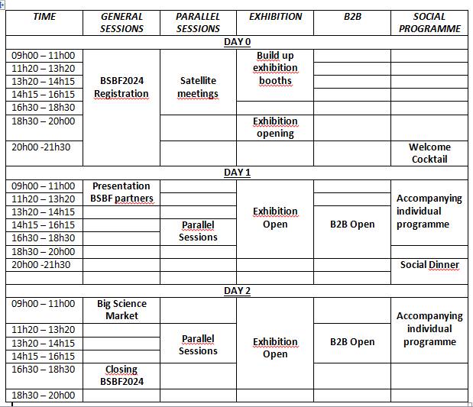

Slide 23
BSBFTrieste2024
Day 3 programme (NEW)
Free access to BSBF2024 (to increase participation of young researchers, women in Big Science, interested general public, etc);
Free stay in exhibition area for BSOs and companies boothes involved in Day 3 satellite meetings for direct contacts;
Extra opening day for B2B and B2C meetings;
Visits to Research Infrastructure reserved to registered in BSBF2024

Slide 24
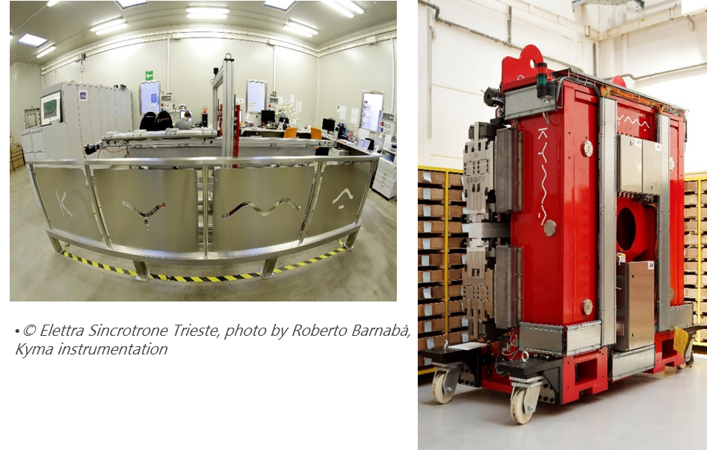
BSBFTrieste2024
Day 3 - Visits Research Infrastructures
As usual BSBF Trieste 2024 is organising visits to nearby cross borders relevant Research Infrastructures in Italy and Slovenia. Reservation is restricted to persons registered to BSBF2024
Option 1 Elettra Sincrotrone Trieste & Kyma
Option 2 Josef Stefan Institute & Nanocenter
Option 3 The National Institute of Oceanography
and Applied Geophysics – OGS

Slide 25
BSBFTrieste2024
Day 3 – Women in Big Science (WBS) Satellite session
According with the final report on WBS first edition in Granada 2022, BSBF Trieste 2024 strongly supports the proposal to replicate and improve the WBS experience.
For this reason It will be garantee free access for attending two hours WBS plenary session during Day 3.
Any relative activity will be under the responsability and directly managed by WBS Committee composed by representative of BSOs and other interested bodies. The organizers of BSBF2024 will collaborate with the WBS Committee.

Slide 26
BSBFTrieste2024
Day 3 – Career opportunities Satellite session
According with the success of the BSBF2022 session «Career opportunities and pathways in the Big Science Market» in Granada, BSBF Trieste 2024 strongly supports the proposal to replicate and improve the Career opportunities dimension in the Forum.
For this reason It will be garantee free access for attending two hours Career opportunity plenary session during Day 3, involving speakers from BSOs and other interested stakeholders.
Moreover It has been established a collaboration with the EURES Network of European Commission in order to adapt their matching system for Job Fair and a new dedicated section to the Big Science domain.
BSBF Trieste 2024 will collect availabilities from BSOs and companies in order to organise this new initiative.

Slide 27
BSBFTrieste2024
BSBF Promotion – website
BSBF Trieste 2024 has implemented a first on line version of website www.BSBF2024.org which it will be updated by an external service progressivily.
Moreover it is possible to get in contact with the BSBF Trieste 2024 organization writing to the relevant person in charge or to:
info@bsbf2024.org

Slide 28
BSBFTrieste2024
BSBF Promotion – Presentation in conferences
BSBF Trieste 2024 wants to promote participation and consolidate the BSBF brand in the research and business international context. For this reason It will be present with promotional material in many conferences, where it will have the chance to present BSBF activities.
Those are some events where presence is already planned in 2023:
IPAC’23 – International Particle Accellerator Conference;
IOD’23 – Industrial Opportunity Days;
ISFNT15 – International Symposium on Fusion Nuclear Technology (Las Palmas (ES), 11 – 15 September);
Please inform BSBF Trieste 2024 on conferences, events or meetings at national or international level in order to organise a brief presentation on BSBF activities and/or disseminate related BSBF2024 material.

Slide 29
BSBFTrieste2024
BSBF Promotion – BSOs and ILOs
BSBF Trieste 2024 will organise some industrial visits to BSBF infrastructures partners in collaboration with related ILO Network.
BSBF visits Big Science Organizations, a new format for industries:
A one visiting day to the major research infrastructure in Europe reserved to international companies, including presentantions by hosting BSO and BSBF organizers.
Information campaign on this new opportunity for companies to get closer and to know better Big Science will be disseminated jointly by BSOs, ILOs and BSBF channels.

Slide 30
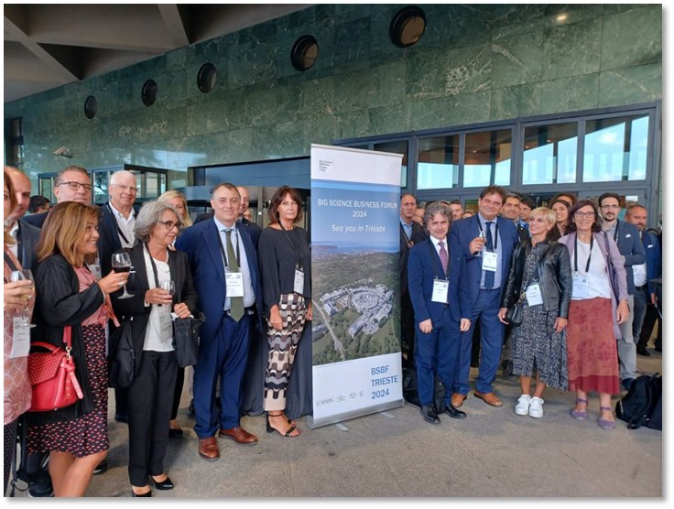
BSBFTrieste2024
Look forward to meet you in Trieste
Paolo Acunzo
BSBF IOC/LOC Coordinator
paolo.acunzo@bsbf2024.org
+39 338 4945822

Slide 31
BSBFTrieste2024

Slide 32
BSBFTrieste2024

