Slide 1
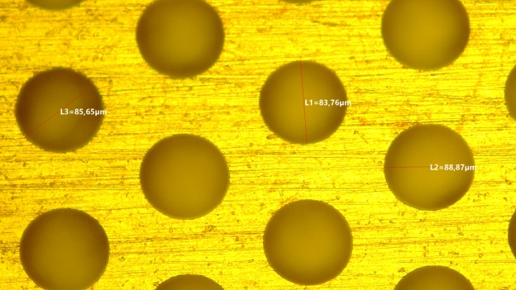
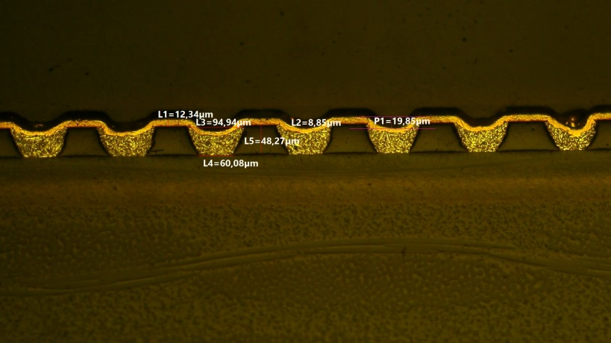
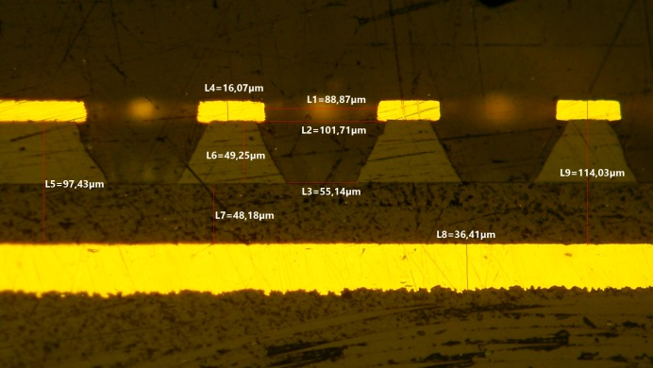
Test beam 𝜇-RWELL
G. Bencivenni, G. Morello, M.Poli Lener
LNF - INFN

Slide 2
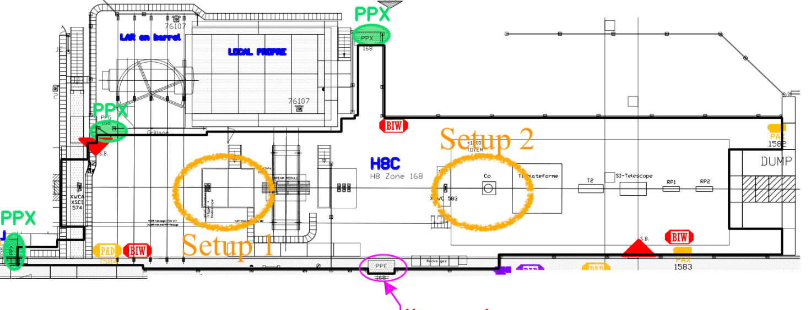
MAIN REQUESTS
Two set-up & 1 contact person
Set-up 1 – RD-FCC tracking uRWELL
N.1 Gas line: Ar/CO2/CF4 (45:15:40)
Cu/Flex-INOX INLET & OUTLET pipes (6mm outer diameter) from bottle to GAS Box & GAS Rack to the setup
DESY table (XYZ)
N.1 RACK near the setup
N.2 ethernet ports for HV slow control & SRS DAQ
N.1 desk
Set-up 2 – LHCb Muon uRWELL
N.1 Gas line: Ar/CO2/CF4 (45:15:40), Ar/CO2 (70:30), Ar/CO2/iso-C4H10 (68:30:2)- Cu /Flex-INOX INLET & OUTLET pipes (6mm outer diameter) from bottle to GAS Box & GAS Rack to the setup
DESY table (XYZ)
N.1 RACK near the setup
N.2 ethernet ports for HV slow control & DAQ control
N.1 desk
BEAM
60% Muon (free access mode), 40% Pion
RD-FCC Tracking uRWELL
LHCb Muon uRWELL
Period: 14 – 28 June 2023

