Slide 1
During the previous SC meeting in November 2022 three possible scenarios for operation of DAFNE during year 2023 were taken into consideration
Full DAFNE+BTF run: 15.4 GWh total power consumption
Full up to July + BTF only in Fall 10.2 GWh (-32%)
Run only in Spring-Summer 9.1 GWh (-41%)
It was noted that if the price of energy would have been as high as the one registered in Aug.22, the full cost of the run for option A could have been as high as 11 M€
Due to the volatile situation of the price of energy on the international market, however, the SC has recommended to keep all the options open and to rediscuss the plan during the present meeting

Slide 2
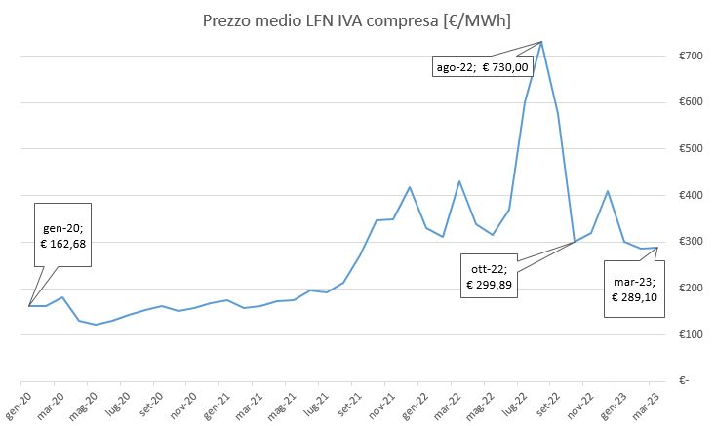
Present Situation
A 4.5 M€
Current estimate
B 3.1 M€
C 2.6 M€
It seems to me that there are all the premises to choose strategy A.

Slide 3
The PNRR business
Since last year INFN participates with different roles in the National Recovery and Resilience Plan (PNRR) with several different projects, both in the capacity of leader and partner
These projects obey to slightly different rules, depending on whether they are labelled as «National Centers», «Research Infrastructures», «Innovation Ecosystems» or «Extended Partnerships»
All of them however provide money for acquisition of new hardware and/or for new personnel with fixed term contracts
The Laboratory is participating in 6 projects, at various level, for a total of ∼20 M€ and 20 positions
Their impact on the lab’s schedule is relevant also in view of the fact that they (and their relative spendings) must be closed whithin 2025, so that they must properly prioritised

Slide 4
Project | Leader | Budget (M€) |  | People involved (FTE) | New personnel |  | Activities @ LNF
 |  |  |  |  | Technologist | Technician
 |  | Overall | LNF
EuAPS | INFN-LNF | 22.3 | 7.8 | 4.0 | 2 +1 Manager | 0 | Implementation of a betatron source @ SPARC
IRIS | INFN-MI | 60 | 1.1 | 0.5 | 1 | 2 | Equiment for magnetic measurments laboratory
ICSC | INFN-BO | 320 | 6.2 | 0.75 | 3 | 3 | Consolidation and upgrading of computing rooms and infrastructure;
Rome Technopole | Sapienza | 110 | 2.9 | 5.8 | 6 | 0 | upgrade of existing open research infrastructures; outreach & dissemination
NQSTI | Università Camerino | 140 | 0.5 | 0.5 | 1 | 1 | Development of superconducting qubits and 3D quantum memories
CHANGE5 | Sapienza | … | 0.4 | 0.1 | 0 | 0 | Research project on cultural heritage
TOTAL |  |  | 18.9 | 11.65 | 13 (+1) | 6

Slide 5
Extension of the Laboratory
On Dec. 20, 2022, the Laboratory has acquired a new estate consisting of a large (∼ 3000 m²) warehouse and about the same area of free land, formerly used as a parking lot
We are now studying the best use for this new area, which however need important consolidation and restoration works

